Slide 1

A qualitative analysis of mobility-related durable medical equipment needs in Hampton Roads
Kimberly Rosenthal, MD
Physical medicine & rehabilitation

Slide 2
Project design
Literature review - assess what formal study/data exist
Provider surveys
Family and individual surveys
Data review & themes
Intervention
Notes:
Quality improvement sort of project

Slide 3
Desired outcomes
Improved understanding of mobility durable medical equipment (DME) access and existing barriers in Hampton Roads for families of and children with neurodevelopmental differences
Including multiple stakeholder perspectives
Comparison to other regions

Slide 4
Literature review
Question: current trends and barriers relating to wheelchair/DME/adaptive equipment access
Database(s): PubMed
Notes:
To understand issue/see what formal study has been done
Short answer – very little, particularly concerning individuals with NDD

Slide 5
Literature review
Inclusion criteria: DME, adaptive equipment, access, barriers, adults and/or children with disability affecting mobility, wheelchairs, standers, mobility aid, neurodevelopmental disorders, intellectual disability, 2000-present (potentially expand depending on # articles), any study type, English, United States
Exclusion criteria: before 2000, non-mobility related DME

Slide 6
Literature review – search terms
(wheelchair) AND (insurance)
(wheelchair) AND (barrier)
(durable medical equipment) AND (barrier)
(adaptive equipment) AND (barrier)
(adaptive equipment) AND (access)
((((disabilit*) AND (barrier*)) AND (access)) OR (adaptive equipment)) OR (wheelchair)
((((disabilit*) AND (barrier*)) AND (durable medical equipment)) OR (adaptive equipment)) OR (wheelchair)
(access) AND (wheelchair)
(access) AND (durable medical equipment)
(intellectual disabilit*) AND (durable medical equipment)
(developmental disabilit*) AND (assitive technology)
(developmental disabilit*) AND (equipment)
(((care transition) AND (pediatric)) AND (barrier*)) AND (disabilit*)
((care transition) AND (pediatric*)) AND (barrier*)
(care transition) AND (adaptive equipment)
((intellectual disability) AND (barrier*)) AND (adaptive equipment)
((intellectual disability) AND (barrier*)) AND (wheelchair)
((intellectual disability) AND (barrier*)) AND (mobility)
((cerebral palsy) AND (wheelchair)) AND (barrier*)
((cerebral palsy) AND (mobility)) AND (barrier*)
((cerebral palsy) AND (wheelchair)) AND (access*)
(cerebral palsy) AND (adaptive equipment)
((accessibility) AND (pediatric*)) AND (neurodevelopmental)
((adaptive equipment) AND (access)) AND (pediatric*)
(neurodevelopmental disability) AND (wheelchair)
(((disability) AND (pediatric)) AND (adaptive equipment)) AND (access)
(((intellectual disability) AND (adaptive equipment)) AND (access)) AND (inequity) (development*) AND (adaptive equipment)) AND (access)

Slide 7
Literature review – abstract screening
39 articles of interest screened using Rayyan
15 excluded, 14 included

Slide 8
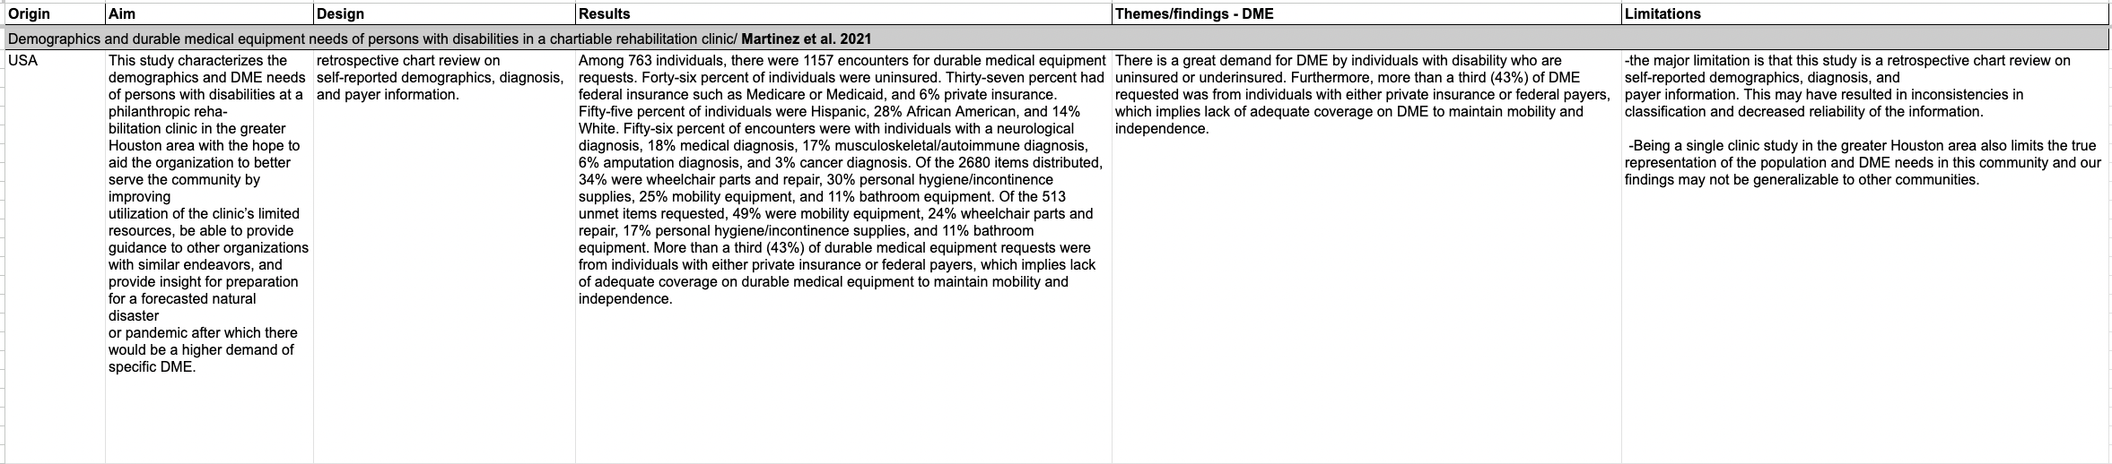
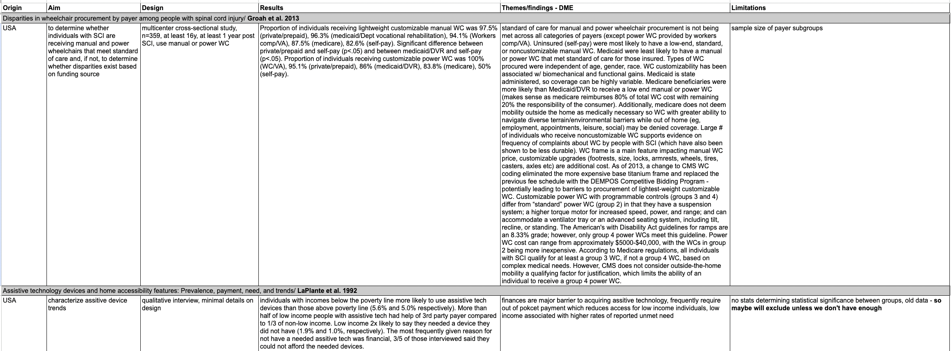
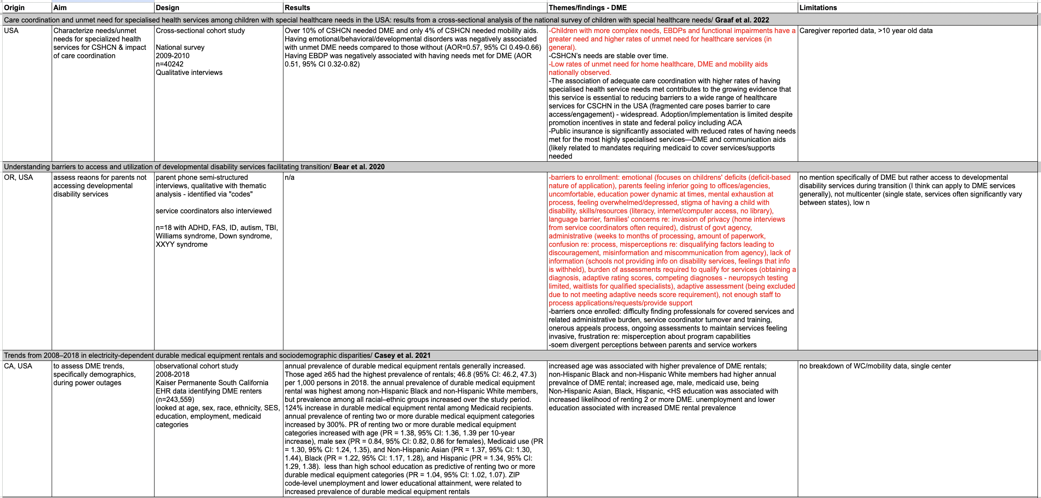
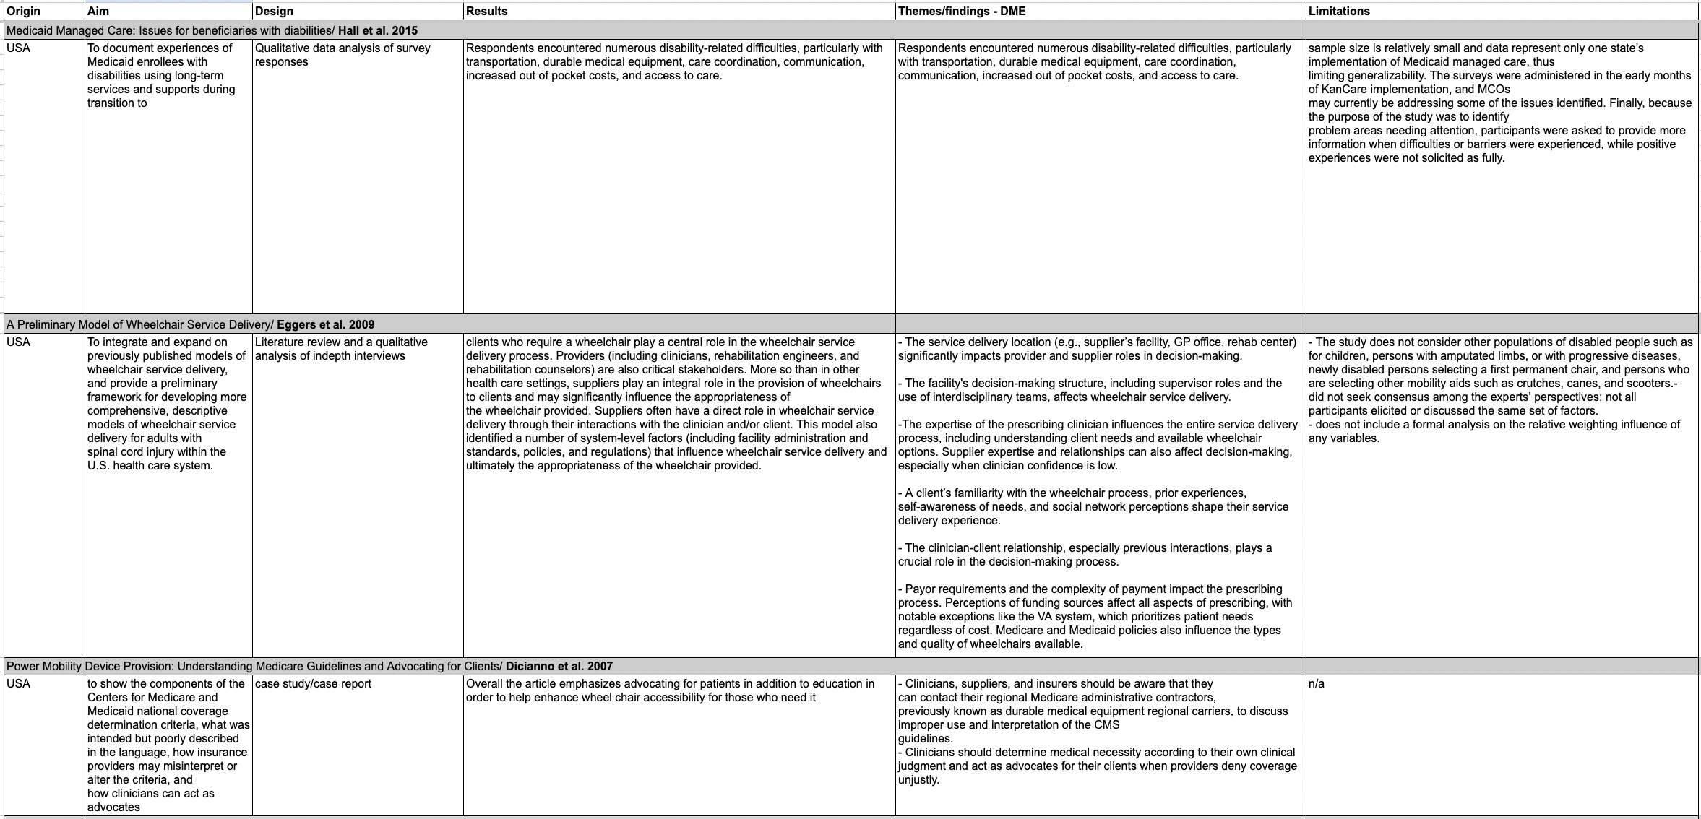
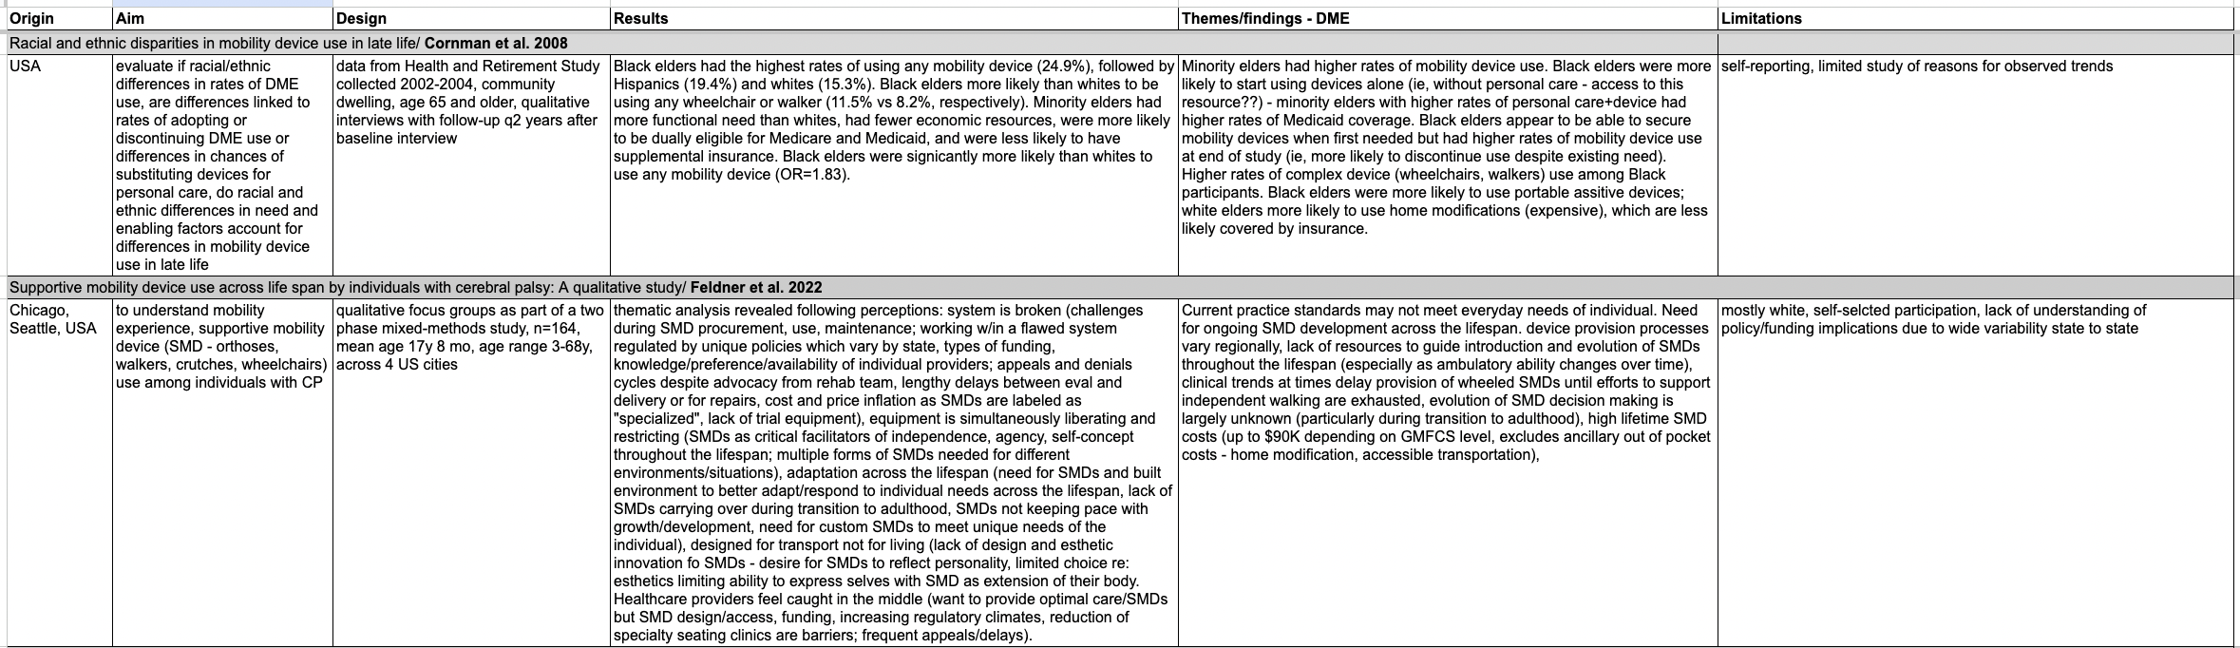
Literature review - table

Slide 9
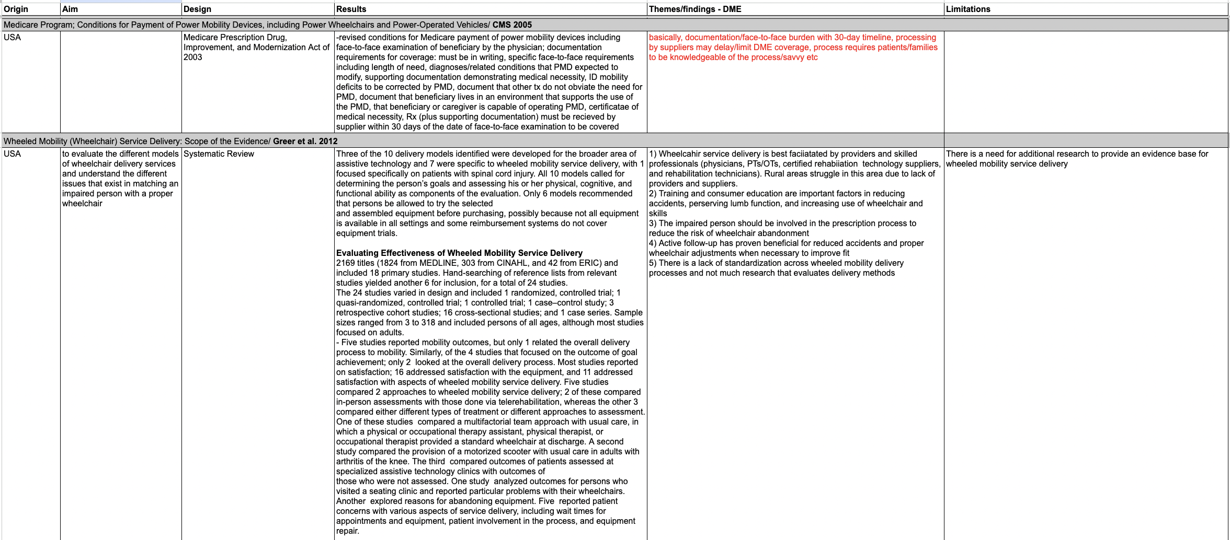
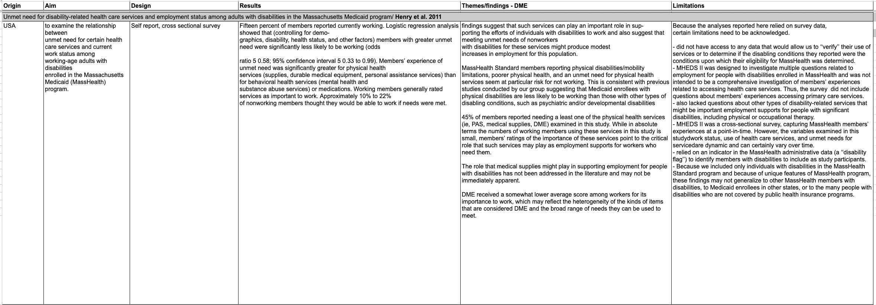
Literature review - table

Slide 10
Literature review - themes
A survey of over 40,000 caregivers of children with complex medical needs found that, in general, these children have higher rates of unmet healthcare needs
Low rates of need for home health, DME and mobility aids (Graff et al. 2022)
Henry et al. 2011 survey of adults with disabilities showed greater need for physical health services including DME vs. behavioral health or medication-related needs
Graff et al. 2022
Notes:
Overall very little data on this specific question
But some related publications

Slide 11
Literature review - themes
Race, education level, age, sex were factors in increased likelihood of increased DME rentals (Casey et al. 2021)
Adults
Individuals with disability who are uninsured or underinsured demonstrated lack of adequate DME coverage to maintain mobility and independence (Martinez et al. 2021)

Slide 12
Literature review - themes
Acknowledge that delays in DME delivery and coverage likely related to documentation and face-to-face burden with 30-day timeline, supplier processing delays
Note that process requires individuals and families to be knowledgeable of the process
CMS 2005

Slide 13
Literature review - themes
Factors affecting wheelchair delivery
Delivery location (supplier facility, PCP office, rehab center)
Facility’s decision-making structure (ie, use of interdisciplinary teams, etc.)
Expertise of prescribing clinician
Client familiarity with wheelchair process, prior experiences
Clinician-client relationship and previous interactions
Payor requirements, complexity of payment
*survey of individuals with spinal cord injury
Eggers et al. 2009

Slide 14
Literature review - themes
DME experience
Patient/client perception: system is broken/flawed regarding procurement, maintenance, payment/insurance; lack of trial equipment, adaptation across the lifespan not accounted for, devices designed for transport rather than living
Notes:
Survey of individuals with cerebral palsy

Slide 15
Provider surveys
Online survey
Questions:
In what capacity do you care for individuals with intellectual and/or neurodevelopmental disabilities/differences? Please describe as appropriate.
What DME/wheelchair/mobility equipment access barriers have you observed?
How does your institution address these needs (e.g., complex care program, device donation program, etc.)?

Slide 16
Provider surveys
>250 surveys sent
All pediatricians at Children’s Hospital of the King’s Daughters system
Select/random pediatricians from Midwest and West Coast hospital systems
~10% response rate
Midwest underrepresented/few responses
For all survey responses:
72.4% general pediatricians, did not work specifically with children with NDD
27.6% work in Complex Care or specifically in the care of individuals with NDD

Slide 17
Thematic analysis – provider surveys
2. What DME/wheelchair/mobility equipment access barriers have you observed?
Issues with process and resources across all regions
Insurance approval/prior authorization, claim denials – complicated and lengthy process
Lack of clarity on insurance documentation requirements/not standardized, communication issues
Wait times for in-home and face-to-face evaluations
Unclear which vendors accept which insurance/payor source
Lack of dedicated personnel for these tasks
Out of pocket costs
Appropriate home set-up, equipment availability

Slide 18
Thematic analysis – provider surveys
3. How does your institution address these needs (e.g., complex care program, device donation program, etc.)?
Regional differences observed!
West and Midwest – increased utilization of patient-centered medical home and care coordination programs, PM&R, DME coordinator, donation programs (though limited access)
Hampton Roads
Multiple providers reporting “unsure” or “none”
Some dedicated staff, Care Connections program, PM&R, care coordinator

Slide 19
Action
Infographic detailing initial steps when prescribing DME:
CHKD and EVMS PM&R department referral, if needed
Care Connections program details
Equipment donation program
Example of DME prescription/face-to-face

Slide 20


Slide 21
Family and individual surveys
Same questions
Flyers to be displayed in clinics of providers surveyed at CHKD
IRB approval pending protocol edits

Slide 22
Notes:
Likely will be changes/clarification to wording per ODU IRB request

Slide 23
Future direction
Most important: family and individual surveys!
Notes:
For a more complete understanding
Anticipate barriers/themes identified may be more complex and challenging to address
Obviously don’t expect this to solve the larger problem, but self-identified barriers and goals may help guide larger hospital systems in the area (ie Sentara, CHKD) work toward more appropriate interventions
Would obviously hope for fuller community engagement/panels/representation in related discussions
Depending on data/themes, may design similar infographic for display in clinics or advocate for panel

