Slide 1

Stronger Together: Fostering Youth Mental Wellness
Jaime Pirie (She/Her), SPT
02/5/25
Notes:
Hello everyone. My name is Jaime and I am a 3rd year PT student at VCU and I am apart of the LEND program on the long term academic track. I am here to present on the topic of mental health in our youth. If you have any questions, please feel free to stop me at any point to ask and I will also try to monitor the chat.

Slide 2
DISCLAIMER!!!!
Please take care of your own mental health throughout the presentation!
Notes:
I am going to be touching on some very sensitive topics throughout the presentation today. I want to make sure that we all are taking care of ourselves and each other. I want to point out that I am not discussing how to diagnosis mental health conditions. I am discussing surface level ways that we as providers can hopefully get a better understanding of youth mental health and some basic steps to take to help our youth on their road to getting professional help.

Slide 3
TABLE OF CONTENTS
01
02
03
04
05
06
Prevalence & Mythbusting
What are the major risk factors?
Recognition of signs & symptoms
What can we do during a time of crisis?
What is your role?
What resources are available?

Slide 4

Learning Objectives
The learner will:
Understand the impact of mental health conditions on development of youth and the caretakers.
Describe the prevalence, signs and symptoms of youth mental health distress.
Identify the role you play in mental health as a future DPT and as a current SPT.

Slide 5

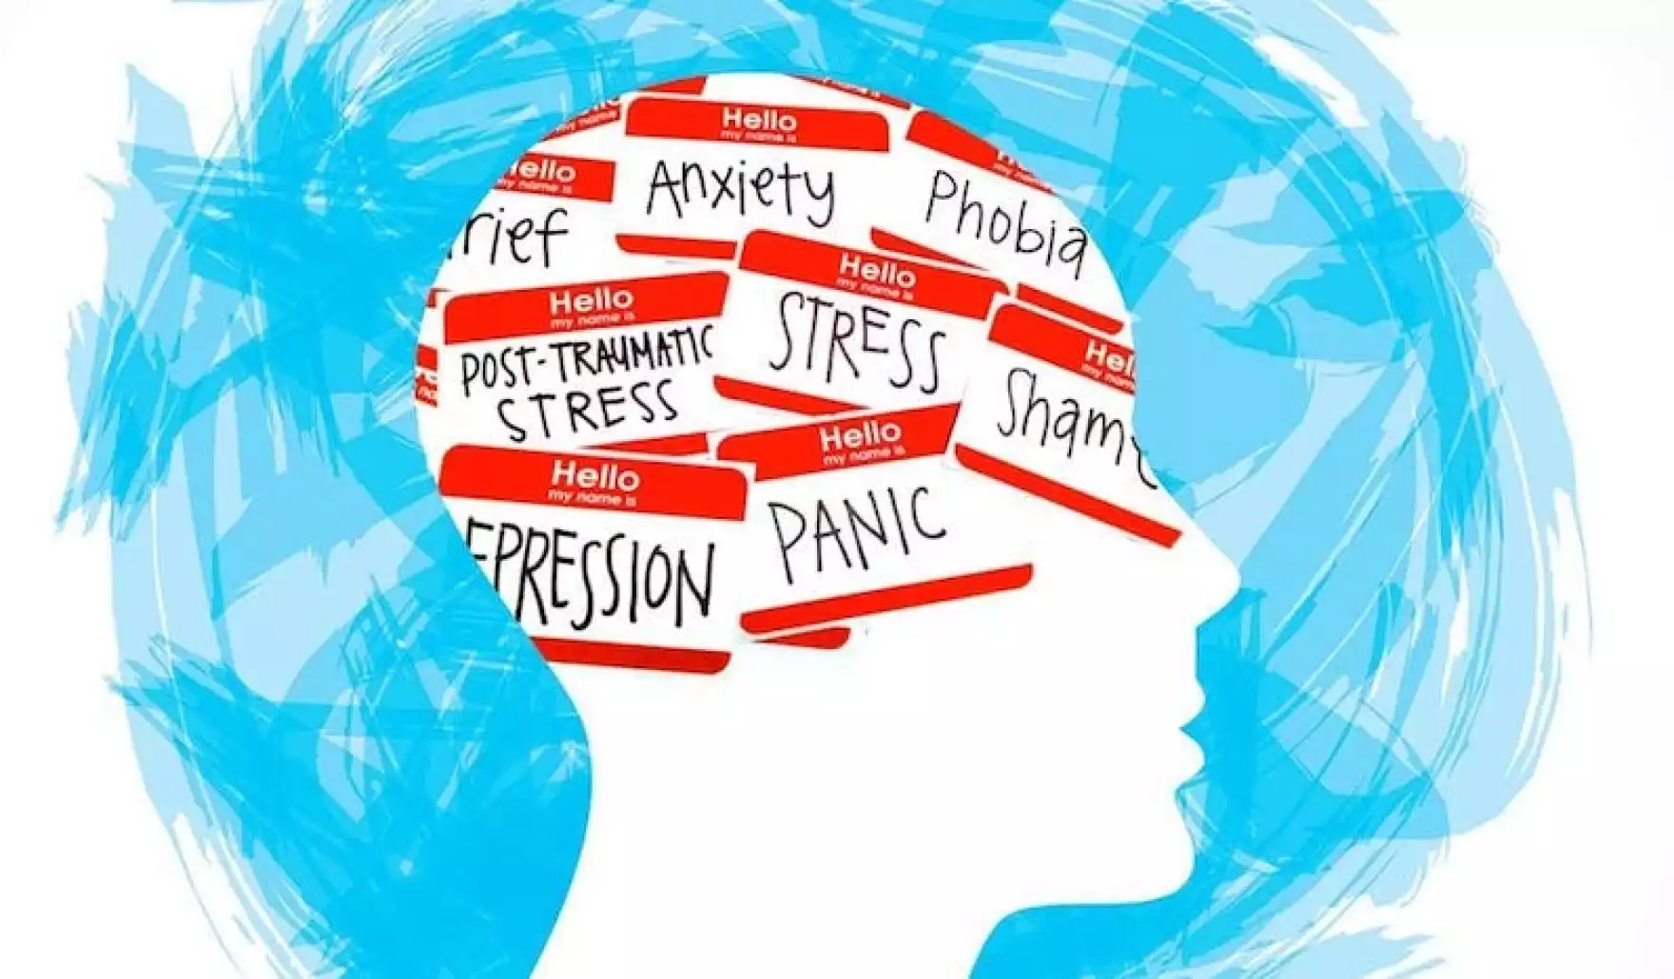

01
Prevalence & Mythbusting
"mental health charities", by Andy Zurichs, used under CC license/ resized and cropped

Slide 6
What percentage of children with a chronic health condition do you think have significant mental health concerns before the age of 14?
Colizzi, M., Lasalvia, A., & Ruggeri, M. (2020),
Notes:
Go ahead and put your answers in the chat.

Slide 7
What is the prevalence of mental health disorders in youth?
46
38% reported feeling sad or depressed
Chronic Physical Condition
As of May 1st, 2024, 38% of Virginia high school students reported feeling sad or depressed in the past two weeks and 21% reported thoughts of self harm.
Children with a chronic physical condition were 62% more likely to have a mental health disorder
Atkinson, C. (2024, May 2).
Notes:
According to Colizzi, M., Lasalvia, A., & Ruggeri, M. (2020), most mental disorders peak in presentation in the transition between childhood to young adulthood. It stated that 1 in 5 people that experience a significant mental health issue develop this before the age of 25, 50% of whom have symptoms by the age of 14.
According to the national institute of mental health 2021, suicude is the second leading cause of death for ages 10-24. Up to slide
As of 2023:
Virginia is Ranked 48/50 when comparing the prevalence of mental health in our youth to access to mental health services that are available, meaning that the children in our state are more likely to have a mental health condition and are less likely to be able to receive services.
Virginia ranks 39th lowest in the country for the number of mental health providers (social worker, counselors, psychologists, etc) that specialize in mental health care.
Geldmaker, B., HRSA VMAP Project Director, & State Health Commissioner’s Advisory Council on Health Disparity and Health equity. (2023). Virginia Mental Health Access Program (VMAP) overview. https://www.vdh.virginia.gov/content/uploads/sites/76/2023/04/2023-VMAP-Overview-Presentation.April-11-2023-1.pdf

Slide 8
Test your knowledge!

Slide 9
True or false:
People with intellectual disability cannot have a mental health disorder

Slide 10
False: These are referred to as co-occuring diagnosis or a dual diagnosis.
Can you guess the top 3 diagnoses?
Navigating Life Texas. (n.d.)
Notes:
Common mental health conditions that kids with an intellectual disability are diagnosed with are ADHD, anxiety, and conduct disorder (aggressive/disruptive behavior - higher risk if you have adhd).

Slide 11
True or False:
People with an intellectual disability can take the same medications as their neurotypical peers to address their mental health concerns?

Slide 12
True: As long as it is deemed safe by their doctors and does not conflict with other medications, they are safe to take these medications.
Navigating Life Texas. (n.d.)

Slide 13
True or False:
A child with an intellectual disability should not receive mental health services along with their other services, such as PT/OT/SLP?

Slide 14
False: as long as it is deemed appropriate for that child, there is no reason that a child should not receive services to address their mental health concerns.
Navigating Life Texas. (n.d.)

Slide 15

02
What are the major risk factors?

Slide 16
Adverse childhood experiences (ACEs): what are they and why are they important to consider?
According to the CDC (2024), ACEs are potentially traumatic experiences that happen in childhood (0-17yo), examples can include
Experiencing violence, abuse, neglect
Witnessing violence in the home/community
Having a family member attempt/die by suicide
Centers for Disease Control and Prevention (2024).
Notes:
Other examples can include substance abuse, mental health disorders, instability in the home due to parent separation/jail, homelessness, food insecurity, and others.
“Three in four high school students reported experiencing one or more ACEs, and one in five experienced four or more ACEs. ACEs that were most common among high school students were emotional abuse, physical abuse, and living in a household affected by poor mental health or substance abuse”
“Some people are at greater risk of experiencing one or more ACEs than others. While all children are at risk of ACEs, numerous studies show inequities in such experiences. These inequalities are linked to the historical, social, and economic environments in which some families live. ACEs were highest among females, non-Hispanic American Indian or Alaska Native adults, and adults who are unemployed or unable to work.”

Slide 17
Adverse childhood experiences (ACEs): can we prevent them?
All children are at risk for experiencing an ACE, but there are ways that we can reduce the risk of long term impact on the child.
This includes:
Children who have caring adults outside of their family who can serve as a role model.
Communities were families have access to medical care and mental health services.
Centers for Disease Control and Prevention (2024).
Notes:
These two examples are scratching the surface of protective factors; however, I felt like these two were the ones that we could impact the most. As a PT, we spend so much time with our patients. Acting as a safe space for children to learn and grow while as working to treat their impairments could make a difference for a child.
As health care professionals, it is our responsibility to advocate for our patients. Voting and speaking to legislators to ensure that children have access to healthcare is extremely important.

Slide 18
The Big 5: Protective factors against developing a mental health condition
Higher levels of friendship quality
High self-esteem
High levels of resilience
A supportive relationship with an adult at home, school, etc
Higher levels of self-compassion
Beer, PhD, Jessica (2024)

Slide 19
The Big 4: Risk factors for developing a mental health condition in youth with an IDD
Increased stress
Social challenges that can make coping difficult
Limited language or nervous system conditions that impact mental health
Higher risk for experiencing trauma - such as abuse and bullying
Navigating Life Texas. (n.d.) &
Beer, PhD, Jessica (2024)
Notes:
A study by Colizzi, M., Lasalvia, A., & Ruggeri, M. (2020)., found that meeting the child’s physical, psychological, and social needs is key to support brain development, emotional regulation, and other higher order cognitive function. However, adverse childhood experiences, also referred to as ACEs, have been shown to negatively impact academic achievement, psychosocial skills, and more.
Other risk factors for those without an IDD include use of alcohol/illicit drugs, early puberty, excessive social media, and others.
Beer, PhD, Jessica (2024). Mental health in teens: Risk and protective factors. https://positivepsychology.com/mental-health-in-teens/#10-risk-and-protective-factors

Slide 20
Social Determinants of Health and Depression:
Race
Gender/Sexual Orientation
Income
As of May 1, 2024,:
53.3% of Black youth
26.9% of multiracial youth
58.9% of Latino/e youth
As of May 3rd, 2024:
Children living in poverty do not have access to the same resources.
As of May 1, 2024:
83.3% of Lation/e nonbinary and transgender youth
Atkinson, C. (2024, May 2).
Notes:
As of May 1st, 2024, 53.3% of black youth reported feeling moderate to severe depressive symptoms, 26.9% of multiracial youth reported self-harm, and 58.9% of Latino/e experienced mild to severe anxiety. A review by Colizzi, M., Lasalvia, A., & Ruggeri, M. (2020)., revealed that male, socioeconomically disadvantaged, and ethnic minority, are less likely to seek mental health treatment, with stigma being a major barrier for finding help. When treatment is sought after, there is a limited number of available providers.
83.3% of latino/e nonbinary and transgender youth experienced moderate to severe anxiety.
Income: this impacts their ability to mitigate how their mental health struggles impact their adult life. These students are also 10x more likely to drop out of school, which perpetuates the cycle of poverty.

Slide 21
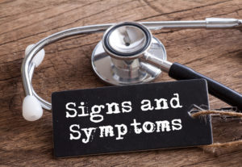
03
Recognition of signs & symptoms
Wyoming Department of Health. (2020). Signs and symptoms of COVID-19. https://health.wyo.gov/signs-and-symptoms-wording/

Slide 22
Recognize the Signs Early: Ages 5-10 years
High risk behaviors; Major change in eating habits; significant change in sleep; physical aggression; hurting themselves; talking about death
Increased Support
Having thoughts of suicide over the past few days; talking about taking their own life; threats or plans to harm others; hearing voices or experiencing other symptoms of psychosis; experiencing a drug or alcohol overdose; making a suicide attempt
Immediate intervention
National Council for Wellbeing. (2023).
Notes:
It is extremely important to be able to recognize the signs and symptoms of youth who may be experiencing a mental health crisis. There is often a delay between when a child first displays symptoms and when they are able to seek treatment which on average takes about 6-8 years. This can result in lifelong mental health conditions and can impact how a child develops into adulthood. This is really important to keep in mind as healthcare professionals, family members, and self advocates.
Common signs a symptoms are going to very by age. The signs and symptoms listed above are specific to youth who are in mental health crisis and who likely need professional support/increased support.

Slide 23
Recognize the Signs Early: Ages 11-21 years
Inability to perform daily self-care; major changes to sleep; drinking alcohol or using drugs; rapid changes to their mood; sudden increase energy; increased agitation or aggression; putting themselves in danger; hurting themselves;
Isolating Talking about death
Increased Support
Having thoughts/talking about/making plans about suicide; severely hurting themselves; threats or plans to harm others; hearing voices, seeing things that aren’t there or experiencing other symptoms of psychosis ; experiencing a drug or alcohol overdose; making a suicide attempt
Immediate intervention
National Council for Wellbeing. (2023).
Notes:
It is extremely important to be able to recognize the signs and symptoms of youth who may be experiencing a mental health crisis. There is often a delay between when a child first displays symptoms and when they are able to seek treatment which on average takes about 6-8 years. This can result in lifelong mental health conditions and can impact how a child develops into adulthood. This is really important to keep in mind as healthcare professionals, family members, and self advocates.
Common signs a symptoms are going to very by age. The signs and symptoms listed above are specific to youth who are in mental health crisis and who likely need professional support/increased support.

Slide 24
04
What can we do during a time of crisis?

Slide 25
What can you do: ALGEE
Start
Action A: approach
Action L: listen non-judgmentally
Action G: give reassurance
Action E: Encourage help
Approach the youth while watching for signs of crisis.
Initiate a conversation even if the youth does not
Set aside judgment about youth or their situation
Goals are to get an understanding of what is going on
Once youth feels heard, more likely to accept resources
Can provide information about mental health and provide hope.
Youth mental health challenges are more likely to resolve when treated by the appropriate medical professional.
Action E: encourage self help
National Council for Wellbeing. (2023)
Encourage them to find someone to talk to and take care of themselves.
Notes:
Action A: if necessary, call 911 if you are worried about the youth hurting themselves/others. Make sure everyone involved feels safe to have a conversation.
Action L: use of “I” statements can help you demonstrate understanding of what they are saying though active listening to demonstrate understanding. Make sure that you are present and do not compare their situation to one you had.
Action G: can help address current difficulties and address future one
Action E: encourage them to find someone to talk to and take care of themselves physically and emotionally by eating right and exercising.

Slide 26
05
What is your role?
Notes:
Consider the fact that your role can change based on the setting that you work in and what resources you have at your disposal. If you are in a setting where mental health professionals are around, such as in a school setting or in a hospital, then your role may be to get the child into the appropriate professional; whereas, if you are in a area where professionals are more scarce then you may be doing more while still remaining within your scope of practice. This will also change depending on your location. In more urban locations, you may be in a place where mental health professionals are more easily accessible compared to other locations.

Slide 27
What is Your Role?
Support recovery, maintaining healthy relationships, taking care of yourself (NAMI, n.d.)
Family
Be up to date with current understanding of your condition, take care of yourself, ask for help (NAMI n.d.).
Self Advocates
Work to promote positive behavior while supporting those with disabilities and identifying those at risk for mental health concerns (AOTA, n.d.).
Occupational Therapy
Notes:
Family: If you are noticing symptoms of distress from your child it is important to schedule an appointment with a psychiatrist/psychologist as soon as you can and contact their pediatrician as well. Be ready answer questions and have a good understanding of when you are noticing these symptoms. It can be helpful to think through when you started noticing these changes as well as this is very likely to come up in the conversation. It can be helpful to talk with your child’s school as well to keep them informed about what is going on with your child and how they can assist them in being successful. Keep in mind that you are there to support your child and to help them, but that you are also learning too. It is just as important to take care of yourself during this time as well.
Self advocacy: There is so much more to be said about self advocacy then what I can do today, but here are a few things to keep in mind. It is very important to know what you need/want before starting these conversations. It makes the process so much easier and can help you find your footing. Be assertive and express those needs. People cannot help you if they do not know what you need from them. Take care of yourself, educating people on your needs can be exhausting. Eating right, taking your medications, and getting enough sleep are all things that you can do to help yourself.
Occupational therapy: “Address health and wellness needs, recovery support, and social determinants such as housing and educational/vocational goals”

Slide 28
What is Your Role?
Play an important role in helping children put their emotions into words, which can help decrease other behavioral concerns. They can also help get modifications made in the classroom, which might allow the child to interact with their peers more easily. (Norkiewicz, M., n.d.)
Speech and language
Can provide one-on-one or group counseling sessions, they can assess students such as those with learning difficulties to determine what accommodations may be needed, they can also connect families to community resources (University of Central Florida. 2023).
Social Work
Notes:
A study by Colizzi, M., Lasalvia, A., & Ruggeri, M. (2020)., found that meeting the child’s physical, psychological, and social needs is key to support brain development, emotional regulation, and other higher order cognitive function. However, adverse childhood experiences, also referred to as ACEs, have been shown to negatively impact academic achievement, psychosocial skills, and more.

Slide 29
What is your role?
Discuss the role that genetics play in mental health conditions and to help families understand how environmental factors can influence a child’s mental health (Ryan, J., Virani, A., & Austin, J. C., 2015).
Genetic counselors
Notes:
Genetic counselors: they can also help clients understand their own role in their wellbeing, help normalize their feelings and provide an explanation of how etiology can impact one's mental health but that there are so many factors that can influence mental health.

Slide 30
What is Your Role as a Future Physical Therapist?
It is within the scope of practice of physical therapists to address behavioral and mental health concerns of patients/clients (APTA, 2020).
A scoping review performed in 2020 found that physical activity/exercise had a positive effect on:
Anxiety
Body image
Depression/anxiety symptoms
Fatigue
Mood states
Quality of life
Self-concept/self-esteem
Etc.
Notes:
Physical therapy: This statement came from a document that the general assembly put together. “ This includes appropriate consultation, referral, or comanagement with licensed health services providers in the prevention and management of behavioral and mental health conditions.”
According to a scoping review performed in 2020, of the 22 studies that were reviewed it was determined that physical activity/exercise had a positive effect on affect, anxiety symptoms, body image, depression symptoms, fatigue, functioning, mood states, self perception, quality of life, resilience, self-concept, self esteem, social skills, stress, and substance use.

Slide 31
05
What resources are available?
Notes:
Keep in mind that resources vary based on location and the type of services needed.

Slide 32
Local Resources: Places to receive support/services
Staunton: The Commonwealth Center for Children and Adolescents - Virginia’s sole inpatient hospital
Richmond: Child and Family Healing Center
Richmond: Veritas Collaborative
Richmond: Virginia Treatment Center for Children
Norfolk: Kempsville Center for Behavioral Health
Hampton: Riverside Behavioral Health Center
2020 State of the Commonwealth Report (2021).
Notes:
According to the 2020 State of the Commonwealth report, in 1993, Virginia passed the Children’s service Act (CSA) which introduced the use of state-funded mental health services for eligible children and families. The Virginia General Assembly passed several bills during the 2020 pandemic to address rising mental health concerns. As a result of these bill’s approval, students in K-12 are allowed excused absences for mental or behavioral health issues.
The commonwealth center for children's and adolescents is virginia's sole inpatient hospital that is dedicated to providing mental health services for children and is located in Staunton. The hospital has 12-bed living units and recreational/educational spaces. In 2018, this facility was so overrun that is experienced four consecutive months of 100+ admissions for a state psychiatric hospital with only 48 beds.
The other listed locations are options that I pulled from the reference as I thought these were other bigger areas. The site lists other sources as well and provide services such as short and long term rehab, inpatient and outpatient services, acute crisis stabilization and more.

Slide 33
Citations
2020 State of the Commonwealth Report (2021). Youth Mental Health in Virginia.
https://digitalcommons.odu.edu/cgi/viewcontent.cgi?article=1046&context=soc_reports
American Occupational Therapy Association. (n.d.). OCCUPATIONAL THERAPY IN MENTAL AND BEHAVIORAL
HEALTH. https://www.aota.org/-/media/corporate/files/advocacy/federal/overview-of-ot-in-mental-health.pdf
American Physical Therapy Association. (2020). The role of the Physical therapist and the American Physical Therapy
Association in Behavioral and Mental health. https://www.apta.org/siteassets/pdfs/policies/role-pt-apta-behavioral-mental-health.pdf
Atkinson, C. (2024, May 2). Toward Wellness: The Status of School-Based Mental Health Initiatives in Virginia Report -
Voices for Virginia's Kids. Voices for Virginia’s Kids.
https://vakids.org/our-news/blog/toward-wellness-the-status-of-school-based-mental-health-initiatives-in-virginia-report#:~:text=In%202021%2C%20the%20Virginia%20Youth,attempting%20suicide%20and%20self%2Dharmed
Bahri, N., Sterrett, K., & Lord, C. (2023). Marital status over 28 years of parents of individuals with autism and other
developmental disabilities. Journal of Family Psychology, 37(6), 920–931.https://doi.org/10.1037/fam0001093

Slide 34
Citations
Beer, PhD, Jessica (2024). Mental health in teens: Risk and protective factors.
https://positivepsychology.com/mental-health-in-teens/#10-risk-and-protective-factors
Catie's Closet. (2024, May 2). How poverty impacts children's mental health and educational outcomes.
https://www.catiescloset.org/blog/2024/05/02/how-poverty-impacts-childrens-mental-health-and-educatio
nal-outcomes/
Centers for Disease Control and Prevention. (2024, October 8). About Adverse Childhood Experiences. U.S. Centers
for Disease Control and Prevention; CDC. https://www.cdc.gov/aces/about/index.html
‌
Colizzi, M., Lasalvia, A., & Ruggeri, M. (2020). Prevention and early intervention in youth mental health: is it time for
a multidisciplinary and trans-diagnostic model for care? International Journal of Mental Health Systems, 14(1), 23–23. https://doi.org/10.1186/s13033-020-00356-9
Geldmaker, B., HRSA VMAP Project Director, & State Health Commissioner’s Advisory Council on Health Disparity
and Health equity. (2023). Virginia Mental Health Access Program (VMAP)
overview.https://www.vdh.virginia.gov/content/uploads/sites/76/2023/04/2023-VMAP-Overview-Presentatio
n.April-11-2023-1.pdf

Slide 35
Citations
National Alliance on Mental Illness. (n.d.). Family members and caregivers.
https://www.nami.org/your-journey/family-members-and-caregivers/
National Alliance on Mental Illness. (n.d.). Individuals with mental illness.
https://www.nami.org/your-journey/individuals-with-mental-illness/
National Alliance on Mental Illness. (n.d.). Do you know the layers of self-advocacy?
https://www.nami.org/individual-rights-responsibilities/do-you-know-the-layers-of-self-advocacy/
National Council for Wellbeing. (2023). Mental health first aid USA: Youth manual. Mental Health First Aid
USA.
Navigating Life Texas. (n.d.). Mental health for children with intellectual and developmental disabilities.
https://www.navigatelifetexas.org/en/diagnosis-healthcare/mental-health-for-children-with-intellectual-and-developmental-disabilities

Slide 36
Citations
Norkiewicz, M. (n.d.). Speech Therapy and Mental Health Advocacy: What is Our Role?
https://chatwithus.org/wp-content/uploads/2021/05/Friday-Team-Call.pdf
OpenAI. (2023). ChatGPT (Mar 14 version) [Large language model]. https://chat.openai.com/cha
Pascoe, M., Bailey, A. P., Craike, M., Carter, T., Patten, R., Stepto, N., & Parker, A. (2020). Physical activity and
exercise in youth mental health promotion: a scoping review. BMJ Open Sport & Exercise Medicine,
6(1), e000677–e000677. https://doi.org/10.1136/bmjsem-2019-000677
Ryan, J., Virani, A., & Austin, J. C. (2015). Ethical issues associated with genetic counseling in the context of
adolescent psychiatry. Applied & translational genomics, 5, 23–29.
https://doi.org/10.1016/j.atg.2015.06.001

Slide 37
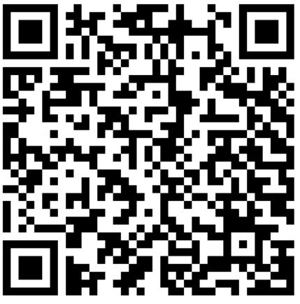
Thank you for your time!! Please complete the short survey below! Any questions?

