Slide 1

Va-Lend Leadership project

Slide 2

Agenda
Speaker Background
Project Title/Topic
Project Description
The Why
Hopeful Impact

Slide 3

Jill Hamlin, OTD, OTR/L
Licensed Occupational Therapist

Slide 4

The Power of interdisciplinary connection

Slide 5

Project Description
Based on work of Virginia’s P-3 ECCS (Prenatal-3 Early Childhood Comprehensive Systems) Project
  https://docs.google.com/document/d/1qRcGaY7-fZbOL3BKSiLIH1v6LA-ivh_nY5xthvaUoO8/edit#heading=h.z7lo4wl2l4k1

Slide 6

Project Description Cont…
Specific extension of the VA P-3 ECCS Project Shared Knowledge Workgroup
Aim is to identify or document current resources and care-related gaps
Identify additional sectors that may be important to include
Virginia’s Early childhood/P3 Relationship Map: Virginia Kumu Map

Slide 7

Kumu Mapping
Enhancing your referral connections

Slide 8
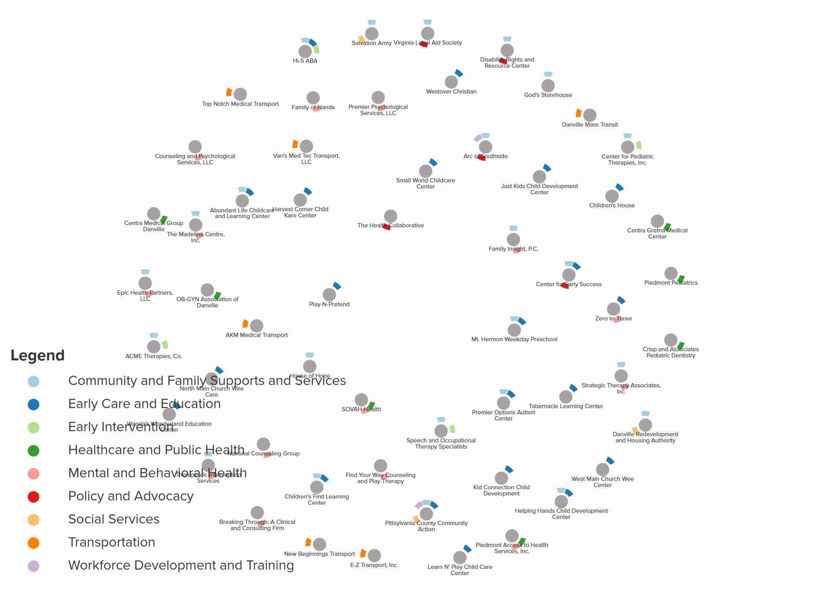
Danville/Pitts Co. Kumu Map
Google Sheets Document

Slide 9

My Why
Interdisciplinary connection brings increased treatment outcomes
Rural areas in the state are often under-funded and under-represented
Providers rarely know other providers exist or how to contact them
Families are very overwhelmed with the responsibilities to manage their loved one’s needs AND navigate their healthcare connections

Slide 10

Hopeful impact
Identify geographical areas of need
Identify service areas of need
Provide data to support applications for funding sources
Families feel increased support
Patients referred to services needed
Improved communication across state and disciplines

Slide 11

Thank you

