Slide 1

Preparing RVA Kids For School Success
VCU VA LEND
Leadership Project Long Term
Non-Academic Trainee 2025
Justine Zinskie, MS, OTR/L

Slide 2
How I Determined my Leadership Project
Observations in my own work
Teachers informally reporting concerns
Families reporting they are unfamiliar with resources and who to contact
Noticing that resources that are available are widespread and may be inaccessible
Identifying what is needed for success in kindergarten can also potentially help families know if their child with a disability need extra supports and how to access these supports and services

Slide 3
Gathering my Data - Survey to RPS Kindergarten Teachers
Sent a survey to all RPS teachers with the following questions:
What skills are most important to a student incoming to kindergarten? Please write all that apply.
What skills do you feel most kindergarteners are lacking when they start kindergarten that they should have to begin kindergarten? Please write all that apply.
What is the most efficient and effective way to communicate with parents/guardians of students?
In your opinion, how can parents support their students journey before and during kindergarten?
If you had an OT in your classroom for the day, which skill area would you like to collaborate on most for your students?
This last question was to help guide my personal advocacy and guidance as a school based occupational therapist

Slide 4
Survey Responses
What skills are most important to a student incoming to kindergarten? Please write all that apply.
What skills do you feel most kindergarteners are lacking when they start kindergarten that they should have to begin kindergarten? Please write all that apply.
Self regulation
Activities of Daily living (toilet training, shoe tying, managing personal needs and hygiene)
Sit and attend to a story or activity
Follow 1-2 step directions
exposure/familiarity to pencils/scissors/crayons/markers
Exposure to writing, writing their name
Waiting for short periods of time before getting a toy/playtime or for attention
Social skills/play with others/turn taking
Knowing first/last name
Basic Academic skills: ID some letters, counting, shapes and colors
Fine motor skills

Slide 5
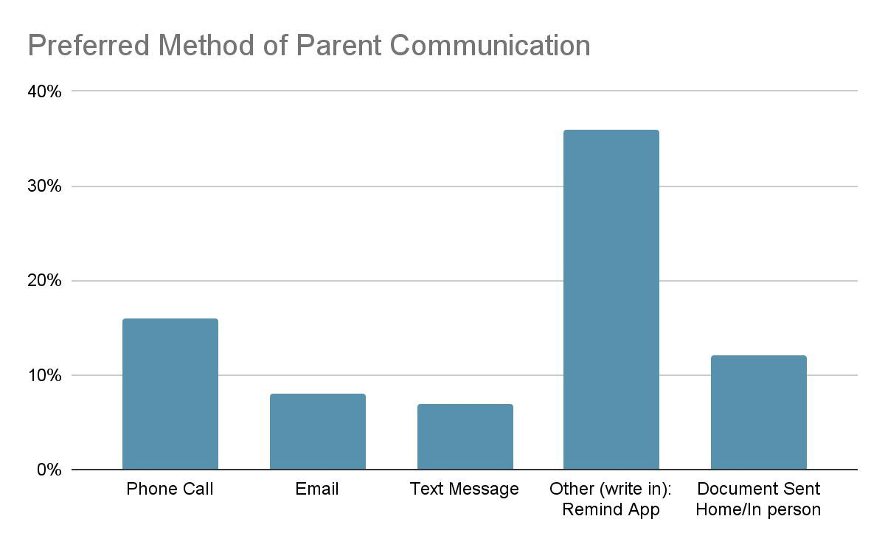
Survey Responses

Slide 6
Survey Responses: How can parents support readiness?
Enroll in preschool if possible
Community activities where sharing, turn taking, being around others are occurring
routines/responsibilities
Use materials during play - expose to a variety of things
Reading to your child daily, or accessing read aloud materials

Slide 7
Putting it All Together
Created a QR code accessible website parents can access by phone as this is appears to be the preferred way to communicate.
Disseminate this QR code to RPS preschools, pediatrician offices, libraries in Richmond city, etc.
It will include:
Access to links which include easy to do activity suggestions to work on fine/visual motor skills, routines/schedules, and self regulation
Links for contact Information for RPS and ITCVA for those who’s child has an identified disability or a suspected disability and want additional help
A link to access sign up for kindergarten readiness groups in the community - this is coming soon and in the works with VCU Department of OT

Slide 8
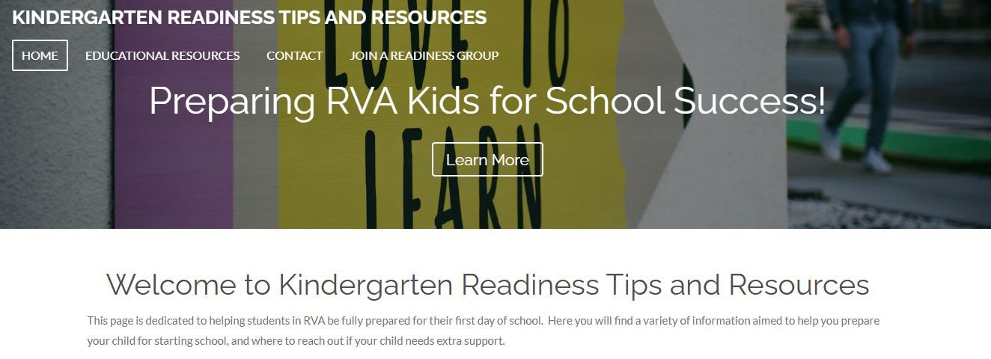
The Website and Link
Link: http://www.rvagoestoschool.com
Rva Goes to School

Slide 9
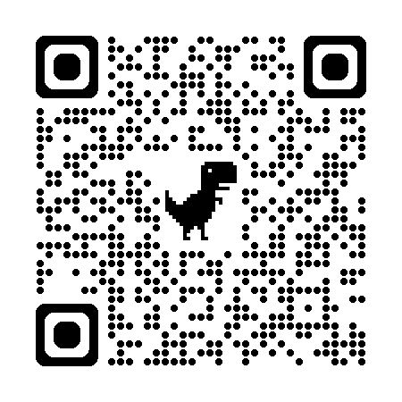

Slide 10
Next Steps for this Project
In addition to a resource guide website that is accessible and easy to follow, feel that families would benefit from a readiness group that is in person and hands on
Collaborating with VCU OT department capstone students to create a community program that focuses on kindergarten readiness skills
Collaborating with VCU OT department on seeking grants to fund this program for improved accessibility
Website will include direct link with information for this group including location, sign up, etc. which will be updated when available

Slide 11
Takeaways and Afterthoughts
Expect to alter and change over time with updated information to stay relevant and informed
Yearly reviews from teachers to make sure needs are being taken into consideration
Website allowed for more accessibility with read-aloud options
What I learned
Important to reach out to stakeholders to know what is truly needed, not just my own perceptions
A lot of great information out there! No need to recreate the wheel - but rather get it in one easy to access place.
Need to add a hands on component to reach and impact as many children as possible

Slide 12

Thank you for being here!
Any Questions?
Contact Information:
Justine Zinskie, MS, OTR/L
VCU VA LEND Long-term non-Academic
Trainee Graduate 2025
JzinskieOT@gmail.com

