Slide 1
VTSS Advanced Tiers July 16, 2020
Supporting Students after an Extended Absence: Elements of Successful Reintegration

Slide 2
Welcome
All participants are muted and video turned off.
Please use the chat feature to pose questions.

Slide 3
Facilitators
Martha Montgomery
Office of Student Services, Virginia Department of Education
Kelley Henderson
Formed Families Forward
Kim Dupre
VTSS Systems Coach
Wendi Jenkins
VTSS Systems Coach

Slide 4
Learning Intentions
Participants will explore practices that foster greater and more authentic collaboration with, and engagement of families whose children require more intensive supports.

Slide 5
COVID-19 School Re-Opening
VDOE 2020 Recover. Redesign. Restart.
Offers guidance for implementing universal practices for all students.

Slide 6
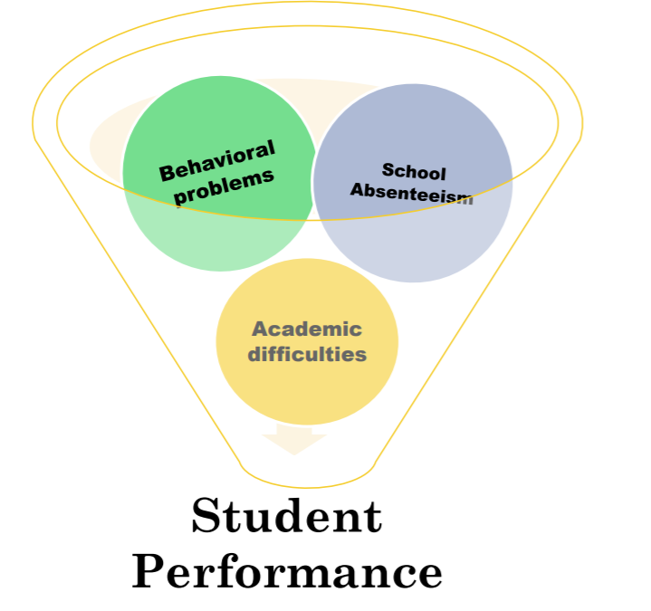
What Impact Does an Extended Absence Have in Education?

Slide 7
Tier 2 & Tier 3 Interventions for Students Returning from an Extended School Absence
Mental Health Crisis
Suspension
Extended Health Absence
Notes:
Students returning from an extended school absence may require Tier 1, 2, or 3 Interventions.
We know that when students miss school for any length of time, the return or recovery to normalcy at school isn’t always immediate. There are several considerations that must be made to assist the student in that transitions back.

Slide 8
Example
Amber was returning to school after a three-day suspension. She had missed three days of instruction, was angry with her teachers for issuing the consequence, and was embarrassed by the problem that had occurred in front of her peers.
What are some critical steps to set this student up for success?

Slide 9
Considerations for Students Returning to School
The student’s health and safety,
The factors that lead to the absence,
Status of academic make-up work,
Family or student concerns

Slide 10
School, Family, and Provider Collaboration
Keeping in touch with families while students are absent,
Collaborating with outside providers* (after securing confidential release form), and
Planning for needs
*HIPAA/FERPA Sharing Guide (add link)
Notes:
The transition back to school requires collaboration between the school, family and any outside providers.

Slide 11
Connect with VDOE
Twitter: @VDOE_News Facebook: @VDOENews
#VAis4Learners #EdEquityVA

Slide 12
Contact Information
NAME@doe.virginia.gov
www.doe.virginia.gov
Twitter: @VDOE_News Facebook: @VDOENews
#VAis4Learners #EdEquityVA

Slide 13
Who is Involved in the Return?
school
student
private providers
community agencies
families
Notes:
Leads into family role

Slide 14
6 Components of Family Engagement
Positive Relationships- Relationships between educators and families are positive, educators recognize families’ needs and cultural characteristics, leading to greater understanding and respect among all.
Family Empowerment- Educators use effective strategies to identify and encourage families’ knowledge, skills and efficacy for supporting students learning. Results in empowered families who serve as leaders, advocates, supports and partners in student learning.
Notes:
This is an acknowledgement that VTSS is organizing learning and implementation of FE around 6 components, hopefully staff are already familiar with these. Briefly, here are the 4 we won’t get into today.

Slide 15
6 Components of Family Engagement
Leadership- Leadership establishes family engagement as a priority; FE is included in school vision, mission, goals and these are aligned with division vision & goals for FE. Professional development and ongoing coaching to build capacity for staff and families to work together to support student outcomes.
Data-based Goals & Outcomes- Family engagement goals and outcomes are identified and monitored with data. Based on student outcome data and input from families

Slide 16
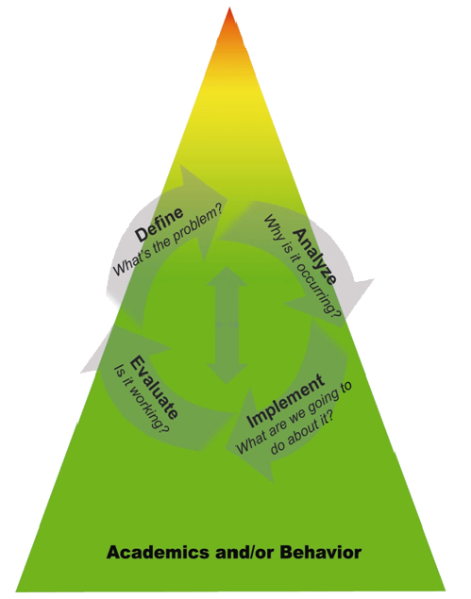
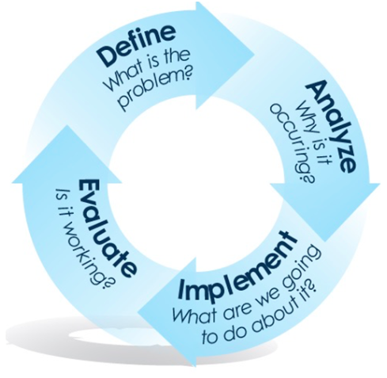
2 Components for Today
Multi-Dimensional, Multi-Tiered Approach
Collaborative Problem Solving

Slide 17
Multi-Dimensional, Multi-Tiered Approach
Educators use multidimensional approaches to engage families in dialogue (multiple communication modes).
Educators use multi-tiered approaches including tier 1 strategies for all families, more intensive tier 2 and tier 3 approaches for fewer families.
Notes:
5th and 6th components (multitiered, multi-dimensional approaches AND Collaborative problem solving) are the most directly impacting advanced tiers. Let’s review briefly these two components.

Slide 18
Multi-tiered Approach to
Family Engagement
Responsive to Family and Student Needs
Aligns with & supports goals of children receiving Tier 3 support
Empowers families
Aligns with and supports the goals of children receiving Tier 2 support
Networking & leadership opportunities
Welcoming, inviting school culture
Families’ preferences are basis of communication methods
Positive relationships, awareness, and two-way communication
Notes:
Let’s look at some examples of GOALS for differentiating family engagement at each of the tiers. School
-- Positive relationships
Two way communication
Information
Awareness
Tier 2 FACE:
Collaborative problem-solving
Direct support opportunities (trainings, etc.)
Empowering
Tier 3 FACE:
Frequent communication & collaboration
Direct support
Community resources
Home visits/case management

Slide 19
What are you currently doing to engage families in tiered supports?
Tier 3 Supports
Daily Progress Reports that allow for bidirectional communication; Personal monthly parent contacts with updates on progress; Point System at Home
Providing families with resources to supplement target skills at home (e.g., behavior tips and training
Embedding behavioral reflection during in-school suspensions
Tier 2 Supports
Bidirectional communication log regarding CICO
Skillstreaming Cards at home
Giving families specific prompts, and verbiage to use when dealing with behavior
Tier 1 Supports
Title 1 or Family Engagement rep on Leadership Team integrates PBIS/VTSS content in regular family communications and workshops
Parent surveys request communication preferences and needs
Open door policy- teachers request permission to live steam classroom to a portal only parents can access
Coffee talks (based on family preference data)
PBS Tips School Newsletter (based on family preference data)
Home Expectations/Matrix
Online videos demonstrating effective behavior management
How well are the strategies working?
How do you know?
Notes:
This is for School level
Effective two-way communication
Differentiated outreach efforts responsive to intensive need
Input drives schoolwide plan
Ongoing monitoring and adjustments to remove barriers
Responsive use of community resources

Slide 20
How do you currently support students and engage families throughout the Tiered Model?
Supporting Behavior
Engaging Families
Tier 3 Supports for Students:
Engaging Families at Tier 3:
School-Level
Tier 2 Supports for Students:
Engaging Families at Tier 2:
Tier 1 Supports for Students:
Engaging Families at Tier 1:
Responsive to Family and Student Needs
Notes:
We looked at approaches and strategies at each tier with a family focus on previous slide. This slide reminds of us need to align what is happening for kids with what is happening for families.
Example if we are implementing Tier 2 CICO for kids, we might want to consider family education activities around CICO home/school logs. What is helpful for families to know/see in the logs and what is helpful for schools to know/see from families each night/week?
Activity- School level- complete if there is time, or take this tool home.
Which tier is strongest for students?
Which tier is strongest for families?
Revisit their goals and results of IC: where do they want to start engaging families?

Slide 21
Collaborative Problem Solving
Families of children receiving Tier 2 and Tier 3 supports are effectively engaged in all steps of the problem-solving process to address individualized student needs:
Define problem
Analyze problem
Implement interventions
Evaluate impact
(start over!)
Notes:
6th component really helps provide a framework for iimpacting this topic of return to learn in Adv Tiers- Collaborative Problem Solving
Some examples of structured approaches for including family perspectives and family voice in collaborative problem solving conversations include Learning labs and Academic Parent Teacher Teams. Other examples include- •Conjoint Behavioral Consultation/Teachers & Parents as Partners (Sheridan)
•Positive Family Support/Family Check Up (Dishion)
In this component, we are answering- Are families included (input obtained and utilized, participation encouraged and made accessible) in the practices and processes (including the problem-solving process) for students receiving tier 2/3 services?
This approach of joining hand in hand with families throughout the return to learn is really key.

Slide 22
School Reentry Poll
Does your division currently have practices to address students returning to school following:
A mental health crisis
Suspension
An extended health absence
All of the above
None of the above

Slide 23
Division Introductions

Slide 24
Chesterfield
Erin Krietsch, M.A.
Mental Health Support Specialist

Slide 25
Fairfax
Kasey Cain, LPC & Kristen Biernesser
Resource Counselors

Slide 26
Loudoun
Stefanie LaPolla, MA, CAS, Nationally Certified School Psychologist
Supervisor, Multi-Tiered System of Supports

Slide 27
Division Overviews
Teams
Return to Learn Plan
Communication Plan
Training

Slide 28
Panel Discussion
How did you get started? (informal to formal, gap analysis)

Slide 29
Panel Discussion
Is there a process for obtaining/
sharing information
Confidentiality
MOU’s

Slide 30
Panel Discussion
Talk about your engagement with families/communities

Slide 31
Panel Discussion
What are the decision rules? How are you consistent with implementation?

Slide 32
Panel Discussion
Evaluation/feedback on how your process is working? Progress monitoring; fidelity; feedback from families, students, schools, teachers?

Slide 33
Q & A

Slide 34
Thanks

