Slide 1
Introduction to Advanced Tiers
Building and Sustaining an Effective System of Supports

Slide 2
Virginia Tiered Systems of Supports
Welcome to the Virginia Department of Education’s professional learning event through the Virginia Tiered Systems of Supports (VTSS).
This professional learning opportunity is funded and hosted by the Virginia Department of Education.

Slide 3
Day 1 Agenda
9:00 - 9:30
Intro, Connections & Advanced Tiers Overview
9:30 - 10:00
Teaming
10:00 - 10:30
Screening and Requests for Assistance
10:30-10:45 Break
10:45 - 11:15
Decision Rules
11:15 - 11:45
Continuum of Supports
11:45 - 12:00
Team Time

Slide 4
Welcome!
What is your ideal summer trip?

Slide 5
Virtual Norms
Be Engaged | Unmute to share ideas/questions. Participate in virtual activities
Be Respectful | Eliminate distractions like cell phones, email, social media, and background noise Give others time to talk and share Be committed to attend the full session
Be Prepared | Download materials prior to session Set dates/times with your team to continue action planning after sessions

Slide 6
Learning Intentions for Session 1
Participants will:
1. Describe and synthesize essential elements of advanced tier systems of supports
2. Define roles, responsibilities and meeting structures for advanced tier teams that demonstrate authentic family engagement
3. Identify screening and “requests for assistance” tools for the identification of students who might benefit from advanced tiers supports
4. List decision rules for evidenced-based practices in an advanced tiers continuum of supports

Slide 7
Success Criteria
During this session or in the coming year, my team will:
Use and sustain effective advanced tier meeting structures for data-informed decision making using screening and requests for assistance data
Document and use decision rules to match identified student instruction needs to an evidence-based continuum of supports

Slide 8
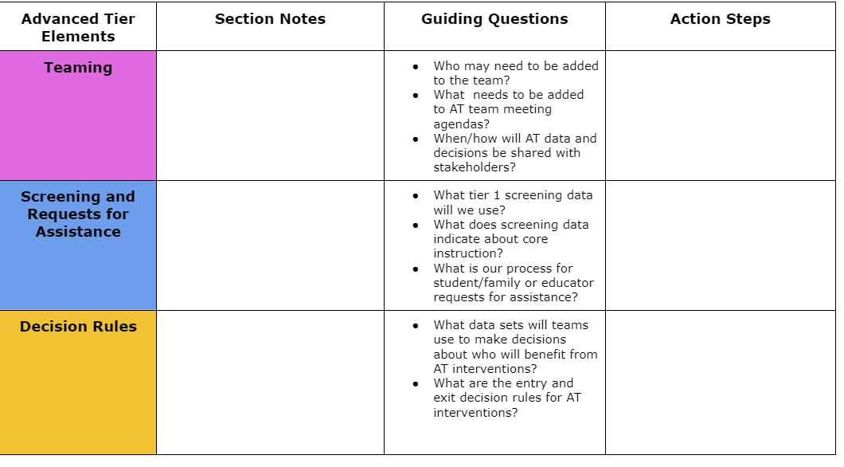
Advanced Tiers Notetaker

Slide 9
Where Are We in the Triangle?
Tier 3 for a Few: Intensive, Individualized
Tier 2 for Some: Targeted for Small Groups
Tier I for All: Core/Universal
1 - 5%
5 - 15%
80 - 90%

Slide 10
Social Competence & Academic Achievement
OUTCOMES
What we use to make decisions? Monitor progress?
Monitor fidelity?
SYSTEMS
DATA
What we do to support adults to implement the practices?
PRACTICES
What we do to
support students?
Notes:
‹#›

Slide 11
Why Advanced Tiers?
Core Instruction doesn’t work in isolation
Avert students from trajectories toward further learning/behavior challenges
Provide a unifying framework: Programs and strategies

Slide 12
What is Advanced Tiers?
VTSS Tier 2
Targeted support for students not successful with Tier 1 alone
Small group intervention
Provided in addition to universal, Tier 1 instruction and aligned with student needs
For students who may be struggling or who need more challenge

Slide 13
What is Advanced Tiers?
VTSS Tier 3
Frequent, intensive, and individualized intervention
Intensive support for students not responding to Tier 2 support or need more intensive support
Individualized intervention
Different than special education

Slide 14
Moving In and Out of Tiers
How are students’ experiences in a multi-tiered system of supports similar to a lava lamp?

Slide 15
Advanced Tiers Overview Quiz
Students not responding to core instruction should be removed and receive advanced tier interventions that teach different content in a different way for student success.
When high quality core instruction is in place, schools can anticipate about 5-15% of students will benefit from tier 2 interventions, and 1-5% of students from tier 3.
Identifying students as Tier 1, Tier 2 or Tier 3 will help school teams effectively plan advanced tiers interventions.

Slide 16
Advanced Tiers Foundations
“The Essential Eight”
Teaming
Professional Learning and Coaching
Screening and Request for Assistance
Progress Monitoring
Decision Rules
Data-
Informed Decision Making
Continuum of Support
Alignment

Slide 17
Teaming
Teaming
Professional Learning and Coaching
Screening and Request for Assistance
Decision Rules
Progress Monitoring
Data-
Informed Decision Making
Continuum of Support
Alignment

Slide 18
2.1 Team Composition
Team includes a coordinator and members with behavioral expertise administrative authority student knowledge school operations knowledge | School organization chart Tier II team meeting minutes | 0 = no coordinator or all 4 core areas of expertise 1 = no coordinator, core expertise OR member attendance is below 80% 2 = all members attendance at or above 80%

Slide 19
2.1 Academic TFI
Tier II (or Tier II/III) team includes staff members with a) intervention expertise; b)knowledge of the intervention c) admin. role d)knowledge of students | List of team members Inclusion of additional staff as needed as per team minutes | 0 = Tier II team meets no more than one of the feature criteria 1= Tier II meets two of the four feature criteria 2= Tier II team includes coordinator and meets all four feature criteria

Slide 20
What Do Teams Look Like?
We are a small school. Our Tier I, Tier II & III teams are the same people
Our Team meets monthly, and our Tier II Team meets every other week
We meet every week for 30 minutes for each Tier

Slide 21
Flippity Practice
Tier 1 Team
Advanced
Tiers Team

Slide 22
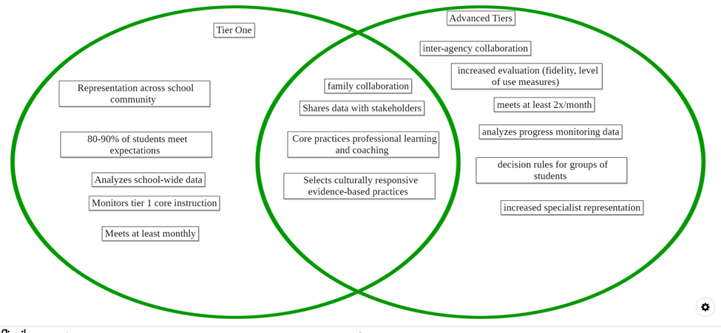
Teaming Venn Diagram

Slide 23
2.2 Team Operating Procedures
Tier II team meets at least monthly and has (a) regular meeting format/agenda (b) minutes, (c) defined meeting roles (d) a current action plan | Tier II team meeting agenda and minutes Tier II meeting roles descriptions Tier II action plan | 0 = uses none or 1 of the features listed 1= Team uses at least 2 but not all 4 features 2 = Tier II team meets at least monthly and uses all 4 features

Slide 24
2.2 Academic TFI
Meets at least monthly and has regular agenda, minutes, defined meeting roles; and current action plan | Meeting agendas and minutes Meeting roles and responsibilities Tier II action plan | 0 = 0-1 criteria 1 = 2-3 criteria 2 = 4 criteria
Procedure for communication across teams at all tiers for effective student planning. | Cross team agendas Aligned dashboard Intervention plans | 0 = no evidence 1= internal team communication 2 = Across team communication

Slide 25
Tier 2 Team Meetings
Occur more frequently (2x month)
Process referrals:
Screening data and Requests for Assistance
Standing Agenda Items
Monitor student progress and Tier 2 intervention effectiveness data
Communicate with staff and stakeholders

Slide 26
Team Data Conversations
Tier 1/ Universal
Tier 2/3
Targeted
Tier 3/ Tertiary
Student referral and progress monitoring
Intensified
student progress monitoring
Intervention level of use and % of students making progress
Schoolwide and classroom
Increased progress monitoring, fidelity measures and family engagement

Slide 27
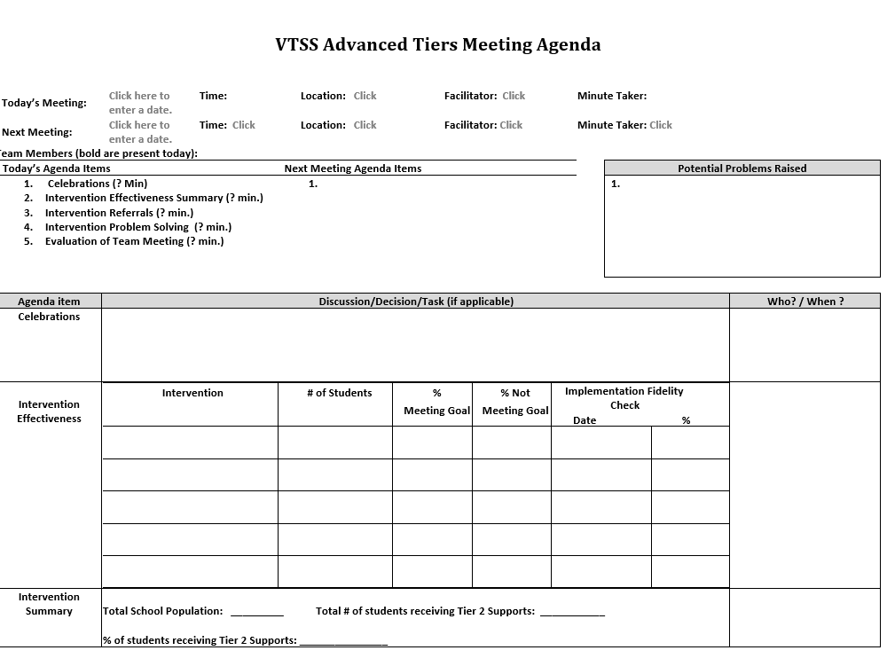
Advanced Tier Sample Meeting Agenda

Slide 28
Advanced Tiers Standing Agenda Items
Intervention Effectiveness
# of students
# meeting goal
# not meeting goal
Level of Use
Total school population
# of students receiving intervention
Fidelity
Intervention Referrals and Decision Rules
Team Problem Solving

Slide 29
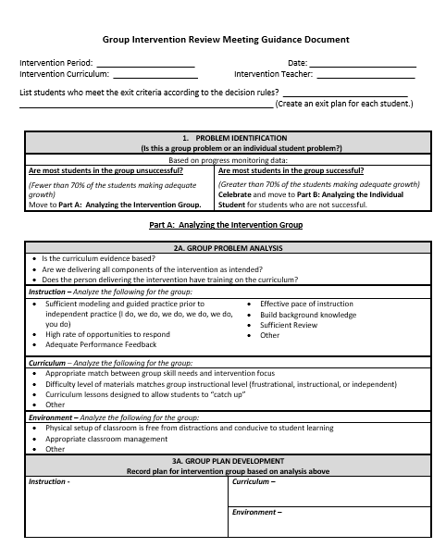
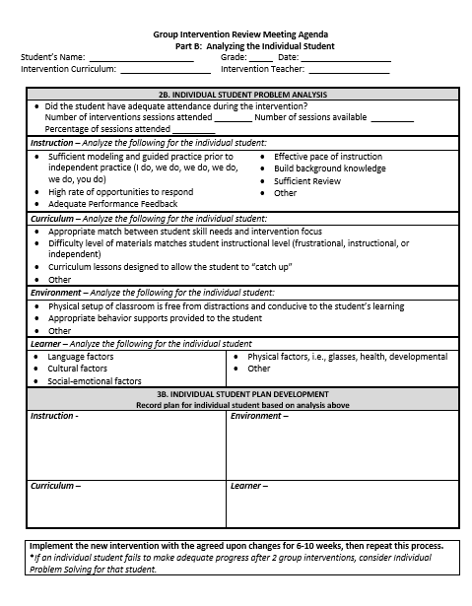
Different Forms,
Same Discussions!
retrieved from http://www.oregonrti.org/resources

Slide 30
3.4 Student Support Team
A uniquely constructed individual student support (ISS) team exists to design, implement, monitor, and adapt the student-specific support plan. | Behavior Support Plans | 0 = ISS teams do not exist for all students who need them 1 = ISS teams exist, but lack input from student/family 2 = ISS teams exist, with active input from student/family and meet regularly to review progress data

Slide 31
Stakeholder Communication
Share student progress graphs in CLTs and grade level meetings
Include graphs in school-to-home communication
Builds commitment to advanced tier interventions
Increases awareness of interventions

Slide 32
Teaming Structures True or False
Advanced tiers teams include more specialized personnel.
Advanced tiers teams look the same across divisions and schools.
The most important data conversation that takes place at an advanced tier meeting is individual student performance.
Tier 3 team conversations include caregivers as problem-solving partners

Slide 33
Team Breakout
Who is, or will be on your advanced tiers team?
Who else is needed?
Behavioral, academic, and medical expertise
General and Special Education knowledge
Data/graphing knowledge
Authority to access/provide resources
Understanding of support across grades/departments and school, including other tiered support
Family/school connection
What agenda does, or will your advanced tier team use?
What needs to be created, added or changed?

Slide 34
Big Ideas
Teaming
Advanced tier teams benefit from specialized knowledge and expertise
There should be at least one person with overarching knowledge of the interventions used in the schools
Use a predictable agenda that includes intervention systems and student performance data discussions

Slide 35
Screening and Request for Assistance
Teaming
Professional Learning and Coaching
Screening and Request for Assistance
Progress Monitoring
Decision Rules
Data-
Informed Decision Making
Continuum of Support
Alignment

Slide 36
2.3: Screening
Feature | Data Sources | Scoring Criteria
Decision rules and multiple sources of data (e.g., ODRs, screening tools, attendance, student nominations) are used to identify students. | Multiple data sources used (e.g., ODRs, time out of instruction, attendance, academic performance) Decision rubric Meeting minutes School policy | 0 = No speciﬁc rules for identifying students 1 = Data decision rules established but not consistently followed or used with only one data source 2 = Written policy exists that uses multiple data sources and ensures prompt notice to families.

Slide 37
Purpose of Screening
PROCESS
Evaluate Effectiveness of Core (Tier 1)
INTERVENTION
Part of the Request for Assistance Process that is one data point used to measure progress.
Adapted from https://assets-global.website-files.com/5d3725188825e071f1670246/5d7035c071700f1e3b846aab_b1_lewis_powers_dixon_revised.pdf

Slide 38
Integrated Screening
INFORMAL
FORMAL
Nominations/ Requests for Assistance
Existing Data Sets
Universal Screeners

Slide 39
Steps to Universal
Screener Implementation
Establish Clear Roles/Responsibilities
Identify Stakeholders
Determine the frequency/timelines
Communicate the Purpose
Ensure Accessibility of ALL and elimination of potential bias
Provide/Participate in Professional Development of Assessment Tools

Slide 40
Universal Screeners
ACADEMIC National Center on Intensive Interventions RAND Education Assessment Finder | BEHAVIOR University of Missouri Evidence Based Intervention Network National Center on Intensive Interventions Center on PBIS | MENTAL WELLNESS CASEL Assessment Guide RAND Education Assessment Finder Ohio Department of Education

Slide 41
Universal Screener Selection
Questions
Consideration
Is the core instruction sufficient/ is it improving?
For which groups is it working/not working?
What is the efficacy of the tiered interventions?
What is the individual growth of our students?
Cost
Capacity to administer and analyze
Ability to Scale-up
Communication of Results and Reporting of Needs

Slide 42
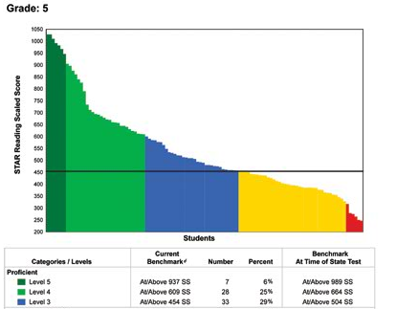
Other Screening Example
60 % of students
40 % of students

Slide 43
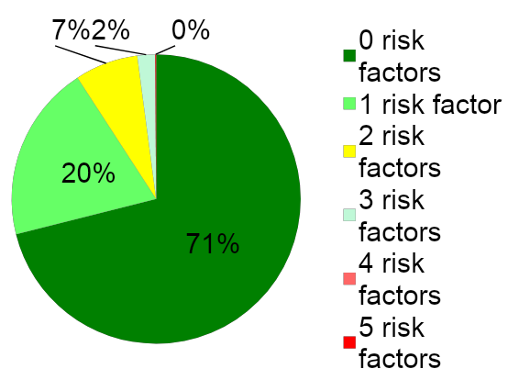
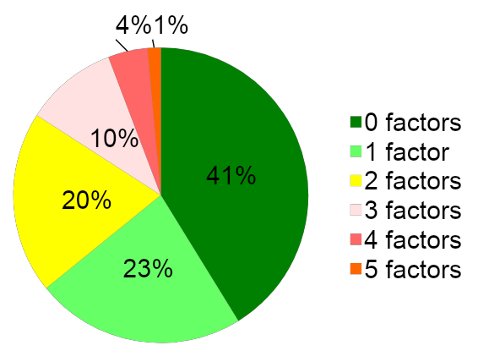
Risk Factors and Decision Rules
School A
School B

Slide 44
Student Issue or
Systems Issue?
Environment or student?
Fig. “Classroom Chaos”. May 31, 2020. http://healthyteachingonline.com/blog/wp-content/uploads/2014/09/schoolchaos.jpg

Slide 45
Quick Check: 1
YES
SO-SO
NO
We have universal screening data at Tier 1 in at least one area of academics, behavior, mental wellness (can be Early Warning System in secondary)
We use the data to answer “is the core sufficient” based on the triangle
We have conversations around “is it a student issue or a systems issue” rather than always looking at individual students

Slide 46
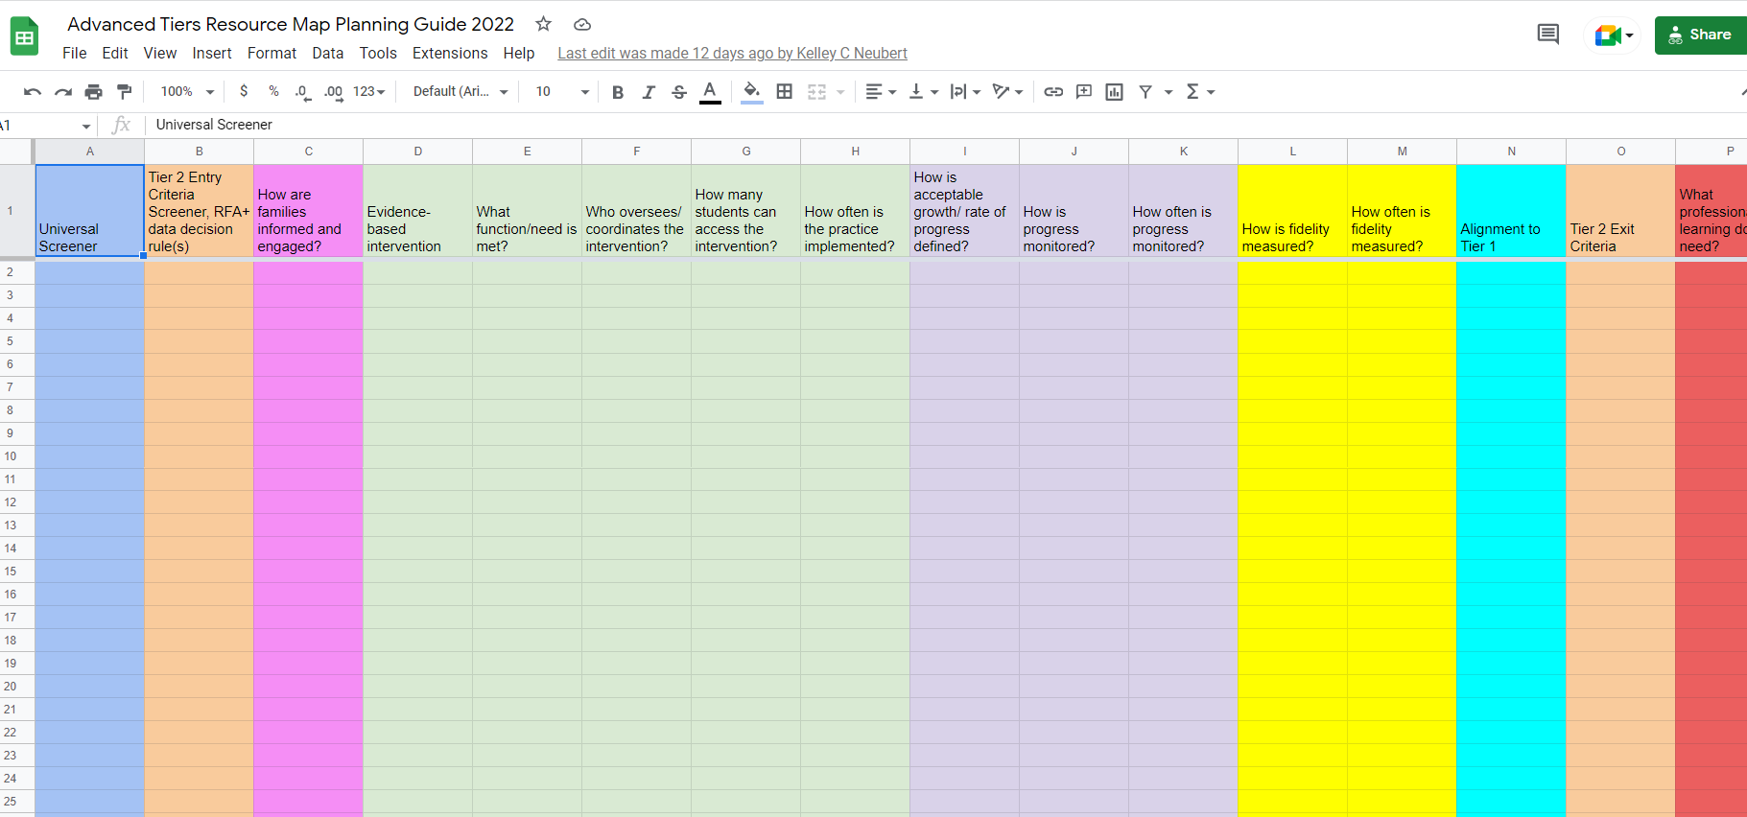
Advanced Tiers Resource Map and Planning Guide
ye

Slide 47
Screening Breakout Rooms
Choose a domain (reading, math, behavior, mental health, attendance)
List screeners (formal or data sets) that are used to support advanced tier entry considerations
How are caregivers involved in the screening process?

Slide 48
2.4: Requests for Assistance
A-TFI
Feature | Data Sources | Scoring Criteria
Process for seeking additional team assistance for meeting the needs of students and/or teachers when progress is not sufficient at Tier 2 | Documented assistance team Listing on asset or resource map Flow chart Decision rules defined | 0 = Teachers solve problems independently 1 = Process exists but lacks clear follow-through 2 = Process is clear, organized, and utilized by teachers

Slide 49
Requests for Assistance?
Grab the reading specialist in the hall and ask if she can add one more to the group.
*Tell the high school counselor that a student just got on your last nerve and they need to see them so they can be added to the social skills group.
*Email the school psychologist and everyone else you know because a student seriously interferes with learning in the classroom. “Please send the Tier 3 behavior specialist at once!”

Slide 50
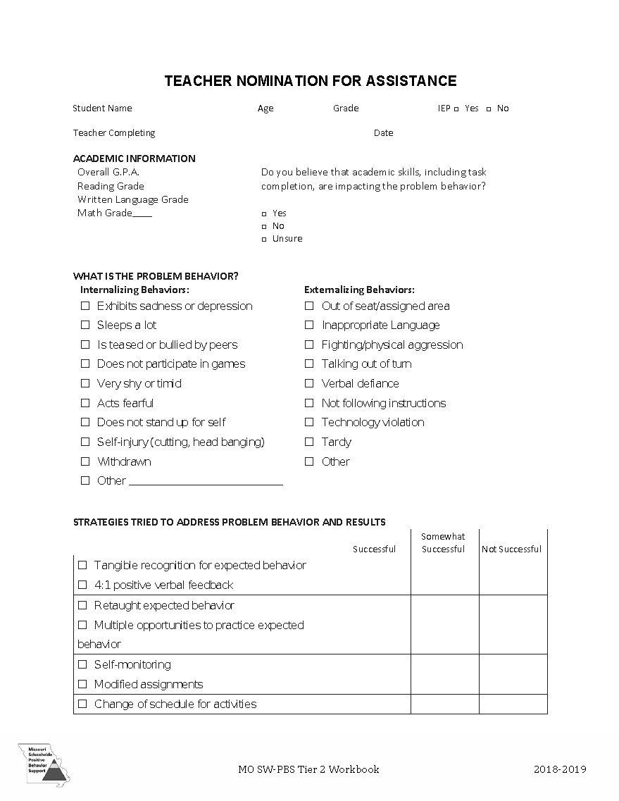
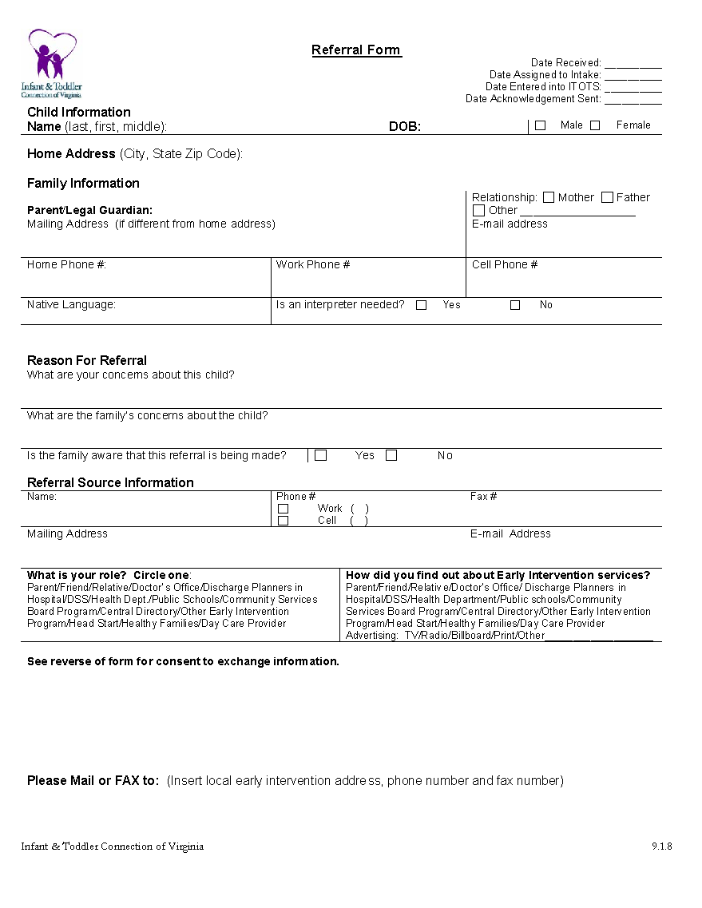
Nominations/ Request for Assistance Forms
Designed for quick response
Staff (Teacher, Support Staff, Administration), Caregiver and/or Student may make a nomination.
Should identify students with not only externalizing (interpersonal) risk characteristics but those with internalizing (intrapersonal) risk characteristics as well.
Scheduled to occur at designated points across the school year.

Slide 51
Share What You Use
How are requests for assistance shared at your school?
What type (staff, caregiver, student) of information is collected?

Slide 52
Let’s Practice!
Figure 4. Flippity.net. (n.d.) Retrieved June 4, 2020 from https://www.flippity.net/ma.php?k=1idyF2KkopwZiuJtQBxUcZci_0xSW8YKmaDGLFf0miyQ. Screenshot by author.

Slide 53
Consideration Activity
Figure 4. Flippity.net. (n.d.) Retrieved June 4, 2020 from https://www.flippity.net/ma.php?k=1idyF2KkopwZiuJtQBxUcZci_0xSW8YKmaDGLFf0miyQ. Screenshot by author.

Slide 54
Big Ideas
Screening and RFAs
Screening data helps us to know if the core is sufficient and differentiate a systems issue from a student issue, and for which groups of students the core instruction is successful.
Universal screening provides data advanced tiers teams need for data informed decision making.
Request for Assistance should be easily accessed by staff, students and caregivers.

Slide 55
15 Minute Stretch Break
Stand, stretch, move away from screen!

Slide 56
Decision Rules
Teaming
Professional Learning and Coaching
Screening and Request for Assistance
Progress Monitoring
Decision Rules
Data-
Informed Decision Making
Continuum of Support
Alignment

Slide 57
2.3: Screening & RFA Decision Rules
Feature | Data Sources | Scoring Criteria
Decision rules and multiple sources of data (e.g., ODRs, screening tools, attendance, student nominations) are used to identify students. | Multiple data sources used (e.g., ODRs, time out of instruction, attendance, academic performance) Decision rubric Meeting minutes School policy | 0 = No speciﬁc rules for identifying students 1 = Decision rules established but not consistently followed or used with only one data source 2 = Written policy exists that uses multiple data sources and ensures prompt notice to families.

Slide 58
Decision Rules
1.Decision rules, or “entry and exit criteria” allow for equitable decisions on who receives support.
2. Provide a uniform method to refer students to advanced tiers.
3. Provide clear exit criteria from advanced tiers interventions and supports.

Slide 59
Academic Data Example
Tier 2 Decision Rules
Below 25% on universal screener
Below 70% on benchmark assessments
Did not meet PALS benchmark
Did not pass prior year’s SOL
Did not achieve course credit

Slide 60
Sample Mathematics
Decision Rules

Slide 61
Behavior Data Example
Tier 2 Decision Rules
2-5 ODR’s
1 Suspension
> ? minutes missed instruction
> ? days unexcused absences
Incomplete classwork/homework
Tardies
Student, caregiver, staff nomination

Slide 62
Mental Wellness Data Example
Tier 2 Decision Rules
5+ visits to the nurse/school counselor per month
3-5 absences per month
2-4 tardies and/or early dismissals
Student, caregiver, staff nomination
Mental Wellness Screener

Slide 63
Sample Data Dashboard Decision Rules
Measure | Proficient Score | At-Risk | High Risk
Classroom Managed | 0-4 | 5 or more | 15 or more
ODR | 0-1 | 2-5 | 6 or more
Absences | <5 / trimester | 5+ / trimester | 10 / trimester
Tardy | <4 / trimester | 4+ / trimester | 10 / trimester
ISS | 0-1 | 2 | 4 or more
OSS | 0 | 1 | 2
Reading Virginia Growth Assessment | scores red or higher | scores fall between purple and red | scores fall below purple
Math Virginia Growth Assessment | scores red or higher | scores fall between purple and red | scores fall below purple
Writing Assessment | 3 or 4 | 2 | NS; 1
Nurse (non-medication) | 0-1 (no pattern) | 2-5 (patterns of regular visits) | 6 or more (patterns of regular visits)
*Ensure schools are looking at more than one data point to determine intervention need(s)*

Slide 64
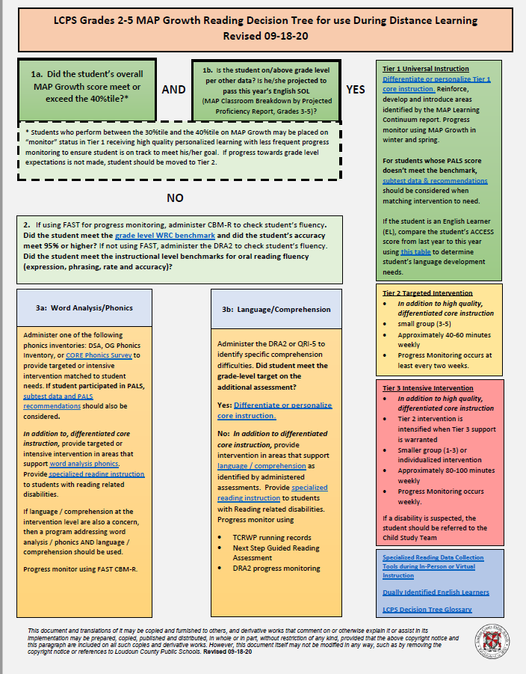
Sample Decision Tree
Grade 3-5
Reading

Slide 65
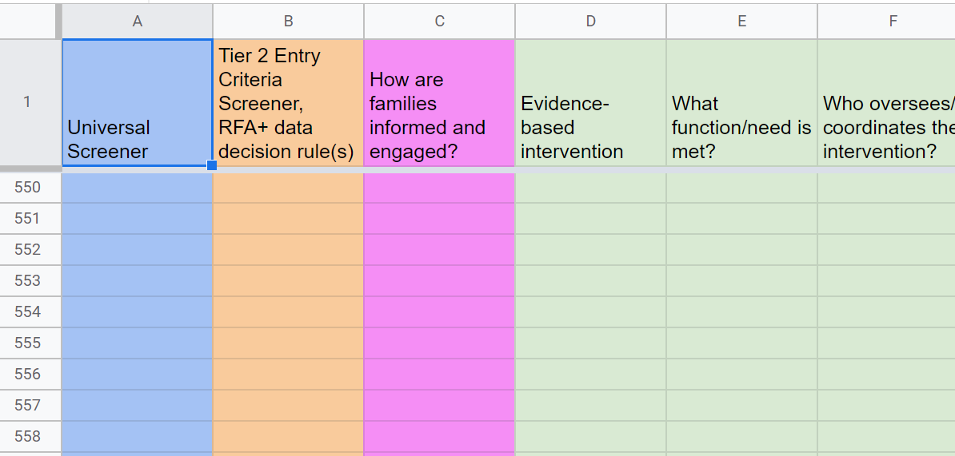
Decision Rules Team Planning

Slide 66
Decision Rules Breakout Rooms
What are the decision rules at your school for a student to enroll in an advanced tier intervention?
What are the decision rules for exiting an advanced tier intervention?
How are caregivers involved in advanced tier intervention entry and exit decisions?

Slide 67
Big Ideas
Decision Rules
Provide a uniform method for student accessing advanced tiers interventions and supports.
Decision rules, or “entry and exit criteria” allow for more equitable decisions on who receives support.
Provide clear advanced tier intervention fading criteria.

Slide 68
Continuum of Supports
Teaming
Professional Learning and Coaching
Screening and Request for Assistance
Decision Rules
Progress Monitoring
Continuum of Support
Data-
Informed Decision Making
Alignment

Slide 69
2.5: Options for Tier 2
Intervention
Feature | Possible Data Sources | Scoring Criteria
Tier II team has multiple ongoing behavior support interventions with documented evidence of effectiveness matched to student need. | School Tier II Handbook Targeted Intervention Reference Guide | 0=No Tier II interventions w/ documented evidence of effectiveness 1=Only 1 Tier II intervention 2=Multiple Tier II interventions w/ documented EOE

Slide 70
2.5: Intervention Resources
Feature | Possible Data Sources | Scoring Criteria
Tier II providers have access to multiple evidence-based interventions matched to student need. | Resource map Student data Meeting minutes Description of interventions Selection process | 0 = limited supports 1 = instructional match not consistently evident /unavailable 2 =continuum of evidence- based supports to match instructional needs exists

Slide 71
2.6: Tier 2 Critical Features
Feature | Possible Data Sources | Scoring Criteria
Interventions provide additional instruction/time for student skill development, structure and predictability and increased opportunities for feedback | Universal lesson plans Tier II lesson plans Daily/weekly progress report School schedule | 0=do not include core features 1=contain some but not all features 2=All interventions include all features

Slide 72
2.6a: Tier II Intervention
System Features
Feature | Possible Data Sources | Scoring Criteria
Tier II interventions clearly defined & include scheduled time; identified provider; progress monitoring schedule; and fidelity measure. | Interim reports Aim line School schedule Progress monitoring data Tier definition/ resource map Fidelity documents | 0=Tier II interventions provided but not clearly defined/ monitored 1=At least 2 of 4 features are met 2=All four feature criteria are met

Slide 73
2.6b: Tier II Intervention
Practice Features
Feature | Possible Data Sources | Scoring Criteria
Tier II interventions include increased: time, intensity and dosage; opportunities for feedback; and structures and prompts. | School schedules Fidelity tools Programmatic descriptions Lesson plans | 0=Intervention design is not clear and/or inconsistently utilized. 1= At least 2 of the 3 feature criteria are met. 2= All 3 feature criteria are met.

Slide 74
Tier 2 Core Intervention Features
Increased Structure & Prompts
Increased Intensity of Data Collection
Increased
Regular Feedback
Increased Family Engagement
Additional Instruction on Skills (prosocial, emotional, academic)
Tier 2 Core Features
Efficient system for access and delivery of intervention
Adapted from Horner & Sugai (2016)

Slide 75
Core Features Quick Check
Tier 2 Core Features
Adapted from Horner & Sugai (2016)

Slide 76
Continuum of Supports Planning
Evidence –based intervention | What function or need is met? | Who oversees or coordinates the intervention? | How often do students receive it?

Slide 77
Evidence-Based Practices Selection Tool (Existing Practices)

Slide 78
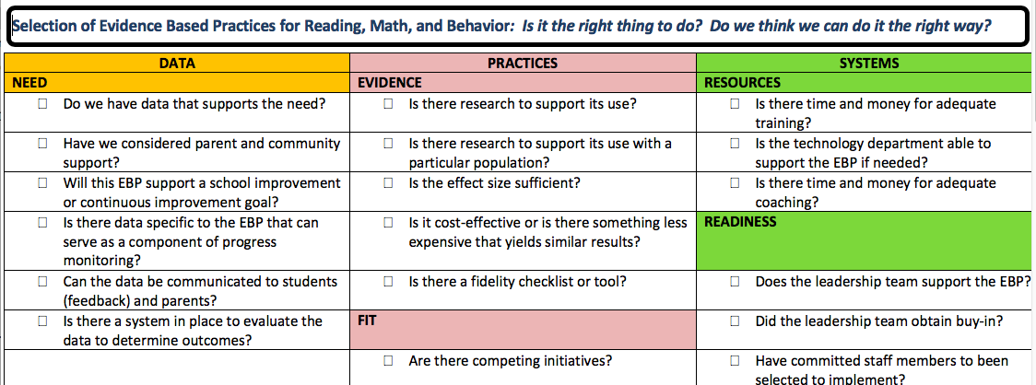
Evidence-Based Practices Selection (New Interventions)

Slide 79
2.7: Practice Matched to Student Need
Feature | Possible Data Sources | Scoring Criteria
A formal process is in place to select Tier II interventions that are matched to student need and adapted to improve contextual fit | Data sources used to identify interventions School policy Tier 2 handbook Needs assessment Targeted Interventions Reference Guide | 0=No process in place 1=Process w/o documentation that interventions are matched to student need 2=Formal process in place w/ documentation

Slide 80
2.7: Intervention Selection
Feature | Possible Data Sources | Scoring Criteria
A process exists for selecting evidence-based interventions and creating a match to student need. | Resource map Evidence- based selection tool Individual student data Data outcomes Documentation of selection process | 0= process unclear/ inconsistently utilized. 1=process exists for selection OR matching to student need. 2=process exists for section AND matching to student need.

Slide 81
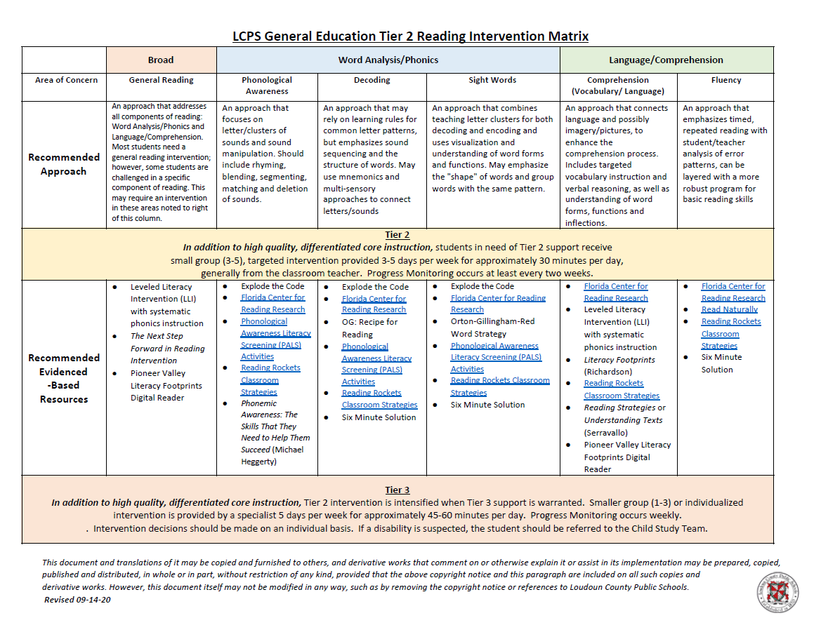
Matching Interventions to Instructional Needs

Slide 82
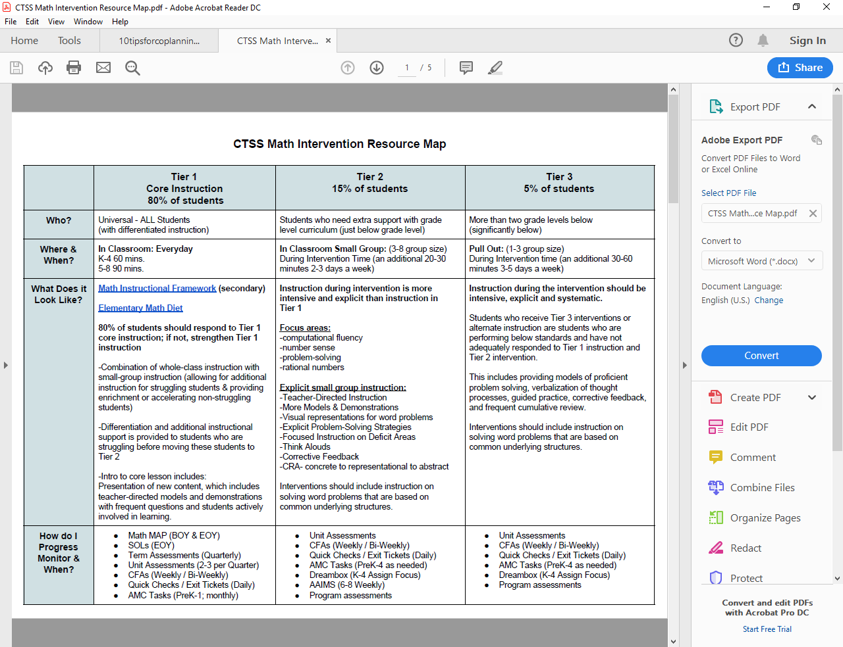
Mathematics Resource Map Example

Slide 83
Continuum of Supports
Breakout Rooms
Use the notetaker to record your team’s next steps in developing an effective continuum of supports
Check for 6 core features?
Use EBP selection tool?
Match interventions to instructional need?

Slide 84
Big Ideas
Continuum of Supports
A few viable interventions are more effective than many under-supported options on the continuum of supports
Document a continuum of supports that contain 6 core features of advanced tiers interventions and are matched to instructional need

Slide 85
Day 1 Wheel of Review

Slide 86
Introduction to Advanced Tiers - Day 2
Building and Sustaining an Effective System of Supports

Slide 87
Virginia Tiered Systems of Supports (day 2)
Welcome to the Virginia Department of Education’s professional learning event through the Virginia Tiered Systems of Supports (VTSS).
This professional learning opportunity is funded and hosted by the Virginia Department of Education.

Slide 88
Welcome Back!
Teaming
Professional Learning and Coaching
Screening and Request for Assistance
Progress Monitoring
Decision Rules
Data-
Informed Decision Making
Continuum of Support
Alignment

Slide 89
Welcome and Connect!
R + R
TRAVEL
CCCCCCC
M1Y L1I1F1E

Slide 90
Day 2 Agenda
9:00 - 9:30
Alignment
9:30 - 10:00
Data-informed decision making
10:00 - 10:30
Progress monitoring
10:30 - 10:45 Break
10:45 - 11:00
Data-informed decision making (fidelity)
11:00 -11:45
Professional learning and coaching
11:45 -12:00
Putting it all together and evaluation

Slide 91
Learning Intentions for Session 2
Participants will:
1. Describe and synthesize remaining essential elements of advanced tier systems of supports
2. Examine advanced tiers level of use, progress monitoring, student performance and fidelity data
3. Explain the importance of alignment across tiers and domains
4. Delineate essential components of professional learning and coaching plans for effective advanced tiers implementation

Slide 92
Success Criteria-Day 2
During this session or in the coming year, my team will:
Align advanced tier systems across domains and interventions to core instruction
Analyze and make decisions using intervention level of use, progress monitoring/student performance and fidelity of implementation data
Develop and use a professional learning and coaching plan to support for effective and sustained advanced tiers systems

Slide 93
Alignment
Teaming
Professional Learning and Coaching
Screening and Request for Assistance
Progress Monitoring
Decision Rules
Data-
Informed Decision Making
Continuum of Support
Alignment

Slide 94
2.8: Practice Matched
to Student Need
Feature | Possible Data Sources | Scoring Criteria
Tier 2 supports are explicitly linked to Tier 1 supports, and students receiving Tier 2 supports have access to/are included in Tier 1 supports. | Universal lesson plans Tier II lesson plans Acknowledgement system Student of the month documentation Family communication | 0=No evidence that students receiving Tier 2 supports have access to Tier 1 supports 1=students have some access to Tier 1 supports 2=students have full access to Tier 1 supports

Slide 95
2.8: Intervention Selection
Feature | Possible Data Sources | Scoring Criteria
All interventions are aligned with Tier I content and coordinated with Tier I schedules to maintain access to Tier I content. | Resource map Evidence- based selection tool Individual student data Data outcomes Documentation of selection process | 0= process unclear/ inconsistently utilized. 1=process exists for selection OR matching to student need. 2=process exists for section AND matching to student need.

Slide 96
Alignment Vision
Build and sustain a system than ensures that all students receive high quality core, equitable academic, behavioral and social-emotional instruction and evidence-based advanced tier interventions to support their learning needs.

Slide 97
Essential Element Alignment
Teaming
Universal Screening/RFA
EBP Interventions and Supports Continuum
Academics
Behavior and Mental Health
Progress Monitoring
Data-informed Decision Making

Slide 98
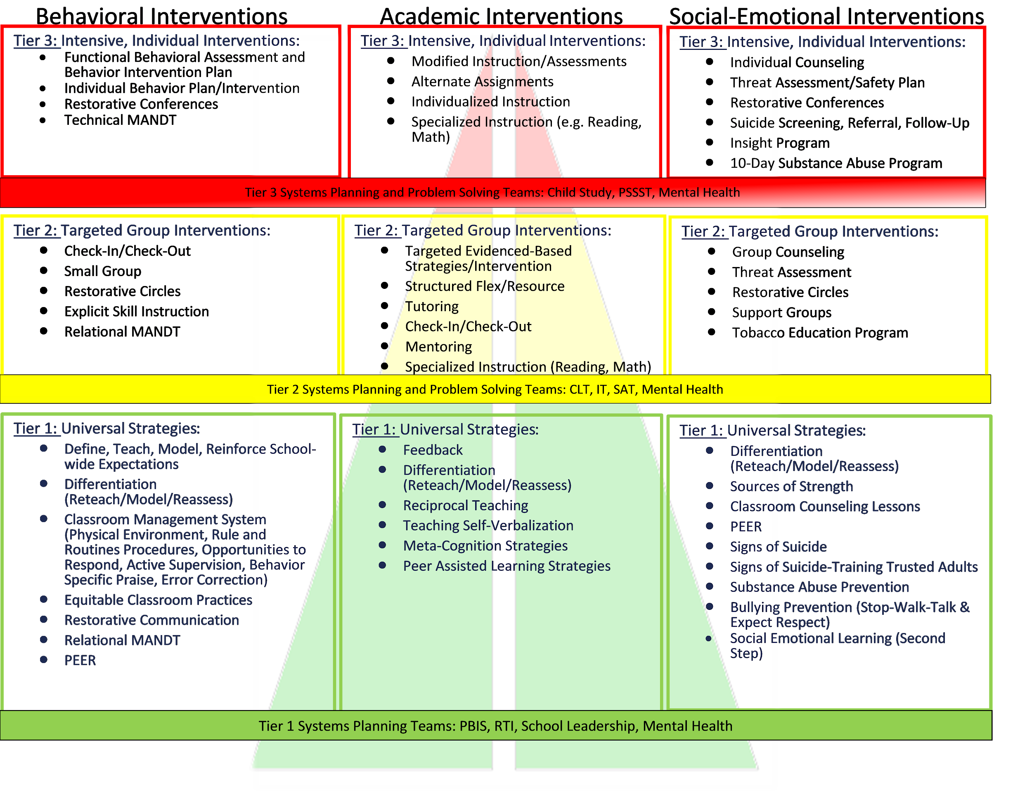
Aligned System
LCPS MTSS Pyramid of (Strategies) Interventions

Slide 99
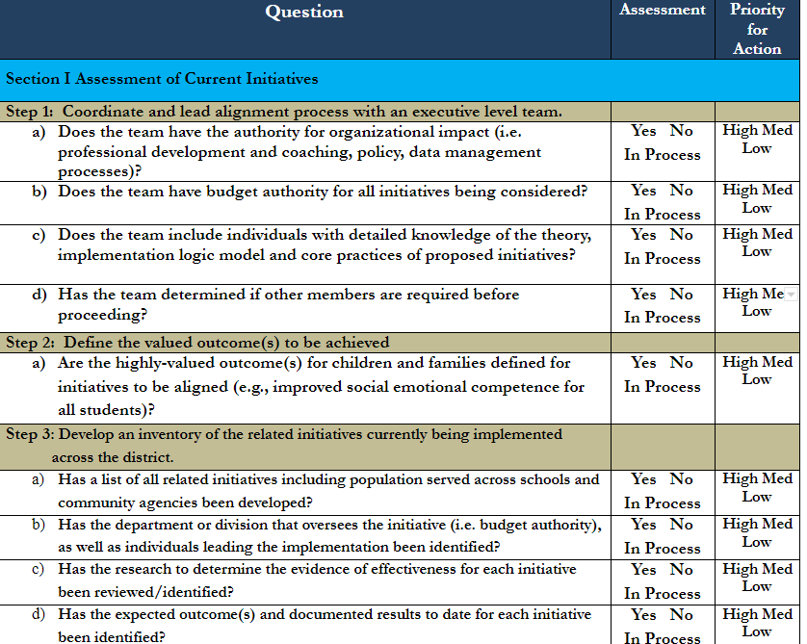
PBIS Alignment Tool

Slide 100
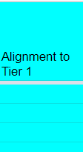
Alignment Breakout Rooms
How are advanced tier interventions listed
on your current continuum of supports aligned with Tier One Core instruction?
What changes, if any, might you consider?
What questions listed on the PBIS Alignment tool could assist your team in developing or enhancing an aligned system of advanced tier supports across domains?

Slide 101
Big Ideas:
Alignment
The more time you spend away from the right side (Tier 1), the harder it is to keep pushing the ball uphill out of Advanced Tiers
Content and scheduling needs to align so students are able to access Tier 1 core instruction

Slide 102
Data-informed Decision Making
Teaming
Professional Learning and Coaching
Screening and Request for Assistance
Decision Rules
Progress Monitoring
Data-
Informed Decision Making
Continuum of Support
Alignment

Slide 103
Social Competence & Academic Achievement Logic Model
OUTCOMES
How will schools know that students are responding to the intervention and making progress towards their goal?
SYSTEMS
DATA
What we do to support adults to implement the practices?
PRACTICES
What we do to
support students?
Notes:
‹#›

Slide 104
What is DIDM?
Data-Informed Decision Making (DIDM):
Analyzing and evaluating student data to inform educational decisions around instruction, intervention, allocation of resources, development of policy, movement within a multi‐level system, and disability identification.
Simplified:
Using data to inform decisions/actions

Slide 105
DIDM in Tier II
Identify students in need of Tier II supports
Match students to Tier II interventions
Evaluate level of Tier II access/use
Monitor student performance
Individual student progress
% of students experiencing success
Monitor implementation fidelity
Screening and Request for Assistance
Decision Rules

Slide 106
Using Data in Advanced Tiers
Support the System
Support the Student
Level of Use: % of students accessing advanced tiers interventions
Effectiveness of EACH intervention in place
Monitor students entering and exiting advanced tiers (movement across tiers)
Fidelity of implementation
Progress monitoring: Continue, fade, modify, or move on (movement within the tier)

Slide 107
LEVEL OF USE

Slide 108
2.10 Level of Use
Feature | Possible Data Sources | Scoring Criteria
Team follows written process to track proportion of students participating in Tier II supports, and access is proportionate. | Tier II enrollment data Tier II team meeting minutes Progress monitoring tool | 0 = Team does not track Tier II data 1 = Student data monitored but no data decision rules established to alter support 2 = Team defines criteria, tracks proportion, at least 5% of students receiving Tier II supports

Slide 109
2.10 Academic TFI
2.10 Level of Use Team follows written process to track proportion of students with equitable access to and participation in Tier II. | Documentation of process Tier II enrollment data Tier II meeting minutes Student enrollment data for school | 0 = No written process and/or student data 1 = Track proportion of students OR equitable participation 2 = Track both proportion AND equitable student participation

Slide 110
Level of Use Guidance
Team uses data to determine if there is sufficient use of Tier II
Not too many: >20%
Not too few: <1%
Just Right: 5-15%

Slide 111
How Do I Know?
Potential Steps: | Example:
Identify # of students in your building | 500 students
Determine 5% of your school population. Determine 20% of your school population | 5%= 25 students 15%= 100 students 25-100 students should be accessing Tier II interventions
Can our current systems support this many students? Yes: Keep Going No: Team Problem Solving
Determine how many students are currently accessing or requiring access to Tier II interventions (consider decision rules and RFA). | Less than 25 or more than 100: Team Problem Solving Between 25 and 100: Just Right!
Reassess at month as students move in and out of receiving Tier II interventions.

Slide 112
What is Your Data Story?
Too many students will require more intensive instruction?
Consider:
Revisiting decision rules
Increasing Tier 1 instruction

Slide 113
Breakout Room Practice
Universal screening data and current decision rules for identifying students in need of Tier II supports show 37% of students are in need of targeted instruction for math calculation.
What is the problem?
Why is it occurring?
What can be done?
How will we know if it worked?

Slide 114
Progress Monitoring
Teaming
Professional Learning and Coaching
Screening and Request for Assistance
Decision Rules
Progress Monitoring
Data-
Informed Decision Making
Continuum of Support
Alignment

Slide 115
Student Performance
Progress Monitoring

Slide 116
2.11a Student Performance Data
Feature | Possible Data Sources | Scoring Criteria
Tier II team tracks proportion of students experiencing success (% of participating students being successful) | Student progress data (% of students meeting goals) Intervention Tracking Tool | 0 = Student data not monitored 1 = Student data monitored / no data decision rules to alter support 2 = Student data monitored and used at least monthly, with data decision rules established

Slide 117
2.11c Academic TFI
For each intervention, there are progress monitoring data ...(c) within each intervention, the percent of students making sufficient progress | Agenda and minutes for data team meetings Parent contact logs Intervention tracking tool | Scoring for 2.11 a, b and c 0 = only 1 criteria is met for progress monitoring. 1 = Two criteria are met . 2 = All criteria are met

Slide 118
Intervention Success Rates
Teams need to know whether advanced tier interventions are effective
What does adequate progress look like (decision rule)?
What % of students are being successful in each intervention?

Slide 119
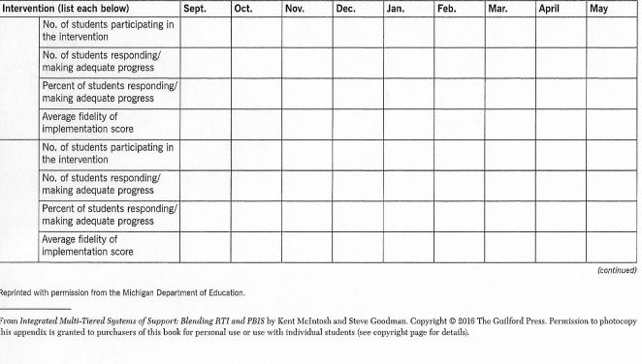
Intervention Effectiveness Data

Slide 120
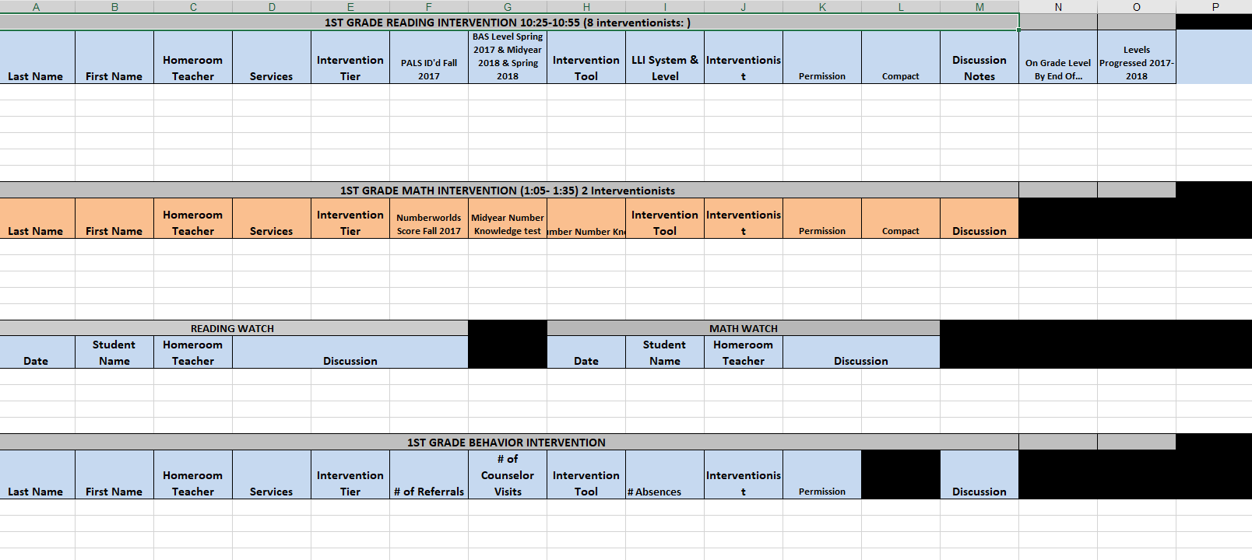
Powhatan Sample Tracking Tool

Slide 121
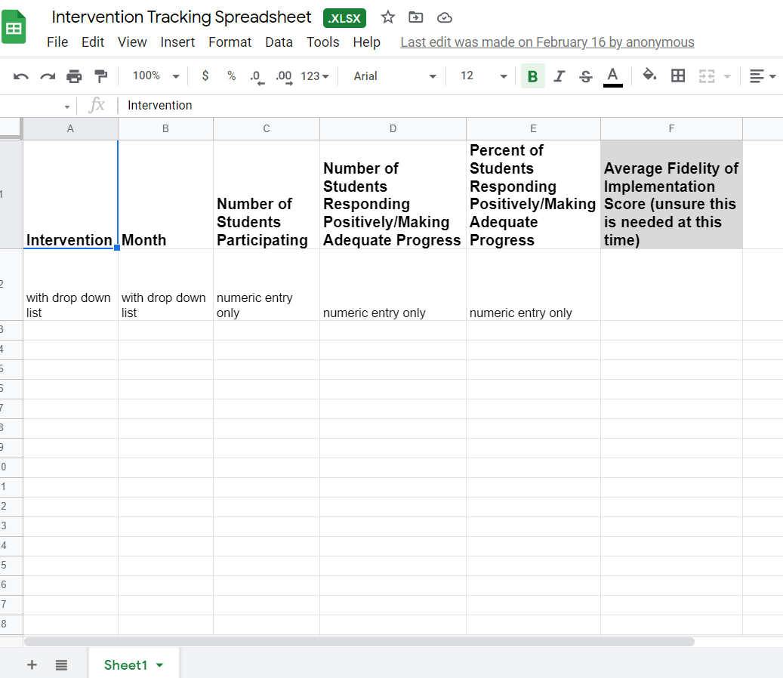
Electronic Intervention Tracking
Intervention Tracking Spreadsheet

Slide 122
2.11b Student Performance Data
Tier II team uses Tier II intervention outcomes data and decision rules for progress monitoring and modification | Student progress data Daily/Weekly Progress Report sheets Family communication | 0 = Student data not monitored 1 = Student data monitored / no data decision rules 2 = Student data monitored at least monthly; use data decision rules to alter support

Slide 123
2.11a, b Academic TFI
Progress monitoring data for students receiving Tier 2 supports which are displayed and discussed to make decisions monthly regarding individual progress | Agenda and minutes for data team meetings Caregiver contact logs Intervention tracking tool | Scoring for 2.11 a, b and c 0 = only 1 criteria is met for progress monitoring. 1 = Two criteria are met . 2 = All criteria are met

Slide 124
Progress Monitoring Is…
“…used to assess student progress or performance in those areas in which they were identified by universal screening as being at-risk for failure (e.g., reading, mathematics, social behavior).
It is the method by which teachers or other school personnel determine if students are benefitting appropriately from the typical (e.g., grade level, locally determined, etc.) instructional program, identify students who are not making adequate progress, and help guide the construction of effective intervention programs for students who are not profiting from typical instruction” (paragraph 2). Source: RTI Action Network

Slide 125
Progress Monitoring Across Tiers
Tier 1: Universal screening of all students to determine who is and is not, responding to universal instruction
Tier 2: Assess response to Tier 2 intervention
Tier 3: Assess response to intensive, Tier 3 intervention and use data to modify individualized instruction, as needed

Slide 126
Advanced Tiers
Progress Monitoring is...
“a form of assessment in which student learning is evaluated on a regular basis (e.g., weekly, every two weeks) to provide useful feedback about performance to both students and teachers” (iris.peabody.vanderbilt.edu)
Two Types
Mastery Monitoring: assessment of the mastery of a sequence of skills, with one skill being assessed to mastery before moving to the next skill
Curriculum-Based Measurement: evaluative tool that targets specific skills or abilities covered within a curriculum

Slide 127
Progress Monitoring
Decision Rules
Decision Rules
Determine how you will define progress.
Expected Rate of Progress
How much progress should the student make each week based on the intervention?
What is the goal?
Student Baseline:
Where is the student currently performing?

Slide 128
Graphing Progress Monitoring Data
Baseline: where the student is performing prior to intervention
Goal: where the student is expected to be performing by a given date (this may be to meet a benchmark or based on expected rate of progress)
Goal Line/ Aim Line: line connecting the baseline to the goal. If the student’s progress follows this line, they will meet their goal
Phase Line: line that separates changes to the intervention
Trendline: the current trend of the data *If the student continues to make progress as they currently are, this is the trajectory of their progress
Note: trendline should be analyzed only within the current phase of intervention, data from prior interventions should not be used to determine the current data trend

Slide 129
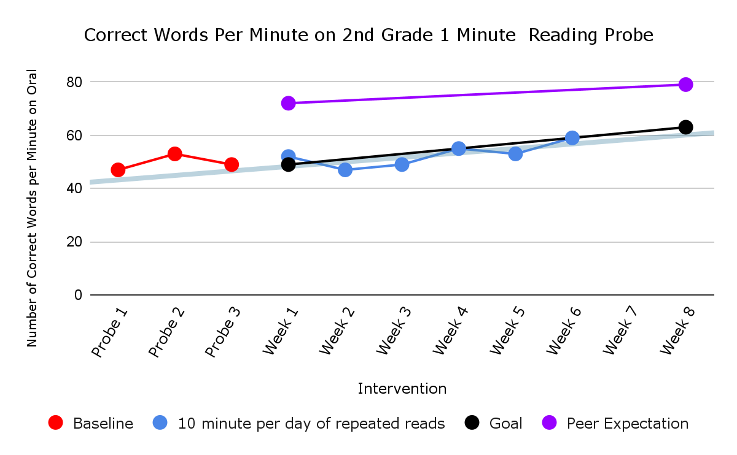
Importance of Graphing
Baseline
Intervention

Slide 130
Progress Monitoring Practice
Looking at this graph, can we determine if the student is making progress?
Is the student expected to meet their goal?
Should an intervention change be made?

Slide 131
Progress Monitoring Data Decision Rules
How will you measure if the student’s rate of progress is enough to meet the goal?
Trendline analysis
4 point decision rule
When will you be able to make this decision?
7 data points
6-8 intervention sessions

Slide 132
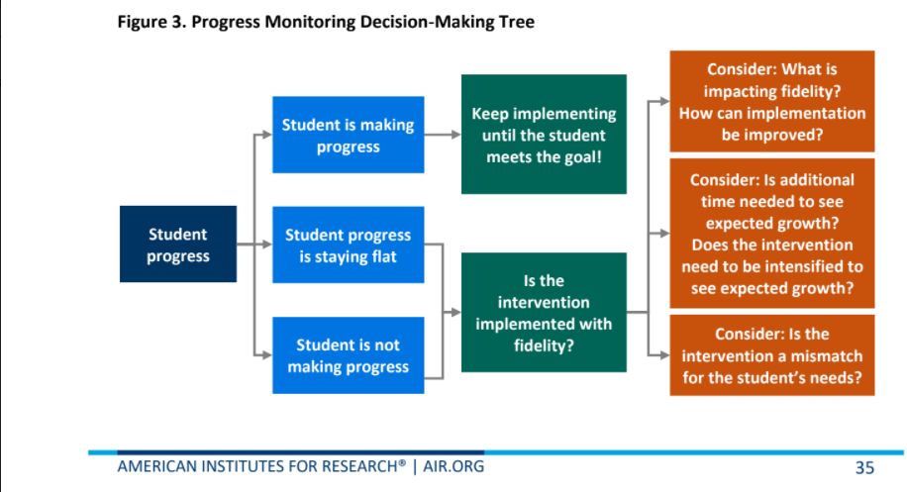
Progress Monitoring
Decision Tree Example

Slide 133
How Often Should We PM?
Intensity of progress monitoring increases with intensity of the intervention
Ex. A student receiving 15 minutes of intervention each day may have progress monitored once a week, whereas a student receiving 15 minutes 3 times a week may only be progress monitored once every 2 weeks

Slide 134
Some Considerations
for Progress Monitoring
Progress is measured at equal intervals from baseline throughout the intervention.
Each probe has the same level of difficulty (stays consistent), so probe data can reflect the child's rate of progress accurately.
With each probe, comparisons are made as to how much the child is expected to have learned, the individual goal, and to the child's actual rate of learning.
A change in the intervention is considered if the rate of progress is not showing student will meet the goal.

Slide 135
Progress Monitoring Reports
Prior to meeting, intervention coordinators review data and determine:
Continue: students making progress, but have not met their goal
Fade/Graduate: students who have met their goal and should be considered for fading or movement back to Tier I
Modify/Intensify/Change: students not responding

Slide 136
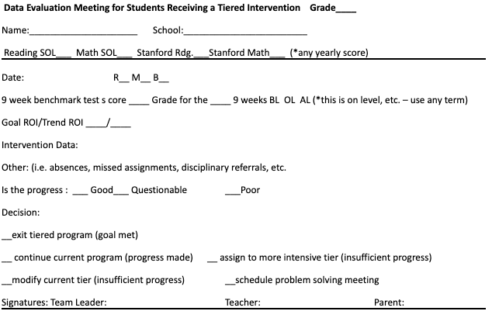
Coordinator Report Example

Slide 137
Student Performance Team Data Conversations
Look at the graph. Is the student making enough progress to meet their goal?
Is the intervention being implemented with fidelity?
Sufficient Progress - Goal Not Yet Met | Consider continuing the intervention
Sufficient Progress - Goal Met | Consider fading the intervention back to Tier I instruction
Insufficient Progress - High Fidelity | Consider modifying/changing the intervention
Insufficient Progress - Low Fidelity | Consider supporting staff to increase fidelity

Slide 138
Breakout Rooms:
Progress Monitoring
How is acceptable growth or rate of progress defined? | How is progress monitored? | How often is progress monitored?

Slide 139
Big Ideas:
Progress Monitoring
Track progress of students in intervention to determine intervention effectiveness.
Progress monitor individual student performance data and apply decision rules to continue or alter support
Graph data for team data-informed decision-making

Slide 140
Stretch Break
Stand, stretch, move away from screen!

Slide 141
FIDELITY

Slide 142
2.12 Fidelity Data
Feature | Possible Data Sources | Scoring Criteria
Tier II team has a protocol for ongoing review of fidelity for each Tier II practice | Tier II coordinator training • District technical assistance • Fidelity probes taken monthly by a Tier II team member | 0 = Fidelity data are not collected for any practice 1 = Fidelity data (e.g., direct, self report) collected for some but not all Tier II interventions 2 = Periodic, direct assessments of fidelity collected by Tier II team for all Tier II interventions

Slide 143
2.12 Academic TFI
Tier II team has a protocol for ongoing review of fidelity for each Tier II practice | School schedule Intervention attendance sheets Fidelity measure specific to the intervention Scheduled fidelity checks | 0= Fidelity data not collected 1= Fidelity data collected for some interventions 2= A schedule for ongoing fidelity checks for all Tier II interventions is followed

Slide 144
Implementation Fidelity
The degree to which an intervention is delivered as intended.
Helps us to know if the student is not responding to the intervention and may need something more of different
…or if we are not implementing the intervention the way it is intended to reach the desired outcomes.

Slide 145
Five Elements of Fidelity
O’Donnell (2008)
NIRN & AIR

Slide 146
How to Measure Fidelity
Make a checklist of the core implementation features of the intervention.
Observe the intervention and look for the core features.
Compare expected implementation with what is currently being implemented.
Note: many evidence-based interventions have fidelity monitoring tools!

Slide 147
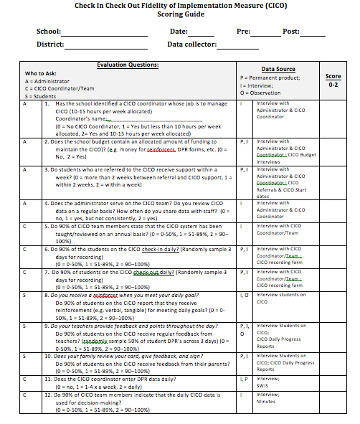
Behavior Intervention Fidelity Checklist Example
Notes:
‹#›

Slide 148
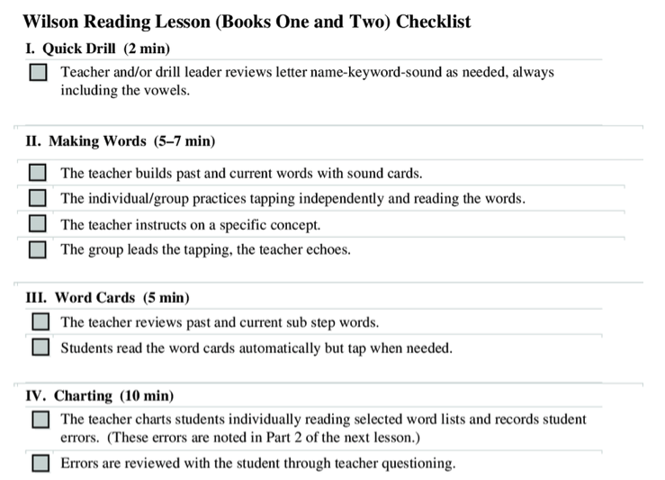
Reading Intervention
Fidelity Checklist Example
Notes:
‹#›

Slide 149
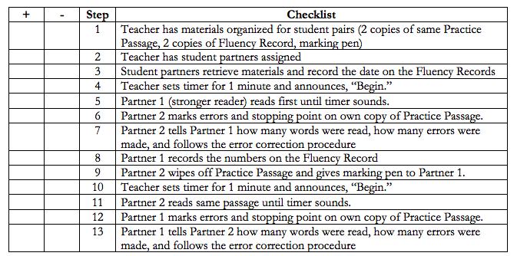
“Program” Fidelity Checklist Example

Slide 150
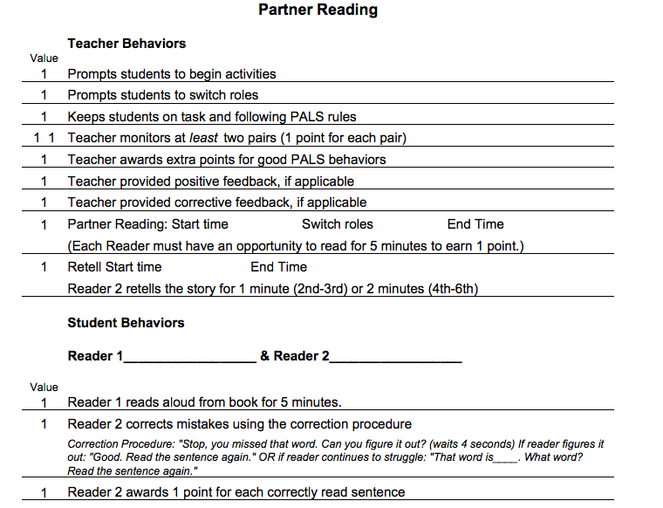
Strategies Fidelity Checklist Example

Slide 151
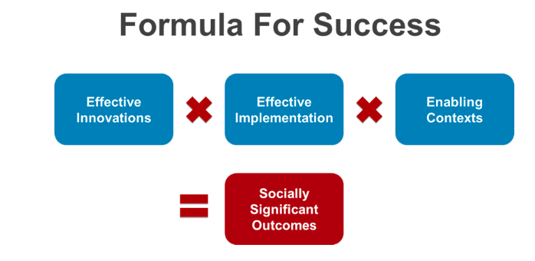
Power of Fidelity
National Implementation Research Network

Slide 152
Team Fidelity Data Conversations
Evaluate fidelity of intervention implementation
more staff training? modeling?
Evaluate match to student need
is it the right fit?
Evaluate contextual fit
right match between the strategies, procedures, or elements of an intervention and the values, needs, skills, and resources of those who implement and experience the intervention

Slide 153
Breakout Room
Fidelity Measures
How is fidelity measured? | How often is fidelity measured?

Slide 154
Big Ideas:
Data-informed Decision Making
Regularly analyze and evaluate advanced tier data including:
level of use
intervention effectiveness
student performance
fidelity of implementation

Slide 155
Professional Learning and Coaching
Teaming
Professional Learning and Coaching
Screening and Request for Assistance
Data-
Informed Decision Making
Decision Rules
Progress Monitoring
Continuum of Support
Alignment

Slide 156
TFI 2.9 Professional Learning
Feature A written process is followed for teaching all relevant staff how to refer students and implement each Tier II intervention that is in place. | Possible Data Sources Professional development calendar Staff handbook Lesson plans for teacher trainings School policy | Scoring Criteria 2-written process used to teach all staff all aspects of intervention delivery, including RFA,delivering feedback, and monitoring student progress 1-informal process 0-no process in place

Slide 157
2.9 Academic TFI
Teams have access to professional learning needed to provide interventions with fidelity, reinforce the intervention across settings, including families | Professional learning plans and calendars Fidelity checklists Family communication Fidelity checklists Staff handbook | 0= only 1 criteria is met 1= Two criteria are met 3= All 3 criteria are met

Slide 158
School Professional Learning Process
Presentation of Theory and Research
Coaching and Follow up
Demonstration of the Strategy or Skill
Practice and Feedback

Slide 159
Professional Learning Impact

Slide 160
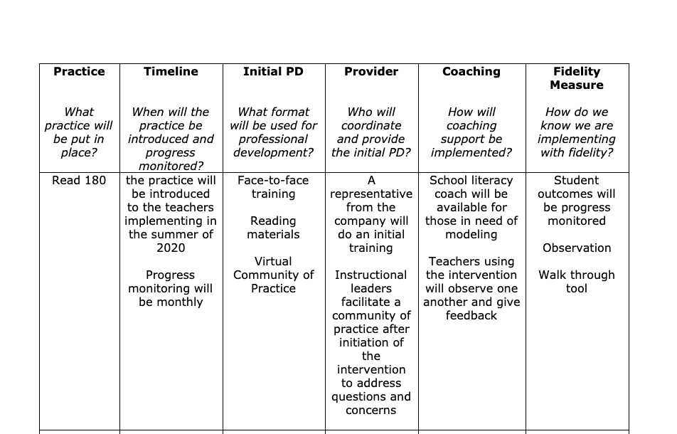
Planning for Success

Slide 161
Big Ideas:
Professional Learning & Coaching
Staff who deliver interventions need both professional learning and coaching for support in delivering interventions.
We change adult behavior first to ensure success for students

Slide 162
Professional Learning
Breakout Room
What professional learning do staff need to implement the intervention? | Who will provide the professional learning when? | What coaching supports are needed for staff? | Who will provide coaching when?
What is the professional learning and coaching needed for the person delivering the intervention to be able to teach with fidelity?

Slide 163
Closing: Name that Circle

Slide 164
Advanced Tier Interventions
Core Features
Adapted from Horner & Sugai (2016)

Slide 165
Day 2 Quick Check
T/F – We align advanced tier interventions to Tier One Core instruction across all domains.
Two types of progress monitoring are ________________________ and _________________________
T/F – The most important data advanced tier teams analyze is individual student performance.
The intensity of progress monitoring decreases/increases with the intensity of interventions.

Slide 166
Day 2 Quick Check (cont.)
T/F Graphing data is an option, but it not worth the time and effort for team meetings.
Progress monitoring data allows teams to make decisions whether to ________________, ________________ or ___________________ an intervention.
T/F - We change adult behavior first to ensure success for students.
8. We need both ____ and ____ for support in delivering interventions.

Slide 167
Day 2 Group Response
9. Intensity/Fidelity is the degree to which an intervention is delivered as intended.
10. Fidelity = “Did we ______ what we said we would _____ in the way we said we would _____ it.”
Blue Ribbon Winners!

Slide 168
Graduation!

Slide 169
References
Algozzine, B., Barrett, S., Eber, L., George, H., Horner, R., Lewis, T., Putnam, B., Swain-Bradley, J., McIntosh, K., & Sugai, G. (2014).
Crone, D. A., Horner, R. H., & Hawken, L.. S. (2004). Responding to problem behavior in schools: The Behavior Education Program. New York: Guilford.
Everett, S., Sugai, G., Fallon, L., Simonsen, B., & O’Keeffe, B. (2011). School-wide Tier II interventions: Check-In Check-Out Getting Started Workbook. OSEP Technical Assistance Center on Positive Behavioral Interventions and Supports.

Slide 170
References (2)
Hosp, J. L., Hosh, M. K., Howell, K. W., Allison, R. (2014). The ABCs of curriculum-based evaluation: A practical guide to effective decision making. New York: Guilford.
Lembke, D. (n.d.). Interventions in RTI Handouts. Retrieved from https://rti4success.org/sites/default/files/interventions_in_rti_handouts.pdf
McIntosh, K. & Goodman, S. (2016). Integrating multi-tiered systems of support: Blending RTI and PBIS. New York: Guilford
ford Press.

Slide 171
References (3)
Riley-Tillman, C. T., Burns, M. K., & Kilgus, S. P. (2020). Evaluating Educational Interventions, Second Edition: Single-Case Design for Measuring Response to Intervention (Second ed.). The Guilford Press.
Sanetti, L. & Meek, M. (2019). Supporting successful interventions in schools : tools to plan, evaluate, and sustain effective implementation. New York: The Guilford Press.

Slide 172
References (4)
The IRIS Center. (2014). Evidence-based practices (part 3): Evaluating learner outcomes and fidelity. Retrieved from https://iris.peabody.vanderbilt.edu/module/ebp_03/
Tiered Fidelity Inventory (TFI) Scoring Guide - Adapted from Algozzine, B., Barrett, S., Eber, L., George, H., Horner, R., Lewis, T., Putnam, B., Swain-Bradway, J., McIntosh, K., & Sugai, G (2014). School-wide PBIS Tiered Fidelity Inventory. OSEP Technical Assistance Center on Positive Behavioral Interventions and Supports. www.pbis.org.

