Slide 1
Introduction to Advanced Tiers
Building and Sustaining an Effective System of Supports

Slide 2
Welcome
Welcome to the Virginia Department of Education’s professional learning event through the Virginia Tiered Systems of Supports (VTSS).
This professional learning opportunity is funded and hosted by the Virginia Department of Education.

Slide 3
Follow VTSS
Thank you for attending. Please feel free to tag us at any of our social media handles below!
Twitter - VTSS_RIC
Facebook - VTSSRIC

Slide 4
VTSS - Additional Resources

Slide 5
Day 1 Agenda
10:00-10:30: Intro, Connections, and Materials Walk
10:30-11:15: Advanced Tiers Overview
11:15-12:00: Teaming
12:00–1:00: Lunch
1:00-1:45: Screening and Request for Assistance
1:45-2:30: Decision Rules
2:30-2:45: Break
2:45-3:45: Continuum of Supports
3:45-4:00: Exit Ticket and Evaluation
Notes:
.

Slide 6
Materials
Advanced Tiers Digital Workbook
https://bit.ly/3qYLleu

Slide 7
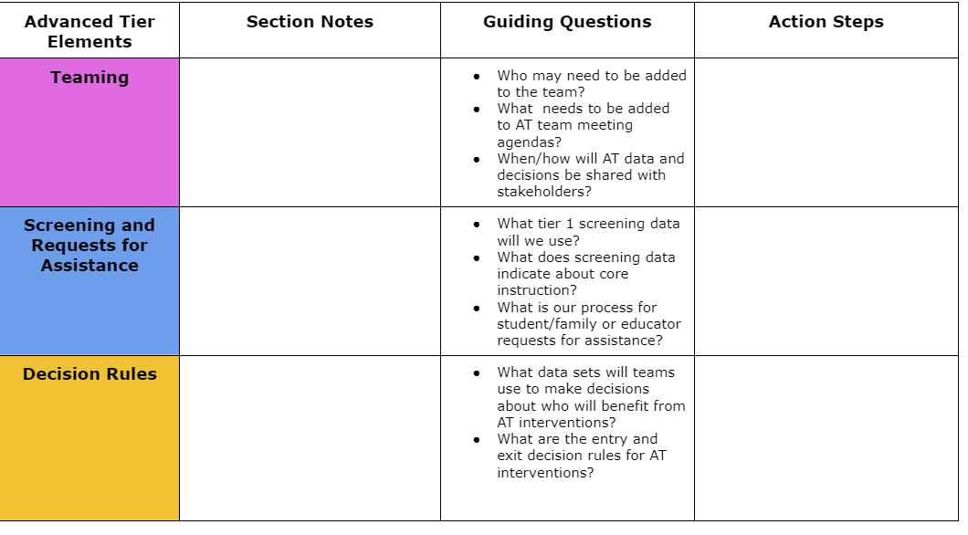
Advanced Tiers Notetaker
6

Slide 8
Authentic Family Engagement

Slide 9
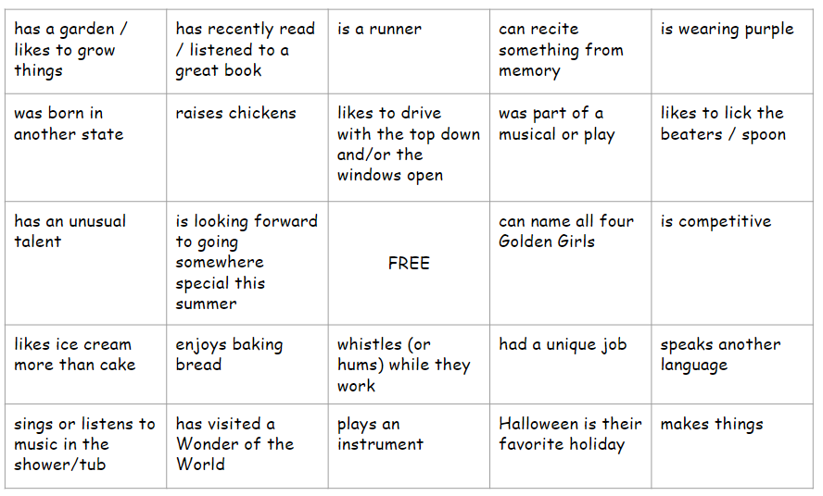
Meet and Connect!
7

Slide 10
Meet and Connect!
8

Slide 11
In-Person Norms
Be Responsible | Take care of personal needs Share your questions with the group
Be Respectful | Turn volume/sound off on cell phones Listen to others attentively Follow up and complete assigned tasks
Be Engaged | Ask what you need to know to understand and contribute Share your expertise, information and ideas Maximize team time by engaging with assigned tasks

Slide 12
Learning Intentions for Day 1
Participants will:
Describe and synthesize and apply essential elements of advanced tier systems of supports
Define roles, responsibilities and meeting structures for advanced tier teams that demonstrate authentic family engagement
Identify screening and “requests for assistance” tools that can be used for identifying students in at least one domain who might benefit from advanced tiers supports
List intervention decision rules for evidenced-based practices in at least one domain in an advanced tiers continuum of supports

Slide 13
Anchor Documents
9

Slide 14
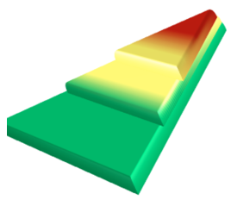
Where Are We in the Triangle?
Tier 3 for a Few: Intensive, Individualized
Tier 2 for Some: Targeted for Small Groups
Tier I for All: Core/Universal
1 - 5%
5 - 15%
80 - 90%

Slide 15
Social Competence & Academic Achievement
OUTCOMES
What we use to make decisions? Monitor progress?
Monitor fidelity?
SYSTEMS
DATA
What we do to support adults to implement the practices?
PRACTICES
What we do to
support students?
Notes:
15

Slide 16
Why Advanced Tiers?
Core Instruction doesn’t work in isolation
Avert students from trajectories toward further learning/behavior challenges
Provide a unifying framework: Programs and strategies

Slide 17
What is Tier 2?
Targeted support for students not successful with Tier 1 alone
Small group intervention
Provided in addition to universal, Tier 1 instruction and aligned with student needs
For students who may be struggling or who need more challenge

Slide 18
What is Tier 3?
Frequent, intensive, and individualized intervention
Intensive support for students not responding to Tier 2 support or need more intensive support
Individualized intervention
Different than special education

Slide 19
3.4 Student Support Team
A uniquely constructed individual student support (ISS) team exists to design, implement, monitor, and adapt the student-specific support plan. | Behavior Support Plans | 0 = ISS teams do not exist for all students who need them 1 = ISS teams exist, but lack input from student/family 2 = ISS teams exist, with active input from student/family and meet regularly to review progress data

Slide 20
Moving In and Out of Tiers
How are students’ experiences in a multi-tiered system of supports like a lava lamp?

Slide 21
Quick Check: Overview T/F
11
Students not responding to core instruction should be removed and receive advanced tier interventions that teach different content in a different way for student success.
When high-quality core instruction is in place, schools can anticipate that about 5-15% of students will benefit from tier 2 interventions and 1-5% of students from tier 3.
Identifying students as Tier 1, Tier 2, or Tier 3 will help school teams effectively plan advanced tiers interventions.

Slide 22
Advanced Tiers Foundations
“The Essential Eight”
5
Teaming
Professional Learning and Coaching
Screening and Request for Assistance
Progress Monitoring
Decision Rules
Data-
Informed Decision Making
Continuum of Support
Alignment

Slide 23
Teaming
Teaming
Professional Learning and Coaching
Screening and Request for Assistance
Decision Rules
Progress Monitoring
Data-
Informed Decision Making
Continuum of Support
Alignment

Slide 24
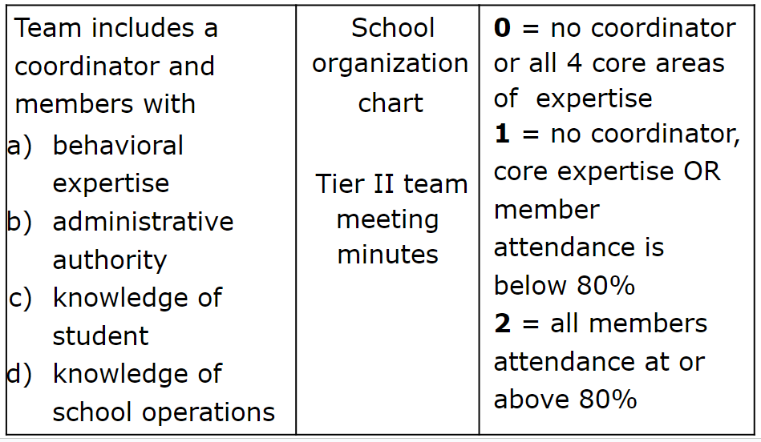
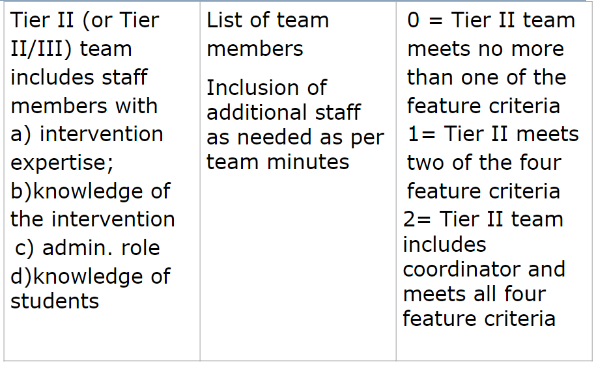
2.1 Team Composition

Slide 25
Bi-Directional Stakeholder Communication
Share student progress graphs in grade level meetings
Include graphs in school/home communication
Builds shared commitment to advanced tier interventions
Increases awareness of interventions
Fosters deeper understanding of family and culture-specific functions of behaviors

Slide 26
What Do Teams Look Like?
We are a small school. Our Tier I, Tier II & III teams are the same people.
Our Team meets monthly, and our Tier II Team meets every other week.
We meet every week for 30 minutes for each Tier.

Slide 27
Card Sort
12
Tier 1 Team
Advanced
Tiers Team

Slide 28
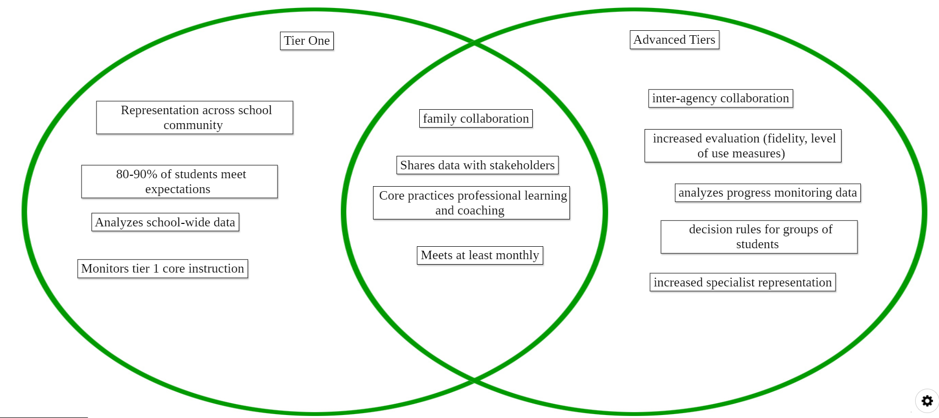
Teaming Venn Diagram

Slide 29
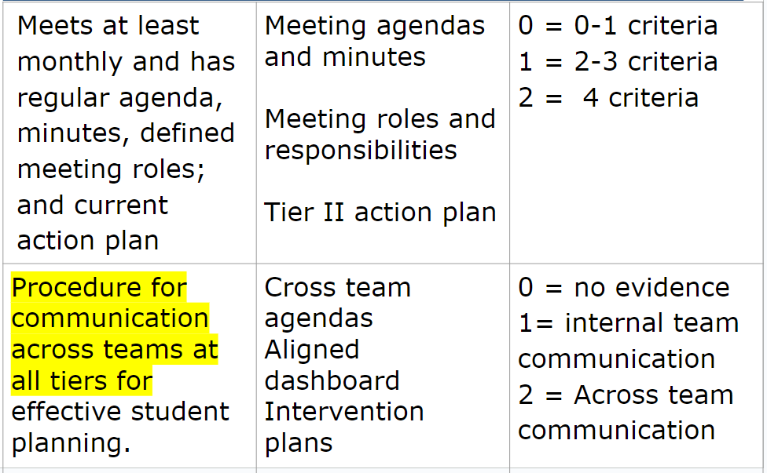
2.2 Team Operating Procedures
13
Tier II team meets at least monthly and has
(a) regular meeting format/agenda
(b) minutes
(c) defined meeting roles
(d) a current action plan.
Tier II team meeting
agendas and minutes
Tier II meeting role
descriptions
Tier II action plan
0 = Tier II team meets at least monthly and uses regular meeting format /agenda, minutes, defined meeting roles, AND has a current action plan
1=Tier II team has at least 2 but
not all 4 features
2=Tier II team does not use
regular meeting format/agenda, minutes, defined roles, or a current action plan

Slide 30
Tier 2 Team Meetings
Occur more frequently (recommended)
Process referrals:
Screening data and Requests for Assistance
Standing Agenda Items
Monitor student progress and Tier 2 intervention effectiveness data
Communicate with stakeholders (staff, students, families, community partners)

Slide 31
Team Data Conversations
Tier 1/ Universal
Tier 2/3
Targeted
Tier 3/ Tertiary
Intervention level of use and % of students making progress
Student referral and progress monitoring
Intensified
student progress monitoring
Schoolwide and classroom
Increased progress monitoring, fidelity measures and family engagement

Slide 32
Advanced Tiers Standing Agenda Items
Intervention Effectiveness
# of students
# meeting goal
# not meeting goal
Level of Use
Fidelity
Intervention Referrals and Decision Rules
Team Problem Solving
Communication with families, staff, students and community partners

Slide 33
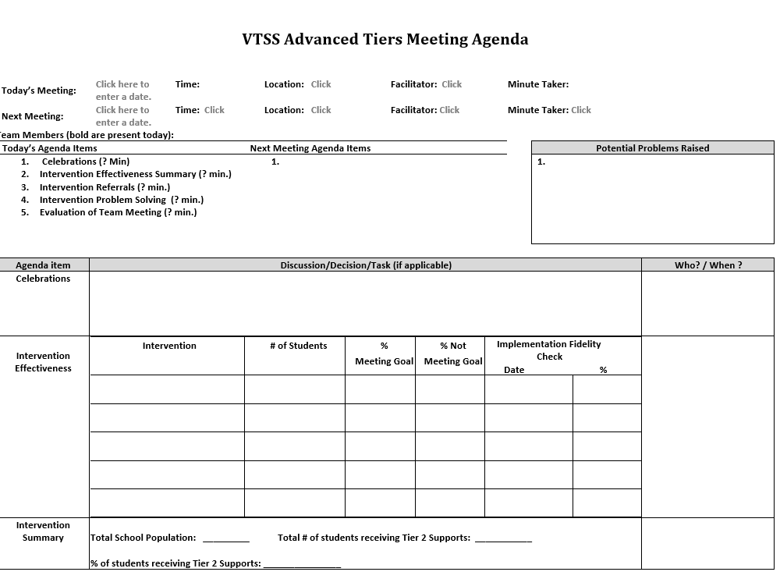
Advanced Tier
Sample Meeting Agenda
14

Slide 34
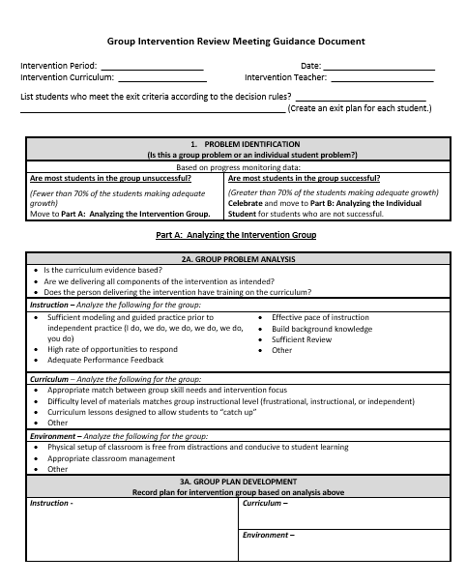
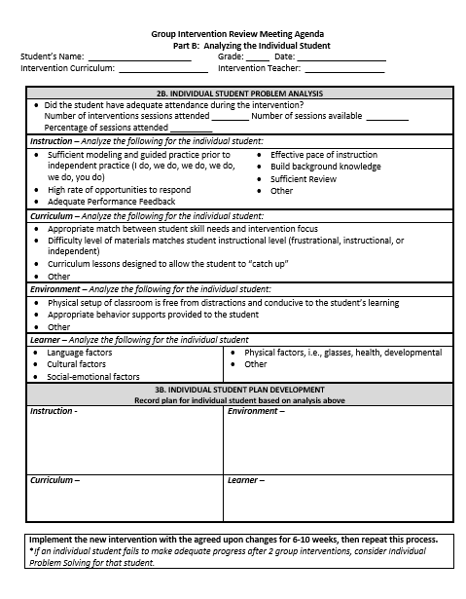
Different Forms,
Same Discussions!
14
retrieved from http://www.oregonrti.org/resources

Slide 35
Quick Check: Teaming Structures T/F
15
Advanced tiers teams include more specialized personnel.
Advanced tiers teams look the same across divisions and schools.
The most important data conversation that takes place at an advanced tier meeting is individual student performance.
Tier 3 team conversations include caregivers as problem-solving partners

Slide 36
Team Time: Teaming
16
Who is, or will be on your advanced tiers team?
Who else is needed?
Behavioral, academic, and medical expertise
General and Special Education knowledge
Data/graphing knowledge
Authority to access/provide resources
Understanding of support across grades/departments and school, including other tiered support
Family/school connection
What agenda will you use?
What needs to be created, added or changed?

Slide 37
Big Ideas
Teaming
Advanced tier teams benefit from specialized knowledge and expertise
There should be at least one person with overarching knowledge of the interventions used in the schools
Use a predictable agenda that includes intervention systems and student performance data discussions

Slide 38
Let’s Move!

Slide 39
Screening and Request for Assistance
Teaming
Professional Learning and Coaching
Screening and Request for Assistance
Progress Monitoring
Decision Rules
Data-
Informed Decision Making
Continuum of Support
Alignment

Slide 40
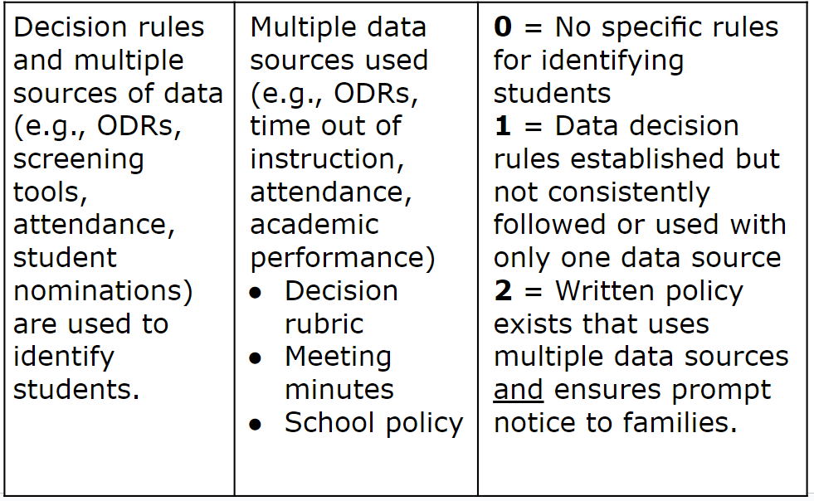
2.3 Screening
17

Slide 41
Purpose of Screening
PROCESS
Evaluate Effectiveness of Core (Tier 1)
INTERVENTION
Part of the Request for Assistance Process that is one data point used to measure progress.
Adapted from https://assets-global.website-files.com/5d3725188825e071f1670246/5d7035c071700f1e3b846aab_b1_lewis_powers_dixon_revised.pdf

Slide 42
Integrated Screening
INFORMAL
FORMAL
Nominations/ Requests for Assistance
Existing Data Sets
Universal Screeners

Slide 43
Steps to Universal
Screener Implementation
Establish Clear Roles/Responsibilities
Identify Stakeholders
Determine the frequency/timelines
Communicate the Purpose
Ensure Accessibility of ALL and elimination of potential bias
Provide/Participate in Professional Development of Assessment Tools

Slide 44
Universal Screeners
18
ACADEMIC National Center on Intensive Interventions RAND Education Assessment Finder | BEHAVIOR University of Missouri Evidence Based Intervention Network National Center on Intensive Interventions Center on PBIS | MENTAL WELLNESS RAND Education Assessment Finder Ohio Department of Education

Slide 45
Universal Screener Selection
18
Questions
Consideration
Is the core instruction sufficient/is it improving?
For which groups is it working/not working?
What is the efficacy of the tiered interventions?
What is the individual growth of our students?
Cost
Capacity to administer and analyze
Ability to Scale-up
Communication of Results and Reporting of Needs

Slide 46
Advanced Tiers in Action
Screening:
statewide reading and/or math assessments

Slide 47
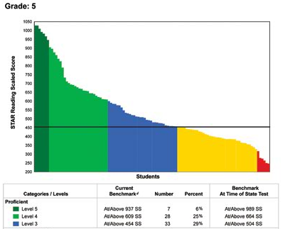
Screening to Assess Core Instruction
60 % of students
40 % of students

Slide 48
Student Issue or
Systems Issue?
Environment or student?
Fig. “Classroom Chaos”. May 31, 2020. http://healthyteachingonline.com/blog/wp-content/uploads/2014/09/schoolchaos.jpg

Slide 49
Quick Check: Screening
19
YES
SO-SO
NO
We have universal screening data at Tier 1 in at least one area of academics, behavior, mental wellness (can be Early Warning System in secondary)
We use the data to answer “is the core sufficient” based on the triangle
We have conversations around “is it a student issue or a systems issue” rather than always looking at individual students

Slide 50
Team Time: Screening
20
Choose a domain (reading, math, behavior, mental health, attendance)
List screeners (formal or data sets) that are used to support advanced tier entry considerations
How are caregivers involved in the screening process?

Slide 51
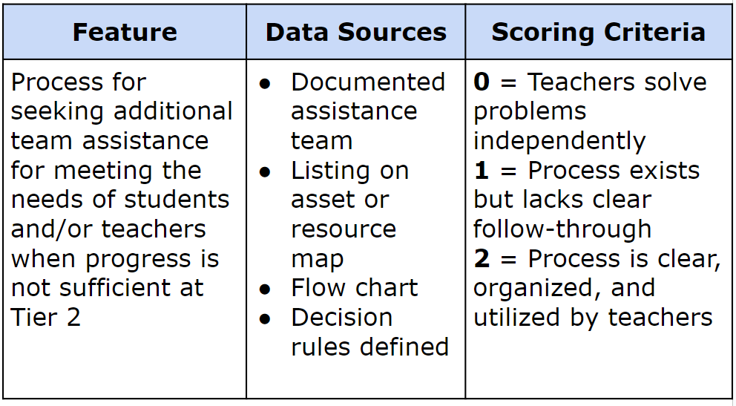
2.4 Requests for Assistance
21

Slide 52
Requests for Assistance?
Grab the reading specialist in the hall and ask if she can add one more to the group.
Tell the high school counselor a student just got on your last nerve, and they need to see them so they can be added to the social skills group.
Email the school psychologist and everyone else you know to request the Tier 3 behavior specialist come at once because a student seriously interferes with learning in the classroom!

Slide 53
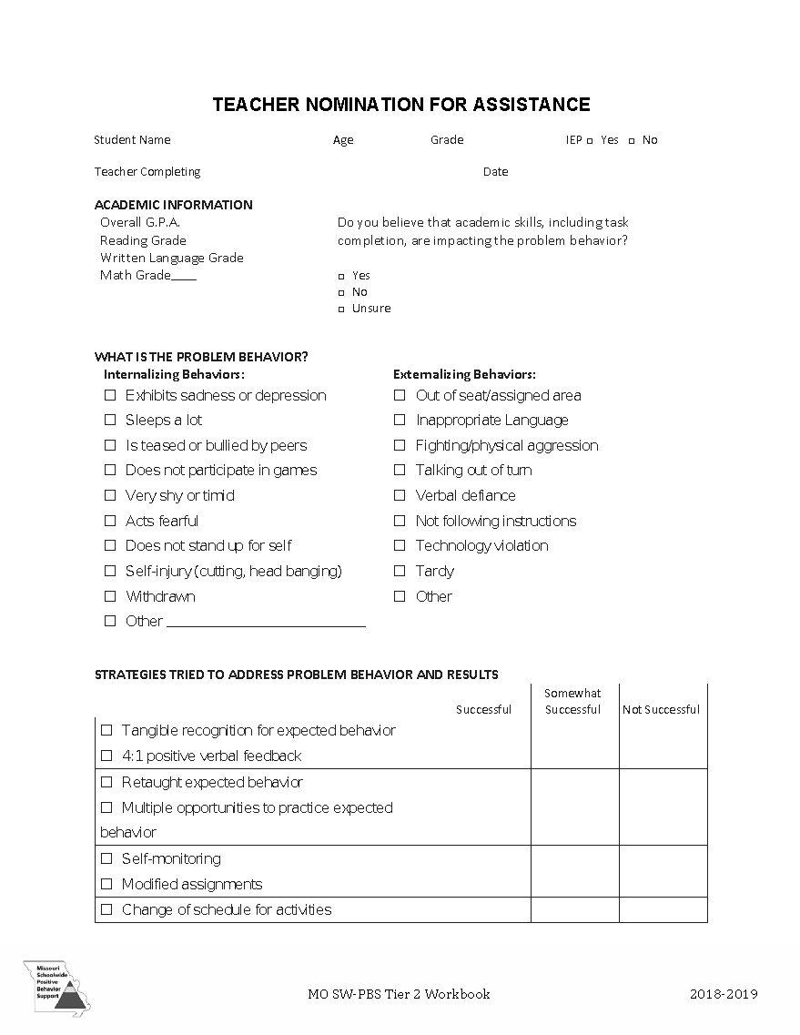
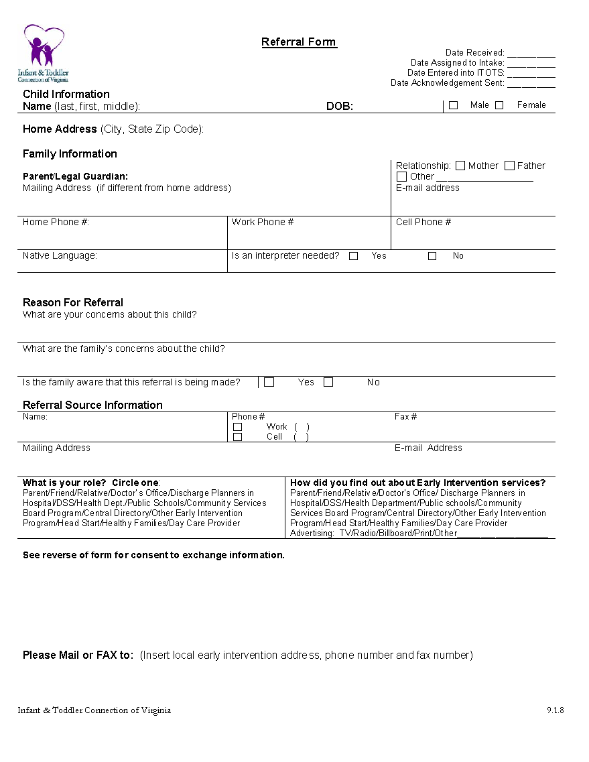
Nominations/ Request for
Assistance Forms
22

Slide 54
Sorting for Practice!
23
Sort the Screening and Requests for Assistance cards into three categories:
Nominations
Existing Data
Universal Screener
Stand when you are finished!

Slide 55
Consideration Activity
24

Slide 56
Team Time: Student Identification
25
Identify what tier 1 screening data will be used
Discuss what screening data indicates about core instruction
Determine the process for student/family or educator requests for assistance

Slide 57
Big Ideas
Screening and RFAs
Screening data helps us to know if the core is sufficient and differentiate a systems issue from a student issue, and for which groups of students the core instruction is successful.
Universal screening provides data advanced tiers teams need for data informed decision making.
Request for Assistance should be easily accessed by staff, students and caregivers.

Slide 58
Decision Rules
Teaming
Professional Learning and Coaching
Screening and Request for Assistance
Progress Monitoring
Decision Rules
Data-
Informed Decision Making
Continuum of Support
Alignment

Slide 59
Decision Rules
Decision rules, or “entry and exit criteria”
Allow for decisions to be made objectively on who receives support.
Provide a uniform method to refer students to advanced tiers.
Provide clear exit criteria from advanced tiers interventions and supports.

Slide 60
2.3 Screening & RFA Decision Rules
26
Decision rules and multiple sources of data (e.g., Rs, screening tools, attendance, student nominations) are used to identify students. | Multiple data sources used (e.g., ODRs, time out of instruction, attendance, academic performance) Decision rubric Meeting minutes School policy | 0 = No speciﬁc rules for identifying students 1 = Decision rules established but not consistently followed or used with only one data source 2 = Written policy exists that uses multiple data sources and ensures prompt notice to families.

Slide 61
Tier 2 Academic Decision Rules Reading Data Example
Below 25% on universal screener
Below 70% on benchmark assessments
Did not meet PALS benchmark
Did not pass prior year’s SOL
Did not achieve course credit

Slide 62
Tier 2 Academic Decision Rules Mathematics Data Example

Slide 63
Advanced Tiers in Action: Decision Rules
Decision Rules:
Non-proficient and at-risk students defined as current 3 – 8 students who score in the low proficient range on their grade 3 – 7 reading and/or math assessment.
Virginia Growth Assessment (VGA) in the fall and winter in both reading and mathematics annually. Students in grade 3 are required to be placed in tutoring based on their scores on the fall administration of the VGA in reading and mathematics.
Low proficient= 18 weeks
At Significant Risk= 36 weeks

Slide 64
Tier 2 Decision Rules Behavior Data Example
2-5 ODR’s
1 Suspension
> ? minutes missed instruction
> ? days unexcused absences
Incomplete classwork/homework
Tardies
Student, caregiver, staff nomination

Slide 65
Tier 2 Decision Rules:
Mental Wellness Data Example
5+ visits to the nurse/school counselor per month
3-5 absences per month
2-4 tardies and/or early dismissals
Student, caregiver, staff nomination
Mental Wellness Screener

Slide 66
Sample Data Decision Rules Dashboard
Measure | Proficient Score | At-Risk | High Risk
Classroom Managed | 0-4 | 5 or more | 15 or more
ODR | 0-1 | 2-5 | 6 or more
Absences | <5 / trimester | 5+ / trimester | 10 / trimester
Tardy | <4 / trimester | 4+ / trimester | 10 / trimester
ISS | 0-1 | 2 | 4 or more
OSS | 0 | 1 | 2
Reading Virginia Growth Assessment | scores red or higher | scores fall between purple and red | scores fall below purple
Math Virginia Growth Assessment | scores red or higher | scores fall between purple and red | scores fall below purple
Writing Assessment | 3 or 4 | 2 | NS; 1
Nurse (non-medication) | 0-1 (no pattern) | 2-5 (patterns of regular visits) | 6 or more (patterns of regular visits)
*Ensure schools are looking at more than one data point to determine intervention need(s)*

Slide 67
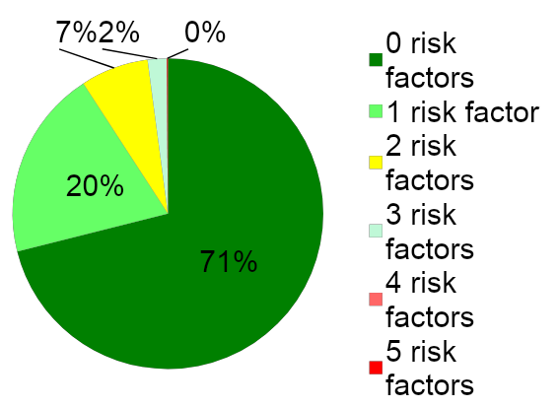
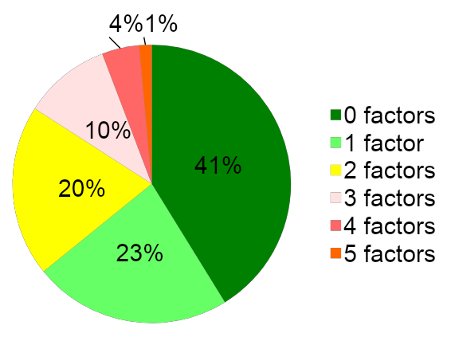
Risk Factors and Decision Rules
School A
School B

Slide 68
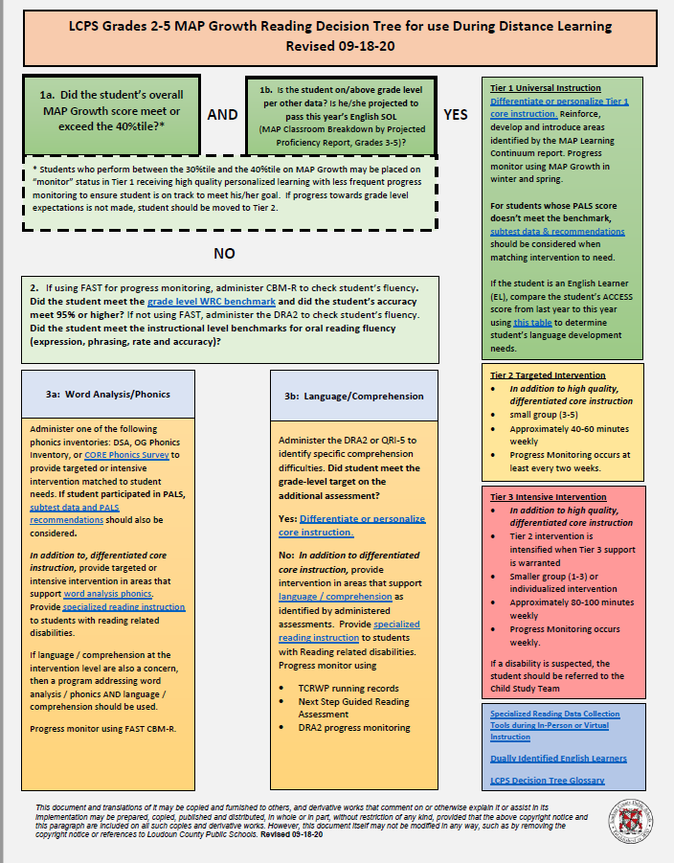
Sample Decision Tree
Grade 2-5
Reading
(Loudoun County Public Schools example

Slide 69
Decision Rules Practice
31
Review the data given to you.
Determine decision rules for who might be considered for advanced tier support.
Be prepared to share your decision rules and why.
This Photo by Unknown Author is licensed under CC BY-SA

Slide 70
Team Time:
Decision Rules
32
What are the decision rules at your school for a student to enroll in an advanced tier intervention?
What are the decision rules for exiting an advanced tier intervention?
How are caregivers involved in advanced tier intervention entry and exit decisions?

Slide 71
Big Ideas
Decision Rules
Provide a uniform method for student accessing advanced tiers interventions and supports.
Decision rules, or “entry and exit criteria” allow for decisions to be made objectively on who receives support.
Provide clear advanced tier intervention fading criteria.

Slide 72
Continuum of Supports
Teaming
Professional Learning and Coaching
Screening and Request for Assistance
Decision Rules
Progress Monitoring
Continuum of Support
Data-
Informed Decision Making
Alignment

Slide 73
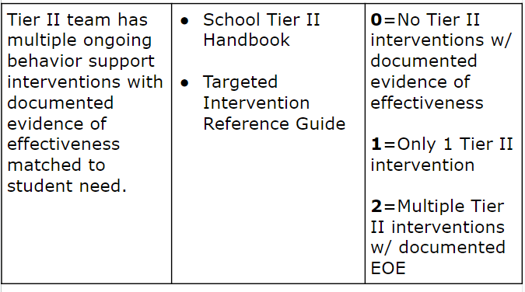
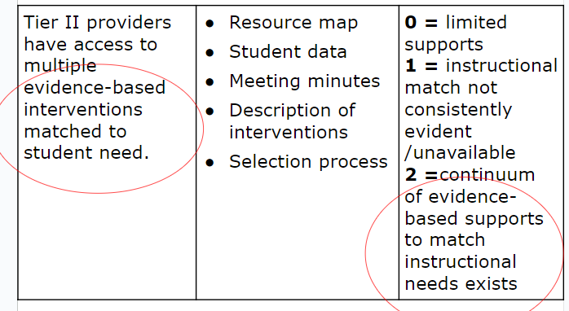
2.5 Options for Tier 2 Intervention/ Intervention Resources
33
34

Slide 74
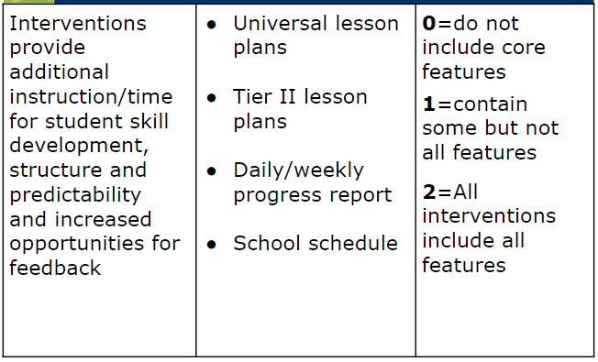
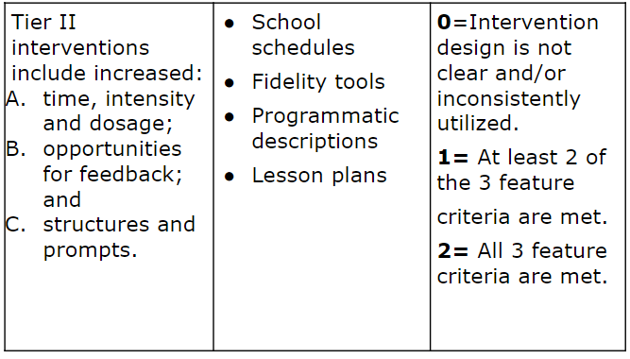
2.6 Critical Features
35
36

Slide 75
Tier 2 Core Intervention Features
Increased Structure & Prompts
Increased Intensity of Data Collection
Increased
Regular Feedback
Increased Family Engagement
Increased Instruction on Skills (prosocial, emotional, academic)
Tier 2 Core Features
Efficient system for access and delivery of intervention
Adapted from Horner & Sugai (2016)

Slide 76
Core Features Quick Check
Tier 2 Core Features
Adapted from Horner & Sugai (2016)

Slide 77
CICO Example

Slide 78
CICO Secondary Example

Slide 79
CICO Tier 2 Core Features
Increased Structure & Prompts
Increased Intensity of Data Collection
Increased
Regular Feedback
Increased Family Engagement
Additional Instruction on Skills (prosocial, emotional, academic)
Tier 2 Core Features
TFI 2.6
Efficient system for access and delivery of intervention
Adapted from Horner & Sugai (2016)

Slide 80
Check-in, Check-out Example
Increased:
Instruction?
Feedback?
Structure and prompts?
Progress monitoring/data collection?
Family engagement?
System for access and delivery?

Slide 81
Behavior Intervention Sample Resource Mapping
Function
Possible School Interventions
Skill acquisition and development
Reinforce prosocial behavior skills
“Anger Control Training”
“Cognitive Reframing”
“Social Problem Solving”
“Skillstreaming”
“Behavior Education Program
“Check-in, check-out”

Slide 82
Evaluating Products and Interventions
Guiding Questions
Has it been reviewed and evaluated for ‘standards of evidence’ by an organization such as “What Works Clearinghouse”?
If not, is there any evidence that the strategy has been researched? (e.g., journal articles, book chapter, report from developer)
Does it have a manual describing the procedures for each step, so anyone would be able to implement the strategy?
Does it include a method for evaluating fidelity of implementation?
Can it be implemented without regular and/or intensive involvement from the developer?
Does it evidence advanced tiers core features?

Slide 83
Evidence-Based Academic Interventions

Slide 84
VTSS Evidence-Based Practices Selection Tool (Existing Practices)
40

Slide 85
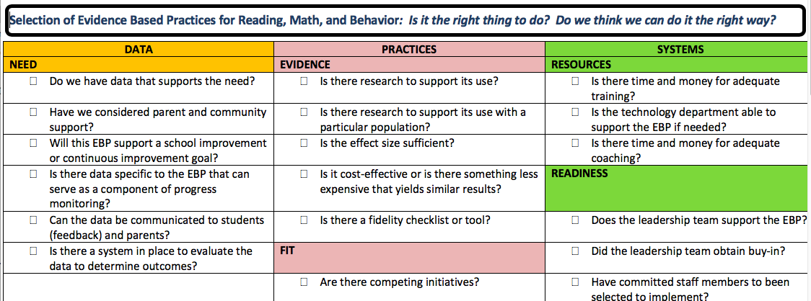
Evidence-Based Practices Selection (New Interventions)
41

Slide 86
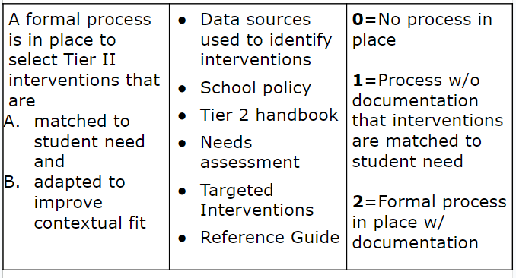
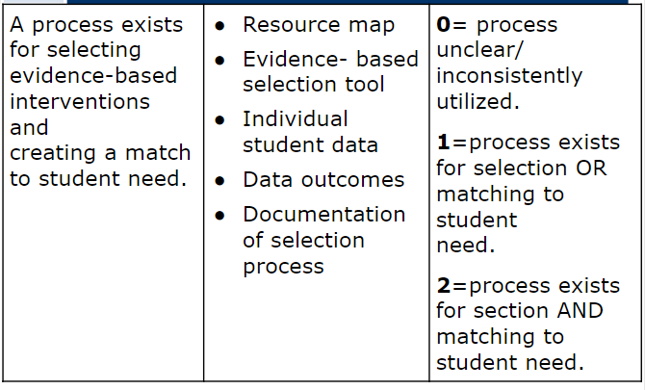
2.7 Practices Matched to Student Need/Intervention Selection
42
43

Slide 87
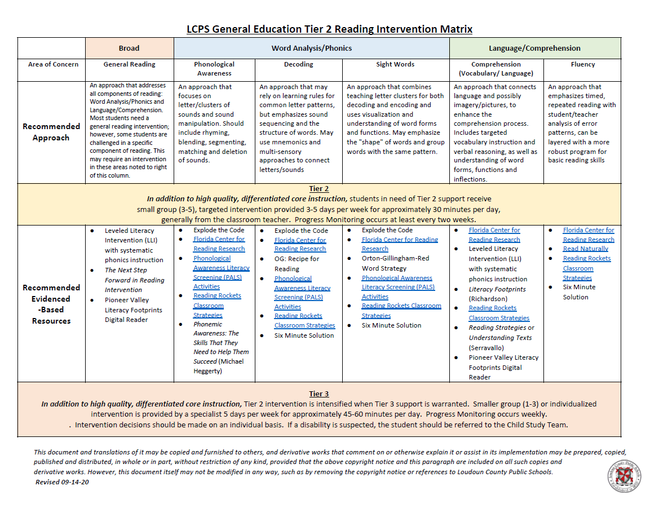
Matching Interventions to Instructional Needs
44

Slide 88
Advanced Tiers in Action
Continuum of Support:
Tutoring; digital platforms 1- reading; 1- math
Ratio of no more than 10 students per tutor

Slide 89
Example of SEB Needs & Matched Interventions
Area of Need | Intervention Category | Interventions
Conduct problems | Check-In/Check-Out variations | Check-In/Check-Out Check and Connect Check, Connect, Expect
Hyperactivity/ Inattention | Self-regulation | Goal-setting strategies Self-monitoring Self-graphing
Social Skills | Social-problem-solving activities | Social/behavioral contracts Problem-solving activities Restorative meeting or circle Social skills or S-E training
Emotional | Cognitive-behavioral therapy | small-group or individual therapy/counseling
Academic | Explicit academic & academic-supporting activities | supplemental explicit instruction Breaks are Better (BrB) Homework Organization & Planning Skills (HOPS)
McDaniel, Sara, etal. (2024). Social, Emotional, and Behavioral Supports in Schools: Linking
Assessment to Tier 2 Intervention. p. 31

Slide 90
Team Time:
Continuum of Supports
45
List interventions matched to need on continuum of supports
Check for 6 core features?
Use EBP selection tool?
Interventions matched to instructional need?

Slide 91
Big Ideas
Continuum of Supports
A few viable interventions are more effective than many under-supported options on the continuum of supports
Document a continuum of supports that contain 6 core features of advanced tiers interventions and are matched to instructional need

Slide 92
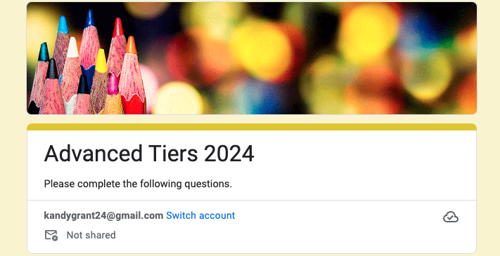
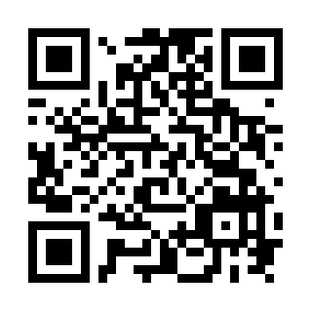
Exit Ticket
81
qrfy.io/s5bGNx6j5T
exit ticket

Slide 93
Summer Snowballs
Write one big idea from today you want to be sure doesn’t melt away between now and the new school year.

Slide 94
Virginia Tiered Systems of Supports (Day 2)
Welcome to the Virginia Department of Education’s professional learning event through the Virginia Tiered Systems of Supports (VTSS).
This professional learning opportunity is funded and hosted by the Virginia Department of Education.

Slide 95
Welcome Back!
Teaming
Professional Learning and Coaching
Screening and Request for Assistance
Progress Monitoring
Decision Rules
Data-
Informed Decision Making
Continuum of Support
Alignment

Slide 96
Welcome and Connect!
R + R
TRAVEL
CCCCCCC
M1Y L1I1F1E

Slide 97
Day 2 Agenda
9:00 - 9:30: Alignment
9:30 - 10:15: Data-informed decision making (DIDM)
10:15 - 10:30: Break
10:30 - 11:15: DIDM-Progress Monitoring
11:15- 12:00: DIDM-Fidelity
12:00-1:00 Lunch
1:00-2:00: Professional learning and coaching
2:00-3:00 Putting it all together and evaluation

Slide 98
Learning Intentions for Day 2
Review and analyze:
intervention level of use
progress monitoring
student performance
fidelity data
and apply advanced tiers data-informed decision-making to a school MTSS framework
Align the MTSS framework for schools across tiers and domains
Delineate essential components of school-based professional learning and coaching plans to support advanced tiers interventions and effective implementation

Slide 99
Alignment
Teaming
Professional Learning and Coaching
Screening and Request for Assistance
Progress Monitoring
Decision Rules
Data-
Informed Decision Making
Continuum of Support
Alignment

Slide 100
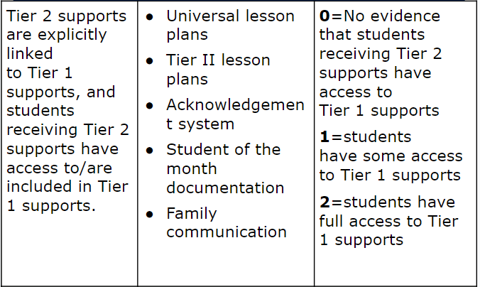
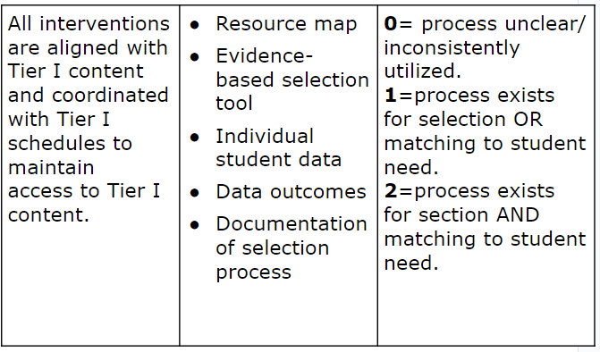
2.8 Access to Tier 1 Supports/ Alignment
46
47

Slide 101
Alignment Vision
Build and sustain a system that ensures that all students receive high quality core academic, behavioral and social-emotional instruction and evidence-based advanced tier interventions to support their learning needs.
This Photo by Unknown Author is licensed under CC BY-NC-ND

Slide 102
Essential Element Alignment
Teaming
Universal Screening/RFA
EBP Interventions and Supports Continuum
Academics
Behavior and Mental Wellness
Progress Monitoring
Data-informed Decision Making

Slide 103
Advanced Tiers in Action
Alignment:
Embedding tutors into existing structures strengthens tutors while aligning tutors to the school division and school vision.
Verbal and/or written communication between teachers and tutors
Notes:
I

Slide 104
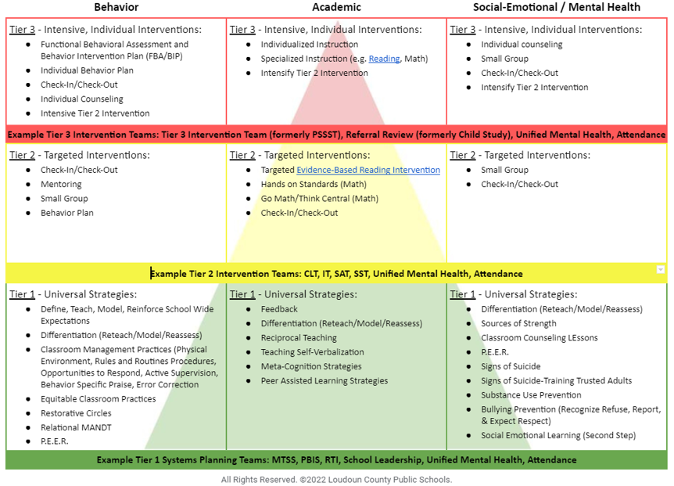
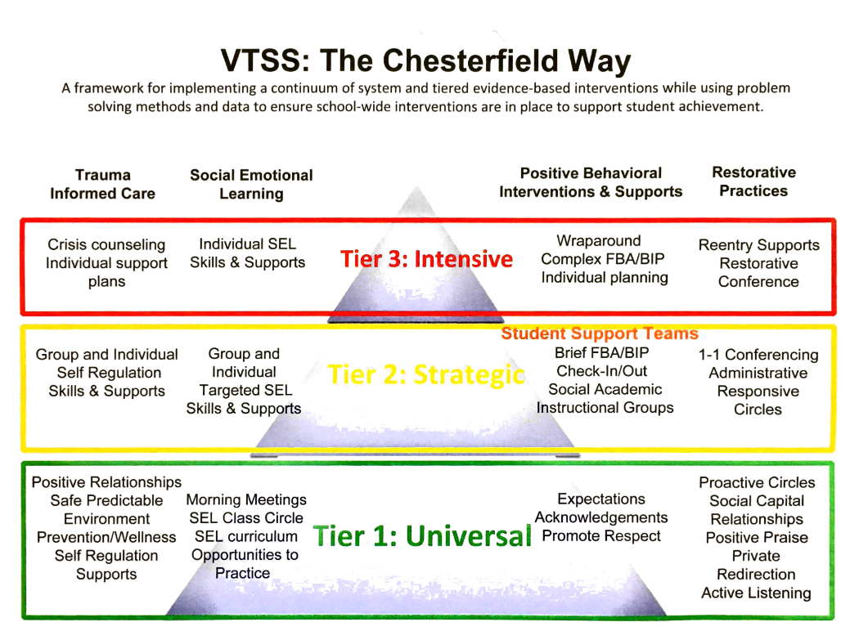
Aligned Systems Examples
48
49
Loudoun County Schools
Chesterfield County Schools

Slide 105
Team Time: Alignment
50
How do we know AT interventions align with tier 1?
How do students continue to access tier 1?
How are AT systems aligned across domains (academic, behavior, mental health)?

Slide 106
Big Ideas:
Alignment
The more time students spend away from Tier 1 core instruction, the harder it may become for them to exit from advanced tiers intervention
Strive to align content and scheduling needs so that students are able to access Tier 1 core instruction

Slide 107
Data-informed Decision Making
Teaming
Professional Learning and Coaching
Screening and Request for Assistance
Decision Rules
Progress Monitoring
Data-
Informed Decision Making
Continuum of Support
Alignment

Slide 108
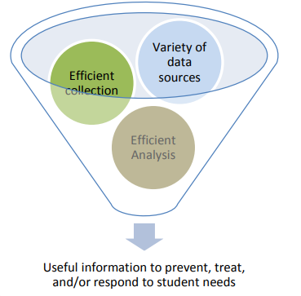
Data Informed Decision Making
Helps identify student needs in relation to established goals (DEFINE)
Helps identify the barriers to students reaching their goals (ANALYZE)
Provides sufficient information to select, match, and deliver services to students (IMPLEMENT)
Supports evaluation of the effectiveness of services and supports provided to students (EVALUATE)
* Florida PBIS

Slide 109
Advanced Tiers DIDM
Identify students in need of Tier II supports
Match students to Tier II interventions
Evaluate level of Tier II access/use
Monitor student performance
Individual student progress
% of students experiencing success
Monitor implementation fidelity
Screening and Request for Assistance
Decision Rules

Slide 110
Advanced Tiers Data
Support the System
Support the Student
Level of Use:
% of students accessing advanced tiers interventions
Effectiveness of EACH intervention in place
Students entering and exiting advanced tiers (movement across tiers)
Fidelity of implementation
Progress monitoring: Continue, fade, modify, or move on (movement within a tier)

Slide 111
LEVEL OF USE

Slide 112
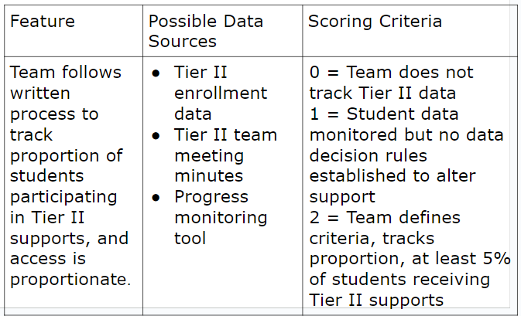
2.10 Level of Use
51

Slide 113
Level of Use Guidance
Team uses data to determine if there is sufficient use of Tier II
Too many: >20%
Too few: <1%
Just Right: 5-15%

Slide 114
Calculating Level Of Use Data
Potential Steps: | Example:
Identify # of students in your building | 500 students
Determine 5% of your school population. Determine 20% of your school population | 5%= 25 students 20%= 100 students 25-100 students should be accessing advanced tier interventions
Can our current systems support this many students? | Yes: Keep Going No: Team Problem Solving
Determine how many students are currently accessing or requiring access to Tier II interventions (consider decision rules and RFA). | Less than 25 or more than 100: Team Problem Solving Between 25 and 100: Just Right!
Reassess each month | And as students move in and out of receiving Tier II interventions.

Slide 115
Healthy Framework Quick Math
53
What is your total school population?
What is the 10-15 % range of your total school population?
What might be the number of students in your school receiving tier 2 intervention at any one point in time?
What is the 1-5% range of your total school population?
What might be the number of students in your school receiving tier 3 intervention at any one point in time?
Healthy

Slide 116
The Case of the Flipped Triangle
Below Benchmark 60%-80%
At Benchmark 20%-40%

Slide 117
Level of Use Problem Solving
Too many students require more intensive instruction?
Consider:
Revisiting decision rules
Modify and enhance Tier 1 instruction

Slide 118
Level of Use
Tier 2 Team Meeting Example
54

Slide 119
Behavior
Level of Use DIDM Practice
IF
THEN?
More than 35% of students received one or more office discipline referrals.
Tier 1 School-wide system
Tier 2 Group Interventions
Tier 3 Individual Systems

Slide 120
Level of Use Practice
55
Universal screening data and current decision rules for identifying students in need of Tier II supports show 37% of students need targeted instruction for math calculation.
What is the problem?
Why is it occurring?
What can be done?
How will we know if it worked?

Slide 121
Progress Monitoring
Teaming
Professional Learning and Coaching
Screening and Request for Assistance
Decision Rules
Progress Monitoring
Data-
Informed Decision Making
Continuum of Support
Alignment

Slide 122
Student Performance
Progress Monitoring

Slide 123
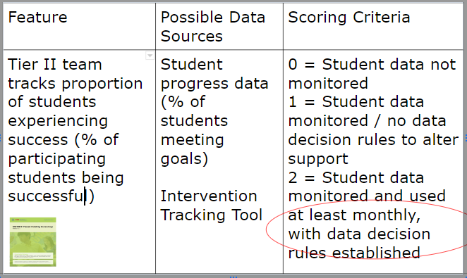
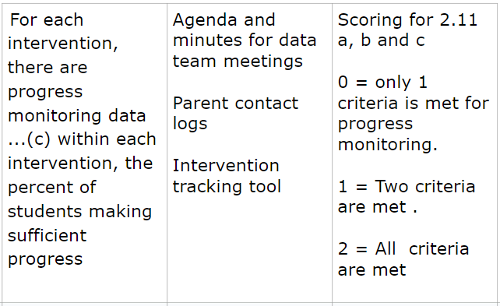
2.11 Student Performance Data/ Progress Monitoring
56
57

Slide 124
Progress Monitoring Definition
Monitors student progress across all three tiers
Evaluates the effectiveness of instruction so that teachers can create better instructional programs
Identifies students who are not making adequate progress and who need additional or alternative instruction
Estimates rates of improvement for each student

Slide 125
Progress Monitoring Across Tiers
Tier 1: Universal screening of all students to determine who is and is not, responding to universal instruction
Tier 2: Assess response to Tier 2 interventions
Tier 3: Assess response to intensive interventions and uses data to modify individualized instruction, as needed

Slide 126
Intervention Success Rates
Teams need to know whether advanced tier interventions are effective
What does adequate progress look like (decision rule)?
What % of students are being successful in each intervention?

Slide 127
Intervention Effectiveness
Tier 2 Team Meeting Example
54

Slide 128
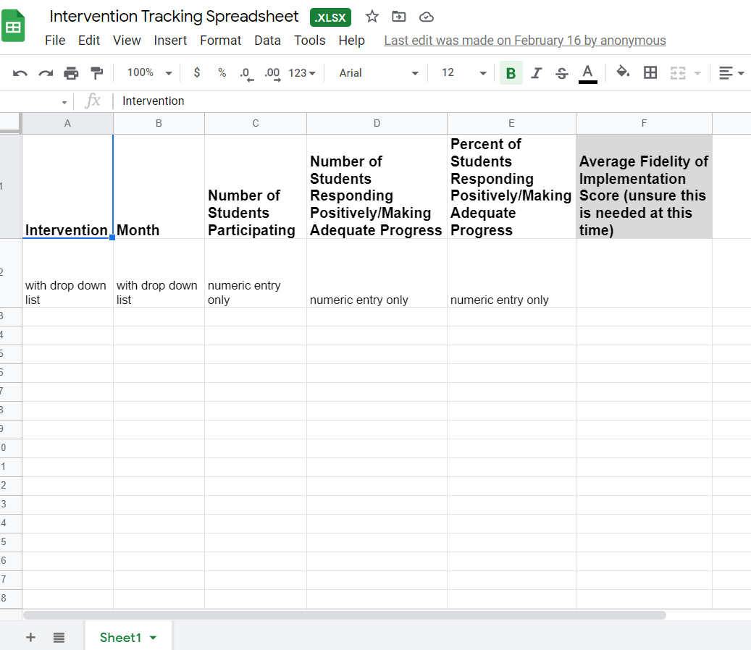
Electronic Intervention Tracking
58
Intervention Tracking Spreadsheet

Slide 129
Advanced Tiers in Action
Platforms collect student data and are used to inform lessons weekly.
How do teams need to know whether tutoring interventions are effective?
What does adequate progress look like (decision rule)?
What % of students are being successful in tutoring intervention(s)?
Notes:
I

Slide 130
Team Time:
Intervention Effectiveness
59
How is intervention effectiveness defined?
What is defined as “adequate progress?
How often is intervention effectiveness reported and evaluated by your school team?
Who brings this data?
What might teams consider when intervention effectiveness data is lower than desired?

Slide 131
2.11a, b Academic TFI
60
61
Progress monitoring data for students receiving Tier 2 supports which are displayed and discussed to make decisions monthly regarding individual progress. | Agenda and minutes for data team meeting Caregiver contact logs Intervention tracking tool | Scoring for 2.11 a, b, and c 0= only 1 criteria is met for progress monitoring 1 = Two criteria are met 2 = All criteria are met

Slide 132
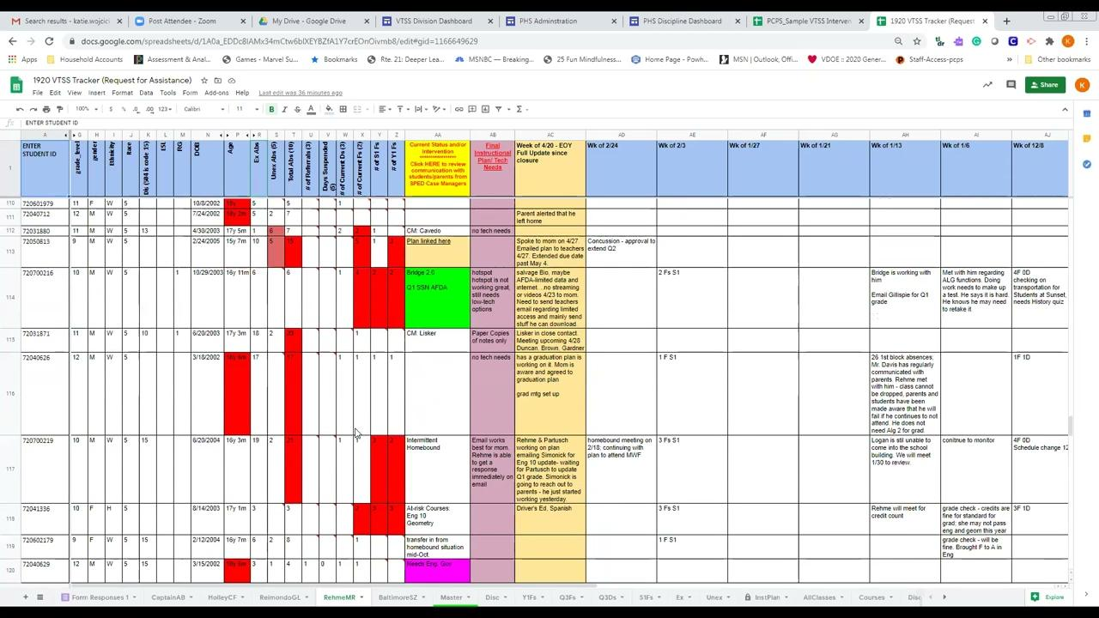
Powhatan County Public Schools Progress Monitoring Example
62

Slide 133
Progress Monitoring
Example Decision Rules
Definition of adequate progress
Expected Rate of Progress
How much progress should the student make each week based on the intervention?
Frequency of measurement
Progress monitoring intensity increases with intensity of intervention

Slide 134
Graphing Progress Monitoring Data
Baseline: where the student is performing prior to intervention
Goal: where the student is expected to be performing by a given date
Goal Line/ Aim Line: line connecting the baseline to the goal.
Phase Line: line that separates changes to the intervention

Slide 135
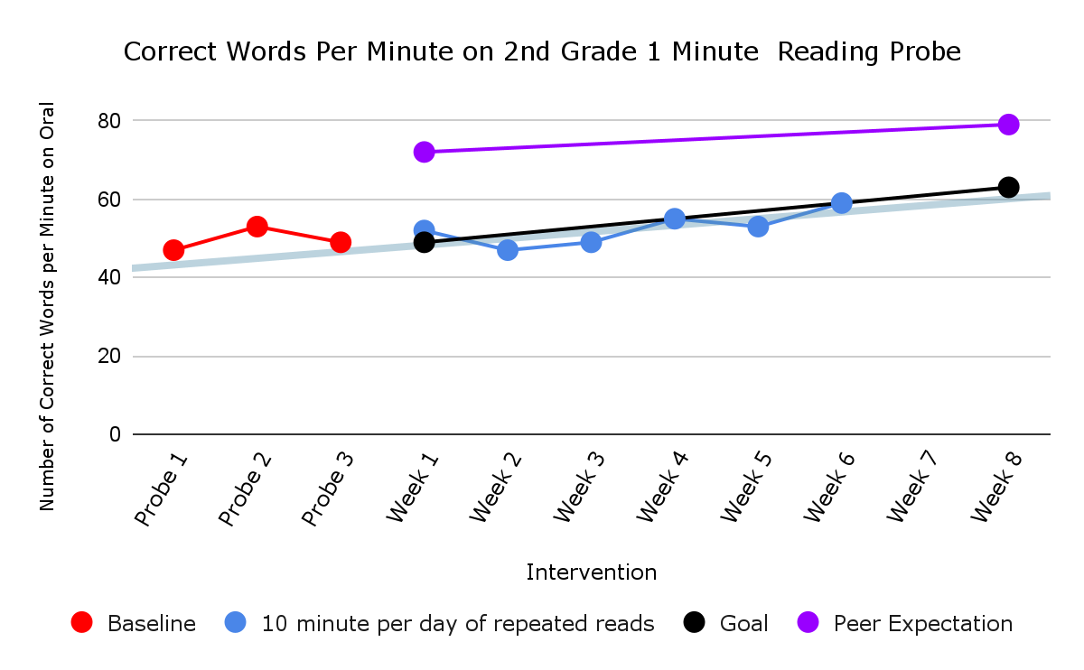
Academic Graphing Example
63
Baseline
Intervention

Slide 136
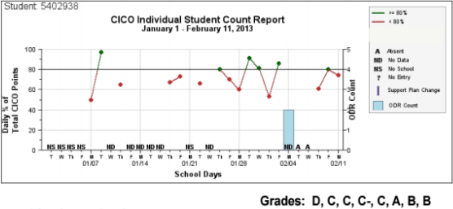
Behavior Graphing Example
64
transition out of CICO?
continue for 1 more 4-week cycle and then review?
add another intervention?

Slide 137
Progress Monitoring Practice
63
Looking at this graph, can we determine if the student is making progress?
Is the student expected to meet their goal?
Should an intervention change be made?

Slide 138
Progress Monitoring:
Advanced Tiers in Action
Many “ALL in Tutoring” interventions are digital platforms that include progress monitoring graphs
How do teams determine if a student is making adequate progress?
Can teams determine if the student expected to meet their goal?
What decision rules guide whether an intervention change be made?
What is the frequency that data will be examined to evaluate student progress?

Slide 139
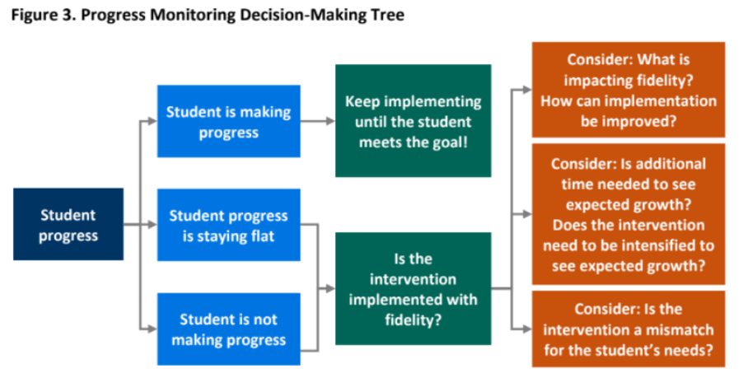
Decision Tree Example

Slide 140
Progress Monitoring Frequency
Frequency of progress monitoring increases with intensity of the intervention
Ex. A student receiving 15 minutes of intervention each day may have progress monitored once a week, whereas a student receiving 15 minutes 3 times a week may only be progress monitored once every 2 weeks

Slide 141
Progress Monitoring Reports
Prior to meeting, intervention coordinators review data and determine:
Continue: students making progress, but have not met their goal
Fade/Graduate: students who have met their goal and should be considered for fading or movement back to Tier I
Modify/Intensify/Change: students not responding

Slide 142
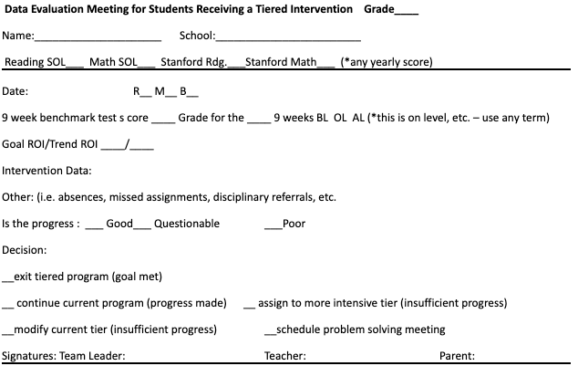
Coordinator Report Sample

Slide 143
Team Data Conversations about Student Performance
Is the student making enough progress to meet their goal?
Sufficient Progress - Goal Not Yet Met
Consider continuing the intervention
Sufficient Progress - Goal Met
Consider fading the intervention back to Tier I instruction
Insufficient Progress - High Fidelity
Consider modifying/changing the intervention
Insufficient Progress - Low Fidelity
Consider supporting staff to increase fidelity

Slide 144
Team Time:
Intervention Progress Monitoring
65
What is acceptable growth or rate of progress for each intervention on your continuum of supports?
What are the decision rules to continue, change/modify or fade each advanced tier intervention?
How often is progress monitored for each advanced tier intervention?

Slide 145
Big Ideas:
Progress Monitoring
Track progress of students in intervention to determine intervention effectiveness.
Progress monitor individual student performance data and apply decision rules to continue or alter support
Graph data for team data-informed decision-making

Slide 146
Stretch Break
Stand, stretch, move!

Slide 147
FIDELITY

Slide 148
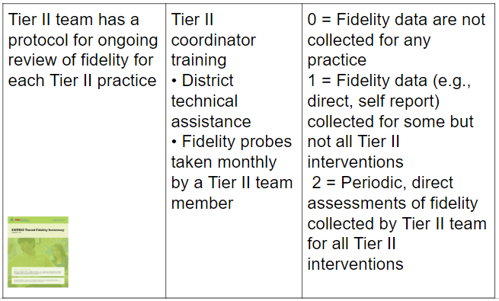
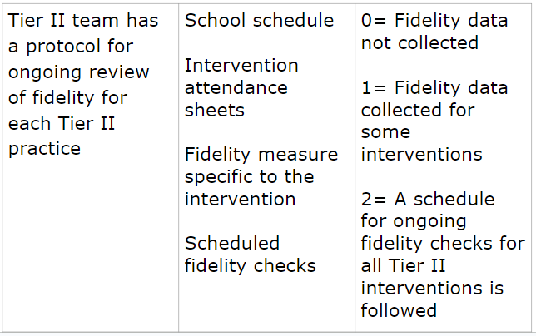
2.12 Fidelity Data
66
67

Slide 149
Implementation Fidelity
The degree to which an intervention is delivered as intended.
Helps us to know if the student is not responding to the intervention and may need something more or different.
…or if we are not implementing the intervention the way it is intended to reach the desired outcomes.

Slide 150
Checklist Manifesto
68

Slide 151
How to Measure Fidelity
Make a checklist of the core implementation features of the intervention.
Observe the intervention and look for the core features.
Compare expected implementation with what is currently being implemented.
Note: many evidence-based interventions have fidelity monitoring tools!

Slide 152
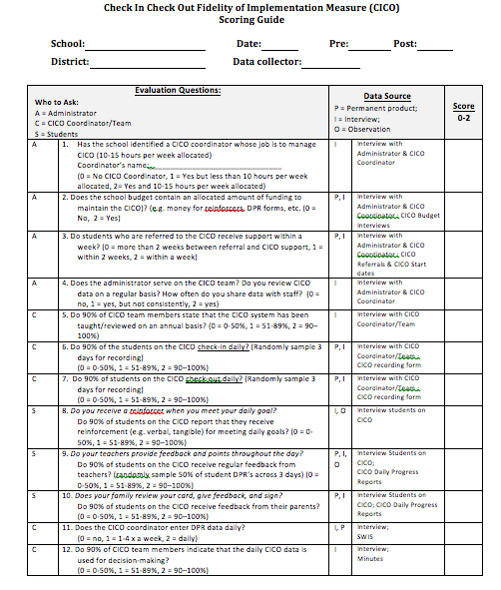
Behavior Intervention Fidelity Checklist Example
69
Notes:
152

Slide 153
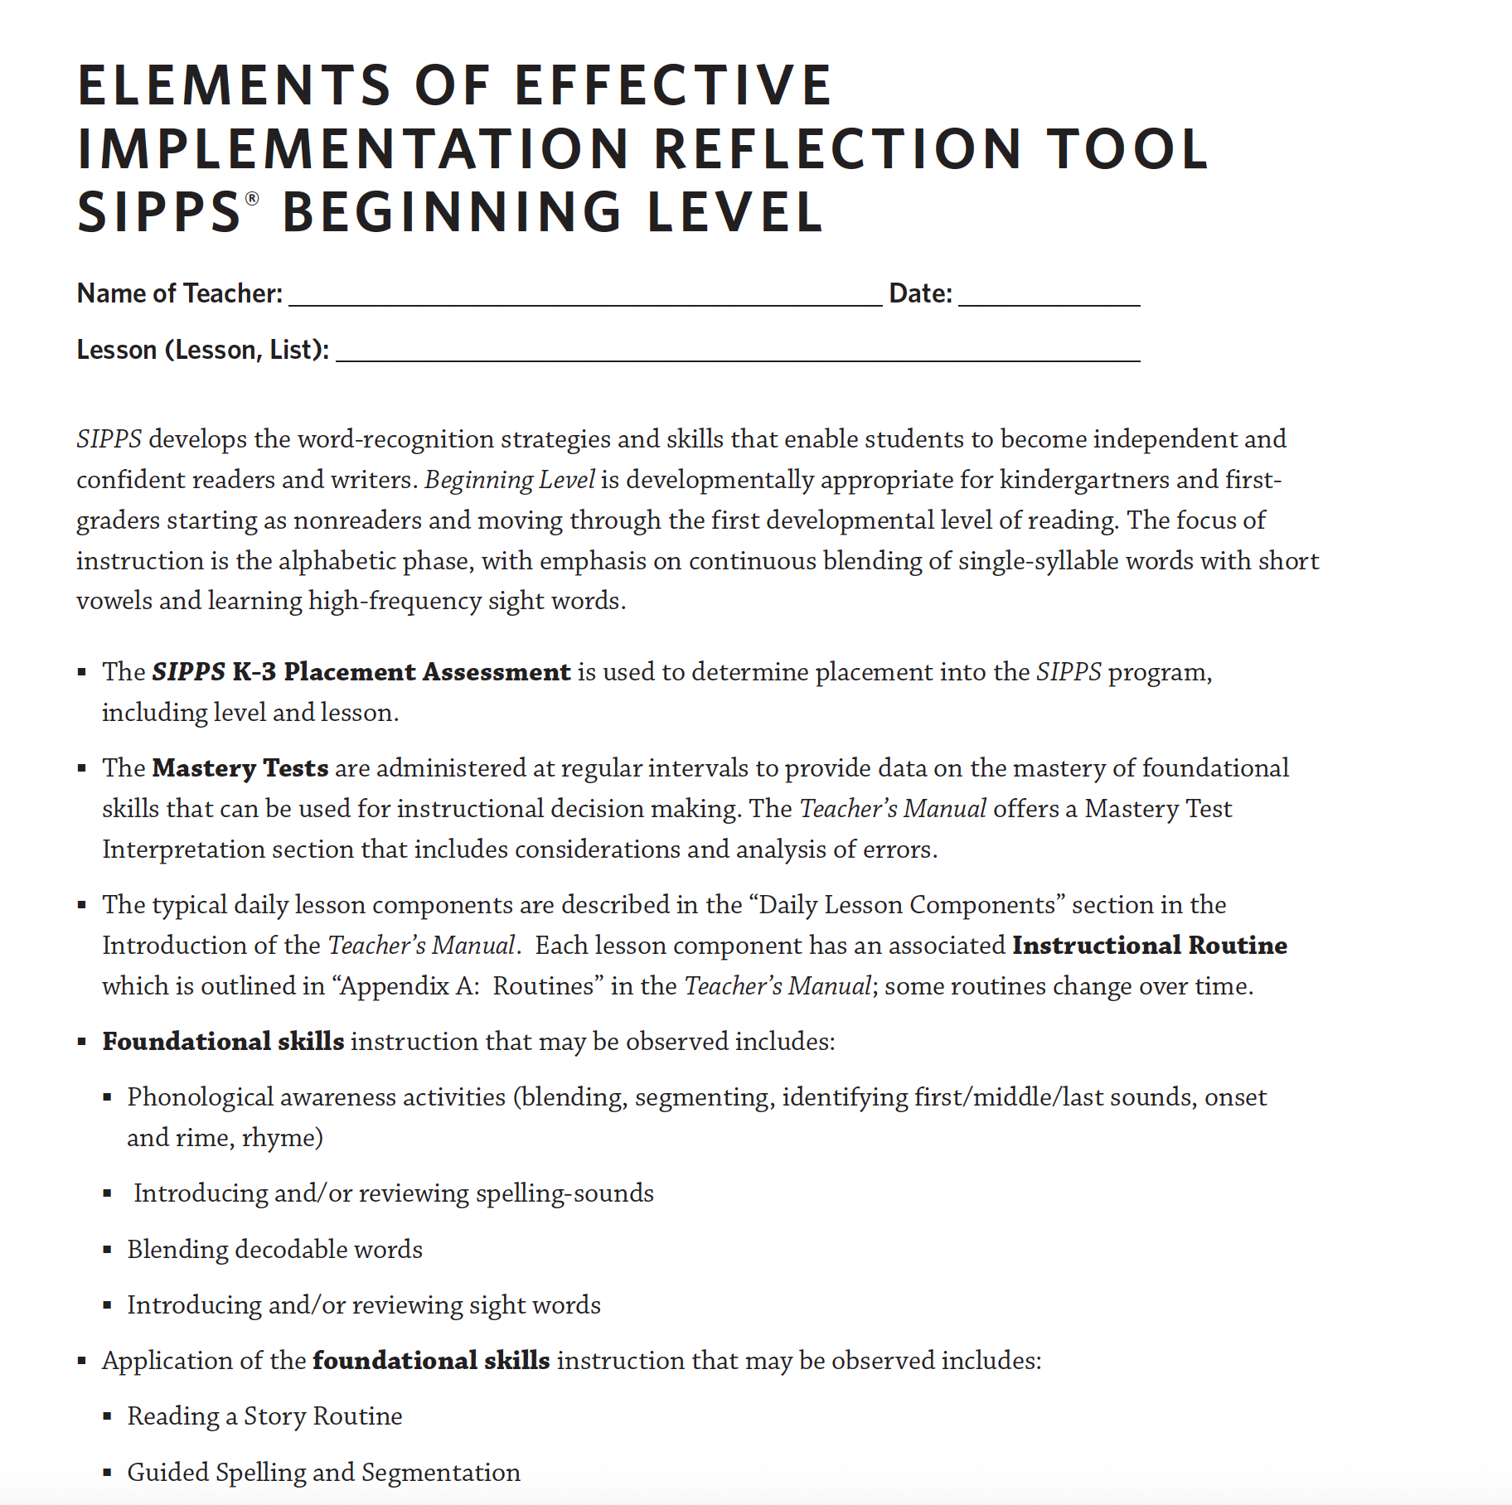
Reading Intervention
Fidelity Checklist Example
Notes:
153

Slide 154
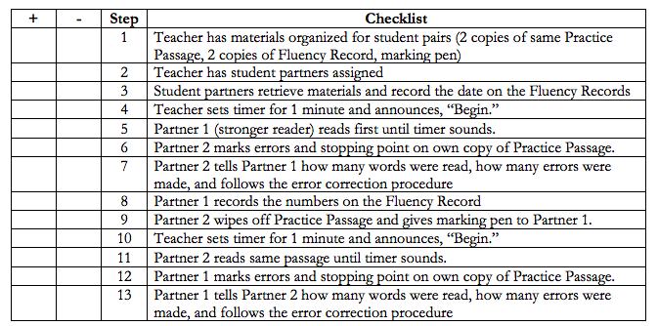
“Program” Fidelity Checklist Example
71

Slide 155
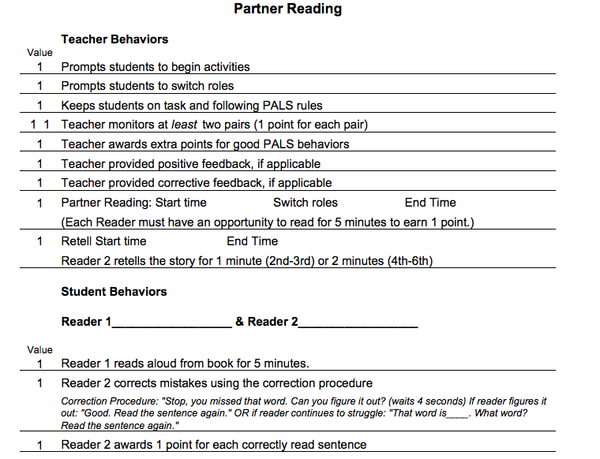
Strategies Fidelity
Checklist Example
72

Slide 156
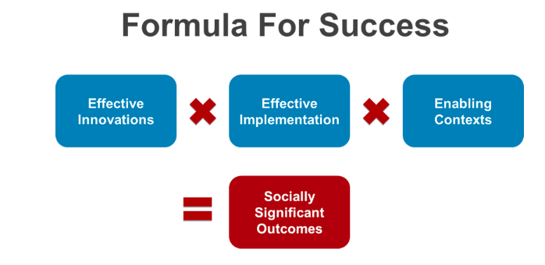
Power of Fidelity
National Implementation Research Network

Slide 157
Advanced Tiers Team Fidelity Conversations
Evaluate fidelity of intervention implementation
more staff training? modeling?
Evaluate match to student need
is it the right fit?
Evaluate contextual fit
right match between the strategies, procedures, or elements of an intervention and the values, needs, skills, and resources of those who implement and experience the intervention

Slide 158
Team Time:
Fidelity Measures
73
Discuss how fidelity will be measured?
Determine how often fidelity is measured?
This Photo by Unknown Author is licensed under CC BY-NC

Slide 159
DIDM Big Idea:
Fidelity
Regularly analyze and evaluate advanced tier data including:
level of use
intervention effectiveness
student performance
fidelity of implementation

Slide 160
Professional Learning and Coaching
Teaming
Professional Learning and Coaching
Screening and Request for Assistance
Data-
Informed Decision Making
Decision Rules
Progress Monitoring
Continuum of Support
Alignment

Slide 161
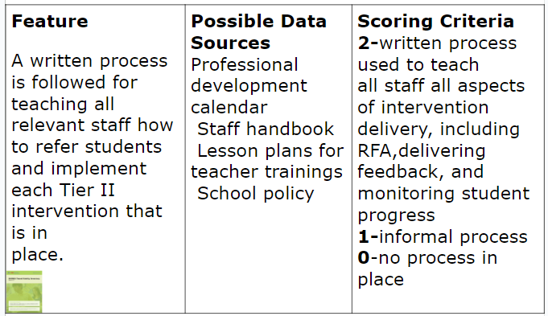
2.9 Professional Learning
74
75

Slide 162
School Professional Learning Process
Presentation of Theory and Research
Coaching and Follow up
Demonstration of the Strategy or Skill
Practice and Feedback

Slide 163
Professional Learning Impact

Slide 164
Planning for Success
76

Slide 165
Advanced Tiers in Action
Professional Learning and Coaching:
Training of licensed teachers, aspiring teachers, paraeducators and community tutors on a continuum of support
New tutors should be given scripted lesson plans.(through digital platforms)
Training on school building safety, the Family Educational Rights and Privacy Act (FERPA)
All in tutoring online training
Support tutors with learning how to implement best practices, align tutoring practices to classroom instruction and build background knowledge in reading and math.

Slide 166
Big Ideas:
Professional Learning & Coaching
Staff who deliver interventions need both professional learning and coaching for support in delivering interventions.
We change adult behavior first to ensure success for students

Slide 167
Team Time:
Professional Learning
77
What is the professional learning and coaching needed for the person delivering the intervention to be able to teach with fidelity?
Identify what professional learning staff need to implement this intervention
Discuss who will provide the professional learning
Determine what coaching supports are needed for staff
Identify who will provide coaching and when

Slide 168
Closing: Name that Circle!

Slide 169
Closing: Name that Circle
78
Teaming
Professional
Learning &
Coaching
Screening & Request for Assistance
Data-informed Decision
Making
Decision
Rules
Continuum of
Supports
Progress
Monitoring
Alignment

Slide 170
Advanced Tier Interventions
Core Features

Slide 171
Advanced Tier Interventions
37
Increased
Structure &
Prompts
Increased
Data
Collection
Increased
Feedback
Increased
Family
Engagement
Core Features
Increased
Instruction
Increased
Systems
Adapted from Horner & Sugai (2016)

Slide 172
AT Quick Check
79
80

Slide 173
Quick Check-slide 2
79
80

Slide 174
Quick Check-slide 3
79
80

Slide 175
Graduation!

Slide 176
Evaluation
Pix4free.org - link to - https://pix4free.org/

Slide 177
References
Algozzine, B., Barrett, S., Eber, L., George, H., Horner, R., Lewis, T., Putnam, B., Swain-Bradley, J., McIntosh, K., & Sugai, G. (2014).
Crone, D. A., Horner, R. H., & Hawken, L.. S. (2004). Responding to problem behavior in schools: The Behavior Education Program. New York: Guilford.
Everett, S., Sugai, G., Fallon, L., Simonsen, B., & O’Keeffe, B. (2011). School-wide Tier II interventions: Check-In Check-Out Getting Started Workbook. OSEP Technical Assistance Center on Positive Behavioral Interventions and Supports.

Slide 178
References (2)
Hosp, J. L., Hosh, M. K., Howell, K. W., Allison, R. (2014). The ABCs of curriculum-based evaluation: A practical guide to effective decision making. New York: Guilford.
Lembke, D. (n.d.). Interventions in RTI Handouts. Retrieved from https://rti4success.org/sites/default/files/interventions_in_rti_handouts.pdf
McIntosh, K. & Goodman, S. (2016). Integrating multi-tiered systems of support: Blending RTI and PBIS. New York: Guilford
ford Press.

Slide 179
References (3)
Riley-Tillman, C. T., Burns, M. K., & Kilgus, S. P. (2020). Evaluating Educational Interventions, Second Edition: Single-Case Design for Measuring Response to Intervention (Second ed.). The Guilford Press.
Sanetti, L. & Meek, M. (2019). Supporting successful interventions in schools : tools to plan, evaluate, and sustain effective implementation. New York: The Guilford Press.

Slide 180
References (4)
The IRIS Center. (2014). Evidence-based practices (part 3): Evaluating learner outcomes and fidelity. Retrieved from https://iris.peabody.vanderbilt.edu/module/ebp_03/
Tiered Fidelity Inventory (TFI) Scoring Guide - Adapted from Algozzine, B., Barrett, S., Eber, L., George, H., Horner, R., Lewis, T., Putnam, B., Swain-Bradway, J., McIntosh, K., & Sugai, G (2014). School-wide PBIS Tiered Fidelity Inventory. OSEP Technical Assistance Center on Positive Behavioral Interventions and Supports. www.pbis.org.

