Slide 1
Introduction to Advanced Tiers
Building and Sustaining an Effective System of Supports

Slide 2
Welcome
Welcome to the Virginia Department of Education’s professional learning event through the Virginia Tiered Systems of Supports (VTSS).
This professional learning opportunity is funded and hosted by the Virginia Department of Education.

Slide 3
Day 1 Agenda
2
10:00-10:30: Intro, Connections, and Materials Walk
10:30-11:00: Advanced Tiers Overview
11:00-11:30: Teaming
11:30-12:00: Screening and Requests for Assistance
12:00–1:00: Lunch
1:00-1:30: Decision Rules
1:30-2:00: Continuum of Supports and Alignment
2:00-2:15: Break
2:15-3:00: Data-informed Decision Making
3:00-3:30: Professional Learning and Coaching
3:30-4:00: Exit Ticket and Evaluation

Slide 4
Meet and Connect!
Find Someone Who…or Dice Breaker

Slide 5
Meet and Connect!
7
Has a garden/likes to grow things | Has recently read/listened to a good book | Is a runner | Can recite something from memory | Is wearing purple
Was born in another state | Raises chickens | Likes to drive with the top down and/or the windows open | Was part of a musical or play | Likes to lick the beaters/spoon
Has an unusual talent | Is looking forward to going somewhere special this summer | FREE | Can name all four Golden Girls | Is competitive
Likes ice cream more than cake | Enjoys baking bread | Whistles (or hums) while they work | Had a unique job | Speaks another language
Sings or listens to music in the shower/tub | Has visited a wonder of the world | Plays an instrument | Halloween is their favorite holiday | Makes things

Slide 6
Meet and Connect!
8
What are you excited/not excited about this summer?
What do you enjoy during the summer?
What is a good memory you have from this past year?
What is something you are looking forward to?
What is something new you would like to experience this summer?
Describe your favorite summer place.

Slide 7
In-Person Norms
4
Be responsible | Take care of personal needs Share your questions with the group
Be respectful | Turn volume/sound off on cell phones Listen to others attentively Follow up and complete assigned tasks
Be engaged | Ask what you need to know to understand and contribute Share your expertise, information and ideas Maximize team time by engaging with assigned tasks

Slide 8
Learning Intentions - 1
Participants will:
Describe & synthesize the essential elements of an advanced tiers system of supports
Define advanced tiers team roles, responsibilities, & meeting structures that demonstrate authentic family engagement
Explore screening and “requests for assistance” tools for identifying students who might benefit from advanced tiers supports
List examples of intervention decision rules within an advanced tiers continuum of supports

Slide 9
Learning Intentions - 2
Participants will:
Examine advanced tiers level of use, progress monitoring, student performance, and fidelity data
Explain the importance of alignment across tiers and domains
Delineate essential components of professional learning and coaching plans for effective advanced tiers implementation

Slide 10
Success Criteria
9
During this session or in the coming year, my team will:
Use and sustain effective advanced tier meeting structures for data-informed decision making using screening and requests for assistance data
Document and use decision rules to match identified student instruction needs to an evidence-based continuum of supports

Slide 11
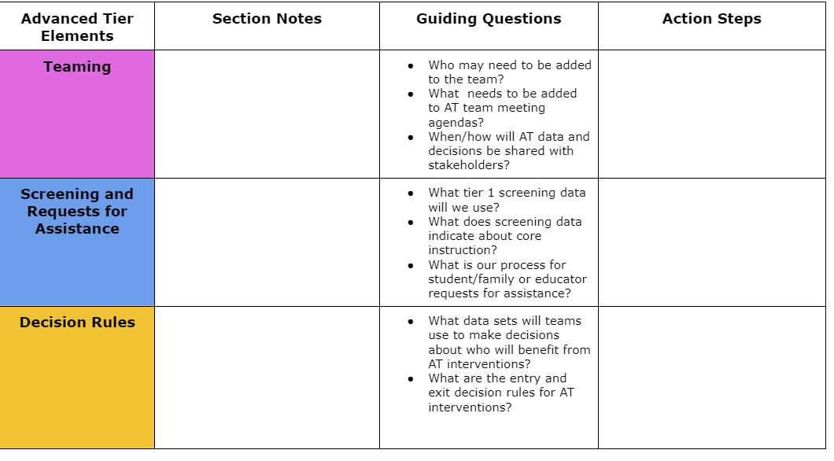
Advanced Tiers Notetaker
6

Slide 12
Where Are We in the Triangle?
Tier 3 for a Few: Intensive, Individualized
Tier 2 for Some: Targeted for Small Groups
Tier I for All: Core/Universal
1 - 5%
5 - 15%
80 - 90%

Slide 13
Social Competence & Academic Achievement
OUTCOMES
What we use to make decisions? Monitor progress?
Monitor fidelity?
SYSTEMS
DATA
What we do to support adults to implement the practices?
PRACTICES
What we do to
support students?
Notes:
13

Slide 14
Why Advanced Tiers?
Core Instruction doesn’t work in isolation
Avert students from trajectories toward further learning/behavior challenges
Provide a unifying framework: Programs and strategies

Slide 15
What is Tier 2?
Targeted support for students not successful with Tier 1 alone
Small group intervention
Provided in addition to universal, Tier 1 instruction and aligned with student needs
For students who may be struggling or who need more challenge

Slide 16
What is Tier 3?
Frequent, intensive, and individualized intervention
Intensive support for students not responding to Tier 2 support or need more intensive support
Individualized intervention
Different than special education

Slide 17
3.4 Student Support Team
A uniquely constructed individual student support (ISS) team exists to design, implement, monitor, and adapt the student-specific support plan. | Behavior Support Plans | 0 = ISS teams do not exist for all students who need them 1 = ISS teams exist, but lack input from student/family 2 = ISS teams exist, with active input from student/family and meet regularly to review progress data

Slide 18
Moving In and Out of Tiers
10
How are students’ experiences in a multi-tiered system of supports similar to a lava lamp?

Slide 19
Quick Check: Overview T/F
11
Students not responding to core instruction should be removed and receive advanced tier interventions that teach different content in a different way for student success.
When high-quality core instruction is in place, schools can anticipate that about 5-15% of students will benefit from tier 2 interventions and 1-5% of students from tier 3.
Identifying students as Tier 1, Tier 2, or Tier 3 will help school teams effectively plan advanced tiers interventions.

Slide 20
Advanced Tiers Foundations
“The Essential Eight”
5
Teaming
Professional Learning and Coaching
Screening and Request for Assistance
Progress Monitoring
Decision Rules
Data-
Informed Decision Making
Continuum of Support
Alignment

Slide 21
Teaming
Teaming
Professional Learning and Coaching
Screening and Request for Assistance
Decision Rules
Progress Monitoring
Data-
Informed Decision Making
Continuum of Support
Alignment

Slide 22
Authentic Family Engagement

Slide 23
2.1 Team Composition
Team includes a coordinator and members with behavioral expertise administrative authority knowledge of student knowledge of school operation | School organization chart Tier II team meeting minutes | 0 = no coordinator or all 4 core areas of expertise 1 = no coordinator, or member attendance is below 80% 2 = all members attendance at or above 80%
Tier II (or Tier II/III) team includes staff members with intervention expertise knowledge of the intervention admin role knowledge of students | List of team members Inclusion of additional staff as needed as per team minutes | 0 = Tier II team meets no more than one of the feature criteria 1 = Tier II meets two of the four feature criteria 2 = Tier II team includes coordinator and meets all four feature criteria

Slide 24
What Do Teams Look Like?
We are a small school. Our Tier I, Tier II & III teams are the same people
Our Team meets monthly, and our Tier II Team meets every other week
We meet every week for 30 minutes for each Tier

Slide 25
Card Sort
12
Tier 1 Team
Advanced
Tiers Team

Slide 26
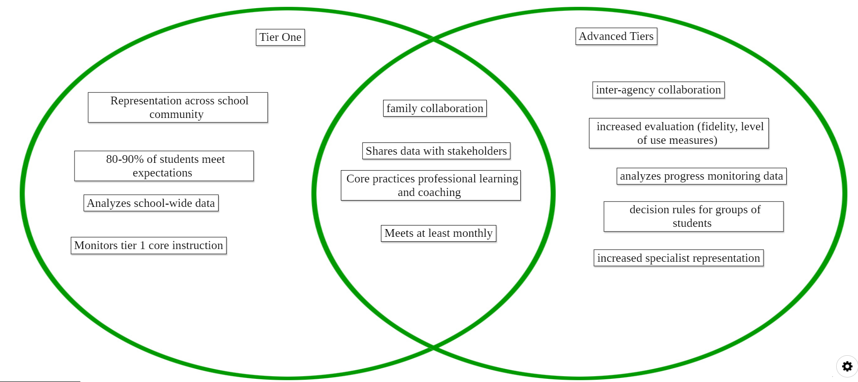
Teaming Venn Diagram

Slide 27
2.2 Team Operating Procedures
13
Team includes a coordinator and members with behavioral expertise administrative authority knowledge of student knowledge of school operation | School organization chart Tier II team meeting minutes | 0 = no coordinator or all 4 core areas of expertise 1 = no coordinator, or member attendance is below 80% 2 = all members attendance at or above 80%
Meets at least monthly and has regular agenda, minutes, defined meeting roles; and current action plan | Meeting agendas and minutes Meeting roles and responsibilities Tier II action plan | 0 = 0-1 criteria 1 = 2-3 criteria 2 = 4 criteria
Procedure for communication across teams at all tiers for effective student planning. | Cross team agendas Aligned dashboard Intervention plans | 0 = no evidence 1 = internal team communication 2=across team communication

Slide 28
Tier 2 Team Meetings
Occur more frequently (recommended)
Process referrals:
Screening data and Requests for Assistance
Standing Agenda Items
Monitor student progress and Tier 2 intervention effectiveness data
Communicate with stakeholders (staff, students, families, community partners)

Slide 29
Team Data Conversations
Tier 1/ Universal
Tier 2/3
Targeted
Tier 3/ Tertiary
Intervention level of use and % of students making progress
Student referral and progress monitoring
Intensified
student progress monitoring
Schoolwide and classroom
Increased progress monitoring, fidelity measures and family engagement

Slide 30
Advanced Tiers Standing Agenda Items
Intervention Effectiveness
# of students
# meeting goal
# not meeting goal
Level of Use
Fidelity
Intervention Referrals and Decision Rules
Team Problem Solving
Communication with families, staff, students and community partners

Slide 31
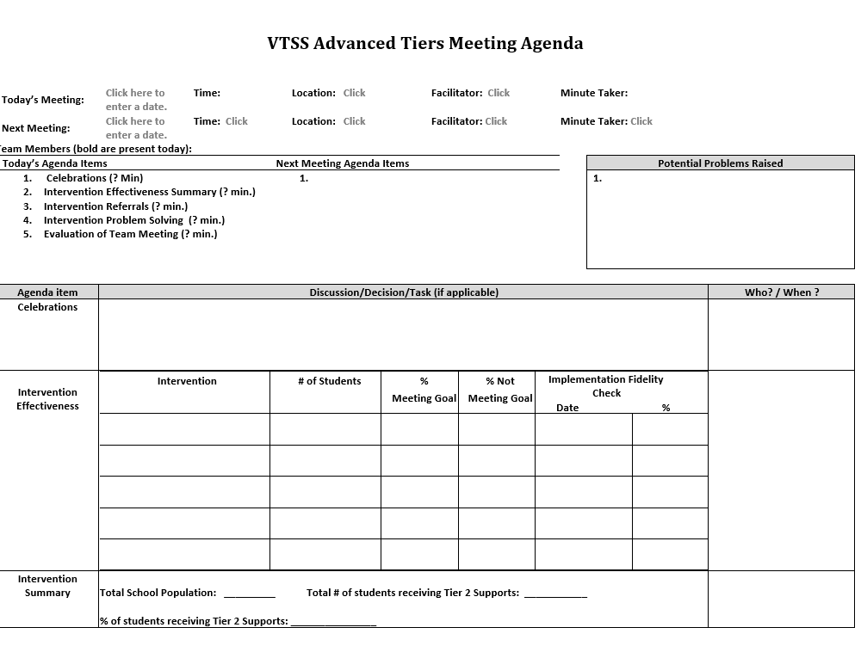
Advanced Tier
Sample Meeting Agenda
14

Slide 32
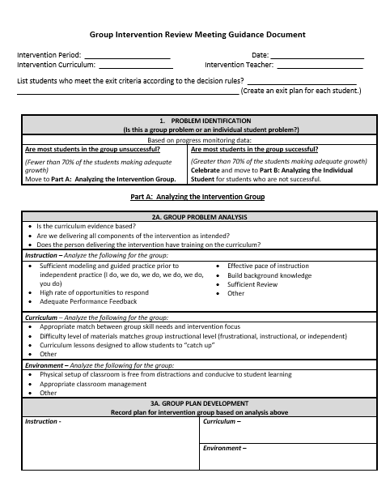
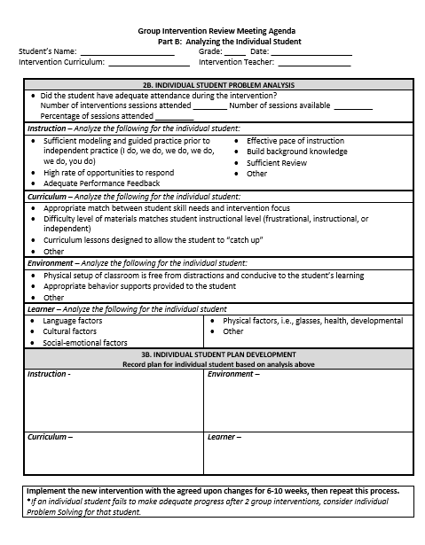
Different Forms,
Same Discussions!
14
retrieved from http://www.oregonrti.org/resources

Slide 33
Bi-Directional Stakeholder Communication
Share student progress graphs in CLTs and grade level meetings
Include graphs in school/home communication
Builds shared commitment to advanced tier interventions
Increases awareness of interventions
Fosters deeper understanding of family and culture-specific functions of behaviors

Slide 34
Quick Check: Teaming Structures T/F
15
Advanced tiers teams include more specialized personnel.
Advanced tiers teams look the same across divisions and schools.
The most important data conversation that takes place at an advanced tier meeting is individual student performance.
Tier 3 team conversations include caregivers as problem-solving partners

Slide 35
Team Time: Teaming
16
Who is, or will be on your advanced tiers team?
Who else is needed?
Behavioral, academic, and medical expertise
General and Special Education knowledge
Data/graphing knowledge
Authority to access/provide resources
Understanding of support across grades/departments and school, including other tiered support
Family/school connection
What agenda will you use?
What needs to be created, added or changed?

Slide 36
Big Ideas
Teaming
Advanced tier teams benefit from specialized knowledge and expertise
There should be at least one person with overarching knowledge of the interventions used in the schools
Use a predictable agenda that includes intervention systems and student performance data discussions

Slide 37
Break
Get up and move!

Slide 38
Screening and Request for Assistance
Teaming
Professional Learning and Coaching
Screening and Request for Assistance
Progress Monitoring
Decision Rules
Data-
Informed Decision Making
Continuum of Support
Alignment

Slide 39
2.3 Screening
17
Decision rules and multiple sources of data (e.g., ODRs, screening tools, attendance, student nominations) are used to identify students | Multiple data sources used (e.g., ODRs, time out of instruction, attendance, academic performance) Decision rubric Meeting minutes School policy | 0 = no specific rules for identifying students 1 = Data decision rules established but no consistently followed or used with only one data source 2 = Written policy exists that uses multiple data sources and ensures prompt notice to families

Slide 40
Purpose of Screening
PROCESS
Evaluate Effectiveness of Core (Tier 1)
INTERVENTION
Part of the Request for Assistance Process that is one data point used to measure progress.
Adapted from https://assets-global.website-files.com/5d3725188825e071f1670246/5d7035c071700f1e3b846aab_b1_lewis_powers_dixon_revised.pdf

Slide 41
Integrated Screening
INFORMAL
FORMAL
Nominations/ Requests for Assistance
Existing Data Sets
Universal Screeners

Slide 42
Steps to Universal
Screener Implementation
Establish Clear Roles/Responsibilities
Identify Stakeholders
Determine the frequency/timelines
Communicate the Purpose
Ensure Accessibility of ALL and elimination of potential bias
Provide/Participate in Professional Development of Assessment Tools

Slide 43
Universal Screeners
18
ACADEMIC National Center on Intensive Interventions RAND Education Assessment Finder | BEHAVIOR University of Missouri Evidence Based Intervention Network National Center on Intensive Interventions Center on PBIS | MENTAL WELLNESS CASEL Assessment Guide RAND Education Assessment Finder Ohio Department of Education

Slide 44
Universal Screener Selection
18
Questions
Consideration
Is the core instruction sufficient/is it improving?
For which groups is it working/not working?
What is the efficacy of the tiered interventions?
What is the individual growth of our students?
Cost
Capacity to administer and analyze
Ability to Scale-up
Communication of Results and Reporting of Needs

Slide 45
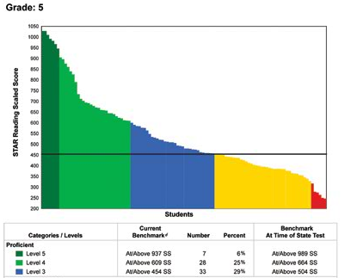
Screening to Assess Core Instruction
60 % of students
40 % of students

Slide 46
Student Issue or
Systems Issue?
Environment or student?
Fig. “Classroom Chaos”. May 31, 2020. http://healthyteachingonline.com/blog/wp-content/uploads/2014/09/schoolchaos.jpg

Slide 47
Quick Check: Screening
19
YES
SO-SO
NO
We have universal screening data at Tier 1 in at least one area of academics, behavior, mental wellness (can be Early Warning System in secondary)
We use the data to answer “is the core sufficient” based on the triangle
We have conversations around “is it a student issue or a systems issue” rather than always looking at individual students

Slide 48
Team Time: Screening
20
Choose a domain (reading, math, behavior, mental health, attendance)
List screeners (formal or data sets) that are used to support advanced tier entry considerations
How are caregivers involved in the screening process?

Slide 49
2.4 Requests for Assistance
21
Feature | Data Sources | Scoring Criteria
Process for seeking additional team assistance for meeting the needs of students and/or teachers when progress is not sufficient at Tier 2 | Documented assistance team Listing on asset or resource map Flow chart Decision rules defined | 0 = Teachers solve problems independently 1 = Process exists but lacks clear follow-through 2 = Process is clear, organized, and utilized by teachers

Slide 50
Requests for Assistance?
Grab the reading specialist in the hall and ask if she can add one more to the group.
Tell the high school counselor a student just got on your last nerve and they need to see them so they can be added to the social skills group.
Email the school psychologist and everyone else you know to request the Tier 3 behavior specialist come at once because a student seriously interferes with learning in the classroom!

Slide 51
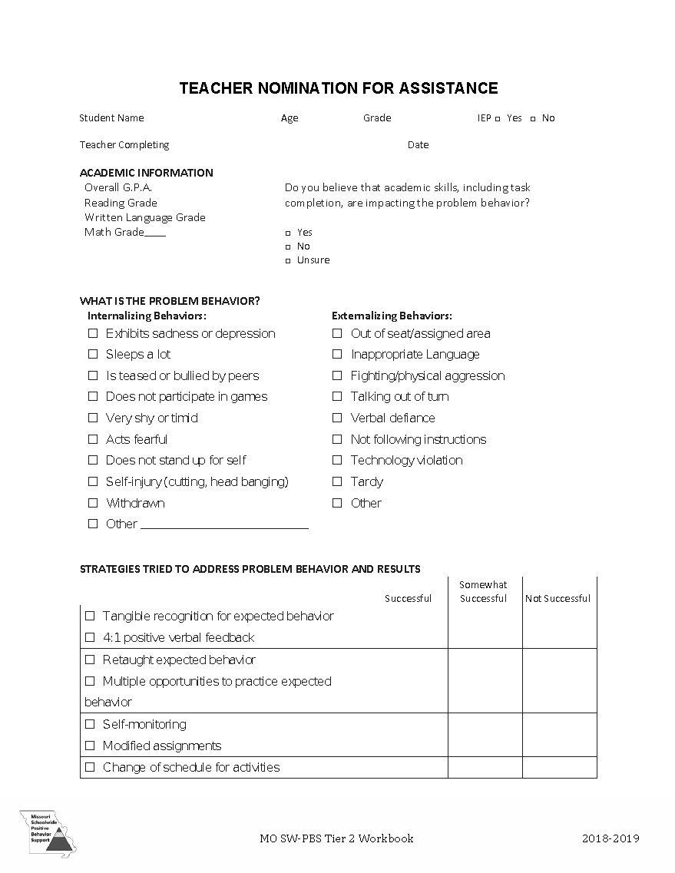
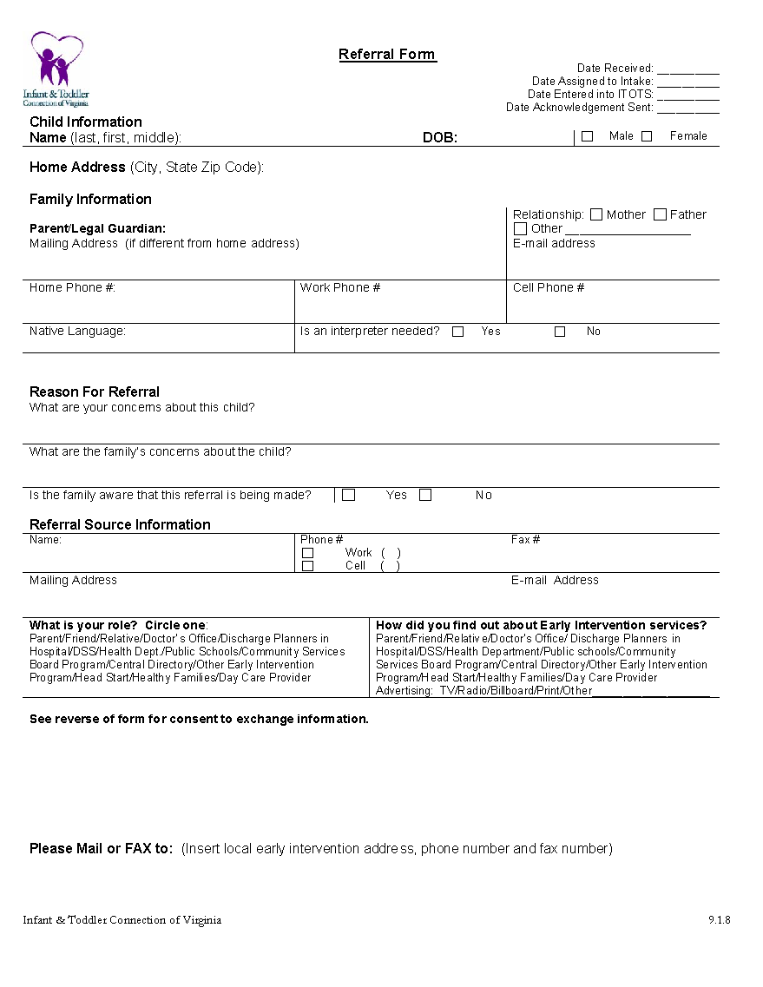
Nominations/ Request for
Assistance Forms
22

Slide 52
Sorting for Practice!
23
Sort the Screening and Requests for Assistance cards into three categories:
Nominations
Existing Data
Universal Screener
Stand when you are finished!

Slide 53
Consideration Activity
24

Slide 54
Team Time: Student Identification
25
Identify what tier 1 screening data will be used
Discuss what screening data indicates about core instruction
Determine the process for student/family or educator requests for assistance

Slide 55
Big Ideas
Screening and RFAs
Screening data helps us to know if the core is sufficient and differentiate a systems issue from a student issue, and for which groups of students the core instruction is successful.
Universal screening provides data advanced tiers teams need for data informed decision making.
Request for Assistance should be easily accessed by staff, students and caregivers.

Slide 56
Lunch

Slide 57
Welcome Back!
Teaming
Professional Learning and Coaching
Screening and Request for Assistance
Progress Monitoring
Decision Rules
Data-
Informed Decision Making
Continuum of Support
Alignment

Slide 58
Welcome and Connect!

Slide 59
Decision Rules
Teaming
Professional Learning and Coaching
Screening and Request for Assistance
Progress Monitoring
Decision Rules
Data-
Informed Decision Making
Continuum of Support
Alignment

Slide 60
Decision Rules
Decision rules, or “entry and exit criteria”
Allows for decisions to be made objectively on who receives support
Provide a uniform method to refer students to advanced tiers.
Provide clear exit criteria from advanced tiers interventions and supports.

Slide 61
2.3 Screening & RFA Decision Rules
26
Decision rules and multiple sources of data (e.g., Rs, screening tools, attendance, student nominations) are used to identify students. | Multiple data sources used (e.g., ODRs, time out of instruction, attendance, academic performance) Decision rubric Meeting minutes School policy | 0 = No speciﬁc rules for identifying students 1 = Decision rules established but not consistently followed or used with only one data source 2 = Written policy exists that uses multiple data sources and ensures prompt notice to families.

Slide 62
Tier 2 Academic Decision Rules Reading Data Example
Below 25% on universal screener
Below 70% on benchmark assessments
Did not meet PALS benchmark
Did not pass prior year’s SOL
Did not achieve course credit

Slide 63
Tier 2 Academic Decision Rules Mathematics Data Example
27

Slide 64
Tier 2 Decision Rules Behavior Data Example
2-5 ODR’s
1 Suspension
> ? minutes missed instruction
> ? days unexcused absences
Incomplete classwork/homework
Tardies
Student, caregiver, staff nomination

Slide 65
Tier 2 Decision Rules:
Mental Wellness Data Example
5+ visits to the nurse/school counselor per month
3-5 absences per month
2-4 tardies and/or early dismissals
Student, caregiver, staff nomination
Mental Wellness Screener

Slide 66
Sample Data Decision Rules Dashboard
28
Measure | Proficient Score | At-Risk | High Risk
Classroom Managed | 0-4 | 5 or more | 15 or more
ODR | 0-1 | 2-5 | 6 or more
Absences | <5 / trimester | 5+ / trimester | 10 / trimester
Tardy | <4 / trimester | 4+ / trimester | 10 / trimester
ISS | 0-1 | 2 | 4 or more
OSS | 0 | 1 | 2
Reading Virginia Growth Assessment | scores red or higher | scores fall between purple and red | scores fall below purple
Math Virginia Growth Assessment | scores red or higher | scores fall between purple and red | scores fall below purple
Writing Assessment | 3 or 4 | 2 | NS; 1
Nurse (non-medication) | 0-1 (no pattern) | 2-5 (patterns of regular visits) | 6 or more (patterns of regular visits)
*Ensure schools are looking at more than one data point to determine intervention need(s)*

Slide 67
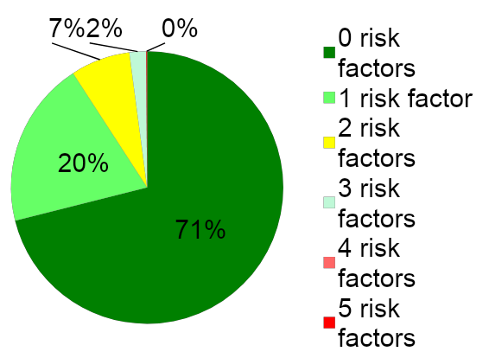
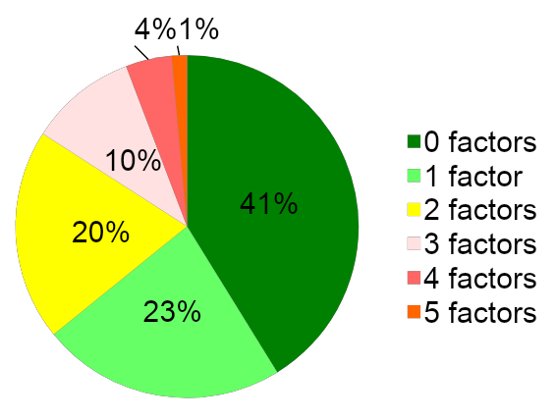
Risk Factors and Decision Rules
School A
School B

Slide 68
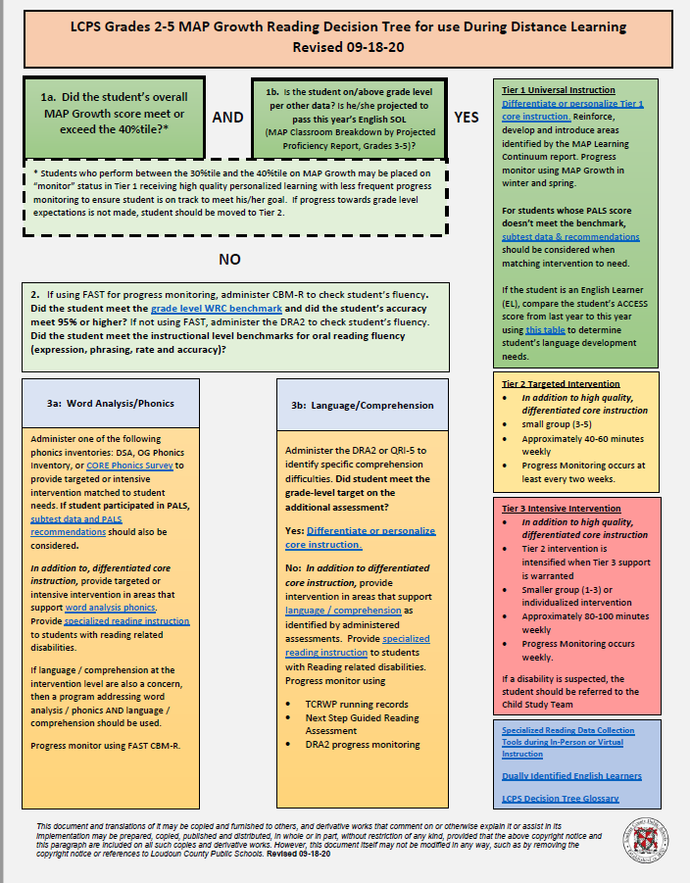
Sample Decision Tree
Grade 2-5
Reading
(Loudoun County Public Schools example
29

Slide 69
Decision Rules Practice
31
Review the data given to you.
Determine decision rules for who might be considered for advanced tier support.
Be prepared to share your decision rules and why.
30

Slide 70
Team Time:
Decision Rules
32
What are the decision rules at your school for a student to enroll in an advanced tier intervention?
What are the decision rules for exiting an advanced tier intervention?
How are caregivers involved in advanced tier intervention entry and exit decisions?

Slide 71
Big Ideas
Decision Rules
Provide a uniform method for student accessing advanced tiers interventions and supports.
Decision rules, or “entry and exit criteria” allow for more equitable decisions on who receives support.
Provide clear advanced tier intervention fading criteria.

Slide 72
Continuum of Supports
Teaming
Professional Learning and Coaching
Screening and Request for Assistance
Decision Rules
Progress Monitoring
Continuum of Support
Data-
Informed Decision Making
Alignment

Slide 73
2.5 Options for Tier 2 Intervention/ Intervention Resources
33
34
Tier II team has multiple ongoing behavior support interventions with documented evidence of effectiveness matched to student need. | School Tier II Handbook Targeted Intervention Reference Guide | 0 = No Tier II interventions w/ documented evidence of effectiveness 1 = Only 1 Tier II intervention 2 = Multiple Tier II interventions w/ documented EOE
Tier II providers have access to multiple evidence-based interventions matched to student need. | Resource map Student data Meeting minutes Description of interventions Selection Process | 0 = limited supports 1 = instructional match not consistently evident/unavailable 2 = continuum of evidence-based supports to match instructional needs exist

Slide 74
2.6 Critical Features
35
36
Interventions provide additional instruction/time for student skill development, structure and predictability and increased opportunities for feedback | Universal lesson plans Tier II lesson plans Daily/weekly progress report School schedule | 0 = do not include core features 1 = contain some but not all features 2 = All interventions include all features
Tier II interventions include increased: time, intensity, and dosage; opportunities for feedback and structures and prompts | School schedules Fidelity tools Programmatic descriptions Lesson plans | 0 = Intervention is not clear and/or inconsistently utilized 1 = At least 2 of the 3 feature criteria are met. 2 = All 3 feature criteria are met

Slide 75
Tier 2 Core Intervention Features
Increased Structure & Prompts
Increased Intensity of Data Collection
Increased
Regular Feedback
Increased Family Engagement
Increased Instruction on Skills (prosocial, emotional, academic)
Tier 2 Core Features
Efficient system for access and delivery of intervention
Adapted from Horner & Sugai (2016)

Slide 76
Core Features Quick Check
37
Tier 2 Core Features
Adapted from Horner & Sugai (2016)

Slide 77
CICO Example
38

Slide 78
CICO Secondary Example
39

Slide 79
CICO Tier 2 Core Features
Increased Structure & Prompts
Increased Intensity of Data Collection
Increased
Regular Feedback
Increased Family Engagement
Additional Instruction on Skills (prosocial, emotional, academic)
Tier 2 Core Features
TFI 2.6
Efficient system for access and delivery of intervention
Adapted from Horner & Sugai (2016)

Slide 80
Check-in, Check-out Example
Increased:
Instruction?
Feedback?
Structure and prompts?
Progress monitoring/data collection?
Family engagement?
System for access and delivery?

Slide 81
Behavior Intervention Sample Resource Mapping
Function
Possible School Interventions
Skill acquisition and development
Reinforce prosocial behavior skills
“Anger Control Training”
“Cognitive Reframing”
“Social Problem Solving”
“Skillstreaming”
“Behavior Education Program
“Check-in, check-out”

Slide 82
Evaluating Products and Interventions
Guiding Questions
Has it been reviewed and evaluated for ‘standards of evidence’ by an organization such as “What Works Clearinghouse”?
If not, is there any evidence that the strategy has been researched? (e.g., journal articles, book chapter, report from developer)
Does it have a manual describing the procedures for each step, so anyone would be able to implement the strategy?
Does it include a method for evaluating fidelity of implementation?
Can it be implemented without regular and/or intensive involvement from the developer?
Does it evidence advanced tiers core features?

Slide 83
Evidence-Based Academic Interventions

Slide 84
VTSS Evidence-Based Practices Selection Tool (Existing Practices)
40

Slide 85
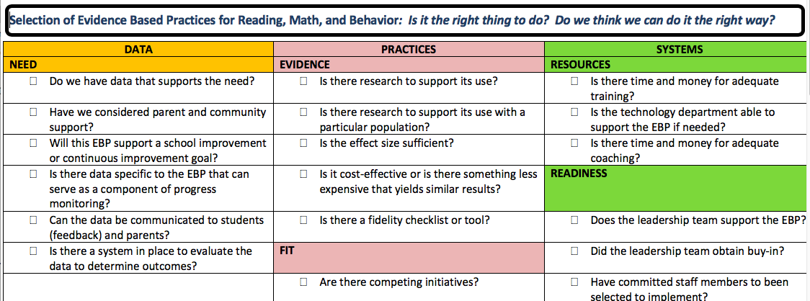
Evidence-Based Practices Selection (New Interventions)
41

Slide 86
2.7 Practices Matched to Student Need/Intervention Selection
42
43
A formal process is in place to select Tier II interventions that are matched to student need and adapted to improve contextual fit | Data sources used to identify interventions School policy Tier II handbook Needs assessment Targeted Interventions Reference Guide | 0 = No process in place 1 = Process w/o documentation that interventions are matched to student need 2 = Formal process in place w/ documentation
A process exists for selecting evidence-based interventions and creating a match to student need. | Resource map Evidence-based selection tool Individual student data Data outcomes Documentation of selection process | 0 = process unclear/ inconsistently utilized 1 = process exists for selection OR matching to student need 2 = process exists for section AND matching to student need

Slide 87
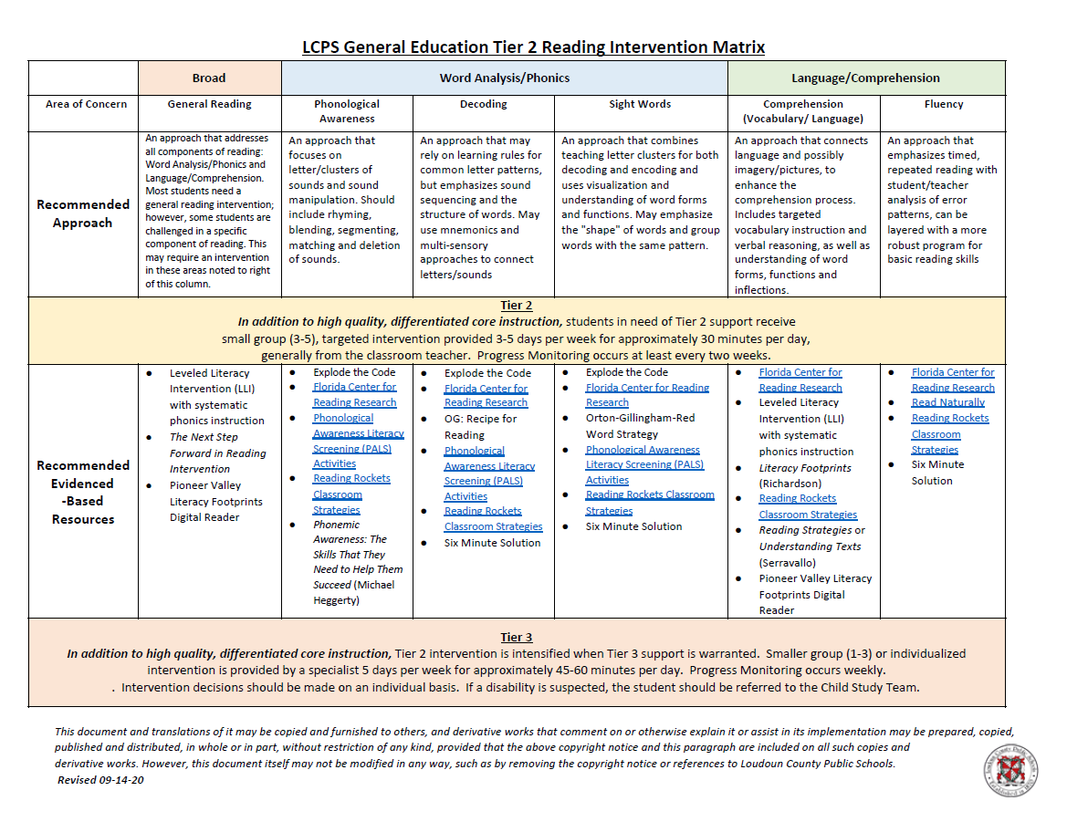
Matching Interventions to Instructional Needs
44

Slide 88
Team Time:
Continuum of Supports
45
List interventions matched to need on continuum of supports
Check for 6 core features?
Use EBP selection tool?
Interventions matched to instructional need?

Slide 89
Big Ideas
Continuum of Supports
A few viable interventions are more effective than many under-supported options on the continuum of supports
Document a continuum of supports that contain 6 core features of advanced tiers interventions and are matched to instructional need

Slide 90
Alignment
Teaming
Professional Learning and Coaching
Screening and Request for Assistance
Progress Monitoring
Decision Rules
Data-
Informed Decision Making
Continuum of Support
Alignment

Slide 91
2.8 Access to Tier 1 Supports/ Alignment
46
47
Tier 2 supports are explicitly linked to Tier 1 supports, and students receiving Tier 2 supports have access to/are included in Tier 1 supports. | Universal lesson plans Tier II lesson plans Acknowledgement system Student of the month documentation Family communication | 0 = No evidence that students receiving Tier 2 supports have access to Tier 1 supports 1 = students have some access to Tier 1 supports 2 = students have full access to Tier 1 supports
All interventions are aligned with Tier 1 content and coordinated with Tier 1 schedules to maintain access to Tier 1 content | Resource map Evidence-based selection tool Individual student data Data outcomes Documentation of selection process | 0 = process unclear/ inconsistently utilized 1 = process exists for selection OR matching to student need 2 = process exists for section AND matching to student need

Slide 92
Alignment Vision
Build and sustain a system than ensures that all students receive high quality core, academic, behavioral and social-emotional instruction and evidence-based advanced tier interventions to support their learning needs

Slide 93
Essential Element Alignment
Teaming
Universal Screening/RFA
EBP Interventions and Supports Continuum
Academics
Behavior and Mental Wellness
Progress Monitoring
Data-informed Decision Making

Slide 94
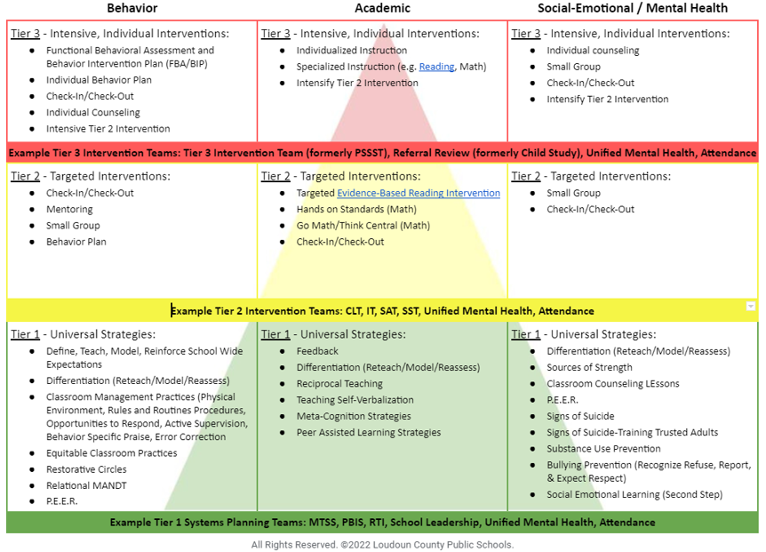
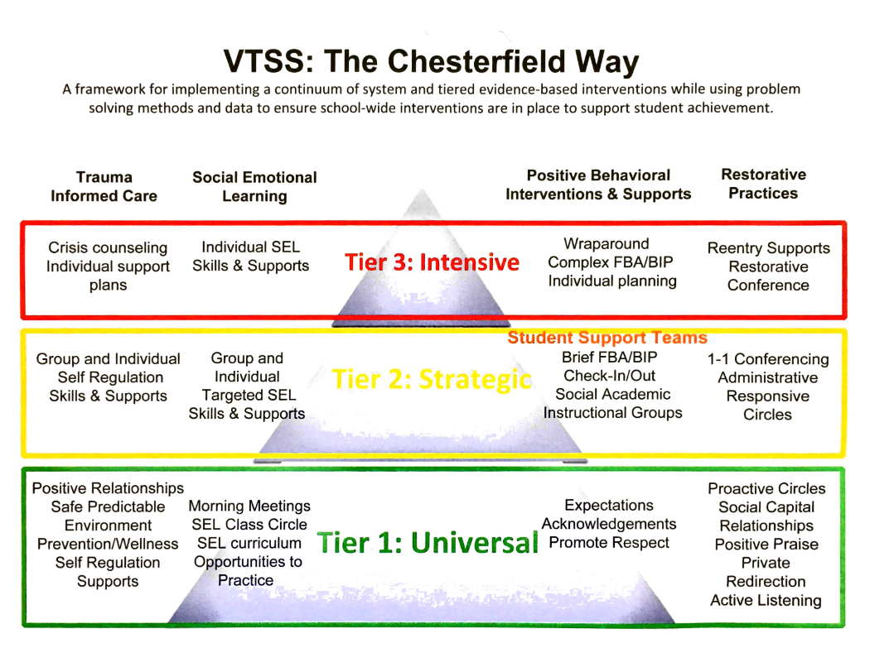
Aligned Systems Examples
48
49
Loudoun County Schools
Chesterfield County Schools

Slide 95
Team Time: Alignment
50
How are advanced tier interventions listed on your current continuum of supports aligned with Tier One Core instruction?
What changes, if any, might you consider?
How are systems aligned across tiers and domains in your school framework?

Slide 96
Big Ideas:
Alignment
The more time students spend away from Tier 1 core instruction, the harder it may become for them to exit from advanced tiers intervention
Strive to align content and scheduling needs so that students are able to access Tier 1 core instruction

Slide 97
Data-informed Decision Making
Teaming
Professional Learning and Coaching
Screening and Request for Assistance
Decision Rules
Progress Monitoring
Data-
Informed Decision Making
Continuum of Support
Alignment

Slide 98
Social Competence & Academic Achievement Logic Model
OUTCOMES
How will schools know that students are responding to the intervention and making progress towards their goal?
SYSTEMS
DATA
What we do to support adults to implement the practices?
PRACTICES
What we do to
support students?
Notes:
98

Slide 99
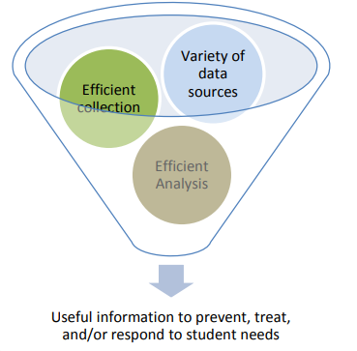
Data Informed Decision Making
Helps identify student needs in relation to established goals (DEFINE)
Helps identify the barriers to students reaching their goals (ANALYZE)
Provides sufficient information to select, match, and deliver services to students (IMPLEMENT)
Supports evaluation of the effectiveness of services and supports provided to students (EVALUATE)
* Florida PBIS

Slide 100
Advanced Tiers DIDM
Screening and Request for Assistance
Identify students in need of Tier II supports
Match students to Tier II interventions
Evaluate level of Tier II access/use
Monitor student performance
Individual student progress
% of students experiencing success
Monitor implementation fidelity
Decision Rules

Slide 101
Advanced Tiers Data
Support the System
Support the Student
Level of Use:
% of students accessing advanced tiers interventions
Effectiveness of EACH intervention in place
Students entering and exiting advanced tiers (movement across tiers)
Fidelity of implementation
Progress monitoring: Continue, fade, modify, or move on (movement within a tier)

Slide 102
LEVEL OF USE

Slide 103
2.10 Level of Use
51
Feature | Possible Data Sources | Scoring Criteria
Team follows written process to track proportion of students participating in Tier II supports and access is proportionate | Tier II enrollment data Tier II team meeting minutes Progress monitoring tool | 0 = Team does not track Tier II data 1 = Student data monitored but no data decision rules established to alter support 2 = Team defines criteria, tracks proportion, at least 5% of students receiving Tier II supports

Slide 104
Level of Use Guidance
Team uses data to determine if there is sufficient use of Tier II
Too many: >20%
Too few: <1%
Just Right: 5-15%

Slide 105
Calculating Level Of Use Data
Potential Steps: | Example:
Identify # of students in your building | 500 students
Determine 5% of your school population. Determine 20% of your school population | 5%= 25 students 20%= 100 students 25-100 students should be accessing advanced tier interventions
Can our current systems support this many students? | Yes: Keep Going No: Team Problem Solving
Determine how many students are currently accessing or requiring access to Tier II interventions (consider decision rules and RFA). | Less than 25 or more than 100: Team Problem Solving Between 25 and 100: Just Right!
Reassess each month | And as students move in and out of receiving Tier II interventions.

Slide 106
Healthy Framework Quick Math
53
What is your total school population?
What is the 10-15 % range of your total school population?
What might be the number of students in your school receiving tier 2 intervention at any one point in time?
What is the 1-5% range of your total school population?
What might be the number of students in your school receiving tier 3 intervention at any one point in time?

Slide 107
The Case of the Flipped Triangle
Below Benchmark 60%-80%
At Benchmark 20%-40%

Slide 108
Level of Use Problem Solving
Too many students require more intensive instruction?
Consider:
Revisiting decision rules
Modify and enhance Tier 1 instruction

Slide 109
Level of Use
Tier 2 Team Meeting Example
54

Slide 110
Behavior
Level of Use DIDM Practice
IF
THEN?
More than 35% of students received one or more office discipline referrals.
Tier 1 School-wide system
Tier 2 Group Interventions
Tier 3 Individual Systems

Slide 111
Screening Practice
55
Universal screening data and current decision rules for identifying students in need of Tier II supports show 37% of students are in need of targeted instruction for math calculation.
What is the problem?
Why is it occurring?
What can be done?
How will we know if it worked?

Slide 112
Progress Monitoring
Teaming
Professional Learning and Coaching
Screening and Request for Assistance
Decision Rules
Progress Monitoring
Data-
Informed Decision Making
Continuum of Support
Alignment

Slide 113
Student Performance
Progress Monitoring

Slide 114
2.11 Student Performance Data/ Progress Monitoring
56
57
Feature | Possible Data Sources | Scoring Criteria
Tier II team tracks proportion of students experiencing success (% of participating students being successful) | Student progress data (% of students meeting goals) Intervention Tracking Tool | 0 = student data not monitored 1 = student data monitored/no data decision rules to alter support 2 = Student data monitored and used at least monthly, with data decision rules established
For each intervention, there are progress monitoring data…(c) within each intervention, the percent of students making sufficient progress | Agenda and minutes for data team meetings Parent contact logs Intervention tracking tool | Scoring for 2.11 a, b, and c 0 = only 1 criteria is met for progress monitoring. 1 = Two criteria are met. 2 = All criteria are met.

Slide 115
Intervention Success Rates
Teams need to know whether advanced tier interventions are effective
What does adequate progress look like (decision rule)?
What % of students are being successful in each intervention?

Slide 116
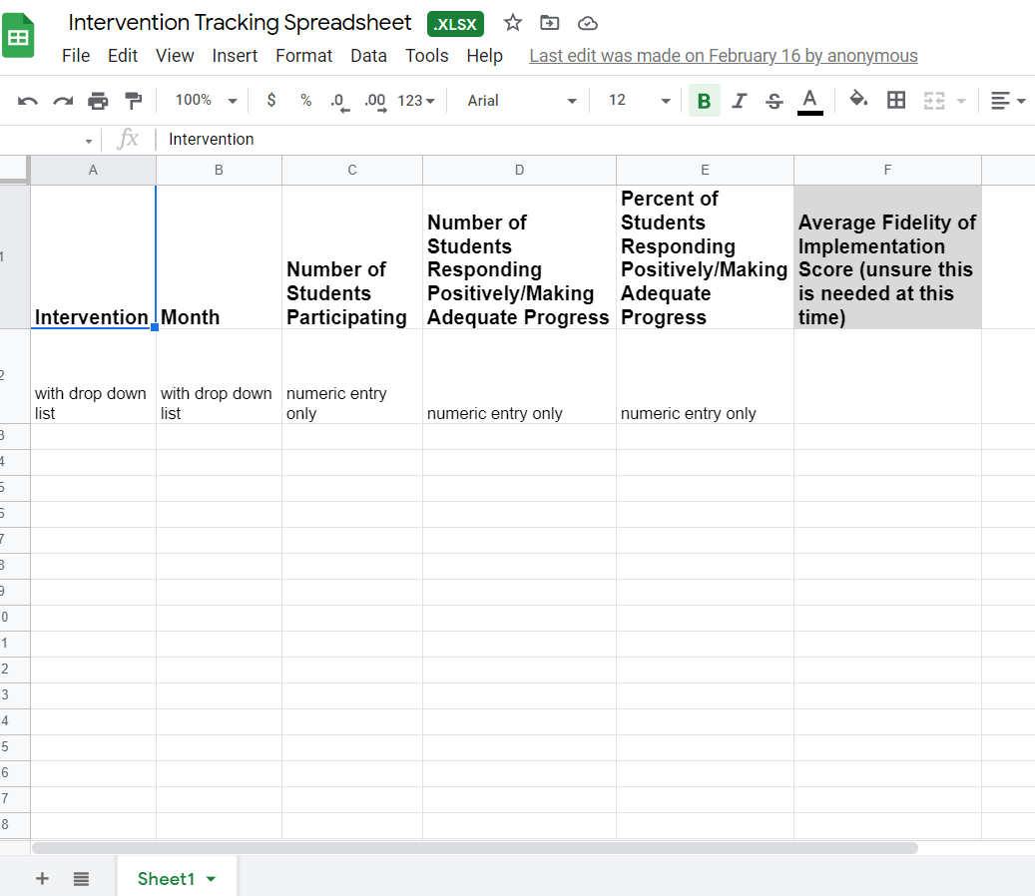
Electronic Intervention Tracking
58
Intervention Tracking Spreadsheet

Slide 117
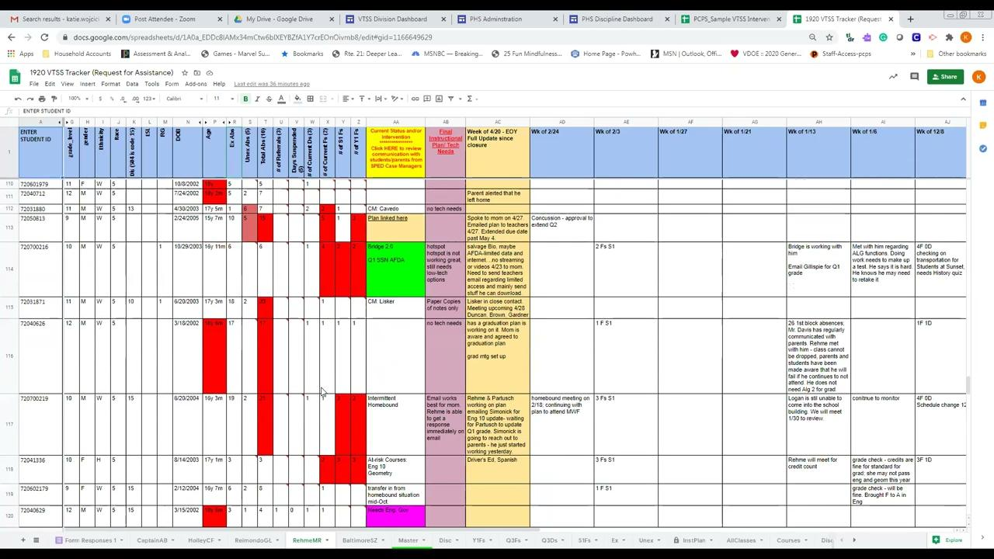
Powhatan County Public Schools Intervention Tracking Example
59

Slide 118
Team Time:
Intervention Effectiveness
60
How often is intervention effectiveness reported and evaluated by your school team?
Who brings this data?
How does evaluating intervention effectiveness connect to decision rules and alignment MTSS core components?

Slide 119
2.11a, b Academic TFI
62
Progress monitoring data for students receiving Tier 2 supports which are displayed and discussed to make decisions monthly regarding individual progress | Agenda and minutes for data team meetings Caregiver contact logs Intervention tracking tool | Scoring for 2.11 a, b, and c 0 = only 1 criteria is met for progress monitoring 1 = Two criteria are met 2 = All criteria are met

Slide 120
Progress Monitoring Definition
Monitors student progress at all three tiers
Evaluates the effectiveness of instruction so that teachers can create better instructional programs
Identifies students who are not making adequate progress and who need additional or alternative instruction
Estimates rates of improvement for each student

Slide 121
Progress Monitoring Across Tiers
Tier 1: Universal screening of all students to determine who is and is not, responding to universal instruction
Tier 2: Assess response to Tier 2 interventions
Tier 3: Assess response to intensive interventions and uses data to modify individualized instruction, as needed

Slide 122
Advanced Tiers
Progress Monitoring
“a form of assessment in which student learning is evaluated on a regular basis (e.g., weekly, every two weeks) to provide useful feedback about performance to both students and teachers” (iris.peabody.vanderbilt.edu)
Two Types
Mastery Monitoring: assessment of the mastery of a sequence of skills, with one skill being assessed to mastery before moving to the next skill
Curriculum-Based Measurement: evaluative tool that targets specific skills or abilities covered within a curriculum

Slide 123
Progress Monitoring
Example Decision Rules
Definition of adequate progress
Expected Rate of Progress
How much progress should the student make each week based on the intervention?
Frequency of measurement
Progress monitoring intensity increases with intensity of intervention

Slide 124
Graphing Progress Monitoring Data
Baseline: where the student is performing prior to intervention
Goal: where the student is expected to be performing by a given date
Goal Line/ Aim Line: line connecting the baseline to the goal.
Phase Line: line that separates changes to the intervention

Slide 125
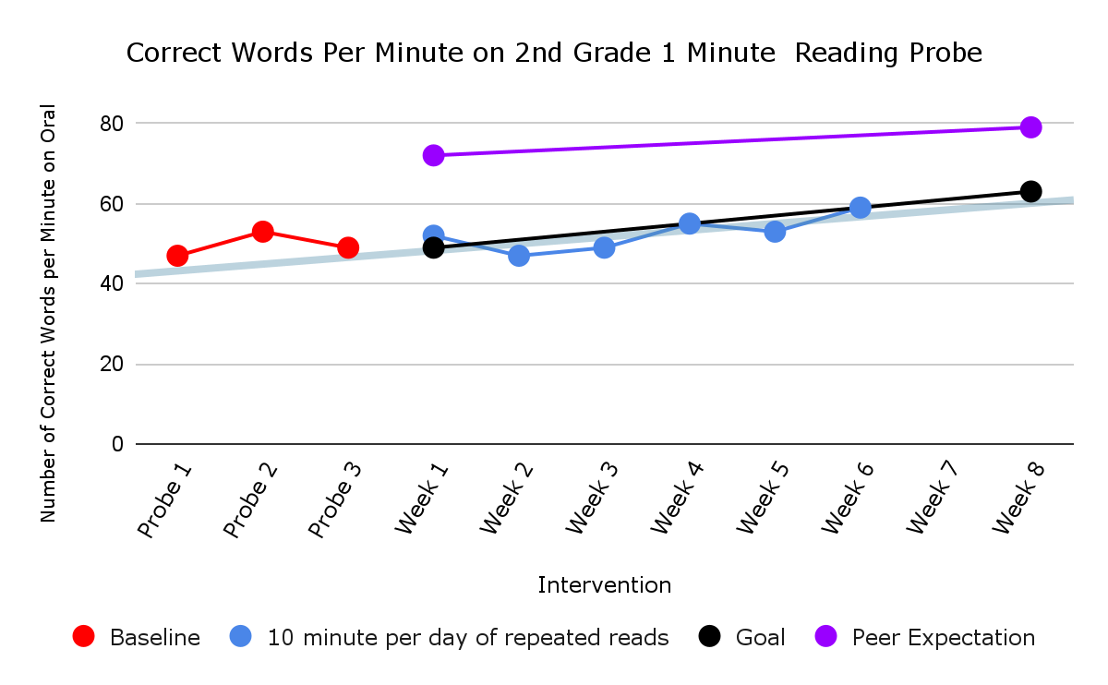
Academic Graphing Example
63
Baseline
Intervention

Slide 126
Progress Monitoring Practice
63
Looking at this graph, can we determine if the student is making progress?
Is the student expected to meet their goal?
Should an intervention change be made?

Slide 127
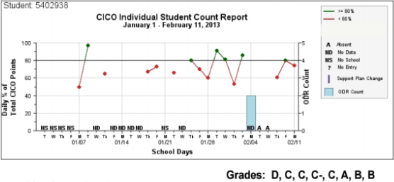
Behavior Graphing Example
64
transition out of CICO?
continue for 1 more 4-week cycle and then review?
add another intervention

Slide 128
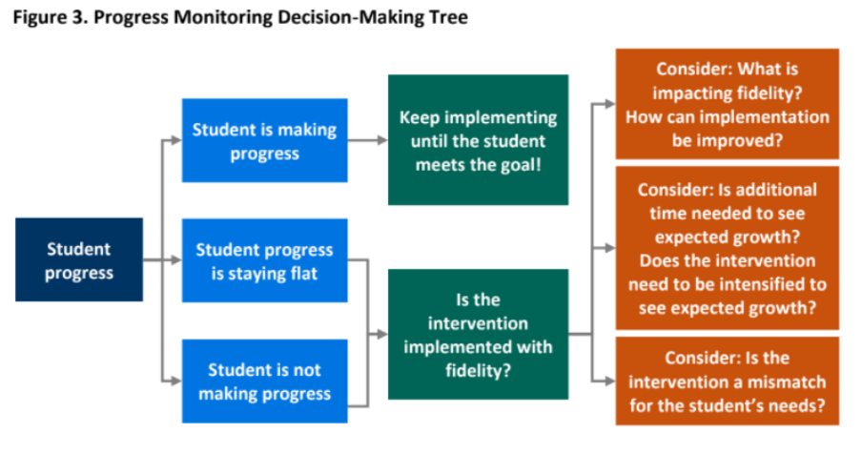
Decision Tree Example

Slide 129
Progress Monitoring Frequency
Intensity of progress monitoring increases with intensity of the intervention
Ex. A student receiving 15 minutes of intervention each day may have progress monitored once a week, whereas a student receiving 15 minutes 3 times a week may only be progress monitored once every 2 weeks

Slide 130
Progress Monitoring Reports
Prior to meeting, intervention coordinators review data and determine:
Continue: students making progress, but have not met their goal
Fade/Graduate: students who have met their goal and should be considered for fading or movement back to Tier I
Modify/Intensify/Change: students not responding

Slide 131
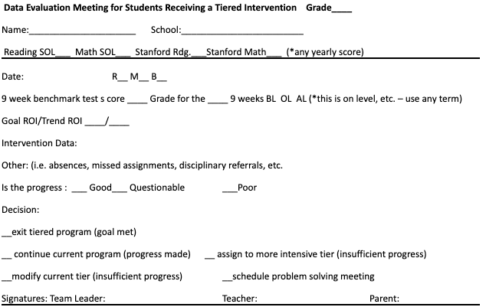
Coordinator Report Sample

Slide 132
Team Data Conversations about Student Performance
Is the student making enough progress to meet their goal?
Sufficient Progress - Goal Not Yet Met
Consider continuing the intervention
Sufficient Progress - Goal Met
Consider fading the intervention back to Tier I instruction
Insufficient Progress - High Fidelity
Consider modifying/changing the intervention
Insufficient Progress - Low Fidelity
Consider supporting staff to increase fidelity

Slide 133
Team Time:
Intervention Progress Monitoring
65
Identify how acceptable growth or rate of progress is defined?
Discuss how progress will be monitored?
Determine how often progress will be monitored?

Slide 134
Big Ideas:
Progress Monitoring
Track progress of students in intervention to determine intervention effectiveness.
Progress monitor individual student performance data and apply decision rules to continue or alter support
Graph data for team data-informed decision-making

Slide 135
Stretch Break
Stand, stretch, move!

Slide 136
FIDELITY

Slide 137
2.12 Fidelity Data
66
67
Tier II team has a protocol for ongoing review of fidelity for each Tier II practice | Tier II coordinator training District technical assistance Fidelity probes taken monthly by a Tier II team member | 0 = Fidelity data are not collected for any practice 1 = Fidelity data (e.g., direct, self report) collected for some but not all Tier II interventions 2 =Periodic, direct assessments of fidelity collected Tier II team for all Tier II interventions
Tier II team has a protocol for ongoing review of fidelity for each Tier II practice | School schedule Intervention attendance sheets Fidelity measure specific to the intervention Scheduled fidelity checks | 0 = Fidelity data not collected 1 = Fidelity data collected for some interventions 2 = A schedule for ongoing fidelity checks for all Tier II interventions is followed

Slide 138
Implementation Fidelity
The degree to which an intervention is delivered as intended.
Helps us to know if the student is not responding to the intervention and may need something more or different.
…or if we are not implementing the intervention the way it is intended to reach the desired outcomes.

Slide 139
Checklist Manifesto
68

Slide 140
How to Measure Fidelity
Make a checklist of the core implementation features of the intervention.
Observe the intervention and look for the core features.
Compare expected implementation with what is currently being implemented.
Note: many evidence-based interventions have fidelity monitoring tools!

Slide 141
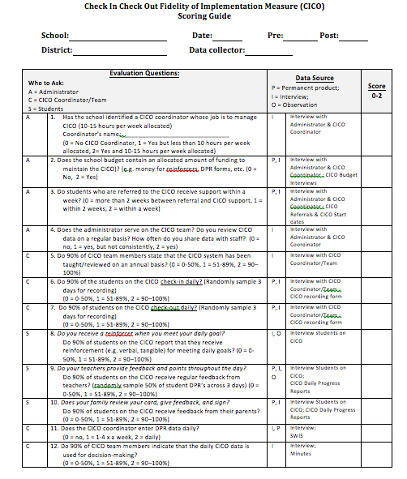
Behavior Intervention Fidelity Checklist Example
69
Notes:
141

Slide 142
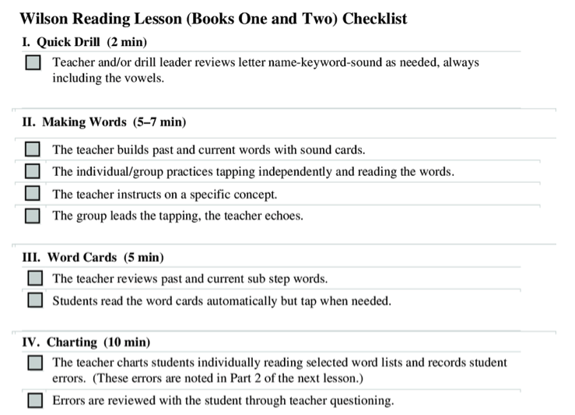
Reading Intervention
Fidelity Checklist Example
70
Notes:
142

Slide 143
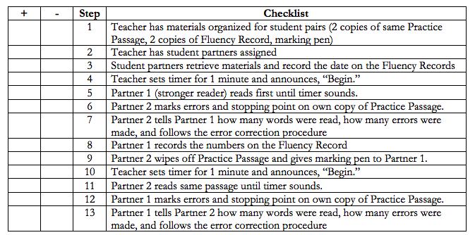
“Program” Fidelity Checklist Example
71

Slide 144
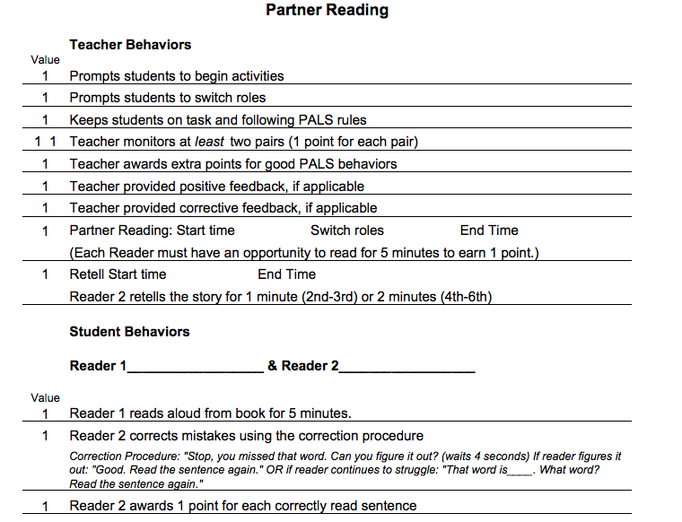
Strategies Fidelity
Checklist Example
72

Slide 145
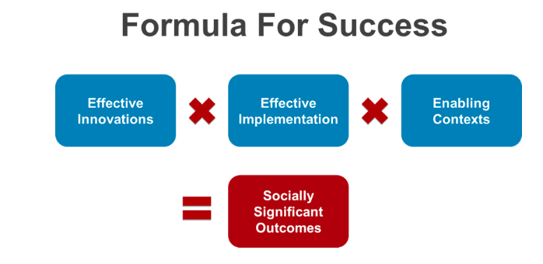
Power of Fidelity
National Implementation Research Network

Slide 146
Team Fidelity Data Conversations
Evaluate fidelity of intervention implementation
more staff training? modeling?
Evaluate match to student need
is it the right fit?
Evaluate contextual fit
right match between the strategies, procedures, or elements of an intervention and the values, needs, skills, and resources of those who implement and experience the intervention

Slide 147
Team Time:
Fidelity Measures
73
Discuss how fidelity will be measured?
Determine how often fidelity is measured?

Slide 148
DIDM Big Idea:
Fidelity
Regularly analyze and evaluate advanced tier data including:
level of use
intervention effectiveness
student performance
fidelity of implementation

Slide 149
Professional Learning and Coaching
Teaming
Professional Learning and Coaching
Screening and Request for Assistance
Data-
Informed Decision Making
Decision Rules
Progress Monitoring
Continuum of Support
Alignment

Slide 150
2.9 Professional Learning
74
75
Feature | Possible Data Sources | Scoring Criteria
A written process is followed for teaching all relevant staff how to refer to students and implement each Tier II intervention that is in place. | Professional development calendar Staff handbook Lesson plans for teacher trainings School Policy | 0 = no process in place 1 = informal process 2 =written process used to teach all staff all aspects of intervention delivery, including RFA, delivering feedback, and monitoring student progress
Teams have access to professional learning needed to provide interventions with fidelity, reinforce the intervention across settings, including families | Professional learning plans and calendars Fidelity checklists Family communication Fidelity checklists Staff handbook | 0 = only 1 criteria is met 1 = Two criteria are met 2 = All 3 criteria are met

Slide 151
School Professional Learning Process
Presentation of Theory and Research
Coaching and Follow up
Demonstration of the Strategy or Skill
Practice and Feedback

Slide 152
Professional Learning Impact

Slide 153
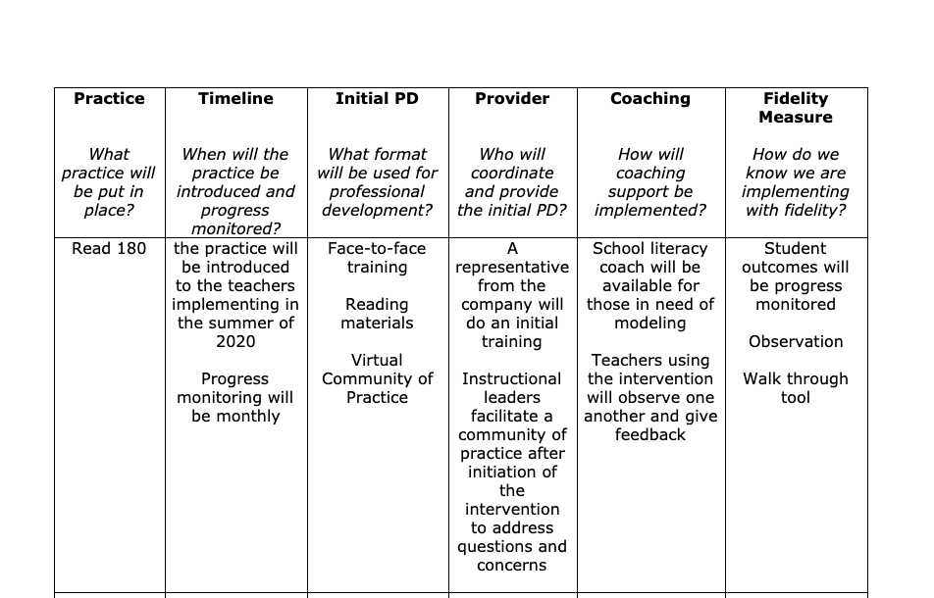
Planning for Success
76

Slide 154
Big Ideas:
Professional Learning & Coaching
Staff who deliver interventions need both professional learning and coaching for support in delivering interventions.
We change adult behavior first to ensure success for students

Slide 155
Team Time:
Professional Learning
77
What is the professional learning and coaching needed for the person delivering the intervention to be able to teach with fidelity?
Identify what professional learning staff need to implement this intervention
Discuss who will provide the professional learning
Determine what coaching supports are needed for staff
Identify who will provide coaching and when

Slide 156
Closing: Name that Circle
78

Slide 157
Advanced Tier Interventions
37
Core Features
Adapted from Horner & Sugai (2016)

Slide 158
AT Quick Check
79
80
T/F – We align advanced tier interventions to Tier One Core instruction across all domains.
Two decision rules about progress monitoring are ________________ ________________ and _________________________.
T/F – The most important data advanced tier teams analyze is individual student performance.
The intensity of progress monitoring ___________ with the intensity of interventions.

Slide 159
Quick Check-slide 2
79
80
5. T/F Graphing data is an option, but it not worth the time and effort for team meetings.
6. Progress monitoring data allows teams to make decisions whether to __________, ___________ or ___________ an intervention.
7. T/F - Fidelity measures may require adult behavior to change to ensure success for students.
8. We need both ____________ ________________
and __________ to support adults providing intervention.

Slide 160
Quick Check-slide 3
79
80
9. ______________ is the degree to which an intervention is delivered as intended.
10. “Did we ______ what we said we would _____ in the way we said we would _____ it.”
Blue Ribbon Winners!

Slide 161
Exit Ticket
81
https://bit.ly/45UZrxL

Slide 162
Evaluation
81
Pix4free.org - link to - https://pix4free.org/

Slide 163
Graduation!

Slide 164
Graduation!
Thank you for attending. Please feel free to tag us at any of our social media handles below!
Twitter - VTSS_RIC
Facebook - VTSSRIC

Slide 165
References
82
Algozzine, B., Barrett, S., Eber, L., George, H., Horner, R., Lewis, T., Putnam, B., Swain-Bradley, J., McIntosh, K., & Sugai, G. (2014).
Crone, D. A., Horner, R. H., & Hawken, L.. S. (2004). Responding to problem behavior in schools: The Behavior Education Program. New York: Guilford.
Everett, S., Sugai, G., Fallon, L., Simonsen, B., & O’Keeffe, B. (2011). School-wide Tier II interventions: Check-In Check-Out Getting Started Workbook. OSEP Technical Assistance Center on Positive Behavioral Interventions and Supports.

Slide 166
References (2)
83
Hosp, J. L., Hosh, M. K., Howell, K. W., Allison, R. (2014). The ABCs of curriculum-based evaluation: A practical guide to effective decision making. New York: Guilford.
Lembke, D. (n.d.). Interventions in RTI Handouts. Retrieved from https://rti4success.org/sites/default/files/interventions_in_rti_handouts.pdf
McIntosh, K. & Goodman, S. (2016). Integrating multi-tiered systems of support: Blending RTI and PBIS. New York: Guilford
ford Press.

Slide 167
References (3)
84
Riley-Tillman, C. T., Burns, M. K., & Kilgus, S. P. (2020). Evaluating Educational Interventions, Second Edition: Single-Case Design for Measuring Response to Intervention (Second ed.). The Guilford Press.
Sanetti, L. & Meek, M. (2019). Supporting successful interventions in schools : tools to plan, evaluate, and sustain effective implementation. New York: The Guilford Press.

Slide 168
References (4)
85
The IRIS Center. (2014). Evidence-based practices (part 3): Evaluating learner outcomes and fidelity. Retrieved from https://iris.peabody.vanderbilt.edu/module/ebp_03/
Tiered Fidelity Inventory (TFI) Scoring Guide - Adapted from Algozzine, B., Barrett, S., Eber, L., George, H., Horner, R., Lewis, T., Putnam, B., Swain-Bradway, J., McIntosh, K., & Sugai, G (2014). School-wide PBIS Tiered Fidelity Inventory. OSEP Technical Assistance Center on Positive Behavioral Interventions and Supports. www.pbis.org.

