Slide 1
Advanced Tiers Refresher
January 30, 2024
Building and Sustaining an Effective System of Supports

Slide 2
Follow VTSS
Thank you for attending. Please feel free to tag us at any of our social media handles below!
Twitter - VTSS_RIC
Facebook - VTSSRIC

Slide 3
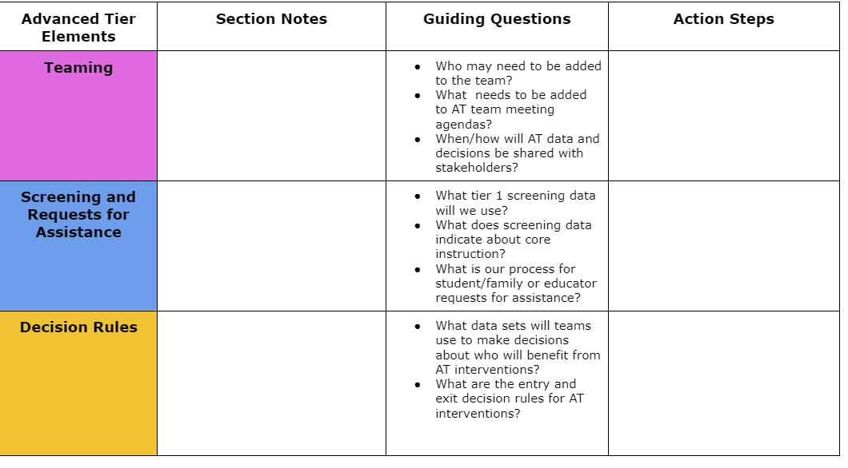
Advanced Tiers Notetaker

Slide 4
Authentic Family Engagement

Slide 5
Community Agreements
Community Norms | Overall | Chat
Be Responsible | Use a shared action plan for your team Complete session evaluation Be committed to attend all sessions Set dates/times with your team to continue action planning | Post positive on-topic comments Post questions in the Chat Box
Be Respectful | Limit distractions Follow up on your assigned action items Please mute your sound | Use inclusive language
Be Safe | Take movement breaks Be aware of your stress level | Engage in productive dialogue
For Presenters | Provide access to current materials | Monitor chat box to respond to participants

Slide 6
Learning Intentions
Participants will describe and synthesize essential elements of advanced tier systems of supports:
-Teaming
-Screening and Requests for Assistance
-Decision Rules
-Continuum of Supports
-Alignment
-Data-informed Decision-Making
-Progress Monitoring
-Professional and Coaching

Slide 7
Anchor Documents

Slide 8
Where Are We in the Triangle?
Tier 3 for a Few: Intensive, Individualized
Tier 2 for Some: Targeted for Small Groups
Tier I for All: Core/Universal
1 - 5%
5 - 15%
80 - 90%

Slide 9
Social Competence & Academic Achievement
OUTCOMES
What we use to make decisions? Monitor progress?
Monitor fidelity?
SYSTEMS
DATA
What we do to support adults to implement the practices?
PRACTICES
What we do to
support students?
Notes:
9

Slide 10
Why Advanced Tiers?
Core Instruction doesn’t work in isolation
Avert students from trajectories toward further learning/behavior challenges
Provide a unifying framework: Programs and strategies

Slide 11
What is Tier 2?
Targeted support for students not successful with Tier 1 alone
Small group intervention
Provided in addition to universal, Tier 1 instruction and aligned with student needs
For students who may be struggling or who need more challenge

Slide 12
What is Tier 3?
Frequent, intensive, and individualized intervention
Intensive support for students not responding to Tier 2 support or need more intensive support
Individualized intervention
Different than special education

Slide 13
Moving In and Out of Tiers
How are students’ experiences in a multi-tiered system of supports similar to a lava lamp?

Slide 14
Quick Check: Overview T/F
Students not responding to core instruction should be removed and receive advanced tier interventions that teach different content in a different way for student success.
When high-quality core instruction is in place, schools can anticipate that about 5-15% of students will benefit from tier 2 interventions and 1-5% of students from tier 3.
Identifying students as Tier 1, Tier 2, or Tier 3 will help school teams effectively plan advanced tiers interventions.

Slide 15
Advanced Tiers Foundations
“The Essential Eight”
Teaming
Professional Learning and Coaching
Screening and Request for Assistance
Progress Monitoring
Decision Rules
Data-
Informed Decision Making
Continuum of Support
Alignment

Slide 16
Teaming
Teaming
Professional Learning and Coaching
Screening and Request for Assistance
Decision Rules
Progress Monitoring
Data-
Informed Decision Making
Continuum of Support
Alignment

Slide 17
What Do Teams Look Like?
We are a small school. Our Tier I, Tier II & III teams are the same people
Our Team meets monthly, and our Tier II Team meets every other week
We meet every week for 30 minutes for each Tier

Slide 18
Tier 2 Team Meetings
Occur more frequently (recommended)
Process referrals:
Screening data and Requests for Assistance
Standing Agenda Items
Monitor student progress and Tier 2 intervention effectiveness data
Communicate with stakeholders (staff, students, families, community partners)

Slide 19
Advanced Tiers Standing Agenda Items
Intervention Effectiveness
# of students
# meeting goal
# not meeting goal
Level of Use
Fidelity
Intervention Referrals and Decision Rules
Team Problem Solving
Communication with families, staff, students and community partners

Slide 20
Quick Check: Teaming Structures T/F
Advanced tiers teams include more specialized personnel.
Advanced tiers teams look the same across divisions and schools.
The most important data conversation that takes place at an advanced tier meeting is individual student performance.
Tier 3 team conversations include caregivers as problem-solving partners

Slide 21
Big Ideas
Teaming
Advanced tier teams benefit from specialized knowledge and expertise
There should be at least one person with overarching knowledge of the interventions used in the schools
Use a predictable agenda that includes intervention systems and student performance data discussions

Slide 22
Screening and Request for Assistance
Teaming
Professional Learning and Coaching
Screening and Request for Assistance
Progress Monitoring
Decision Rules
Data-
Informed Decision Making
Continuum of Support
Alignment

Slide 23
Purpose of Screening
PROCESS
Evaluate Effectiveness of Core (Tier 1)
INTERVENTION
Part of the Request for Assistance Process that is one data point used to measure progress.
Adapted from https://assets-global.website-files.com/5d3725188825e071f1670246/5d7035c071700f1e3b846aab_b1_lewis_powers_dixon_revised.pdf

Slide 24
Integrated Screening
INFORMAL
FORMAL
Nominations/ Requests for Assistance
Existing Data Sets
Universal Screeners

Slide 25
Universal Screeners
ACADEMIC National Center on Intensive Interventions RAND Education Assessment Finder | BEHAVIOR University of Missouri Evidence Based Intervention Network National Center on Intensive Interventions Center on PBIS | MENTAL WELLNESS RAND Education Assessment Finder Ohio Department of Education

Slide 26
Quick Check: Screening
YES
SO-SO
NO
We have universal screening data at Tier 1 in at least one area of academics, behavior, mental wellness (can be Early Warning System in secondary)
We use the data to answer “is the core sufficient” based on the triangle
We have conversations around “is it a student issue or a systems issue” rather than always looking at individual students

Slide 27
Requests for Assistance?
Grab the reading specialist in the hall and ask if she can add one more to the group.
Tell the high school counselor a student just got on your last nerve and they need to see them so they can be added to the social skills group.
Email the school psychologist and everyone else you know to request the Tier 3 behavior specialist come at once because a student seriously interferes with learning in the classroom!

Slide 28
Nominations/ Request for
Assistance Forms
Designed for quick response
Staff (Teacher, Support Staff, Administration), Caregiver and/or Student may make a nomination.
Should identify students with not only externalizing (interpersonal) risk characteristics but those with internalizing (intrapersonal) risk characteristics as well.
Scheduled to occur at designated points across the school year.

Slide 29
Team Time: Screening and RFA’s
Use your notetaker to document your discussion of these questions:
What tier 1 screening data will we use?
What does screening data indicate about core instruction?
What is our process for student/family or educator requests for assistance?

Slide 30
Big Ideas
Screening and RFAs
Screening data helps us to know if the core is sufficient and differentiate a systems issue from a student issue, and for which groups of students the core instruction is successful.
Universal screening provides data advanced tiers teams need for data informed decision making.
Request for Assistance should be easily accessed by staff, students and caregivers.

Slide 31
Decision Rules
Teaming
Professional Learning and Coaching
Screening and Request for Assistance
Progress Monitoring
Decision Rules
Data-
Informed Decision Making
Continuum of Support
Alignment

Slide 32
Decision Rules
Decision rules, or “entry and exit criteria”
Allows for decisions to be made objectively on who receives support.
Provide a uniform method to refer students to advanced tiers.
Provide clear exit criteria from advanced tiers interventions and supports.

Slide 33
Tier 2 Academic Decision Rules Reading Data Example
Below 25% on universal screener
Below 70% on benchmark assessments
Did not meet PALS benchmark
Did not pass prior year’s SOL
Did not achieve course credit

Slide 34
Tier 2 Decision Rules Behavior Data Example
2-5 ODR’s
1 Suspension
> ? minutes missed instruction
> ? days unexcused absences
Incomplete classwork/homework
Tardies
Student, caregiver, staff nomination

Slide 35
Tier 2 Decision Rules:
Mental Wellness Data Example
5+ visits to the nurse/school counselor per month
3-5 absences per month
2-4 tardies and/or early dismissals
Student, caregiver, staff nomination
Mental Wellness Screener

Slide 36
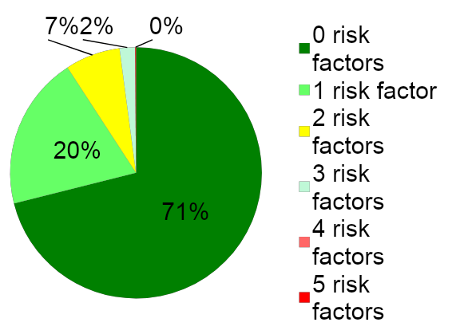
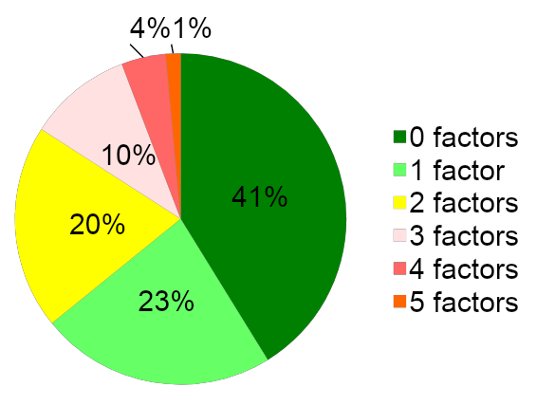
Risk Factors and Decision Rules
School A
School B

Slide 37
Team Time:
Decision Rules
Use your notetaker to document your discussion about these questions:
What data sets will teams use to make decisions about who will benefit from Advanced Tiers interventions?
What are the entry and exit decision rules for Advanced Tiers interventions?

Slide 38
Big Ideas
Decision Rules
Provide a uniform method for student accessing advanced tiers interventions and supports.
Decision rules, or “entry and exit criteria” allow for more equitable decisions on who receives support.
Provide clear advanced tier intervention fading criteria.

Slide 39
Continuum of Supports
Teaming
Professional Learning and Coaching
Screening and Request for Assistance
Decision Rules
Progress Monitoring
Continuum of Support
Data-
Informed Decision Making
Alignment

Slide 40
Tier 2 Core Intervention Features
Increased Structure & Prompts
Increased Intensity of Data Collection
Increased
Regular Feedback
Increased Family Engagement
Increased Instruction on Skills (prosocial, emotional, academic)
Tier 2 Core Features
Efficient system for access and delivery of intervention
Adapted from Horner & Sugai (2016)

Slide 41
Evaluating Products and Interventions
Guiding Questions
Has it been reviewed and evaluated for ‘standards of evidence’ by an organization such as “What Works Clearinghouse”?
If not, is there any evidence that the strategy has been researched? (e.g., journal articles, book chapter, report from developer)
Does it have a manual describing the procedures for each step, so anyone would be able to implement the strategy?
Does it include a method for evaluating fidelity of implementation?
Can it be implemented without regular and/or intensive involvement from the developer?
Does it evidence advanced tiers core features?

Slide 42
Evidence-Based Academic Interventions

Slide 43
VTSS Evidence-Based Practices Selection Tool (Existing Practices)

Slide 44
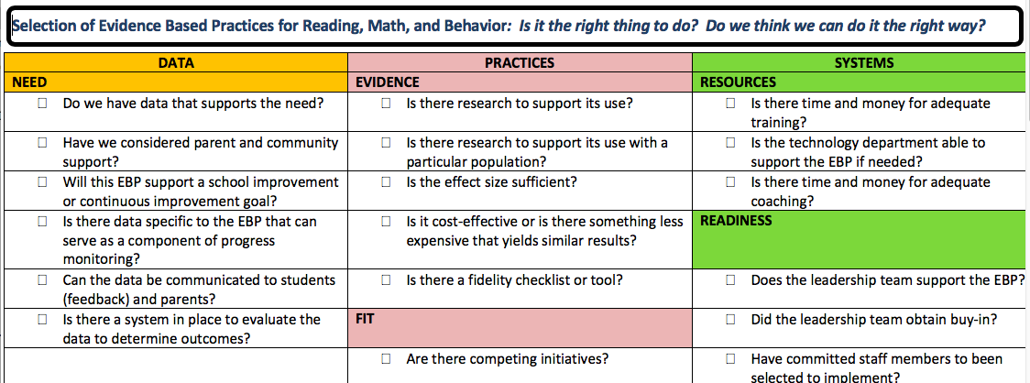
Evidence-Based Practices Selection (New Interventions)

Slide 45
Team Time:
Continuum of Supports
Use your notetaker to document your discussions about these questions:
What are the documented evidence-based interventions available?
Are AT interventions matched to instructional needs?
Are 6 features present in selected AT interventions?

Slide 46
Big Ideas
Continuum of Supports
A few viable interventions are more effective than many under-supported options on the continuum of supports
Document a continuum of supports that contain 6 core features of advanced tiers interventions and are matched to instructional need

Slide 47
Alignment
Teaming
Professional Learning and Coaching
Screening and Request for Assistance
Progress Monitoring
Decision Rules
Data-
Informed Decision Making
Continuum of Support
Alignment

Slide 48
Alignment Vision
Build and sustain a system that ensures that all students receive high quality core academic, behavioral and social-emotional instruction and evidence-based advanced tier interventions to support their learning needs

Slide 49
Essential Element Alignment
Teaming
Universal Screening/RFA
EBP Interventions and Supports Continuum
Academics
Behavior and Mental Wellness
Progress Monitoring
Data-informed Decision Making

Slide 50
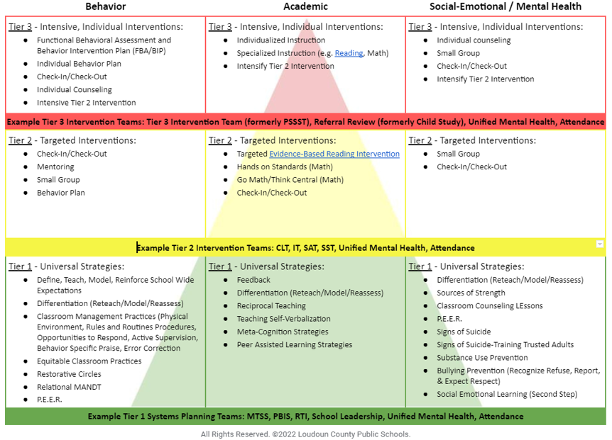
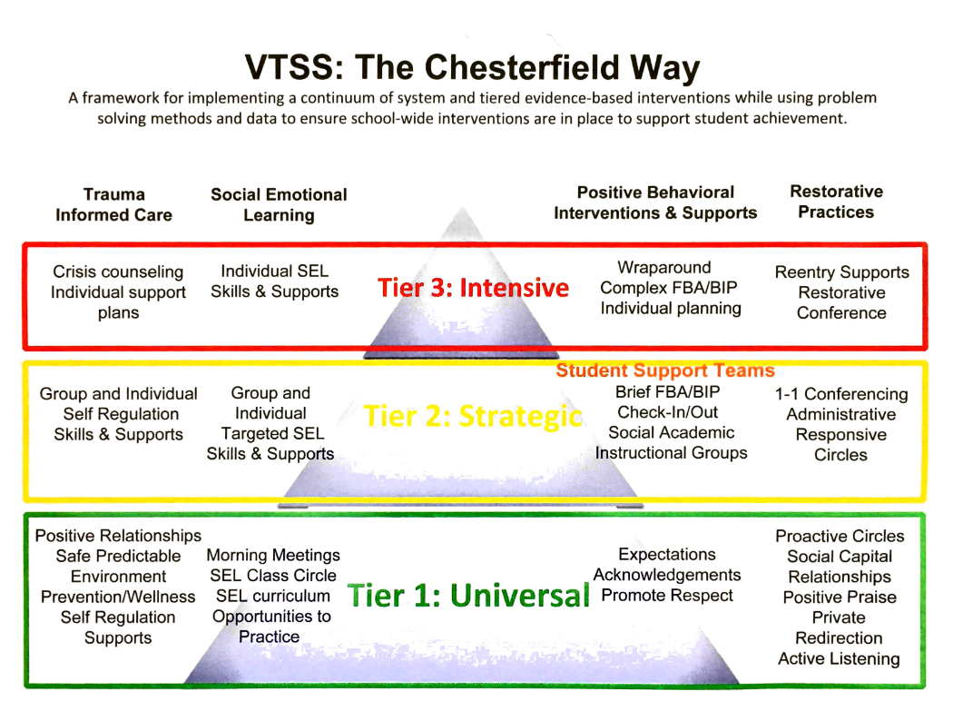
Aligned Systems Examples
Loudoun County Schools
Chesterfield County Schools

Slide 51
Team Time: Alignment
Use your notetaker to document your discussions about:
How do students continue to access tier 1?
How do we know AT interventions align with tier 1?
How are AT systems aligned across domains?

Slide 52
Big Ideas:
Alignment
The more time students spend away from Tier 1 core instruction, the harder it may become for them to exit from advanced tiers intervention
Strive to align content and scheduling needs so that students are able to access Tier 1 core instruction

Slide 53
Stretch Break
Stand, stretch, move!

Slide 54
Data-informed Decision Making
Teaming
Professional Learning and Coaching
Screening and Request for Assistance
Decision Rules
Progress Monitoring
Data-
Informed Decision Making
Continuum of Support
Alignment

Slide 55
Advanced Tiers DIDM
Screening and Request for Assistance
Identify students in need of Tier II supports
Match students to Tier II interventions
Evaluate level of Tier II access/use
Monitor student performance
Individual student progress
% of students experiencing success
Monitor implementation fidelity
Decision Rules

Slide 56
Advanced Tiers Data
Support the System
Support the Student
Level of Use:
% of students accessing advanced tiers interventions
Effectiveness of EACH intervention in place
Students entering and exiting advanced tiers (movement across tiers)
Fidelity of implementation
Progress monitoring: Continue, fade, modify, or move on (movement within a tier)

Slide 57
Level of Use Guidance
Team uses data to determine if there is sufficient use of Tier II
Too many: >20%
Too few: <1%
Just Right: 5-15%

Slide 58
Healthy Framework Quick Math
What is your total school population?
What is the 10-15 % range of your total school population?
What might be the number of students in your school receiving tier 2 intervention at any one point in time?
What is the 1-5% range of your total school population?
What might be the number of students in your school receiving tier 3 intervention at any one point in time?

Slide 59
Behavior
Level of Use DIDM Practice
IF
THEN?
More than 35% of students received one or more office discipline referrals.
Tier 1 School-wide system
Tier 2 Group Interventions
Tier 3 Individual Systems

Slide 60
Team Time: DIDM
Use your notetaker to document discussions about these questions:
How, and how often will we monitor intervention level of use?
How, and how often will we monitor intervention effectiveness?

Slide 61
Progress Monitoring
Teaming
Professional Learning and Coaching
Screening and Request for Assistance
Decision Rules
Progress Monitoring
Data-
Informed Decision Making
Continuum of Support
Alignment

Slide 62
Intervention Success Rates
Teams need to know whether advanced tier interventions are effective
Who is successful and who is not?
What does adequate progress look like (decision rule)?
What % of students are being successful in each intervention?

Slide 63
Progress Monitoring Across Tiers
Tier 1: Universal screening of all students to determine who is and is not, responding to universal instruction
Tier 2: Assess response to Tier 2 interventions
Tier 3: Assess response to intensive interventions and uses data to modify individualized instruction, as needed

Slide 64
Progress Monitoring
Example Decision Rules
Definition of adequate progress
Expected Rate of Progress
How much progress should the student make each week based on the intervention?
Frequency of measurement
Progress monitoring intensity increases with intensity of intervention

Slide 65
Team Data Conversations about Student Performance
Is the student making enough progress to meet their goal?
Sufficient Progress - Goal Not Yet Met
Consider continuing the intervention
Sufficient Progress - Goal Met
Consider fading the intervention back to Tier I instruction
Insufficient Progress - High Fidelity
Consider modifying/changing the intervention
Insufficient Progress - Low Fidelity
Consider supporting staff to increase fidelity

Slide 66
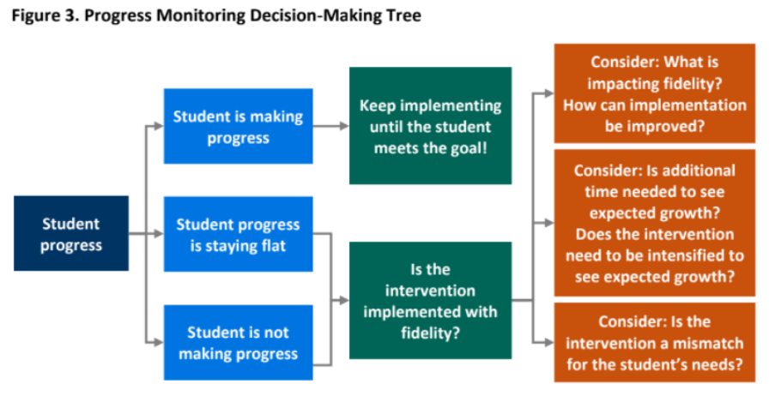
Decision Tree Example

Slide 67
Team Time:
Intervention Effectiveness
Use your notetaker to document discussions about:
How is adequate progress defined for interventions provided?
What are decision rules to continue, change/modify or fade AT intervention?

Slide 68
Big Ideas:
Progress Monitoring
Track progress of students in intervention to determine intervention effectiveness.
Progress monitor individual student performance data and apply decision rules to continue or alter support
Graph data for team data-informed decision-making

Slide 69
How to Measure Fidelity
Make a checklist of the core implementation features of the intervention.
Observe the intervention and look for the core features.
Compare expected implementation with what is currently being implemented.
Note: many evidence-based interventions have fidelity monitoring tools!

Slide 70
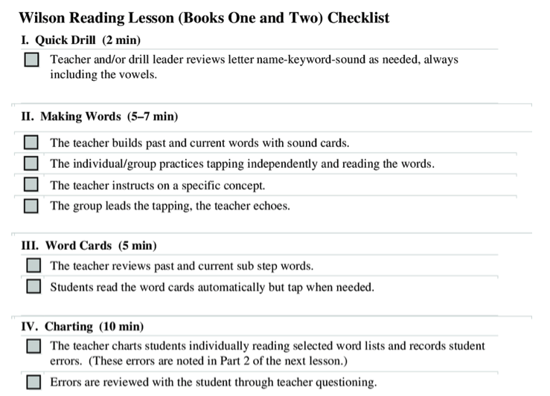
Reading Intervention
Fidelity Checklist Example
70
Notes:
70

Slide 71
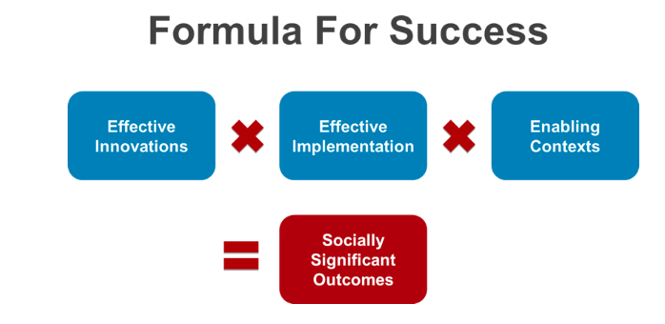
Power of Fidelity
National Implementation Research Network

Slide 72
Team Fidelity Data Conversations
Evaluate fidelity of intervention implementation
more staff training? modeling?
Evaluate match to student need
is it the right fit?
Evaluate contextual fit
right match between the strategies, procedures, or elements of an intervention and the values, needs, skills, and resources of those who implement and experience the intervention

Slide 73
Team Time:
Fidelity Measures
Use your notetaker to document discussion about this question:
How, and how often will we evaluate intervention fidelity?

Slide 74
DIDM Big Idea:
Fidelity
Regularly analyze and evaluate advanced tier data including:
level of use
intervention effectiveness
student performance
fidelity of implementation

Slide 75
Professional Learning and Coaching
Teaming
Professional Learning and Coaching
Screening and Request for Assistance
Data-
Informed Decision Making
Decision Rules
Progress Monitoring
Continuum of Support
Alignment

Slide 76
Professional Learning Impact

Slide 77
Big Ideas:
Professional Learning & Coaching
Staff who deliver interventions need both professional learning and coaching for support in delivering interventions.
We change adult behavior first to ensure success for students

Slide 78
References
Algozzine, B., Barrett, S., Eber, L., George, H., Horner, R., Lewis, T., Putnam, B., Swain-Bradley, J., McIntosh, K., & Sugai, G. (2014).
Crone, D. A., Horner, R. H., & Hawken, L.. S. (2004). Responding to problem behavior in schools: The Behavior Education Program. New York: Guilford.
Everett, S., Sugai, G., Fallon, L., Simonsen, B., & O’Keeffe, B. (2011). School-wide Tier II interventions: Check-In Check-Out Getting Started Workbook. OSEP Technical Assistance Center on Positive Behavioral Interventions and Supports.

Slide 79
References (2)
Hosp, J. L., Hosh, M. K., Howell, K. W., Allison, R. (2014). The ABCs of curriculum-based evaluation: A practical guide to effective decision making. New York: Guilford.
Lembke, D. (n.d.). Interventions in RTI Handouts. Retrieved from https://rti4success.org/sites/default/files/interventions_in_rti_handouts.pdf
McIntosh, K. & Goodman, S. (2016). Integrating multi-tiered systems of support: Blending RTI and PBIS. New York: Guilford
ford Press.

Slide 80
References (3)
Riley-Tillman, C. T., Burns, M. K., & Kilgus, S. P. (2020). Evaluating Educational Interventions, Second Edition: Single-Case Design for Measuring Response to Intervention (Second ed.). The Guilford Press.
Sanetti, L. & Meek, M. (2019). Supporting successful interventions in schools : tools to plan, evaluate, and sustain effective implementation. New York: The Guilford Press.

Slide 81
References (4)
The IRIS Center. (2014). Evidence-based practices (part 3): Evaluating learner outcomes and fidelity. Retrieved from https://iris.peabody.vanderbilt.edu/module/ebp_03/
Tiered Fidelity Inventory (TFI) Scoring Guide - Adapted from Algozzine, B., Barrett, S., Eber, L., George, H., Horner, R., Lewis, T., Putnam, B., Swain-Bradway, J., McIntosh, K., & Sugai, G (2014). School-wide PBIS Tiered Fidelity Inventory. OSEP Technical Assistance Center on Positive Behavioral Interventions and Supports. www.pbis.org.

