Slide 1
Introduction to Advanced Tiers
Workbook
These slides are your division’s work space for your Advanced Tier session(s). They contain space to record your thoughts/ideas; links to reference materials; and organizers for your team’s work.
Make the space your own! You can create new slides, import slides or images, take photos, etc.
All of the grey spaces are text boxes and ready for you to record your responses.
Slides 2-6 are important reference materials and are located at the front of the deck for easy access.

Slide 2
One Day Agenda
10:00-10:30: Introduction, Connections, & Materials Walk
10:30-11:00: Advanced Tiers Overview
11:00-11:30: Teaming
11:30-12:00: Screening and Requests for Assistance
12:00–1:00: Lunch
1:00-1:30: Decision Rules
1:30-2:00: Continuum of Supports and Alignment
2:00-2:15: Break
2:15-3:00: Data-informed Decision Making
3:00-3:30: Professional Learning and Coaching
3:30-4:00: Exit Ticket and Evaluation
Notes:
.

Slide 3
Two Day Agenda
DAY 1
10:00-10:30: Intro, Connections, and Materials Walk
10:30-11:15: Advanced Tiers Overview
11:15-12:00: Teaming
12:00–1:00: Lunch
1:00-1:45: Screening and Request for Assistance
1:45-2:30: Decision Rules
2:30-2:45: Break
2:45-3:45: Continuum of Supports
3:45-4:00: Exit Ticket and Evaluation
DAY 2
9:00 - 9:30: Alignment
9:30 - 10:15: Data-informed decision making (DIDM)
10:15 - 10:30: Break
10:30 - 11:15: DIDM-Progress Monitoring
11:15- 12:00: DIDM-Fidelity
12:00-1:00 Lunch
1:00-2:00: Professional learning and coaching
2:00-3:00 Putting it all together and evaluation

Slide 4
In-Person Norms
Be responsible | Take care of personal needs Share your questions with the group
Be Respectful | Turn volume/sound off on cell phones Listen to others attentively Follow up and complete assigned tasks
Be engaged | Ask what you need to know to understand and contribute Share your expertise, information and ideas Maximize team time by engaging with assigned tasks

Slide 5
Advanced Tiers Foundations
“The Essential Eight”
Teaming
Professional Learning and Coaching
Screening and Request for Assistance
Progress Monitoring
Decision Rules
Data-
Informed Decision Making
Continuum of Support
Alignment

Slide 6
Advanced Tier Elements | Guiding Questions | Action Steps
Teaming | Who may need to be added to the team? What needs to be added to AT team meeting agendas? When/how will AT data and decisions be shared with stakeholders?
Screening and Requests for Assistance | What tier 1 screening data will we use? What does screening data indicate about core instruction? What is our process for student/family or educator requests for assistance?
Decisions Rules | What data sets will teams use to make decisions about who will benefit from AT interventions? What are the entry and exit decision rules for AT interventions?
Continuum of Supports | What are the documented evidence-based interventions available? Are AT interventions matched to instructional needs? Are 6 features present in selected AT interventions?
Alignment | How do students continue to access tier 1? How do we know AT interventions align with tier 1? How are AT systems aligned across domains?
Data Informed Decision Making | How, and how often will we monitor intervention level of use? How, and how often will we monitor intervention effectiveness? How, and how often will we evaluate intervention fidelity?
Progress Monitoring | What are decision rules to continue, change/modify or fade AT intervention? What platform will we use to visually graph PM data?
Professional Learning and Coaching | What is the professional learning plan to grow AT capacity in our school? What is the coaching plan to ensure AT interventions are provided with fidelity?
Notes:
Advanced Tiers Notetaker

Slide 7
Find Someone Who…
has a garden / likes to grow things | has recently read / listened to a great book | is a runner | can recite something from memory | is wearing purple
was born in another state | raises chickens | likes to drive with the top down and/or the windows open | was part of a musical or play | likes to lick the beaters / spoon
has an unusual talent | is looking forward to going somewhere special this summer | FREE | can name all four Golden Girls | is competitive
likes ice cream more than cake | enjoys baking bread | whistles (or hums) while they work | had a unique job | speaks another language
sings or listens to music in the shower/tub | has visited a Wonder of the World | plays an instrument | Halloween is their favorite holiday | makes things

Slide 8
Dice Breaker
What are you excited / not excited about about this summer?
What do you enjoy during the summer?
What is a good memory you have from this past year?
What is something you are looking forward to?
What is something new you would like to experience this summer?
Describe your favorite summer place.

Slide 9
Anchor Documents
Tiered Fidelity Inventory (TFI)
Academic Tiered Fidelity Inventory (ATFI)

Slide 10
Moving In and Out of Tiers
How are students’ experiences in a multi-tiered system of supports similar to a lava lamp?

Slide 11
Quick Check: Overview T/F
Students not responding to core instruction should be removed and receive advanced tier interventions that teach different content in a different way for student success.
True
False
When high quality core instruction is in place, schools can anticipate about 5-15% of students will benefit from tier 2 interventions, and 1-5% of students from tier 3.
True
False
Identifying students as Tier 1, Tier 2 or Tier 3 will help school teams effectively plan advanced tiers interventions.
True
False

Slide 12
Representation across school community
80-90% of students meet expectations
Analyzes progress monitoring data
Tier 1 Team
Advanced Tiers Team
Monitors Tier One core instruction
Core practices, professional learning and coaching
Representation across school community
Shares data with stakeholders
Recommended that team meets at least twice monthly
Inter-agency collaboration
Meets at least monthly
Analyze school-wide data
Family collaboration
Decision rules for groups of students
Selects evidence-based practices that reflect all student’s backgrounds
Increased evaluation (fidelity, level of use measures)
Increased specialist representation

Slide 13
2.2 Team Operating Procedures
Where do you feel your team currently is with TFI 2.2?
Tier II team meets at least monthly and has (a) regular meeting format/agenda (b) minutes, (c) defined meeting roles (d) a current action plan | Tier II team meeting agenda and minutes Tier II meeting roles descriptions Tier II action plan | 0 = uses none or 1 of the features listed 1= Team uses at least 2 but not all 4 features 2 = Tier II team meets at least monthly and uses all 4 features

Slide 14
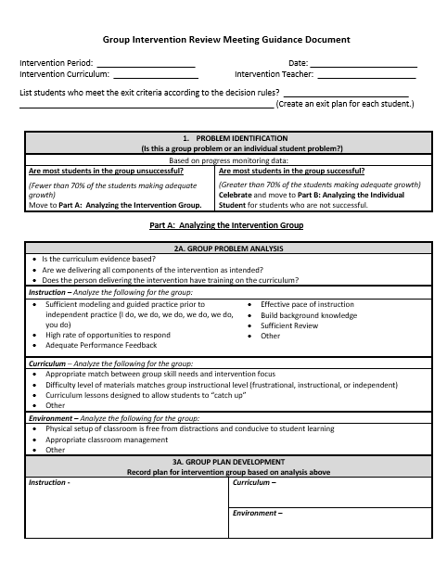
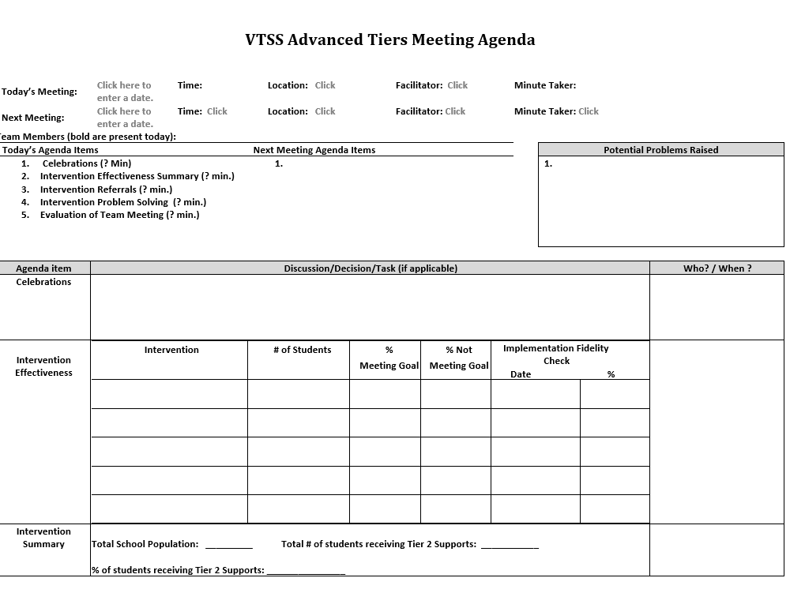
Group Intervention Review
Meeting Agenda
VTSS Advanced Tiers Meeting Agenda
What key features need to be included on your team meeting agenda?

Slide 15
Quick Check: Teaming Structures T/F
True
False
Advanced tiers teams include more specialized personnel.
Advanced tiers teams look the same across divisions and schools.
True
False
The most important data conversation that takes place at an advanced tier meeting is individual student performance.
True
False
Tier 3 team conversations include caregivers as problem-solving partners.
True
False

Slide 16
Team Time: Teaming
Who is, or will be on your advanced tiers team?
Who else is needed?
Behavioral, academic, and medical expertise
General and Special Education knowledge
Data/graphing knowledge
Authority to access/provide resources
Understanding of support across grades/departments and school, including other tiered support
Family/school connection
What agenda format will you use?

Slide 17
2.3: Screening
Where do you feel your team currently is with TFI 2.3?
Decision rules and multiple sources of data (e.g., ODRs, screening tools, attendance, student nominations) are used to identify students. | Multiple data sources used (e.g., ODRs, time out of instruction, attendance, academic performance) Decision rubric Meeting minutes School policy | 0 = No speciﬁc rules for identifying students 1 = Data decision rules established but not consistently followed or used with only one data source 2 = Written policy exists that uses multiple data sources and ensures prompt notice to families.

Slide 18
Universal Screeners
ACADEMIC National Center on Intensive Interventions RAND Education Assessment Finder | BEHAVIOR University of Missouri Evidence Based Intervention Network National Center on Intensive Interventions Center on PBIS | MENTAL WELLNESS CASEL Assessment Guide RAND Education Assessment Finder Ohio Department of Education
Questions:
Is the core instruction sufficient/is it improving?
For which groups is it working/not working?
What is the efficacy of the tiered interventions?
What is the individual growth of our students?
Considerations:
Cost
Capacity to administer and analyze
Ability to Scale-up
Communication of Results and Reporting of Needs

Slide 19
Quick Check: Screening
YES
SO-SO
NO
We have universal screening data at Tier 1 in at least one area of academics, behavior, mental wellness (can be Early Warning System in secondary)
We use the data to answer “is the core sufficient” based on the triangle
We have conversations around “is it a student issue or a systems issue” rather than always looking at individual students

Slide 20
Team Time: Screening
Choose a domain:
reading
math
behavior
mental health
attendance
List screeners (formal or data sets) that are used to support advanced tier entry considerations
How are caregivers involved in the screening process?

Slide 21
2.4: Requests for Assistance
A-TFI
Where do you feel your team currently is with ATFI 2.4?
Feature | Data Sources | Scoring Criteria
Process for seeking additional team assistance for meeting the needs of students and/or teachers when progress is not sufficient at Tier 2 | Documented assistance team Listing on asset or resource map Flow chart Decision rules defined | 0 = Teachers solve problems independently 1 = Process exists but lacks clear follow-through 2 = Process is clear, organized, and utilized by teachers

Slide 22
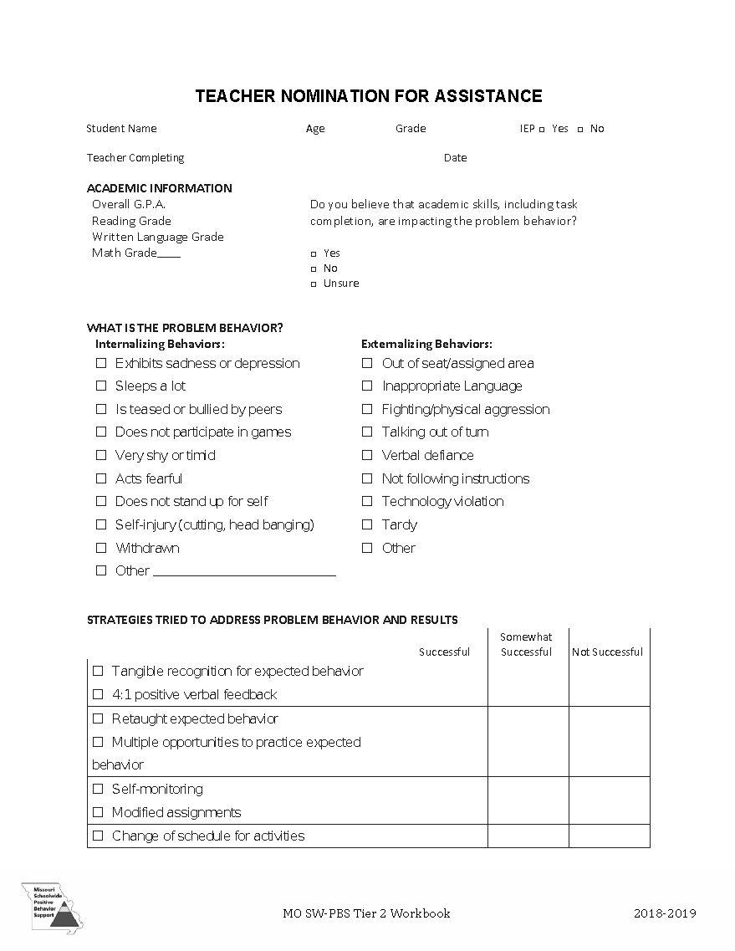
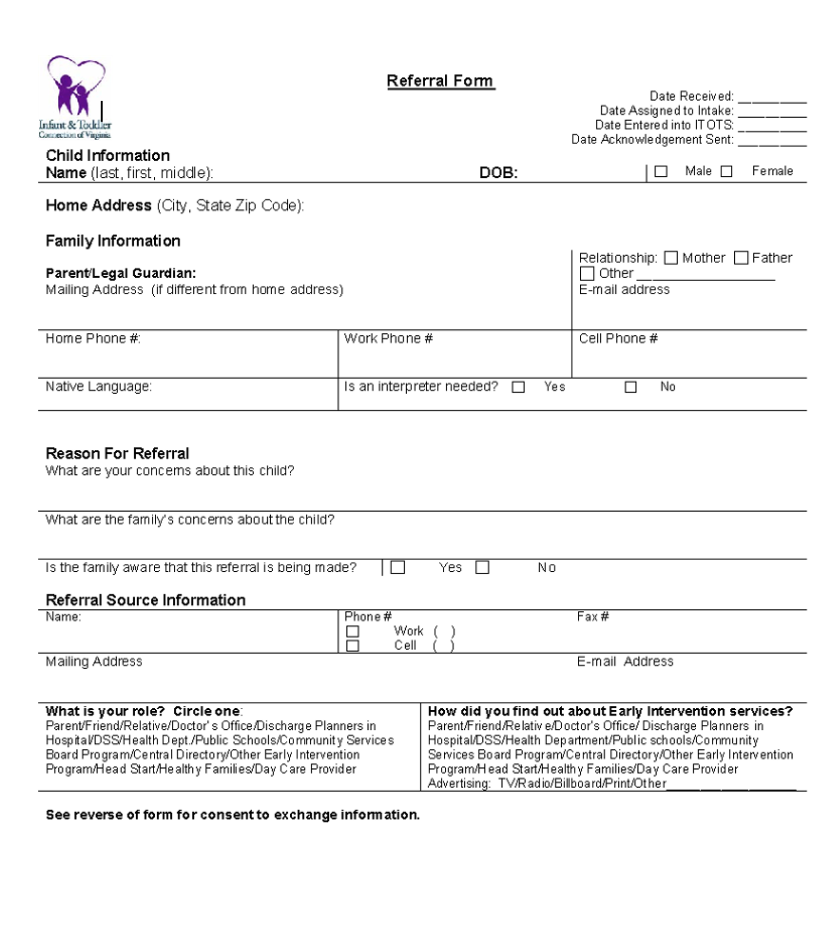
Nominations/ Request for Assistance Forms
Request for Assistance - Sample
Referral Form - Sample
Designed for quick response
Staff (Teacher, Support Staff, Administration), Caregiver and/or Student may make a nomination.
Should identify students with not only externalizing (interpersonal) risk characteristics but those with internalizing (intrapersonal) risk characteristics as well.
Scheduled to occur at designated points across the school year.

Slide 23
Screening and Request for Assistance Sort
Staff refers a student for ____ consecutive minor incidents in classroom.
Missed 10% or more of the school year, regardless of the reason
Nominations | Existing Data | Universal Screener
D or F in any course
Score below 40 on DESSA mini
Score below 28 on BASC-2 during Fall Administration
2-5 Office Disciplinary Referrals
Caregiver contacts Infant and Toddler Connection regarding their child’s development
Score below 25% nationally on CBM
More than ___ minutes away from instruction
Referral due to incomplete classwork / homework
Notes:
Sort the Screening and Requests for Assistance cards into three categories:
Nominations
Existing Data
Universal Screener

Slide 24
Screening and Request for Assistance Sort
What data point(s) might be used as an indicator across all three areas: academic, behavior and social emotional.
What are some common data points commonly used at the Elementary level? Middle school level? High School Level?
Notes:
Link to printable activity: https://docs.google.com/presentation/d/1OGgjCUTiE2qOESxxrTfm3b7ZNiV9tEBvSuAmHYq9V3I/edit?usp=sharing

Slide 25
Team Time: Request for Assistance
Identify what tier 1 screening data will be used:
What does this screening data indicate about core instruction?
Determine the process for student/family or educator requests for assistance:

Slide 26
2.3: Screening & RFA Decision Rules
Where do you feel your team currently is with the highlighted areas TFI 2.3?
Decision rules and multiple sources of data (e.g., ODRs, screening tools, attendance, student nominations) are used to identify students. | Multiple data sources used (e.g., ODRs, time out of instruction, attendance, academic performance) Decision rubric Meeting minutes School policy | 0 = No speciﬁc rules for identifying students 1 = Decision rules established but not consistently followed or used with only one data source 2 = Written policy exists that uses multiple data sources and ensures prompt notice to families.

Slide 27
Academic Advanced Tiers Decision Rules Example
Notes:
Academic Advanced Tiers Decision Rules examples link: https://docs.google.com/document/d/1gSe9WBes8EsVviP7HX8f1Str-Qcp8ceb/edit?usp=sharing&ouid=110403042282951422266&rtpof=true&sd=true

Slide 28
Sample Data Decision Rules Dashboard
Measure | Proficient Score | At-Risk | High Risk
Classroom Managed | 0-4 | 5 or more | 15 or more
ODR | 0-1 | 2-5 | 6 or more
Absences | <5 / trimester | 5+ / trimester | 10 / trimester
Tardy | <4 / trimester | 4+ / trimester | 10 / trimester
ISS | 0-1 | 2 | 4 or more
OSS | 0 | 1 | 2
Reading Virginia Growth Assessment | scores red or higher | scores fall between purple and red | scores fall below purple
Math Virginia Growth Assessment | scores red or higher | scores fall between purple and red | scores fall below purple
Writing Assessment | 3 or 4 | 2 | NS; 1
Nurse (non-medication) | 0-1 (no pattern) | 2-5 (patterns of regular visits) | 6 or more (patterns of regular visits)
*Ensure schools are looking at more than one data point to determine intervention need(s)*

Slide 29
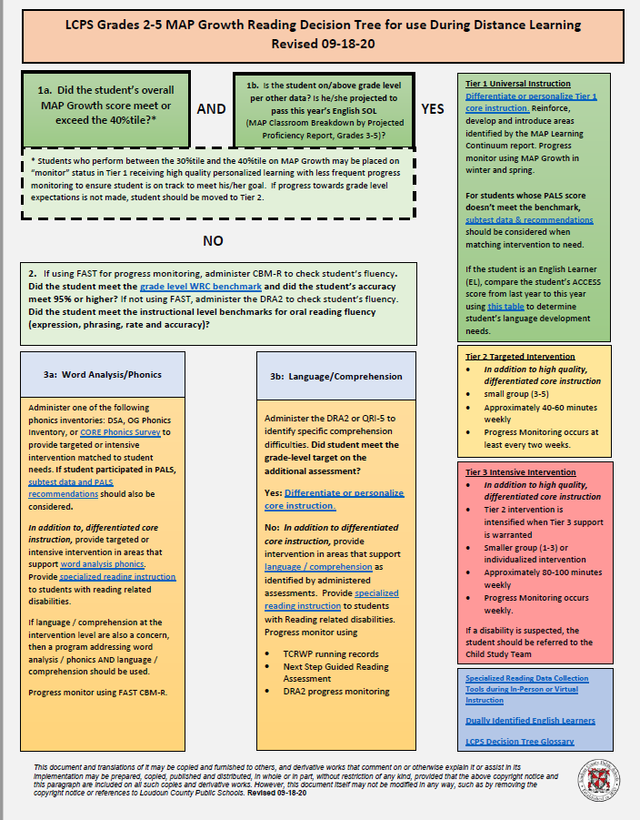
Sample Decision Tree
Grade 2-5
Reading
(Loudoun County Public Schools example)
Notes:
This Loudoun County Public Schools Grade 3-5 Reading Decision provides a sample of how yes/no questions and agreed upon decision rules can guide and enhance advanced tier team decision making regarding students and intervention. This sample may be hard to view on the slide, but can be accessed on the division’s MTSS website at, https://www.lcps.org/Page/246007

Slide 30
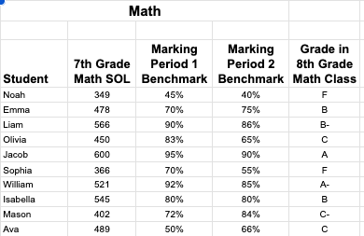
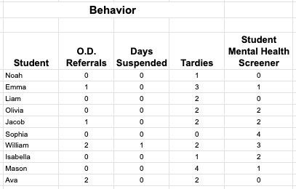
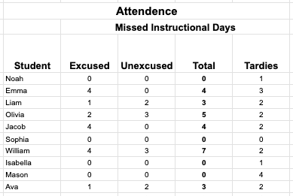
Click here to see full sample data set.

Slide 31
Let’s Practice
Review the data given to you.
Determine decision rules for who might be considered for advanced tier support:
Be prepared to share your decision rules and why.

Slide 32
Team Time: Decision Rules
What are the decision rules at your school for a student to enroll in an advanced tier intervention?
What are the decision rules for exiting an advanced tier intervention?
How are caregivers involved in advanced tier intervention entry and exit decisions?

Slide 33
2.5: Options for Tier 2 Intervention
Where do you feel your team currently is with TFI 2.5?
Tier II team has multiple ongoing behavior support interventions with documented evidence of effectiveness matched to student need. | School Tier II Handbook Targeted Intervention Reference Guide | 0=No Tier II interventions w/ documented evidence of effectiveness 1=Only 1 Tier II intervention 2=Multiple Tier II interventions w/ documented EOE

Slide 34
2.5: Intervention Resources
Where do you feel your team currently is with ATFI 2.5?
Tier II providers have access to multiple evidence-based interventions matched to student need. | Resource map Student data Meeting minutes Description of interventions Selection process | 0 = limited supports 1 = instructional match not consistently evident /unavailable 2 =continuum of evidence- based supports to match instructional needs exists

Slide 35
2.6: Tier 2 Critical Features
Where do you feel your team currently is with TFI 2.6?
Interventions provide additional instruction/time for student skill development, structure and predictability and increased opportunities for feedback | Universal lesson plans Tier II lesson plans Daily/weekly progress report School schedule | 0=do not include core features 1=contain some but not all features 2=All interventions include all features

Slide 36
2.6b: Tier II Intervention
Practice Features
Where do you feel your team currently is with ATFI 2.6b?
Tier II interventions include increased: time, intensity and dosage; opportunities for feedback; and structures and prompts. | School schedules Fidelity tools Programmatic descriptions Lesson plans | 0=Intervention design is not clear and/or inconsistently utilized. 1= At least 2 of the 3 feature criteria are met. 2= All 3 feature criteria are met.

Slide 37
Core Features Quick Check
Tier 2 Core Features
Adapted from Horner & Sugai (2016)
Notes:
Name the feature for each box on the graphic.

Slide 38
CICO Example
As you watch the video, what evidence of the advanced tier core features do you see/hear?
Notes:
Video link: https://www.youtube.com/watch?v=f8Jhy_LxWDk

Slide 39
CICO Secondary Example
As you watch the video, what evidence of the advanced tier core features do you see/hear?
Notes:
Video link: https://youtu.be/zqAU_6-w7xw

Slide 40
VTSS Evidence-Based Practices Selection Tool (Existing Practices)
Examine the questions listed for existing practices.
Choose one question that would help your team consider the effectiveness of advanced tier interventions in place at your school.

Slide 41
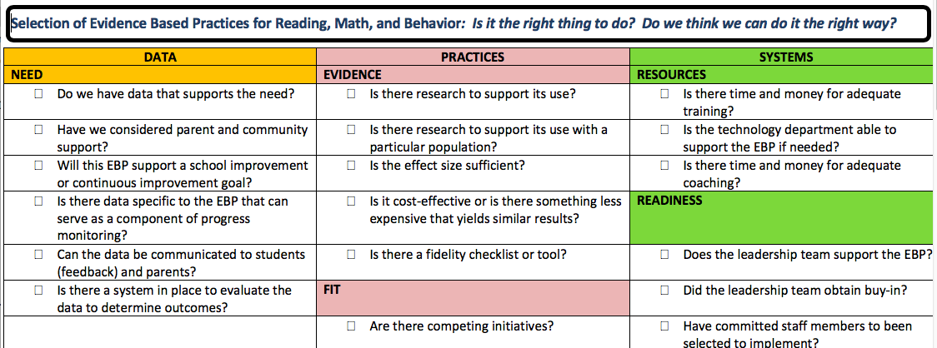
Evidence-Based Practices Selection (New Interventions)
Examine the questions listed for new practices selection.
Choose a critical question for teams when considering adding a new intervention to their continuum of supports.

Slide 42
2.7: Practice Matched to Student Need
Where do you feel your team currently is with TFI 2.7?
A formal process is in place to select Tier II interventions that are matched to student need and adapted to improve contextual fit | Data sources used to identify interventions School policy Tier 2 handbook Needs assessment Targeted Interventions Reference Guide | 0=No process in place 1=Process w/o documentation that interventions are matched to student need 2=Formal process in place w/ documentation

Slide 43
2.7: Intervention Selection
Where do you feel your team currently is with ATFI 2.7?
A process exists for selecting evidence-based interventions and creating a match to student need. | Resource map Evidence- based selection tool Individual student data Data outcomes Documentation of selection process | 0= process unclear/ inconsistently utilized. 1=process exists for selection OR matching to student need. 2=process exists for section AND matching to student need.

Slide 44
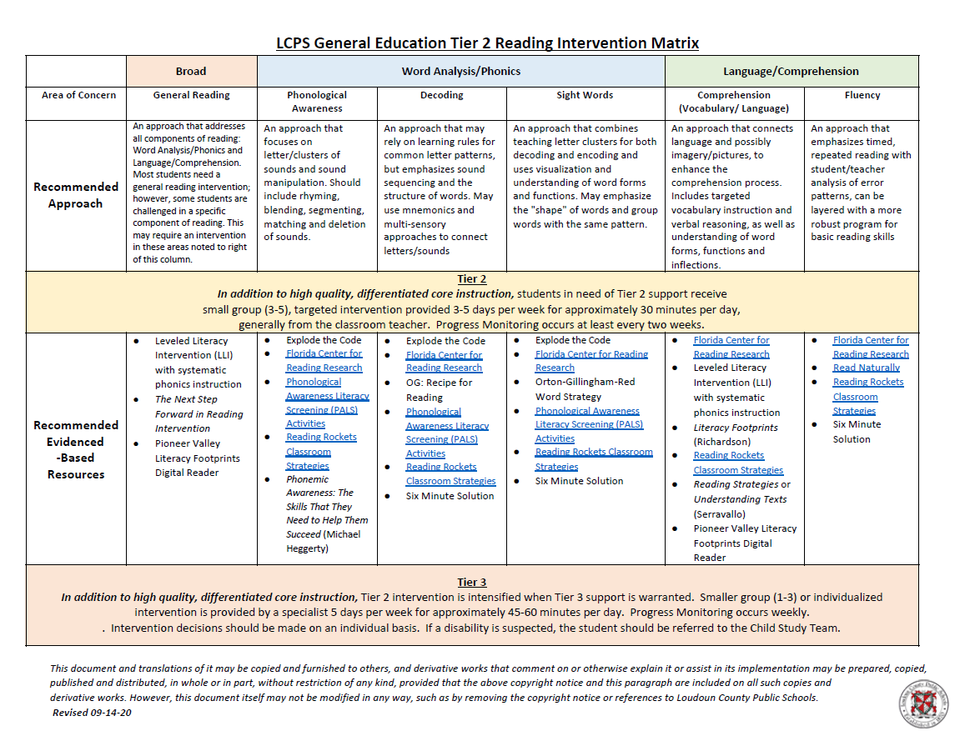
Matching Interventions to Instructional Needs
Notes:
Loudoun County Public Schools displaying a continuum of reading interventions specifically matched to student instructional needs

Slide 45
Team Time: Continuum of Supports
Make a list of interventions matched to need on continuum of supports.
Does the intervention…
address the 6 core features?
meet your criteria when using the Evidence Based Practice tool?
matched to instruction?

Slide 46
2.8: Access to Tier 1 Supports
Where do you feel your team currently is with TFI 2.8?
Tier 2 supports are explicitly linked to Tier 1 supports, and students receiving Tier 2 supports have access to/are included in Tier 1 supports. | Universal lesson plans Tier II lesson plans Acknowledgement system Student of the month documentation Family communication | 0=No evidence that students receiving Tier 2 supports have access to Tier 1 supports 1=students have some access to Tier 1 supports 2=students have full access to Tier 1 supports

Slide 47
2.8: Alignment
Where do you feel your team currently is with ATFI 2.8?
All interventions are aligned with Tier I content and coordinated with Tier I schedules to maintain access to Tier I content. | Resource map Evidence- based selection tool Individual student data Data outcomes Documentation of selection process | 0= process unclear/ inconsistently utilized. 1=process exists for selection OR matching to student need. 2=process exists for section AND matching to student need.

Slide 48
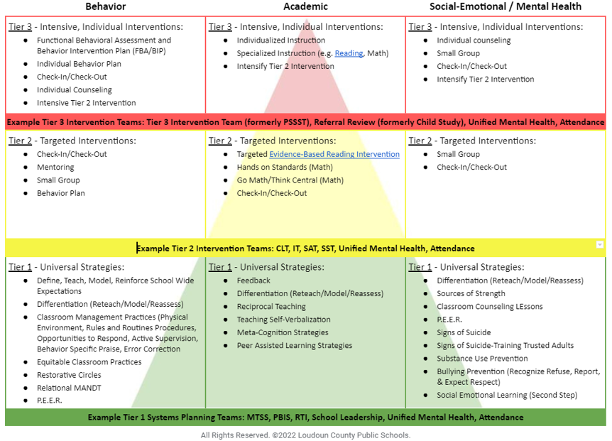

Slide 49
Notes:
link: https://drive.google.com/file/d/1dFeQjoeZlN0EFIUieOSI8YvwjyzJgW7t/view?pli=1

Slide 50
Team Time: Alignment
How are advanced tier interventions listed on your current continuum of supports aligned with Tier One Core instruction? What changes, if any, might you consider?
How are systems aligned across tiers and domains in your school framework?

Slide 51
2.10 Level of Use
Where do you feel your team currently is with TFI 2.10?
Team follows written process to track proportion of students participating in Tier II supports, and access is proportionate. | Tier II enrollment data Tier II team meeting minutes Progress monitoring tool | 0 = Team does not track Tier II data 1 = Student data monitored but no data decision rules established to alter support 2 = Team defines criteria, tracks proportion, at least 5% of students receiving Tier II supports

Slide 52
2.10 Academic TFI
Where do you feel your team currently is with ATFI 2.10?
Team follows written process to track proportion of students with equitable access to and participation in Tier II. | Documentation of process Tier II enrollment data Tier II meeting minutes Student enrollment data for school | 0 = No written process and/or student data 1 = Track proportion of students OR equitable participation 2 = Track both proportion AND equitable student participation

Slide 53
Healthy Framework Quick Math
What is your total school population?
What is the 10-15 % range of your total school population?
What might be the number of students in your school receiving tier 2 intervention at any one point in time?
What is the 1-5% range of your total school population?
What might be the number of students in your school receiving tier 3 intervention at any one point in time?

Slide 54
Tier 2 Team Meeting Example
Notes:
https://www.youtube.com/watch?v=OwplSr0yEI0

Slide 55
Let’s Practice
Universal screening data and current decision rules for identifying students in need of Tier II supports show 37% of students are in need of targeted instruction for math calculation.
What is the problem?
Why is it occurring?
What can be done?
How will we know it worked?

Slide 56
2.11a Student Group Performance Data
Where do you feel your team currently is with TFI 2.11a?
Tier II team tracks proportion of students experiencing success (% of participating students being successful) | Student progress data (% of students meeting goals) Intervention Tracking Tool | 0 = Student data not monitored 1 = Student data monitored / no data decision rules to alter support 2 = Student data monitored and used at least monthly, with data decision rules established

Slide 57
2.11c Academic TFI
Where do you feel your team currently is with ATFI 2.11c?
For each intervention, there are progress monitoring data ...(c) within each intervention, the percent of students making sufficient progress | Agenda and minutes for data team meetings Parent contact logs Intervention tracking tool | 0 = only 1 criteria is met for progress monitoring. 1 = Two criteria are met . 2 = All criteria are met

Slide 58
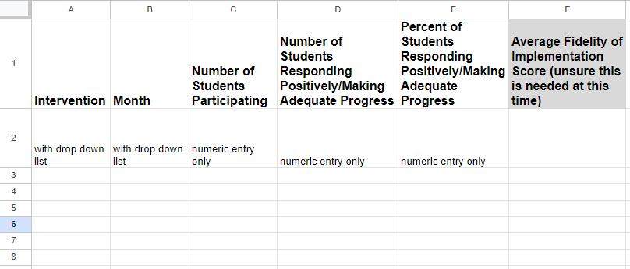
Electronic Intervention Tracking
Intervention Tracking Spreadsheet
Notes:
Electronic Intervention Tracking Sheet: https://drive.google.com/file/d/1C3i9MNVVO8IgThpgPXqrYs20-fF9ncoc/view?usp=sharing

Slide 59
Team Time: Intervention Effectiveness
How often is intervention effectiveness reported and evaluated by your school team?
Who brings this data?
How does evaluating intervention effectiveness connect to decision rules and alignment MTSS core components?

Slide 60
2.11b Student Performance Data
Where do you feel your team currently is with TFI 2.11b?
Tier II team uses Tier II intervention outcomes data and decision rules for progress monitoring and modification | Student progress data Daily/Weekly Progress Report sheets Family communication | 0 = Student data not monitored 1 = Student data monitored / no data decision rules 2 = Student data monitored at least monthly; use data decision rules to alter support

Slide 61
2.11a, b Academic TFI
Where do you feel your team currently is with ATFI 2.11 a and b?
Progress monitoring data for students receiving Tier 2 supports which are displayed and discussed to make decisions monthly regarding individual progress | Agenda and minutes for data team meetings Caregiver contact logs Intervention tracking tool | 0 = only 1 criteria is met for progress monitoring. 1 = Two criteria are met . 2 = All criteria are met

Slide 62
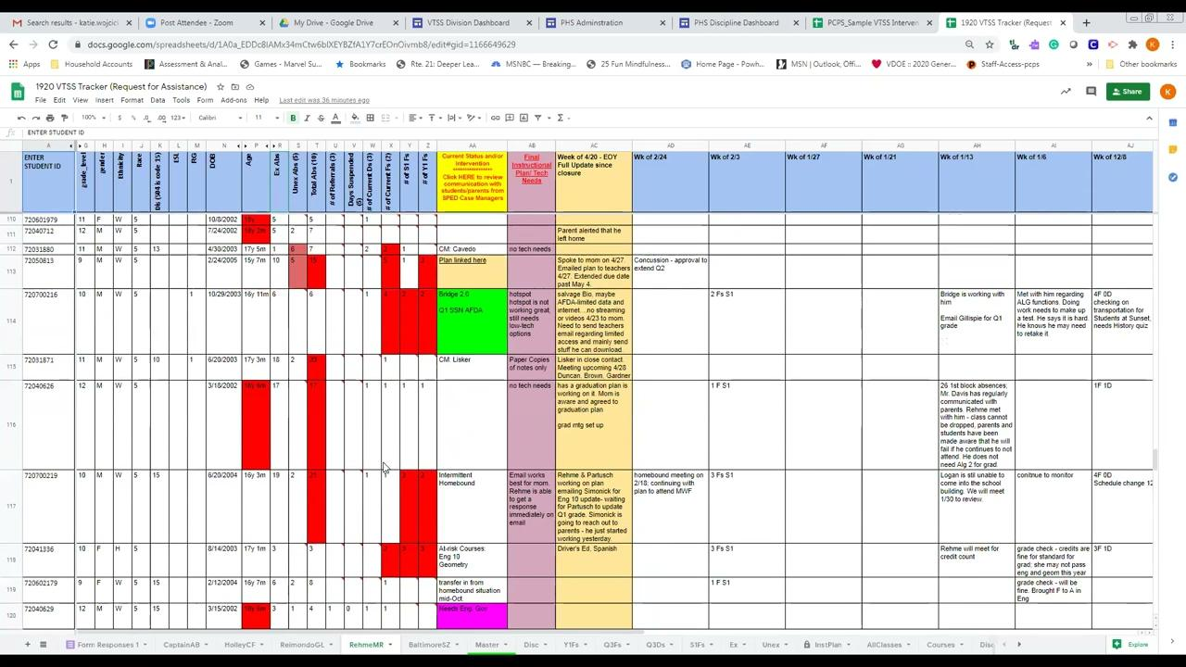
Powhatan County Public Schools Progress Monitoring Example

Slide 63
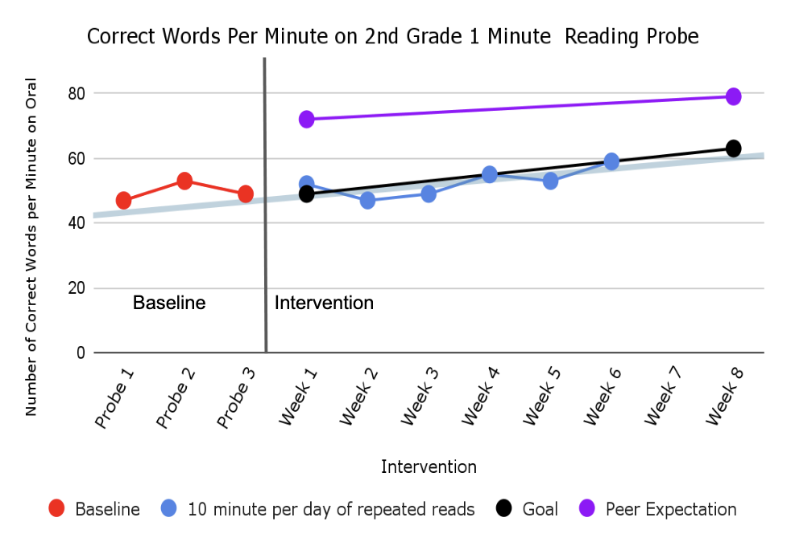
Academic Graphing Example
Looking at this graph, can we determine if the student is making progress?
Is the student expected to meet their goal?
Should an intervention change be made?

Slide 64
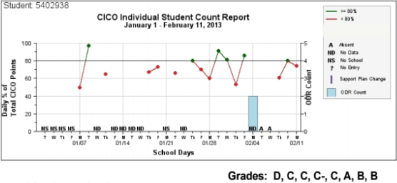
Behavior Graphing Example
What should we recommend for this student?
transition off CICO or move to self-monitoring/fading intervention?
maintain current intervention for 1 more 4-week cycle and then review again?
add another intervention?

Slide 65
Team Time: Progress Monitoring
How is acceptable growth/rate of progress defined?
How is progress monitored?
How often is progress monitored?

Slide 66
2.12 Fidelity Data
Where do you feel your team currently is with TFI 2.12?
Tier II team has a protocol for ongoing review of fidelity for each Tier II practice | Tier II coordinator training • District technical assistance • Fidelity probes taken monthly by a Tier II team member | 0 = Fidelity data are not collected for any practice 1 = Fidelity data (e.g., direct, self report) collected for some but not all Tier II interventions 2 = Periodic, direct assessments of fidelity collected by Tier II team for all Tier II interventions

Slide 67
2.12 Academic TFI
Where do you feel your team currently is with ATFI 2.12?
Tier II team has a protocol for ongoing review of fidelity for each Tier II practice | School schedule Intervention attendance sheets Fidelity measure specific to the intervention Scheduled fidelity checks | 0= Fidelity data not collected 1= Fidelity data collected for some interventions 2= A schedule for ongoing fidelity checks for all Tier II interventions is followed

Slide 68
Checklist Manifesto
Notes:
Start at 2:19 - https://youtu.be/55Nc8nccPa0

Slide 69
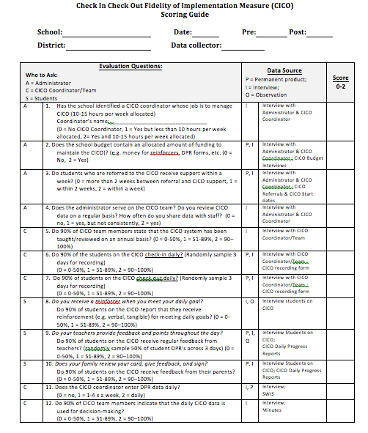
Behavior Intervention Fidelity Checklist Example
Notes:
Link to document: https://vtss-ric.vcu.edu/media/vtss-ric/documents/cop/advanced-tiers/CICO-Fidelity-Measure-and-Planning-Tool.pdf
69

Slide 70
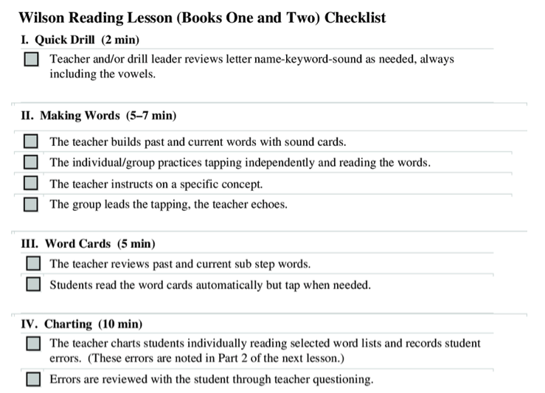
Reading Intervention Fidelity Checklist Example
Notes:
link to checklist: https://www.researchgate.net/figure/Wilson-Fidelity-Lesson-checklist_fig1_281576222
70

Slide 71
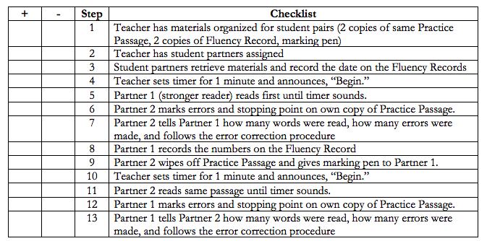
“Program” Fidelity Checklist Example
Notes:
Sample implementation fidelity checklist link: https://www.matsuk12.us/cms/lib/AK01000953/Centricity/Domain/105/MTSS%20page/fidelity%20checklists/Six_Min_Solution_Checklist.pdf

Slide 72
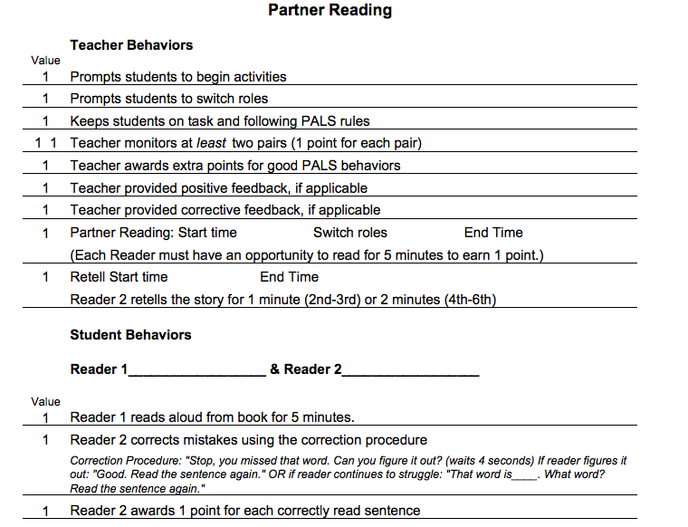
Strategies Fidelity Checklist Example
Notes:
Link to document: http://www.bemidji.k12.mn.us/wp-content/uploads/2013/11/PALS-Reading-2-6-Integrity-Check3.pdf

Slide 73
Team Time: Fidelity Measures
Discuss how fidelity will be measured?
Determine how often fidelity is measured?

Slide 74
TFI 2.9 Professional Learning
Where do you feel your team currently is with TFI 2.9?
A written process is followed for teaching all relevant staff how to refer students and implement each Tier II intervention that is in place. | professional development calendar staff handbook lesson plans for teacher trainings school policy | 2-written process used to teach all staff all aspects of intervention delivery, including RFA,delivering feedback, and monitoring student progress 1-informal process 0-no process in place

Slide 75
2.9 Academic TFI
Where do you feel your team currently is with ATFI 2.9?
Teams have access to professional learning needed to provide interventions with fidelity, reinforce the intervention across settings, including families | Professional learning plans and calendars Fidelity checklists Family communication Fidelity checklists Staff handbook | 0= only 1 criteria is met 1= Two criteria are met 3= All 3 criteria are met

Slide 76
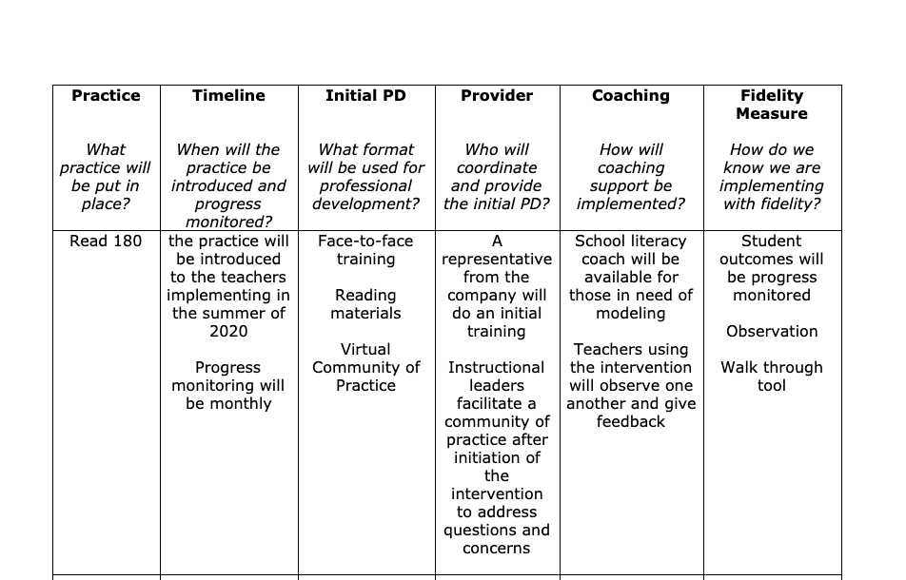
Planning for Success
What do you notice? What do you like?

Slide 77
Team Time: Professional Learning
What is the professional learning and coaching needed for the person delivering the intervention to be able to teach with fidelity?
Identify what professional learning staff need to implement this intervention
Discuss who will provide the professional learning
Determine what coaching supports are needed for staff
Identify who will provide coaching and when

Slide 78
Closing: Name that Circle

Slide 79
Day 2 Quick Check
We align advanced tier interventions to Tier One Core instruction across all domains. True False
Two decision rules about progress monitoring are
and
The most important data advanced tier teams analyze is individual student performance. True False
The intensity of progress monitoring
with the intensity of interventions.
Graphing data is an option, but it not worth the time and effort for team meetings.
True False

Slide 80
Progress monitoring data allows teams to make decisions whether to
or
an intervention.
Fidelity measures may require adult behavior to change to ensure success for students. True False
We need both and
to support adults providing intervention.
is the degree to which an intervention is
delivered as intended.
“Did we what we said we would
in the way we said we would it.”

Slide 81
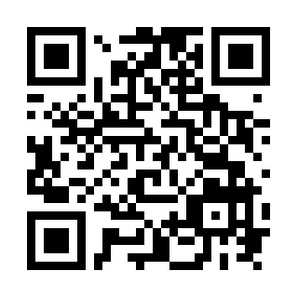
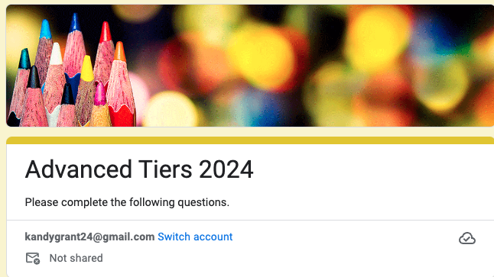
Exit Ticket
exit ticket

Slide 82
Notes:
Please take a second to give us feedback: http://bit.ly/ateval_july

Slide 83
References
Algozzine, B., Barrett, S., Eber, L., George, H., Horner, R., Lewis, T., Putnam, B., Swain-Bradley, J., McIntosh, K., & Sugai, G. (2014). School-wide PBIS tiered fidelity inventory. OSEP Technical Assistance Center on Positive Behavioral Interventions and Supports. www.pbis.org
Crone, D. A., Horner, R. H., & Hawken, L.. S. (2004). Responding to problem behavior in schools: The Behavior Education Program. New York: Guilford.
Everett, S., Sugai, G., Fallon, L., Simonsen, B., & O’Keeffe, B. (2011). School-wide Tier II interventions: Check-In Check-Out Getting Started Workbook. OSEP Technical Assistance Center on Positive Behavioral Interventions and Supports.

Slide 84
References (2)
Hosp, J. L., Hosh, M. K., Howell, K. W., Allison, R. (2014). The ABCs of curriculum-based evaluation: A practical guide to effective decision making. New York: Guilford.
Lembke, D. (n.d.). Interventions in RTI Handouts. Retrieved from https://rti4success.org/sites/default/files/interventions_in_rti_handouts.pdf
McIntosh, K. & Goodman, S. (2016). Integrating multi-tiered systems of support: Blending RTI and PBIS. New York: Guilford Press.

Slide 85
References (3)
Riley-Tillman, C. T., Burns, M. K., & Kilgus, S. P. (2020). Evaluating Educational Interventions, Second Edition: Single-Case Design for Measuring Response to Intervention (Second ed.). The Guilford Press.
Sanetti, L. & Meek, M. (2019). Supporting successful interventions in schools : tools to plan, evaluate, and sustain effective implementation. New York: The Guilford Press.

Slide 86
References (4)
The IRIS Center. (2014). Evidence-based practices (part 3): Evaluating learner outcomes and fidelity. Retrieved from https://iris.peabody.vanderbilt.edu/module/ebp_03/
Tiered Fidelity Inventory (TFI) Scoring Guide - Adapted from Algozzine, B., Barrett, S., Eber, L., George, H., Horner, R., Lewis, T., Putnam, B., Swain-Bradway, J., McIntosh, K., & Sugai, G (2014). School-wide PBIS Tiered Fidelity Inventory. OSEP Technical Assistance Center on Positive Behavioral Interventions and Supports. www.pbis.org.

