Slide 1
Advanced Tiers
Setting Up Tier 2 Systems
Day 1

Slide 2
Materials
Link to powerpoint
Link to notetaker
Link to Resource Folder

Slide 3
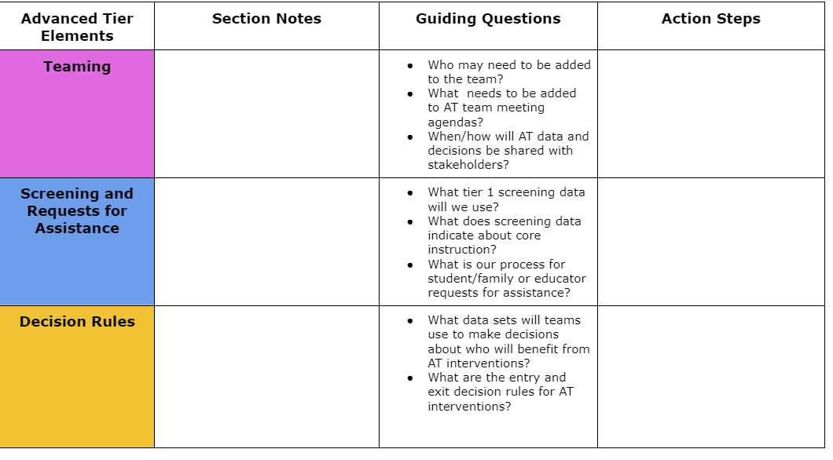
Advanced Tiers Notetaker

Slide 4
Day 1 Agenda
9:00 - 9:30 - Welcome/Introduction
9:30 - 10:30 - Teaming
10:30 - 10:45 - Break
10:45 - 12:00 - Screening/Request for Assistance
12:00 - 1:00 - Lunch
1:00 - 1:30 - Wrap up Screening/Request for Assistance
1:30 - 3:30 - Decision Rules
3:30 - 4:00 - Wrap-up/Feedback

Slide 5
Community Agreements
Be Responsible | Take care of your needs. Share your questions with the group.
Be Respectful | Respect others intentions Honor the impact of your words Earnestly move toward completing tasks during team work time
Be Engaged | Ask what you need to know to understand and contribute. Stay present Listen to others attentively. Share your expertise, information and ideas.

Slide 6
Learning Intentions - Day 1
Establish written processes and procedures for the Tier 2 team, including defining team membership and setting up meeting structures.
Evaluate, refine, and/or create decision rules that incorporate multiple data sources to accurately identify students in need of Tier 2 support.
Design a standardized request for assistance form accessible to teachers, students, and families, ensuring clarity and ease of use.

Slide 7
Anchor Assessment Documents

Slide 8
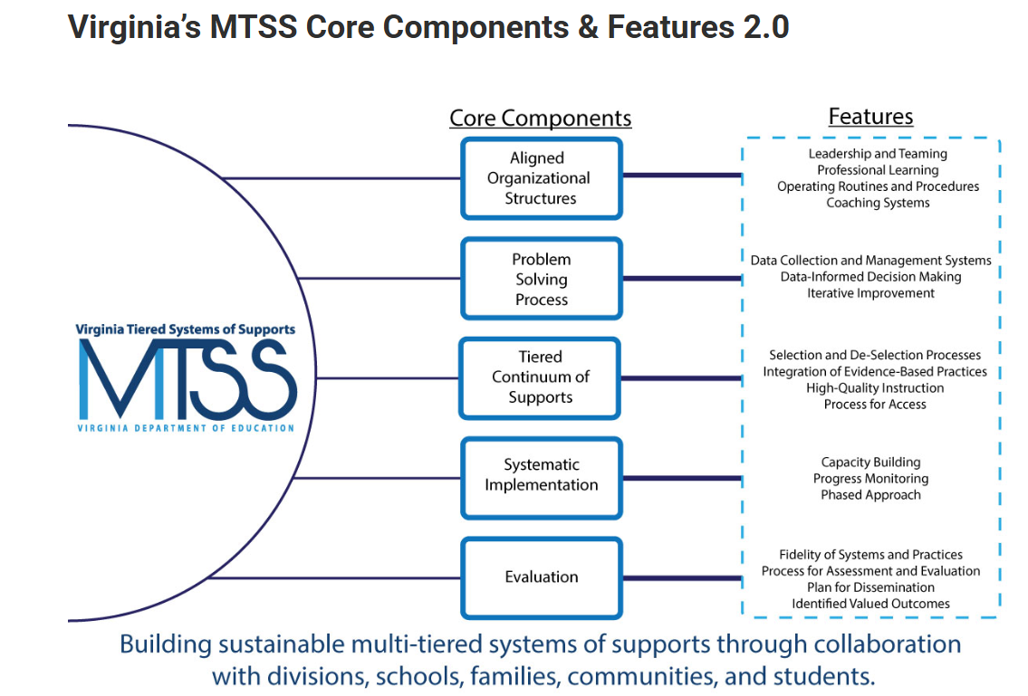
VTSS Core Components

Slide 9
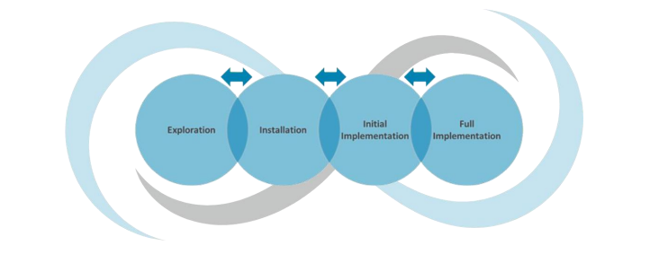
Adv. Tier -Phases of Implementation
Previous MTSS PD: EXPLORATION Exploration involves an assessment of assets and needs of the focus population, fit of the program or practice with those needs and assets and feasibility of implementation.
This PD: INSTALLATION Installation involves building the infrastructure (systems) necessary to implement the program or practice, which includes building practitioner and organizational capacity.

Slide 10
Where are we in the Triangle?
Tier 3 for a Few: Intensive, Individualized
Tier 2 for Some: Targeted for Small Groups
Tier I for All: Core/Universal
1 - 5%
5 - 15%
80 - 90%

Slide 11
What is your outcome?
Advanced Tiers
What we use to make decisions? Monitor progress?
Monitor fidelity?
SYSTEMS
DATA
What we do to support adults to implement the practices?
PRACTICES
What we do to
support students?
Notes:
11

Slide 12
Why Advanced Tiers?
Core Instruction doesn’t work in isolation
Avert students from trajectories toward further learning/behavior challenges
Provide a unifying framework: Programs and strategies

Slide 13
What is Tier 2?
Targeted support for students not successful with Tier 1 alone
Small group intervention
Provided in addition to universal, Tier 1 instruction and aligned with student needs
For students who may be struggling or who need more challenge

Slide 14
Goals of Tier 2 Supports
•Provide remediation
•Prevent problems from getting worse
•Provide a continuum of supports
•Identify and support students at-risk for not reaching behavioral expectations
•Provide sufficient and appropriate interventions
–Teach new skills to assist students in reaching and exceeding behavioral expectations

Slide 15
Tier 2 Process Includes..
•Data Based problem solving
•Predetermined data decision rules
–Selecting and prioritizing students
–Making changes to interventions
–Changing levels of support
•Appropriate, evidence-based interventions
•Checks for fidelity of implementation

Slide 16
Moving In and Out of Tiers
How are students’ experiences in a multi-tiered system of supports like a lava lamp?

Slide 17
Quick Check: Overview T/F
Students not responding to core instruction should be removed and receive advanced tier interventions that teach different content in a different way for student success.
When high-quality core instruction is in place, schools can anticipate that about 5-15% of students will benefit from tier 2 interventions and 1-5% of students from tier 3.
Identifying students as Tier 1, Tier 2, or Tier 3 will help school teams effectively plan advanced tiers interventions.

Slide 18
Advanced Tiers Foundations
“The Essential Eight”
Teaming
Professional Learning and Coaching
Screening and Request for Assistance
Progress Monitoring
Decision Rules
Data-
Informed Decision Making
Continuum of Support
Alignment

Slide 19
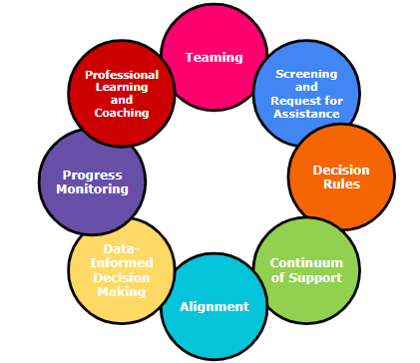
Teaming
What is your System?
Team Membership &
Team Operating Procedures
Core Component 1: Leadership and Teaming

Slide 20
Is my school ready to implement Tier 2 Supports?
Tier 2 Essentials
•Administrative support
–Allocation of resources (planning and meeting time, money, materials, etc)
•Tier 1 implemented with fidelity (> 70% TFI)
•Staff buy-in
•No significant changes in school climate
–i.e., morale, funding, restructuring
•Tier 2 implementation is a top priority

Slide 21
Who is on your team?

Slide 22
Responsibilities of the Tier 2 Team
Identify and prioritize students in need of Tier 2 supports
Match student needs to interventions
Monitor/coordinate implementation of interventions
Monitor student progress
Evaluate data and make decisions
Communicate with all stakeholders (staff, students, caregivers, and community partners)
Identify staff professional development needs
Monitor Tier 2 system:
Number of students receiving support
Implementation fidelity
Student progress across interventions

Slide 23
Bi-directional Stakeholder Communication
Why?
Builds shared commitment to advanced tier interventions
Increases awareness of interventions
Fosters deeper understanding of family and culture-specific functions of behaviors
How?
Share student progress graphs in grade level meetings
Include graphs in school/home communication

Slide 24
Example of a Tier 2 Meeting

Slide 25
Team Data Conversations
Tier 1/ Universal
Tier 2/3
Targeted
Tier 3/ Tertiary
Intervention level of use and % of students making progress
Student referral and progress monitoring
Intensified
student progress monitoring
Schoolwide and classroom
Increased progress monitoring, fidelity measures and family engagement

Slide 26
Advanced Tiers Standing Agenda Items
Intervention Effectiveness
# of students
# meeting goal
# not meeting goal
Level of Use
Fidelity
Intervention Referrals and Decision Rules
Team Problem Solving
Communication with families, staff, students and community partners

Slide 27
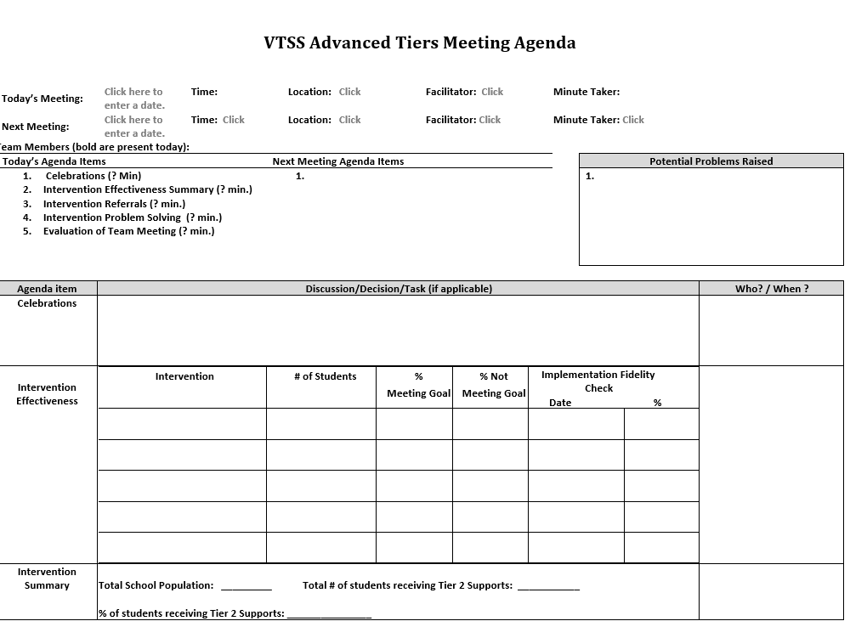
Advanced Tier
Sample Meeting Agenda

Slide 28
Quick Check: Teaming Structures T/F
Advanced tiers teams includes more specialized personnel.
Advanced tiers teams look the same across divisions and schools.
The most important data conversation that takes place at an advanced tier meeting is individual student performance.
Tier 3 team conversations include caregivers as problem-solving partners

Slide 29
Team Time: Teaming
Establish written processes & procedures for the Tier 2 team, including defining team membership and setting up meeting structures
Consider what you have in
place.What is working, and
what you may need to refine
in terms of team membership,
scheduling, standing
structures/agendas, etc.

Slide 30
Team Share Out

Slide 31
Big Ideas
Teaming
Advanced tier teams benefit from specialized knowledge and expertise
There should be at least one person with overarching knowledge of the interventions used in the schools
Use a predictable agenda that includes intervention systems and student performance data discussions

Slide 32
Student Identification Process
What is your System?
Screening, Request for Assistance & Decision Rules
Core Component 1- Aligned Organizational Structures
Core component 2- Problem Solving Process

Slide 33
Purpose of Screening
PROCESS
Evaluate Effectiveness of Core (Tier 1)
INTERVENTION
Part of the Request for Assistance Process that is one data point used to measure progress.
Adapted from https://assets-global.website-files.com/5d3725188825e071f1670246/5d7035c071700f1e3b846aab_b1_lewis_powers_dixon_revised.pdf

Slide 34
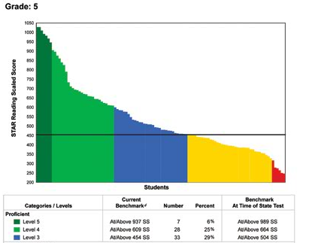
Screening to Assess Core Instruction
60 % of students
40 % of students

Slide 35
Student Issue or Systems Issue?
Environment or student?
Fig. “Classroom Chaos”. May 31, 2020. http://healthyteachingonline.com/blog/wp-content/uploads/2014/09/schoolchaos.jpg

Slide 36
Integrated Screening
INFORMAL
FORMAL
Nominations/ Requests for Assistance
Existing Data Sets
Universal Screeners

Slide 37
What is Universal Screening?
Universal screening is a systematic process of assessing all students to identify students at risk of academic, behavioral, or social-emotional challenges.

Slide 38
Steps to Universal
Screener Implementation
Establish Clear Roles/Responsibilities
Identify Stakeholders
Determine the frequency/timelines
Communicate the Purpose
Ensure Accessibility of ALL and elimination of potential bias
Provide/Participate in Professional Development of Assessment Tools

Slide 39
Universal Screeners
What universal screeners are being used in your division/school?
Academic
Behavioral
Social-Emotional
Connectedness/Belonging

Slide 40
Universal Screener Selection
Questions
Considerations
Is the core instruction sufficient/is it improving?
For which groups is it working/not working?
What is the efficacy of the tiered interventions?
What is the individual growth of our students?
Cost
Capacity to administer and analyze
Ability to Scale-up
Communication of Results and Reporting of Needs

Slide 41
Resource: Universal Screeners
ACADEMIC National Center on Intensive Interventions RAND Education Assessment Finder | BEHAVIOR National Center on Intensive Interventions Center on PBIS | MENTAL WELLNESS RAND Education Assessment Finder

Slide 42
Table Talk:
Universal Screening
Discuss what your screening data indicates about core instruction.
Evaluate how universal screening is being being used to identify students in need of additional support. How can that be used as you are setting up systems to identify students? Are there any changes needed?

Slide 43
Request for Assistance
Process for seeking additional team assistance for meeting the needs of students and/or teachers when progress is not sufficient at Tier 2
What is your System and how is that communicated to all?

Slide 44
Requests for Assistance?
Grab the reading specialist in the hall and ask if she can add one more to the group.
Tell the high school counselor a student just got on your last nerve, and they need to see them so they can be added to the social skills group.
Email the school psychologist and everyone else you know to request the Tier 3 behavior specialist come at once because a student seriously interferes with learning in the classroom!

Slide 45
Nominations/ Request for
Assistance Forms
Designed for quick response
Staff (Teacher, Support Staff, Administration), Caregiver and/or Student may make a nomination.
Should identify students with not only externalizing (interpersonal) risk characteristics but those with internalizing (intrapersonal) risk characteristics as well.
Scheduled to occur at designated points across the school year.

Slide 46
Team Time: Requests for assistance
Design a standardized request for assistance form accessible to teachers, students, and families, ensuring clarity and ease of use.

Slide 47
Team Share Out

Slide 48
Big Ideas
Screening and RFAs
Screening data helps us to know if the core is sufficient and differentiate a systems issue from a student issue, and for which groups of students the core instruction is successful.
Universal screening provides data advanced tiers teams need for data informed decision making.
Request for Assistance should be easily accessed by staff, students and caregivers.

Slide 49
What is your system?
Data Decision Rules (DDR)
Decision rules, or “entry and exit criteria”
Allow for decisions to be made objectively on who receives support.
Provide a uniform method to refer students to advanced tiers.
Provide clear exit criteria from advanced tiers interventions and supports.

Slide 50
2 Types of Data Decision Rules
Systems Data Decision Rules: identification of students who are recommended for Tier 2 supports.
Intervention Decision Rules: identification of which intervention “matches” the students need, with clear entry/exit criteria.

Slide 51
The Process
Identify Data Sources
Triangulate Data
Identify Students
Identify Need
Select Practices
Develop Intervention DDRs

Slide 52
What data sources do you have available to identify that students at-risk?
Parent Contacts
Counselor Visits
SOLs
ODRs
Attendance
Data!
GPA
ISS/OSS
Nurse referrals
Teacher Nominations
Universal screening scores
Benchmarks
Identify at least 3 data sources.

Slide 53
Triangulate the Data
Triangulation of data is critical as screening will over-identify students at risk.
Triangulation will identify a smaller, more precise group to target for interventions.
We are not making decisions about the data yet, that will come with data decision rules (DDR).

Slide 54
Set Floors & Ceilings with Data
Determine what the threshold is for students who need tier 2 support
ALSO determine the cap for students who need more intensive supports

Slide 55
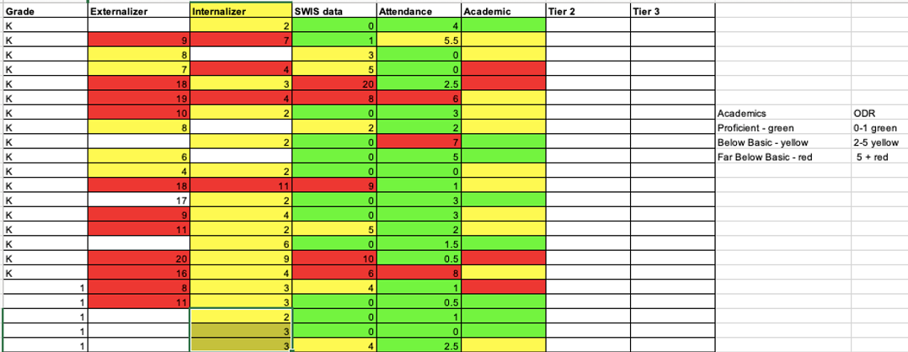
Identify Students

Slide 56
Examples of systems data that can be used to identify students

Slide 57
Tier 2 Academic Decision Rules Reading Data Example
Below 25% on universal screener
Below 70% on benchmark assessments
Did not meet PALS benchmark
Did not pass prior year’s SOL
Did not achieve course credit

Slide 58
Tier 2 Academic Decision Rules Mathematics Data Example

Slide 59
Tier 2 Decision Rules Behavior Data Example
2-5 ODR’s
1 Suspension
> ? minutes missed instruction
> ? days unexcused absences
Incomplete classwork/homework
Tardies
Student, caregiver, staff nomination

Slide 60
Tier 2 Decision Rules:
Mental Wellness Data Example
5+ visits to the nurse/school counselor per month
3-5 absences per month
2-4 tardies and/or early dismissals
Student, caregiver, staff nomination
Mental Wellness Screener

Slide 61
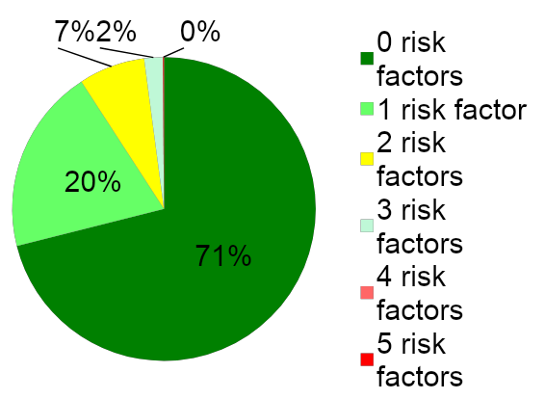
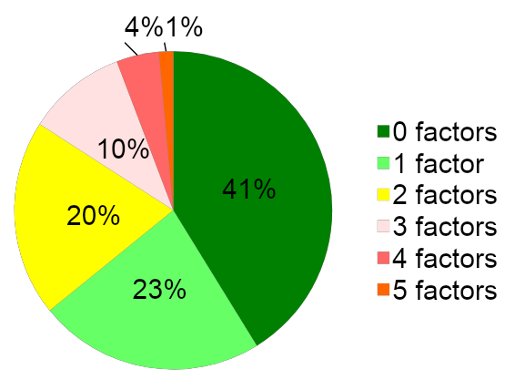
Risk Factors and Decision Rules
School A
School B

Slide 62
Sample Data Decision Rules Dashboard
Measure | Proficient Score | At-Risk | High Risk
Classroom Managed | 0-4 | 5 or more | 15 or more
ODR | 0-1 | 2-5 | 6 or more
Absences | <5 / trimester | 5+ / trimester | 10 / trimester
Tardy | <4 / trimester | 4+ / trimester | 10 / trimester
ISS | 0-1 | 2 | 4 or more
OSS | 0 | 1 | 2
Reading Virginia Growth Assessment | scores red or higher | scores fall between purple and red | scores fall below purple
Math Virginia Growth Assessment | scores red or higher | scores fall between purple and red | scores fall below purple
Writing Assessment | 3 or 4 | 2 | NS; 1
Nurse (non-medication) | 0-1 (no pattern) | 2-5 (patterns of regular visits) | 6 or more (patterns of regular visits)
*Ensure schools are looking at more than one data point to determine intervention need(s)*

Slide 63
Team Time:
Decision Rules
Evaluate, refine and/or create decision rules that incorporate multiple sources to accurately identify students in need of Tier 2 support.

Slide 64
Team Share Out

Slide 65
Big Ideas
Decision Rules
Provide a uniform method for student accessing advanced tiers interventions and supports.
Decision rules, or “entry and exit criteria” allow for decisions to be made objectively on who receives support.
Provide clear advanced tier intervention fading criteria.

Slide 66
Advanced Tiers
Setting Up Tier 2 Systems
Day 2

Slide 67
Virginia Tiered Systems of Supports
WELCOME BACK!

Slide 68
Day 2 Agenda
9:00 - 9:05 - Welcome Back
9:05 - 11:15 - Identification of Interventions
11:15 - 12:00 - Alignment
12:00 - 1:00 - Lunch
1:00 - 3:00 - Systems for Collecting and Reviewing Data
3:15 - 4:00 - Action Plan/Wrap-up/Evaluation

Slide 69
Learning Intentions - Day 2
Conduct resource mapping of existing Tier 2 interventions, identify gaps, and explore additional intervention options. Utilize findings to build a continuum of support, establish decision rules for student entry and exit, and explore scheduling of interventions.
Develop systems for collecting and reviewing data, including level of use, monitoring intervention effectiveness and fidelity, and monitoring student progress.
Create an action plan outlining ongoing tasks to be addressed upon the team’s return to school.

Slide 70
Identification of Interventions
What is your System?
Resource Mapping & Continuum of Supports
Core Component 3: Tiered Continuum of Supports

Slide 71
Tier 2 Core Intervention Features
Increased Structure & Prompts
Increased Intensity of Data Collection
Increased
Regular Feedback
Increased Family Engagement
Increased Instruction on Skills (prosocial, emotional, academic)
Tier 2 Core Features
Efficient system for access and delivery of intervention
Adapted from Horner & Sugai (2016)

Slide 72
What is an Intervention
Interventions involve instruction and assessment.
Beware of things that seem like interventions, but are not:
Policies and laws
Initiatives that have no practices
One-time events

Slide 73
Setting up interventions
Based on data, what interventions do you need to address the identified problem(s)?
What interventions do you have in place? Are they working?
Are there additional interventions you need to identify to address the identified problem(s)?

Slide 74
Evaluating Products and Interventions
Guiding Questions
1. Has it been reviewed and evaluated for ‘standards of evidence’ by an organization such as “What Works Clearinghouse”?
2. If not, is there any evidence that the strategy has been researched? (e.g., journal articles, book chapter, report from developer)
3. Does it have a manual describing the procedures for each step, so anyone would be able to implement the strategy?
4. Does it include a method for evaluating fidelity of implementation?
5. Can it be implemented without regular and/or intensive involvement from the developer?
6. Does it evidence advanced tiers core features?

Slide 75
Evidence-Based Academic Interventions

Slide 76
Behavior Intervention Sample Resource Mapping
Function
Possible School Interventions
Skill acquisition and development
Reinforce prosocial behavior skills
“Anger Control Training”
“Cognitive Reframing”
“Social Problem Solving”
“Skillstreaming”
“Behavior Education Program”
“Check-in, check-out”

Slide 77
Example of Social, Emotional & Behavioral Needs & Matched Interventions
Area of Need | Intervention Category | Interventions
Conduct problems | Check-In/Check-Out variations | Check-In/Check-Out Check and Connect Check, Connect, Expect
Hyperactivity/ Inattention | Self-regulation | Goal-setting strategies Self-monitoring Self-graphing
Social Skills | Social-problem-solving activities | Social/behavioral contracts Problem-solving activities Restorative meeting or circle Social skills or S-E training
Emotional | Cognitive-behavioral therapy | small-group or individual therapy/counseling
Academic | Explicit academic & academic-supporting activities | supplemental explicit instruction Breaks are Better (BrB) Homework Organization & Planning Skills (HOPS)
McDaniel, Sara, etal. (2024). Social, Emotional, and Behavioral Supports in Schools: Linking
Assessment to Tier 2 Intervention. p. 31

Slide 78
Data Decision Rules for
Tier 2 Interventions
For all advanced tier interventions, teams need to:
Explicitly describe the intervention and skills taught
Identify ENTRY criteria for students to access the intervention
Identify the progress monitoring mechanism, specific to each intervention
Identify the EXIT criteria for each intervention
Identify the PD and Coaching needed for the intervention

Slide 79
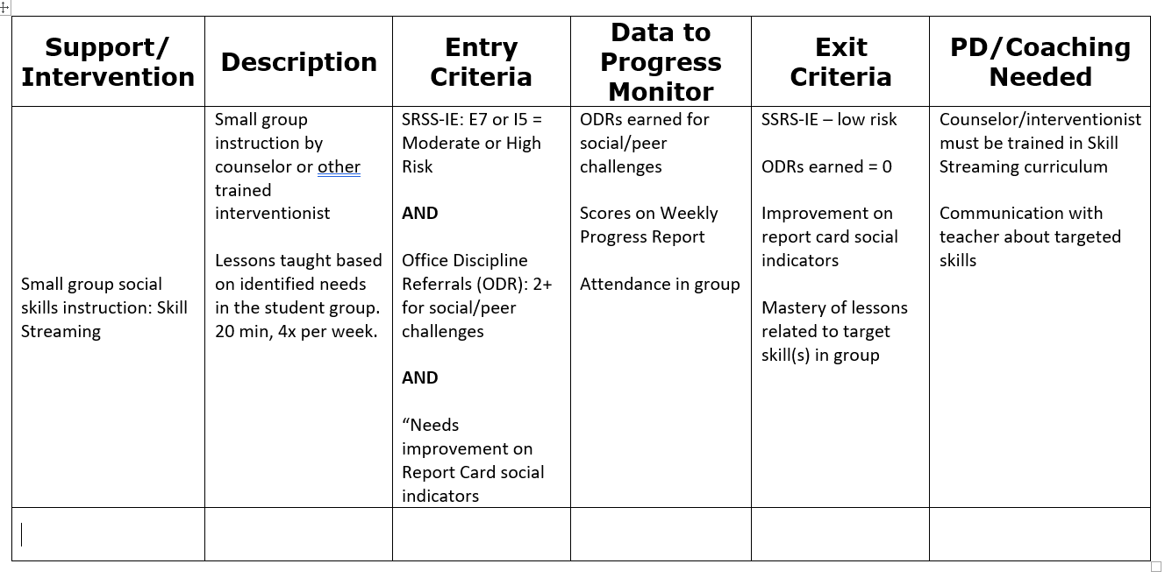
Example: Intervention DDRs

Slide 80
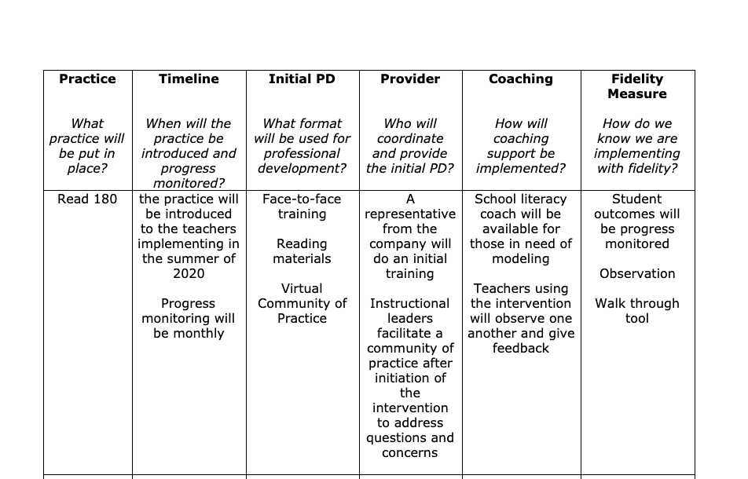
PD & Coaching: Planning for Success

Slide 81
Scheduling Interventions
What is your system and how is that communicated?

Slide 82
Team Time:
Continuum of Supports
Conduct resource mapping of existing Tier 2 interventions, identify gaps, and explore additional intervention options. Utilize findings to build a continuum of supports, establish decision rules for student entry and exit, and explore scheduling of interventions.

Slide 83
Team Share Out

Slide 84
Big Ideas
Continuum of Supports
A few viable interventions are more effective than many under-supported options on the continuum of supports
Staff who deliver interventions need both professional learning and coaching for support in delivering interventions.

Slide 85
Alignment
Core Component 1: Aligned Organizational Structures

Slide 86
Vision
Build and sustain a system that ensures that all students receive high quality core academic, behavioral and social-emotional instruction and evidence-based advanced tier interventions to support their learning needs.
This Photo by Unknown Author is licensed under CC BY-NC-ND

Slide 87
Essential Element Alignment
Teaming
Universal Screening/RFA
EBP Interventions and Supports Continuum
Academics
Behavior and Mental Wellness
Progress Monitoring
Data-informed Decision Making

Slide 88
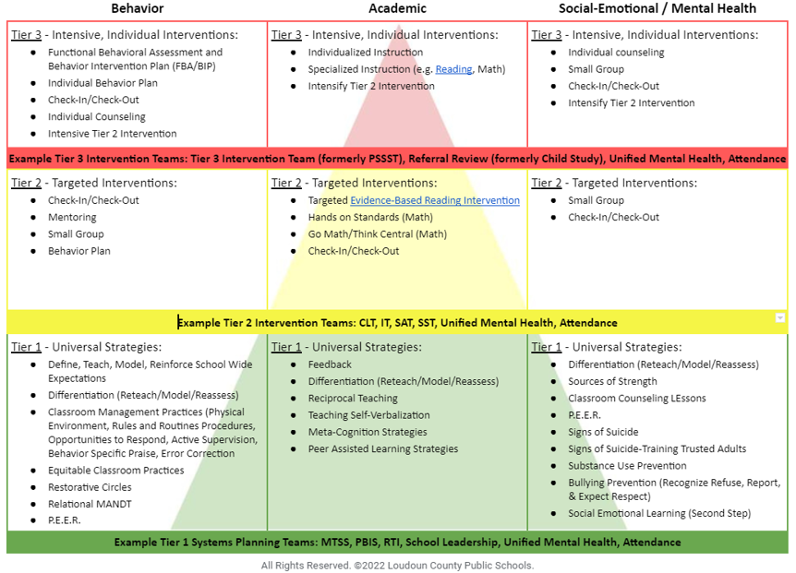
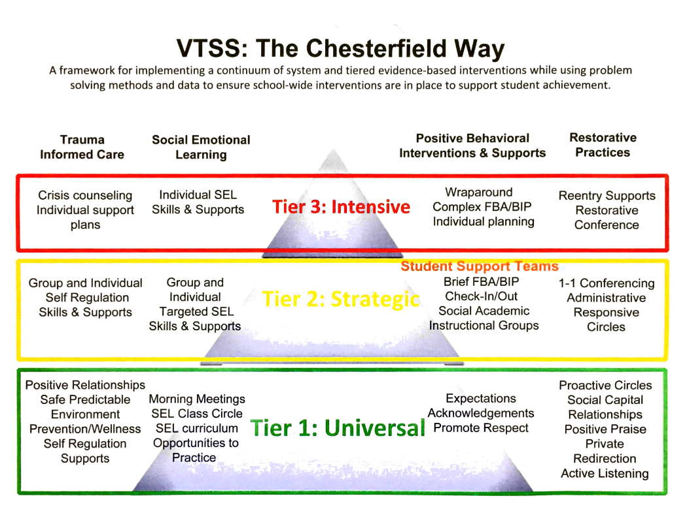
Aligned Systems Examples
Loudoun County Schools
Chesterfield County Schools

Slide 89
Discussion: Alignment
How do we know AT interventions align with tier 1?
How do students continue to access tier 1?
How are Advanced Tiers systems aligned across domains (academic, behavior, mental health)?

Slide 90
Big Ideas:
Alignment
The more time students spend away from Tier 1 core instruction, the harder it may become for them to exit from advanced tiers intervention
Strive to align content and scheduling needs so that students are able to access Tier 1 core instruction

Slide 91
Systems for Collecting & Reviewing Data
Level of Use, Monitoring Intervention Effectiveness & Fidelity, Monitoring Student Progress
Core Component 2 - Problem Solving Process
Core Component 3 - Tiered Continuum of Supports
Core Component 4 - Systematic Implementation
Core Component 5 - Evaluation

Slide 92
Tier 2 Data Systems
LEVEL OF USE
DATA
INTERVENTION EFFECTIVENESS
STUDENT
PERFORMANCE
INTERVENTION FIDELITY

Slide 93
Advanced Tiers Data
Support the System
Support the Student
Level of Use:
% of students accessing advanced tiers interventions
Effectiveness of EACH intervention in place
Students entering and exiting advanced tiers (movement across tiers)
Fidelity of implementation
Progress monitoring: Continue, fade, modify, or move on (movement within a tier)

Slide 94
Level of Use
Team uses data to determine if there is sufficient use of Tier II
Too many: >20%
Too few: <1%
Just Right: 5-15%

Slide 95
Calculating Level Of Use Data
Potential Steps: | Example:
Identify # of students in your building | 500 students
Determine 5% of your school population. Determine 20% of your school population | 5%= 25 students 20%= 100 students 25-100 students should be accessing advanced tier interventions
Can our current systems support this many students? | Yes: Keep Going No: Team Problem Solving
Determine how many students are currently accessing or requiring access to Tier II interventions (consider decision rules and RFA). | Less than 25 or more than 100: Team Problem Solving Between 25 and 100: Just Right!
Reassess each month | And as students move in and out of receiving Tier II interventions.

Slide 96
Healthy Framework Quick Math
What is your total school population?
What is the 10-15 % range of your total school population?
What might be the number of students in your school receiving tier 2 intervention at any one point in time?
What is the 1-5% range of your total school population?
What might be the number of students in your school receiving tier 3 intervention at any one point in time?
Healthy

Slide 97
The Case of the Flipped Triangle
Below Benchmark 60%-80%
At Benchmark 20%-40%

Slide 98
Level of Use Problem Solving
Too many students require more intensive instruction?
Consider:
Revisiting decision rules
Modify and enhance Tier 1 instruction

Slide 99
Intervention Effectiveness
Teams need to know whether advanced tier interventions are effective
What does adequate progress look like (decision rule)?
What % of students are being successful in each intervention?

Slide 100
Intervention Effectiveness
Tier 2 Team Meeting Example

Slide 101
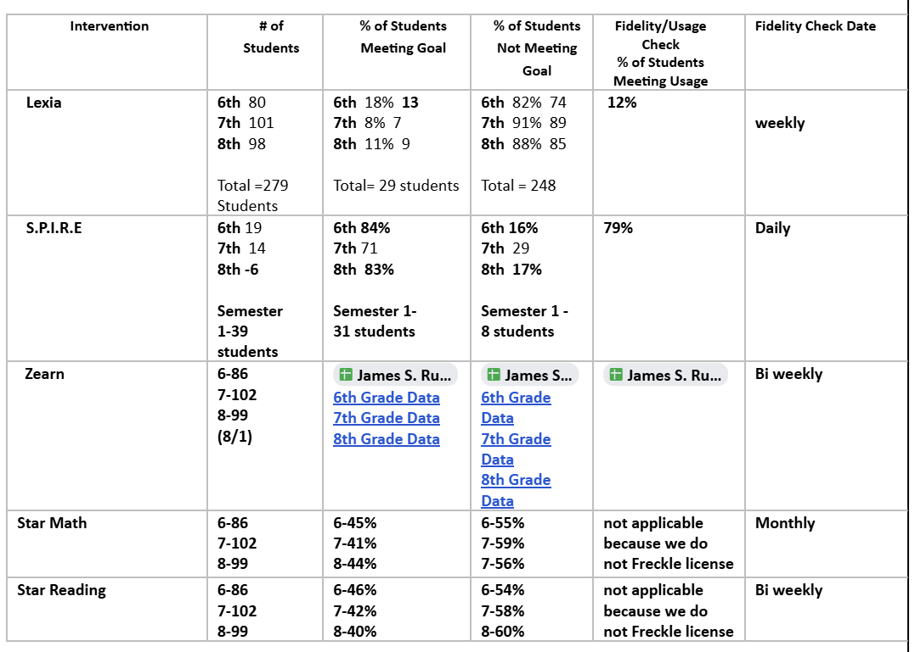
Intervention Monitoring

Slide 102
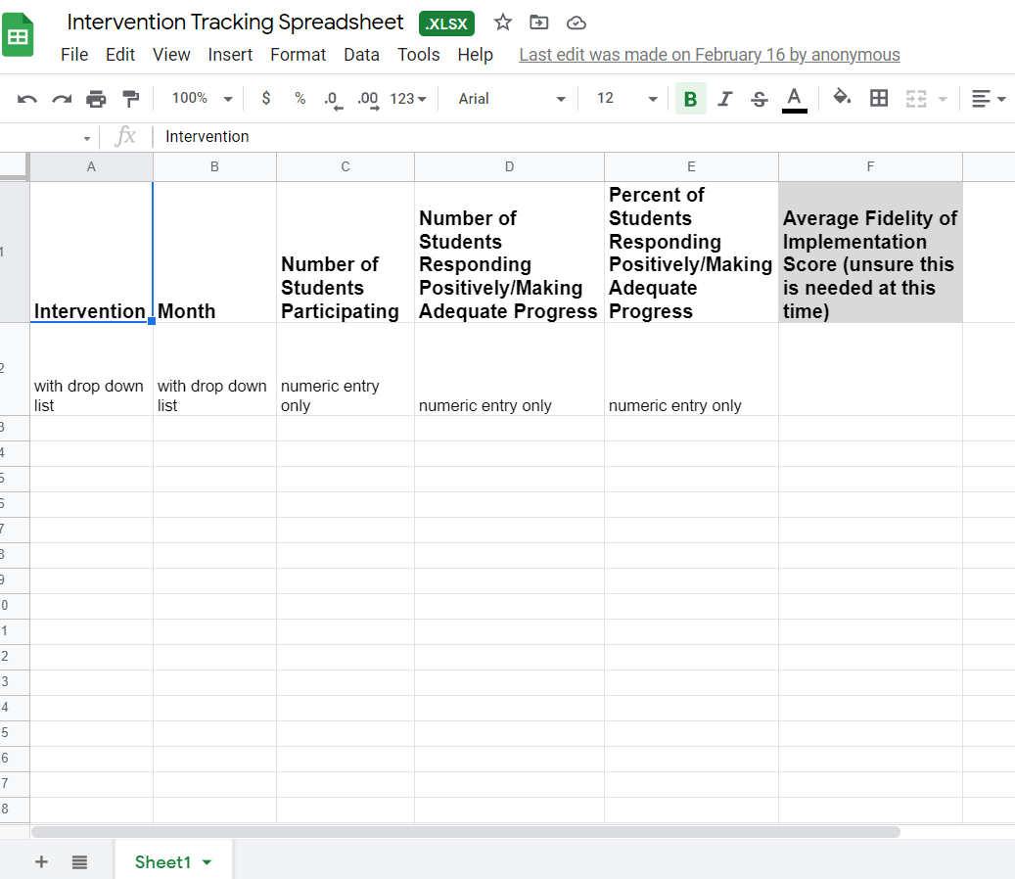
Electronic Intervention Tracking
Intervention Tracking Spreadsheet

Slide 103
Progress Monitoring Student Data

Slide 104
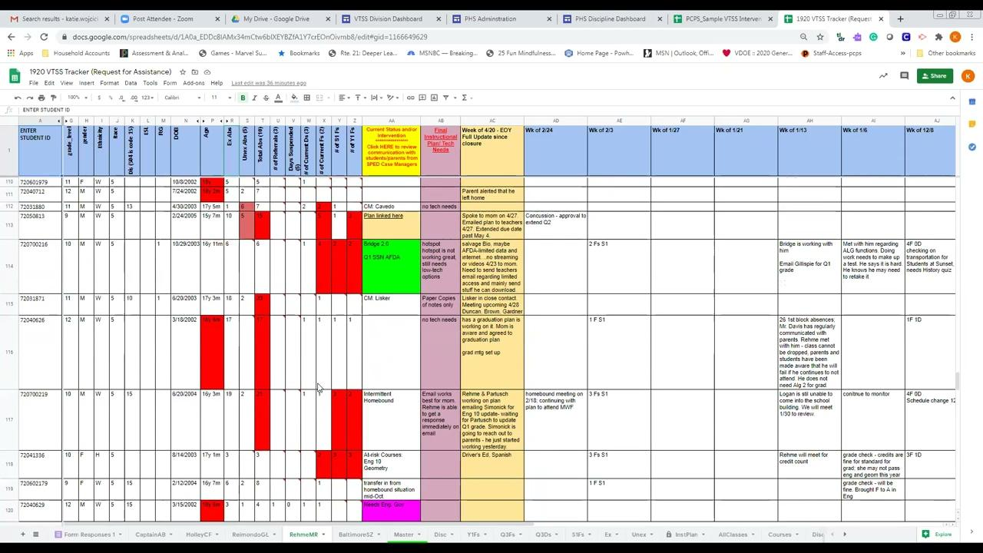
Powhatan County Public Schools Progress Monitoring Example

Slide 105
Defining Progress Monitoring
Common Language
Monitors student progress across all three tiers
Evaluates the effectiveness of instruction so that teachers can create better instructional programs
Identifies students who are not making adequate progress and who need additional or alternative instruction
Estimates rates of improvement for each student

Slide 106
Progress Monitoring Across Tiers
Tier 1: Universal screening of all students to determine who is and is not, responding to universal instruction
Tier 2: Assess response to Tier 2 interventions
Tier 3: Assess response to intensive interventions and uses data to modify individualized instruction, as needed

Slide 107
Progress Monitoring
Example Decision Rules
Definition of adequate progress
Expected Rate of Progress
How much progress should the student make each week based on the intervention?
Frequency of measurement
Progress monitoring intensity increases with intensity of intervention

Slide 108
Graphing Progress Monitoring Data
Baseline: where the student is performing prior to intervention
Goal: where the student is expected to be performing by a given date
Goal Line/ Aim Line: line connecting the baseline to the goal.
Phase Line: line that separates changes to the intervention

Slide 109
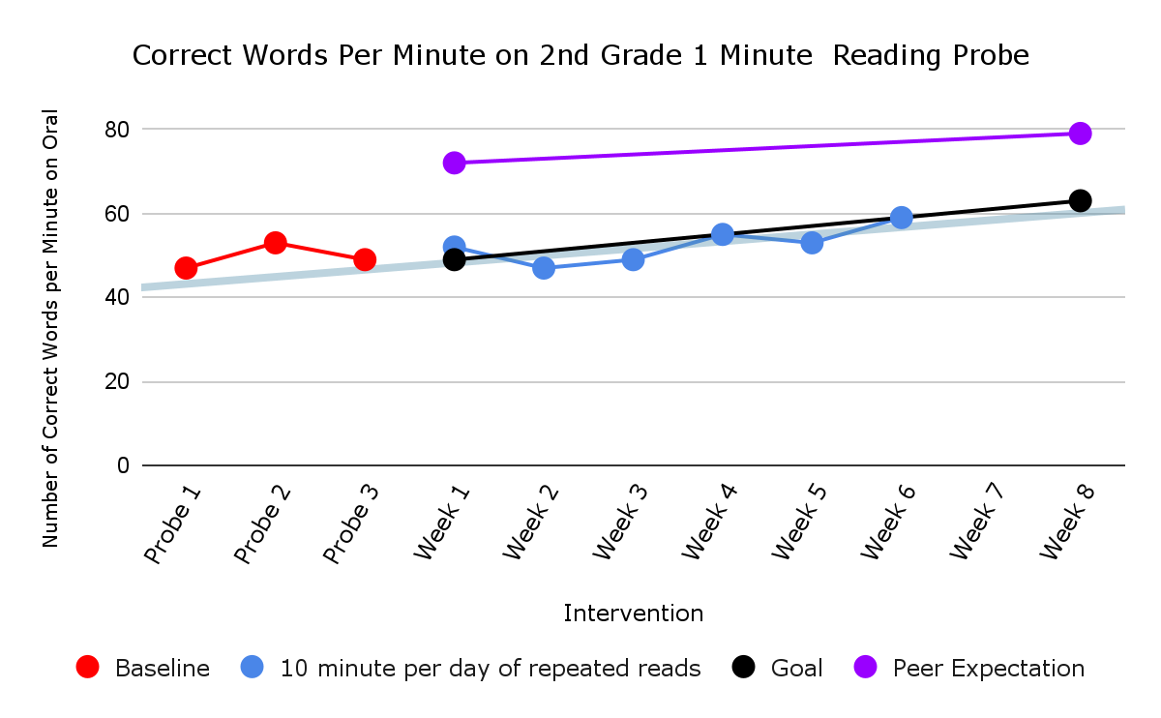
Academic Graphing Example
Baseline
Intervention

Slide 110
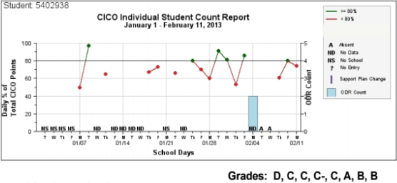
Behavior Graphing Example
transition out of CICO?
continue for 1 more 4-week cycle and then review?
add another intervention?

Slide 111
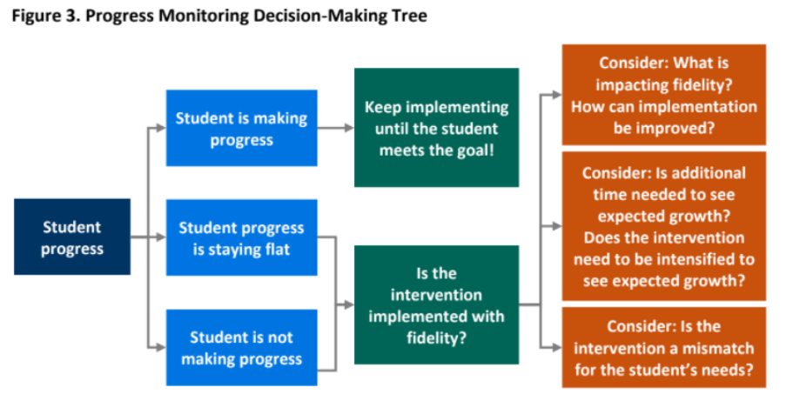
Decision Tree Example

Slide 112
Progress Monitoring Frequency
Frequency of progress monitoring increases with intensity of the intervention
Ex. A student receiving 15 minutes of intervention each day may have progress monitored once a week, whereas a student receiving 15 minutes 3 times a week may only be progress monitored once every 2 weeks

Slide 113
Progress Monitoring Reports
Prior to meeting, intervention coordinators review data and determine:
Continue: students making progress, but have not met their goal
Fade/Graduate: students who have met their goal and should be considered for fading or movement back to Tier I
Modify/Intensify/Change: students not responding

Slide 114
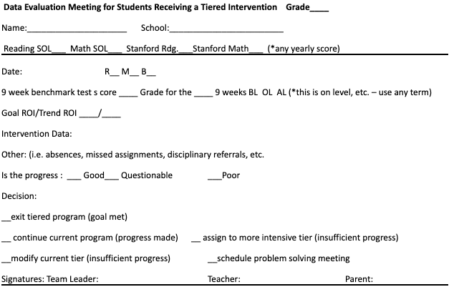
Coordinator Report Sample

Slide 115
Team Data Conversations about Student Performance
Is the student making enough progress to meet their goal?
Sufficient Progress - Goal Not Yet Met
Consider continuing the intervention
Sufficient Progress - Goal Met
Consider fading the intervention back to Tier I instruction
Insufficient Progress - High Fidelity
Consider modifying/changing the intervention
Insufficient Progress - Low Fidelity
Consider supporting staff to increase fidelity

Slide 116
Big Ideas:
Progress Monitoring
Track progress of students in intervention to determine intervention effectiveness.
Progress monitor individual student performance data and apply decision rules to continue or alter support
Graph data for team data-informed decision-making

Slide 117
Fidelity of Implementation
What is your System?
What does Fidelity mean? The degree to which an intervention is delivered as intended.
Why is that is important?
Helps us to know if the student is not responding to the intervention and may need something more or different.
…or if we are not implementing the intervention the way it is intended to reach the desired outcomes.

Slide 118
Checklist Manifesto

Slide 119
How to Measure Fidelity
Make a checklist of the core implementation features of the intervention.
Observe the intervention and look for the core features.
Compare expected implementation with what is currently being implemented.
Note: many evidence-based interventions have fidelity monitoring tools!

Slide 120
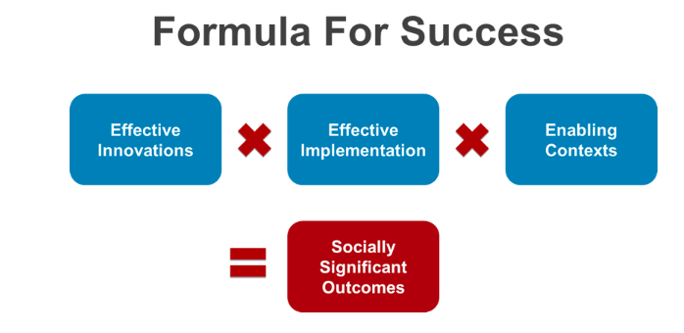
Power of Fidelity
National Implementation Research Network

Slide 121
Advanced Tiers Team Fidelity Conversations
Evaluate fidelity of intervention implementation
more staff training? modeling?
Evaluate match to student need
is it the right fit?
Evaluate contextual fit
right match between the strategies, procedures, or elements of an intervention and the values, needs, skills, and resources of those who implement and experience the intervention

Slide 122
DIDM Big Idea:
Fidelity
Regularly analyze and evaluate advanced tier data including:
level of use
intervention effectiveness
student performance
fidelity of implementation

Slide 123
Team Time:
Collecting and Reviewing Data
Develop systems for collecting and reviewing data, including level of use, monitoring intervention effectiveness & fidelity and monitoring student progress.

Slide 124
Team Share Out

Slide 125
Action Planning
Create an action plan outlining ongoing tasks to be addressed upon the team’s return to school.

Slide 126
Team Time: Action Planning
Create an action plan outlining ongoing tasks to be addressed upon the team’s return to school.

Slide 127
References
Algozzine, B., Barrett, S., Eber, L., George, H., Horner, R., Lewis, T., Putnam, B., Swain-Bradley, J., McIntosh, K., & Sugai, G. (2014).
Crone, D. A., Horner, R. H., & Hawken, L.. S. (2004). Responding to problem behavior in schools: The Behavior Education Program. New York: Guilford.
Everett, S., Sugai, G., Fallon, L., Simonsen, B., & O’Keeffe, B. (2011). School-wide Tier II interventions: Check-In Check-Out Getting Started Workbook. OSEP Technical Assistance Center on Positive Behavioral Interventions and Supports.

Slide 128
References (2)
Hosp, J. L., Hosh, M. K., Howell, K. W., Allison, R. (2014). The ABCs of curriculum-based evaluation: A practical guide to effective decision making. New York: Guilford.
Lembke, D. (n.d.). Interventions in RTI Handouts. Retrieved from https://rti4success.org/sites/default/files/interventions_in_rti_handouts.pdf
McIntosh, K. & Goodman, S. (2016). Integrating multi-tiered systems of support: Blending RTI and PBIS. New York: Guilford Press.

Slide 129
References (3)
Riley-Tillman, C. T., Burns, M. K., & Kilgus, S. P. (2020). Evaluating Educational Interventions, Second Edition: Single-Case Design for Measuring Response to Intervention (Second ed.). The Guilford Press.
Sanetti, L. & Meek, M. (2019). Supporting successful interventions in schools : tools to plan, evaluate, and sustain effective implementation. New York: The Guilford Press.

Slide 130
References (4)
The IRIS Center. (2014). Evidence-based practices (part 3): Evaluating learner outcomes and fidelity. Retrieved from https://iris.peabody.vanderbilt.edu/module/ebp_03/
Tiered Fidelity Inventory (TFI) Scoring Guide - Adapted from Algozzine, B., Barrett, S., Eber, L., George, H., Horner, R., Lewis, T., Putnam, B., Swain-Bradway, J., McIntosh, K., & Sugai, G (2014). School-wide PBIS Tiered Fidelity Inventory. OSEP Technical Assistance Center on Positive Behavioral Interventions and Supports. www.pbis.org.

