Slide 1
Advanced Tiers
Setting Up Tier 2 Systems
Day 1

Slide 2
Follow VTSS
Thank you for attending. Please feel free to tag us at any of our social media handles below!
Facebook - VTSSRIC
LinkedIn – VTSS

Slide 3
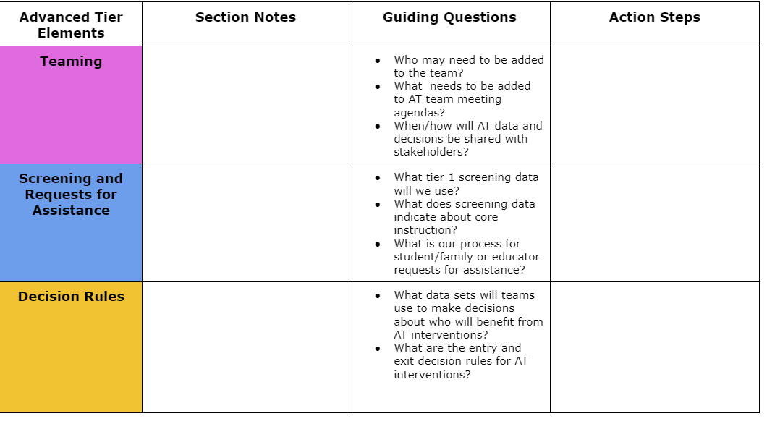
Advanced Tiers Notetaker

Slide 4
Day 1 Agenda
8:30-8:45 Welcome and MTSS Grounding
8:45 -9:00 Introduction-What is Tier 2? Characteristics of Tier 2 interventions, who for and who provides?
9:00-10:30 Tier 2 Teaming-Systems and Individual Student Support
10:30 - 10:45 Break
10:45 - 12:15 Data Systems for Identifying Students
12:15 - 12:30 Wrap-up/Feedback

Slide 5
Community Agreements
Be Responsible | Take care of your needs. Share your questions with the group.
Be Respectful | Respect others intentions Honor the impact of your words Earnestly move toward completing tasks during team work time
Be Engaged | Ask what you need to know to understand and contribute. Stay present Listen to others attentively. Share your expertise, information and ideas.

Slide 6
Learning Intentions - Day 1
Develop an understanding of essential components necessary for implementing Tier 2 support.
Clarify the roles and responsibilities of the Tier 2 team in supporting both systems and individual students.
Develop and document clear Tier 2 team processes and procedures, including team membership and meeting structures.
Determine the data sources necessary to accurately identify students in need of Tier 2 support.

Slide 7



Anchor Documents

Slide 8
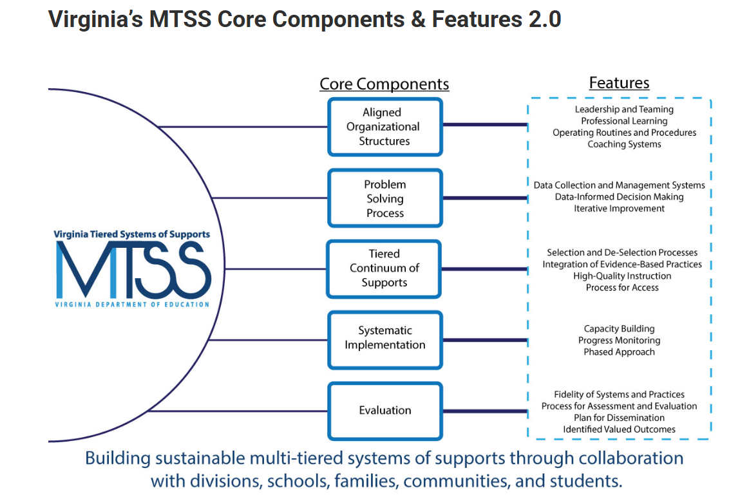
VTSS Core Components

Slide 9

What is MTSS?

Slide 10
What is MTSS
MTSS is a systemic, data-driven approach that allows divisions and schools to provide evidence-based practices and interventions to meet the needs of their students. This is done through a clearly defined process that is implemented to fidelity by all stakeholders within the school and/or division.

Slide 11
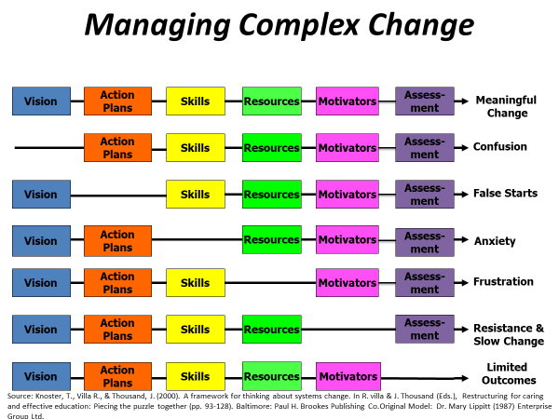
Vision For Advanced Tiers
Build and sustain a system that ensures that all students receive high quality core academic, behavioral and social-emotional instruction and evidence-based advanced tier interventions to support their learning needs.

Slide 12
What is Your Vision for Tier 2 School Implementation?

Slide 13

Essential Element Alignment
Teaming
Universal Screening/RFA
EBP Interventions and Supports Continuum
Academics
Behavior and Mental Wellness
Progress Monitoring
Data-informed Decision Making

Slide 14
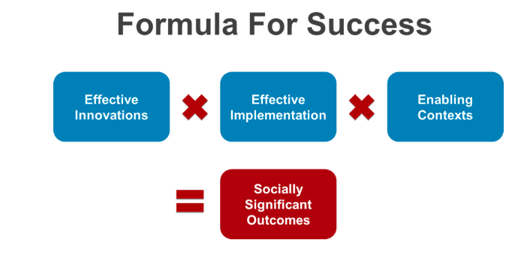
Science of Implementation
National Implementation Research Network

Slide 15
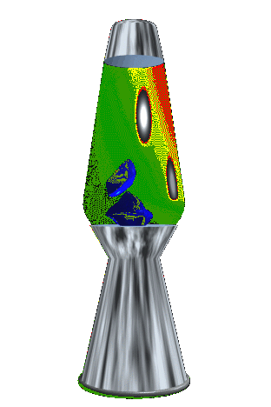
Moving In and Out of Tiers
How are students’ experiences in a multi-tiered system of supports like a lava lamp?

Slide 16

Where are we in the Triangle?
Tier 3 for a Few: Intensive, Individualized
Tier 2 for Some: Targeted for Small Groups
Tier I for All: Core/Universal
1 - 5%
5 - 15%
80 - 90%

Slide 17
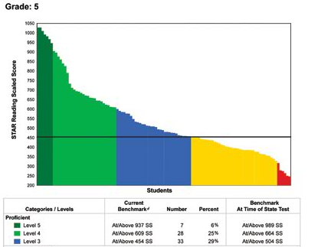
Data to Assess Core Instruction
60% of students
40% of students

Slide 18



To get to the outcome
Advanced Tiers
What we use to make decisions? Monitor progress?
Monitor fidelity?
SYSTEMS
DATA
What we do to support adults to implement the practices?
PRACTICES
What we do to
support students?
Notes:
18

Slide 19
What is Tier 2?
Targeted supports which are highly efficient and readily accessible to students not being successful with Tier 1
Small group intervention
Providing a ‘higher dose” of universal, Tier 1 instruction, and interventions aligned to student needs
Involves implementing systems and practices layered upon Tier 1

Slide 20
Who is supported by Tier 2?
Tier 2 is designed to provide an additional layer of proactive support to the 10-15% of students who need more than Tier 1 supports
The focus of Tier 2 is on implementing preventative strategies that address academic and SEB needs before students require more intensive supports

Slide 21
Who provides Tier 2 Supports?
All school staff play a role in successfully implementing Tier 2.
Each staff member in the school should expect and be prepared to provide Tier 2 supports
Members of a school-level Tier 2 Team lead & coordinate overall Tier 2 implementation

Slide 22
Goals of the Tier 2 team
Provide supports to identified students proactively and effectively
Install and sustain an efficient and effective array of Tier 2 interventions
Identify and match students to appropriate targeted interventions
Monitor progress regularly

Slide 23
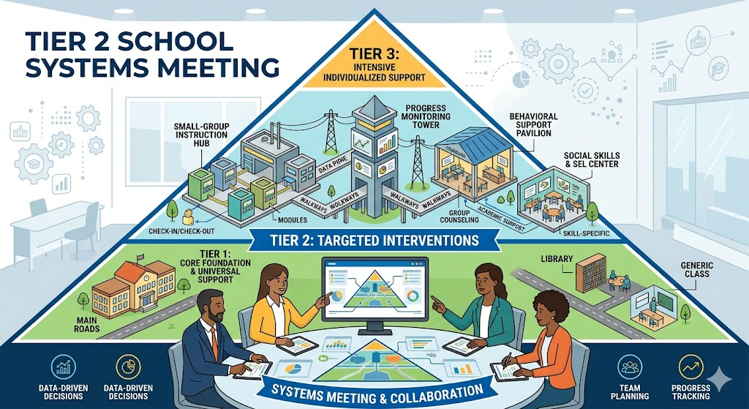
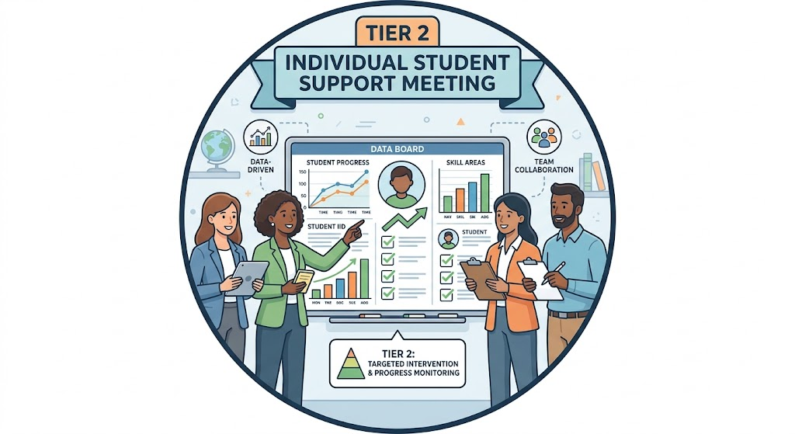
Tier 2 Meeting Types and Teaming Structures
Tier 2 Systems Meetings
Tier 2 Individual Student Support Meetings
Team Composition
Agenda

Slide 24

Student Issue or Systems Issue?
Environment or student?
Fig. “Classroom Chaos”. May 31, 2020. http://healthyteachingonline.com/blog/wp-content/uploads/2014/09/schoolchaos.jpg

Slide 25
Team Icons

Slide 26
Tier 2 Team Meeting:
Systems
Purpose: to install and monitor the implementation of targeted interventions, which includes:
Identifying and installing an array of evidence-based interventions matched to student need
Monitoring overall fidelity and effectiveness of Tier 2 interventions
Addressing system barriers (e.g., staff training, time for student intervention to occur) to implementation

Slide 27
Key Activities to Define and Monitor
Tier 2 Systems
Identifying student strengths & needs using aggregate data and selecting & installing evidence-based interventions aligned with Tier 1
Creating, documenting, and monitoring the use of a request for assistance process
Defining decision rules and processes for identifying, monitoring, and exiting students
Tracking the total number of students within subgroups receiving Tier 2 & types of interventions
Evaluating overall student response to Tier 2 interventions
Identifying tools & procedures to assess fidelity
Coordinating with DLT to provide training opportunities to ensure staff have necessary skills to support Tier 2 interventions

Slide 28
Tier 2 Team Meeting:
Individual Student Support
Purpose: to implement and monitor individual student progress on Tier 2 interventions, which includes:
Matching individual students to interventions based on referral data/need, and function of behavior
Monitoring each student’s progress.
Fading or intensifying supports

Slide 29
Key Activities for Tier 2
Individual Student Support Team
Uses data to match referred students to appropriate Tier 2 interventions
Uses data decision rules to determine student response to intervention
When there is a lack of response to intervention, analyzing individual student data to make adjustments to the intervention (e.g., increase frequency or intensity, re-evaluate function)
When there is a positive response to intervention, fading the student to lower levels of support

Slide 30

Who is on your team? Roles and Expertise Matter

Slide 31
Effective Team Operating Procedures
Regular meeting format and agenda (evaluated for fidelity)
Established team norms that are monitored for impact & include procedures for all members to participate as equal partners
Defined meeting roles (timekeeper, notetaker, etc.)
Regular two-way data sharing and communication with Tier 1 and Tier 3 teams
Current action plan

Slide 32
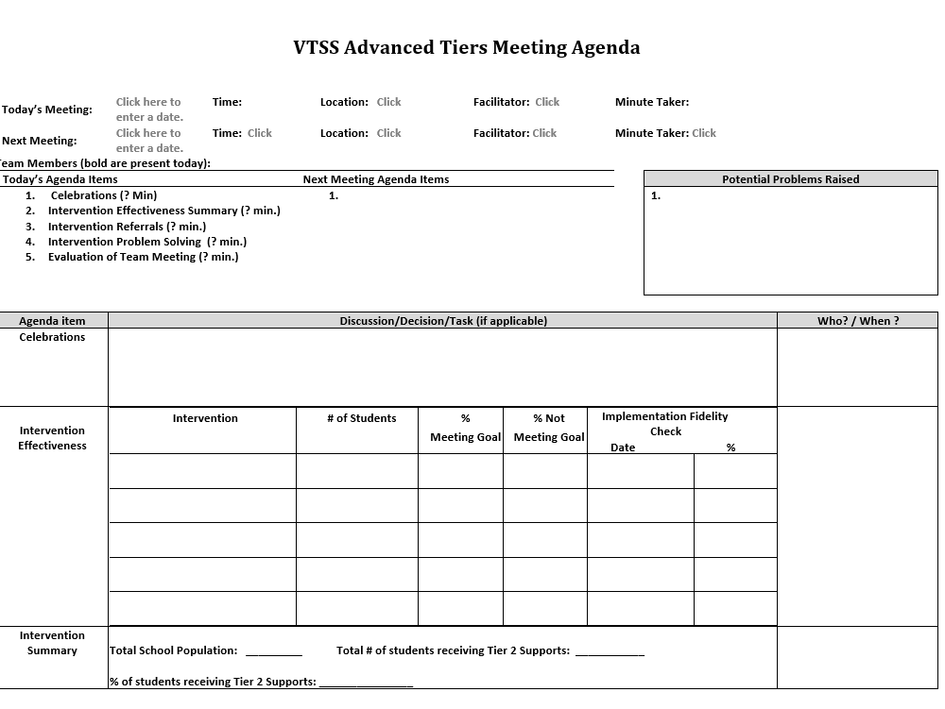
Advanced Tier
Sample Meeting Agenda

Slide 33
Bi-directional Stakeholder Communication
Why?
Builds shared commitment to advanced tier interventions
Increases awareness of interventions
Fosters deeper understanding of family and culture-specific functions of behaviors
How?
Share student progress graphs in grade level meetings
Include graphs in school/home communication

Slide 34
Team Time: Teaming
Which of the activities has your team defined and how do they monitor these?
What activities might you want to consider including in your Tier 2 meetings?
What needs refining? Do you need written processes & procedures for team membership, scheduling, standing structures/agendas, etc.

Slide 35

Example of a Tier 2 Meeting

Slide 36

Team Share Out

Slide 37
Data Systems Overview

Slide 38
DATA Systems
Why would you want a data system?
What would be some common features of a data system that would be helpful for your Tier 2 team?

Slide 39
Team Data Conversations
Tier 1/ Universal
Tier 2/3
Targeted
Tier 3/ Tertiary
Intervention level of use and % of students making progress
Student referral and progress monitoring
Intensified
student progress monitoring
Schoolwide and classroom
Increased progress monitoring, fidelity measures and family engagement

Slide 40
Tier 2 Core Intervention Features
Increased Structure & Prompts
Increased Intensity of Data Collection
Increased
Regular Feedback
Increased Family Engagement
Increased Instruction on Skills (prosocial, emotional, academic)
Tier 2 Core Features
Efficient system for access and delivery of intervention
Adapted from Horner & Sugai (2016)

Slide 41
Teams building Infrastructure around WHAT?
Support the System
Support the Student
Level of Use:
  % of students accessing advanced tiers interventions
Effectiveness of EACH intervention in place
Students entering and exiting advanced tiers (movement across tiers)
Fidelity of implementation
Progress monitoring: Continue, fade, modify, or move on (movement within a tier)

Slide 42
What Data Sources do you use for Identifying Students?

Slide 43
Possible data sources you might use to identify students are at-risk.
Parent Contacts
Counselor Visits
SOLs
ODRs
Attendance
Data!
GPA
ISS/OSS
Nurse referrals
Teacher Nominations
Universal screening scores
Benchmarks

Slide 44
Breakout - Data Sources
Discuss data sources currently used and other sources the team would like to consider.
(Table 2)
Data Source | Description | Benefits
Academic indicators | Grades work samples | consistency across all students in a class
Time spent out of class | attendance nurse visits | Objective identifies students with internalizing behaviors

Slide 45
Share Out - Data Sources
Discuss data sources currently used and other sources the team would like to consider.
(Table 2)
Data Source | Description | Benefits | Proactive/Reactive
Academic indicators | Grades work samples | consistency across all students in a class
Time spent out of class | attendance nurse visits | Objective identifies students with internalizing behaviors

Slide 46
What is Universal Screening?
Universal screening is a systematic process of assessing all students to identify students at risk of academic, behavioral, or social-emotional challenges.

Slide 47
Purpose of Screening
PROCESS
Evaluate Effectiveness of Core (Tier 1)
INTERVENTION
Part of the Request for Assistance Process that is one data point used to measure progress.
Adapted from https://assets-global.website-files.com/5d3725188825e071f1670246/5d7035c071700f1e3b846aab_b1_lewis_powers_dixon_revised.pdf

Slide 48
Universal Screener Selection
Questions
Considerations
Is the core instruction sufficient/is it improving?
For which groups is it working/not working?
What is the efficacy of the tiered interventions?
What is the individual growth of our students?
Cost
Capacity to administer and analyze
Ability to Scale-up
Communication of Results and Reporting of Needs

Slide 49



Data Sources: Universal Screeners
ACADEMIC National Center on Intensive Interventions RAND Education Assessment Finder | BEHAVIOR National Center on Intensive Interventions Center on PBIS | MENTAL WELLNESS RAND Education Assessment Finder

Slide 50
Break Out
Universal Screening
Discuss what your screening data indicates about core instruction.
Evaluate how universal screening is being being used to identify students in need of additional support. How can that be used as you are setting up systems to identify students? Are there any changes needed?
Review resources provided in slides.

Slide 51
Finish Today-Exit survey
What to expect for Day 2
Design effective data systems to monitor Tier 2 implementation, interventions, and student outcomes.
Create an action plan that outlines ongoing and priority tasks for the Tier 2 team.

Slide 52
Advanced Tiers – Day 2
Setting Up Tier 2 Systems

Slide 53
Learning Intentions - Day 2
Design effective data systems to monitor Tier 2 implementation, interventions, and student outcomes.
Create an action plan that outlines ongoing and priority tasks for the Tier 2 team.

Slide 54
Day 2 Agenda
8:30-8:45 Welcome
8:45-9:00 Recap
9:00-9:30 Outcome Data Systems
9:30-10:30 Data Systems: Level of Use & Intervention Effectiveness
10:30-10:45 Break
10:45-12:00 Data Systems - Student Performance & Fidelity
12:15-12:30 Wrap-up/Feedback/exit survey

Slide 55

Mental Wellness Conference

Slide 56
Recap from Day 1
What is Tier 2?
Characteristics of Tier 2 interventions, who for and who provides?
Tier 2 Teaming-Systems and Individual Student Support
Components of Tier 2 interventions-a brief overview
Data Sources

Slide 57
Outcome Data
Outcome data systems are used to evaluate individual students' progress towards meeting intervention goals and the overall effectiveness of interventions to monitor Tier 2 systems (Algozzine et al., 2019; Center on PBIS, 2025).

Slide 58
Tier 2 system use and outcome data
Tier 2 data systems should allow teams to ask and answer the following systems-level questions on a monthly to quarterly basis:
What percent of the school population is enrolled in the intervention?
What percent of students enrolled in the intervention are responding to the intervention?
What percentage of students are meeting their daily/weekly individual goals?
Does data suggest a need for a systems-level modification to the intervention?

Slide 59
Data Source: Request for Assistance
Written procedure that provides guidance for teachers and/or caregivers to seek additional support for students who are not making sufficient progress at Tier 1.
What is your System and how is that communicated to all?
(Students may also use this process to request additional support.)

Slide 60
Request for
Assistance Forms
Designed for quick response
Staff (Teacher, Support Staff, Administration), Caregiver and/or Student may make a nomination.
Should identify students with not only externalizing (interpersonal) risk characteristics but those with internalizing (intrapersonal) risk characteristics as well.
Recommendations may also be scheduled to occur at designated times across the school year.

Slide 61
Team Time: Request for assistance
What is your current process?
Is it formal or informal?
Is it accessible to teachers, students, and families?
Is the request data-based?
How is it communicated across your division?

Slide 62
What is your system?
Data Decision Rules (DDR)
Decision rules, or “entry and exit criteria”
Allow for decisions to be made objectively on who receives support.
Provide a uniform method to refer students to advanced tiers.
Provide clear exit criteria from advanced tiers interventions and supports.

Slide 63
2 Types of Data Decision Rules
Systems Data Decision Rules: identification of students who are recommended for Tier 2 supports.
Intervention Decision Rules: identification of which intervention “matches” the students need, with clear entry/exit criteria. (What and How)

Slide 64
The Process
Identify Data Sources
Triangulate Data
Identify Students
Identify Need
Select Practices
Develop Intervention data decision rules DDRs

Slide 65
The Process- D
Identify Data Sources
Triangulate Data
Identify Students
Identify Need
Select Practices
Develop Intervention data decision rules DDRs

Slide 66
Triangulate the Data
is critical as screening will over-identify students at risk
will identify a smaller, more precise group to target for interventions
We are not making decisions about the data yet, that will come with data decision rules (DDR).

Slide 67

Set Floors & Ceilings with Data
Determine what the threshold is for students who need tier 2 support
ALSO determine the cap for students who need more intensive supports

Slide 68
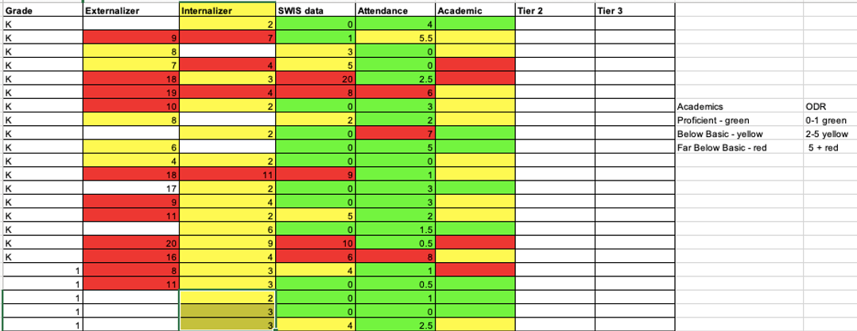
Identify Students

Slide 69
Tier 2 Academic Decision Rules
Reading Data Example
Below 25% on universal screener
Below 70% on benchmark assessments
Did not meet PALS benchmark
Did not pass prior year’s SOL
Did not achieve course credit

Slide 70
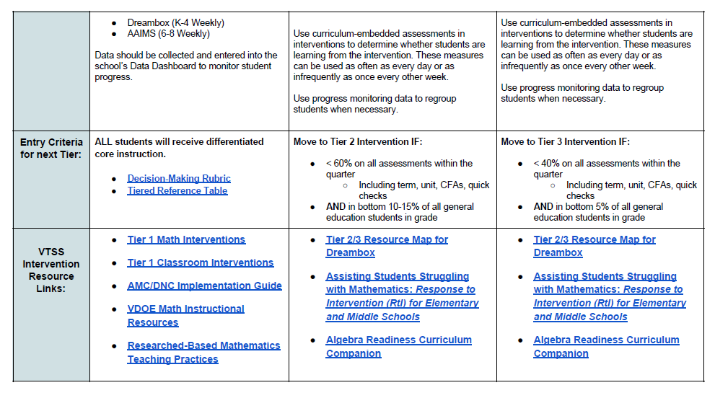
Tier 2 Academic Decision Rules
Mathematics Data Example

Slide 71
Tier 2 Decision Rules
Behavior Data Example
2-5 ODR’s
1 Suspension
> ? minutes missed instruction
> ? days unexcused absences
Incomplete classwork
Tardies
Student, caregiver, staff nomination

Slide 72
Tier 2 Decision Rules:
Mental Wellness Data Example
5+ visits to the nurse/school counselor per month
3-5 absences per month
2-4 tardies and/or early dismissals
Student, caregiver, staff nomination
Mental Wellness Screener

Slide 73
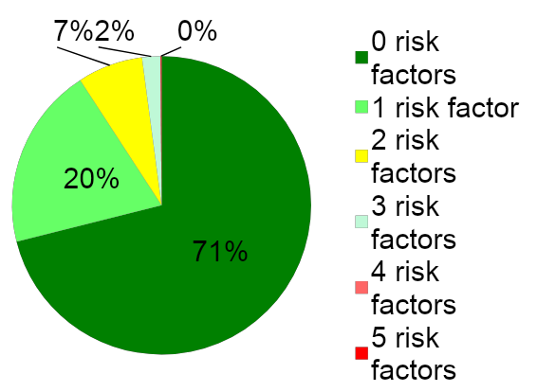
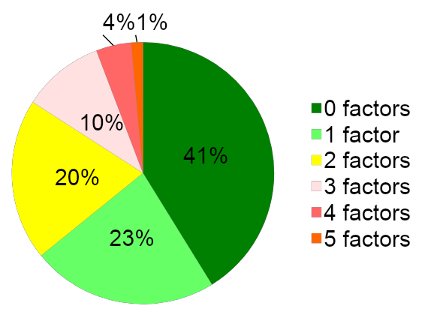
Risk Factors and Decision Rules
School A
School B

Slide 74
Sample Data Decision Rules Dashboard
Measure | Proficient Score | At-Risk | High Risk
Classroom Managed | 0-4 | 5 or more | 15 or more
ODR | 0-1 | 2-5 | 6 or more
Absences | <5 / trimester | 5+ / trimester | 10 / trimester
Tardy | <4 / trimester | 4+ / trimester | 10 / trimester
ISS | 0-1 | 2 | 4 or more
OSS | 0 | 1 | 2
Reading Virginia Growth Assessment | scores red or higher | scores fall between purple and red | scores fall below purple
Math Virginia Growth Assessment | scores red or higher | scores fall between purple and red | scores fall below purple
Writing Assessment | 3 or 4 | 2 | NS; 1
Nurse (non-medication) | 0-1 (no pattern) | 2-5 (patterns of regular visits) | 6 or more (patterns of regular visits)
*Ensure schools are looking at more than one data point to determine intervention need(s)*

Slide 75
Team Time:
Decision Rules
Evaluate, refine and/or create decision rules that triangulate multiple data sources to accurately identify students in need of Tier 2 support.

Slide 76
Team Share Out

Slide 77
Systems for Collecting & Reviewing Data
Level of Use, Monitoring Intervention Effectiveness & Fidelity, Monitoring Student Progress

Slide 78
Tier 2 Data Systems
LEVEL OF USE
DATA
INTERVENTION EFFECTIVENESS
STUDENT
PERFORMANCE
INTERVENTION FIDELITY

Slide 79
Advanced Tiers Data for Decision Making
Support the System
Support the Student
Level of Use:
  % of students accessing advanced tiers interventions
Effectiveness of EACH EB intervention in place
Students entering and exiting advanced tiers (movement across tiers)
Fidelity of implementation
Progress monitoring: Continue, fade, intensify or move on according to the responsiveness

Slide 80

Level of Use
Team uses data to determine if there is sufficient use of Tier II
Too many: >20%
Too few: <1%
Just Right: 5-15%

Slide 81
Calculating Level Of Use Data
Potential Steps: | Example:
Identify # of students in your building | 500 students
Determine 5% of your school population. Determine 20% of your school population | 5%= 25 students 20%= 100 students 25-100 students should be accessing advanced tier interventions
Can our current systems support this many students? | Yes: Keep Going No: Team Problem Solving
Determine how many students are currently accessing or requiring access to Tier II interventions (consider decision rules and RFA). | Less than 25 or more than 100: Team Problem Solving Between 25 and 100: Just Right!
Reassess each month | And as students move in and out of receiving Tier II interventions.

Slide 82

Healthy Framework Quick Math
What is your total school population?
What is the 10-15 % range of your total school population?
What might be the number of students in your school receiving tier 2 intervention at any one point in time?
What is the 1-5% range of your total school population?
What might be the number of students in your school receiving tier 3 intervention at any one point in time?
Healthy

Slide 83
The Case of the Flipped Triangle
Below Benchmark 60%-80%
At Benchmark 20%-40%

Slide 84

Level of Use Problem Solving
Too many students require more intensive instruction?
Consider:
_ Elevate Tier 1 Practices
  Revisiting decision rules
  Modify and enhance Tier 1 instruction
Do we have a healthy core?

Slide 85
Tier 2 Data Systems
Tier 2 Data Systems
LEVEL OF USE
DATA
INTERVENTION EFFECTIVENESS
STUDENT
PERFORMANCE
INTERVENTION FIDELITY

Slide 86
Intervention Effectiveness
Teams need to know whether advanced tier interventions are effective
What does adequate progress look like (decision rule)?
What % of students are being successful in each intervention?

Slide 87
Intervention Effectiveness
Tier 2 Team Meeting Example

Slide 88
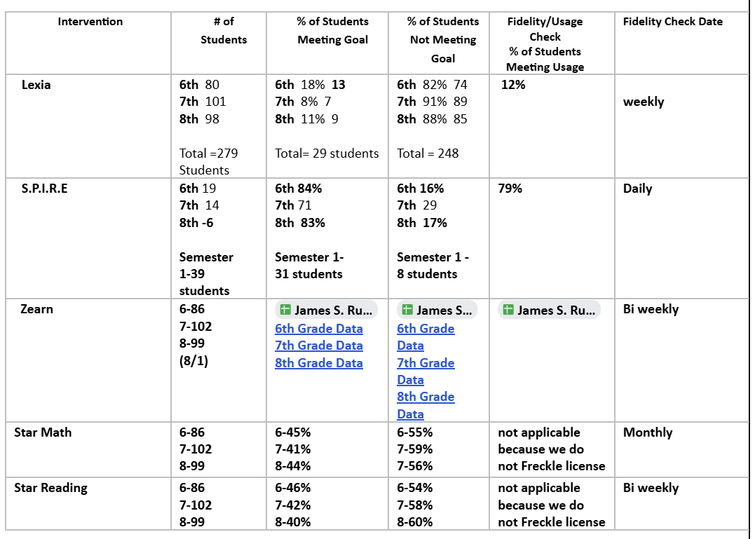
Tracking tool-Intervention Monitoring

Slide 89
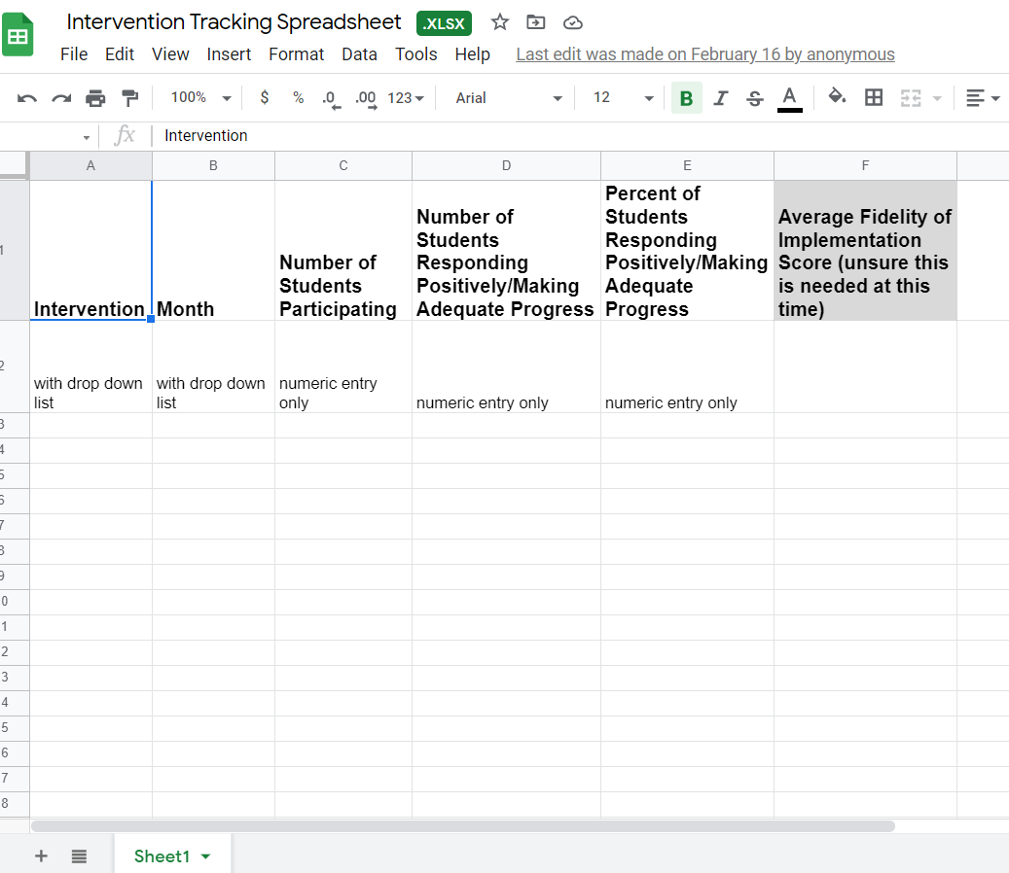
Electronic Intervention Tracking
Intervention Tracking Examples

Slide 90
Tier 2 Data Systems
Tier 2 Data Systems
LEVEL OF USE
DATA
INTERVENTION EFFECTIVENESS
STUDENT
PERFORMANCE
INTERVENTION FIDELITY

Slide 91
Defining Progress Monitoring
Common Language
Monitors student progress across all three tiers
Evaluates the effectiveness of instruction so that teachers can create better instructional programs
Identifies students who are not making adequate progress and who need additional or alternative instruction
Estimates rates of improvement for each student

Slide 92
Graphing Progress Monitoring Data
Baseline: where the student is performing prior to intervention
Goal: where the student is expected to be performing by a given date
Goal Line/ Aim Line: line connecting the baseline to the goal.
Phase Line: line that separates changes to the intervention

Slide 93
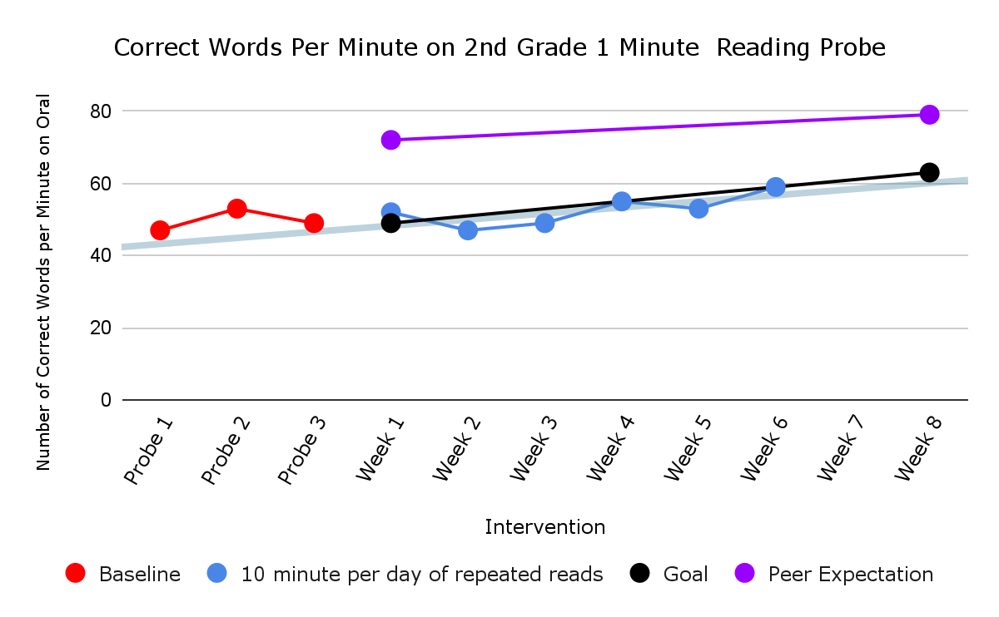
Academic Graphing Example
Baseline
Intervention

Slide 94
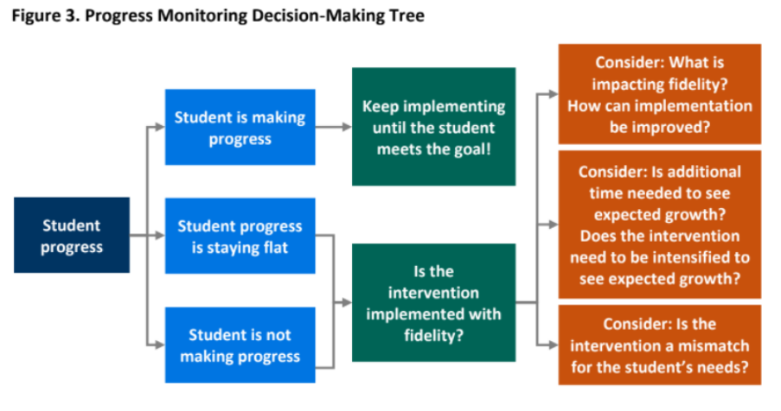
Decision Tree Example

Slide 95
Progress Monitoring Reports
Prior to meeting, intervention coordinators review data and determine:
  Continue: students making progress, but have not met their goal
  Fade/Graduate: students who have met their goal and should be considered for fading or movement back to Tier I
  Modify/Intensify/Change: students not responding

Slide 96
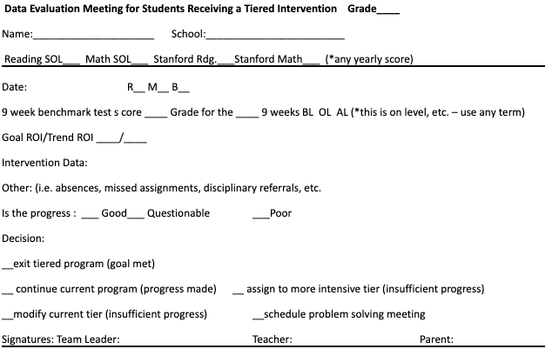
Coordinator Report Sample

Slide 97
Team Data Conversations about Student Performance
Is the student making enough progress to meet their goal?
Sufficient Progress - Goal Not Yet Met
  Consider continuing the intervention
Sufficient Progress - Goal Met
  Consider fading the intervention back to Tier I instruction
Insufficient Progress - High Fidelity
  Consider modifying/changing the intervention
Insufficient Progress - Low Fidelity
  Consider supporting staff to increase fidelity

Slide 98

Big Ideas:
Progress Monitoring
Track progress of students in intervention to determine intervention effectiveness.
Progress monitor individual student performance data and apply decision rules to continue or alter support
Graph data for team data-informed decision-making

Slide 99
Intervention Effectiveness
Teams need to know whether advanced tier interventions are effective
What does adequate progress look like (decision rule)?
What % of students are being successful in each intervention?

Slide 100
Fidelity of Implementation
What is your System?
What does Fidelity mean? The degree to which an intervention is delivered as intended.
Why is that is important?
Helps us to know if the student is not responding to the intervention and may need something more or different.
…or if we are not implementing the intervention the way it is intended to reach the desired outcomes.

Slide 101

Checklist Manifesto

Slide 102
How to Measure Fidelity
Make a checklist of the core implementation features of the intervention.
Observe the intervention and look for the core features.
Compare expected implementation with what is currently being implemented.
Note: many evidence-based interventions have fidelity monitoring tools!

Slide 103
Power of Fidelity
National Implementation Research Network

Slide 104
Advanced Tiers Team Fidelity Conversations
Evaluate fidelity of intervention implementation
  more staff training? modeling?
Evaluate match to student need
  is it the right fit?
Evaluate contextual fit
  right match between the strategies, procedures, or elements of an intervention and the values, needs, skills, and resources of those who implement and experience the intervention

Slide 105
Action Planning
Create an action plan outlining ongoing and priority tasks to be addressed upon the team’s return to school.

Slide 106
We love feedback!!
Please complete the evaluation for us. We appreciate the feedback.

Slide 107

Thank you

Slide 108
References
Center on PBIS. (2025). Tier 2 School-Level Systems Guide. Center on PBIS, University of Oregon. www.pbis.org
Crone, D. A., Horner, R. H., & Hawken, L.. S. (2004). Responding to problem behavior in schools: The Behavior Education Program. New York: Guilford.
Everett, S., Sugai, G., Fallon, L., Simonsen, B., & O’Keeffe, B. (2011). School-wide Tier II interventions: Check-In Check-Out Getting Started Workbook. OSEP Technical Assistance Center on Positive Behavioral Interventions and Supports.

Slide 109
References (2)
Hosp, J. L., Hosh, M. K., Howell, K. W., Allison, R. (2014). The ABCs of curriculum-based evaluation: A practical guide to effective decision making. New York: Guilford.
National Center on Response to Intervention (March 2010). Essential Components of RTI – A Closer Look at Response to Intervention. Washington, DC: U.S. Department of Education, Office of Special Education Programs, National Center on Response to Intervention, https://mtss4success.org/sites/default/files/2020-07/rtiessentialcomponents_042710.pdf.
McIntosh, K. & Goodman, S. (2016). Integrating multi-tiered systems of support: Blending RTI and PBIS. New York: Guilford Press.

Slide 110
References (3)
Riley-Tillman, C. T., Burns, M. K., & Kilgus, S. P. (2020). Evaluating Educational Interventions, Second Edition: Single-Case Design for Measuring Response to Intervention (Second ed.). The Guilford Press.
Sanetti, L. & Meek, M. (2019). Supporting successful interventions in schools : tools to plan, evaluate, and sustain effective implementation. New York: The Guilford Press.

Slide 111
References (4)
The IRIS Center. (2014). Evidence-based practices (part 3): Evaluating learner outcomes and fidelity. Retrieved from https://iris.peabody.vanderbilt.edu/module/ebp_03/
Tiered Fidelity Inventory (TFI) Scoring Guide - Adapted from Algozzine, B., Barrett, S., Eber, L., George, H., Horner, R., Lewis, T., Putnam, B., Swain-Bradway, J., McIntosh, K., & Sugai, G (2014). School-wide PBIS Tiered Fidelity Inventory. OSEP Technical Assistance Center on Positive Behavioral Interventions and Supports. www.pbis.org.

