Slide 1
Continuing to Grow Your Coaching System
November 30, 2023

Slide 2





A Message of Gratitude

Slide 3
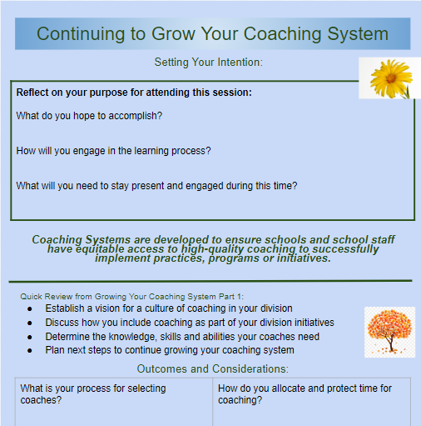
Walk with Us: Notetaker

Slide 4




Establishing our Purpose for Learning
Identify a process for selecting coaches
Determine how time for coaching is allocated and protected
Define the decision making authority of coaches and expectations for planning and communication
Develop a plan to monitor coaching fidelity and effectiveness

Slide 5
Community Agreements
Practice presence
Grasp opportunity
Embrace quick wins and bold next steps

Slide 6
Be Intentional
Take 60 seconds to reflect on your purpose for attending this session today.
What do you hope to accomplish?
How will you engage in the learning process?
What will you need to stay present and engaged during this time?

Slide 7

Connection Activity
In your small group, discuss the following:
Which figure best represents your vision for coaching in your division?
Why?
Source: School Counselors for MTSS

Slide 8
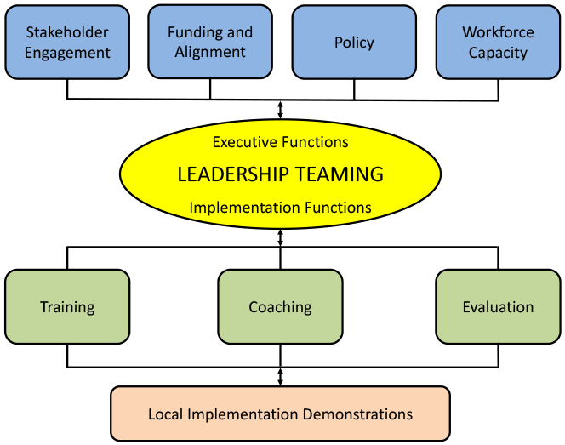
Where does coaching fit in?
Source: OSEP Technical Assistance Center on Positive Behavioral Interventions and Supports. (2015)

Slide 9
Where does coaching fit in?
Coaching
Systems Coach(es)
Liaison(s) between the division and schools -
Coach Data, Practices & Systems
Communication: within & beyond groups
School Coach
Administrator
SCHOOL LEADERSHIP TEAM
School Coach
Administrator
Communication: within & beyond groups
Grade Level Teams
Department Teams
Content/Specialty Area Teams
Advanced Tier Teams
Individual Student Teams

Slide 10
Focus on Systems for Coaching
Coaching Systems are developed to ensure schools and school staff have equitable access to high-quality coaching to successfully implement practices, programs, or initiatives.
25. Division has a coaching system to support schools in their implementation of EIs including VTSS | 2 | 1 | 0
26. DIT uses a coaching service delivery plan for VTSS | 2 | 1 | 0
27. DIT uses coaching effectiveness data | 2 | 1 | 0

Slide 11
Growing Your Coaching System
Part 1
Established a vision for a culture of coaching in your division?
Discussed how do you include coaching as a part of your division initiatives?
Determined the knowledge, skills, and abilities your coaches need?
Planned next steps to continue growing your coaching system?

Slide 12
Independent Reflection and Small Group Discussion
What are your next steps for establishing a vision for a culture of coaching in your division?
Do you include coaching as a part of your division initiatives?
What knowledge, skills, and abilities do your coaches need?
What are your next steps for these considerations?

Slide 13

Walk with Us: Learning Cycle
Content
Processing/
Discussion/Activity
Choice of Breakout
Support from a VTSS Coach (1 & 2)
Wellness Room (3)
Division Rooms
Open Rooms

Slide 14

Gardeners Guide & Notetaker

Slide 15
Examine the Plants
Guidelines for Selecting Coaches

Slide 16

In GYCS, we discussed
Roles and responsibilities
Knowledge and skills

Slide 17
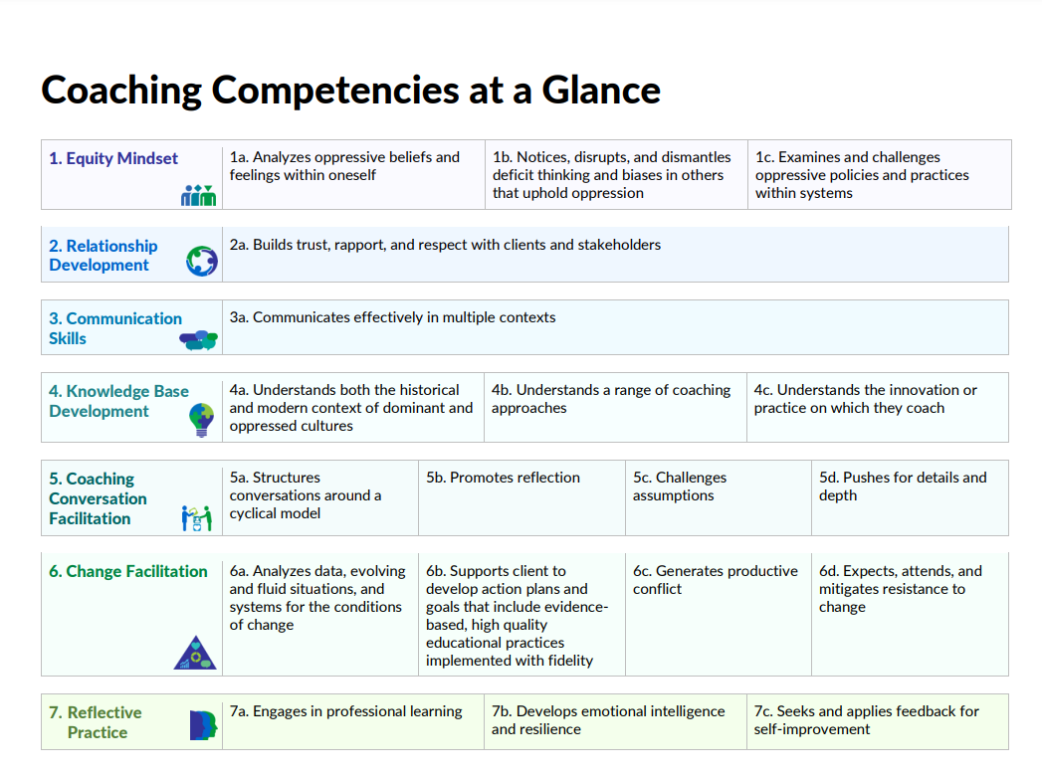
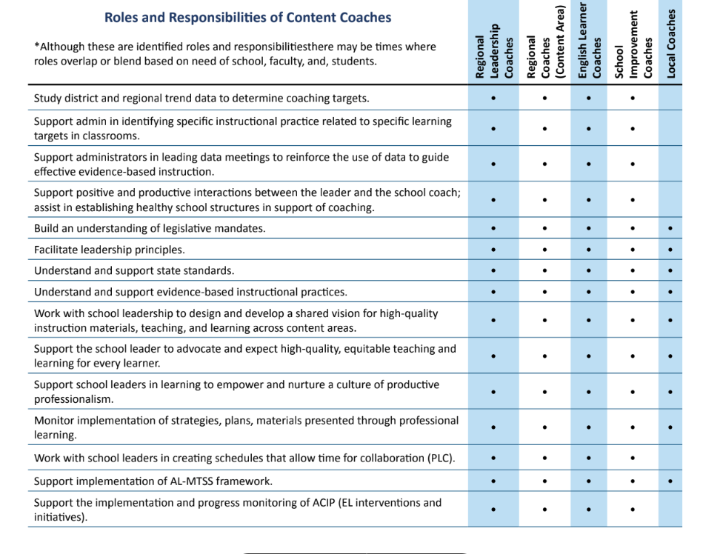
Examples
Source: Wisconsin Department of Public Instruction
Source: The Alabama Coaching Framework (pg. 20-22)
Knowledge and skills

Slide 18
Selection Criteria
Coaches should be an expert in their field and should have considerable experience teaching their content or subject area (for purposes of this document, subject area can also refer to behavior).
Coaches should be knowledgeable about MTSS and DBI.
Coaches should be able to make the time commitment needed for the level of intensity they are providing.
Coaches should be knowledgeable about adult learning principles and alliance-building strategies (e.g., collaborating, developing trusting relationships).
Knowledge and skills
Source: National Center on Intensive Intervention

Slide 19
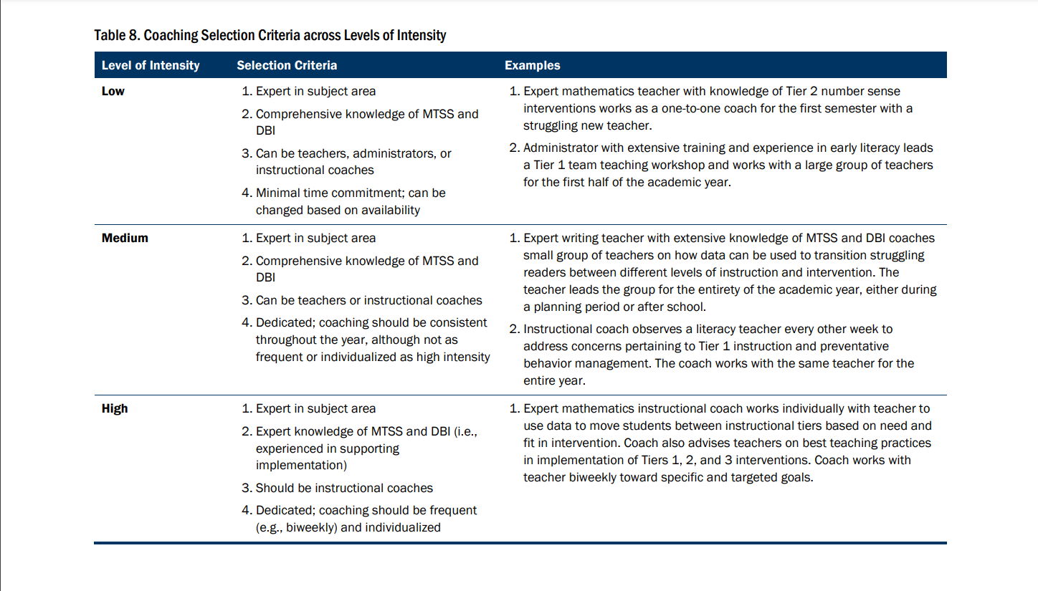
Example of Selection Criteria
Knowledge and skills
Source: National Center on Intensive Intervention

Slide 20

Selecting Coaches
“When I select coaches, I look for many criteria, but to start with, I look for indicators that they know themselves; have strategies to respond to strong emotions when they arise; and are reflective, humble, and eager to improve their own practice.”
-Elena Aguilar
Knowledge and skills

Slide 21
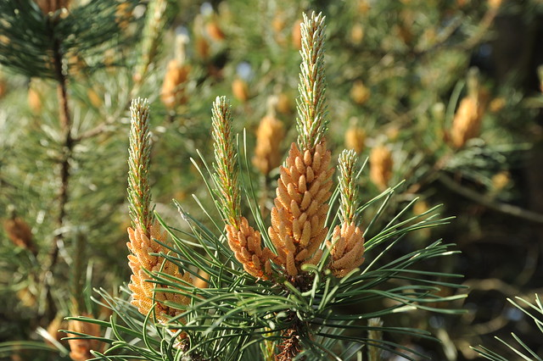
Activity: Selection Criteria
Options:
Create a list of interview
questions or selection
considerations for
different types of
coaches in your system.
Create a selection rubric
Join another group to
work on necessary
knowledge and skills for
different types of coaches
Knowledge and skills

Slide 22
Decide When to Harvest the Garden
Decision Making Authority for Coaches

Slide 23
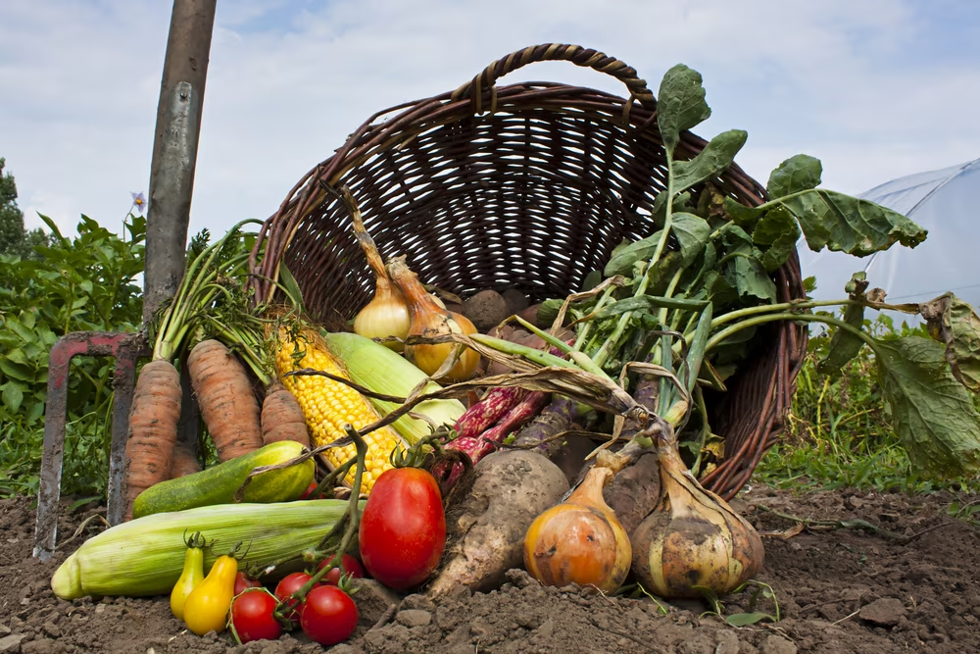
When is it time to harvest?
Decision making authority is the power to make important decisions.
Source: Law Insider

Slide 24
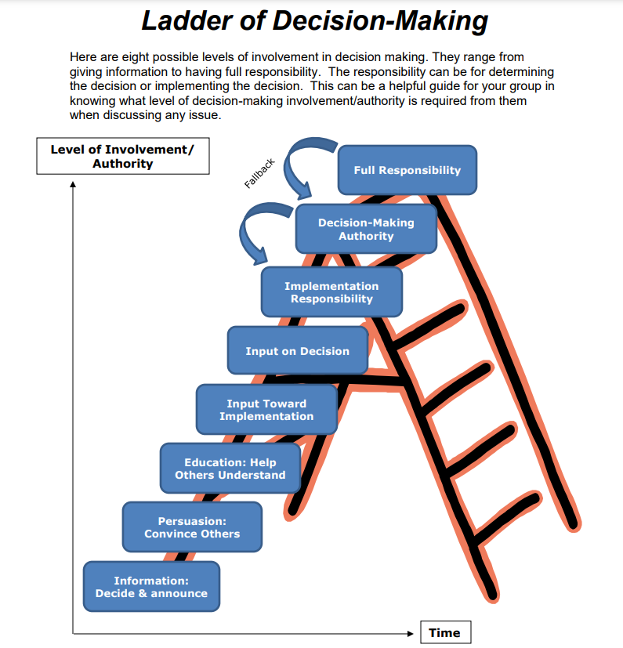
Ladder of Decision Making
Source: North Star Facilitators

Slide 25




A decision needs to be made…
Monitor and evaluate results
Identify problem with precision
What strategies/ practices will we select and implement? (Supporting student academic and social behavior)
Data
What does the data say? Analyze strengths and opportunities for growth.
What do teachers need to implement/sustain?
Establish a SMART goal
Knowledge and skills
Source: Florida Positive Behavioral Interventions & Supports Project

Slide 26
Activity: Decision Making Authority
Choose one to discuss and take notes:
Is there a decision making process coaches are expected to use? If yes, what is it? How is it communicated to coaches? If no, what do you need to do to select one?
Create a list of the decisions coaches have and do not have the authority to make. How is a coach’s decision making authority communicated?
Knowledge and skills

Slide 27
Create a Pruning, Weeding and Watering Schedule
Time Allocation for Coaches

Slide 28

Time Allocation for Coaches
“...coaching is part of differentiated professional learning. It is not a one-size-fits-all process that can be delivered at a school faculty meeting or in a one-day workshop. Coaching is embedded within the context of instruction and/or systems work in order to increase instructional and leadership capacity.”
-Catherine Moran
Knowledge and skills

Slide 29
Time Allocation for Coaches
Considerations for a school systems coach:
Time allocation includes, but is not limited to, the following activities:
• Attendance at professional learning sessions
• Attendance at monthly coaches meetings
• Meetings with administrator
• Facilitation of monthly SLT meetings
• Preparing to facilitate monthly meetings
• Completion of assigned action items
• Data collection and analysis
Knowledge and skills

Slide 30
Time Allocation for
Instructional Coaches
Time allocation may include, but is not limited to, the following activities:
• Team/grade level meetings
• Data meetings
• Regular peer to peer coaching cycles
• Meetings with administrator
• Facilitation of school leadership team meetings
• Preparing to facilitate data, grade/content, leadership,
peer to peer coaching meetings
• Providing/receiving professional development
• Covering classes to allow peer observation
Knowledge and skills

Slide 31

Protecting Time Allocation for Coaches
Common barriers to protecting time for coaching activities:
Serving as administrator designee
Administrative duties/paperwork
Substitute teacher
Extra duties
Writing assessments
Managing local/state assessment schedules
Discipline
Small group instruction
Knowledge and skills

Slide 32
Time Allocation Activity
Option 1:
Identify activities for
each type of coach in
your system.
Prioritize activities as
they relate to your
vision and purpose for
coaching.
Estimate percentage of
time allocation for each
activity.
Identify potential barriers and solutions to protecting the time of coaches.
Option 2:
Join another group to work on creating your vision for coaching.
Knowledge and skills

Slide 33
Plan the Harvest
Planning the Delivery of Coaching

Slide 34
What is needed?
SKILLS
Coaching “Coaching”
ORGANIZATION
Planning for Coaching
Performance Feedback
Creating an Enabling Context
Data use
Application of Content Knowledge
Continuum of Supports
Scaffolding
Routine
Structure
Templates, Protocols, Processes
Building in Sustainability

Slide 35
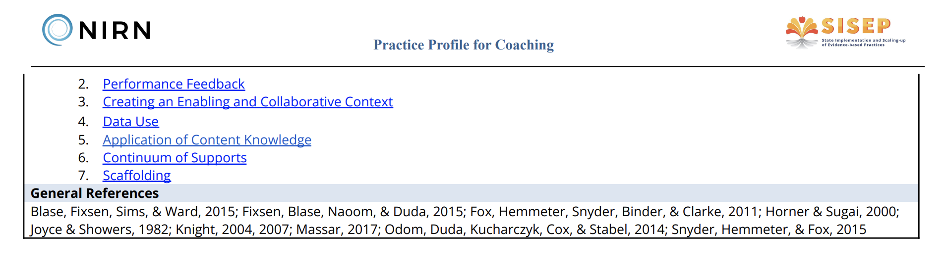
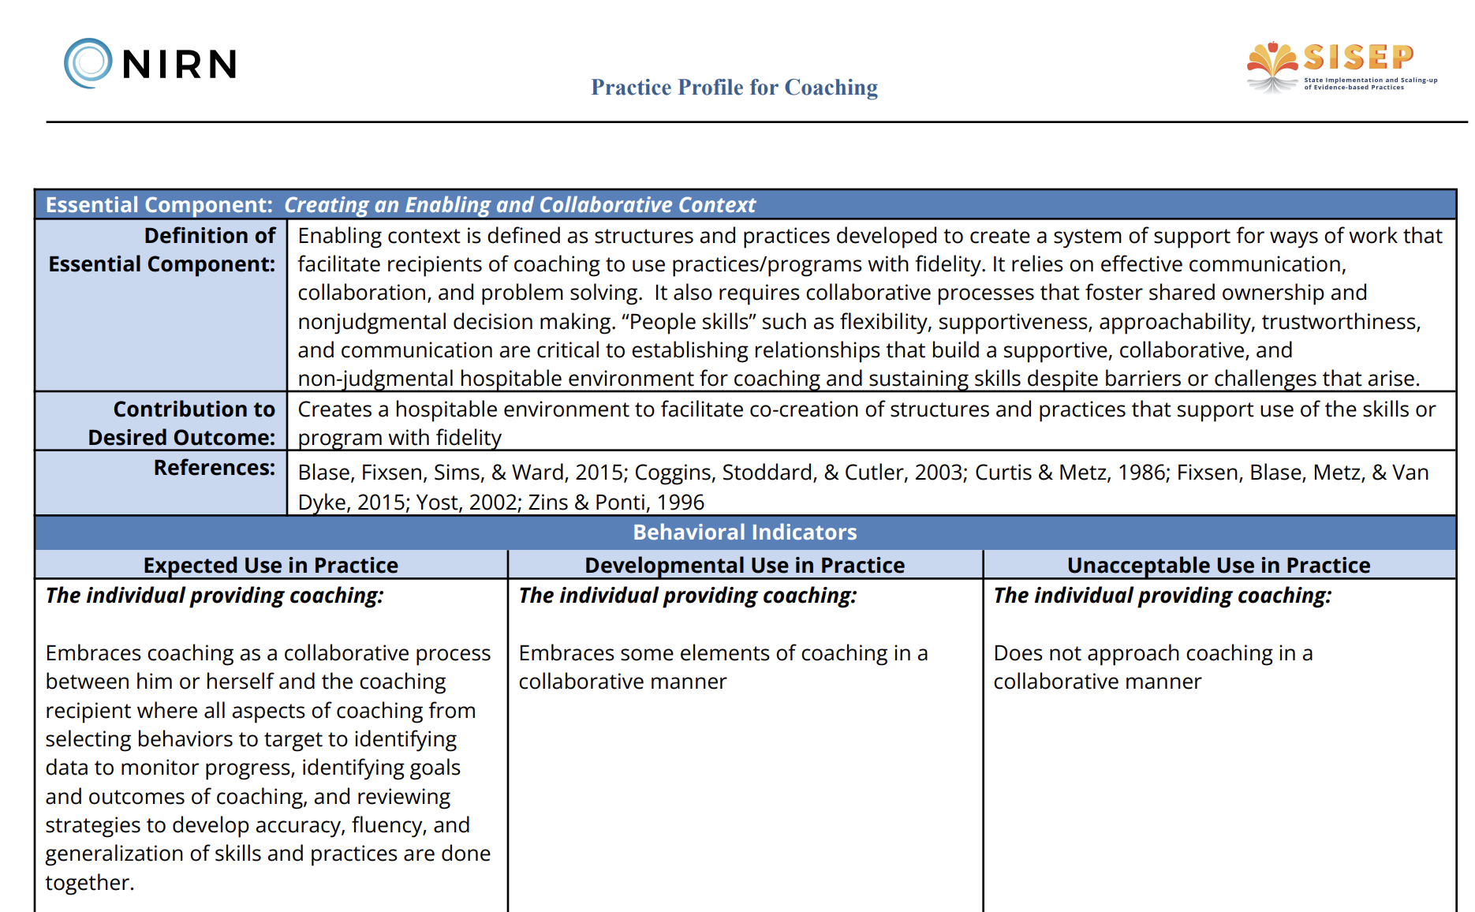
Coaching Skills
Practice Profiles identify the core components of a program, and describe the key activities that are associated with each core component. Practice profiles enable a program to be teachable, learnable, and doable in typical human service settings.
Source: AIHub https://implementation.fpg.unc.edu/

Slide 36
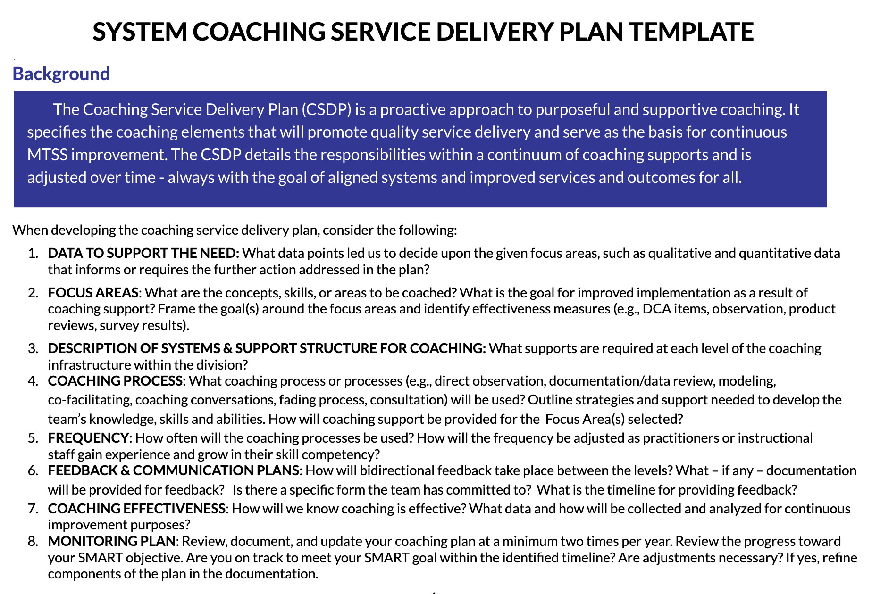
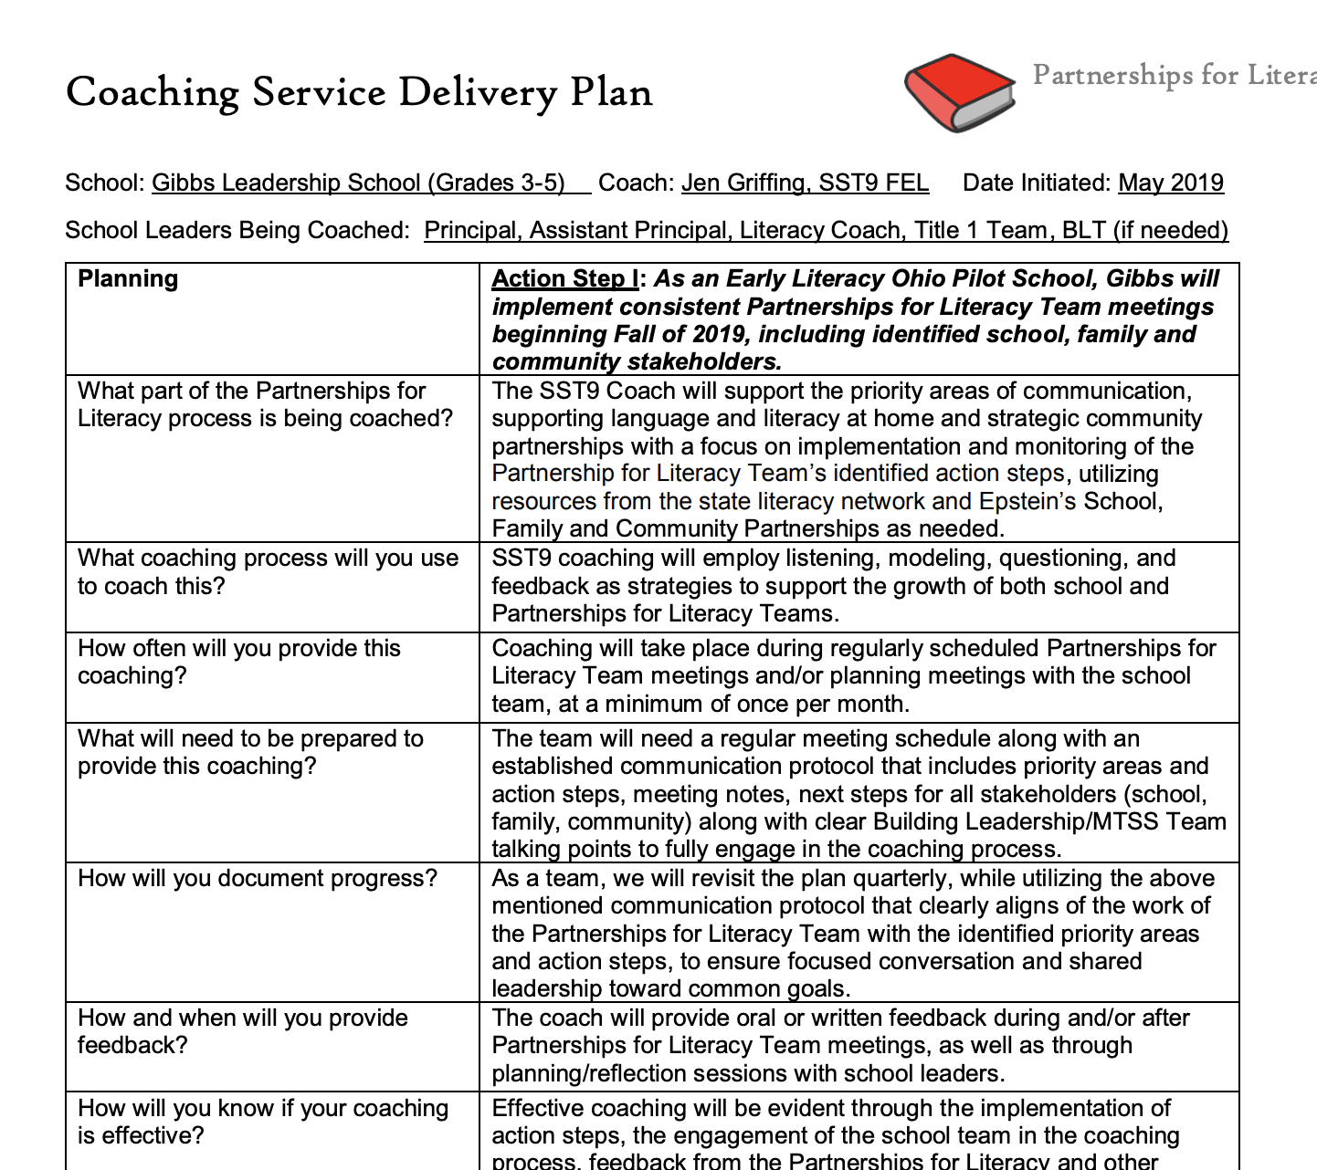
Organization

Slide 37
Contrasts Between Traditional and Learning-focused Feedback
Traditional feedback (Evaluation) | Learning-focused feedback (Coaching)
Product | Process
Opinion/judgement | Criteria-based
Single form/source of data/ evidence | Multiple forms and sources of data/evidence
Expected | Desired
Untimely | Timely
Impersonal | Responsive to learner
Occasional | Frequent
Past-focused | Future-focused
One-way | Reciprocal
Communicated | Skillful Interaction
One dimensional | Multidimensional

Slide 38
Intentional Feedback
When will you provide performance feedback?
How will you provide performance feedback?
  Feedback protocols, etc.
How will you monitor fidelity to these expectations?

Slide 39
Activity
Options for discussion:
Planning for coaches’ ongoing professional development
Designing feedback loops
What will you do & what tools will you use

Slide 40
Communicate the Harvest Plan
Plan for Coaches to Communicate with Others

Slide 41
Virginia’s Cascading Model of Support
Virginia’s Cascading Model of Support
National TA Support
State
Agencies
Provides guidance,
coordinates training
and technical assistance.
Creates local guidance, allocates funding, and provides training for school leaders.
Divisions
Creates guidance for implementation, provides teacher training and allocates resources.
Schools
Classrooms
Implements practices to fidelity to support all students.
Coaching
Students
Increased positive outcomes.

Slide 42
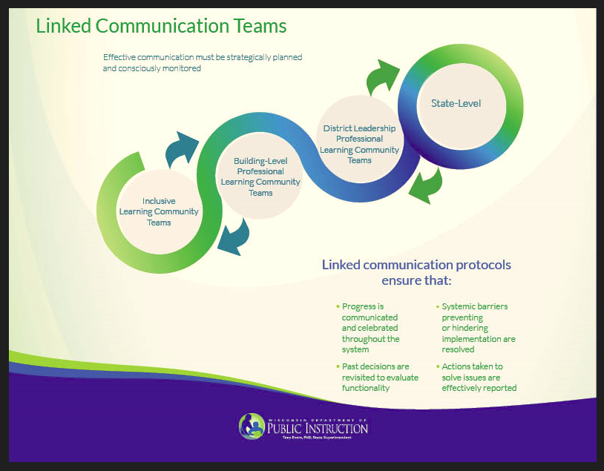
Another example
Knowledge and skills
Source: Wisconsin Department of Public Instruction

Slide 43
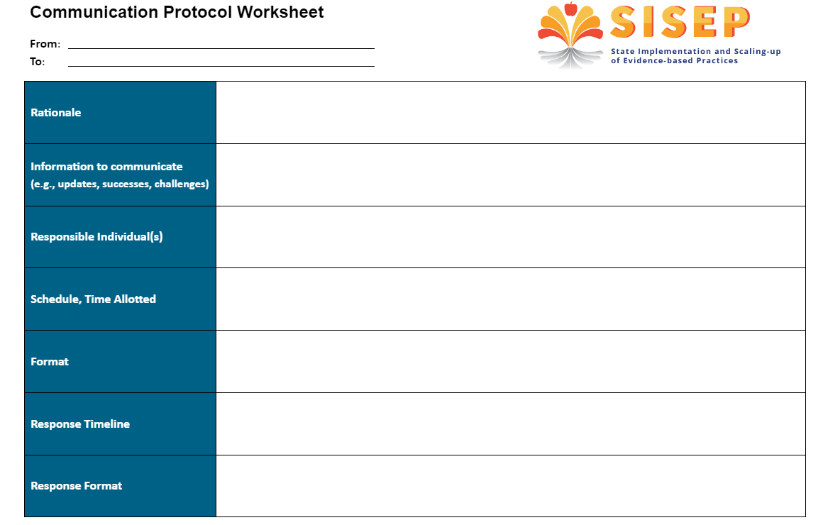
Develop a communication protocol
Knowledge and skills
Source: State Implementation and Scaling-up of Evidence-based Practices (SISEP)

Slide 44
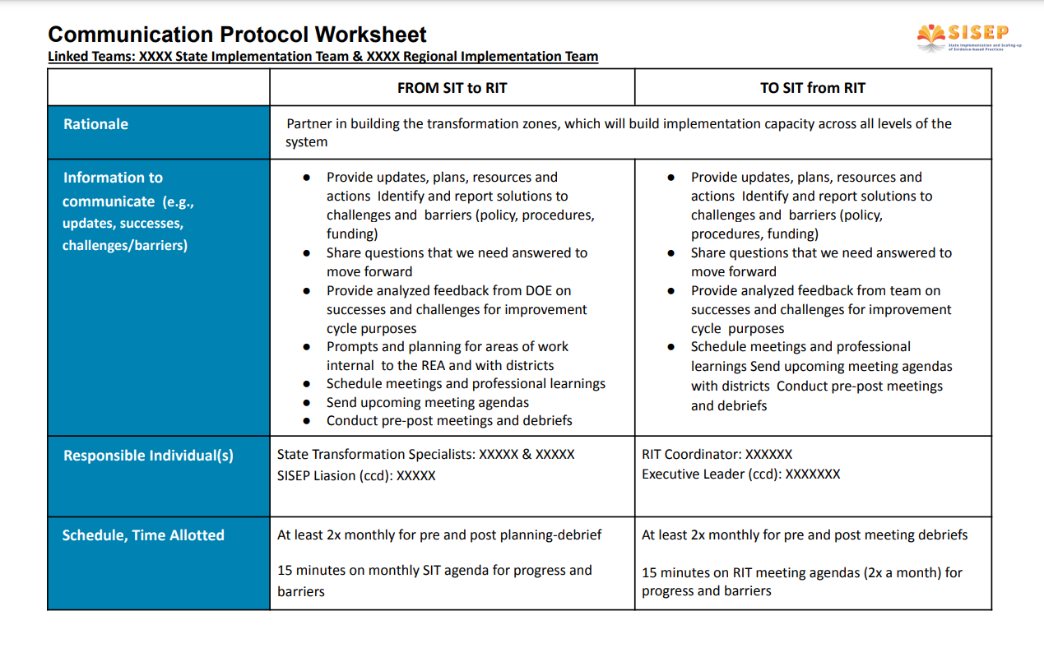
Example communication protocol
Knowledge and skills
Source: State Implementation and Scaling-up of Evidence-based Practices (SISEP)

Slide 45
Activity
As a group, work on one of the following tasks:
  Draw a cascading model with detail to represent the coaching communication needed in your division.
  Complete a Communication protocol worksheet for one aspect of coaching communication in your division.
Knowledge and skills

Slide 46
Measure the Harvest
Monitoring and Measuring (Accountability)

Slide 47
Accountability
What Are Various Options?
Current fidelity measures
School/student outcome data
Coaching satisfaction surveys
Observations
Progress monitoring of CSDP
Coaching logs
Knowledge and skills

Slide 48
Monitoring Fidelity &
Measuring Outcomes

Slide 49
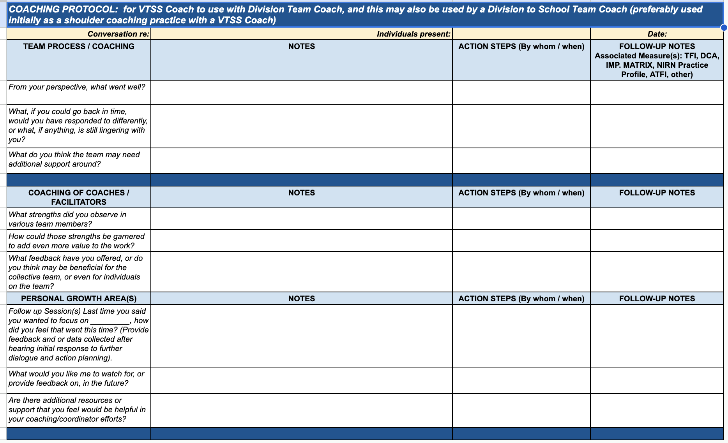
Monitoring Fidelity &
Measuring Outcomes

Slide 50
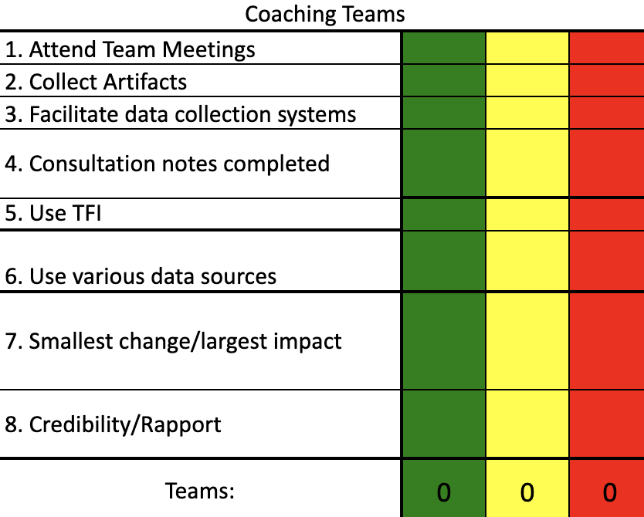
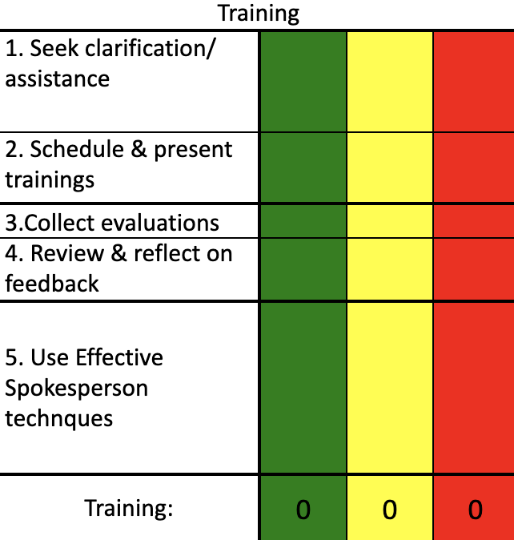
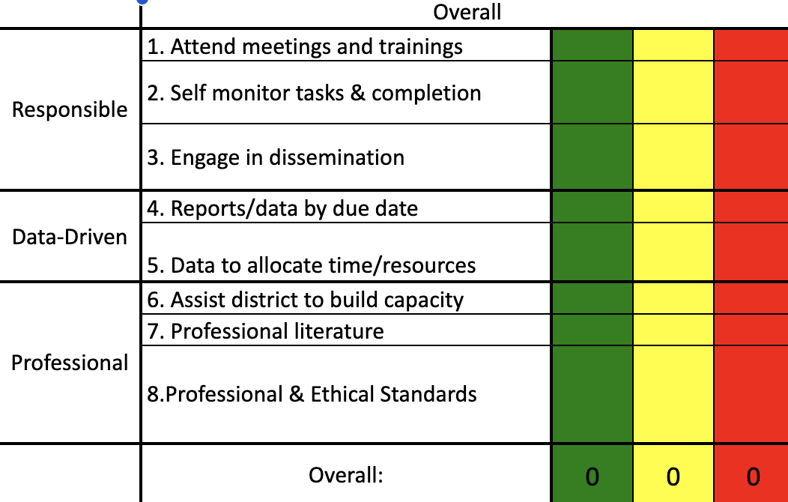

Monitoring Fidelity &
Measuring Outcomes
TPS:
Total Performance System

Slide 51

Activity
Record on the Padlet
Ways you do/can monitor fidelity
Ways you do/can measure coaches’ growth
Ways you do/can measure desired outcomes
Knowledge and skills

Slide 52
Preserve the Ongoing Growth

Slide 53

Thank you for all that you do!!

