Slide 1
#LCPSAttendanceChallenge
1
Attend today Achieve Tomorrow

Slide 2
How It All Began…
2
Data Driven Decision Making Form
LCPS Comprehensive Plan

Slide 3
3

Slide 4
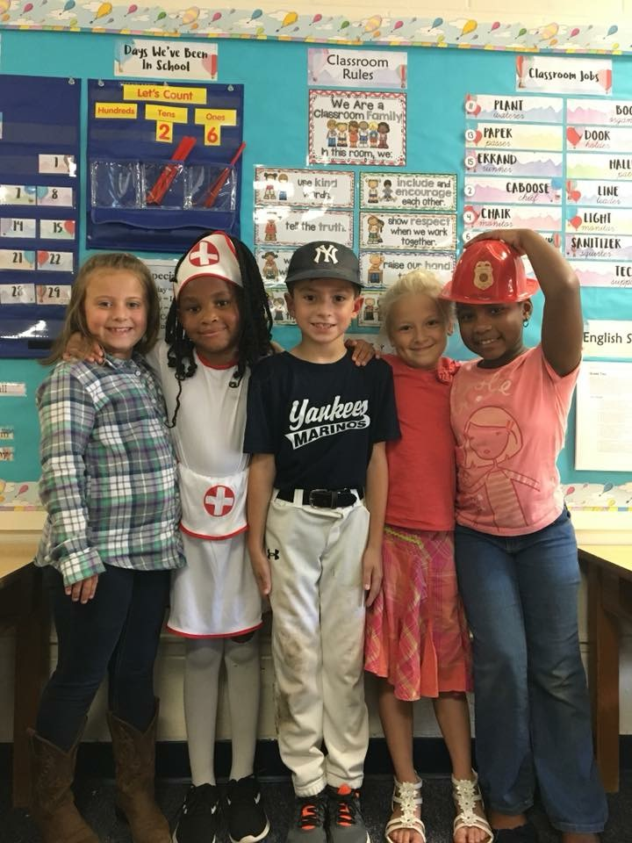
Attendance Awareness Dress Up Week
4

Slide 5
Attendance Awareness Poster Contest Winners
5

Slide 6
Attendance Awareness Logo Contest Winner
6

Slide 7
7

Slide 8
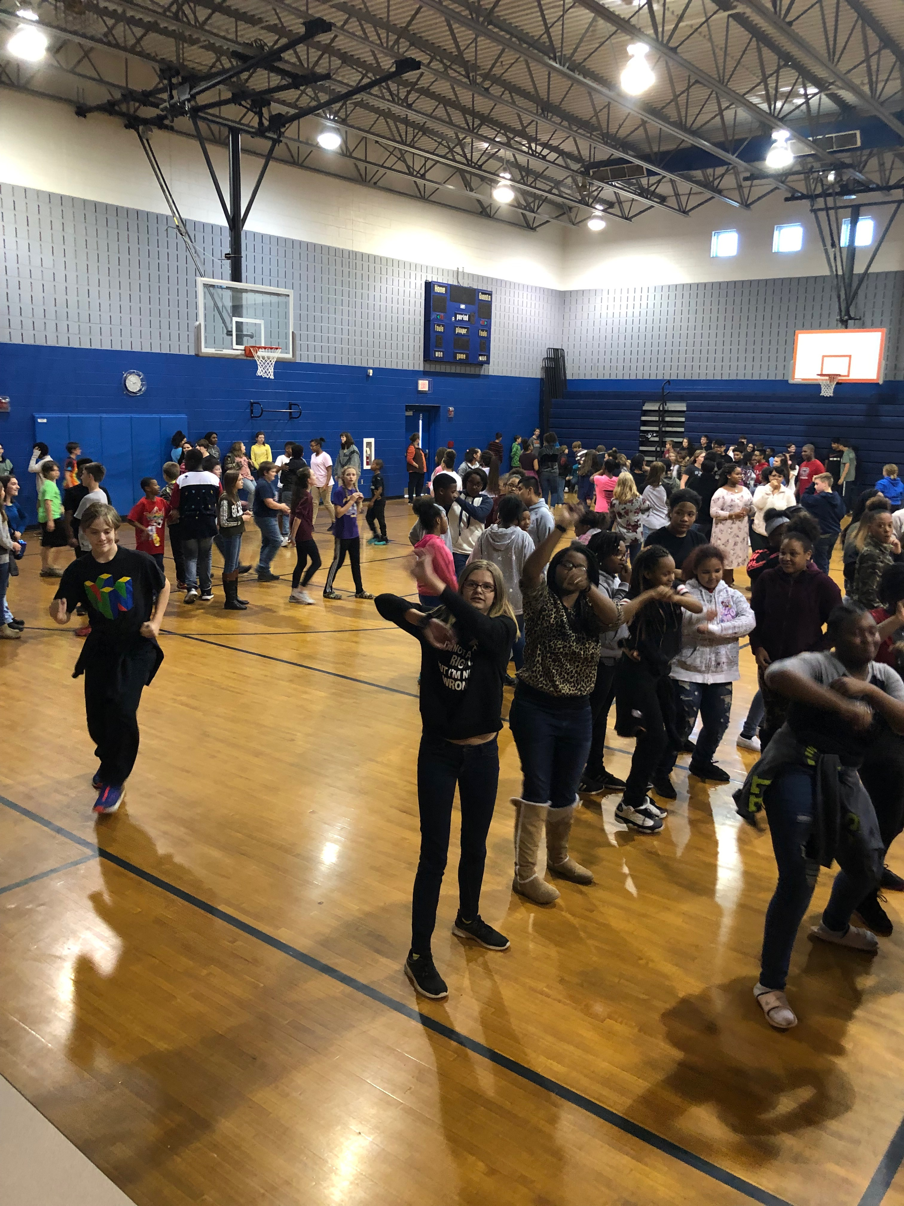
Chronic Absenteeism Lowered by 2% in October All Schools Rose to the Occasion DANCE PARTIES ALL AROUND!
8

Slide 9
Daily Attendance Report and Attendance Policy
9
Each LCPS Student had his/her Daily Attendance Report along with the Attendance Policy ready for them at Fall Parent Teacher Conferences.
If parents didn’t attend, these items were sent home in the student’s backpack at the elementary level and mailed home at the secondary level.

Slide 10
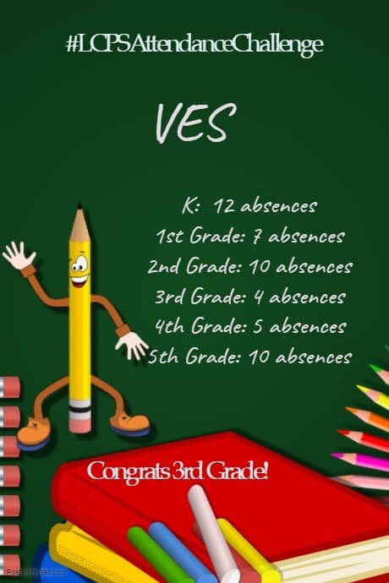
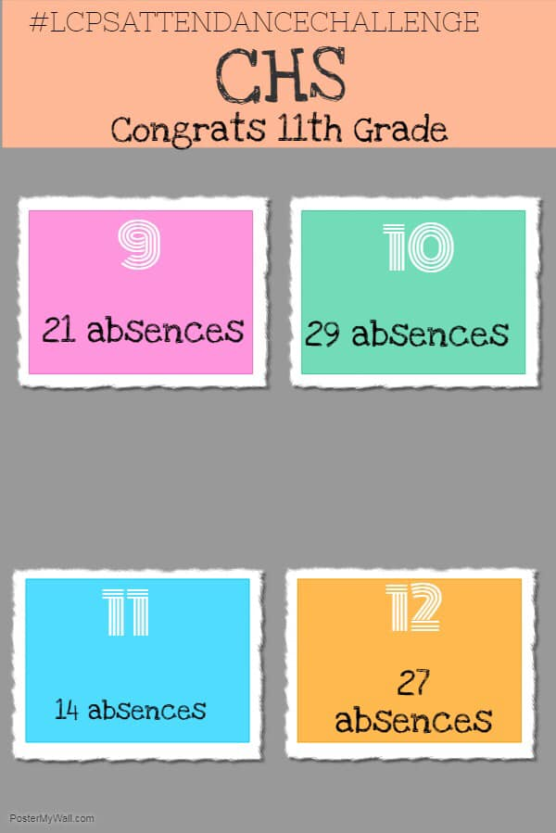
#LCPSAttendanceChallenge Semester Long Grade Level Challenge at Each School
10

Slide 11
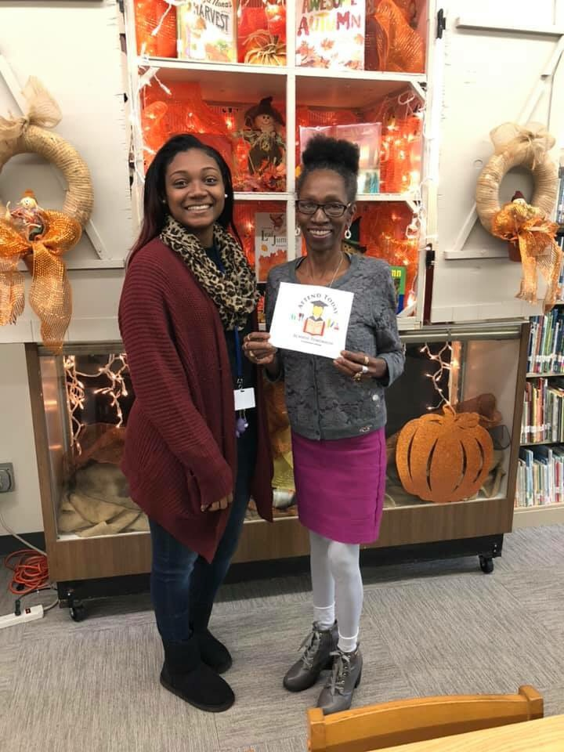
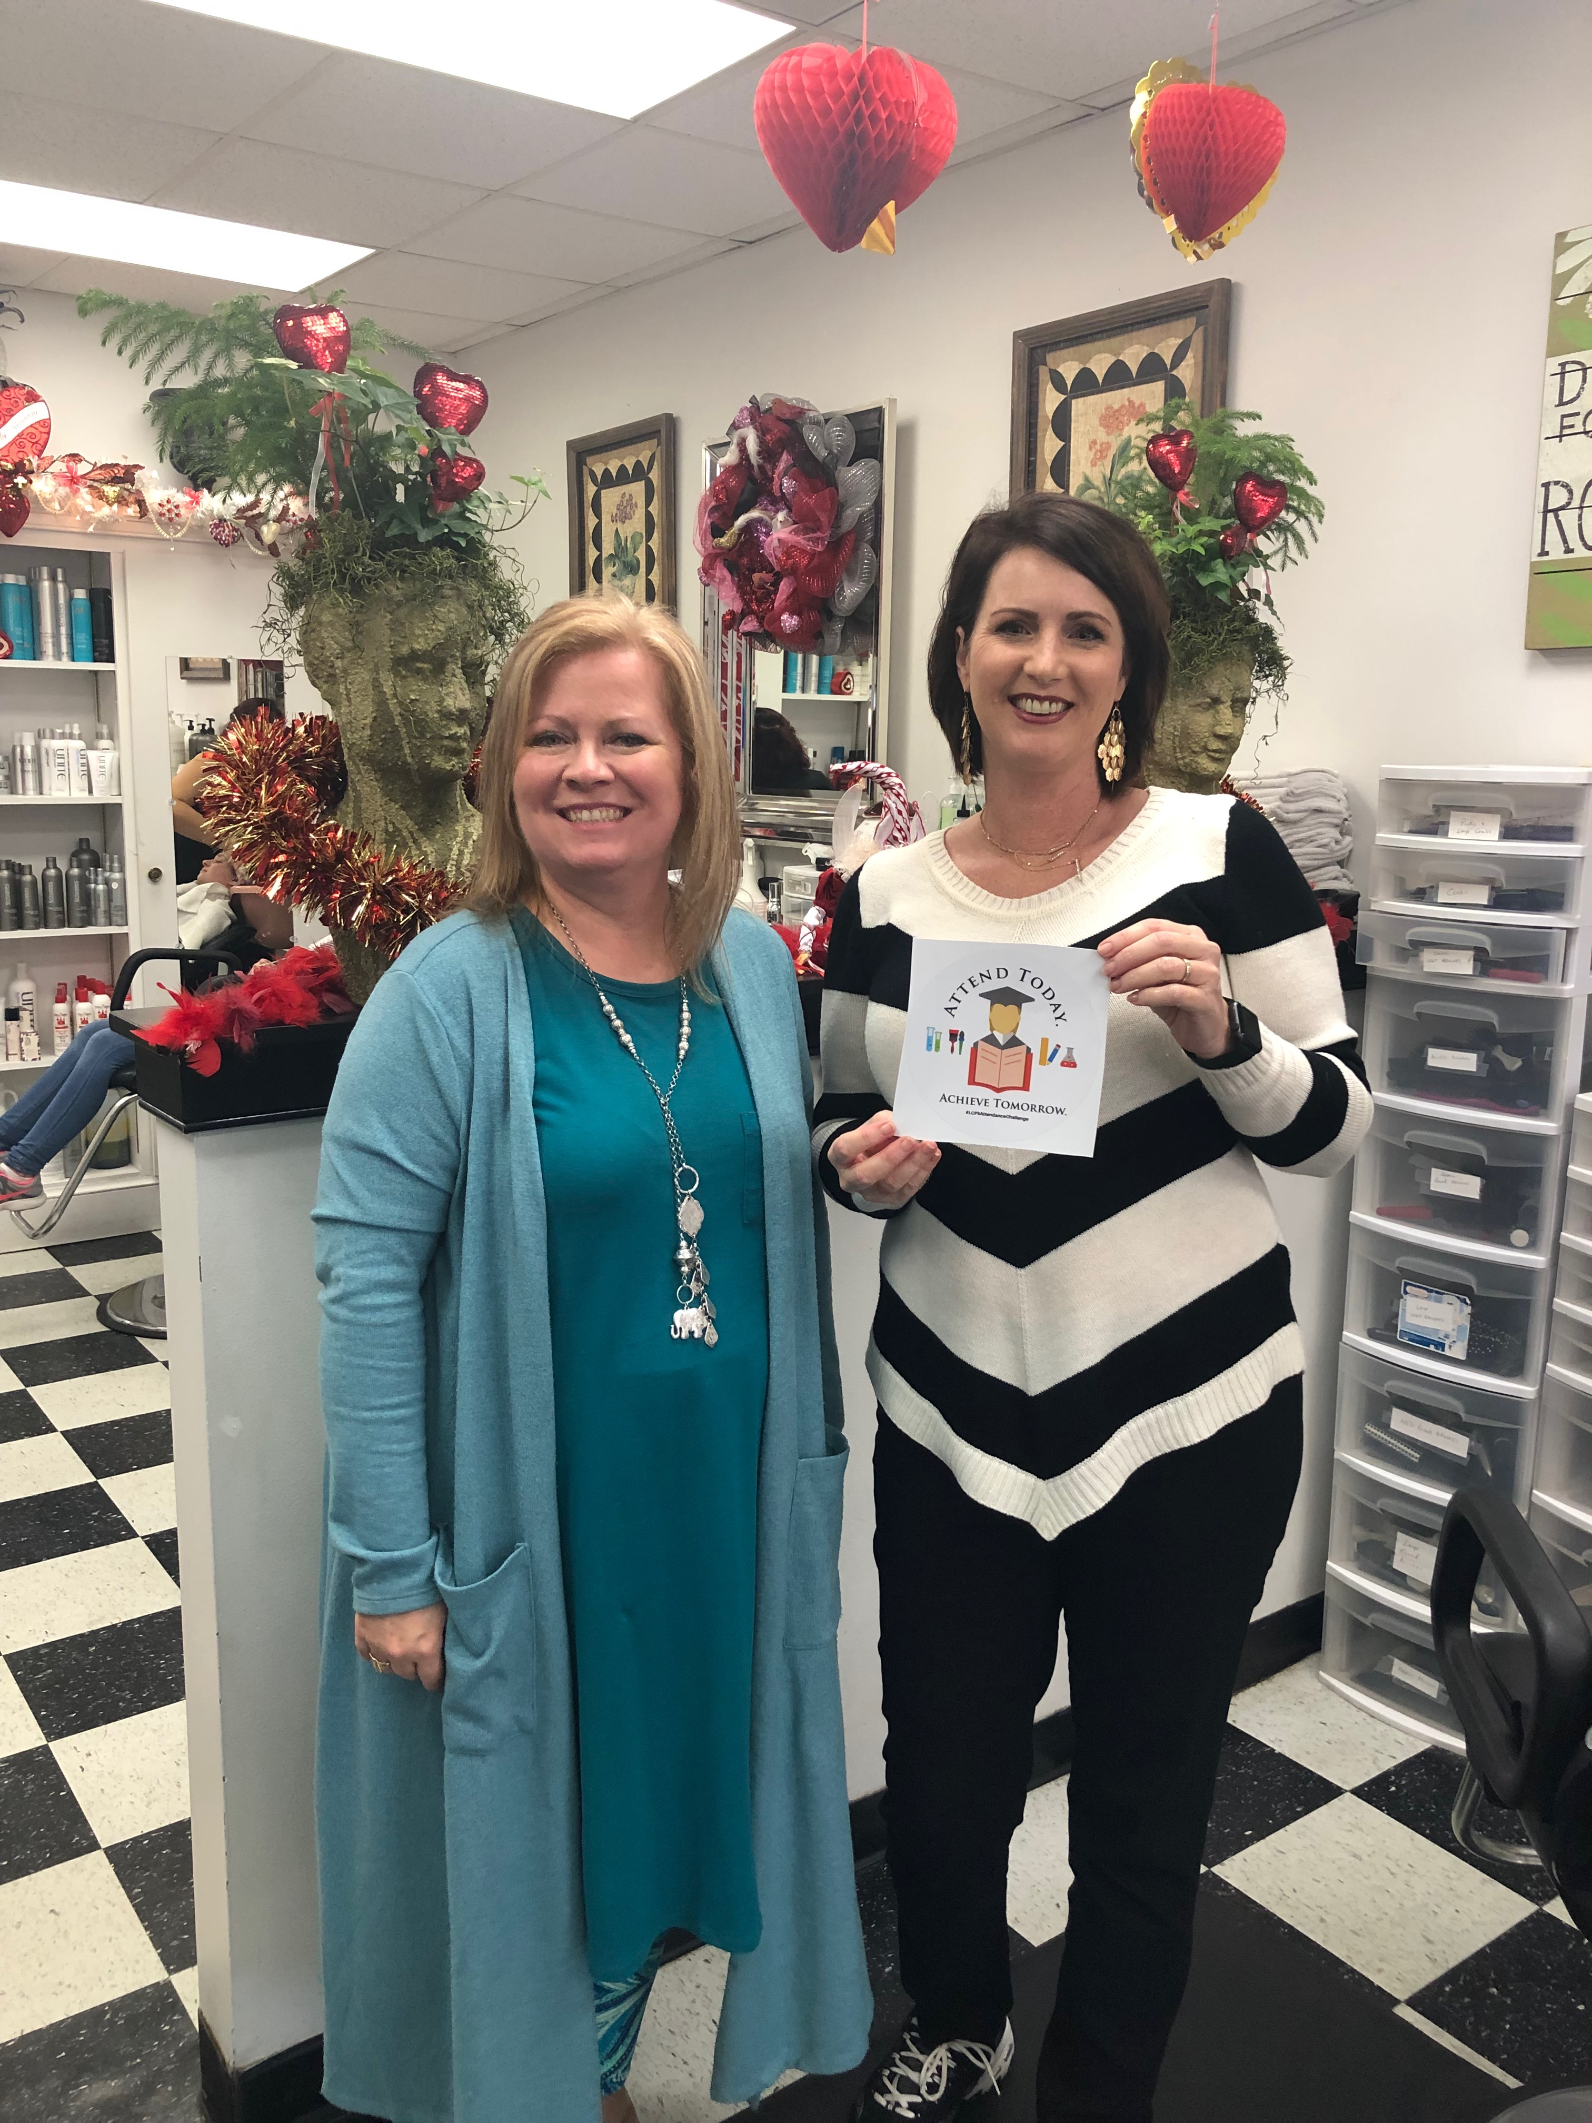
#LCPSAttendanceChallenge Community Partnerships
11

Slide 12
Using Data for Intervention & Support
12

Slide 13
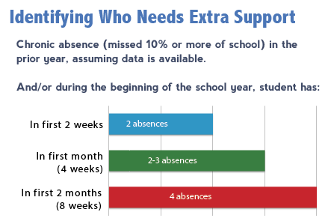
Monitor chronic absence data
13

Slide 14
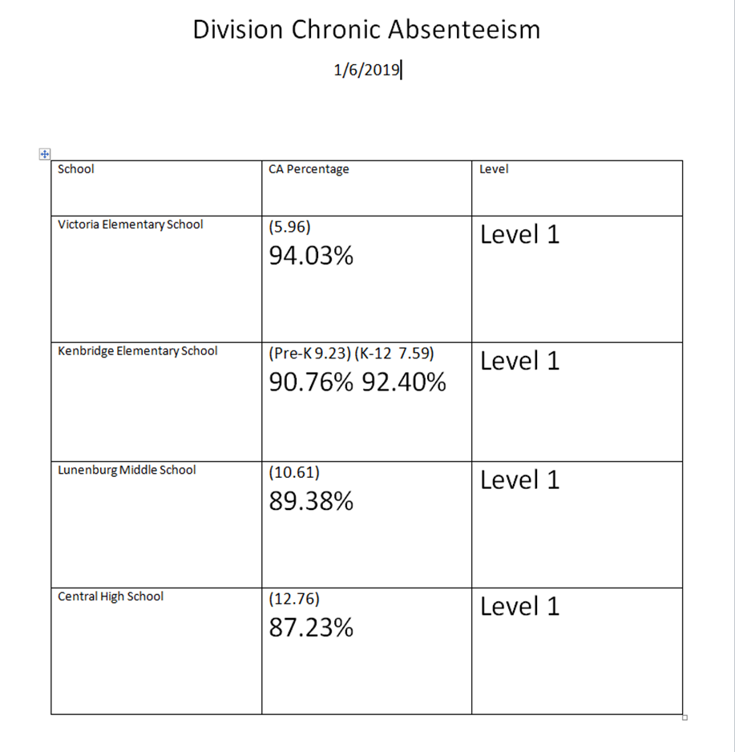
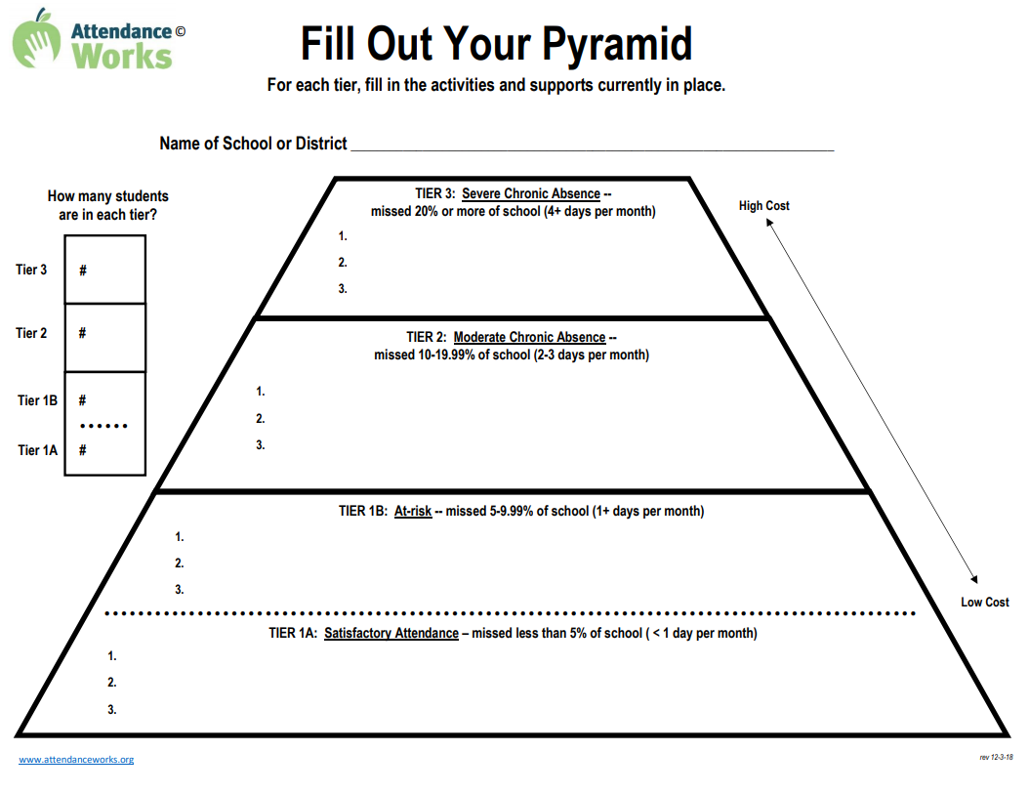
Review Available Resources
14

Slide 15
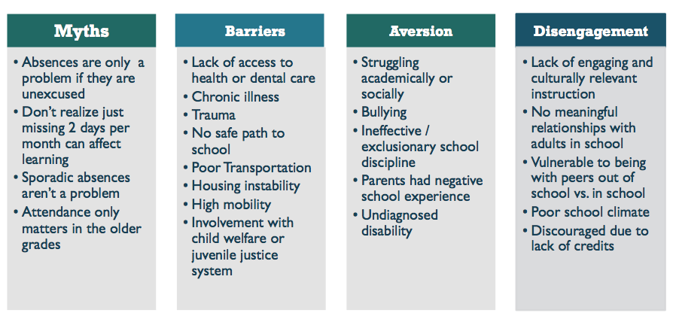
15

Slide 16
Connect with Families
16

