Slide 1
Systems Change: Coaching
Sustainability and Managing Complex Change
within your Current Reality
September 15, 2020
3:30 - 4:30

Slide 2
Let us know you are here!
Please use the Google spreadsheet link in the chat box to record your information.
We will send discussion materials using the information you share!
A recording of this event will be available on the VTSS website.

Slide 3
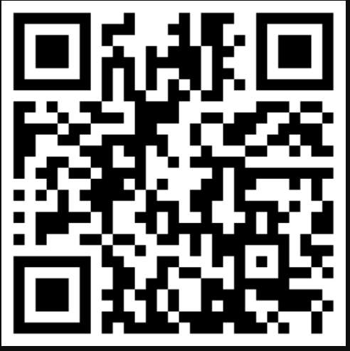
Padlet
We will be using Padlet to organize our learning. Please take the time to have this up and ready on your computer or phone by clicking on the link in the chat box or using the QR code.

Slide 4
Navigating ZOOM!
CHAT
MUTE YOUR MICROPHONE
HIDE YOUR VIDEO CAMERA

Slide 5
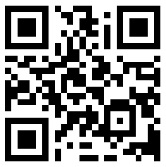
Slido Time!

Slide 6
Slido Question #1
What has been the greatest challenge around change you’ve experienced this year:
Working from home
Educating students at home while working
Loss of in person contact with family and friends
Too much time in your home due to quarantine
Increase in anxiety over the future
New social norms (masks and social distancing)
Financial concerns
Equity concerns

Slide 7
Slido Question #2
What change have you made to adapt to your new reality and remain hopeful:
I have a new hobby
I am exercising more and getting outside
I am intentionally checking on friends and family more often
I am exploring and learning new skills
I am connecting more with nature
I am being more intentional about self-care

Slide 8
Learning Intentions
Review and apply managing complex change to our present reality
Learn from York County’s experiences managing change
Review and apply the VTSS Implementation Matrix to support coaching needs

Slide 9
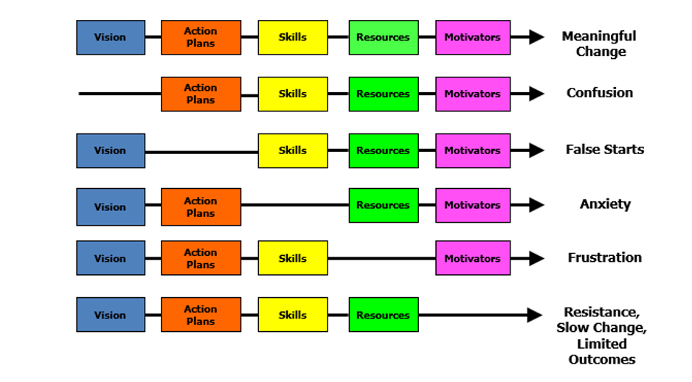
Managing Complex Change
Source: Adapted from Knoster, T., Villa R., & Thousand, J. (2000). A framework for thinking about systems change. In R. villa & J. Thousand (Eds.), Restructuring for caring and effective education: Piecing the puzzle together (pp. 93-128). Baltimore: Paul H. Brookes Publishing Co.

Slide 10
The Team’s Work is Managing Change
The graphic on the previous slide is a framework for thinking about systems change developed by Knoster, Villa and Thousand. This framework outlines the components of meaningful change: vision, action plans, skills, resources and motivators. When components are missing, certain organizational behaviors will manifest: without vision, there is confusion; without action plans, there are false starts; without skill building, there is anxiety; without resources, there is frustration; without motivators, there is resistance and limited outcomes.

Slide 11
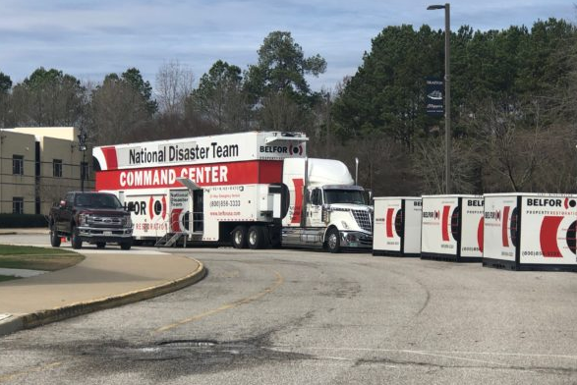
Pre-work - Article from
York County
Ready for anything: Making complex decisions with confidence and clarity
Click on the photo below to read the article from District Administration

Slide 12
Background

Slide 13
Revisiting Our Vision
Social Emotional Wellness for staff, students, and families
Equity
Family Engagement

Slide 14
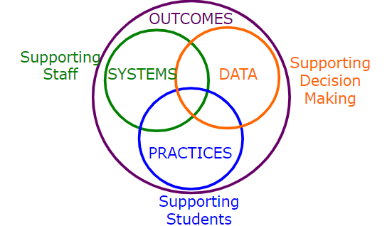
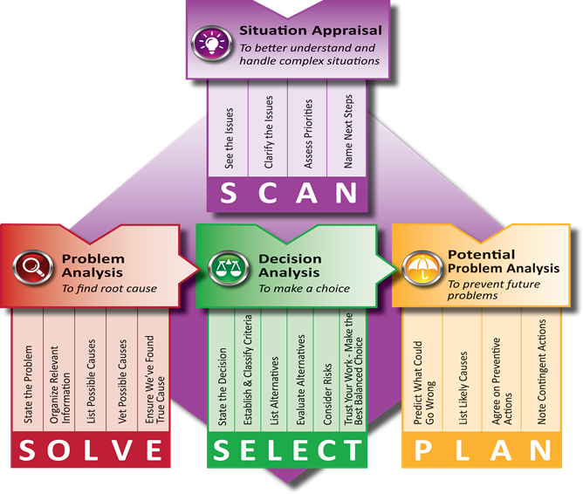
Problem Solving Frameworks
TregoEd
VTSS Problem Solving/ Implementation Logic

Slide 15
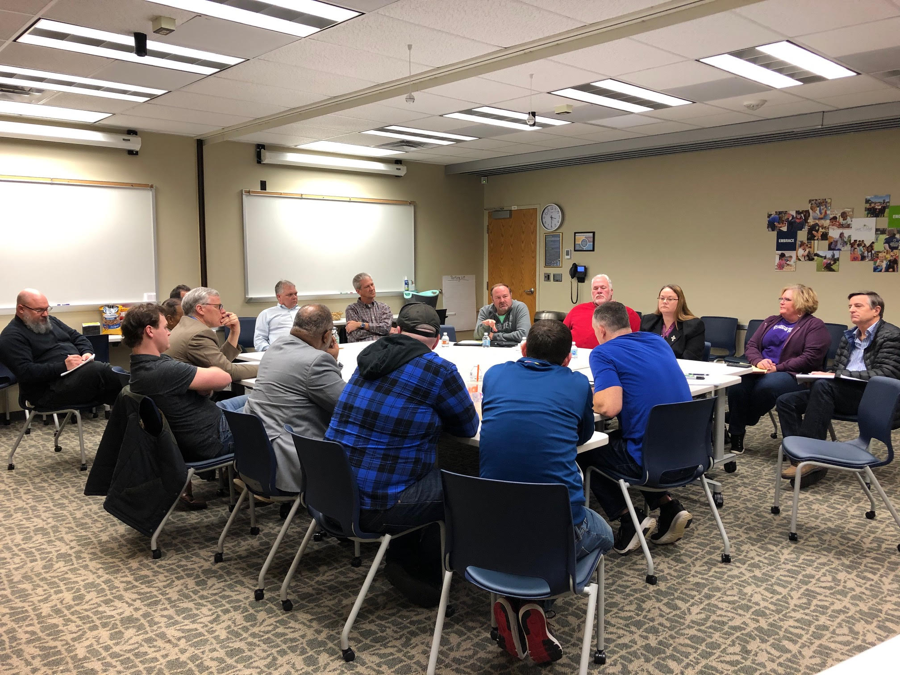
Working with Your Community
Involve community stakeholders who can provide support
Be willing to think “outside the box” for solutions

Slide 16
Breakout Rooms
Share your division’s vision, and how you are supporting/coaching: Social Emotional Learning, Equity, and Family Engagement.
*Please select someone to take notes on Padlet.
Link to Padlet in “Chat Box” or use the QR code.

Slide 17
Action Plans
Division Level Team Action Plans
School Team Action Plans

Slide 18
Skills
Behavior
Academics
Mental Wellness

Slide 19
Resources
Time
Staff
Funding
Coaching Supports
Access to Professional Learning and Materials

Slide 20
Motivators
Importance of self-care for staff
Feedback and Acknowledgement
Supportive Team
Professional Learning/Coaching
Financial Resources

Slide 21
Breakout Rooms Activity
When we look at managing complex change, what are you doing well?
Where are your gaps, and how can you begin setting a goal with action steps?
On the padlet, please capture your next action steps as a coach.

Slide 22
VTSS Implementation Matrix, Part 1
Features | Exploration | Installation
1.H Coaching (Developing coaching plans and processes to support data, practices, and systems. | DLT determines necessary coaching skills and needs for selection of internal coaches. The DLT evaluates existing roles for coaching, and develops an aligned coaching plan. | DLT selects coaches, modifies job descriptions to include Coaching time and responsibilities, and determines a measure of coaching effectiveness.

Slide 23
VTSS Implementation Matrix, Part 2
Initial Implementation | Full Implementation
DLT provides feedback to coaches based on areas of need and evidence of coaching effectiveness. | DLT continually monitors fidelity and outcome data and collaborates with coaches to adjust coaching plans for desired outcomes. The DLT addresses turn over as needed.

Slide 24
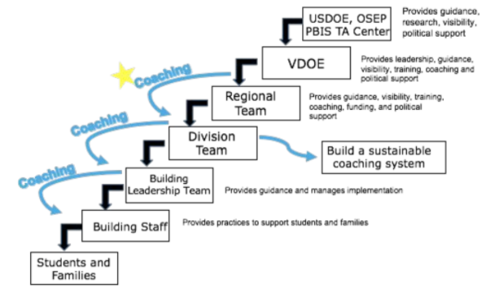
Cascading Model of Supports

Slide 25
Questions to take home and review with others.
Which challenge is most pressing for my division/school?
How can we assess the missing component for growth?

Slide 26
Upcoming Community of
Practice Dates
October 20, 2020 | Moving from Behavior to
Academics
April 20, 2021 | Coaching for Equity: Data,
Practices, and Systems for Improved Outcomes
3:30 - 4:30 p.m. each day

Slide 27
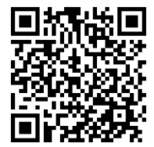
Help us grow! Please complete the brief evaluation with this Quick Response (QR) Code or link in the chat box!

