Slide 1
Moving to Academics
Coaching Community of Practice

Slide 2
Virtual Community Norms
Be Engaged | Unmute to share ideas/ questions Participate in virtual activities
Be Respectful | Eliminate distractions like cell phones, email, social media and background noise. Give others time to talk and share. Be committed to attend all three days
Be Prepared | Download materials prior to the session. Set dates/times with your team to continue action planning after professional learning.

Slide 3
Overarching Learning Expectations
Participants will:
Understand the alignment of process across behavior, academics and social emotional learning.
Develop a plan for the data collection, professional learning and coaching needed at the school and division level in order to promote the use of effective classroom practices.
Assist others in their understanding of the connection between instructional practices and equitable classroom systems to promote high achievement for all learners.

Slide 4
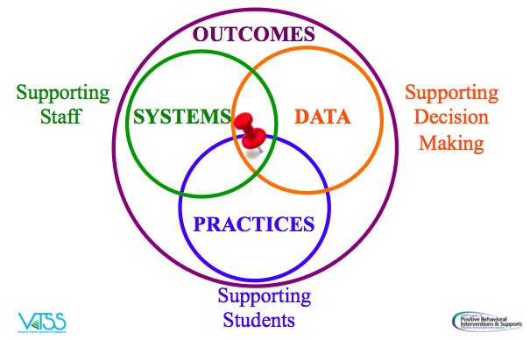
VTSS Implementation Logic
1
4
2
3

Slide 5
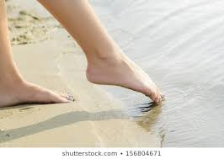
Let’s Just Dip a Toe Into Coaching Academics

Slide 6
Data:
Support Decision Making

Slide 7
Data that Indicates a Need
Walkthrough data
Data Dashboard
Office Discipline Referrals
Attendance
Screening data
Benchmark data
SOLs
Climate surveys
Family surveys

Slide 8
Walkthrough Observation Data

Slide 9
Your thoughts on Padlet
What additional data sources are used in your division to determine the use of instructional practices?
Which data sources are the most valuable to you as an individual or team?

Slide 10
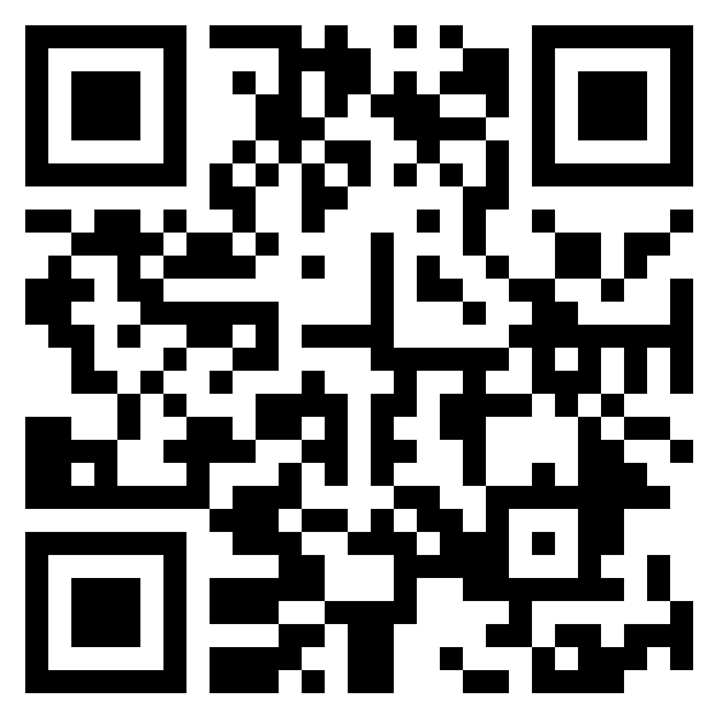
Padlet Link for Breakout Room
Link to Padlet

Slide 11
Practices

Slide 12
Why practices?
The greatest impact on learning is the daily lived experiences of students in classrooms, and that is determined much more by how teachers teach than by what they teach.
-Dylan William

Slide 13
WHY?
We need to ensure that evidence-based practices are the way of work in our schools and classrooms
Our purpose is to create a system that ensures quality instruction in all classrooms.
Our goal is to make sure that they are universally employed and sustained

Slide 14
The VTSS Ten from Effective Classroom Practices
Arranging the Physical Environment
Active Supervision
Classroom Expectations (aligned to schoolwide expectations)
Routines and Procedures
Opportunities to Respond
Formative Assessment
Scaffolding
Feedback: Acknowledgement and Behavior Specific Praise
Feedback: Error Correction
Feedback: Building Community Through Feedback

Slide 15
Each VTSS practice can stand alone
Name of the practice
Definition
Rational
Examples
Data Collection Tool

Slide 16
Opportunities to Respond
“A teacher behavior that prompts or solicits a student response (verbal, written, gesture).”
Simonsen, Myers & DeLuca 2010

Slide 17
Rationale
Students are able to:
Remain attentive and on task
Retrieve, rehearse and practice information, concepts, skills and strategies being taught
Refrain from inappropriate behaviors
Teachers are able to:
Provide corrective feedback immediately
Adjust the lesson
Offer behavior specific praise

Slide 18
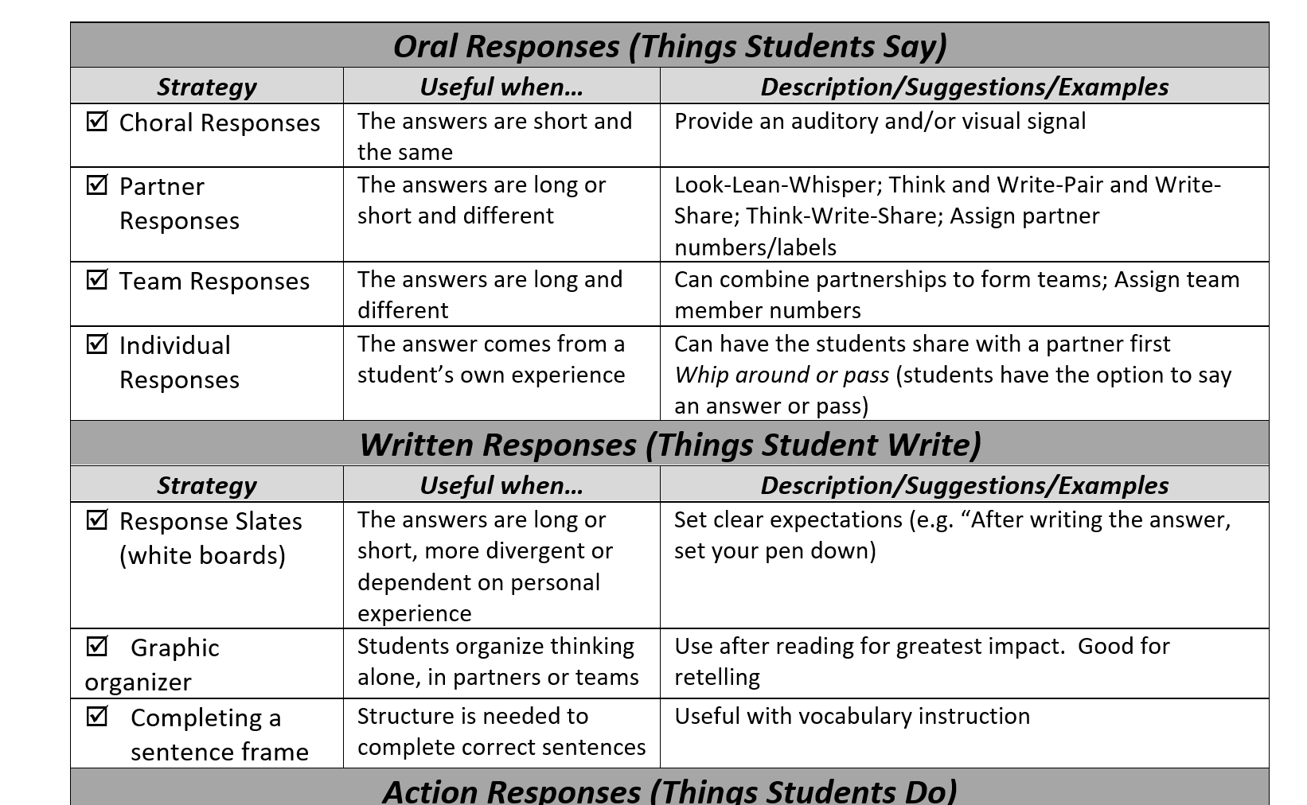
Opportunities to Respond - When and How to Use

Slide 19
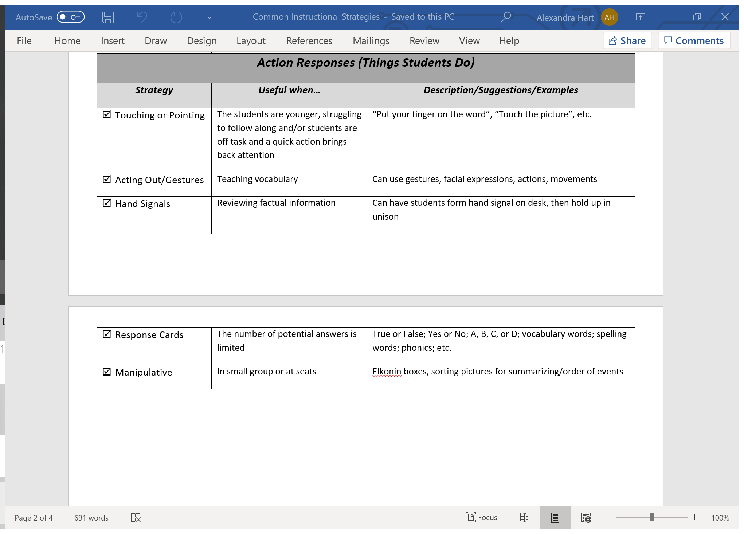
Action Responses

Slide 20
Opportunities to respond in a remote teaching environment
Response sheet (Anita Archer)
Breakout room conversations
Chat box
Polls
White boards (zoom)

Slide 21
Verbal Responses
Visible Learning Through Success Criteria

Slide 22
Reflect on your own
Dylan Williams said, “If you’re allowing children to volunteer whether to participate or not in your classroom, quite simply, you’re making the achievement gap bigger.”
What does that statement mean to you as an educator, a team member, a leader?

Slide 23
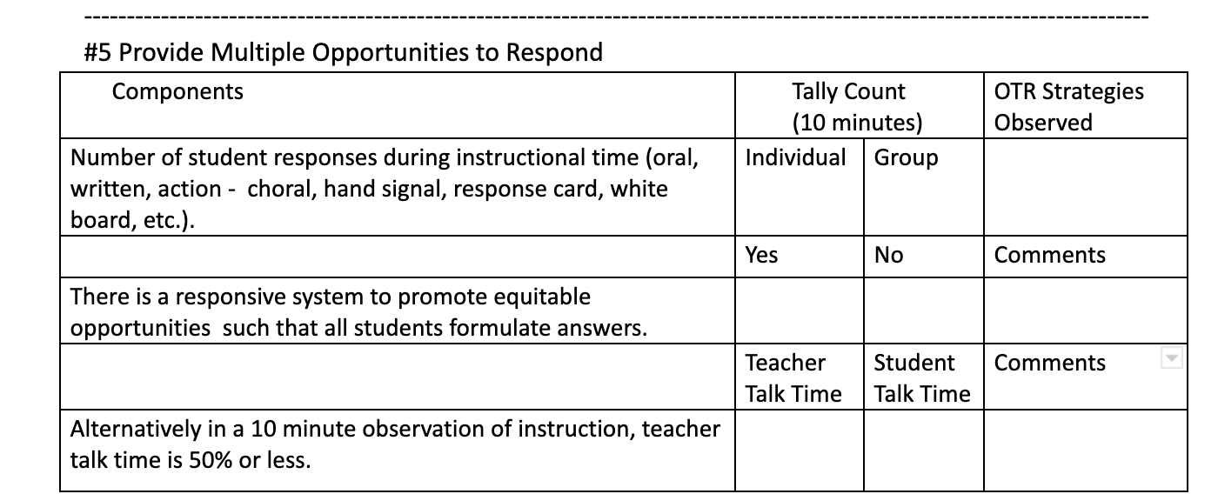
Data Collection Tool

Slide 24
Some additional resources…

Slide 25
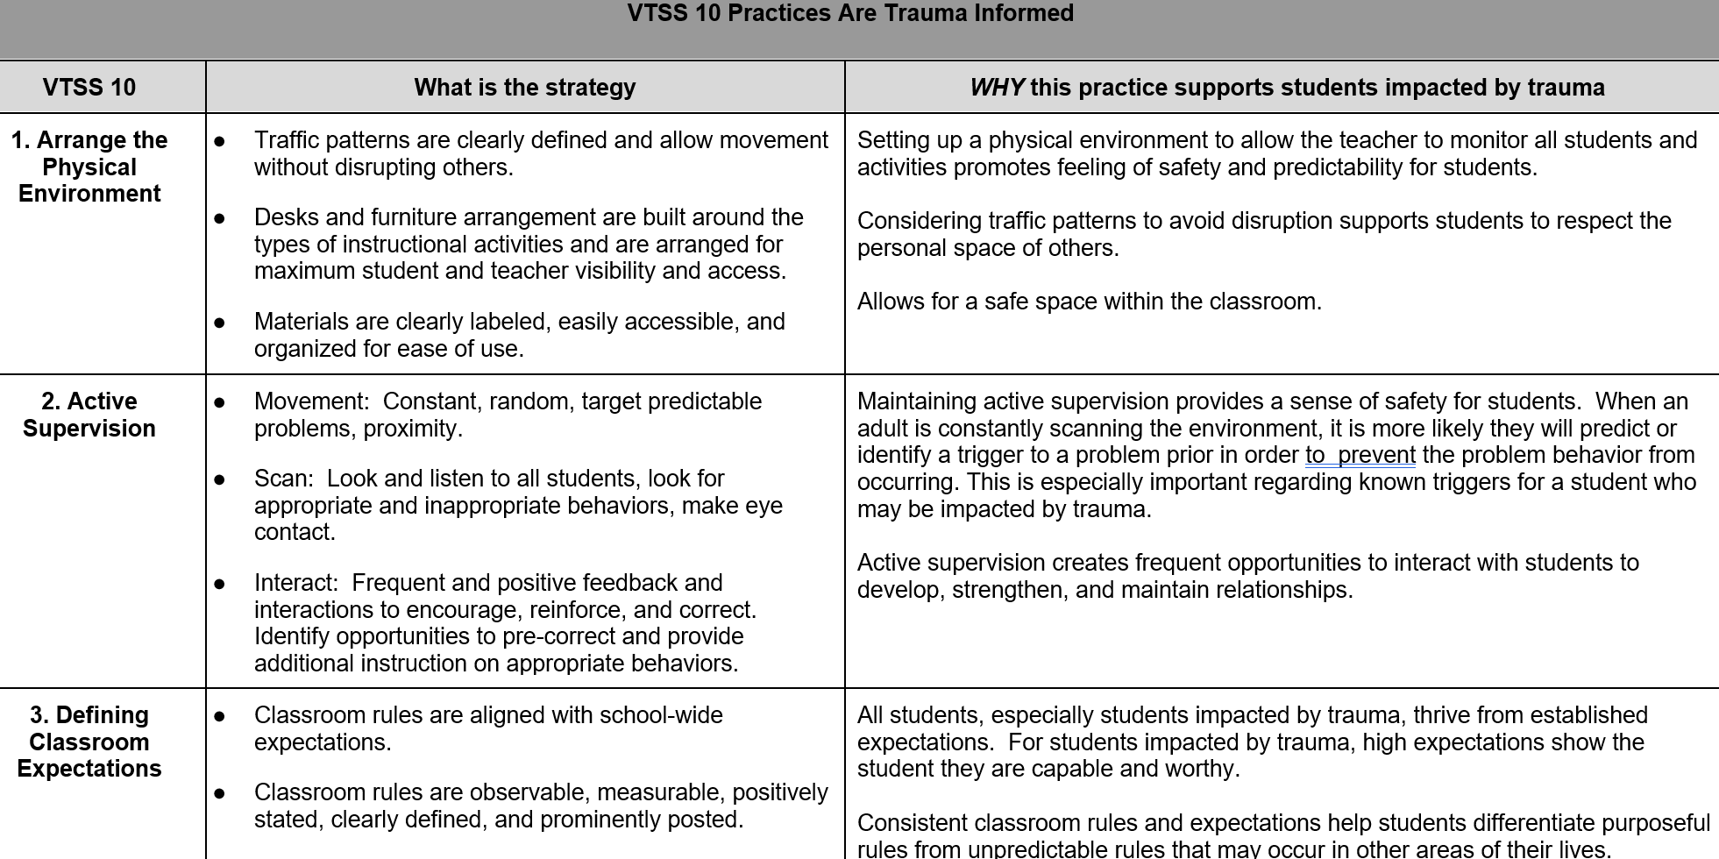
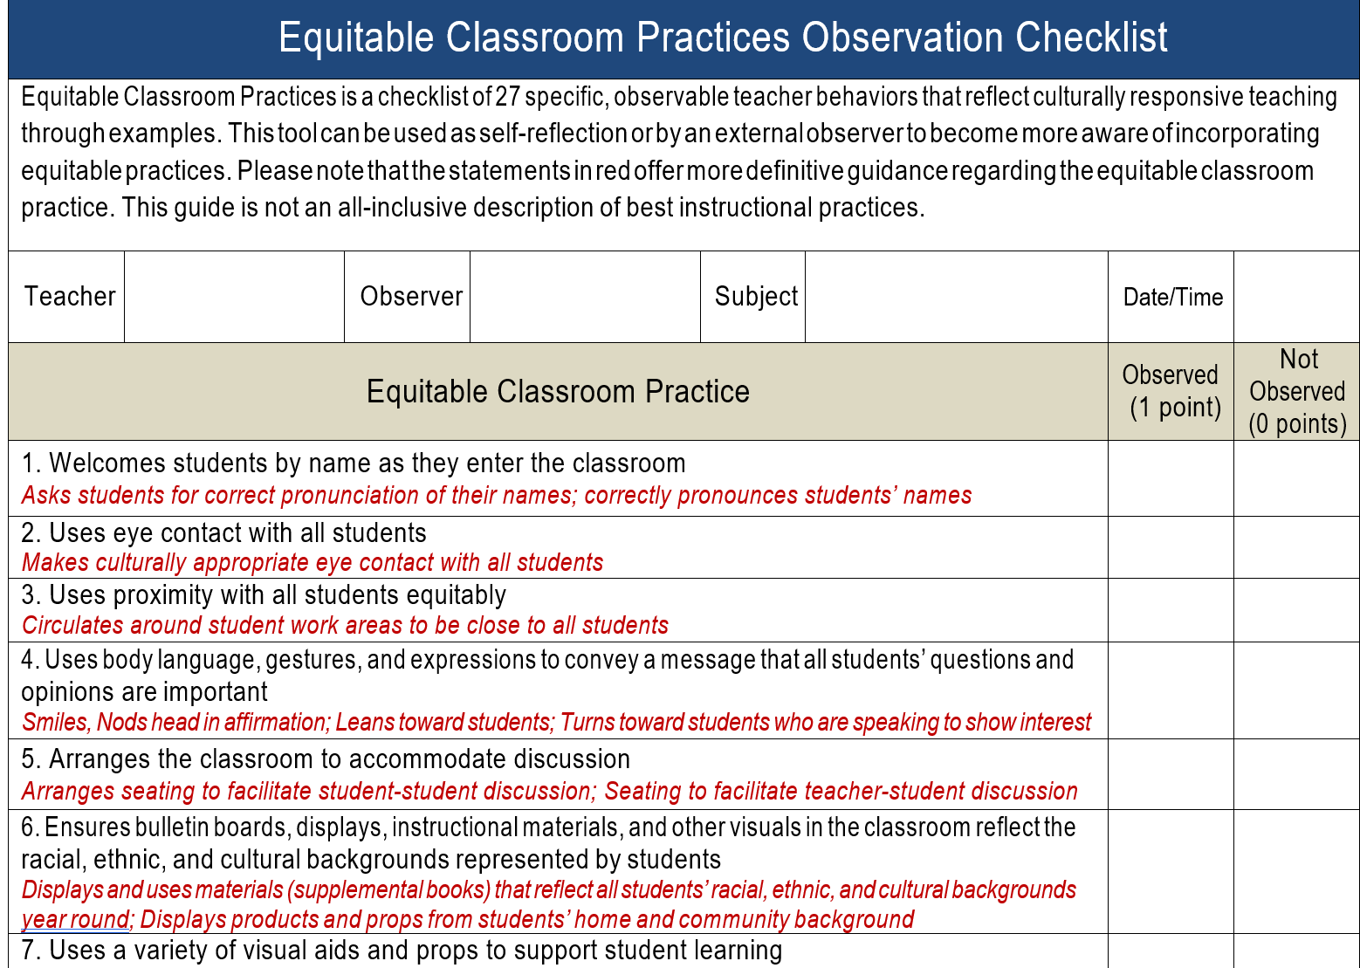
Explicit Links

Slide 26
How could an ECS module be customized for use in your division?
Linked to division goals?
Examples included from division personnel?
Separated into elementary and secondary modules?
Include videos of division leaders?

Slide 27
Padlet for Breakout Room
Link to Padlet for Breakout Room

Slide 28
Support the Staff
Systems

Slide 29
Build the System
Step 1: (concern identified through DATA)
Provide professional learning on PRACTICE.
Begin implementation.
Step 2: Teachers practice strategies and self assess.
They meet in small groups to reflect on practice, successes and challenges,
Teachers ask for support from peers and/or coach.

Slide 30
Building the Plan
Step 3:
Teachers collect data on fluency with the practice
Record themselves or ask for a peer or coach observation with feedback
They discuss in small group the best places to incorporate the practice in a lesson
Step 4:
Meet again as a large group to share data and experiences with practice

Slide 31
Data Collection Tool:
Opportunities to Respond

Slide 32
Coaching Ideas
The Pause Procedure
Stop talking after 12 minutes!
Ask students to process, by discussion in pairs, rewriting notes, or sharing experiences. (remote pairing if necessary)
Result: Significantly higher retention rates
Liven up the PowerPoint
Insert a processing slide after a certain number of content slides. Allow students time to work on a formative assessment question (remote pairing if necessary).

Slide 33
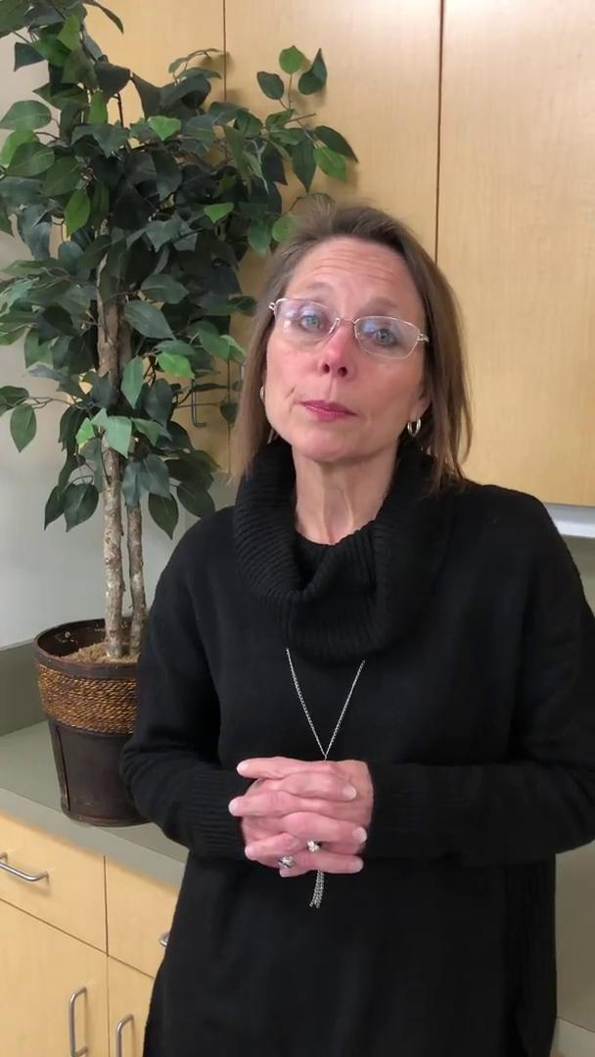
Sharon Clark
Transcript of this video is available at the Virtual Networking for Coaches web page under the “2020-2021” section.

Slide 34
Padlet for Breakout
Padlet for Breakout

Slide 35
This is our way of work.

Slide 36
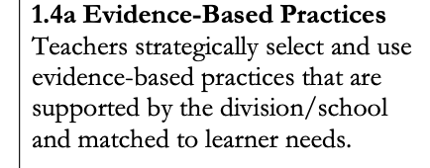
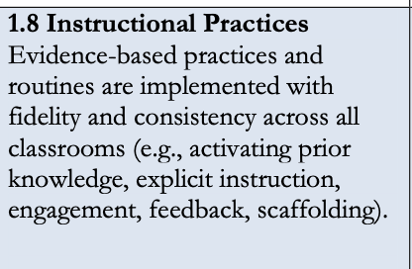
Academic Tiered Fidelity Inventory

