Slide 1
Defusing Disruptive Behavior
Day 1
Summer 2024

Slide 2

A Message of Gratitude

Slide 3
Establishing Our Purpose
Understand the foundational principles of behavior in order to design more effective interventions
Develop an understanding of the escalation cycle and contributing factors
Examine our responses throughout the phases of the escalation cycle in order to support student behavior
Explore evidenced-based interventions to apply throughout the escalation cycle

Slide 4

Materials

Slide 5

Honoring Your Expertise
When it comes to Defusing Disruptive Behavior, what strength do you bring to the table?

Slide 6
Community Agreements
Practice
Self-Compassion
Extend patience, grace, and kindness
Focus on solutions to make things easier
Practice
Growth Mindset
Be open to new thoughts and ideas
Embrace learning opportunities
Practice
Presence
Focus on the here and now
Share your expertise, information and ideas.
Assign a group recorder

Slide 7

Setting Intentions
What is your personal intention for our time together?

Slide 8

Fist to Five

Slide 9

Questions/Celebrations/A Little Helping Hand
Share your questions or celebrations.
Send us a direct message in the chat.

Slide 10




Agenda for Today
      Setting Ourselves up for Success
      2. Setting Our Classrooms up for Success
3. Setting our Students up for Success

Slide 11

A Balanced Approach to Implementation

Slide 12

Personal Reflection

Slide 13
1 – Setting Ourselves up for Success

Slide 14
Foundational Understandings of Behavior
Behavior is Communication and has a function
We change behavior through an instructional approach
Behavior occurs as a sequence of events

Slide 15








Behavior is Communication

Slide 16
Why do they keep doing that?
GAIN
task/activity
attention of adult or peer
a specific item/object
sensory input
ESCAPE
task/activity
attention of adult or peer
a specific item/object
sensory input

Slide 17
ABC’s of Behavior Example
Antecedent
Mr. Jones passes out a math worksheet
Behavior
Carson runs out of the classroom
Consequence
Carson is followed and sent to the office

Slide 18
ABC’s of Behavior Example 2
Antecedent
Mr. Jones prompts students to take out notebooks
Behavior
Student says, ‘Mr. Jones, what is up with that ugly haircut?”
Consequence
The class laughs

Slide 19
ABC’s of Behavior Example 3
Antecedent
Mr. Jones prompts students to put phones away
Behavior
Student ignores Mr. Jones, pulls up the hood, and stays on phone
Consequence
Mr. Jones stops his instruction and raises his voice, prompting the student to put up the phone.

Slide 20

Reflection
Let’s reflect on your personal scenario.
Identify the antecedent, behavior and consequence.

Slide 21
Setting Events
… help explain why people respond differently at different times when presented with the same set of triggers
FATIGUE
TRANSITIONS
TIME OF DAY
HUNGER
SICK/ALLERGIES
MEDICATIONS
ANXIETY/DEPRESSION
CONFLICT
SLEEP PROBLEMS
TRAUMATIC EVENT

Slide 22
ABC’s of Behavior
SETTING EVENT
ANTECEDENT
BEHAVIOR
CONSEQUENCE

Slide 23
ABC’s of Behavior and Setting Events
What are some potential setting events for this scenario?
Antecedent
Mr. Jones prompts students to put phones away
Behavior
Student ignores Mr. Jones, pulls up the hood, and stays on phone
Consequence
Mr. Jones stops his instruction and raises his voice, prompting the student to put up the phone.

Slide 24
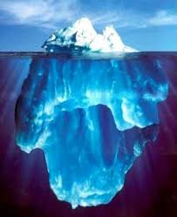
Chat Waterfall
What setting events are your students dealing with?
What setting events are your colleagues dealing with?

Slide 25
Reflection and Small Group Discussion
Let’s reflect on your personal scenario.
What setting events impacted your scenario?
Based on the ABC’s and settings events, what is your hypothesis of the function?
How could communication with families help you understand these setting events?

Slide 26
Behavior Chains
Each ensuing behavior in a given behavior chain becomes more serious than the one preceding it (Walker et al., 1995).
Prevent the behavior from becoming more serious by interrupting the behavioral chain at any time
One way to change the student’s successive behaviors is to change the teacher’s responses.

Slide 27
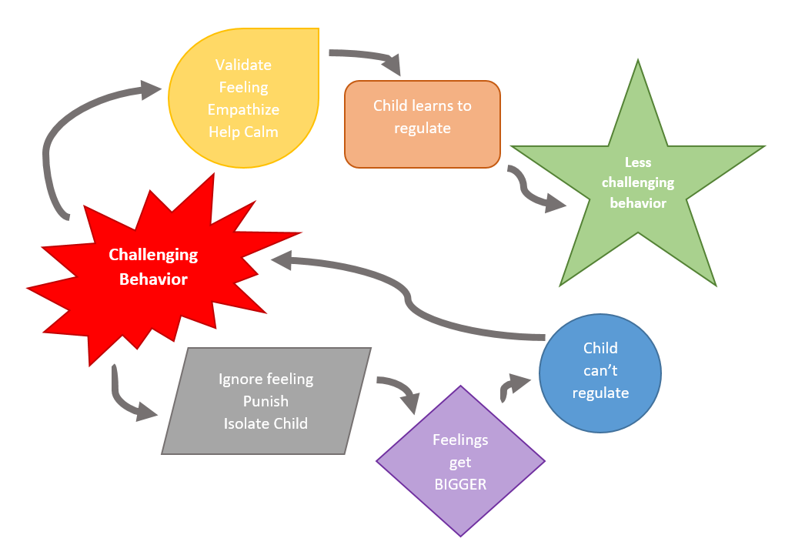
Responding
@The_Therapist_Parent

Slide 28
Behavior Chain
Teacher | Student
Mr. Jones greets Carson as as he enters the classroom. | Carson nods and puts his head down.
Mr. Jones repeats himself, “I said good morning Carson.” | Carson looks up, sucks his teeth and looks away.
Mr. Jones says, “Fine, you can just start your work.” and passes out a math worksheet. | Carson runs out of the classroom.
Mr. Jones follows and sends Carson to the office. | …..

Slide 29
Reflection
Let’s reflect on your personal scenario.
Can you identify one or more behavior chains?

Slide 30

What else can contribute to behavior?

Slide 31
Impact of Trauma on Behavior
Results from an event, series of events, or set of circumstances that is experienced by an individual as physically or emotionally harmful or life threatening and that has lasting adverse effects on the individual's functioning and mental, physical, social, emotional, or spiritual well-being.
(SAMHSA, 2023)

Slide 32
Types of Trauma
ACUTE
A single incident
CHRONIC
Experiences that occur repeatedly over long periods of time
HISTORICAL
The collective and cumulative trauma experienced by a particular group across generations still suffering the effects
(Goldsmith et al., 2013)

Slide 33
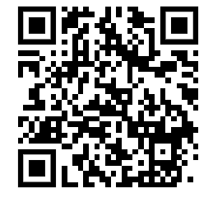
Padlet Discussion
What types of trauma have your students experienced?
How does this impact families?
How did this impact you?

Slide 34
The Impact of Trauma
Individuals who have experienced trauma may react differently as they go through the phases of the escalation cycle.
Often more challenging for adults to identify triggers and functions
Faster escalation to crisis/peak or little/no reaction when one would be expected
Longer time in crisis/peak before de-escalating

Slide 35
Impact in the Classroom?
Executive Functioning
Language and Communication Skills
Memory
Ability to see Cause and Effect
Organizational Ability
Concentration and Attention
(Krasnoff, 2017)

Slide 36
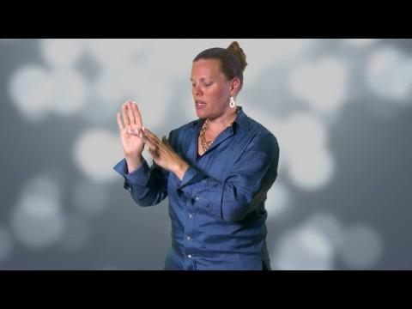
Flip Your Lid

Slide 37
Small Group Discussion
What stood out to you in this video?
Why is it important to understand this information when responding to disruptive behavior?
Why is it important to understand this information when talking with families?

Slide 38
Survival Brain
Increased
Decreased
Emotional instability
  Anxiety
  Irritability
  Anger
  Frustration
Impulsivity with regards to language or actions
Problem solving
Communication skills
Emotional regulation
Ability to retrieve previously learned information
Decision making

Slide 39
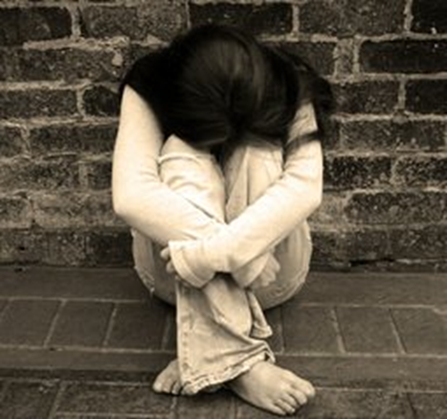
Fight, Flight, Freeze, Appease

Slide 40
What Does This Look Like?
Fight
Argumentative
Aggressive
Confrontational
Alone
Immature
Glaring
Hands in fists
Flight
Hyperactive
Aggressive
Running away
Disruptive
Leg Movement
Fidgety
Immature
Freeze
Bored
Distracted
Not listening
Zoned out
Wide-eyed
Standing still
Appease
Socially withdrawn
Quiet
Compliant
Passive
Resigned
Low energy
Neutral expression

Slide 41
Poll
When faced with a stressor, which is the following is your most common response:
Fight
Flight
Freeze
Appease

Slide 42

Small Group Discussion
How does this play out in your classroom?
(With yourself and your students)
How does this play out when interacting with families?

Slide 43
Reflection
Let’s reflect on your personal scenario.
Does this information increase your understanding of what was happening with your student or with you?

Slide 44
Responding
When little people are overwhelmed with BIG EMOTIONS, it’s our job to
share our calm, not join their chaos.
L. R. Knost

Slide 45
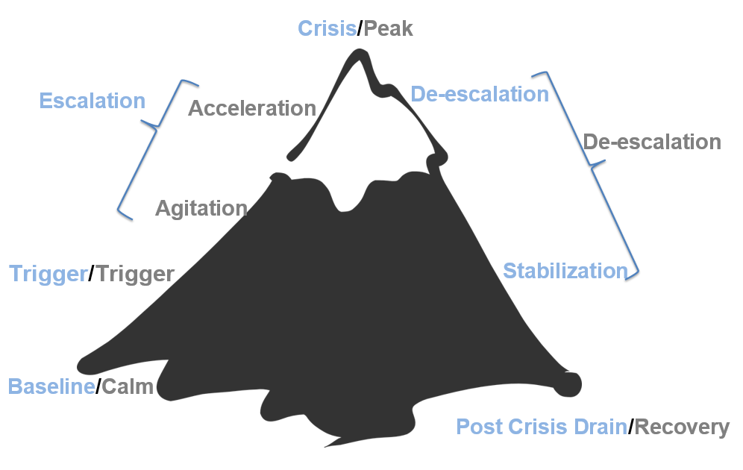
The Escalation Cycle

Slide 46
How Full is Your Cup?
email from Administrator
Overslept this morning
lack of engagement from students
Car Trouble
Struggle with your third period
Taking care of a parent
Sarcastic tone from student
anxiety
second job
grades due
health concerns

Slide 47
Independent Reflection
How full is your cup?
Take a few minutes to fill in your own cup with all of the things that you have on your plate right now.
(Complete independently with no expectation to share)

Slide 48
Let’s Talk About Stress
Stressors
Stress
Threats that activate the stress response in your body
Anything you see, hear, smell, touch, taste or imagine could do you harm
Internal or External
Neurological and physiological shift that happens when you encounter one of these threats.
Designed to help us survive (flight, fight, freeze, appease)
(Nagoski & Nagoski, 2020)

Slide 49
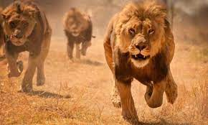
The Stress Cycle

Slide 50
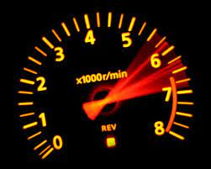
The Impact of Ongoing Stress
Our bodies and brains react to danger to keep us safe
Ongoing stress and failing to complete the stress cycle makes this system less effective and more reactive
This can lead to wear and tear on the body and brain
This could be compared to revving a car engine for weeks at a time

Slide 51
Chat Waterfall
How does ongoing stress impact you on a daily basis?

Slide 52
Words of Wisdom
“I’ve come to a frightening conclusion that I am the decisive element in the classroom. It’s my personal approach that creates the climate. It’s my daily mood that makes the weather. As a teacher, I possess a tremendous power to make a child’s life miserable or joyous. I can be a tool of torture or an instrument of inspiration. I can humiliate or heal. In all situations, it is my response that decides whether a crisis will be escalated or de-escalated and a child humanized or dehumanized.”
― Haim Ginott

Slide 53
Our Role in the Escalation Cycle?
First, we need to engage in practices that allow us to bring our best selves each day
We need a plan to maintain self control during a crisis/power struggle. (Remember fight, flight, freeze, or appease response)
Our goal is to remain calm & regain an “emotional balance”

Slide 54
Vulnerable Decision Points (VDP)
A VDP is a given situation coupled with a person's internal state that affects discipline decision making.

Slide 55
Situations
Subjective problem behavior
  Defiance, Disrespect, Disruption
  Major vs. Minor
Non-classroom areas
  hallways, cafeterias
Classrooms
Afternoons

Slide 56
Decision States
Setting Events - an event occurring before or with an antecedent that increases the likelihood of a behavior
Resource Depletion - as we become fatigued, our filters for appropriate behavior can be affected

Slide 57
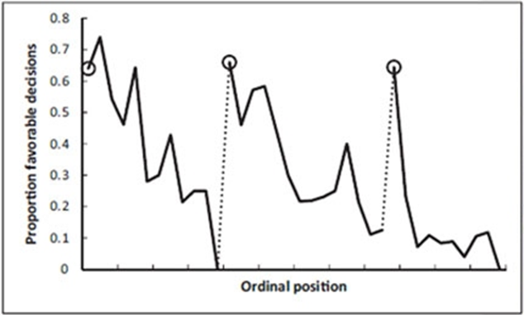
Example: Resource Depletion
Outcomes of parole hearings
Judge’s snack break
Judge’s lunch break
(Danziger et al., 2011)

Slide 58
Small Group Brainstorming and Discussion
What are some common VDP’s for adults in your school?
Reminder: A VDP is a given situation coupled with a person's internal state (setting events and resource depletion) that affects discipline decision making.

Slide 59
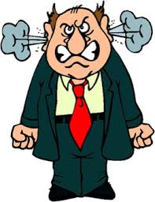
Vulnerable Decision Points & Neutralizing Routines
When you see an unwanted behavior or the start a power struggle, stop and ask yourself…
“Am I triggered or agitated?”
  by this student or situation
  or an outside factor
If yes, use an agreed-upon alternative response (neutralizing routine)
(Northeast PBIS Network, 2023)

Slide 60
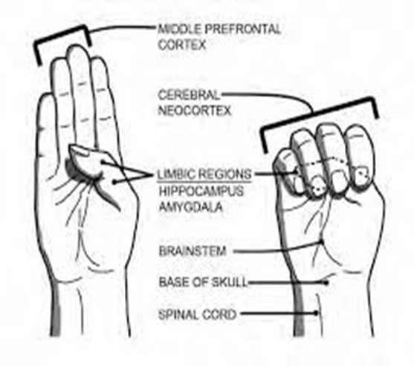
Goal of Neutralizing Routines

Slide 61
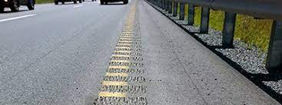
Emotions are Our Warning System

Slide 62
Emotional Agility
“Emotional Agility….choosing how you’ll respond to your emotional warning system...between stimulus and response there is a space.” (David, 2021)
“In that space is our power to choose our response. In our response lies our growth and freedom.” (Frankl, 1946)

Slide 63
Neutralizing Routines
EXAMPLES:
COMPONENTS:
If - then statement
Brief
Clear Steps
Doable
Interrupts the chain of events
Delay the decision until I can think clearly
Reframe the situation
Take care of yourself

Slide 64

A Quick Neutralizing Routine

Slide 65
Mindfulness as a Neutralizing Routine
Release your tongue from the top of your mouth
Name 5 things you see
Push your feet through the floor
Relax your jaw
Count the things in the room that begin with the letter B
Drop your shoulders away from your ears

Slide 66
Padlet Activity
What neutralizing routines work for you?
Could you turn these into classroom or school-wide routines for your students as well?

Slide 67
Independent Reflection
Reflect on your personal scenario.
Was there an opportunity for you to utilize a neutralizing routine?
Any opportunity for growth in this area?

Slide 68
Setting Our Classrooms up for Success
2 - Setting Our Classrooms up for Success

Slide 69
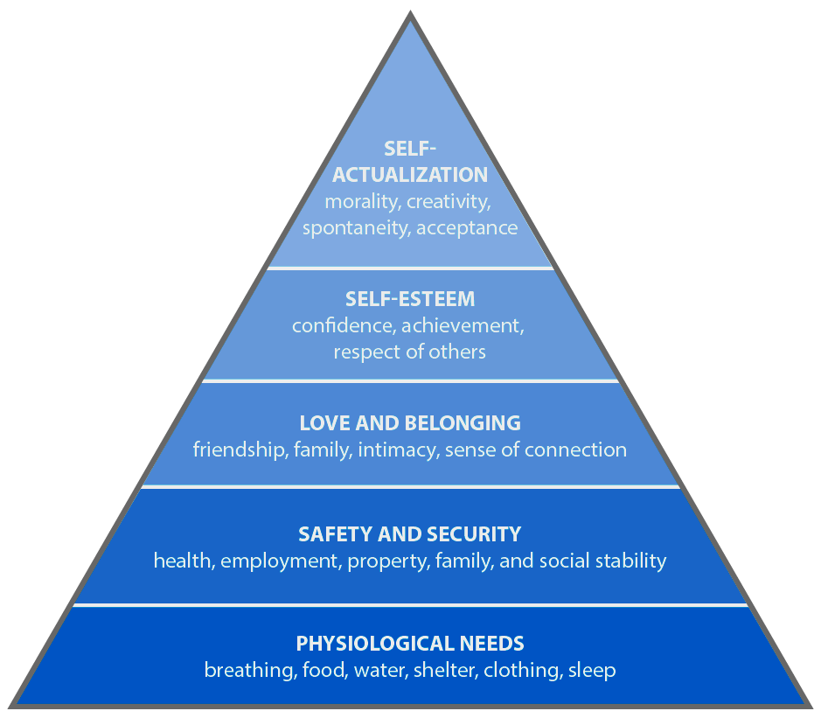
Meet Basic Needs
Food
Rest/sleep
Safety (physical & emotional)
Belonging through non-contingent and contingent praise

Slide 70
Chat Waterfall
What is one thing you do to establish a sense of emotional safety in your classroom?

Slide 71

The Importance of Relationships

Slide 72
Small Group Discussion
What resonated with you about this video?
What did the teacher do to access her brilliance?

Slide 73
Independent Reflection
Reflect on the strategies and practices that we have covered today.
What are some things you have learned that you can apply to access your own brilliance?

Slide 74
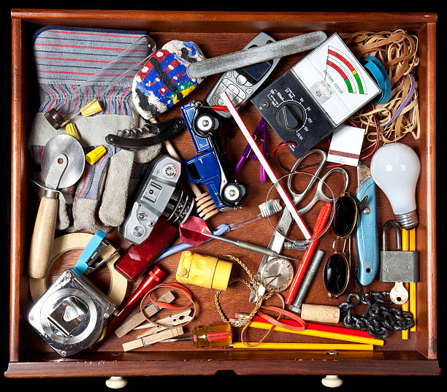
Junk Drawer- Chat Waterfall

Slide 75
Exit Ticket
Please complete the exit ticket before you leave for the day!

