Slide 1
Defusing Disruptive Behavior
Day 1
Summer 2023
Notes:
10:00-
Copies: Notetaker- notetaker, good day plan, Take Care of me List, self-care assessment
Bring: Emotion/Check-in chart, Post-its (small and large),Dots,copies (do I need card stock?)
Reminders Day Of:
Small Groups of 4-5 (at least 7 tables)
Have Parking lot up in room
Have community norms poster up in room
Large post-it for Establishing Emotional Safety
Check-in Activity: As they enter pass out dots and have them place a dot beside how they are feeling today.

Slide 2
A Message of Gratitude
Notes:
Everyone Stand Activity: Sit down based on how long they have been teaching, raise hands based on position
Acknowledgement
Family of Teachers

Slide 3
Establishing Our Purpose
Understand the foundational principles of behavior in order to design more effective interventions
Develop an understanding of the escalation cycle and contributing factors
Examine our responses throughout the phases of the escalation cycle in order to support student behavior
Explore evidenced-based interventions to apply throughout the escalation cycle
Notes:
10:05
Day 1: 10-4
Day 2: 9-3

Slide 4
Materials
Notes:
Add icons for activity, small group discussion, and workbook

Slide 5
Honoring Your Expertise
When it comes to Defusing Disruptive Behavior, what strength do you bring to the table?
Notes:
10:07
Small Group Share: Honoring your expertise

Slide 6
Community Agreements
Practice
Self-Compassion
Extend patience, grace, and kindness
Focus on solutions to make things easier
Practice
Growth Mindset
Be open to new thoughts and ideas
Embrace learning opportunities
Practice
Presence
Focus on the here and now
Share your expertise, information and ideas.
Assign a group recorder
Notes:
10:15
Post it Independent Activity- 2 minutes
Which one of these will be hardest for you?
Self-Compassion
Growth Mindset
Presence
None-I’m good to go
Post-it Activity: What do you need from us or yourself in order to honor the community agreement?

Slide 7
Setting Intentions
What is your personal intention for our time together?

Slide 8
Routines for Our Time Together
Attention Getting Signal:
5, 4, 3, 2, 1
Notes:
10:19
Honor us as adult learners, Honor your expertise, Allow for maximum discussion and engagement. Our goal is for you to be able to process and discuss as we move through this content
We have a ton to cover, quick pace so routines are necessary
Two routines to help us to engage in the most effective way throughout our time together

Slide 9
Fist to Five
Notes:
Pose a topic and allow participants to share their feelings on it by holding up a number representing where they fall on the scale of 0 (fist) to five (all five fingers up). A fist indicates that they are feeling very uneasy and need more support or instruction. A five indicates that they are comfortable, excited and ready to go! For example, after introducing a new math concept, you could ask your students to use “Fist to Five” to indicate how well they understand the information
How happy are you to come back to school after the weekend?
How are you feeling about that activity? That concept? The upcoming test?

Slide 10
Community Parking Lot
Share your curiosities and great ideas!
Place any questions and celebrations on the Community Parking Lot!

Slide 11
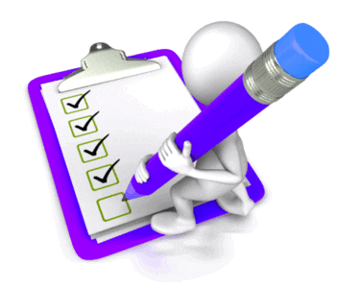
Agenda for Today
Setting Ourselves up for Success
2. Setting Our Classrooms up for Success
3. Setting our Students up for Success
Notes:
10:22
Day 1: 10-4
Day 2: 9-3
We will cover the two highlighted areas today with the heavy emphasis on 1

Slide 12
A Balanced Approach to Implementation
Notes:
Balance between personal and school lens
The training will allow you to add to your personal toolkit as well as planning for school wide implementation and capacity building

Slide 13
Personal Reflection
Notes:
10:24
Set the stage independent activity- take a minute to remember a time when you were face with a behavior or a series of behaviors that were not conducive to learning. Maybe the behavior escalated to a referral, maybe the student stormed out of class, maybe they or you raised your voice. Just think of a time and take time to do a braindump of everything you remember about that event. Did you involve other stakeholders, administration, families? When did that happen?

Slide 14
1 - Setting Ourselves up for Success
Notes:
10:30
Understanding Behavior
Escalation Cycle
Vulnerable Decision Points/ Neutralizing Routines

Slide 15
Foundational Understandings of Behavior
Behavior is Communication and has a function
We change behavior through an instructional approach
Behavior occurs as a sequence of events
Notes:
Behavior is communication
Behavior has a function
Behavior occurs as a sequence of events
Behavior can be changed through an instructional approach

Slide 16
Behavior is Communication
Notes:
10:32
Think of a time…..
Why did you behave in the way that you did?
Seeking Approval
Tired
Hungry
Overwhelmed
Seeking Attention
Avoiding Attention
Anxious or scared
Feeling undervalued
Other
Function of behavior describes Why a behavior is occurring
Identifying function helps guide interventions

Slide 17
Why do they keep doing that?
GAIN
task/activity
attention of adult or peer
a specific item/object
sensory input
ESCAPE
task/activity
attention of adult or peer
a specific item/object
sensory input

Slide 18
ABC’s of Behavior Example
Antecedent
Mr. Jones passes out a math worksheet
Behavior
Carson runs out of the classroom
Consequence
Carson is followed and sent to the office
Notes:
10:35
Fist to Five: You may have seen this slide explaining the ABC’s of behavior and it is important to understand that this is how you determine what instruction needs to take place. We have to determine the “why”, the function of behavior in order to #1 prevent it and #2 respond appropriately. (Go through the slide).
Independent Activity: Reflect on your personal scenario that you wrote down earlier. Can you identify the ABC’s in that scenario? Take 2 minutes to fill in the ABC Chart on your notetaker.

Slide 19
ABC’s of Behavior Example 2
Antecedent
Mr. Jones prompts students to take out notebooks
Behavior
Student says, ‘Mr. Jones, what is up with that ugly haircut?”
Consequence
The class laughs
Notes:
Teacher prompts students to take out notebooks
Student says, “Mr. Jones, what is up with that ugly haircut”
Class laughs

Slide 20
ABC’s of Behavior Example 3
Antecedent
Mr. Jones prompts students to put phones away
Behavior
Student ignores Mr. Jones, pulls up the hood, and stays on phone
Consequence
Mr. Jones stops his instruction and raises his voice, prompting the student to put up the phone.
Notes:
Teacher prompts student to put phone away
Student continues to stay on the phone
Teacher raises voice and again prompts

Slide 21
Reflection
Let’s reflect on your personal scenario.
Identify the antecedent, behavior and consequence.
Notes:
10:37
Personal Scenario

Slide 22
Setting Events
… help explain why people respond differently at different times when presented with the same set of triggers
FATIGUE
TRANSITIONS
TIME OF DAY
HUNGER
SICK/ALLERGIES
MEDICATIONS
ANXIETY/DEPRESSION
CONFLICT
SLEEP PROBLEMS
TRAUMATIC EVENT
Notes:
10:42-

Slide 23
ABC’s of Behavior
SETTING EVENT
ANTECEDENT
BEHAVIOR
CONSEQUENCE

Slide 24
ABC’s of Behavior and Setting Events
What are some potential setting events for this scenario?
Antecedent
Mr. Jones prompts students to put phones away
Behavior
Student ignores Mr. Jones, pulls up the hood, and stays on phone
Consequence
Mr. Jones stops his instruction and raises his voice, prompting the student to put up the phone.
Notes:
Teacher prompts student to put phone away
Student continues to stay on the phone
Teacher raises voice and again prompts

Slide 25
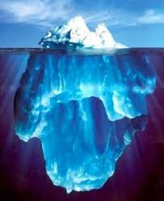
Small Group Discussion
What setting events are your students dealing with?
What setting events are your colleagues dealing with?
Notes:
10:44

Slide 26
Let’s Take a Break
Notes:
11:00

Slide 27
Reflection and Small Group Discussion
Let’s reflect on your personal scenario.
What setting events impacted your scenario?
Based on the ABC’s and settings events, what is your hypothesis of the function?
How could communication with families help you understand these setting events?
Notes:
10:55
Personal Scenario

Slide 28
Behavior Chains
Each ensuing behavior in a given behavior chain becomes more serious than the one preceding it. (Walker et al., 1995)
Prevent the behavior from becoming more serious by interrupting the behavioral chain at any time
One way to change the student’s successive behaviors is to change the teacher’s responses.
Notes:
11:07
Behavior does not occur in a silo. There are many interaction pathways that have an influence.
Behaviors build on previous interactions each response setting the stage for the next ; the teachers response determines what the student will do next; the teachers response serves to reinforce each student response

Slide 29
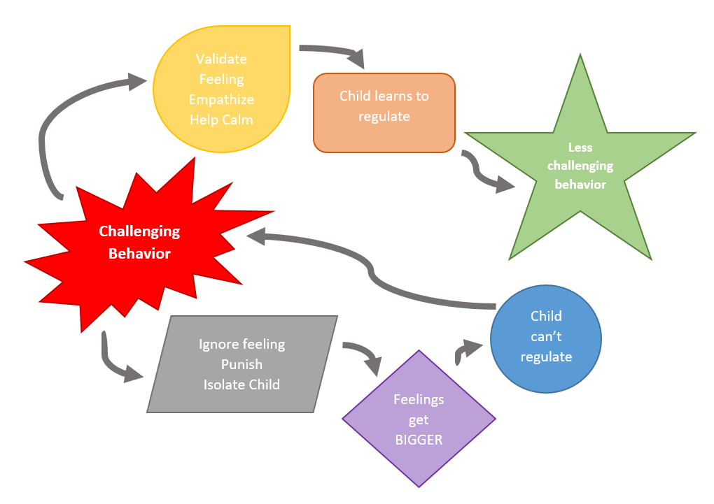
Responding
@The_Therapist_Parent
Notes:
Fist to Five: how are we feeling about ABCs, Setting Events, Function

Slide 30
Behavior Chain
Teacher | Student
Mr. Jones greets Carson as as he enters the classroom. | Carson nods and puts his head down.
Mr. Jones repeats himself, “I said good morning Carson.” | Carson looks up, sucks his teeth and looks away.
Mr. Jones says, “Fine, you can just start your work.” and passes out a math worksheet. | Carson runs out of the classroom.
Mr. Jones follows and sends Carson to the office. | …..
Notes:
11:10

Slide 31
Reflection
Let’s reflect on your personal scenario.
Can you identify one or more behavior chains?
Notes:
11:12
Personal Scenario

Slide 32
What else can contribute to behavior?
Notes:
11:15

Slide 33
Impact of Trauma on Behavior
Results from an event, series of events, or set of circumstances that is experienced by an individual as physically or emotionally harmful or life threatening and that has lasting adverse effects on the individual's functioning and mental, physical, social, emotional, or spiritual well-being.
(SAMHSA, 2023)
Notes:
Let’s start with the basic definition of trauma, offered by the US Substance Abuse and Mental Health Services Admin (SAMHSA). When we consider this definition we look at the 3 E’s—Event, Experience, and Effects.
Give examples of how these impact students, families, communities (including the school community)

Slide 34
Types of Trauma
ACUTE
A single incident
CHRONIC
Experiences that occur repeatedly over long periods of time
HISTORICAL
The collective and cumulative trauma experienced by a particular group across generations still suffering the effects
(Goldsmith et al., 2013)
Notes:
11:17
According to the National Childhood Stress Network there are 13 categories of trauma. This is another reason as to why schools should be addressing trauma. Today we will focus on three; Acute, Chronic, and Historical trauma. Acute Trauma is an event that occurs at a particular time and place and is usual short lived such as a natural disaster, accident, or sudden loss. Chronic trauma are experiences that occur repeatedly over long periods of time such as abuse, community violence, long term illness, ongoing bullying, chronic homelessness, chronic exposure to poverty, racism. Historical trauma is the collective and cumulative trauma experienced by a particular group across generations that are still suffering the effects
https://www.flcourts.org/content/download/215866/1961142/TypesofTrauma.pdf
https://www.tandfonline.com/doi/abs/10.1080/15299732.2014.871666?journalCode=wjtd20

Slide 35
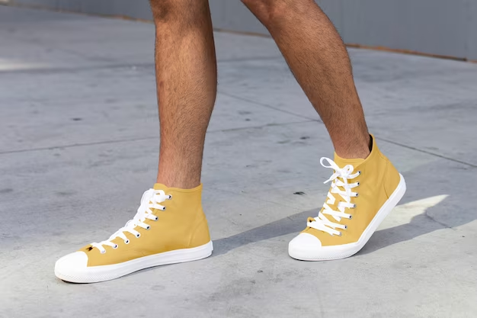
Shoe Partner
What types of trauma have your students experienced?
How did this impact you?
Notes:
11:19
What types of trauma have your students experienced?
How does this impact families and family engagement?
How did this impact you?

Slide 36
The Impact of Trauma
Individuals who have experienced trauma may react differently as they go through the phases of the escalation cycle.
Often more challenging for adults to identify triggers and functions
Faster escalation to crisis/peak or little/no reaction when one would be expected
Longer time in crisis/peak before de-escalating
Notes:
11:26

Slide 37
Impact in the Classroom?
Executive Functioning
Language and Communication Skills
Memory
Ability to see Cause and Effect
Organizational Ability
Concentration and Attention
(Krasnoff, 2017)
Notes:
The impact of trauma on learning presents in multiple ways. For example, often students who have experienced trauma are able to complete a task one day and then not be able to complete the same task the next day. Our natural tendency is to think the student is just being noncompliant since they had previously demonstrated the ability. However, we must be aware that the state they are in on any given day can influence their ability to comprehend, communicate or even remember previously learned content. Also, it is challenging for students who have experienced trauma to concentrate and attend when they are moving in and out of the survival brain.
So, it is important to consider these possibilities when structuring your physical environment, establishing routines and procedures, and implementing instructional strategies.
References: Rodenbush, K. (2015). The effects of trauma on behavior in the classroom included in Education Northwest “A Practitioner’s Guide to Educating Traumatized Children”

Slide 38
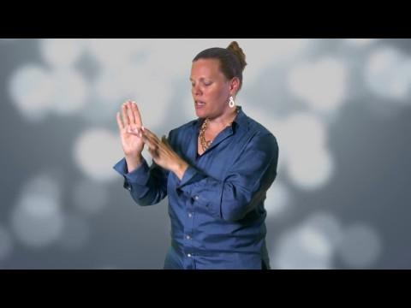
Flip Your Lid
Notes:
11:29

Slide 39
Small Group Discussion
What stood out to you in this video?
Why is it important to understand this information when responding to disruptive behavior?
Why is it important to understand this information when talking with families?
Notes:
11:31

Slide 40
Survival Brain
Increased
Decreased
Emotional instability
Anxiety
Irritability
Anger
Frustration
Impulsivity with regards to language or actions
Problem solving
Communication skills
Emotional regulation
Ability to retrieve previously learned information
Decision making
Notes:
11:36
When an individual is functioning in their survival brain there is an increase in emotional instability and impulsivity (with regards to language or actions). However, other functions decrease. Individuals have a lowered ability to problem solve, interact, communicate, regulate our emotions, retrieve previously learned information, plan and make decisions.
Think about the impact this has on students in your classrooms, hallways, cafeterias etc.

Slide 41
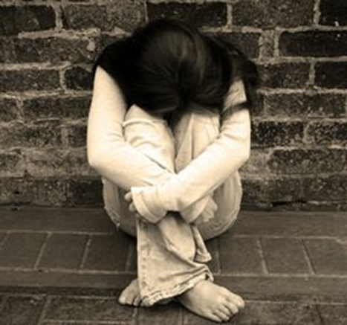
Fight, Flight, Freeze, Appease
Notes:
11:38
When a child in functioning in survival brain or is faced with a situation that causes them fear or stress, they will have one of four reactions. They will fight, flee (flight), freeze or appease. You have likely heard of fight, flight or freeze but there is an additional category, called appease that we are going to explain in a moment. When a child is in fight, they will demonstrate behaviors that could be labeled as aggressive. They may take something out of another student’s hand, they may yell or run at you, or cry and throw themselves on the floor. A child who is experiencing flight will usually be looking for a way to escape. They may attempt to run out of the classroom, hide under a desk or cover their ears. A student who is experiencing freeze may become quiet, they may look around the room or stumble over their words. You may not see any behavior at all but they may still be functioning in survival brain. The last category is appease. This is also referred to as fawn or submit. Children who are experiencing appease may simply go along or comply with the request given because they see that as the only safe alternative. It is important for us, as educators, to remember that even though they may seem calm and compliant, they may actually be functioning in survival brain.

Slide 42
What Does This Look Like?
Fight
Argumentative
Aggressive
Confrontational
Alone
Immature
Glaring
Hands in fists
Flight
Hyperactive
Aggressive
Running away
Disruptive
Leg Movement
Fidgety
Immature
Freeze
Bored
Distracted
Not listening
Zoned out
Wide-eyed
Standing still
Appease
Socially withdrawn
Quiet
Compliant
Passive
Resigned
Low energy
Neutral expression
Notes:
I wish they would like me
I wish I could do this
I wish I had friends
I’m so alone
If I hit first, I can’t get hurt
I wish you knew how scary this was for me
I need to get out of here
It’s too loud
I am under attack
I hate myself
I am scared

Slide 43
Four Corners Activity
When faced with a stressor, which is the following is your most common response:
Fight
Flight
Freeze
Appease
Go to the corner assigned to your response.
Notes:
11:42
Activity

Slide 44
Four Corners Activity Continued
Find a partner in your group and take 4 minutes to discuss the following:
Discuss a situation that elicited the fight, flight, freeze, appease response?
Notes:
11:44
Activity Continued and share out depending on time

Slide 45
Small Group Discussion
How does this play out in your classroom?
(With yourself and your students)
How does this play out when interacting with families?
Notes:
11:47

Slide 46
Reflection
Let’s reflect on your personal scenario.
Does this information increase your understanding of what was happening with your student or with you?
Notes:
11:55
Personal Scenario

Slide 47
Responding
When little people are overwhelmed with BIG EMOTIONS, it’s our job to
share our calm, not join their chaos.
L. R. Knost
Notes:
11:58

Slide 48
Lunch Break
Notes:
Last 15 minutes, fun review game and application to school-wide practices

Slide 49
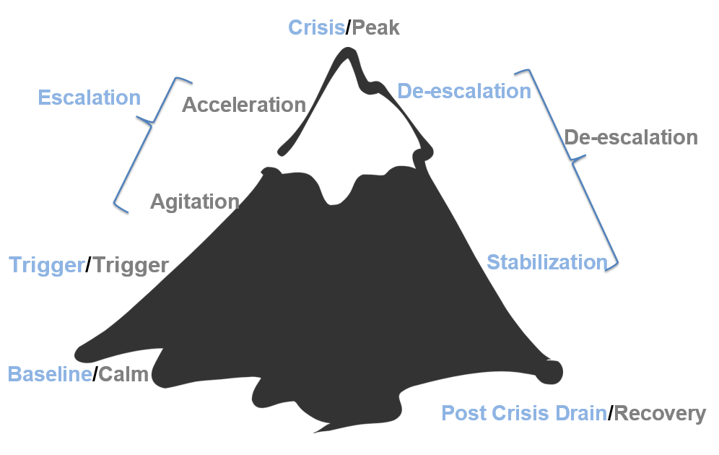
The Escalation Cycle
Notes:
1:00
Fist to Five

Slide 50
How Full is Your Cup?
email from Administrator
Overslept this morning
lack of engagement from students
Car Trouble
Struggle with your third period
Taking care of a parent
Sarcastic tone from student
anxiety
second job
grades due
health concerns
Notes:
1:02
Let’s be realistic

Slide 51
Independent Reflection
How full is your cup?
Take a few minutes to fill in your own cup with all of the things that you have on your plate right now.
(Complete independently with no expectation to share)
Notes:
1:04

Slide 52
Let’s Talk About Stress
Stressors
Stress
Threats that activate the stress response in your body
Anything you see, hear, smell, touch, taste or imagine could do you harm
Internal or External
Neurological and physiological shift that happens when you encounter one of these threats.
Designed to help us survive (flight, fight, freeze, appease)
(Nagoski & Nagoski, 2020)
Notes:
1:14
External: work, family, pandemic, cultural norms and expectations, time, experiences of discrimination, death or illness, divorce etc.
Internal: memories, self-criticism, body image, perfectionism, anxiety, identity, worry etc.

Slide 53
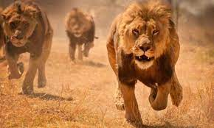
The Stress Cycle
Notes:
The Stress Cycle

Slide 54
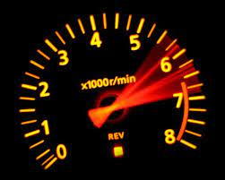
The Impact of Ongoing Stress
Our bodies and brains react to danger to keep us safe
Ongoing stress and failing to complete the stress cycle makes this system less effective and more reactive
This can lead to wear and tear on the body and brain
This could be compared to revving a car engine for weeks at a time
Notes:
Our bodies and brains react to danger in order to keep us safe. Ongoing stress and failing to complete the stress cycle can make this system less effective, causing our stress-response system to activate whether or not real danger is present. Experiencing things like racism or community violence, ongoing stress the pandemic can literally “get under our skin” and cause toxic ongoing stress. this excessive activation of the stress response system can lead to wear and tear on the body and brain. To give you a visual it would be the same as reviving a car engine for days or weeks at a time.

Slide 55
Make A New Connection
Connect with someone who is NOT at your table and discuss the following.
How does ongoing stress impact you on a daily basis?
Notes:
1:21
How does ongoing stress impact you on a daily basis

Slide 56
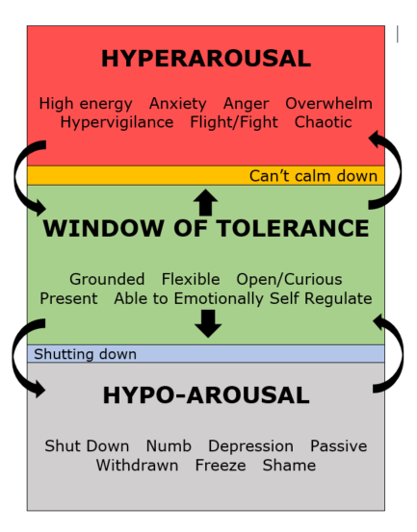
Window of Tolerance
Notes:
1:28

Slide 57
Small Group Discussion
How does the window of tolerance apply to you?
How could you use this in the classroom?
How could you use this at the schoolwide level?
Notes:
1:30
Window of tolerance as a visual for your school? For your classroom?
Make sure to talk about internalizers
How could you communicate with families about this?

Slide 58
Our Role in the Escalation Cycle?
First, we need to engage in practices that allow us to bring our best selves each day
We need a plan to maintain self control during a crisis/power struggle. (Remember fight, flight, freeze, or appease response)
Our goal is to remain calm & regain an “emotional balance”
Notes:
1:36

Slide 59
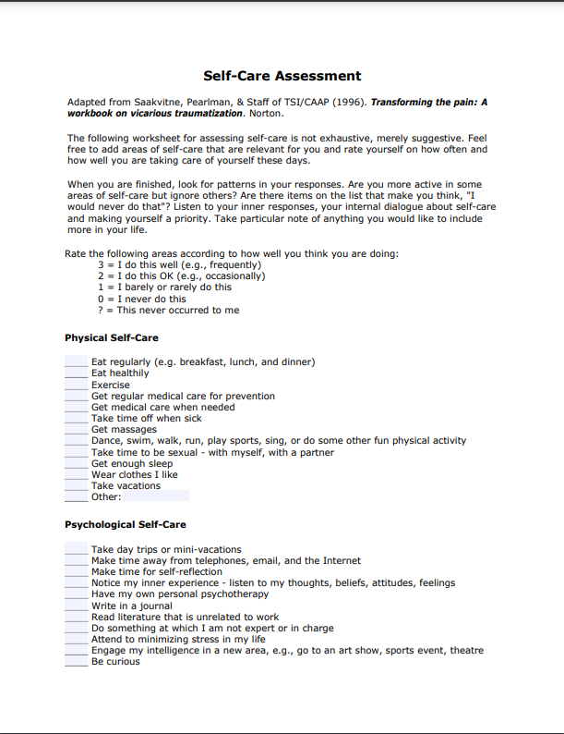
Personal Assessment
Take 10 minutes to complete the assessment in your workbook.
Notes:
1:38
https://socialwork.buffalo.edu/content/dam/socialwork/home/self-care-kit/self-care-assessment.pdf

Slide 60
What is Wellness?
“To be “well” is not to live in a state of perpetual safety and calm, but to move fluidly from a state of adversity, risk, adventure, or excitement, back to safety and calm, and out again.”
(Nagoski & Nagoski, 2020)
Notes:
1:48

Slide 61
Small Group Discussion
What would it look like and sound like if we were to think about wellness, individual and collective, as a precursor to showing up as our best selves?
Notes:
1:49

Slide 62
Give One, Get Many
Choose your favorite strategy/idea to foster a culture of wellness in your classroom or school?
Write that strategy down on 5 separate post-it notes.
Connect with 5 people (not at your table) and exchange post-it notes.
Notes:
1:56
Give one, get many
Leverage brilliance. How can we foster a culture of wellness in our classrooms, in our school?
How to make those practices more of a reality

Slide 63
Vulnerable Decision Points (VDP)
A VDP is a given situation coupled with a person's internal state that affects discipline decision making.
Notes:
2:05
Everyone has them.
The goals is not to be a person that has no VDP. The goal is recognize what they are and employ neutralizing routines to help students (and ourselves!) move from trigger back to baseline

Slide 64
Situations
Subjective problem behavior
Defiance, Disrespect, Disruption
Major vs. Minor
Non-classroom areas
hallways, cafeterias
Classrooms
Afternoons
Notes:
Based on national ODR data, there are several common situations for vulnerable decision points. Subjective problem behaviors such as defiance, disrespect and disruption are ambiguous and are often interpreted differently depending on the student. We know that this often leads to disproportionality. Fortunately, the new model code has eliminated these terms.
In non-classroom areas there is often less supervision and a lack of contact with adults which also influences responses.
And finally, afternoons are a frequent situation.

Slide 65
Decision States
Setting Events - an event occurring before or with an antecedent that increases the likelihood of a behavior
Resource Depletion - as we become fatigued, our filters for appropriate behavior can be affected
Notes:
Decision states include setting events, which we just identified, and also resource depletion. For instance, think about how your response might be different in the afternoon than it would have been in the morning to the same behavior. I know typically by the end of the day, I am more apt to become frustrated with my 17 year old’s behavior than I am in the morning.

Slide 66
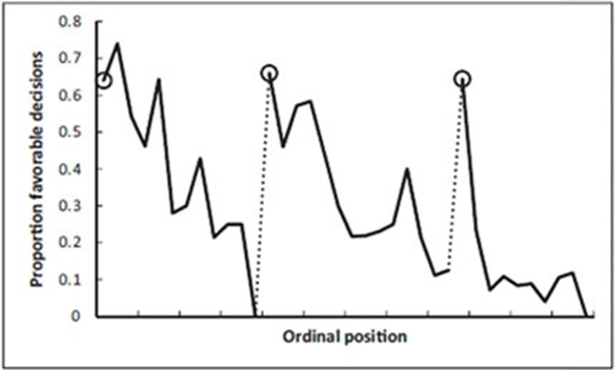
Example: Resource Depletion
Outcomes of parole hearings
Judge’s snack break
Judge’s lunch break
(Danziger et al., 2011)
Notes:
Let’s take a minute to look at this example which illustrates resource depletion….What does this say to you? This picture shows that if you want parole ….when does the judge offer parole more often? What we want to recognize is that this is naturally occuring, and we may not be even be aware of how our VDP impacts our decision making.

Slide 67
Small Group Brainstorming and Discussion
What are some common VDP’s for adults in your school?
Reminder: A VDP is a given situation coupled with a person's internal state (setting events and resource depletion) that affects discipline decision making.
Notes:
2:12
VDPs across your school

Slide 68
Let’s Take a Break
Notes:
2:20

Slide 69
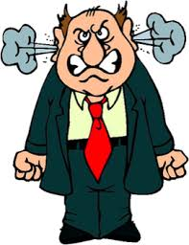
Vulnerable Decision Points & Neutralizing Routines
When you see an unwanted behavior or the start a power struggle, stop and ask yourself…
“Am I triggered or agitated?”
by this student or situation
or an outside factor
If yes, use an agreed-upon alternative response (neutralizing routine)
(Northeast PBIS Network, 2023)
Notes:
2:30
Fist to Five
Activity: Independent Reflection and Small Group Discussion: 4 minutes

Slide 70
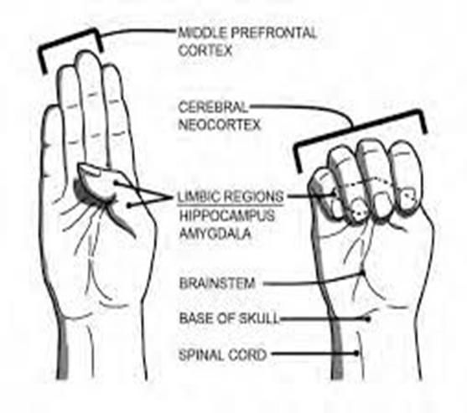
Goal of Neutralizing Routines

Slide 71
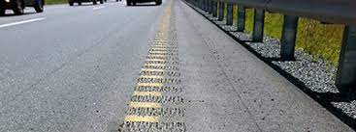
Emotions are Our Warning System
Notes:
2:33

Slide 72
Emotional Agility
“Emotional Agility….choosing how you’ll respond to your emotional warning system...between stimulus and response there is a space. (David, 2021)
“In that space is our power to choose our response. In our response lies our growth and freedom.” (Frankl, 1946)
Notes:
2:36
Reference
David, S. (2021). Emotional agility.: Get unstuck, embrace change, and thrive in work and life. Avery.

Slide 73
Neutralizing Routines
COMPONENTS:
EXAMPLES:
If - then statement
Brief
Clear Steps
Doable
Interrupts the chain of events
Delay the decision until I can think clearly
Reframe the situation
Take care of yourself
Notes:
2:37

Slide 74
A Quick Neutralizing Routine
Notes:
2:38

Slide 75
Mindfulness as a Neutralizing Routine
Release your tongue from the top of your mouth
Name 5 things you see
Push your feet through the floor
Relax your jaw
Count the things in the room that begin with the letter B
Drop your shoulders away from your ears
Notes:
2:42
The role of mindfulness in addressing implicit bias and acting as neutralizing routines
Mindfulness—the cultivation of moment-to-moment awareness—is an invaluable tool to help us notice and interrupt unconscious bias.
Through this practice, we observe our thoughts, emotions, preferences, and biases. This helps us interrupt mental stories we’ve come to rely on. To change our stories, we must recognize when we’re telling a story and then activate our agency to tell different stories.
Its just one tool but its a starting point right.
so how do we do that...overwhelming…
Just breathe, notice, breathe, notice….get back to your frontal lobe and be aware
Her article: Getting Mindful About Race in Schools by Elena Aguilar Ed Leadership April 2019

Slide 76
Small Group Discussion
What neutralizing routines work for you?
What routines might you add to your toolkit?
Could you turn these into classroom or school-wide routines for your students as well?
Notes:
2:47-
Small Group Activity- What works for them, what can they do?
How can you build this into your practice with your students?
How can you communicate with families about these?

Slide 77
Independent Reflection
Reflect on your personal scenario.
Was there an opportunity for you to utilize a neutralizing routine?
Any opportunity for growth in this area?
Notes:
2:57
Connect to personal scenario- permission to be vulnerable

Slide 78
2 - Setting Our Classrooms up for Success
Notes:
3:00
Meeting Basic Needs
Relationships
Effective Classroom Systems

Slide 79
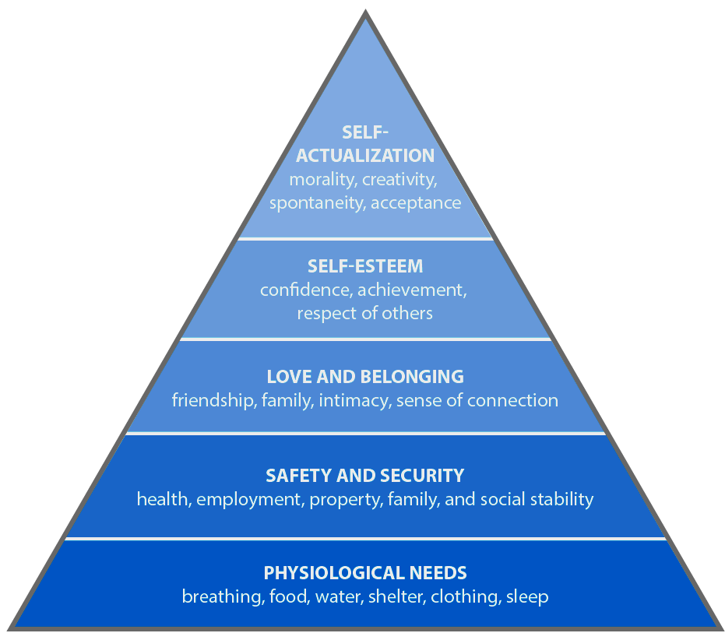
Meet Basic Needs
Food
Rest/sleep
Safety (physical & emotional)
Belonging through non-contingent and contingent praise
Notes:
3:01
Importance of meeting basic needs and how when physiological needs and safety and security needs are not met, students are likely to experience difficulty with learning. We want to create environments that meet students basic needs… provide examples on how some schools are meeting these needs.

Slide 80
Small Group Discussion
What is one thing you do to establish a sense of emotional safety in your classroom?
Be prepared to share 1 or 2 ideas from your table.
Notes:
3:03
Small Group Discussion:

Slide 81
The Importance of Relationships
Notes:
3:13
https://youtu.be/DRJYJrs7Fso (From Gang Member to Graduate)

Slide 82
Small Group Discussion
What resonated with you about this video?
What did the teacher do to access her brilliance?
Notes:
3:21

Slide 83
Independent Reflection
Reflect on the strategies and practices that we have covered today.
What are some things you have learned that you can apply to access your own brilliance?
Notes:
3:30
What are some things you have learned that you can apply to access your own brilliance?

Slide 84
Grab Bag Activity
Choose an item from the bag.
How is this item connected to what we have learned today?
Share in your small group.
As a table, pick two people to share out with the larger group.
Notes:
3:45- Grab bag- How is this item connect to what you have learned today.- Group share or small group share (as a table pick two people to share out with the group)

Slide 85
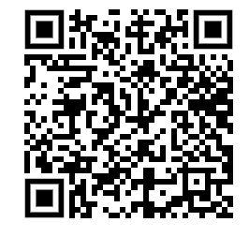
Exit Ticket
Please complete the exit ticket before you leave for the day!
https://tinyurl.com/33zhw5jt
Notes:
3:50
https://docs.google.com/forms/d/1bzQTCal4MHYNPpJR23Vhp1mPT887CuSrWsPGshe12qY/edit

