Slide 1
Defusing Disruptive Behavior
Day 1
July 16
Summer 2025

Slide 2

A Message of Gratitude

Slide 3
Establishing Our Purpose
Understand the foundational principles of behavior in order to design more effective interventions
Develop an understanding of the escalation cycle and contributing factors
Examine our responses throughout the phases of the escalation cycle in order to support student behavior
Explore evidenced-based interventions to apply throughout the escalation cycle

Slide 4

Materials

Slide 5

Honoring Your Expertise
When it comes to Defusing Disruptive Behavior, what strength do you bring to the table?

Slide 6
Community Agreements
Practice
Self-Compassion
Extend patience, grace, and kindness
Focus on solutions to make things easier
Practice
Growth Mindset
Be open to new thoughts and ideas
Embrace learning opportunities
Practice
Presence
Focus on the here and now
Share your expertise, information and ideas.
Assign a group recorder
Notes:
6

Slide 7

Setting Intentions
What is your personal intention for our time together?

Slide 8

Routines for Our Time Together
Attention Getting Signal:
Have fun and…
Stay cool!
5, 4, 3, 2, 1

Slide 9

Fist to Five

Slide 10

Community Parking Lot
Share your curiosities and great ideas!
Place any questions and celebrations on the Community Parking Lot!

Slide 11



Agenda for Today
      1. Setting Ourselves up for Success
      2. Setting Our Classrooms up for Success
      3. Setting our Students up for Success

Slide 12

A Balanced Approach to Implementation

Slide 13

Personal Reflection

Slide 14
1 - Setting Ourselves up for Success

Slide 15
Foundational Understandings
of Behavior
Behavior is communication and has a
function
We change behavior through an instructional approach
Behavior occurs as a sequence of events

Slide 16








Behavior is Communication

Slide 17
Why do they keep doing that?
GAIN
task/activity
attention of adult or peer
a specific item/object
sensory input
ESCAPE
task/activity
attention of adult or peer
a specific item/object
sensory input

Slide 18
ABC’s of Behavior Example
Antecedent
Mr. Jones passes out a math worksheet
Behavior
Carson runs out of the classroom
Consequence
Carson is followed and sent to the office

Slide 19
ABC’s of Behavior Example 2
Antecedent
Mr. Jones prompts students to take out notebooks
Behavior
Student says, ‘Mr. Jones, what is up with that ugly haircut?”
Consequence
The class laughs

Slide 20
ABC’s of Behavior Example 3
Antecedent
Mr. Jones prompts students to put phones away
Behavior
Student ignores Mr. Jones, pulls up the hood, and stays on phone
Consequence
Mr. Jones stops his instruction and raises his voice, prompting the student to put up the phone.

Slide 21


Reflection
Let’s reflect on your personal scenario.
Identify the antecedent, behavior, and consequence.

Slide 22
Setting Events
… help explain why people respond differently at different times when presented with the same set of triggers
FATIGUE
TRANSITIONS
TIME OF DAY
HUNGER
SICK/ALLERGIES
MEDICATIONS
ANXIETY/DEPRESSION
CONFLICT
SLEEP PROBLEMS
ADVERSE EVENT

Slide 23
ABC’s of Behavior
SETTING EVENT
ANTECEDENT
BEHAVIOR
CONSEQUENCE

Slide 24
ABC’s of Behavior and Setting Events
What are some potential setting events for this scenario?
Antecedent
Mr. Jones prompts students to put phones away
Behavior
Student ignores Mr. Jones, pulls up the hood, and stays on phone
Consequence
Mr. Jones stops his instruction and raises his voice, prompting the student to put up the phone.

Slide 25
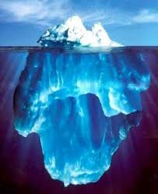
Small Group Discussion
What setting events are your students dealing with?
What setting events are your colleagues dealing with?

Slide 26

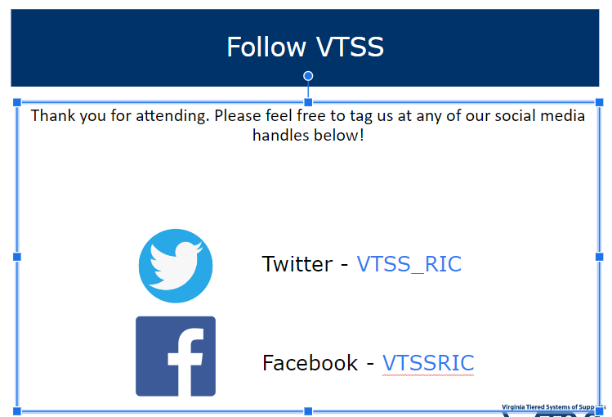
Let’s Take a Break

Slide 27
Reflection & Small Group Discussion
Let’s reflect on your personal scenario.
What setting events impacted your scenario?
Based on the ABC’s and settings events, what is your hypothesis of the function?
How could communication with families help you understand these setting events?

Slide 28
Behavior Chains
Each ensuing behavior in a given behavior chain becomes more serious than the one preceding it
(Walker et al., 1995).
Prevent the behavior from becoming more serious by interrupting the behavioral chain at any time.
One way to change the student’s successive behaviors is to change the teacher’s responses.

Slide 29
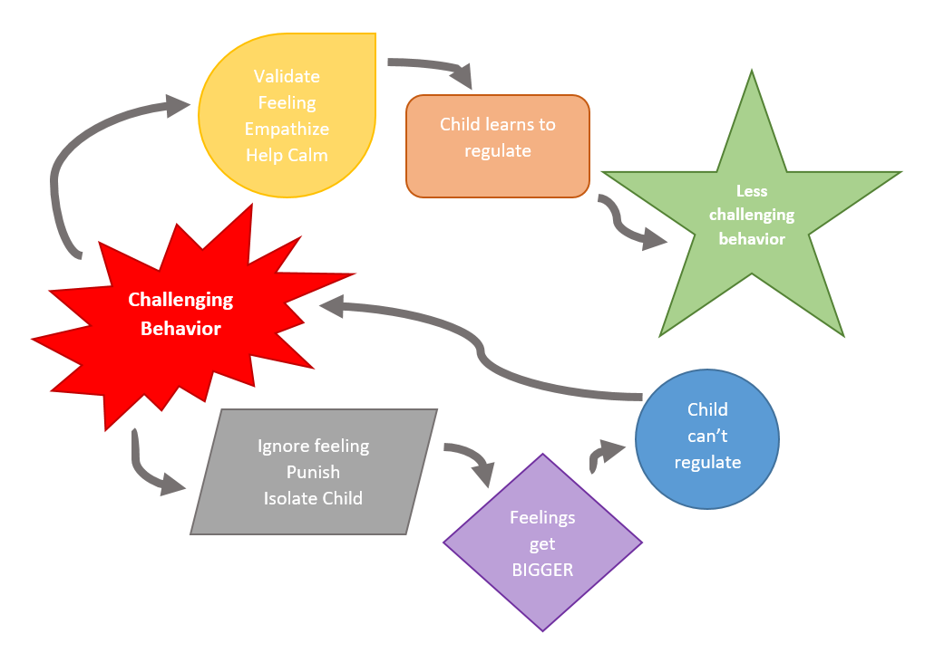
Responding
@The_Therapist_Parent

Slide 30
Behavior Chain
Teacher | Student
Mr. Jones greets Carson as as he enters the classroom. | Carson nods and puts his head down.
Mr. Jones repeats himself, “I said good morning Carson.” | Carson looks up, sucks his teeth and looks away.
Mr. Jones says, “Fine, you can just start your work.” and passes out a math worksheet. | Carson runs out of the classroom.
Mr. Jones follows and sends Carson to the office. | …..

Slide 31
Reflection
Let’s reflect on your personal scenario.
Can you identify one or more behavior chains?

Slide 32

What else can contribute to behavior?

Slide 33
Impact of Hardships on Behavior
Results from an event, series of hardships, or set of circumstances that is experienced by an individual as physically or emotionally harmful or life threatening and that has lasting adverse effects on the individual's functioning and mental, physical, social, emotional, or spiritual well-being.
(SAMHSA, 2023)
Notes:
33

Slide 34
Types of Hardships
ACUTE
A single incident
CHRONIC
Experiences that occur repeatedly over long periods of time
HISTORICAL
The collective and cumulative hardships experienced by a particular group across generations still suffering the effects
(Goldsmith et al., 2013)
Notes:
34

Slide 35


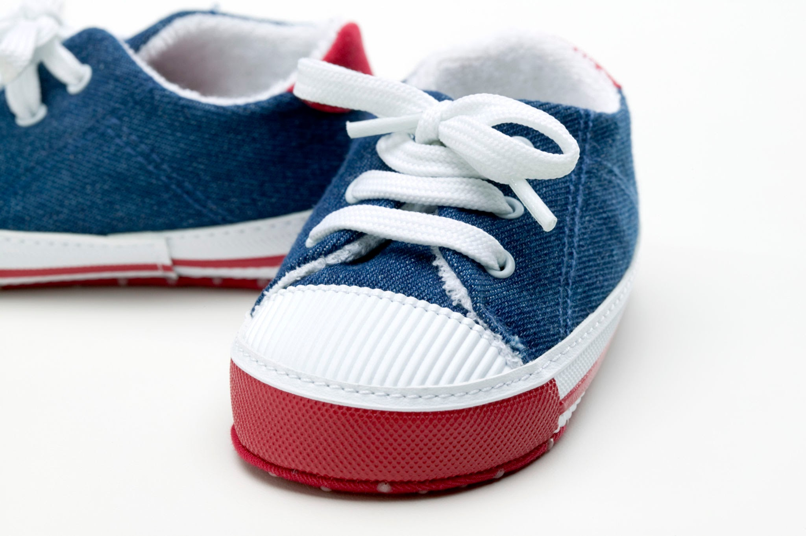

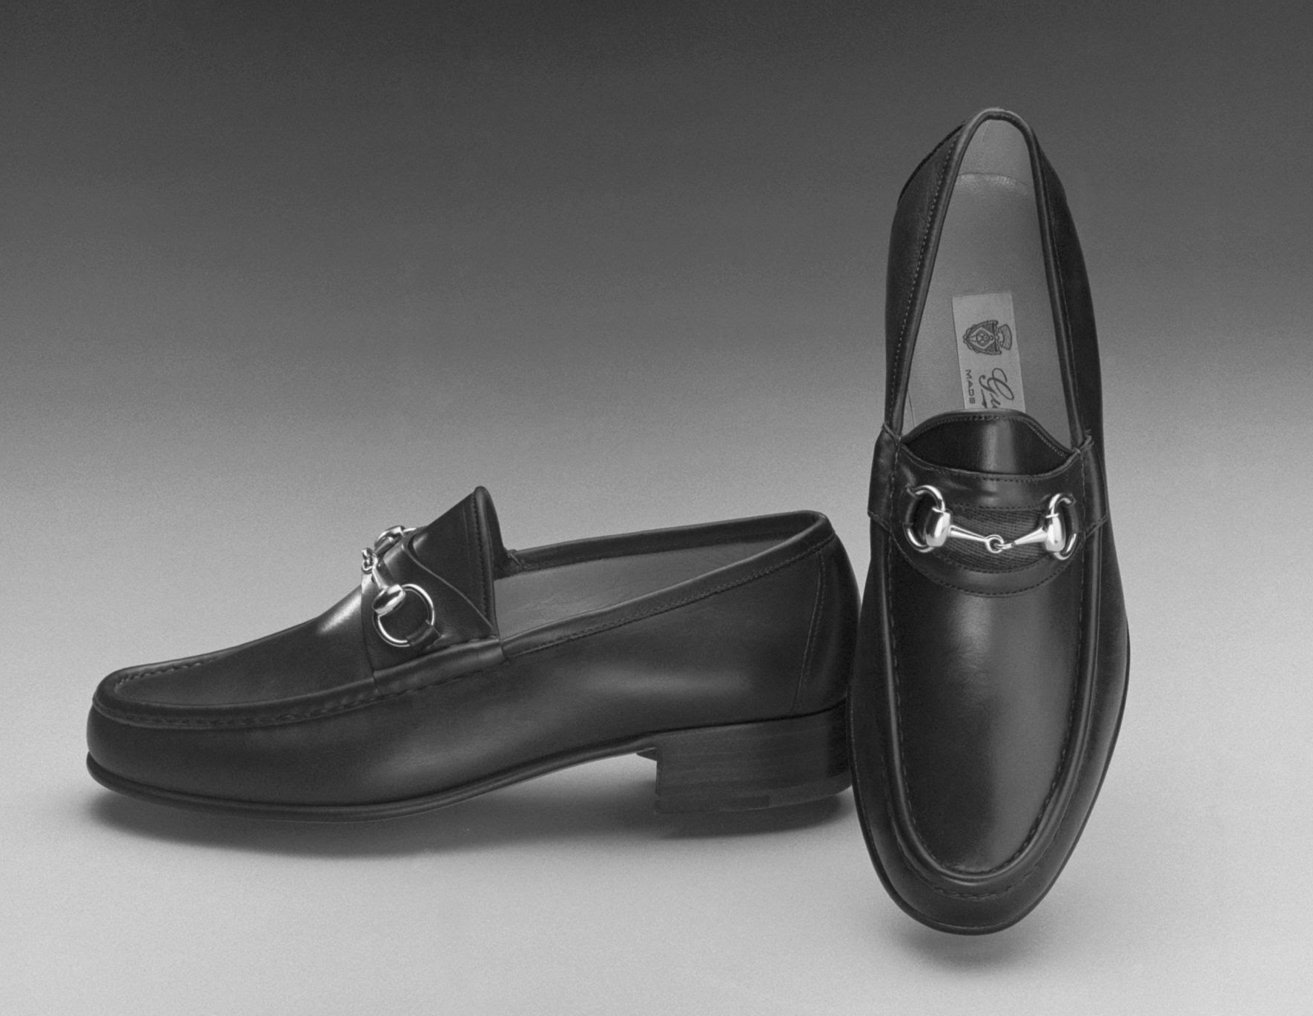
Shoe Partner
What types of hardships have your students experienced?
How did their experiences impact your teaching in the classroom?

Slide 36
The Impact of Hardships
Individuals who have experienced hardships may react differently as they go through the phases of the escalation cycle.
Often more challenging for adults to identify triggers and functions
Faster escalation to crisis/peak or little/no reaction when one would be expected
Longer time in crisis/peak before de-escalating
Notes:
36

Slide 37
Impact in the Classroom?
Executive functioning
Language and communication skills
Memory
Ability to see cause and effect
Organization
Concentration and attention
(Krasnoff, 2017)
Notes:
37

Slide 38
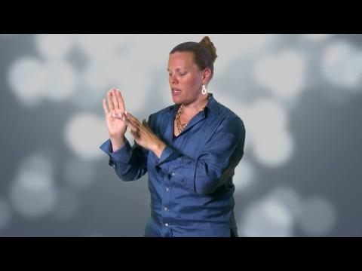
Flip Your Lid
Notes:
38

Slide 39
Small Group Discussion
What stood out to you in this video?
Why is it important to understand this information when responding to disruptive behavior?
Why is it important to understand this information when talking with families?

Slide 40
Survival Brain
Increased
Decreased
Emotional instability
  Anxiety
  Irritability
  Anger
  Frustration
Impulsivity with regards to language or actions
Problem solving
Communication skills
Emotional regulation
Ability to retrieve previously learned information
Decision making
Notes:
40

Slide 41

Fight, Flight, Freeze, Appease

Slide 42
What Does This Look Like?
Fight
Argumentative
Aggressive
Confrontational
Alone
Immature
Glaring
Hands in fists
Flight
Hyperactive
Aggressive
Running away
Disruptive
Leg Movement
Fidgety
Immature
Freeze
Bored
Distracted
Not listening
Zoned out
Wide-eyed
Standing still
Appease
Socially withdrawn
Quiet
Compliant
Passive
Resigned
Low energy
Neutral expression

Slide 43
Four Corners Activity
When faced with a stressor, which is the following is your most common response:
Fight
Flight
Freeze
Appease
Go to the corner assigned to your response.

Slide 44
Four Corners Activity Continued
Find a partner in your group and take 4 minutes to discuss the following:
Discuss a situation that elicited the fight, flight, freeze, appease response?

Slide 45

Small Group Discussion
How does this play out in your classroom? (With yourself and your students)
How does this play out when interacting with families?

Slide 46
Reflection
Let’s reflect on your personal scenario.
Does this information increase your understanding of what was happening with your student or with you?

Slide 47
Responding
When little people are overwhelmed with BIG EMOTIONS, it’s our job to
share our calm, not join their chaos.
L. R. Knost

Slide 48

Lunch Break

Slide 49
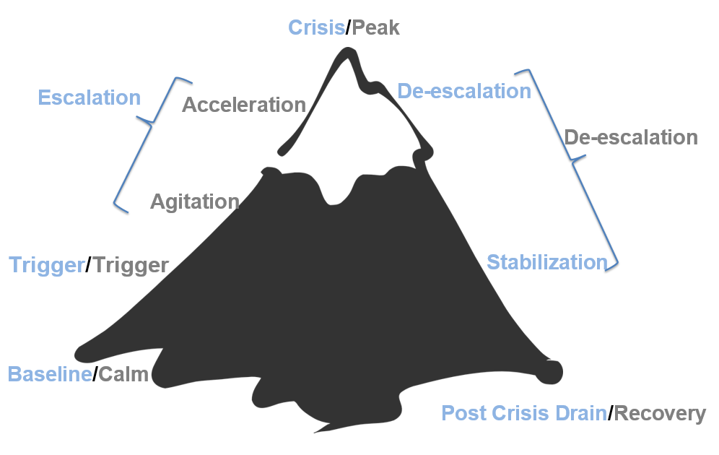
The Escalation Cycle

Slide 50
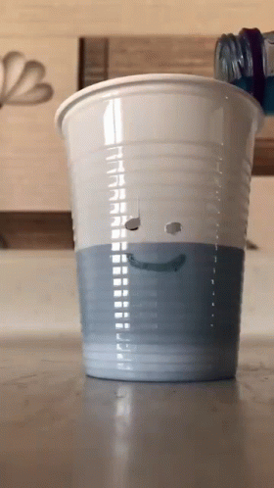
How Full is Your Cup?
Overslept this morning
Car Trouble
Struggle with your third period
Taking care of a parent
anxiety
second job
grades due
health concerns

Slide 51
Independent Reflection
How full is your cup?
Take a few minutes to fill in your own cup with all of the things that you have on your plate right now.
(Complete independently with no expectation to share)

Slide 52
Let’s Talk About Stress
Stressors
Stress
Threats that activate the stress response in your body
Anything you see, hear, smell, touch, taste or imagine could do you harm
Internal or External
Neurological and physiological shift that happens when you encounter one of these threats.
Designed to help us survive (flight, fight, freeze, appease)
(Nagoski & Nagoski, 2020)
Notes:
52

Slide 53
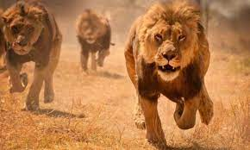
The Stress Cycle
Notes:
53

Slide 54
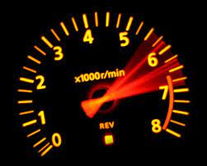
The Impact of Ongoing Stress
Our bodies and brains react to danger to keep us safe
Ongoing stress and failing to complete the stress cycle makes this system less effective and more reactive
This can lead to wear and tear on the body and brain
This could be compared to revving a car engine for weeks at a time
Notes:
54

Slide 55
Make A New Connection
Connect with someone who is NOT at your table and discuss the following.
How does ongoing stress impact you on a daily basis?

Slide 56
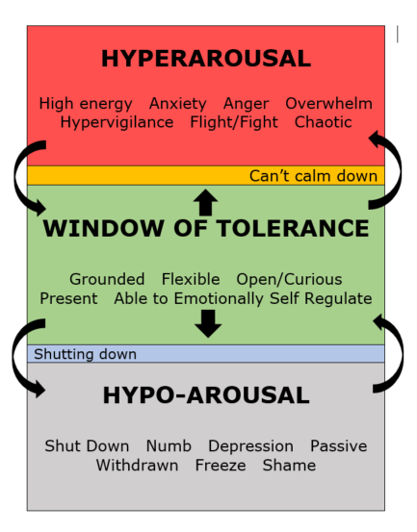
Window of Tolerance

Slide 57
Small Group Discussion
How does the window of tolerance apply to you?
How could you use this in the classroom?
How could you use this at the schoolwide level?

Slide 58
Our Role in the Escalation Cycle?
First, we need to engage in practices that allow us to bring our best selves each day
We need a plan to maintain self control during a crisis/power struggle. (Remember fight, flight, freeze, or appease response)
Our goal is to remain calm & regain an “emotional balance”

Slide 59
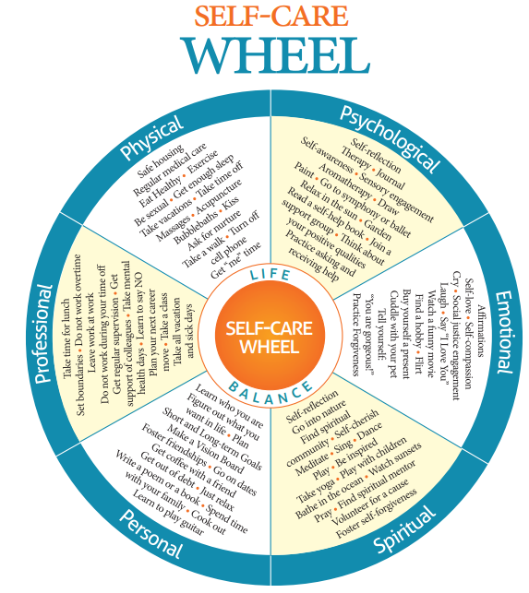
Self-Care Wheel
Workbook pg. 18

Slide 60
What is Wellness?
“To be “well” is not to live in a state of perpetual safety and calm, but to move fluidly from a state of adversity, risk, adventure, or excitement, back to safety and calm, and out again.”
(Nagoski & Nagoski, 2020)
Notes:
60

Slide 61
Small Group Discussion
What would it look like and sound like if we were to think about wellness, individual and collective, as a precursor to showing up as our best selves?

Slide 62

Words of Wisdom
“I’ve come to a frightening conclusion that I am the decisive element in the classroom. It’s my personal approach that creates the climate. It’s my daily mood that makes the weather. As a teacher, I possess a tremendous power to make a child’s life miserable or joyous. I can be a tool of torture or an instrument of inspiration. I can humiliate or heal. In all situations, it is my response that decides whether a crisis will be escalated or de-escalated and a child humanized or dehumanized.”
― Haim Ginott

Slide 63
Vulnerable Decision Points (VDP)
A VDP is a given situation coupled with a person's internal state that affects discipline decision making.

Slide 64
Situations
Subjective interfering behavior
  Defiance, Disrespect, Disruption
  Major vs. Minor
Non-classroom areas
  hallways, cafeterias
Classrooms
Afternoons

Slide 65
Decision States
Setting Events - an event occurring before or with an antecedent that increases the likelihood of a behavior
Resource Depletion - as we become fatigued, our filters for appropriate behavior can be affected

Slide 66
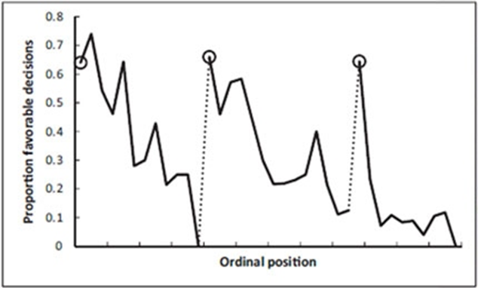
Example: Resource Depletion
Outcomes of parole hearings
Judge’s snack break
Judge’s lunch break
(Danziger et al., 2011)

Slide 67
Small Group Brainstorming and Discussion
What are some common VDP’s for adults in your school?
Reminder: A VDP is a given situation coupled with a person's internal state (setting events and resource depletion) that affects discipline decision making.

Slide 68
Let’s Take a Break

Slide 69
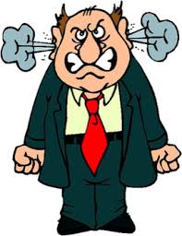
Vulnerable Decision Points
& Neutralizing Routines
When you see an interfering behavior or the start a power struggle, stop and ask yourself…
“Am I triggered or agitated?”
by this student or situation
or an outside factor
If yes, use an agreed-upon alternative response (neutralizing routine)
(Northeast PBIS Network, 2023)

Slide 70
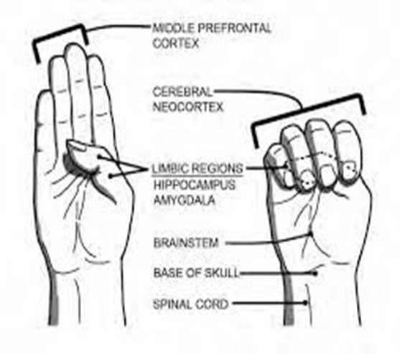
Goal of Neutralizing Routines

Slide 71
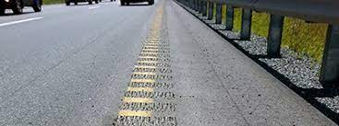
Emotions are Our Warning System

Slide 72
Emotional Agility
“Emotional Agility….choosing how you’ll respond to your emotional warning system...between stimulus and response there is a space.”
(David, 2021)
“In that space is our power to choose our response. In our response lies our growth and freedom.”
(Frankl, 1946)

Slide 73

Neutralizing Routines
COMPONENTS:
EXAMPLES:
If - then statement
Brief
Clear Steps
Doable
Interrupts the chain of events
Delay the decision until I can think clearly
Reframe the situation
Take care of yourself

Slide 74

A Quick Neutralizing Routine
Notes:
74

Slide 75
Mindfulness as a Neutralizing Routine
Release your tongue from the top of your mouth
Name 5 things you see
Push your feet through the floor
Relax your jaw
Count the things in the room that begin with the letter B
Drop your shoulders away from your ears

Slide 76
Small Group Discussion
What neutralizing routines work for you?
What routines might you add to your toolkit?
Could you turn these into classroom or school-wide routines for your students as well?

Slide 77
Independent Reflection
Reflect on your personal scenario.
Was there an opportunity for you to utilize a neutralizing routine?
Any opportunity for growth in this area?

Slide 78

2 - Setting Our Classrooms up for Success

Slide 79
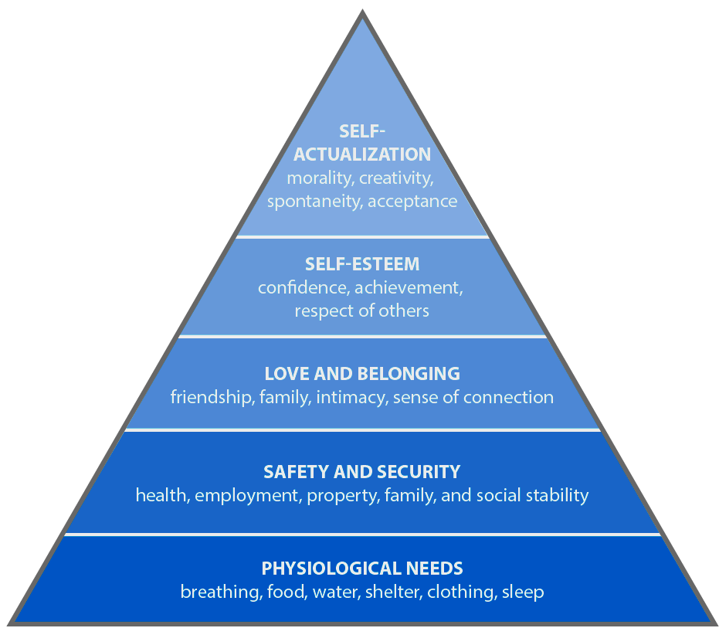
Meet Basic Needs
Food
Rest/sleep
Safety (physical & emotional)
Belonging through non-contingent and contingent praise

Slide 80
Small Group Discussion
What is one thing you do to establish a sense of emotional safety in your classroom?
Be prepared to share 1 or 2 ideas from your table.
Notes:
80

Slide 81

The Importance of Relationships

Slide 82
Small Group Discussion
What resonated with you about this video?

Slide 83
Independent Reflection
Reflect on the strategies and practices that we have covered today.
What are some things you have learned that you can apply to access your own brilliance?

Slide 84
Grab Bag Activity
Choose an item from the bag.
How is this item connected to what we have learned today?
Share in your small group.
As a table, pick two people to share out with the larger group.

Slide 85
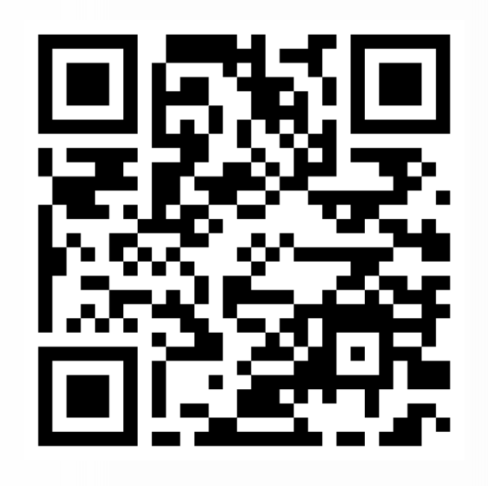
Exit Ticket
Please complete the exit ticket before you leave for the day!
https://forms.gle/k37T5uZdftXdxa9r6

