Slide 1
Welcome!
Defusing Disruptive Behavior
Day 1
October 13, 2026

Slide 2
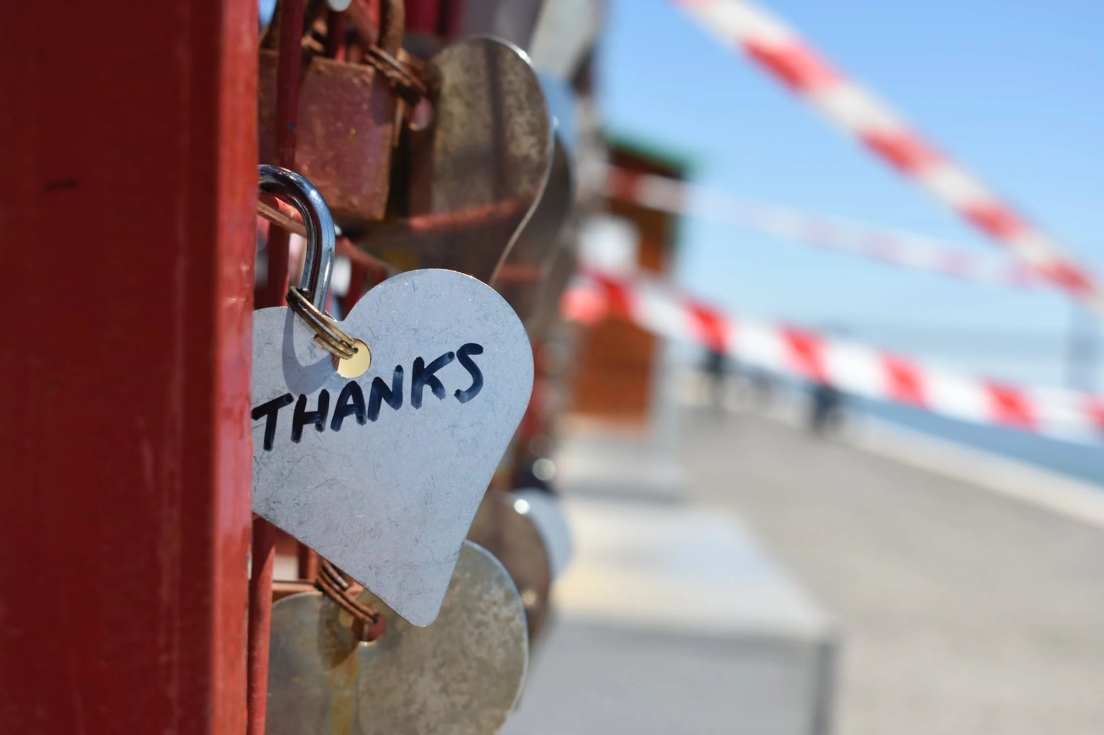
A Message of Gratitude
Please share in the chat your division, position and how long you have been in education.

Slide 3
Establishing Our Purpose
Understand the foundational principles of behavior in order to design more effective interventions
Develop an understanding of the escalation cycle and contributing factors
Examine our responses throughout the phases of the escalation cycle in order to support student behavior
Explore evidenced-based interventions to apply throughout the escalation cycle

Slide 4

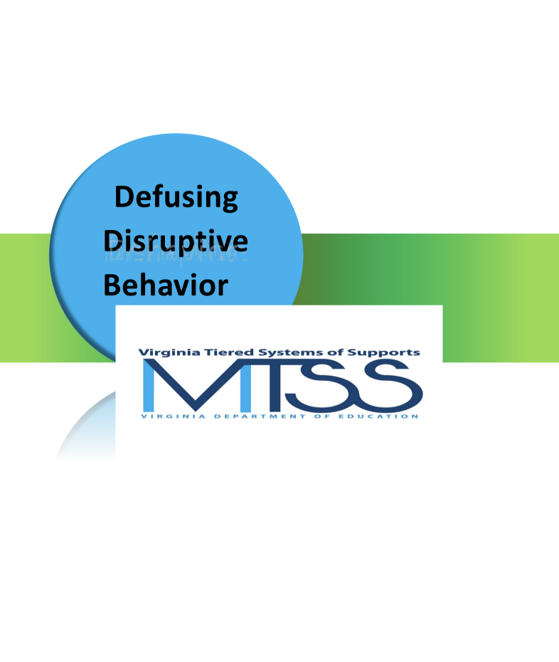
Materials
Workbook

Slide 5

Honoring Your Expertise
When it comes to Defusing Disruptive Behavior, what strength do you bring to the table?
Workbook pg. 2

Slide 6
Community Agreements
Extend patience, grace, and kindness
Focus on solutions to make things easier
Practice
Self-Compassion
Practice
Growth Mindset
Be open to new thoughts and ideas
Embrace learning opportunities
Focus on the here and now
Share your expertise, information and ideas.
Assign a group recorder
Practice
Presence
Workbook pg. 2

Slide 7

Setting Intentions
What is your personal intention for our time together?

Slide 8

Questions/Celebrations/
A Little Helping Hand
Share your questions or celebrations.
Send us a direct message in the chat.
Dayla Brown
Kristen O’Sullivan

Slide 9



Agenda for Today
Setting Ourselves up for Success
Setting Our Classrooms up for Success
Setting our Students up for Success

Slide 10

A Balanced Approach to Implementation

Slide 11

Personal Reflection
Workbook pg. 3

Slide 12
1 - Setting Ourselves up for Success

Slide 13

Foundational Understandings
of Behavior
Workbook pg. 4
Behavior is Communication and has a function
We change behavior through an instructional approach
Behavior occurs as a sequence of events

Slide 14








Behavior is Communication

Slide 15
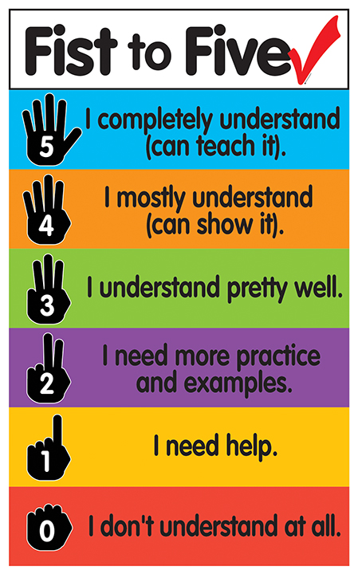
Fist to Five:
Function and the ABCs of Behavior

Slide 16

Why do they keep doing that?
GAIN
task/activity
attention of adult or peer
a specific item/object
sensory input
ESCAPE
task/activity
attention of adult or peer
a specific item/object
sensory input
Workbook pg. 4

Slide 17
The ABCs of Behavior
Antecedent
What happens before the behavior occurs?
Behavior
What (objective) behavior is observed?
Consequence
What occurs after the behavior takes place?
Workbook pg. 5

Slide 18
ABC’s of Behavior Example
GAIN or ESCAPE?
Antecedent
Mr. Jones prompts students to take out notebooks
Behavior
Student says, ‘Mr. Jones, what is up with that ugly haircut?”
Consequence
The class laughs
Workbook pg. 5

Slide 19
ABC’s of Behavior Example 2
GAIN or ESCAPE?
Antecedent
Mr. Jones passes out a math worksheet
Behavior
Carson runs out of the classroom
Consequence
Carson is followed and sent to the office
Workbook pg. 5

Slide 20
ABC’s of Behavior Example 3
Antecedent
Mr. Jones prompts students to put phones away
Behavior
Student ignores Mr. Jones, pulls up the hood, and stays on phone
Consequence
Mr. Jones stops his instruction and raises his voice, prompting the student to put up the phone.
GAIN or ESCAPE?
Workbook pg. 5

Slide 21

Reflection
Let’s reflect on your personal scenario.
Identify the antecedent, behavior and consequence.
Workbook pg. 6

Slide 22
Setting Events
… help explain why people respond differently at different times when presented with the same set of triggers
FATIGUE
TRANSITIONS
TIME OF DAY
HUNGER
SICK/ALLERGIES
MEDICATIONS
ANXIETY/DEPRESSION
CONFLICT
SLEEP PROBLEMS
TRAUMATIC EVENT
Workbook pg. 7

Slide 23
ABC’s of Behavior
SETTING EVENT
ANTECEDENT
BEHAVIOR
CONSEQUENCE
Workbook pg. 7

Slide 24
ABCs of Behavior and Setting Events
What are some potential setting events for this scenario?
Antecedent
Mr. Jones prompts students to put phones away
Behavior
Student ignores Mr. Jones, pulls up the hood, and stays on phone
Consequence
Mr. Jones stops his instruction and raises his voice, prompting the student to put up the phone.

Slide 25
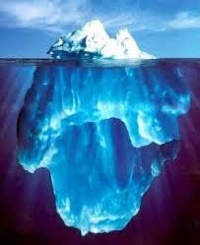
Chat Waterfall
What setting events are your students dealing with?
What setting events are your colleagues dealing with?
Workbook pg. 7

Slide 26
Reflection and Small
Group Discussion
Let’s reflect on your personal scenario.
What setting events impacted your scenario?
Based on the ABC’s and settings events, what is your hypothesis of the function?
How could communication with families help you understand these setting events?
Workbook pg. 8

Slide 27
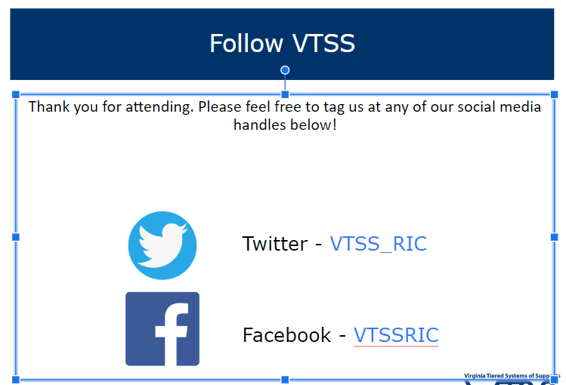

Let’s Take a Break

Slide 28
Behavior Chains
A behavior chain is a connected sequence of behaviors in which each action sets the occasion for the next, often increasing in intensity or seriousness as the chain unfolds.
Each ensuing behavior becomes more serious than the one preceding it (Walker et al., 1995).
Interrupting the chain at any point prevents the behavior from escalating.
Changing the teacher’s responses can shift or stop the student’s successive behaviors, breaking the chain.

Slide 29
Behavior Chain
Teacher | Student
Mr. Jones greets Carson as as he enters the classroom. | Carson nods and puts his head down.
Mr. Jones repeats himself, “I said good morning Carson.” | Carson looks up, sucks his teeth and looks away.
Mr. Jones says, “Fine, you can just start your work.” and passes out a math worksheet. | Carson runs out of the classroom.
Mr. Jones follows and sends Carson to the office. | …..

Slide 30
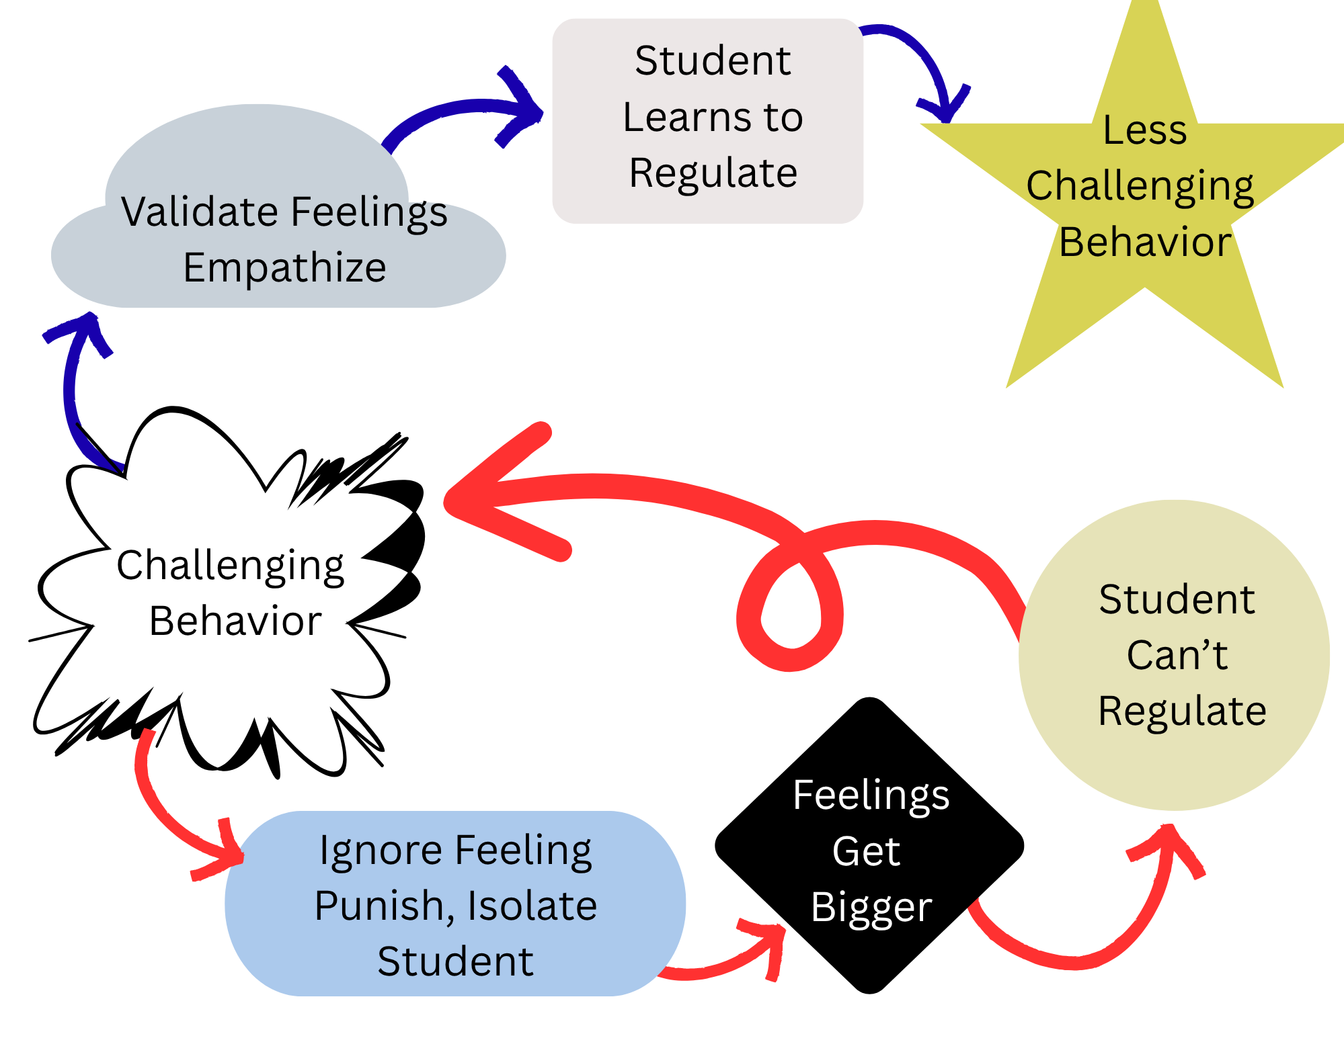
Responding
@The_Therapist_Parent

Slide 31
Reflection
Let’s reflect on your personal scenario.
Can you identify one or more behavior chains?
Workbook pg. 10

Slide 32

What else can contribute to behavior?

Slide 33
Impact of Trauma on Behavior
Results from an event, series of events, or set of circumstances that is experienced by an individual as physically or emotionally harmful or life threatening and that has lasting adverse effects on the individual's functioning and mental, physical, social, emotional, or spiritual well-being.
(SAMHSA, 2023)

Slide 34
Types of Trauma
ACUTE
A single incident
CHRONIC
Experiences that occur repeatedly over long periods of time
HISTORICAL
The collective and cumulative trauma experienced by a particular group across generations still suffering the effects
(Goldsmith et al., 2013)

Slide 35
Small Group Discussion
What types of trauma have your students experienced?
How does this impact families?
How did this impact you?

Slide 36
The Impact of Trauma
Individuals who have experienced trauma may react differently as they go through the phases of the escalation cycle.
Often more challenging for adults to identify triggers and functions
Faster escalation to crisis/peak or little/no reaction when one would be expected
Longer time in crisis/peak before de-escalating

Slide 37
Impact in the Classroom
Executive Functioning
Language and Communication Skills
Memory
Ability to see Cause and Effect
Organizational Ability
Concentration and Attention
(Krasnoff, 2017)

Slide 38
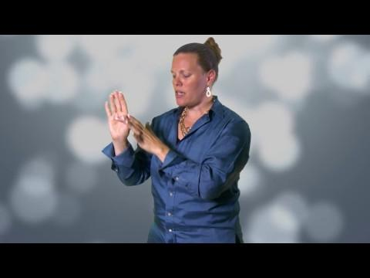
Flip Your Lid

Slide 39
Small Group Discussion
What stood out to you in this video?
Why is it important to understand this information when responding to disruptive behavior?
Why is it important to understand this information when talking with families?

Slide 40
Survival Brain
INCREASED
DECREASED
Emotional instability
  Anxiety
  Irritability
  Anger
  Frustration
Impulsivity with regards to language or actions
Problem solving
Communication skills
Emotional regulation
Ability to retrieve previously learned information
Decision making

Slide 41
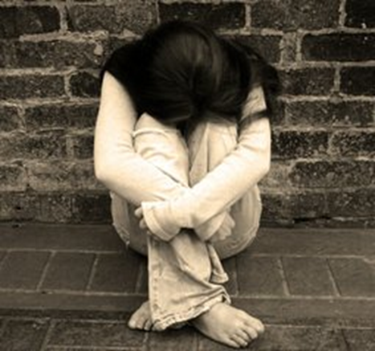
Fight, Flight, Freeze, Appease

Slide 42
Fight
Argumentative
Aggressive
Confrontational
Alone
Immature
Glaring
Hands in fists
Flight
Hyperactive
Aggressive
Running away
Disruptive
Leg Movement
Fidgety
Immature
Freeze
Bored
Distracted
Not listening
Zoned out
Wide-eyed
Standing still
Appease
Socially withdrawn
Quiet
Compliant
Passive
Resigned
Low energy
Neutral expression

Slide 43
Poll
When faced with a stressor, which is the following is your most common response:
Fight
Flight
Freeze
Appease

Slide 44

Small Group Discussion
How does this play out in your classroom?
(With yourself and your students)
How does this play out when interacting with families?

Slide 45
Reflection
Let’s reflect on your personal scenario.
Does this information increase your understanding of what was happening with your student or with you?
Workbook pg. 14

Slide 46
Responding
When little people are overwhelmed with BIG EMOTIONS, it’s our job to
share our calm, not join their chaos.
L. R. Knost
Workbook pg. 14

Slide 47
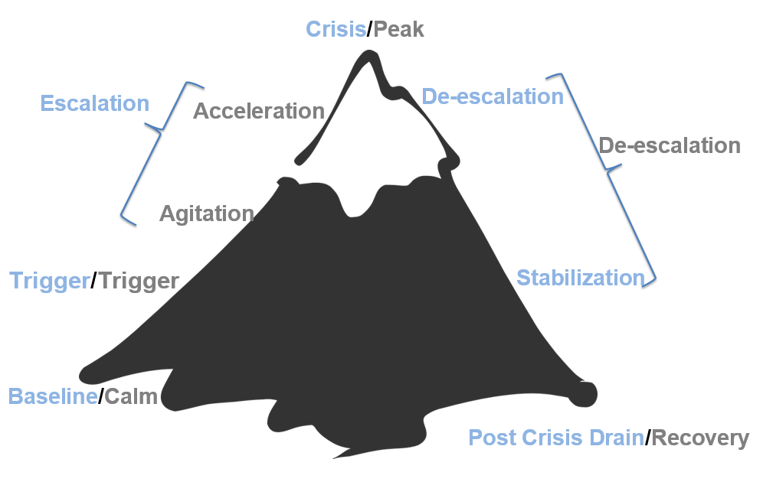
The Escalation Cycle
Workbook pg. 14

Slide 48
How Full is Your Cup?
email from Administrator
Overslept this morning
lack of engagement from students
Car Trouble
Struggle with your third period
Taking care of a parent
Sarcastic tone from student
anxiety
second job
grades due
health concerns

Slide 49
Independent Reflection
How full is your cup?
Take a few minutes to fill in your own cup with all of the things that you have on your plate right now.
Workbook pg. 15

Slide 50
Let’s Talk about Stress
Stressors
Stress
Threats that activate the stress response in your body
Anything you see, hear, smell, touch, taste or imagine could do you harm
Internal or External
Neurological and physiological shift that happens when you encounter one of these threats.
Designed to help us survive (flight, fight, freeze, appease)
(Nagoski & Nagoski, 2020)

Slide 51
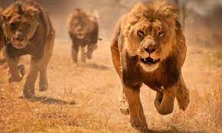
The Stress Cycle

Slide 52
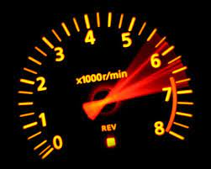
The Impact of Ongoing Stress
Our bodies and brains react to danger to keep us safe
Ongoing stress and failing to complete the stress cycle makes this system less effective and more reactive
This can lead to wear and tear on the body and brain
This could be compared to revving a car engine for weeks at a time

Slide 53
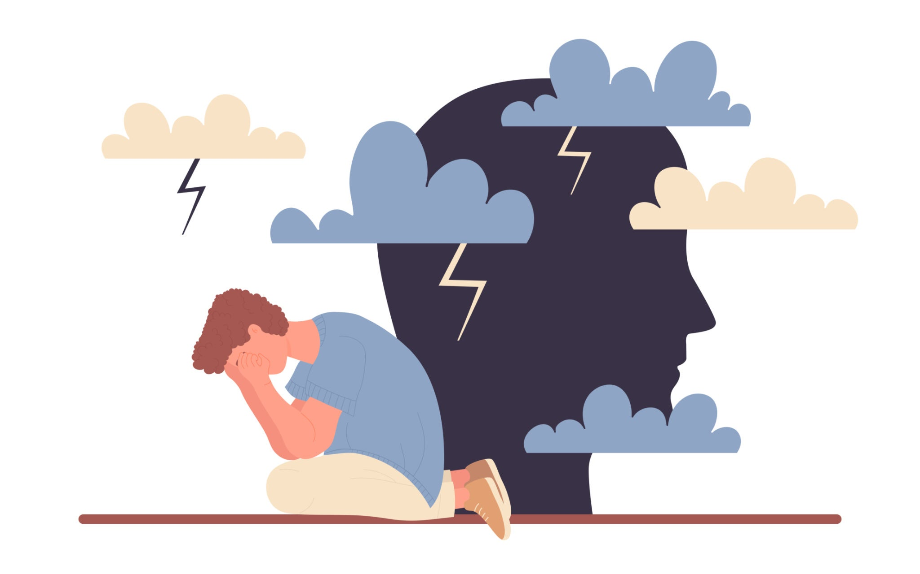
Chat Waterfall
How does ongoing stress impact you on a daily basis?
Workbook pg. 16

Slide 54
Let’s Take a Break

Slide 55
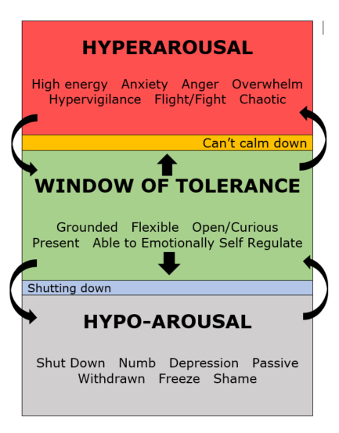
Window of Tolerance

Slide 56
Small Group Discussion
How does the window of tolerance apply to you?
How could you use this in the classroom?
How could you use this at the schoolwide level?
Workbook pg. 16

Slide 57
Our Role in the Escalation Cycle?
First, we need to engage in practices that allow us to bring our best selves each day
We need a plan to maintain self control during a crisis/power struggle. (Remember fight, flight, freeze, or appease response.)
Our goal is to remain calm & regain an “emotional balance”

Slide 58
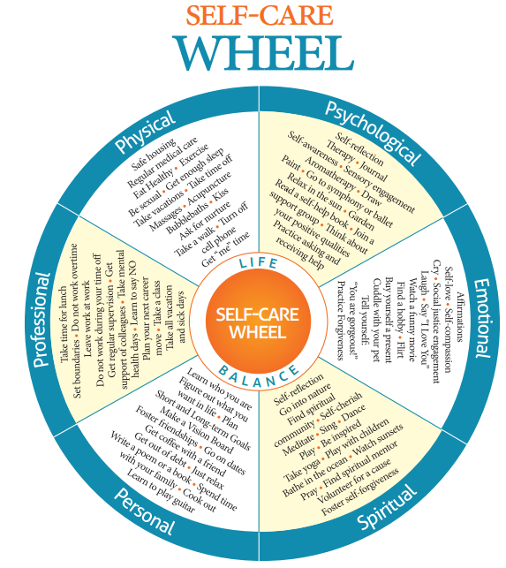
Self-Care Wheel
Workbook pg. 17

Slide 59
What is Wellness?
“To be ‘well’ is not to live in a state of perpetual safety and calm, but to move fluidly from a state of adversity, risk, adventure, or excitement, back to safety and calm, and out again.”
(Nagoski & Nagoski, 2020)

Slide 60
Small Group Discussion
What are some ways you practice personal wellness?
How does it impact your interactions with students?

Slide 61
Vulnerable Decision Points (VDP)
A VDP is a given situation coupled with a person's internal state that affects discipline decision making.

Slide 62

Situations
Subjective problem behavior
  Defiance, Disrespect, Disruption
  Major vs. Minor
Non-classroom areas
  Hallways, Cafeterias
Classrooms
Afternoons

Slide 63
Decision States
Setting Events - an event occurring before or with an antecedent that increases the likelihood of a behavior
Resource Depletion - as we become fatigued, our filters for appropriate behavior can be affected

Slide 64
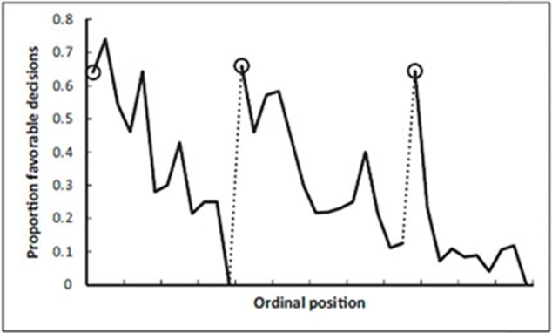
Example: Resource Depletion
Outcomes of parole hearings
Judge’s snack break
Judge’s lunch break

Slide 65
Small Group Discussion
What are some common VDP’s for adults in your school?
Reminder: A VDP is a given situation coupled with a person's internal state (setting events and resource depletion) that affects discipline decision making.

Slide 66
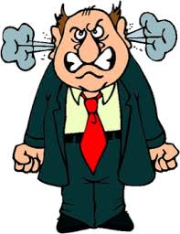
Vulnerable Decision Points & Neutralizing Routines
When you see an unwanted behavior or the start a power struggle, stop and ask yourself…
“Am I triggered or agitated?”
by this student or situation
or an outside factor
If yes, use an agreed-upon alternative response (neutralizing routine)
(Northeast PBIS Network, 2023)

Slide 67
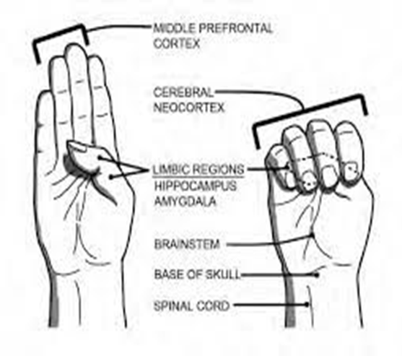
Vulnerable Decision Points & Neutralizing Routines

Slide 68
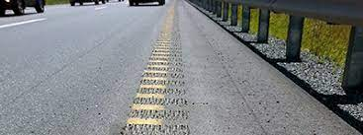
Emotions are Our Warning System

Slide 69
Emotional Agility
“Emotional Agility….choosing how you’ll respond to your emotional warning system...between stimulus and response there is a space.” (David, 2021)
“In that space is our power to choose our response. In our response lies our growth and freedom.” (Frankl, 1946)

Slide 70
Neutralizing Routines
COMPONENTS:
EXAMPLES:
If - then statement
Brief
Clear Steps
Doable
Interrupts the chain of events
Delay the decision until I can think clearly
Reframe the situation
Take care of yourself

Slide 71

A Quick Neutralizing Routine

Slide 72
Mindfulness as a
Neutralizing Routine
Release your tongue from the top of your mouth
Name 5 things you see
Push your feet through the floor
Relax your jaw
Count the things in the room that begin with the letter B
Drop your shoulders away from your ears

Slide 73
Small Group Discussion
What neutralizing routines work for you?
What routines might you add to your toolkit?
Could you turn these into classroom or school-wide routines for your students as well?

Slide 74
Independent Reflection
Reflect on your personal scenario.
Was there an opportunity for you to utilize a neutralizing routine?
Any opportunity for growth in this area?

Slide 75
2 - Setting Our Classrooms up for Success

Slide 76
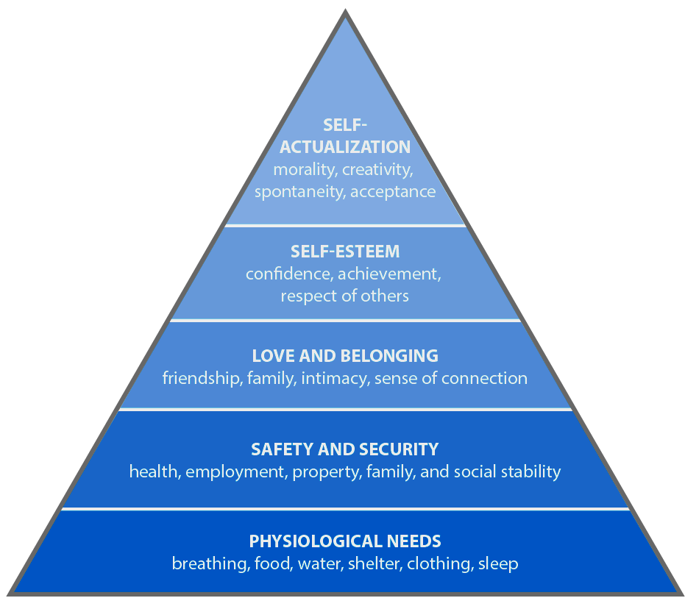
Meet Basic Needs
Food
Rest/sleep
Safety (physical & emotional)
Belonging through non-contingent and contingent praise

Slide 77
Chat Waterfall
What is one thing you do to establish a sense of emotional safety in your classroom?

Slide 78
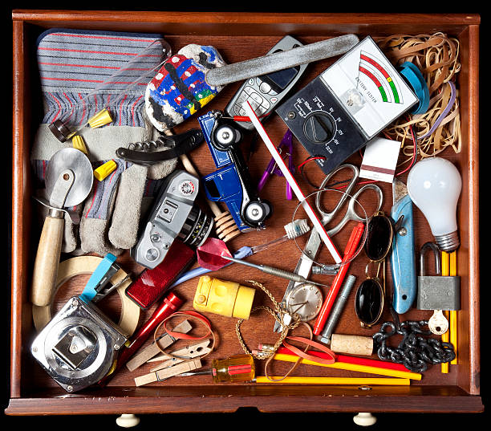
Which Item Relates to What You Learned Today?

Slide 79
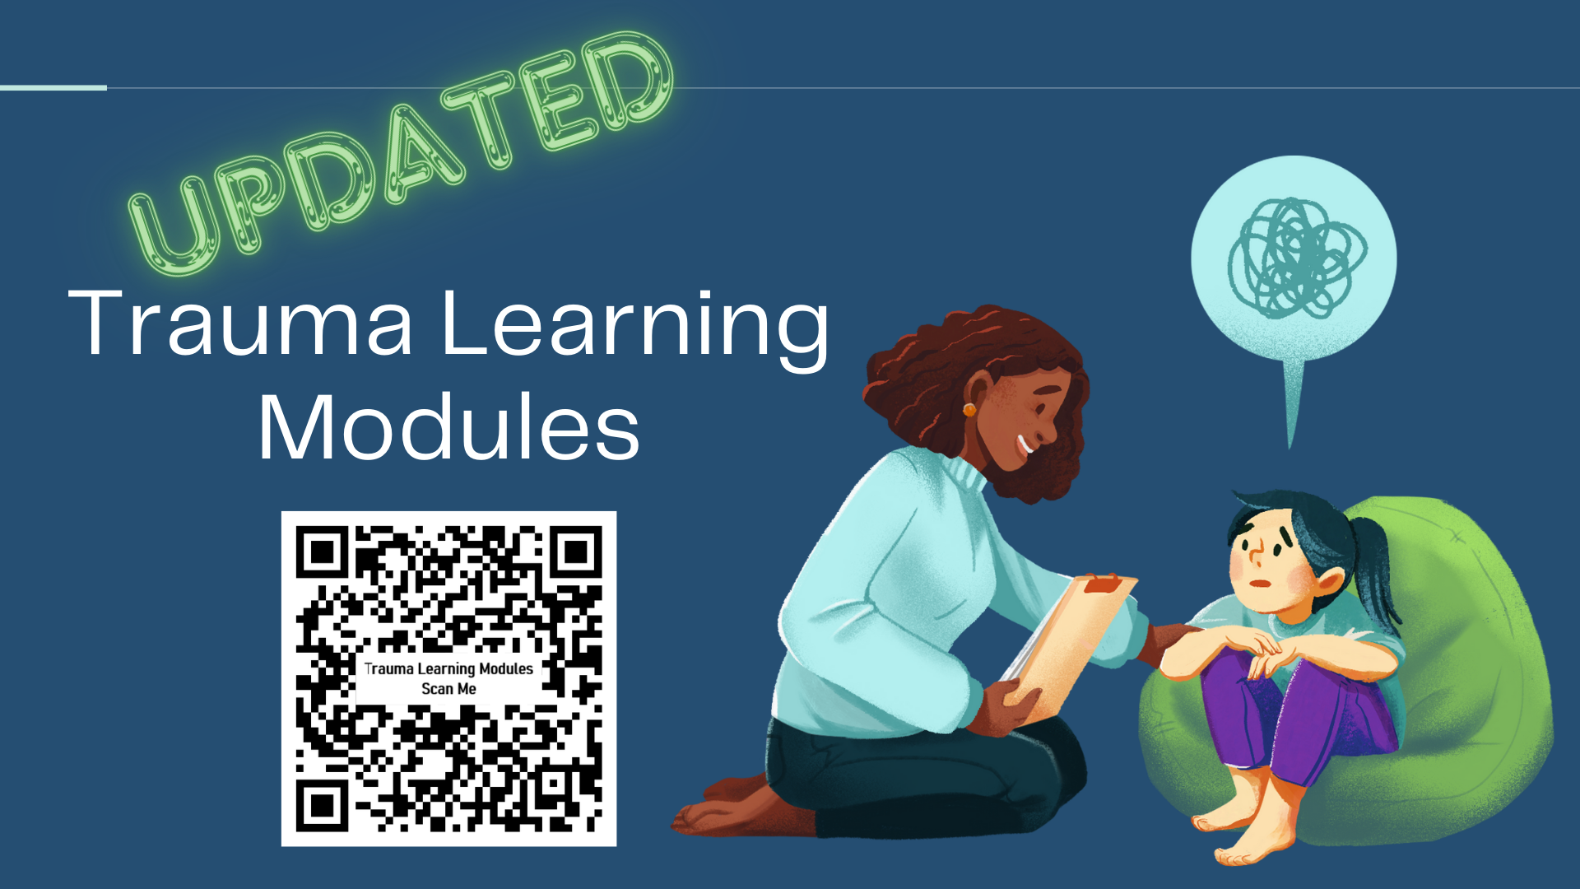
Bonus Content

