Slide 1
Defusing Disruptive Behavior
Day 2
Fall 2026
Notes:
Kara, Kate, Howard Day 2 (Kara 1-17, Howard 17-27, Kara 28-66, Kate 66-117)
Whitney is our technology expert for the day. If you have any questions or concerns, please feel free to private chat her. You’ll see attendance link in the chat. Please fill this out.
Day 1: 8:30-1:00
Day 2: 8:30-1:00
Set up random small group breakouts 5-6
Chat:
Day 2 Attendance Link: https://forms.gle/MPH3TF7jUbq8XGtu8

Slide 2

Fist to Five
Notes:
Yesterday you were able to engage in “fist to five” as a strategy to share feelings or representation of where you fall on the scale of 0 - 5, with 0 being “uneasy” and need for more support, and 5, I’m feeling comfortable.
Polls:
Poll 1: How much do you need caffeine to be a functioning human?
0 = I’m good!
1 = Nice to have
2 = Probably
3 = Definitely
4 = Immediately
5 = Do not approach until caffeine has been delivered
Poll 2: How under control is your inbox right now?
0 = Do not ask
1 = It's a disaster
2 = We're working on it
3 = Manageable
4 = Pretty under control
5 = Inbox zero. I am a unicorn.
Poll 3: How ready is your brain to learn something new today?
0 = My brain is still at home
1 = Please give me a minute
2 = Slowly coming online
3 = I’m with you
4 = Ready to learn
5 = Brain is ON!
Pose a topic and allow participants to share their feelings on it by holding up a number representing where they fall on the scale of 0 (fist) to five (all five fingers up). A fist indicates that they are feeling very uneasy and need more support or instruction. A five indicates that they are comfortable, excited and ready to go! For example, after introducing a new math concept, you could ask your students to use “Fist to Five” to indicate how well they understand the information

Slide 3
Community Agreements
Practice
Self-Compassion
Extend patience, grace, and kindness
Focus on solutions to make things easier
Practice
Growth Mindset
Be open to new thoughts and ideas
Embrace learning opportunities
Practice
Presence
Focus on the here and now
Share your expertise, information and ideas.
Assign a group recorder
Notes:
Practice Presence in your breakout room to offer voice and be available to share ideas.

Slide 4

Showcasing Student Strengths
What are some things that our students do really well?
How do they show up in ways that exhibit these skills?
Notes:
Please place in chat:
What are some things that our students do really well?
How do they show up in ways that exhibit these skills? (flexible, adaptable, empathy, etc)
Open Breakouts Small Group Discussion: 8 minutes
Yesterday we discussed the challenges that our students are facing and how numerous those challenges are. We also know our students show a great deal of resilience and perseverance. Workbook page 23/notetaker

Slide 5




Agenda for Today
      1. Setting Ourselves up for Success
      2. Setting Our Classrooms up for Success
      3. Setting our Students up for Success
Notes:
Workbook: https://vtss-ric.vcu.edu/media/vtss-ric/documents/ddb/2023-24/DDBWorkbook2024updated.pdf
How do we set up a safe and inclusive learning environment? Now more than ever this is so important for our staff and students.

Slide 6
Setting Our Classrooms up for Success
2 - Setting Our Classrooms up for Success
Notes:
Meeting Basic Needs/Foundational Practices
Relationships
Effective Classroom Systems

Slide 7
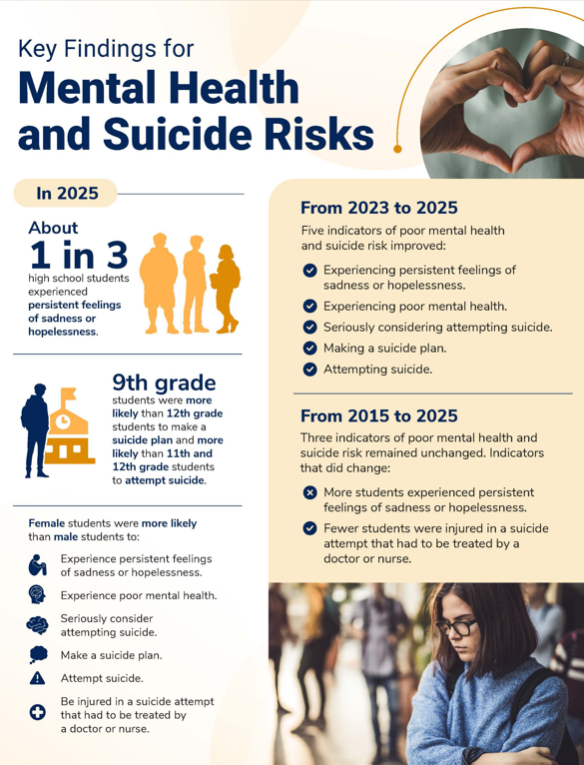
Youth At Risk
Youth At Risk
CDC Youth Health In Focus, 2026
Notes:
Please place links in chat:
CDC Adolescent Health in Focus 2026
https://www.cdc.gov/yrbs/youth-health-in-focus/mental-health.html
2025 State of mental health in America:
https://mhanational.org/the-state-of-mental-health-in-america/
Workbook page 24
There is more:
◦Among girls, 30 percent said they seriously considered attempting suicide, double the rate among boys and up almost 60 percent from a decade ago.
◦Almost 20 percent of girls reported experiencing rape or other sexual violence in the previous year, also an increase over previous years.
◦Almost half of LGBTQ students said they had seriously considered a suicide attempt.
◦More than a quarter of American Indians and Alaska natives said they had seriously considered a suicide attempt — higher than other races and ethnicities.

Slide 8
A Sense of Urgency
11.3 % of youth (ages 12-17) in the U.S. experienced a major depressive episode (MDE) with severe impairment in the past year, meaning it severely impacted their functioning at work, school, or home. That’s a total of 2.8 million youth whose depression significantly impaired their functioning.
Nearly 3 million youth (ages 12-17) reported frequent thoughts of suicide.
Suicide is one of the top 3 leading causes of death among youth ages 15-19.
State of Mental Health in America, 2025)
CDC Adolescent Health, 2024
Notes:
Please place links in chat:
CDC Adolescent Health 2024
https://wonder.cdc.gov/controller/saved/D158/D470F668
2025 State of mental health in America:
https://mhanational.org/the-state-of-mental-health-in-america/
Workbook page 24
There is more:
◦Among girls, 30 percent said they seriously considered attempting suicide, double the rate among boys and up almost 60 percent from a decade ago.
◦Almost 20 percent of girls reported experiencing rape or other sexual violence in the previous year, also an increase over previous years.
◦Almost half of LGBTQ students said they had seriously considered a suicide attempt.
◦More than a quarter of American Indians and Alaska natives said they had seriously considered a suicide attempt — higher than other races and ethnicities.

Slide 9

Impact of Pandemic Stress on Adolescent Brains
Notes:
Please place link in chat:
https://news.stanford.edu/2022/12/01/pandemic-stress-physically-aged-teens-brains-new-study-finds/
scans of 163 adolescents revealed major differences in the brains of 16-year-olds compared to the 16-year-olds scanned pre-pandemic.
These changes suggest that pandemic-related stressors accelerated developmental changes in the brain, changes previously only seen in children who have suffered chronic adversity.
Enlarging of the amygdala and hippocampus….. memory, concentration, learning, emotion, reactivity and judgement.
Their brains are different and we need to adapt our adult practices to reach them.
These experiences - such as childhood neglect, violence and family dysfunction - are associated with poor mental health outcomes later in life, although it is not clear if the same is true of the changes in the brain structure observed by the Stanford team.
image: https://umaine.edu/news/blog/2022/03/11/pandemic-mental-health-impacts-on-adolescents-quantified-in-new-umaine-study/

Slide 10


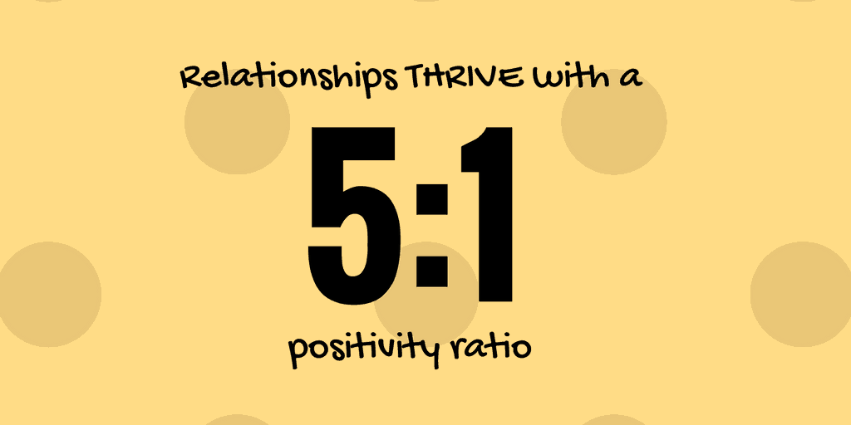


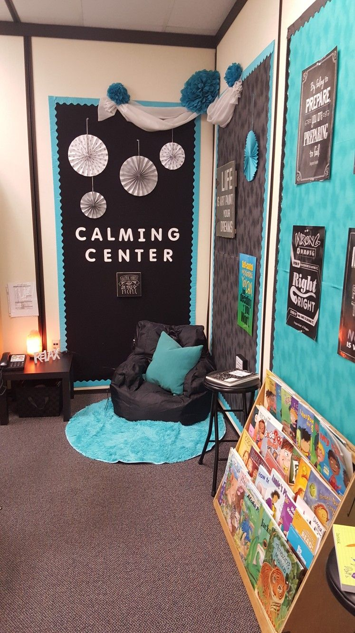
Effective Classroom Systems
Notes:
Go through a few examples
Active supervision
Flexible seating
Opportunities to respond
Positive feedback
Space to reflect and regulate

Slide 11

Our Top Ten
Physical Environment (HLP 7,17, 18, 19)
Active Supervision (HLP 4, 7, 8, 9, 15, 16, 17, 18, 21, 22)
Classroom Expectations (HLP 7, 8, 9, 14, 15, 21, 22)
Routines and Procedures (HLP 7, 8, 9, 14, 15, 16, 21, 22)
Opportunities to Respond (HLP 7,17, 18, 19)
Formative Assessment (HLP 1, 4, 5, 6, 8, 11, 15, 21, 22)
Scaffolding (HLP 6, 7, 9, 11, 12, 13, 14, 15, 16, 17, 21)
Acknowledgment and Behavior Specific Praise (HLP 1, 3, 4, 7, 8, 8, 10, 18, 22)
Error Correction (HLP 4, 5, 6, 7, 8, 9, 10, 15, 16, 18, 20, 21, 22)
Building Community through Feedback (HLP 1, 2, 3, 4, 8, 22)
HIGH-LEVERAGE PRACTICES
Developed by the Council for Exceptional Children and the CEEDAR Center, high-leverage practices are 22 essential special education techniques that all K-12 special education teachers should master for use across a variety of classroom contexts. Learn more about these practices in the guidance documentPDF of High Leverage Practices in Special Education guidance bookHigh-Leverages Practices in Special Education.
http://ceedar.education.ufl.edu/hlps/
Notes:
Four classroom contexts. How children engage within these contexts affects their ability to learn.
These settings direct engagement, which enhances learning, which affects desired behaviors. Creating a classroom that is sensory friendly must address these four contexts. 7 senses include: touch, taste, smell, hearing, sight, sense of movement, sense of body awareness.
Physical Context: all physical components within a classroom. Wall decor, lighting, layout, temperature, desk and chair design, seating opportunities, supplies and resources, and calming spaces.
Social Context: Interactions with peers, teachers/staff, and emotional reactions to scenarios during the learning day
Cultural Context: Culture of the classroom. Includes the norms developed by the whole, expectations of the teacher regarding operations and performance.
Temporal Context: Timing and routines within the classroom
Stearns, K. (2022). Creating a Sensory Friendly Classroom (dissertation).Activity: using hand out
Also A list of these ten practices can be found on pages 43 - 45 of your workbook. There is a description of each practice and why that practice supports students who have experienced trauma. Also, on page 48 of the workbook, there is an activity designed where you can self-reflect on these practices and note what you are already doing, as well as considering what you may want to be more intentional about, as well as if there are things you may want to add or change that you are doing in the classroom.
For today’s purposes we are going to look at just a few of these practices through a trauma sensitive lens.
Partially adapted from: Classroom Check- Up: A Consultation Model to Support Effective Classroom Management (Reinke et al., 2008) and The Classroom Check-up: A Classwide Teacher Consultation Model for Increasing Praise and Decreasing Disruptive Behavior (Reinke, Wendy; Lewis-Palmer, Teri; and Merrell, Kenneth

Slide 12
Independent Reflection
Independent Reflection
Review the resource in the chat.
Which of the top ten features lends itself to defusing interfering behaviors?
Is there a feature that you want to be more intentional with in your school or classroom to support a sense of safety?
Notes:
Drop link in chat: Trauma Aligned VTSS 10 .docx - Google Docs
Physical Environment
Active Supervision
Define Classroom Expectations
Routines and Procedures
Opportunities to Respond
Formative Assessment
Scaffolding
Acknowledgement and Behavior
Specific Praise
Error Correction
Building Community Through Feedback
Resource from PBIS: https://www.pbis.org/resource/positive-behavior-support-classroom-management-self-assessment

Slide 13
Small Group Discussion
Is there a feature that you want to be more intentional with in your school or classroom to support a sense of safety?
Notes:
Drop question in chat: Is there a feature that you want to be more intentional with in your school or classroom to support a sense of safety?
Open Breakouts Small Group Discussion: 5 minutes
As we have stated before, our goal is to establish a calm, safe and secure environment for all students and it is through the foundations of the VTSS top 10 practices that we can do that. These practices are from the work of Hattie and Anita Archer. VTSS offers a 2-day training specific to these ten Effective Classroom Practices which expands on each of these practices.
A list of these ten practices can be found on pages 43 - 45 of your workbook. There is a description of each practice and why that practice supports students who have experienced trauma. Also, on page 48 of the workbook, there is an activity designed where you can self-reflect on these practices and note what you are already doing, as well as considering what you may want to be more intentional about, as well as if there are things you may want to add or change that you are doing in the classroom.
For today’s purposes we are going to look at just a few of these practices through a trauma sensitive lens.
Partially adapted from: Classroom Check- Up: A Consultation Model to Support Effective Classroom Management (Reinke et al., 2008) and The Classroom Check-up: A Classwide Teacher Consultation Model for Increasing Praise and Decreasing Disruptive Behavior (Reinke, Wendy; Lewis-Palmer, Teri; and Merrell, Kenneth

Slide 14

Relationships
Notes:
Howard
Start with: Think of your most impactful memory in your educational career. Was it tied to an important relationship you had?
Research - Hattie - Teacher - student relationship effect size = .72 (anything above .4 has high positive effects
A Review of Educational Research analysis of 46 studies found that strong teacher-student relationships were associated in both the short- and long-term with improvements on practically every measure schools care about: higher student academic engagement, attendance, grades, fewer disruptive behaviors and suspensions, and lower school dropout rates. Those effects were strong even after controlling for differences in students' individual, family, and school backgrounds.” Education Week, March 12, 2019
A study in the European Journal of Psychology of Education found that a teacher's relationship with students was the best predictor of how much the teacher experienced joy versus anxiety in class. Education Week, March 12, 2019

Slide 15
More Small Group Discussion
What does relationship-building look and sound like in your classroom/building?
How do you connect with students and their families in ways that feel real and lasting?
When something goes wrong, how do you reconnect with students or families and repair the relationship?
(Be prepared to share a tip when we return)
Notes:
Questions in Chat:
What does relationship-building look
What does relationship-building look and sound like in your classroom/building?
Open Breakouts Small Group Discussion: 5 minutes

Slide 16
Ways to Connect and Support
Tier One
✔ Conduct relationship mapping
✔ Daily greetings
✔ Two-by-Ten: For 10 days in a row, spend 2 minutes
✔ Community Building Circles
✔ Closegap: Daily student mental health check-in.
✔ Mental Wellness Awareness: Engage families through training and dialogue to promote awareness.
✔ Routines and Procedures: Create planned, predictable, & supportive environments.
✔ One and done: first 30 days demonstrate a single act of empathy.
Notes:
Support comes through connection strategies. Evidence based tier 1 practices include:
✔ Conduct relationship mapping
✔ Daily greetings (as discussed in slide 31)
✔ Two-by-Ten: For 10 days in a row, spend 2 minutes
✔ Community Building Circles
✔ Close Gap: Daily student mental health check-in (free, online daily check in by all students) helps teachers monitor those in their class, can flag students who might need more support on a given day or who need a referral for intensive supports from a provider.
✔ Mental Wellness Awareness: Engage families through training and dialogue to promote awareness. Mental health first aid, mental health literacy programs
✔ Routines and Procedures: Create planned, predictable, & supportive environments.
✔ One and done: first 30 days demonstrate a single act of empathy.

Slide 17
Advanced Tiers
Tier Two
Tier Three
✔ Check-In/Check-Out: A brief interaction with a trusted adult daily.
✔ Check & Connect: A brief interaction aimed at fostering wanted behaviors
✔ Mentor Programs: Pair student with an adult for ongoing support.
✔ Small Groups: Focused sessions such as sessions focused on coping strategies or social skills.
✔ Check-in/check-out systems with intensive mentoring
✔ Check & Connect: systems with intensive mentoring, connections, student reflection, and goal setting.
✔ Individual & family counseling
✔ Wraparound services
✔ Functional Behavior Assessment (student centered, consider preferred adults, relational connections/incentives)
Notes:
Advanced tier supports to build connection and better support students include
Check in check out
Check and connect
Mentoring programs
Small groups with targeted skill areas
Individual and family counseling
Wraparound services, community services
Functional Behavior Assessment (student centered, consider preferred adults, relational connections/incentives)

Slide 18
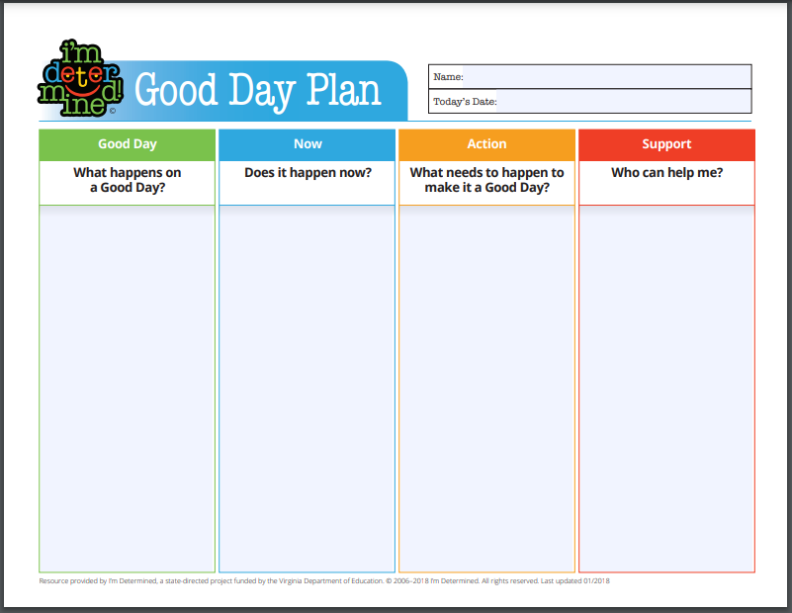
I’m Determined Good Day Plan
Notes:
Mention the connection to family engagement

Slide 19
The Take Care of Me List
•Ask students to fill a page with specific things you can do to take care of them as learners.
•Have them think back to a previous experience that made them happy to learn and describe what the teacher did to support them
•Model this by having your own “Take Care of Me List” that highlights things you need from them as students
•Read them all and write a short response
(Ott, 2018)
Notes:
Connect to families with this as well

Slide 20
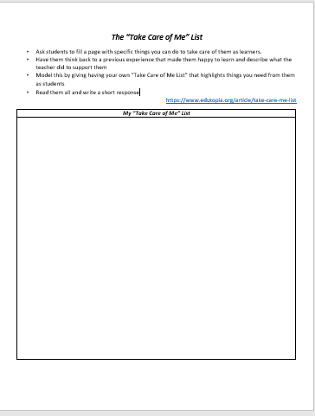
Independent Reflection
How can you use this with your students, with families?
Notes:
If we have time, ask them to come off of mute and share their family engagement strategies.

Slide 21
Setting Our Students up for Success
3 Setting Our Students up for Success
Strategies during Baseline Phase
Strategies during Trigger Phase
Strategies during Escalation Phase

Slide 22
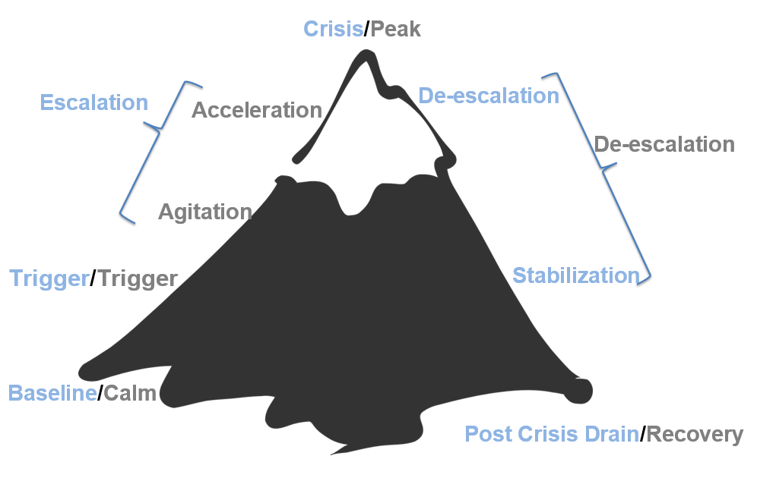
The Escalation Cycle
Notes:
We have to address the whole escalation cycle and not just at crisis/peak
We all start from a place of calm, something triggers us and hopefully we are using calming strategies that we covered yesterday. But, if not, we begin to accelerate and experience a crisis or peak. During this time academic instruction can not take place.

Slide 23

Peak -Small Group Discussion
How can we shift to an instructional approach to address disruptive behavior?
Notes:
Historically during this time we may suspend a student. How do we make a shift to a supportive place so that we are supporting the student instructionally through managing the behaviors. Connecting with the student. Being mindful of our language, too. For example, challenging or disruptive. More recently, we are shifting to the wording “interfering behavior” which speaks to the importance of going back to instruction vs. being in judgment. Hold tight to the idea of we can teach when disruptions take place.
Open Breakouts Small Group Discussion:
Chat: How can we shift to an instructional approach to address disruptive behavior?

Slide 24
Teaching during Baseline
When to teach:
  NOT when the child is engaging in the inappropriate behavior, especially if stressed or escalated
Where to teach
  in a safe environment;
  then practice generalization
How to teach
  using the Teaching Model– with praise and role modeling – and practice!
Notes:
Creating a positive learning environment will depend on the teacher staying in their comfort zone.
Remember what we learned about the brain --when we are in our emotional brain it is difficult to access the learning brain. Teaching during baseline is our goal. We teach, “I do, we do, you do” and we model, practice.

Slide 25
Teaching Model
Use the traditional teaching model of:
  - Tell them
  - Show them
  - Provide "Guided practice"
  - Provide feedback (with lots of encouragement and specific praise) from oneself, peers, and the teacher
Practice, practice, PRACTICE via homework assignments, review sessions, assignment in different settings and under various conditions.
Notes:
practicing in different settings and under various conditions
-prompting and coaching the student in naturally occurring situations throughout the day
Making sure we are providing more feedback on what they are doing well, and directing our words towards the behaviors not the child--keeping in mind their identity and agency.

Slide 26
Small Group Discussion - Escalation
Thinking back to the effective classroom practice you planned to be more intentional about—what shifts in the instructional approach is needed to align this practice with the early phases of the escalation cycle?
In what ways can this help prevent escalation and support student regulation before behaviors interfere with learning?
🚌 How can we equip teachers to make these shifts in their instructional approach?
Notes:
Open Breakouts Small Group Discussion:
Chat:
Thinking back to the effective classroom practice you planned to be more intentional about—what shifts in the instructional approach is needed to align this practice with the early phases of the escalation cycle?
In what ways can this help prevent escalation and support student regulation before behaviors interfere with learning?
How can we equip teachers to make these shifts in their instructional approach?

Slide 27
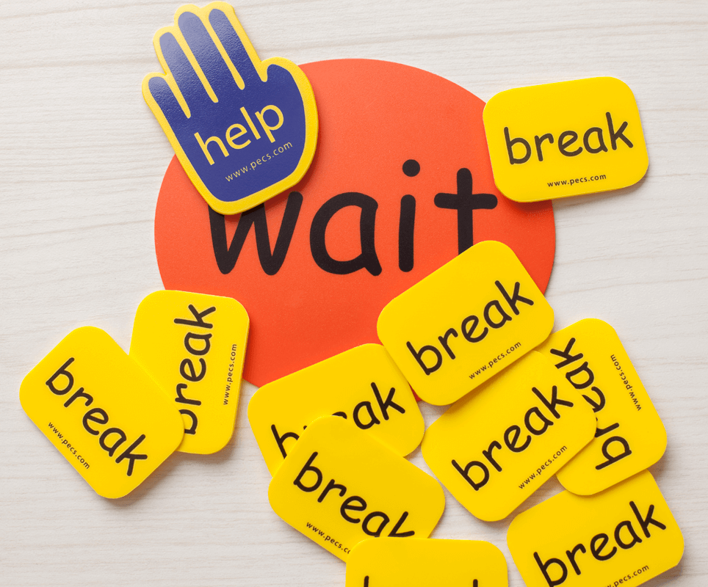
Replacement Behaviors
A replacement behavior is an alternative behavior that allows a student to meet the same need or achieve a similar outcome as the undesired behavior they are currently using.
Notes:
In addition to proactively teaching specific behaviors anchored to the matrix, behaviors to replace interfering behavior may require specific instruction.
Link back to ABC’s and how that fits in with function.
We pick a behavior that works for them and matching the same function/need that the student has. A more appropriate behavior for the school setting that also meets the needs of the student. For example, when you have a block of ice, it shapes into a beautiful swan. So, too, with behaviors, we shape them over time with intentionality and care.

Slide 28
ABC’s of Behavior
Antecedent
Behavior
Consequence
Mr. Jones handed an assignment to Mike
paper ripped up, thrown on floor
Mr. Jones redirected him
Notes:
Remember what we talked about with the ABCs of behavior. To prevent this in future, what is a replacement behavior for ripping up the paper? Are there prompts/cues to this skill or strategy?Possible chat box response. What would be acceptable replacement behaviors. Stair step
Presenter notes:
We will assume “escape from work”. What might be a replacement behavior that has the same function and is appropriate.
(potential answers: get at they why, root cause, why is that the function? Have the student to put the paper in their binder or flip it over to acknowledge that they are not ready to do the work. Maybe, you work with a partner, or chunk it, or alternative activities vs. the worksheet.)
What additional scaffolding do you need?

Slide 29
Replacement Behaviors Must Be
Functionally Equivalent
Meets the same need or purpose as the interfering behavior
Easy to Perform
Requires no more effort than the original behavior
Efficient
Works just as quickly to get the desired result
Effective
Produces the same or better outcome for the student
Notes:
Consider the examples….are they easy to perform, efficient, effective? Do they meet the same need?
Examples:
Yelling out answers Raising hand and waiting to be called on
Hitting to get a toy Using words to ask for a turn
Refusing to start work Requesting a break or asking for help
Leaving class Using a signal to indicate frustration and request support
Interrupting Using a “wait” card or written note to ask questions appropriately

Slide 30

Important Consideration for Replacement Behaviors
Remember that students,
like adults, are not wired to
be one-time learners.
Teaching replacement behaviors allows you to encourage behavioral learning so that students’ needs are fulfilled, but it is done in a way that is more pro-social.
Notes:
Just like adults we are not one time learners. We is the big picture and how can provide wraparound supports.

Slide 31
Replacement Behaviors Small Group Discussion
Go back to the ABC examples from Day 1.
Identify replacement behaviors for each of the examples.
Notes:
Remember we are shaping behaviors, or shifting behaviors. It needs to be gradual and meet the same function/needs. Happy talking once again! See you back in about 8 minutes.
Open Breakouts Small Group Discussion:
Please place in chat:
Go back to the ABCs from day 1. Chose one or more to discuss and identify replacement behavior

Slide 32

Prompting & Cueing
A hint meant to encourage a person to perform a desired behavior.
Paired with a desired behavior (i.e. social skill, coping skill, replacement behavior)
Verbal, visual, gesture, etc.
Notes:
Prompts are subtle, like a verbal cue or gesture, something you’ve agreed upon by the student. It is not a reprimand or public shaming, but a soft reminder or nudge to engage in replacement behavior. “Oh that’s right, I need to take a deep breath.” There is so much power in cueing when we are trying to shift behaviors.

Slide 33
Let’s revisit what we learned!
The next three slides offer the ABC examples from Day One. Choose one example.
Identify a possible replacement behavior for the behavior shown. What prompt or cue might be needed?
Discuss with your small group. Be prepared to share out.
🚌 What systems (PD, coaching, reflection tools) are in place to help staff apply theory to real classroom dynamics (Or what is missing?)
Notes:
10:45
Our next three slides will do a bit of review and application. We are going to dig into the scenarios from day one with Mr. Jones.
What systems (PD, coaching, reflection tools) are in place to help staff apply theory to real classroom dynamics.

Slide 34
ABC’s of Behavior Example
Antecedent
Mr. Jones passes out a math worksheet
Behavior
Carson runs out of the classroom
Consequence
Carson is followed and sent to the office
Notes:
Find handout with three examples.
5 minutes: Choose one to discuss and identify replacement behavior, remember we want a function-based replacement behavior so you need to establish what the function might be.
2 minutes: Share out

Slide 35
ABC’s of Behavior Example 2
Antecedent
Mr. Jones prompts students to take out notebooks
Behavior
Student says, ‘Mr. Jones, what is up with that ugly haircut?”
Consequence
The class laughs
Notes:
Teacher prompts students to take out notebooks
Student says, “Mr. Jones, what is up with that ugly haircut”
Class laughs

Slide 36
ABC’s of Behavior Example 3
Antecedent
Mr. Jones prompts students to put phones away
Behavior
Student ignores Mr. Jones, pulls up the hood, and stays on phone
Consequence
Mr. Jones stops his instruction and raises his voice, prompting the student to put up the phone.
Notes:
Teacher prompts student to put phone away
Student continues to stay on the phone
Teacher raises voice and again prompts

Slide 37
ABCs of Behavior - Independent Reflection
Reflect on your personal scenario.
Identify a replacement behavior.
What additional skills might your students need to engage in that replacement behavior?
Notes:
Personal Scenario
Identify the replacement behavior- what additional skills might your students need to engage in that behavior
For example, a visual cue with a sticky note, 5 to 1.

Slide 38

What Does It Take
to Be Ready to Learn?
Emotional intelligence refers to the ability to identify and manage one’s own emotions, as well as the emotions of others.
Self-Awareness
Self-Management
Social Awareness/Empathy
Social Management/Social Skills
Notes:
In Summary:
Teachers with emotional intelligence create classrooms that are more responsive, inclusive, and emotionally safe—laying the foundation for both academic and personal growth.
Four core components:
Self-Awareness
Self-Management
Social Awareness/Empathy
Social Management/Social Skills
Poll:
Which skill do you see your students needing the most support developing right now?
Self-Awareness
Self-Management
Social Awareness/Empathy
Social Management/Social Skills

Slide 39
Self-Awareness
What Self-Awareness Looks Like in Students:
“I’m starting to feel overwhelmed, I need a break.”
“I get distracted when I sit near the window.”
“I was really proud of how I handled that situation.”
“I notice I shut down when I make a mistake.”
Self-Awareness
The ability to recognize your own feelings and to name them, recognizing the impact of your emotions, and to know your strengths and limits, and to have self-confidence and the awareness of your capabilities.
Elena Aguilar, The Art of Coaching Teams: Building Resilient Communities that Transform Schools. Jossey-Bass, 2016.
Notes:
It helps students understand themselves—how they feel, think, and act—which is essential for making positive choices, building relationships, and managing emotions. When students can name what they’re feeling (e.g., frustrated, anxious, excited), they’re more likely to choose healthy ways to respond instead of acting out or shutting down. Life circumstances, age, children, stages of life can impact this.
Self-awareness includes recognizing internal self-talk. Teaching students to notice negative thoughts (“I’m not good at this”) and reframe them (“I’m still learning this”) builds resilience and a belief in their own potential.
What Self-Awareness Looks Like in Students:
“I’m starting to feel overwhelmed, I need a break.”
“I get distracted when I sit near the window.”
“I was really proud of how I handled that situation.”
“I notice I shut down when I make a mistake.”

Slide 40
Self-Management
Self Management (Regulation)
The ability to make conscious decisions on how to respond to emotions (emotional self-control, transparency, and adaptability, and initiative—the readiness to act and to anticipate the consequences, aligned with your values).
What Self-Management Looks Like in Students:
Taking a break instead of yelling when upset
Using a checklist to complete assignments
Asking for help instead of giving up
Practicing mindfulness to calm anxiety before a test
Resisting peer pressure and making independent choices
Elena Aguilar, The Art of Coaching Teams: Building Resilient Communities that Transform Schools. Jossey-Bass, 2016.
Notes:
Teaching self-management in schools is essential because it equips students with the skills they need to regulate their emotions, behaviors, and actions in ways that support their learning and relationships. Self-management is a key pillar of social-emotional learning and directly impacts students’ academic success, well-being, and readiness for life beyond the classroom.
Students who can manage emotions are more likely to stay engaged and less likely to escalate into disruptive behavior.
Students with self-management skills can: Sustain attention, Resist distractions, Persist through difficult tasks, Organize their time and materials
What Self-Management Looks Like in Students:
Taking a break instead of yelling when upset
Using a checklist to complete assignments
Asking for help instead of giving up
Practicing mindfulness to calm anxiety before a test
Resisting peer pressure and making independent choices

Slide 41
Social Awareness
What Social Awareness Looks Like in Students:
Listening attentively to others without interrupting
Recognizing when a classmate is struggling emotionally
Respecting differences
Acknowledging how their behavior impacts others
Being willing to compromise or share
Social Awareness (Empathy)
The ability to recognize and understand the feelings that other people experience (empathy, organizational awareness, service—the needs of others and meeting them).
Elena Aguilar, The Art of Coaching Teams: Building Resilient Communities that Transform Schools. Jossey-Bass, 2016.
Notes:
Teaching social awareness in schools is critically important because it helps students understand and respect the perspectives, experiences, and emotions of others. Social awareness fosters empathy, inclusion, and strong interpersonal relationships, which are essential for a safe, supportive, and equitable learning environment.
Empathy is the foundation of respectful classrooms and inclusive communities.
Understanding others’ backgrounds, identities, and experiences allows students to appreciate diversity and challenge stereotypes or biases. Socially aware students are more likely to be allies, stand up against bullying, and create space for all voices.
Students Work more effectively in groups, Resolve conflicts more peacefully, Develop deeper friendships
What Social Awareness Looks Like in Students:
Listening attentively to others without interrupting
Recognizing when a classmate is struggling emotionally
Respecting different cultural norms or traditions
Acknowledging how their behavior impacts others
Being willing to compromise or share

Slide 42
Social Management
Social Management (Social Skills)
The ability to manage conflict with others to form healthy relationships, collaboration, feedback and guidance, and to motivate and inspire others.
What Social-Management Looks Like in Students:
Asking someone to stop respectfully instead of retaliating
Working through disagreement in a group project
Knowing when to include others or give space
Apologizing and repairing harm after conflict
Recognizing when a peer needs support
Elena Aguilar, The Art of Coaching Teams: Building Resilient Communities that Transform Schools. Jossey-Bass, 2016.
Notes:
Social management helps students develop and maintain positive relationships with peers and adults. It includes skills like communication, cooperation, turn-taking, and repairing harm after conflict.
Students who can manage social interactions are more likely to build friendships, feel connected, and avoid social isolation.
In both school and life, success often depends on the ability to work well with others. Social management skills help students:Share responsibility, Listen actively, Disagree respectfully, Problem-solve as a team, and Less likely to bully,
What Social Management Looks Like in Students:
Asking someone to stop respectfully instead of retaliating
Working through disagreement in a group project
Knowing when to include others or give space
Apologizing and repairing harm after conflict
Recognizing when a peer needs support

Slide 43

Chat Waterfall
How are you already incorporating teaching these skills in your classroom?
Notes:
Give them a second to process, then encourage them to do the chat waterfall.

Slide 44
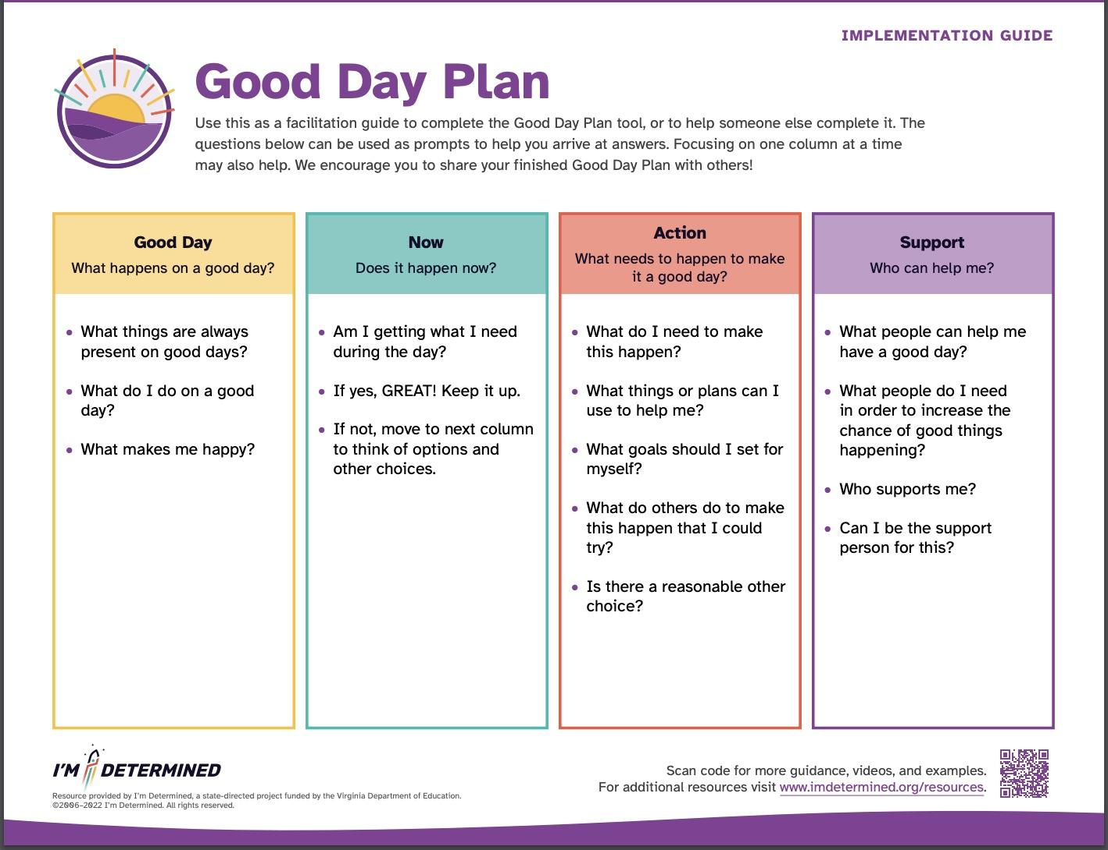
I’m Determined Good Day Plan Alternate Version
Notes:
https://imdetermined.org/tool/good-day-plan/
This tool helps individuals identify the factors that contribute to a good day and create a plan to make those factors happen.
It encourages reflection on what makes a good day and how to structure a daily routine to achieve that.
Mention the connection to family engagement

Slide 45
The Take Care of Me List Revisited
Ask students to fill a page with specific things you can do to take care of them as learners.
Have them think back to a previous experience that made them happy to learn and describe what the teacher did to support them
Model this by having your own “Take Care of Me List” that highlights things you need from them as students
Read them all and write a short response
https://tinyurl.com/TakeCareOfMeList
(Ott, 2018)
Notes:
This activity invites students to create a “Take Care of Me List,” where they detail specific ways their teacher can support them as learners, along with brief explanations. There are no limitations on their responses, allowing each list to reflect the student’s unique personality.
The teacher also shares their own list as a model, highlighting the behaviors and habits that foster a successful learning environment. Instead of introducing traditional rules, this approach emphasizes mutual care and shared responsibility for a supportive classroom culture.
Can use to connect with families

Slide 46

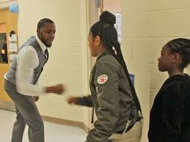

Taking Time to Greet Your Students
Notes:
In the study, when teachers started class by welcoming students at the door, academic engagement increased by 20 percentage points and disruptive behavior decreased by 9 percentage points—potentially adding “an additional hour of engagement over the course of a five-hour instructional day,” according to the researchers.Ten middle school teachers were randomly assigned by the researchers to one of two groups. The first group started class by greeting their students at the door, saying each student’s name while using a nonverbal greeting such as a handshake or nod. The teachers also used precorrective statements—reminders of what to do at the start of class like, “Spend the next few minutes reviewing what we covered yesterday.” If a student had struggled with their behavior the previous day, the teachers often gave a positive message to encourage them to improve.Teachers in the second group attended classroom management training sessions offered by their schools, but they weren’t given any specific instructions on how to start class.Researchers observed classrooms in the fall and spring, looking at academic engagement—how attentive students were to their teacher or classwork—and disruptive behavior, including speaking out of turn, leaving one’s seat, and distracting classmates. Both measures improved in classrooms where teachers greeted their students, confirming what many teachers already know: Meeting students’ emotional needs is just as important as meeting their academic needs.
“The results from this study suggest that teachers who spend time on the front end to implement strategies such as the PGD [positive greetings at the door] will eventually save more time on the back end by spending less time reacting to problem behavior and more time on instruction,” the study authors write
https://www.edutopia.org/article/welcoming-students-smile

Slide 47
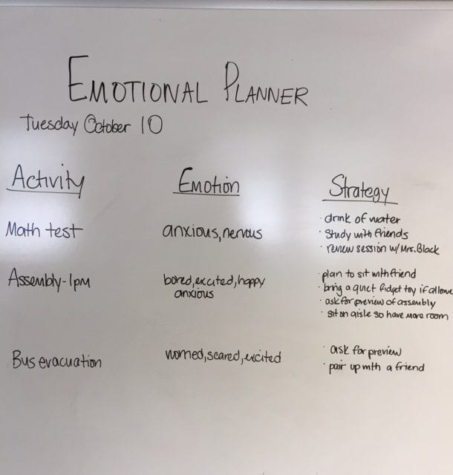
Identifying & Communicating Emotions
Notice the Emotion
  Impact on Body and Mind
Name the Emotion
  Use words to describe
  Emotion Wall
    Emotional Check-in
Use literary fiction
Interpret the Emotion
  Explore why you are feeling this way and how emotions can be helpful
Notes:
The Notice, Name, and Interpret strategy is a powerful tool for building emotional awareness in the classroom. It helps students recognize and make sense of their own emotions—and the emotions of others—so they can respond more thoughtfully rather than react impulsively. It also promotes a shared emotional vocabulary and a supportive classroom culture. Make It a Routine: Use visuals or feeling charts to support naming. Use this as a daily check in. Practice during morning meetings or after high-emotion moments. Model the steps yourself to normalize emotion talk
Notice: Physical signs (tight stomach, clenched fists, racing thoughts), Facial expressions and body language in others, Environmental or situational triggers
Name it: Naming emotions helps students label their internal state, which is the key to understanding and managing it.
Interpret: This step encourages students to reflect on what’s driving the emotion—whether it’s unmet needs, misunderstandings, stressors, or external events. Example: “I feel embarrassed because I got the answer wrong in front of everyone.” Interpretation helps students make connections between emotions, actions, and outcomes. It also allows them to take perspective and build empathy: “She seems upset—maybe because her friend ignored her.”
Here’s a strategy: Have students list their emotion via chat box, emoji, slido, drawing or facial expression. Participate and model your emotion as well. Use this as an entry routine, check-in throughout the lesson or as a closing.
https://www.edutopia.org/discussion/got-sel-teaching-students-describe-emotions

Slide 48
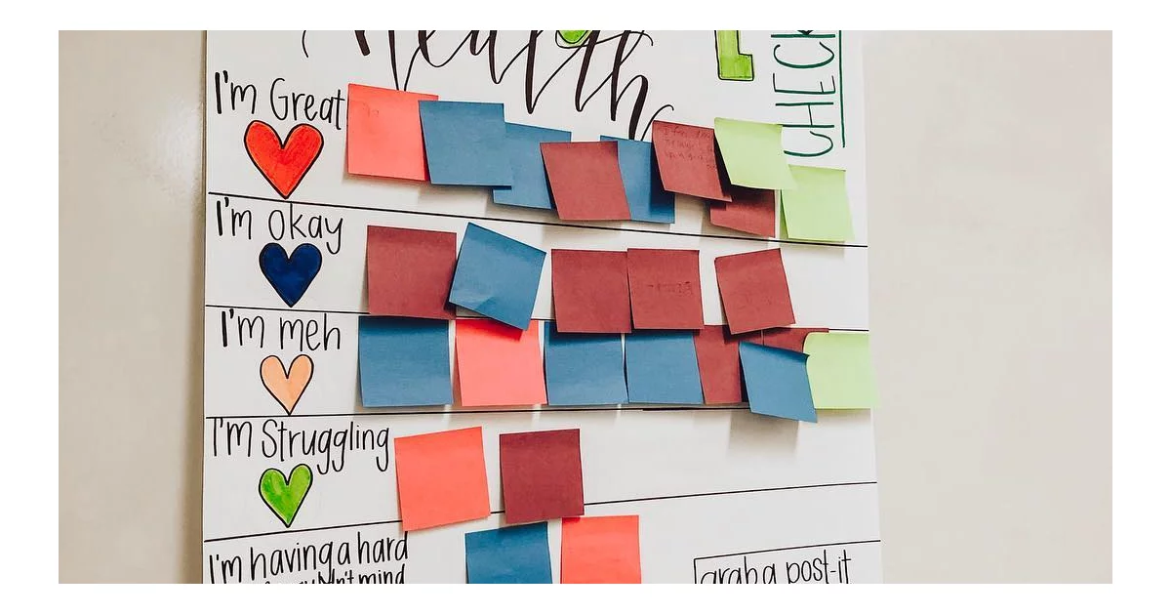
Check-in Routine
Notes:
How are we increasing of self-awareness through check-ins? Here is an example of post it notes for students to check in where they are. Secondary, a teacher can use a Google Form for check in, then the teacher can view and check on students. “How are you doing?” “How can I help you?”
Use the chat to share your ideas for check-in routines. (read through them)
We validate as adults by checking in ourselves. “We are all human” and We have emotions.

Slide 49
Regulation
Strategies and Activities
Time
Management
Stress
Management
Motivation
Management
Mindfulness
Exercise & Yoga
Movement Breaks
Deep Breathing
Grounding Activities
Imagery Exercises
Goal Setting & Reflection
Service to Others
Checklists
Logs
Visual Schedule
Notes:
11:20
Why These Skills Should Be Taught in Schools. These are not innate—they must be explicitly taught and practiced. Students often struggle academically not because of content, but because of weak self-management skills. Teaching these skills reduces behavior issues, improves student engagement, and fosters a classroom culture of ownership and accountability. They are directly linked to college, career, and life readiness
Teaching and practicing time management, stress management, and motivation management in schools is essential because these skills empower students to become independent, resilient, and goal-oriented learners. They are foundational components of self-management, one of the core social-emotional competencies, and they directly impact academic achievement, mental health, and long-term success.
Time Management
Helps students plan ahead, prioritize tasks, and meet deadlines
Reduces last-minute stress and procrastination
Builds a sense of responsibility and independence
Prepares students for life beyond school (college, careers, adult life)
Example: A student who can map out a project timeline is more likely to stay on track and feel confident.
Stress Management
Teaches students how to cope with pressure, frustration, and anxiety in healthy ways
Prevents emotional overwhelm and behavioral escalation
Supports mental health and emotional regulation
Helps students stay focused and productive during high-stakes situations (e.g., tests, presentations)
Students who know how to pause, breathe, or take a break are more likely to stay calm and recover from setbacks.
Motivation Management
Encourages students to set goals, track progress, and stay focused—even when tasks are difficult or boring
Builds a growth mindset by helping students connect effort to achievement
Helps students reflect on what drives them (internal vs. external motivation)
Reduces dependency on constant adult prompting
Example: A motivated student is more likely to persist through a challenging math problem instead of giving up.
See slide for Examples of What This Looks Like in Practice:

Slide 50

Meditation
Video of "Arrive" - A Mindful Minute Helps Students Arrive in the Classroom
Notes:
“You go through the day without feeling how you feel.” A great quote from the student in the video to emphasize the importance of teaching skills. To calm and get ready for learning. It’s about being present.

Slide 51
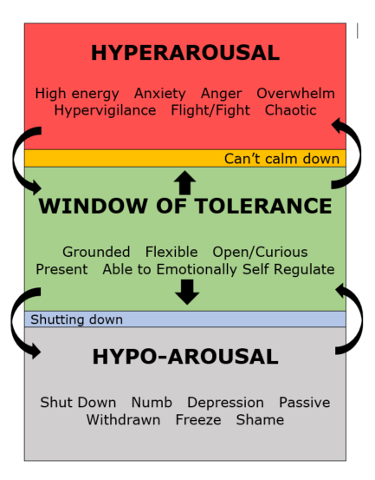
Window of Tolerance
Notes:
You’ll notice in the green area is our learning brain, or our wise owl. We are present and can regulate or emotions. When we are experiencing the barking dog, we may be hyperarousal or hypo arousal. What does this look like? (read a few).
What are we feeling and what is going on--recognizing the importance of routines in the classroom and schools to normalize the conversations and how to regulate.

Slide 52
Small Group Showcase
In your small groups brainstorm creative and unique ways to teach one of the following skills
  Self-Awareness
  Self-Management
  Social Awareness
  Relationship Skills
  Responsible Decision Making
Have one person record and be prepared to share when we return.
Notes:
Open breakouts Small Group Discussion:
Please place in chat:
In your small groups brainstorm creative and unique ways to teach one of the following skills
Self-Awareness
Self-Management
Social Awareness
Relationship Skills
Responsible Decision Making
Have one person record and be prepared to share when we return.
Presenter Note:
The person with the most pets will facilitate the conversation, choose one way to teach that the group agrees on, then the facilitator will share in the large group.

Slide 53
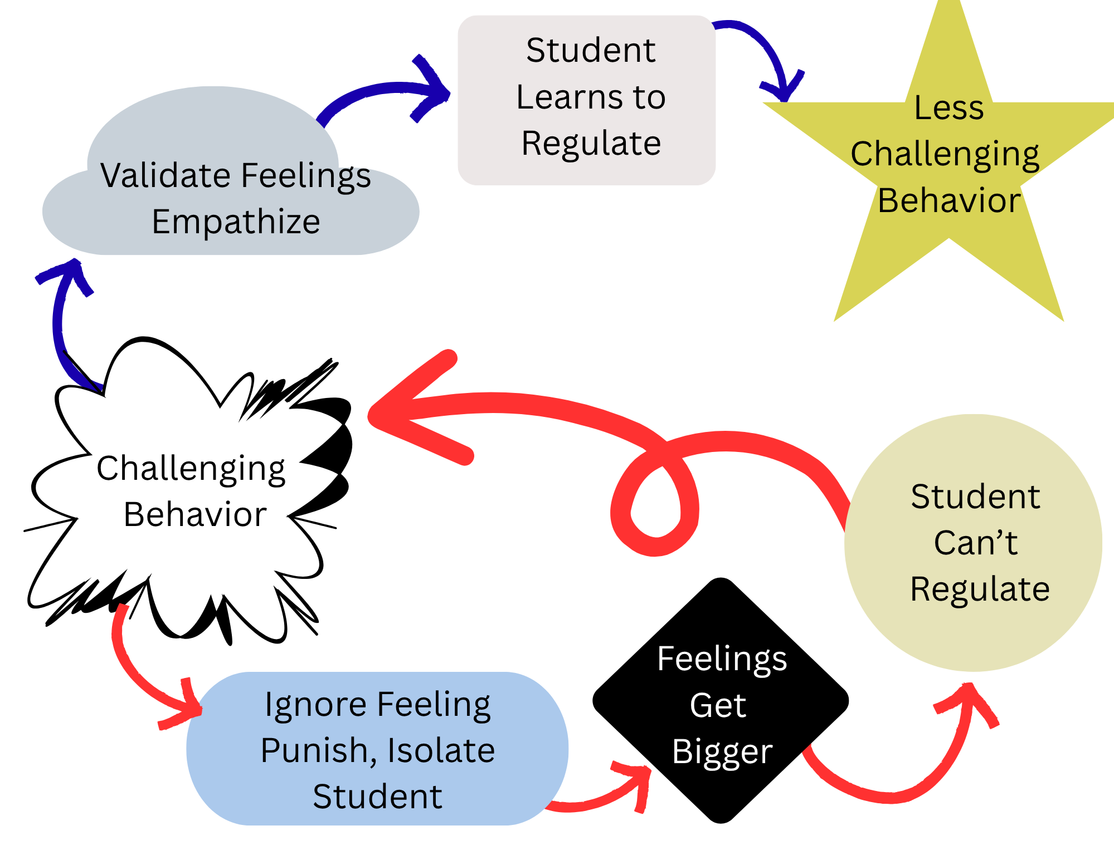
The Power Behind Every Response
Our initial response determines what happens next.
Challenge
Reprimand
Argue
Escalate Emotion
Bigger Problem
Listen
Paraphrase
Validate
Show empathy
Calm
Support
BEHAVIOR
OUR RESPONSE
The first moment determines the next hour.
(Adapted from Bob Garrity, Garrity Mediation and Consulting)
Notes:
Animated: Call back to the behavior chain and how our action impact the outcomes
How we respond matters
If we Challenge Reprimand Argue Escalate Emotion to a Bigger Problem
If we Listen Paraphrase Validate Show empathy Remain Calm and Supportive we change the trajectory of the behavior chain

Slide 54

Reacting vs. Responding
REACTING
RESPONDING
Impulsive, based on feelings
Emotional and automatic
Defensive reactive
Short-sighted
Lead to miscommunication
Problem-based, may lead to conflict
Thoughtful, based on feelings and reason
Deliberate and intentional
Goal driven and purposeful
Encourages connected, effective communication
Focuses on solution-based outcomes
Notes:
Reacting vs. responding. Take a look at these differences. Responding is the replacement behavior for the reacting.

Slide 55
Examples:
Reacting vs. Responding
REACTING
RESPONDING
Distrust – Power – Punishment
“Hey!!”
“What are you supposed to be doing?”
“Get busy”
“What did you say?!!”
“You’re going to the office”
Referral/Suspension
Trust - Support Understanding
“Hey, can we chat?
“What are you working on right now?”
“Need help getting started?”
“It sounds like you are having a hard time.”
“Let’s step aside and talk about what’s going on”
Provide Support
(Adapted from Bob Garrity, Garrity Mediation and Consulting)
Notes:
Thumbs up if they have observed or engaged in behaviors that are more reactive.

Slide 56
What Does Reacting Look and Sound Like?
Raising voice or shouting in frustration
Cornering or physically closing in on a student
Engaging in power struggles (e.g., “In my classroom, you will...”)
Invading personal space or standing over the student
Touching or grabbing the student
Responding impulsively or with sudden movements
Making dismissive or discrediting comments (e.g., “This isn’t elementary school”)
Becoming defensive or argumentative
Displaying anger or frustration through tone, posture, or facial expressions
AVOID
Notes:
Animated
11:36 We also need to be careful about not just want we say, but how

Slide 57

When Adults Respond
Pause – No immediate reaction is often the most powerful response
Treat students with dignity and respect at all times
Use private communication when addressing behavior
Model calm behavior through tone, posture, and presence
Be aware of your body language
Stay open and non-threatening
Stay composed with a calm, matter-of-fact tone
Avoid showing anxiety or frustration
Notes:
When you “pause”, it can be ok to model that and tell the student you are pausing so that you have time to process how to respond.
Think:
What is the student trying to communicate?
What does the child see as the outcome?
(Think FUNCTION: What is the student trying to gain or avoid?)
What can we do to change the behavior?
How can we help meet the child’s need?

Slide 58
De-Escalating Through
Non-Threatening Responses
Move slowly and deliberately toward the problem situation
Keep reasonable distance
Establish eye-level position
Speak calmly, privately, respectfully
Minimize body language
Be brief
Stay with the agenda – focus on the problem at hand
Avoid power struggles – don’t get drawn into “I won’t, and you will” engagement
Acknowledge cooperation
Withdraw if the situation escalates
Notes:
The important “pause” allows us to refocus and be able to enter into this zone so that we respond in way that are listed here. Helps us help them go begin to de-escalate.

Slide 59
What is your go to?
What’s your go-to response, and what great phrases have you learned from others?
Notes:
These responses don’t always come naturally, especially when we are busy multi-tasking, teaching lessons, monitoring learning, engagement, managing time, practicing empathy.
So we must be intentional and practice. Recommend copying what a peer or partner says, this builds instant credibility and consistency.
Share story about “all done”

Slide 60
Independent Reflection
Let’s go back to your personal scenario….
What might you try next time?
Notes:
Go back to the scenario…..
(Did this on day 1) Set the stage independent activity-Take a minute to remember a time when you were face with a behavior or a series of behaviors that were not conducive to learning. Maybe the behavior escalated to a referral, maybe the student stormed out of class, maybe they or you raised your voice. Just think of a time and take time to do a braindump of everything you remember about that event. Did you involve other stakeholders, administration, families? When did that happen?

Slide 61
The Escalation Cycle – Trigger Phase
Notes:
Kate 66-on
(35 minutes)
Ordinarily we would walk through each of the phases and provide information and strategies. But for today, we are going to focus on the trigger phase, escalation phase and crisis phase. When we get back together, we will spend time on strategies we want work with when students are at baseline, as well as discuss how to handle things as the student de-escalates…
Scenario: Set the stage independent activity-
wb page 42
Take a minute to remember a time when you were faced with a behavior or a series of behaviors that were not conducive to learning. Maybe the behavior escalated to a referral, maybe the student stormed out of class, maybe they or you raised your voice. Just think of a time and take time to do a braindump of everything you remember about that event. Did you involve other partners, administration, families? When did that happen?

Slide 62

Understanding Student Triggers
Unexpected changes
(routine shifts, corrections, being told "no")
Social stressors
(peer conflict, feeling ignored, loss of connection)
Academic challenges
(confusion, failure, pressure, low-interest tasks)
Sensory or environmental overload
(noise, lighting, crowded spaces)
Emotional vulnerability
(grief anniversaries, hardship reminders, loneliness)
Fear or uncertainty
(frightening events, unmet needs, lack of belonging)
Notes:
1:05 - 1:08
Humans love routine and predictability. Changes in routine can upset us. Remember our discussion on setting events. There many things can push us out of our zone of tolerance.
Why is it important to know common triggers for students? (It can help us set up a classroom environment that addresses the triggers preventively).
If time, maybe ask them to use the annotate tool or chat box to share which one of these triggers do they see most often. Consider the next slide, too.

Slide 63
Triggers We Often Miss
Feeling overwhelmed by responsibilities or emotions
Worrying about grades, deadlines, or upcoming projects
Exposure to frightening or distressing news events
Being ignored or receiving criticism (even subtly)
Anniversary of a loss or adversity
A trusted adult or peer being suddenly unavailable
Feeling a lack of connection
Spending extended time in isolation (social or emotional)
Experiencing a breakup or friendship loss
Notes:
1:08-1:09
Additionally, ……
Highlight lack of connection and belonging

Slide 64
Escalation Cycle - Small Group Discussion
What are triggers for you?
What are triggers for your students?
What does
that look like?
Notes:
Small Group Discussion: 8 minutes?
Please place in chat:
What are triggers for you?
What are triggers for your students?
What does that look like?

Slide 65
Identify the Triggers
Maya walked into her art class, a subject she usually loved. Today, however, Ms. Evans announced a last-minute change to the project: instead of working on their individual sculptures, they would be collaborating on a large mural. Maya's stomach tightened. She thrives on independent work and planning, and the sudden, unannounced change instantly threw her off balance.
As Ms. Evans began explaining the new group assignments, Maya felt a familiar wave of anxiety wash over her. She struggled with public speaking and hated having her ideas scrutinized by others. The thought of having to present her ideas to a group, let alone compromise on a shared vision, felt overwhelming. She found herself staring at the blank mural paper, her mind racing with all the ways this could go wrong, completely unable to focus on Ms. Evans's instructions for the project.
When Ms. Evans then asked each group to brainstorm initial ideas aloud, Maya pulled her sleeves down over her hands and began to doodle furiously on the corner of her sketchbook, avoiding eye contact with her group members.
Notes:
1:15 - 1:20
Do this as a larger group.

Slide 66

Trigger Phase: Strategies
First Step: Check Yourself
Precorrection
Limit setting
Offering Choice
Redirection / Prompting
Behavior momentum
Validation
Active Listening
Systematically Modifying Context
Differential Reinforcement
Reduce situation demands
Teacher proximity
Provide independent, passive, or movement activities
Goal: Interrupt/Intervene
(Separate student from trigger)
Think “Function”!
Notes:
Workbook page 43-46
Pull up page 46 and read example? If you have time.
Isn’t it helpful to know there is so much you can do during the trigger phase?! We have covered what you can do to be the well emotionally managed adult, neutralized in VDP AND you can provide effective response strategies for the student!
Think about the continuum of responses flowchart and how and when you can keep this menu for teachers available and accessible to teachers in your buildings. We will briefly go over these, offering just a little more detail.
Precorrection is one my favorite strategies to support what might happen. For example, when we start peer presentations, what are the norms when providing feedback or asking questions? Or just before a transition or location like library or cafeteria.
We are trying to avoid a power struggle & to demonstrate a regulated classroom and interactions. The goal is to interrupt the chain of events that potentially could happen. Think about function and the underlying need.
(Extra Notes)
Behavioral momentum is a strategy used in Applied Behavior Analysis (ABA) to increase the likelihood of a learner doing what is desired. It involves making a series of easy requests, or "high-probability" requests, followed by a more difficult request, or "low-probability" request. The goal is to create positive momentum so that the learner is more likely to comply with the more challenging request.
Differential reinforcement is a behavior modification technique used in Applied Behavior Analysis (ABA), which involves selectively reinforcing desired behaviors while withholding reinforcement for undesired behaviors.
Passive play settings offer areas for children to play on their own or gather with friends. These areas are intended for social-emotional development and learning and provide opportunities for socialization, relaxation, and observation. Sensory gardens, music panels, play panels, water/sand play, and dramatic play activities offer rich play experiences for children of all abilities. These areas should be organized near other similar areas that can further enhance play experiences. For example, a themed play area that resembles a store or restaurant could be positioned near a table and seats to encourage children to pretend and foster communication.
Avoidance, Access, Attention (adult or peer), Sensory

Slide 67
Whole Group Discussion
Using Precorrection to Address Behavior
Using Maya’s story, how could we use precorrection to address behavior?
Acknowledge the change and validate feelings
Clearly state the new plan and the "why"
Proactively address social anxiety around group work
Provide concrete structures and expectations for collaboration (with options); model varied participation ideas
Notes:
1:21- 1:23
Precorrection, in the context of classroom management, is a proactive strategy aimed at preventing interfering behaviors by providing cues or prompts for desired behaviors before they are likely to occur. Instead of reacting to misbehavior, precorrection anticipates and addresses it by ensuring students are aware of expectations and provided with the necessary support.
By implementing these precorrection strategies, Ms. Evans aims to:
Reduce Maya's initial anxiety: By acknowledging the change and potential discomfort, Maya feels understood rather than simply having to adjust.
Provide a sense of control: Offering choices in how to contribute empowers Maya and lessens the feeling of being forced into an uncomfortable situation.
Structure the task to support anxious learners: The clear guidelines for group work and the facilitated roles reduce the unknown and provide a predictable framework.
Prevent the undesirable behavior: By addressing the triggers proactively, Ms. Evans creates an environment where Maya is less likely to resort to avoidance behaviors like doodling and eye contact avoidance, and more likely to engage, even if subtly at first.

Slide 68
Limit Setting
Setting limits effectively requires a balance of firmness and respect.
State request clearly and concisely.
Provide limited, but reasonable choices.
Use instructive consequences that hold students accountable for their actions.
Notes:
Warm demander
What do you notice about limit setting? What do you suppose might be the result of one feature of limit setting is omitted?
Here are the consequences of this path…For example, you can go to the hall and get a sip of water, if you choose to continue to be verbal with me, this may result in a further conversation later. No power struggle, or flex your control. It’s a healthy conversation with boundaries and safety. Clarity around intention for the classroom. It is not about shaming or belittling.

Slide 69
Why Provide Choices?
The more “backed against a wall” a student feels, the more “acting out” behavior will occur.
A simple solution is to give the student a small sense of control.
To do this, offer the student choices within the trying situation.
Notes:
1:25

Slide 70
Offering Choice
Structured choice gives a student a sense of control over a situation by providing options
Structured choice interventions are used to prevent or de-escalate interfering behaviors and to increase appropriate behaviors.
Notes:
1:25
Make sure choices are provided without sarcasm, such as “You can do your work...OR you can go to the office.” This is NOT an example of Offering Choice as a response to behavior.

Slide 71

Redirection/Prompting
Remind student of the task without commenting on the off task behavior.
Examples:
Calling on the student to answer a question
Assigning him or her a task to carry out
Notes:
Back to relationships - this works even more successfully when you have already established a good relationship with the student.

Slide 72
Systematically Modifying Context
Providing student opportunity to temporarily remove themselves from setting/triggering event, which allows them to:
calm down,
move,
avoid embarrassment,
return and begin to work again.
Notes:
1:27
This is not “allowing the student to escape tasks/work”.This provides the student with an opportunity to step away from a situation before it escalates so that they ARE able to return to the task and complete it.

Slide 73

Modifying Context Examples
Sending student on an errand
Taking a note to a colleague
Returning material to the library
*Color coding the note/pass can be used to indicate the student needed a "change of pace" and a response is not necessary.
Notes:
Take a pause and allow the participants to share their ideas in the chat. (possible ideas, take a note to a teacher, returning materials to the library, giving opportunities to “save face”.

Slide 74
Behavior Momentum
Make requests that are easy for the student before making requests that are more challenging or difficult.
By following a pattern of easy-easy-hard-easy-easy-hard, student motivation to engage increases in response to increased opportunities for success.
Notes:
1:29

Slide 75
Behavior Momentum Example
Michael does not like to read, so when he has to read, he puts his head on his desk and closes his eyes. His teacher, on this occasion, reads to him for a couple of minutes and engages his attention.
She then asks him to read with her, which he does, and he is then asked to read a little by himself. He continues to read and the teacher praises him.
(Colvin, 2009, p.46)
Notes:
1:30 - 1:31
Ask for volunteers to answer “How is this demonstrating behavior momentum?” and “Can anyone provide an additional example of how this might work in the classroom setting?”
Reference: Colvin, G. 2009. Managing Noncompliance and Defiance in the Classroom. Corwin.

Slide 76
What about Maya?
Asking Maya to share a shading technique--something she does well.
Reflecting on what went well in the last group project.
Sketching one small element for the mural before jumping into big ideas or drawing on the larger paper.
Notes:
1:31 - 1:32

Slide 77
Behavior Momentum Small Group Discussion
How could you use behavior momentum to address the following?
Written assignment
Collaboration
Putting phone away
Maya’s Story, What would you add?
Notes:
1:32 - 1:40

Slide 78

Active Listening
“Is there anything I can add that would be more beautiful than the silence?”
Notes:
1:40- 1:41
What is the intention with which I enter this conversation
“Is there anything I can add that would be more beautiful than the silence?”
The Value of Listening and Observation: When we are silent, we are often better able to listen, observe what is going on in the classroom and with our students. The question encourages this mindful presence.

Slide 79

Behavior Momentum -Independent Reflection
Reflect on your personal scenario
What strategies that we just discussed might have helped in your scenario?
What else might you try next time?
Notes:
1:41 - 1:46
Connect to personal scenario

Slide 80
Maya’s behaviors escalate.
As her group brainstormed, Maya's anxiety spiraled. When Sam asked for her input, she mumbled, hunching over her sketchbook. The vibrant discussion felt overwhelming, each voice amplifying her anxiety. Maya’s teacher notices her disconnection with the group and her agitation (e.g. biting her lip, shaking her leg under her desk, sighing)
Notes:
1:46 - 1:47

Slide 81
Escalation Phase: Strategies
Goal: Interrupt/Intervene-Connect
Calming Strategies
Redirection
Proximity–(for attention motivated behavior)
Provide space
Modify task-(Academic lesson is not priority at this time; moving student back to calm phase is primary goal)
Choice
Provide alternate/enriched sensory options
Notes:
1:47 - 1:48

Slide 82
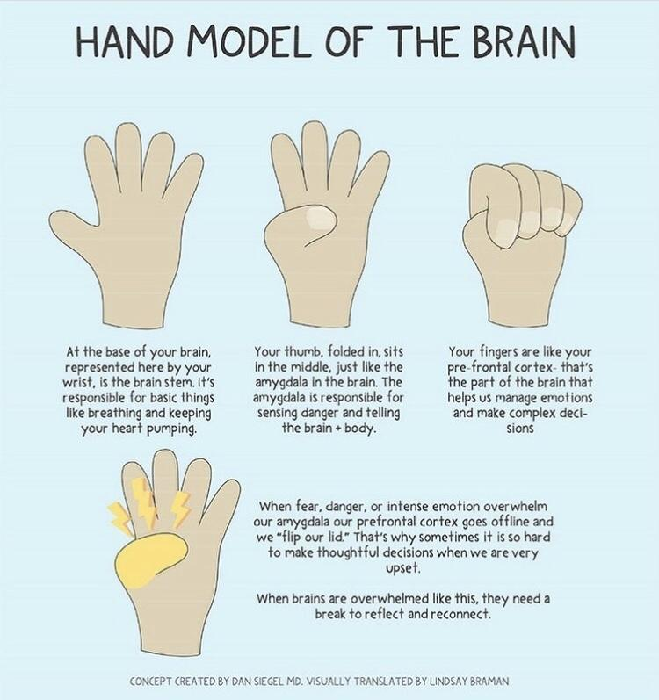
A Reminder of What Happens When we Move up the Crisis Cycle
Notes:
1:48
Let’s remember what happens when we move up the crisis cycle
Decrease in problem solving, communication skills, emotional regulation, decision making,
Increase in emotional instability: panic, sorrow, anxiety, irritability, anger, frustration, shame
Increase in impulsivity with regards to language or actions: lack of self-control, aggression, word surge

Slide 83
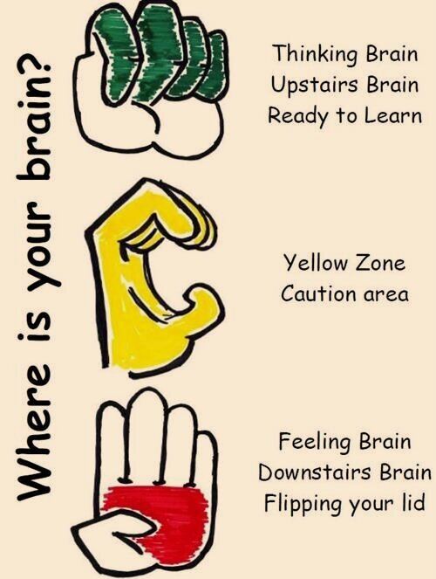
Where is your brain?
Notes:
1:49

Slide 84

Connection before Correction
Talk privately with the student
Use encouraging words
Show empathy/understanding
Notes:
1:49 - 1:50
Letting a student know that you see them, and recognize they are upset will sometimes allow the student to take a deep breath and deescalate somewhat.

Slide 85
Validation
In the moment,
Don’t try to fix it.
Don’t give a life lesson or lecture.
Try using Validating Statements:
What can I help you with?
What do you need to feel safer?
I hear you, that sounds hard.
How did that make you feel?
It sounds like you are really struggling.
Notes:
1:50-1:51
Reminder of body language and relationships

Slide 86
Practice Activity: Validation
Let’s brainstorm!
What would you say to Maya? How could Maya’s behaviors been avoided if we had addressed the situation ahead of time? Or, when we noticed a trigger response?
Notes:
1:51 - 2:00
A reminder that these can apply to students, colleagues, families
Give feedback on tone- reminder of body language

Slide 87
Calming Strategies
Calming Strategies
Take 10 Deep Breaths
Count to 20 Slowly
Doodle or Draw
Do Some Stretches
Do 10 Jumping Jacks
Give Yourself a Hug
Drink Water and Have A Snack
Imagine a Safe and Happy Place
Listen to Music
Notes:
2:00
How can your class come up with calming strategies? How do we teach them ahead of time so when they are needed they are automatic?

Slide 88

Find Your Focus
Notes:
2:15 - 2:17
1:10 minutes
How can you use videos like this in the classroom?
Link: https://www.youtube.com/watch?v=IReEu2kI6oI

Slide 89
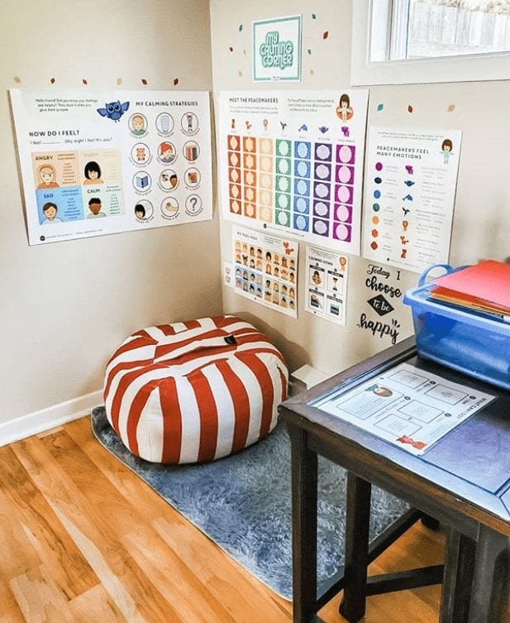
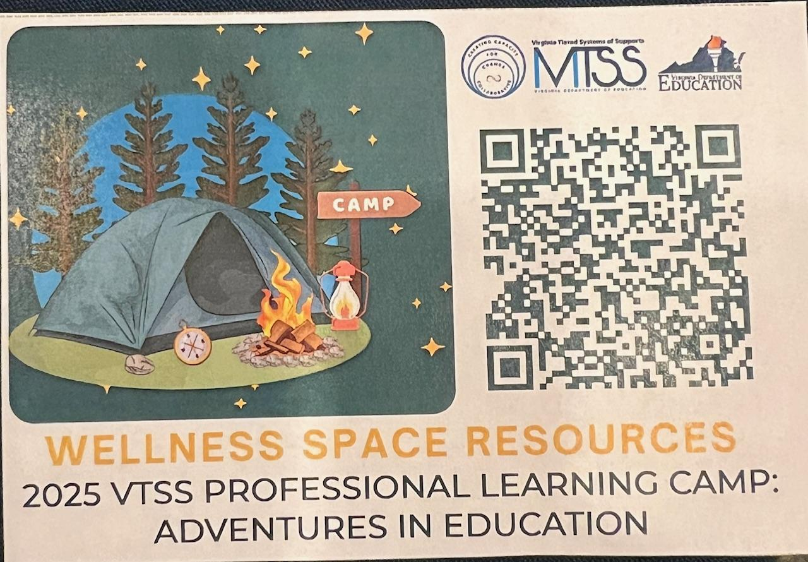
Calm Kits & Spaces
Notes:
2:17 -2:18
Making sure we review when and how to use--guided expectations, and not a punishment.

Slide 90
Peak Phase
This is the point where you just let things run its course and keep everyone as safe as you can.
The risk of harm is the greatest at this phase.
Safety is priority.
Notes:
2:19

Slide 91
What do I do to During Crisis/Peak Phase?
Goal: Ensure Everyone's Safety
Interact as little as is necessary to ensure safety
Provide physical space
Limit talking (to student and other staff)
Be aware and plan ahead
Notes:
2:20
How does your school/division respond? What support staff is available? This needs to be a community response and plan.

Slide 92
Scenario
Tyler is a 7th grade boy. This morning, when he arrived at school, his teacher asked him for his homework and Tyler did not have it. She expressed frustration and told him he had lunch detention as a consequence. Less than 5 minutes later, the student that sits behind Tyler accidentally bumped him. Tyler reacted by kicking the student. His teacher, shouted at Tyler to stop. He then began pushing his materials off of his desk, yelling at his peers to leave him alone and then sat in the back of the room on the floor. After 10 minutes of trying to get Tyler to stand up and go back to his desk, the principal showed up, walked Tyler to the office and suspended him for 5 days for fighting and disruptive behavior.
Groups of 3 Activity
Notes:
2:20 - 2:25
https://www.youtube.com/watch?v=x4JDQO7DjzE
Hand in the air, get in threes, read scenario, and answer questions

Slide 93
Peak Phase - Small Group Discussion
Discuss with your group:
How did the teacher play a part in further escalating the situation?
What could have been done at the very beginning to change how this situation played out?
What other changes could have been made?
Notes:
2:25 - 2:30
Discuss with your group:
What could have been done at the very beginning to change how this situation played out?
What other changes could have been made?
Where did the teacher react when they should have responded?
Did the teacher play a part in further escalating the situation?

Slide 94
Peak Phase - Independent Reflection
How do you feel after a major emotional escalation?
How do your students act after a peak crisis escalation?
Notes:
2:30 - 2:35
Start with a discussion of what it looks like

Slide 95
De-escalation & Stabilization
Physical and/or emotional discomfort is still present.
While muscle tension and breathing are decreasing, this phase is similar to the escalation phase.
Notes:
2:35

Slide 96

During the De-escalation and Recovery
During the De-escalation and Recovery
Student behavior can look like…
Reconciliation
Withdrawal
Denial
Blaming others
Increased responsiveness to directions
Avoidance of discussion
Confusion
Preference for busy work
Subdued
Avoidance of debriefing
May show signs of lethargy and fatigue
Notes:
2:36

Slide 97
De-escalation & Stabilization Strategies
Goal: Avoid Re-escalation
Assign low level independent task
Avoid blaming
Provide Structured Choice
Provide Differential Reinforcement
Notes:
2:37

Slide 98
Post Crisis Drain/ Recovery Phase
May experience a drop below baseline, appearing withdrawn or depressed.
May require rest due to emotional or physical drain.
Notes:
2:38

Slide 99
Post Crisis Drain/Recovery Strategies
Goal: Support and Observe
Positively reinforce any display of appropriate behavior
Focus intervention on re-establishing routine activities
Debrief (after student has been calm at least 20 minutes)
Not an aversive consequence
No more than 3-5 minutes
Notes:
2:39
Spiral back to graphs and emphasize importance of adequate recovery time.

Slide 100
Debriefing Problem Solving Example
What happened?
What role did I play?
Who was affected by my behavior?
What can I do to make amends?
What can I do differently in the future?
Can I do it when I begin to become upset?
Notes:
2:40

Slide 101
Debriefing Plan
Purpose of debrief is to facilitate transition back to instruction and to effectively problem solve, not further negative consequence
Identify the sequence of events
Pinpoint decision making moments during the sequence of events
Evaluate the decisions
Identify acceptable decision options for future situations
Notes:
2:41
These are the components of a debriefing plan
Mention Focus and Recovery: benefit of have a system in place for the debriefing process that ensures consistency and fidelity

Slide 102
Post Crisis

Slide 103
What Do I Do Post Crisis?
Goal: Plan for Support and Skill Building
Meet with teachers/staff and collaborate to identify
Triggers
Function
Proactively plan response for future occurrences
Reach out to family
Notes:
2:42

Slide 104
Life Happens
“It is always important to remember that if you inadvertently assist the student to escalate, do not be concerned; you will get another chance to do it right the next time around.”
(Colvin, 1989)
Notes:
2:43

Slide 105
Staff Reflection
What triggered the behavior?
What was the function of the behavior?
What strategies worked? Didn’t work?
What skills/replacement behaviors does the student need to learn that align with the function?
How can they be taught?
Are there environmental changes we can make to set the student up for success?
How can we involve the family?
Notes:
2:44

Slide 106

Post Crisis - Small Group Discussion
What is your current process for supporting the student(s) and staff post crisis?
Are there any adjustments that need to be made to that process?
Notes:
2:45 - 3:00

Slide 107

Putting It All Together

Slide 108
Post Crisis - Independent Reflection
Reflect on your personal scenario.
What have we covered over the past two days that would have shifted the outcome?
What might you try next time?
How can you use this information to adjust school-wide practices and build capacity?
Notes:
3:00 - 3:05

Slide 109



Large Group Wrap-Up
      1. Setting Ourselves up for Success
      2. Setting Our Classrooms up for Success
      3. Setting our Students up for Success
Notes:
3:05 - 3:
Anna
Think of a our three agenda items over the last two days. Where was your focus? How did you answer the reflection questions?
Run out of time use this one: We are going to get into groups of 3 and share our next steps AND network! What do you have that you can share, and take those names/emails with you! I’ll either play music, find 3 people, and then stop the music. You hear the music again, and you switch. One thing that you are doing well. After two rounds; stay where you are, and let’s dance it out!
If we have time: we will have these outcomes on post it paper and folks will go to a respective outcome to share ideas, goals, and next steps. Have them up there twice for space.
Divisions, at your table, count off by 1, 2, 3
Head to the designated Learning Outcome of 1, 2, 3, (point to them)
Spend 10 minutes discussing and networking your next steps and ideas from your two days together, workbook and notes, and record them on the post it paper.
We will have a 2 minute share out per sheet --all share will share so have a recorder, just your top few ideas
Take you notes, workbook, computer as needed.

Slide 110
Resources
Defusing Disruptive Behavior Workbook
Take Care of Me List
I’m Determined Good Day Plan
Classroom Management: Revised Self Assessment
VTSS Top Ten
VTSS 10 One pagers (VTSS Resource Hub)
Classroom Environment Checklist
Trigger Worksheet
The Escalation Cycle Handout
Internalizing Behaviors Google Folders
Trauma Learning Modules
Mental Wellness Space Resources

Slide 111
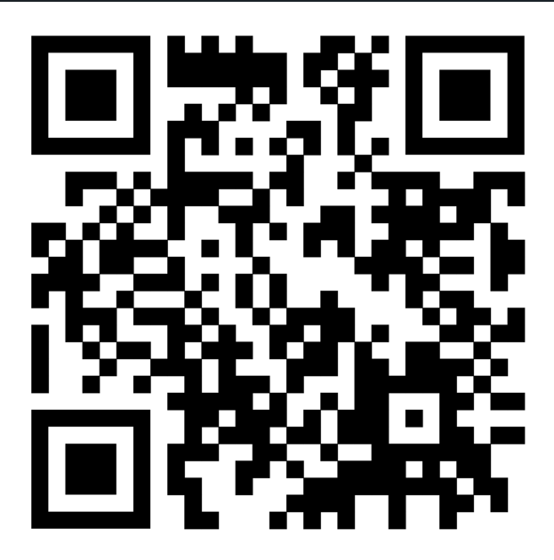
We love feedback!!
Please complete the evaluation for us. We appreciate the feedback.
ODU Evaluation Survey

