Slide 1
VTSS Tier I New Team Professional Learning
Data-Informed Decision Making 1.12 - 1.15

Slide 2
Housekeeping

Slide 3
Community Norms
Be Responsible | Take care of your needs. Share your questions with the group.
Be Respectful | Turn volume/sound off on cell phones. Listen to others attentively. Follow up and complete assigned tasks.
Be Engaged | Ask what you need to know to understand and contribute. Share your expertise, information and ideas.

Slide 4
Professional Learning Roadmap
Our Focus: Evaluation Subscale
Workbook Pages 3-7

Slide 5
Learning Intentions
Participants will:
Recognize the critical elements of an integrated and aligned data system that allows “real time” access to data necessary for decision making (1.12)
Analyze current systems for data collection and identify the opportunities for enhancing the school-wide system for aggregating data to inform instructional decisions. (1.12)

Slide 6
Learning Intentions Cont.
Participants will:
Understand the importance of analyzing fidelity, root causes, and outcome data to evaluate implementation progress (1.14/1.15)
Select routines for examining these data to inform practices that result in equitable outcomes for ALL students. (1.12/1.13 DIDM)

Slide 7
Learning Intentions Cont..
Participants will:
Reflect on the current data informed decision making process in order to identify successes and opportunities for a more efficient and effective system for continuous learning and improvement that is utilized division wide. (1.13)

Slide 8
The Big Picture!
Orienting Ourselves to Core Instruction

Slide 9
Build a Culture of Data Literacy
What do we mean by data literacy, OR to develop a data culture?

Slide 10
Data Literacy or a Culture of Data
Exploration: Data Exploration
Installation: Data Management
Implementation: Data Use
Sustainability: Continuous Improvement
Purpose and vision
What do we need to know about instruction?
What do we want to know about climate and culture?
Who are impacted stakeholders?
We are starting HERE today!
Data definitions
Data selection
Data collection and access
Data submission
Data fidelity
Data management systems and storage
TFI 1.12 and A-TFI 1.12
Data analysis
A process for data informed decision making
Data sharing and reporting
TFI 1.13 and A-TFI 1.13
Does the data show that instruction had improved?
Has climate improved?
Is instruction improving?

Slide 11
Data Culture
Teams study data at the school-wide level
Define specific problems
Leverage evidence-based practices as solutions to problems
Focus on systems change
And when we have it and are fluent, it looks like this!!

Slide 12
Academic –Behavior Relationships
Academic → Behavior
Effective Instruction that is matched to need engages students, and is central to reduction in problem behavior
Behavior → Academic
Effective Classroom Management and Behavior Instruction improves student engagement and is central to increased academic success.
Nature of analysis questions are about what the
adults are doing or not doing.

Slide 13
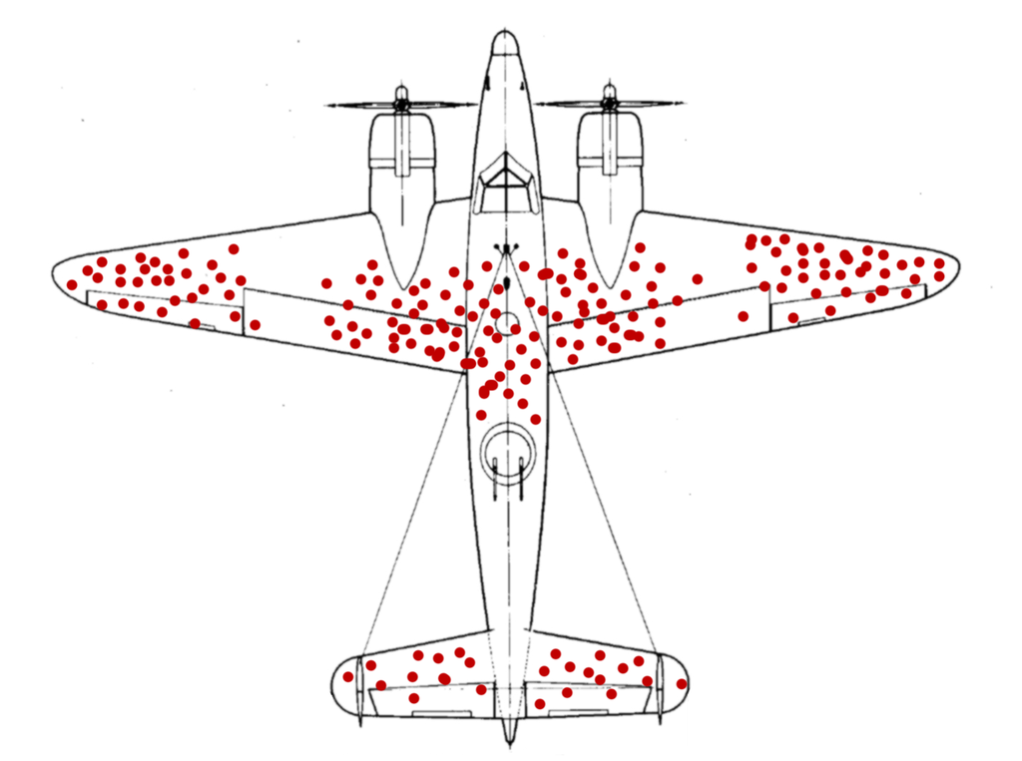
Analyzing data...Finding Solutions

Slide 14
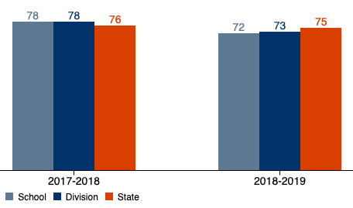
Example: Reading
Largest Gap Groups Identified
Economically Disadvantaged
Students with Disabilities

Slide 15
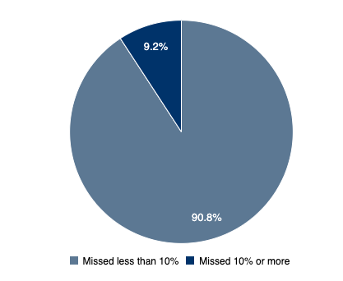
Example: Chronically Absent
All Students:
9.2% Chronically Absent

Slide 16
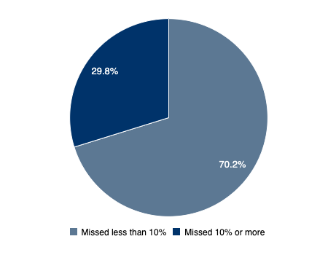
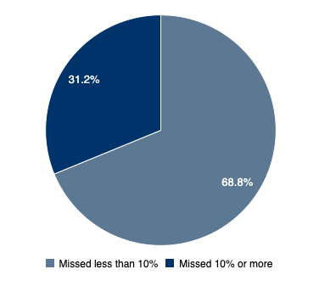
Example: Gap Groups
Economically Disadvange
29.8 Chronically Absent
Economically Disadvantaged:
29.8 Chronically Absent
Students with Disabilities:
31.2 Chronically Absent

Slide 17
Example: ODR’s

Slide 18
And the moral of the story (example) is...
Knowing your context, there are still many data points to consider, i.e. benchmark scores, suspensions, etc.
Had we looked at literacy in isolation, we may have jumped straight to solution without fully examining the problem.
Schools that know how to do this well have built a culture of inquiry and data literacy
Our problem-solving process can’t look at academics without behavior and other factors.

Slide 19
Wait! What?
Nature of analysis questions are about what the
adults are doing or not doing.

Slide 20
A Culture of Inquiry
If we implement data-informed decision-making well, it can become a tool for professional learning.
In the right conditions, data analysis and problem-solving should stimulate curiosity, questions, dialogue, investigation, LEARNING, and CHANGE (among adults).
Notes:
:

Slide 21
How Does the Team Make This Shift?
Problem solving teams already…
And can function like learning communities if they also…
Use evidence to clearly define problems
Collaborate to study impact and effectiveness of instruction
Hypothesize why things happen as they do
Brainstorm possible solutions and define success
Monitor students
Align their problem-solving to school-wide goals for student (and teacher) learning
Have the autonomy to pose questions and prioritize the learning challenges that matter most to them
Collaborate with stakeholders to brainstorm and define points of fidelity and flexibility
Reflect on permanent changes to practice

Slide 22
School Data Culture
As you discuss what is “going on” in your building, how often is data the basis for the conversation?
How do those conversations look and feel?
Which of these pictures of a tree best describes your schools current data process and feelings about data usage?

Slide 23
What teams are doing the work?
Have your teams completed the Working Smarter (Not harder) activity? (Workbook Pages 14-16)
Outline which teams look at which data?
Core teams, department teams, leadership, school improvement, PBIS.
Workbook Pages 9-12

Slide 24
Exploring Identity
Teacher
Parent
Student
Anyone else?
Administrator
Staff
Counselor

Slide 25
VTSS - Tier 1 New Team Professional Learning
TFI 1.12 Core Data

Slide 26
Data Subscale: Evaluation
Feature | Possible Data Sources | Scoring Criteria
1.12 Discipline Data: Tier I team has instantaneous access to graphed reports summarizing discipline data organized by the frequency of problem behavior events by behavior, location, time of day, and by individual student. | School policy Team meeting minutes Student outcome data | 0 = No centralized data system with ongoing decision making exists 1 = Data system exists but does not allow instantaneous access to full set of graphed reports 2 = Discipline data system exists that allows instantaneous access to graphs of frequency of problem behavior events by behavior, location, time of day, and student.

Slide 27
Data: Academic TFI
Subscale Evaluation
1.12a Data Alignment Team(s) have access to a consistent and integrated data dashboard (e.g. attendance, academics, behavior, emotional wellness) that allows for disaggregation by demographics and skills for Tier 1 instructional effectiveness. | School data dashboard Team meeting agendas and meeting notes Quarterly data reports | 0 = No integrated dashboard. 1 = Dashboard available and meets feature criteria for either disaggregation capability or integrated to reflect all aspects of the student profile. 2 = Integrated dashboard with disaggregation capabilities exists.
1.12b Universal Screening Schoolwide universal screening for all students is conducted for literacy and mathematics. Secondary: Early warning system utilized for screening. | Universal screening tool Early warning system data Team meeting agendas and meeting notes | 0 = No universal screening. 1 = Universal screening is conducted with some students but not all students or in either literacy or mathematics but not both. 2 = Universal screening exists for all students in literacy and mathematics.

Slide 28
Success Criteria
Success today is measured by:
our ability to name the critical components of an effective and efficient data dashboard
the determination of a risk ratio based on a data set
a written draft or revision of an integrated data dashboard to bring back for school wide discussion. We will have at least identified the critical data points for collection.
written steps in our action plan that are necessary to establish and utilize a data dashboard and data collection process

Slide 29
Establishing Common Understanding
Data come in many forms such as office referrals, attendance records, grades, surveys, fidelity measures, universal screening results as well as classroom or other school assessments
Data must be disaggregated to reflect the divisions priorities (i.e. SWDs, AA males, etc. break down attendance if chronic absenteeism is a concern)
Data must be documented, and shared to be most effective in action planning.

Slide 30
Efficient and Effective
Decisions are more likely to be effective and efficient when they are based on data.

Slide 31
Do We Have an Effective Efficient Data System?
(Effective) Are we collecting the right information? What, where, when, who (why?)
(Efficiency) Is data collection easy to enter and easy to extract?
Do we get data in the right format (Efficiency) ?
Graphic format

Slide 32
Do We Have an Efficient Data System?
Do we get the data at the right time (Efficiency) ?
Before and during meetings
Data no more than 24 hours old where applicable
Are data used for decision-making by all (Effective)?
Data presented to all faculty at least monthly
Data available for whole school, small group and individual student evaluation
Data collected on FIDELITY (what we do) as well as IMPACT (student behavior)

Slide 33
Action Planning
What do we need to do to have an effective and efficient data system?
Workbook Page 9-12

Slide 34
Got Data
What data are you collecting?
Stop and Jot
Workbook Pages 17-19

Slide 35
Got data? Examples 1
Behavior
Academic
ODR’s
Suspension/Expulsion
Attendance
Nursing/Counselor visits
Minor incident reports
At risk factors
Fidelity (TFI) data
Universal screening data
Benchmark data
Common formative assessments (classroom performance)
Progress monitoring data
Historical SOL results
Early Warning Systems
Workbook Page 19

Slide 36
Got data? Examples 2
Equity
Mental Wellness
Disaggregated Behavior and Academic Data
Graduation rates and types of diplomas (standard vs advanced) for different groups
Enrollment in Honors and AP classes
Community Data: poverty, unemployment, incarceration, etc.
School Climate and Safety
Nurse/Counselor visits
Student Engagement
Community Data: statistics on prevalence of mental illnesses in the U.S. or your community, trends in the use of mental health services
Workbook Page 19

Slide 37
Got data? Examples 3
Attendance
Climate
Average daily attendance? (ADA)
Truancy
Chronic absence
Suspension
Expulsion
Absences due to health
*includes tardy, excused, unexcused
Student/Parent/Staff Climate surveys or focus groups
Harassment/bullying
Hot spots (Environment)
Physical aggression/fighting
Attendance (staff and student)
Workbook Page 19

Slide 38
Chronic Absences: Key Indicator for Driving Strategic Decisions
Excused Absences
Chronic Absence
Unexcused absences
Suspensions

Slide 39
Your School
Go to schoolquality.virgina.gov
Type in your school or division name to find your school.
Explore your school’s data using the worksheet provided.
Workbook Page 20

Slide 40
Additional Key Data Critical in Our Analysis
Think about:
If there are critical aspects for postsecondary success, wouldn’t we want to be sure they are on our dashboard?
Do you consider student voice?
Is disproportionality an issue?
How are you using universal screening data and is it on your dashboard?
Workbook Pages 21-30

Slide 41
Student Voice
How do you know if students feel:
- Safe
- Happy
- Motivated
- Supported
How could you collect data that informs your knowledge?

Slide 42
Calculating Dispro:
The Why
1.Disproportionality represents one of the most significant problems in education today (Gregory, Skiba, & Noguera, 2010; U.S. Government Accountability Office, 2013).
2. Disproportionality in exclusionary discipline blocks us from the overall objective of promoting positive outcomes for all students.
3. You can examine dispro to promote equity in many areas: academics, students enrolled in AP classes, chronic absenteeism, discipline, etc.

Slide 43
Calculating Dispro:
The What
Typically calculated as a risk ratio
Risk ratios represent the likelihood of the outcome (e.g., ODRs) for one group in relation to a comparison group.
Frequently used for interpretation:
1.0 - 1.9 = low risk
2.0 - 2.9 = moderate
3.0 and above = significant

Slide 44
Calculating Dispro:
The How
Let’s Calculate!!
Make sure one team member has the worksheet, and the other team members pull up the Attendance section on the School Quality Profiles.

Slide 45
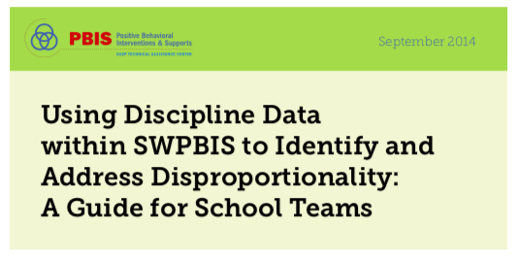
Calculating Dispro:
Resources
Voicethread:https://voicethread.com/myvoice/thread/13064397/78844938/73313522
Workbook pages:31-35

Slide 46
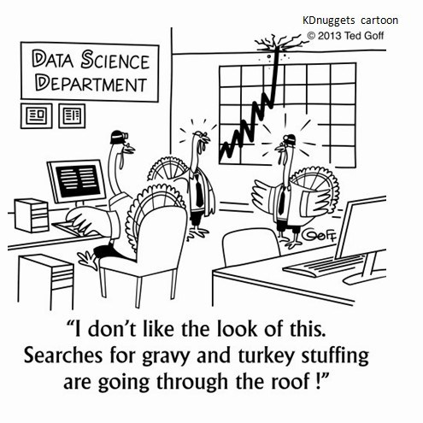
The Data Science Department

Slide 47
Why universal screening?
Division
School
Is the core instruction sufficient and is it improving?
For which groups (gaps, schools, grade levels) is it working/not working?
What is the efficacy of the tiered interventions?
Is the core instruction sufficient and is it improving?
For which groups (gaps, grade levels, classrooms) is it working/not working?
What is the efficacy of the tiered interventions?
What is the individual growth of our students?

Slide 48
Know the indicators of a good screener
1. Is brief
2. Is predictive
3. Is reliable
4. Provides an awareness of false positives
5. Provides normative data
6. Can be disaggregated

Slide 49
Examples and non-examples
Screening Tools
Not Screening Tools
DIBELS
Oral Reading Fluency
Easy CBM
STAR
MAP
AIMSweb
FastBridge
DESSA
SAEBRS
Quick Phonics Screener
QRI-IV
DRA2
Running Records
Report Cards
Meeting SOL standards
Core curriculum weekly tests on skills that are learned

Slide 50
Let’s talk about high school
The concept of universal screening most typically applies to an early warning system.
There are a lot of data available.
Have the pertinent data been assembled in an accessible format?
Once a group of students who may be at risk have been identified, more information may be needed.
What do we know about students who are new to school?

Slide 51
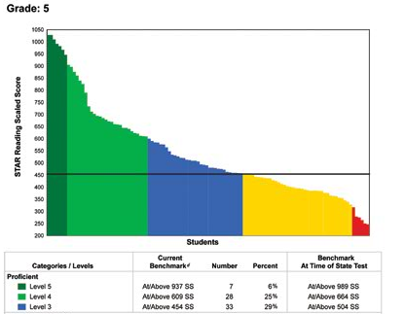
Examples: School Level
Workbook Page 36

Slide 52
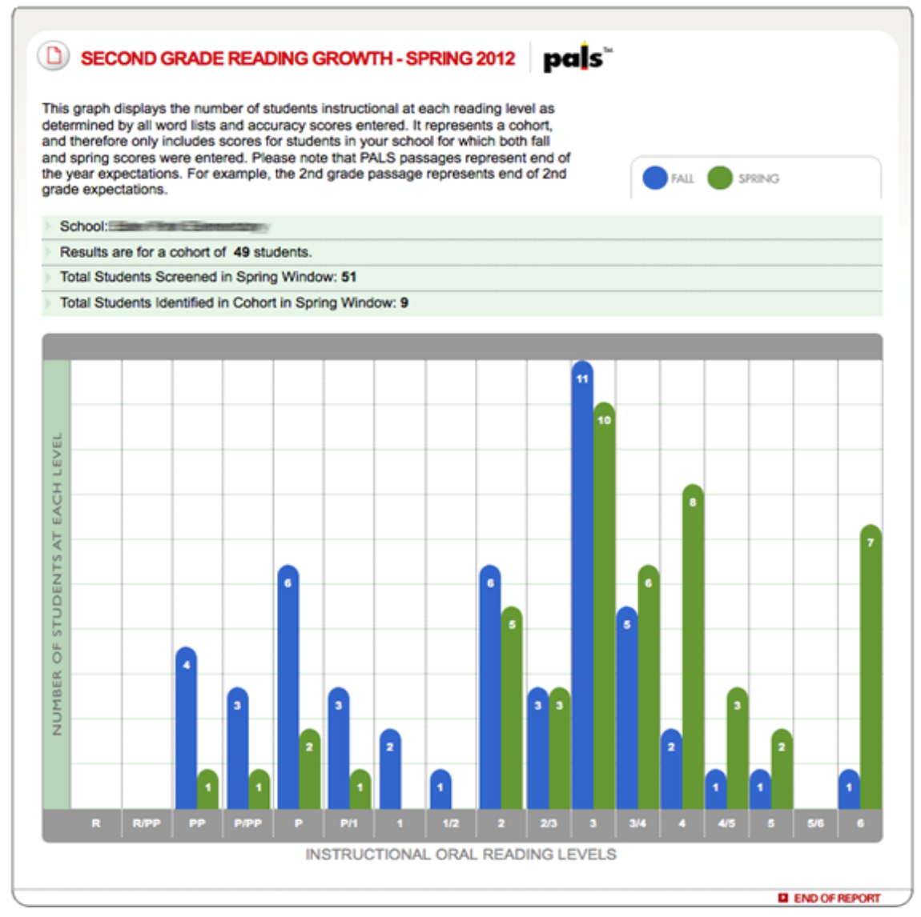
Example: Grade Level
Workbook Page 37

Slide 53
Universal Data
C | D | E | F
School | 0-1 ODRs % | 2-5 ODRs % | 6+ ODRs %
Wonderful Elementary
Grade 1 | 98% | 2% | 0%
Grade 2 | 99% | 1% | 0%
Grade 3 | 65% | 22% | 13%
Grade 4 | 82% | 15% | 3%
Grade 5 | 86% | 10% | 4%
Work Page 37

Slide 54
Moving to the Dashboard
Activity
The next slides are dashboard examples.
You have these in your workbook on pages 38-41.
Keep in mind, the dashboard matches your assessments and context.
Talk with your team about what you notice and jot down for action planning any ideas these examples might trigger.
Workbook Pages 38-41

Slide 55
Elementary Dashboard Example
Reading | Math | Attendance | Behavior | Wellness
Prior SOL Universal Screener 3X PALS 3X Reading level Formative assessment (i.e. common benchmark | Prior SOL Universal Screener 3X Curriculum assessment Formative assessment (i.e. common benchmark | Days Absent | ODR | Screener

Slide 56
Middle School Dashboard Based On Subject
Utilizing the dashboard, the math specialists work with the Tier 1 Team for lesson design based on the data.
The Tier 1 Team is able to match the behavior data and the reading data on separate tabs of the Excel sheet.

Slide 57
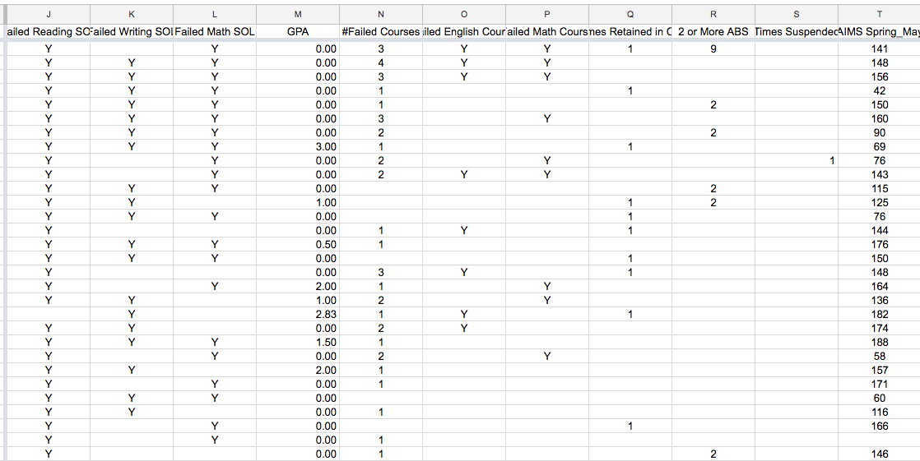
High School Criteria for Tier 1 Determine Percentage

Slide 58
Blue Ribbon High School Data Dashboard
What Criteria?
Grades and GPA
SOL
Absences
Tardies
Court Ordered
Discipline Count
Expulsion
Anticipated Diploma
Verified Credits( aggregated by English and Math, etc.)

Slide 59
Common Challenges
There is so much data…what do we look at and when?
We input and collect a lot of data; it’s hard to organize it and share it for analysis.
Our data doesn’t seem to tell us what we need to know.
Different personnel study different data – who’s getting the big picture?
TIME! Is a tough barrier to collecting and organizing data.

Slide 60
Consider the Research
Activity:
Look over the pages in your workbook on risk indicators. Talk with your team about how these data sets will impact a data dashboard.
Workbook Pages 24-25

Slide 61
Let’s Practice
Think about your data dashboard. We have a sheet on our table to help guide you.
If you have a data dashboard:
What does it look like?
Did your division IT department provide assistance, if so, how?
What data do you have?
What is missing?
Do you have too much data?
Who fills it in?
How are you reporting it?
If you don’t have a data dashboard:
What would you like it to look like?
Do you have any internal resources that can support you in creating a data dashboard?
What data do you have?
What data is missing?
Workbook Page 42

Slide 62
Action Planning
What are your written steps on your action plan that are necessary to establish and utilize a data dashboard and data collection process?
Workbook Pages 9-12

Slide 63
Success!
Can we name the critical components of an effective and efficient data dashboard?
Do we have a written draft or revision of an integrated data dashboard to bring back for school wide discussion? Have we at least identified the critical data points for collection?
Do we have written steps in our action plan that will help us establish and utilize a data dashboard and data collection process?

Slide 64
VTSS - Tier 1 New Team Professional Learning
TFI 1.13 Data-Informed Decision Making

Slide 65
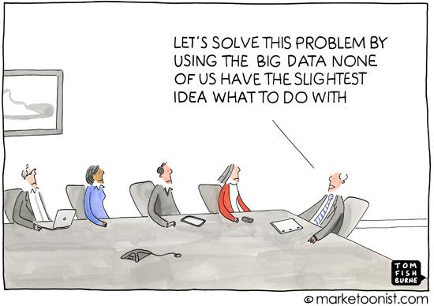
You Might Recognize the Following

Slide 66
Data-based Decision Making
1.13 Data-based Decision Making: Tier I team reviews and uses discipline data and academic outcome data (e.g. Curriculum-Based Measures, state tests) at least monthly for decision-making. | Data decision rules Staff professional development calendar Staff handbook Team meeting minutes | 0 = No process/protocol exists, or data are reviewed but not used 1 = Data reviewed and used for decision-making, but less than monthly 2 = Team reviews discipline data and uses data for decision-making at least monthly. If data indicate an academic or behavior problem, an action plan is developed to enhance or modify Tier I supports

Slide 67
Academic TFI: Data-based Decision Making
1.13 Data-Informed Decision Making The team has adopted and utilizes a schoolwide problem solving process inclusive of data, systems, and practices. | Schoolwide problem solving process template Team meeting notes Professional learning plan | 0 = Uniform schoolwide problem solving process not adopted. 1 = Adequate schoolwide problem solving process adopted but not utilized consistently. 2 = Schoolwide problem solving process adopted and used consistently with data, systems, and practices.

Slide 68
Success Criteria
Success today is measured by:
the completion of a draft of an agenda that has question prompts for discussion of relevant data and includes timelines of these discussions
our completion of a practice example of the data informed decision making process on the VTSS template using our own data for comparison to our own process

Slide 69
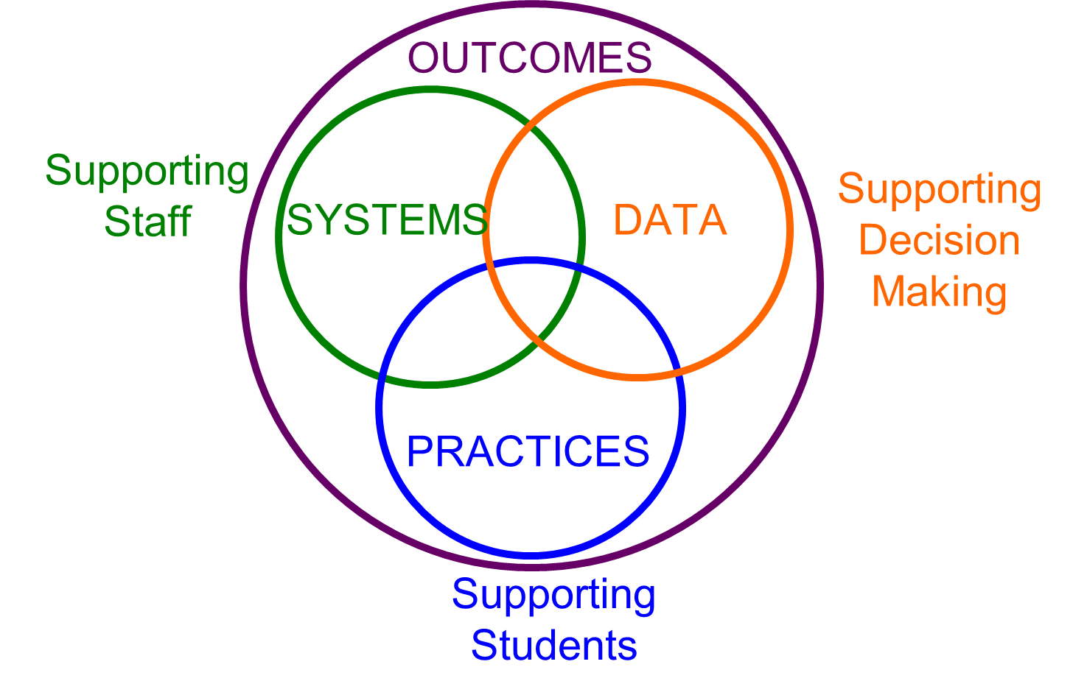
Implementation Logic

Slide 70
Data Informed Decision Making
HOW WE DECIDE WHAT INSTRUCTION OR SUPPORTS TO GIVE STUDENTS (Tiers)
Continuum of Instruction & Intervention (Tiers)
Data-based Problem Solving Process
HOW STUDENTS RESPOND TO OUR INSTRUCTION AND RELATED SUPPORTS (Data)

Slide 71
Implementation Logic

Slide 72
Problem Solving
“If I had an hour to solve a problem I’d spend 55 minutes thinking about the problem and 5 minutes thinking about solutions.”
Albert Einstein

Slide 73
What Teams?
Tier I Team
(plans SW and Class-wide supports
Grade Level Team
Content Level Team

Slide 74
These Teams Ask...
How healthy is our core instruction for ALL students?
We taught it...did ALL students get it? Who did? Who didn't? If not, why not?

Slide 75
Essential Elements of Effective Teams
Team foundations (roles, schedules, agenda)
Team works to clarify problems and define them with precision - solution focused
Teams should define goals prior to designing solutions
Teams should transform solutions into actionable plans
Teams should regularly monitor fidelity
Teams should adapt solutions based on data

Slide 76
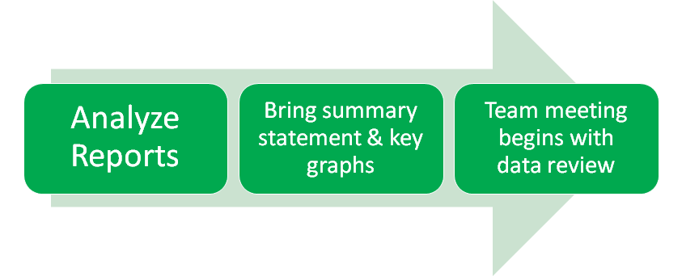
What is a Data Analyst?

Slide 77
The Role of the Data Analyst
Workbook Page 43

Slide 78
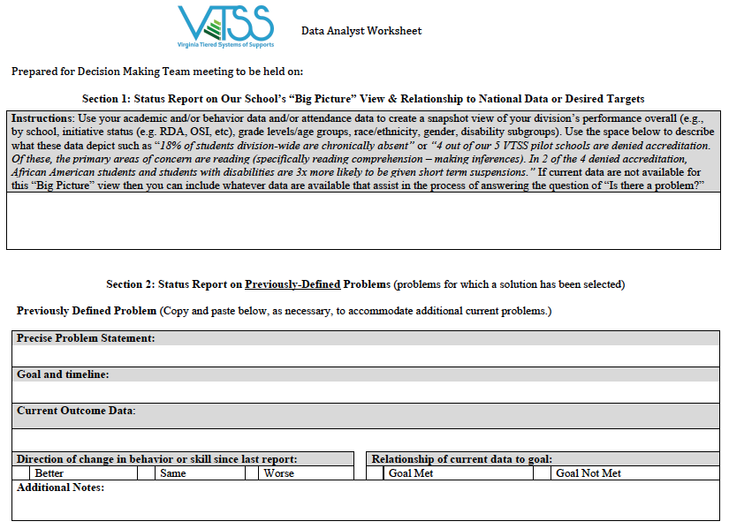
Data Analyst Worksheet
Workbook Pages 44-45

Slide 79
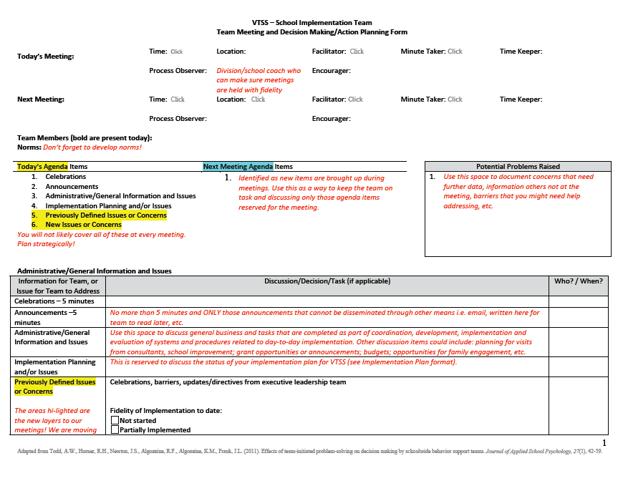
Efficient Agenda
Workbook Pages 48-49

Slide 80
Examples of Team Agendas
You have in your workbook some examples (elementary and secondary) of ways to have a process, or routine and procedure, when you analyze data.
Review pages 51-59 with your team and decide if your data meetings would benefit from putting a more clearly defined system in place.

Slide 81
Why is it happening? (Elementary)
Refer to Worksheet
Workbook Pages 51-54

Slide 82
Why is it happening? (Secondary)
Refer to Worksheet
Workbook Pages 55-58

Slide 83
Progress Monitoring
Refer to Worksheet

Slide 84
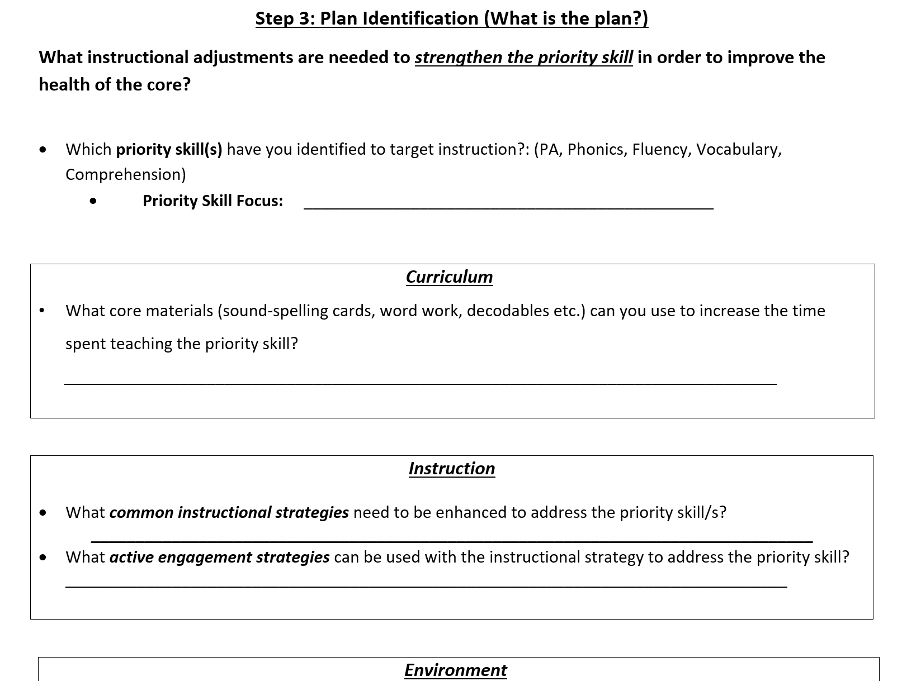
Instructional Adjustments (Secondary)
Refer to Worksheet

Slide 85
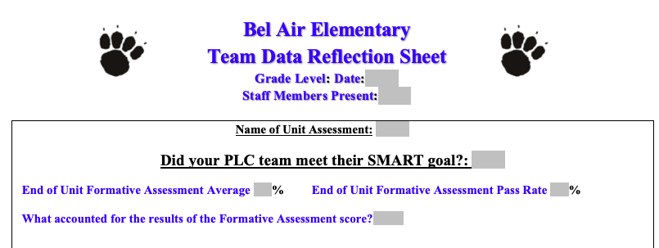
One More Process Example
Refer to Worksheet
Workbook Page 59

Slide 86
Where Do we Start?
Data-Driven Decision Making: School
DATA/Evidence of Need: Here we answer the question .. Is there a problem? | DATA You can: Attach data analyst worksheet Attach charts, graphs, reports Electronically link to charts, graphs, reports in a shared folder for meeting minutes

Slide 87
Efficient Process
Refer to Worksheet
Workbook Page 13

Slide 88
Your Data Story
Box 1
Workbook Page 13 and on your tables

Slide 89
Wrap-Up
Stop - I am totally confused (please write your division name so we can provide coaching support)
Go - I am ready to move on
Proceed with Caution - I could use some clarification on...

Slide 90
Success!
Do we have written steps in our action plan that will help us establish effective teams processes?
Do we have a clear picture of our data story and needs?
Notes:
Rick: 95-111
Intent: Review
Trainer Talking Points:
Training Activities:
You can do a stand up/sit down...or have them use yes/no cards...etc.

Slide 91
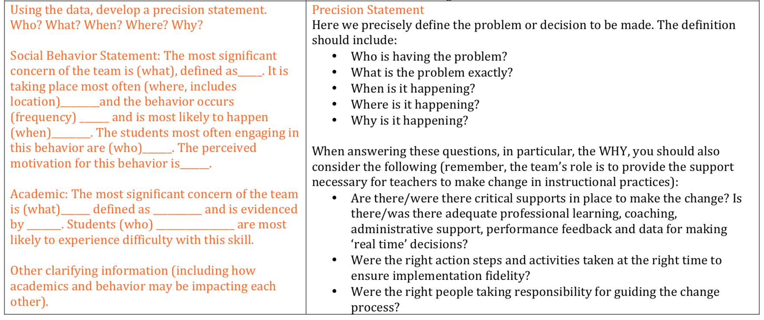
Identify Problem with Precision
ON YOUR TABLES

Slide 92
Identifying Problems/Issue
What question to answer
Do we have a problem?
What questions to ask of level, trend, peaks
How do our data compare with last year?
How do our data compare with national/regional norms?
How do our data compare with our preferred/expected status?
If a problem is identified, then ask
Do we need any additional data to make a good decision?
Have we considered root causes and “bigger” issues (i.e. Mental Wellness, Poverty, Race/Ethnicity, specific groups of students)?

Slide 93
Ask the RIGHT Questions!
Academic
Behavior
SAME QUESTIONS!
What is the problem?
Are school wide learning supports appropriately matched to student needs? (Why?)
Are resources and assistance provided to educators for implementation fidelity? (Why?)
Is the problem in one or more subject area, grade, classroom and/or sub-group? (Who? Where?)
For each area identified, do we have enough information to make some curricular or instructional decisions? (Where?)
Is there a need for strategic differentiation of core? (When?)
Is there a small group of students that need to be referred to advanced tiers for further inquiry? (Who?)
Are accommodations and modifications at core being implemented with fidelity and are they well matched to manifestations of the disability? (Why?)
What is the problem behavior?
How often is the problem happening?
Where is the problem happening?
Who is engaged in the behavior?
When is the problem most likely to occur?
Why is the problem sustaining?
DIFFERENT LENS!

Slide 94
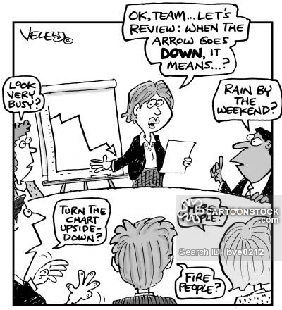
TELL THE STORY
Compare “The Story” to what is typical?
What is the mean/median?
What should we expect?
Compare “The Story” to what is possible?
What does “ideal” look like?
What are our success criteria for ALL students?
Compare “The Story” to what is needed?
What is the goal?
What is the standard?

Slide 95
Don’t forget WHY?
Ecological Factors
(Comprehensive Inclusion of Hypotheses)
Ecological Factor | Examples
School Climate | Collaborative decision making; order & discipline; parent involvement; staff dedication to student learning (e.g., beliefs); physical structure; established procedural routines; recognition for positive behavior; school pride & student involvement, continuous improvement culture, etc.
Relationships | Teacher-student relationships – expectations; mentoring, encouragement Family-child relationships – parenting style & involvement in child’s education Peer relationships – interpersonal skill development; support group network Each – opportunities for positive or negative social reinforcement
Instruction | Instructional planning, management, delivery, and evaluation practices; opportunities for feedback (positive or negative reinforcement; extinction; DRO, etc.); hierarchy of skills focus
Curriculum | Match of content with student skills and culture; opportunities for deep vs. surface learning. Alignment with education standards for promotion/graduation
Instructional Environment | Classroom management and arrangement; predictable classroom routines; home-school collaboration & congruence of performance expectations; enriched and engaging activities, recognition for positive behavior/ acad performance
Learner | Skills or abilities, physical (e.g., vision impaired) and neurological factors (e.g., ADHD; TBI), developmental history, nutritional experiences, motivation (attention or escape/avoid)
School Organization | Efficiency of resource allocation to provide supports matched to needs; supports for fidelity of instruction/interventions; scheduling systems, teaming and student grouping structures, education service delivery methods (e.g., tiered system of supports)
Workbook Page 60

Slide 96
Class-wide Issues: Behavior Data Consider…
Were matrix and lessons taught with fidelity?
Were students engaged with instruction?
Does the class need strategically spaced practice and reinforcement?
Is the acknowledgement system utilized fully?
Are there any barriers to implementing PBIS core curriculum?
Are there any patterns in hypothesized functions of behaviors?
Could academic issues be contributing to behaviors?

Slide 97
Class-wide Issues: Academic Data Consider…
Is the teacher adhering to the curriculum?
Is the teacher following the pacing guide?
Is this class a homogeneous group of achievers
Did the students master the prerequisite skills
Instructional environment: Academic engaged time? Student responses accurate or provided corrective feedback?

Slide 98
Moving to Precision
The most significant concern of the team is tardiness and class disruption defined as talking out, moving around the room and “playing” with materials. This is most likely to happen in 7th grade at the beginning of a block during “bell ringers”. It is hypothesized that this is to avoid the task. Further observational data reveal that the bell ringers are typically paper pencil tasks that are at students’ frustration vs. instructional level.

Slide 99
Precision Statement Behavior
The most significant concern of the team is disruption, disrespect, and inappropriate language that is taking place most often in the cafeteria. There has been an increasing trend in these behaviors during the first 3 months of school - 17 students have 5 or more ODRS during all lunch periods (10:50 am to 12:25 pm).
We think students are engaging in this behavior to gain adult attention. It appears that students are being reinforced when staff argue back and forth the students.

Slide 100
Precision Statement Academic
The most significant concerns of the team are the academic outcomes in World History and Geography. On the last SOL 30% of all students failed. This seems to be specifically a confusion of the understanding the cause and effect of events. Of the 30% of students who failed, 25% were Hispanic males in 9th grade.
After review of teacher walkthroughs 40% of students were disengaged during whole group instruction.
Workbook Page 48

Slide 101
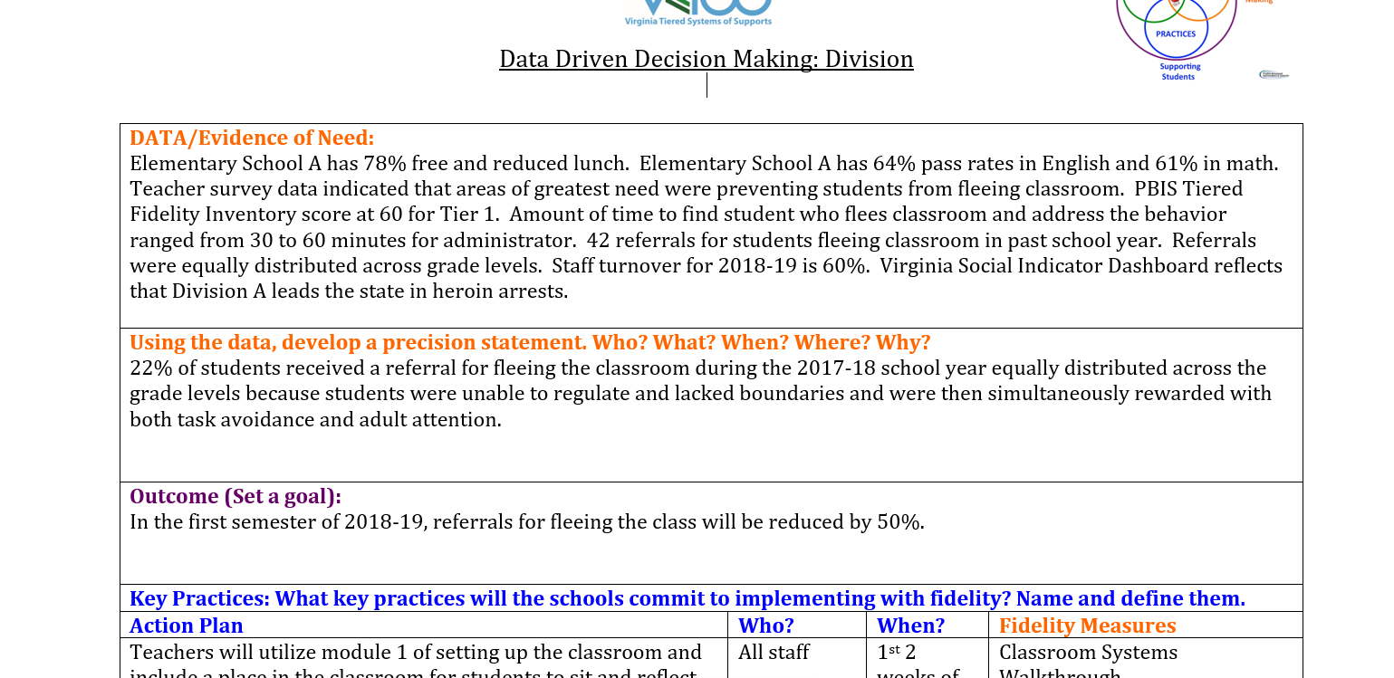
Data Informed Decision Making Example

Slide 102
Moving to Precision!
Using your data, create a precision problem statement.
Workbook Page 13

Slide 103
Identify Goal for Change
Outcome (Set a goal):
Set a goal that is achievable, time bound and has explicit criteria for success.
Outcome (Set a goal):
Is your goal SMART? (Specific, Measurable, Achievable, Realistic, and Timely)
Workbook Page 57

Slide 104
Identify a Measurable Goal
Goals allow you to analyze, monitor, and adjust professional practice.
Reduce hallway ODRs by 50% per month (currently 24 per month average) or increase 2nd grade fluency to 90% accuracy with by the winter benchmark
Specific?
Measurable?
Achievable?
Relevant?
Timely?

Slide 105
Goal
What?
By when?
Office Discipline Referrals rates for disrespect will be at or below the national median for our school size by April of this school year and will remain at or below this level for the remainder of the school year.
Referral rates for aggression on the playground will reduce to one or fewer each week (.20 per day) among 5th grade students and will stay at this level for the rest of the school year.
Reading assessment data for students in literacy intervention group performance will move from High to Low Risk status by the Winter benchmark and will be at this level or move to “No Risk” levels by the Spring benchmark.
Referrals for tardiness among ninth graders will reduce by 50% by our March meeting and will continue to decrease across the next 3 months until there are no more than 2 per month for 3 months.

Slide 106
Moving to Goal Setting!
Based on your precision statement, identify a goal.
Workbook Page 13

Slide 107
Develop Solutions for Practices
Key Practices: What key practices will the schools commit to implementing with fidelity? Name and define them. | Key Practices: First, refer to your resource maps for the specific area. Are you implementing a practice that works? Do you already have practices that work but that might just need “tweaking” for fidelity, scaling up to another area or grade level, etc. Remember that the practice(s) you select should be teachable, learnable, doable, and readily assessed in practice. We know what works in education. Does your school /division subscribe to Hattie’s list of positive effect sizes? Marzano? Anita Archer? Other places to check for EBPs: Collaborative on Academic, Social and Emotional Learning Evidence-Based Intervention Network Evidence-Based Behavioral Practices National Center on Intensive Interventions Promising Practices RTI Action Network What Works Clearinghouse Evidence for ESSA
Sheet on Tables

Slide 108
Solutions - Behavior
Prevent | How can we avoid the problem context?
Teach | How can we define, monitor, and teach what we want?
Prompt | How can we set up opportunities for the desired behavior?
Reinforce | How can we build in systemic reward for the desired behavior?
Extinguish or Withhold Reward | How can we prevent the problem behavior from being rewarded?
Correction | What are the effective and consistent consequences for problem behavior?
Workbook Page 62

Slide 109
Solutions - Academic
Pre-Teach | How can we assure that all students have the background knowledge?
Teach | How can we define explicit lesson design and delivery? Do lessons have high leverage and/or evidence based practices? Are they culturally relevant? Is there real world relevance?
Cue | How can we prompt the 5C’s (Critical Thinking, Creativity, Communication, Collaboration and Citizenship)? How do we scaffold instruction for success?
Practice with task specific feedback | How can we build in multiple opportunities for performance feedback? (using growth mindset as a frame)
Reinforce | How can we build in massed AND spaced practice in brain friendly intervals?
Error Correction | How do we reteach and make sure students end with the correct response?
Workbook page 64

Slide 110
Let’s Practice
Using your own data use the Solution Development table in your workbook for academic and behavior to identify solutions.
Remember, you should have created your precision statement around this
Workbook Pages 62-65

Slide 111
Decide Your Evidence Based Practice!
Workbook Page 66

Slide 112
Improving Attendance Requires a Tiered Approach That Begins With Prevention
TIER III
Students who missed 20% or more of
school (severe chronic absence)
Intensive case management with coordination of public agency and legal response as needed
High Cost
TIER II
Students missing 10-19% (moderate chronic absence)
Provide personalized early outreach
Meet with student/family to develop plan
Offer attendance Mentor/Buddy
TIER I
All students
Recognize good and improved attendance
Educate & engage students and families
Monitor attendance data
Establish positive and welcoming school climate
Identify and address common attendance barriers
Low Cost

Slide 113
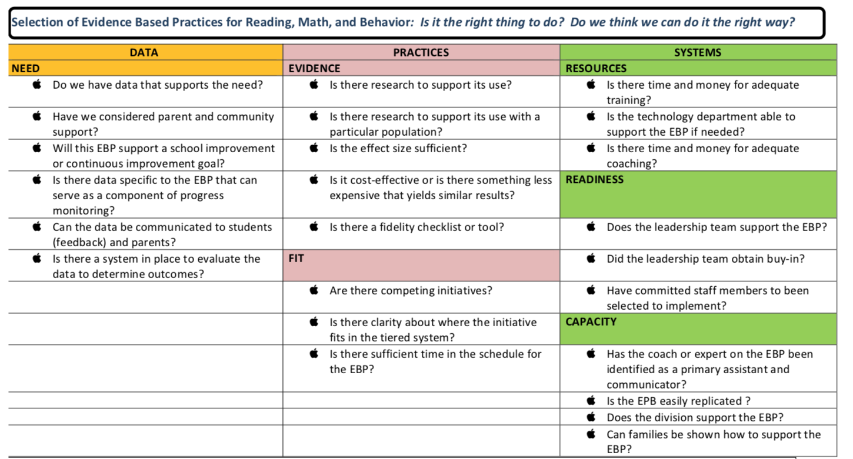
There Are Ways to Find New Practices!
Workbook Pages 67-68

Slide 114
Identify your Key Practices
What key practices will your school commit to implementing with fidelity? Name and define them.
Workbook Page 13

Slide 115
When Student Learning is our Compass
“Right” actions identified.
Actions improve learning.
Midstream adjustments are possible.

Slide 116
Remember!
Selecting something that is likely to work is a good first step, but once something is implemented, the most important function of leadership is ensuring that desired outcomes are reached and sustained over time.

Slide 117
Develop solutions for systems
How will the team support the school in the implementation of new practices?

Slide 118
Systems
Can include
What do you have?
Professional learning
Coaching
Performance feedback
Critical friends groups
Lesson study
PLCs
Data meeting structures

Slide 119
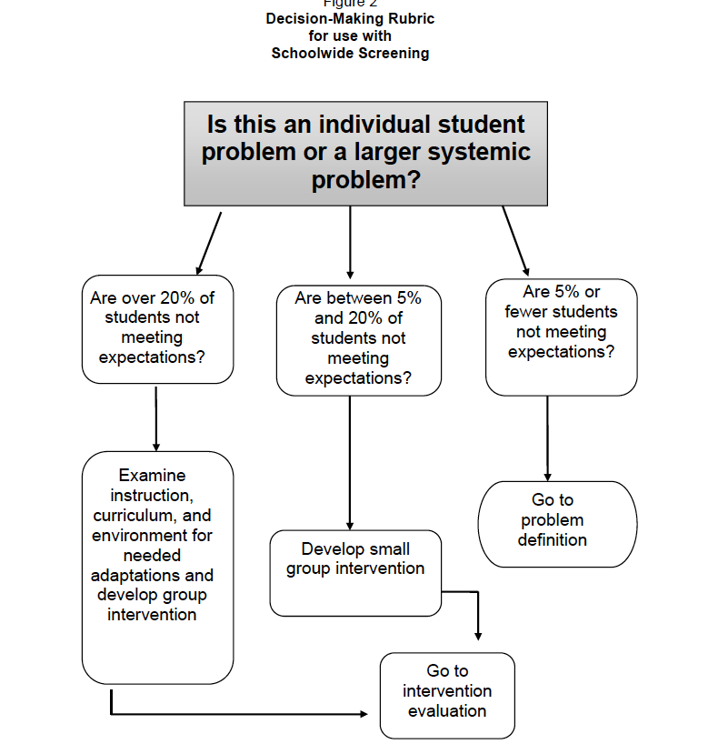
Your Data Will Tell You Where to Focus!
Workbook Page 69

Slide 120
Progress Monitoring
Data/Progress Monitoring
Data/Progress Monitoring
Did we do what we said we would do? With fidelity? Outcomes? Are we making progress?
Be sure to include fidelity AND outcome data. We cannot begin to assess outcomes if we have not implemented with fidelity.

Slide 121
Decision Rules
Decision rules allow us to use data to plan our actions and determine practices.
Decision rules allow for more equitable decisions
Decision rules allow us to move students more quickly into higher tiers of support
Decision rules allow us to organize our resources more efficiently
Remember…

Slide 122
Decision Rules
Decision rules help us to understand when to get curious about what is happening with instruction. When do we change course? Add a layer of instruction? Make environmental changes?
Let’s think about what makes
sense in your context!
Workbook Pages 22-23

Slide 123
Develop solutions for systems
How will the team support the school in the implementation of new practices?

Slide 124
Action Planning
Do we have written steps that will help us establish effective team processes?
Do we have a data analyst?
Do we have a school wide problem solving process in place?
Do we have a clear picture of our data story and needs?
Have we resource mapped our practices?
Do we have data decision rules in place?
Do we have a system in place to select evidence-based practices?
Workbook Pages 9-12

Slide 125
VTSS - Tier 1 New Team Professional Learning
TFI 1.14 Fidelity Data

Slide 126
HOW WILL WE KNOW THAT WE: 1. Did what we said we would do? 2. Checked to see that it worked 3. Shared it with stakeholders
SELF STUDY
1.14 and 1.15 of TFI
1.14, 1.15a, and 1.15b of A-TFI

Slide 127
Professional Learning Roadmap

Slide 128
Fidelity
1.14 Fidelity Data: Tier I team reviews and uses SWPBIS fidelity (e.g., SET, BoQ, TIC, SAS, Tiered Fidelity Inventory) data at least annually | School policy Staff handbook School newsletters School website | 0 = No Tier I SWPBIS fidelity data collected 1 = Tier I fidelity collected informally and/or less often than annually 2 = Tier I fidelity data collected and used for decision-making annually
Workbook page 4-5

Slide 129
Fidelity Academic TFI
Workbook page 6-8

Slide 130
Success Criteria
Success today is measured by:
written steps in our action plan for how we will bring this process back to our division/schools
written steps in our action plan for sustaining our current decision making process if it meets our needs or steps to revise our process for effectiveness and efficiency

Slide 131
Let’s Get Started...
There is a simple way to think about fidelity: did we do what we said we would do in the way it was meant to be done?
When we think about fidelity in education, we can consider 3 categories:
1.Implementation
2.Instruction
3.Assessment

Slide 132
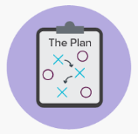
Fidelity of Implementation
We have a plan to implement tiered systems in our building, but are we doing it?
So, for example, do we have teams
set up that communicate with one
another? Does our schedule allow for time to teach the schoolwide expectations? Are coaching plans written? Do we plan and document ways to engage families?

Slide 133
Good News on Implementation!
Research tells us how to implement effective and efficient tiered systems of supports.
This is mapped out for you and reflects what you have already been doing!
Here are two measures of implementation fidelity:

Slide 134
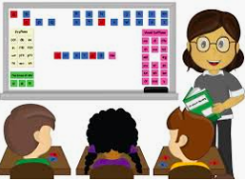
2. Fidelity of Instruction
Have we defined quality core instruction and taught it in the way it was intended?
So, for example, do all teachers in the building deliver the content as expected in academics, behavior, and mental wellness? Is that defined in our system? Do we consistently use common evidence-based practices?

Slide 135
Fidelity of Instruction:
Why
Something to Consider:
Why is fidelity of instruction a critical component in planning for equity? Shouldn’t ALL students have access to high quality instruction?

Slide 136
Fidelity of Instruction
How
Something to Consider:
How do we measure fidelity of instruction? Here are a few examples to think about:
Teacher walkthroughs
School schedule to teach the schoolwide expectations
Coaching logs and/or mentoring plans
Student assessments
Lesson plans

Slide 137
3. Fidelity of Assessment
Since data-informed decision making is a key component of a tiered system, we ask ourselves if the data we are collecting is accurate.
An elementary example would be PALS: does everyone administer PALS consistently and without bias?
A secondary example would be a common formative assessment: does everyone allow the same time? permit the same cues?

Slide 138
Matching to Student Outcomes
And finally, don’t forget to examine outcome data with fidelity data:
How did one set contribute to the other? Even if our outcomes are good, can they be replicated?

Slide 139
In summary…
Fidelity is required at the student level up to the division level when looking at the data, practices, and systems that fill our implementation logic framework.
And
Fidelity is embedded in problem – solving with efficiency and effectiveness
And
Fidelity is a necessary feature of the evaluation component of the six essential components of VTSS
And
We match or fidelity data to student outcomes

Slide 140
Check for Understanding
Working with a partner, answer the following questions:
What do we mean by fidelity in general?
What are three areas we need to consider?
Name one way that you check for fidelity in your building (it can be any of the three areas).
Why is fidelity of instruction a critical component for equity?

Slide 141
Action Planning
Steps on how you will sustain your current decision making process.
Process for reviewing and sharing data at least annually
Workbook Pages 9-12

Slide 142
VTSS - Tier 1 New Team Professional Learning
TFI 1.15 Annual Evaluation

Slide 143
Evaluation
1.15 Annual Evaluation: Tier I team documents fidelity and effectiveness (including on academic outcomes) of Tier I practices at least annually (including year-by-year comparisons) that are shared with stakeholders (staff, families, community, district) in a usable format | Staff, student, and family surveys Tier I handbook Fidelity tools School policy Student outcomes District reports School newsletters | 0 = No evaluation takes place, or evaluation occurs without data 1 = Evaluation conducted, but not annually, or outcomes are not used to shape the Tier I process and/or not shared with stakeholders 2 = Evaluation conducted at least annually, and outcomes (including academics) shared with stakeholders, with clear alterations in process based on evaluation.

Slide 144
Evaluation Academic TFI
1.15a Outcome Data Schoolwide data indicate improved outcomes in reading, math, behavior and attendance that lead to at least 80% proficiency in core. | Student outcome data (e.g., attendance, discipline, math, behavior, PALS, universal screening data) | 0 = Zero or one of the four areas for improved outcomes meet 80% core proficiency. 1 = Two or three of the four areas for improved outcomes meet 80% core proficiency. 2 = Student outcome data indicate 80% core proficiency in all four areas.
1.15b Annual Evaluation Schoolwide data are shared at least annually with all stakeholders in a usable format and inclusive of trend data across years. | Stakeholder reports Stakeholder surveys Faculty meeting notes School website Family meeting notes School Board meeting notes | 0 = Inconsistent data sharing practices. 1 = One or two of feature criteria met for sharing annually, usable format, and trend data. 2 = Data are shared annually, usable, and inclusive of trends across years.

Slide 145
Rationale
Evaluation systems are a way to hold ourselves accountable, celebrate our successes, and change our PBIS implementation based on data.
Evaluation helps us see the big picture and fit in all the small details.

Slide 146
Let’s Think About This in a 2 - Pronged Process
Documenting and Sharing Annual Data
Decision Making With the Annual Data
Here’s where that dashboard is necessary!
Besides faculty, what other stakeholders? List them.
This can also be thought of as “marketing.” Who can put together the data in a meaningful way? List them.
What data sets would be most critical and reflect trends over time? List them
Here’s the wrap-up of the last two days!
Using your data and the DIDM process you’ve just learned, return to what the data has been telling you.
What data can you celebrate?
What data indicates need?
And the process goes on...
Based on work of McIntosh and Goodman, 2016

Slide 147
Let’s Think About An Important Point
1.15 on A-TFI and “The Triangle”
A-TFI Item
We know that to be accredited or to meet certain state and federal guidelines, we don’t have to meet an 80% pass rate. But providing services in a tiered system helps us think differently. We know that in order to successfully serve all students, we may not have the resources to intensify for more that 20%. This item reminds us that it is our goal to reach 80% AND MORE in Tier 1.
1.15a Outcome Data
Schoolwide data indicate improved outcomes in reading, math, behavior and attendance that lead to at least 80% proficiency in core.

Slide 148
Creating an Evaluation Plan
Evaluation plans have two main functions:
Provide summative annual analysis of achievements and areas for action planning
Help teams to report results of their efforts to the broader staff and stakeholder groups
Based on work of McIntosh and Goodman, 2016

Slide 149
Activity Action Plan
Using the information you acquired over the past two days, complete the DIDM form template in your workbook to address an area of need.
Workbook Page 13

Slide 150
Data Sharing
SHARE monthly
How are we displaying the data?
Are we looking at multiple measures of achievement?
Get feedback
Communication is two way
Stress to our staff the importance of accurate and consistent input
Staff should know what data to bring to each type of data meeting.
Think about a marketing lens!
Notes:
information.

Slide 151
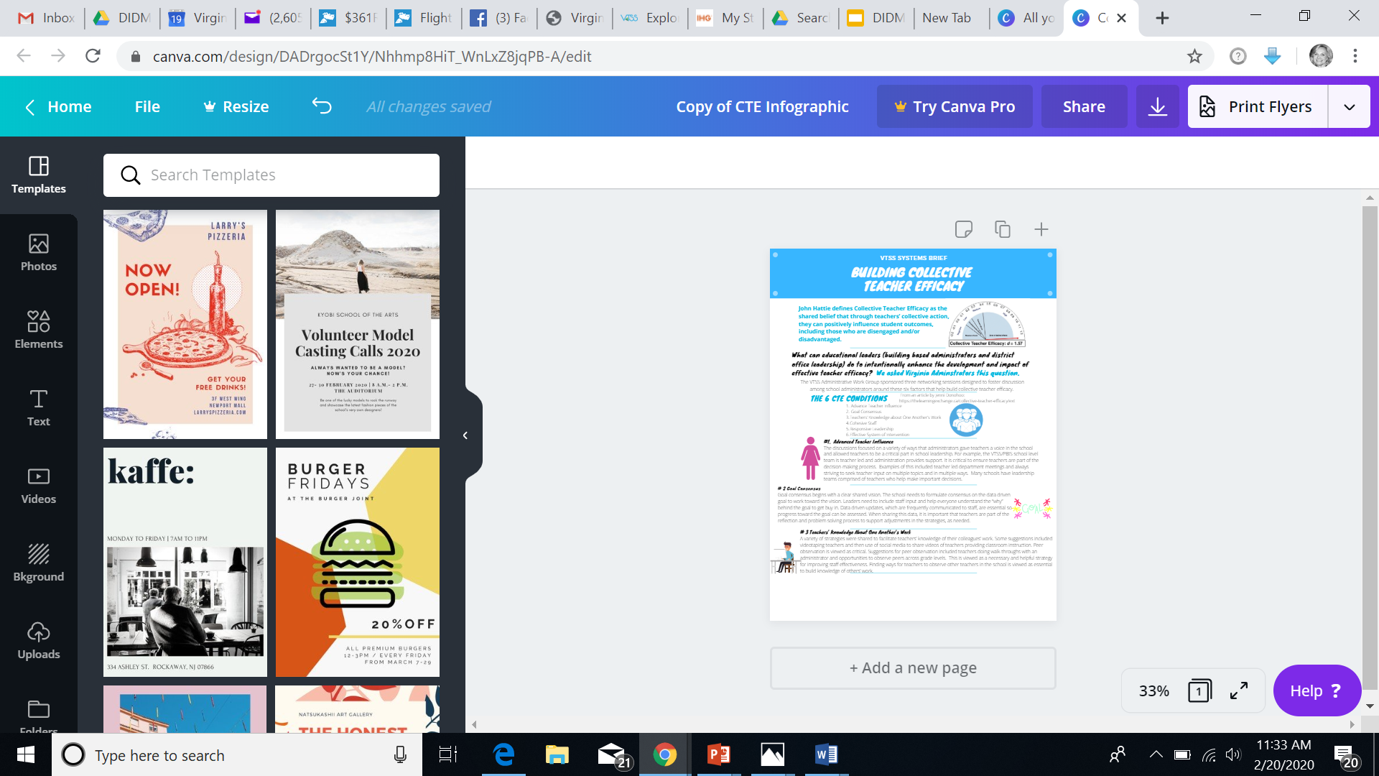
Canva
www.canva.com

Slide 152
Celebrate!
Cake walk activity -
Notes:
.

Slide 153
CELEBRATE!
What next?

Slide 154
Action Planning
How will the team document the effectiveness of Tier 1 practices at least annually?
How will you share outcome data with stakeholders (staff, families, community, division)?
Workbook Pages 9-12

Slide 155
Wrap-Up
Stop - I am totally confused (please write your division name so we can provide coaching support)
Go - I am ready to move on
Proceed with Caution - I could use some clarification on...
Notes:
I

Slide 156
You are Prepared for Your Data Journey
Have a safe trip home!!

