Slide 1
Data Informed Decision Making for Division Level Teams:
Establishing a Consistent and Effective Problem Solving Process
Wifi: Hilton Honors (promotion code)
Password: LobbyP
Notes:
1 min
9:00 to 3:00

Slide 2
Follow VTSS
Thank you for attending. Please feel free to tag us at any of our social media handles below!
X (Twitter) - VTSS_RIC
Facebook - VTSSRIC

Slide 3
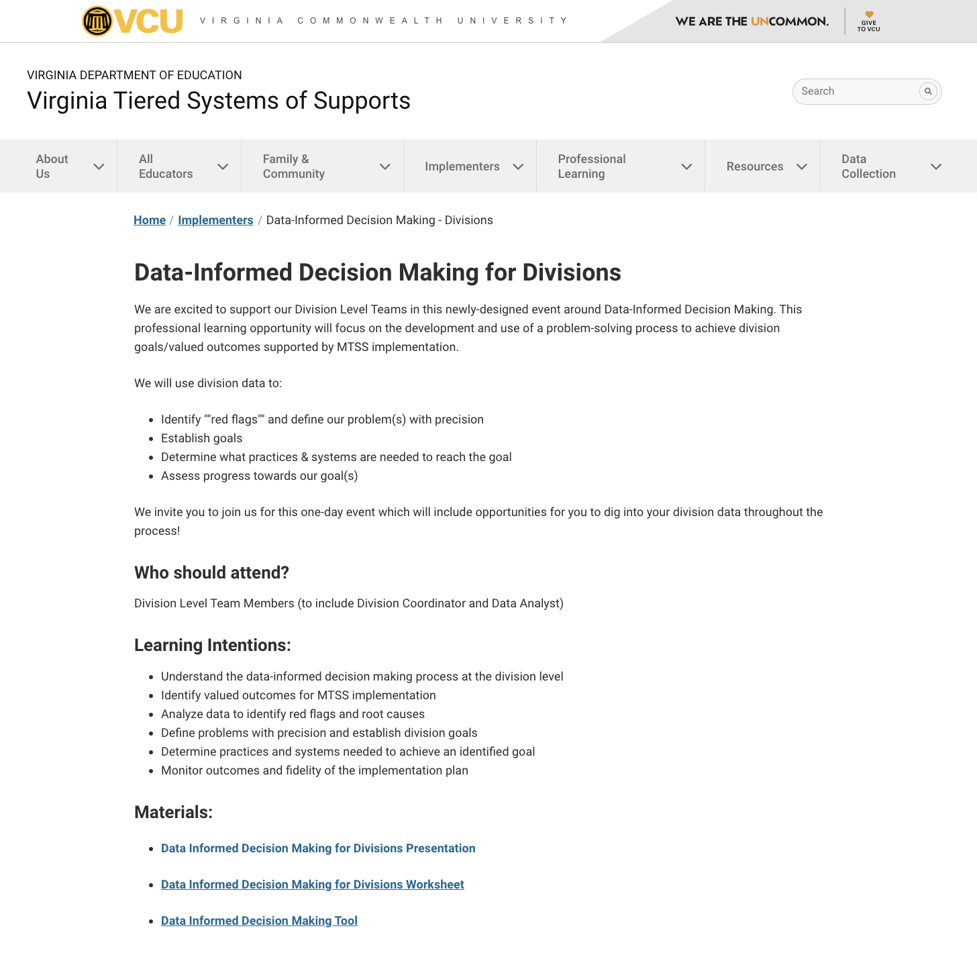
Materials
Workbook
https://vtss-ric.vcu.edu/events/

Slide 4
Agenda
9:00 - 9:45: Welcome & Overview
9:45 - 10:45: Define
10:45 - 10:55: Break
10:55 - 12:15: Analyze
12:15 - 1:00: Lunch
1:00 - 2:15: Implement
2:15 - 2:30: Break
2:30 - 2:50: Evaluate
2:50 - 3:00: Closing & Evaluation
*Work time: 2 ½ hours*
Notes:
1 min
Review agenda anchored to problem solving steps we will be using the guide discussion around DIDM today.
Highlight the ample work time provided throughout the day, within each section.
March 19 presenters’ reflection:
When we presented we stopped just before goal setting (at 12:20) and sent folks to lunch. They returned at 1:10.
We eliminated the work time during goal setting to save time, but in retrospect we could have kept it.
We also added time at the end on the “call to auction” slide to give folks 10 min to identify next steps.
We ended with 15 min to spare and gave them time to complete the eval.

Slide 5
Learning Intentions
Participants will:
Understand the data-informed decision making process at the division level
Identify valued outcomes for MTSS implementation
Analyze data to identify red flags and root causes
Define problems with precision and establish division goals
Determine practices and systems needed to achieve an identified goal
Monitor outcomes and fidelity of the implementation plan
Notes:
1 min
Learning intentions
Possible: which of these learning intentions has been a particular focus for you? As you arrived today, which were you most curious about?

Slide 6
Community Agreements
Be Responsible | Take care of your needs. Share your questions with the group.
Be Respectful | Respect others intentions Honor the impact of your words Earnestly move toward completing tasks during team work time
Be Engaged | Ask what you need to know to understand and contribute. Stay present Listen to others attentively. Share your expertise, information and ideas.
Notes:
1 min
Invite you to join us in establishing these community agreements to support our learning and collaboration today.
Check for agreement. Anything to add or enhance?

Slide 7
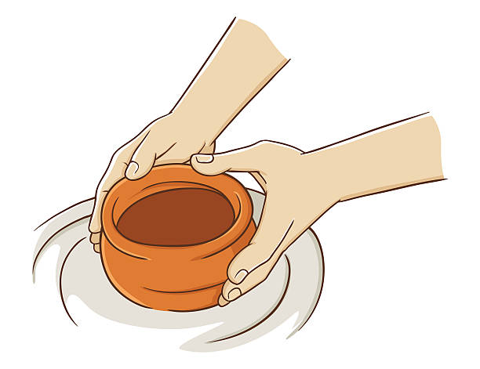
Connection Activity
In my experience, data informed decision making at the division level is like….because….
Notes:
5 min
Connection activity called Synectics that supports social emotional skill development both for students and adults.
Discuss at your table or with your team how you might complete this sentence.
TO DO: Copy pics for hanging up around the room

Slide 8
Overview
Division-level Data Informed Decision Making
Why is this process important?
What are critical features of this process?
How does it relate to school-level decision making?
What valued outcomes have we developed to guide MTSS implementation?
Notes:
1 min
This section will provide us with foundational knowledge related to division level data informed decision making.
We are sharing these up front as they will be revisited throughout the day.

Slide 9
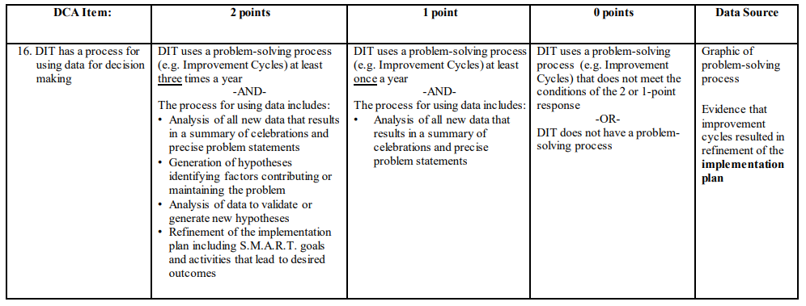
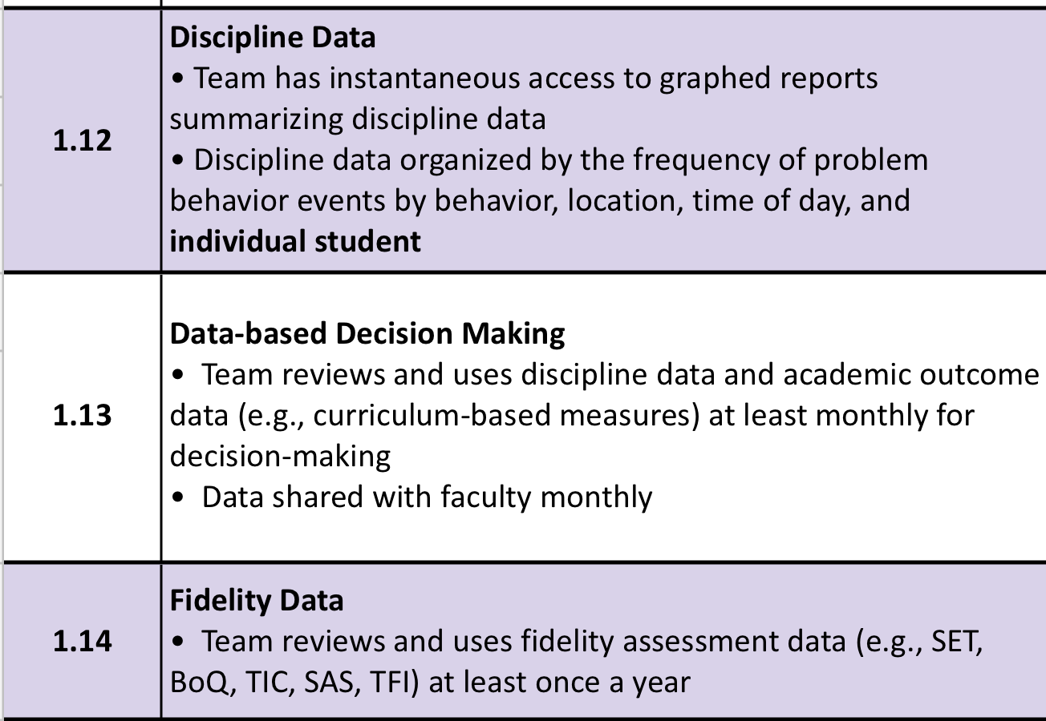
DCA Item 16
Workbook pg. 3
Notes:
1 min
Learning today directly supports DCA item 16 - DLT has a process for using data for decision making.
Many divisions have set goals around this and are looking to engage in learning and collaboration today to move work forward within your divisions in this area.

Slide 10
What is MTSS?
MTSS is a systemic, data-driven approach that allows divisions and schools to provide evidence-based practices and interventions to meet the needs of their students. This is done through a clearly defined process that is implemented to fidelity by all stakeholders within the school and/or division.
VTSS is who we are, MTSS is what we do!
Notes:
1 min
Focus on how MTSS is a framework that can be used and applied to many different educational domains. It is a way of analyzing and providing tiers of interventions.
Before we begin, it is important to frame our discussion around the definition of MTSS as it will guide our work throughout this process.
We bring this forward to ensure that our focus remains on a common goal, but also to understand how critical it is that MTSS is implemented through a clearly defined process. Today we will talk about that process as it related to DIDM.
Also highlight - VTSS is who we are; MTSS is what we do.

Slide 11
Thoughts on Data-Based Decisions
“As decision-makers, we need a deliberate process to guide us through the examination and analysis of data. Without this, we may be apt to substitute strongly held opinions for the fact-based conclusions that would be derived from a review of the actual data.”
- D.B. Reeves, The Leader’s Guide to Standards, 2022
Notes:
1 min
Invite a participant to read.
Our “why” for today.
Possible: Consider key word, phrase that stand out?

Slide 12
Data Informed Decision Making
Monitor and Evaluate Results
Identify problem with precision
What strategies/ practices will we select and implement? (Supporting student academic and social behavior)
Data
What does the data say? Analyze strengths and opportunities for growth.
What do teachers need to implement/sustain?
Establish a SMART goal
Workbook pg. 9
Florida Positive Behavioral Interventions & Supports Project
Notes:
2 min
Here is one decision making process we will use today to engage in problem solving around data.
There are lots of decision-making models available, but all have the same core components – just might be organized or termed differently.
For example - Analyze (CNA)
Though there are key stages of this process that can be critical to effective decision making, the key is consistency and clarity division wide.
Today we will use this process to guide our planning and reflection.

Slide 13
Root Cause Analysis
There’s no single way to conduct a root cause analysis, but it usually comprises of three steps:
Identify a problem
Identify the cause(s) of a problem
Identifying strategies to address the problem.
There are many publicly available tools to use for this process.
U.S. Dept of Education, Office of Elementary and Secondary Education
Notes:
2 min
We also want to talk a bit about root cause analysis as we frame our learning around DIDM.
RCA is a process similar to what we just shared on the previous slide and includes several steps.
We are highlighting RCA because it involves specific actions within the second step listed here that we will be revisiting today within the DIDM.
This step - identifying the cause(s) of a problem - provides the opportunity to look deeper at problems in response to data and more effectively engage in decision making.
It’s important to note that there is no single way to conduct a root cause analysis, and there are many tools available to engage in this process.

Slide 14
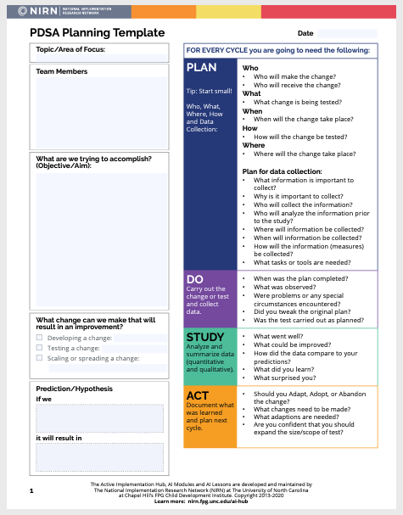
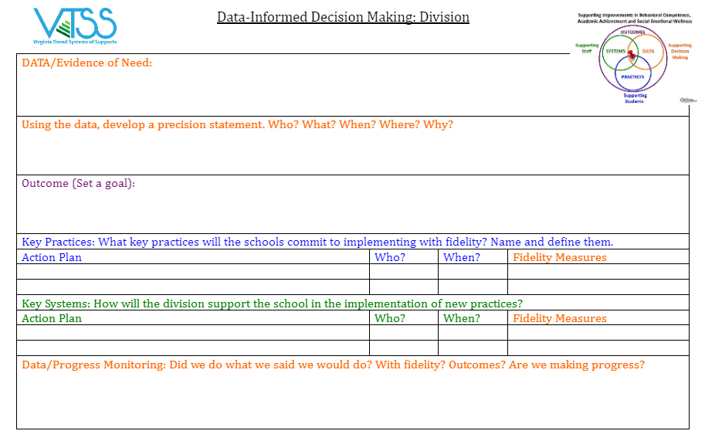
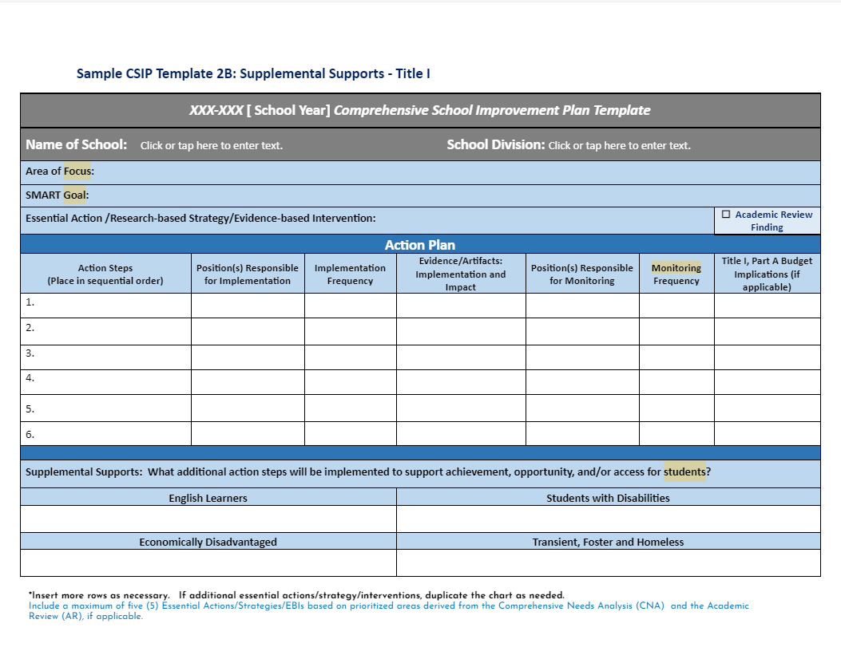
Function over Form
(as long as you are documenting)
Workbook pg. 8
Notes:
1 min
There are many forms and processes that can guide this work.
Once again, the key is consistency and clarity about what process will guide this work within your division.
Introduce the VTSS data informed decision making form as the form used for today’s work (and worksheet).
Data-Informed Decision Making Tool (on the website)

Slide 15
Role of Data Analyst
The role of the data analyst(s) can vary depending on the platform, size of division, etc.
HOWEVER: Be sure that you are always coming back to monitor the goals you set in your data informed decision making process and that someone is responsible for having it available.
Division A: This division has subgroups that report the data to the division leadership team, i.e. literacy.
Division B: The data is organized by the accountability and testing staff.
Division C: A sophisticated data systems exists. The data analyst is the “driver” in the meeting.
Notes:
1 min -
We also want to highlight the benefit of defining roles within this work. Having a data analyst can efficiently support this process.
This role can vary, however, depending on the size of your division or the makeup of your DLT. There are many ways to coordinate data collection and sharing. Here are a few.
Context matters: what will work best for you?
Data needs to be disaggregated by the data analyst at the division level
The data is fed up to the division by the schools
The division shares a process with the schools

Slide 16
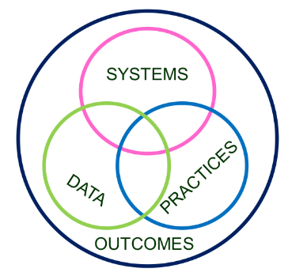
Division and School Level
Decision Making
Workbook pg. 10
Invest in Systems!!! (Leadership teams, support professional learning and coaching)
Differentiate and ensure outcomes are reflective of all students
Data informs decisions about screening, progress monitoring, fidelity, and outcomes
Prioritize efficient and effective practices
(evidence, culture, context)
Growth & benefit are central. Must reflect learning opportunities for all
‹#›
Notes:
3 min
What is the connection between division level and school level DIDM - why 2 separate PD sessions?
Arrows animate:
What MTSS valued outcomes are critical for the division, currently?
What does the data currently reveal in relation to these outcomes?
When looking to address needs revealed in the data, what division-level practices do we offer schools to support implementation of MTSS?
What division-level systems can be established to support schools in the use of these practices?

Slide 17
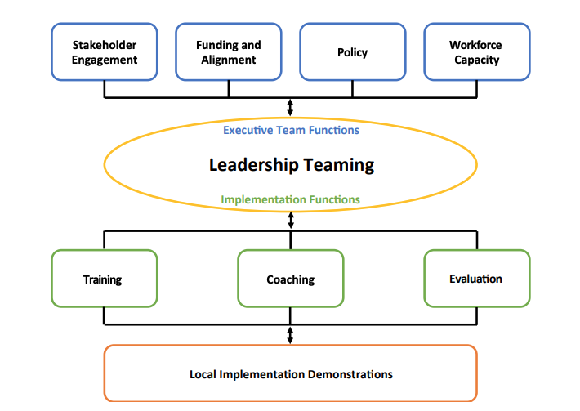
Division-level MTSS
Organizing across multiple schools improves efficiency in resources, implementation efforts, and organizational management. It provides a supportive context for implementation at the local level.
Notes:
1 min
Division level DIDM focuses on systemic changes and supports for schools.
As a division level team, we are planning and organizing across multiple schools.
This improves efficiency in resources, implementation, how leadership is coordinated to support those efforts.
Ideally, it will provide a supportive context for implementation at the school level.

Slide 18
DIDM at the Division Level
DIDM at a division level helps teams to progress monitor toward identified valued outcomes that are aligned with:
division strategic goals
division mission and vision statements
Notes:
1 min
As schools will often focus on their plan for continuous improvement or CSIPs, the unique role of the DLT as they engage in DIDM, is to progress monitor toward identified valued outcomes that are aligned with division strategic goals and the division mission and vision.

Slide 19
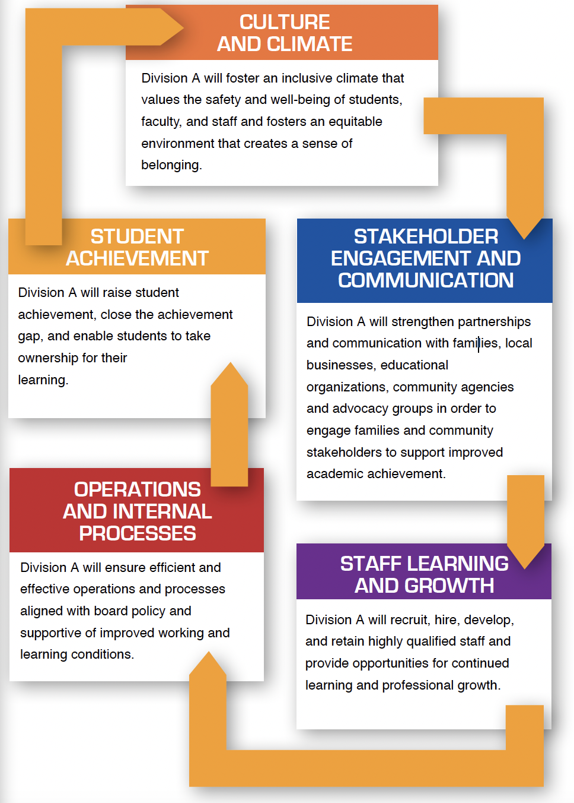
Division A
Vision and Mission
Strategic Goals
VISION
We envision a school division that cultivates excellence for all.
MISSION
The mission of Division A is to inspire, educate, and develop students, in collaboration with families and the community, to ensure students graduate college and/or career ready.
Notes:
1 min Division A-Rhonda
Before we invite you to consider your own division goals and MTSS valued outcomes,
we would like to share the work of a sample division to help support your reflection.
Had CAP plan, strategic plan helped support them
Division Motto: Cultivate excellence for all:
Needed alignment;
valued outcomes aligns with strategic goals
DLT Divided into 3 groups-

Slide 20
Division A: The Beginning
Strategic Plan
Identified ONE (1) Area on Strategic Plan
Culture and Climate
Identified ONE (1) Objective in that Area
Create and maintain a welcoming, inclusive, and equitable school climate that promotes learning
Notes:
1 min
Division A -
Example -
All areas of the strategic plan for this division had been established based on data identifying the need.
The DLT spent 2 hours discussing the data that pointed them to this specific area and category of CULTURE & CLIMATE
This was identified based on:
(1)climate surveys
(2)HR teacher exit interviews, and
(3) Family surveys given after school visits.
Within that one strategic plan area, they focused in on one category in that area that had 5 objectives.
Looked at each and narrowed down to one objective struggling with to problem-solve around.

Slide 21
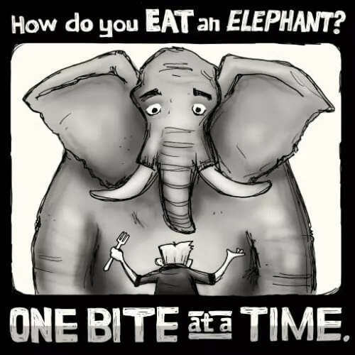
Division A
Notes:
1 min
Let’s revisit Division A - Rhonda
Example
Their motto? INVESTING IN BRIGHT FUTURES
Have to see it as a giant process.
Small bites (1 obj) to get to the whole (5 year plan).

Slide 22
Work Time
Discuss:
What valued critical outcomes are critical?
How have you used the MTSS framework to address any of these valued outcomes?
Identify current valued outcome/s that can be addressed using the MTSS framework.
Valued Outcomes
Workbook pgs. 4-7
Notes:
15 min
Reiterate how MTSS is a framework that can be used and applied to many different educational domains. It is a way of analyzing and providing tiers of interventions.
Independent activity first. What valued outcomes are critical in your division? List your top 3….come together as a group, list your top 3-5 (3 min)
Give additional examples of valued outcomes - divisions asking for schools to have a goal related to a specific area.
Discuss responses together: (10 min)
How have you used the MTSS framework to address any of these outcomes?
Identify division’s valued outcome.
Each division can put answers to the last prompt on chart paper. Then do a gallery walk. (2 min)

Slide 23
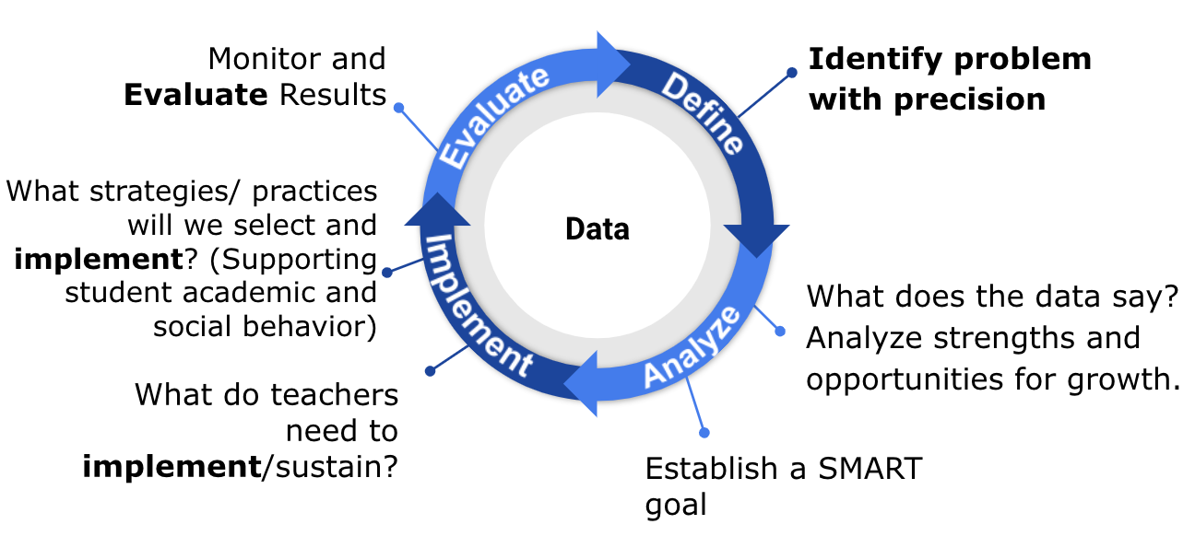
DEFINE: What is the Problem?
Notes:
Time: 9:40 am
1 min
As we mentioned, we are sharing one problem solving process that can support data informed decision making, and we will begin by taking time to consider the first step - define - where we will work together to identify a problem with precision.
Why is this important?
How many of us have heard - cafeteria chaos, bathroom fighting, not motivated, hanging out and loud in hallways, etc.
How can we begin to engage in focused thought and action planning if we have not effectively defined what is actually occuring?

Slide 24
Types of Problems
Known/Suspected
Unknown/Hidden
Begins with a concern or a question from superintendent or DLT
Specific data (grade retention, attendance, SOL’s, climate surveys, etc.) are used to determine if an issue exists.
Cannot assume the concern or question accurately represents reality
Recognizes areas outside of daily lived experiences
Looks at big data and disaggregates based on grade, gender, race, SES, location, time, etc.
Involves teacher, student, and family voice and concerns
Notes:
2 min
As a DLT member you have likely engaged in discussion around different types of problems.
You’ll often find that there will be problems that are brought to the DLT team often through the superintendent or other DLT team members OR through a review of data that is used to determine if an issue exists. While this is a great place to start, this data may often that accurately or fully represent what is really happening. These are known or suspected problems.
There are also problems which might be unknown or hidden - these might occur outside of the daily lived experiences of DLT members or other school staff. These problems may also be uncovered as we disaggregate our data based on various markers or might be uncovered as we provide opportunities for teachers, students and families to voice their concerns.

Slide 25
Data: Evidence of Need
What is your data story?
Here, we answer the following question:
Is there a problem? What is the data that indicates that there is a problem that needs to be addressed?
Academics
Behavior
Attendance
Social Emotional Wellness
Community health
Teacher retention
Family engagement
Notes:
1 min
As we begin the process of problem identification, we first need to ask “what is our data story?” What evidence do we have that there is a need.
The data we may begin with could include any of those here or may include other data your division chooses to include. These are often the most common.

Slide 26
VA School Quality Profile
https://schoolquality.virginia.gov/
Notes:
2 min
In a moment , we will ask your group to identify data sources that might assist you in monitoring your division’s valued outcomes.
The VA School Quality Profile is one site that is frequently used as a source of data (and you may choose to use it today during our activities).
We also recognize that you may also be using your own data platform or data collection system to display division level data.

Slide 27
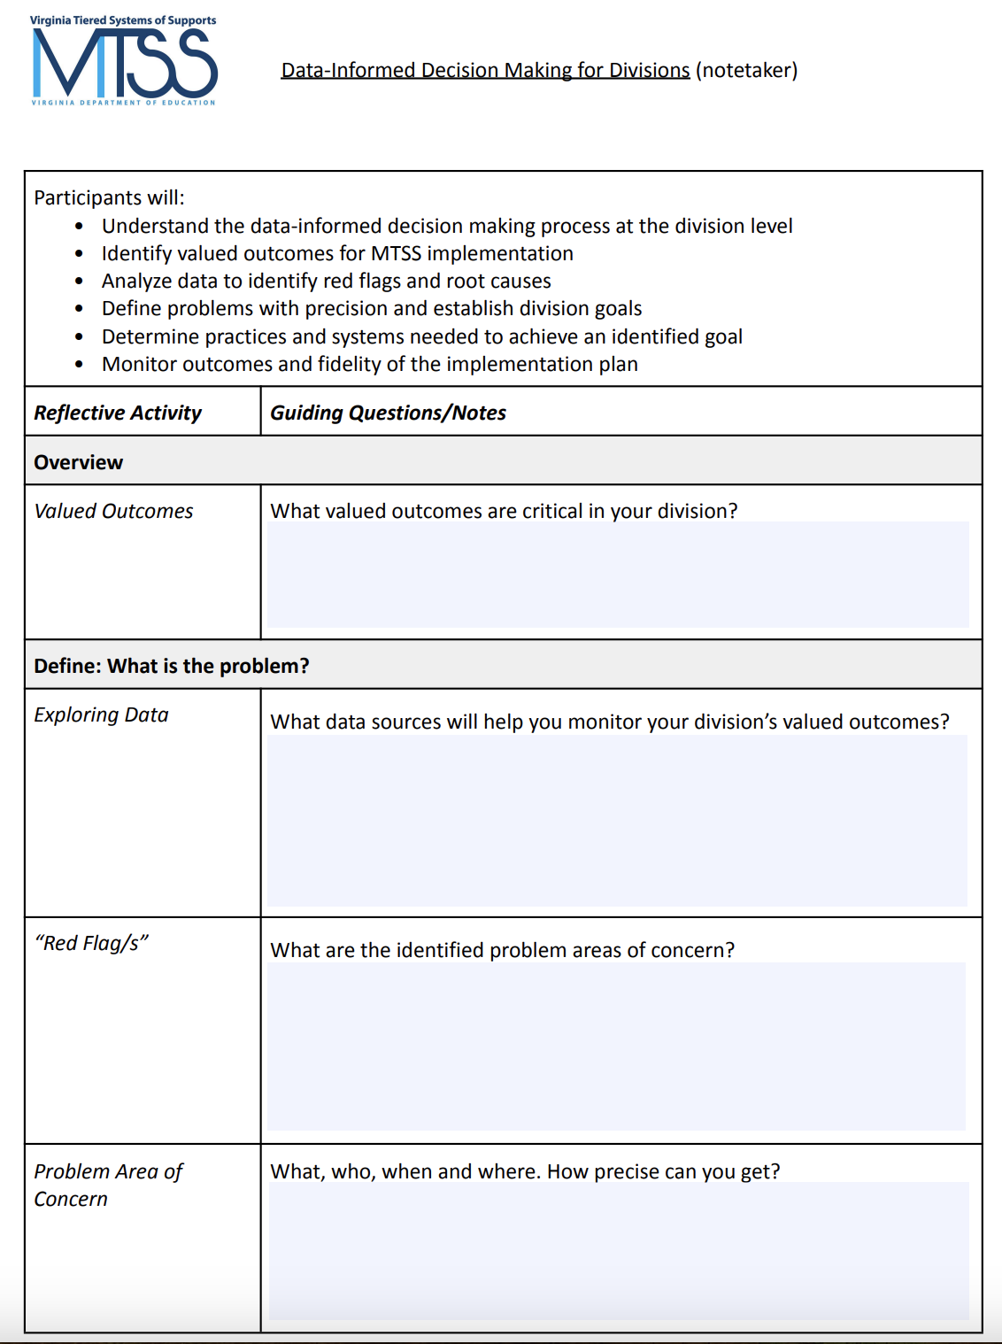
Work Time
Discuss:
What data sources will help you monitor your division’s valued outcomes?
Exploring Data
Workbook pgs. 11 & 12
5 minutes
Notes:
5 min
You took some time in our last activity to discuss your division’s valued outcomes related to MTSS implementation.
Now, we would like to give you all the opportunity to identify these data sources as you think about how you might monitor the valued outcomes you discussed earlier today.
These data sources will help you begin to tell your “data story”.
Example - attendance, truancy … (one nine weeks, one semester, last year, last three years?)

Slide 28
Got Data?
Notes:
1 min
Drowning in data:
Has anyone ever experienced having so much data that you don’t know what to do with it?
“Admiring the data”
Use this to explain that protocols can offer offer support for teams when reviewing data to define the problem.

Slide 29
Data Driven Dialogue Protocol
Phase I-Prediction:
I predict/expect the data show…
My predictions/expectations are influenced by…
Prediction
Observations
Inferences
Workbook pgs. 13-16
Notes:
3 min. Reflect and predict

Slide 30
Data Driven Dialogue Protocol
Phase II-Observations:
I observe that…
Some patterns/trends that I notice…
I can count…
I’m surprised that I see…
*No judgment or explanation
Prediction
Observations
Inferences
Workbook pgs. 13-16
Notes:
5 min. to note observations
10 min. team discussion

Slide 31
Data Driven Dialogue Protocol
Phase III-Inferences
I believe the data suggests… because…
Additional data that would help me verify/confirm my explanations is…
Additional data that would help guide implementation of solutions/responses and determine if they are working
Prediction
Observations
Inferences
Workbook pgs. 13-16
Notes:
10 min. team discussion

Slide 32
Data Protocols
Protocols that support data exploration:
Data-driven Dialogue Protocol
Atlas Protocol
Data-Mining Protocol
https://www.schoolreforminitiative.org/protocols/
Workbook pg. 28
Notes:
Protocols – School Reform Initiative

Slide 33
Identifying Red Flags
In what general area(s) are our outcomes not meeting our shared expectations?
What trends have we observed across schools related to identified problem areas?
Are groups of students disproportionately represented in the data?
Do data suggest we have a strong tier 1 across academic, behavior, social emotional wellness?
Which unmet needs have we uncovered?
Which are the most pressing to address
now?
Notes:
2 min
As we examine our data we then begin to dig a bit deeper and ask several additional questions in order to identify red flags.
what trends are we observing across our schools related to our identified problem areas? For example, are groups of students disproportionately represented in the data?
Do our data suggest we have strong Tier 1 supports in place across domains including academics, behavior and social emotional wellness?
Once we may have identified unmet needs, which are the most pressing to address right now?
Comprehensive Needs Assessment Toolkit (Vermont Agency of Education, Revised: April 2020)
National School Reform data protocol

Slide 34
Division A Red Flags
Strategic Plan
Identified ONE (1) Area on Strategic Plan
Culture and Climate
Identified ONE (1) Objective in that Area
Create and maintain a welcoming, inclusive, and equitable school climate that promotes learning
Notes:
1 min
Let’s revisit Division A - Rhonda
Example - All areas of the strategic plan for this division had been established based on data identifying the need.
DLT spent two hours discussing the data that pointed them to this specific area and category.
This was identified based on:
climate surveys,
HR teacher exit interviews,
and family surveys given after school visits.
Division who has identified their value outcome for MTSS, based on vision and mission - connected to strategic plan; use Matt’s division as the example?

Slide 35
Division A
What is the “Red Flag?”
VA School Quality Profile data reflects that, during that 2022-23 SY, 30% of the student population missed 10% or more school days.
Currently, during the 2023-24 SY, 35% of the student population is at-risk of being chronically absent (missing 10% of the current school days).
Notes:
1 min
Division A
Example
Here are the data sources they collected - internal culture/climate surveys
What they found when looking at their school quality profile data from 2022-23 and the 2023-24 attendance data……….
this helped the division to identify their red flags.

Slide 36
Work Time
Discuss:
Looking at your data sources that monitor your valued outcomes, what are the areas of concern?
Your “red flags.”
Red Flag/s
15 minutes
Notes:
5 min (or longer)
During this next group activity, we’ll invite you to take this process a step further and identify your red flags.
As you reviewed the data sources in the last DDD activity, consider what might be areas of concern and identify 1-2 red flags.

Slide 37
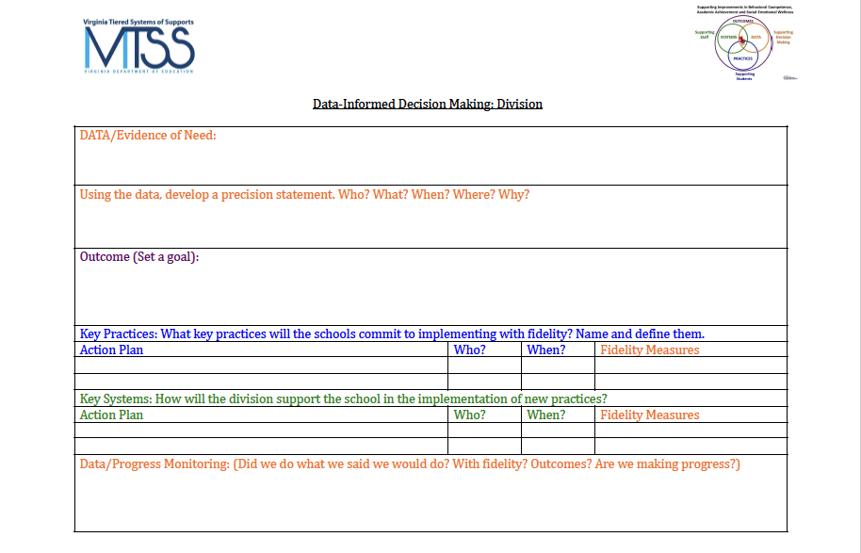
Documentation:
Data/Evidence of Need
Workbook Page 8
Notes:
1 min
Focus is not on the form, but documentation of the process. This is only one way to document.

Slide 38
Based on your data…
Precisely define the problem by identifying who, what, when, where, and why.
What is the problem?
Who is having the problem?
When is the problem occurring?
Where is the problem occurring?
Why is the problem occurring?
Notes:
1 min
At this point, you have identified a problem area of focus, and now you’ll begin to define that problem.
We precisely define the problem by providing as much specificity as possible, looking at the who, what, when, where….and (sneak peak - the why will come later)
(each of these areas may not be applicable to your problem area but we look to define the problem as specifically as possible where data may be relevant)
Specifically, we look at…
What - Define what is happening related to our problem area of focus and at what rate
Who - Which students are experiencing this problem, do those rates differ by student group?
When - Could the problem be occurring most often during certain times of the year?
Where - Is the problem primarily occurring at certain levels or is it related to what is specifically occurring within the classroom environment?

Slide 39
Examples:
Problem Area of Concern
Example: Across the division, 47% of eighth grade students in 2023 failed to pass the reading SOL.
Example: During the 2022-23 school year 31% of high school students, grades 9-12, received multiple office discipline referrals for dress code violations, as defined in the student handbook.
Notes:
1 min
Here are a couple of examples of statements developed by teams that described specific problem areas of concern.

Slide 40
Division A:
Problem Area of Concern
“Currently, during the 2023-24 SY, 35% of the student population is at-risk of being chronically absent (missing 10% of the current school days). The highest levels of chronic absenteeism were more prevalent in secondary schools among students being reported as economically disadvantaged. During the 2022-23 SY, absenteeism was higher in September and January.”
Notes:
1 min
Division A -
Example:

Slide 41
Work Time:
Problem Area of Concern
Write a Problem Area of Concern
Where Are Your Gaps?
What
Who
When
Where
(We’ll get to the “Why”)
How precise can you get?
Don’t get lost in the weeds, but be clear about the problem.
Are all assumptions challenged or verified by data?
What do you need to finish your problem statement?
Notes:
10 min - Work Time
Let’s take time now to begin to develop a problem statement that might address the what, who, when and where.
See how precise you can get as you describe the problem without getting lost in the weeds, consider whether you have challenged assumptions with data and if you cannot describe the problem, identify what data you might need to finish the problem statement.

Slide 42
Notes:
10:45
10 min break

Slide 43
ANALYZE Why is it occurring?
Notes:
Time: 10:55 pm
1 min
Define -> analyze (this step can often be skipped when we think about our tendency to want to solve problems immediately)
Here, we’ll be taking the time to look closer at our problem statement, asking why it might be occurring, involving key stakeholders in that process and ultimately developing a SMART goal.

Slide 44
Precision Statement
Now we precisely define the problem by identifying who, what, when, where, and why.
What is the problem?
Who is having the problem?
When is the problem occurring?
Where is the problem occurring?
Why is the problem occurring?
Notes:
1 min
Earlier we defined our problem by asking what, who, when, and where and now we will begin to also ask why the problem is occurring in order to develop a precise problem statement around which we can action plan.

Slide 45
Stakeholder Feedback
Notes:
1 min
Critical element - stakeholder feedback and engagement
Stakeholders provide critical “pieces to the puzzle” helping us to better understand and analyze the problem.
Presenter: Anyone functioned as staff and parent in a school?

Slide 46
Importance of Stakeholder Engagement
“When schools and districts can learn from and meaningfully engage the expertise of the students, families, and communities who have been marginalized by our systems, we can begin to work together toward building more responsive and just schools.”
Ishimaru & Takahashi (2017)
Notes:
1 min
Why focus on stakeholder engagement?
Read quote - thinking about what stands out for you. (words that stand out)
Mine - meaningfully, expertise
We need to be intentional about involving stakeholders whose voices might not typically be heard, also thinking about tapping into voices that represent your division’s demographics.
When we involve stakeholders in the DIDM process (identifying the why) we also have a greater chance of developing goals and plans that are truly responsive to the needs of students, families and staff.
Disrupting Racialized Institutional Scripts: Toward Parent–Teacher Transformative Agency for Educational Justice
Ann M. Ishimaru & Sola Takahashi
Peabody Journal of Education, Pages 343-362 | Accepted author version posted online: 09 May 2017, Published online: 08 Jun 2017

Slide 47
Important Conversations
To truly understand the problem/challenge we have to gain insight from those affected by the problem/challenge.
They can help us understand:
What does this problem
look/sound/feel like for them?
Who is this problem affecting and
in what way?
When is this problem affecting them more? the least?
Where do they experience this problem the most?
Why do they think this problem is occuring?
Notes:
2 min
Your problem/challenge will most likely have MANY possible causes. In order to determine which factor is having the greatest impact, we have to do a little more digging. To truly understand the problem/challenge we have to gain insight from those affected by the problem/challenge. They hold information that is KEY to our understanding of the problem.
Has your team discussed the potential impact of students’ feelings that they are not honored and valued as individuals in the school?
Has your team considered school and division policies that may contribute to the precise problem?
Examples: Dress code, student access to gifted/honors/AP courses, availability of resources for marginalized students, diverse representations in school curricula, etc.
Have students been asked about their feelings of belonging and connection to the school community?
Have family perspectives and input about school/division policies and practices been sought?

Slide 48
Tools for Feedback
There are different tools you might use to explore the WHYs from the perspective of stakeholders.
Empathy interviews
Focus groups
Surveys
Ex. Conducting a school climate survey for students and families to see how they feel about school. Include what they think is working / not working. Work with schools to figure out the best time and way to give surveys. Get results back by mid-October and review as a team at
November meeting.
Notes:
1 min
There are many tools and some which you all have used that are not represented here.
Climate surveys could be helpful.

Slide 49
Work Time
How are you currently obtaining stakeholder feedback?
Identify which stakeholder groups you need to obtain feedback from.
Who is the problem impacting?
Discuss the method(s) by which feedback will be gathered.
Stakeholder Feedback
*Workbook pg. 17
Notes:
10 min
Your division:
Take some time to discussed how you are currently obtaining stakeholder feedback
Which group do you still need to obtain feedback from and how you might obtain it?
Possible share when returning from discussion?
OBTAINING STAKEHOLDER FEEDBACK TO IMPROVE THE MIDDLE TO HIGH SCHOOL TRANSITION

Slide 50
Division A:
Stakeholder Feedback
Families:
illness
housing instability
economic hardships
confusion about attendance policies and procedures
Students: “Why do you come to school?”
adult support
belonging to a positive peer group
commitment to education and future goals
school environment (e.g. feel safe,
supported and engaged in class; school is fun)

Slide 51
Identifying the “Why”
Notes:
1 min
Now that we understand the critical role of stakeholders, let’s dive into how we might go about beginning to identify the why.

Slide 52
Why Conduct
Root Cause Analysis?
Prevents “solutionitis”
Produces insights into the system as a whole
Prompts brutally honest discussions about why unsatisfactory outcomes occur
Prompts participants to look at problems from the user perspective
Ensures the initial problem is narrow and concrete enough to improve
Informs tactical action and solutions moving forward
Enhances the group’s ability to develop targeted and measurable outcomes
Office of School Quality, Dr. April Kaiser Edwards, VDOE
Notes:
2 min
We mentioned earlier about a process called root cause analysis which involves protocols that help us to identify the why.
Why root cause analysis?
OSQ slide, Dr. April Kaiser-Edwards

Slide 53
Root Cause Helps Separate Story from Fact
Example:
Story: Students are not coming to school because they don’t care.
Fact: Data shows that some students are having difficulty getting up for school on time because they have to be at the bus stop by 6:30am.
Notes:
1 min
One of the important benefits of RCA is that is helps us to separate story from fact and directs us to “validate assumptions”.
Here is one example.
Another - HS tardies.

Slide 54
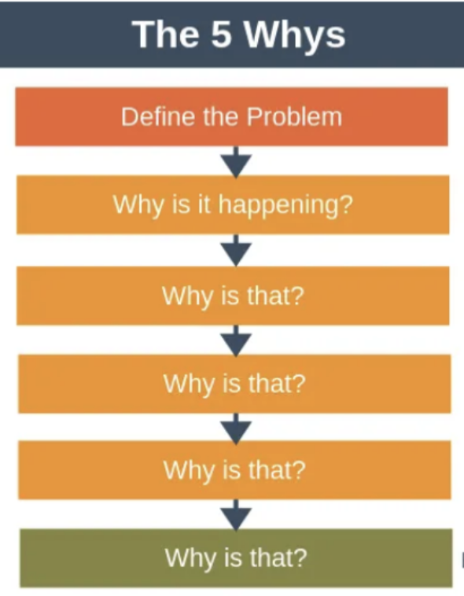
The 5 Whys
“Instead of jumping to solutions, we take the time to ask ‘why’ to get closer to the root cause.”
Notes:
1 min

Slide 55
An Example
Black and Latinx students are underrepresented in our in our AP classes
Why?
Black and Latinx students don’t sign up for AP classes.
Why do Black and Latinx students not sign up for AP classes?
Black and Latinx students are not encouraged by their teachers or counselors to sign up for AP classes.
Why are B/L students not encouraged to sign up for AP classes?
Teachers and counselors do not believe that most B/L demonstrate the skills necessary to handle the rigor of AP classes.
Why do teachers and counselors not believe that most B/L demonstrate the skills necessary to handle the rigor of AP classes?
Teachers and counselors equate low test scores and grades with inability to handle higher level courses.
Notes:
3 min

Slide 56
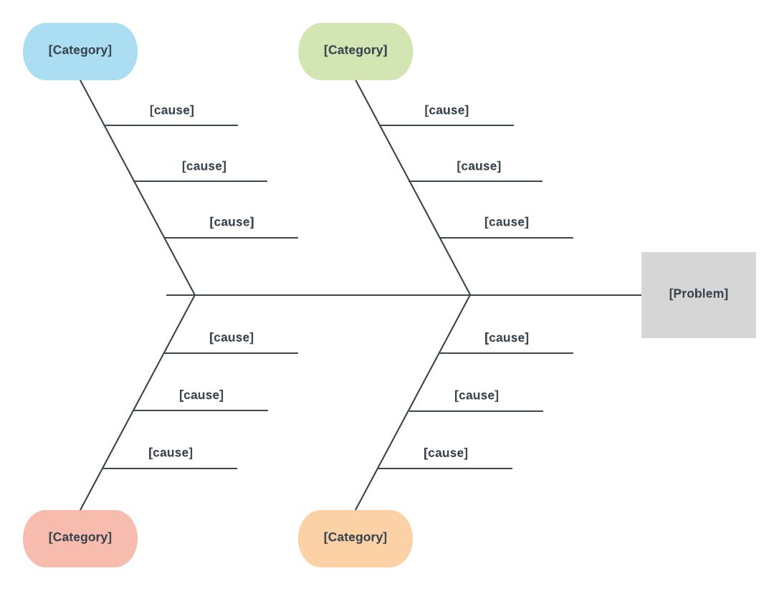
Fishbone Diagram
A “fishbone” diagram, can help in brainstorming to identify possible causes of a problem and in sorting ideas into useful categories.
Workbook pg. 21
Notes:
2 min
There are various protocols out there that assist us with identifying root cause, today we will explore one - the fishbone diagram.
(Going to use Fishbone, but may have heard about 5 whys. We Added in the 5 whys as an example they may have heard, they are hidden, to reach out to coaches if interested.)
The problem or effect is displayed at the head of the diagram.
Brainstorm all the possible causes of the problem, listed at the top of each branch. Consider what data you may have to support that “why”.
For each “why”, continue to ask “Why does this happen?” and generate deeper levels of causes; continue organizing them under related categories.
*Include team members who have personal knowledge of the processes and systems involved in the problem or event to be investigated.
A visual, structured way to look at cause and effect.
Keeps the team focused on the causes of the problem, rather than the symptoms.
Can be helpful in identifying possible causes for a problem that might not otherwise be considered by directing the team to look at the categories and think of alternative, associated causes.
Helps to dig deeper to better understand what in the systems and processes may be causing the problem, so those factors can be addressed.

Slide 57
Division A: Getting to the “Why”
“Why is 35% of the student population at-risk of being chronically absent, particularly within secondary schools among students being reported as economically disadvantaged?”
DLT fishbone of the problem
8 initial “whys”
Notes:
2 min
Example

Slide 58
Brainstorming our “Why”:
“Why is 35% of the student population at-risk of being chronically absent, particularly within secondary schools among students being reported as economically disadvantaged?”
Lack of communication with families about attendance procedures and supports and their student’s current attendance record
Health concerns (short-term illness, chronic illness, and medical/dental/mental health appointments)
Personal stress (depression/ sadness, stressed/upset, family emergencies)
Transportation difficulties; food and housing insecurity
Challenges associated with poverty: lack of health and mental health resources, affordable housing, transportation concerns, witnessing or being a victim of violence
School stress (perception of difficulty with schoolwork, lack of preparedness for a class, and avoidance of a teacher, class or student)
Lack of school connectedness or perception of relevance for reaching future goals
Disproportionate rates of suspension for economically disadvantaged students
Workbook pg. 18
Notes:
2 min
Generated these root causes/contributing factors from the following research:
https://www.nasponline.org/assets/Documents/MH_School-Attendance-Problems.pdf
https://www.attendanceworks.org/chronic-absence/addressing-chronic-absence/3-tiers-of-intervention/root-causes/
https://www.attendanceworks.org/wp-content/uploads/2018/04/Aggregate-RCA-Report-Final-4.pdf
https://www.attendanceworks.org/why-are-secondary-students-missing-so-much-school/
https://scholarscompass.vcu.edu/cgi/viewcontent.cgi?article=1135&context=merc_pubs

Slide 59
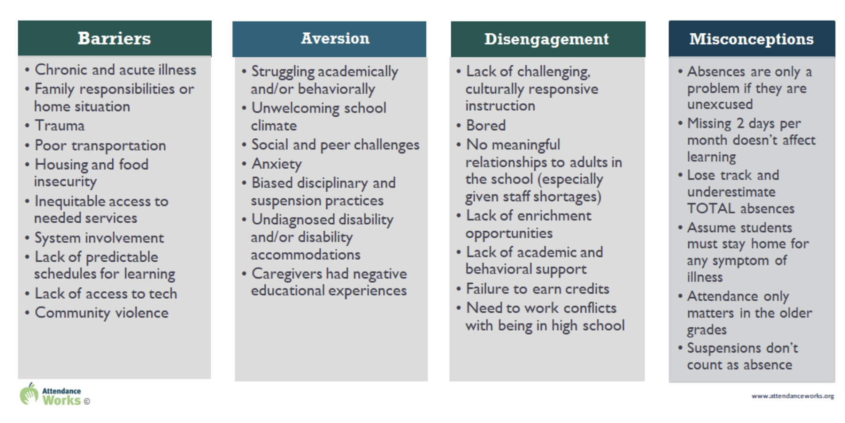
Root Cause:
What does the Research Say?
https://www.attendanceworks.org/chronic-absence/addressing-chronic-absence/3-tiers-of-intervention/root-causes/
Workbook pg. 19
Notes:
2 min
It is important to research the problem you are investigating when beginning to brainstorm root cause.
For example, with relation to attendance, Attendance Works shares 4 general categories that, based on research, reflect the most prevalent contributing factors leading to chronic absenteeism

Slide 60
Division A:
Making Sense of our “Why”
Barriers:
Health concerns (short-term illness, chronic illness, and medical/dental/mental health appointments)
Personal stress (depression/ sadness, stressed/upset, family emergencies)
Transportation difficulties; food and housing insecurity
Challenges associated with poverty: lack of health and mental health resources, affordable housing, transportation concerns, witnessing or being a victim of violence
Aversion:
School stress (perception of difficulty with schoolwork, lack of preparedness for a class, and avoidance of a teacher, class or student)
Disengagement:
Lack of school connectedness or perception of relevance for reaching future goals
Disproportionate rates of suspension for economically disadvantaged students
Misconceptions:
Lack of communication with families about attendance procedures and supports and their student’s current attendance record

Slide 61
Division A:
Where Will We Start?
What are the overlaps between the potential root causes and family/student feedback?
2. Which root cause/s do we have data to support?
3. Which root cause/s will have the greatest positive impact on our goal?
Notes:
These data dives can provide additional information for potential areas of intervention.

Slide 62
Lack of communication with families about attendance procedures and supports and their student’s current attendance record
Example:
Faculty and staff are unsure of district policy
Only sent home once at the beginning of the year in the handbook
Not prominent on the website
Why is 35% of the student population at-risk of being chronically absent, particularly within secondary schools among students being reported as economically disadvantaged?
Hard to reach the families of chronically absent students
Faculty and staff are unsure who is responsible for reaching out to families
Workbook pg. 20
Students don’t feel like they belong/are accepted at school
Students have jobs and work late hours
Lack of scaffolding in instruction
Instruction primarily focuses on “drill and kill” teaching strategies
Transportation difficulties; food and housing insecurity
Increase in reported anxiety and depression among students
School stress (perception of difficulty with schoolwork, lack of preparedness for a class, and avoidance of a teacher, class or student)
Notes:
5 min
Drilled down on the 2 that felt most pressing & data and would have the most impact
These 2 are what was selected as a focus (peach boxes)
Continue to ask “Why does this happen?” and generate deeper levels of causes/contributing factors
(Share blue boxes) these are the contributing factors that were then identified
Webinar: (Richmond Public Schools) Attendance Works May 10, 2023: Relationships All Year Round: Nurturing Showing Up (00:38:27 and 01:10:00)
Dr. Shadae Harris (Chief Engagement Officer) - “eviction crisis”; reframed attendance as an engagement issue; housing insecurity is an education issue preventing students from engaging; partnered with the community organization Housing Families First; found that a large # of families were living in hotels/motels; did not have first/last month’s rent; wrote a grant to pay for families first/last month’s rent

Slide 63
Lack of communication with families about attendance procedures and supports and their student’s current attendance record
Example:
Faculty and staff are unsure of district policy
Not prominent on the website
Why is 35% of the student population at-risk of being chronically absent, particularly within secondary schools among students being reported as economically disadvantaged?
Lack of scaffolding in instruction
Increase in reported anxiety and depression among students
School stress (perception of difficulty with schoolwork, lack of preparedness for a class, and avoidance of a teacher, class or student)
Notes:
5 min
Drilled down on the 2 factors for each that felt most pressing, those they had data to support and areas they might have the most impact

Slide 64
Division A:
Data to support the “why”
Lack of communication with families about attendance procedures and supports and their student’s current attendance record
Faculty and staff are unsure of the district policy and student attendance rates…and…who is responsible for communicating with families
Feedback from families where multiple variants of the district policy (if any) were relayed to families from faculty and staff…and they were unaware of their student’s current attendance record
Website is difficult to navigate and the policy was not prominently displayed
Website traffic data indicated the policy page was the least visited
Lack of communication with families about attendance procedures and supports and their student’s current attendance record
Notes:
2 min

Slide 65
Division A:
Data to support the “why” (cont’d)
School stress (perception of difficulty with schoolwork, lack of preparedness for a class, and avoidance of a teacher, class or student)
School stress (perception of difficulty with schoolwork, lack of preparedness for a class, and avoidance of a teacher, class or student)
“Increase in reported anxiety and depression among students.”
Student safety survey indicated an increase in student anxiety and depression
“Lack of scaffolding in instruction.”
A review of principal classroom walkthroughs showed a high percentage of teachers inadequately scaffolding concepts and content to help students develop understanding
Notes:
2 min

Slide 66
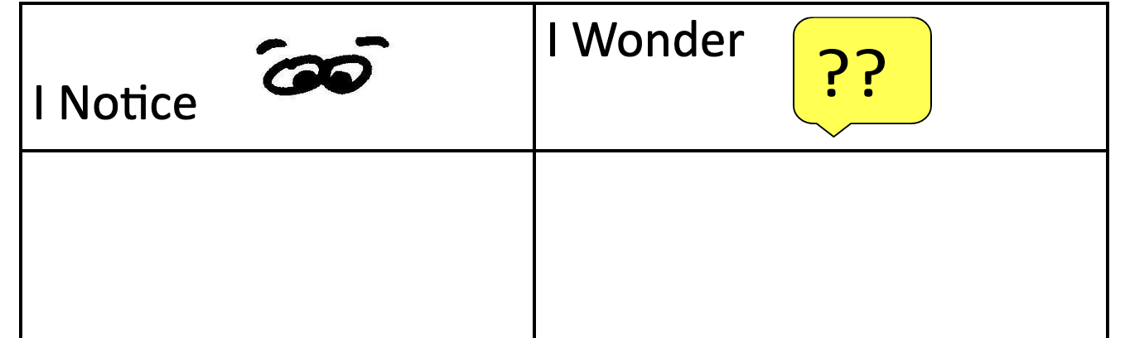
Independent Work Time:
Fishbone Step 1
What do you notice about your red flag/issue/problem?
What questions do you have?
Why might the red flag/issue be happening?
Notes:
1 min
Fishbone step 1
Now, we will guide you through an exploration of the fishbone diagram through 3 steps.
First, we will give you 5 minutes to think about what you notice or wonder about your red flag or problem statement you identified earlier.
As you think about your “wonder”, consider what “whys” might be you be thinking about.

Slide 67
Work Time: Fishbone Step 2
In your teams, share out what you noticed and wondered about your red flag/issue/problem.
How can these noticings/wonderings be grouped?
These groupings will be used to define your major categories.
Notes:
10 minutes
Share - 3 min
Categorize - 7 min

Slide 68
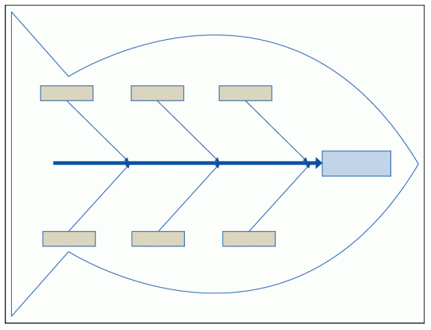
Work Time: Fishbone Step 3
Place your red flag at the “head of the fish.”
Place all of your major categories from your group time as the “ribs” of the fish.
Select one “rib” and ask “Why is this?”
Have a recorder write down the group’s answers.
Workbook pg 21
Notes:
20 min (Other protocols: https://drive.google.com/file/d/1j-thgSBVEOUWW1ZMt9Z63Faih9ym0Npe/view?usp=drive_link)
Place your red flag at the “head of the fish.”
Categorize any “whys” you discussed as major categories at the head of each “Rib” of the fish.
Select one “rib” and ask “Why is this?” Have a recorder write down the group’s answers.
Point to highlight → Answers at this point might just be conjecture or anecdotal experiences. All answers MUST have data to validate them before moving forward and including them in a precision problem statement.

Slide 69
Division A Precision Statement:
Bringing it All Together
“In 2023, 35% of the student population was at-risk of being chronically absent, particularly within secondary schools among students being reported as economically disadvantaged. This is believed to be due to a lack of communication about our absentee policy, student’s current attendance record, and attendance supports along with an increase in student stress.”
Notes:
2 min
Division A

Slide 70
Documentation:
Precision Statement
Page 8
Notes:
1 min
Focus is not on the form, but documentation of the process. This is only one way to document.

Slide 71
Lunch Time!
Notes:
Time: 12:35pm

Slide 72
Identify a Goal for Change
After a precision statement is developed, teams will now describe how they will know when the problem has been resolved.
What does success look like?
When do we expect to see the problem resolved?
(Center on PBIS, Data Based Decision Making)
Notes:
Time: 12:15 pm
1 min
Last step as we analyze our data, after we identify the “why” is to develop a goal.
What would it look like if your red flag were no longer a red flag?
What is the ultimate goal?
What is a realistic step for right now?

Slide 73
Characteristics of a Strong Goal
Goals allow you to analyze, monitor, and adjust professional practice. Goals are…
Notes:
1 min
The more targeted a goal is, the more targeted the plan will be.

Slide 74
SMART Goal Example
Timely
Specific
By December 2024, educators will develop and implement with 85% fidelity a science instructional framework as evidenced by classroom observations and a 5% increase between pre and post teacher benchmark scores.
Measurable & Achievable
Realistic
Notes:
1 min

Slide 75
SMART Goal Example 2
The number of middle school students with multiple ODR’s for inappropriate dress will decrease by 30% within the first semester of the 2024-25 school year as compared to the first semester of the 2023-24 school year.
Notes:
1 min

Slide 76
SMART Goal Example 2.1
The number of middle school students with 0-1 ODR’s for inappropriate dress will increase by 30% within the first semester of the 2024-25 school year as compared to the first semester of the 2023-24 school year.
Notes:
1 min
It can be helpful to think about how goals can be framed in the positive, looking to capture how specific positive behaviors or achievement levels can be increased vs. decreasing negative behaviors.

Slide 77
Work Time: SMART Goal
Division A Precision Statement:
“In 2023, 35% of the student population was at-risk of being chronically absent, particularly within secondary schools among students being reported as economically disadvantaged. This is believed to be due to a lack of communication about our absentee policy, student’s current attendance record, and attendance supports along with an increase in student stress.”
Specific
Measurable
Achievable
Realistic
Timely
Notes:
10 minutes
Share Division A’s precision statement.
What might be a goal you would suggest for this division?

Slide 78
Division A: Smart Goal
By June 2025, the percentage of students being reported as economically disadvantaged in secondary schools who are attending school more than 90% of the year will increase from 65% to 80%. This will be periodically checked each nine weeks across all grade levels to see if progress is on track for the end of the year.
Specific
Measurable
Achievable
Realistic
Timely
Notes:
2 min
Division A
Share why we picked 80% as a goal. What did the research say on how to achieve this.

Slide 79
Documentation: Setting a Goal
Notes:
1 min
Focus is not on the form, but documentation of the process. This is only one way to document.

Slide 80
IMPLEMENT What are we going to do about it?
Notes:
Time: 1:30 pm
1 min
Explore the next step - Implement - identify what school staff need to sustain or what new practices/strategies need to be implemented. Also identify the systems that need to be in place to support this school level implementation.

Slide 81
Developing Solutions
Notes:
1 min
You may have been wondering - when are we going to get to action planning/solution development.
Often this is where we want to begin after reviewing data.

Slide 82
According to Research…
Typical Problem Solvers
Effective Problem Solvers
Define problems loosely or vaguely.
Define a problem in observable and measurable terms.
Don’t validate assumptions before building a plan.
Collect and use multiple sources of information to validate assumptions about the problem.
Develop generic plans.
Create highly detailed steps to implement the intervention/plan with fidelity.
Brian Gaunt, Ph.D., University of South Florida, May 2023
Notes:
2 min
It’s important to recognize that we all problem solve. The goal as we move through today’s session is to become better problem solvers.
Typically, we may tend to define problems vaguely, often based on assumption. We all naturally make assumptions. We are generally not objective. We usually base our decisions on a few variables. As a result of having vague assumptions, we often develop generic plans. This prevents us from measuring the fidelity of the plan’s implementation. In these situations it becomes easier to blame the students, families, or staff that the plan did not work.
Taking that time up front to understand the problem, helps us to develop more responsive and effective solutions…and interventions that will be less likely to be abandoned and start from scratch losing valuable time and momentum.
The difference between these 2 approaches is that effective problem solvers don’t “run with assumptions”. We take time to back up our claims with evidence. And take time to match our solutions with the needs of the students and /or staff.

Slide 83
School Leadership Involvement
How can we loop schools into the goal setting and solution finding?
ASK! Engage in collaborative inquiry with your school leadership teams.
How is the school’s data part of (or not) division trends?
Did we develop a good goal?
Have we developed solutions that will seem to work? (DCA #11 - Process for addressing internal barriers.)
What supports are needed to effectively implement the solutions?
Notes:
2 min
Before we begin to discuss the development of solutions, let’s talk about a key component that will need to be in place in order to effectively develop action plans - stakeholder involvement.
How are we planning to tap into school leaders and school teams during solution development. Asking…

Slide 84
Stakeholder Voice:
Students and Families
Whose perspectives do we normally include when developing solutions?
How do we include missing perspectives into the conversation?
“Authentic family or community engagement includes providing family, students, and community members with meaningful opportunities to be heard, and voice their opinions, and exercise leadership within the school system.” (pbis.org, 2021)
Notes:
3 min
Family and Student Engagement is critical as we have discussed earlier - even more in the identification of solutions.
Possible: what word or phrase stands out for you as important within this process?
Family and student voice is used as data points, but they need to be utilized more as collaborators and partners in the decision making process.

Slide 85
Developing Solutions:
Stakeholder Involvement
Team Representation:
Are additional team members needed for action planning? (i.e. stakeholders impacted by the data)
Division A
“By June 2025 the percentage of students being reported as economically disadvantaged in secondary schools who are attending school more than 90% of the year will increase from 65% to 80%. This will be periodically checked each nine weeks across all grade levels to see if progress is on track for the end of the year.”
Notes:
1 min / 5 min / 1 min share
Review Division A’s goal statement.
At your table, discuss which stakeholders this team may need to effectively engage in the development of solutions?

Slide 86
Developing Solutions
What practices need to be in place in order to address the problem?
What systems (i.e. PD, coaching) need to in place to support the implementation of these practices?
The precision statement developed through root cause analysis can guide this planning.
Notes:
1 min
Now that we have the right people at the table, we can begin to action plan.
During this stage of solution development, there will be 2 key actions we will be involved in this process.
Critical to note that the precision statement developed earlier, when done with the intentionality modeled/practiced today, will help to guide the development of these solutions.

Slide 87
Practices
Notes:
You’ll notice that the focus on practices and systems sounds familiar - circles.

Slide 88
Identifying Practices:
What has been done already?
What is being implemented now to address the problem?
What barriers did schools face when implementing? Was there sufficient support for barrier-busting?
Was there adequate professional learning, coaching, administrative support, performance feedback?
Were the right action steps taken to ensure fidelity of implementation?
Were the right people taking responsibility for guiding the change process?
Notes:
3 min
Before we get too excited :)
It is important to examine closely what has already been done to address the problem, and whether these actions been implemented with fidelity. These are several specific questions division teams can reflect on.
Initiative and resource maps (if developed) can help teams identify some of these practices and can help answer some of these questions.

Slide 89
Identifying Practices:
What still needs to be done?
THINK: Innovation!
What are the appropriate responses that address the needs implied in the data?
What do you want schools and teachers to do?
If you don’t have key practices, you may have to utilize a formal selection process.
* Remember! Practices you select should be teachable, learnable, doable, and readily assessed in practice.
Notes:
2 min
If you find that there are still some gaps in practices then it might be necessary to move forward and think about what appropriate responses can be taken now to address the needs revealed in the data - asking what do we desire for teachers and schools to do?
Using a formal selection process to identify appropropriate practices will be critical as practices should be teachable, learnable, doable, and readily assessed in practice.

Slide 90
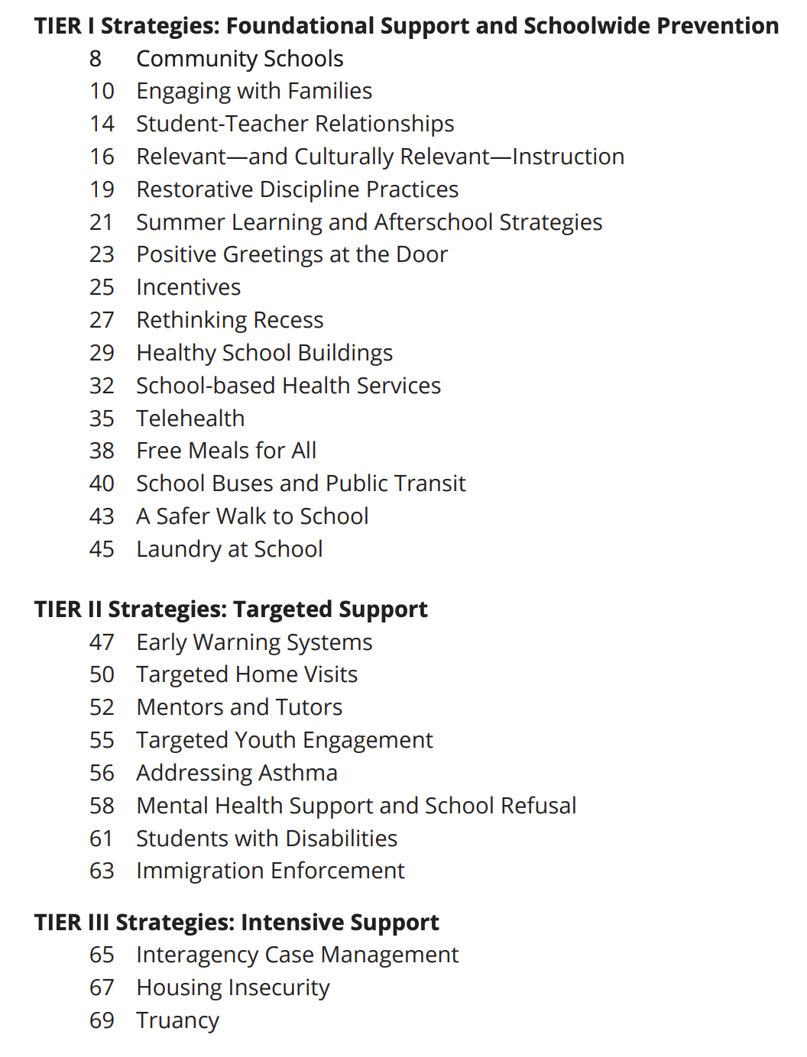
Attendance Works:
What Does the Research Say?
Notes:
https://www.future-ed.org/wp-content/uploads/2023/05/Attendance-Playbook.5.23.pdf

Slide 91
Attendance Works:
Alignment to Root Cause

Slide 92
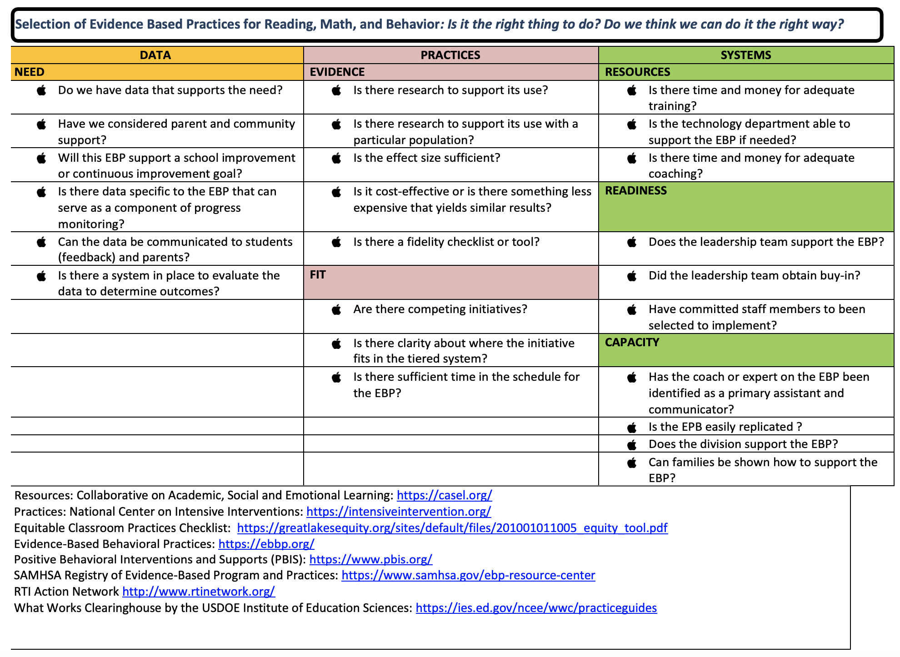
Selection Tools: Exploring Context
Hexagon Tool
Evidence-Based Practice Selection Tool
Notes:
2 min -
Just 2 selection tools we wanted to share today. There are many out there, but these might be familiar to you as we have shared these in VTSS trainings in the past. *Function over form
EBP Selection Tool - VTSS
https://vtss-ric.vcu.edu/media/vtss-ric/documents/advanced-tiers/2022-23/Evidence-BasedInterventionSelectionTool-Accessible
Hexagon Tool (NIRN)
https://www.schoolmentalhealth.org/media/SOM/Microsites/NCSMH/Documents/Archives/CS-2.11-Hexagon-Tool

Slide 93
Solution Development
Does your division have a process for selecting practices/programs?
Choose 1 tool and identify any questions/areas that might have been helpful in any past decision making processes.
Selecting Practices
Workbook pgs. 22-24
Notes:
10 min
Activity - we want to give you an opportunity to examine either of these documents for their usefulness within this process in your division.
Discuss - does your division currently have a process for selecting practices or programs?
Choose one of these 2 documents and identify any questions or prompts you feel might have been helpful in any past decision making processes.
After the activity - helpful resource to refer to (Stakeholder Engagement Guide):
https://nirn.fpg.unc.edu/sites/nirn.fpg.unc.edu/files/imce/documents/Stakeholder%20Engagement%20Guide_10.12.18_0.pdf
Who should participate in these discussions?

Slide 94
Systems
Notes:
Time: 2:10 pm
Moving into our next area within solution development, systems.
An essential area of focus that can at times be overlooked.
Systems - Not only do we ask “How will the plan be implemented?” BUT ALSO “How will the plan be supported?”

Slide 95
Identifying Systems: Expectations
Include actions that provide a clear definition of expectations for schools. i.e.
new/revised policies and procedures
performance feedback
progress monitoring
* Management structures and division size impact these factors.
Notes:
2 min
There are a few areas that can be important to focus on when thinking about systems.
One is expectations - ensuring that we include clear definitions of expectations for schools…
And we likely know that, as with all systems, management structures and division size will impact these factors.
How does this look as part of the communication plan spoken to on slide 97?

Slide 96
Identifying Systems: Support
Be specific about how the division plans to support school staff in implementation. i.e.
professional learning
coaching
data systems
* Management structures and division size impact these factors.
Notes:
2 min
Another area of focus with systems is support. What supports need to be in place for staff so that implementation can occur and be sustained?
This can often include…
Here you are doing DCA #18 so you will want to document that in your implementation plan for your DCA.
DCA 18: DIT supports the composition of Building Implementation Teams (BITs)

Slide 97
Identifying Systems: Communication
Include communication plan. i.e.
Who is sharing the plan? How will that occur?
Who will report progress back to the division?
Who will share progress with students and families?
* Management structures and division size impact these factors.
Notes:
2 min
And also systems for communication. If you have developed a communication plan (DCA 10), this can support this process.

Slide 98
Work Time
Division A
Division A tentative Plan:
Establish a text messaging system to communicate students’ absenteeism rate with families.
Revise division website to direct the community more prominently to attendance policies and current attendance campaigns.
Increase instructional coaching focus to target scaffolding within secondary classrooms.
Partner with students to establish mentor programs for students who are identified as being high risk.
Identifying Systems
To ensure effective implementation of these identified practices,
what systemic supports should
be considered?
Workbook pg. 25
Notes:
1 min / 10 min / 2 min share
Division A developed this plan with the input of families/caregivers/ and stakeholders. This will work in Division A, but might not work in other divisions. The point is to get input from the people being impacted.
Share Division A’s tentative plan, and suggested practices to be implemented. (worksheet)
To ensure effective implementation of the identified practices, what systems would you suggest should be in place for staff?
Division A systems:
???

Slide 99
Evaluation Plan
After identifying practices and systems, consider…
When are they expected to be implemented?
How will we know it’s been done?
Who will monitor fidelity of the plan?
Fidelity
When will the DLT review progress toward outcomes?
Who will gather and
share outcome data?
Outcomes
Notes:
2 min
Only 1 slide but it is a critical piece that is often overlooked in planning.
What fidelity and outcome measures will we use (and when) to monitor our progress?

Slide 100
Evaluation: Fidelity & Outcome Data
Workbook pg. 22
Lucky | Sustaining
Positive outcomes, low understanding of how they were achieved Replication of success is unlikely | Positive outcomes, high understanding of how they were achieved Replication of success likely
Losing Ground | Learning
Undesired outcomes, low understanding of how they were achieved Replication of failure likely | Undesired outcomes, high understanding of how they were achieved Replication of mistakes unlikely
Outcomes
Fidelity
Notes:
3 min
Lucky & Losing Ground. The danger in looking at only outcomes or looking at fidelity separately is that when our outcomes look good, we consider it luck or attribute it to things outside our control (e.g., it’s a good group of kids). When the outcomes show that we’re losing ground, we are surprised or start blaming resources or students. Both set up schools for failure. Even if we wanted to take ownership we really couldn’t because we can’t show what we are doing as adults.
Learning & Sustaining. When we pay attention to adult behaviors and student behaviors then connect both data together, then we can learn from mistakes and adjust practices and systems as needs change. We can start sustaining success over time.

Slide 101
Work Time
Division A
Division A tentative Plan:
Establish a text messaging system to communicate students’ absenteeism rate with families.
Revise division website to direct the community more prominently to attendance policies and current attendance campaigns.
Increase instructional coaching focus to target scaffolding within secondary classrooms.
Partner with students to establish mentor programs for students who are identified as being high risk.
Developing an Evaluation Plan
What fidelity and outcome data might you suggest
this division use?
Notes:
1 min / 10 min (potentially whole group) / 1 min share
Share Division A’s hypothesis, and suggested practices to be implemented. WORKSHEET Data-Informed Decision Making Tool
How and when would you propose to evaluate this plan?

Slide 102
Documentation:
Implementation Plan
Notes:
1 min
If you choose to use the form we have provided, the information we discussed related to practices and systems would be documented in this area.
Focus is not on the form, but documentation of the process. This is only one way to document.

Slide 103
Keep in mind…
DIDM cannot be completed in 1-2 meetings.
DIDM is an ongoing process.
As teams select practices, they may need to go back to the identification of systems.
Notes:
1 min
You might be feeling like this right now - hopefully not.
Reminder to consider a schedule throughout the year when fidelity and outcome data can be reviewed.
Develop structures now that can support the efficiency of this process - such as predictable avenues for staff, student and family involvement.

Slide 104
5 Minute Break

Slide 105
EVALUATE Is it working?
Notes:
Time: 2:45 pm
Did we do what we said we would do?
Was it done with fidelity?
How are our outcomes?
Are we making progress?

Slide 106
Are we making adequate progress toward our goal?
YES
NO
Celebrate!!
If the goal is met:
Identify strategies to maintain or sustain
Determine if there are components that require fading
Consider extending the scope of the plan if relevant
Check fidelity
Notes:
1 min
The key question we are going to ask ourselves as we progress monitor is going to be - are we making progress toward or goal?
If we are…
If we see that we are not making progress toward our goal, then we check fidelity.

Slide 107
Adapted from “Prevent-Teach-Reinforce:
The School-Based Model of Individualized Positive Behavior Support”, 2010
Workbook pg. 27
Data is not improving
Trend data is moving in the opposite direction than desired.
No
Yes
Are the interventions being implemented with fidelity?
Strategies are too difficult or time consuming
Plan does not match school context.
Experiencing intervention drift
Precision statement is incorrect
Precision Statement is correct. Interventions are insufficient.
Identify features of strategies that are difficult and modify.
Select alternate strategies that match hypothesis.
Provide additional training and technical assistance.
Modify features to match context.
Select alternate strategies that match school context and hypothesis.
Identify features of interventions affected by drift.
Provide booster training and technical assistance to refresh implementation.
Revise statement
Collect additional data if necessary.
Select new interventions to match revised statement.
Provide training and technical assistance.
Identify features of strategies that affect potency
Modify features to strategies to make more powerful.
Select new strategies if necessary.
Provide training and technical assistance in revised or new strategy implementation.
Notes:
1 min
I am going to walk us through this flowchart which will help to outline who we might engage in decision making as a result of this evaluation process. (refer to the PPT slides as a reference)
Adapted from “Prevent-Teach-Reinforce: The School-Based Model of Individualized Positive Behavior Support,” by G. Dunlap, R. Ivannone, D. Kincaid, K. Wilson, K. Christiansen, P. Strain, and C. English, 2010, Brookes Publishing Company. https://search-ebscohost-com.proxy.library.vcu.edu/login.aspx?direct=true&AuthType=ip,url,cookie,uid&db=eric&AN=ED509567&site=ehost-live&scope=site.
Adapted from PTR Manual Page 117

Slide 108
Data is not improving
Trend data is moving in the opposite direction than desired.
No
Yes
Are the interventions being implemented with fidelity?
Strategies are too difficult or time consuming
Plan does not match school context.
Experiencing intervention drift
Precision statement is incorrect
Precision Statement is correct. Interventions are insufficient.
Identify features of strategies that are difficult and modify.
Select alternate strategies that match hypothesis.
Provide additional training and technical assistance.
Modify features to match context.
Select alternate strategies that match school context and hypothesis.
Identify features of interventions affected by drift.
Provide booster training and technical assistance to refresh implementation.
Revise statement
Collect additional data if necessary.
Select new interventions to match revised statement.
Provide training and technical assistance.
Identify features of strategies that affect potency
Modify features to strategies to make more powerful.
Select new strategies if necessary.
Provide training and technical assistance in revised or new strategy implementation.
Notes:
1 min
As we mentioned, first we are asking the question - are the interventions or practices being implemented with fidelity?

Slide 109
Data is not improving
Trend data is moving in the opposite direction than desired.
No
Yes
Are the interventions being implemented with fidelity?
Strategies are too difficult or time consuming
Plan does not match school context.
Experiencing intervention drift
Precision statement is incorrect
Precision Statement is correct. Interventions are insufficient.
Identify features of strategies that are difficult and modify.
Select alternate strategies that match hypothesis.
Provide additional training and technical assistance.
Modify features to match context.
Select alternate strategies that match school context and hypothesis.
Identify features of interventions affected by drift.
Provide booster training and technical assistance to refresh implementation.
Revise statement
Collect additional data if necessary.
Select new interventions to match revised statement.
Provide training and technical assistance.
Identify features of strategies that affect potency
Modify features to strategies to make more powerful.
Select new strategies if necessary.
Provide training and technical assistance in revised or new strategy implementation.
Notes:
1 min
If the answer is no, we ask examine whether the strategies or practices are too difficult or time consuming.
If they are…

Slide 110
Data is not improving
Trend data is moving in the opposite direction than desired.
No
Yes
Are the interventions being implemented with fidelity?
Strategies are too difficult or time consuming
Plan does not match school context.
Experiencing intervention drift
Precision statement is incorrect
Precision Statement is correct. Interventions are insufficient.
Identify features of strategies that are difficult and modify.
Select alternate strategies that match hypothesis.
Provide additional training and technical assistance.
Modify features to match context.
Select alternate strategies that match school context and hypothesis.
Identify features of interventions affected by drift.
Provide booster training and technical assistance to refresh implementation.
Revise statement
Collect additional data if necessary.
Select new interventions to match revised statement.
Provide training and technical assistance.
Identify features of strategies that affect potency
Modify features to strategies to make more powerful.
Select new strategies if necessary.
Provide training and technical assistance in revised or new strategy implementation.
Notes:
1 min
If the answer is no, we might also investigate whether the plan matches the school context. Sometimes, this can be avoided through the involvement of stakeholders in the process, but at times this may still occur. Practices may not match the needs of students and families or may not meet the needs of staff within their current context - whether that refers to the current procedures and schedules in place, or possibly the selected practices may have been evidence based but studies have not shown that those practices produced results with your specific school population.

Slide 111
Data is not improving
Trend data is moving in the opposite direction than desired.
No
Yes
Are the interventions being implemented with fidelity?
Strategies are too difficult or time consuming
Plan does not match school context.
Experiencing intervention drift
Precision statement is incorrect
Precision Statement is correct. Interventions are insufficient.
Identify features of strategies that are difficult and modify.
Select alternate strategies that match hypothesis.
Provide additional training and technical assistance.
Modify features to match context.
Select alternate strategies that match school context and hypothesis.
Identify features of interventions affected by drift.
Provide booster training and technical assistance to refresh implementation.
Revise statement
Collect additional data if necessary.
Select new interventions to match revised statement.
Provide training and technical assistance.
Identify features of strategies that affect potency
Modify features to strategies to make more powerful.
Select new strategies if necessary.
Provide training and technical assistance in revised or new strategy implementation.
Notes:
1 min
Lastly, if the answer is no, this might indicate “intervention drift”. Staff may no longer implementing the intended practice due to many possible reasons. It’s important, here, to identify features that are no longer being implemented with fidelity and provide PD and/or coaching to refresh implementation.

Slide 112
Data is not improving
Trend data is moving in the opposite direction than desired.
No
Yes
Are the interventions being implemented with fidelity?
Strategies are too difficult or time consuming
Plan does not match school context.
Experiencing intervention drift
Precision statement is incorrect
Precision Statement is correct. Interventions are insufficient.
Identify features of strategies that are difficult and modify.
Select alternate strategies that match hypothesis.
Provide additional training and technical assistance.
Modify features to match context.
Select alternate strategies that match school context and hypothesis.
Identify features of interventions affected by drift.
Provide booster training and technical assistance to refresh implementation.
Revise statement
Collect additional data if necessary.
Select new interventions to match revised statement.
Provide training and technical assistance.
Identify features of strategies that affect potency
Modify features to strategies to make more powerful.
Select new strategies if necessary.
Provide training and technical assistance in revised or new strategy implementation.
Notes:
1 min
What if practices are being implemented with fidelity?
We may first conclude that the precision statement could have been incorrect.
In that case…

Slide 113
Data is not improving
Trend data is moving in the opposite direction than desired.
No
Yes
Are the interventions being implemented with fidelity?
Strategies are too difficult or time consuming
Plan does not match school context.
Experiencing intervention drift
Precision statement is incorrect
Precision Statement is correct. Interventions are insufficient.
Identify features of strategies that are difficult and modify.
Select alternate strategies that match hypothesis.
Provide additional training and technical assistance.
Modify features to match context.
Select alternate strategies that match school context and hypothesis.
Identify features of interventions affected by drift.
Provide booster training and technical assistance to refresh implementation.
Revise statement
Collect additional data if necessary.
Select new interventions to match revised statement.
Provide training and technical assistance.
Identify features of strategies that affect potency.
Modify features to strategies to make more powerful.
Select new strategies if necessary.
Provide training and technical assistance in revised or new strategy implementation.
Notes:
1 min
If we believe the precision statement is correct, we may conclude that the interventions are insufficient.
In that case we can identify the features of those practices or interventions that most directly impact the effectiveness of the plan and modify those features. We may even select new strategies if necessary and provide any related PD or coaching to support further implementation.
Remember consistent communication with stakeholders to include school leaders and teams will help to guide you through this decision making.

Slide 114
What Does the Data Say?
Notes:
1 min
If you choose to use the form we have provided, the information we discussed related to evaluation would be documented in this area.
Focus is not on the form, but documentation of the process. This is only one way to document.

Slide 115
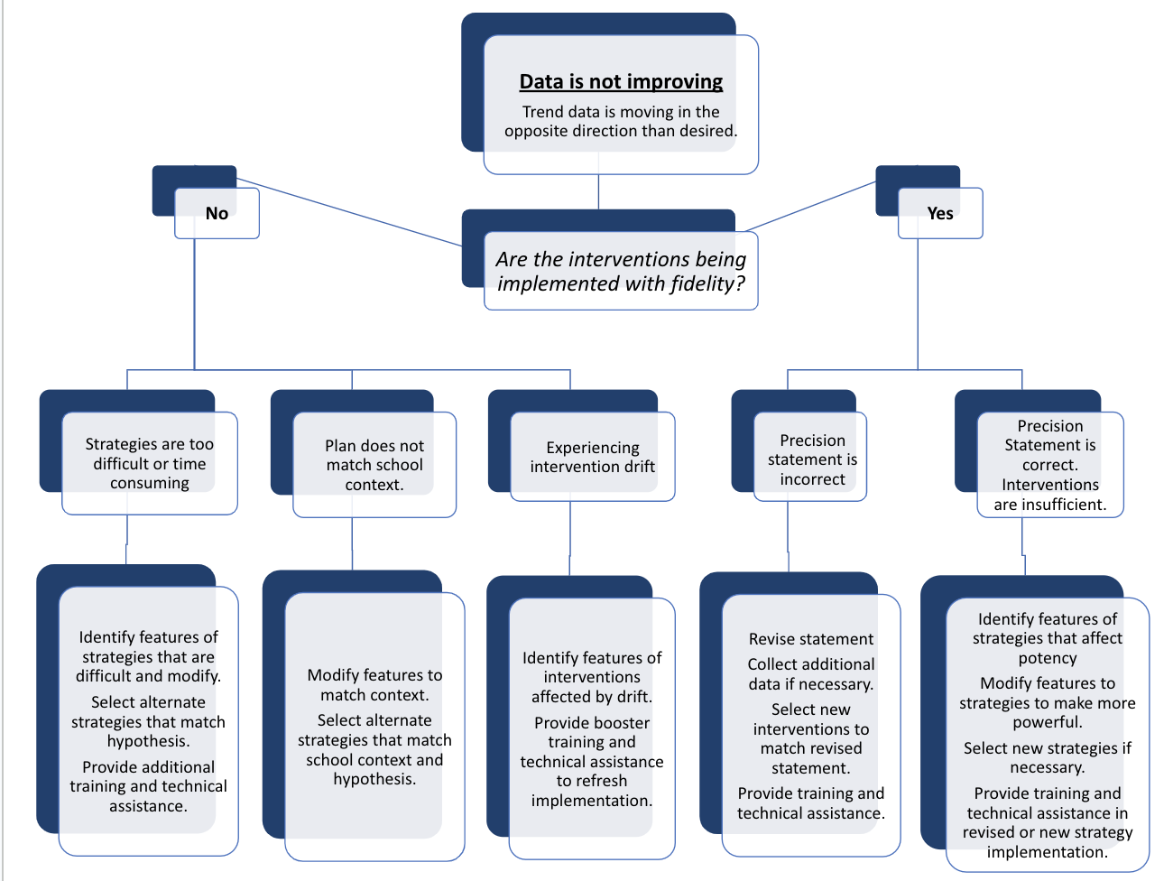
Work Time: Evaluate
To what extent have you considered these evaluation questions?
Evaluate fidelity, outcomes
Notes:
5 min
We want to give you a few minutes to review the flowchart and reflect on and discuss…
To what extent have you considered these evaluation questions?

Slide 116
Evaluate the MTSS Process
Who is
participating?
Reach
Process
What activities
have occurred?
Capacity
What is our overall capacity?
Fidelity
To what extent are we implementing?
Outcomes
Are we achieving valued outcomes?
Notes:
1 min
As we close today, we want to frame our discussion today around the need to always engage in evaluation of MTSS implementation.

Slide 117
Closing
Call to Action!
What is an immediate next step to facilitate the DIDM process in your division?
Consider where you are in this process:
Identifying data to collect?
Identifying red flags?
Working on establishing the “why?”
First draft of a precision statement and goal?
Notes:
Time: 3:00
What is an immediate next step?
Where is your team in this process? (Share with your table - 5 min)

Slide 118
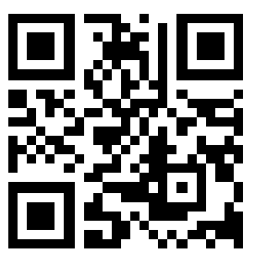
Evaluation
https://tinyurl.com/2p8ppvba

