Slide 1
Data Informed Decision Making for Division Level Teams:
Establishing a Consistent and Effective Problem Solving Process

Slide 2


Follow VTSS
Thank you for attending. Please feel free to tag us at any of our social media handles below!
X (Twitter) - VTSS_RIC
Facebook - VTSSRIC

Slide 3
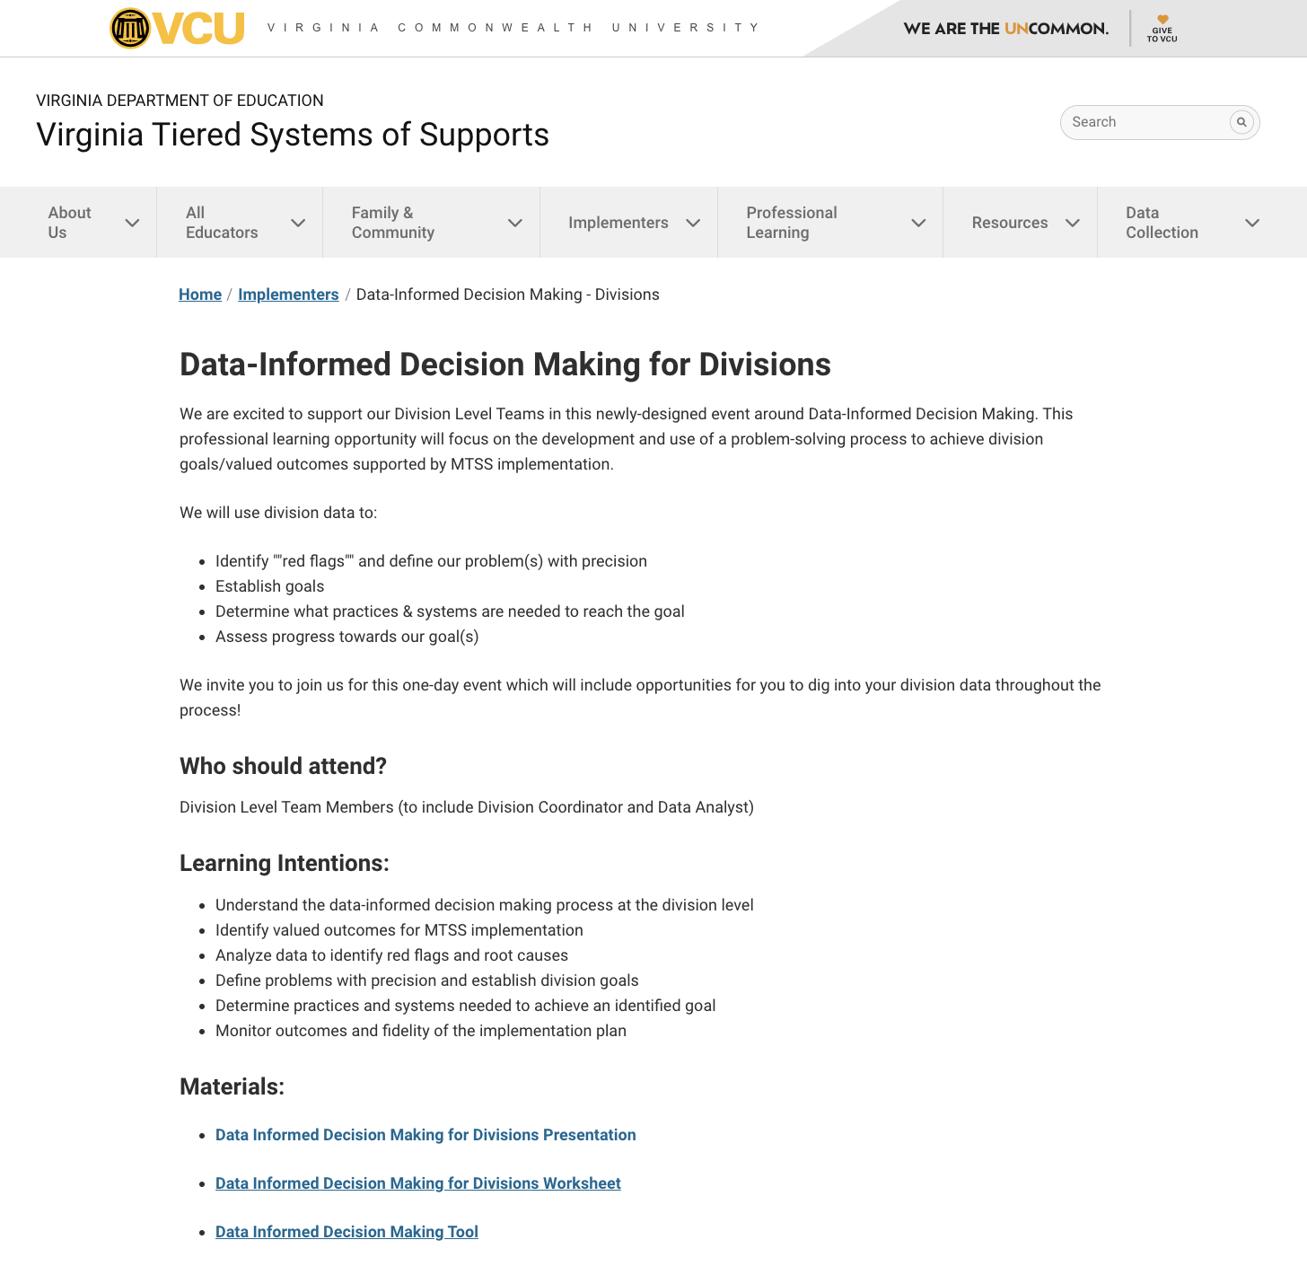

Materials
Workbook
https://vtss-ric.vcu.edu/events/

Slide 4

Agenda
9:00 - 9:45: Welcome & Overview
9:45 - 10:45: Define
10:45 - 10:55: Break
10:55 - 12:15: Analyze
12:15 - 1:00: Lunch
1:00 - 2:15: Implement
2:15 - 2:30: Break
2:30 - 2:50: Evaluate
2:50 - 3:00: Closing & Evaluation
*Work time: 2 ½ hours*

Slide 5
Learning Intentions
Participants will:
Understand the data-informed decision making process at the division level
Identify valued outcomes for MTSS implementation
Analyze data to identify red flags and root causes
Define problems with precision and establish division goals
Determine practices and systems needed to achieve an identified goal
Monitor outcomes and fidelity of the implementation plan

Slide 6
Community Agreements
Be Responsible | Take care of your needs. Share your questions with the group.
Be Respectful | Respect others intentions Honor the impact of your words Earnestly move toward completing tasks during team work time
Be Engaged | Ask what you need to know to understand and contribute. Stay present Listen to others attentively. Share your expertise, information and ideas.

Slide 7


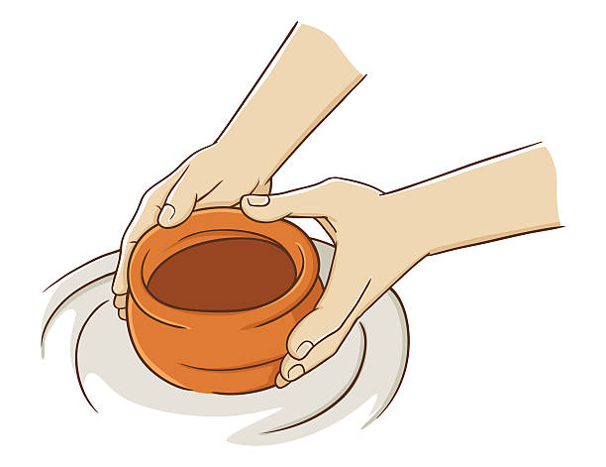



Connection Activity
In my experience, data informed decision making at the division level is like….because….

Slide 8
Overview
Division-level Data Informed Decision Making
Why is this process important?
What are critical features of this process?
How does it relate to school-level decision making?
What valued outcomes have we developed to guide MTSS implementation?

Slide 9
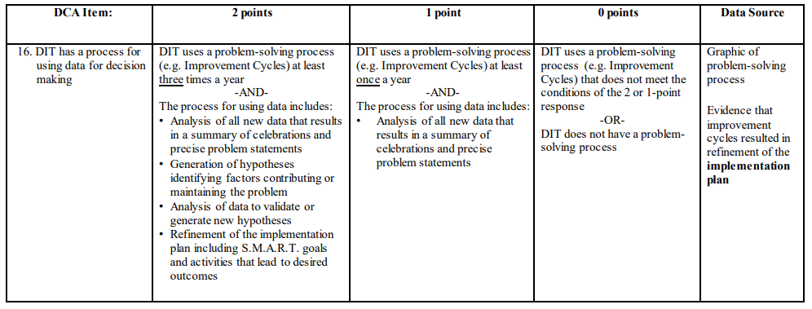
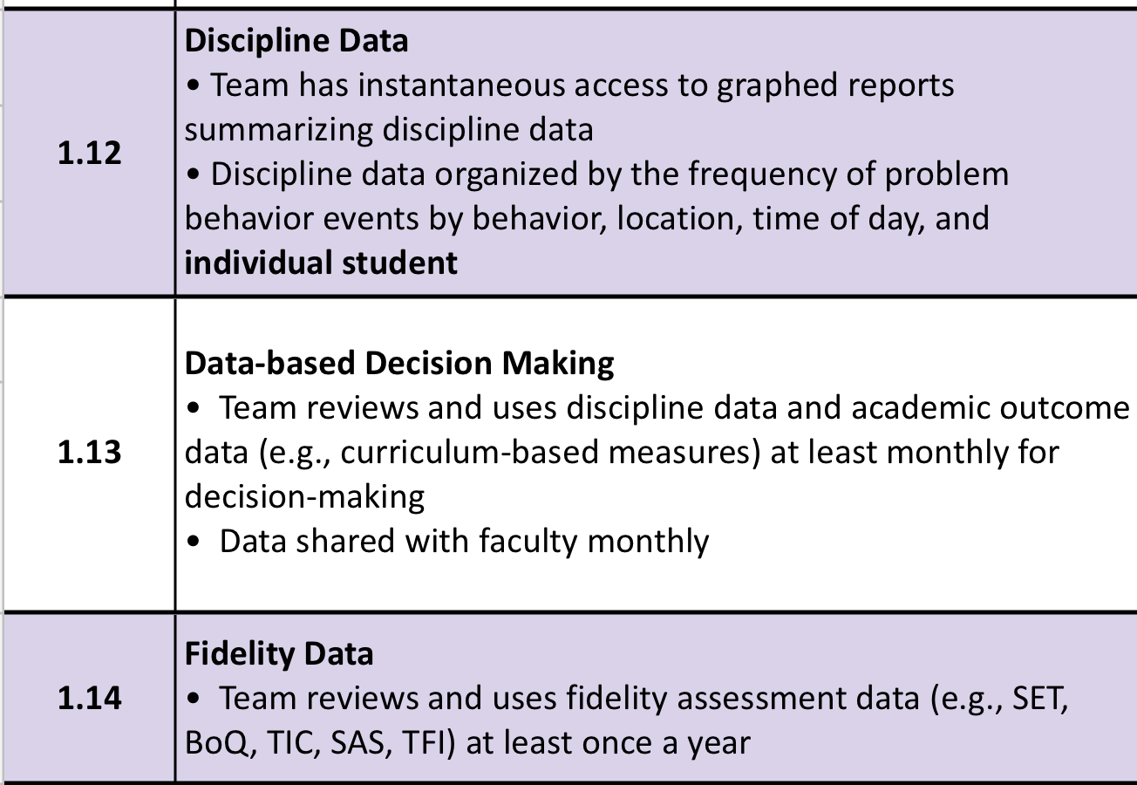
DCA Item 16
Workbook pg. 3

Slide 10
What is MTSS?
MTSS is a systemic, data-driven approach that allows divisions and schools to provide evidence-based practices and interventions to meet the needs of their students. This is done through a clearly defined process that is implemented to fidelity by all stakeholders within the school and/or division.
VTSS is who we are, MTSS is what we do!

Slide 11
Thoughts on Data-Based Decisions
“As decision-makers, we need a deliberate process to guide us through the examination and analysis of data. Without this, we may be apt to substitute strongly held opinions for the fact-based conclusions that would be derived from a review of the actual data.”
- D.B. Reeves, The Leader’s Guide to Standards, 2022

Slide 12




Data Informed Decision Making
Monitor and Evaluate Results
Identify problem with precision
What strategies/ practices will we select and implement? (Supporting student academic and social behavior)
Data
What does the data say? Analyze strengths and opportunities for growth.
What do teachers need to implement/sustain?
Establish a SMART goal
Workbook pg. 9
Florida Positive Behavioral Interventions & Supports Project

Slide 13
Root Cause Analysis
There’s no single way to conduct a root cause analysis, but it usually comprises of three steps:
Identify a problem
Identify the cause(s) of a problem
Identifying strategies to address the problem.
There are many publicly available tools to use for this process.
U.S. Dept of Education, Office of Elementary and Secondary Education

Slide 14
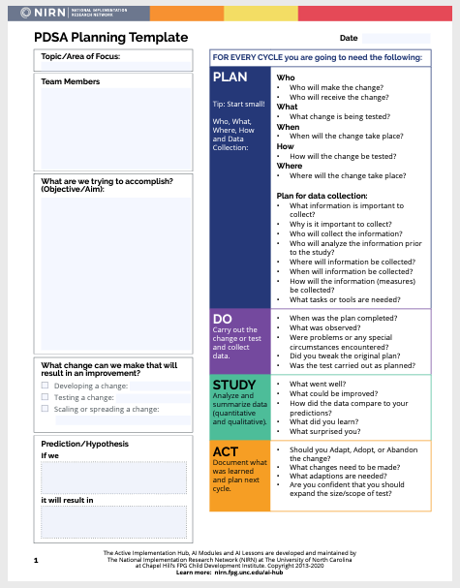
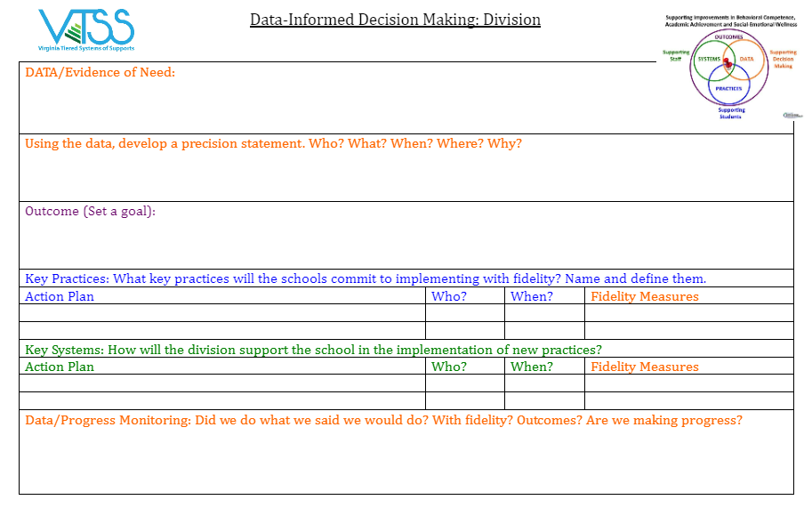
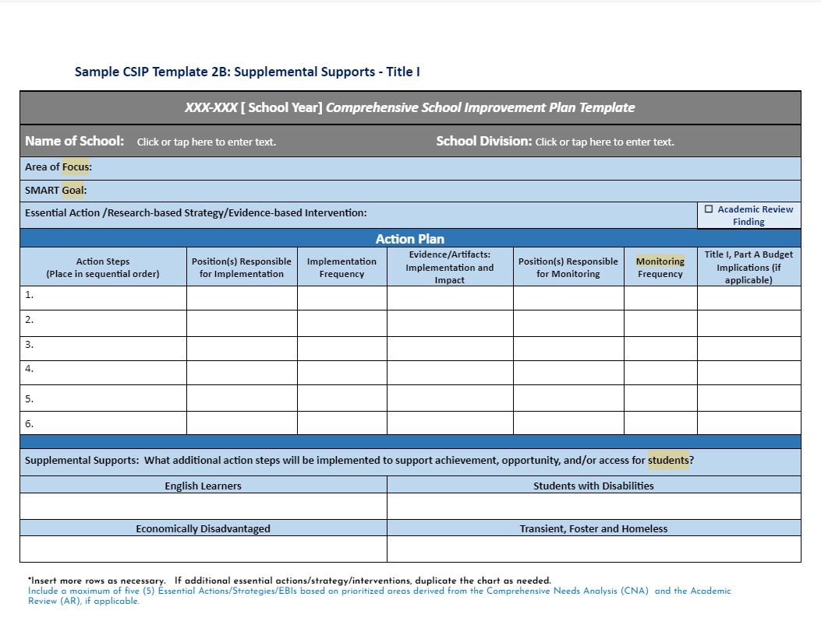
Function over Form
(as long as you are documenting)
Workbook pg. 8

Slide 15
Role of Data Analyst
The role of the data analyst(s) can vary depending on the platform, size of division, etc.
HOWEVER: Be sure that you are always coming back to monitor the goals you set in your data informed decision making process and that someone is responsible for having it available.
Division A: This division has subgroups that report the data to the division leadership team (e.g., literacy).
Division B: The data is organized by the accountability and testing staff.
Division C: A sophisticated data systems exists. The data analyst is the “driver” in the meeting.

Slide 16
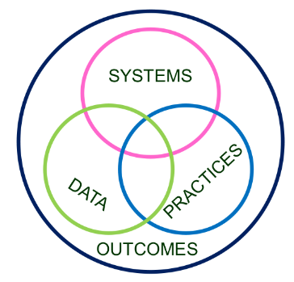
Division and School Level
Decision Making
Workbook pg. 10
Invest in Systems!!! (Leadership teams, support professional learning and coaching)
Differentiate and ensure outcomes are reflective of all students
Data informs decisions about screening, progress monitoring, fidelity, and outcomes
Prioritize efficient and effective practices
(evidence, culture, context)
Growth & benefit are central. Must reflect learning opportunities for all
16

Slide 17
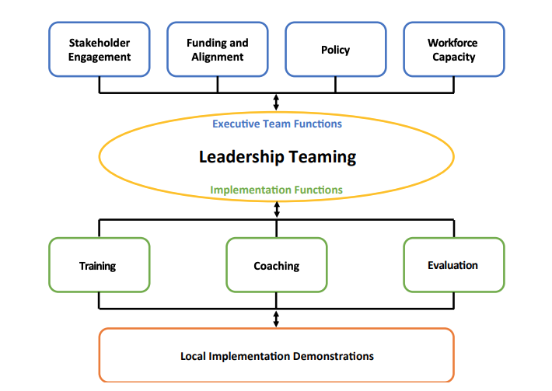
Division-level MTSS
Organizing across multiple schools improves efficiency in resources, implementation efforts, and organizational management. It provides a supportive context for implementation at the local level.

Slide 18
Data Through a MTSS Lens
MTSS integrates data-informed decisions that are already happening in silos.
MTSS provides a consistent common approach and structure for reviewing multiple data points, identifying trends, and determining root cause.
(Dana Ashley, American Educator, 2015)

Slide 19
DIDM at the Division Level
DIDM at a division level helps teams to progress monitor toward identified valued outcomes that are aligned with:
division strategic goals
division mission and vision statements

Slide 20
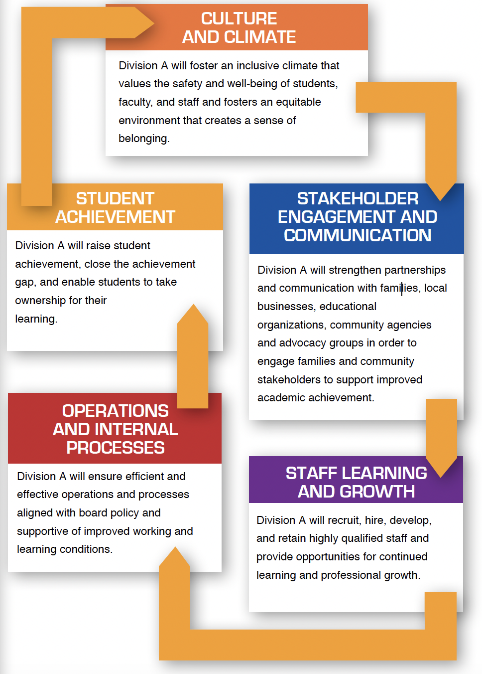
Division A
Vision and Mission
Strategic Goals
VISION
We envision a school division that cultivates excellence for all.
MISSION
The mission of Division A is to inspire, educate, and develop students, in collaboration with families and the community, to ensure students graduate college and/or career ready.

Slide 21
Division A: The Beginning
Strategic Plan
  Identified ONE (1) Area on Strategic Plan
    Culture and Climate
  Identified ONE (1) Objective in that Area
    Create and maintain a welcoming, inclusive, and equitable school climate that promotes learning

Slide 22
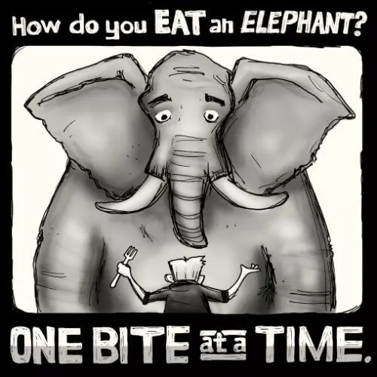
Division A

Slide 23



Work Time
Discuss:
What valued critical outcomes are critical?
How have you used the MTSS framework to address any of these valued outcomes?
Identify current valued outcome/s that can be addressed using the MTSS framework.
Valued Outcomes
Workbook pgs. 4-7

Slide 24
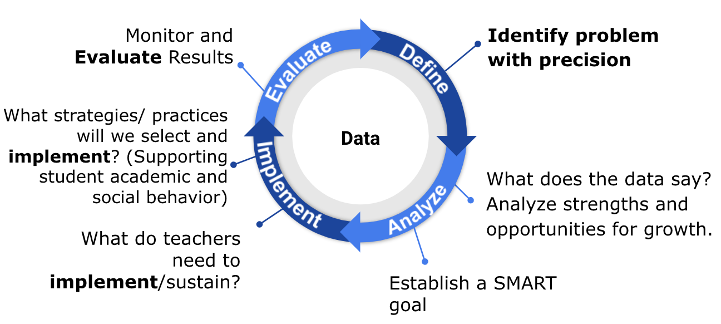
DEFINE:
What is the Problem?

Slide 25

Types of Problems
Known/Suspected
Unknown/Hidden
Begins with a concern or a question from superintendent or DLT
Specific data (grade retention, attendance, SOL’s, climate surveys, etc.) are used to determine if an issue exists.
Cannot assume the concern or question accurately represents reality
Recognizes areas outside of daily lived experiences
Looks at big data and disaggregates based on grade, gender, race, SES, location, time, etc.
Involves teacher, student, and family voice and concerns

Slide 26
Data: Evidence of Need
What is your data story?
Here, we answer the following question:
Is there a problem? What is the data that indicates that there is a problem that needs to be addressed?
Academics
Behavior
Attendance
Social Emotional Wellness
Community health
Teacher retention
Family engagement

Slide 27

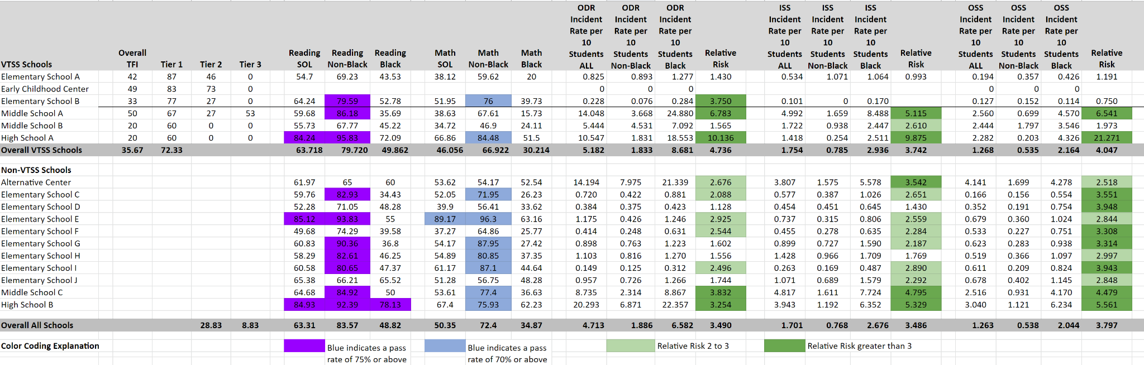
VA School Quality Profile
https://schoolquality.virginia.gov/

Slide 28
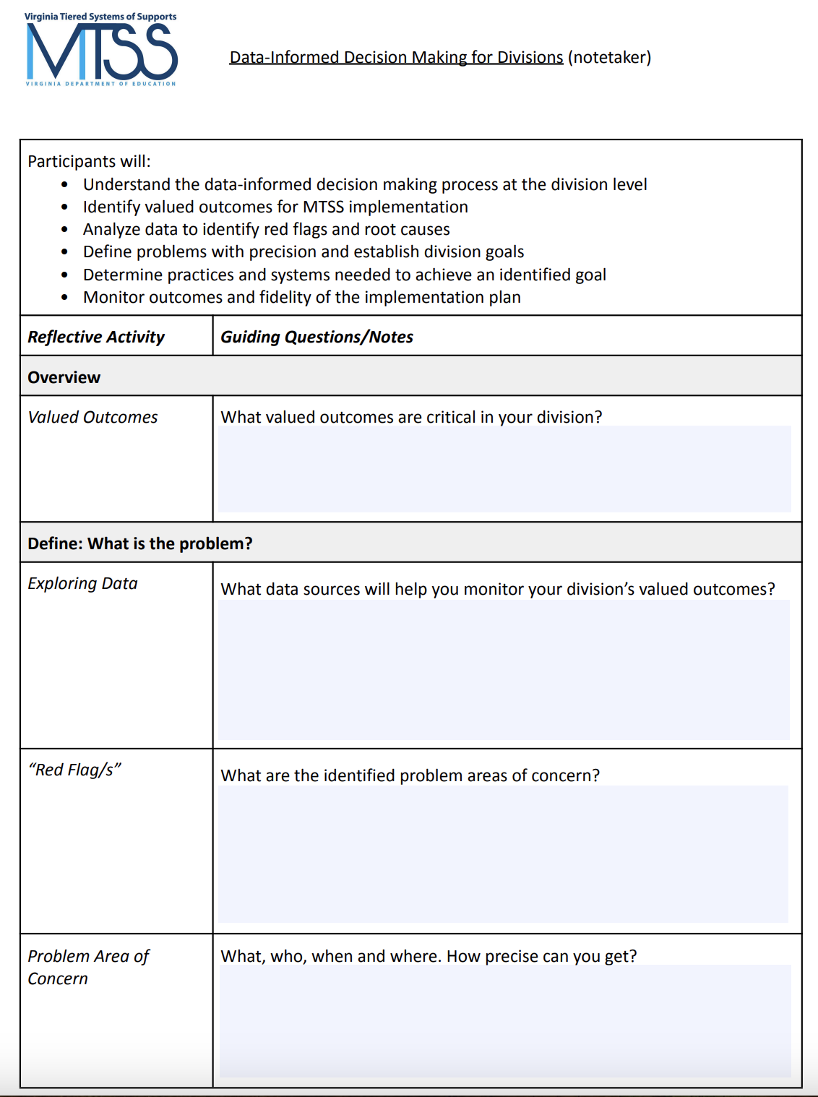

Work Time
Discuss:
What data sources will help you monitor your division’s valued outcomes?
Exploring Data
Workbook pgs. 11 & 12
pg. 4
5 minutes

Slide 29

Got Data?

Slide 30

Data Driven Dialogue Protocol
Phase I-Prediction:
I predict/expect the data show…
My predictions/expectations are influenced by…
Prediction
Observations
Inferences
Workbook pgs. 13-16

Slide 31

Data Driven Dialogue Protocol
Phase II-Observations:
I observe that…
Some patterns/trends that I notice…
I can count…
I’m surprised that I see…
*No judgment or explanation
Prediction
Observations
Inferences
Workbook pgs. 13-16

Slide 32
Data Driven Dialogue Protocol
Phase III-Inferences
I believe the data suggests… because…
Additional data that would help me verify/confirm my explanations is…
Additional data that would help guide implementation of solutions/responses and determine if they are working
Prediction
Observations
Inferences
Workbook pgs. 13-16

Slide 33

Data Protocols
Protocols that support data exploration:
Data-driven Dialogue Protocol
Atlas Protocol
Data-Mining Protocol
https://www.schoolreforminitiative.org/protocols/
Workbook pg. 28

Slide 34

Identifying Red Flags
In what general area(s) are our outcomes not meeting our shared expectations?
  What trends have we observed across schools related to identified problem areas?
    Who is not experiencing success based on what is represented in the data?
Do data suggest we have a strong Tier 1 across academic, behavior, and social emotional wellness?
Which unmet needs have we uncovered?
  Which are the most pressing to address
now?

Slide 35
Division A Red Flags
Strategic Plan
  Identified ONE (1) Area on Strategic Plan
    Culture and Climate
  Identified ONE (1) Objective in that Area
    Create and maintain a welcoming, inclusive, and equitable school climate that promotes learning

Slide 36
Division A
What is the “Red Flag?”
VA School Quality Profile data reflects that, during that 2022-23 SY, 30% of the student population missed 10% or more school days.
Currently, during the 2023-24 SY, 35% of the student population is at-risk of being chronically absent (missing 10% of the current school days).

Slide 37
Work Time
Discuss:
Looking at your data sources that monitor your valued outcomes, what are the areas of concern?
Your “red flags.”
Red Flag/s
Workbook pg. 4
15 minutes

Slide 38
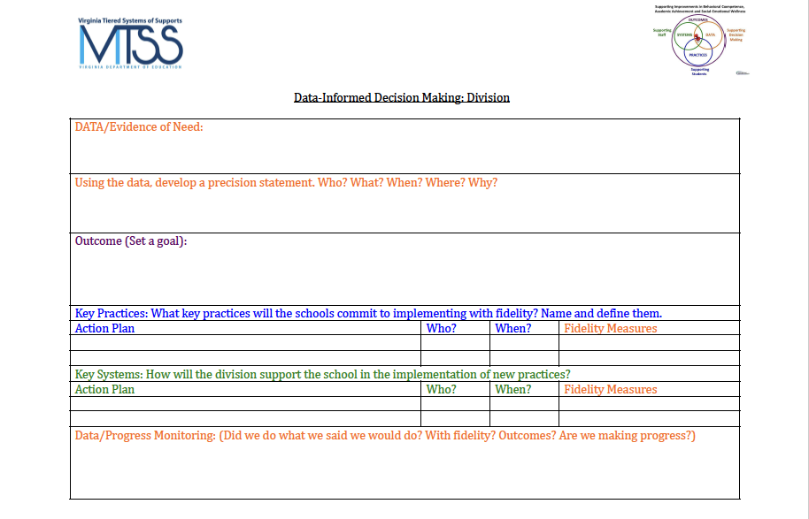
Documentation:
Data/Evidence of Need
Workbook Page 8

Slide 39
Based on your data…
Precisely define the problem by identifying who, what, when, where, and why.
What is the problem?
Who is having the problem?
When is the problem occurring?
Where is the problem occurring?
Why is the problem occurring?

Slide 40
Examples:
Problem Area of Concern
Example: Across the division, 47% of eighth grade students in 2023 failed to pass the reading SOL.
Example: During the 2022-23 school year 31% of high school students, grades 9-12, received multiple office discipline referrals for dress code violations, as defined in the student handbook.

Slide 41
Division A:
Problem Area of Concern
“Currently, during the 2023-24 SY, 35% of the student population is at-risk of being chronically absent (missing 10% of the current school days). The highest levels of chronic absenteeism were more prevalent in secondary schools among students being reported as economically disadvantaged. During the 2022-23 SY, absenteeism was higher in September and January.”

Slide 42
Work Time:
Problem Area of Concern
Write a Problem Area of Concern
Where Are Your Gaps?
What
Who
When
Where
(We’ll get to the “Why”)
How precise can you get?
Don’t get lost in the weeds, but be clear about the problem.
Are all assumptions challenged or verified by data?
What do you need to finish your problem statement?

Slide 43


Slide 44
ANALYZE
Why is it occurring?

Slide 45
Precision Statement
Now we precisely define the problem by identifying who, what, when, where, and why.
What is the problem?
Who is having the problem?
When is the problem occurring?
Where is the problem occurring?
Why is the problem occurring?

Slide 46

Stakeholder Feedback

Slide 47
Importance of Stakeholder Engagement
“When schools and districts can learn from and meaningfully engage the expertise of the students, families, and communities who have been marginalized by our systems, we can begin to work together toward building more responsive and just schools.”
Ishimaru & Takahashi (2017)

Slide 48

Important Conversations
To truly understand the problem/challenge we have to gain insight from those affected by the problem/challenge.
They can help us understand:
What does this problem
look/sound/feel like for them?
Who is this problem affecting and
in what way?
When is this problem affecting them more? the least?
Where do they experience this problem the most?
Why do they think this problem is occuring?

Slide 49
Tools for Feedback
There are different tools you might use to explore the WHYs from the perspective of stakeholders.
Empathy interviews
Focus groups
Surveys
Ex. Conducting a school climate survey for students and families to see how they feel about school. Include what they think is working / not working. Work with schools to figure out the best time and way to give surveys. Get results back by mid-October and review as a team at
November meeting.

Slide 50


Work Time
How are you currently obtaining stakeholder feedback?
Identify which stakeholder groups you need to obtain feedback from.
  Who is the problem impacting?
Discuss the method(s) by which feedback will be gathered.
Stakeholder Feedback
*Workbook pg. 17

Slide 51
Division A:
Stakeholder Feedback
Families:
illness
housing instability
economic hardships
confusion about attendance policies and procedures
Students: “Why do you come to school?”
adult support
belonging to a positive peer group
commitment to education and future goals
school environment (e.g. feel safe,
supported and engaged in class; school is fun)

Slide 52

Identifying the “Why”

Slide 53
Why Conduct
Root Cause Analysis?
Prevents “solutionitis”
Produces insights into the system as a whole
Prompts brutally honest discussions about why unsatisfactory outcomes occur
Prompts participants to look at problems from the user perspective
Ensures the initial problem is narrow and concrete enough to improve
Informs tactical action and solutions moving forward
Enhances the group’s ability to develop targeted and measurable outcomes
Office of School Quality, Dr. April Kaiser Edwards, VDOE

Slide 54
Root Cause Helps Separate
Story from Fact
Example:
Story: Students are not coming to school because they don’t care.
Fact: Data shows that some students are having difficulty getting up for school on time because they have to be at the bus stop by 6:30am.

Slide 55
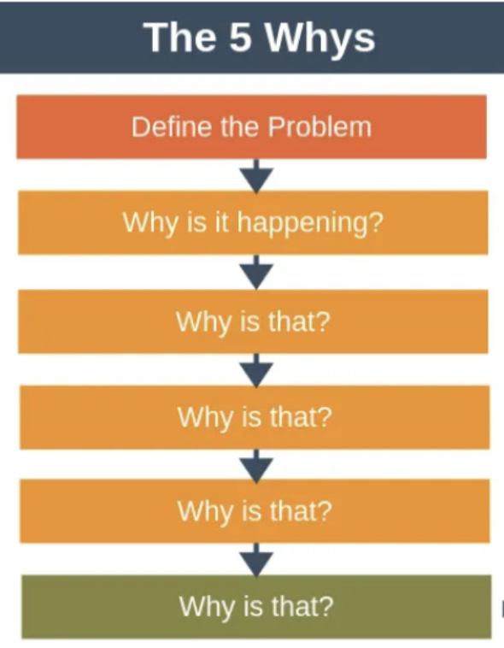
The 5 Whys
“Instead of jumping to solutions, we take the time to ask ‘why’ to get closer to the root cause.”

Slide 56

A Division Example
Black and Latinx students are underrepresented in our in our AP classes
Why?
Black and Latinx students don’t sign up for AP classes.
Why do Black and Latinx students not sign up for AP classes?
Black and Latinx students are not encouraged by their teachers or counselors to sign up for AP classes.
Why are B/L students not encouraged to sign up for AP classes?
Teachers and counselors do not believe that most B/L demonstrate the skills necessary to handle the rigor of AP classes.
Why do teachers and counselors not believe that most B/L demonstrate the skills necessary to handle the rigor of AP classes?
Teachers and counselors equate low test scores and grades with inability to handle higher level courses.

Slide 57
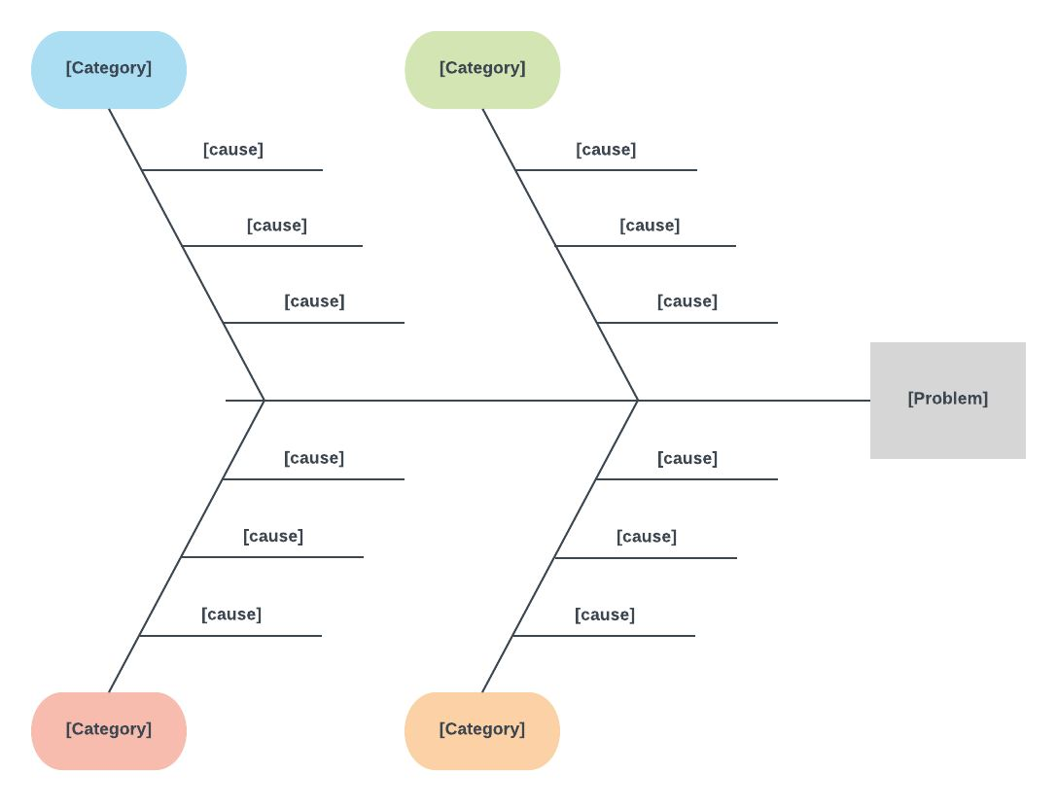
Fishbone Diagram
A “fishbone” diagram, can help in brainstorming to identify possible causes of a problem and in sorting ideas into useful categories.
Workbook pg. 21

Slide 58
Division A: Getting to the “Why”
“Why is 35% of the student population at-risk of being chronically absent, particularly within secondary schools among students being reported as economically disadvantaged?”
DLT fishbone of the problem
  8 initial “whys”

Slide 59
Brainstorming our “Why”:
“Why is 35% of the student population at-risk of being chronically absent, particularly within secondary schools among students being reported as economically disadvantaged?”
Lack of communication with families about attendance procedures and supports and their student’s current attendance record
Health concerns (short-term illness, chronic illness, and medical/dental/mental health appointments)
Personal stress (depression/ sadness, stressed/upset, family emergencies)
Transportation difficulties; food and housing insecurity
Challenges associated with poverty: lack of health and mental health resources, affordable housing, transportation concerns, witnessing or being a victim of violence
School stress (perception of difficulty with schoolwork, lack of preparedness for a class, and avoidance of a teacher, class or student)
Lack of school connectedness or perception of relevance for reaching future goals
Rates of suspension too small or too large for identified groups of students
Workbook pg. 18

Slide 60
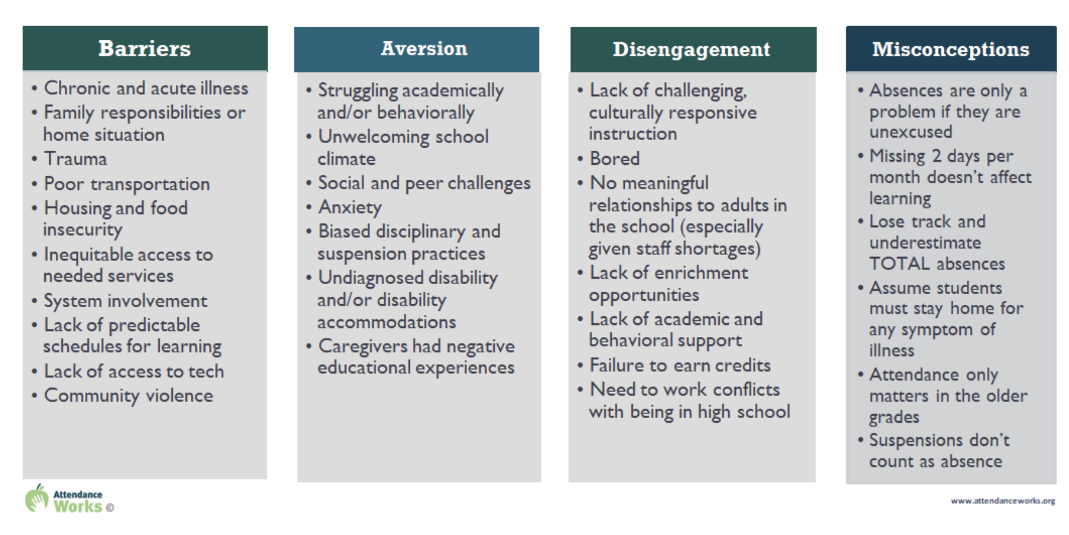
Root Cause:
What does the Research Say?
https://www.attendanceworks.org/chronic-absence/addressing-chronic-absence/3-tiers-of-intervention/root-causes/
Workbook pg. 19

Slide 61
Division A:
Making Sense of our “Why”
Barriers:
Health concerns (short-term illness, chronic illness, and medical/dental/mental health appointments)
Personal stress (depression/ sadness, stressed/upset, family emergencies)
Transportation difficulties; food and housing insecurity
Challenges associated with poverty: lack of health and mental health resources, affordable housing, transportation concerns, witnessing or being a victim of violence
Aversion:
School stress (perception of difficulty with schoolwork, lack of preparedness for a class, and avoidance of a teacher, class or student)
Disengagement:
Lack of school connectedness or perception of relevance for reaching future goals
Misconceptions:
Lack of communication with families about attendance procedures and supports and their student’s current attendance record

Slide 62
Division A:
Where Will We Start?
What are the overlaps between the potential root causes and family/student feedback?
2. Which root cause/s do we have data to support?
3. Which root cause/s will have the greatest positive impact on our goal?

Slide 63
Lack of communication with families about attendance procedures and supports and their student’s current attendance record
Example:
Faculty and staff are unsure of district policy
Only sent home once at the beginning of the year in the handbook
Not prominent on the website
Why is 35% of the student population at-risk of being chronically absent, particularly within secondary schools among students being reported as economically disadvantaged?
Hard to reach the families of chronically absent students
Faculty and staff are unsure who is responsible for reaching out to families
Workbook pg. 20
Students don’t feel like they belong/are accepted at school
Students have jobs and work late hours
Lack of scaffolding in instruction
Instruction primarily focuses on “drill and kill” teaching strategies
Transportation difficulties; food and housing insecurity
Increase in reported anxiety and depression among students
School stress (perception of difficulty with schoolwork, lack of preparedness for a class, and avoidance of a teacher, class or student)

Slide 64
Lack of communication with families about attendance procedures and supports and their student’s current attendance record
Example:
Faculty and staff are unsure of district policy
Not prominent on the website
Why is 35% of the student population at-risk of being chronically absent, particularly within secondary schools among students being reported as economically disadvantaged?
Lack of scaffolding in instruction
Increase in reported anxiety and depression among students
School stress (perception of difficulty with schoolwork, lack of preparedness for a class, and avoidance of a teacher, class or student)

Slide 65
Division A:
Data to support the “why”
Lack of communication with families about attendance procedures and supports and their student’s current attendance record
Faculty and staff are unsure of the district policy and student attendance rates…and…who is responsible for communicating with families
Feedback from families where multiple variants of the district policy (if any) were relayed to families from faculty and staff…and they were unaware of their student’s current attendance record.
Website is difficult to navigate and the policy was not prominently displayed
Website traffic data indicated the policy page was the least visited.
Lack of communication with families about attendance procedures and supports and their student’s current attendance record

Slide 66
Division A:
Data to support the “why” (cont’d)
School stress (perception of difficulty with schoolwork, lack of preparedness for a class, and avoidance of a teacher, class or student)
School stress (perception of difficulty with schoolwork, lack of preparedness for a class, and avoidance of a teacher, class or student)
“Increase in reported anxiety and depression among students.”
  Student safety survey indicated an increase in student anxiety and depression.
“Lack of scaffolding in instruction.”
  A review of principal classroom walkthroughs showed a high percentage of teachers inadequately scaffolding concepts and content to help students develop understanding.

Slide 67
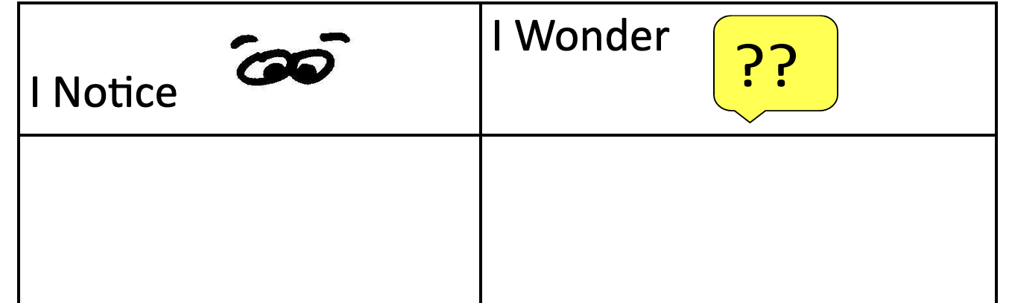


Independent Work Time:
Fishbone Step 1
What do you notice about your red flag/issue/problem?
What questions do you have?
Why might the red flag/issue be happening?

Slide 68
Work Time: Fishbone Step 2
In your teams, share out what you noticed and wondered about your red flag/issue/problem.
How can these noticings/wonderings be grouped?
These groupings will be used to define your major categories.

Slide 69
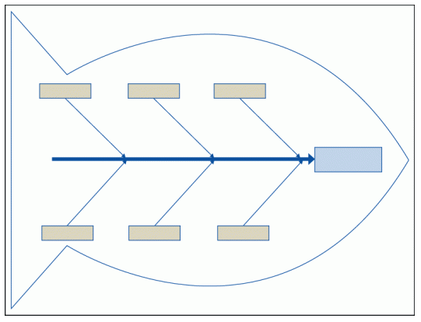

Work Time: Fishbone Step 3
Place your red flag at the “head of the fish.”
Place all of your major categories from your group time as the “ribs” of the fish.
Select one “rib” and ask “Why is this?”
Have a recorder write down the group’s answers.
Workbook pg 21

Slide 70
Division A Precision Statement:
Bringing it All Together
“In 2023, 35% of the student population was at-risk of being chronically absent, particularly within secondary schools among students being reported as economically disadvantaged. This is believed to be due to a lack of communication about our absentee policy, student’s current attendance record, and attendance supports along with an increase in student stress.”

Slide 71
Documentation:
Precision Statement
Page 8

Slide 72

Lunch Time!

Slide 73


Identify a Goal for Change
After a precision statement is developed, teams will now describe how they will know when the problem has been resolved.
What does success look like?
When do we expect to see the problem resolved?
(Center on PBIS, Data Based Decision Making)

Slide 74

Characteristics of a Strong Goal
Goals allow you to analyze, monitor, and adjust professional practice. Goals are…

Slide 75
SMART Goal Example
Timely
Specific
By December 2024, educators will develop and implement with 85% fidelity a science instructional framework as evidenced by classroom observations and a 5% increase between pre and post teacher benchmark scores.
Measurable & Achievable
Realistic

Slide 76
SMART Goal Example 2
The number of middle school students with multiple ODR’s for inappropriate dress will decrease by 30% within the first semester of the 2024-25 school year as compared to the first semester of the 2023-24 school year.

Slide 77
SMART Goal Example 2.1
The number of middle school students with 0-1 ODR’s for inappropriate dress will increase by 30% within the first semester of the 2024-25 school year as compared to the first semester of the 2023-24 school year.

Slide 78


Work Time: SMART Goal
Division A Precision Statement:
“In 2023, 35% of the student population was at-risk of being chronically absent, particularly within secondary schools among students being reported as economically disadvantaged. This is believed to be due to a lack of communication about our absentee policy, student’s current attendance record, and attendance supports along with an increase in student stress.”
Specific
Measurable
Achievable
Realistic
Timely

Slide 79


Division A: Smart Goal
“By June 2025, the percentage of students being reported as economically disadvantaged in secondary schools who are attending school more than 90% of the year will increase from 65% to 80%. This will be periodically checked each nine weeks across all grade levels to see if progress is on track for the end of the year.”
Specific
Measurable
Achievable
Realistic
Timely

Slide 80
Documentation: Setting a Goal

Slide 81
IMPLEMENT
What are we going to do about it?

Slide 82

Developing Solutions

Slide 83
According to Research…
Typical Problem Solvers
Effective Problem Solvers
Define problems loosely or vaguely.
Define a problem in observable and measurable terms.
Don’t validate assumptions before building a plan.
Collect and use multiple sources of information to validate assumptions about the problem.
Develop generic plans.
Create highly detailed steps to implement the intervention/plan with fidelity.
Brian Gaunt, Ph.D., University of South Florida, May 2023

Slide 84
School Leadership Involvement
How can we loop schools into the goal setting and solution finding?
ASK! Engage in collaborative inquiry with your school leadership teams.
  How is the school’s data part of (or not) division trends?
  Did we develop a good goal?
  Have we developed solutions that will seem to work? (DCA #11 - Process for addressing internal barriers.)
  What supports are needed to effectively implement the solutions?

Slide 85
Stakeholder Voice:
Students and Families
Whose perspectives do we normally include when developing solutions?
How do we include missing perspectives into the conversation?
“Authentic family or community engagement includes providing family, students, and community members with meaningful opportunities to be heard, and voice their opinions, and exercise leadership within the school system.” (pbis.org, 2021)

Slide 86

Developing Solutions:
Stakeholder Involvement
Team Representation:
  Are additional team members needed for action planning? (i.e. stakeholders impacted by the data)
Division A
“By June 2025 the percentage of students being reported as economically disadvantaged in secondary schools who are attending school more than 90% of the year will increase from 65% to 80%. This will be periodically checked each nine weeks across all grade levels to see if progress is on track for the end of the year.”

Slide 87
Developing Solutions
What practices need to be in place in order to address the problem?
What systems (i.e. PD, coaching) need to in place to support the implementation of these practices?
The precision statement developed through root cause analysis can guide this planning.

Slide 88
Practices

Slide 89
Identifying Practices:
What has been done already?
What is being implemented now to address the problem?
What barriers did schools face when implementing? Was there sufficient support for barrier-busting?
Was there adequate professional learning, coaching, administrative support, performance feedback?
Were the right action steps taken to ensure fidelity of implementation?
Were the right people taking responsibility for guiding the change process?

Slide 90
Identifying Practices:
What still needs to be done?
THINK: Innovation!
What are the appropriate responses that address the needs implied in the data?
What do you want schools and teachers to do?
If you don’t have key practices, you may have to utilize a formal selection process.
* Remember! Practices you select should be teachable, learnable, doable, and readily assessed in practice.

Slide 91

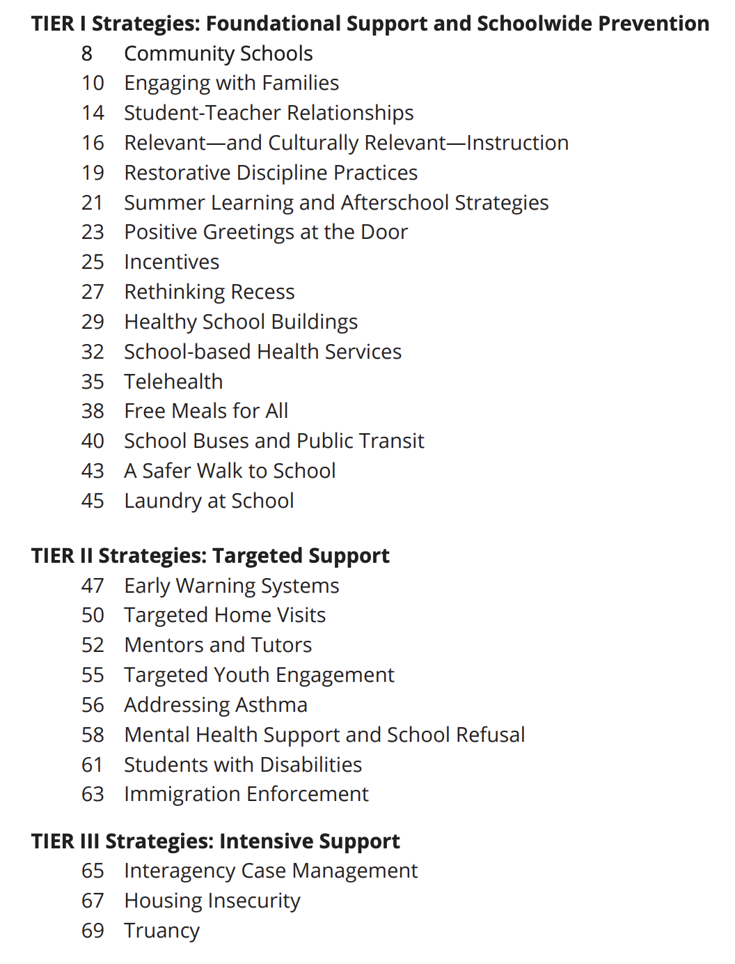
Attendance Works:
What Does the Research Say?

Slide 92
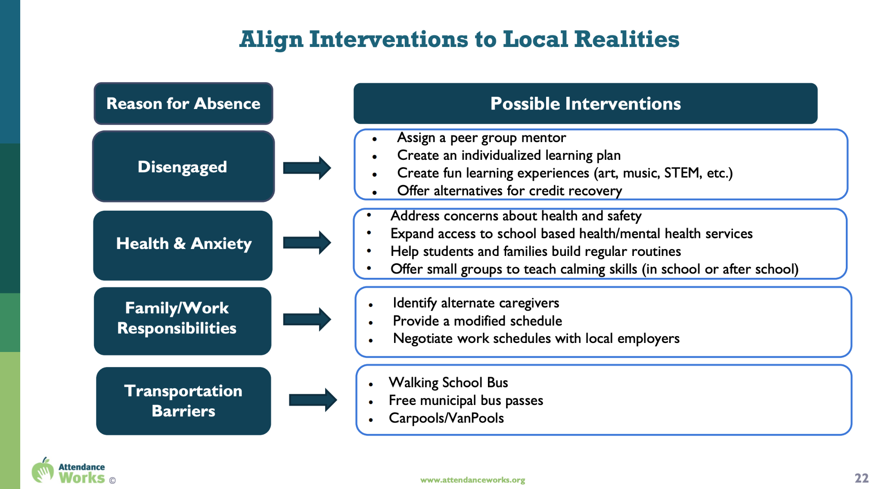
Attendance Works:
Alignment to Root Cause

Slide 93
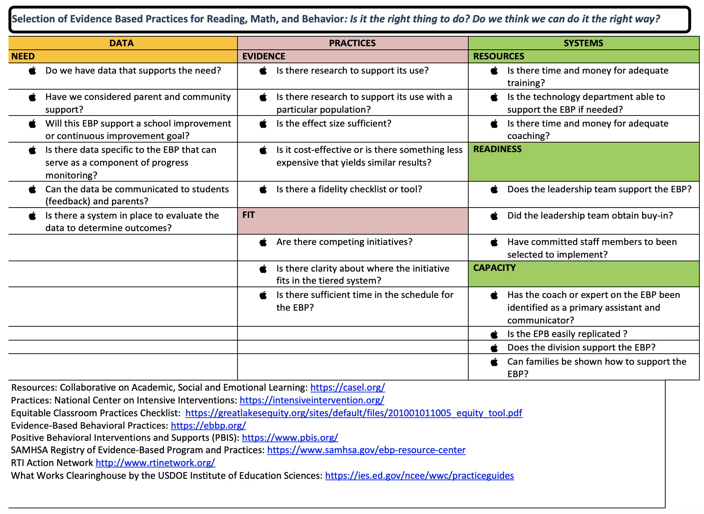
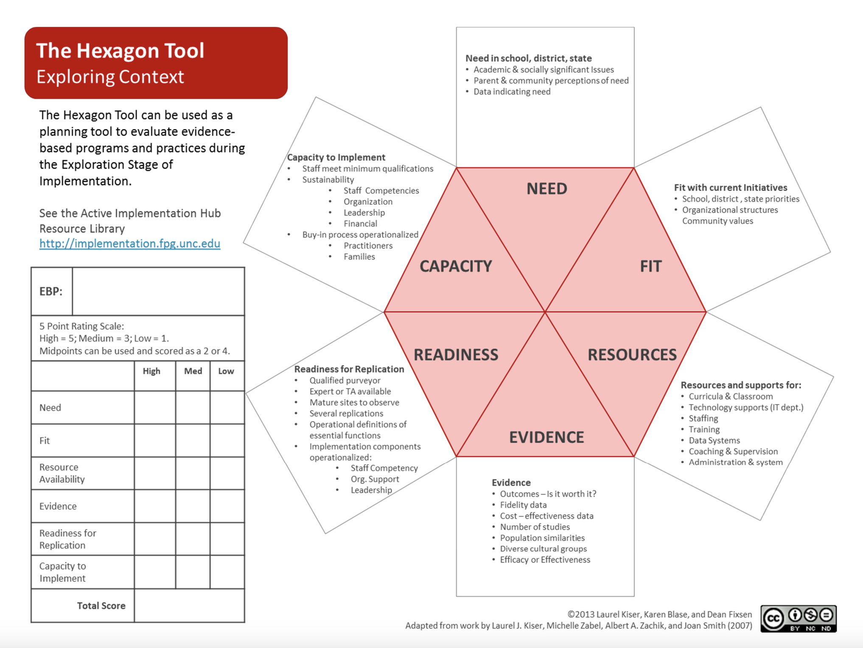
Selection Tools: Exploring Context
Hexagon Tool
Evidence-Based Practice Selection Tool

Slide 94
Solution Development
Does your division have a process for selecting practices/programs?
Choose 1 tool and identify any questions/areas that might have been helpful in any past decision making processes.
Selecting Practices
Workbook pgs. 22-24

Slide 95
Systems

Slide 96
Identifying Systems: Expectations
Include actions that provide a clear definition of expectations for schools. i.e.
new/revised policies and procedures
performance feedback
progress monitoring
* Management structures and division size impact these factors.

Slide 97
Identifying Systems: Support
Be specific about how the division plans to support school staff in implementation. i.e.
professional learning
coaching
data systems
* Management structures and division size impact these factors.

Slide 98
Identifying Systems: Communication
Include communication plan. i.e.
Who is sharing the plan? How will that occur?
Who will report progress back to the division?
Who will share progress with students and families?
* Management structures and division size impact these factors.

Slide 99
Work Time
Division A
Division A tentative Plan:
Establish a text messaging system to communicate students’ absenteeism rate with families.
Revise division website to direct the community more prominently to attendance policies and current attendance campaigns.
Increase instructional coaching focus to target scaffolding within secondary classrooms.
Partner with students to establish mentor programs for students who are identified as being high risk.
Identifying Systems
To ensure effective implementation of these identified practices,
what systemic supports should
be considered?
Workbook pg. 25

Slide 100
Evaluation Plan
After identifying practices and systems, consider…
When are they expected to be implemented?
How will we know it’s been done?
Who will monitor fidelity of the plan?
Fidelity
When will the DLT review progress toward outcomes?
Who will gather and
share outcome data?
Outcomes

Slide 101

Evaluation: Fidelity & Outcome Data
Workbook pg. 22
Lucky | Sustaining
Positive outcomes, low understanding of how they were achieved Replication of success is unlikely | Positive outcomes, high understanding of how they were achieved Replication of success likely
Losing Ground | Learning
Undesired outcomes, low understanding of how they were achieved Replication of failure likely | Undesired outcomes, high understanding of how they were achieved Replication of mistakes unlikely
Outcomes
Fidelity

Slide 102
Work Time
Division A
Division A tentative Plan:
Establish a text messaging system to communicate students’ absenteeism rate with families.
Revise division website to direct the community more prominently to attendance policies and current attendance campaigns.
Increase instructional coaching focus to target scaffolding within secondary classrooms.
Partner with students to establish mentor programs for students who are identified as being high risk.
Developing an Evaluation Plan
What fidelity and outcome data might you suggest
this division use?

Slide 103
Documentation:
Implementation Plan

Slide 104

Keep in mind…
DIDM cannot be completed in 1-2 meetings.
DIDM is an ongoing process.
As teams select practices, they may need to go back to the identification of systems.

Slide 105

5 Minute Break

Slide 106
EVALUATE
Is it working?

Slide 107

Are we making adequate progress toward our goal?
YES
NO
Celebrate!!
If the goal is met:
Identify strategies to maintain or sustain
Determine if there are components that require fading
Consider extending the scope of the plan if relevant
Check fidelity

Slide 108
Adapted from “Prevent-Teach-Reinforce:
The School-Based Model of Individualized Positive Behavior Support”, 2010
Workbook pg. 27
Data is not improving
Trend data is moving in the opposite direction than desired.
No
Yes
Are the interventions being implemented with fidelity?
Strategies are too difficult or time consuming
Plan does not match school context.
Experiencing intervention drift
Precision statement is incorrect
Precision Statement is correct. Interventions are insufficient.
Identify features of strategies that are difficult and modify.
Select alternate strategies that match hypothesis.
Provide additional training and technical assistance.
Modify features to match context.
Select alternate strategies that match school context and hypothesis.
Identify features of interventions affected by drift.
Provide booster training and technical assistance to refresh implementation.
Revise statement
Collect additional data if necessary.
Select new interventions to match revised statement.
Provide training and technical assistance.
Identify features of strategies that affect potency
Modify features to strategies to make more powerful.
Select new strategies if necessary.
Provide training and technical assistance in revised or new strategy implementation.

Slide 109
Data is not improving
Trend data is moving in the opposite direction than desired.
No
Yes
Are the interventions being implemented with fidelity?
Strategies are too difficult or time consuming
Plan does not match school context.
Experiencing intervention drift
Precision statement is incorrect
Precision Statement is correct. Interventions are insufficient.
Identify features of strategies that are difficult and modify.
Select alternate strategies that match hypothesis.
Provide additional training and technical assistance.
Modify features to match context.
Select alternate strategies that match school context and hypothesis.
Identify features of interventions affected by drift.
Provide booster training and technical assistance to refresh implementation.
Revise statement
Collect additional data if necessary.
Select new interventions to match revised statement.
Provide training and technical assistance.
Identify features of strategies that affect potency
Modify features to strategies to make more powerful.
Select new strategies if necessary.
Provide training and technical assistance in revised or new strategy implementation.

Slide 110
Data is not improving
Trend data is moving in the opposite direction than desired.
No
Yes
Are the interventions being implemented with fidelity?
Strategies are too difficult or time consuming
Plan does not match school context.
Experiencing intervention drift
Precision statement is incorrect
Precision Statement is correct. Interventions are insufficient.
Identify features of strategies that are difficult and modify.
Select alternate strategies that match hypothesis.
Provide additional training and technical assistance.
Modify features to match context.
Select alternate strategies that match school context and hypothesis.
Identify features of interventions affected by drift.
Provide booster training and technical assistance to refresh implementation.
Revise statement
Collect additional data if necessary.
Select new interventions to match revised statement.
Provide training and technical assistance.
Identify features of strategies that affect potency
Modify features to strategies to make more powerful.
Select new strategies if necessary.
Provide training and technical assistance in revised or new strategy implementation.

Slide 111
Data is not improving
Trend data is moving in the opposite direction than desired.
No
Yes
Are the interventions being implemented with fidelity?
Strategies are too difficult or time consuming
Plan does not match school context.
Experiencing intervention drift
Precision statement is incorrect
Precision Statement is correct. Interventions are insufficient.
Identify features of strategies that are difficult and modify.
Select alternate strategies that match hypothesis.
Provide additional training and technical assistance.
Modify features to match context.
Select alternate strategies that match school context and hypothesis.
Identify features of interventions affected by drift.
Provide booster training and technical assistance to refresh implementation.
Revise statement
Collect additional data if necessary.
Select new interventions to match revised statement.
Provide training and technical assistance.
Identify features of strategies that affect potency
Modify features to strategies to make more powerful.
Select new strategies if necessary.
Provide training and technical assistance in revised or new strategy implementation.

Slide 112
Data is not improving
Trend data is moving in the opposite direction than desired.
No
Yes
Are the interventions being implemented with fidelity?
Strategies are too difficult or time consuming
Plan does not match school context.
Experiencing intervention drift
Precision statement is incorrect
Precision Statement is correct. Interventions are insufficient.
Identify features of strategies that are difficult and modify.
Select alternate strategies that match hypothesis.
Provide additional training and technical assistance.
Modify features to match context.
Select alternate strategies that match school context and hypothesis.
Identify features of interventions affected by drift.
Provide booster training and technical assistance to refresh implementation.
Revise statement
Collect additional data if necessary.
Select new interventions to match revised statement.
Provide training and technical assistance.
Identify features of strategies that affect potency
Modify features to strategies to make more powerful.
Select new strategies if necessary.
Provide training and technical assistance in revised or new strategy implementation.

Slide 113
Data is not improving
Trend data is moving in the opposite direction than desired.
No
Yes
Are the interventions being implemented with fidelity?
Strategies are too difficult or time consuming
Plan does not match school context.
Experiencing intervention drift
Precision statement is incorrect
Precision Statement is correct. Interventions are insufficient.
Identify features of strategies that are difficult and modify.
Select alternate strategies that match hypothesis.
Provide additional training and technical assistance.
Modify features to match context.
Select alternate strategies that match school context and hypothesis.
Identify features of interventions affected by drift.
Provide booster training and technical assistance to refresh implementation.
Revise statement
Collect additional data if necessary.
Select new interventions to match revised statement.
Provide training and technical assistance.
Identify features of strategies that affect potency
Modify features to strategies to make more powerful.
Select new strategies if necessary.
Provide training and technical assistance in revised or new strategy implementation.

Slide 114
Data is not improving
Trend data is moving in the opposite direction than desired.
No
Yes
Are the interventions being implemented with fidelity?
Strategies are too difficult or time consuming
Plan does not match school context.
Experiencing intervention drift
Precision statement is incorrect
Precision Statement is correct. Interventions are insufficient.
Identify features of strategies that are difficult and modify.
Select alternate strategies that match hypothesis.
Provide additional training and technical assistance.
Modify features to match context.
Select alternate strategies that match school context and hypothesis.
Identify features of interventions affected by drift.
Provide booster training and technical assistance to refresh implementation.
Revise statement
Collect additional data if necessary.
Select new interventions to match revised statement.
Provide training and technical assistance.
Identify features of strategies that affect potency.
Modify features to strategies to make more powerful.
Select new strategies if necessary.
Provide training and technical assistance in revised or new strategy implementation.

Slide 115
What does the data say?

Slide 116
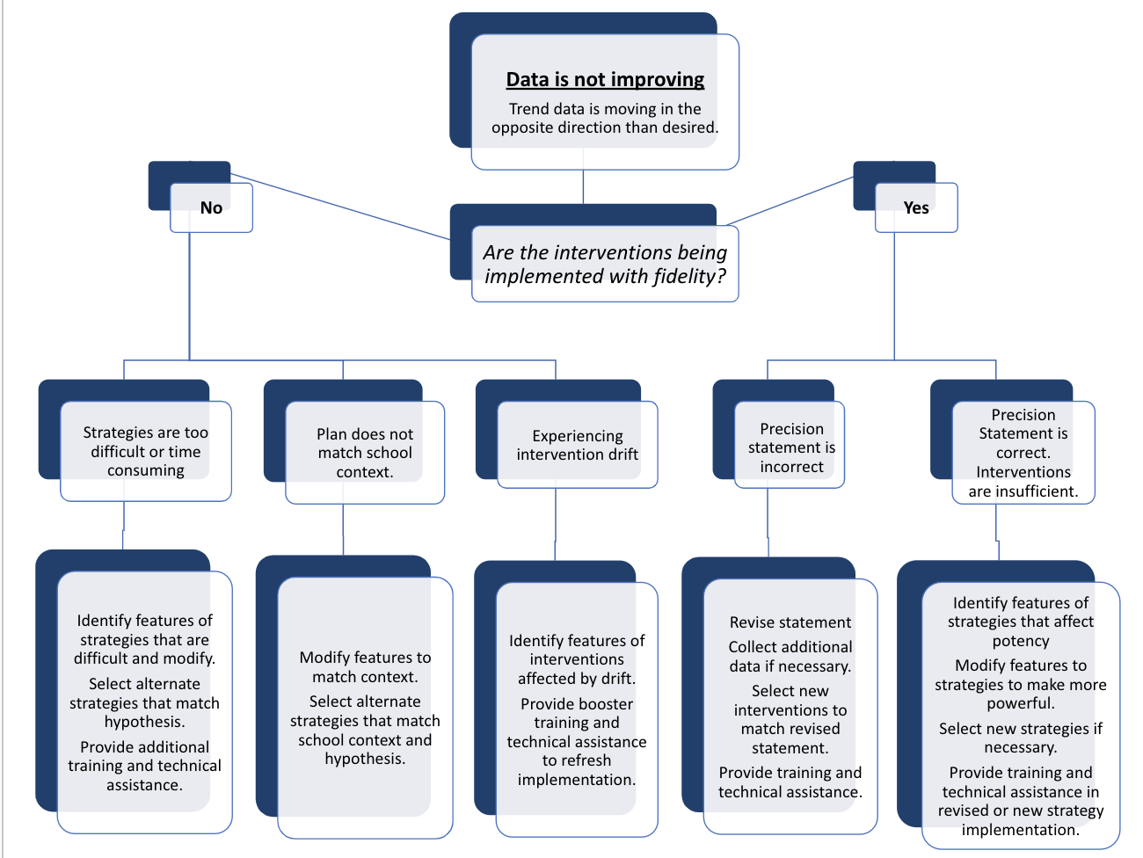
Work Time: Evaluate
To what extent have you considered these evaluation questions?
Evaluate fidelity, outcomes

Slide 117





Evaluate the MTSS Process
Who is
participating?
Reach
Process
What activities
have occurred?
Capacity
What is our overall capacity?
Fidelity
To what extent are we implementing?
Outcomes
Are we achieving valued outcomes?

Slide 118
Closing
Call to Action!
What is an immediate next step to facilitate the DIDM process in your division?
Consider where you are in this process:
Identifying data to collect?
Identifying red flags?
Working on establishing the “why?”
First draft of a precision statement and goal?

Slide 119
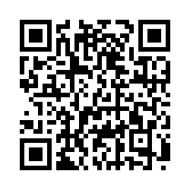
We love feedback!!
Please complete the evaluation for us. We appreciate the feedback.
http://bit.ly/45LrNge

