Slide 1
Data-Informed
Decision Making
for Tier 1 School Teams
July 2024

Slide 2
Follow VTSS
Please feel free to tag us at any of our social media handles below!
Twitter/X - VTSS_RIC
Facebook - VTSSRIC

Slide 4
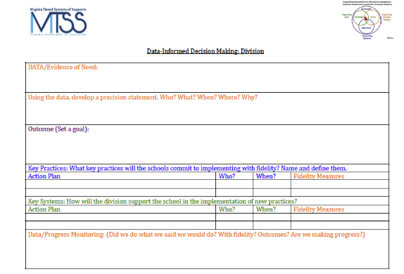
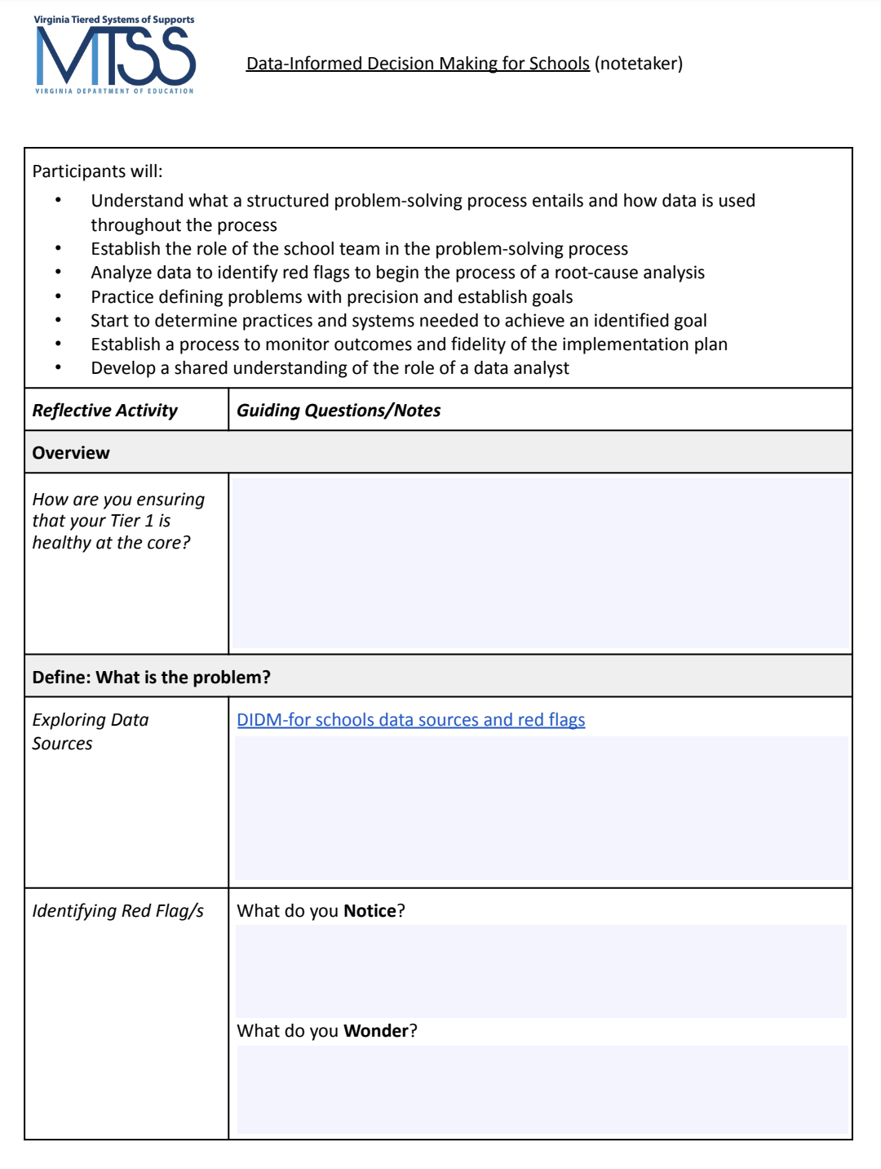
Materials
https://vtss-ric.vcu.edu/events/
workbook
←DIDM form
Notetaker →

Slide 5
Agenda
9:00 – 9:30 - Welcome and Overview
9:30 – 10:30 - Define
10:30 – 10:40 - Break
10:40 - 12:00 - Analyze
12:00 – 1:00 - Lunch
1:00 – 2:00 - Implement
2:00 – 2:30 - Evaluate
2:30 – 3:00 - Building a Culture of Data Literacy

Slide 6
Community Agreements
Be Responsible | Take care of your needs. Share your questions with the group.
Be Respectful | Respect others intentions Honor the impact of your words Earnestly move toward completing tasks during team work time
Be Engaged | Ask what you need to know to understand and contribute. Stay present Listen to others attentively. Share your expertise, information and ideas.

Slide 7
Our Purpose for Today
What | How | Why
The purpose of our professional learning is to equip participants with the knowledge and skills necessary to implement a structured problem-solving process within the school setting, leveraging data to drive decision making and improve outcomes for students. | Understand the components and steps of a structured problem solving process and the role of data within it Establish role of school team in the problem solving process Analyze data effectively to identify red flags and initiate root cause analysis Clearly define problems with precision Establish clear goals Develop actionable plans for intervention and improvement | Empower teams to address challenges proactively, optimize resource allocation, foster collaboration among partners, and ultimately enhance the academic, social, and emotional outcomes of students.

Slide 8
Before we Begin…
All people engage in some type of problem-solving approach.
Different people solve problems in different ways, many times using different approaches and vocabulary.
Not all data is equal in value.
Different people have different trust or comfort with analyzing data.

Slide 9
Connection Activity
In your experience data informed decision making at the school level is like…because…

Slide 10
Where do most of our decisions about supporting students occur?

Slide 11
Data Through a MTSS Lens
MTSS integrates data-informed decisions that are already happening in silos.
MTSS provides a consistent common approach and structure for reviewing multiple data points, identifying trends, and determining root cause.
(Dana Ashley, American Educator, 2015)

Slide 12
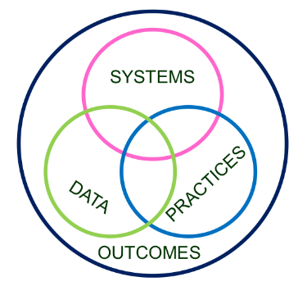
Division and School Level
Decision Making
Invest in Systems!!! (Leadership teams, support professional learning and coaching)
Differentiate and ensure outcomes are reflective of all students
Data informs decisions about screening, progress monitoring, fidelity, and outcomes
Prioritize efficient and effective practices
(evidence, culture, context)
Growth & benefit are central. Must reflect learning opportunities for all
workbook p. 10
12

Slide 13
Overview
School-level Data Informed Decision Making
Why is this process important?
What are critical features of this process?
How does it relate to school-level decision making?
Role of Tier 1 Team

Slide 14
Thoughts on Data-Informed Decisions
“As decision-makers, we need a deliberate process to guide us through the examination and analysis of data. Without this, we may be apt to substitute strongly held opinions for the fact-based conclusions that would be derived from a review of the actual data.”
-D.B. Reeves, The Leader’s Guide to Standards, 2022

Slide 15
What is Our Process?
The Process
Problem
Solution

Slide 16
Problem Solving Process Themes
Monitor and Evaluate Results
Define problems with precision
What strategies/ practices will we select and implement? (Supporting student academic and social behavior)
TIER 1 CORE TEAM
Data
What does the data say? Analyze strengths and opportunities for growth
What do teachers need to implement/sustain
Establish a SMART goal
Florida Positive Behavioral Interventions & Supports Project
workbook p. 11

Slide 17
Where is your Tier 1 Team? Typical vs. Effective Problem Solvers
Effective Problem Solvers…
Typical Problem Solvers…
Define a problem in observable and measurable terms
Collect and use multiple sources of information to validate assumptions about the problem
Create highly detailed steps to implement the intervention with fidelity including assessment procedures, decision-rules and actions to support interventionists
Use student data & intervention fidelity to identify & implement next steps through continuous cycles of problem solving
Define problems loosely or vaguely
Don’t validate assumptions before building a plan
Develop generic plans
Don’t monitor fidelity of actions
Don’t measure or evaluate impacts
Typically abandon interventions without considering fidelity or feasibility
Brian Gaunt, Ph.D., University of South Florida, May 2023

Slide 18
How well are we serving all students?
1 - 5%
Tier 3 for a Few: Intensive, Individualized
Tier 2 for Some: Targeted for Small Groups
Tier I for All: Core/Universal
5 - 15%
80 - 90%

Slide 19
Do We Have the Right People on our Team?
Teacher
Family Member
Anyone else?
Student
Staff
Administrator
Counselor

Slide 20
Work Time
Discuss:
Established commitment of our Tier 1 Team (behavior, academics, and social-emotional wellness) which includes family and student voice.
Established and teaching positive school-wide expectations
Design systems for positive feedback and acknowledgement
Design predictable systems for responding to behaviors, academics, and social-emotional wellness needs based on the data
Established data-informed decision making system and data collection
How are you ensuring that your Tier 1 is healthy?
workbook p. 12 General Features of Tier 1 Standards of Practice

Slide 21
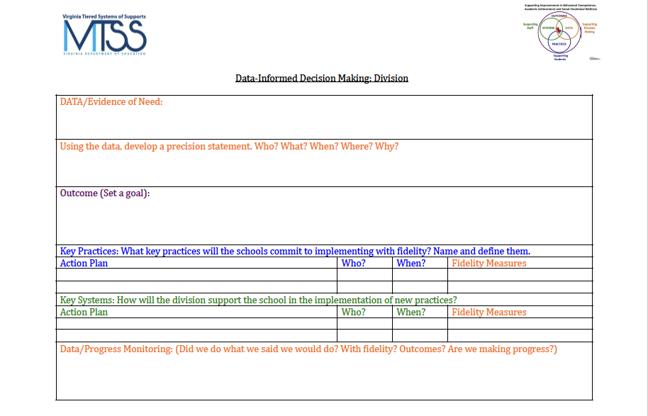
Structured Process
workbook p. 13

Slide 22
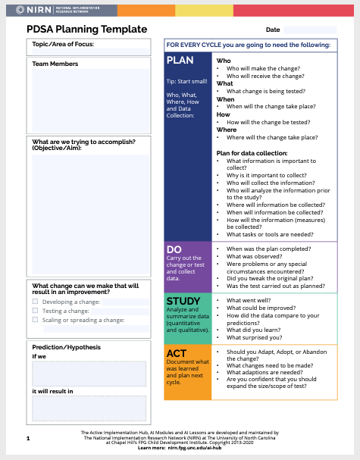
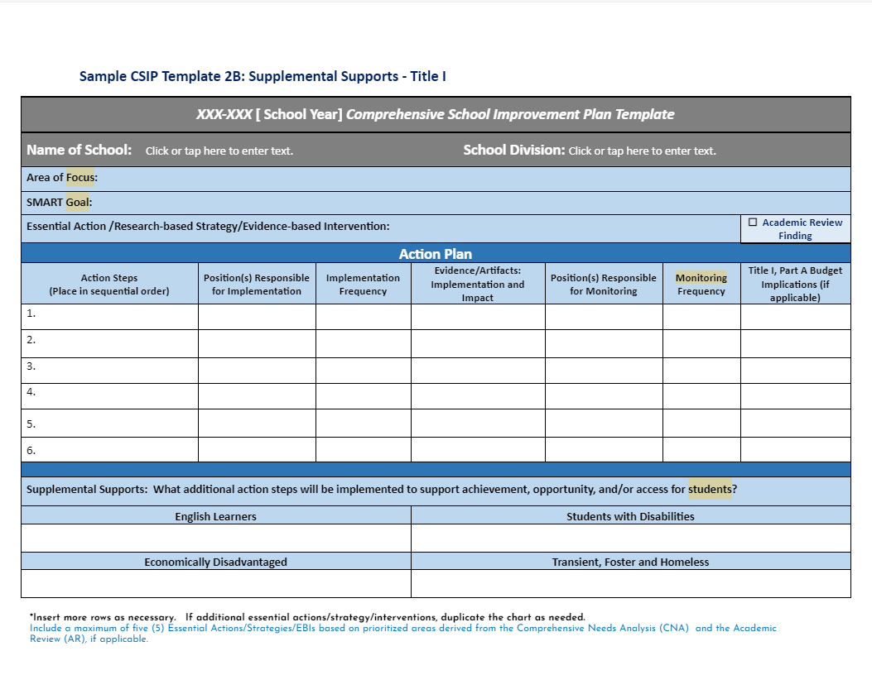
Function over Form
(as long as you are documenting)

Slide 23
Where to start?
Problem Identification

Slide 24
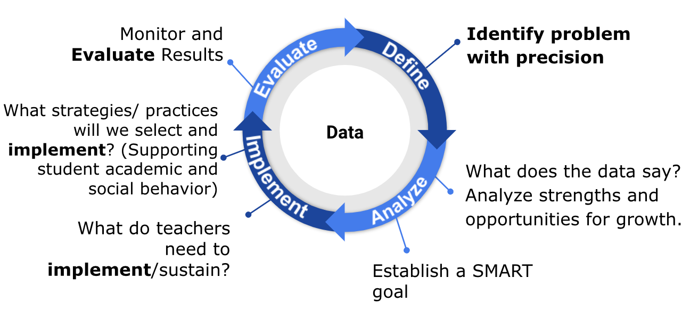
DEFINE: What is the Problem?

Slide 25
Can you Relate?
“If I had an hour to solve a problem I’d spend 55 minutes thinking about the problem and 5 minutes thinking about solutions.”
~Albert Einstein

Slide 26
Types of Problems
Known/Suspected
Unknown/Hidden
Begins with a concern or a question from the principal, central office, BLT
Specific data (grade retention, attendance, SOL’s, climate surveys, ODR’s, etc.) are used to determine if an issue exists.
Cannot assume the concern or question accurately represents reality
Recognizes areas outside of daily lived experiences
Looks at big data and disaggregates based on grade, gender, race, SES, location, time, etc.
Involves teacher, student, and family voice and concerns

Slide 27
Data: Evidence of Need
What is your data story?
Is there a problem?
Academics
Behavior
Attendance
Social Emotional Wellness
Community health
Teacher retention
Family engagement
What is the data that indicates that there is a problem that needs to be addressed?

Slide 28
VA School Quality Profile
https://schoolquality.virginia.gov/

Slide 29
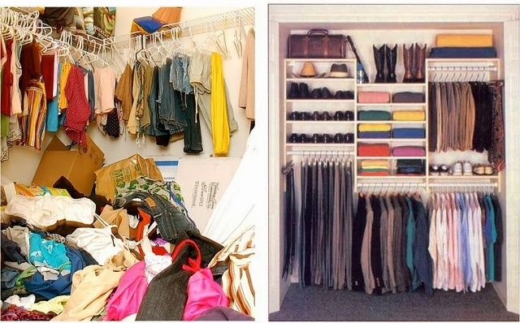
From This to That

Slide 30
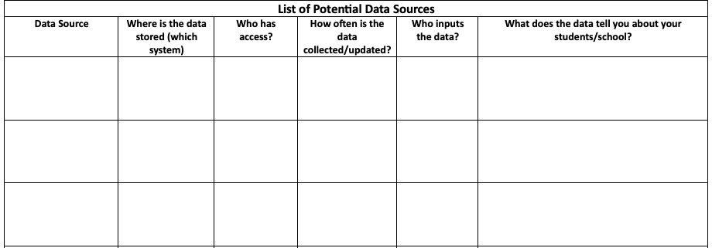
Work Time
Discuss:
What data sources will help you monitor your school’s potential problems?
Exploring Data
workbook p. 14 - List of potential data
workbook p. 15 - Potential data sources worksheet

Slide 31
What is Your Data Saying?
Compare the data to what is typical?
What is the mean/median?
What should we expect?
Compare the data to what is possible?
What does “ideal” look like?
What are our success criteria for ALL students?
Compare the data to what is needed?
What is the goal?
What is the standard?

Slide 32
Identifying Red Flags
In what general area(s) are our outcomes not meeting our shared expectations?
What trends have we observed in our school related to identified problem areas?
Are groups of students disproportionately represented in the data?
Do data suggest we have a strong tier 1 across academic, behavior, social emotional wellness?
Which unmet needs have we uncovered?
Which are the most pressing to address now?

Slide 33
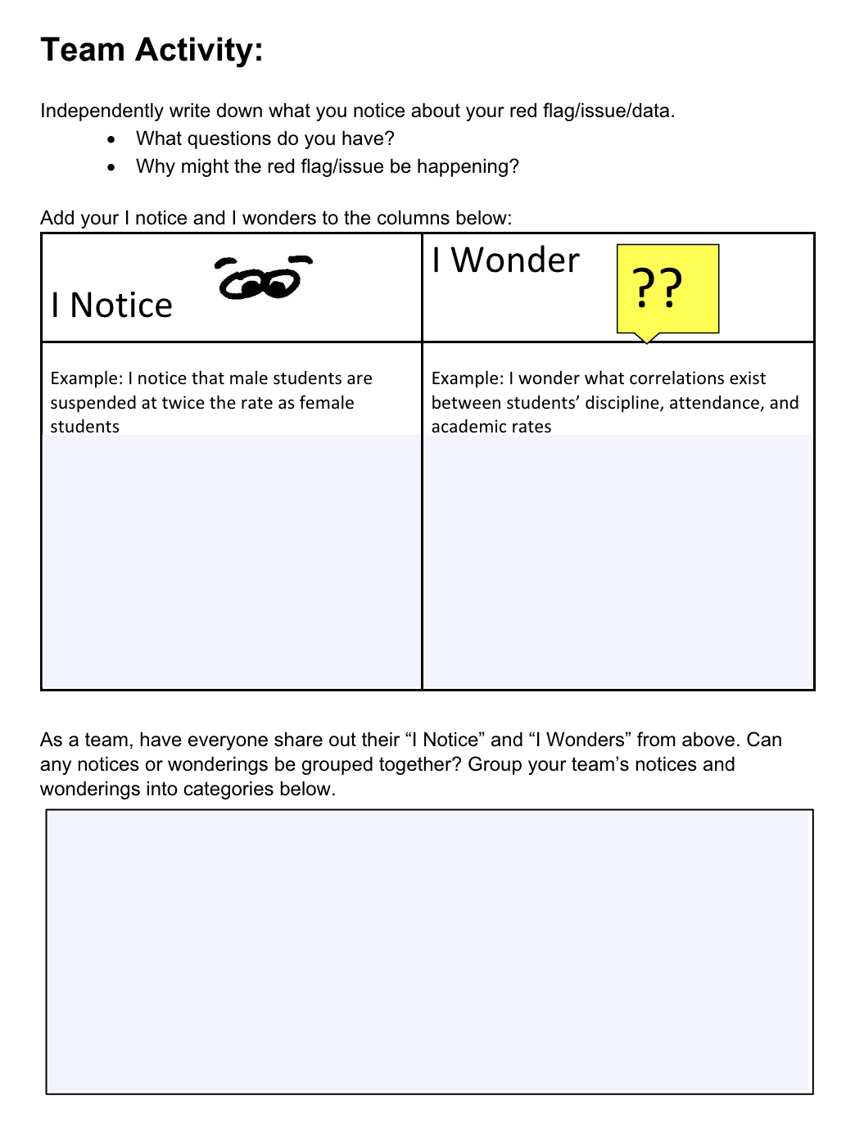
Work Time
Identifying
Red Flag/s
workbook p.16

Slide 34
What Does our Data Say -
Evidence of Need

Slide 35
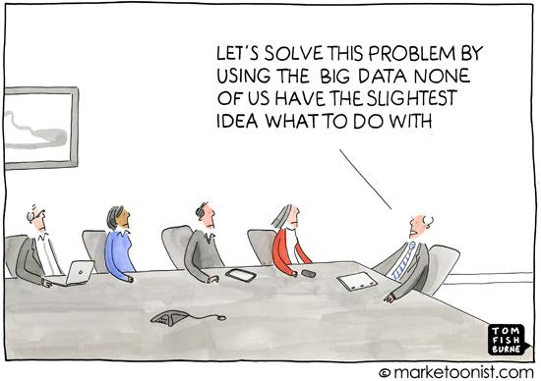
Moving from
General to Precise

Slide 36
Based on Your Data…
Precisely define the problem by identifying who, what, when, where, and why.
What is the problem?
Who is having the problem?
When is the problem occurring?
Where is the problem occurring?
Why is the problem occurring?

Slide 37
Using Data to Create
Problem Statements
The statement of a problem is important for team-based problem solving.
Everyone must be working on the same problem with the same assumptions.
Problems often are framed in a “Primary” or “General” form. That form creates concern, but is not useful for problem-solving.
Frame primary problems based on initial review of data.
Use more detailed review of data to build “Solvable Problem Statements.”

Slide 38
Primary vs. Precision Statements
Primary / General Statements
Precision Statement
Too many referrals
September has more suspensions than last year
Math SOL pass rates are decreasing
The cafeteria is out of control
Student disrespect is out of control
There are more ODRs for aggression on the playground than last year. These are most likely to occur during first recess, with a large number of students, and the aggression is related to getting access to the new playground equipment.

Slide 39
Examples
Example: 47% of eighth grade students in 2023 failed to pass the reading SOL, with 61% of ELL students failing the SOL.
Example: During the 2022-23 school year 31% of ninth grade females received multiple office discipline referrals for dress code violations, as defined in the student handbook.
Anywhere School: In 2023, 35% of the student population was at-risk of being chronically absent, particularly among 7th and 8th grade students being reported as economically disadvantaged.

Slide 40
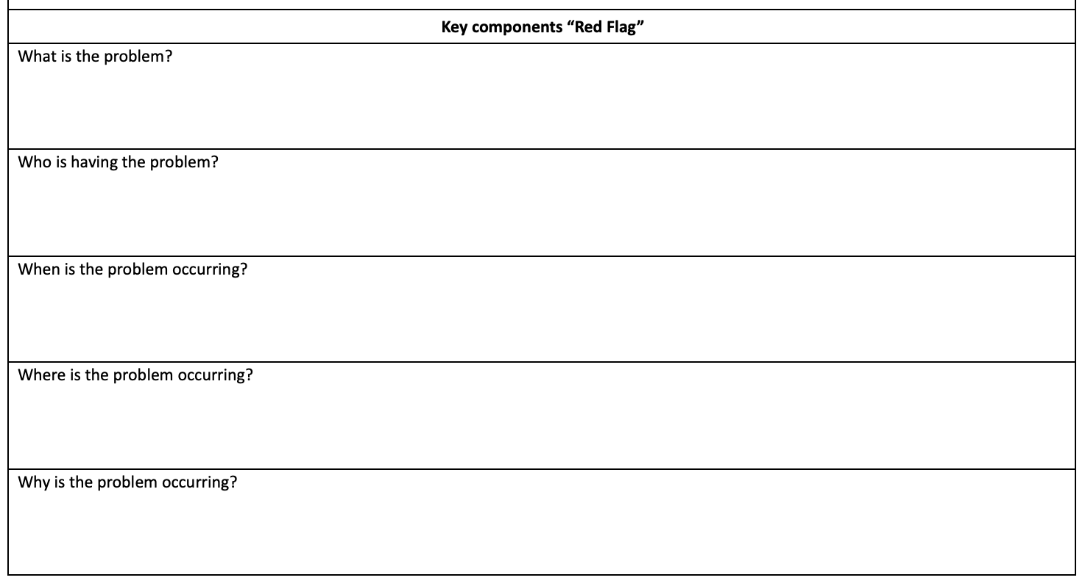
Work Time:
Developing a Problem Statement
Write a Problem Statement
Where Are Your Gaps?
What
Who
When
Where
(We’ll get to the “Why”)
How precise can you get?
Don’t get lost in the weeds, but be clear about the problem.
Are all assumptions challenged or verified by data?
What do you need to finish your problem statement?
workbook p. 17

Slide 41
ANALYZE Why is it occurring?

Slide 42
Precision Statement
Now we precisely define the problem by identifying who, what, when, where, and why.
What is the problem?
Who is having the problem?
When is the problem occurring?
Where is the problem occurring?
Why is the problem occurring?

Slide 43
Root Cause Analysis
There’s no single way to conduct a root cause analysis, but it usually comprises of three steps:
Identify a problem
Identify the cause(s) of a problem
Identifying strategies to address the problem.
There are many publicly available tools to use for this process. Today we will use the fishbone.

Slide 44
Why Conduct Root Cause Analysis?
Prevents “solutionitis”
Produces insights into the system as a whole
Prompts brutally honest discussions about why unsatisfactory outcomes occur
Prompts participants to look at problems from the student’s perspective
Ensures the initial problem is narrow and concrete enough to improve
Informs tactical action and solutions moving forward
Enhances the group’s ability to develop targeted and measurable outcomes
Office of School Quality, Dr. April Kaiser Edwards, VDOE

Slide 45
Root Cause Helps
Separate Story from Fact
Example:
Story: Students are not coming to school because they don’t care.
Fact: Data shows that some students are having difficulty getting up for school on time because they have to be at the bus stop by 6:30am.

Slide 46
Importance of Stakeholder Engagement
“When schools and districts can learn from and meaningfully engage the expertise of the students, families, and communities who have been marginalized by our systems, we can begin to work together toward building more responsive and just schools.”
Ishimaru & Takahashi (2017)

Slide 47
Important Conversations
To truly understand the problem/challenge we have to gain insight from those affected by the problem/challenge.
They can help us understand:
What does this problem
look/sound/feel like for them?
Who is this problem affecting and
in what way?
When is this problem affecting them more? the least?
Where do they experience this problem the most?
Why do they think this problem is occuring?

Slide 48
Tools for Feedback
There are different tools you might use to explore the WHYs from the perspective of students and families.
(e.g. empathy interviews, focus groups, surveys)
Ex. Conducting a school climate survey for students and families to see how they feel about school. Include what they think is working / not working. Get results back by mid-October and review as a team at the November meeting.
workbook p. 18

Slide 49
Work Time
How are you currently obtaining student and family feedback?
Identify which stakeholder groups you need to obtain feedback from.
Who is the problem impacting?
Discuss the method(s) by which feedback will be gathered.
Stakeholder Feedback

Slide 50
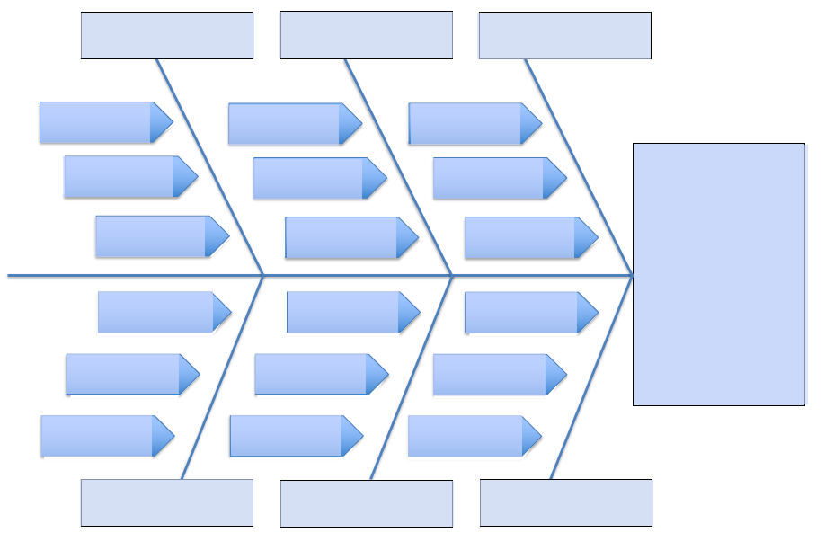
Fishbone Diagram
A “fishbone” diagram, can help brainstorm possible causes of a problem and sort ideas into useful categories.
workbook p. 19

Slide 51
Anywhere School: Getting to the “Why” (Fishbone Protocol)
Families:
illness
housing instability
economic hardships
confusion about attendance policies and procedures and lack of awareness about their student’s attendance record
Students: “Why do you come to school?”
adult support
belonging to a positive peer group
commitment to education and future goals
school environment (e.g. feel safe,
supported and engaged in class; school is fun)
“Why is 35% of the student population at-risk of being chronically absent, particularly among 7th and 8th grade students who are reported as economically disadvantaged?”

Slide 52
Work Time
What root causes do you predict Anywhere School might identify?
What additional data might this school need to better identify potential root causes?
Identifying root causes

Slide 53
Brainstorming
our “Why”:
“Why is 35% of the student population at-risk of being chronically absent, particularly among 7th and 8th grade students who are reported as economically disadvantaged?”
Lack of communication with families about attendance procedures and supports and their student’s current attendance record
Health concerns (short-term illness, chronic illness, and medical/dental/mental health appointments)
Personal stress (depression/sadness, stressed/upset, family emergencies)
Transportation difficulties; food and housing insecurity
Challenges associated with poverty: lack of health and mental health resources, affordable housing, transportation concerns, witnessing or being a victim of violence
School stress (perception of difficulty with schoolwork, lack of preparedness for a class, and avoidance of a teacher, class or student)
Lack of school connectedness or perception of relevance for reaching future goals
Disproportionate rates of suspension for economically disadvantaged students
workbook p. 20

Slide 54
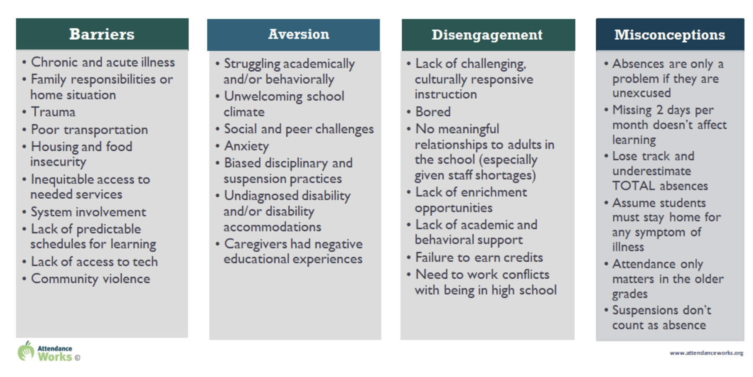
Root Cause:
What does the Research Say?
https://www.attendanceworks.org/chronic-absence/addressing-chronic-absence/3-tiers-of-intervention/root-causes/
workbook p.21

Slide 55
Anywhere School:
Making Sense of our “Why”
Barriers:
Health concerns (short-term illness, chronic illness, and medical/dental/mental health appointments)
Personal stress (depression/ sadness, stressed/upset, family emergencies)
Transportation difficulties; food and housing insecurity
Challenges associated with poverty: lack of health and mental health resources, affordable housing, transportation concerns, witnessing or being a victim of violence
Aversion:
School stress (perception of difficulty with schoolwork, lack of preparedness for a class, and avoidance of a teacher, class or student)
Disengagement:
Lack of school connectedness or perception of relevance for reaching future goals
Disproportionate rates of suspension for economically disadvantaged students
Misconceptions:
Lack of communication with families about attendance procedures and supports and their student’s current attendance record

Slide 56
Narrowing our Focus
Imagine you are on the Anywhere School leadership team.
What questions might you ask to assist the team to narrow down their focus to 1-2 root causes?
Identifying the “Why”
See workbook page 20 for
Anywhere School’s list of root causes

Slide 57
Anywhere School:
Where Will We Start?
What are the overlaps between the potential root causes and family/ student feedback?
Which root cause/s do we have data to support?
Which root cause/s will have the greatest positive impact on our goal?

Slide 58
Lack of communication with families about attendance procedures and supports and their student’s current attendance record
Anywhere School
Fishbone Example
Faculty and staff are unsure of district policy
Only sent home once at the beginning of the year in the handbook
Not prominent on the website
Why is 35% of the student population at-risk of being chronically absent, particularly among 7th and 8th grade students being reported as economically disadvantaged?
Hard to reach the families of chronically absent students
Faculty and staff are unsure who is responsible for reaching out to families
Students don’t feel like they belong/are accepted at school
Students have jobs and work late hours
Lack of scaffolding in instruction
Instruction primarily focuses on “drill and kill” teaching strategies
workbook p. 22
Increase in reported anxiety and depression among students
School stress (perception of difficulty with schoolwork, lack of preparedness for a class, and avoidance of a teacher, class or student)

Slide 59
Lack of communication with families about attendance procedures and supports and their student’s current attendance record
Example:
Faculty and staff are unsure of district policy
Why is 35% of the student population at-risk of being chronically absent, particularly among 7th and 8th grade students being reported as economically disadvantaged?
Faculty and staff are unsure who is responsible for reaching out to families
Lack of scaffolding in instruction
Increase in reported anxiety and depression among students
School stress (perception of difficulty with schoolwork, lack of preparedness for a class, and avoidance of a teacher, class or student)

Slide 60
Anywhere School:
Data to support the “why”
Lack of communication with families about attendance procedures and supports and their student’s current attendance record
Faculty and staff are unsure of the district policy and student attendance rates…and…who is responsible for communicating with families
Feedback from families where multiple variants of the district policy (if any) were relayed to families from faculty and staff…and they were unaware of their student’s current attendance record
Staff surveys indicated 75% of staff were unclear about who was responsible for communicating with families

Slide 61
Anywhere School:
Data to support the “why” (cont’d)
School stress (perception of difficulty with schoolwork, lack of preparedness for a class, and avoidance of a teacher, class or student)
“Increase in reported anxiety and depression among students.”
Student safety survey indicated an increase in student anxiety and depression
“Lack of scaffolding in instruction.”
A review of administrator classroom walkthroughs showed a high percentage of teachers inadequately scaffolding concepts and content to help students develop understanding

Slide 62
Anywhere School Precision Statement:
Bringing it All Together
“In 2023, 35% of the student population was at-risk of being chronically absent, particularly among 7th and 8th grade students being reported as economically disadvantaged.
This is believed to be due to a lack of communication about our absentee policy and procedures, student’s current attendance record, and attendance supports along with an increase in student stress.”

Slide 63
Work Time: Step 1
Revisit your problem statement. Individually brainstorm as many possible contributing factors of the problem that you can. Use data to justify your claims!
Developing a Precision Statement
workbook p. 23 - Ecological Factors

Slide 64
Things to Consider:
Ecological Factors
Ecological Factor | Examples
School Climate | Collaborative decision making; order & discipline; parent involvement; staff dedication to student learning (e.g., beliefs); physical structure; established procedural routines; recognition for positive behavior; school pride & student involvement, continuous improvement culture, etc.
Relationships | Teacher-student relationships – expectations; mentoring, encouragement Family-child relationships – parenting style & involvement in child’s education Peer relationships – interpersonal skill development; support group network Each – opportunities for positive or negative social reinforcement
Instruction | Instructional planning, management, delivery, and evaluation practices; opportunities for feedback (positive or negative reinforcement; extinction; DRO, etc.); hierarchy of skills focus
Curriculum | Match of content with student skills and culture; opportunities for deep vs. surface learning. Alignment with education standards for promotion/graduation
Instructional Environment | Classroom management and arrangement; predictable classroom routines; home-school collaboration & congruence of performance expectations; enriched and engaging activities, recognition for positive behavior/ acad performance
Learner | Skills or abilities, physical (e.g., vision impaired) and neurological factors (e.g., ADHD; TBI), developmental history, nutritional experiences, motivation (attention or escape/avoid)
School Organization | Efficiency of resource allocation to provide supports matched to needs; supports for fidelity of instruction/interventions; scheduling systems, teaming and student grouping structures, education service delivery methods (e.g., tiered system of supports)
workbook p. 23

Slide 65
Work Time: Step 2
Revisit your problem statement. Individually brainstorm as many possible contributing factors of the problem that you can. Use data to justify your claims!
Categorize/cluster the possible root causes by common themes.
* Consider what additional information may be needed.
Developing a Precision Statement (cont’d)

Slide 66
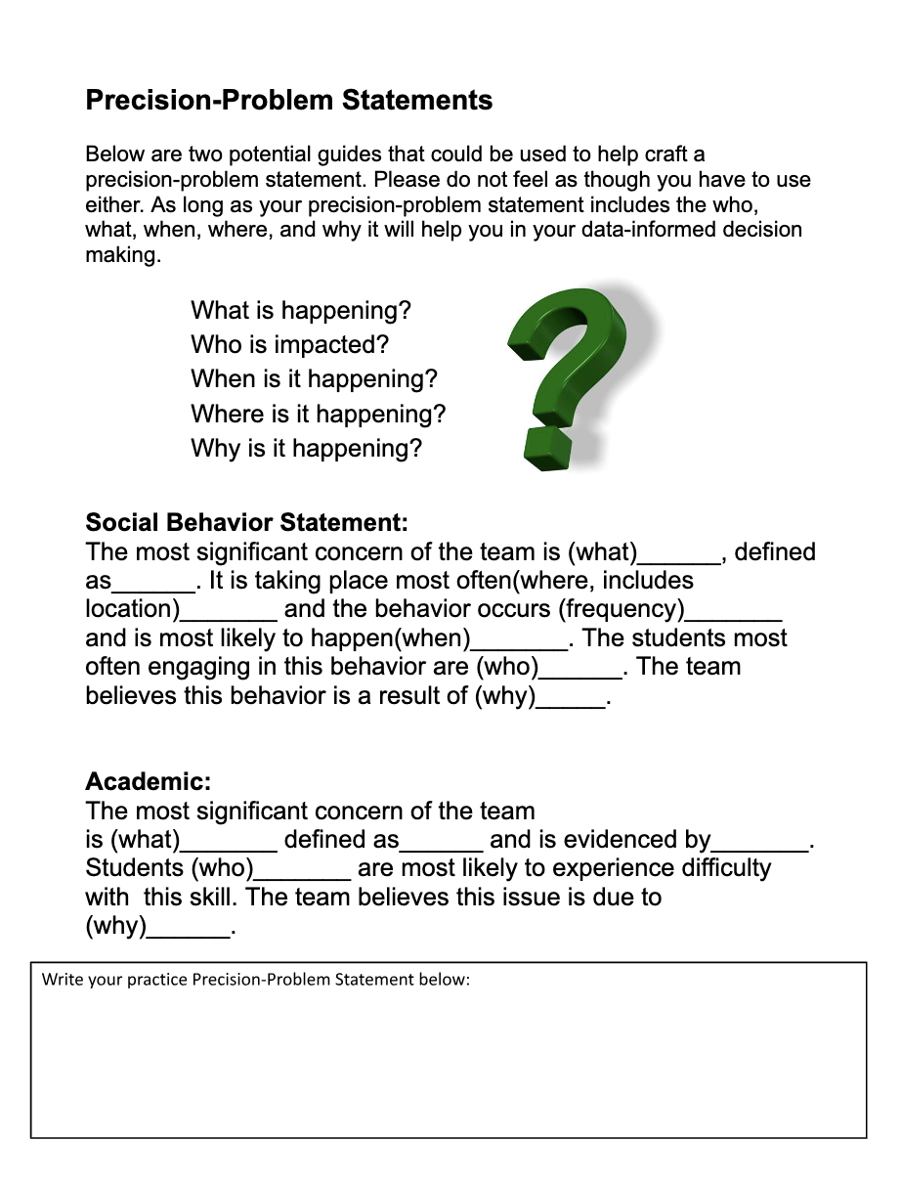
Work Time: Step 3
Developing a Precision Statement (cont’d)
workbook p. 24

Slide 67
Documentation:
Precision Statement

Slide 68
Establish a Goal
Monitor and Evaluate Results
Define problems with precision
What strategies/practices will we select and implement? (Supporting student academic and social behavior)
Data
What does the data say? Analyze strengths and opportunities for growth
What do teachers need to implement/sustain
Establish a SMART goal

Slide 69
Characteristics of a Strong Goal
Goals allow you to analyze, monitor, and adjust professional practice. Goals are:
workbook p. 25

Slide 70
SMART Goal Example
Timely
Specific
By December 2023, educators will develop and implement with 85% fidelity a science instructional framework as evidenced by classroom observations and a 5% increase between pre and post teacher benchmark scores.
Measurable & Achievable
Realistic

Slide 71
Goal
What?
By when?
Office Discipline Referrals rates for disrespect will be at or below the national median for our school size by April of this school year and will remain at or below this level for the remainder of the school year.
Referral rates for aggression on the playground will reduce to one or fewer each week (.20 per day) among 5th grade students and will stay at this level for the rest of the school year.
Reading assessment data for students in literacy intervention group performance will move from High to Low Risk status by the Winter benchmark and will be at this level or move to “No Risk” levels by the Spring benchmark.
Referrals for tardiness among ninth graders will reduce by 50% by our March meeting and will continue to decrease across the next 3 months until there are no more than 2 per month for 3 months.

Slide 72
Work Time
Based on your precision statement, identify a preliminary goal.
Start a Goal

Slide 73
IMPLEMENT What are we going to do about it?

Slide 74
What Do you See Here?

Slide 75
Team Time Reflection
How was it approached?
What was strong?
What were some of the barriers?
Did we have the right team members?
Did we review what we already had to address our concern?
Did our teachers have what they needed to implement the intervention?
Was anything missing from the system (PD, coaching, measurable objectives, defined skills, resources, student and family voice) to support implementation?
Think of an intervention you have been involved in….

Slide 76
What was Strong?

Slide 77
How do we ensure a strong plan?
The instruction and interventions are evidence-based and linked.
We have the capacity to implement the plan in a timely manner and delivered in the way it is intended by people who are qualified.
The individuals implementing the plan have the support needed to implement the plan.
There is a plan for monitoring implementation fidelity.

Slide 78
Developing Solutions
What practices need to be in place in order to address the problem?
What systems (i.e. PD, coaching) need to be in place to support the implementation of these practices?

Slide 79
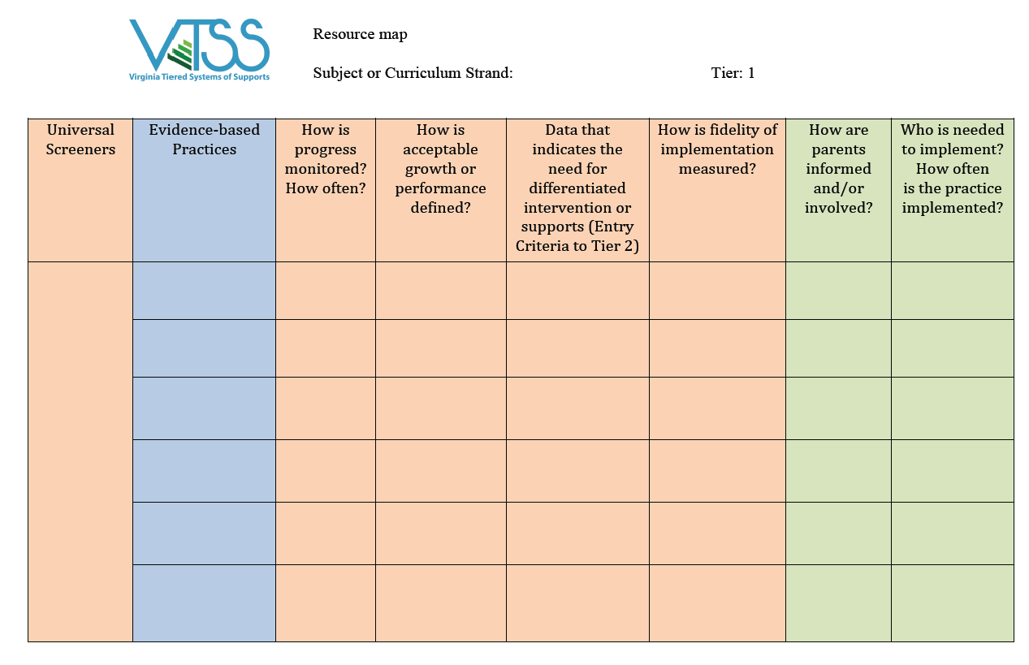
Let’s Start with Looking at What you Have
Resource Mapping
workbook p. 26

Slide 80
What still needs to be done?
THINK: Innovation!
What are the appropriate responses that address the needs implied in the data?
What do you want teachers to do?
By when? How will you know it’s been done?
Refer to your resource maps!
If you don’t have key practices, you may have to utilize a formal selection process.
* Remember! Practices you select should be teachable, learnable, doable, and readily assessed in practice.

Slide 81
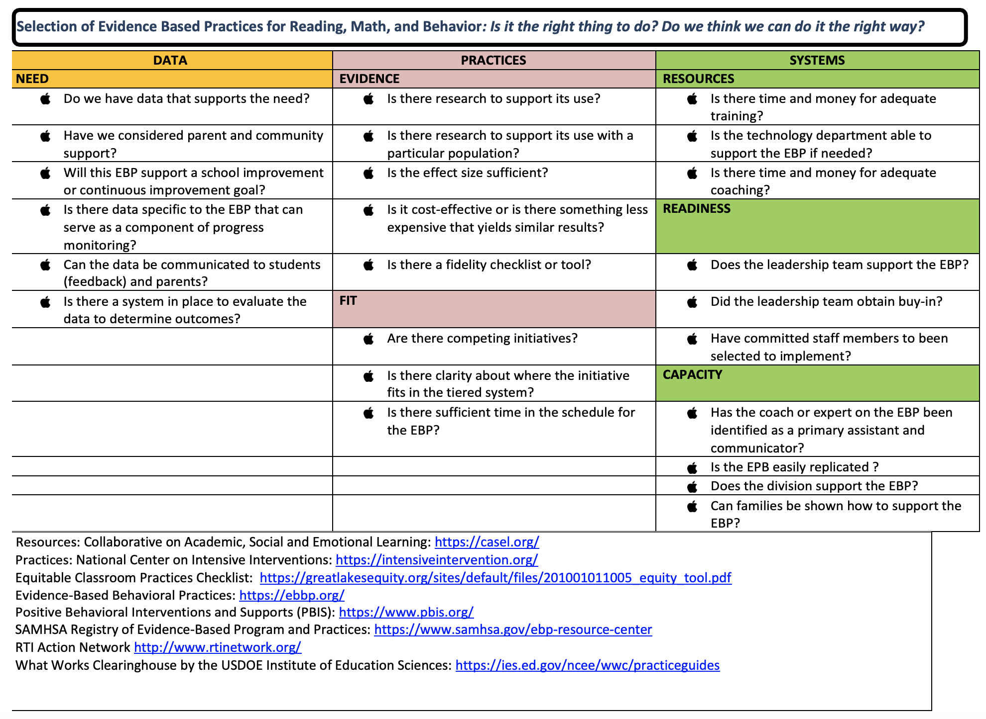
Selection Tools:
Exploring Context
Hexagon Tool
Evidence-Based Practice Selection Tool
workbook pp. 27-29

Slide 82
Solution Development
Solution Component | Action Steps
Prevention | Increase active supervision. Administration and Grade levels establish a supervision rotation.
Teaching | Teach behavioral expectations in the indoor and outdoor common areas.
Recognition | Increase recognition for appropriate behavior. Provide feedback tickets that can be used for spirit wear. Spirit rally and dance for the grade level with fewest referrals.
Extinction | Post weekly grade level data. Encourage all students to work for the spirit day and dance.
Corrective Consequences | Active supervision and continued early consequences, prompt, redirect, reteach, provide choices
Data Collection | Use weekly data to evaluate change
workbook p. 30

Slide 83
Action Steps and Fidelity
Solution components | What are the action steps? | Who is responsible? | By When? | How will fidelity be measured? | What systems need to be put in place?
Prevention | Increase active supervision | Principals All staff | Ongoing | Staff visible in the indoor/outdoor common areas | Reminder to staff about the expectation to be visible in the common areas (inside/outside) - email and faculty meeting. Follow-up with staff who are not meeting expectation.
Teaching | Teach behavioral expectations for the commons and hallways. | Teachers will teach commons & hallways expectations to their HR classes | January 15 | Sheet posted next to PBIS bulletin board in faculty lounge for people to sign and indicate they did it. | Incentives will be for the grade level which can have 10 students tell the principal the expectations first: set up plan for principal to gather information from students Remind teachers where to find lesson plans; provide support to new teachers.
Recognition | Spirit rally and dance recognition tickets for school store. | PBIS team will coordinate | Rally by January 31st. Tickets by January 10th | Spirit rally and dance tickets used at the spirit store
Extinction | Post weekly data. Encourage all students to work for the spirit rally. | All staff | Ongoing | Weekly data posted in commons & hallway | Data analyst will complete data and make poster with information.
Corrective Consequence | Active supervision and continued early consequences (minor/major, ODR) | All staff | Ongoing | Staff visible in hallways
 | What data will we look at? | Who is responsible for gathering the data? | When/How often will data be gathered? | Were will data be shared? | Who will see the data?
Data Collection | ODR record | SWIS Data Entry person & principal | Weekly | Emailed to staff and posted in hallways & common areas for students | All staff and students
workbook p. 31

Slide 84
Work Time
What key practices
will your school commit to implementing with fidelity? Name and define them.
How will the team support the school in the implementation of new practices?
Identifying
Practices & Systems
workbook p. 32 - Blank Action Steps template
workbook pp. 33 - 36 - Elementary & Secondary Sample Root Cause Analysis/Tiered Support Plan

Slide 85
EVALUATE Is it working?

Slide 86
Evaluation Plan
After identifying practices and systems, consider…
When are they expected to be implemented?
How will we know it’s been done?
Who will monitor fidelity of the plan?
Fidelity
When will the team review progress toward outcomes?
Who will gather and
share outcome data?
Outcomes

Slide 87
Did we implement our solutions with fidelity?
O’Donnell (2008)
NIRN & AIR

Slide 88
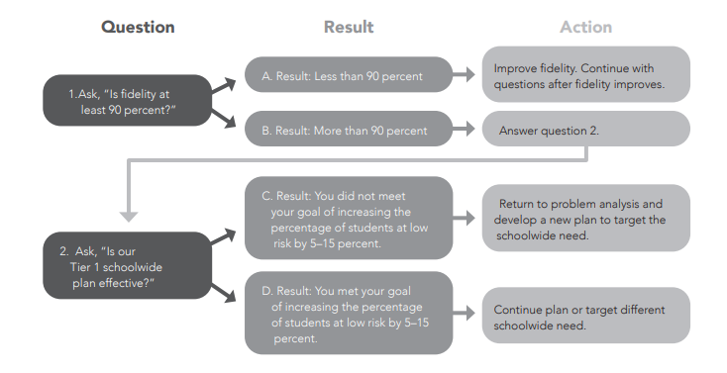
Evaluation
Untangling Data-Based Decision Making © 2024 Marzano Resources • MarzanoResources.com Visit MarzanoResources.com/reproducibles to download this page.

Slide 89
Work Time
How will you evaluate
fidelity and monitor progress towards your goal?
What fidelity and outcome data might you want to collect?
Evaluation

Slide 90
Continuous Process
Monitor and Evaluate Results
Define problems with precision
What strategies/practices will we select and implement? (Supporting student academic and social behavior)
Data
What does the data say? Analyze strengths and opportunities for growth
What do teachers need to implement/sustain
Establish a SMART goal

Slide 91
Building a Culture of Data Literacy
Making it Routine - Wrap up

Slide 92
Data Literacy Helps us…
Explore which data is needed to deeply understand the problems driving poor systemic results
Enables access to the necessary data
Helps us to analyze, interpret use and report data to promote goals
Reflect on data access and analysis for continuous improvement

Slide 93
What Data Literacy Looks Like
Teams study data at the school-wide level
Define specific problems
Leverage evidence-based practices as solutions to problems
Focus on systems change

Slide 94
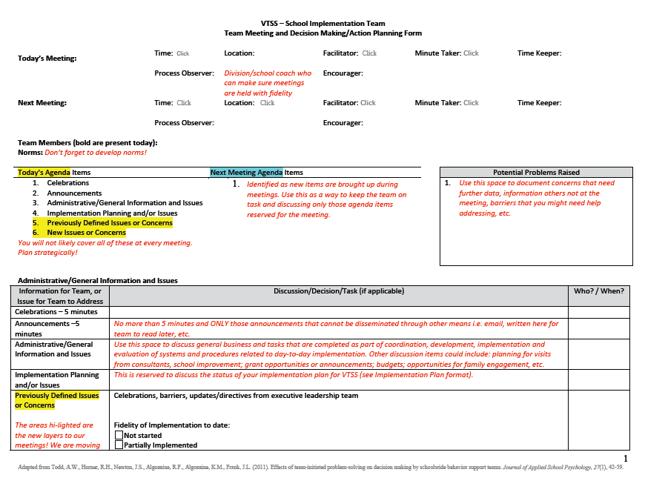
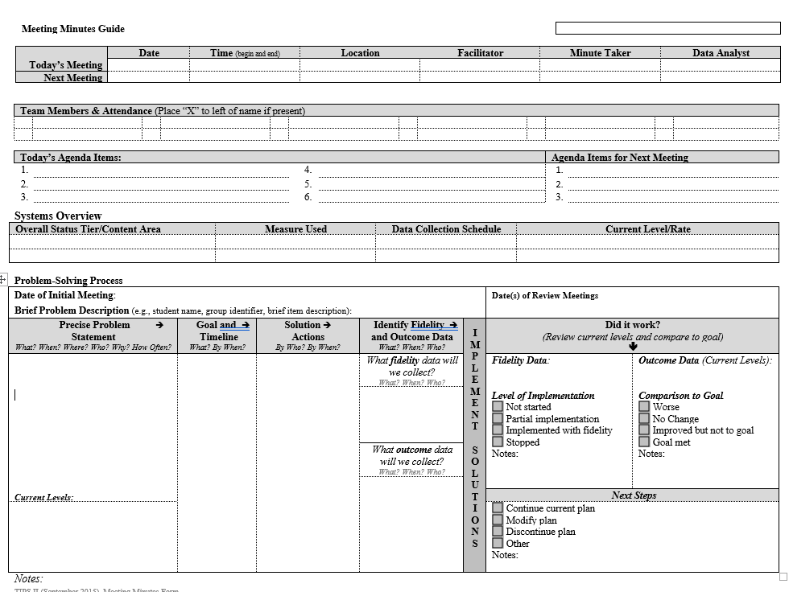
Efficient Agenda
workbook pp. 38-40

Slide 95
Right Data / Right People
Identify the RIGHT data, in the right format
Identify the RIGHT people who:
Meet consistently (RIGHT time)
Start meetings with data
Strategically use data to develop solutions and action plans
Implement and monitor action plans (fidelity & outcomes)
Have access to student and family voices

Slide 96
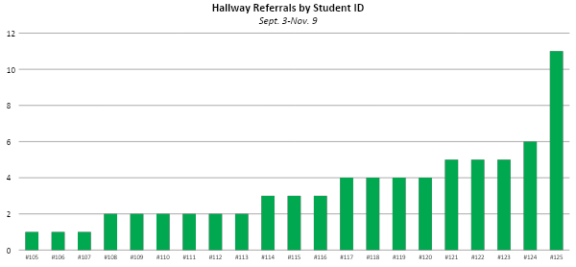
Systems vs. Individual

Slide 97
Data Sharing

Slide 98
Data Analyst
The role of the data analyst(s) can vary depending on the platform, size of school, etc.
HOWEVER: Be sure that you are always coming back to monitor the goals you set in your data informed decision making process and that someone is responsible for having it available.
School A: This school has subgroups that report the data to the school VTSS team, i.e. academic,behavior.
School B: The data is organized by school leadership.
School C: A sophisticated data systems exists. The data analyst is the “driver” in the meeting.
workbook p. 41

Slide 99
Role of Data Analyst and Team
Data Analyst
Tier 1 Team
Identify Red Flags
Drill Down to Precision
Summarize (precise statement & supporting graphs)
Prioritize problems
Develop goal
Develop solutions & action plan

Slide 100
In Action
Source: https://www.youtube.com/watch?v=ZCr4MyTCAxw

Slide 101
Work Time
What are 3 features that are put in place to structure this meeting?
What are 2 questions that you may have from this video?
What is 1 way that you can see this influencing your process in your team meetings?
workbook p. 42

Slide 102
Call to Action
What is an immediate next step to facilitate the DIDM process in your school?
Consider where you are in this process:
Identifying data to collect?
Identifying red flags?
Working on establishing the “why?”
First draft of a precision statement and goal?

