Slide 1
Intro
Data-Informed
Decision Making
for Tier 1 School Teams
July 2026

Slide 2


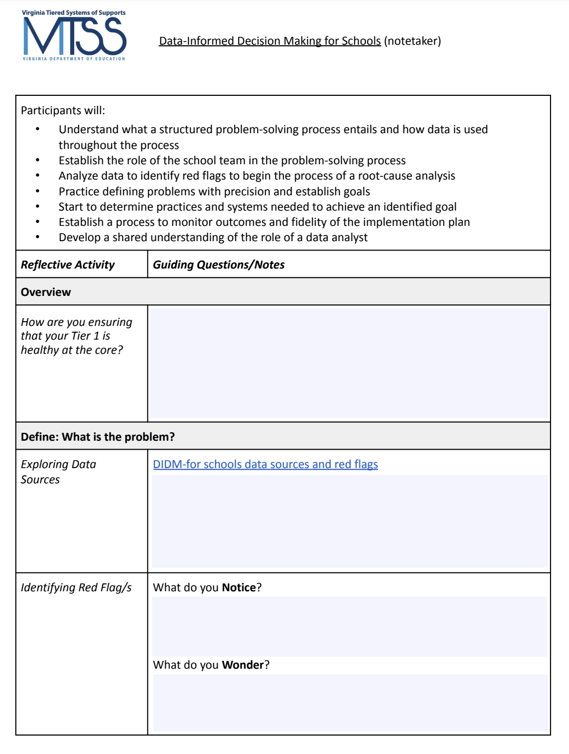
Materials
https://vtss-ric.vcu.edu/implementers/didm-s/
Workbook
Notetaker →
p.5-9

Slide 3

Agenda
Welcome and Overview
Define
Break
Analyze
Lunch
Implement
Evaluate
Building a Culture of Data Literacy

Slide 4
Community Agreements
Be Responsible | Take care of your needs. Share your questions with the group.
Be Respectful | Respect others intentions Honor the impact of your words Earnestly move toward completing tasks during team work time
Be Engaged | Ask what you need to know to understand and contribute. Stay present Listen to others attentively. Share your expertise, information and ideas.

Slide 5
Learning Intentions
Understand the components of a structured problem solving process.
Establish the role of the school team in the problem solving process.
Clearly define problems with precision.
Analyze data effectively to identify red flags and initiate root cause analysis.
Establish clear goals.
Practice developing actionable plans and a process for evaluation.

Slide 6

Before we begin…
All people engage in some type of problem-solving approach.
Different people solve
problems in different ways,
many times using different
approaches and vocabulary.
Not all data holds the same value for everyone.
Different people have different trust or comfort with analyzing data.

Slide 7






Connection Activity: Let’s Go Camping!
In your experience data informed decision making at the school level is like…because…

Slide 8
Data Through a MTSS Lens
MTSS integrates data-informed decisions that are already often happening in silos.
MTSS provides a consistent common approach and structure for reviewing multiple data points, identifying trends, and determining root cause.
(Dana Ashley, American Educator, 2015)

Slide 9
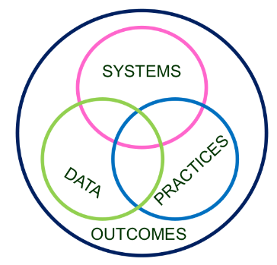
Division and School Level
Decision Making
Invest in Systems!!! (Leadership teams, support professional learning and coaching)
Differentiate & ensure outcomes are reflective of all students
Data informs decisions about screening, progress monitoring, fidelity, and outcomes
Prioritize efficient and effective practices
(evidence, culture, context)
Growth & benefit are central
Reflects learning opportunities for all
p.10
9

Slide 10
Overview
School-level Data Informed Decision Making
Why is this process important?
What are critical features of this process?
How does it relate to school-level decision making?
Role of Tier 1 Team

Slide 11
Thoughts on Data-Informed Decisions
“As decision-makers, we need a deliberate process to guide us through the examination and analysis of data. Without this, we may be apt to substitute strongly held opinions for the fact-based conclusions that would be derived from a review of the actual data (p. 125).”
Reeves, D. B. (2022). The Leader’s Guide to Standards.

Slide 12

What is our process?
The Process
Problem
Solution

Slide 13





A Problem Solving Process
Monitor and Evaluate Results
Define problems with precision
What strategies/ practices will we select and implement? (Supporting student academic and social behavior)
TIER 1 CORE TEAM
Data
What does the data say? Analyze strengths and opportunities for growth.
Workbook p.11
What do teachers need to implement/sustain?
Establish a SMART goal.
Florida Positive Behavioral Interventions & Supports Project (2016)

Slide 14
Where is your Tier 1 Team?
Typical vs. Effective Problem Solvers
Effective Problem Solving
Typical Problem Solving
Observable and measurable terms
Multiple sources of data to validate assumptions
Highly detailed steps to implement the intervention with fidelity
Use student & intervention fidelity data to identify next steps
Defined vaguely
Assumptions not validated
Generic plans
Fidelity of actions and/or outcomes not monitored
Abandon interventions without considering fidelity or feasibility
Gaunt, B. (2023)

Slide 15

How well are we serving all students?
1 - 5%
Tier 3 for a Few: Intensive, Individualized
Tier 2 for Some: Targeted for Small Groups
Tier I for All: Core/Universal
5 - 15%
80 - 90%

Slide 16


Where do most of our decisions about supporting students occur?

Slide 17
Do we have the right people on our team?
Teacher
Family Member
Anyone else?
Student
Staff
Administrator
Counselor

Slide 18


Work Time
General Features of Tier 1 Standards of Practice
Instruction
Curriculum
Environment
(Harlacher, Collins & Potter, 2024)
How are you ensuring that your Tier 1 is healthy?
Workbook p. 12

Slide 19

Where to start?
Problem Identification

Slide 20
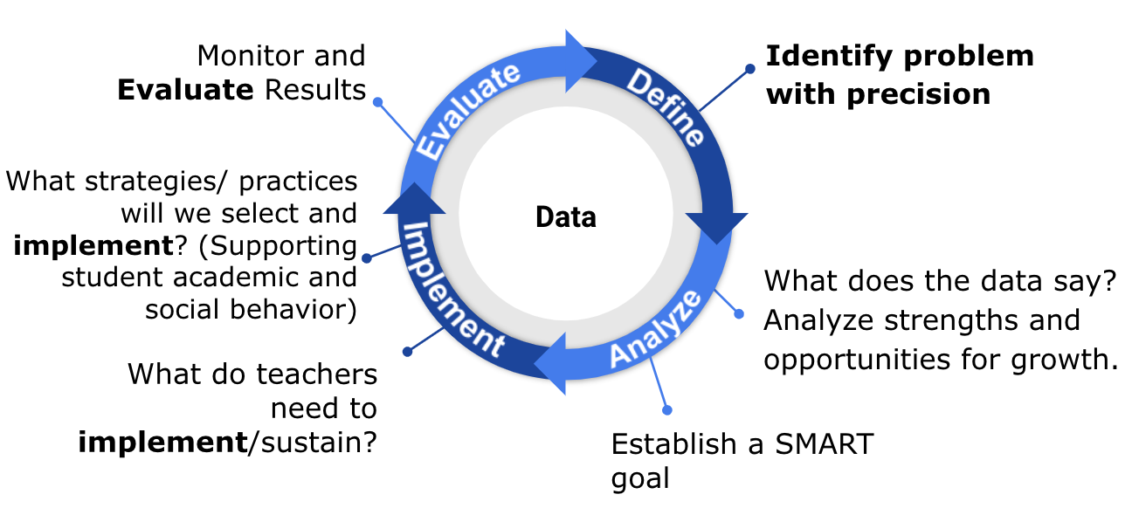
DEFINE:
What is the Problem?

Slide 21

Can you relate?
“If I had an hour to solve a problem I’d spend 55 minutes thinking about the problem and 5 minutes thinking about solutions.”
~Albert Einstein

Slide 22

Types of Problems
Known/Suspected
Unknown/Hidden
Concern or a question from the principal, central office, BLT
Specific data (grade retention, attendance, SOLs, climate surveys, ODR’s, etc.)
Cannot assume the concern or question accurately represents reality
Recognizes areas outside of daily lived experiences
Looks at big data and discusses how we can find out more about who is not experiencing success
Involves teacher, student, and family voice and concerns

Slide 23
Data: Evidence of Need
What is your data story?
Is there a problem?
Academics
Behavior
Attendance
Social Emotional Wellness
Community health
Teacher retention
Family engagement
What is the data that indicates that there is a problem that needs to be addressed?

Slide 24

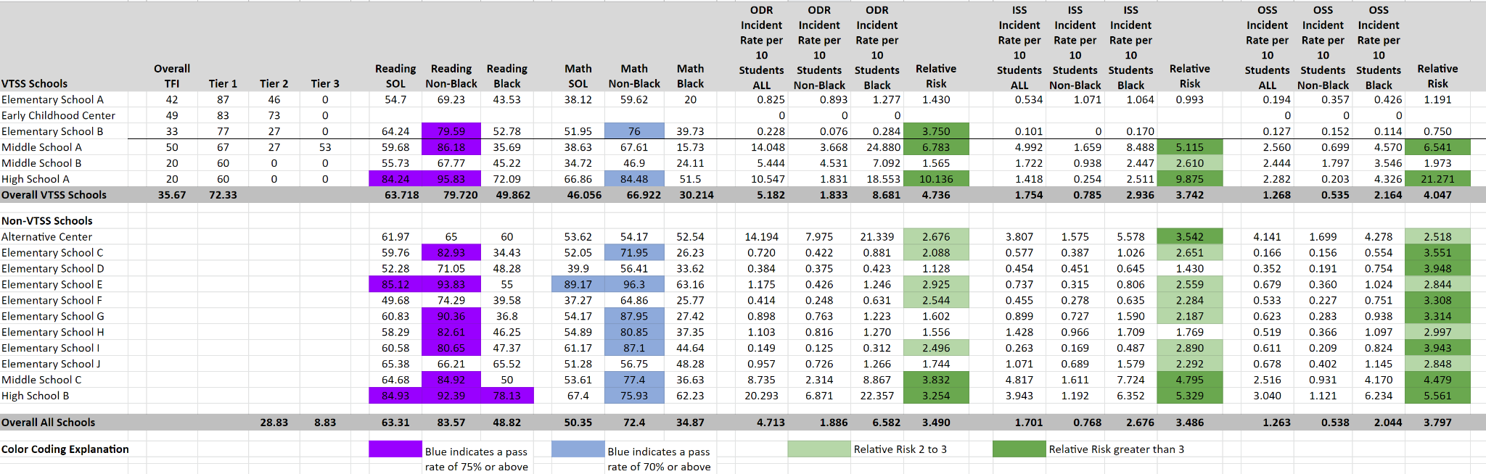
VA School Quality Profile
https://schoolquality.virginia.gov/

Slide 25
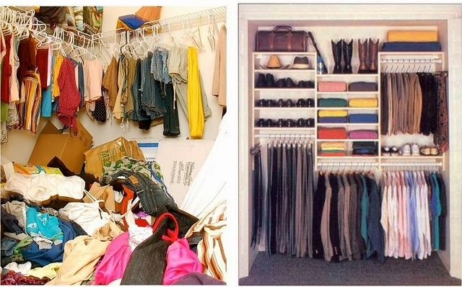
From This to That

Slide 26
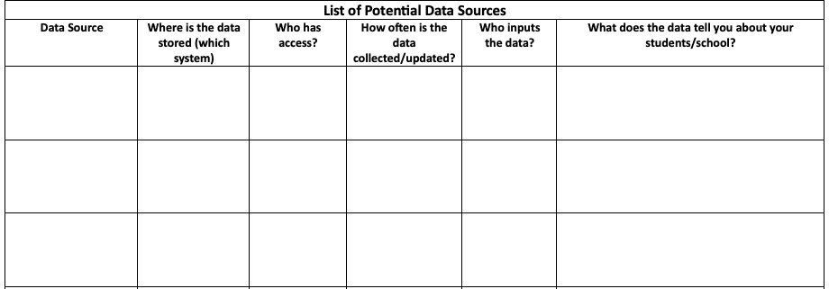

Work Time
Discuss:
What data sources will help you monitor your school’s potential problems?
Exploring Data
Workbook p.13 - List of potential data
Workbook p.14 - Potential data sources worksheet

Slide 27

What are your data saying?
  Compare the data to what is typical?
  What is the mean/median?
  What should we expect?
  Compare the data to what is possible?
  What does “ideal” look like?
  What are our success criteria for ALL students?
  Compare the data to what is needed?
  What is the goal?
  What is the standard?

Slide 28

Identifying Red Flags
In what general area(s) are our outcomes not meeting our shared expectations?
  What trends have we observed in our school related to identified problem areas?
  Who is not experiencing success based on what is represented in the data?
Do data suggest we have a strong tier 1 across academic, behavior, social emotional wellness?
Which unmet needs have we uncovered?
  Which are the most pressing to address now?

Slide 29
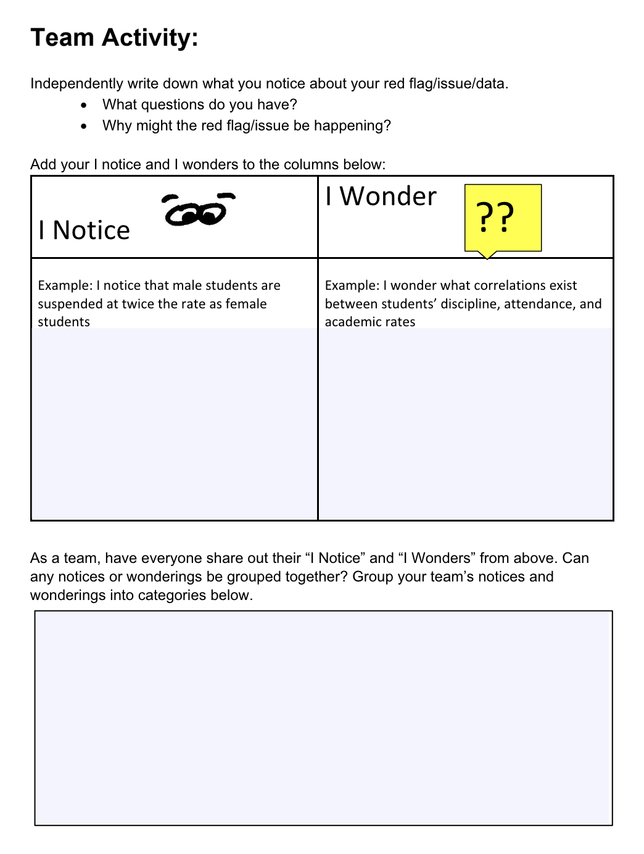

Work Time
Identifying
Red Flag/s
Workbook p.15

Slide 30
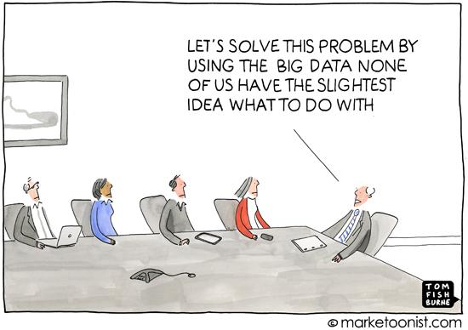
Moving From General to Precise

Slide 31
Based on your data…
Precisely define the problem by identifying who, what, when, where, and why.
What is the problem?
Who is having the problem?
When is the problem occurring?
Where is the problem occurring?
Why is the problem occurring?

Slide 32
Using Data to Create
Problem Statements
The statement of a problem is important for team-based problem solving.
Everyone must be working on the same problem with the same assumptions.
Problems often are framed in a “Primary” or “General” form. That form creates concern, but is not useful for problem-solving.
Shift the framing of “primary” problems based on initial review of data.
Use more detailed review of data to build “Solvable Problem Statements.”

Slide 33




Drilling Down
Domain area (Attendance, Behavior/SEL, Academics)

Slide 34
Primary vs Precision Statements
Primary / General Statements
Precision Statement
Too many referrals
September has more suspensions than last year
Math SOL pass rates are decreasing
Student disrespect is out of control
Recess has been wild
There are more ODRs for aggression on the playground than last year. These are most likely to occur during first recess, with a large number of students, and the aggression is related to getting access to the new playground equipment.

Slide 35
Examples
Example 1: 47% of students in 2025 failed to pass the reading SOL, with 75% of this group identified as 8th graders.
Example 2: During the 2024-25 school year, 31% of students received multiple office discipline referrals for dress code violations (as defined in the student handbook), with 65% of this group identified as female.
Anywhere School: In 2025, 35% of the student population was at-risk of being chronically absent, with 85% of this group identified as students with disabilities.

Slide 36
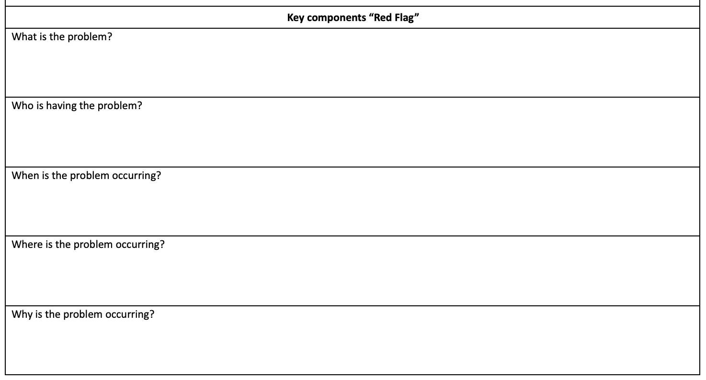
Work Time:
Developing a Problem Statement
Write a Problem Statement
Where Are Your Gaps?
What
Who
When
Where
(We’ll get to the “Why”)
How precise can you get?
Don’t get lost in the weeds, but be clear about the problem.
Are all assumptions challenged or verified by data?
What do you need to finish your problem statement?
Workbook p. 16

Slide 37
ANALYZE
Why is it occurring?

Slide 38
Precision Statement
Now we precisely define the problem by identifying who, what, when, where, and why.
What is the problem?
Who is having the problem?
When is the problem occurring?
Where is the problem occurring?
Why is the problem occurring?

Slide 39
Root Cause Analysis
There’s no single way to conduct a root cause analysis, but it usually comprises of three steps:
Identify a problem
Identify the cause(s) of a problem
Identifying strategies to address the problem.
There are many publicly available tools to use for this process.

Slide 40
Why conduct root cause analysis?
Prevents “solutionitis”
Produces insights into the system as a whole
Prompts honest discussions
Invites the student and family perspective
Defines problems in narrow, concrete terms
Informs practical and strategic action and solutions
Assists with targeting measurable outcomes
Dr. Edwards, VDOE (2023)

Slide 41

Important Conversations
To truly understand the problem/challenge we have to gain insight from those affected by the problem/challenge.
They can help us understand:
What does this problem
look/sound/feel like for them?
Who is this problem affecting and
in what way?
When is this problem affecting them more? the least?
Where do they experience this problem the most?
Why do they think this problem is occuring?

Slide 42

Importance of Partner Engagement
“When schools and districts can learn from and meaningfully engage the expertise of the students, families, and communities who have been marginalized by our systems, we can begin to work together toward building more responsive and just schools.”
Ishimaru & Takahashi (2017)

Slide 43
Tools for Feedback
There are different tools you might use to explore the WHYs from the perspective of students and families.(e.g. empathy interviews, focus groups, student advisory committees, surveys)
Ex. Conducting a school climate survey for students and families to see how they feel about school including what they think is working / not working. Get results back by mid-October and review as a team at the November meeting; disaggregating for students with disabilities and their families.
Workbook p. 17

Slide 44
Root Cause Helps
Separate Story from Fact
Example:
Story: Students are not coming to school because they don’t care.
Fact: Data show that at least 40% of students with disabilities report:
…not having a positive, supportive relationship with a staff member.
…lacking confidence in their ability to succeed academically.

Slide 45

Work Time
Identify which partner groups you need to obtain feedback from. (Who is the problem impacting?)
Discuss the method(s) by which feedback will be gathered. (What methods currently exist?)
Partner Feedback
Workbook p. 17
(Neseet al., 2021)

Slide 46
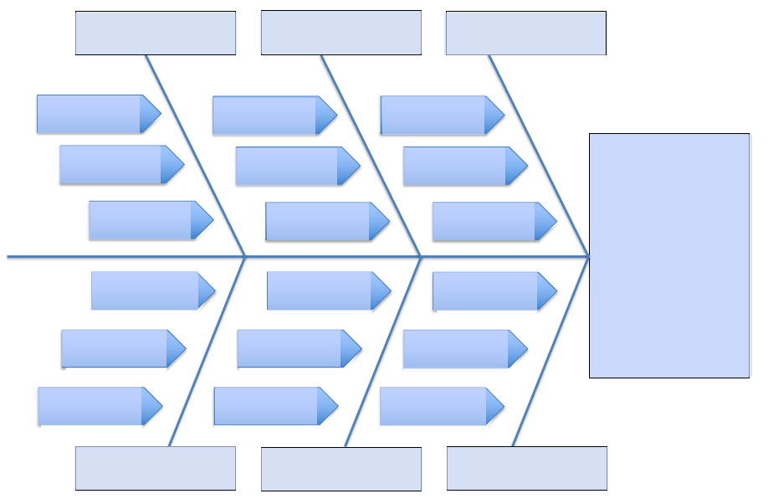
Fishbone Diagrams
A “fishbone” diagram, can help brainstorm possible causes of a problem and sort ideas into useful categories.
Workbook p. 18

Slide 47
Anywhere School: Getting to the “Why” (Fishbone Protocol)
Families:
Illness, medical appointments, chronic physical or mental health conditions, housing instability, economic hardships, suspensions
Students: “Why do you come to school?”
Adult support
Belonging to a positive peer group
Competence/Confidence
School environment
“Why is 35% of the student population at-risk of being chronically absent, particularly among students with disabilities (85%)?”

Slide 48


Work Time
1 - Based on this feedback, what root causes do you predict Anywhere School might identify?
2 - What additional data might this school need to better identify potential root causes?
Identifying root causes

Slide 49
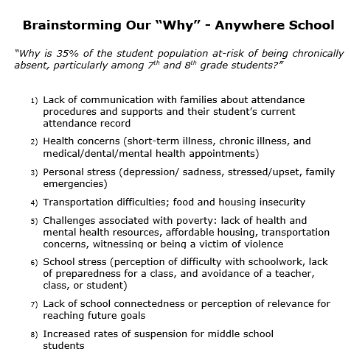
Brainstorming
our “Why”:
“Why is 35% of the student population at-risk of being chronically absent, particularly among students with disabilities (85%)?”
Workbook p. 19

Slide 50
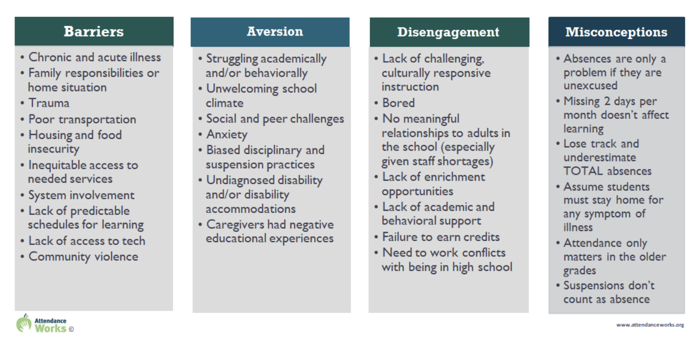
Root Cause:
What does the Research Say?
Workbook p.20
Attendance Works (2025)

Slide 51
Anywhere School:
Making Sense of our “Why”
Barriers:
Health concerns
Personal stress
Transportation difficulties; food and housing insecurity
Lack of access to mental health resources
Aversion:
Increased rates of suspension
Struggling academically or behaviorally
Disengagement:
No meaningful relationships to adults in school
Lack of academic and behavioral support
Lack of enrichment opportunities
Misconceptions:
Suspensions don’t count as absences

Slide 52
Narrowing our Focus
Imagine you are on the Anywhere School leadership team.
What question might you ask to assist the team to narrow down their focus to 1-2 root causes?
Identifying the “Why”
See Workbook p.21 for
Anywhere School’s list of root causes

Slide 53
Anywhere School:
Where will we start?
What are the overlaps between the potential root causes and family/ student feedback?
Which root cause/s do we have data to support?
Which root cause/s will have the greatest positive impact on our goal?

Slide 54
Struggling academically and/or behaviorally
Anywhere School
Fishbone Example
Increase in suspensions
Instruction primarily focuses on “drill and kill” teaching strategies
Why is 35% of the student population at-risk of being chronically absent, particularly among students with disabilities (85%)?
Increase in reported anxiety and depression among students
Lack of scaffolding in instruction
Students don’t feel like they belong/are accepted at school
Lack of enrichment opportuntities
Lack of access to mental health resources
Workbook p. 21
No meaningful relationships to adults in school
Personal stress (e.g., illness, isolation, mental health concerns, economic hardships)

Slide 55
Struggling academically and/or behaviorally
Anywhere School
Fishbone Example
Increase in suspensions
Why is 35% of the student population at-risk of being chronically absent, particularly among students with disabilities (85%)?
Lack of scaffolding in instruction
Lack of enrichment opportuntities
Workbook p. 21
No meaningful relationships to adults in school
Personal stress (illness, isolation, mental health concerns, economic hardships)

Slide 56
Anywhere School:
Data to support the “why”
Struggling academically and/or behaviorally
TFI features 1.4, 1.5 and 1.9 scored a 1 or 0
teaching expectations
problem behavior definitions/discipline flowchart
feedback & acknowledgement system
Classroom observations indicated lack of fidelity for scaffolding across 60% of classrooms

Slide 57
Anywhere School:
Data to support the “why” (cont’d)
Personal stress (illness, isolation, mental health concerns, economic hardships)
- Student survey data indicated that students were experiencing high levels of stress leading to increased rates of absences.
- Student survey data indicated that 50% of all students participate in enrichment activities while only 25% of students with disabilities are involved in an enrichment activity.
- Student survey data also indicated that 20% of students with disabilities had a meaningful relationship with an adult.

Slide 58
Anywhere School Precision Statement:
Bringing it All Together
In 2025, 35% of the student population was at-risk of being chronically absent, with 85% of this group identified as students with disabilities.
This is believed to be due to a lack of fidelity of Tier 1 academic and behavioral practices along with students with disabilities having fewer meaningful relationships with adults and lower rates of participation in enrichment activities.

Slide 59

Work Time: Step 1
Revisit your problem statement. Individually brainstorm as many possible contributing factors of the problem that you can. Use data to justify your claims!
Developing a Precision Statement
Workbook p.22 Ecological Factors

Slide 60
Work Time: Step 2
Revisit your problem statement. Individually brainstorm as many possible contributing factors of the problem that you can. Use data to justify your claims!
Categorize/cluster the possible root causes by common themes.
* Consider what additional information may be needed.
Developing a Precision Statement (cont’d)

Slide 61
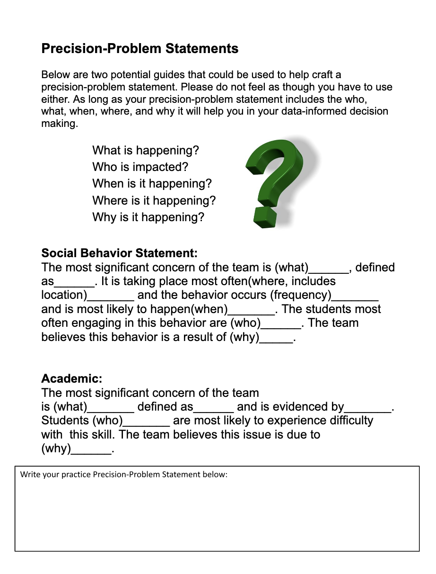
Work Time: Step 3
Developing a Precision Statement (cont’d)
Workbook p. 23

Slide 62
Establish a Goal
Monitor and Evaluate Results
Define problems with precision
What practices will we select & implement?
Data
What does the data say?
Analyze strengths & opportunities for growth
What do teachers need to implement/sustain
Establish a SMART goal

Slide 63

Characteristics of a Strong Goal
Goals allow you to analyze, monitor, and adjust professional practice. Goals are:
Workbook p.24

Slide 64
SMART Goal Example
Timely
Specific
By December 2024, educators will develop and implement with 85% fidelity a science instructional framework as evidenced by classroom observations and a 5% increase between pre and post teacher benchmark scores.
Realistic
Measurable & Achievable

Slide 65
Work Time
Revisit your draft precision statement.
Practice developing a SMART goal based on that statement.
Start a Goal

Slide 66
Anywhere School
Precision Statement & Goal
Precision statement: In 2025-26, 35% of the student population was at-risk of being chronically absent, with 85% of this group identified as students with disabilities. This is believed to be due to a lack of fidelity of Tier 1 academic and behavioral practices along with students with disabilities having fewer meaningful relationships with adults and lower rates of participation in enrichment activities.
Goal: By June 2027, the percentage of students with disabilities who are attending school more than 90% of the year will increase by 15%. This will be checked every nine weeks to see if progress is on track for the end of the year.

Slide 67
IMPLEMENT
What are we going to do about it?

Slide 68

What do you see here?

Slide 69

Team Time Reflection
How was the intervention selected?
How was the plan for implementation developed?
Did staff have what they needed to implement the intervention?
Think of an intervention you have been involved in….

Slide 70
Developing Solutions
What practices need to be in place in order to address the problem?
What systems (e.g., professional development, coaching) need to be in place to support the implementation of these practices?

Slide 71
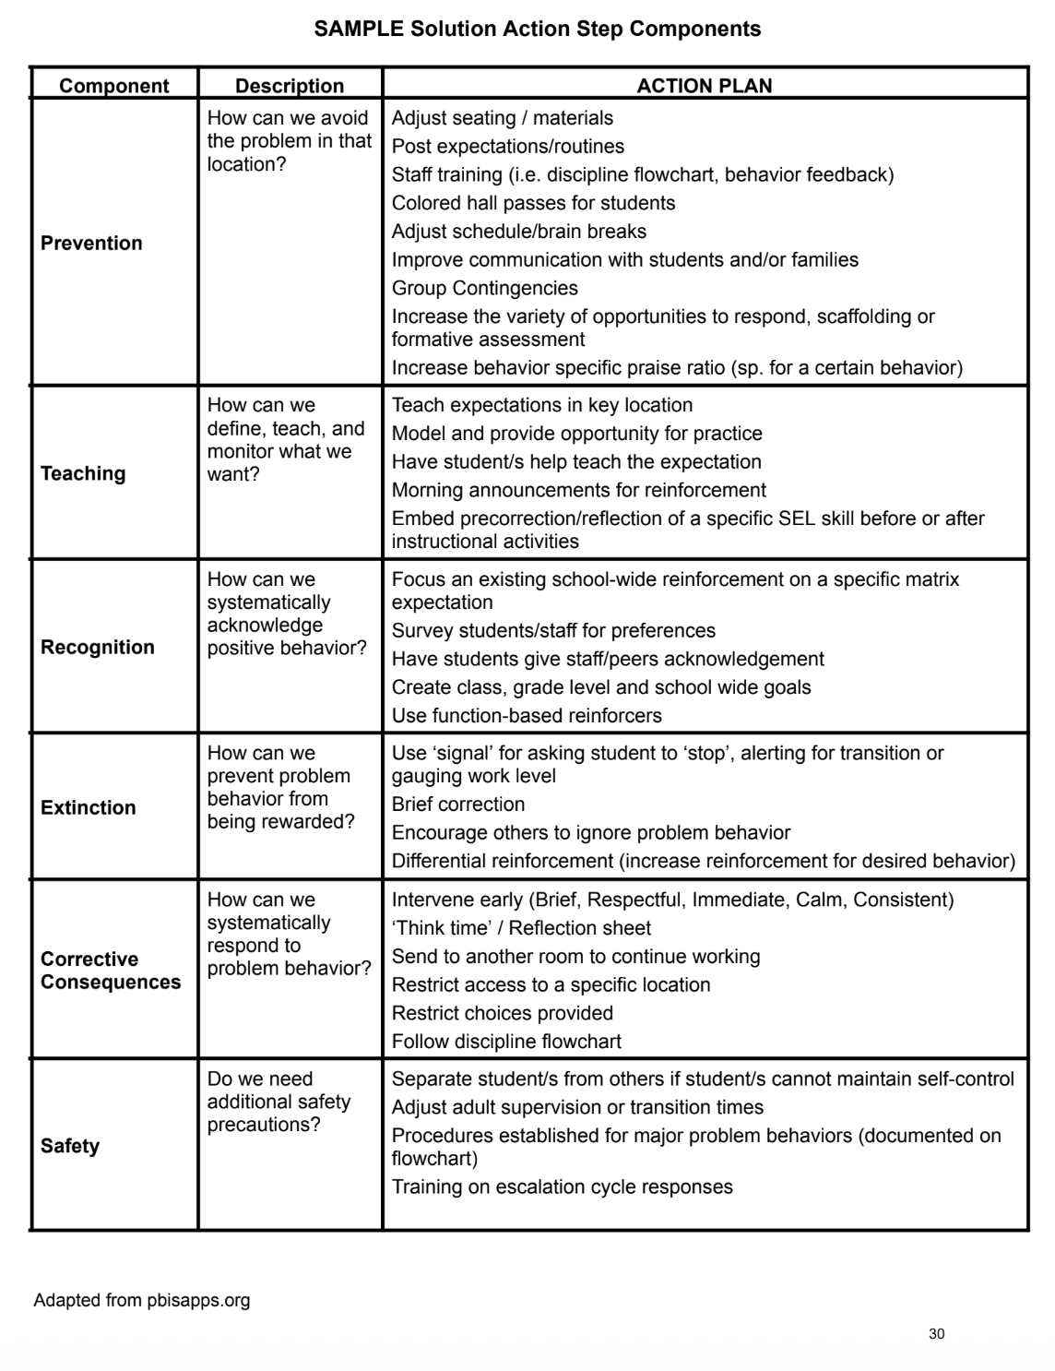
What is still needed?
Solution Development
Workbook p.29
PBISApps (2020)

Slide 72
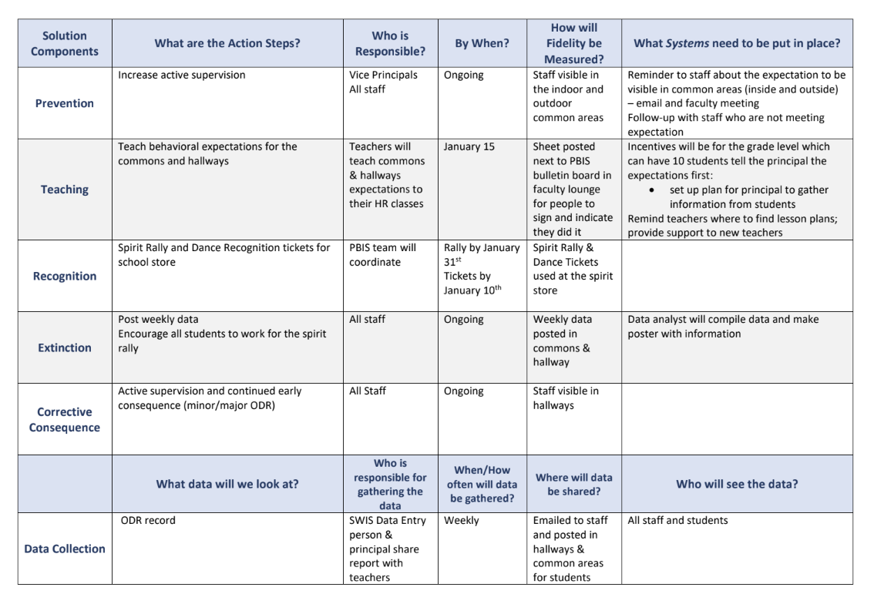
Example Action Plan
Workbook p. 30

Slide 73
What is included in an effective action plan?
The instruction and interventions are evidence-based and linked.
We have the capacity to implement the plan in a timely manner and delivered in the way it is intended by people who are qualified.
The individuals implementing the plan have the support needed to implement the plan.
There is a plan for monitoring implementation fidelity.

Slide 74
Work Time
Refer to the General Features of Tier 1 Standards of Practice document…
Consider your established goal. What key practice(s)
would your school consider implementing or improving with fidelity?
OR
Consider our example. How will the team support the school in the implementation of the new practice(s)?
Identifying
Practices & Systems
Workbook pp. 32-35

Slide 75
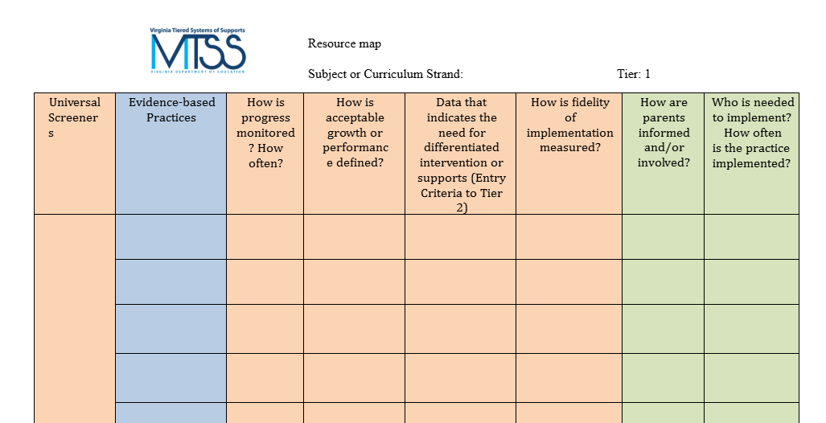
What do we currently have in place to address this need?
Resource Mapping
Workbook p. 25

Slide 76
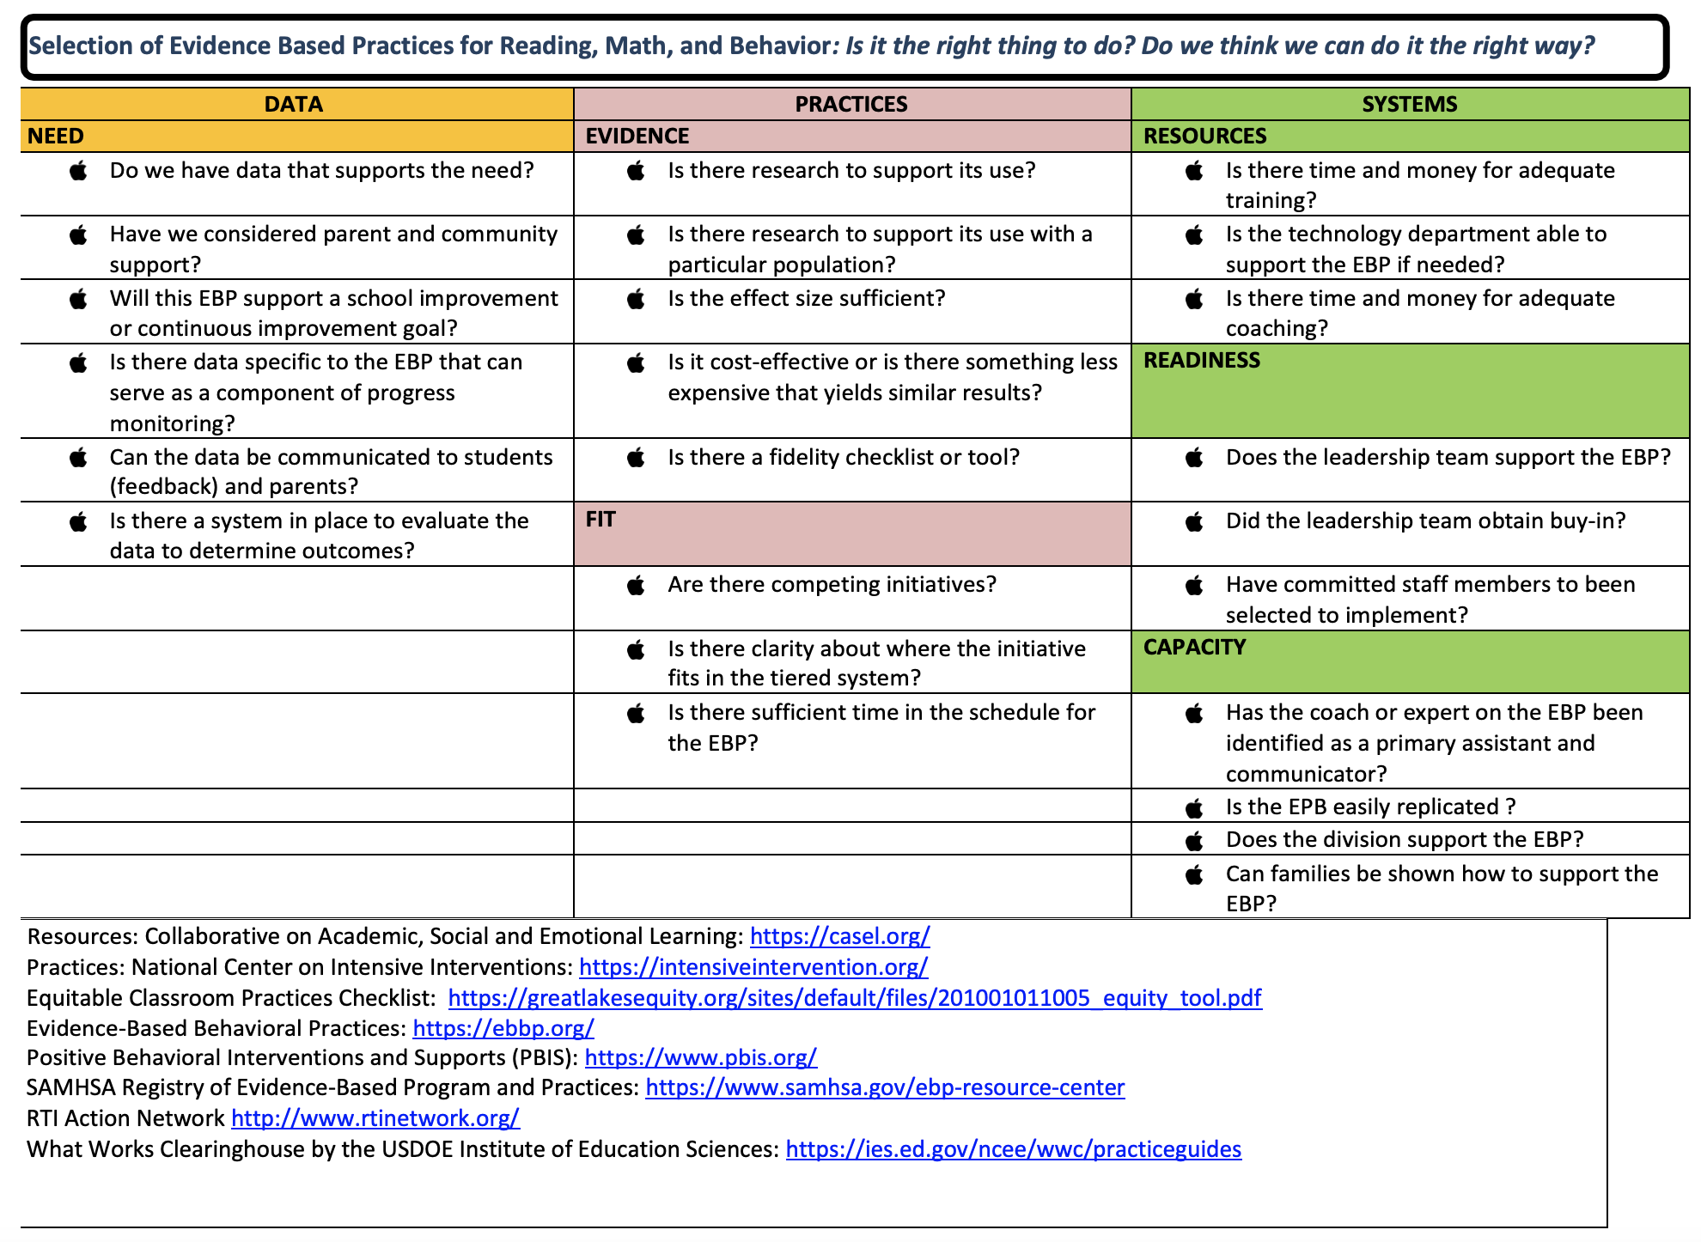
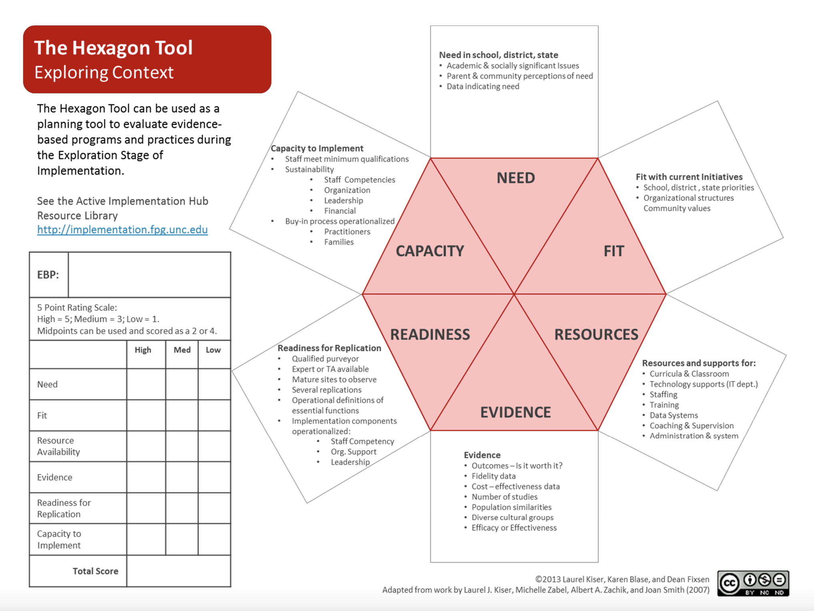
Selection Tools:
Exploring Context
Workbook pp.26-28
Hexagon Tool
Evidence-Based Practice Selection Tool

Slide 77
EVALUATE
Is it working?

Slide 78
Evaluation Plan
After identifying practices and systems, consider…
When are they expected to be implemented?
How will we know it’s been done?
Who will monitor fidelity of the plan?
Fidelity
When will the team review progress toward outcomes?
Who will gather and
share outcome data?
Outcomes

Slide 79
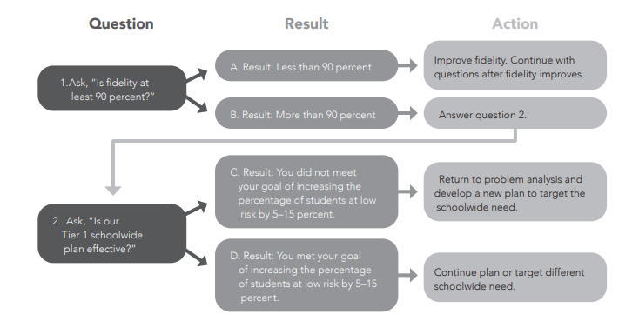
Evaluation Process
Workbook p. 41
Collins, A., Harlacher, J. & Potter, J. (2024). Untangling data-based decision making.

Slide 80

Work Time
How will you evaluate
fidelity and monitor progress towards your goal?
What fidelity and outcome data might you want to collect?
Evaluation

Slide 81
Continuous Process
Monitor and Evaluate Results
Define problems with precision
What practices will we select & implement?
Data
What does the data say?
Analyze strengths & opportunities for growth
What do teachers need to implement/sustain
Establish a SMART goal

Slide 82
Building a Culture of Data Literacy
Making it Routine - Wrap up

Slide 83
Data literacy helps us…
Explore which data is needed to deeply understand the problems driving poor systemic results
Enables access to the necessary data
Helps us to analyze, interpret use and report data to promote goals
Reflect on data access and analysis for continuous improvement

Slide 84
What Data Literacy Looks Like
Teams study data at the school-wide level
Define specific problems
Leverage evidence-based practices as solutions to problems
Focus on systems change

Slide 85
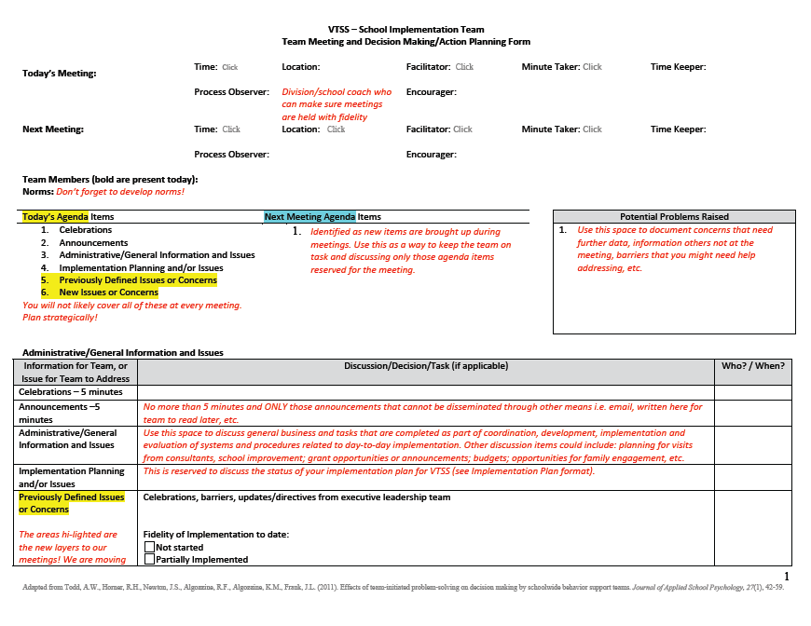
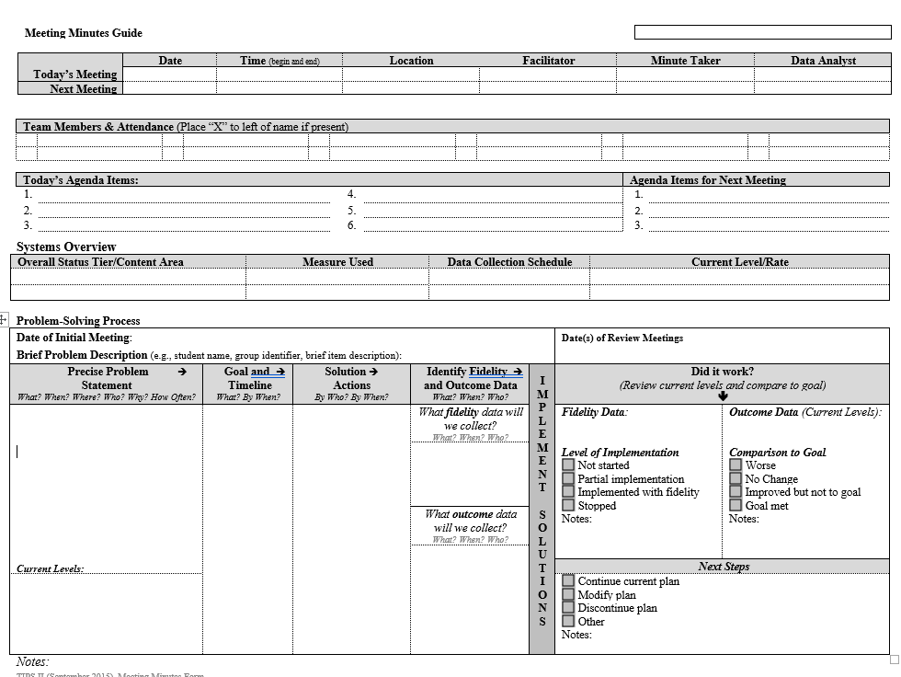
Efficient Agenda
Workbook pp. 36-39

Slide 86

Right Data/Right People
Identify the RIGHT data, in the right format.
Identify the RIGHT people who:
  Meet consistently (RIGHT time)
  Start meetings with data
  Strategically use data to develop solutions and action plans
  Implement and monitor action plans (fidelity & outcomes)
  Have access to student and family voices

Slide 87
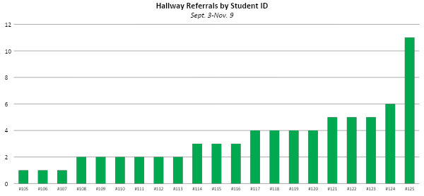
Systems vs Individual

Slide 88

Data Sharing

Slide 89
Data Analyst
School A: This school has subcommittees that report the data to the school VTSS team, e.g., academic data, behavior data.
School B: The data is organized by school leadership.
School C: A sophisticated data system exists. The data analyst is the “driver” in the meeting.
Workbook p. 40

Slide 90

Role of Data Analyst and the Team
Data Analyst
Tier 1 Team
Identify red flags
Drill down to precision
Summarize (i.e., precise statement & supporting graphs)
Prioritize problems
Develop goal
Develop solutions and action plan

Slide 91

In Action
Source: https://www.youtube.com/watch?v=ZCr4MyTCAxw

Slide 92
Work Time
What features are put in place to structure this meeting?
What questions may you have from this video?
How can you see this influencing your process in your team meetings?

Slide 93
Learning Intentions
Understand the components of a structured problem solving process.
Establish the role of the school team in the problem solving process.
Clearly define problems with precision.
Analyze data effectively to identify red flags and initiate root cause analysis.
Establish clear goals.
Practice developing actionable plans and a process for evaluation.

Slide 94
Call to Action
What is an immediate next step to facilitate the DIDM process in your school?
Consider where you are in this process:
Identifying data to collect?
Identifying red flags?
Working on establishing the “why?”
First draft of a precision statement and goal?

Slide 95
We love feedback!!
Please complete the evaluation for us. We appreciate the feedback.

Slide 96


Slide 97
References
Ashley, D. M. (2015–2016, Winter). It’s about relationships: Creating positive school climates. American Educator, 39(4), 13–16.
Attendance Works. (2025, April 29). Root causes. https://www.attendanceworks.org/chronic-absence/addressing-chronic-absence/3-tiers-of-intervention/root-causes/
Educational and Community Supports. (2020). SWIS user manual. PBISApps. https://files.pbisapps.org/pub/pdf/SWIS-User-Manual.pdfUVM People & Planet+4
Edwards, A. (2023). Root cause analysis. [Presentation]. Office of School Quality, VDOE.

Slide 98
References
Florida PBIS Project. (2016). Problem-solving process. https://flpbis.cbcs.usf.edu/foundations/problem-solving.html
Gaunt, B. (2023). Data-based decision making. [Presentation].
Goodreads. (2025, May 6).
Albert Einstein>Quotes>Quotable Quote. Goodreads. https://www.goodreads.com/quotes/60780

Slide 99
References
Harlacher, J. E. L., Potter, J., & Collins, A. (2024). Untangling data-based decision making: A problem-solving model to enhance MTSS. Marzano Resources.
Ishimaru, A., and Takahashi, S. (2017). Disrupting racialized institutional scripts: Toward parent–teacher transformative agency for educational justice. Peabody Journal of Education, 92(3)(343-362).
Nese, R. N. T., Santiago-Rosario, M. R., Triplett, D., & Austin, S. C. (May, 2021). Obtaining stakeholder feedback to improve the middle to high school transition. Center on PBIS, University of Oregon. www.pbis.org.

Slide 100
References
Reeves, D. B. (2002). The Leader’s Guide to Standards: A Blueprint for Educational Equity and Excellence. Jossey-Bass. Chapter 7, page 125.
TIPS2 Grant. (2015, May 15). Sample TIPS Meeting for a PBIS Team [Video]. YouTube. https://www.youtube.com/watch?v=ZCr4MyTCAxw
US Department of Education. (2020, September 15). Approaches to root cause analysis. Office of Elementary and Secondary Education. Retrieved April 11, 2023, from https://oese.ed.gov/resources/oese-technical-assistance-centers/state-support-network/resources/approaches-root-cause-analysis/

