Slide 1
Data-Based Decision Making

Slide 2
Materials
Workbook
https://vtss-ric.vcu.edu/events/

Slide 3
VTSS Resource Hub
Notes:
https://tinyurl.com/2bp8dhch

Slide 4
Follow VTSS
Thank you for attending. Please feel free to tag us at any of our social media handles below!
Twitter - VTSS_RIC
Facebook - VTSSRIC

Slide 5
Agenda
Morning:
Welcome and problem solving overview.
How do we identify and analyze the problem?
How do we set goals?
*Lunch*
Afternoon
How do we implement?
How do we evaluate?
How do we make this routine?

Slide 6
Learning Intentions
Participants will:
Understand what a structured problem-solving process entails and how data is used throughout the process.
Establish the role of their school team in the problem-solving process
Analyze data to identify red flags to begin the process of a root-cause analysis
Practice defining problems with precision and establish goals

Slide 7
Learning Intentions Continued
Start to determine practices and systems needed to achieve an identified goal
Establish a process to monitor outcomes and fidelity of the implementation plan
Develop a shared understanding of the role of a data analyst

Slide 8
Community Agreements
Be Responsible | Take care of your needs. Share your questions with the group.
Be Respectful | Respect others intentions Honor the impact of your words Earnestly move toward completing tasks during team work time
Be Engaged | Ask what you need to know to understand and contribute. Stay present Listen to others attentively. Share your expertise, information and ideas.

Slide 9
Before we Begin- What is your Lens? Agree or Disagree
All people engage in some type of problem-solving approach?
Different people solve problems in different ways, many times using different approaches and vocabulary.
Not all data is equal in value.
Different people have different values, trust, and comfort in using data to analyze data for decision making.

Slide 10
Connection Activity
Which of these pictures of a tree best describes your school’s current problem solving process and feelings about data usage in this process?
Notes:
Which of these pictures of a tree best describes your school’s current problem solving process and feelings about data usage?
Share out

Slide 11
Where do most of our decisions about supporting students occur?
Notes:
Have them shout out or talk about this.
Do we have several teams looking at the same issues and/or students?
Prompt participants to recall how often we include family input when making decision about our students, if it is not one of their suggestions.

Slide 12
Data Through a MTSS Lens
MTSS integrates data-informed decisions that are already happening in silos.
MTSS provides a consistent common approach and structure for reviewing multiple data points, identifying trends, and determining root cause.
(Dana Ashley, American Educator, 2015)
Notes:
When we have quality implementation of MTSS we will have improved student outcomes, reduced competition across competition area initiatives and capacity building of staff skills and knowledge.

Slide 13
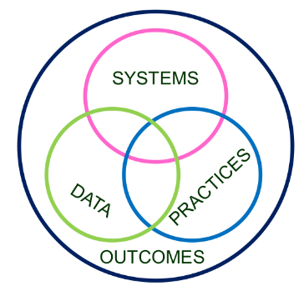
School-Level MTSS
Growth & benefit are central. Must reflect equitable learning opportunities
Data informs decisions about screening, progress monitoring, fidelity, and equitable outcomes
Invest in Systems!!! (Leadership teams, support professional learning and coaching)
Differentiate and ensure outcomes are reflective of all students
Prioritize efficient and effective practices
(evidence, culture, context)
Notes:
Outcomes: As an agency, as divisions/departments that will support the agency. : is what your school or district values wants to achieve. It is important to clearly identify your outcomes and come to consensus on how it will be measured and monitored before selecting interventions/initiative/or programs to achieve it.
Systems support Divisions/departments that support the adults…equipt a common way of work and support for adults across the agency..coaching and training (coaching for compliance). refers to the tools, and support structures we put in place for staff to implement the evidence based practices we’ve selected. We know that the practices will not magically reach the student without proper coaching, support, and performance feedback.
Data: helps us to identify our needs (what practices do we need? And once things are being implemented we continually check for two things
One: Are we implementing with fidelity, and
TWO: is it having the intended impact on students?
Practices refers to the evidence based practices and interventions that we implement with students at tiers 1, 2, and 3. To reiterate, these practices are selected based on need and that need is identified through data
Once the systems are in place for staff to implement the practice, we continuously progress monitor the effects and adjust as necessary so that we can achive our valued outcomes.

Slide 14
Thoughts on Data-Informed Decisions
“As decision-makers, we need a deliberate process to guide us through the examination and analysis of data. Without this, we may be apt to substitute strongly held opinions for the fact-based conclusions that would be derived from a review of the actual data.”
-D.B. Reeveds, The Leader’s Guide to Standards, 2022

Slide 15
What is Our Process?
The Process
Problem
Solution
Notes:
We all solve problems everyday. We are going to be talking about the structure of a problem solving process.
Have teams answer: Do we have a structured process? What are the components of their process?
A barrier to solving problems is often due to our habits of jumping to solutions without really understanding what the problem is that we are trying to solve.
How many of us are solution providers? We hear a problem and we immediately know a solution. (raise hands if they feel comfortable)
Reflect on when your Tier 1 team is deciding on solutions to a problem. Do we have a process or do we jump to solutions? Poll the crowd, chat, annotate, whatever
If you have a process - Where are your strengths and where are your challenges?

Slide 16
Problem Solving Process Themes
Monitor and Evaluate Results
Identify problem with precision
What strategies/practices will we select and implement? (Supporting student academic and social behavior)
Data
What does the data say? Analyze strengths and opportunities for growth
What do teachers need to implement/sustain
Establish a SMART goal
Notes:
There are many good data-based decision making models available. They all have the same 4 thematic questions: What is the problem? Why is it occurring? What will we do about it? Is the plan working?
This is a simplified model that shows the basic features. We want data to drive our decisions toward continuous quality improvement. To accomplish this, we evaluate current data to determine where we are currently and define any current problems. Then we use data to plan where we want to be and how we will get there. Then we implement the plan and use data to ensure that the plans are delivered with integrity and fidelity. Then we go back and gather more data to evaluate whether we are making progress toward goals and revisions to it if needed.

Slide 17
Where is your Tier 1 Team? Typical vs. Effective Problem Solvers
Typical Problem Solvers…
Define problems loosely or vaguely
Don’t validate assumptions before building a plan
Develop generic plans
Monitor fidelity of actions
Don’t measure or evaluate impacts
Typically abandon interventions without considering fidelity

Slide 18
Where is your team?
Define a problem in observable and measurable terms
Collect and use multiple sources of information to validate assumptions about the problem
Create highly detailed steps to implement the intervention with fidelity including assessment procedures, decision-rules and actions to support interventionist
Use student data & intervention fidelity to identify & implement next steps through continuous cycles of problem solving
Effective Problem Solvers

Slide 19
Role of Tier 1 Systems Team with Data
Problem Analysis
Plan
Collects, analyzes, and shares data
Develops school-wide action plans based on data analysis
TIER 1 CORE TEAM
Adjust
Monitor
Suggests changes to current action plans, classroom and school-wide procedures, behavior lesson plans, etc.
Evaluates the effectiveness of programs, practices, procedures, and any suggested changes
Notes:
Most of our decisions about supporting students occur in teams. The Tier 1 team is the systems change team. They are committed to school-wide systems change.
Student(s) needs stated in measurable and observable terms and in relation to Tier 1 standards of student performance
Selection of evidence-based practices to improve student(s) performance(s)
Development of actions to implement and use selected treatment – with emphasis on all team members participating in the implementation and use.
Monitoring the quality and adherence to using the practices consistently
Evaluating impacts of the treatment and making decisions about next-steps for continuous improvement.

Slide 20
How well are we serving all students?
Tier 3 for a Few: Intensive, Individualized
Tier 2 for Some: Targeted for Small Groups
Tier I for All: Core/Universal
1 - 5%
5 - 15%
80 - 90%
Notes:
This is what a healthy system looks like.
As a Tier 1 team we are identifying, addressing, and resolving students academic and behavior concerns for all students not individual students. Our focus is on the BIG PICTURE and delivering quality core instruction to all students. As we go up the tiers we increase our time spent on analysis of smaller groups of students and individual students.
How well are we serving our students at Tier 1?

Slide 21
Data-Informed Decision Making is a Key Component at Every Tier
Identifies our problems and/or gaps
Helps us to identify the interventions to address our challenges
Helps us to assess improvements in student outcomes
Optimizes how we are allocating our resources

Slide 22
Do We Have the Right People on our Team?
Teacher
Family Member
Student
Anyone else?
Administrator
Staff
Counselor
Notes:
This is a Tier 1 Training so we are going to spend a little time looking at your Tier 1 team.
We want to start looking at who is on the team that uses the DIDM process.
This is your Tier 1 team, and eventually all MTSS teams.
Effectiveness of PS can be enhanced when parents/caregivers are involved (CBC)
Are our teams representative of our school faculty/staff (departments/grade levels, specialists)?
How are we seeking input from multiple sources (students, families, stakeholders, etc?) Why is it important to include additional perspectives in a teams? Allow participants to answer in the chat or verbally.
Any team is going to be limited by the lived experiences of its members. The makeup of the team could lead to possible blindspots in identifying data concerns, causes and solutions. It is not practical to include everyone in every meeting and decision, but teams should have a plan for regularly seeking input from students, families and other community stakeholders.
Equity Questions
1. Have team members considered their own blind spots and the impact of implicit bias in defining the problem?
2. Has your team discussed the potential impact of students’ feelings that their identities are not honored and valued in the school?
3. Have students been asked about their feelings of belonging and connection to the school community?
4. When looking at your precise problem, are certain groups over- or under- represented in the data?
5. Has your team considered school and division policies that may contribute to the precise problem?
Examples: Dress code, student access to gifted/honors/AP courses, availability of resources for marginalized students, diverse representations in school curricula, etc.

Slide 23
Does Our Team Use a Structured Process?
Notes:
This is not about the forms but about the function of the forms. We are building one framework to achieve our outcomes and that system is data, practices and systems. Implementation Logic is seen here and put into motion as team operates. Color coded.

Slide 24
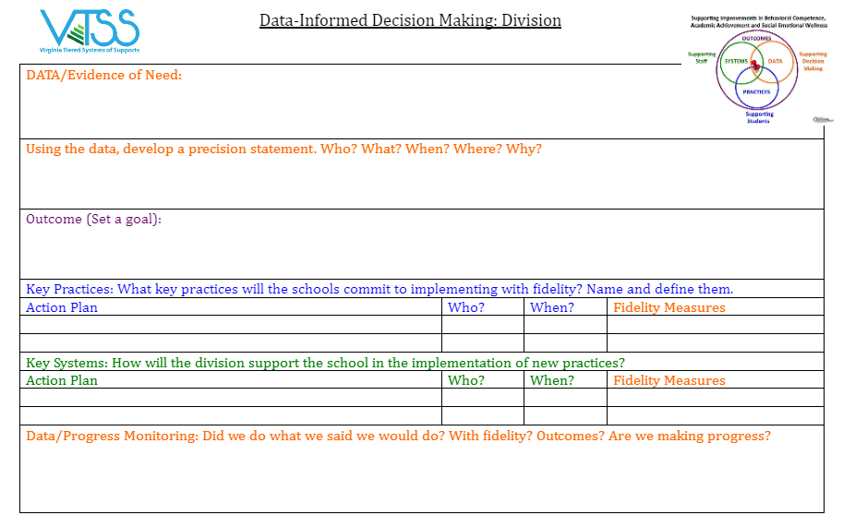
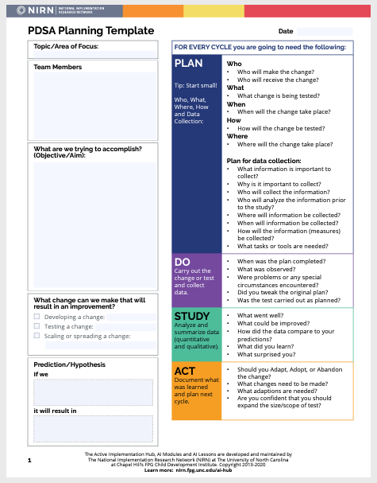
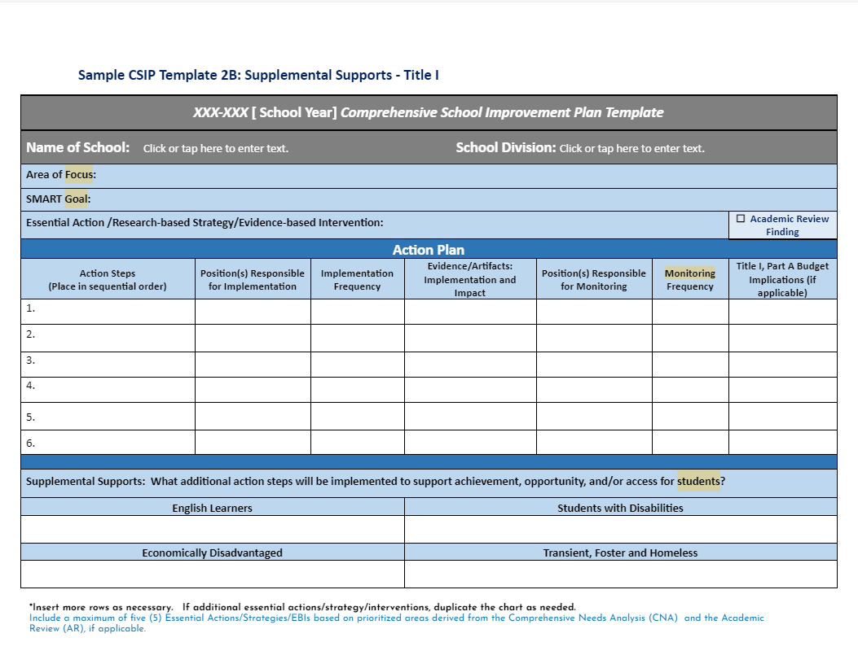
Function over Form
(as long as you are documenting)
Notes:
There are many different models of problem solving but they all have the same 4 thematic questions:
What is the problem, why is the problem occuring, what will we do about it, and is the plan working.

Slide 25
Where to Start?
Problem Identification

Slide 26
Identify the Problem
Monitor and Evaluate Results
Identify problem with precision
What strategies/practices will we select and implement? (Supporting student academic and social behavior)
Data
What does the data say? Analyze strengths and opportunities for growth
What do teachers need to implement/sustain
Establish a SMART goal
Notes:
The more time we spend up front on identifying the problem the more likely we are to be able to put the right action steps in place to make an impact on our student outcomes. Research (Young & Gaughan, 2010)

Slide 27
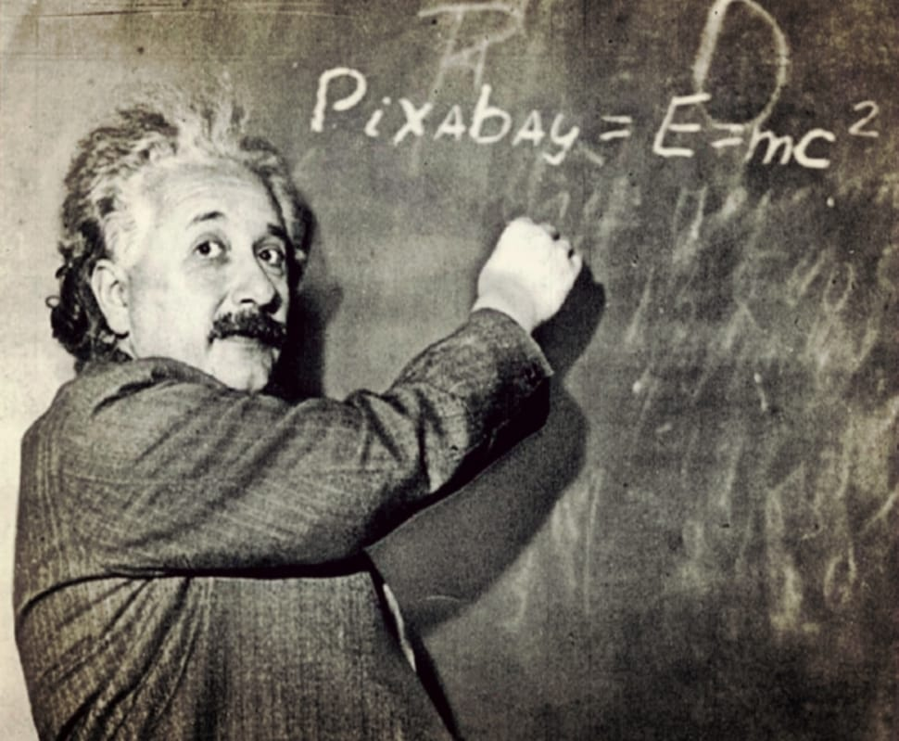
Can you Relate?
“If I had an hour to solve a problem I’d spend 55 minutes thinking about the problem and 5 minutes thinking about solutions.”
~Albert Einstein
Notes:
We want to use a problem solving process that help us make better solutions. Planning is a process not an event. We tend to jump to the problem (reactive) then immediately right to the solution. The piece that often gets left out is the data. In order for us to begin problem solving we need to look at the data. Often, we described problems very broadly (Cafeteria is out of control) and then implemented a solution (turn out the lights, reduced lunch time, more staff in lunchroom, etc.) that didn’t always specifically address who, what, when, where and why the problem was occurring.
Analogy: When you go to the doctor’s office or the ER, they do not simply take your blood pressure and then decide to remove your appendix. Quite the contrary. They make informed decisions based upon the data and define the problem with precision to clarify the solution.

Slide 28
Data: Evidence of Need
What is your data story?
Here, we answer the following question:
Is there a problem? What is the data that indicates that there is a problem that needs to be addressed?
Academics
Behavior
Attendance
Social Emotional Wellness
Community health
Teacher retention
Family engagement
Notes:
1 min
If possible, put links to the data sources (e.g., charts, graphs, reports) that will be used in problem solving and decision making in this section of the DIDM tool.

Slide 29
VA School Quality Profile
https://schoolquality.virginia.gov/
Notes:
2 min
Access to school quality profiles
You may also be using your own data platform or data collection system to display division level data

Slide 30
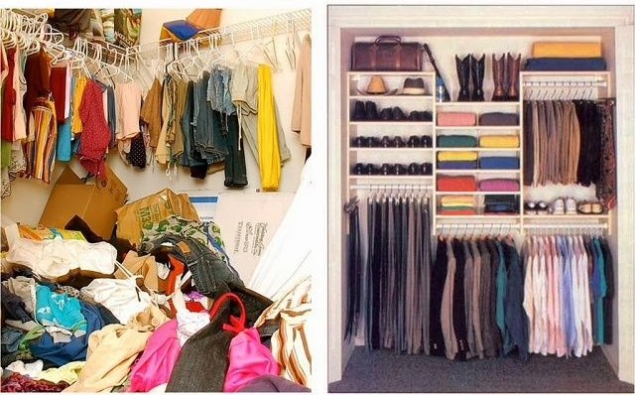
Organization and Data Management

Slide 31
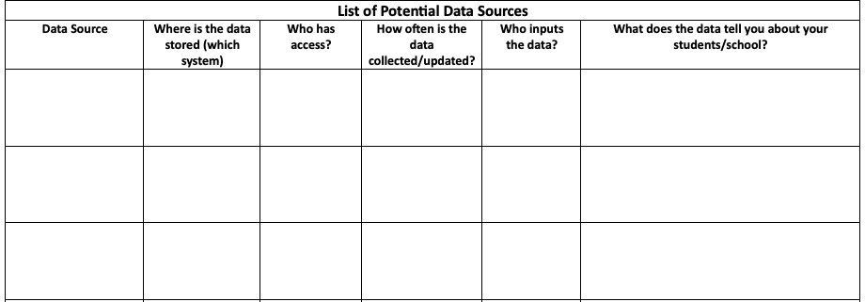
Work Time
Discuss:
What data sources will help you monitor your school’s valued outcomes?
Exploring Data
Workbook pages 12 (Downloadable Version)
Potential Data Sources - Workbook pages 13-14
Notes:
10 min
Your school:
Document data points that tell your “data story”.

Slide 32
Recommendations for Data Use
Build “decision systems” not “data systems”
Use data in “decision layers”
Is there a problem?
(overall rate of ODR, academic assessment)
Localize the problem
(location, problem behavior, students, time of day, SOL, curriculum)
Get specific
Be precise but don’t drown in the data
Be efficient
Notes:
Trainer Notes:
Schools/Facilities want to build structures that enhance decision making. SWIS is designed to help schools be more effective in decision making by gathering the right data at the right times and in the right formats. This stands in contrast to a data system which simply stores the data. It’s the difference between actively using a tool and storing something in a filing cabinet.
When using data for decision making, there is a large amount of data that is readily accessible. To avoid drowning in data, users want to use data in layers to be specific and laser-like. For example:
Do we have a problem?
What is the problem?
Where is the problem occurring?
When is the problem likely to occur in the identified location?
Why is the problem being maintained in the specific location at the specific times?
The overall goal is to use the data as an effective tool and look identify connections.

Slide 33
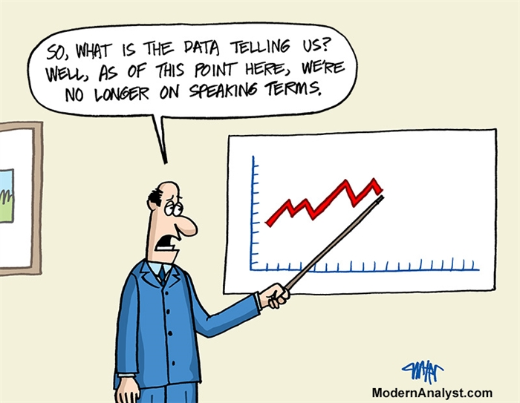
What is Your Data Saying?
Compare the data to what is typical?
What is the mean/median?
What should we expect?
Compare the data to what is possible?
What does “ideal” look like?
What are our success criteria for ALL students?
Compare the data to what is needed?
What is the goal?
What is the standard?
Notes:
2 min
Is our story connected to, and a reflection of, what is typical, possible, and needed?
We looked at our data, we identified the problem and now we really need to look at is this really a problem?

Slide 34
Identifying Red Flags
In what general area(s) are our outcomes not meeting our shared expectations?
What trends have we observed in our school related to identified problem areas?
Are groups of students disproportionately represented in the data?
Do data suggest we have a strong tier 1 across academic, behavior, social emotional wellness?
Which unmet needs have we uncovered?
Which are the most pressing to address now?
Notes:
2 min
Comprehensive Needs Assessment Toolkit (Vermont Agency of Education, Revised: April 2020)
National School Reform data protocol
***Include feedback on identified school-level problem statements of focus??? These can inform a key area of focus for the division.
***Include a question about connection to strategic plan goals/objectives?

Slide 35
Work Time
Discuss:
Looking at your data sources that monitor your valued outcomes, what are the areas of concern?
Your “red flags.”
Red Flag/s
Notes:
15 min
Your division:
Document data points that tell your “data story”.
Identify 1-2 red flags.

Slide 36
Evidence of Need
Workbook pages 6-9 (Downloadable Version)

Slide 37
Based on your data…
Precisely define the problem by identifying who, what, when, where, and why.
What is the problem?
Who is having the problem?
When is the problem occurring?
Where is the problem occurring?
Why is the problem occurring?
Notes:
1 min
Why will come later

Slide 38
Examples: Problem Area of Concern
Example: 47% of eighth grade students in 2023 failed to pass the reading SOL.
Example: During the 2022-23 school year 31% ninth and tenth graders received multiple office discipline referrals for dress code violations, as defined in the student handbook.
Notes:
1 min

Slide 39
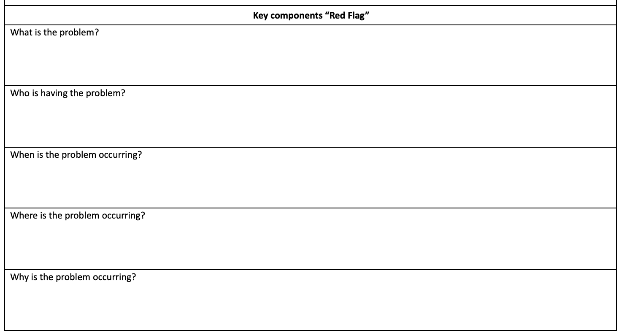
Work Time:
Problem Area of Concern
Write a Problem Area of Concern
Where Are Your Gaps?
What
Who
When
Where
(We’ll get to the “Why”)
How precise can you get?
Don’t get lost in the weeds, but be clear about the problem.
Are all assumptions challenged or verified by data?
What do you need to finish your problem statement?
Notes:
10 min - Work Time
working with own data

Slide 40
Precision Statement
Now we precisely define the problem by identifying who, what, when, where, and why.
What is the problem?
Who is having the problem?
When is the problem occurring?
Where is the problem occurring?
Why is the problem occurring?
Notes:
1 min

Slide 41
Why Conduct Root Cause Analysis?
Prevents “solutionitis”
Produces insights into the system as a whole
Prompts brutally honest discussions about why unsatisfactory outcomes occur
Prompts participants to look at problems from the user perspective
Ensures the initial problem is narrow and concrete enough to improve
Informs tactical action and solutions moving forward
Enhances the group’s ability to develop targeted and measurable outcomes
Office of School Quality, Dr. April Kaiser Edwards, VDOE
Notes:
2 min
OSQ slide, Dr. April Kaiser-Edwards

Slide 42
Root Cause Helps Separate Story from Fact
Example:
Story: Students are not coming to school because they don’t care.
Fact: Data shows that some students are having difficulty getting up for school on time because they have to be at the bus stop by 6:30am.
Notes:
1 min
“validate assumptions”

Slide 43
Root Cause Analysis
There’s no single way to conduct a root cause analysis, but it usually comprises of three steps:
Identify a problem
Identify the cause(s) of a problem
Identifying strategies to address the problem.
There are many publicly available tools to use for this process. We will use a fishbone for our training.
Notes:
MTSS Canvas Course:
US Department of Education. (2020, September 15). Approaches to root cause analysis. Office of Elementary and Secondary Education. Retrieved April 11, 2023, from https://oese.ed.gov/resources/oese-technical-assistance-centers/state-support-network/resources/approaches-root-cause-analysis/
RCA focuses on systems, processes and outcomes, not people. That’s important, because this process is not about placing blame or punishing people. -VA Dept of Behavioral Health & Devel Svs

Slide 44
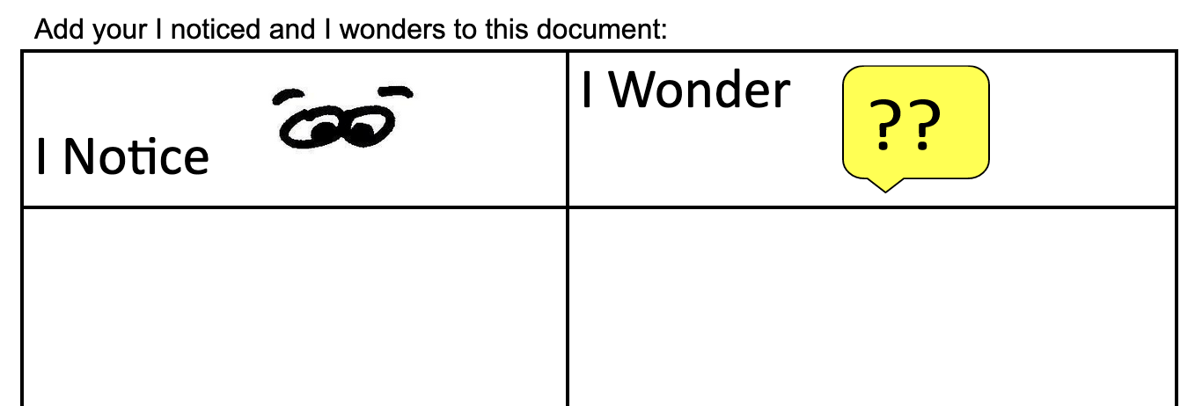
What do you Notice?
Independently write down what you notice about your red flag/issue/data.
What questions do you have?
Why might the red flag/issue be happening?
Notes:
5 minutes

Slide 45
Group Time
In your teams share out what you noticed and wondered about your red flag/issue/data.
How can these noticings/wonderings be grouped?
Define your major categories.
Notes:
10 minutes

Slide 46
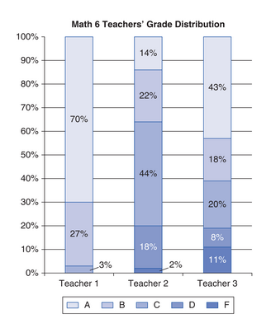
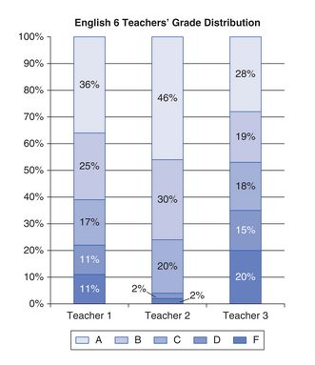
If you were a student in two of the three teachers’ math classes you had about a 20 percent chance of getting a D or F, but if you were in the third teacher’s math class, you had 0 percent chance of getting a D or F. In the English classes, taught by three different teachers, the range of D and F rates—4 percent, 22 percent, and 35 percent—was even more dramatic.
Feldman, 2019
Notes:
Tracy
https://www.kqed.org/mindshift/52679/why-its-crucial-and-really-hard-to-talk-about-more-equitable-grading
Presenter Notes:
We’re going to do fishbone diagram together using this example from Centennial College Prep Middle School. This example comes from the Mindshift article Why It's Crucial – And Really Hard – To Talk About More Equitable Grading by Joe Feldman. A copy of the full article can be found in your workbook on slides 18-21
Activity:
Look at the data the principal of this middle school discovered.
With your chat partner, in the chat box quickly share:
What’s the problem?
What might be the reason / cause for the problem?

Slide 47
“No substantive differences in instruction. Teachers were using the same curriculum with the same tests and even scored those tests as a team to ensure fairness and uniform evaluation. Mallory scoured students’ previous test scores and grades, with no indication of drastically different profiles of the classes as a whole. No substantive difference in the classroom physically—it wasn’t as if one classroom had a broken thermostat or was closer to a noisy playground. What was even odder was that students with identical standardized test scores received different grades depending on their teacher. The teachers were teaching similarly, the students were demonstrating similar achievement, but the grades showed inconsistency. This data seemed unexplainable, impossible, and grossly inequitable.”
Feldman, 2019
Notes:
Tracy
Presenter Notes:
The principal determined that the problem was the chances of receiving a particular grade varied greatly from teacher to teacher within the same grade/subject area. Here are some of the underlying factors of causes the principal considered. Did you and your chat partner come up with any others?

Slide 48
Assessment
Instruction
Content /Material
Skills covered
Tests
Support / feedback
Materials (books, essays, etc.)
Scoring Tests
Chances of receiving a particular grade varies greatly from teacher to teacher within the same grade/subject area
Curriculum
Homework
Climate (hot/cold)
Previous performance on SOLs
Noise
# of students qualifying for additional supports
Physical Environment
Class profile / student make-up
Notes:
Tracy
Presenter Notes:
So, if we were charting out the factors this principal was considering, here’s what it might look like on a fishbone diagram. The problem goes at the head of the fish. Each major cause gets its own rib and is listed at the top. Factors within each cause get listed underneath. The number of “ribs” and sub-causes will vary depending on your problem. There is no “right” number.

Slide 49
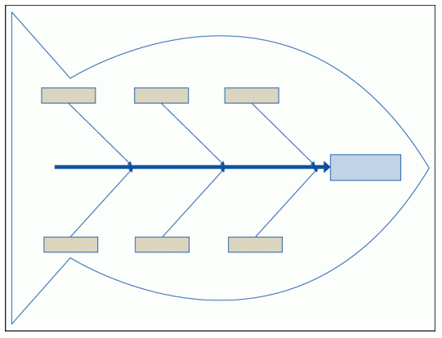
Fishbone Diagram

Slide 50
Still Thinking About the Problem
“If I had an hour to solve a problem I’d spend 55 minutes thinking about the problem and 5 minutes thinking about solutions.”
~Albert Einstein

Slide 51
Important Conversations
To truly understand the problem/challenge we have to gain insight from those affected by the problem/challenge.
They can help us understand:
What does this problem look/sound/feel like for them?
Who is this problem affecting and in what way?
When is this problem affecting them more? the least?
Where do they experience this problem the most?
Why do they think this problem is occuring?
Notes:
Presenter’s Notes:
Your problem/challenge will most likely have MANY possible causes. In order to determine which factor is having the greatest impact, we have to do a little more digging. To truly understand the problem/challenge we have to gain insight from those affected by the problem/challenge. They hold information that is KEY to our understanding of the problem.
Remember that our families can lend so much information to helping us understand their child and provide insights to help us be more efficient in understanding the problem.

Slide 52
Experiencing the Problem
“Last Maria had received a B in math, her most challenging subject, but this year was barely passing with a D. What was really frustrating Maria was that even though she often handed in homework assignments late or incomplete -- she had after-school responsibilities at home in addition to dance class three times a week -- she consistently performed well on every exam. She obviously had learned the math and had shown it when it mattered most, and though last year this type of performance had earned her a B, her teacher this year gave zeros for late or incomplete homework, resulting in her D.”
Feldman, 2019
Notes:
Tracy
Presenter Notes:
Let’s come back to the problem of Centennial College Prep Middle School. The principal had considered many factors - instruction, curriculum, class make-up, but her real insight came when she was approached by one of the students in the three math classes, who told her that despite performing well on the tests, she was receiving a failing grade b/c of late or incomplete homework. This lead the principal to take a look at the teacher’s syllabuses and consider grading practices.

Slide 53
Assessment
Instruction
Content /Material
Skills covered
Tests
Support / feedback
Materials (books, essays, etc.)
Scoring Tests
Chances of receiving a particular grade varies greatly from teacher to teacher within the same grade/subject area
Curriculum
Homework
Weighted assignments
Criteria (name on paper, ripped paper, etc.)
Climate (hot/cold)
Previous performance on SOLs
Correct vs. completion
Noise
# of students qualifying for additional supports
Accepting late work
Grading
Physical Environment
Class profile / student make-up
Notes:
Tracy
Presenter Notes:
The student’s insight into the problem lead her to a whole new possibility.

Slide 54
Tools for Feedback
Explore the different tools you might use to explore the WHYs from the perspective of stakeholders.
Empathy interviews
Focus groups
Surveys
Ex. Conducting a school climate survey for students and families to see how they feel about school. Include what they think is working / not working. Work with schools to figure out the best time and way to give surveys. Get results back by mid-October and review as a team at November meeting.
Workbook page 17
Notes:
Survey participation can be challenging. We learned from the pandemic that many families respond to text messages more than an email. QR Codes at events are a great tool for families to quickly access and complete a survey on their phone.
Links - stakeholder data gathering https://docs.google.com/document/d/1X12STs3bLHoFKl2ls4pURdRLfGvuv4h2GcMvG2zDW-U/edit?usp=sharing

Slide 55
Define The Problem With Precision & Setting Goals
Notes:
Look at the Big Picture. Then use data to refine the problem to a Precise Problem Statement.

Slide 56
Making Sense of the Data
Monitor and Evaluate Results
Identify problem with precision
What strategies/practices will we select and implement? (Supporting student academic and social behavior)
Data
What does the data say? Analyze strengths and opportunities for growth
What do teachers need to implement/sustain
Establish a SMART goal

Slide 57
Using Data
to Create Problem Statements
The statement of a problem is important for team-based problem solving.
Everyone must be working on the same problem with the same assumptions.
Problems often are framed in a “Primary” or “General” form. That form creates concern, but is not useful for problem-solving.
Frame primary problems based on initial review of data
Use more detailed review of data to build “Solvable Problem Statements.”
Notes:
Trainer Notes:
Problem statements are critical for solution success. Schools/Facilities must clearly identify and define the problem, and do so with precision, so that everyone is working on the same problem in the same way.
Initially, problem statements are framed in a “primary” form after a surface-level or initial review of the data.
Primary problem statements tell us we feel there is a problem.
Precise problem statements tell us exactly what the problem.

Slide 58
Precision Problem Statements Include…
What is happening?
Who is impacted?
When is it happening?
Where is it happening?
Why is it happening?

Slide 59
Primary vs. Precision Statements
Primary/ General Statements
Precision Statements
There are more ODRs for aggression on the playground than last year. These are most likely to occur during first recess, with a large number of students, and the aggression is related to getting access to the new playground equipment.
Too many referrals
September has more suspensions than last year
Gang behavior is increasing
The cafeteria is out of control
Student disrespect is out of control
Notes:
Trainer Notes:
Here are examples of several primary statements and a precision statement.

Slide 60
Precision Problem Statement
Social Behavior Statement:
The most significant concern of the team is (what)______, defined as______. It is taking place most often(where, includes location)_______ and the behavior occurs (frequency)_______ and is most likely to happen(when)_______. The students most often engaging in this behavior are (who)______. The team believes this behavior is a result of (why)_____.
Academic:
The most significant concern of the team
is (what)_______ defined as______ and is evidenced by_______. Students (who)_______ are most
likely to experience difficulty with this skill. The team believes this issue is due to (why)______.

Slide 61
Any Blanks of Gaps?
Need to gather input from students and families?
Still have questions/concerns about the data?
Take the time to collect what you need to accurately identify the problem.
Stop spinning tires guessing at issues and applying time consuming interventions.

Slide 62
Let’s try!
Think back to the article. What would a precision problem statement look like based on their data?
Who has the problem?
What is the problem?
When is the problem occurring?
Where is the problem happening?
Why do we believe the problem is happening?
Notes:
5-10 minutes

Slide 63
WHO?
6th grade students
Is this happening to students in other grade levels as well?
WHAT?
difference in percentage of students earning D’s and F’s across classes
WHEN?
during the current academic school year
Is there a history of this issue in other years?
WHERE?
6th grade math and English classes
Is there a similar grade discrepancy in other subject areas?
WHY?
teacher’s approach to grading (grading policy)

Slide 64
Example
The most significant concern of the team
is (what) the difference in (who) sixth grade students earning D’s and F’s across (where) English and math classes (when) during the current school year. This is evidenced by 35% of students in one class receiving a D or F, 22% in another, but only 4% in a third. The team believes this issue is due to (why)inconsistent grading practices among the 6th grade English and math teachers.

Slide 65
Lunch

Slide 66
Moving to Precision!
Using your data, create a precision problem statement.

Slide 67
Establish a Goal
Monitor and Evaluate Results
Identify problem with precision
What strategies/practices will we select and implement? (Supporting student academic and social behavior)
Data
What does the data say? Analyze strengths and opportunities for growth
What do teachers need to implement/sustain
Establish a SMART goal

Slide 68
Defining Goals
Define the problem with precision.
Define the measure of the problem (level, amount).
Define what would be considered “good.”
Use the goal to guide the solution.
How can we move from where we are to where we want to be?
Notes:
Trainer Notes:
The problem solving process is multi-faceted. We do not just want to make snap judgments based upon perceptual data alone. Acting solely on our day-to-day experiences, feelings, and assumptions is ineffectual. Best practice involves using data for decision making.
Best practice involves:
Using data to define a problem with precision.
Using the data to define the current measure of the problem. How many? How often?
Using the current measure of the problem to define what is considered “good” or what a smart goal would be.
Using the smart goal to guide solution steps.

Slide 69
Identify Goal for Change
Goals allow you to analyze, monitor, and adjust professional practice. Goals are:
Notes:
Remember, we use data to EVALUATE where our current reality is. This will help us move into the PLANNING phase, establishing a goal and developing solutions that will guide us to IMPLEMENT a solution.
Goals can be tricky, because we all want to have the best outcomes as soon as possible. Goals are the outcomes we intend to accomplish.
Goals are SMART.
We need to be just as purposeful in developing our goals as we are in identifying our problems.
How will we know when we’ve addressed our problem?
How will we know if our interventions worked?
How long will it take to address our problem?
One systematic way of developing a goal is to use the SMART acronym (Specific, Mesurable, Achievable, Realistic, and Timely). Use SMART goals to guide solution steps.

Slide 70
SMART Goal Example
Time-bound
Specific
By December 2021, educators will develop and implement with 85% fidelity a science instructional framework as evidenced by classroom observations and a 5% increase between pre and post teacher benchmark scores.
Measurable & Attainable
Realistic

Slide 71
SMART Goal Example 2
We want to reduce incidences of inappropriate language used in third grade, as measured in our ODR data, to less than 10 referrals for inappropriate language over the first semester of the school year.

Slide 72
Let’s try!
Problem Statement:
The most significant concern of the team
is the difference in sixth grade students earning D’s and F’s across English and math classes during the current school year. This is evidenced by 35% of students in one class receiving a D or F, 22% in another, but only 4% in a third. The team believes this issue is due to inconsistent grading practices among the 6th grade English and math teachers.
Specific
Measurable
Achievable
Realistic
Timely
Notes:
10 minutes

Slide 73
The rates of A’s, Bs, Cs, Ds, and Fs in 6th grade math and English classes at Centennial College Prep Middle School will be relatively similar, within 5%, as measured by final grade distribution tabulation across teachers of the same course by the final grading period of the 2023-24 school year.
Specific
Measurable
Achievable
Realistic
Timely

Slide 74
Moving to Goal Setting!
Based on your precision statement, identify a goal.

Slide 75
Quick Check-in
Where is your team in this process?
Identifying red flags?
Identifying data to collect?
Working on establishing the “why?”
First draft of a precision problem statement?
Spend time at your table to identify what your team needs before you write a SMART goal.
Notes:
team talk time: 10 min

Slide 76
Implement
What are we going to do about it?
Notes:
Kim - We do not want this to rest on the shoulders of one or two people.

Slide 77
Implement
Monitor and Evaluate Results
Identify problem with precision
What strategies/practices will we select and implement? (Supporting student academic and social behavior)
Data
What does the data say? Analyze strengths and opportunities for growth
What do teachers need to implement/sustain
Establish a SMART goal
Notes:
We want to directly link our plan. What are we going to do about attaining the goal that we established? A detailed plan will increase the likelihood that the intervention will be effective. If the plan is weak, the results will be weak. How can we engage families in two way communication to strengthen the implementation?

Slide 78
What Do you See Here?
Video clip of “I Love Lucy” from the “Job Switching” episode.
https://www.youtube.com/watch?v=K3axU2b0dDk
Notes:
What do you see here? Is this a systems problem? Has someone come in and checked on progress using any data?
Structures need to be in place that identifies objectives, lays out key initiatives, and define the metrics for which success is measured.

Slide 79
Team Time Reflection
Think of an intervention you have been involved in….
How was it approached?
What was strong?
What were some of the barriers?
Did we have the right team members?
Did we review what we already had to address our concern?
Did our teachers have what they needed to implement the intervention?
Was anything missing from the system (PD, coaching, measurable objectives, defined skills, resources, student and family voice) to support implementation?

Slide 80
What was Strong?

Slide 81
How do we ensure a strong plan?
The instruction and interventions are evidence-based and linked.
We have the capacity to implement the plan in a timely manner and delivered in the way it is intended by people who are qualified.
The individuals implementing the plan have the support needed to implement the plan.
There is a plan for monitoring implementation fidelity.
Notes:
What systems do we need to put in place? What do we currently have and what do we need to?
Building the systems is critical for sustainability.
High level of fidelity leads to better outcomes.

Slide 82
Developing Solutions
What practices need to be in place in order to address the problem?
What systems (i.e. PD, coaching) need to in place to support the implementation of these practices?

Slide 83
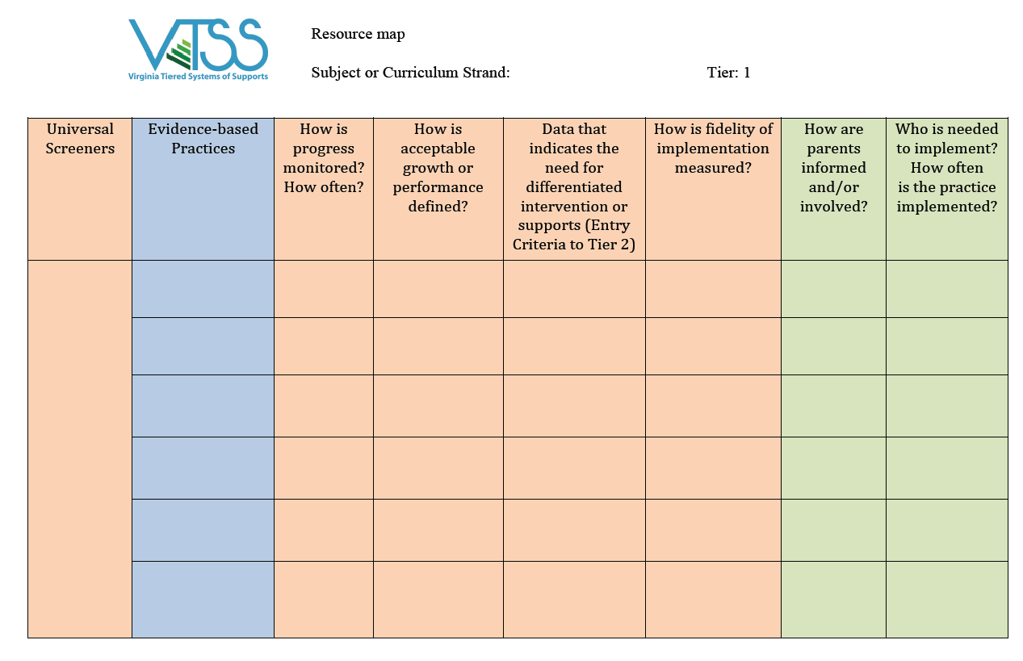
Let’s Start with Looking at What you Have
Resource Mapping

Slide 84
What still needs to be done?
THINK: Innovation!
What are the appropriate responses that address the needs implied in the data?
What do you want teachers to do?
By when? How will you know it’s been done?
Refer to your resource maps!
If you don’t have key practices, you may have to utilize a formal selection process.
* Remember! Practices you select should be teachable, learnable, doable, and readily assessed in practice.
Notes:
from strand 1

Slide 85
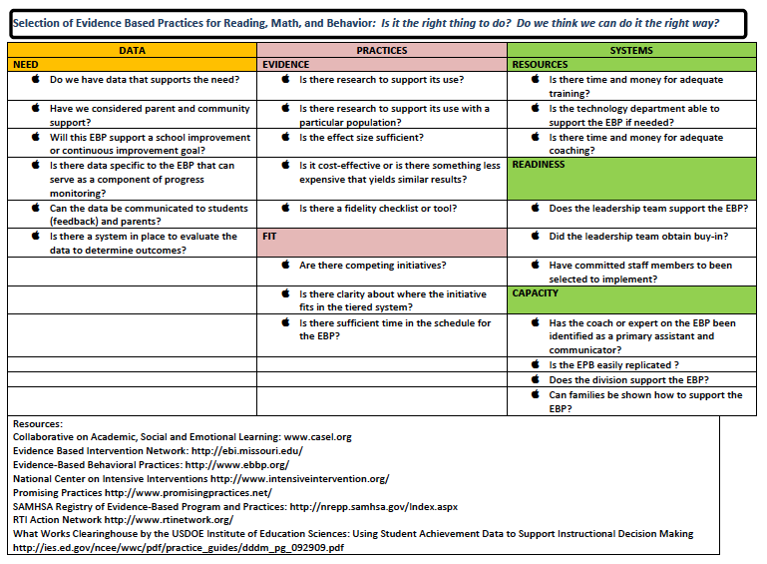
Practices Selection Tool
Notes:
from strand 1

Slide 86
Essential Components of Solution Development
Academic
Behavior
Pre-teach
Teach
Cue
Practice with feedback
Reinforce
Error Correction
Prevention
Teaching
Acknowledging
Extinguish
Correct
Safety
How will we collect and use data?
Notes:
Solutions should fit the context of the problem. Once an appropriate goal has been identified, there are several, critical components of solution development that should be addressed in order to effectively solve the problem. Remember, we want a minimum level of energy, effort, or intervention that will produce the maximum level of effect. Keep it simple. We want to focus on prevention first. How do we reduce the situations that lead to these behaviors? Teach- how do we ensure that students know what they should be doing when these situations arise? How do we acknowledge when students are doing what is expected of them and how do we ensure that the problem is not being rewarded. How will we correct errors. What are the efficient and consistent consequences such as our behavior flow chart. Are there any other safety measures?

Slide 87
Identify your Key Practices
What key practices will your school commit to implementing with fidelity? Name and define them.
What are the action steps?
Who is responsible?
By when?
How will fidelity be measured?

Slide 88
Develop solutions for systems
How will the team support the school in the implementation of new practices?

Slide 89
Evaluate
How will we know the solution was implemented with fidelity?

Slide 90
Evaluate
Monitor and Evaluate Results
Identify problem with precision
What strategies/practices will we select and implement? (Supporting student academic and social behavior)
Data
What does the data say? Analyze strengths and opportunities for growth
What do teachers need to implement/sustain
Establish a SMART goal

Slide 91
Finally…
Did we do what we said we would do?
Did we implement the practices identified in our action plan?
Did we implement the systems identified in our action plan?

Slide 92
Progress Monitoring
Be sure to include fidelity AND outcome data. We cannot begin to assess outcomes if we have not implemented with fidelity.
Data/Progress Monitoring
Notes:
and at the universal level we are ensuring that he health of our Tier 1 is strong. How many times during the year do we really pause and ask this question? In your meetings are you setting actual behavioral goals? Example: High school focused on respect. Let’s focus on what good respect looks like from student to student, teacher to student, student to teacher. We are then going to progress monitor.

Slide 93
Did we implement our solutions with fidelity?
O’Donnell (2008)
NIRN & AIR
Notes:
Why Fidelity? If we don’t implement critical components of an intervention with consistency, we cannot link student outcomes to the instruction provided. Fidelity can help us to determine the effectiveness of an intervention, and identify if a student requires more intensive supports. Adherence - ask how well did we stick to the plan, curriculum, or assessment? Are the intervention and assessment delivered consistently across different teachers and settings? Exposure/Duration - Ask does the schedule allow the intervention to be delivered for the recommended dosage (duration and frequency)? How often does a student receive an intervention? How long does it last? Is the student regularly attending school? Is the teacher regularly available to support instruction? Did any factors prevent the student from receiving the intervention as intended? Quality of Delivery = Does the interventionist have the necessary training, knowledge, and skills to deliver the intervention correctly? How well is the intervention, assessment, or instruction delivered? Are quality teaching practices used consistently and with appropriate intensity across the sessions and or by all interventionists?
Program Specificity - How well is the intervention defined and different from other interventions? Student Engagement - How attentive and involved are the students in this intervention or activity? (information from National Center of Intensive Intervention)

Slide 94
Evaluate Progress
Are we making progress towards our goal
Is progress being made at the desired rate?
if yes, CELEBRATE!!!
if no, determine why… fidelity issue? do we need to re-define the problem?

Slide 95
Back to Define
Monitor and Evaluate Results
Identify problem with precision
What strategies/practices will we select and implement? (Supporting student academic and social behavior)
Data
What does the data say? Analyze strengths and opportunities for growth
What do teachers need to implement/sustain
Establish a SMART goal
Notes:
At this point, teams need to determine how to proceed. Do they continue working toward the goal? Are there modifications they need to make to be more successful? Do we need to revise our goal to make it measurable or feasible? This is a refining step where teams make decisions together on how to move forward. Recycle through problem solving process.

Slide 96
Determine Next Steps
Reassess our action plan (practices and systems)
who is it working for?
who is still having problems?
Develop new solution(s), as needed

Slide 97
Building a Culture of Data Literacy
Making it Routine - Wrap up
Notes:
Once we have an efficient process in place. We need to make it routine. Data literacy helps us at the systems level. We work across systems such as the state, our divisions, our schools and our teacher level to build that collective efficacy.
How many times have we been in a meeting and people are only looking at one type of data? As a teacher, have you ever felt judged by your test scores? Now let's scale that up to the whole school and talking about systems data. When we are talking about data literacy this is an equal conversation. We don’t want to make decisions about teachers and their classrooms without talking to them first. Just as we would not want to talk about school….
For example: leadership schedule a meeting with staff and they are using the spring SOL scores.
When this is collective, the teacher is bringing the full story to the table. The teacher could say, yes, these are my test scores but they don’t actually paint the picture of what is currently happening in my classroom. Since this test my students are improving in both math and reading skills using other assessments. I have also done a survey with my students on classroom procedures that I can share. This is an example of how we would use multiple sources of data to have this conversation.

Slide 98
Data Literacy Helps us…
Explore which data is needed to deeply understand the problems driving poor systemic results
Enables access to the necessary data
Helps us to analyze, interpret use and report data to promote goals
Reflect on data access and analysis for continuous improvement

Slide 99
Data Literacy Culture
Teams study data at the school-wide level
Define specific problems
Leverage evidence-based practices as solutions to problems
Focus on systems change
And when we have it and are fluent, it looks like this!!
Notes:
When we are implementing fluently it looks like this (slide). When we are data literate as a school, we have established a culture of data use - we are fluent in data use. A strong culture of data use is critical to ensuring routine, consistent, and effective data-informed decision making.
To help all students achieve, we need to systematically and routinely use data to guide instructional decisions and meet students’ learning needs.

Slide 100
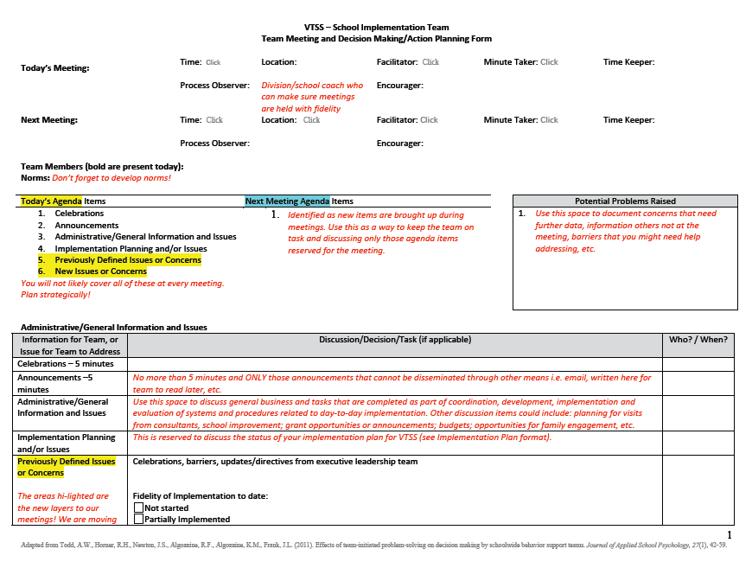
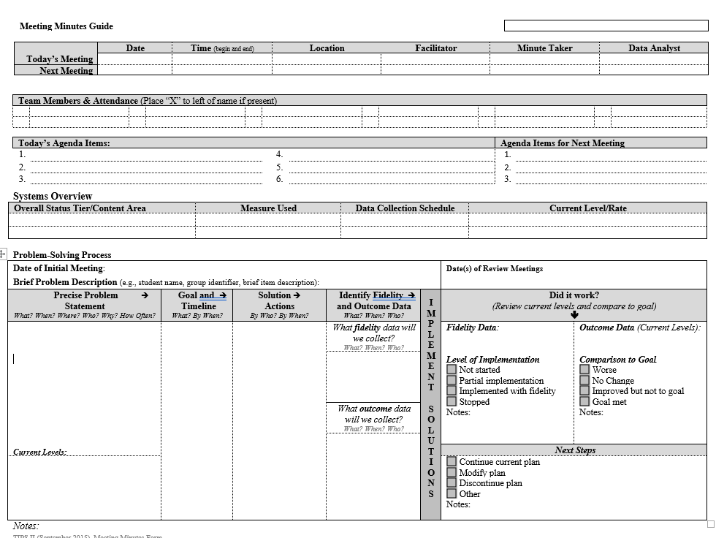
Efficient Agenda

Slide 101
Right Data / Right People
Identify the RIGHT data, in the right format
Identify the RIGHT people who:
Meet consistently (RIGHT time)
Start meetings with data
Strategically use data to develop solutions and action plans
Implement and monitor action plans (fidelity & outcomes)
Have access to student and family voices
Notes:
Basically, the idea is that we have the right information in a format that’s easy to use.
We also have the right people who regularly meet to analyze data to identify problems, solutions, and action plans... Then they implement those plans and monitor fidelity and outcomes to make sure the plans have the intended impact on students.

Slide 102
Data Sharing
Notes:
SHARE monthly
How are we displaying the data?
Are we looking at multiple measures of achievement?
Get feedback
Communication is two way
Stress to our staff the importance of accurate and consistent input
Staff should know what data to bring to each type of data meeting.
Think about a marketing lens! Do we have someone to put data together in a useful way?

Slide 103
Role of Data Analyst
The role of the data analyst(s) can vary depending on the platform, size of school, etc.
HOWEVER: Be sure that you are always coming back to monitor the goals you set in your data informed decision making process and that someone is responsible for having it available.
School A: This school has subgroups that report the data to the school VTSS team, i.e. academic,behavior.
School B: The data is organized by school leadership.
School C: A sophisticated data systems exists. The data analyst is the “driver” in the meeting.
Notes:
When to introduce this slide?
Intent: Data Analyst example
Context matters: what will work best for you?
Data needs to be disaggregated by the data analyst at the division level
The data is fed up to the division by the schools
The division shares a process with the schools

Slide 104
Summarizing Data for the Team
Recommendations
Current Core Reports
Scheduled Additional Reports
Old Problems: Updated data for previously discussed problems
New Problems: 1-2 precise problem statements based on drill down
Drill Down graphs of interest (especially if a pattern was less clear or you made a specific judgment call)
Notes:
Since you are responsible for bringing data to the team before a meeting it’s important to be strategic about which graphs and information to share.
Here are a few recommendations from the PBISApps team based on the Team Initiated Problem Solving Model or TIPS.
Current Core Reports
Always provide the most recent Core Reports. Use consistent date ranges... Maybe the date since the last meeting or the most recent 6 weeks. This reduces any confusion about comparing summaries from last meeting to this one.
Additional Reports
Some of the additional reports will be useful to look at quarterly or at least annually. For example, PBISApps recommends reviewing the Ethnicity Reports, the Suspension/Expulsion Reports, and Multi-Year reports at least twice each year. Be sure that you set up reminders about when the team expects to see which reports.
Old Problem Updates
Once you start using SWIS data consistently in meetings it’s likely that most months you’ll need to provide an update on problems that the team discussed in the previous meeting. You might be checking on whether an intervention worked or not... Or there might have been a “problem” that the team wanted to “hold” on.
New Problem Updates
Unless you didn’t notice any new red flags in your review of reports you will likely have at least one new problem to bring to the team’s attention. This does not mean that the team will address this problem at this meeting but it allows the team to make informed choices about the priorities and how to use the meeting time.
Drill Down Graphs
When you are drilling into old problems to provide an update or new potential problems, consider whether there are graphs that would help the team (or others) to better understand the potential problem or see how and why you used specific filters. For example, if a problem included all grades but you decided to focus on the 4-6th graders you’ll want to provide this information and it might help to share the Referrals by Grade report (before you filtered down to those grades) just in case the team decides to address this across all grades first. You don’t necessarily need to include every graph, be choosey and consider what questions the team is likely to ask or where you made a professional judgement that others might have looked at differently.

Slide 105
The Role of the Data Analyst
School-Wide or System-Level Problems
Data Analyst
Identify Red Flags
Drill Down to precision
Summarize (precise statement & supporting graphs)
Team
Prioritize problems
Develop goal
Develop solutions & action plan
Student, Group, or Grade-Specific Problems
Data Analyst
Identify Red Flags
Drill Down to precision
Summarize (precise statement & supporting graphs)
Share with appropriate staff members or administrator
Potentially support goal & solution development

Slide 106
In Action
A video example of an effective and efficient data meeting.
Source: https://www.youtube.com/watch?v=ZCr4MyTCAxw
Notes:
Yesterday Matt walked you through a problem solving process. Today we are going to model this again through an actual team meeting. This is a great way for you to see where we are headed. As you are watching this video we ask that you use the 3-2-1 form on your one pager and think about the following: What are 3 features that are put in place to structure this meeting? Think about what you learned about problem solving processes yesterday. What are 2 questions that you may have from this video? What is 1 way that you can see this influencing your process in your team meetings? When you come back we will put you in a team breakout to process your answers.
Breakout 3-4 minutes
Video is 12 minutes

Slide 107
Pause & Reflect
3 takeaways;
3 wonderings, clarifications
Notes:
ACTIVITY: use post it notes for take-a-ways, where we need clarification. Discuss and come to consensus.
In person: poster
Virutal: jamboard/whiteboard

Slide 108
Exit Ticket
https://bit.ly/3PbEFEa

Slide 109
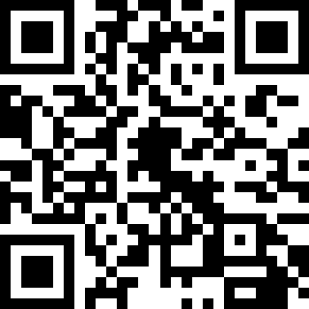
Evaluation
https://tinyurl.com/didmschoolseval

Slide 110
CELEBRATE!
What next?
Notes:
Staff and students work hard, we must celebrate as part of our acknowledgement system
Ask teams to consider how often they plan celebrations, what they do, and who helps to plan celebrations.
Talk about why celebrations build “buy-in”

