Slide 1
Effective Classroom Systems Module B: Responding to the Matrix
#3. Classroom Expectations Aligned to Schoolwide Matrix
#4. Routines and Procedures for Academics and Behavior

Slide 2
Effective Classroom Systems
Making it Stick
Creating a system to support evidence based practices
Module A: The Set-Up for Success
Physical environment
Active supervision
Module B: Responding to the Matrix
Define classroom expectations aligned to SW expectations (specificity to matrix)
Routines and Procedures
Module C: The Engaged and Successful Student
Engagement: opportunities to respond
Formative Assessment
Scaffolding
Module D: The Power of Feedback
Feedback: Behavior specific praise
Feedback: Acknowledgement and reinforcement/group contingencies
Feedback: Error correction
Notes:
Facilitator
Keeping up with our roadmap
In this module, we discuss the alignment of classroom expectations to the schoolwide expectations. Next, we review the utilization of routines and procedures to positively impact student learning.

Slide 3
Learning Intentions
Understand that a classroom matrix is aligned with school-wide expectations
Understand the importance of creating and teaching procedures and routines in both behavior and academics

Slide 4
Success Criteria
Create a classroom matrix aligned with school-wide expectations,and including classroom expectations and routines for daily procedures

Slide 5
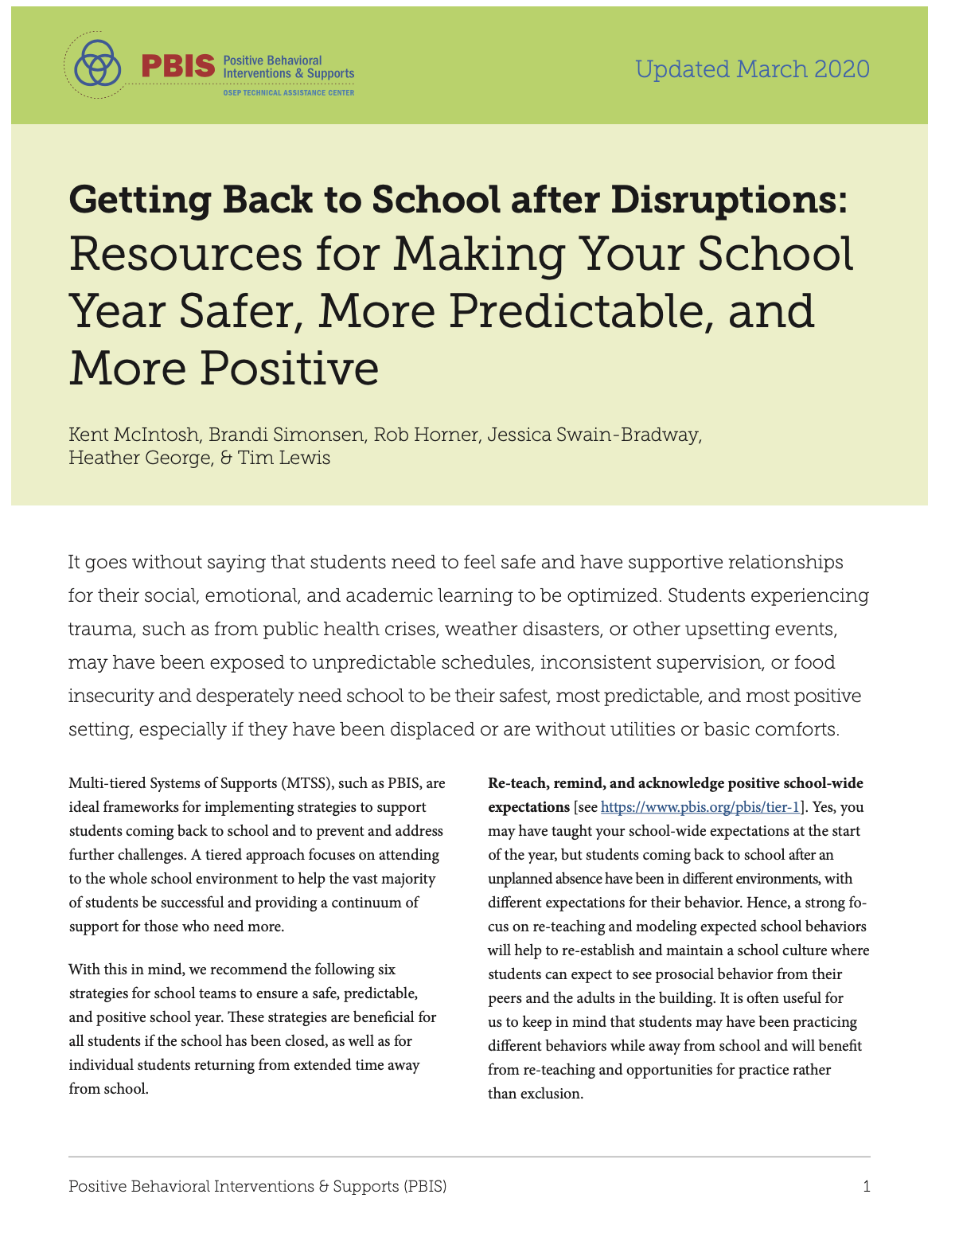
Importance in Our Current Reality
It is often useful for us to keep in mind that students may have been practicing different behaviors while away from school and will benefit from re-teaching and opportunities for practice rather than exclusion.
After traumatic or unplanned events, making routines as predictable as possible will help students regain a sense of safety that they may have been missing.

Slide 6
In Other Words: Consistency Matters
Our physical and emotional well-being impacts our ability to think and learn effectively
Increases predictability
Students can focus on being engaged
Notes:
Facilitator
The rationale for the clarity around the positive behaviors for success and the alignment to the school wide expectations is what we already know: Consistency Matters. We want students to feel safe in a predictable classroom so they can be engaged in their thinking and learning.
This instruction is part of what we’ve called classroom management in the past. Challenge thinking to consider it in another way - instead of classroom management, just instruction
However we reference it - Hattie:Effect size of Classroom Management=0.52.
Increased predictability in the environment helps support student’s social/emotional well-being. While they will challenge expectations to see if you really mean what you say, student’s crave stability, consistency and predictability, particularly those dealing with trauma or home lives that are unpredictable.
Having classroom procedures:
increases instruction time by preventing problem behavior
Improves classroom climate
Creates shared ownership of the classroom
Develops self-discipline

Slide 7
School-wide Matrix
Teaching Matrix | All Settings | Hallways | Playgrounds | Cafeteria | Library/ Computer Lab | Assembly | Bus
Respect Ourselves | Be on task. Give your best effort. Be prepared. | Walk. | Have a plan. | Eat all your food. Select healthy foods. | Study, read, compute. | Sit in one spot. | Watch for your stop.
Respect Others | Be kind. Hands/feet to self. Help/share with others. | Use normal voice volume. Walk to right. | Play safe. Include others. Share equipment. | Practice good table manners | Whisper. Return books. | Listen/watch. Use appropriate applause. | Use a quiet voice. Stay in your seat.
Respect Property | Recycle. Clean up after self. | Pick up litter. Maintain physical space. | Use equipment properly. Put litter in garbage can. | Replace trays & utensils. Clean up eating area. | Push in chairs. Treat books carefully. | Pick up. Treat chairs appropriately. | Wipe your feet. Sit appropriately.
Expectations
Notes:
Possibly add a remote learning column; changing cafeteria to meals, take out assembly

Slide 8
Defining Expected Classroom Behaviors
Use the school-wide expectations as the foundation for classroom expectations
Observable
Measurable
Positively Stated
Understandable
Applicable

Slide 9
Practice
Which of the following could be used as an expected classroom behavior?
Safety comes first
Come to class on time, prepared with all supplies and assignments
Be responsible
Be ready to learn
Sit in your seat unless you have permission to leave it
Notes:
Facilitator
Before advancing to the next slide, decide which numbered items could be used as an expected classroom behavior.
This will be an activity with Yes /No cards. After reminding participants of the guidelines for writing behaviors (rules) listed in the notes, the facilitator would read the statement and they would hold up their cards. Bullets 1,3,4 are expectations (more general, not measurable…), and 2 and 5 are behaviors.
Use the YES/NO cards - then with partner, for a higher level thinking, how would you change the “no” into a “yes” - (we’ll tell our audience what we are doing here - making a task higher level) (Alternatively, have them stand for a behavior, remain seated if not.)
Talk and decide… which of these statements meet the 5 guidelines for writing rules, now referred to as behaviors? Remember, to be considered a “behavior,” it must be observable, measurable, positively stated, understandable, and always applicable.
Ask them to revise the examples that are not behaviors to make them work as behaviors. Ask volunteers to share.

Slide 10
Answers: Behaviors
Safety comes first
Come to class on time, prepared with all supplies and assignments
Be responsible
Be ready to learn
Sit in your seat unless you have permission to leave it

Slide 11
New Slide suggestion from Family Engagement team - Routines While at Home
Poll Questions
1. if had children at home,. what was their age range… preschool, K-12, college
2. how many found it easy to establish routines you thought were healthy/helpful for your kids & yourself?
Chat - Did you find ways to help families create routines / predictable structures at home? Share

Slide 12
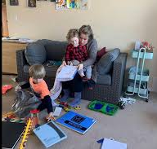
New Slide suggestion from Family Engagement team - Family Input
How will you seek input from diverse families to enable them to support learning at home and at school?

Slide 13
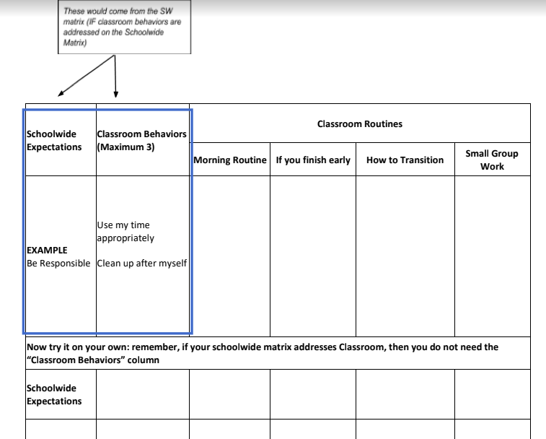
Classroom Expectations
Notes:
What does this look like at home?
Facilitator
Its time to take out your downloaded sheet. We are going to only work first on what is outlined in the blue box – routines and procedures is coming up next. Write down your SW expectations and create classroom behaviors consistent with these expectations. If you already have these, examine them - to see if they are adequate and meet the recommended criteria of
Observable MeasurablePositively StatedUnderstandableApplicable

Slide 14
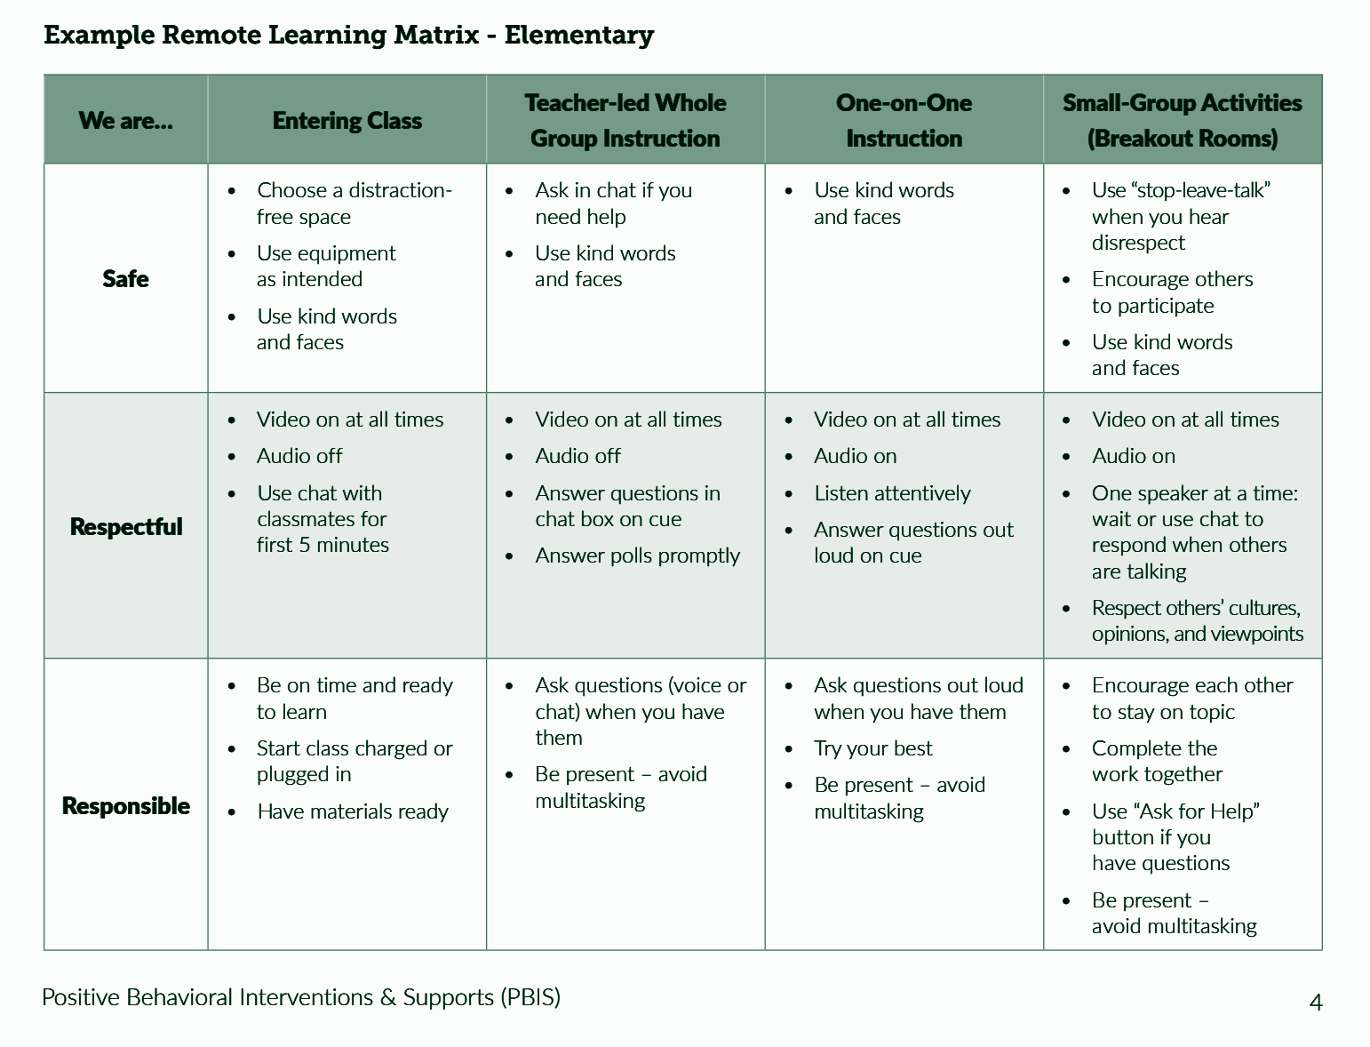
Remote Learning Matrix
Elementary

Slide 15
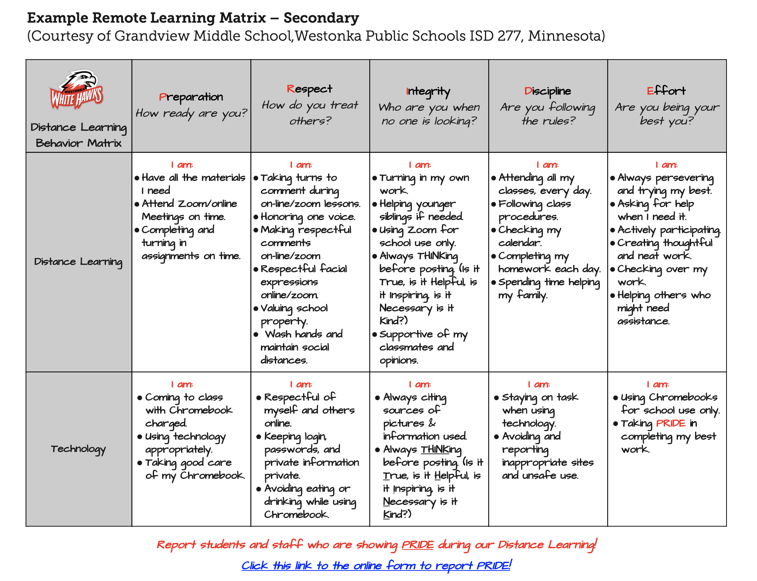
Remote Learning Matrix
Secondary

Slide 16
Continuing Support
Think ahead of any issues that might arise and discuss them with the class beforehand. Prepare students before an event/activity. (Remember: “If it’s predictable, it’s preventable.”)
Embed expectations into the classroom
Teacher consistently models expectations.
Students follow class expectations despite the absence of the teacher:
Substitute
Guest teacher
Buddy teacher
Volunteer

Slide 17
Discussion Time
Things to talk about:
Should a grade level encourage consistency in some or all routines?
If yes, how do you create buy-in for all teachers?
What are the top 5 routines to develop in a virtual or physical classroom?
How can you gain student input when creating the classroom matrix?
Notes:
Take a moment and jot your personal thoughts down before going into Breakout rooms for discussion

Slide 18
Teaching the Matrix
Teaching Routine: how the procedure or activity looks (examples and nonexamples)
Active Supervision: a method for effectively monitoring students
Positive Reinforcement Procedures: incentives for appropriate behavior (praise, high fives…)
Pre-corrections: quick reminders of expected behavior before the transition

Slide 19
INSTRUCTIONAL ROUTINES
Routines are not just about behavior
Notes:
family engagement

Slide 20
Choosing Instructional Routines
Some routines relate to learning structures embedded in the content, such as starting each unit with the same graphic organizer or using a consistent vocabulary routine
Some routines and/or procedures are signals and cues, such as giving a choral response or ending peer conversation time
Data drives routines
Notes:
This is referring to the idea that we can look to data for those times when students are off task, transitions that are difficult, etc. to determine when a procedure/routine is needed. It might be helpful to have a colleague observe and document times when things aren’t running as tightly as they could - suggest times for procedures/routines as well as things they’ve used that have worked well. Everyone needs to find what works for them, but especially new teachers would benefit from ideas that work and could be tweaked to meet their own style.

Slide 21
Anita Archer: Instructional Routines
Anita Archer on Instructional Routines
Listen for how both teachers and students are empowered by instructional routines?
Notes:
Do we show this?

Slide 22
Explicit Teaching in Every Routine
I do- informing, explaining, modeling, and providing examples
We do- working together to complete the steps of a particular task
You do- students practice what was taught by themselves

Slide 23
Data Collection Form

Slide 24
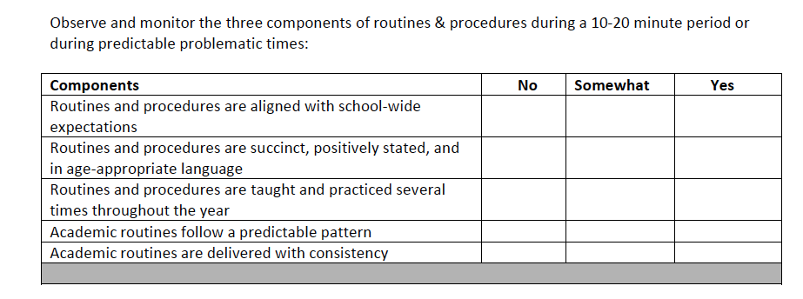
Data Collection

Slide 25
Next Steps: Making Connections
Notes:
virtual and physical

Slide 26
Making it Stick
Creating a System for Implementing High Leverage Practices

Slide 27
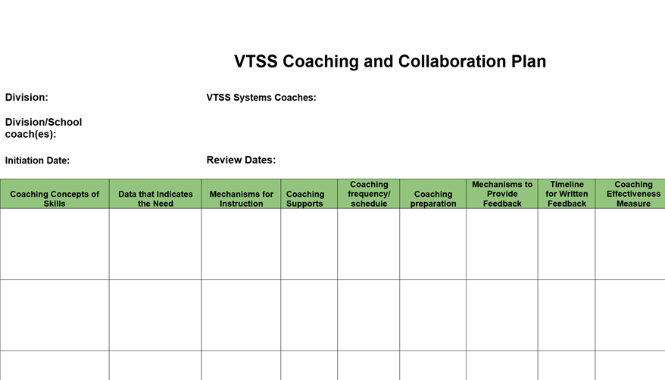
Coaching Plan - Introduction

Slide 28
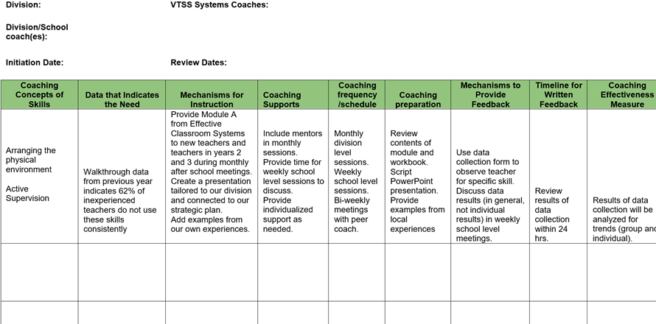
Coaching Plan - A Sample

Slide 29
“Activate the Village” Work Time
Develop your coaching plan
*Remember - everyone is a coach!
Resources from your workbook to facilitate this process:
Classroom roll out slides - how to get started
Sample of coaching plan
Copy of coaching plan template
Data collection tools
Also, your notes from the first modules and work time

