Slide 1
Module D
“The Power of Feedback”
Acknowledgement and Behavior Specific Praise
Error Correction
Building Community with Feedback

Slide 2
Learning Intentions
Understand the power and importance of feedback in a classroom setting
Be able to identify and use examples of behavior specific praise statements
Identify steps of effective error correction
Explore examples of how to use effective feedback strategies within the ‘group’ to build community, collaboration and citizenship!

Slide 3
Learning Intentions 2
Create a school or division coaching plan to support one of the following:
behavior specific praise
error correction
building community through feedback

Slide 4
Think about a time...

Slide 5
Did you know?

Slide 6
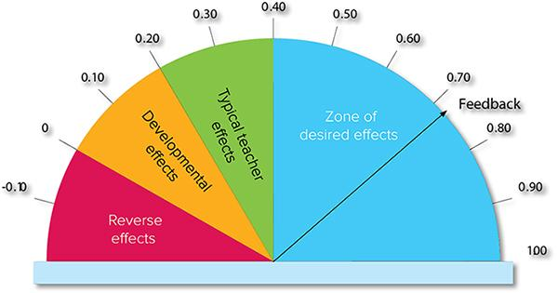
The Power of Feedback

Slide 7
High Leverage Practice #8
#8. Provide positive and constructive feedback to guide students’ learning and behavior.

Slide 8
Feedback
Each ‘level’ has a distinct outcome!
We need to know what our outcome is to know what type of feedback to employ.
To get results, feedback follows a very specific ‘level’.

Slide 9
Feedback with a Purpose
To four levels
Outcome
TASK: How well tasks are understood or performed
PROCESS: The process needed to understand or perform the task
Maintain or build understanding of a particular task (right or wrong)
Effective for deep learning! Builds use of strategies and cues
Hattie, J., & Timperley, H. (2007). The Power of Feedback. Review of Education,77, 81-112.

Slide 10
Feedback with a Purpose 2
To four levels
Outcome
SELF REGULATION: Self monitoring, directing and regulating actions
SELF: Personal evaluations and affect
Moves students from external to internal feedback. Builds SEL skills. Growth mindset
Always positive! Builds climate and relationships.
Hattie, J., & Timperley, H. (2007). The Power of Feedback. Review of Education,77, 81-112.

Slide 11
#8 Feedback: Behavior Specific Praise
“Whatever you feed,
will grow.”
~Bishop TD Jakes

Slide 12
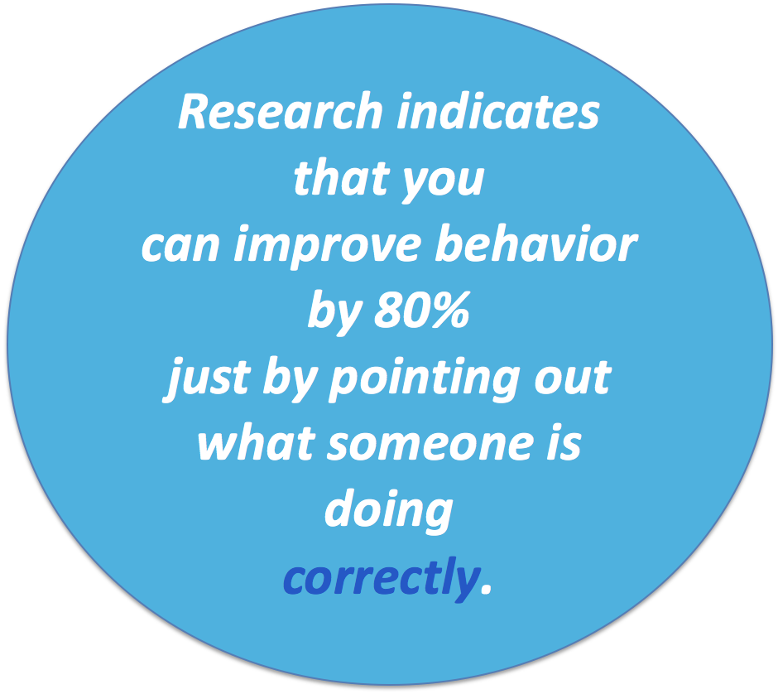
The Quickest Way to Change Behavior
Dewhirst & Davis, 2011

Slide 13
Why do we acknowledge behavior – including ACADEMIC behaviors?
Reinforce the teaching of new behaviors (TASK)
Behavior is likely to become a habit and recur in the future only if demonstrating it has been beneficial – it worked! (PROCESS or SELF REGULATION)
Strengthen positive behaviors that can compete with problem behavior (TASK)
Improve school climate (ALL)

Slide 14
#8 Feedback: Acknowledgment -
5 : 1
Students should experience predominantly positive interactions
(5 positives: 1 corrective)
in the classroom.
For students in vulnerable situations, the frequency is 10:1
SELF – Build relationships – Does not directly impact achievement itself! The result does…relationships.

Slide 15
Behavior Specific Praise: What does it sound like?
Specifically identifies and defines both the student and behavior being recognized
Connects to specific skill or behavior/expectation on matrix
Genuine – (Common error: Do NOT use to correct another student’s behavior!)
Student friendly language

Slide 16
How to Use Behavior Specific Praise Statements
Immediate/High frequency/Predictable/Tangible
Delivered at a high rate for a short period while teaching new behaviors or responding to problem behavior
Name behavior and tie back to classroom expectation
Intermittent/Unexpected
Brings “surprise” attention to certain behaviors or at scheduled intervals
Use to maintain a taught behavior

Slide 17
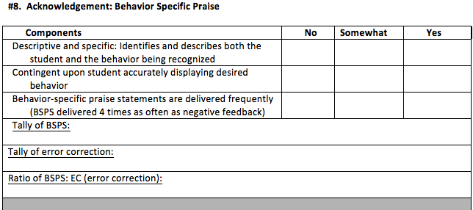
Behavior Specific Praise Chart

Slide 18
Your Role

Slide 19
# 9 Feedback: Error Correction
Error correction = informative statement following the occurrence of an undesired behavior or an incorrect answer.
Focus on:
Task
Process
Self-Regulation

Slide 20
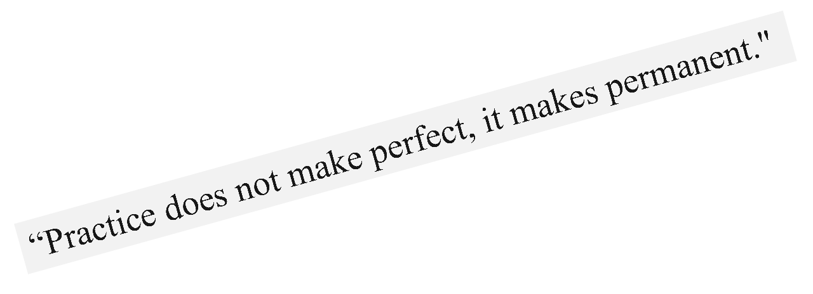
Corrective Feedback or Error Correction - WHY?
Can double the rate of learning (William, 2011)
Effect size of .79 (Hattie, 2012)
Recommended 5 positive to every 1 redirection= BSP
Prevents the practicing of incorrect responses

Slide 21
Correct Response
If confident, quick and firm
Affirm and move on
If hesitant
Affirm and reteach
Planned specific information is more likely to influence student performance than haphazard, general feedback
Herschell, Greco, Filcheck and McNeil, 2002

Slide 22
Remember
Punishing students doesn’t teach them the right way to act.
Dwelling on an incorrect answer does not lead us to the correct answer. FEED UP FEED FORWARD

Slide 23
Error Correction Examples
TASK: “Remember! Raise your hand before calling out an answer (correct answer/behavior). Show me! (ends on correct response)”
PROCESS: “Use a whisper voice while working with your partner (correct answer/behavior). We are working for 5 more minutes, so practice your whisper voice (next time – forward). I’m going to listen for it (end on correct answer)

Slide 24
Error Correction Examples 2
PROCESS: “A paragraph has a main idea sentence and at least three compelling supportive sentences (correct answer). Does your paragraph follow this rule? How can you fix it? Right, it needs another supporting sentence (next time). Go try it and then show me. (end on correct answer)
SELF REGULATION: “I can tell you are getting frustrated. Remember, you can use your break card or move to a quieter space (correct answer). Why don’t you try that and see if that helps! (end on the correct answer) (After student calms) Next time don’t forget to use the card or space! It’s there for you! (next time – forward)

Slide 25
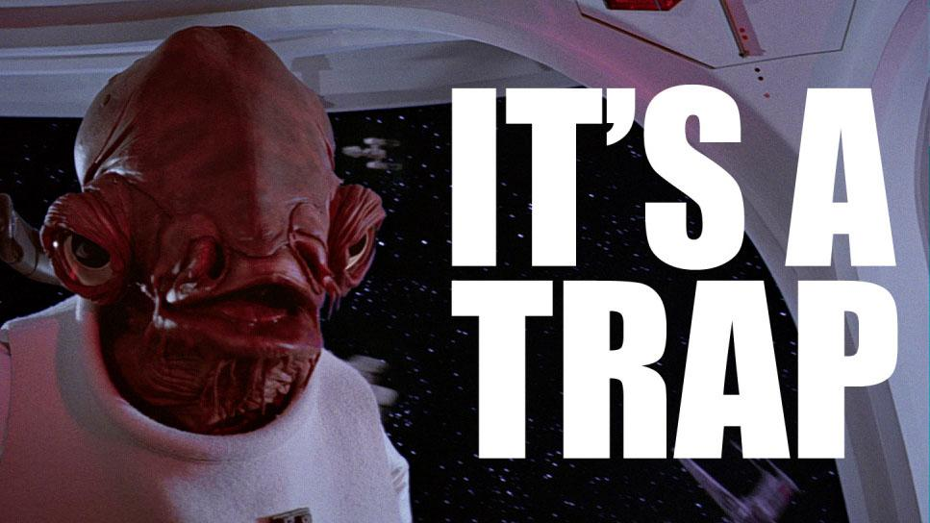
Error Correction Caution:

Slide 26
Error Correction: Common Errors
Never ask why…do you really want to know? “Why are you always late? Why are you talking while I am talking?”
Make private where possible – no shaming! “Sharon, Kandy, Regina, you need to go back and rewrite that paragraph. It is incomplete.”
Never use corrective feedback to the self ex. “You are so messy. You need to get organized.”
Don’t always provide feedback at the task level. Keeping at the task only corrects THAT TASK…it doesn’t generalize. TASK feedback needs to be rotated with PROCESS!

Slide 27
Practice: Taboo
Correct the Behavior WITHOUT saying/doing these:
Ask Why?
Ask any kind of rhetorical question.
Make any accusatory statement that starts with “You are…”

Slide 28
Practice: Feedback Sort

Slide 29
Practice: DIY Mind Map
Create a Mind Map poster that you can place in your classroom with as many ways as possible to provide feedback to your students.
Remember 5:1 positive interactions
Specific Behavior Statement sentence starters
Corrective Feedback sentence starters
Use words and pictures
Share ideas and post it as a reminder!

Slide 30
Educational Leadership – September 2018 – ps. 69-75

Slide 31
DOJO – Clip Charts
Do not align with VTSS if used in a punitive manner
Clip up, not down, send only positive
messages
Use with reward system
May not be necessary if all other
practices are in place
Are there other ways to provide feedback to students that are focused on teaching the desired behavior? Of course! We just showed you!

Slide 32
DOJO
Use only for positive communication with parents
Use specific statements that align to expected behaviors
Only give points DO NOT remove points

Slide 33
To Clip-Up / Clip-Down?
Questions to Consider about “Clip Charts”:
Do these charts change behavior or just track it?
Do the same students consistently clip down? What kind of motivation or impact might that have on these students? What impact does it have on relationships in the classroom?
What role does the judgement of a teacher play in making these requests to clip up or down?

Slide 34
To Clip-Up / Clip-Down? 2
Additional Questions to Consider about “Clip Charts”:
Can students identify the behavior that is attached to the movement of the clip and understand how to make a change?
Are there other ways to provide feedback to students that is focused on teaching the desired behavior? Of course, we just showed you.

Slide 35
Responding to Inappropriate Behavior

Slide 36
Data Collection Form

Slide 37
What’s Your Role?

Slide 38
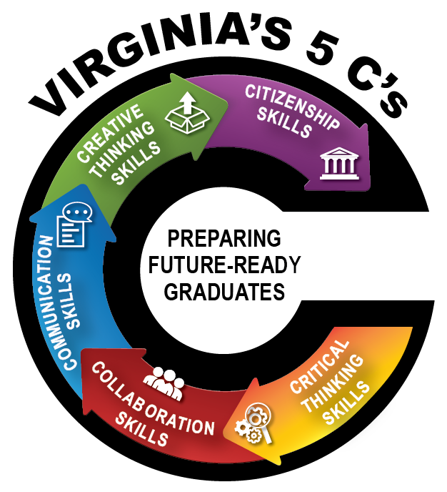
Profile of a Virginia Graduate

Slide 39
# 10 Feedback: Building Community Through Feedback
The dependent relationship between a given task or specified behavior and the ability for the whole group to access a specific reward.
You may have heard “Group Contingency”.
The class/group is rewarded when they work together to achieve a task.

Slide 40
Building Community
Acknowledges students for performing a desired behavior that serves the group functioning
Saves time and resources by designing a program for an entire classroom rather than individual students, and
Encourages positive social interactions between peers
(Murphy et. al, 2007)

Slide 41
Rationale
Increases the climate and culture of the class: it’s a team
Dispels the notion that every single student has to meet the criteria
Allows students who have difficulty meeting expectations to participate and experience success

Slide 42
Advantages
Findings have been favorable across a wide range of behaviors and with a wide range of populations
Doesn’t single out an individual student in need of intervention (Elliot, Turcon, Gresham, 1987)
Can promote cooperation among students (Skinner et al., 1996; Williamson et al., 1992)
Provides the opportunity to increase resource efficacy (e.g. teach time) when more than one student is in need of intervention (Chafouleas, Sanetti, Jaffery & Fallon, in press)

Slide 43
Stop and Jot
How does community/group feedback support appropriate behavior?
How does community/group feedback support academic success?

Slide 44
Supporting Behavior
Acknowledges students for performing a desired behavior
Saves time and resources by designing a program for an entire classroom rather than individual students
Encourages positive social interactions between peers
Increases the efficiency of classroom management for teachers
Ability of teachers to enhance motivation
Involvement of peers increase of positive classroom behaviors
Murphy et. al, 2007

Slide 45
Supporting Academics
State/national goals for education recommend the use of cooperative learning
Cooperative learning is more successful than individual learning
More positive relationships with peers
Exhibit greater social competence
Retain information longer
Show higher levels of reasoning, critical thinking, and metacognition

Slide 46
Types of Supports
Individual Support to the Group
Interdependent Support to the Group
Dependent to the Group (does not align with VTSS) One student determines whether the group succeeds or not.

Slide 47
Individual
Aligns with VTSS
Each individual student has the opportunity to receive reinforcement if he/she meets the criteria set for all students.
The reinforcement/feedback is targeted to ways in which the individual is working in collaboration or building community with the group.

Slide 48
Example: Individual
Individual student has a particular goal he/she must attain within a certain time frame or the individual displays a behavior that brings the group together.
John may select from a reward chart when he earns 15 points for the day for showing respect for others by allowing other students the opportunity to respond during group work.
Rewards on the reward chart should reinforce the community building.
Lunch with a friend
Read a book with a friend
Time with the teacher

Slide 49
Interdependent
Aligns with VTSS
Are reward systems in which all children (or groups of children) can earn token reinforcers for engaging in target behaviors, and work together toward a group goal. Students are interdependent upon one another and learn to function together – ex. “The Marble Jar”
Again, the reinforcement or feedback is targeted to the healthy functioning of the community. It should reinforce the collaboration and citizenship skills.
Chazin, K.T. & Ledford, J.R. (2016)

Slide 50
Example: Class
All members of the class help earn points. Once all 20 points are earned, all members may choose from the rewards chart menu OR a class goal or reward is earned.
Variation- Small Groups
Rewards on the reward chart should reinforce the community building.
Extra recess for all
Pizza party
All get a homework pass or bonus points on a test

Slide 51
Group Feedback: Common Errors
Do NOT take away previously earned points or reinforcement
Each and every student should NOT have to do every single thing for the class to earn the reward
Do NOT have one student or group earn things (or lose things) for the group
Do NOT leverage peer pressure

Slide 52
What works!
Remaining focused on the positive
Maintaining high rates of reinforcement
Taking time to reward students
Providing meaningful rewards
Being Consistent
Considering the school-wide reward system
Keeping it simple

Slide 53
How to Implement
Choose an effective reward
Determine the behavior to change and any collateral behaviors that might be affected
Set appropriate performance criterion
It is important that the goals are clearly identified
Combine with other procedures when appropriate
Select the most appropriate group contingency
Monitor individual and group performance

Slide 54
Activity: Group Feedback
Workbook page:
Establishing a Group Feedback Program
Circle and Star: A Menu of Classroom Reinforcers-with a partner or table group, add a few more examples.
In your workbook, write down at least 1 independent and interdependent contingency to try (or encourage others to try).

Slide 55
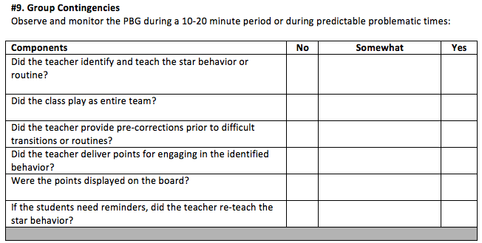
DATA COLLECTION
(Workbook p. 89-90)

Slide 56
Your role!

Slide 57
Through the Lens of ALL Students

Slide 58
References
Archer, Anita. (2011). Explicit Instruction: Effective and Efficient Teaching. New York: The Guilford Press.
Brophy, J. (1998). Motivating Students to Learn. Boston: McGraw Hill.
Evertson, C., & Emmer, E. (1982). Preventive classroom management. In D. Duke (Ed.), Helping teachers manage classrooms. Alexandria, VA: Association for Supervision and Curriculum Development.

Slide 59
References 2
Evertson, C., & Emmer, E. (2008). Classroom management for elementary teachers (8th Edition). Boston: Allyn & Bacon.
Good, T. & Brophy, J. (2000). Look Into Classrooms. Boston: Allyn & Bacon.
Hattie, J., & Timperley, H. (2007). The Power of Feedback. Review of Education,77, 81-112.
Johnson, T.C., Stoner, G. & Green, S.K. (1996). Demonstrating the experimenting society model with classwide behavior management interventions. School Psychology Review, 25(2), 199-214.

