Slide 1
Module A
“The Set-Up for Success”
Physical Environment
Active Supervision
Notes:
Module A consists of two mini-modules: Arranging the physical environment, and active supervision within the environment.

Slide 2

Learning Intentions
Participants will be able to make intentional decisions about optimal placement of furniture and materials in the instructional space
Participants will be able to identify the key elements of active supervision in the classroom
Participants will be prepared to coach others in both arrangement of the physical environment and active supervision

Slide 3

Arrangement of Physical Environment
The creation of a safe and functional
classroom space
Notes:
The definition of Physical Environment is simply creating a safe and functional classroom space. Anita Archer likes to describe it this way: The script has been written (that’s the lesson planning), the play is about to start (your delivery of instruction) but first, the stage must be set (and that is classroom organization or arrangement of the physical environment)

Slide 4

Rationale
Creates efficient work-flow
Increases on-task behavior
Minimizes distractions and congestion
Reduces potential problem behavior
Promotes explicit instruction
Promotes accessibility for all students
Creates a pleasant organized environment
Promotes engagement for all students
Reduces problem behavior by enhancing opportunities for students to follow the academic and behavioral expectations
Notes:
Take a moment to scan the reasons why this “set up” for instruction is so important. This is also our first opportunity to demonstrate the interconnectedness of academic and behavioral practices.

Slide 5
Classroom Contexts
Physical
Context
Social
Context
Cultural
Context
Temporal
Context
Notes:
Four classroom contexts. How children engage within these contexts affects their ability to learn.
These settings direct engagement, which enhances learning, which affects desired behaviors.
Physical Context: all physical components within a classroom. Wall decor, lighting, layout, temperature, desk and chair design, seating opportunities, supplies and resources, and calming spaces.
Social Context: Interactions with peers, teachers/staff, and emotional reactions to scenarios during the learning day
Cultural Context: Culture of the classroom. Includes the norms developed by the whole, expectations of the teacher regarding operations and performance.
Temporal Context: Timing and routines within the classroom
Stearns, K. (2022). Creating a Sensory Friendly Classroom (dissertation).

Slide 6
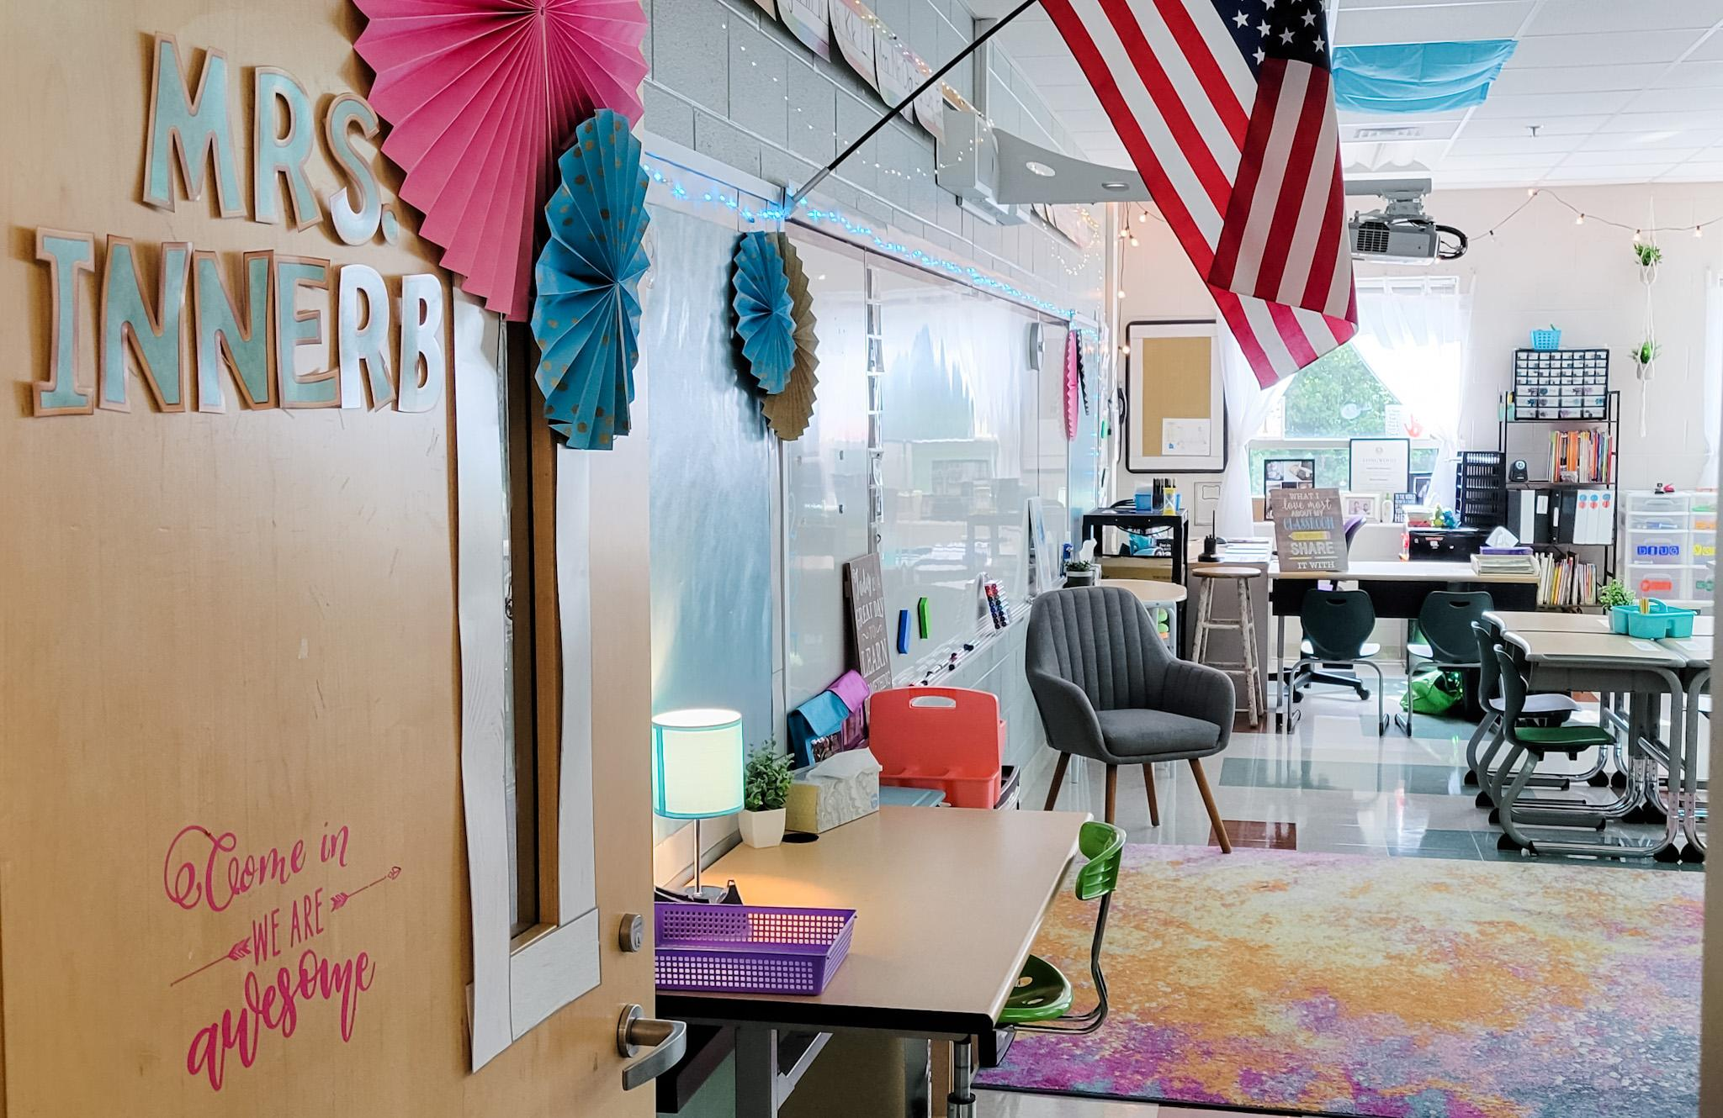
Classroom Example 1
limit overhead lighting to key zones
quiet legged chairs
lamps and ambient lighting
soft surfaces
Notes:
What sensory friendly practices can you spot?

Slide 7
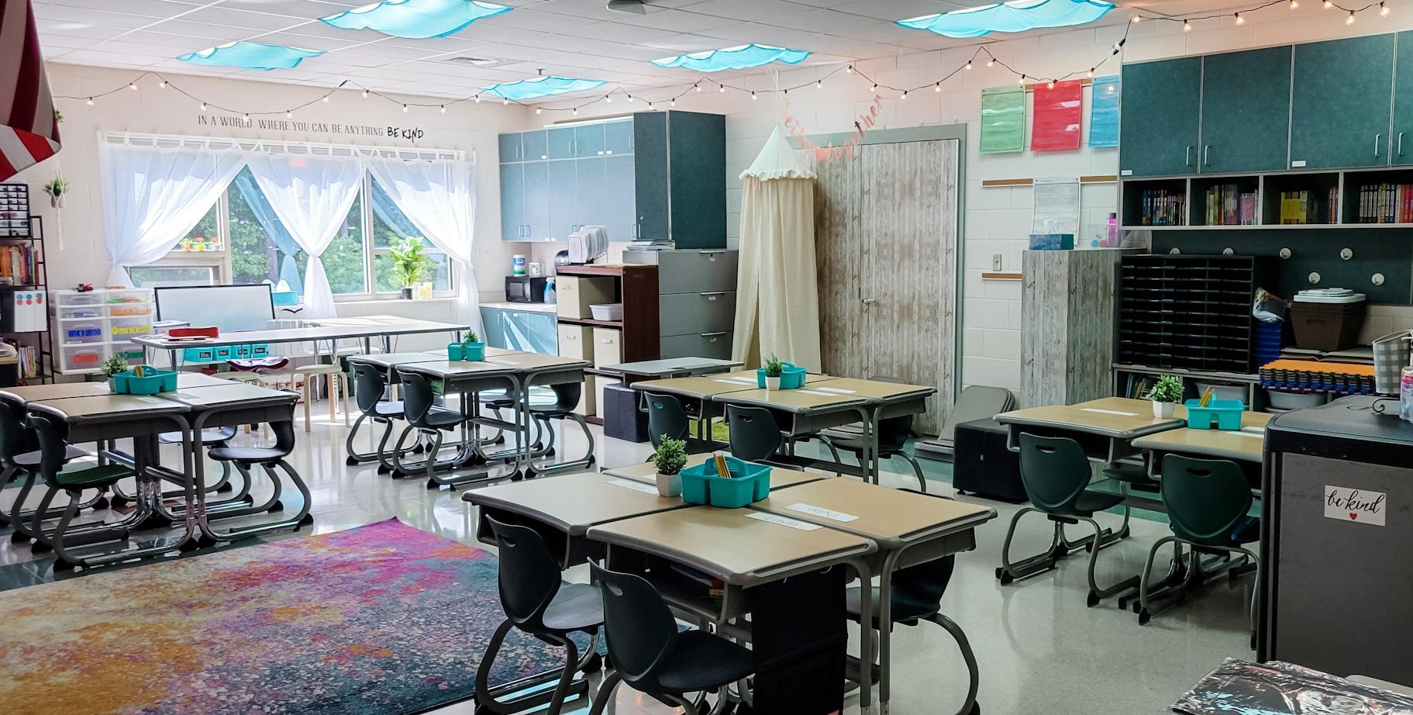
Classroom Example 2
curtains that can be pulled for diffusing bright light
fluorescent light diffusers
ambient lighting
small group station
graphic labels
Notes:
What sensory friendly practices can you spot?

Slide 8
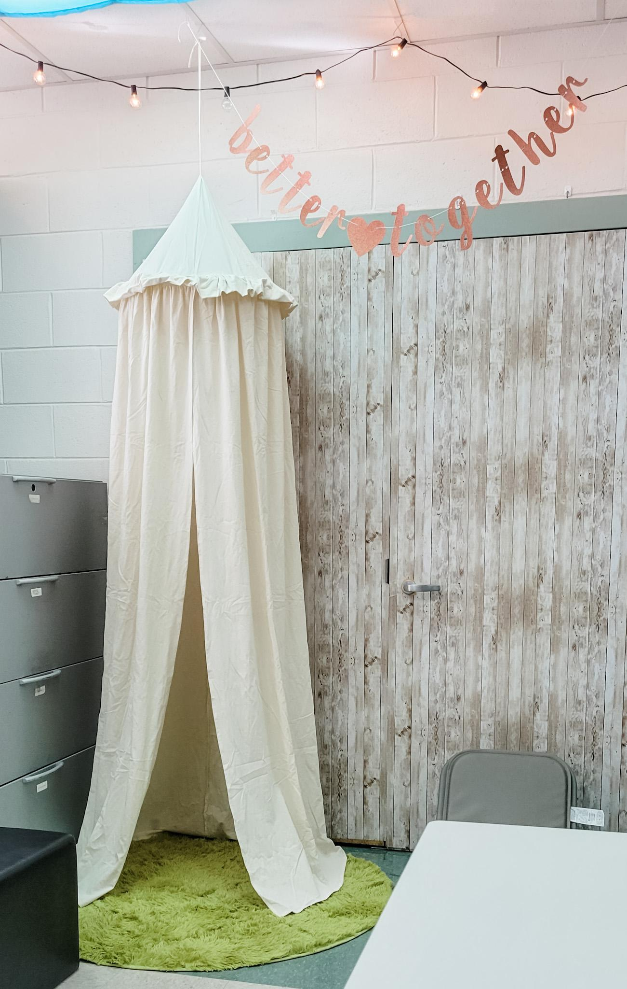
Classroom Example 3
ambient lighting
minimal wall decor
soft surfaces
calming station
Notes:
What sensory friendly practices can you spot?

Slide 9
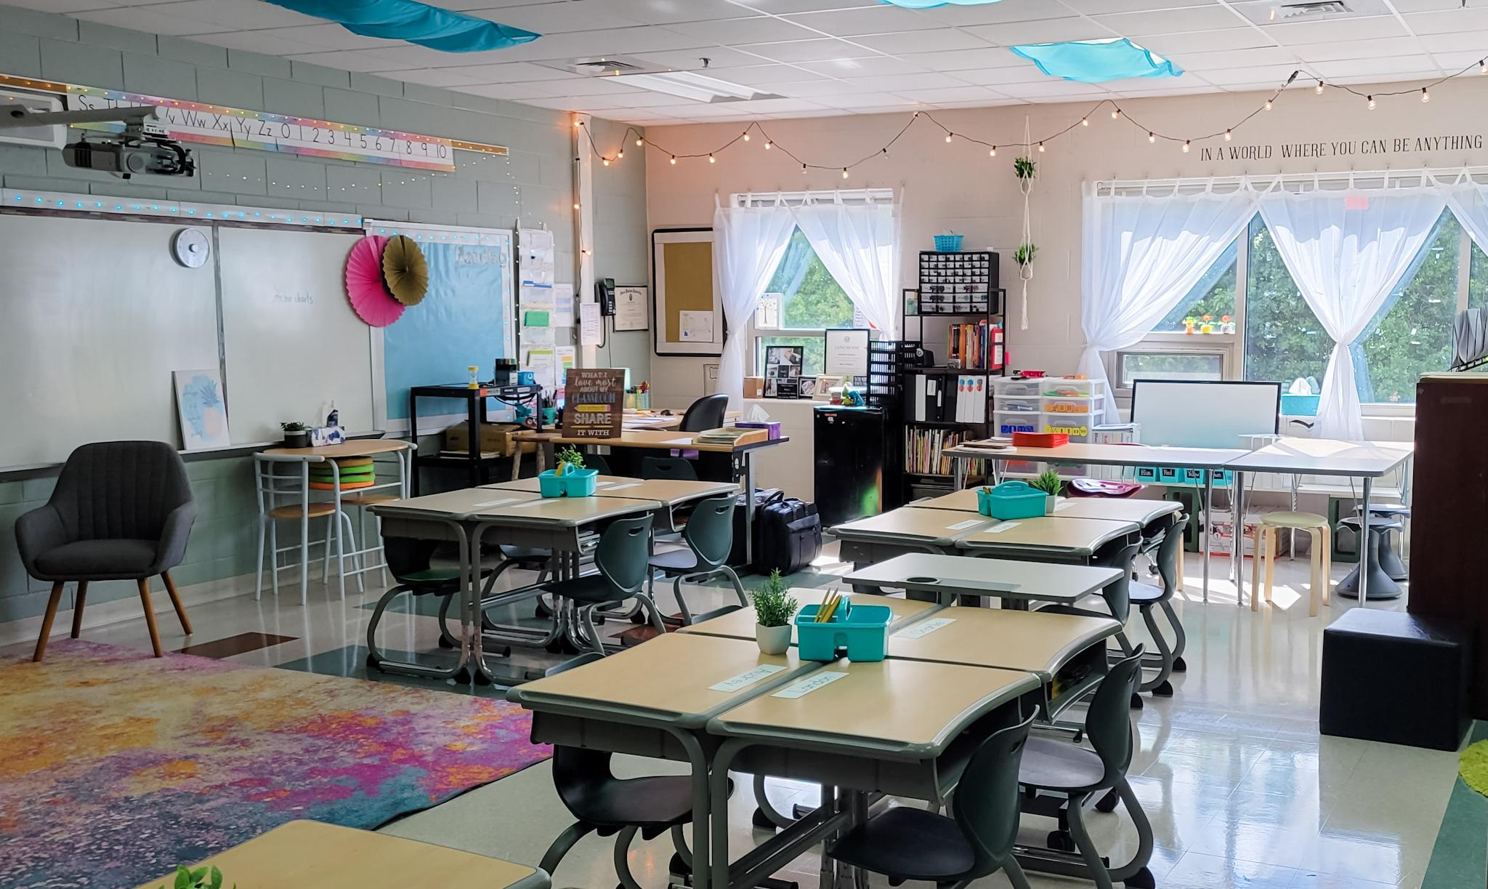
Classroom Example 4
fluorescent light diffusers
central supplies
flexible seating
green plants
Notes:
What sensory friendly practices can you spot?

Slide 10
Organization of the Space to Promote Successful Instruction
Teacher proximity and access to students
Students facing teacher during instruction
Students can easily share answers with a partner
Traffic flow is easy to follow
Materials are easily accessible “Avoid the void, for they will fill it!”
Notes:
There are several key ideas to think about when organizing the classroom. Perhaps the most important is teacher proximity and access to students. You don’t need to have all front row seats if you can easily access the students. Its also important that students can easily face the teacher during instruction but at the same time be able to work with partners and share ideas. An easy to use traffic flow is critical for safety. And finally, students should always have easy access to materials. To quote Anita Archer again” avoid the void, for they will fill it! I think anyone who has been in the classroom knows that to be true!

Slide 11
Wall postings
support instruction
Word walls
Strategy posters
Rubrics
Content/Reference information (maps, strong word for writing)
Expectations for behavior (linked to the matrix)
Notices (menu)
Student work (“Personal Best” display)
Notes:
Research shows that displaying student work enhances their sense of belonging and sense of involvement and therefore they are more likely to learn.
The selection of wall postings is also important. When done intentionally, students have access to needed information and also visual cues and reminders. Limit to what is needed versus for decoration
They also are acknowledged for their work. At the bottom, you’ll notice something called a “Personal Best” display.
At the end of the week, students go through their folders and select an assignment for their space that represents their personal best, and they explain to a partner why they selected it. Now, here is the important part - The posted work will not be perfect – this is not the A+ or 100% wall - , it is designed to encourage students to reflect on their own progress and quality of work. And everyone has their designated spot on the wall.

Slide 12
Accessibility
Is the classroom universally designed? (all individuals have access) or designed for the hegemonic student (the most prominent, dominant student)
Is the technology accessible to all?
Do you need assistive technology to provide access for some?
Are there barriers that will create any issues for a student regardless of disability?
Is the class and presentation visually accessible to all students?
Is there a culture in place for students to seek assistance? Does the instructor seek feedback?
Is the classroom designed for flexibility and choice?
Notes:
“Students learn best through active learning and in environments that promote relationship building, teamwork, and give them a sense of autonomy. They also learn well through the use of technology since they are more comfortable using it than any generation has ever been. The pedagogies and learning spaces play a critical role in either meeting or not meeting the needs of millennials.” President, Angela Ford International Society of Educational Planning (https://isep.info/wp-content/uploads/2016/04/23-1_3ClassroomDesignandLayout.pdf)

Slide 13
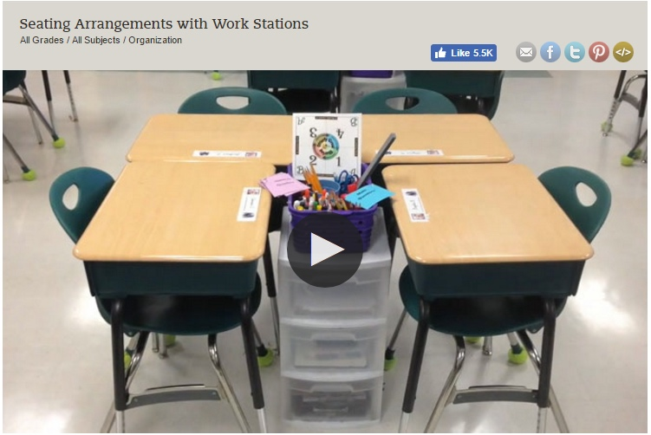
Example:
Elementary
Notes:
Watch these short videos for an elementary and secondary example. There are pinterest pages galore with other ideas. Flexible seating may also be a topic of conversation as well.

Slide 14
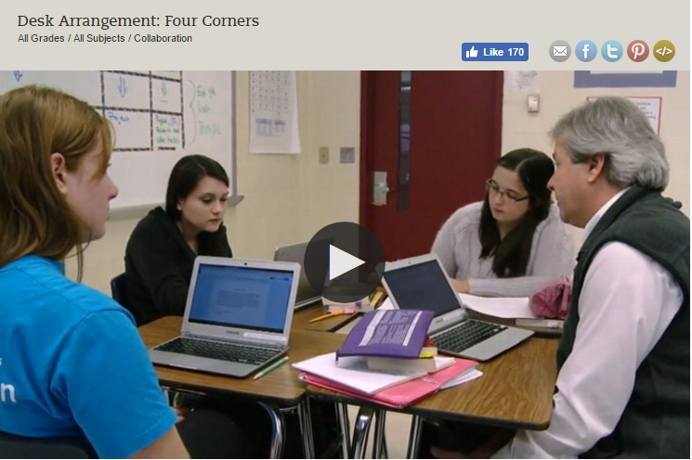
One More Example
Secondary
Notes:
Watch these short videos for an elementary and secondary example. There are pinterest pages galore with other ideas. Flexible seating may also be a topic of conversation as well.

Slide 15
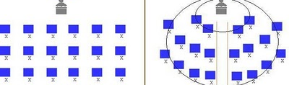
Circular & Matrix/Traditional Type Arrangements
Matrix/Traditional
Arrangment
Circular
Arrangement
  Allows teacher to easily circulate
  Helpful for students with academic or behavioral difficulty
  Helpful during independent learning time
  Facilitates student discussion
  Increases student-initiated questions
  Frequency increases the closer students are seated to the center
Notes:
Let’s take a moment to predict that someone may ask about the benefits of a more traditional seating arrangement. Essentially, there are pros and cons to the various examples. Here you can see that there may be times when the traditional matrix my be useful, while the circular arrangement on the right more readily facilitates student discussion and collaboration.
What we want to keep in mind is that seating arrangements can also be fluid, depending on the types of activities and needs of students.

Slide 16

Data and Evaluation
Utilizing the Worksheet “Evaluating the Physical Organization of the Classroom: Setting the Stage,” discuss for 5 minutes how you might use this to collect data on classroom organization
Notes:
Refer to the handout : Evaluating the Physical Organization of the Classroom. Here is one method of collecting data and evaluating the Physical Environment.

Slide 17
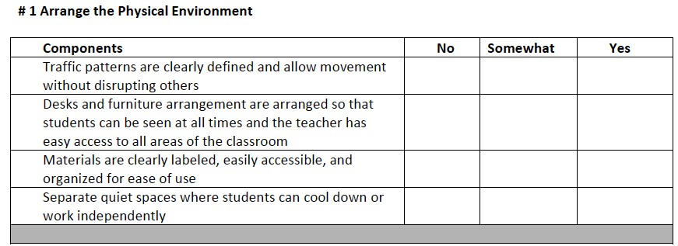
For schoolwide data…
Notes:
You may also choose to use this brief version to determine if there is an orderly physical environment.

Slide 18

Active Supervision
…a process for monitoring the classroom, or any school setting, that incorporates moving, scanning, and interacting frequently with students
Notes:
The second and final mini-module for your pre-work is active supervision. The definition is the process teachers use to monitor the classroom or any school setting that incorporates moving, scanning, and frequently interacting.

Slide 19
Rationale
Allows for immediate feedback and assistance to students
Increases student engagement
Reduces inappropriate behavior; increases academically engaged time on task
Provides opportunities to monitor students’ responses (formative assessment)
Frequent use of encouragement
Timely correction of errors
Builds positive relationships
Notes:
Supervision obviously allows you to monitor learning and to identify students who may have questions or need your assistance. Active supervision can increase student task engagement. We know that when adults are present and actively supervising, student behavior is better (Simonsen, et al., 2008). Your physical presence itself tends to reduce the occurrence of student misbehavior. It is human nature. We have all experienced how we are more likely to honor traffic regulations when a police officer is around. So it is with students. Additionally, monitoring students closely is the only way you will know if students are meeting your expectations. Having clearly defined expectations and teaching them has a limited impact without consistently upholding those expectations through supervision paired with encouragement and correction. Supervision will, of course, allow you to ensure student safety and possibly prevent problematic or even perhaps dangerous situations. Possibly most important, supervision provides an opportunity to establish positive relationships. Adult attention is one of the most powerful ways to impact student positive affect, increase compliance, and meet student needs for attention. Finally, all of the above help to improve the quality of instructional time. Sprick, Knight, Reinke, & McKale (2006). say it well: “The goal of effective classroom management is not creating “perfect” children, but providing the perfect environment for enhancing their growth, using research based strategies that guide students toward increasingly responsible and motivated behavior.”

Slide 20
Anita Archer
“You teach on your feet,
and not from your seat.”
“Walk around, look around,
talk around.”
Notes:
And here is a simple way of stating it from Anita Archer. Moving is walk around, scanning is look around, and interacting with students is talk around.

Slide 21
Components of Active Supervision
Moving: (Walk Around) Continuous, random teacher movement throughout all parts of classroom
Scanning: (Look Around) Frequent and intentional visual sweep of all parts of classroom
Interacting: (Talk Around) Frequent and positive communication to encourage, reinforce, and correct
Notes:
Active supervision creates a safe and supportive environment with teacher presence. The teacher is able to respond individually to students as well as small groups of students, and can intentionally monitor what may be predictable problems.

Slide 22
Moving “Walk Around”
Circulate among students while working
Maintain proximity with students
Demonstrate interest in students:
  assist with learning tasks,
  provide positive and corrective feedback
Periodically move /supervise when providing individual/small group instruction
Notes:
Effective teachers use their body positioning purposefully to ensure student engagement. While instructing the class may mean gaining attention and pausing or standing in the front of the room, supervision of work or activities includes moving or circulating among students with whom you are working. When you are circulating, you will want to keep moving and avoid spending the majority of your time in any one location. Continuous movement and proximity with all students makes your presence known and heightens their attention to tasks and the expected behaviors.
This movement should be random or unpredictable so students are unsure of when you will be in proximity. It should also include moving close to noncompliant students as needed and more frequent contacts with possible targeted problem areas (Lampi, Fenty, & Beaunae, 2005). Circulating allows you to be near students to demonstrate your interest in them, assist with learning tasks by answering questions, build relationships, and provide feedback–both positive and corrective.
Movement can be a challenge when working with a small group or providing individual instruction and also needing to supervise other students. You can still build in ways to periodically and unpredictably supervise the entire group. For example, during small group writing instruction, you can give students a brief task to complete while you get up and move among the large group of students briefly, then resume working with the small group.

Slide 23
Playground or Common Area Strategy
Divide the playground area or common area into a grid with as many sections as you have adult staff at any one time. Assign staff to supervise one area.
While monitoring students on the playground or common area, move around, interact with students, and observe behaviors of individuals and the group. Scan the entire area as you move around all corners of the area.
Notes:
Here is an elementary example for the playground. Divide the area into a grid, and assign staff one area to walk around, talk around, and scan. This strategy works well in other common areas for both elementary and secondary.

Slide 24
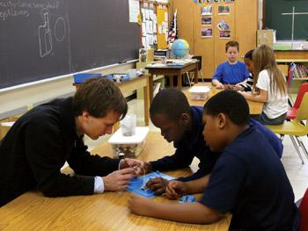
Interacting “Talk Around”
While moving and scanning, you should also frequently interact with students.
Communicates care, trust, and respect
Creates positive climate and increases likelihood of accepting correction if needed
Includes proximity, listening, eye contact, smiles, pleasant voice tone, and use of student’s name
Notes:
There is a relationship between the number of supervisor - to - student interactions and the instances of problem behavior (Simonsen, Fairbanks, Briesch, Myers & Sugai, 2008)
Just as moving and scanning work together, while moving and scanning you should also frequently interact with students. A friendly, open and helpful demeanor communicates care, trust, and respect and helps to build relationships. These interacting behaviors do not change when teaching, encouraging or even addressing problem behavior.
2 x 10 Relationship Building. Spend 2 minutes a day for 10 days. Use with at-risk students to promote positive interactions and connections Article: https://www.ascd.org/el/articles/the-two-minute-relationship-builder

Slide 25
Scanning “Look Around”
Frequently and intentionally look around at students
Make eye contact with students for affirmation
Visually sweep all areas of the room as well as look directly at students nearest you
If working with individuals, position self to scan entire room, or get up and scan occasionally
With some students, use personal cues as reminders
Notes:
Whether you are moving around the room, working with a small group or individual, or leading the group from the front of the room, you should frequently and intentionally look around at the students. This visual scanning includes looking stu­dents in the eye. If you are moving and circulating, visually sweep all areas of the room as well as looking at the students nearest you. If you are working with an individual student, position yourself so as to scan the entire room simultaneously, or stand up occasionally and look around the room, then return to the student. When working with a group, look up and scan the room as you also, alternately, focus on the group. This visual scanning allows you to watch for instances of appropriate or inappropriate behavior that you will want to respond to now or as soon as possible. It will also help you to identify students who may need your assistance with their academic work.

Slide 26
Non-Examples of All Three
Sitting or standing where you cannot see the entire room / space,
    back to the group
    behind your desk
Walking the same, predictable route during entire class period
Stopping and talking with a student(s) for long periods of time
Interacting with the same student(s)
Lesson plans dominated by teacher directed lectures
Notes:
Lets wrap up with a few common non-examples. Times when the teacher cannot see the room well, or engages to long with one student, or always follows a predictable pattern, can lead to missed opportunities to seize on the benefits of active supervision.

Slide 27
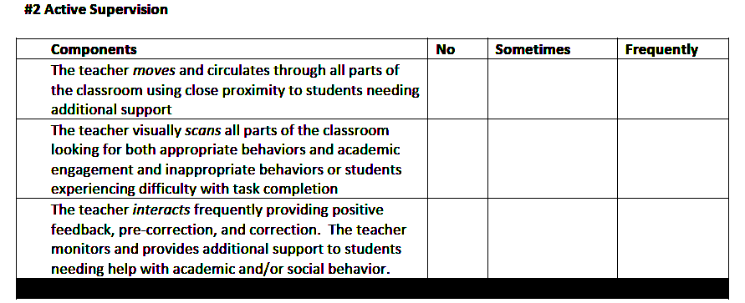
Data Collection Form:
Active Supervision
Notes:
Here is a classroom snapshot for Active Supervision with a simple data collection process. You may pause here and ask yourself if this might be an effective reflection tool, or which components are already reflected in your walk throughs.

