Slide 1
Module B: Responding to the Matrix
Classroom Expectations Aligned to Schoolwide Matrix
Routines and Procedures for Academics and Behavior
Notes:
Welcome to our second module!

Slide 2



Key Terms
Alignment
Expectations
Rules
Behaviors
Procedures
Routines
Notes:
6 key words we’ll focus on in this module
Alignment
Rules
Expectations
Behaviors
Procedures
Routines
Jot the 6 terms down … individually – 1-2 minutes – write down a quick “what does it mean to you” and if you have time give an example
As we go through the module, take note when you hear the terms – check to see how our definitions or descriptions and examples compare with or complement yours
Alignment – ensuring classroom expectations match with / are consistent with schoolwide
Rules – safety guidelines; tend to be right or wrong
Expectations – overarching values, define vision for school / vision of a successful student
Behaviors – specific actions, words – what it looks like / sounds like to follow the expectations across locations/settings
Procedures – how we accomplish tasks/activities
Routines – habitual following of procedures

Slide 3
Effective Classroom Systems
Making it Stick
Creating a system to support evidence-based practices
Module A: The Set-Up for Success
Physical environment
Active supervision
Module B: Responding to the Matrix
  Define classroom expectations aligned to SW expectations (specificity to matrix)
Routines and Procedures
Module C: The Engaged and Successful Student
Engagement: opportunities to respond
Formative Assessment
Scaffolding
Module D: The Power of Feedback
Feedback: Behavior specific praise
Feedback: Acknowledgement and reinforcement/group contingencies
Feedback: Error correction
Notes:
Facilitator
Keeping up with our roadmap
In this module, we’ll be focusing on the value of aligning classroom and schoolwide values and expectations, and the importance of routines and procedures for both behavior and academics.
For us, Alignment (1st of our 6 terms) – focuses on ensuring classroom expectations match with / are consistent with schoolwide

Slide 4

Learning Intentions
Understand that a classroom matrix is aligned with school-wide expectations
Understand the importance of creating and teaching procedures and routines in both behavior and academics
Notes:
Our learning intentions for this module focus on those two big goals:
Understanding the alignment of a classroom matrix with the school-wide matrix; and
Understanding how important, especially in our current situation, it is to create and maintain routines and procedures.
The kinds of supports that enable students to be successful behaviorally are also key to setting students up for success academically.

Slide 5

Success Criteria
Create a classroom matrix aligned with school-wide expectations and including classroom expectations and routines for daily procedures
Notes:
Here are the success criteria that we hope you will achieve after completing this module. The highlighted success criteria is the one we hope you will achieve after learning about opportunities to respond.

Slide 6

Consistency Matters
Our physical and emotional well-being impacts our ability to think and learn effectively
Increases predictability
Students can focus on being engaged
Notes:
The rationale for the clarity around the positive behaviors for success and the alignment to the school wide expectations is what we already know: Consistency Matters. We want students to feel safe in a predictable classroom so they can be engaged in their thinking and learning.
This instruction is part of what we’ve called classroom management in the past. Challenge: to consider it in another way - instead of classroom management, just instruction
However we reference it - Hattie: Effect size of Classroom Management=0.52.
Increased predictability in the environment helps support student’s social/emotional well-being. While they will challenge expectations to see if you really mean what you say, students crave stability, consistency and predictability, particularly those dealing with trauma or home lives that are unpredictable.
Having classroom procedures:
increases instruction time by preventing problem behavior
Improves classroom climate
Creates shared ownership of the classroom
Develops self-discipline
After the disruptions to learning – and to life outside school - across the past several years, we want to continue to communicate with families about the efforts schools are making to create safe, predictable environments.

Slide 7
#3 Classroom Expectations Aligned to Schoolwide Expectations
Classroom expectations define a vision of a successful student by:
Proactively teaching behaviors for success
Communicating positive message to students and families when posted in classroom
Providing language for positive and specific feedback to students
Aligning to the vision of the school (schoolwide expectations)
Notes:
Its logical – since the schoolwide expectations or values are the foundation for a behavior curriculum, we need to have classroom and schoolwide aligned
Expectations (a 2nd beach ball term) – overarching values, define vision for school / vision of a successful student
In essence, we have two key ideas for this practice.
First, the classroom expectations create a vision of a successful student—we are proactive in our language and communication regarding a student’s ability to achieve success in our classroom.
The second key idea is that we align these clearly stated behaviors with the expectations of the schoolwide matrix

Slide 8
School-wide Matrix
Teaching Matrix | All Settings | Hallways | Playgrounds | Cafeteria | Library/ Computer Lab | Assembly | Bus
Respect Ourselves | Be on task. Give your best effort. Be prepared. | Walk. | Have a plan. | Eat all your food. Select healthy foods. | Study, read, compute. | Sit in one spot. | Watch for your stop.
Respect Others | Be kind. Hands/feet to self. Help/share with others. | Use normal voice volume. Walk to right. | Play safe. Include others. Share equipment. | Practice good table manners | Whisper. Return books. | Listen/watch. Use appropriate applause. | Use a quiet voice. Stay in your seat.
Respect Property | Recycle. Clean up after self. | Pick up litter. Maintain physical space. | Use equipment properly. Put litter in garbage can. | Replace trays & utensils. Clean up eating area. | Push in chairs. Treat books carefully. | Pick up. Treat chairs appropriately. | Wipe your feet. Sit appropriately.
    Expectations
Notes:
Circling back to what schools already have in place – a schoolwide matrix which first identifies the school’s core values

Slide 9
Matrix Example
Teaching Matrix |  | SETTINGS
 |  | All Settings | Hallways | Playgrounds | Cafeteria | Library/ Computer Lab | Assembly | Bus
 | Respect Ourselves | Be on task. Give your best effort. Be prepared. | Walk. | Have a plan. | Eat all your food. Select healthy foods. | Study, read, compute. | Sit in one spot. | Watch for your stop.
 | Respect Others | Be kind. Hands/feet to self. Help/share with others. | Use normal voice volume. Walk to right. | Play safe. Include others. Share equipment. | Practice good table manners | Whisper. Return books. | Listen/watch. Use appropriate applause. | Use a quiet voice. Stay in your seat.
 | Respect Property | Recycle. Clean up after self. | Pick up litter. Maintain physical space. | Use equipment properly. Put litter in garbage can. | Replace trays & utensils. Clean up eating area. | Push in chairs. Treat books carefully. | Pick up. Treat chairs appropriately. | Wipe your feet. Sit appropriately.
Behaviors
Notes:
Those matrices also identify the specific behaviors that are the “looks like, sounds like” to achieve the expectations, as well as the locations or settings in which they occur.
So for example, we respect others in the hallway by walking to the right.
Example settings/locations – likely many of you have some/all of these; your data may tell you which you need

Slide 10

Defining Expected Classroom Behaviors
Use the school-wide expectations as the foundation for classroom expectations
Observable
Measurable
Positively Stated
Understandable
Applicable
Notes:
Behaviors (3rd term) – specific actions, words – what it looks like / sounds like to follow the expectations across locations/settings
When we identify expected behaviors for our classrooms, they must adhere to the following criteria:
Are they observable – this is particularly important for an equity lens so we can be objective.
Are they measurable, positively stated, can the students understand them and do they apply to our setting.
We’ll offer a description of Rules (#4) here, too – we often think about “rules” as being safety guidelines; certainly have schoolwide (often division wide) rules for behavior, and those typically tend to be right or wrong guidelines
In our classrooms, it can be helpful to start with the school-wide expectations and then ask ourselves,
“What are the specific behaviors we need to meet each outcome?
(Those specific behaviors are what we have sometimes referred to as classroom “rules”)
In order to be preventative, what do we teach to prevent problem behaviors from occurring?
In answering these questions, we need to develop as few rules as possible and be sure that each meets the OMPUA guidelines.

Slide 11
SW Expectation: Be Responsible
Turn in completed assignments on time.
Always walk in the classroom.
Keep hands, feet, and objects to yourself.
Classroom Behavior Examples:
Be in your seat when the bell rings.
Be on task during work times.
Notes:
Take a moment to look at this examples matched to a schoolwide expectation, “Be responsible”
Examples are explicit, unambiguous, and indisputable statements of appropriate behavior for the classroom.

Slide 12
Practice
Which of the following could be used as an expected classroom behavior?
Safety comes first
Come to class on time, prepared with all supplies and assignments
Be responsible
Be ready to learn
Sit in your seat unless you have permission to leave it
Notes:
Before advancing to the next slide, decide which numbered items could be used as an expected classroom behavior.
Activity:
Table groups
Read and decide… which of these statements meet the 5 guidelines for writing behaviors? Remember, to be considered a “behavior,” it must be observable, measurable, positively stated, understandable, and always applicable.
Work as a group to revise the examples which do not meet the guidelines, to make them work as expected behaviors.
Ask volunteers to share.

Slide 13

Answers: Behaviors
Safety comes first
Come to class on time, prepared with all supplies and assignments
Be responsible
Be ready to learn
Sit in your seat unless you have permission to leave it
Notes:
Correct answers: #2 and 5

Slide 14



Family Input
How will you seek input from diverse families to enable them to support learning at home and at school?
Notes:
Focus on two-way communication with families.
Families need to know about the classroom expectations/behaviors (not just what they are, but why/how they were developed).
It often takes more than just a newsletter, survey, or email home asking families for input.

Slide 15
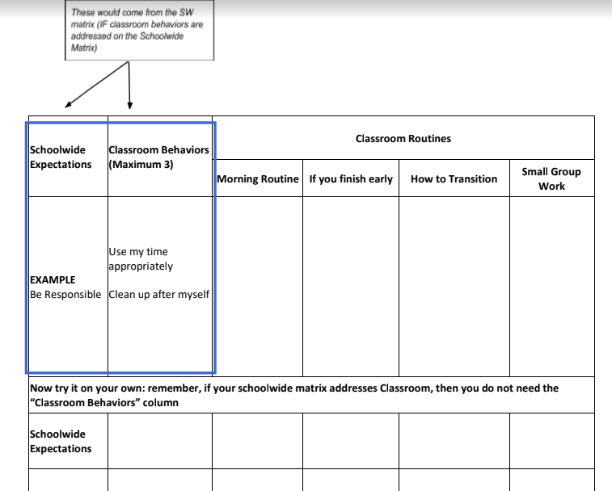
Classroom Expectations
Notes:
If you haven’t been using a classroom matrix that includes expectations, specific behaviors and classroom routines, here’s one example of how you might organize it.
We won’t take time now to create specific behaviors, but keep in mind, as you think about developing classroom expected behaviors for the upcoming year, the recommended criteria of Observable, Measurable, Positively Stated, Understandable, Applicable

Slide 16
Continuing Support
Think ahead of any issues that might arise and discuss them with the class beforehand. Prepare students before an event/activity. (Remember: “If it’s predictable, it’s preventable.”)
Embed expectations into the classroom
  Teacher consistently models expectations.
  Students follow class expectations despite the absence of the teacher:
        Substitute
        Guest teacher
        Buddy teacher
        Volunteer

Slide 17
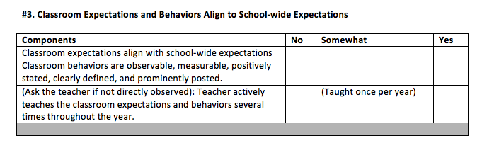
Data Collection Form
Notes:
You’ll have time to think about data collection during team planning time.

Slide 18
Routines and Procedures
Classroom Procedures are steps for accomplishing classroom tasks; they
Explain the accepted process for carrying out a specific activity such as:
  Walking in the hallway
  Using lockers
  Sharpening pencils
Routines are procedures that are used on a consistent basis, such as:
When students arrive to class
During in-class transitions
At dismissal
Notes:
Moving on! We’ll focus now on effective practice #4, Routines & Procedures
Final two terms:
Procedures – how we accomplish tasks/activities
Routines – habitual following of procedures
According to Harry Wong in his book The First Days of School, effective teachers spend the first two weeks teaching students to be in control of their own actions in a consistent classroom environment. The way to do this is through the teaching of procedures that, with repetition, become a routine.
Again, procedures are the steps we take to complete a task such as sharpening pencils or going to the restroom. Teaching, rehearsing and reinforcing the procedures eventually creates a routine that defines how things are done in that classroom. Routines become automatic and help students follow rules and meet expectations.
Harry Wong goes as far to say that “The number one problem in the classroom is not discipline: it is the lack of procedures and routines.”
So what do these look like in your school and how will you help ensure they’re in place and effective?

Slide 19

Rationale: A Safe and Predictable Environment
“To build and foster positive relationships, teachers should establish age appropriate and culturally responsive expectations, routines, and procedures within their classrooms that are positively stated and explicitly taught and practiced across the school year. When students demonstrate mastery and follow established rules and routines, teachers should provide age-appropriate specific performance feedback in meaningful and caring ways.”
McLeskey, J., Barringer, M-D., Billingsley, B., Brownell, M., Jackson, D., Kennedy, M., Lewis, T., Maheady, L., Rodriguez, J., Scheeler, M. C., Winn, J., & Ziegler, D. (2017, January). High-leverage practices in special education. Arlington, VA: Council for Exceptional Children & CEEDAR Center. © 2017 CEC & CEEDAR
Notes:
We know that consistency in the classroom is a high leverage practice in inclusive classrooms, but also supports all learners. Take a moment to read on your own the rationale.
Optional - can highlight key words

Slide 20
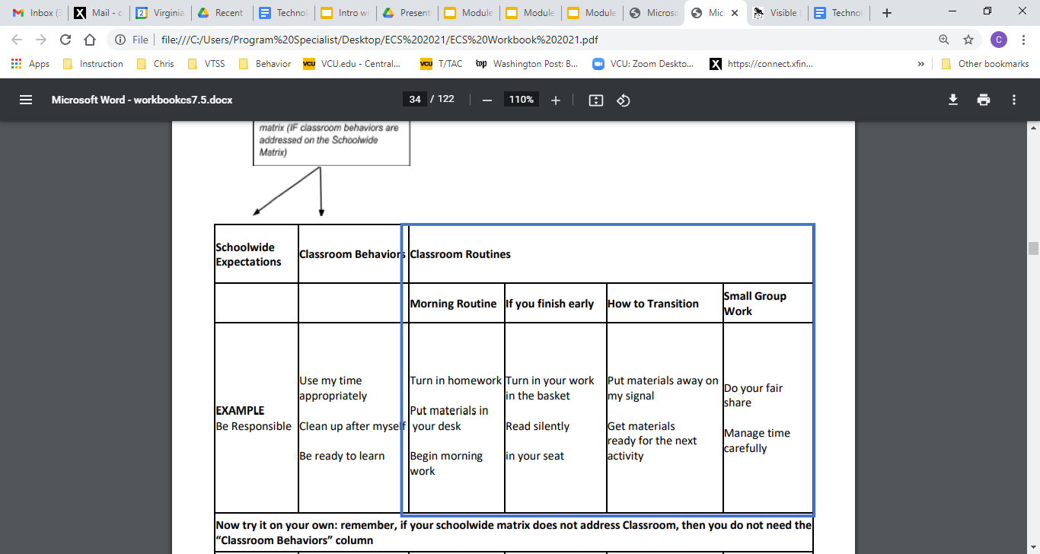
Classroom Procedures and Routines
Notes:
After thinking about what the school-wide expectations will look like and sound like in the classroom, you will want to think about when it would be helpful to have procedures and a routine for different times during the class or during the block.

Slide 21
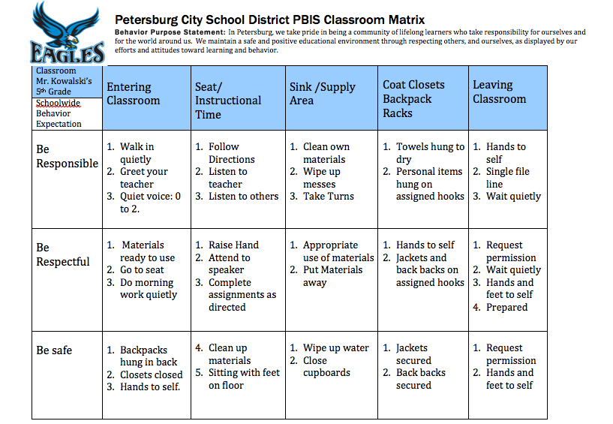
Example
Notes:
Elementary example – Petersburg 5th grade

Slide 22

Discussion Time
Things to talk about:
Should a grade level encourage consistency in some or all routines?
If yes, how do you create buy-in for all teachers?
What are a “top 5” classroom routines you might develop for a classroom?
How can you gain student input when creating the classroom matrix?
Notes:
8-10 minutes
Take a moment and write your personal thoughts down before discussion

Slide 23
Teaching Effective Procedures and Routines
Teaching Routine: how the procedure or activity looks (examples and nonexamples)
Active Supervision: a method for effectively monitoring students
Positive Reinforcement Procedures: incentives for appropriate behavior (praise, high fives…)
Pre-corrections: quick reminders of expected behavior before the transition
Notes:
Once the routines have been decided upon, it’s time to teach them and plan how to keep them fresh in students’ minds.
One such way is the use of precorrection. This is simply reminding students of the routine before the event. For example, it’s time for lunch- remind the class that when they are called they stand up, push in their chairs, and walk to get their lunch box and proceed to the line.
Any reminders for the cafeteria or walking in the hall can also be given.
When students are demonstrating the desired behaviors, acknowledge them with behavior specific praise, a high five, or a token from your SW acknowledgement program.
Remember to consistently supervise the students in the routines and practice or reteach as necessary.

Slide 24
Movement Out of the Classroom: Secondary
Students wait to pack up materials until teacher indicates end of class. The teacher dismisses students.
Teacher moves to door and dismisses students.
Teacher may require an exit task:
  Show me tomorrow’s assignment on your calendar.
  Write a 10-word summary of today’s lesson.
  Show it to me as you exit.
  Show me your notes from today’s lesson.
  Show me the rough draft of your paper.
Notes:
Set-up for next few slides - examples
Let’s quickly look at a few examples of how we can use routines to “organize for instruction”
As teachers design routines, remember you must identify who, what, when, where, why and how these procedures are designed for as well as how they will be taught and enforced. It is imperative for routines to be established for transitions to save valuable instructional time.
Again, think through the desired steps. Teach, rehearse and reinforce until the routine becomes automatic. You know you’ve reached automaticity when the students can complete the task themselves.

Slide 25
Only When Near
When the student has a question and the teacher is not near, the student may consult with his/her partner or use the rule “three before me”
If assistance is not adequate, student circles the item and continues working
The teacher moves around the room monitoring (Walk around. Look around. Talk around.)
When the teacher is NEAR, the student may raise his/her hand and request assistance
Notes:
As teachers we often deal with multiple students needing assistance and becoming off-task while awaiting their turn. This routine allows students to seek peer assistance and the opportunity to get additional help from the teacher, if needed, while continuing to work.
Again, this may be front loaded, with a need for consistency in teaching and reminding students of the procedure, but once the routine becomes automatic, it will save frustration for both students and teachers.

Slide 26

Attention Signal Examples
Clapping in a special rhythm and having students repeat it.
Holding two fingers in the air.
Counting down: “5, 4, 3, 2, 1”.
Call/Response: (Teacher:“1-2-3 all eyes on me”. Students: “1-2 all eyes on you.”)
Shaking or playing an instrument.
Secret Word
Notes:
Here are some simple ways to gain students’ attention.
Look how much time an attention signal saved for us in this professional learning today :)
Optional - think of a movie where the students are out of control and the teacher is always yelling at them to come back together and listen to them i.e. Faris Bueller - claaaas, claaas...
If time –
Quick turn to neighbor activity – share one or more of your favorite attention signal examples
(Use an attention signal to bring group back together!)

Slide 27
Combining Classroom Behaviors
and Routines
These would come from the SW matrix (IF classroom behaviors are addressed on the Schoolwide Matrix)
Can insert school name/mascot here Schoolwide Expectations | Classroom Behaviors (Maximum 3) | Classroom Routines (Can add room number)
 |  | Morning Routine | If you Finish Early | How to Transition / Line up | Small Group Work
Be Responsible | Use my time appropriately Clean up after myself Be ready to learn | Turn in homework Put materials in your desk Begin morning work | Turn in your work in the basket Read silently in your seat | Put materials away on my signal Get materials ready for the next activity | Do your fair share Manage time carefully
Be Respectful
Be Safe
Notes:
Matrix example combining expected behaviors and classroom routines
In your team planning time, think again about engaging with families:
Use every opportunity to seek out understanding of their child, their culture, and their suggestions, or what they need to support learning at home.
Share the established routines with families to reinforce at home.

Slide 28

INSTRUCTIONAL ROUTINES
Routines are not just about behavior
Notes:
We’ve been focusing on behavioral routines; and, we know instructional routines are equally critical in creating an effective, efficient, supportive and consistent learning environment.

Slide 29
Choosing Instructional Routines
Some routines relate to learning structures embedded in the content, such as starting each unit with the same graphic organizer or using a consistent vocabulary routine
Some routines and/or procedures are signals and cues, such as giving a choral response or ending peer conversation time
Data drives routines
Notes:
We can look to data to identify times when students are off task, transitions that are difficult, etc. to determine when a procedure/routine is needed.
It might be helpful to have a colleague observe and document times when things aren’t running as tightly as they could - suggest times for procedures/routines as well as things they’ve used that have worked well.
Everyone needs to find what works for them, but new teachers especially might benefit from ideas that work and could be tweaked to meet their own style.

Slide 30

Anita Archer: Instructional Routines
Anita Archer on Instructional Routines
Listen for how both teachers and students are empowered by instructional routines.
Notes:
2:36 length
Teachers are empowered – it is empowering, to use with automaticity, seamless flow
Students are also empowered – can put all their “cognitive thoughtfulness” on the content, rather than on the task; students who are at risk – especially benefit – more confident, more likely to participate fully

Slide 31
Explicit Teaching in Every Routine
I do- informing, explaining, modeling, and providing examples
We do- working together to complete the steps of a particular task
You do- students practice what was taught by themselves
Notes:
You’re likely already using “I do / we do / you do” in your instruction
Consider how “I do, we do, you do” can be used as a framework to support family members to work with their own children to reteach, reinforce, acknowledge - consistent with what the school is doing.
Think about how you can support family members' readiness to reinforce explicit teaching themselves. For example, you might record and share a video of teacher delivering the instruction; show families techniques for the “we do”, how to scaffold, etc.

Slide 32
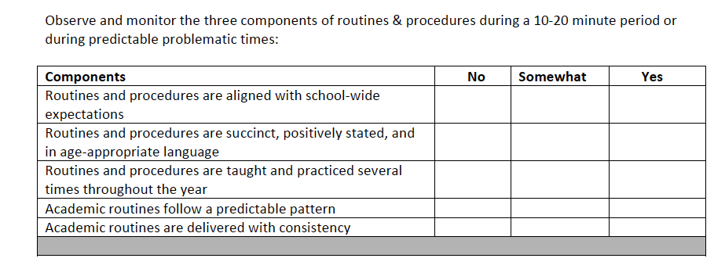
Data Collection
Notes:
Again – you’ll have time to consider the use of data collection within your team planning.

Slide 33
Review of Key Terms
Alignment
Expectations
Rules
Behaviors
Procedures
Routines
Notes:
IF time for a quick closing activity and IF beach balls are available -
Do a quick ball toss activity at tables -
When you have a ball, share an “a-ha” or “something new” thinking about one of the terms, then toss (gently!) to someone else at the table.

Slide 34

Making it Stick
Creating a System for Implementing High Leverage Practices

