Slide 1
Module C
The Engaged and Successful Student
Opportunities to Respond
Formative Assessment
Scaffolding
Notes:
We’re going to talk about three practices today that we call the engaged and successful student because those are so important to our work. We know how important it is to keep students engaged if they are going to learn, but we also need to facilitate teaching to promote their success.

Slide 2
Learning Intentions
Understand how opportunities to respond create a more equitable classroom and improve student achievement
Understand the five formative assessment strategies
Describe scaffolding strategies that support student achievement
Notes:
Please read the learning intentions on your own. The highlighted learning intention is the focus of the next practice we will discuss, opportunities to respond.

Slide 3
Success Criteria
Explain the different forms of student responses and when/how to use them
Notes:
Here are the success criteria that we hope you will achieve after completing this module. The highlighted success criteria is the one we hope you will achieve after learning about opportunities to respond.

Slide 4
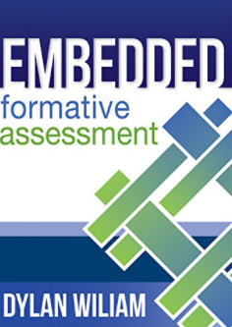
Resources
Notes:
These are some of the books and authors that we rely on to keep advancing our own understanding about evidence based practices.
These resources have been used to contribute to the content of the module. They are not the only resources available to support the content and your work in these areas.

Slide 5
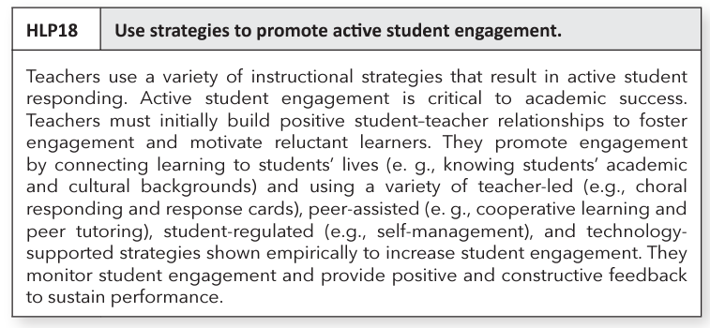
HLP 18

Slide 6
Opportunities to Respond
Source: Simonsen, Myers & DeLuca, 2010
“A teacher behavior that prompts or solicits a student response (verbal, written, gesture).”
Notes:
Opportunities to respond are practices which support classroom management as well as academic achievement.

Slide 7
Rationale
Students are able to:
Teachers are able to:
Remain attentive and on task
Retrieve, rehearse and practice information, concepts, skills and strategies being taught
Refrain from inappropriate behaviors
Provide corrective feedback immediately
Adjust the lesson
Offer behavior specific praise
Notes:
Students and teachers benefit from frequent opportunities to respond.
Because we as teachers know this, how intentional are we with opportunities to respond in the classroom? Do we think about which ones we use and when? Which ones do we use for different content, activities, etc.? Are we intentional about the equitable use of opportunities to respond to engage all students?

Slide 8
Teacher Talk Time
How much time are you talking?
______% of students surveyed in Virginia cohorts reported that their teachers talk most of the time.
When in fact….
Teacher talk should be no more than ____ to ____ % of instructional time.
76
40
50
HINT: It isn’t consecutive minutes necessarily, but rather “I say something, you say something…”
Notes:
Virtual: Let’s do the Chat Waterfall again. Participants respond in the Chat Box with their guesses for the first percentage..
Face-to-face: Turn and tell your neighbor what you think the first percentage is.
Teachers shouldn’t be working harder than their students! We talked about that as one of the principles of effective classroom feedback.
Ask: What do you think the first percentage is? 76% of students who were surveyed said teachers talk most of the time. Source
Ask: What about the second sentence? Teachers should talk no more than 40 - 50% of instructional time. Students need to talk more. The more back and forth from teacher talk to student talk, the better. What can this look like? Teacher talks, students respond orally, teacher talks, students work with a partner, teacher talks, students work in a group, teacher talks, students teach, reteach each other.

Slide 9
When and How to Use Opportunities to Respond
Choral
Partner or team
Individual
Written responses
Response system
Graphic organizer
Action responses
Act out/Gestures
Hand signals
Manipulatives
Notes:
Chat Box/Talk with a partner: What are some ways that students are asked to respond in your classroom or in classrooms that you have visited? Consider each of these areas (Display the three areas on the slide; ask participants to provide responses).
There are a variety of opportunities to respond. The Oregon handout in your materials explains the different examples listed on the slide.
Oral responses can be choral, partner or team, individual;
Examples of written responses: it could be a response system such as a white board, use of a graphic organizer such as one for vocabulary instruction;
Examples of action responses: act it out or use gestures (use to remember a process, to answer questions), hand signals (thumbs up, 1,2,3,4 for multiple choice, manipulatives).
The Oregon document can be used by having it available for every meeting when teacher teams review data, so that they can, as a group, recommit to using these engagement strategies and plan ahead for when to use them. Isn’t that a great data tool? This is an example of intentionality and thinking about and planning how they will be used.
Add brief description/example for Conversation Roundtable. pg. 39 of workbook. Remaining examples in workbook have brief description available for how to use.

Slide 10
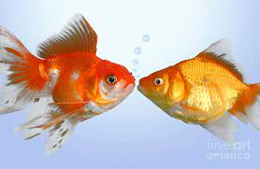
Using Partners
Consider:
Structure partners: Number 1 or 2.
Use triads when appropriate.
For secondary: Prepare a seating chart indicating names, partners, and numbers.
Teach students how to work together.
Change partnerships every few weeks.
istock/Gregory_DUBUS
Notes:
When students teach each other (e.g., peer explaining, peer checking, peer assessing), help each other, give each other feedback, the research indicates an effect size that it influences student performance (peer tutoring: .55, cooperative learning vs individual learning: .59).
How can partnering and peer learning happen in the classroom? As we look at the slide, we can see there are a variety of ways that we can use partners.
The use of partners connects to the 5C’s - communication and collaboration.
There is a resource in your materials, the Active Participation Reference Sheet that provides examples of ways you can use partners.

Slide 11
Breaking up the Lecture
The Pause Procedure
Liven up the Powerpoint
Stop talking after 12 minutes!
Ask students to process, by discussion in pairs, rewriting notes, or sharing experiences. (remote pairing if necessary)
Result: Significantly higher retention rates
Insert a processing slide after a certain number of content slides. Allow students time to work on a formative assessment question (remote pairing, if necessary).
Notes:
These strategies may increase buy-in from teachers of older students, teachers reluctant to alter their lesson plans, or teachers seeking “different" ideas for older students. The Pause Procedure encourages engagement during a content instructional block.
When using a presentation, how might we liven it up? These are suggestions for how you can engage students during a Power Point presentation.

Slide 12
Opportunities to respond and long-term memory
Third graders read an article about the sun.
Which scenario brings about the most learning and why?
Option 1:
The next day, students answer questions about the sun. The following procedure is followed: 1) a question is presented on the screen, 2) students think about the answer 3) students share with their partners, 4) individuals share out, and 5) the teacher provides feedback.
Option 2:
The next day, students reread the article, highlighting important information within the passage. Using their highlighting, students make a list of the important points about the sun and compare their lists to those of their partners.
Notes:
Working to remember a piece information is an excellent way to ensure that the information goes into long term memory. So using recall, students learn more. You may have heard of this with retrieval practice or spaced vs massed practice.
Ask: Read these two examples and select the one that you believe would bring about more learning (Virtual presentation: ask participants to annotate their slide).
Answer: Number 1 because it requires students to recall information from the previous day. And, they talk about it with their peers and the teacher provides feedback.

Slide 13
Raising Hands
Dylan Wiliam said,
“If you’re allowing children to volunteer whether to participate or not in your classroom, quite simply, you’re making the achievement gap bigger.”
Notes:
Video: View clip from 2:08-3:25.
What about raising hands? Many teachers use this form of responding most often in their classroom. In this clip, Wiliam has observed classrooms for several days. He wants to encourage the teachers to use an all student response system. He introduces them to a strategy to increase student responses during instruction. As you view the video clip, what is the strategy he would like teachers to implement?
Discuss the video. What other strategies could the teachers use?
What does this statement mean to you as an educator, a team member, and/or a leader?

Slide 14
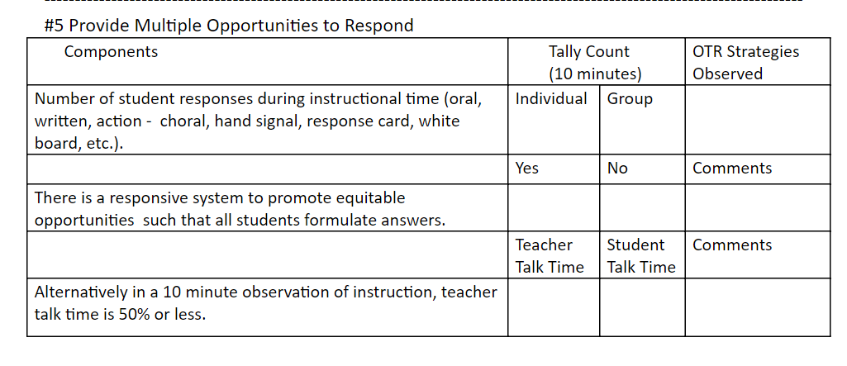
Data Collection:
Opportunities to Respond
Notes:
Once again, how do we know if what we are doing is working? We need to collect data. Here is the data collection tool to that helps us to know if we are using the for opportunities to respond and scaffolding. The data collection tools can be used in a variety of ways: partners observing each other, self-reflection, classroom walk throughs, etc.

Slide 15
Let’s Review
Opportunities to respond provide corrective feedback to teachers.
Opportunities to respond help students to remain inattentive and off task.
Teacher talk time should be no more than 40-50% of instructional time.
Notes:
Face-to-face: Thumbs up for TRUE, thumbs down for FALSE.
Virtual: Annotate tools for TRUE (star, check, heart) and FALSE (X)
True
False
True

Slide 16
Take 5
What opportunities to respond do you see used in your school?
How can you encourage the use of and the variety of opportunities to respond in your school?
Notes:
Breakout:

Slide 17
Formative Assessment…
is a process used by students and teachers during instruction to elicit and use evidence to improve understanding of intended learning outcomes and support students to become more self-directed learners.
Source: Virginia Department of Education
Notes:
Our next practice is formative assessment. We have all known that formative assessment is a practice used by teachers to understand their students level of understanding of the material.
What is important in this definition of formative assessment, which was recently used in a VDOE document, is it adds the student into the process of evaluating their own understanding. This statement reflects our growing understanding of the importance of helping students become “self-directed learners”.

Slide 18
Learning Intentions: Formative Assessment
Understand how opportunities to respond create a more equitable classroom and improve student achievement
Understand the five formative assessment strategies
Describe scaffolding strategies that support student achievement
Notes:
We are ready to examine our second learning intention about formative assessment.

Slide 19
Success Criteria: Formative Assessment
Explain the five formative assessment strategies
Notes:
Here are the success criteria that we hope you will achieve after completing this module. The highlighted success criteria is the one we hope you will achieve after learning about opportunities to respond.

Slide 20
Five Strategies of
Formative Assessment
Clarify, share, and understand learning intentions and success criteria
Find out what students have learned
Provide feedback that moves learning forward
Activate students as instructional resources for one another
Activate students as owners of their own learning
Notes:
Dylan Wiliam has explained the concept of formative assessment using these five strategies.
Student achievement is best achieved by paying attention to all of these strategies.

Slide 21
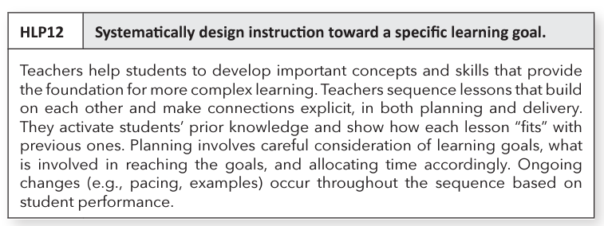
HLP 12

Slide 22
Strategy #1: Clarify, share, and understand learning intentions and success criteria
Notes:
Let’s start with the first strategy: clarify, share, and understand learning intentions and success criteria. Doug Fisher and John Almarode are going to share their thoughts. As you listen, I would like you to think about why it is important for teachers to have learning intentions and success criteria for their lessons.
View video: 4:00 min -7:00 min section: https://www.youtube.com/watch?v=pqAHh3pZ57M&t=413s
Respond in Chat Box/Face-to-face: Why is it important for teachers to have learning intentions and success criteria for their lessons?
Teacher clarity has a .75 effect size based upon Hattie’s review of the studies. It is when teachers have clarity about what students will know and be able to do. When teachers are clear, it can speed up the rate of student learning.

Slide 23
Teacher Clarity: Learning intentions and success criteria
Students should be able to answer…
Teacher format
for success criteria
What am I learning today?
Why am I learning this?
How will I know that I have learned it?
Checklists
Rubrics
“I can…” statements
Exemplars
Modeling and demonstrating
Negotiation
Other?
Notes:
Learning intentions are introduced at the beginning of a lesson and should be referred to throughout the lesson. During instruction, it is important that students know what they are expected to learn from each task they are asked to do.
Success criteria help students know what it means to have learned something. They answer these three questions: What am I learning today? Why am learning it? How do I know I have learned it?
If we want students to understand what they are meant to be learning and why, what formats can teachers use? Teachers might use “I can” statements, rubrics, checklists, exemplars, and modeling to show students what success looks like. Also, teachers can save quality products from previous classes, say, several completed projects, and then share these examples with students as they work on a similar task.
Negotiations are when a teacher and students co-construct a rubric, say, so that students have some opportunity to react to the expectations.

Slide 24
Strategy #2: Eliciting evidence of learners’ achievement
Just Say No to Calling on Volunteers
Response Systems
Choral response (with think time and clear signal)
White boards
Popsicle sticks
Partners
Discussion groups
Exit tickets
Notes:
Dig deeper into number 2
An example seen so frequently uses both whole group and individual.
Remember that by calling on raised hands only doesn't really inform us of much.
Anita Archer tells us that two things she would like all teachers to do is to stop calling on raised hands and stop calling on inattentive students as a means of calling them out.
If questioning is used, think about ways for all students to respond, and be sure to allow wait time or ways to reframe the question so that it leads to discussion and not just a “right or wrong” answer.
Reflect on how this is an equity issue; who are the students most apt to participate?
Move to talking about ALL the other ways we can gather information...

Slide 25
Strategy #3: Provide feedback that moves learning forward
Feedback is most effective when:
The relationship between the teacher and student needs to be a positive one.
The teacher needs to be seen as credible in the eyes of the student.
The climate of the classroom needs to be such that errors are not viewed with shame, but as part of the learning process.
The Distance Learning Playbook p. 151
Notes:
Before we delve deeper into the third strategy, Provide feedback that moves learning forward, we want to highlight the socioemotional links to feedback.
Without trust, feedback, no matter how well delivered, won’t be accepted. John Almarode says in Clarity for Learning, “Feedback is about the task and not the individual completing the task. My solution to the mathematics problem is wrong, but I am not a wrong person.” (p.133)
Ask the group: In your classroom or school, how do you create a climate of mistakes as a natural part of the learning process? Participants share.

Slide 26
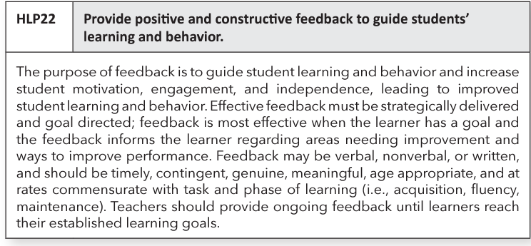
HLP 22

Slide 27
Effective Classroom Feedback:
Focused and Specific
Feedback should be focused.
Notes:
The second principle of effective classroom feedback is feedback should be focused.
Less is more when it comes to feedback. Being specific helps the students and helps you. For example, on a writing assignment, select only one or two elements of the rubric for which to provide feedback on an assignment.

Slide 28
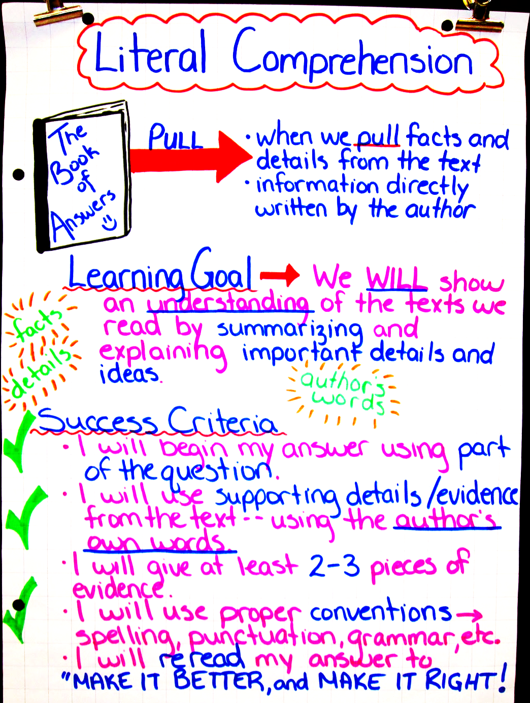
Effective Classroom Feedback: Related to Learning Goals
Feedback should relate to the learning goals that have been shared with students.
Notes:
The final effective classroom feedback principle is feedback should relate to the learning goals that have been shared with students.
This principle reinforces the first formative assessment strategy: clarify, share, and understand learning intentions and success criteria.
The purpose of feedback is to progressively close the gap between present and desired performance. If there are learning intentions and success criteria for the work, then the feedback should loop to them. Knowing what success looks like allows students to work toward their learning goals.

Slide 29
Take a minute….
What formats do teachers use to explain success criteria to students?
Discuss where in your building do you see examples of feedback that moves learning forward (yourself and others).
Notes:
Breakout:

Slide 30
Strategy #4. Having students help each other learn
Cooperative learning with a group goal and individual accountability
Discussion
Partner work
Collaboration
Peer tutoring
Turn and talk
Important: Students need to be taught
how to collaborate
Notes:
Doesn’t this remind you of the 5 C’s? Here is an important connection and reminder - formative assessment isn’t something that has to be separate - if we are using student engagement, if we are having them collaborate and communicate and be creative in a team, then we are formatively assessing as we guide them in this work. Remember the definition - the students assess their own learning when they work in a team. But it also brings us back to the current realities - how do we do this now.
having the high school teacher do the pause procedure in the powerpoint as an example
fly in- you can’t really separate out how the five Cs are working together with engaging instruction and student collaboration and how that fosters language and critical thinking and allowing students to be more creative in their cooperative work - they are all interconnected. Here is another resource for you with related activities.

Slide 31
Peer Critiques
Peer critiques video
Notes:
Video: https://players.brightcove.net/268012963001/rJenILPQx_default/index.html?videoId=5518311215001
Should we do another surprise party of how this relates to 5 Cs
Consider video of structure peer review
Let them know that they can search for the video Austin’s Butterfly on YouTube

Slide 32
Strategy #5: Activate students as owners of their own learning
Self-regulated Learning
Share learning goals
Promote the belief that learning is incremental
Decrease comparisons with others
Provide feedback that moves them forward
Transfer control of the learning from teacher to student
Notes:
The final formative assessment strategy is activate students as owners of their own learning.
Dylan Wiliam says that “assessment can improve instruction, but it can also impact the learner’s willingness, desire or capacity to learn (p. 151).” How can we get students more involved in their own learning? We can create learning environments that encourage students to activate their growth and use the suggestions on the slide.

Slide 33
How to support students to become owners of their learning
Individual Tracking
Individual Understanding
Graphs
Stars on rubrics (video)
Project checklists
What did we learn today?
Learning logs
“Personal best” selections
Notes:
Here are ways to support students to become owners of their learning. (Review the slide)
Graphs: students graph their progress in an individual graph; it can be motivating for students
Stars on rubrics: we will watch an example of this in a video we will view in minute
Project checklists: students check off the tasks on a project checklist as they are completed.
Red/Green disks or cups: students have red and green cups or disks are a communication tool for students to indicate if they need the teacher to slow down or answer a question (red) or if they are doing well with the pace of instruction.
What did we learn today? students respond to the question via an exit ticket, sharing with a peer, etc.
Learning logs: students record what they are learning in a subject area/class/course
“Personal best” selections: students choose a product/assignment that they feel represents their best work
Chat Box/Face-to-face: Are there ways that you have seen teachers support students to become owners of their learning, in a remote learning environment or face-to-face?

Slide 34
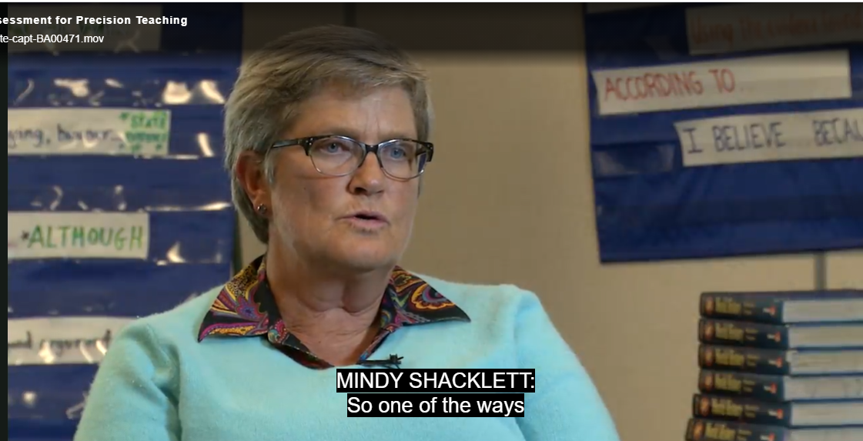
Student self monitoring
Mindy 3:58-7:15
Notes:
Ask participants to think about this question as view the video: How is Mindy’s use of the rubric and stars supporting students and monitoring their learning?
Video Mindy starts at 3:58-7:15. http://players.brightcove.net/268012963001/default_default/index.html?videoId=5117777016001
Discuss video with participants (e.g., her use of the stars for students to monitor their learning, how students feel about the stars on the rubric etc.).

Slide 35
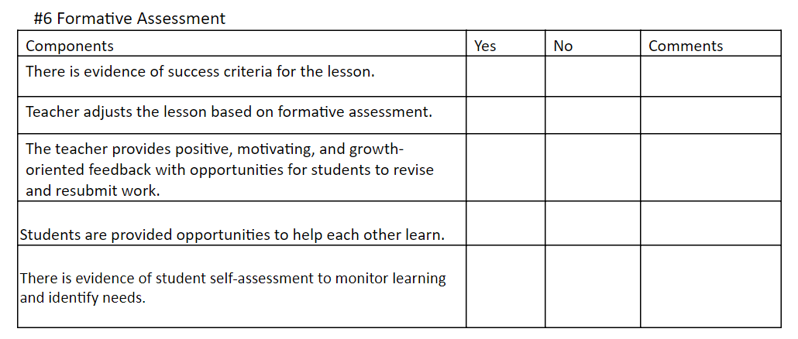
Data Collection:
Formative Assessment
Notes:
Once again, how do we know if what we are doing is working? We need to collect data. Here is the data collection tool to that helps us to know if we are using the five formative assessment strategies.

Slide 36
5 Strategies for Formative Assessment
Clarify, share, and understand learning intentions and success criteria
Find out what students have learned
Provide feedback that moves learning forward
Activate students as instructional resources for one another
Activate students as owners of their own learning
Notes:
Dylan Wiliam has explained the concept of formative assessment using these five strategies.
Student achievement is best achieved by paying attention to all of these strategies.

Slide 37
Time to Talk
How can you support students to be able to support each other in their learning?
How can you assist students with developing ownership of their learning?
Notes:
Breakout:

Slide 38
DAY 2
Effective Classroom Systems
Module C

Slide 39
Scaffolding
“When scaffolding, teachers typically provide high levels of initial guidance and then systematically reduce support as students respond with greater accuracy.”
Source: Archer, A. & Hughes, C. Explicit Instruction, p. 10
Notes:
These strategies can be used whole group, with students and teachers, fading use as needed.
Instructional scaffolding is a process where the teacher adds supports for students in order to enhance learning and aid in the mastery of tasks. The teacher does this by building on students' experiences and knowledge as they are learning new skills. It is like the scaffold on a building. The building’s scaffold is temporary and adjustable. As students master the assigned tasks, the supports are gradually removed.

Slide 40
Learning Intentions: Scaffolding
Understand how opportunities to respond create a more equitable classroom and improve student achievement
Understand the five formative assessment strategies
Describe scaffolding strategies that support student achievement
Notes:
We are ready to examine our second learning intention about formative assessment.

Slide 41
Success Criteria: Scaffolding
Name scaffolding strategies that support student performance
Notes:
Here are the success criteria that we hope you will achieve after completing this module. The highlighted success criteria is the one we hope you will achieve after learning about opportunities to respond.

Slide 42
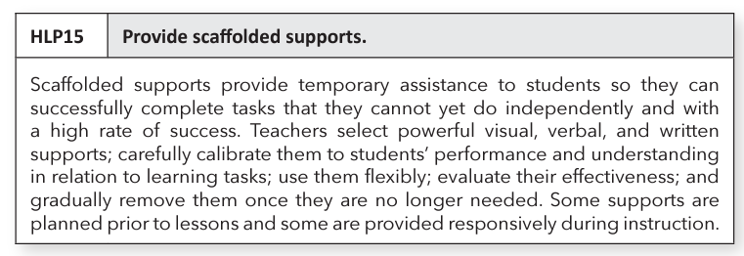
HLP 15

Slide 43
Scaffolding Promotes Academic Success
Goal
This is where the scaffolding comes in for students who need more support to
reach that goal.
Current Level
Notes:
The visual on the slide helps us understand where scaffolding occurs and how to use it.
We want all of our students to reach a high level of achievement. Not all are ready to do that on their own. The scaffolding is applied to assist them with reaching those goals. What are some of the reasons, that you see with your students, that they would need scaffolding?
,

Slide 44
Strategies for Scaffolding
Partnering
Chunking
Sequencing/Progress in Complexity
Demonstrations and completed models
Provide hints and prompts
Provide aids such as cue cards and checklists
Notes:
Refer to the handout in their materials and workbook pages 49-57.
The different strategies for scaffolding are:
Partnering: Pages 49-52 in the workbook. Once again, how can peers be used to support each other.
Chunking: Breaking up information into small, digestible bites and/or grouping pieces of information. Chunking supports comprehension and retention of information.
Sequencing/Progress in complexity: Move from simple asks to complex tasks. You can think of it in terms of skill development. Such as what coaches do when training athletes. Like in baseball, players build their skills through batting practice, fielding practice, strength training, sliding, etc. They need to learn all of these skills in order to hit the ball, hit a homerun.
Demonstrations and completed models: Provide demonstrations and completed models. Students can use the models to process the content and to assist with their own skill development.
Provide hints and prompts: Visual (guide thinking or understanding), verbal (say things to bring attention for students), gestural (hand movements to indicate a student is missing something or has it correct) and environmental (use classroom surroundings to support student understanding; anchor charts, manipulatives). Pages 55-56 on your workbook provide examples.
Provide aids such as cue cards and checklists: Use one for a project, for math problem solving, for writing

Slide 45
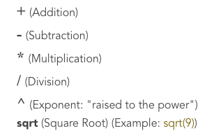
Demonstrations and Completed Models
Which one?
Demonstrations and completed models
Provide hints and prompts
Notes:
If you think it is 1, turn your camera on (virtual setting) or hold up one finger. If it is 2, keep it off (virtual) or hold up two fingers.
Answer: 1

Slide 46
Cue Cards and Checklists
Which one?
1. Chunking
2. Provide aids such as cue cards and checklists
Notes:
If you think it is 1, use the heart or star annotate stamp (virtual) or stand up. If it is 2, use the check stamp (virtual) or sit down.
Answer: 2

Slide 47
Sequencing/Progressing in complexity
Mr. Juarez’s students are expected to be able to complete a challenging math problem.
He separates the problem into several parts and uses mini lessons to teach them in order.
After each mini-lesson, Mr. Juarez checks to ensure the students understood the concept. He gives them time to practice the problems and explains how the math skills they are learning will help them to solve the more challenging math problem.
Which one?
1.Sequencing/
Progressing in complexity
2. Partnering
Notes:
To achieve the goals of this lesson, Mr. Juarez decides to break up the lesson into a series of mini-lessons that progressively move students toward stronger understanding.
If you think it is 1, use the thumbs up reaction button (virtual) or thumbs up. If you think it is 2, use the heart reaction (virtual) or thumbs down.
Answer: 1

Slide 48
Chunking
Example: Break down the social studies text to write a summary.
Purpose
Which one?
1. Provide hints
and prompts
2. Chunking
Key Events
Key Players
Setting
Enduring Understanding
Notes:
When the teacher and students break down a text into sections or parts, they are……
Virtual: Chat Box: Waterfall response; Face-to-face: Choral response: say the number
Answer: 2

Slide 49
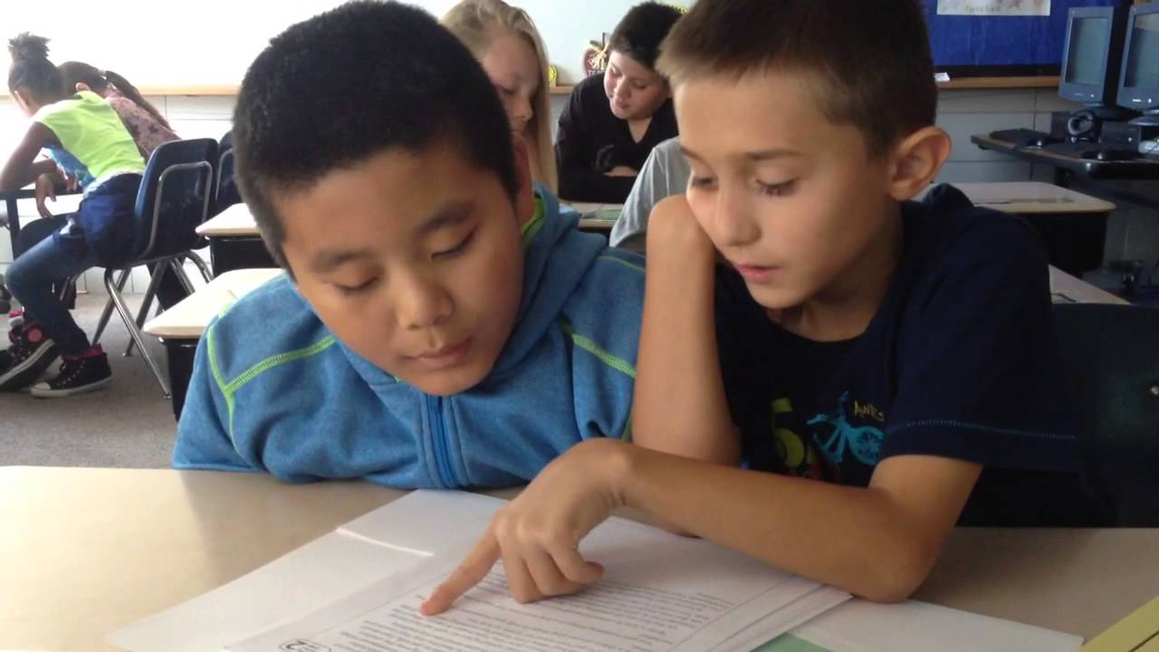
Partnering
Which one?
1.Partnering
2.Demonstrations
and completed
models
Students read to each other everyday.
Image source: PALS Partner Reading
Notes:
Partnering or Demonstrations and completed models? Virtual: Camera on for #1, camera off for #2; Face-to-face: show 1 finger for #1 and two fingers for #2.
Research has shown that students who spent two weeks reading to each other every day improved in their fluency, correct words read per minute. All students benefit from partnering to read to each other; everyone’s fluency improves.

Slide 50
Provide hints and prompts
Math:
What information do you have?
Review the worked example on page 47.
Recheck your thinking here (point to the problem on the page).
Which one?
Provide hints and prompts
Provide aids such as checklists and cue cards
Notes:
These are questions to guide students to use what they already know or have access to to move forward. These are ……….
Virtual: Waterfall Chat response; Face-to-face: Stand up for #1, sit down for #2.
Answer: 1
The big idea behind prompts and cues is that it’s a reminder to the student of what he already knows.

Slide 51
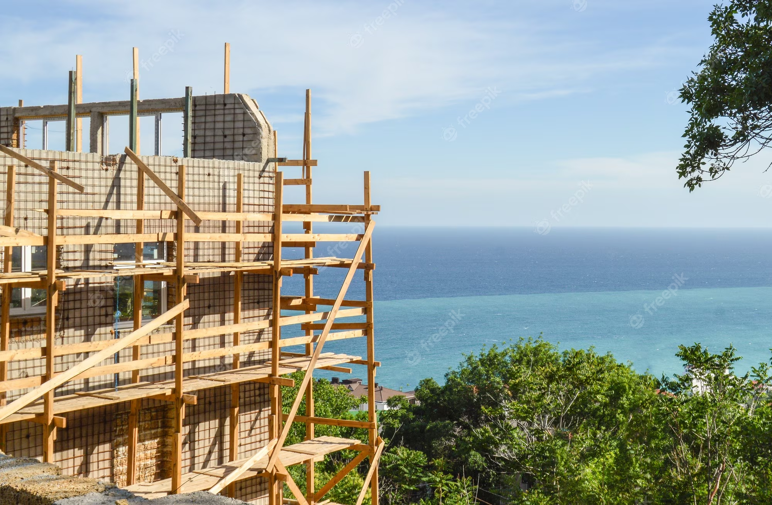
Stages of Scaffolding
I do it (modeling)
We do it (prompting)
You do it(fading)
Notes:
And another way to look at the scaffolding process.
Does this look familiar? We shared this process in Module B with teaching expectations to students.

Slide 52
Data Collection:
Scaffolding

