Slide 1
Surf, Sand, Sun, and Systems that Work for Your Classroom!
VTSS Effective Classroom Systems
July 2024

Slide 2
A Message of Gratitude

Slide 3
Summer Surprise!

Slide 4
Why are we here?
Apply implementation of the ten VTSS practices to their context, including a demonstrated understanding of common errors in consistency of use.
Develop a plan for the data collection, professional learning, and coaching needed at the school and division level in order to promote the use of effective classroom practices.
Assist others in their understanding of the connection of these foundational practices to impartial classroom systems to promote high achievement for all learners.

Slide 5
Setting Our Intentions
Practice presence
Grasp opportunity
Embrace quick wins and bold next steps

Slide 6
Our Wish for You
Take care of your needs
Use this time to connect and plan
Wonder and “What if”
Practice the approach of “Yes, and…”

Slide 7
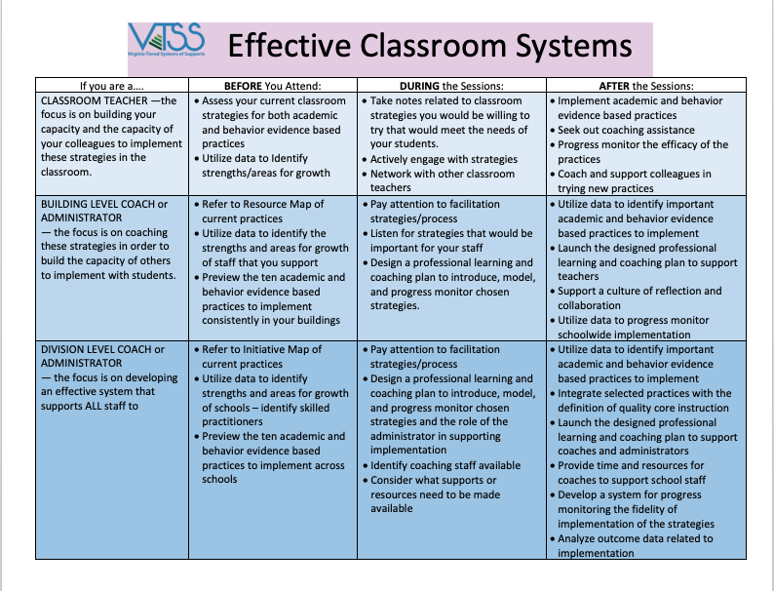
Your Role
Materials: https://vtss-ric.vcu.edu/implementers/effective-classroom-systems/
Notes:
Materials link in Chat
Everyone comes with a different role. Find page and read across about your job

Slide 8
Making It Stick
Creating a SYSTEM for
Implementing High Leverage Practices

Slide 9
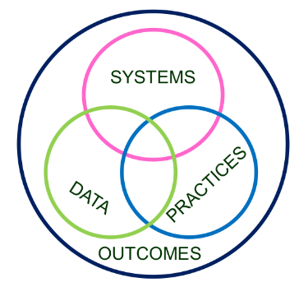
From Practices to Systems
Invest in Systems!!! (Leadership teams, support professional learning and coaching)
Differentiate and ensure outcomes are reflective of all students
Data informs decisions about screening, progress monitoring, fidelity, and outcomes
Prioritize efficient and effective practices
(evidence, culture, context)
Growth & benefit are central. Must reflect learning opportunities for all
‹#›
Notes:
dents in our division and school what
will help them be successful and reach the outcomes we want for them. Once practices are determined we support the staff who will implement those
practices by providing them with professional learning that may be needed and with the proper resources. As we do this work we continuously monitor
the student progress and evaluate to determine if what we have decided is working.

Slide 10
The Five C’s

Slide 11
Building Community
Acknowledges students for performing a desired behavior that serves the group functioning
Saves time and resources by designing a program for an entire classroom rather than individual students, and
Encourages positive social interactions between peers
(Murphy et. al, 2007)

Slide 12
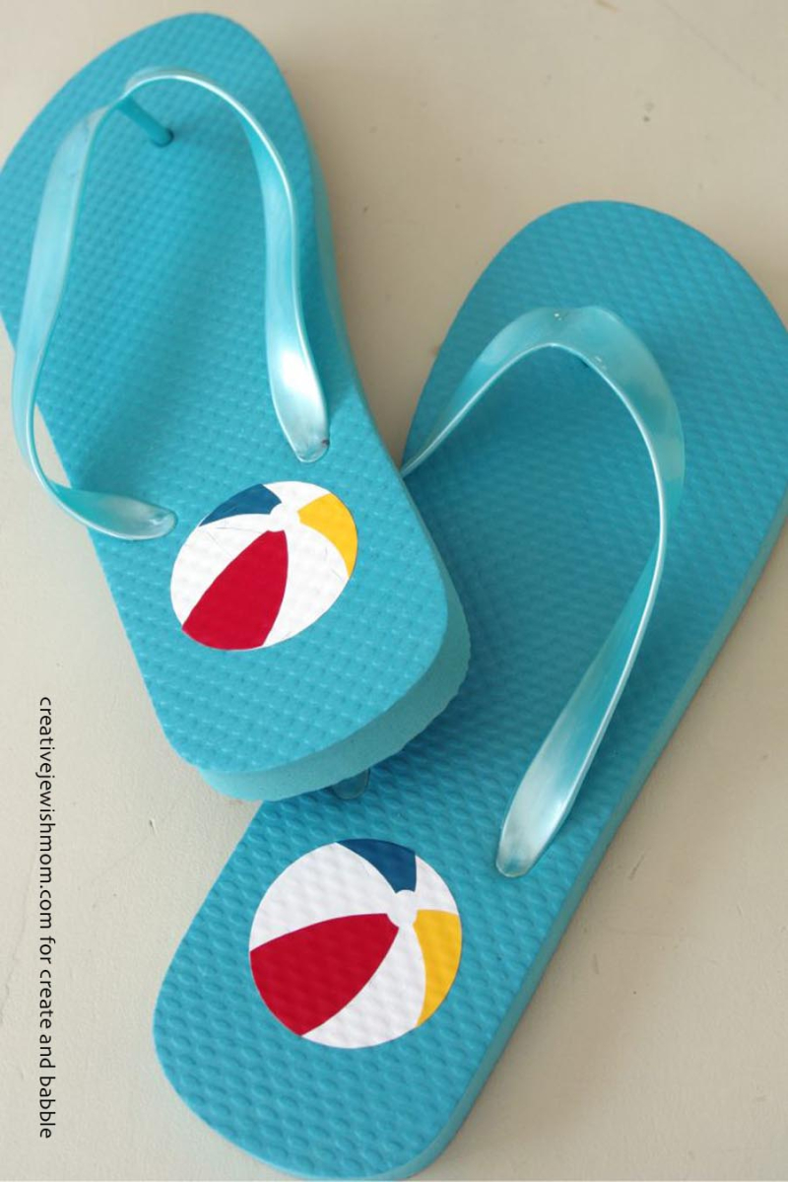
Our Walk on the Beach
Module A: The Set-Up for Success
1. Arranging the Physical Environment
2. Active Supervision
Module B: Responding to the Matrix
3. Classroom Expectations
4. Routines and Procedures
Module C: The Engaged and Successful Student
5. Opportunities to Respond
6. Formative Assessment
7. Scaffolding
Module D: The Power of Feedback
8. Feedback: Acknowledgement and Behavior Specific Praise
9. Feedback: Error Correction
10. Feedback: Building Community Through Feedback

Slide 13
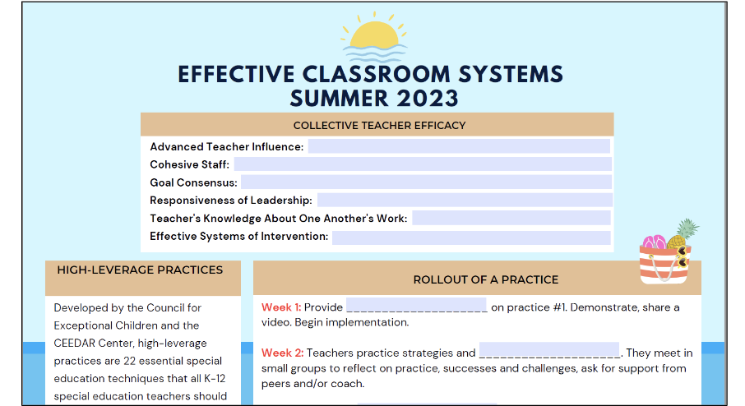

Slide 14
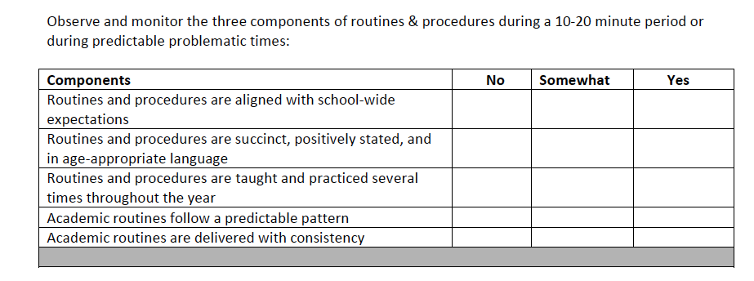
Data Collection

Slide 15
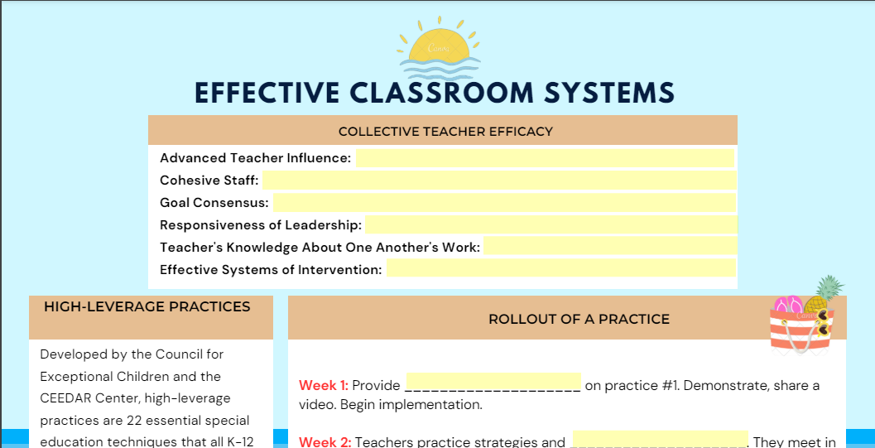
Walk with Us: Notetaker
Materials: Check the table tent.

Slide 16
Module A:
The Set-Up for Success
Physical Environment
Active Supervision

Slide 17
Learning Intentions
Participants will be able to make intentional decisions about optimal placement of furniture and materials in the instructional space.
Participants will be able to identify the key elements of active supervision in the classroom.
Participants will be prepared to coach others in both arrangement of the physical environment and active supervision.

Slide 18
Arrangement of Physical Environment
The creation of a safe and functional
classroom space

Slide 19
Rationale
Creates efficient work-flow
Increases on-task behavior
Minimizes distractions and congestion
Reduces potential problem behavior
Promotes explicit instruction
Promotes accessibility for all students
Creates a pleasant organized environment
Promotes engagement for all students
Reduces problem behavior by enhancing opportunities for students to follow the academic and behavioral expectations

Slide 20
Classroom Contexts
Physical
Context
Social
Context
Cultural
Context
Temporal
Context

Slide 21
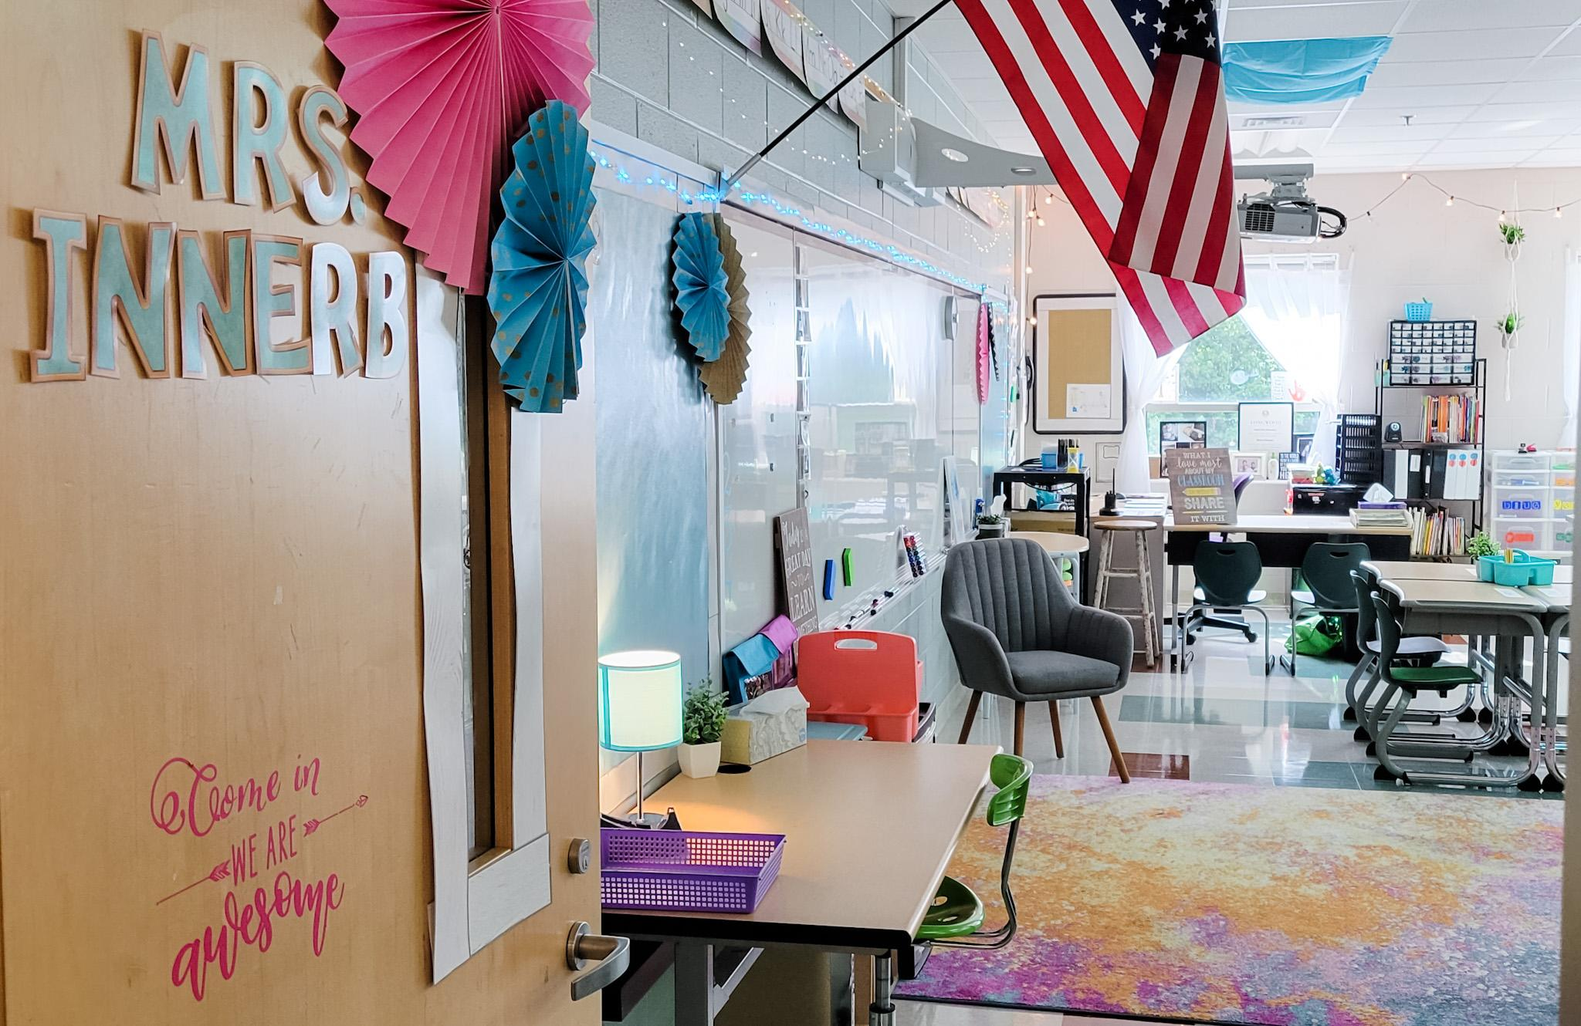
limit overhead lighting to key zones
quiet legged chairs
lamps and ambient lighting
soft surfaces

Slide 22
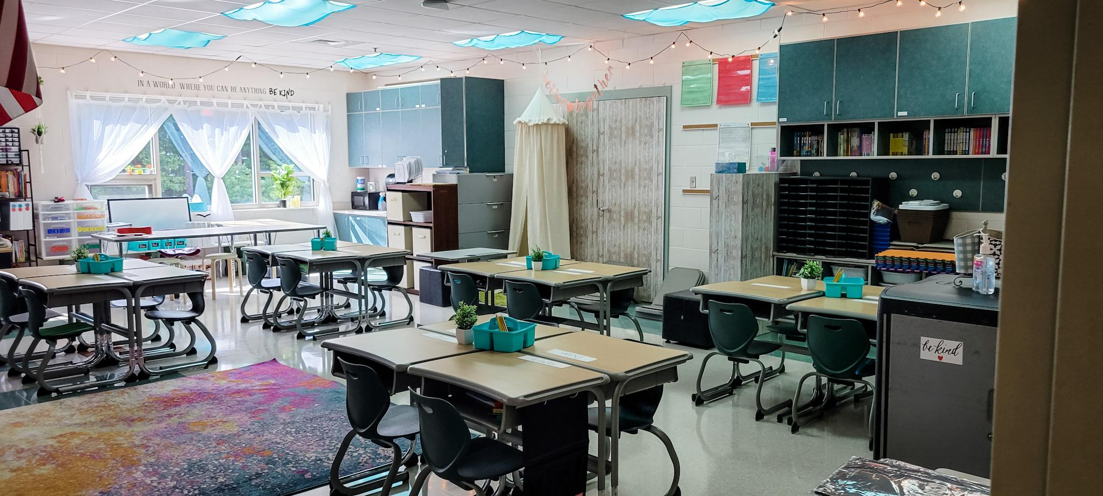
curtains that can be pulled for diffusing bright light
fluorescent light diffusers
ambient lighting
small group station
graphic labels

Slide 23
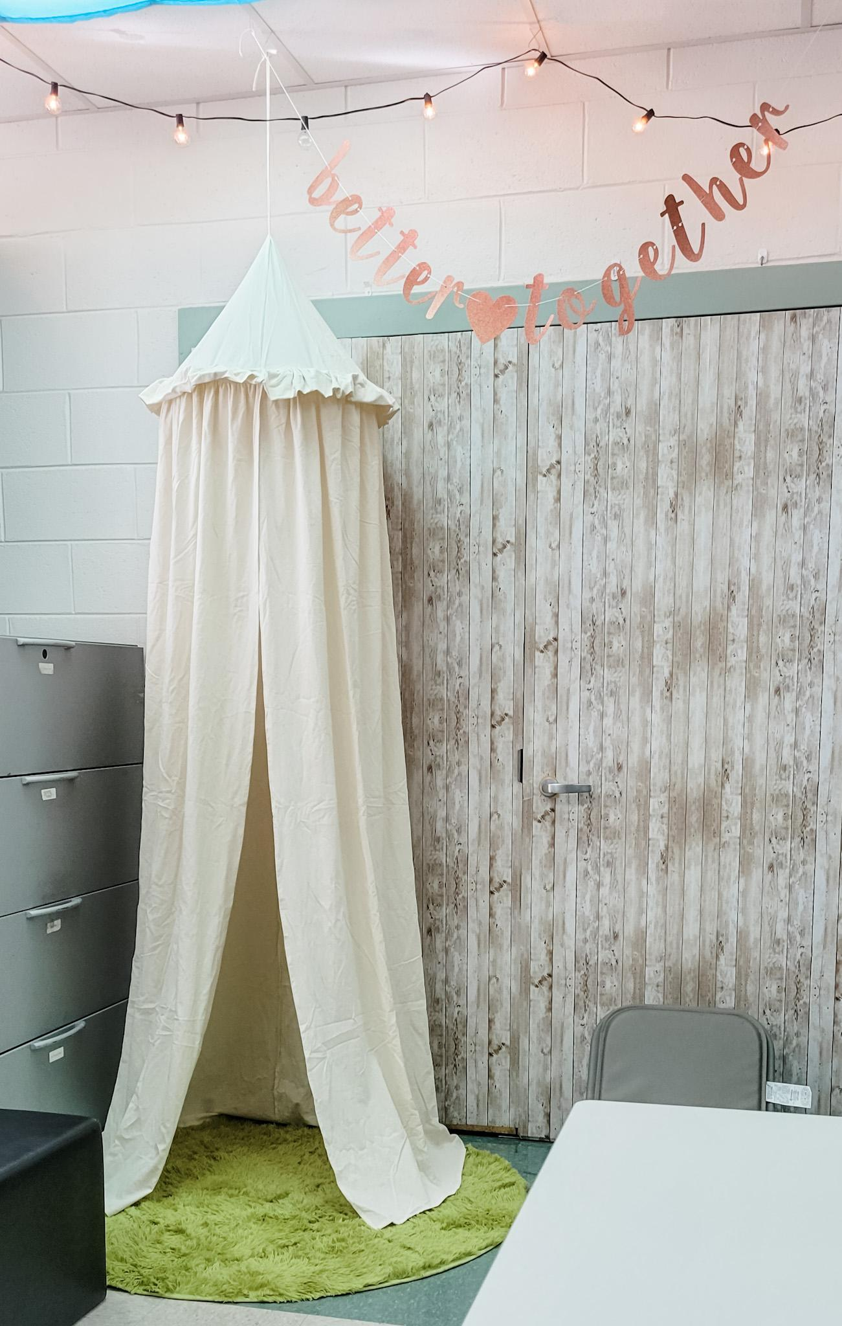
ambient lighting
minimal wall decor
soft surfaces
calming station

Slide 24
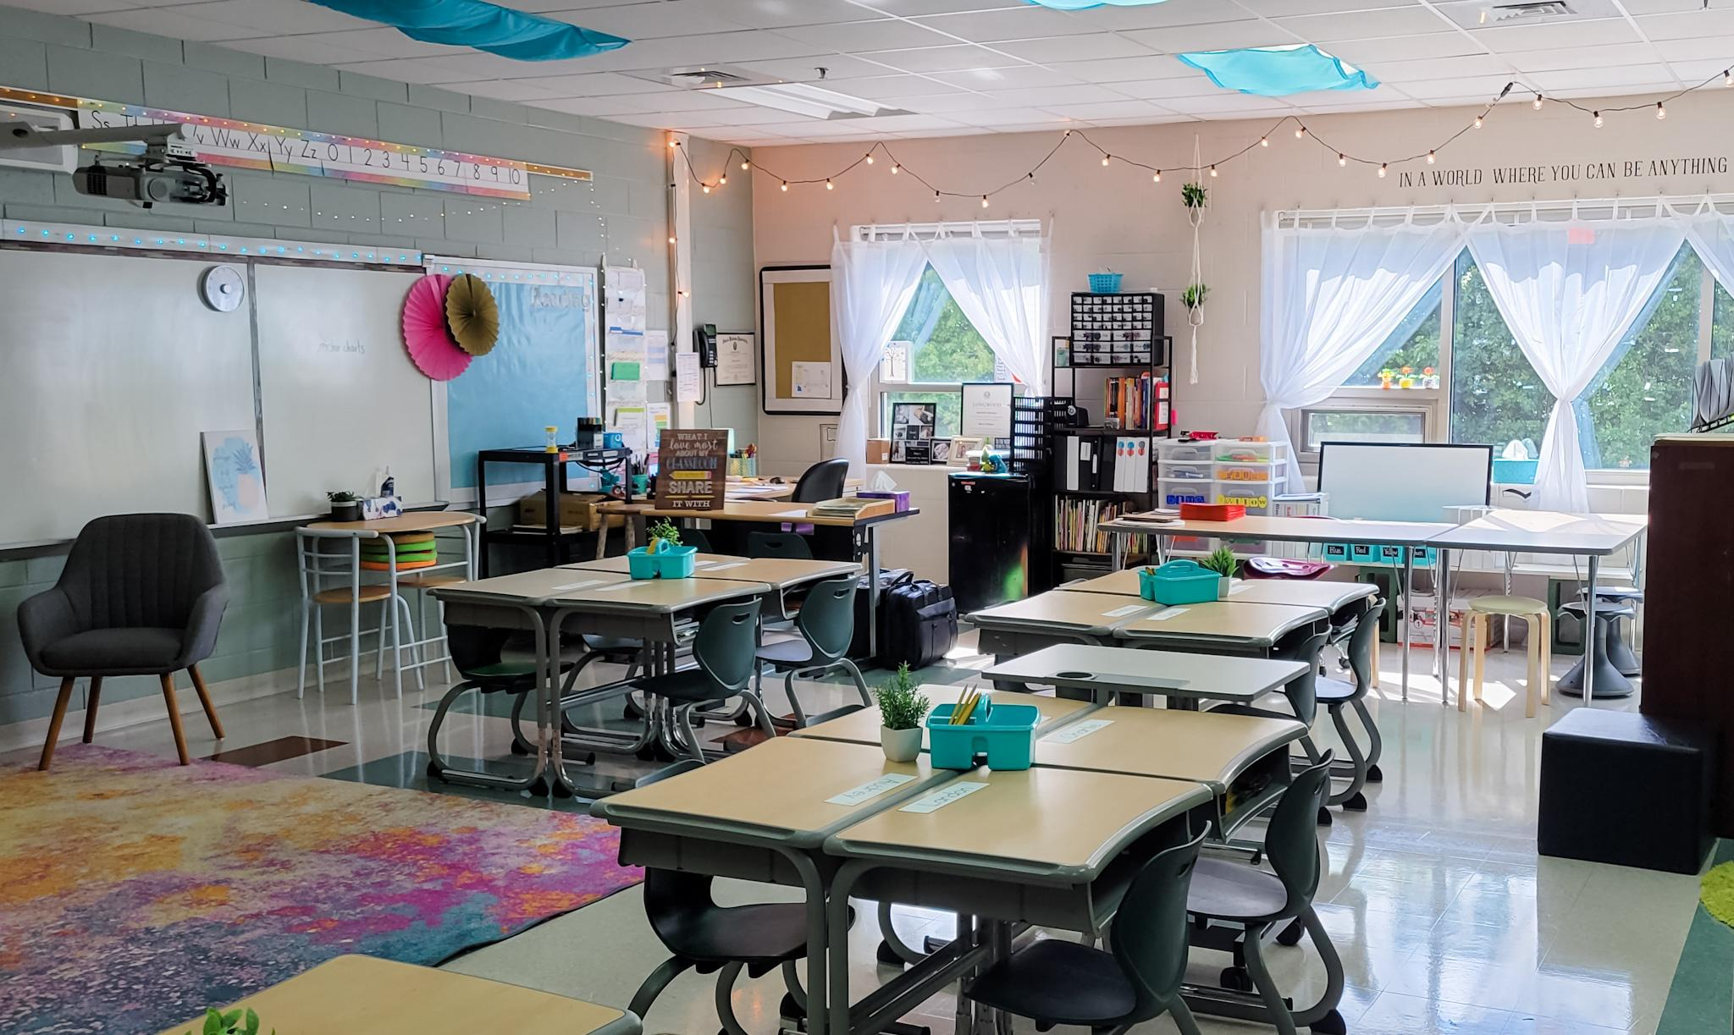
fluorescent light diffusers
central supplies
flexible seating
green plants

Slide 25
Classroom Arrangement
Matrix/Traditional Arrangement
Circular Arrangement
Allows teacher to easily circulate
Helpful for students with academic or behavioral difficulty
Helpful during independent learning time
Facilitates student discussion
Increases student-initiated questions
Frequency increases the closer students are seated to the center

Slide 26
Organization of the Space to Promote Successful Instruction
Teacher proximity and access to students
Students facing teacher during instruction
Students can easily share answers with a partner
Traffic flow is easy to follow
Materials are easily accessible “Avoid the void, for they will fill it!”

Slide 27
Wall postings
support instruction
Word walls
Strategy posters
Rubrics
Content/Reference information (maps, strong word for writing)
Expectations for behavior (linked to the matrix)
Notices (menu)
Student work (“Personal Best” display)

Slide 28
Accessibility
Is the classroom universally designed? (all individuals have access) or designed for the hegemonic student (the most prominent/dominant student)
Is the technology accessible to all?
Do you need assistive technology to provide access for some?
Are there barriers that will create any issues for a student regardless of disability?
Is the class and presentation visually accessible to all students?
Is there a culture in place for students to seek assistance? Does the instructor seek feedback?
Is the classroom designed for flexibility and choice?

Slide 30
One More Example

Slide 31
Data and Evaluation
Utilizing the worksheet “Evaluating the Physical Organization of the Classroom: Setting the Stage. “ How you might use this to collect data on classroom organization?

Slide 32
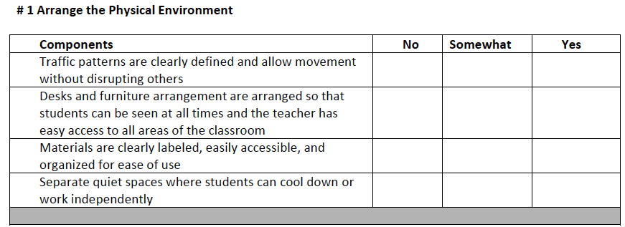
For schoolwide data…

Slide 33
Active
Supervision
Moving, Scanning, Interacting

Slide 34
Active Supervision
…a process for monitoring the classroom, or any school setting, that incorporates moving, scanning, and interacting frequently with students.

Slide 35
Rationale
Allows for immediate feedback and assistance to students
Increases student engagement
Reduces inappropriate behavior; increases academically engaged time on task
Provides opportunities to monitor students’ responses (formative assessment)
Frequent use of encouragement
Timely correction of errors
Builds positive relationships

Slide 36
Anita Archer
“You teach on your feet,
and not from your seat.”
“Walk around, look around,
talk around.”

Slide 37
Where do you see an impact?
Notes:
Utilizing Proximity to Manage Classroom Discipline and Behavior - 3:39 min.

Slide 38
Components of Active Supervision
Moving: (Walk Around) Continuous, random teacher movement throughout all parts of classroom
Interacting: (Talk Around) Frequent and positive communication to encourage, reinforce, and correct
Scanning: (Look Around) Frequent and intentional visual sweep of all parts of classroom

Slide 39
Moving “Walk Around”
Circulate among students while working
Maintain proximity with students
Demonstrate interest in students:
assist with learning tasks,
provide positive and corrective feedback
Periodically move /supervise when providing individual/small group instruction

Slide 40
Playground or Common Area Strategy
Divide the playground area or common area into a grid with as many sections as you have adult staff at any one time. Assign staff to supervise one area.
While monitoring students on the playground or common area, move around, interact with students, and observe behaviors of individuals and the group. Scan the entire area as you move around all corners of the area.

Slide 41
Interacting “Talk Around”
While moving and scanning, you should also frequently interact with students.
Communicates care, trust, and respect
Creates positive climate and increases likelihood of accepting correction if needed
Includes proximity, listening, eye contact, smiles, pleasant voice tone, and use of student’s name

Slide 42
Scanning “Look Around”
Frequently and intentionally look around at students
Make eye contact with students for affirmation
Visually sweep all areas of the room as well as look directly at students nearest you
If working with individuals, position self to scan entire room, or get up and scan occasionally
With some students, use personal cues as reminders

Slide 43
Non-Examples of All Three
Sitting or standing where you cannot see the entire room/space,
back to the group
behind your desk
Walking the same, predictable route during entire class period
Stopping and talking with a student(s) for long periods of time
Interacting with the same student(s)
Lesson plans dominated by teacher directed lectures

Slide 44
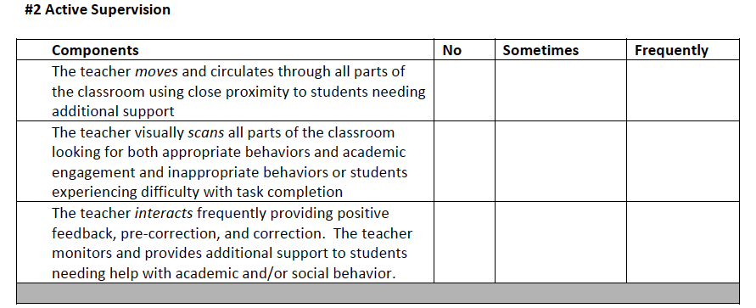
Data Collection Form: Active Supervision

Slide 45
Why are we here?
Apply implementation of the ten VTSS practices to their context, including a demonstrated understanding of common errors in consistency of use.
Develop a plan for the data collection, professional learning, and coaching needed at the school and division level in order to promote the use of effective classroom practices.
Assist others in their understanding of the connection of these foundational practices to impartial classroom systems to promote high achievement for all learners.

Slide 46
Making It Stick
Creating a SYSTEM for
Implementing Coaching

Slide 47
Critical to Systems Success

Slide 48
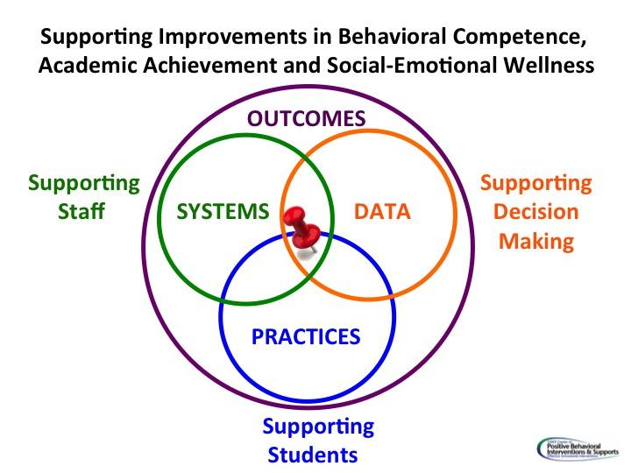
Rollout of a Practice: Example
Week 1: Provide professional learning on practice 1. Demonstrate, share a video. Begin implementation.
Week 2: Teachers practice strategies and self assess. They meet in small groups to reflect on practice, successes and challenges, ask for support from peers and/or coach.

Slide 49
Rollout Continued
Week 3: Teachers collect data on fluency with the practice (teachers may record themselves) or ask for a peer or coach observation with feedback. They discuss in small group the best places to incorporate the practice in a lesson and rewrite the lesson plans.
Week 4: Meet again as a large group to share data and experiences with practice 1. Provide professional learning on practice 2. Continue…

Slide 50
Next Steps

Slide 51
“Activate the Village” Work Time
Begin to develop your coaching plan for Effective Classroom Systems.
*Remember: Everyone is a coach!
Resources to facilitate this process:
Classroom rollout slides - how to get started
Data collection tools
Notes from these modules: Active Supervision and Physical Environment

Slide 52
Module B:
Responding to the Matrix
Classroom Expectations Aligned to Schoolwide Matrix
Routines and Procedures for Academics and Behavior
Notes:
Welcome to our second module!

Slide 53
Key Terms
Alignment
Expectations
Rules
Behaviors
Procedures
Routines

Slide 54
Summer Fun!
Module A: The Set-Up for Success
1. Arranging the Physical Environment
2. Active Supervision
Module B: Responding to the Matrix
3. Classroom Expectations
4. Routines and Procedures
Module C: The Engaged and Successful Student
5. Opportunities to Respond
6. Formative Assessment
7. Scaffolding
Module D: The Power of Feedback
8. Feedback: Acknowledgement and Behavior Specific Praise
9. Feedback: Error Correction
10. Feedback: Building Community Through Feedback

Slide 55
Classroom
Expectations
Creating Consistency & Alignment

Slide 56
Learning Intentions
Understand that a classroom matrix is aligned with school-wide expectations
Understand the importance of creating and teaching procedures and routines in both behavior and academics

Slide 57
Success Criteria
Create a classroom matrix aligned with school-wide expectations and including classroom expectations and routines for daily procedures.

Slide 58
Consistency Matters
Our physical and emotional well-being impacts our ability to think and learn effectively
Increases predictability
Students can focus on being engaged

Slide 59
Classroom Expectations Aligned to Schoolwide Expectations
Classroom expectations define a vision of a successful student by:
Proactively teaching behaviors for success
Communicating positive message to students and families when posted in classroom
Providing language for positive and specific feedback to students
Aligning to the vision of the school (schoolwide expectations)

Slide 60
School-wide Matrix
Teaching Matrix | All Settings | Hallways | Playgrounds | Cafeteria | Library/ Computer Lab | Assembly | Bus
Respect Ourselves | Be on task. Give your best effort. Be prepared. | Walk. | Have a plan. | Eat all your food. Select healthy foods. | Study, read, compute. | Sit in one spot. | Watch for your stop.
Respect Others | Be kind. Hands/feet to self. Help/share with others. | Use normal voice volume. Walk to right. | Play safe. Include others. Share equipment. | Practice good table manners | Whisper. Return books. | Listen/watch. Use appropriate applause. | Use a quiet voice. Stay in your seat.
Respect Property | Recycle. Clean up after self. | Pick up litter. Maintain physical space. | Use equipment properly. Put litter in garbage can. | Replace trays & utensils. Clean up eating area. | Push in chairs. Treat books carefully. | Pick up. Treat chairs appropriately. | Wipe your feet. Sit appropriately.
Expectations

Slide 61
Teaching Matrix |  | SETTINGS
 |  | All Settings | Hallways | Playgrounds | Cafeteria | Library/ Computer Lab | Assembly | Bus
 | Respect Ourselves | Be on task. Give your best effort. Be prepared. | Walk. | Have a plan. | Eat all your food. Select healthy foods. | Study, read, compute. | Sit in one spot. | Watch for your stop.
 | Respect Others | Be kind. Hands/feet to self. Help/share with others. | Use normal voice volume. Walk to right. | Play safe. Include others. Share equipment. | Practice good table manners | Whisper. Return books. | Listen/watch. Use appropriate applause. | Use a quiet voice. Stay in your seat.
 | Respect Property | Recycle. Clean up after self. | Pick up litter. Maintain physical space. | Use equipment properly. Put litter in garbage can. | Replace trays & utensils. Clean up eating area. | Push in chairs. Treat books carefully. | Pick up. Treat chairs appropriately. | Wipe your feet. Sit appropriately.
Behaviors

Slide 62
Defining Expected Classroom Behaviors
Use the school-wide expectations as the foundation for classroom expectations
Observable
Measurable
Positively Stated
Understandable
Applicable

Slide 63
SW Expectation: Be Responsible
Classroom Behavior Examples
Turn in completed assignments on time.
Always walk in the classroom.
Keep hands, feet, and objects to yourself.
Be in your seat when the bell rings.
Be on task during work times.

Slide 64
Practice
Which of the following could be used as an expected classroom behavior?
Safety comes first
Come to class on time, prepared with all supplies and assignments
Be responsible
Be ready to learn
Sit in your seat unless you have permission to leave it

Slide 65
Answers: Behaviors
Safety comes first
Come to class on time, prepared with all supplies and assignments
Be responsible
Be ready to learn
Sit in your seat unless you have permission to leave it
Notes:
Correct answers: #2 and 5

Slide 66
Family Input
How will you seek input from diverse families to enable them to support learning at home and at school?

Slide 67
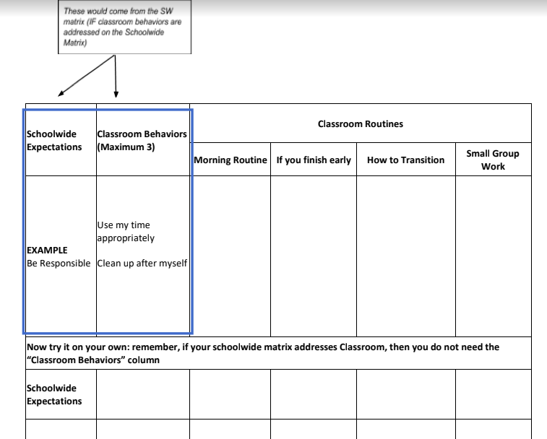
Classroom Expectations

Slide 68
Continuing Support
Think ahead of any issues that might arise and discuss them with the class beforehand. Prepare students before an event/activity. (Remember: “If it’s predictable, it’s preventable.”)
Embed expectations into the classroom
Teacher consistently models expectations.
Students follow class expectations despite the absence of the teacher:
Substitute
Guest teacher
Buddy teacher
Volunteer

Slide 69
Data Collection Form

Slide 70
Routines &
Procedures
Creating Consistency

Slide 71
Routines and Procedures
Classroom procedures are steps for accomplishing classroom tasks; they
Explain the accepted process for carrying out a specific activity such as:
Walking in the hallway
Using lockers
Sharpening pencils
Routines are procedures that are used on a consistent basis, such as:
When students arrive to class
During in-class transitions
At dismissal

Slide 72
Rationale: A Safe and Predictable Environment
To build and foster positive relationships, teachers should establish expectations, routines, and procedures that are age appropriate and respective of individual backgrounds. They should be positively stated and explicitly taught and practiced across the school year. When students demonstrate mastery and follow established rules and routines, teachers should provide age-appropriate specific performance feedback in meaningful and caring ways.
Adapted from McLeskey, J., Barringer, M-D., Billingsley, B., Brownell, M., Jackson, D., Kennedy, M., Lewis, T., Maheady, L., Rodriguez, J., Scheeler, M. C., Winn, J., & Ziegler, D. (2017, January). High-leverage practices in special education. Arlington, VA: Council for Exceptional Children & CEEDAR Center. © 2017 CEC & CEEDAR

Slide 73
Classroom Procedures and Routines

Slide 74
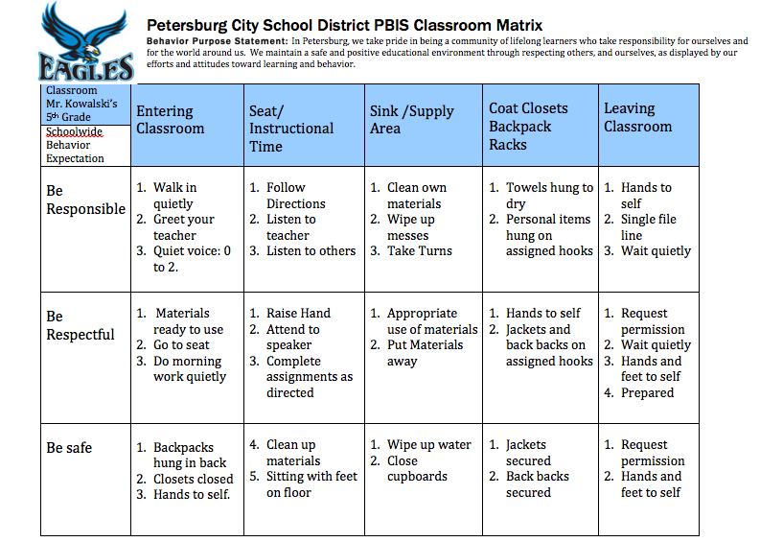
Example

Slide 75
Discussion Time
Things to talk about:
Should a grade level encourage consistency in some or all routines?
If yes, how do you create buy-in for all teachers?
What are a “top 5” classroom routines you might develop for a classroom?
How can you gain student input when creating the classroom matrix?

Slide 76
Teaching Effective Procedures and Routines
Teaching Routine: how the procedure or activity looks (examples and nonexamples)
Active Supervision: a method for effectively monitoring students
Positive Reinforcement Procedures: incentives for appropriate behavior (praise, high fives…)
Pre-corrections: quick reminders of expected behavior before the transition

Slide 77
Movement Out of the Classroom: Secondary
Students wait to pack up materials until teacher indicates end of class. The teacher dismisses students.
Teacher moves to door and dismisses students.
Teacher may require an exit task:
Show me tomorrow’s assignment on your calendar.
Write a 10-word summary of today’s lesson.
Show it to me as you exit.
Show me your notes from today’s lesson.
Show me the rough draft of your paper.

Slide 78
Only When Near
When the student has a question and the teacher is not near, the student may consult with his/her partner or use the rule “three before me”
If assistance is not adequate, student circles the item and continues working
The teacher moves around the room monitoring (Walk around. Look around. Talk around.)
When the teacher is NEAR, the student may raise his/her hand and request assistance

Slide 79
Attention Signal Examples
Clapping in a special rhythm and having students repeat it.
Holding two fingers in the air.
Counting down: “5, 4, 3, 2, 1”.
Call/Response: (Teacher:“1-2-3 all eyes on me”. Students: “1-2 all eyes on you.”)
Shaking or playing an instrument.
Secret Word

Slide 80
Combining Classroom Behaviors
and Routines
These would come from the SW matrix (IF classroom behaviors are addressed on the Schoolwide Matrix)
Can insert school name/ mascot here Schoolwide Expectations | Classroom Behaviors (Maximum 3) | Classroom Routines (Can add room number)
 |  | Morning Routine | If you Finish Early | How to Transition/ Line up | Small Group Work
Be Responsible | Use my time appropriately Clean up after myself Be ready to learn | Turn in homework Put materials in your desk Begin morning work | Turn in your work in the basket Read silently in your seat | Put materials away on my signal Get materials ready for the next activity | Do your fair share Manage time carefully

Slide 81
Instructional Routines
Routines are not just about behavior

Slide 82
Choosing Instructional Routines
Some routines relate to learning structures embedded in the content, such as starting each unit with the same graphic organizer or using a consistent vocabulary routine.
Some routines and/or procedures are signals and cues, such as giving a choral response or ending peer conversation time.
Data drives routines.

Slide 83
Anita Archer: Instructional Routines
Anita Archer on Instructional Routines
Listen for how both teachers and students are empowered by instructional routines.
Notes:
Video: 2:36 length
Teachers are empowered – it is empowering, to use with automaticity, seamless flow
Students are also empowered – can put all their “cognitive thoughtfulness” on the content, rather than on the task; students who are at risk – especially benefit – more confident, more likely to participate fully

Slide 84
Explicit Teaching in Every Routine
I do: Informing, explaining, modeling, and providing examples
We do: Working together to complete the steps of a particular task
You do: Students practice what was taught by themselves

Slide 85
Data Collection

Slide 86
Key Terms
Alignment
Expectations
Rules
Behaviors
Procedures
Routines

Slide 87
Module C:
The Engaged and Successful Student
Opportunities to Respond
Formative Assessment
Scaffolding

Slide 88
Learning Intentions
Understand how opportunities to respond create an impartial classroom and improve student achievement
Understand the five formative assessment strategies
Describe scaffolding strategies that support student achievement

Slide 89
Success Criteria
Explain the different forms of student responses and when/how to use them

Slide 90
Resources

Slide 91
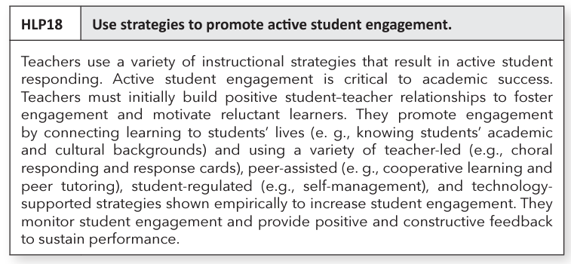
HLP 18

Slide 92
Opportunities To Respond
“A teacher behavior that prompts or solicits a student response (verbal, written, gesture).”
Source: Simonsen, Myers & DeLuca, 2010

Slide 93
Rationale
Students are able to:
Teachers are able
to:
Remain attentive and on task
Retrieve, rehearse and practice information, concepts, skills and strategies being taught
Refrain from inappropriate behaviors
Provide corrective feedback immediately
Adjust the lesson
Offer behavior specific praise

Slide 94
Teacher Talk Time
How much time are you talking?
______% of students surveyed in Virginia cohorts reported that their teachers talk most of the time.
When in fact….
Teacher talk should be no more than ____ to ____ % of instructional time.
76
40
50
HINT: It isn’t consecutive minutes necessarily, but rather “I say something, you say something…”

Slide 95
An opportunity to respond is…
“when a teacher presents an instructional question, statement, or gesture that promotes student responses (e.g., pointing to a flashcard, answering a question aloud, writing an answer on a dry erase board). The teacher then provides feedback to students based on responses.”
Source: Tennessee Behavior Supports Project (n.d.)

Slide 96
When and How to Use Opportunities to Respond
Verbal responses
Choral
Partner or team
Individual
Written responses
Response system
Graphic organizer
Action responses
Act out/Gestures
Hand signals
Manipulatives

Slide 97
Using Partners
Consider:
Structure partners: Number 1 or 2.
Use triads when appropriate.
For secondary: Prepare a seating chart indicating names, partners, and numbers.
Teach students how to work together.
Change partnerships every few weeks.
istock/Gregory_DUBUS

Slide 98
Breaking up the Lecture
The Pause Procedure
Liven up the
Powerpoint
Stop talking after 12 minutes!
Ask students to process, by discussion in pairs, rewriting notes, or sharing experiences. (remote pairing if necessary)
Result: Significantly higher retention rates
Insert a processing slide after a certain number of content slides. Allow students time to work on a formative assessment question (remote pairing, if necessary).

Slide 99
Opportunities to respond and long-term memory
Third graders read an article about the sun.
Which scenario brings about the most learning and why?
Option 2:
The next day, students reread the article, highlighting important information within the passage. Using their highlighting, students make a list of the important points about the sun and compare their lists to those of their partners.
Option 1:
The next day, students answer questions about the sun. The following procedure is followed: 1) a question is presented on the screen, 2) students think about the answer 3) students share with their partners, 4) individuals share out, and 5) the teacher provides feedback.

Slide 100
Raising Hands
Dylan Wiliam said,
“If you’re allowing children to volunteer whether to participate or not in your classroom, quite simply, you’re making the achievement gap bigger.”

Slide 101
Data Collection:
Opportunities to Respond

Slide 102
Let’s Review
Opportunities to respond provide corrective feedback to teachers.
Opportunities to respond help students to remain inattentive and off task.
Teacher talk time should be no more than 40-50% of instructional time.

Slide 103
Take 5
What opportunities to respond do you see used in your school?
How can you encourage the use of and the variety of opportunities to respond in your school?

Slide 104
Why are we here?
Apply implementation of the ten VTSS practices to their context, including a demonstrated understanding of common errors in consistency of use.
Develop a plan for the data collection, professional learning, and coaching needed at the school and division level in order to promote the use of effective classroom practices.
Assist others in their understanding of the connection of these foundational practices to impartial classroom systems to promote high achievement for all learners.

Slide 105
Making It Stick
Creating a SYSTEM for
Implementing and Building Teacher Efficacy
Notes:
Coaching is an important component to support what we are learning and what we take back to share with with our colleagues. In order for it to “stick,” we need to have a coaching plan to support implementation.

Slide 106
John Hattie discusses collective teacher efficacy
Notes
Notes:
https://vimeo.com/267382804https://vimeo.com/267382804
Prior to the video, ask the group to listen for something that stands out to them/resonates with them.

Slide 107
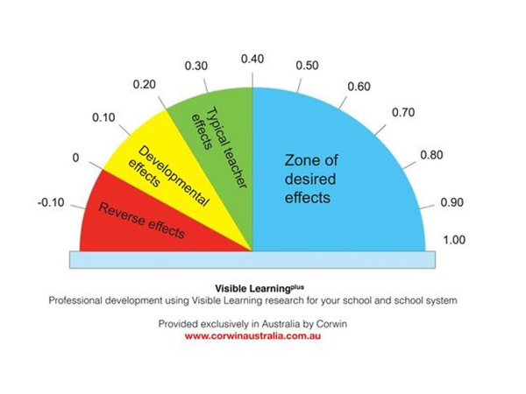
Collective Teacher Efficacy
1.57
Collective Teacher Efficacy

Slide 108
Build a Culture of Teacher Efficacy
“Over time, as teachers discuss the data and success with their peers, they develop collective teacher efficacy…’the perceptions of teachers...that the efforts of the faculty as a whole will have a positive effect on students.’”
Hattie, Fisher, & Frey, Visible Learning for Literacy, p.135

Slide 109
Why?
Strong collective efficacy…
improves student performance.
decreases the negative effects of low socioeconomic status.
enhances parent/teacher relationships.
creates a work environment that builds teacher commitment to the school.
makes an IMPACT on student learning!

Slide 110
But HOW?
What do we do to ensure that collective efficacy happens?
Teachers participate in important school wide decisions
Goal consensus
Teachers knowledge about one another's work
Cohesive staff
Responsiveness of leadership
Effective systems of intervention
Source: Donohoo, J. (2017). Collective teacher efficacy: The effect size research and six enabling conditions. The Learning Exchange.

Slide 111
Building the System

Slide 112
In a school…
With collective
teacher efficacy
Without collective
teacher efficacy
Students are held to high expectations.
The focus is on student learning.
Teachers evaluate their practices and the effect on student outcomes.
Failure is the fault of the students.
Challenging students are being excluded.
Stress runs rampant.

Slide 113
Take 5
What are you currently doing related to collective teacher efficacy in your building?
What other things could you do to enhance/improve collective teacher efficacy in your building?

Slide 114
Rollout of a Practice: Example
Week 1: Provide professional learning on practice 1. Demonstrate, share a video. Begin implementation.
Week 2: Teachers practice strategies and self assess. They meet in small groups to reflect on practice, successes and challenges, ask for support from peers and/or coach.

Slide 115
Rollout Continued
Week 3: Teachers collect data on fluency with the practice (teachers may record themselves) or ask for a peer or coach observation with feedback. They discuss in small group the best places to incorporate the practice in a lesson and rewrite the lesson plans.
Week 4: Meet again as a large group to share data and experiences with practice 1. Provide professional learning on practice 2. Continue…

Slide 116
Next Steps

Slide 117
“Activate the Village” Work Time
Begin to develop your coaching plan for Effective Classroom Systems.
Resources to facilitate this process:
Classroom rollout slides - how to get started
Data collection tools
Notes from these modules: Responding to the Matrix, Aligned Classroom Procedures, Routines and Procedures, and Opportunities to Respond.

Slide 118
Pre-Work for Day #2
Read article:
“Tear Down Your Behavior Charts” under Module D materials, Error Correction.

Slide 120
Surf, Sand, Sun, and Systems that Work for Your Classroom!
Day 2
VTSS Effective Classroom Systems
July 2024

Slide 121
Where can I find the materials?
Notes:
***Add new materials link***

Slide 122
Do you agree or disagree?
There’s no point in eating french fries without ketchup.
Fiction is better than nonfiction.
Monday is the worst day of the week.
Educators understand how to use formative assessment.
Error correction is an area of growth for educators in my school/division.

Slide 123
Setting Our Intentions
Practice presence
Grasp opportunity
Embrace quick wins and bold next steps

Slide 124
Our Wish for You
Take care of your needs
Use this time to connect and plan
Wonder and “What if”
Practice the approach of “Yes, and…”

Slide 126
Why are we here?
Apply implementation of the ten VTSS practices to their context, including a demonstrated understanding of common errors in consistency of use.
Develop a plan for the data collection, professional learning, and coaching needed at the school and division level in order to promote the use of effective classroom practices.
Assist others in their understanding of the connection of these foundational practices to impartial classroom systems to promote high achievement for all learners.

Slide 127
Summer Fun!
Module A: The Set-Up for Success
1. Arranging the Physical Environment
2. Active Supervision
Module B: Responding to the Matrix
3. Classroom Expectations
4. Routines and Procedures
Module C: The Engaged and Successful Student
5. Opportunities to Respond
6. Formative Assessment
7. Scaffolding
Module D: The Power of Feedback
8. Feedback: Acknowledgement and Behavior Specific Praise
9. Feedback: Error Correction
10. Feedback: Building Community Through Feedback

Slide 128
Module C:
The Engaged and Successful Student
Opportunities to Respond
Formative Assessment
Scaffolding

Slide 129
Formative assessment is a process used by students and teachers during instruction to elicit and use evidence to improve understanding of intended learning outcomes and support students to become more self-directed learners.
Source: Virginia Department of Education

Slide 130
Learning Intentions
Understand how opportunities to respond create a more equal classroom and improve student achievement
Understand the five formative assessment strategies
Describe scaffolding strategies that support student achievement

Slide 131
Success Criteria
Explain the five formative assessment strategies

Slide 132
Five Strategies of
Formative Assessment
Clarify, share, and understand learning intentions and success criteria
Find out what students have learned
Provide feedback that moves learning forward
Activate students as instructional resources for one another
Activate students as owners of their own learning

Slide 133
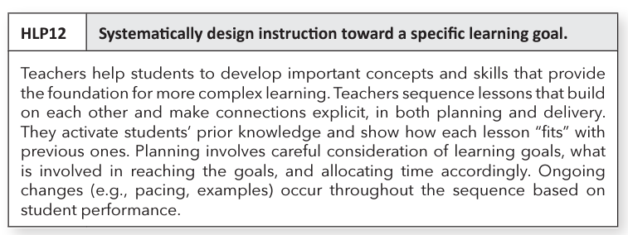
HLP 12

Slide 134
Strategy #1: Clarify, share, and understand learning intentions and success criteria

Slide 135
Teacher Clarity: Learning intentions and success criteria
Students should be able to answer…
Teacher format
for success criteria
What am I learning today?
Why am I learning this?
How will I know that I have learned it?
Checklists
Rubrics
“I can…” statements
Exemplars
Modeling and demonstrating
Negotiation
Other?

Slide 136
Strategy #2: Eliciting evidence of learners’ achievement
Just Say No to Calling on Volunteers
Response Systems
Choral response (with think time and clear signal)
White boards
Popsicle sticks
Partners
Discussion groups
Exit tickets

Slide 137
Strategy #3: Provide feedback that moves learning forward
Feedback is most effective when:
The relationship between the teacher and student needs to be a positive one.
The teacher needs to be seen as credible in the eyes of the student.
The climate of the classroom needs to be such that errors are not viewed with shame, but as part of the learning process.
The Distance Learning Playbook p. 151

Slide 138
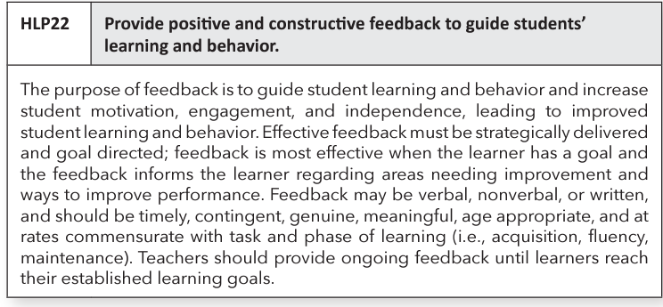
HLP 22

Slide 139
Effective Classroom Feedback:
Focused and Specific
Feedback should be focused.

Slide 140
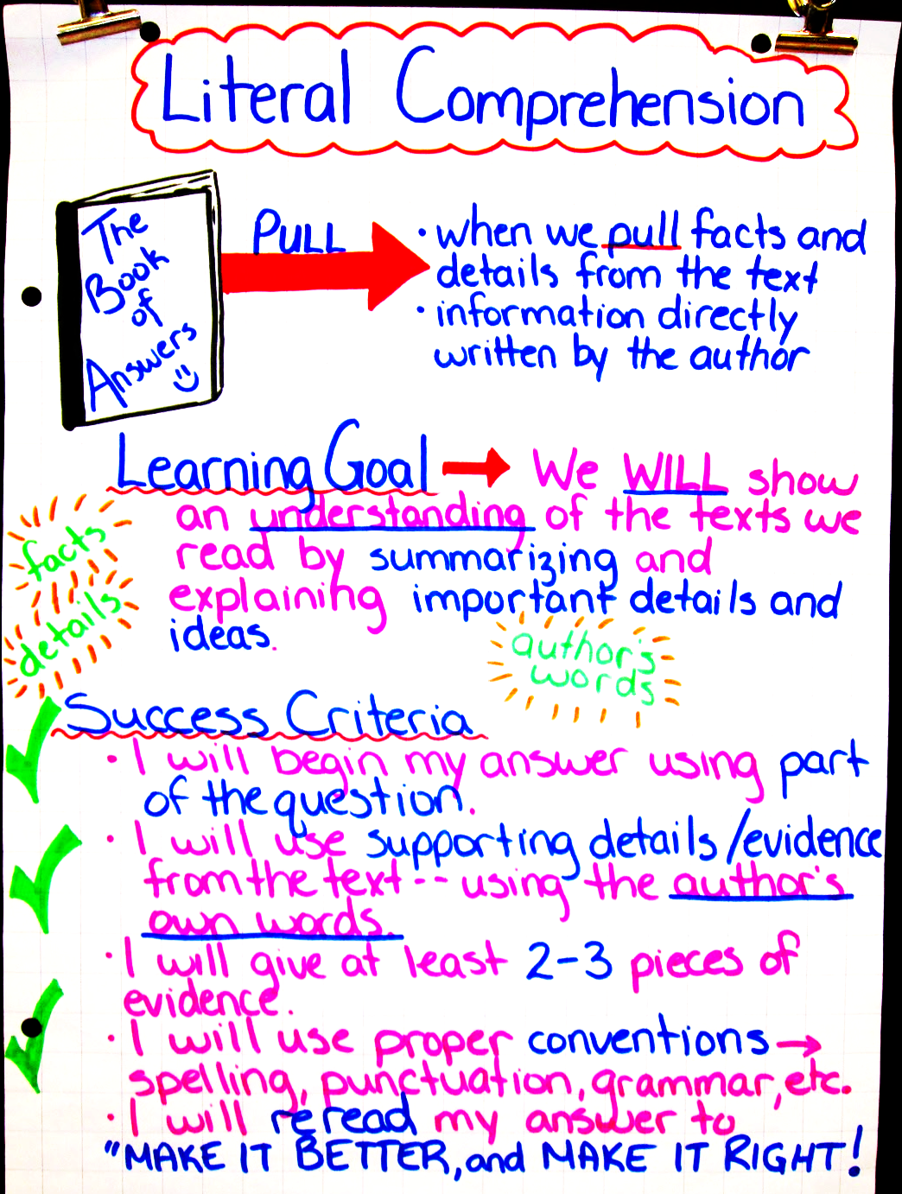
Effective Classroom Feedback: Related to Learning Goals
Feedback should relate to the learning goals that have been shared with students.

Slide 141
Take 5
What formats do teachers use to explain success criteria to students?
Discuss where in your building do you see examples of feedback that moves learning forward (yourself and others).

Slide 142
Strategy #4: Having students help each other learn
Cooperative learning with a group goal and individual accountability
Discussion
Partner work
Collaboration
Peer tutoring
Turn and talk
Important: Students need to be taught
how to collaborate

Slide 143
Peer Critiques
Peer critiques video
Notes:
Video: https://players.brightcove.net/268012963001/rJenILPQx_default/index.html?videoId=5518311215001
Should we do another surprise party of how this relates to 5 Cs
Consider video of structure peer review
Let them know that they can search for the video Austin’s Butterfly on YouTube

Slide 144
Strategy #5: Activate students as owners of their own learning
Self-regulated Learning
Share learning goals
Promote the belief that learning is incremental
Decrease comparisons with others
Provide feedback that moves them forward
Transfer control of the learning from teacher to student

Slide 145
How to support students to become owners of their learning
Individual Tracking
Individual Understanding
What did we learn today?
Personal logs
“Personal best” selections
Graphs
Stars on rubrics (video)
Project checklists

Slide 146
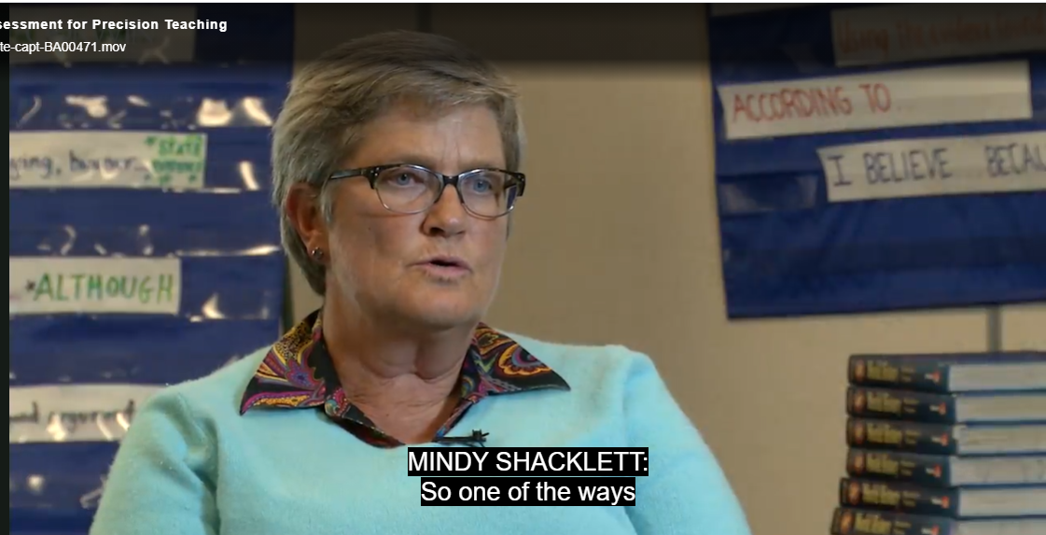
Student self monitoring
Mindy 3:58-7:15

Slide 147
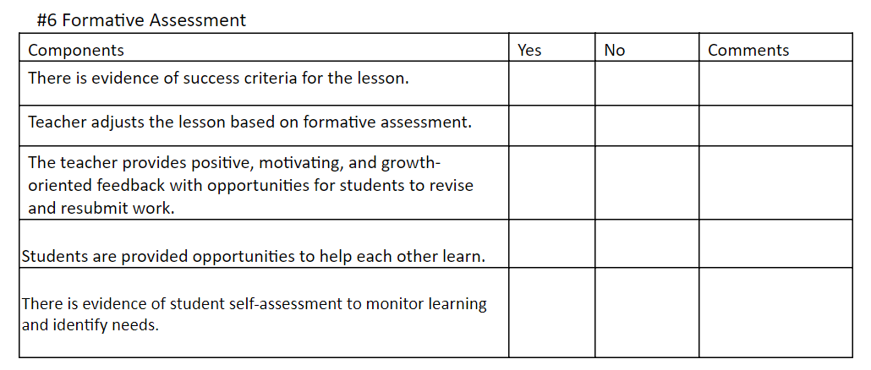
Data Collection:
Formative Assessment

Slide 148
5 Strategies for Formative Assessment
Clarify, share, and understand learning intentions and success criteria
Find out what students have learned
Provide feedback that moves learning forward
Activate students as instructional resources for one another
Activate students as owners of their own learning

Slide 149
Take 5
How can you support students to be able to support each other in their learning?
How can you assist students with developing ownership of their learning?

Slide 150
Scaffolding
Supporting Student Performance

Slide 151
“When scaffolding, teachers typically provide high levels of initial guidance and then systematically reduce support as students respond with greater accuracy.”
Source: Archer, A. & Hughes, C. Explicit Instruction,p. 10

Slide 152
Learning Intentions
Understand how opportunities to respond create a more impartial classroom and improve student achievement
Understand the five formative assessment strategies
Describe scaffolding strategies that support student achievement

Slide 153
Success Criteria
Name scaffolding strategies that support student performance

Slide 154
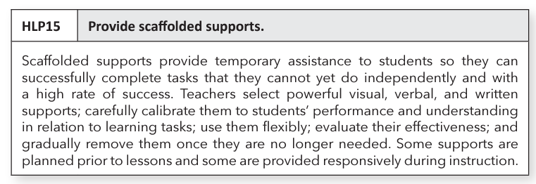
HLP 15

Slide 155
Scaffolding Promotes Academic Success
Goal
This is where the scaffolding comes in for students who need more support to
reach that goal.
Current Level

Slide 156
Strategies for Scaffolding
Partnering
Chunking
Sequencing/Progress in Complexity
Demonstrations and completed models
Provide hints and prompts
Provide aids such as cue cards and checklists

Slide 157
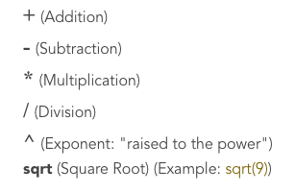
Demonstrations and Completed Models
Which one?
Demonstrations and completed models
Provide hints and prompts

Slide 158
Cue Cards and Checklists
Which one?
1. Chunking
2. Provide aids such as cue cards and checklists

Slide 159
Sequencing/Progressing in complexity
Mr. Juarez’s students are expected to be able to complete a challenging math problem.
He separates the problem into several parts and uses mini lessons to teach them in order.
After each mini-lesson, Mr. Juarez checks to ensure the students understood the concept. He gives them time to practice the problems and explains how the math skills they are learning will help them to solve the more challenging math problem.
Which one?
1.Sequencing/
Progressing in complexity
2. Partnering

Slide 160
Chunking
Example: Break down the social studies text to write a summary.
Purpose
Which one?
1. Provide hints
and prompts
2. Chunking
Key Events
Key Players
Setting
Enduring Understanding
Notes:
When the teacher and students break down a text into sections or parts, they are……
Virtual: Chat Box: Waterfall response; Face-to-face: Choral response: say the number
Answer: 2

Slide 161
Partnering
Which one?
1.Partnering
2.Demonstrations
and completed
models
Students read to each other everyday.
Image source: PALS Partner Reading

Slide 162
Provide hints and prompts
Math:
What information do you have?
Review the worked example on page 47.
Recheck your thinking here (point to the problem on the page).
Which one?
Provide hints and prompts
Provide aids such as checklists and cue cards

Slide 163
Stages of Scaffolding
I do it (modeling)
We do it (prompting)
You do it (fading)

Slide 164
Data Collection:
Scaffolding

Slide 165
Making It Stick
Creating a SYSTEM for
Implementing High Leverage Practices: Creating Teacher Buy-in
Notes:
Coaching is an important component to support what we are learning and what we take back to share with with our colleagues. In order for it to “stick,” we need to have a coaching plan to support implementation.

Slide 166
Creating Buy-In
Use collective teacher efficacy; remember, we are activating the village.
Use the data in a non-evaluative manner; look for trends across the school and emphasize school-wide data.
Emphasize the “working smarter” part: back to the critical links.
Provide support through coaching.
Provide time for reflection both alone and together.
Relate to the strategic plan/improvement plan.
Include family voice.
CELEBRATE IMPROVEMENT!!

Slide 167
Linking to Division/School Goals
Do your division and school have a five year or shorter term goal related to:
Teacher retention?
Student engagement?
Climate?
Improved attendance?
Improved student achievement?

Slide 168
“Not One More Thing”
It All Connects
PBIS
Restorative Practices
Innovate and/or Deeper Learning
Increased Attendance
Fairness
Trauma Informed Practices
Narrowing the Achievement Gap
Special Education Outcomes
Are these some of your initiatives?

Slide 169
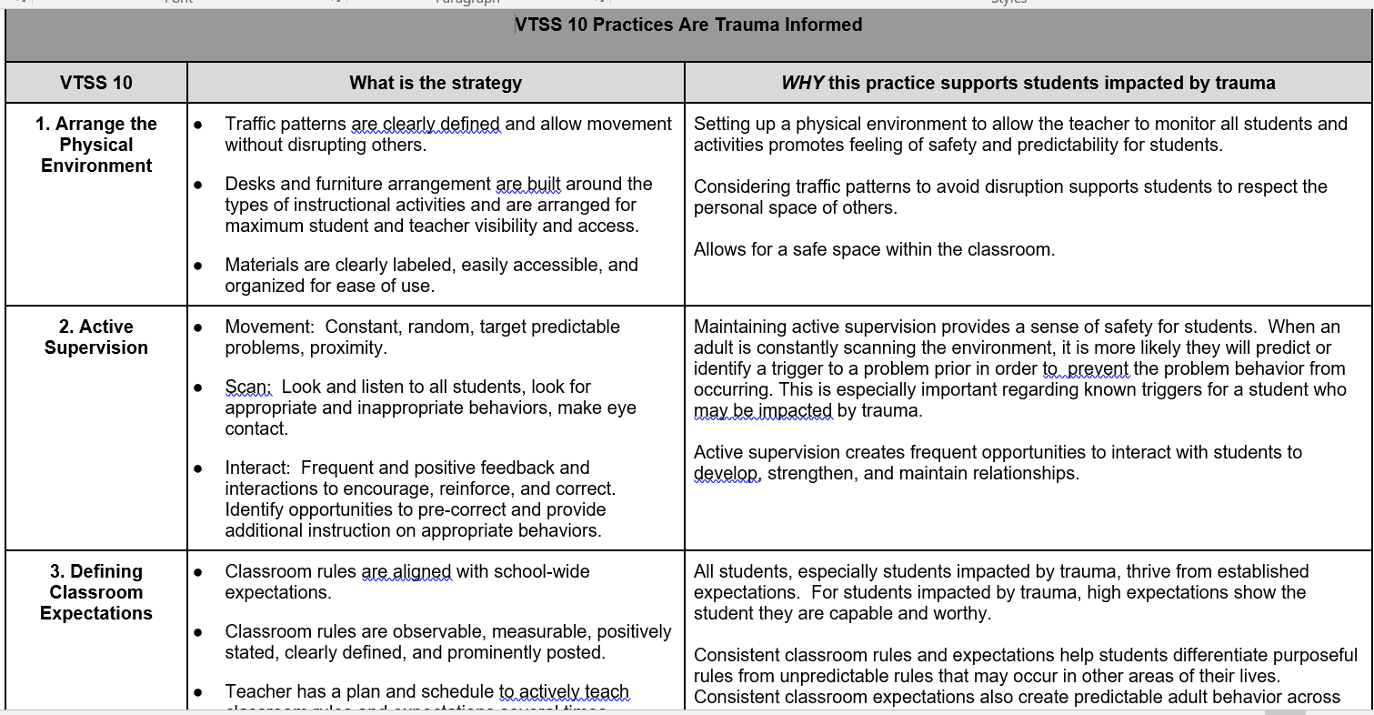
Trauma Alignment

Slide 171
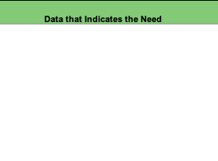
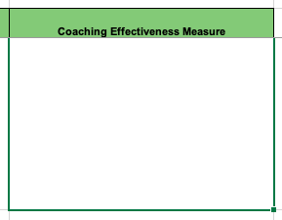
Schoolwide Data Collection
What Are Our Sources?
Data Collection Tools (see workbook)
Walkthrough Tools
Climate Survey
Discipline Data
Formative Assessment
Universal Screening
Data from School Improvement Plan
Other??

Slide 172
Your Role

Slide 173
Module D:
The Power of Feedback
Acknowledgement and Behavior Specific Praise
Error Correction
Building Community with Feedback

Slide 174
Learning Intentions
Understand the power and importance of feedback in a classroom setting
Be able to identify and use examples of behavior specific praise statements
Identify steps of effective error correction
Explore examples of how to use effective feedback strategies within the ‘group’ to build community, collaboration, and citizenship!

Slide 175
Think about a time...

Slide 176
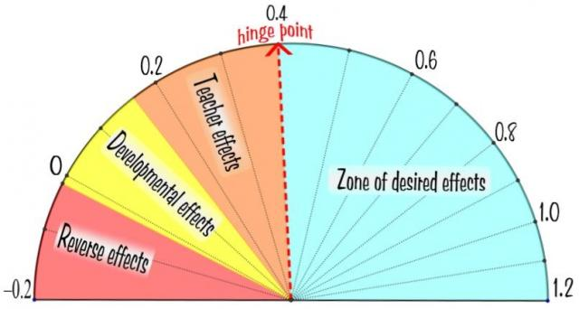
The Power of Feedback
Direct Instruction
Feedback
Teacher
Clarity

Slide 177
With Great Power...
Comes Great Responsibility.

Slide 178
Feedback with a Purpose
TASK
PROCESS
SELF
Hattie, J., & Timperley, H. (2007). The Power of Feedback. Review of Education,77, 81-112.

Slide 179
Which do we tend to use the most? Why?
TASK
PROCESS
SELF
Hattie, J., & Timperley, H. (2007). The Power of Feedback. Review of Education,77, 81-112.

Slide 180
Start here - Positive:Corrective

Slide 181
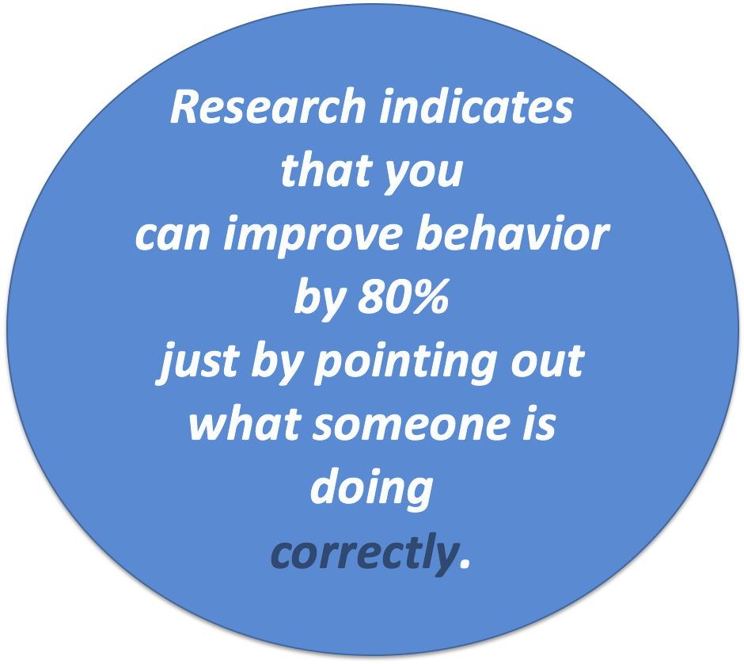
Feedback:
Behavior Specific Praise
“Whatever you feed,
will grow.”
~Bishop TD Jakes

Slide 182
Behavior Specific Praise in
Three Easy Steps
Name the Student.
Recognize the Positive Behavior
Connect the behavior to the matrix or expected academic outcome.
Examples:
Joe, thank you for keeping your hands to yourself. That is safe.
Susie, I noticed you are using a quiet voice level. That is respectful.
Brian, I see you got out your materials. That is responsible.

Slide 183
Behavior Specific Praise: Fill in the blank. What does it sound like?
_________ identifies and defines both the student and behavior being recognized
_________ to specific skill or behavior/expectation on matrix
_________ tone of voice (common error)
________ friendly language
Genuine Specifically Connects Student

Slide 184
Practice with your colleagues! Decide on a few behaviors that you would like to acknowledge in your classroom, and practice giving behavior specific praise
with each other.

Slide 185
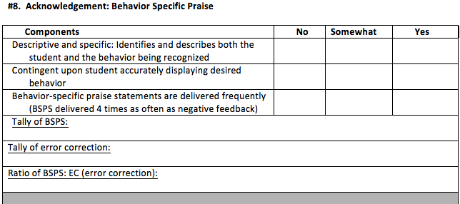
Behavior Specific Praise Chart
Focus on Data!

Slide 186
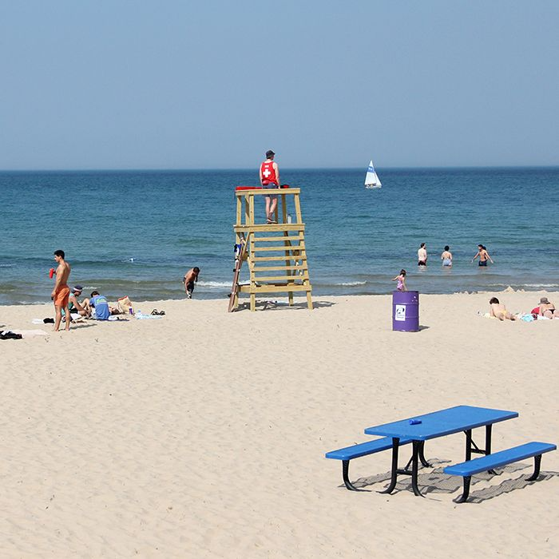
Steps to Error Correction
Correct Answer/Behavior
Next time.../Forward
End on Correct Response

Slide 187
If the student shows the
correct response...
If confident, quick and firm
Affirm and move on
If hesitant,
Affirm and reteach
Planned specific information is more likely to influence student performance than haphazard, general feedback.
Source: Herschell, Greco, Filcheck and McNeil, 2002

Slide 188
Remember
Punishing students doesn’t teach them the right way to act.
Dwelling on an incorrect answer does not lead us to the correct answer. FEED UP FEED FORWARD

Slide 189
Educational Leadership September 2018 –

Slide 190
DOJO – Clip Charts
Clip up, not down, send positive messages
Use with feedback system
May not be necessary if all other practices are in place
Are there other ways to provide feedback to students that are focused on teaching the desired behavior?

Slide 191
To Clip-Up/Clip-Down?
Questions to Consider about “Clip Charts”
Do these charts change behavior or just track it?
Do the same students consistently clip down? What kind of motivation or impact might that have on these students? What impact does it have on relationships in the classroom?
What role does the judgement of a teacher play in making these requests to clip up or down?

Slide 192
To Clip-Up/Clip-Down?
Additional Questions to Consider about “Clip Charts”
Can students identify the behavior that is attached to the movement of the clip and understand how to make a change?
Are there other ways to provide feedback to students that is focused on teaching the desired behavior?
What about secondary classrooms?

Slide 193
Discuss with your colleagues!
Are we changing behavior or just tracking it?
Are there other ways to provide feedback to students that is focused on teaching the desired behaviors?
What challenges might you or your school face in adopting strategies for teaching positive behavior? What steps could you take to address those challenges?

Slide 194
Data Collection Form
#9

Slide 195
Community

Slide 196
Learning Intentions - Part 2
Create a school or division coaching plan to support one of the following:
behavior specific praise
error correction
building community through feedback
Notes:
Final section …

Slide 197
Feedback: Building Community Through Feedback
The dependent relationship between a given task or specified behavior and the ability for the whole group to access a specific reward.
You may have heard “Group Contingency.”
The class/group is rewarded when they work together to achieve a task.

Slide 198
Rationale
Increases the climate and culture of the class: it’s a team
Dispels the notion that every single student has to meet the criteria
Allows students who have difficulty meeting expectations to participate and experience success

Slide 199
Types of Supports
Individual
Interdependent
Dependent

Slide 200
What works!
Providing meaningful rewards
Being consistent
Considering the school-wide reward system
Keeping it simple
Remaining focused on the positive
Maintaining high rates of reinforcement
Taking time to reward students
Communicate with families and build shared understanding

Slide 201
Group Feedback: Cautions
Do NOT take away previously earned points or reinforcement
Each and every student should NOT have to do every single thing for the class to earn the reward
Do NOT have one student or group earn things (or lose things) for the group
Do NOT leverage peer pressure

Slide 202
How to Implement
Choose an effective reward
Determine the behavior to change and any collateral behaviors that might be affected
Set appropriate performance criterion
It is important that the goals are clearly identified
Combine with other procedures when appropriate
Select the most appropriate group contingency
Monitor individual and group performance

Slide 203
Activity: Group Feedback
Establishing a Group Feedback Program
Circle and Star: A Menu of Classroom Reinforcers-with a partner or table group, add a few more examples.
Write down at least 1 independent and interdependent contingency to try (or encourage others to try).

Slide 204
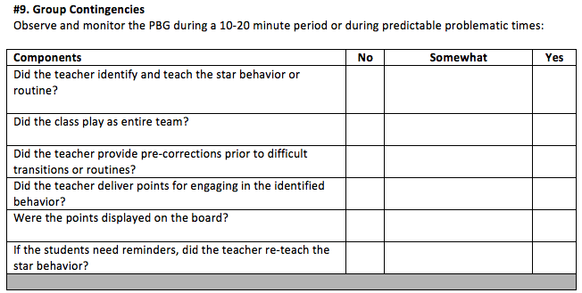
Data Collection
#10

Slide 205
In a sentence or two…
Take a note card/Post-It from the center of your table.
Write 1 or 2 sentences about your learning from the two days of Surf, Sand, Sun, and Systems that you will share with someone at your school or in your division.
Stand up when you are finished.
Notes:
Ask participants to write one sentence about their learning from the two days.
Stand up when finished.
Ask them to find someone wearing the same color and share their sentence.

Slide 206
We wish you many successes during the 2024-2025 school year!

