Slide 1
Surf, Sand, Sun, and Systems that Work for Your Classroom!
VTSS Effective Classroom Systems
July 2023

Slide 2
Making It Stick
Creating a SYSTEM for
Implementing High Leverage Practices

Slide 3
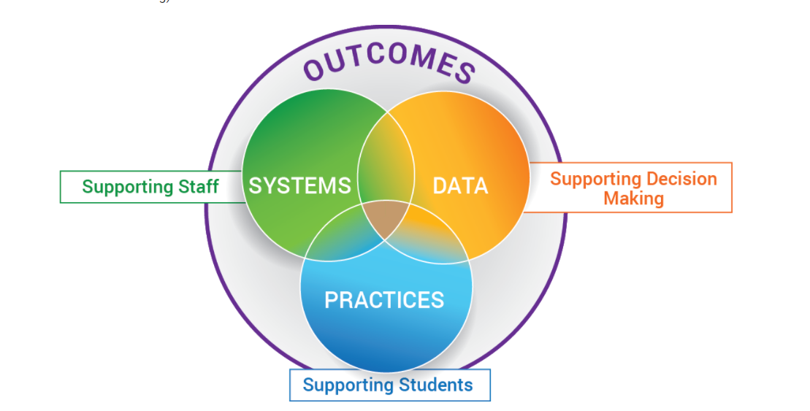
From Practices to Systems

Slide 4
The Five C’s

Slide 5
Building Community
Acknowledges students for performing a desired behavior that serves the group functioning
Saves time and resources by designing a program for an entire classroom rather than individual students, and
Encourages positive social interactions between peers
(Murphy et. al, 2007)

Slide 6
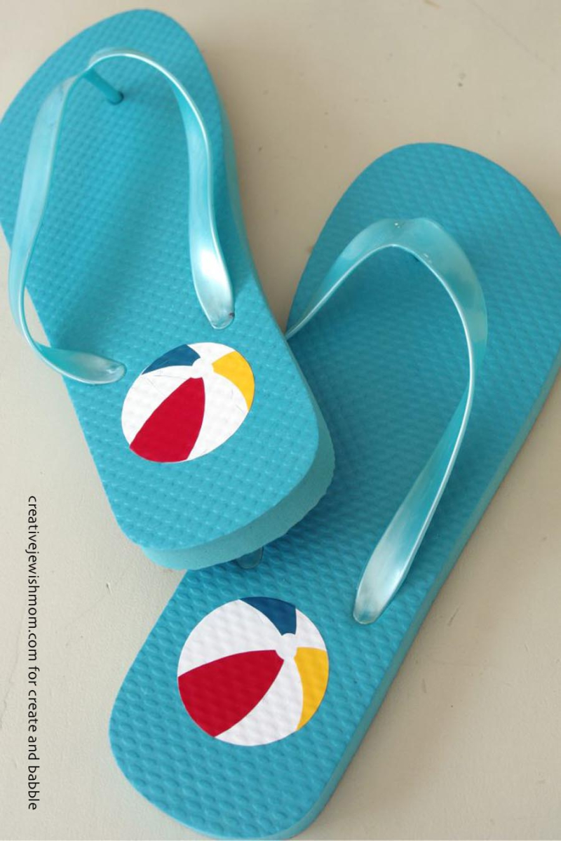
Summer Fun!
Module A: The Set-Up for Success
1. Arranging the Physical Environment
2. Active Supervision
Module B: Responding to the Matrix
3. Classroom Expectations
4. Routines and Procedures
Module C: The Engaged and Successful Student
5. Opportunities to Respond
6. Formative Assessment
7. Scaffolding
Module D: The Power of Feedback
8. Feedback: Acknowledgement and Behavior Specific Praise
9. Feedback: Error Correction
10. Feedback: Building Community Through Feedback

Slide 8
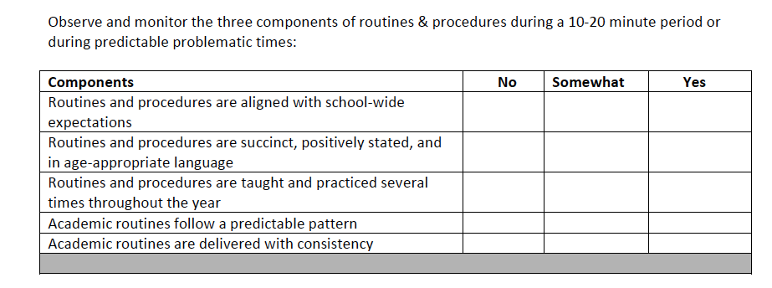
Data Collection

Slide 9
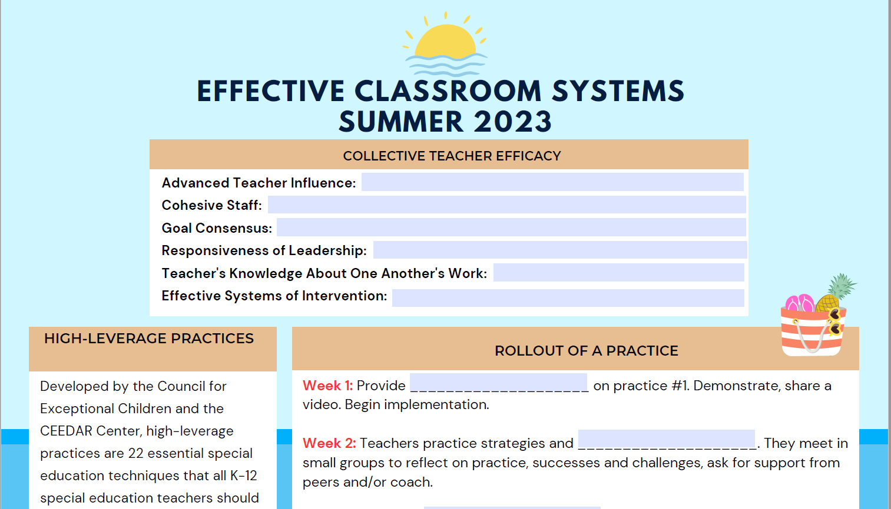
Walk with Us- Notetaker
Materials:

Slide 10
Making It Stick
Creating a SYSTEM for
Implementing Coaching

Slide 11
Critical to Systems Success

Slide 12
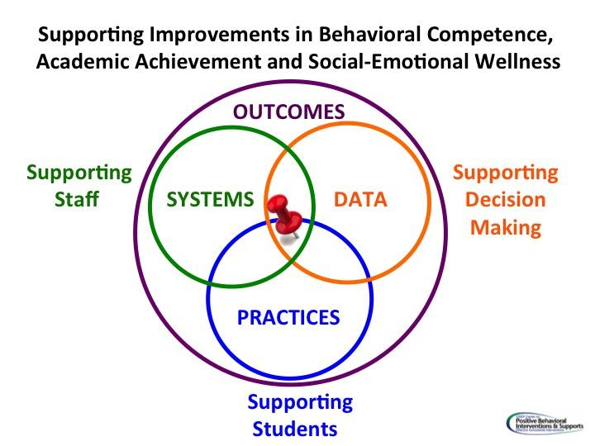
Rollout of a Practice: Example
Week 1: Provide professional learning on practice 1. Demonstrate, share a video. Begin implementation.
Week 2: Teachers practice strategies and self assess. They meet in small groups to reflect on practice, successes and challenges, ask for support from peers and/or coach.

Slide 13
Rollout Continued
Week 3: Teachers collect data on fluency with the practice (teachers may record themselves) or ask for a peer or coach observation with feedback. They discuss in small group the best places to incorporate the practice in a lesson and rewrite the lesson plans.
Week 4: Meet again as a large group to share data and experiences with practice 1. Provide professional learning on practice 2. Continue…

Slide 14
Next Steps

Slide 15
“Activate the Village” Work Time
Begin to develop your coaching plan for Effective Classroom Systems.
*Remember: Everyone is a coach!
Resources to facilitate this process:
Classroom rollout slides - how to get started
Data collection tools
Notes from these modules: Active Supervision and Physical Environment

Slide 16
Making It Stick
Creating a SYSTEM for
Implementing and Building Teacher Efficacy

Slide 17
John Hattie discusses collective teacher efficacy

Slide 18
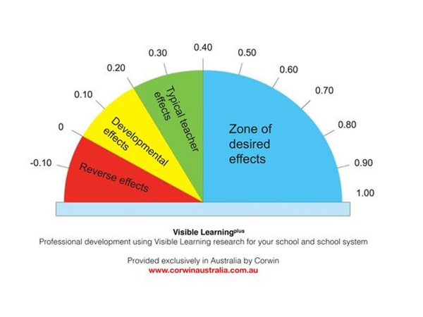
Collective Teacher Efficacy
1.57
Collective Teacher Efficacy

Slide 19
Build a Culture of Teacher Efficacy
“Over time, as teachers discuss the data and success with their peers, they develop collective teacher efficacy…’the perceptions of teachers...that the efforts of the faculty as a whole will have a positive effect on students.’”
Hattie, Fisher, & Frey, Visible Learning for Literacy, p.135

Slide 20
Why?
Strong collective efficacy…
improves student performance.
decreases the negative effects of low socioeconomic status.
enhances parent/teacher relationships.
creates a work environment that builds teacher commitment to the school.
Makes an IMPACT on student learning

Slide 21
But HOW?
What do we do to ensure that collective efficacy happens?
Teachers participate in important school wide decisions
Goal consensus
Teachers knowledge about one another's work
Cohesive staff
Responsiveness of leadership
Effective systems of intervention

Slide 22
In a school…
With collective
teacher efficacy
Without collective
teacher efficacy
Students are held to high expectations
The focus is on student learning
Teachers evaluate their practices and the effect on student outcomes
Failure is the fault of the students.
Challenging students are being excluded.
Stress runs rampant

Slide 23
Building the System

Slide 24
Rollout of a Practice: Example
Week 1: Provide professional learning on practice 1. Demonstrate, share a video. Begin implementation.
Week 2: Teachers practice strategies and self assess. They meet in small groups to reflect on practice, successes and challenges, ask for support from peers and/or coach.

Slide 25
Rollout Continued
Week 3: Teachers collect data on fluency with the practice (teachers may record themselves) or ask for a peer or coach observation with feedback. They discuss in small group the best places to incorporate the practice in a lesson and rewrite the lesson plans.
Week 4: Meet again as a large group to share data and experiences with practice 1. Provide professional learning on practice 2. Continue…

Slide 26
Next Steps

Slide 27
“Activate the Village” Work Time
Begin to develop your coaching plan for Effective Classroom Systems.
Resources to facilitate this process:
Classroom rollout slides - how to get started
Data collection tools
Notes from these modules: Responding to the Matrix, Aligned Classroom Procedures, Routines and Procedures, and Opportunities to Respond.

Slide 28
Making It Stick
Creating a SYSTEM for
Implementing High Leverage Practices: Creating Teacher Buy-in

Slide 29
System Implementation
VTSS 10
Use data to help determine where to begin.
Work on 1-2 practices at a time to implement well. This takes time and intention.
Remember to coach the work.

Slide 30
Creating Buy-In
Use collective teacher efficacy; remember, we are activating the village.
Use the data in a non-evaluative manner; look for trends across the school and emphasize school-wide data.
Emphasize the “working smarter” part: back to the critical links.
Provide support through coaching.
Provide time for reflection both alone and together.
Relate to the strategic plan/improvement plan.
Include family voice.
CELEBRATE IMPROVEMENT!!

Slide 31
Linking to Division Goals
Does your division have a five year or shorter term goal related to:
Teacher retention?
Student engagement?
Climate?
Improved attendance?
Improved student achievement?

Slide 32
“Not One More Thing”
It All Connects
PBIS
Restorative Practices
Innovate and/or Deeper Learning
Increased Attendance
Equity
Trauma Informed Practices
Culturally Responsive Practices
Narrowing the Achievement Gap
Special Education Outcomes
Are these some of your initiatives?

Slide 33
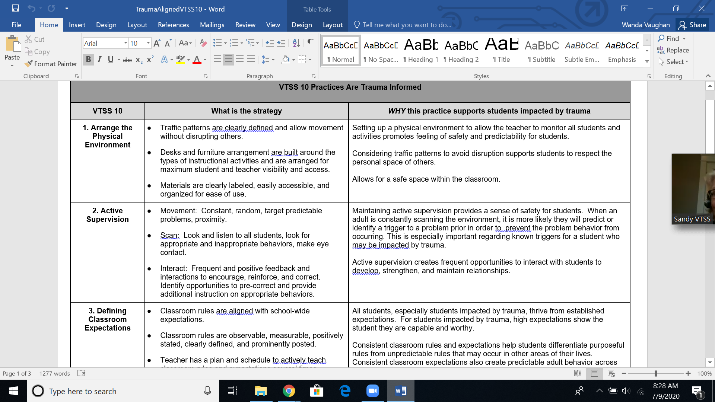
Trauma Alignment

Slide 34
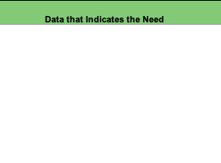
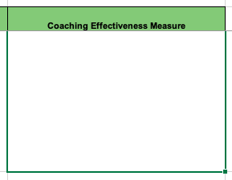
Schoolwide Data Collection
What Are Our Sources?
Data Collection Tools (see workbook)
Walkthrough Tools
Climate Survey
Discipline Data
Formative Assessment
Universal Screening
Data from School Improvement Plan
Other??

Slide 35
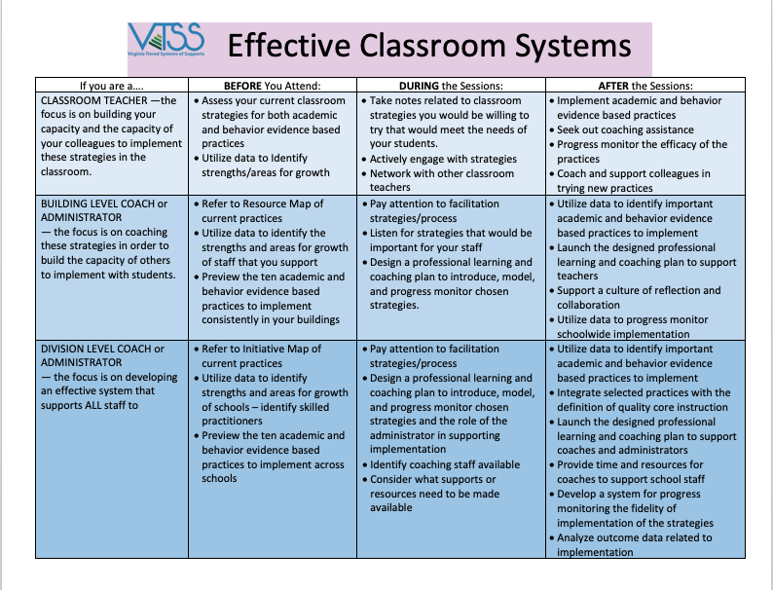
Your Role

Slide 36
Rollout of a Practice: Example
Week 1: Provide professional learning on practice 1. Demonstrate, share a video. Begin implementation.
Week 2: Teachers practice strategies and self assess. They meet in small groups to reflect on practice, successes and challenges, ask for support from peers and/or coach.

Slide 37
Rollout Continued
Week 3: Teachers collect data on fluency with the practice (teachers may record themselves) or ask for a peer or coach observation with feedback. They discuss in small group the best places to incorporate the practice in a lesson and rewrite the lesson plans.
Week 4: Meet again as a large group to share data and experiences with practice 1. Provide professional learning on practice 2. Continue…

Slide 38
Next Steps

Slide 39
“Activate the Village” Work Time
Begin to develop your coaching plan for Effective Classroom Systems.
Resources to facilitate this process:
Classroom rollout slides - how to get started
Data collection tools
Notes from these modules: Formative Assessment and Scaffolding.

