Slide 1
VTSS Exploration and Installation Series
February 20, 2020

Slide 2
Welcome!
Michael Gregory
Virginia Tiered Systems of Support Specialist

Slide 3
#ExploreVTSS

Slide 4
Group Norms
Be Responsible
Make yourself comfortable
Take care of your needs (water, food, restroom, etc.)
Share your questions with the group
Be Respectful
Silence cell phones
Listen to others attentively by staying quiet while they are speaking
Complete assigned tasks and follow up as needed
Be Engaged
Ask what you need to know to understand and contribute
Contribute to the team by sharing relevant information and ideas

Slide 5
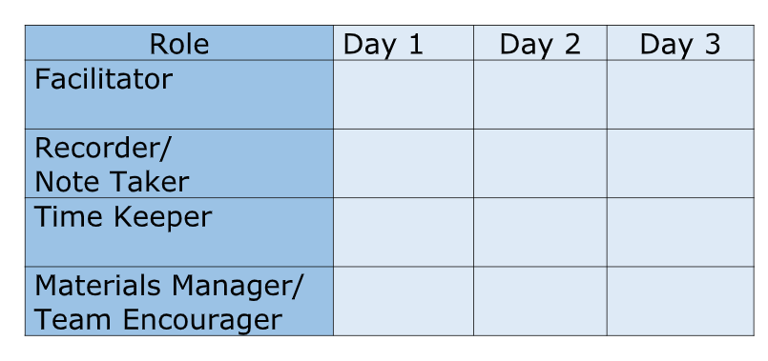
Roles and Responsibilities

Slide 6
Google Drive Directions
Make sure you have the Google Drive link that was shared with your division.
Inside the Google Drive folder and locate your division’s folder.
Please place all working documents in your folder to show your progress in the work. After each webinar we will review what documents need to be completed and placed within your folder.
Remember this is a shared drive.

Slide 7
Establishing a VTSS Team
Did you watch the recording on Establishing Your Team prior to this session?
How did that go?
Are the same people that watched this webinar with you today?

Slide 8
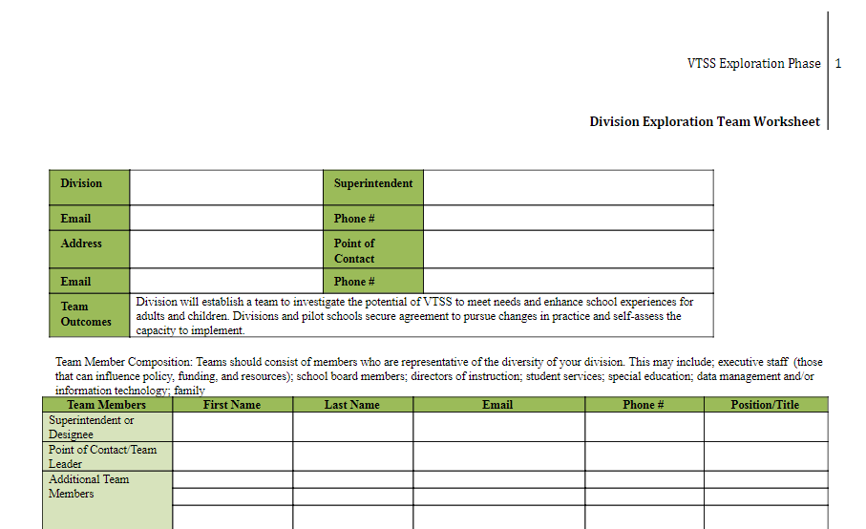
Division Exploration Team Worksheet

Slide 9
Let’s get to know each other.
Please share the roles that you have on our team and why you chose each person.

Slide 10
Success Criteria
identify and document your exploration team members
clearly define VTSS
identify the roadmap for VTSS Implementation, our Implementation Matrix
identify and review the VTSS Implementation Logic, our way of work
identify the data you are hoping to change
understand the importance of family and community partnerships
begin developing your vision for the work, including how VTSS adds value to existing initiatives

Slide 11
Essential Questions
As you learn about VTSS through “E&I” (Exploration & Installation), what information will help you explore the valued added to your current work, mission, and goals as a division?
How will you engage with staff, families, and your community, with the goal of achieving equitable learning outcomes for all students?
What information, data and collaborative dialogue is needed to inform the development of a comprehensive vision for the implementation of VTSS?

Slide 12
The “What”
Virginia Tiered Systems of Supports (VTSS)
integrates academics, behavior, and mental wellness into a framework for establishing the supports needed for a school to be an effective learning environment for all students.
This systemic approach allows divisions, schools, and communities to provide multiple levels of support to students in a more effective and efficient, clearly defined process (VTSS, 2016).

Slide 13
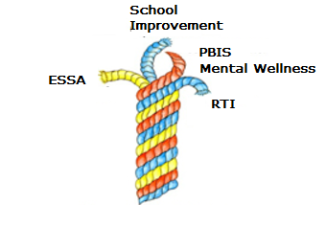
Braiding Our Work

Slide 14
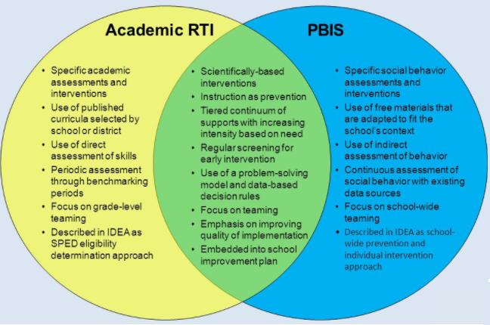
Features of VTSS (adapted from McIntosh & Goodman)

Slide 15
VTSS = Systems Change
Building this framework is a complex and iterative process. Students, staff, families, and community members are consistently included as planning partners.
“We cannot solve our problems with the same level of thinking that created them.”
Albert Einstein

Slide 16
Systems Change Involves…
Pause and discuss how you:
Feel about change
Respond to change
What impacts how you think/feel about change?

Slide 17
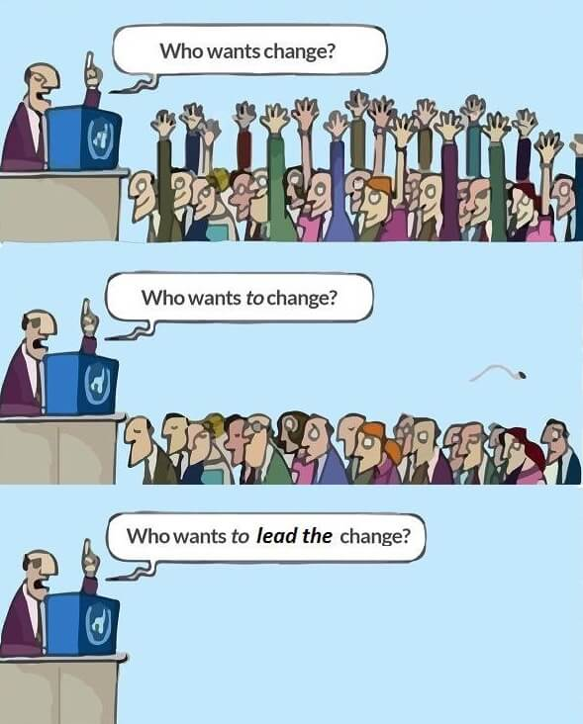
Change Questions

Slide 18
Unfreezing (Changing) the System
Kurt Lewin describes system change “as unfreezing the existing system, changing it, and refreezing it in its new and more effective configuration” (NIRN, 2016).
Change (changing our way of work) isn’t easy!

Slide 19
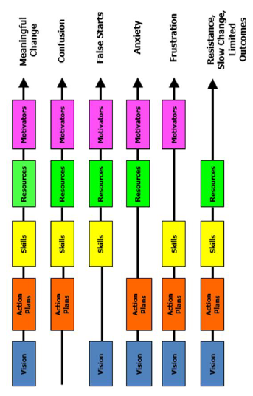
Managing Complex Change

Slide 20
VTSS Implementation Logic
OUTCOMES
Supporting
Staff
Supporting
Decision
Making
SYSTEMS
DATA
PRACTICES
Supporting
Students

Slide 21
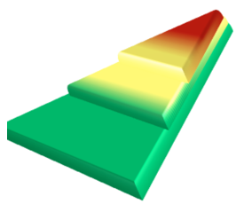
The Three Tier Framework
Tier 3 for a Few: Intensive, Individualized
Tier 2 for Some: Targeted for Small Groups
Tier I for All: Core/Universal

Slide 22
The Why
How does this model align with/connect with current work in your division?
What is the value added?

Slide 23
The “How” of VTSS
We recognize the significant expertise, diverse experiences, strengths and investments that already exist in divisions which choose to participate.
Practices that are effective in their impact on learning will be organized and aligned to be more efficient and effective.
New practices are identified and implemented to meet needs that are identified by the divisions. A new framework evolves that is driven by the division’s goals and local context.

Slide 24
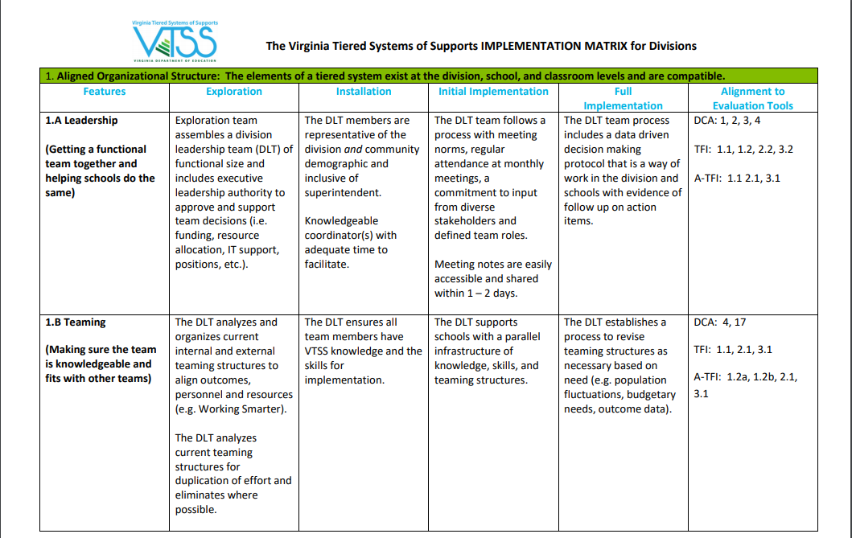
VTSS Implementation Matrix
Aligned Organizational Structures
Does this look familiar?

Slide 25
Implementation Components
Aligned Organizational Structure
Data Informed Decision Making
Evidence-Based Practices
Family, School, and Community Partnerships
Monitoring Student Progress
Evaluation

Slide 26
Implementation - Component 4
Aligned Organizational Structure
Data Informed Decision Making
Evidence-Based Practices
Family, School, and Community Partnerships
Monitoring Student Progress
Evaluation

Slide 27
A Central Component to our work!
Sometimes educators assume that if families don’t visit school or attend meetings, they must not care.
Addressing this requires a shift in thinking from: How do we fix families?
to: How do we fix the conditions that make engagement less accessible for families?
“All families have strengths and the capacity to positively contribute
to the educational success of their child.”
Adapted from Devon Minch, PhD., (VTSS Family Event, March, 2019)

Slide 28
A family representative on your Division Exploration Team

Slide 29
Implementation - Component 2
Aligned Organizational Structure
Data Informed Decision Making
Evidence-Based Practices
Family, School, and Community Partnerships
Monitoring Student Progress
Evaluation

Slide 30
Supporting Improvements in Behavior, Academics, and Social-Emotional Wellness
OUTCOMES
Supporting
Staff
Supporting
Decision
Making
SYSTEMS
DATA
PRACTICES
Supporting
Students

Slide 31
Data Infrastructure and
Data Systems
Data informed decision-making systems support adults in the effective and efficient implementation of instructional practices for teaching academic, behavior and mental wellness skills.

Slide 32
What DATA informs your need to implement VTSS?
What are you hoping to gain from this experience?
What needs to change?
What are your goals?
http://schoolquality.virginia.gov/

Slide 33
Why focus on data?
Data allows us to understand need, identify areas for improvement, and develop meaningful action plans!

Slide 34
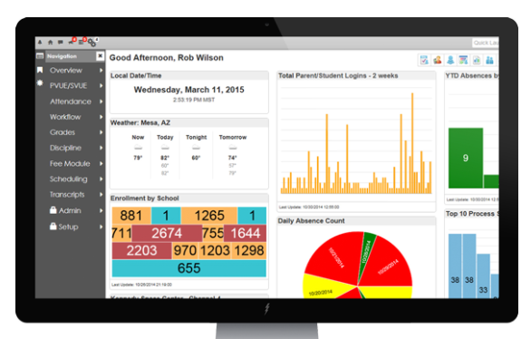
Organizing for Implementation
What does your division use for data:
PowerSchool
SOL’s
MAPs
Benchmarks
Homegrown
Evaluate current data systems for ease of use and functionality for aligned data driven decision making.

Slide 35
How are we organized to utilize data?
Data Infrastructure Data Systems
How is data collected and stored?
How is data communicated?

Slide 36
Data Systems for Successful Implementation

Slide 37
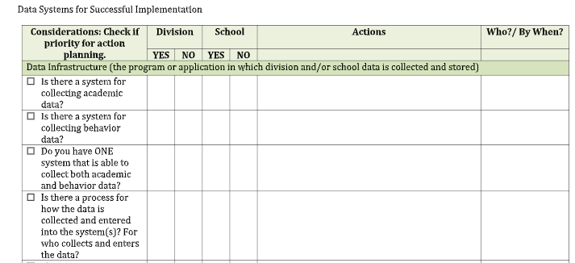
For Example
DATA SYSTEMS FOR SUCCESSFUL IMPLEMENTATION

Slide 38
Your Data Story
Identify and analyze current baseline data to determine needs and prevalence of needs.

Slide 39
Familiar Data within Your Division
Examples of Division Data
Graduation rates
Suspensions
Attendance
SOLs
Referrals to Special Education
% of students reading on grade level
% of students accessing advanced classes
% of students passing Algebra
WIDA growth
% going to 4 year or community college
Examples of School Data
ODRs
ISS
OSS
Attendance
School climate
Student surveys
Universal screening
Benchmark data
SOLs
Formative assessments

Slide 40
Would you like to know more about...
1. The percentage of students by race who are experiencing out of school suspension?
2. Time of day, location and/or grade level for your ODR’s?
3. ODR’s and suspensions for your Special Education population?
4. What are the data points that your division consistently reviews across all schools?
5. What about the performance of English Learners on formative assessments?

Slide 41
Data Driven Decision Making
Data that Indicates a Need
What data answers questions you have about student outcomes related to academics and/or behavior? What data speaks to a division priority? What data speaks to outcomes that you would like to change? Please list the data points below.

Slide 42
Data Driven Decision Making 2
What is the story your data is telling about your students? Be precise! Describe who, what, when, where and why! The more precise the story, the more efficient and effective we can be in our decision-making!
Again please tell the story through the lens of your division data.

Slide 43
Be Precise!
Tell the data story!
Try to explain who, what, when, where, and possibly the whys.
Precision allows us greater efficacy and efficiency in decision making.
Is there any data missing that you might need to go back and find in order to tell the story more completely?
What does the data indicate about the climate of your school(s)?
How does the behavior data impact academic data? Are you noticing any trends?

Slide 44
Data Driven Decision Making 3
Data that Indicates a Need
What data answers questions you have about student outcomes related to academics and/or behavior? What data speaks to a division priority? What data speaks to outcomes that you would like to change? Please list the data points below.

Slide 45
Data Driven Decision Making 4
What is the story your data is telling about your students? Be precise! Describe who, what, when, where and why! The more precise the story, the more efficient and effective we can be in our decision-making!
Again please tell the story through the lens of your division data.

Slide 46
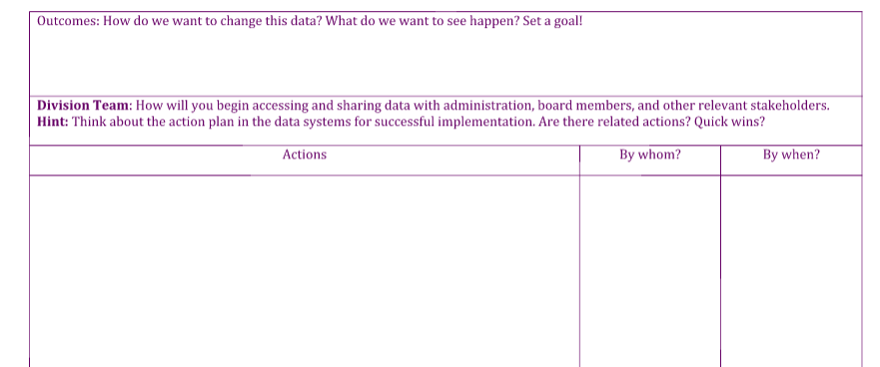
Would you like to rewrite the end of your story?

Slide 47
You ALL have GREAT ideas!

Slide 48
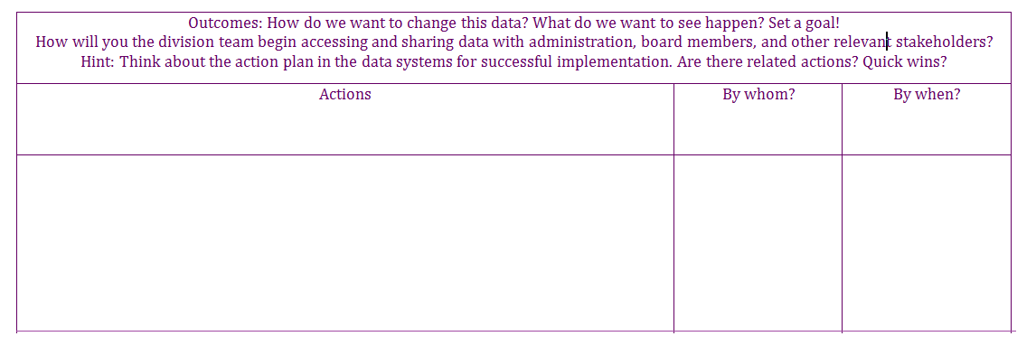
Would you like to rewrite the end of your story? 2

Slide 49
Implementation - Component 3
Aligned Organizational Structure
Data Informed Decision Making
Evidence-Based Practices
Family, School, and Community Partnerships
Monitoring Student Progress
Evaluation

Slide 50
Supporting Improvements in Behavior, Academics, and Social-Emotional Wellness 2
OUTCOMES
Supporting
Staff
Supporting
Decision
Making
SYSTEMS
DATA
PRACTICES
Supporting
Students

Slide 51
Relationships Matter!
Healthy student-teacher relationships improve learning outcomes.
It’s really easy to overlook this key practice (what we do with students) when we don’t have concrete, actionable steps organized systematically to remind us to do so.
“It is teachers who have created positive teacher student relationships that are more likely to have the above average effects on student achievement.”
John Hattie

Slide 52
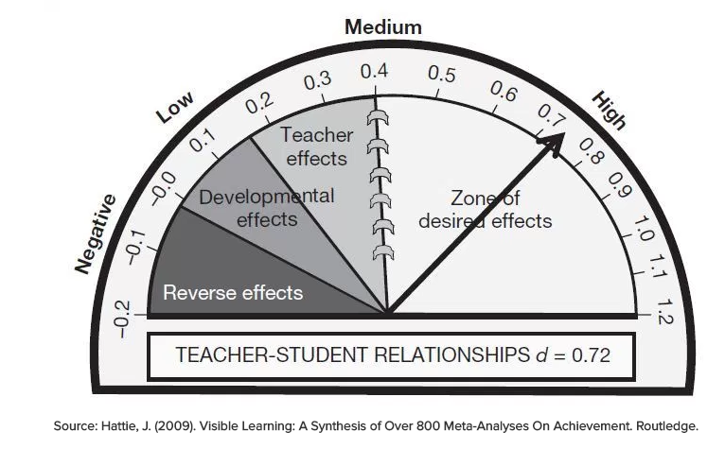
John Hattie’s Zone of Effectiveness

Slide 53
What are you doing as a division to put into practice the importance of building relationships?

Slide 54
Building Relationships

Slide 55
What practices might you implement to change the data?
The 2 X 10 is an evidence based practices for developing relationships.

Slide 56
How does the 2X10 work?
Relationship Mapping
Select Teachers to Participate
Pair them with a student
Do not tell the student you chose them to do the activity (keep it natural and informal)
Spend 2 minutes per day for 10 days in a row with the student having a conversation on any topic they are interested in (try to stay away from school related stress of academics or behavior)

Slide 57
2X10 Implementation: Cumberland Division

Slide 58
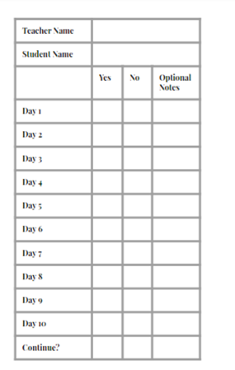
2X10

Slide 59
Connection BEFORE Correction

Slide 60
Practices

Slide 61
Supporting Improvements in Behavior, Academics, and Social-Emotional Wellness: Systems
OUTCOMES
Supporting
Staff
Supporting
Decision
Making
SYSTEMS
DATA
PRACTICES
Supporting
Students

Slide 62
Who loves Lucy?

Slide 63
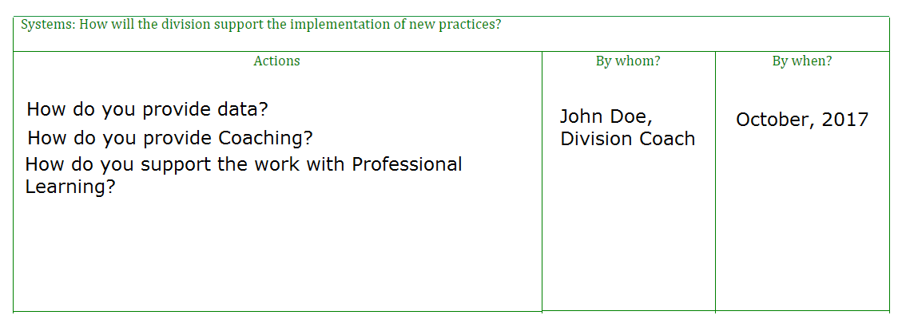
Systems: How does your division support the schools in the implementation of new practices?

Slide 64
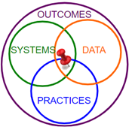
Pause and Reflect
Using the VTSS Implementation Logic,
jot a few notes individually about
each feature
then, with a neighbor, take turns
sharing your understanding of the
logic model.

Slide 65
Supporting Improvements in Behavior, Academics, and Social-Emotional Wellness: Fidelity
OUTCOMES
Supporting
Staff
Supporting
Decision
Making
SYSTEMS
DATA
FIDELITY
PRACTICES
Supporting
Students

Slide 66
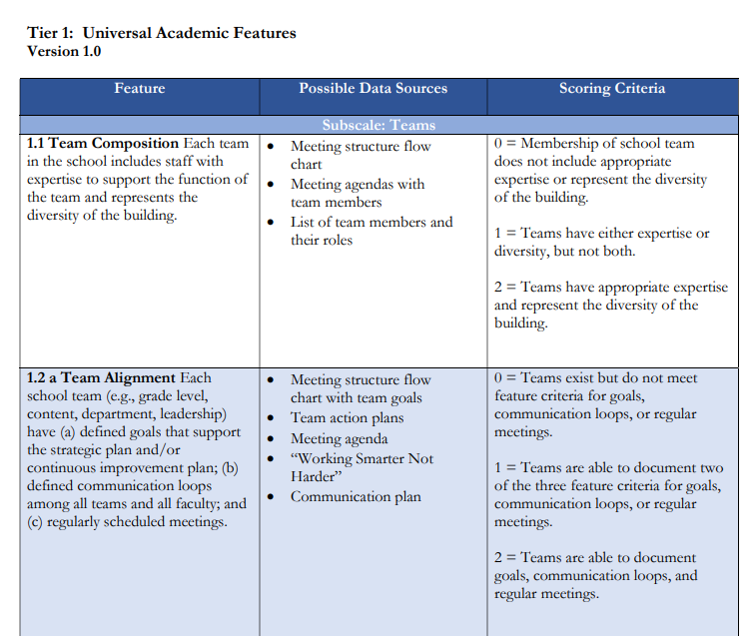
Tiered Fidelity Inventory (TFI) and Academic TFI (A-TFI)
Defining the work ahead
Understanding implementation with fidelity

Slide 67
But why the TFI and A-TFI?
Efficient tool for Measuring Implementation at the school level
Progress Monitoring
Action Planning & Road Map for school

Slide 68
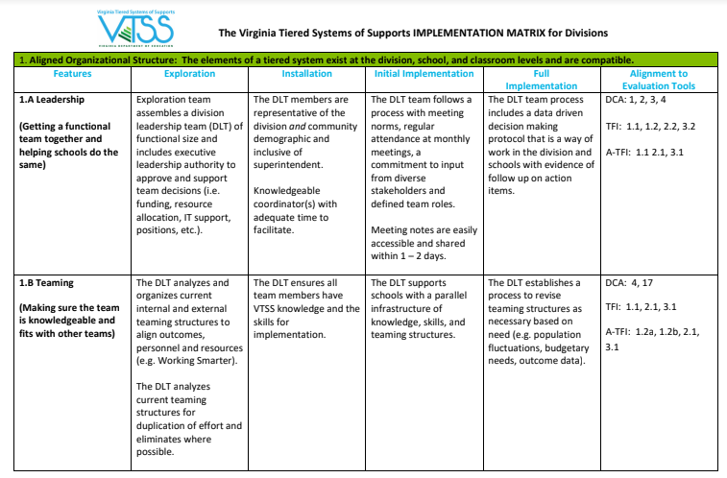
VTSS Implementation Matrix & the
District Capacity Assessment (DCA)

Slide 69
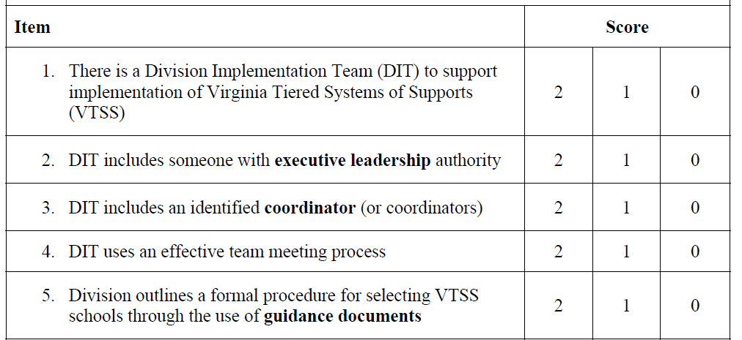
The DCA

Slide 70
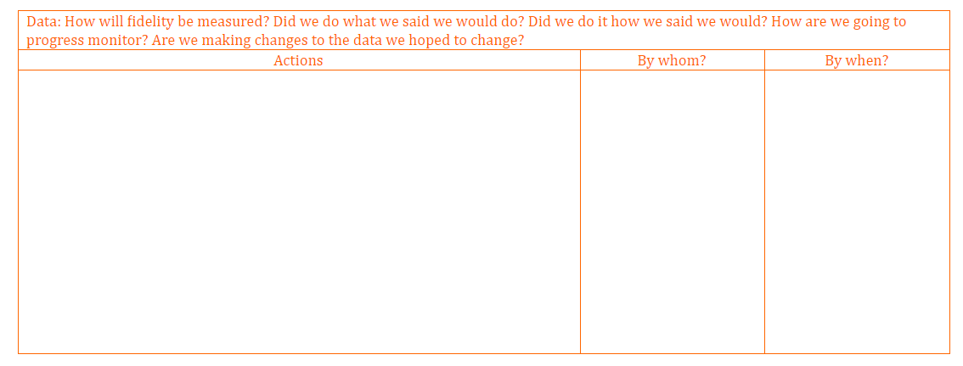
How will fidelity be measured?
How will we progress monitor?
Tiered Fidelity Inventory (TFI) and Academic TFI
Progress Monitor where we identified a need.

Slide 71
Why establishing your team is so important.

Slide 72
Solidify your Division Leadership Team. Who….
•Would support a collaborative partnership?
•Has the authority to allocate resources, including funding?
•Has the authority to influence or change policy?
•Understands academic, behavioral and emotional wellness needs in our division?
•Understands the needs of our families and community?
•Understands the current initiatives and priorities in our division?

Slide 73
Who is coaching who?
VTSS Systems Coaches supports Division and School
Division Coaches supports Building Level Coach
Building Level Coaches supports Staff
We all work together as a VTSS team!

Slide 74
The importance of coaching
To help teams with:
VTSS fluency
Rapid redirection from mis-applications
Fidelity of overall implementation
Sustainability over time
Cheer on!
“Do with”
“Do for” 1 time

Slide 75
Division Coaches Will...
1. Support the activities in the Scope and Sequence.
2. Be in contact with VTSS state level Division Systems Coaches to plan and attend at least one site visit.

Slide 76
The Division Team Will...
3. Schedule division leadership team meetings and list them on your worksheet for leadership team.
4. Share the work with stakeholders as you develop your implementation journey.
5. Plan to attend future trainings
Strand 1 Data Informed Decision Making (3 sessions throughout the year)

Slide 77
The Division Team Will... 2
6. Review notes from the Data Driven Decision Making document you developed earlier and make revisions as needed.

Slide 78
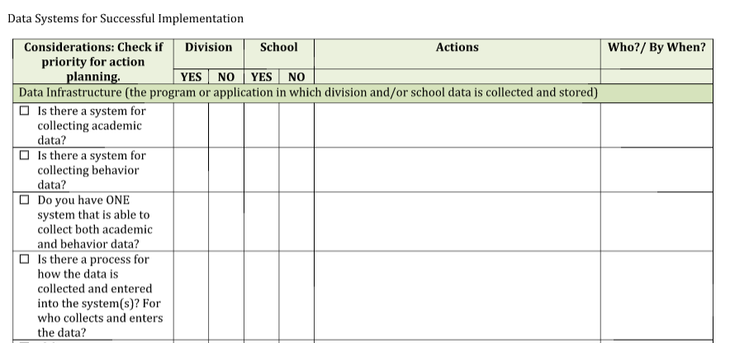
The Division Team Will...
7. Complete your Data Systems for Successful Implementation (data audit)

Slide 79
Now, let’s develop your VISION!

Slide 80
Let’s start with your vision.
The team’s work is to manage this complex change process.
The starting place: creating a clear, shared vision.
(Lack of vision results in confusion!)
Vision
Meaningful
Change

Slide 81
Starting with a Vision
Step 1
Take a few minutes for each team member to respond to the following:
Our division exists to….
If we could create the division of our dreams, what would it look like and sound like?
Use words, or – even better – draw!
What colors or images capture the heart of your vision?

Slide 82
What are the common themes?
Step 2
Take turns sharing your words, phrases and images. What are the common themes and threads?
Step 3
Draft a vision statement that captures the essence of those themes. Be sure to include how VTSS will add value to your current way of work. Is there a visual image that inspires your team?

Slide 83
Set it to Music!
Step 4
Can you come up with a theme song that represents your vision?

Slide 84
Expanding the Vision
Step 5
How might you seek input from families and the community to inform your vision?
What additional data or information might you want to gather to have a clearer picture?

Slide 85
Resources to Deepen Your Knowledge
PBIS Website National Center on Intensive Intervention Website
Integrated Multi-Tiered Systems of Support: Blending RTI and PBIS (The Guilford Practical Intervention in the Schools Series)
by Kent McIntosh and Steve Goodman

Slide 86
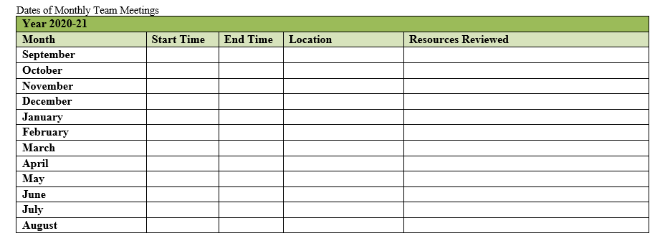
Document Decisions
Resources reviewed by your team and documented here.

Slide 87
Remember your Google Drive for your Cohort 7 application & sharing!
Data Systems for Successful Implementation
Data Driven Decision Making
Division Team Meeting Information Form
Remember to also fill out the bottom portion that includes division meeting dates and resources reviewed.
Starting with a Vision

Slide 88
Wrap Up
1. Talk with stakeholders about outcomes, data, systems, and practices.
2. How can you answer the question:
What do we need VTSS to do for us?
3. Make (or add to) a list of questions we have about VTSS and its “fit” for us. For help or support with questions, please contact Micheal Gregory at michael.gregory@doe.virginia.gov

Slide 89
Success Criteria 2
Did you identify your exploration team members?
Can you clearly define VTSS?
Can you identify information on the Implementation Matrix?
Can you identify and explain the VTSS Implementation Logic?
Have you identified the data are you hoping to change?
Do you have a family and community partnership(s) on your team?
Have you started your vision for the work, including how VTSS adds value to existing initiatives and it’s in your folder?

Slide 90
Exit Ticket
What squares with your thinking?
What question is still circling around in your mind?
Three key points from today.
What made me wiggle in my seat?

Slide 91
Thank you for your participation!
VTSS-RIC Website

