Slide 1
Diving Into Data Webinar 2
VTSS Exploration and Installation Series
Notes:
Kris
Intent:
Talking Points:
Welcome to webinar #2 Diving into Data: Informing the Decision to Implement the Virginia Tiered Systems of Supports (VTSS). My name is Anna Hebb, a VTSS Systems Coach.
(New VT comment) My name is Kris Herakovich-Curtis, a VTSS Systems Coach.
Thank you for sharing your valuable time to learn more about VTSS.

Slide 2
#ExploreVTSS
Notes:
Kris
Intent:
Talking Points:
Team can share your ideas and work. It’s a great way to collaborate and keep in touch. You’ll learn from other divisions who have gone through the exploration activities when you post a tweet!

Slide 3
Success Criteria
Understand the core features of VTSS in exploration and the impact of the framework on student outcomes
Evaluate and analyze division data to begin telling your data story
Notes:
Kris
Intent:
Talking Points:
During this VoiceThread:
We will review the core features of VTSS in exploration and the impact of the framework on student outcomes.
We will also evaluate and analyze division data to begin telling your data story.
Our intention creates our reality!

Slide 4
Essential Questions
Begin installation activities to answer these questions:
What does our data tell us?
Do we have opportunities for growth?
Are the areas of concern prevalent enough that we should allocate resources to them?
Does what we know about VTSS indicate that a multi-tiered framework of supports will address our needs and desired outcomes?
Notes:
Kris
Intent:
Talking Points:
As we look at our intentions and begin our installation activities, we hope that you will begin to answer these four questions:
What does our data tell us?
Do we have opportunities for growth?
Are the areas of concern prevalent enough that we should allocate resources to them?
Does what we know about VTSS indicate that a multi-tiered framework of supports will address our needs and desired outcomes?
As we work through this information, please be thinking about who you would select as your demonstration school or schools. It’s important to think about the administration at this building. Are they ready and willing to leave the charge, have some strong staff, can model the work and are willing to share their success.

Slide 5
The Three Tier Framework
Notes:
Kris
Intent:
Talking Points:
Of course we want to remind you of our three tiers of support with this colored triangle. Is this graphic new to anyone?
All students receive Tier I, or the green, supports and our goal is that 80% of students are successful. Some students will need Tier II support and a small percentage will receive Tier III for intensive and individualized instruction. Our triangle, or tiered system, organizes our supports.

Slide 6
Continuum of Support for ALL
Intensive
Math
Targeted
Spanish
Science
Lacrosse
Universal
Social skills
Reading
Social Studies
We label instruction…not students
Notes:
Kris
Intent:
Talking Points:
We are not about green, yellow, or red students, or Tier 1, 2, or 3 students. This work is about the practices we provide for academic, behavioral, and mental wellness success. This is very important because we are quick to label students. It’s easy to do. If we don’t emphasize this, we have only become an elaborate sorting and labeling system. We tier our supports for students!

Slide 7
VTSS Implementation Logic
OUTCOMES
Supporting
Staff
Supporting
Decision
Making
SYSTEMS
DATA
PRACTICES
Supporting
Students
Notes:
Kris
Intent: VTSS Implementation Matrix.
Talking Points: We always want to recall the VTSS Circle Logic which helps guide the work of VTSS. Our data supports decision making, our practices support the students, and our systems supports our most valued resource--our staff! We are constantly revisiting the circle logic within our work to support our desired outcomes.
VTSS is a WAY OF WORK. The Implementation Logic that you see here is how we organize the work.
The VTSS Implementation Logic is an alignment tool you’ll become very familiar with and return to time again throughout this work. Once you become comfortable with this tool, you’ll be amazed how efficient it is for problem solving many scenarios. It supports improvements in behavioral competence, academic achievement and social-emotional wellness.
We frequently begin our professional learning events and webinars with a reminder of how we align our way of work and organize ourselves in VTSS. We improve student outcomes by utilizing data to set goals, make decisions and evaluate effectiveness. We support students by utilizing evidence based practices in instruction. And we support staff through systems that allow for the professional learning, scheduling, and consistency needed to sustain our work in a more effective and efficient manner. (check each component as we reference it)
Activity: N/A

Slide 8
VTSS Implementation Matrix: Our Roadmap for the Work
6 Core Components of the
Implementation Matrix
1.Aligned Organizational Structure
2.Data Informed Decision Making
3.Evidence-Based Practices
4.Family, School, and Community Partnerships
5.Monitoring Student Progress
6.Evaluation
Notes:
Kris
Intent:
Talking Points:
Please pause and locate the VTSS Implementation Matrix in your Google Drive. We also have a VTSS Implementation Matrix Definition resource to help with understanding the matrix.
Through this work, your division will define their story using the six components—your roadmap to the work you will accomplish. Your story will be unique depending on your division’s team and your division’s needs.
Today we are just going to address the component of Data Informed Decision Making within the exploration phase.

Slide 9
Supporting Improvements in Behavior, Academics, and Social-Emotional Wellness
OUTCOMES
Supporting
Staff
Supporting
Decision
Making
SYSTEMS
DATA
PRACTICES
Supporting
Students
Notes:
Kris
Intent: Take more time with each component of our logic.
Talking Points:Today we are engaging in the Exploration Phase by examining your current data, practices and systems and their compatibility with VTSS. To begin, we are going to work through an example of what data driven decision making can look like and sound like. Data supports our problem solving and implementation…so let’s get started by looking at DATA.
Activity: N/A

Slide 10
Why focus on data?
Data allows us to understand need, identify areas for improvement, and develop meaningful action plans!
Notes:
Kris
Intent:
Talking Points:
This is a fun spin on data.….As we begin with looking at data, it’s imperative that the data be accurate.

Slide 11
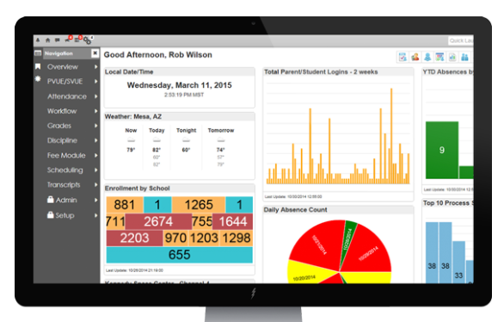
Organizing for Implementation
What does your division use for data:
PowerSchool
SOL’s
MAPs
Benchmarks
Homegrown
Evaluate current data systems for ease of use and functionality for aligned data driven decision making.
Notes:
Kris
Intent:
Talking Points:
We have a lot of data sources, but do we have a system in place that allows us to access our data and organize in a meaningful way? Remember the questions to focus on: Do we have the right DATA to the right PEOPLE in the right FORMAT at the right TIME?
A data dashboard to organize overwhelming amounts of data is so helpful. With a dashboard, meaningful reports and graphs can be accessed in an easy and timely way. Work with your IT guru and talk to other divisions to see what you may need to change! A data dashboard is critical to our way of work. It is so critical that VTSS supports you through statewide training and provides a VTSS Systems Coach to help you develop your data dashboard. One of your very first training events is Data Informed Decision Making!

Slide 12
How are we organized to utilize data?
Data Infrastructure Data Systems
How is data collected and stored?
How is data communicated?
Notes:
Anna
Intent:
Talking Points:
Stop and think. Do your data systems talk to each other? Who in your division is looking at the data and when? Do the right people have easy access to data? Our infrastructure defines how we collect, store, and share data.
To refer back to our Implementation Logic, this is the intersection of data and systems. We always want to think about how we are supporting communication to the staff and utilizing the data to drive actions. This big picture notion of how the data is collected, stored, and shared is so vital for the division to manage and support teachers, because they can’t begin to utilize the data if it isn’t accessible. We hear so often that administrators and teachers have trouble using the data. We have to build the SYSTEMS to help them quickly and efficiently get their hands on it, with complete clarity.

Slide 13
Data Systems for Successful Implementation
Notes:
Anna
Intent:
Talking Points:
Data Systems for Successful Implementation is part of your handouts. Please locate this document. We are going to review the questions of data infrastructure and data systems. Data supports all our work in the Implementation Logic. Priority one is developing a decision based data system with universal screeners, progress monitoring data, and fidelity data. First, let’s look at what your data systems look like. Pause the VoiceThread and with your team begin to work through this document together. If you need to review and come back to this document later that’s okay, too. You will schedule meetings to complete this work. The next slide gives an example of how this document can be completed.

Slide 14
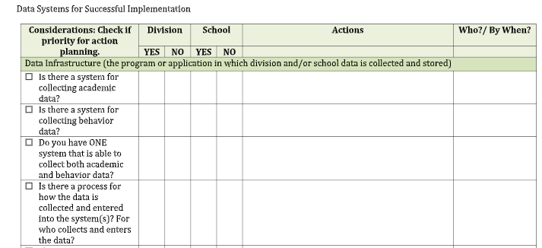
For Example
Notes:
Anna
Intent:
Talking Points:
Here is an example to help you get started on this work.

Slide 15
Your Data Story
Identify and analyze current baseline data to determine needs and prevalence of needs.
Notes:
Anna
Intent:
Talking Points:
As you answered the questions on your Data Systems for Successful Implementation document, you were building your data story and identifying your data infrastructure. Remember, this is the intersection of data and systems within our Implementation Logic.

Slide 16
Familiar Data within Your Division
Examples of School Data
ODRs
ISS
OSS
Attendance
School climate
Student surveys
Universal screening
Benchmark data
SOLs
Formative assessments
Examples of Division Data
Graduation rates
Suspensions
Attendance
SOLs
Referrals to Special Education
% of students reading on grade level
% of students accessing advanced classes
% of students passing Algebra
WIDA growth
% going to 4 year or community college
Notes:
Anna
Intent:
Talking Points:
You are familiar with these data points. Suspensions, Attendance, and ODR’s. Today, we want to peak your curiosity and challenge you to think about what data points we need to examine more closely for disproportionality and/or specific academic and discipline needs.
Are you curious about your data story?

Slide 17
Would you like to know more about...
1. The percentage of students by race who are experiencing out of school suspension?
2. Time of day, location and/or grade level for your ODR’s?
3. ODR’s and suspensions for your Special Education population?
4. What are the data points that your division consistently reviews across all schools?
5. What about the performance of English Learners on formative assessments?
Notes:
Anna
Intent: What would you like to know more about?
Talking Points:
1. The percentage of students by race who are experiencing out of school suspension?
2. Time of day, location and/or grade level for your ODR’s?
3. ODR’s and suspensions for your Special Education population?
4. What are the data points that your division consistently reviews across all schools?
5. What about the performance of English Learners on formative assessments?
Answers to these questions support building your data dashboard.
Activity: Now, please pause and talk for a few minutes on what data points are important to your division.

Slide 18
Data Informed Decision Making
Data that Indicates a Need What data answers questions you have about student outcomes related to academics and/or behavior? What data speaks to a division priority? What data speaks to outcomes that you would like to change? Please list the data points below.
What is the story your data is telling about your students? Be precise! Describe who, what, when, where and why! The more precise the story, the more efficient and effective we can be in our decision-making! Again please tell the story through the lens of your division data.
Notes:
Anna
Intent:
Talking Points:
Today we are working on activities that will help you understand data for decision making. This will help you begin the work and think about whether VTSS will be a good fit for your division and meet your needs. With each exercise, we encourage you to stop and think: Is VTSS the framework or vehicle that can help improve your work?
Now we would like you to review the Data Informed Decision Making handout located in the shared folder. Note the color coding to match the Implementation Logic. Orange is for DATA!
Please take approximately 10 minutes with your team to discuss the questions in the first box and what data is important to you; what data is a concern in your division; what data do you want to change. Pause and Make a list of the data that you need to keep an eye on because it’s a concern in your division.

Slide 19
Be Precise!
Tell the data story!
Try to explain who, what, when, where, and possibly the whys.
Precision allows us greater efficacy and efficiency in decision making.
Is there any data missing that you might need to go back and find in order to tell the story more completely?
What does the data indicate about the climate of your school(s)?
How does the behavior data impact academic data? Are you noticing any trends?
Notes:
Anna
Intent:
Talking Points:
So now we have a sense of what data we have that identifies needs. Next we need to tell our data story. We need to be precise and create a SMART goal that is specific, measurable, attainable, relevant, and time based.
Try to explain who, what, when, where, and possibly the whys.
Precision allows us greater efficacy and efficiency in decision making.
Is there any data missing that you might need to go back and find in order to tell the story more completely?
What does the data indicate about the climate of your school(s)?
How does the behavior data impact academic data? Are you noticing any trends?

Slide 20
Data Informed Decision Making
Data that Indicates a Need What data answers questions you have about student outcomes related to academics and/or behavior? What data speaks to a division priority? What data speaks to outcomes that you would like to change? Please list the data points below.
What is the story your data is telling about your students? Be precise! Describe who, what, when, where and why! The more precise the story, the more efficient and effective we can be in our decision-making! Again please tell the story through the lens of your division data.
Notes:
Anna
Intent:
Talking Points:
Next, pause to write your data story in the second box.
What is the story your data is telling about your students? Be precise! Describe who, what, when, where and why! The more precise the story and SMART, the more efficient and effective we can be in our decision-making!
Again please tell the story through the lens of your division data.

Slide 21
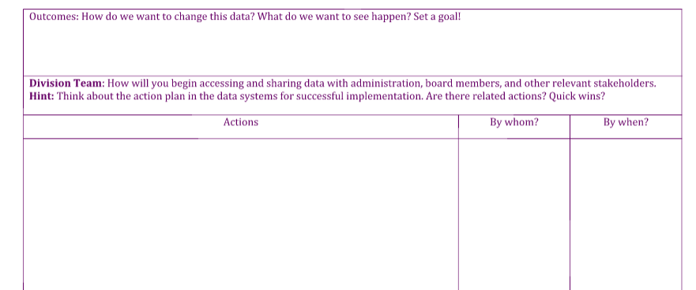
Would you like to rewrite the end of your story?
Notes:
Anna
Intent:
Talking Points:
Now! after processing as a group, would you like to rewrite your story?
It’s important to set a goal! As Steven Covey shares in Habit #2 “Begin with the End in Mind” which means to begin each day, task, or process with a clear vision of your desired direction and destination. Pause now to fill out the Outcomes portion (the purple in our Circle Logic) of your worksheet which is located at the end of the handout. Continue to use your data to create a goal that is SMART. Don’t worry about the other areas. As you progress through future VoiceThread webinars you will learn more about practices and systems.

Slide 22
Demonstration School(s)
Notes:
Anna
On the next slide you will listen to a video on selecting a demonstration school. Regina Pierce shares the importance of a well thought out process with your team in selecting one or two schools that will begin the work of VTSS. If you decide to implement the VTSS framework, you will be asked to select your school teams from a demonstration school prior to summer 2020. The teams will attend Tier 1 New Team Training along with someone from the division team to help coach them and learn the content. The dates for the training will be shared at the end of this webinar.

Slide 23
Early Adopter School Video
Notes:
Anna

Slide 24
Next Steps
Continue to meet with your Exploration Team to discuss what you are learning about VTSS and document your progress.
Decide as a Team when you will listen to Webinar #3 and set a date and time.
Notes:
Anna
Intent:
Talking Points:
Here are your next steps! Please…
Continue to meet with your Exploration Team to discuss what you are learning about VTSS and document your progress.
Decide as a team when you will listen to Webinar #3 and set a date and time.

Slide 25
Google Drive Directions
Make sure you have the Google Drive link that was shared with your division.
Inside the Google Drive folder, locate your division’s folder.
Please place all working documents in your folder to show your progress in the work. After each webinar we will review what documents need to be completed and placed within your folder.
Remember, this is a shared drive.
Notes:
Anna
Intent:
Talking Points:
Prior to watching the webinar, you were sent a Google Drive Link that will house the work of this cohort! Locate your division’s folder or create a folder. Place all your working documents within this folder that will be shared with the VTSS Specialist and Director for review. Please remember this is a shared drive. We are building a community of practice so keep in mind Google Drive space --the unintentional action of changing materials. We’ve all been there!
If you do not have access to the drive, please reach out, and we will help you! Until then, save your work, and you can upload it at a later time.

Slide 26
Documents for Division Folder
Webinar #1
Division Exploration Team Worksheet
Remember to also fill out the bottom portion that includes division meeting dates and resources reviewed.
Starting with a Vision Worksheet
Webinar #2
Data Informed Decision Making
Data Systems for Successful Implementation
Notes:
Anna
Intent:
Talking Points:
Here are the documents to add to your division’s folder! The Division Exploration Team Worksheet and the Starting with a Vision Worksheet.
Remember upon completion of these two items and the placement of them in your folder, we will mail you a copy of the Integrated Multi-Tiered Systems of Support: Blending RTI and PBIS by McIntosh and Goodman. This is a book mentioned in our resources for deepening your knowledge. For webinar #2 you’ll upload data informed decision making and data systems for successful implementation.

Slide 27
Wrap Up
1. Talk with stakeholders about outcomes, data, systems, and practices.
2. Answer the question: After engaging in this webinar about data, how can VTSS help us improve our outcomes?
3. Create (or add to) a list of questions we have about VTSS and its “fit” for us.
For help or support with questions, please contact Michael Gregory - michael.gregory@doe.virginia.gov
Notes:
Anna
Intent:
Talking Points:
As we conclude this session, we encourage you to talk with other stakeholders about outcomes, data, systems and practices, our Implementation Logic.
It will be helpful to make or create a list of questions to help you decide if VTSS is the right fit for your division. And, most importantly, what do you need VTSS to do for your division?

Slide 28
Success Criteria Webinar #1
Did you identify your exploration team members?
Can you clearly define VTSS?
Can you identify information on the Implementation Matrix?
Can you identify and explain the VTSS Implementation Logic?
Have you identified the data are you hoping to change?
Do you have a family and community partnership(s) on your team?
Have you started your vision for the work, including how VTSS adds value to existing initiatives and it’s in your folder?
Notes:
Anna
Intent:
Talking Points:
As a review, we are hopeful that we have met the criteria for your success in webinar 1. Please review these questions with your team. These tasks are important to guide you through this work. It’s critical that you answer these questions with your team. And remember, these questions help build your VTSS application.
Feel free to reach out if you have further questions, or review the webinar as needed!

Slide 29
Success Criteria Webinar #2
Can you identify the core features of VTSS in exploration and the impact of the framework on student outcomes?
Can you evaluate and analyze division data to begin telling your data story?
Notes:
Anna
Intent:
Talking Points:
As a review, we are hopeful that we have met the criteria for your success in webinar 2. Please review these questions with your team.

Slide 30
Tier 1 New Team Forum
June 16 - 18, Greater Richmond Convention Center
OR
July 28-30, The Westin Virginia Beach Town Center
Notes:
Anna
Here are the dates for Tier 1 New Team Forum to be held on June 16 -18th in Richmond, and again on July 28 – 30 in Virginia Beach. You will select which forum is best for your teams. Remember that someone from the division team will attend with the school team to help with coaching and learning the content.

Slide 31
Thank you for your participation!
https://vtss-ric.org/
Notes:
Anna
Intent:
Talking Points:
Thank you for taking valuable time with your team to learn more about this exciting work. We are confident you will find value in this work! The VTSS website, which can be accessed via this link, has a wealth of resources.
We look forward to working with you!!

