Slide 1
Putting the MTSS FRAMEwork to Work
A Day of Learning, Engaging, and Networking
July 2024
Notes:
Get a copy of the slides that were used to connect and introduce participants by name at the beginning. (Chris Frawley)
Putting the MTSS Framework to Work:

Slide 2
Welcome!
We are so glad you are here!
Notes:
Framing our work today!
something fun and different
Connect with Engage cards resources from Chad littlefield –Connection before content cards

Slide 3
Michael Gregory
Erin Sturgis
Japeira Keys
Dr. Jodie Soracco
Dr. Nicole Hollins
Notes:
VDOE Rep – maybe put a pic/title in frame?

Slide 4
Community Agreements
Be responsible
Take care of your needs
Be respectful
Turn cell phone volume down
Be engaged
Stay present
Listen and learn from others
Willingness to share your expertise, information and ideas

Slide 5
VTSS Resource Hub
Notes:
Our Resource Hub was born from the previous VTSS Summit! Divisions asked for a hub to display and share the implementation work from the field. What can you share? Go to the website and look around, and if you can share your brilliance with us, please do! You’ll see that you send the items to the email listed here on the slide. You can also work with your VTSS State Systems Coaches to decide what to share! This is a website for YOU!

Slide 6
Learning Intentions
Understand Virginia’s components and features of MTSS
Identify practices and systems contributing to successful MTSS implementation
Engage in opportunities to learn from and network with other VTSS school division personnel

Slide 7
Agenda
Welcome and Opener
Introduction to MTSS Components 2.0
MTSS in Real Life (VTSS Panel)
LUNCH
Round Table Discussions
Setting intentions for ‘24 - ‘25 SY
Evaluation
Closing

Slide 8
Today, I will…
Create a permission slip for myself that describes my commitment and purpose for the day.
How will I engage? What do I want to commit to? What do I hope to accomplish? What is my intention for today?
Write it down.

Slide 9
MTSS Core Components
Notes:
https://docs.google.com/document/d/1Dj171Sk13yMs3zK11HXaZzEeA8iJNTOj/edit

Slide 10
Learning Intentions
Understand Virginia’s components and features of MTSS
Identify practices and systems contributing to successful MTSS implementation
Engage in opportunities to learn from and network with other VTSS school division personnel

Slide 11
What is VTSS?
The Virginia Tiered Systems of Supports (VTSS) is a collective of organizations funded and led by the Virginia Department of Education to support divisions with implementing and sustaining a multi-tiered system of supports (MTSS). The primary implementation partners include:
VTSS-Research and Implementation Center (VTSS-RIC) at Virginia Commonwealth University
VTSS Evaluation Team at Old Dominion University
Regional Training and Technical Assistance (T/TAC) Partners
“VTSS is who we are and MTSS is what we do.”
Notes:
The VTSS-RIC leads implementation/coaching/PD in collaboration with TTACs at JMU, GMU, RU, W&M, ODU, and VCU. Each of these are centers funded by the Virginia Department of Education working towards supporting school divisions in a number of areas – in this case it is centered on implementation of a multi-tiered system of supports with VTSS.
Next, let’s make sure we are all centered on what we’re doing collectively. What is this thing that we call MTSS?!

Slide 12
MTSS is a systemic, data-driven approach that allows divisions and schools to provide evidence-based practices and interventions to meet the needs of their students. This is done through a clearly defined process that is implemented to fidelity by all stakeholders within the school and/or division.

Slide 13
Previous MTSS Components
Leadership & Teaming
Planning
Communication
Aligned Definitions & Resources
Professional Learning & Coaching
Aligned Organizational Structure
Outcome
Fidelity
Evaluation of Process
Data Informed Decision Making
Data Systems
Decision Making Process
Meeting Structures & DIDM
Whole Child
Assessment Mapping
Screening
Progress Monitoring
Monitoring Student Progress
Evidence Based Practices
Quality Core Instruction
Aligned Instructional Interventions
Continuum of Supports
Fidelity of Practices
Capacity for Coaching & Professional Learning
Family, School, Community Partnerships
Communication
Cultural & Linguistic Responsiveness

Slide 14
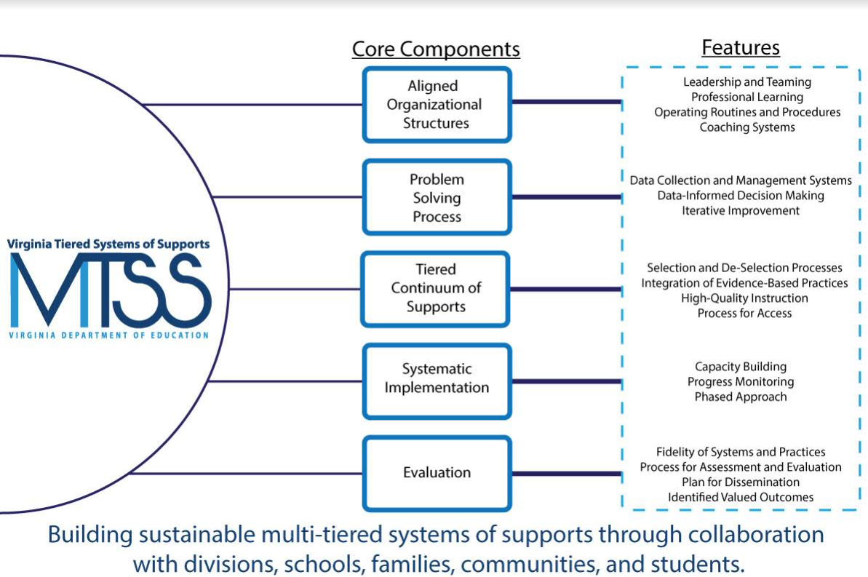
Notes:
Mini-lesson on each of these.
Anchor to our work and how we are defining what we do
discuss and acknowledge the bottom and have opportunities to discuss
How we got this visual…shared from another state

Slide 15
Aligned Organizational Structures
The intentional organization of a system’s processes and components that work in concert to support a common vision, mission, and set of identified goals.
Leadership and Teaming
Professional Learning
Operating Routines and Procedures
Coaching Systems

Slide 16
Problem Solving Process
A process for collecting, analyzing, and evaluating data to inform educational decisions around instruction, intervention, implementation, allocation of resources, development of policy, and movement within a multi-tiered system.
Data Collection and Management Structures
Data-Informed Decision-Making
Iterative Improvement

Slide 17
Tiered Continuum of Supports
A three-tiered continuum of integrated academic, behavioral, and social-emotional instruction, intervention, and supports that are evidence-based and responsive to the unique needs of each and every learner.
Selection and De-selection Processes
Integration of Evidence-Based Practices
High-Quality Instruction
Process for Access

Slide 18
Systemic Implementation
The use of an intentional process to inform, improve, and refine practices or initiatives that can be scaled and sustained over time, resulting in improvement to valued outcomes.
Capacity Building
Progress Monitoring
Phased Approach

Slide 19
Evaluation
A plan for gathering, communicating, and reporting information around key questions to monitor impact, determine potential barriers, and inform decisions related to identified valued outcomes.
Fidelity of Systems and Practices
Process for Assessment and Evaluation
Plan for Dissemination
Identified Valued Outcomes

Slide 20
Learning Intentions
Understand Virginia’s components and features of MTSS
Identify practices and systems contributing to successful MTSS implementation
Engage in opportunities to learn from and network with other VTSS school division personnel

Slide 21
MTSS in Real Life
Notes:
https://docs.google.com/document/d/1Dj171Sk13yMs3zK11HXaZzEeA8iJNTOj/edit

Slide 22
Panelists
Dr. Chip Jones, Superintendent, Cumberland County Public Schools
Dr. Aaron Butler, Director of Student Services, York County Public Schools
Notes:
Lynchburg

Slide 23
Contact Information
Panelist | Email | Topic
Dr. Chip Jones | Superintendent, Cumberland cjones@cucps.k12.va.us | Academic Interventions & Family Engagement
Dr. Aaron Butler | Director Of Student Services, York abutler@ycsd.york.va.us | Attendance
Notes:
Lynchburg

Slide 24
Panelists
Dr. Erica Gervais, MTSS Division Coordinator, Chesterfield County Public Schools
Kim McGrath, Director of Intervention, Chesapeake City Public Schools
Dr. Patricia McMahon, Program Support Coordinator, Gloucester County Public Schools
Dr. Angela Flowers, Coordinator of Student Services, Portsmouth City Public Schools
Notes:
Richmond

Slide 25
Panelist | Email | Topic
Dr. Erica Gervais | MTSS Division Coordinator, Chesterfield County erica_gervais@ccpsnet.net | Social Emotional Learning
Kim McGrath | Director of Intervention, Chesapeake City Kimberly.McGrath@cpschools. com | Behavior
Dr. Angela Flowers | Coordinator of Student Services, Portsmouth City angela.flowers@portsk12.com | Attendance
Dr. Patricia McMahon | Program Support Coordinator, Gloucester County patricia.mcmahon@gc.k12.va.us | Academics
Notes:
Richmond

Slide 26
Learning Intentions
Understand Virginia’s components and features of MTSS
Identify practices and systems contributing to successful MTSS implementation
Engage in opportunities to learn from and network with other VTSS school division personnel

Slide 27
Round Table Discussions
Notes:
https://docs.google.com/document/d/1Dj171Sk13yMs3zK11HXaZzEeA8iJNTOj/edit

Slide 28
Table Topics
Integrating Initiatives
Family Engagement
Data Systems
Communication Plan
Coaching System
Notes:
gold stars for what’s going well

Slide 29
Guiding Questions
What’s going well in your division?
What would you like to grow, do better/differently?
What challenges/barriers are you facing, where are you stuck?
What supports do you need?
Time to talk about your experiences and needs and to learn from each other.

Slide 30
Learning Intentions
Understand Virginia’s components and features of MTSS
Identify practices and systems contributing to successful MTSS implementation
Engage in opportunities to learn from and network with other VTSS school division personnel

Slide 31
Setting Intentions for the New Year
Notes:
https://docs.google.com/document/d/1Dj171Sk13yMs3zK11HXaZzEeA8iJNTOj/edit

Slide 32
Hopes and Dreams for 2024-2025
What would we want this year to feel like?
What are some things we would like to accomplish?
What do we want to learn more about?
How might we keep ourselves focused?
Notes:
Connect to The Dot - “framed in swirly gold”
Find person(s) you met earlier today and share your frame.

Slide 34
Celebrate!
Image source: https://kggfradio.com/local-news/512968

Slide 35
We hope your 2024-2025 school year is filled with joy and success!

