Slide 1


Continuing to Grow Your Coaching System
Setting Your Intention:
Reflect on your purpose for attending this session: What do you hope to accomplish? How will you engage in the learning process? What will you need to stay present and engaged during this time?
Coaching Systems are developed to ensure schools and school staff have equitable access to high-quality coaching to successfully implement practices, programs or initiatives.
Quick Review from Growing Your Coaching System Part 1:
Establish a vision for a culture of coaching in your division
Discuss how you include coaching as part of your division initiatives
Determine the knowledge, skills and abilities your coaches need
Plan next steps to continue growing your coaching system
Outcomes and Considerations:
What is your process for selecting coaches? | How do you allocate and protect time for coaching?
What decision-making authority do coaches have? What are the planning and communication expectations for coaches? | How will you monitor fidelity and effectiveness of coaches within your system?

Slide 2
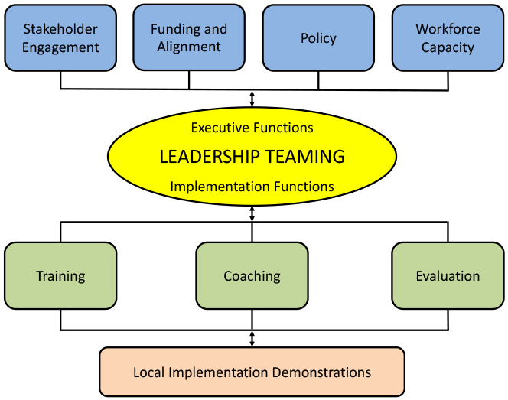
Continuing to Grow Your Coaching System
Where does coaching fit in to the work you are doing?
Before We Dig In, A Few Considerations
What are your next steps for establishing a vision for a culture of coaching in your division?
Do you include coaching as a part of your division initiatives?
What knowledge, skills, and abilities do your coaches need?
What are your next steps for these considerations?

Slide 3

Selection Criteria
Resources related to coaching selection
Selection Criteria Activity
What is your process for selecting coaches? Wisconsin Department of Public Instruction The Alabama Coaching Framework (pp. 20-22) Vermont Coaching as Professional Learning: Guidelines for Implementing Effective Coaching Systems (pg. 3) National Center on Intensive Intervention: Coaching Selection Criteria | Option 1: Create a list of interview questions or selection considerations for different types of coaches in your system
Selection Criteria Activity:
Option 2: Create a selection rubric. How might data be collected? Observation, references, interviews, other?

Slide 4
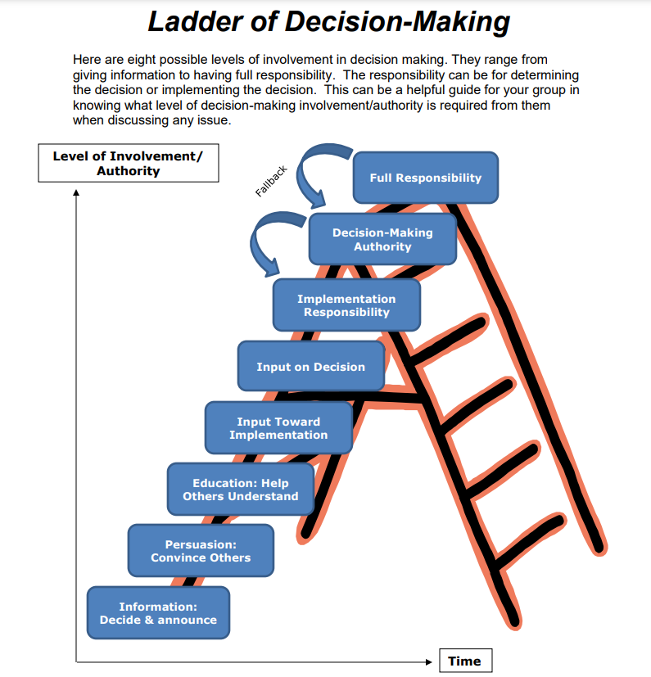
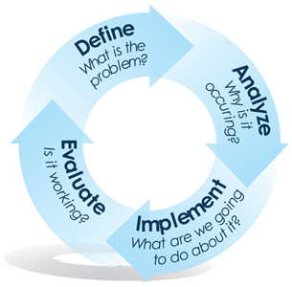
Decision-Making Authority for Coaches
Source: Florida Positive Behavioral Interventions & Supports Project
Source: North Star Facilitators
Decision-Making Authority activity:
Choose one to discuss and take notes:
Is there a decision-making process coaches are expected to use? If yes, what is it? How is it communicated to coaches? If no, what do you need to do to select one?
Create a list of the decisions coaches have and do not have the authority to make. How is a coach’s decision-making authority communicated?

Slide 5
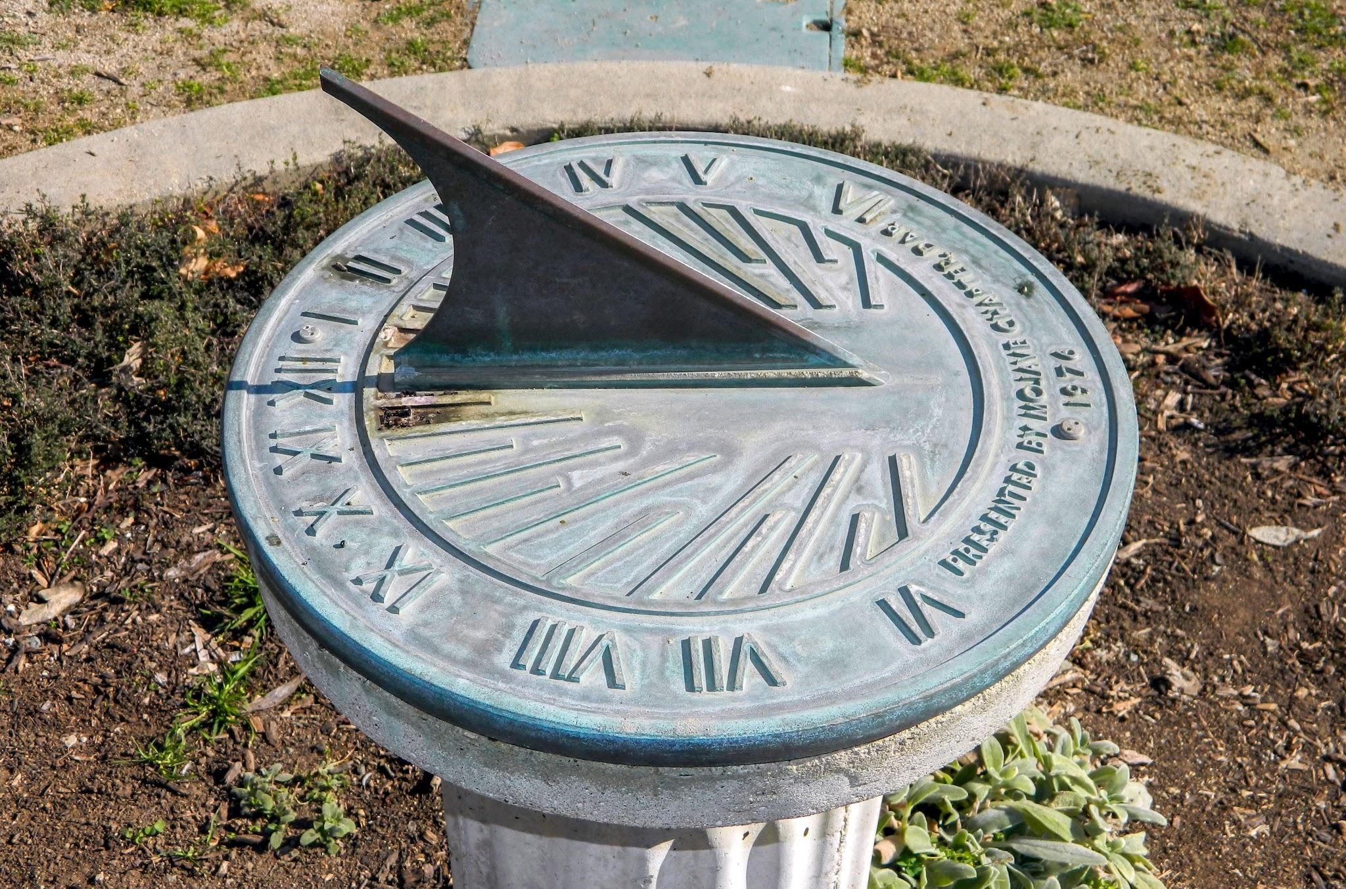
Time Allocation
Time Allocation Activity:
Option 1: If not yet developed, work on creating your vision for coaching.
Option 2:
Identify activities for each type of coach in your system.
Prioritize activities as they relate to your vision and purpose for coaching.
Estimate percentage of time allocation for each activity.
Identify potential barriers and solutions to protecting the time of coaches.
Type of Coach | Activities | Percentage of Time
Barriers to protecting time for coaches
Solutions to protecting time for coaches

Slide 6
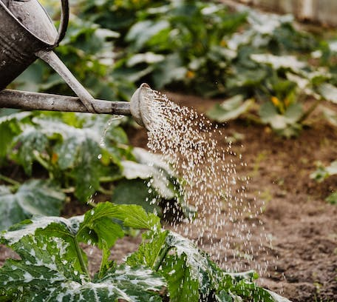
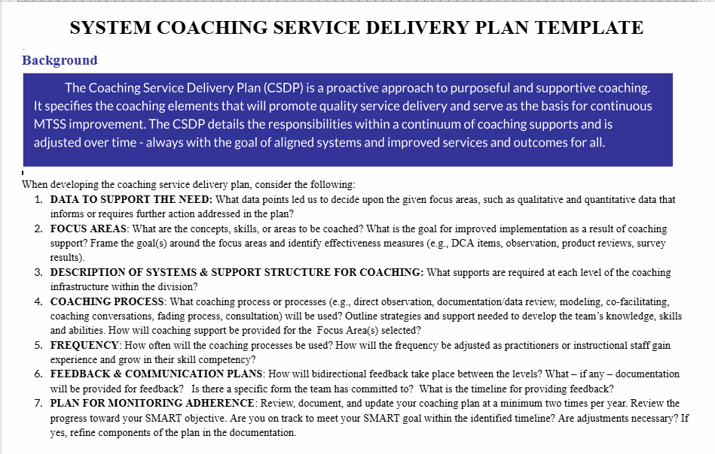
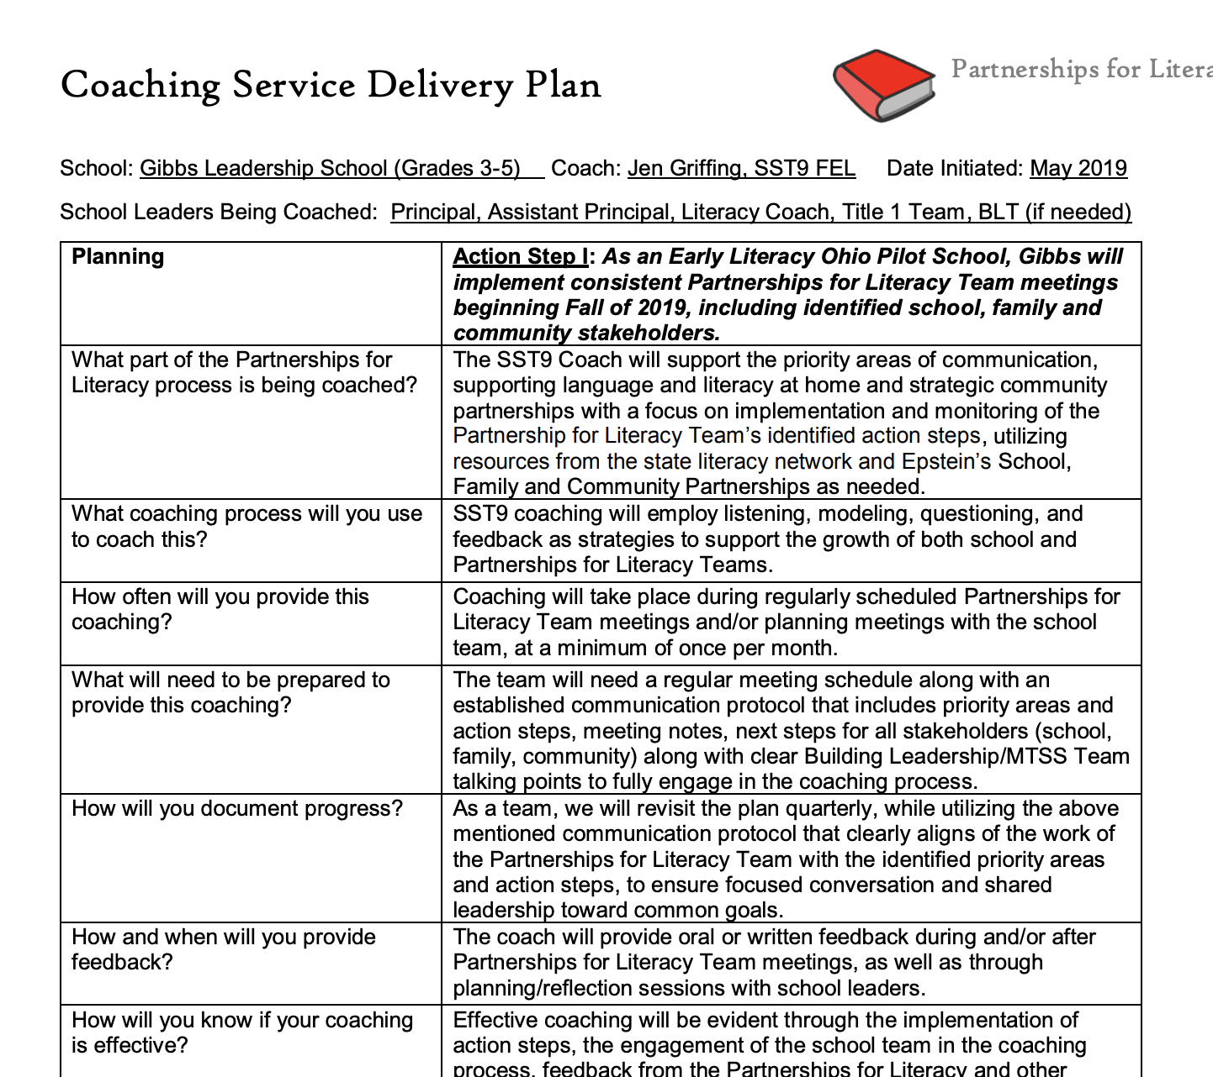
Planning the Delivery of Coaching
Options for Discussion:
What is one goal for your coaching service delivery plan? What skills will be necessary to achieve that goal?
How will feedback be provided (i.e., the feedback loops)?

Slide 7
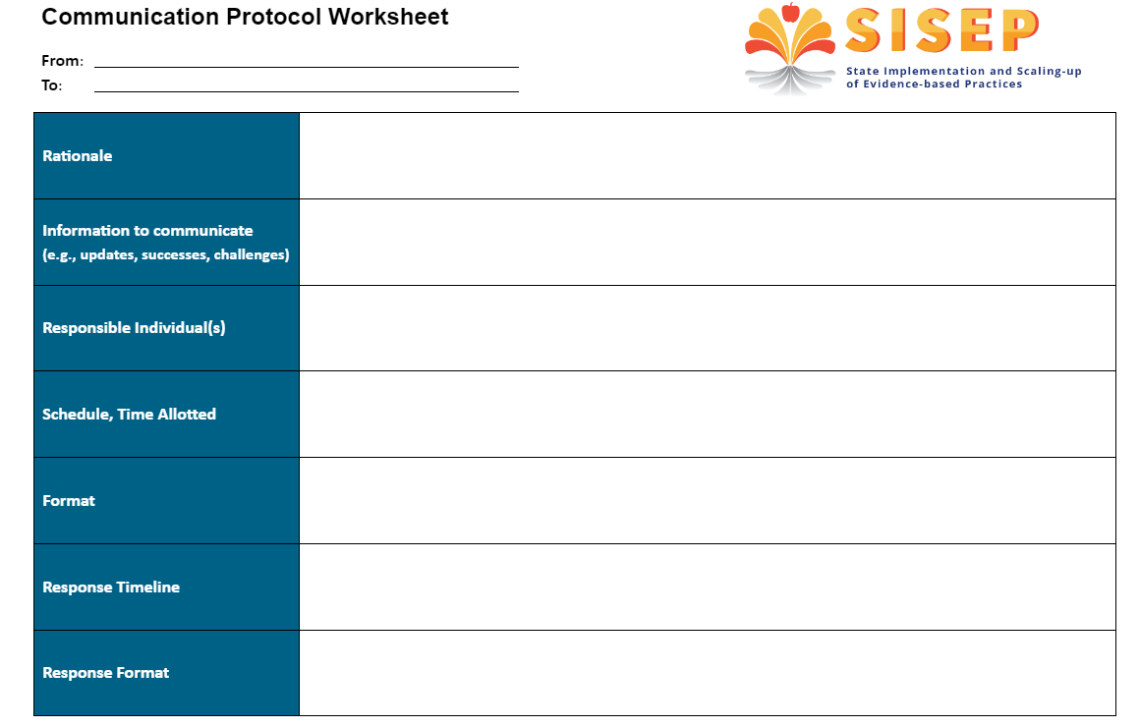
Plan for Coaches to Communicate with Others
As a group, work on one of the following tasks:
Draw a cascading model with detail to represent the coaching communication needed in your division.
Complete a Communication protocol worksheet for one aspect of coaching communication in your division.

Slide 8

Monitoring and Measuring
What Are Various Options?
Current fidelity measures
School/student outcome data
Coaching satisfaction surveys
Observations
Progress monitoring of CSDP
Coaching logs
Options for Discussion
Ways you do/can monitor fidelity
Ways you do/can measure coaches’ growth
Ways you do/can measure desired outcomes

Slide 9
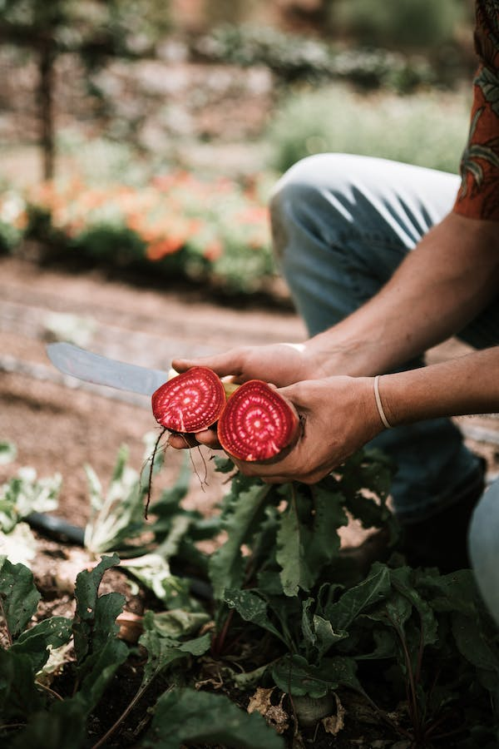

Preserve the Ongoing Growth
Thank you for taking a walk with us today. Please complete the evaluation to provide us feedback to assist with our planning.
Closing Activity
In your small group discuss the following:
What is your priority moving forward?
What is one thing you are excited to take back to your division?

