Slide 1
Growing Your Coaching System
Virtual - October 2023

Slide 2
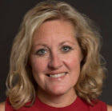
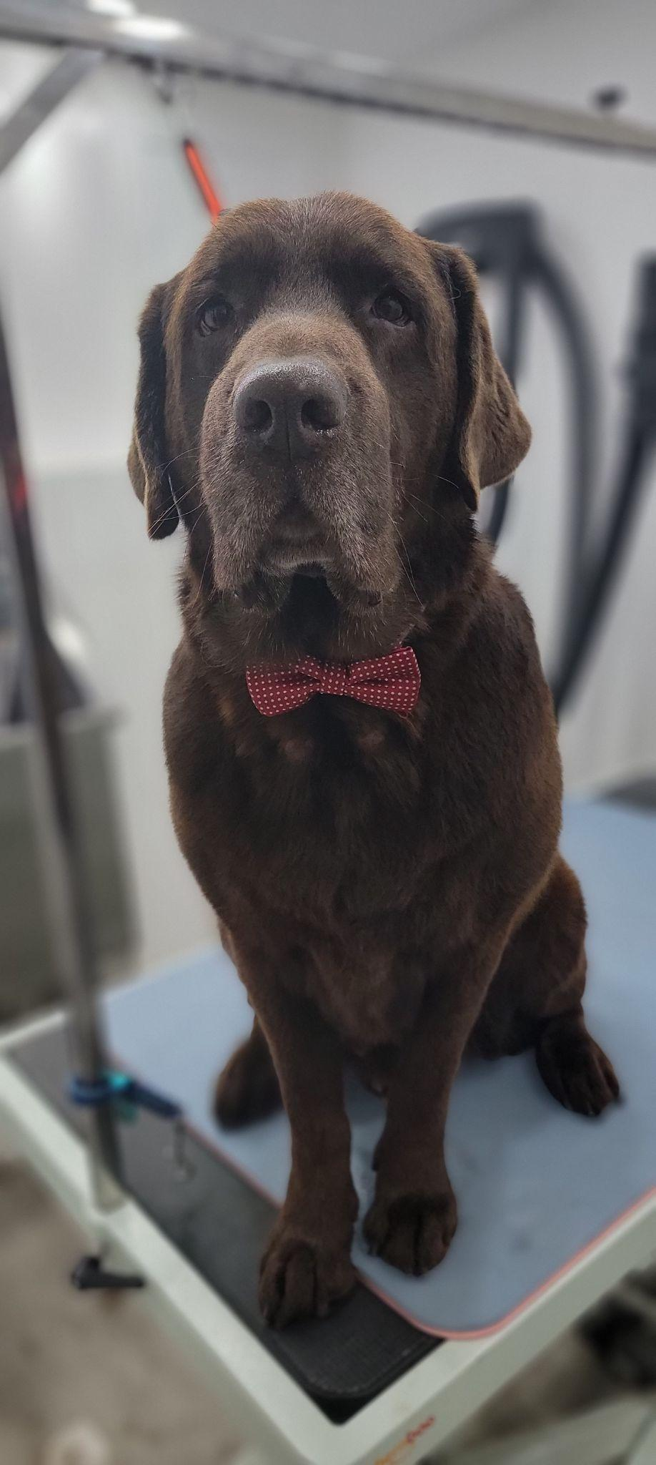
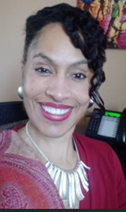
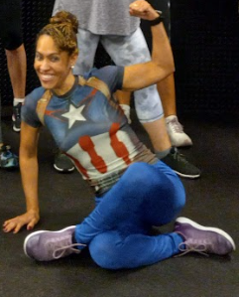
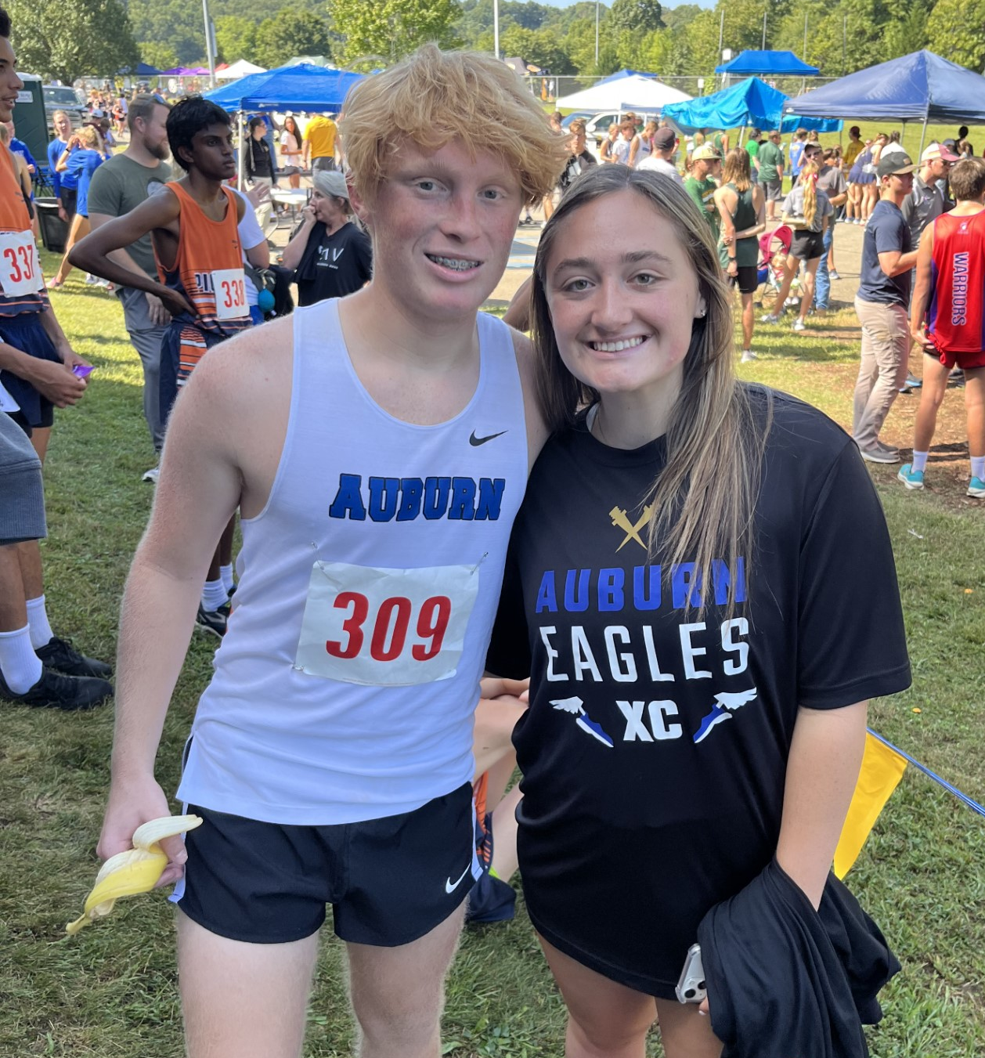
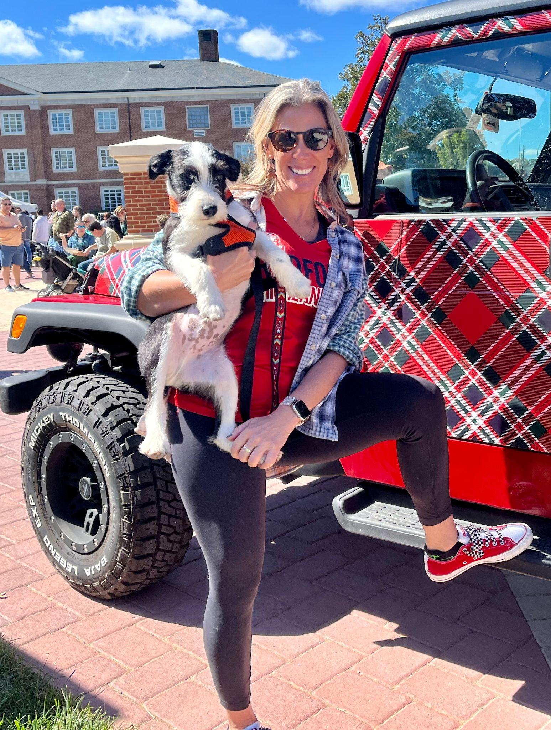
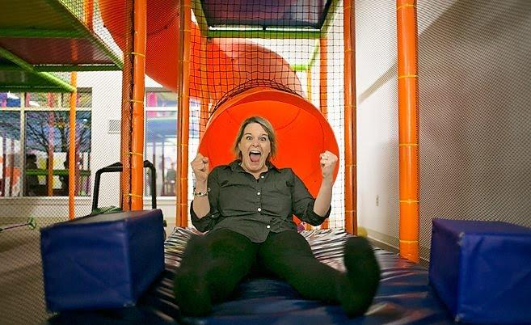
Meet the Presenters
Sharon Zuckerwar
Rhonda Jackson-Smith
Kate Jackson
Kim Dupre

Slide 3
A Message of Gratitude

Slide 4
Walk with Us- Notetaker
Materials:

Slide 5
Establishing our Purpose for Learning
Prepare the soil: What is your vision for a culture of coaching in your division?
Plant the seeds: How do you include coaching as a part of your division initiatives?
Provide water and nutrients: What are the knowledge, skills, and abilities your coaches need?
Preserve the ongoing growth: What are your next steps to continue growing your coaching system?

Slide 6
Setting Our Intentions for Today
Practice presence
Grasp opportunity
Embrace quick wins and bold next steps

Slide 7
Track Your Engagement

Slide 8
Our Wish For You
Take care of your needs
Use this time to connect and plan
Wonder and “What if”
Practice the approach of “Yes, and…”

Slide 9
Cool People Doing Cool Things

Slide 10
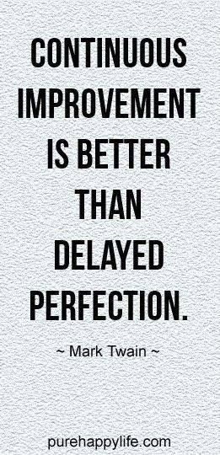
What does success look like?
4
1
3
2
5

Slide 11
Focus on Systems for Coaching
Coaching Systems are developed to ensure schools and school staff have equitable access to high-quality coaching to successfully implement practices, programs, or initiatives.

Slide 12
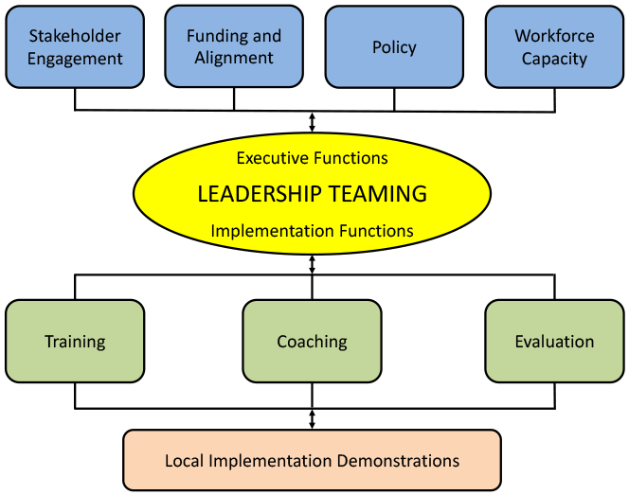
Where does coaching fit in?
Source: OSEP Technical Assistance Center on Positive Behavioral Interventions and Supports. (2015)

Slide 13
Where does coaching fit in?
Coaching
Systems Coach(es)
Liaison(s) between the division and schools -
Coach Data, Practices & Systems
Communication: within & beyond groups
School Coach
Administrator
SCHOOL LEADERSHIP TEAM
School Coach
Administrator
Communication: within & beyond groups
Grade Level Teams
Department Teams
Content/Specialty Area Teams
Advanced Tier Teams
Individual Student Teams

Slide 14
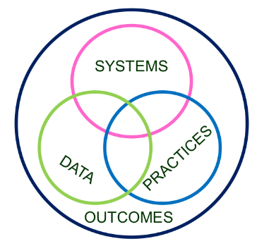
What is happening now?
Invest in Systems!!! (Leadership teams, support professional learning and coaching)
Differentiate and ensure outcomes are reflective of all students
Data informs decisions about screening, progress monitoring, fidelity, and outcomes
Prioritize efficient and effective practices
(evidence, culture, context)
Growth & benefit are central. Must reflect learning opportunities for all
14

Slide 15
Resources

Slide 16
Prepare the Soil
Vision for coaching

Slide 17
Why a coaching system?
The coaching system is developed to ensure building level teams and school staff have equitable access to high quality coaching to successfully use any effective innovation, including MTSS. Division context will inform the coaching system being built in your division.
Source: Ward, C., et al., 2015

Slide 18
Coaching is…
“[j]ob embedded professional development provided to support implementation of new skills and practices. Frequently involves prompting modeling, observing, and/or providing feedback,” District System Fidelity Instrument, 2023, p. 7.
“a form of professional development with a person who willingly engages in reflection and learning,” Aguilar, E., 2019, p. 23.

Slide 19
Vision for Coaching
A vision:
defines coaching and its purpose on the continuum of professional learning.
answers the question, “What will it achieve as a result of our efforts?”
answers the question, “Why do we need a coaching system?”

Slide 20
Example
School systems coaching is focused on building the school leadership team’s (SLT) capacity to effectively implement and sustain the use of a program, practices, or approach to enhance student outcomes. The primary coaching recipient is the SLT. In addition, coaching support is provided to the principal and select school staff, as necessary.
Source: Michigan’s MTSS Technical Assistance Center, 2021.

Slide 21
Begin to clear the land
Create a visual for your vision for coaching in your division.
The vision needs to:
define coaching
include the benefits of coaching
explain why building a coaching system is important for your division
Image source: https://www.landscape-creation.com/landscaping-tips/get-yard-tools-ready-for-landscape-planting-season

Slide 22
Padlet of Inspiration

Slide 23
Considerations for
next steps
Reflect, discuss, and record:
How will you facilitate your division’s vision and definition for coaching?
How will the vision for coaching be communicated and documented?

Slide 24
Take a Break
<<5:00>>

Slide 25
Plant the seeds
Conditions for coaching

Slide 26
Share your experience
Share an experience of being coached or of serving in the role of coach.
Why did you decide to be coached or to coach? Was it something new or requested to refine skill(s)?
What were the benefits of coaching?

Slide 27
Historically…
Source: Northeast Positive Behavioral Interventions and Supports. (2015)

Slide 28
Why coaching?

Slide 29
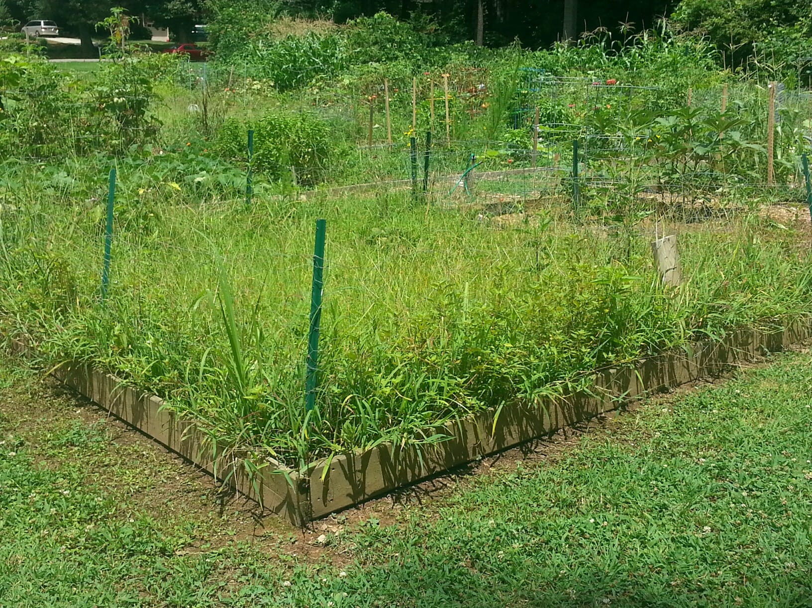
When do we need to coach?
New
Refining
School leadership team (SLT) is learning to use an innovation and support the successful use of the innovation across the school.
Continuous refinements and improvements to the use of innovations require teams to modify and refine their existing structures and/or processes to support the innovations.
Source: Michigan’s MTSS Technical Assistance Center. (2021).

Slide 30
Till the soil
How does your division currently determine a need for coaching?
Think about an initiative that was implemented in your division. What was the success of the initiative? How was coaching included in the roll out?
Image source: https://www.landscape-creation.com/landscaping-tips/get-yard-tools-ready-for-landscape-planting-season

Slide 31
Considerations for
next steps
Reflect, discuss, and record:
How will your division determine coaching needs? What data could be used in your decision making?
How will your division communicate to all stakeholders information about the various conditions that warrant coaching?

Slide 32
Provide water and nutrients
Knowledge and skills of coaches
Responsibilities of coaches

Slide 33
Let’s Learn & Grow Together
Silent Read: Introduction (pages 22-23
stop at “#1 Articulate a Definition and Vision”)
Source: Aguilar, E. (2019).

Slide 34
Jigsaw Reading
We will break into 5 groups. Each room will be assigned by the elements they will be reading. (each group has 2)
Person who has the next birthday coming up, serves as the facilitator.
Groups will have a short discussion on their a-ha’s from their selected readings
Groups will use Padlet and write down about 2-5 of their a-ha’s from the selected readings.
Groups will select one person to share out in our large group.
.

Slide 35
Group Share
Sharing is Caring

Slide 36
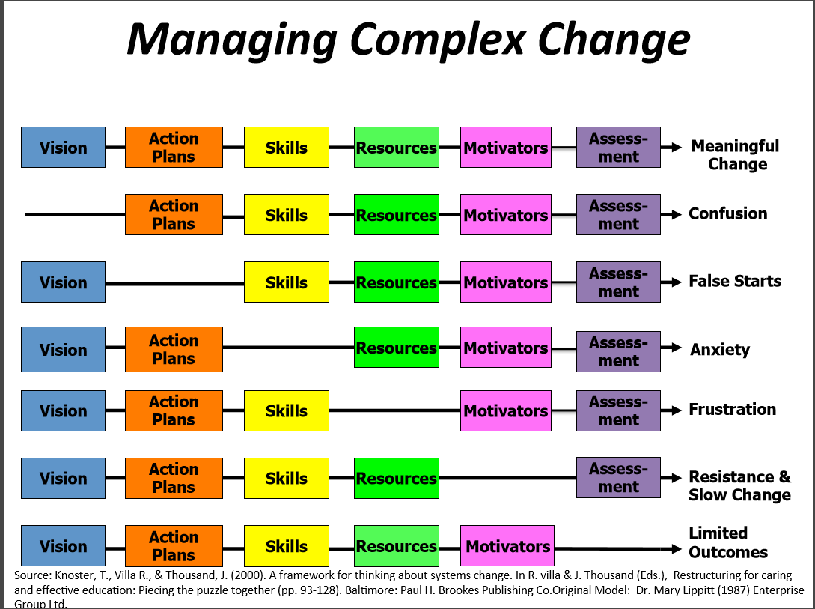
Systems Coaching

Slide 37
Roles and responsibilities
Knowledge and skills

Slide 38
Example:
Virginia’s coaching model

Slide 39
Watch your flower bloom
Create a job description/
advertisement for a division or school coaching position. It must include knowledge, skills, roles, and responsibilities.
Be creative and have fun!

Slide 40
Share Out

Slide 41
Considerations for
next steps
Consider:
How will/do you document the knowledge and skills that your coaches need?
How will/do you communicate and document the roles and responsibilities of your coaches?

Slide 42
Preserve the
ongoing growth
Next Steps

Slide 43
Keep in Mind
Invest in Systems!!! (Leadership teams, support professional learning and coaching)
Differentiate and ensure outcomes are reflective of all students
Data informs decisions about screening, progress monitoring, fidelity, and outcomes
Prioritize efficient and effective practices
(evidence, culture, context)
Growth & benefit are central. Must reflect learning opportunities for all
43

Slide 44
How did you do? Check in.

Slide 45
Closing activity: A parting practice of gratitude
Begin a correspondence of gratitude to someone in your professional circle using:
the cards provided
text message
email

Slide 46
References
Aguilar, E. (2019). You can’t have a coaching culture without structure. Educational Leadership, 77(3), 22-28.
Center on Positive Behavioral Interventions and Supports. (2023). PBIS District Systems Fidelity Instrument (DSFI) Manual. University of Oregon. https://global-uploads.webflow.com/5d3725188825e071f1670246/63dc2bc1817a4ae34e75c8be_PBIS%20District%20Systems%20Fidelity%20Inventory%20(DSFI).pdf
Joyce, B. R. & Showers, B. (1980). Improving inservice training: The messages of research. Educational Leadership, 37 (5), 379-385.

Slide 47
References
Michigan’s MTSS Technical Assistance Center. (2021). District coaching system: School leadership team coach. Michigan Department of Education. https://mimtsstac.org/sites/default/files/Documents/TargetedTA/CoachingSystem/1.0_District_Coaching_System_SLT_Coach.pdf
Northeast Positive Behavioral Interventions and Supports. (2015). School-wide Positive Behavioral Interventions and Supports (SWPBIS): Coaching workbook. https://nepbis.org/wp-content/uploads/2018/08/NEPBIS-SWPBS-School-Team-Training-Workbook-Final-9.2.16.docx

Slide 48
References
OSEP Technical Assistance Center on Positive Behavioral Interventions and Supports. (2015). Positive Behavioral Interventions and Supports (PBIS) implementation blueprint: Part 1 : Foundations and supporting information. University of Oregon. https://pbis.org
Ward, C., St. Martin, K., Horner, R., Duda, M., Ingram-West, K., Tedesco, M., Putnam, D., Buenrostro, M., & Chapparo, E. (2015). District Capacity Assessment. National Implementation Research Network, University of North Carolina at Chapel Hill. https://nirn.fpg.unc.edu/sites/nirn.fpg.unc.edu/files/imce/documents/DCA%207.7%2010-18-19.pdf

