Slide 1
How to
Teach like
Ted Lasso

Slide 2
Open House Pop-In PD ‘Rules’
1. It’s 90 minutes–the CHALLENGE is to be as PRESENT as possible. (oxygen)
2. Engage with others and ideas.
3. Be willing to reflect on what is working and what could be working better in your classroom.
4. Try something.
5. Keep trying. Keep Showing Up. (BELIEVE we can do hard things!)
…and maybe even win a prize!

Slide 3
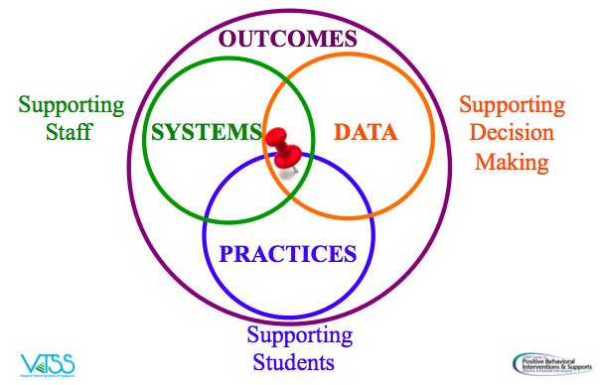
From Practices to Systems
Notes:
@ 8 minutes in
Sharon – This Open House PD is a combination of three VTSS trainings: Effective Classroom Systems, Defusing Disruptive Behavior and Trauma Informed Schools.
Based on current classroom life, we are going to focus on practices and strategies. But remember, data and systems are key to making things work.
Welcome - to Effective Classroom Systems - This model illustrates the way we work - we determine outcomes - where we want to be
We then gather data to determine where we are in relation to the outcomes - we use the data to inform the decisions we make for students and staff. We use a date informed decisions making process - to determine evidence based practices we can use to support the students in our division and school = what will help them be successful and reach the outcomes we want for them. Once practices are determined we support the staff who will implement those practices by providing them with professional learning that may be needed and with the proper resources. As we do this work we continuously monitor the student progress and evaluate to determine if what we have decided is working.

Slide 4
Keep in mind…
We are intentional: “with purpose and intent”
2. Small changes can create positive ripples
One Small Change:
Do you have any questions?
What questions do you have?
Ask me two questions.
Notes:
You don’t need to throw everything out and start over. You don’t need to add in 15 new things. Focus on being intentional and purposeful. Focus on making one change. Add one strategy, take one away. Or focus on one student that you need to connect with.
One change. One strategy. One student.

Slide 5
Get a Piece of Paper…
Challenge:
Fold a piece of paper to make 6 squares.
During the Open House today, identify six practices, strategies, ideas or just ‘back to the basics’ reminders that you want to take away from this 90 minutes.
Notes:
@12 minutes
First Strategy: Notetaking
This is something that you could do with students.
Anita Archer often engages adult learners with this type of strategy. Easy. Effective. Efficient.

Slide 6
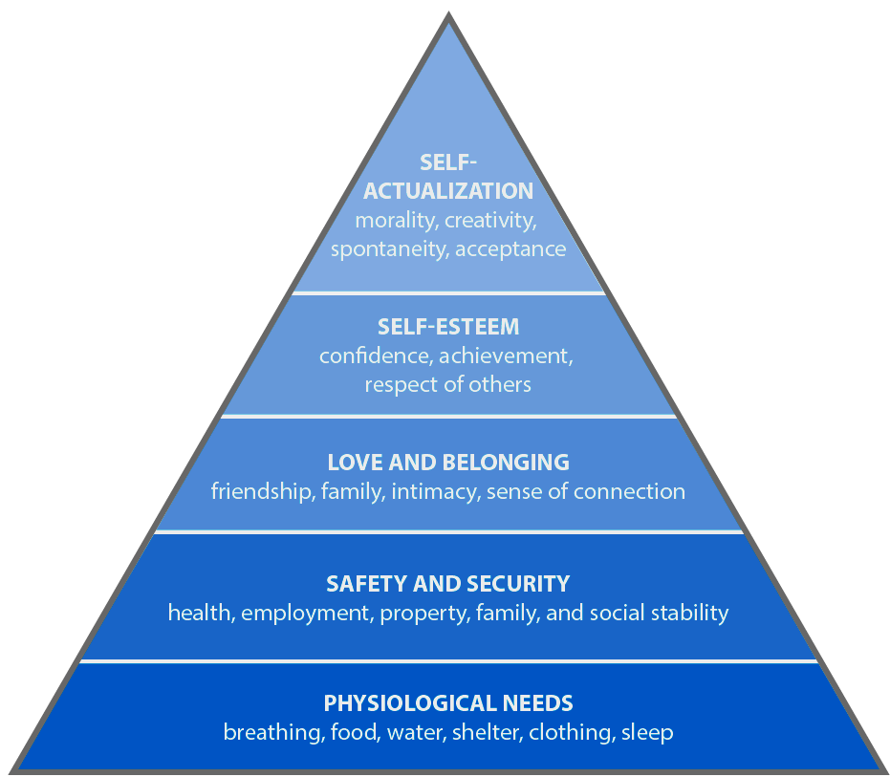
Meet Basic Needs
Food
Rest/sleep
Safety (physical & emotional)
Belonging through non-contingent and contingent praise
Notes:
Maybe: https://www.psychologytoday.com/us/blog/hide-and-seek/201205/our-hierarchy-needs
Importance of meeting basic needs and how when physiological needs and safety and security needs are not met, students are likely to experience difficulty with learning. We want to create environments that meet students basic needs… provide examples on how some schools are meeting these needs.

Slide 7
Ways to Connect
Daily Check-in and Check-outs - brief interaction between student and an adult.
Community Building circles - use a circle format to get to know one another in the classroom, discuss topics, have shared experiences.
Team building activities
One and done - in the first thirty days of school, demonstrate a single act of empathy (do a favor) for a different student each day.
Notes:
Point out that strategy slides will be green in the presentation just to draw attention to these.

Slide 8
More Ways to Connect
Two by Ten - for ten days in a row, spend two minutes talking to a student about anything except school
Three in Thirty - ask enough questions in the first thirty days to learn three things about each student
Me Bag - have each student and teacher fill a bag with two or three items that represent who you are and then provide an opportunity for everyone to share
Notes:
https://static1.squarespace.com/static/5e32157bff63c7446f3f1529/t/5f173d7d7d2c0c271703d543/1595358590081/Building-Rapport-Cultural-Synchronization-Questions.pdf

Slide 9
I’m Determined One Pager

Slide 10
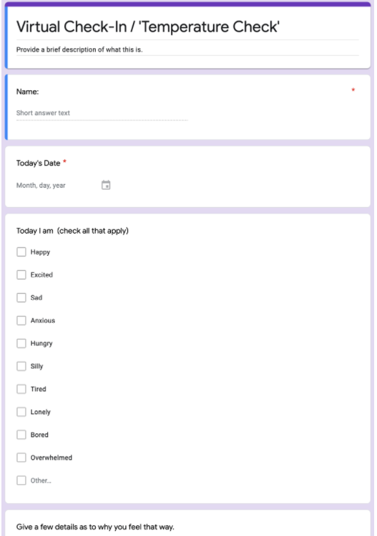
Check-in Routine

Slide 11
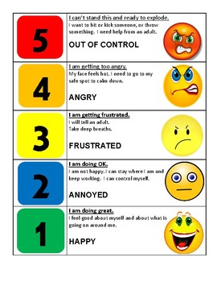
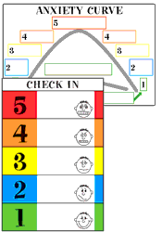
The 5-Point Scale
Notes:
At 20 minutes
Emotional awareness/regulation

Slide 12
Physical Environment
Provide a sense of safety, calm, and security
reduce triggers
create welcoming
space
Notes:
The physical environment can intensify negative experiences in people who have been traumatized, so it is important that we consider how our classrooms are set up. Many individuals who have experienced trauma are hypervigilant… they monitor the environment for perceived threats so they can react to protect themselves. Many children who have experienced trauma have learned that trusting others is dangerous and the only way they can protect themselves is to remain on high alert, which is physically and emotionally draining. We know that when individuals are hypervigilant, they spend times monitoring the doors and windows because they have a strong desire to see who is coming and going. So, it would be good to set up the room so students backs are not to the door. We also want to be aware of sensory triggers, such as flickering lights and loud noises (especially when unexpected.)
Also finally, we may want to create a sense of safety by having a safe place/calm corner in the classroom where students can retreat when needed, without leaving the classroom. A lot of schools have a place in classroom with a beanbag and various activities. In a high school classroom, we might set up a small table and chair in the room (sort of like a coffee shop might have).
http://www.ascd.org/publications/educational_leadership/oct20/vol78/num02/Trauma-Informed_Design_in_the_Classroom.aspx?utm_campaign=ALL-EL-TraumaSensitiveSchools-October2020-100220&utm_medium=email&_hsmi=97067975&_hsenc=p2ANqtz--5JXRuj010tIa5NsnqwDtWkzRCD6msXwRVQIb73uNB-rLD_NDchRGaq_MCyaSwcOMfjCD61P6iZAdLzO8tBTwL02V15A&utm_content=97067975&utm_source=hs_email

Slide 13
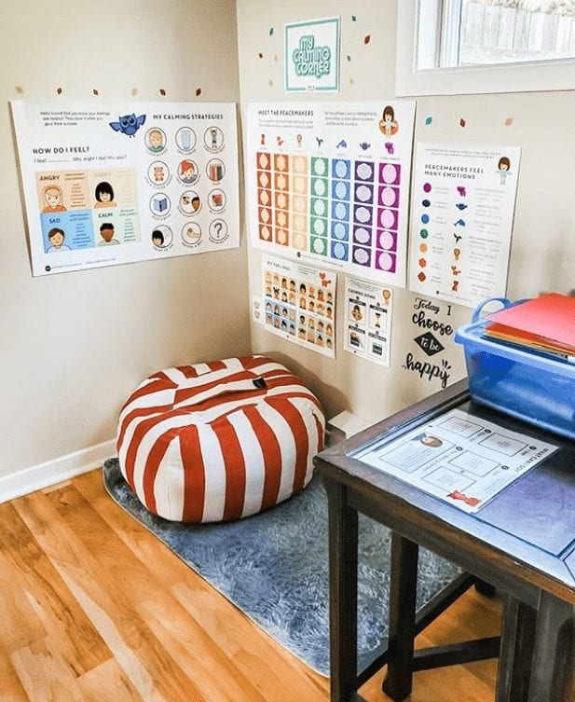
Creating Calm Spaces
Notes:
Chat box: Has anyone had any experience utilizing a calming space/ calming corner in their classrooms?

Slide 14
Considerations
Improve Lighting | Use small lamps, fluorescent light covers, dimmer switch
Reduce Noise | Tennis balls on chairs
Improve Visuals | Post positive messages, reduce clutter, consider furniture arrangement and traffic patterns , use agendas
Bring in Nature | Have plants, use a water feature, have pictures of landscapes and nature
Establish Calming Areas | Quiet space, chair, sensory materials
Adapted from Trauma Informed Design in the Classroom: Frey, Fisher, Smith October 2020 Educational Leadership
Notes:
There are several other considerations when thinking about setting up your physical environment within the classroom; here are a few. Take a minute and look through some of ideas.
Sometimes it is tempting to include lots of bright, colorful items on the wall, but that can be overwhelming to someone who has experienced trauma. However, the posting of positive messages, both the classroom, as well as in other areas, such as the hallways or cafeteria, is a great way to support students. And, don’t forget, you can always ask students for feedback.
If you have other ideas, please type them in the chat to share with everyone!
Potential Chat Box Response: What are some additional considerations for the physical environment? (optional)

Slide 15
Coping Skill Spotlight:
“Imagine Your Favorite Place”
Imagine your most favorite, calming place.
It could be a beach, a garden, or in nature, even on stage.
Take a few minutes and think about
what it would be like to be there.
What is around you?
What’s under your feet?
What do you smell?
What do you hear?
How warm or cool is it?
Really think deeply about all of those senses, and imagine you are there for a few minutes.

Slide 16
Visualization and Goal Setting
When we practice visualization, we can see the end goal and envision the steps to get there.
Vision Boards can act as a tool to facilitate that process
You can create visual representations of goals through a collage of pictures and words.
This can serve as a reminder of what you want to achieve and help motivate you to make the vision a reality.
Can be done individually or as a group.
Notes:
VISUALIZATION AND GOAL-SETTING link to some examples are on the one-pager. It’s not for everyone, but maybe a cool tool to introduce. Sharon had her students keep a scrapbook throughout the year and started with a vision board at the front. You can’t get this wrong. Ha!
Visualization involves creating a mental image of a future event. During visualization, neurons in the brain interpret mental images as equivalent to real-life actions. Neural patterns are created as though the actions were physically performed.
When students practice visualization, they see the end goal and envision the steps to get there. Glimpsing a possible future trains students’ brains for that reality and encourages them to pursue their goals.
WHAT IS A VISION BOARD?
A vision board is a visualization tool that gets students thinking about what they want to accomplish either academically or personally. With a vision board, students create visual representations of goals through a collage of pictures and words.
The board serves as a daily reminder of what students want to achieve and helps motivate them to make their vision a reality.
Learning A-Z

Slide 17
I’m Determined Good Day Plan

Slide 18
Active Supervision
A key element of active supervision is the ability to build relationships. What ideas can you share about how you or someone in your school/division monitored students and made connections?
Moving
Scanning
Interacting
Notes:
Walk around
Talk around
Look around
like this section, but somewhere in notes maybe would it be possible to emphasize that even if you are socially distanced you have to move around the class - talk to kids - have them come up and talk to you - ways to do this. You can't build relationships sitting in front of the room only.

Slide 19
Routines to Create Emotionally Safe Environments
Welcoming Inclusion Activity or Routine
Engaging Strategies (self and others)
Optimistic Closure Routine
Building Rapport Questions
https://schoolguide.casel.org/uploads/sites/2/2018/12/SEL-3-Signature-Practices-Playbook-10.21.19.pdf
Notes:
Link to SEL practices playbook with lots of activities and ideas are included on the one pager.
https://schoolguide.casel.org/uploads/sites/2/2018/12/SEL-3-Signature-Practices-Playbook-10.21.19.pdf

Slide 20
Grounding with “5,4,3,2,1”
5 things you can see
4 things you can touch
3 things you can hear
2 things you can smell
1 thing you can taste
Notes:
Sharon can share this is a great practice anytime that you are feeling overwhelmed in a space. Friend shared that she used this with her tired little people at Disney. When overwhelmed and feeling anxious in crowds. Stop and notice. Great for classrooms…students AND teachers to stay calm and positive when it gets stressful.

Slide 21
Self-Management Activities
Time Management:
Checklists,Logs, ABC prioritizing
Stress Management:
Mindfulness, exercise, yoga, movement breaks, deep breathing
Brain Breaks Example: Would you rather?
https://www.youtube.com/watch?v=FOgcrNrtfpo
Motivation Management
Goal setting and reflection
Service to others
Notes:
Providing time and space for these kinds of activities leads to a more calm and predictable environment for everyone.

Slide 22
Classroom Expectations: Consistency Matters
Our physical and emotional well-being impacts our ability to think and learn effectively
Increases predictability
Students can focus on being engaged
Aligned with Schoolwide expectations
Notes:
Facilitator remind teams to Communicate to families the efforts school is making to create a safe environment with return after pandemic.
The rationale for the clarity around the positive behaviors for success and the alignment to the school wide expectations is what we already know: Consistency Matters. We want students to feel safe in a predictable classroom so they can be engaged in their thinking and learning.
This instruction is part of what we’ve called classroom management in the past. Challenge thinking to consider it in another way - instead of classroom management, just instruction
However we reference it - Hattie:Effect size of Classroom Management=0.52.
Increased predictability in the environment helps support student’s social/emotional well-being. While they will challenge expectations to see if you really mean what you say, student’s crave stability, consistency and predictability, particularly those dealing with trauma or home lives that are unpredictable.
Having classroom procedures:
increases instruction time by preventing problem behavior
Improves classroom climate
Creates shared ownership of the classroom
Develops self-discipline

Slide 23
School-wide Matrix
Teaching Matrix | All Settings | Hallways | Playgrounds | Cafeteria | Library/ Computer Lab | Assembly | Bus
Respect Ourselves | Be on task. Give your best effort. Be prepared. | Walk. | Have a plan. | Eat all your food. Select healthy foods. | Study, read, compute. | Sit in one spot. | Watch for your stop.
Respect Others | Be kind. Hands/feet to self. Help/share with others. | Use normal voice volume. Walk to right. | Play safe. Include others. Share equipment. | Practice good table manners | Whisper. Return books. | Listen/watch. Use appropriate applause. | Use a quiet voice. Stay in your seat.
Respect Property | Recycle. Clean up after self. | Pick up litter. Maintain physical space. | Use equipment properly. Put litter in garbage can. | Replace trays & utensils. Clean up eating area. | Push in chairs. Treat books carefully. | Pick up. Treat chairs appropriately. | Wipe your feet. Sit appropriately.
Notes:
Possibly add a remote learning column; changing cafeteria to meals, take out assembly

Slide 24
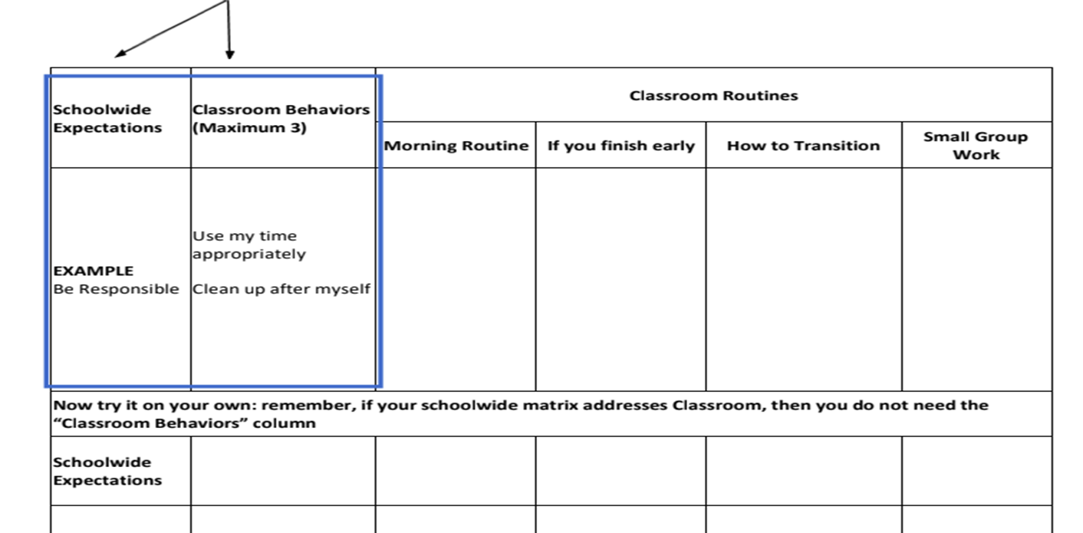
Classroom Expectations:

Slide 25
Classroom Matrix: Routines
 |  | CLASSROOM PROCEDURES
 |  | SMALL GROUP INSTRUCTION | HOW TO ASK FOR HELP | WHEN I FEEL UPSET/ FRUSTRATED
 | Respect | LISTEN TO PEERS WHEN THEY SPEAK USE KIND WORDS | RAISE HAND OR USE PRIVATE SIGNAL TO GAIN TEACHERS ATTENTION | COMMUNICATE WITH TEACHER/ADULT USE KIND WORDS
 | Responsible | KEEP UP WITH YOUR MATERIALS | WAIT FOR TEACHER ACKNOWLEDGEMENT | IDENTIFY EMOTION
 | Safe | WALK WHEN MOVING AROUND THE CLASSROOM | USE QUIET VOICE | USE COPING STRATEGY
EXPECTATIONS
Notes:
Again, focus is on predictable. Students can count on this. Stories of students who get in ‘trouble’ because they didn’t ‘read the room’ fast enough to recognize that the teacher was in a flustered mood or the routines/procedures were off. We aren’t perfect, but if we can try to put things in place to prevent what could probably happen, all the better. If we can predict, we can work to prevent it.
Here we have an example of a classroom matrix that has included a column to highlight specific behaviors one would demonstrate how to ask for help or what to do when they are feeling upset, and it is linked back to are expectations. (Read though) By incorporating routines and procedures into our classroom and schools, we are increasing the predictability for all of our students, but this is a huge support for those who have experienced trauma.
Workbook
ACCESSIBILITY DECISION

Slide 26
Establishing a Sense of Safety
Focus on positive relationships
Set up a trauma-sensitive physical environment
Define, teach, & acknowledge appropriate behavior
Class expectations and norms
Practice active supervision
Establish routines and procedures
Consider structures to support SEL (Class meeting structure)
Notes:
Just make sure we are being intentional with these. Having these things in place act as protective factors that can reduce the likelihood of behavior occurring

Slide 27
Routines and Procedures
Classroom Procedures are steps for accomplishing classroom tasks; they
explain the accepted process for carrying out a specific activity such as:
Walking in the hallway
Using lockers
Sharpening pencils
Routines are procedures that are used on a consistent basis, such as:
When students arrive to class
During in-class transitions
At dismissal
Notes:
According to Harry Wong in his book The First Days of School, effective teachers spend the first two weeks teaching students to be in control of their own actions in a consistent classroom environment. The way to do this is through the teaching of procedures that, with repetition, become a routine.
Very simply, procedures are the steps we take to complete a task such as sharpening pencils or going to the restroom. Teaching, rehearsing and reinforcing the procedures eventually creates a routine that defines how things are done in that classroom. Routines become automatic and help students follow rules and meet expectations.
Harry Wong goes as far to say that “The number one problem in the classroom is not discipline: it is the lack of procedures and routines.”
So what do these look like in your school and how will you help ensure that they are there and effective

Slide 28
Explicit Teaching in Every Routine
I do- informing, explaining, modeling, and providing examples
We do- working together to complete the steps of a particular task
You do- students practice what was taught by themselves
Notes:
This is a strategy that could/should be applied to everything we teach in school and in life. Example: teaching kids to drive long distances. We don’t just give them their license and then say go ahead on a four hour trip. There are steps/scaffolds in place to get them from watching/observing/practice with guidance and supervision to being independent.

Slide 29
Behavior Can Be Taught
Direct Instruction
Modeling
Practice
Feedback/Acknowledgement
Error Correction
Re-teaching

Slide 30
Behavior Change
Behavior change can be quick, or it can be incremental and take time.
Expected behavior can be maintained by reinforcement.
For change to occur, you must address/ acknowledge setting events, skill deficits and functions of behavior.
Notes:
Bullet 2: need to tie back to reinforcement and functional relationships -- remember to reference this again on day 2 -- focus on the importance of reinforcement to shape behavior, strengthen behavior and maintain behavior - particularly in regards to changing behavior to a desired alternative
Bullet 3: Mis-match behaviors are often due to skill deficits; We are not going to assume setting events. Relationships can inform knowledge and understanding of setting events, motivating factors, what is reinforcing for students etc.

Slide 31
Replacement Behaviors
A replacement behavior is an alternative behavior that allows a student to meet the same need or achieve a similar outcome as the undesired behavior they are currently using.
Notes:
In addition to proactively teaching specific behaviors anchored to the matrix and SEL wheel, behaviors to replace interfering behavior may require specific instruction.
Link back to ABC’s and how that fits in with function

Slide 32
Important Consideration for Replacement Behaviors
Remember that students,
like adults, are not wired to
be one-time learners.
Teaching replacement behaviors allows you to encourage behavioral learning so that students’ needs are fulfilled, but it is done in a way that is more pro-social.

Slide 33
Teach Specific Skills
Social Emotional skills
Self Awareness
Self Management
Social Awareness
Relationship skills
Decision making skills
Replacement behaviors
Cueing and prompting
workbook
Notes:
Examples, i.e. when you give a student a timeline for a project, that is self-management skills, or if you use a conversation roundtable, and explain active listening for the task, you are teaching relationship skills as well as critical thinking - something like that...I sometimes notice that schools try to teach these in their own separate box rather than integrate.

Slide 34
Caution: There IS a Good Time
When to teach:
NOT when the child is engaging in the inappropriate behavior, especially if stressed or escalated
Where to teach
in a safe environment;
then practice generalization
How to teach
using the Teaching Model– with praise and role modeling – and practice!
Notes:
Creating a positive learning environment will depend on the teacher staying in their comfort zone.
Remember what we learned about the brain

Slide 35
Prompting & Cueing
A hint meant to encourage a person to perform a desired behavior.
Paired with a desired behavior (i.e. social skill, coping skill, replacement behavior)
Subtle
Verbal, visual, gesture etc.
Notes:
Again… more strategies that we can be intentional about using.

Slide 36
Opportunities to Respond
Students are
able to:
Teachers are able to:
Remain attentive and on task
Retrieve, rehearse and practice information, concepts, skills and strategies being taught
Refrain from inappropriate behaviors
Provide corrective feedback immediately
Adjust the lesson
Offer behavior specific praise
Notes:
Students and teachers benefit from frequent opportunities to respond.
Because we as teachers know this, how intentional are we with opportunities to respond in the classroom? Do we think about which ones we use and when? Which ones do we use for different content, activities, etc.? Are we intentional about the equitable use of opportunities to respond to engage all students?

Slide 37
Teacher Talk Time
How much time are you talking?
______% of students surveyed in Virginia cohorts reported that their teachers talk most of the time.
When in fact….
Teacher talk should be no more than ____ to ____ % of instructional time.
76
40
50
Notes:
Virtual: Let’s do the Chat Waterfall again. Participants respond in the Chat Box with their guesses for the first percentage..
Face-to-face: Turn and tell your neighbor what you think the first percentage is.
Teachers shouldn’t be working harder than their students! We talked about that as one of the principles of effective classroom feedback.
Ask: What do you think the first percentage is? 76% of students who were surveyed said teachers talk most of the time. Source
Ask: What about the second sentence? Teachers should talk no more than 40 - 50% of instructional time. Students need to talk more. The more back and forth from teacher talk to student talk, the better. What can this look like? Teacher talks, students respond orally, teacher talks, students work with a partner, teacher talks, students work in a group, teacher talks, students teach, reteach each other.

Slide 38
Opportunities to Respond - When and How to Use
Oral responses
Choral
Partner or team
Individual
Written responses
Response system
Graphic organizer
Action responses
Act out/Gestures
Hand signals
Manipulatives
Notes:
Chat Box/Talk with a partner: What are some ways that students are asked to respond in your classroom or in classrooms that you have visited? Consider each of these areas (Display the three areas on the slide; ask participants to provide responses).
There are a variety of opportunities to respond. The Oregon handout in your materials explains the different examples listed on the slide.
Oral responses can be choral, partner or team, individual;
Examples of written responses: it could be a response system such as a white board, use of a graphic organizer such as one for vocabulary instruction;
Examples of action responses: act it out or use gestures (use to remember a process, to answer questions), hand signals (thumbs up, 1,2,3,4 for multiple choice, manipulatives).
The Oregon document can be used by having it available for every meeting when teacher teams review data, so that they can, as a group, recommit to using these engagement strategies and plan ahead for when to use them. Isn’t that a great data tool? This is an example of intentionality and thinking about and planning how they will be used.
Opportunities to respond support the second formative assessment strategy: find out what students have learned.
Additional examples opportunities to respond in a virtual setting: (these can be shared with participants, if desired):
Response sheet
Breakout room conversations
Chat box
Polls
White boards
Waterfall chat
Different virtual platforms

Slide 39
More OTR Ideas
socrative.com
polleverywhere.com
Kahoot.com
Plickers.com
Set of few choices (e.g., noun, pronoun, verb, adverb, letters, numbers, story elements)
Guided Notes – teacher prepared handouts leading students through a presentation or lecture with visual cues or prepared blank spaces to fill in key facts or concepts
Numbered Heads Together
Students in quads, assigned a number
Teacher poses question
Group discusses/agrees on answer
Random/specific numbered students get called on to report
Notes:
Kudos to all of the CREATIVE ways teachers have both found and developed to engage students. Absolutely amazing!
Include a quick point about calling on students: using popsicle sticks, random name generators, how when we allow them not to respond, we are doing them a disservice.

Slide 40
Formative Assessment
Formative assessment is a process used by students and teachers during instruction to elicit and use evidence to improve understanding of intended learning outcomes and support students to become more self-directed learners.
Notes:
Our next practice is formative assessment. We have all known that formative assessment is a practice used by teachers to understand their students level of understanding of the material.
What is important in this definition of formative assessment, which was recently used in a VDOE document, is it adds the student into the process of evaluating their own understanding. This statement reflects our growing understanding of the importance of helping students become “self-directed learners”.

Slide 41
Five Strategies of
Formative Assessment
Clarify, share, and understand learning intentions and success criteria
Find out what students have learned
Provide feedback that moves learning forward
Activate students as instructional resources for one another
Activate students as owners of their own learning
Notes:
Dylan Wiliam has explained the concept of formative assessment using these five strategies.
Student achievement is best achieved by paying attention to all of these strategies.

Slide 42
Fist to Five
Pose a topic and allow students to share their feelings by holding up a number.
0: very uneasy and need more support
5: Comfortable, excited and ready to go
Work with students to create the description of what each number means
Examples:
How happy are you to come back to school after the weekend?
How are you feeling about that activity? That concept? The upcoming test?
Notes:
*Can be used as self assessment and also as a lichert scale of agreement for an OTR
Pose a topic and allow participants to share their feelings on it by holding up a number representing where they fall on the scale of 0 (fist) to five (all five fingers up). A fist indicates that they are feeling very uneasy and need more support or instruction. A five indicates that they are comfortable, excited and ready to go! For example, after introducing a new math concept, you could ask your students to use “Fist to Five” to indicate how well they understand the information

Slide 43
Focus on: Activate students as owners of their own learning
Self-regulated Learning
Share learning goals
Promote the belief that learning is incremental
Decrease comparisons with others
Provide feedback that moves them forward
Transfer control of the learning from teacher to student
Notes:
Whoever does the most, learns the most.
The final formative assessment strategy is activate students as owners of their own learning.
Dylan Wiliam says that “assessment can improve instruction, but it can also impact the learner’s willingness, desire or capacity to learn (p. 151).” How can we get students more involved in their own learning? We can create learning environments that encourage students to activate their growth and use the suggestions on the slide.

Slide 44
How to support students to become owners of their learning
Individual Tracking
Individual Understanding
Graphs
Stars on rubrics (video)
Project checklists
Red/Green Disks or Cups
What did we learn today?
Learning logs
“Personal best” selections
Notes:
Here are ways to support students to become owners of their learning. (Review the slide) So powerful for students to be able to do this.
Graphs: students graph their progress in an individual graph; it can be motivating for students
Stars on rubrics: we will watch an example of this in a video we will view in minute
Project checklists: students check off the tasks on a project checklist as they are completed.
Red/Green disks or cups: students have red and green cups or disks are a communication tool for students to indicate if they need the teacher to slow down or answer a question (red) or if they are doing well with the pace of instruction.
What did we learn today? students respond to the question via an exit ticket, sharing with a peer, etc.
Learning logs: students record what they are learning in a subject area/class/course
“Personal best” selections: students choose a product/assignment that they feel represents their best work
Chat Box/Face-to-face: Are there ways that you have seen teachers support students to become owners of their learning, in a remote learning environment or face-to-face?

Slide 45
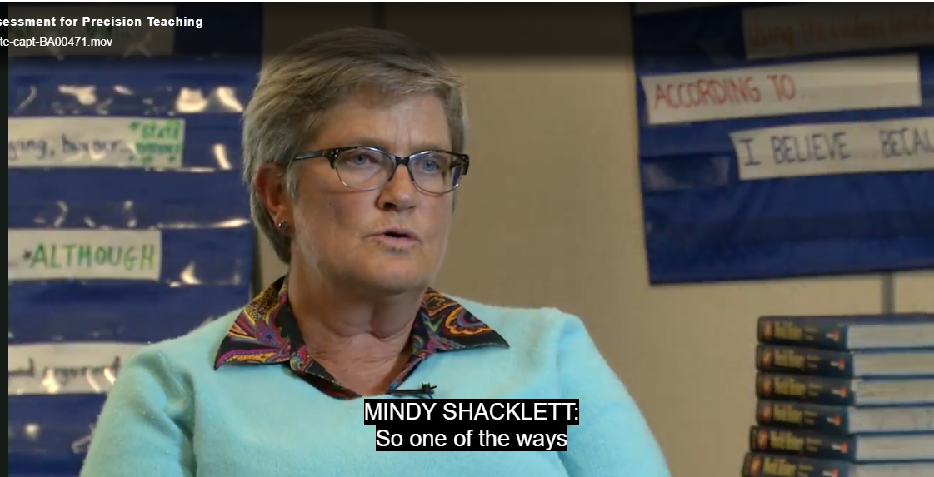
Student self monitoring
Notes:
Ask participants to think about this question as view the video: How is Mindy’s use of the rubric and stars supporting students and monitoring their learning?
Video Mindy starts at 3:58-7:15. http://players.brightcove.net/268012963001/default_default/index.html?videoId=5117777016001
Discuss video with participants (e.g., her use of the stars for students to monitor their learning, how students feel about the stars on the rubric etc.).

Slide 46
Strategies for Scaffolding
Partnering
Chunking
Sequencing/Progress in Complexity
Demonstrations and completed models
Provide hints and prompts
Provide aids such as cue cards and checklists
Notes:
The different strategies for scaffolding are:
Partnering: Pages 49-52 in the workbook. Once again, how can peers be used to support each other.
Chunking: Breaking up information into small, digestible bites and/or grouping pieces of information. Chunking supports comprehension and retention of information.
Sequencing/Progress in complexity: Move from simple asks to complex tasks. You can think of it in terms of skill development. Such as what coaches do when training athletes. Like in baseball, players build their skills through batting practice, fielding practice, strength training, sliding, etc. They need to learn all of these skills in order to hit the ball, hit a homerun.
Demonstrations and completed models: Provide demonstrations and completed models. Students can use the models to process the content and to assist with their own skill development.
Provide hints and prompts: Visual (guide thinking or understanding), verbal (say things to bring attention for students), gestural (hand movements to indicate a student is missing something or has it correct) and environmental (use classroom surroundings to support student understanding; anchor charts, manipulatives). Pages 55-56 on your workbook provide examples.
Provide aids such as cue cards and checklists: Use one for a project, for math problem solving, for writing

Slide 47
Supporting Self Reflection
Ending an activity, class, meeting, or day with a quick reflection and share.
Have each person share an:
Appreciation: Something they appreciated
Acknowledgement/Apology: Something they might need to acknowledge
Ah ha: something that they realized or learned.
Notes:
Link to the picture

Slide 48
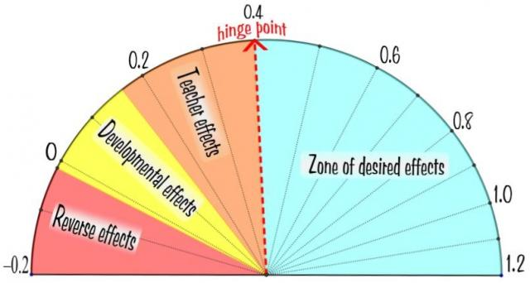
Effective Feedback
Direct Instruction
Feedback
Teacher
Clarity
Notes:
Both formative and summative simple feedback on performance is one of the most effective components of instruction.
Direct Instruction Effect Size = 0.6
Feedback Effect Size = 0.7
Teacher Clarity Effect Size = .75
This was updated from the visible learning website on February 5, 2019
https://visible-learning.org/hattie-ranking-influences-effect-sizes-learning-achievement/
Intent:
Describe the evidence-based practices embedded in explicitly taught lessons.
Share John Hattie’s research of the most effective practices;
Share effect sizes for various practices like feedback, teacher clarity, and direct instruction.
Trainer Talking Points:
In John Hattie’s work, Visible Learning, researchers completed over 800 meta analyses of effective instructional practices.
Found almost everything (over 90%) “works” - has some positive effect size
.40 = average effect size(one year's growth average school year). Hattie calls this the “hinge point”. To “close the gap” we must use EBPs that increase our chances of more than just a year of academic gain.
Greater than .6 = excellent
1.0 = 1 standard deviation = increase in achievement of 2-3 years
(After First Animation)
Ask: Does anyone know the effect size of teacher clarity?
Teacher clarity has .75 effect size in Hattie’s latest updated work.
(After Second Animation)
Ask: How about the effect size of feedback?
Effect size of feedback is .7
Feedback has been found to be more powerful than student’s abilities or socio-economic status.
(After Third Animation)
How about the effect size of direct (or explicit) instruction?
Direct instruction(explicit instruction) has an effect size of .6 – providing background knowledge
Explicit instruction does NOT rule out incorporation of higher level thinking.
Zone of desired effects are not enough sometimes for students with disabilities or in trauma.

Slide 49
Correcting Errors Effectively
Correct Answer/Behavior
Next time.../Forward
End on Correct Response
Notes:
Error correction = informative statement following the occurrence of an undesired behavior or an incorrect answer.
How to help teachers correct behavior quickly and easily.
"Walk instead of run” NOT “You know better than to run because you’ll get hurt.”
Feedback that moves them forward and corrects the behavior NOW.
Focus on levels: Task, Process, and Self-Regulation
Give examples of all three

Slide 50
Know the story
What else is really going on here?
What does this child need?
How can I change my perspective?
What keeps me only looking at the behavior?
What is this behavior communicating right now?
What in the environment could be triggering this behavior?
Notes:
Before considering any reactionary strategy we have to ask what is driving the behavior, dig deeper and consider these questions….
Our goal is to determine what is driving the behavior! Think about what else might be going on.
What does the student need? What do you know about the student? Might he/she be hungry, tired, not understanding the assignment?
Consider if I am putting my values on the situation? Think about vulnerable decision points and how they may be impacting the situation. Am I taking the behavior personally?
Also, think about function of behavior… what is the student communicating?
And finally, is there something in the environment that is triggering the student? And remember, it could be something we are totally unaware of.

Slide 51
Response to Behavior
Our initial response determines what happens next.
Challenge
Reprimand
Argue
Escalate Emotion
Bigger Problem
Listen
Paraphrase
Validate
Show empathy
Calm
Support
BEHAVIOR
OUR RESPONSE
The first moment determines the next hour.
(Adapted from Bob Garrity, Garrity Mediation and Consulting)

Slide 52
Reacting Versus Responding
REACTING
RESPONDING
Based on feelings in the moment
Impulsive
Short-sighted
Poor communication
Problem-based
Based on feelings and reason
Deliberate
Goal driven
Connected communication
Solution-based
Notes:
Sharon has a great example of this. Sometimes as teachers when we get flustered, we react instead of respond. It happens. But what happens … next… is everything.

Slide 53
Examples
REACTING
RESPONDING
Distrust - Power - Punishment
“Hey!!”
“What are you supposed to be doing?”
“Get busy”
“What did you say?!!”
“You’re going to the office”
Referral/Suspension”
Trust - Support Understanding
“How can I help you”
“What do you need?”
Listen
“It sounds like you are having a hard time.”
Provide Support
(Adapted from Bob Garrity, Garrity Mediation and Consulting)
Notes:
Thumbs up if they have observed or engaged in behaviors that are more reactive.

Slide 54
Reacting Behaviors
Agitated behavior from staff such as shouting
Cornering the student
Engaging in power struggles – ex. “In my classroom, you will….”
Moving into the student’s space
Touching or grabbing the student
Making sudden or very quick responses
Making statements that may discredit the student – ex – “this isn’t elementary school”
Becoming defensive, arguing
Communicating anger and frustration through body language
Notes:
This is a good connection to the current state of schools. Recognizing how WE are showing up and feeling can be helpful. Hard to do. But could be the key.

Slide 55
Reacting Behaviors
Agitated behavior from staff such as shouting
Cornering the student
Engaging in power struggles – ex. “In my classroom, you will….”
Moving into the student’s space
Touching or grabbing the student
Making sudden or very quick responses
Making statements that may discredit the student – ex – “this isn’t elementary school”
Becoming defensive, arguing
Communicating anger and frustration through body language
AVOID

Slide 56
Responding Behaviors
The most powerful response for staff is NO IMMEDIATE RESPONSE, PAUSE
Model calm
Treat student with dignity and respect
Consider how you are communicating through body language
Use private communication
Don’t communicate any anxiety, be matter-of-fact
Notes:
When you “pause”, it can be ok to model that and tell the student you are pausing so that you have time to process how to respond.

Slide 57
Strategies to Try
Precorrection
Limit setting
Offering Choice
Redirection / Prompting
Validation
Active Listening
Systematically Modifying Context
Differential Reinforcement
Reduce situation demands
Teacher proximity
Provide independent, passive, or movement activities
Goal: Interrupt/Intervene
(Separate student from trigger)
Notes:
Use content on hidden slides:
Isn’t it helpful to know there is so much you can do during the trigger phase?! We have covered what you can do to be the well emotionally managed adult, neutralized in VDP AND you can provide effective response strategies for the student!
Think about the continuum of responses flowchart and how and when you can keep this menu of teachers available and accessible to teachers in your buildings. We will briefly go over these, offering just a little more detail.

Slide 58
Using Precorrection to Address Behavior
Tardiness to class
Difficulty with schedule changes
Talkative during independent practice
Sleeping in class
Missing materials
Chaotic class changes
Frustration with writing tasks
Notes:
When in this phase we might be dealing with school-based on non-school based triggers and while we can’t always control all of these, we can implement pre-correction strategies. If I know a student hasn’t had breakfast, I can make sure that student gets breakfast each morning when they get to school. I can develop a pre-correction plan to do things on the front end. If I know we are going on a field trip and one of my students really has difficulty in these unstructured settings I can clarify my expectations up front and talk with them about a plan for them to meet those expectations. Look at the following list and pick one that stands out to you. How might you use precorrection to address that behavior? Chat box response.

Slide 59
Remember
Punishing students doesn’t teach them the right way to act.
Dwelling on an incorrect answer does not lead us to the correct answer. FEED UP FEED FORWARD
Notes:
Emphasis on instruction, not punishment.
From Terry Scott (2016)
Studies show that in elementary schools teachers give 3.5 positive feedback per min., middle school 2 every min. And high school .66 per minute. His research says our goal for all ages is to hear 4 every min.

Slide 60
Connection before Correction
Talk privately with the student
Use encouraging words
Show empathy/
understanding
Notes:
Letting a student know that you see them, and recognize they are upset will sometimes allow the student to take a deep breath and deescalate somewhat.

Slide 61
Situation: 2022
In the moment,
Don’t try to fix it.
Don’t give a life lesson or lecture.
Try using Validating Statements:
What can I help you with?
What do you need to feel safer?
I hear you, that sounds hard.
How did that make you feel?
It sounds like you are really struggling.

Slide 62
Not JUST for the Students
Count
Grounding your Senses (54321)
Deep Breathing (Box method)
Visualization
Fidget/Crafting
Listen to music
Exercise/Walk/Move
Drink more WATER
Notes:
What are you doing to take care of yourself and thrive during this time. Its ok to let students see you do this too.

Slide 63
Amazing!
Here’s to you and meeting the challenges with many successes during the second half of the 21-22 school year!

