Slide 1
Applying Effective Classroom Strategies to Positively Impact Student Success during this Challenging Year…
Build positive relationships
Encourage a supportive environment
Engage students
Provide effective feedback
Meet challenges with curiosity and a few new strategies
Pop-In for this 90 minute Open House professional learning opportunity for classroom teachers, administrators, and everyone who supports student success. Designed for you to be able to select a time - before school, during a planning block/ lunch, or after school - to reconnect with effective classroom strategies for student success in 2022.
For more information, visit: https://vtss-ric.vcu.edu/fall-virtual-learning/
VTSS Open House Pop-In
Professional Learning
February 24, 2022
8:00 am, Noon, or
4:00 pm
How to
Teach like Ted Lasso
Or…

Slide 2
Applying Effective Strategies to Positively Impact Student Success (and not lose your mind) in this Challenging Year.
VTSS Open House Pop In
Professional Learning
February 24, 2022

Slide 3
How to
Teach like
Ted Lasso

Slide 4
2022…

Slide 5
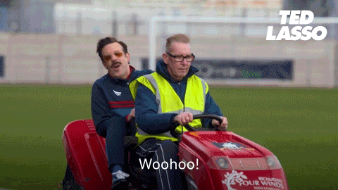
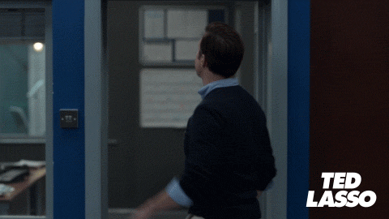
Are you “Feeling 2022”?
1
2
4
3

Slide 6
Open House Pop-In PD ‘Rules’
1. It’s 90 minutes–the CHALLENGE is to be as PRESENT as possible. (oxygen)
2. Engage with others and ideas.
3. Be willing to reflect on what is working and what could be working better in your classroom.
4. Try something.
5. Keep trying. Keep Showing Up. (BELIEVE we can do hard things!)
…and maybe even win a prize!

Slide 7
Why This Open House?

Slide 8
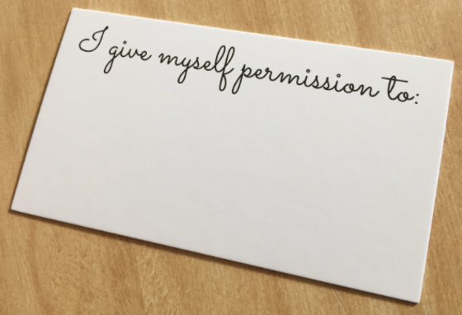
I Am Here

Slide 9
New idea slide

Slide 10
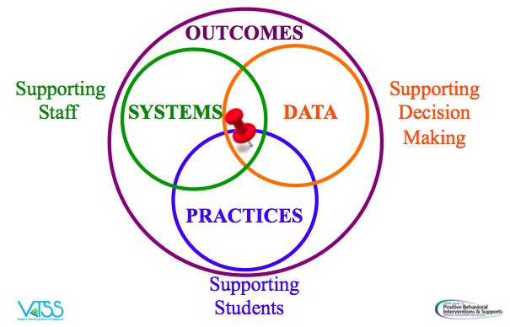
From Practices to Systems

Slide 11
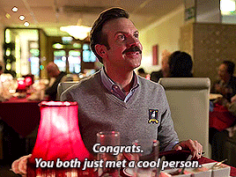
But first, we… Connect!

Slide 12
Keep in mind…
We are intentional: “with purpose and intent”
Small changes can create positive ripples
One Small Change:
Do you have any questions?
What questions do you have?
Ask me two questions.

Slide 13
Get a Piece of Paper…
Challenge:
Fold a piece of paper to make 6 squares.
During the Open House today, identify six practices, strategies, ideas or just ‘back to the basics’ reminders that you want to take away from this 90 minutes.

Slide 14
Ted on: Positive Relationships and Building Community

Slide 15
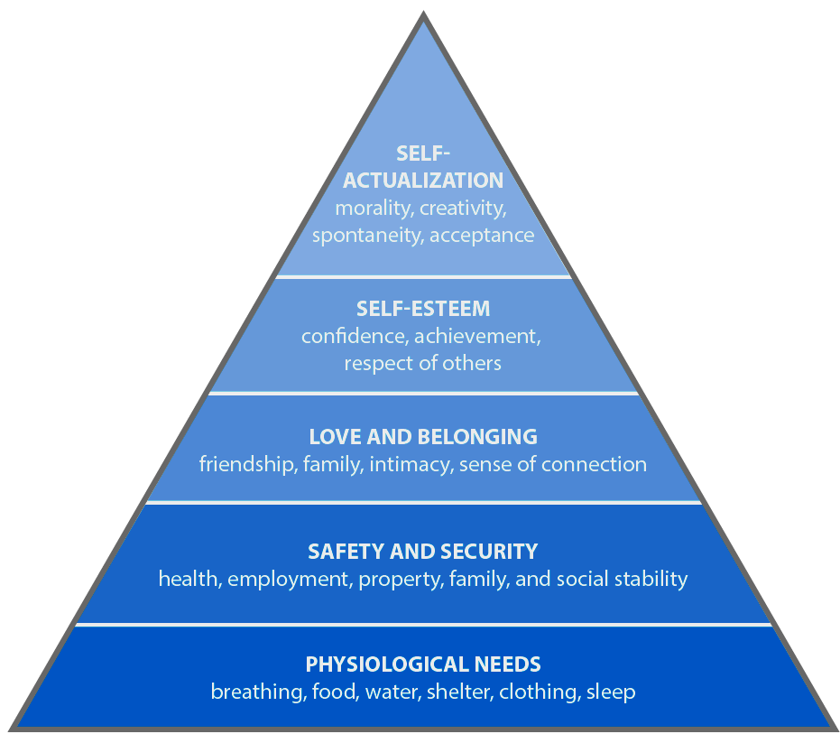
Meet Basic Needs
Food
Rest/sleep
Safety (physical & emotional)
Belonging through non-contingent and contingent praise

Slide 16
Ways to Connect
Daily Check-in and Check-outs - brief interaction between student and an adult.
Community Building circles - use a circle format to get to know one another in the classroom, discuss topics, have shared experiences.
Team building activities
One and done - in the first thirty days of school, demonstrate a single act of empathy (do a favor) for a different student each day.

Slide 17
More Ways to Connect
Two by Ten - for ten days in a row, spend two minutes talking to a student about anything except school
Three in Thirty - ask enough questions in the first thirty days to learn three things about each student
Me Bag - have each student and teacher fill a bag with two or three items that represent who you are and then provide an opportunity for everyone to share

Slide 18
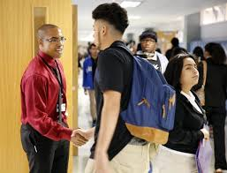
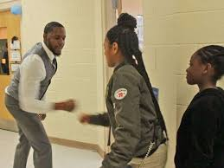
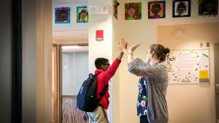
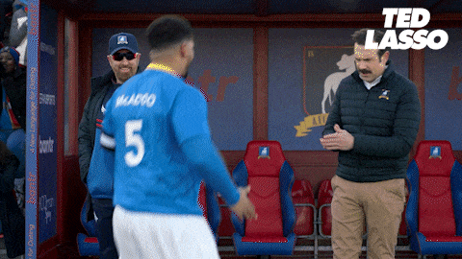
Taking Time to Greet Your Students

Slide 19
I’m Determined One Pager

Slide 20
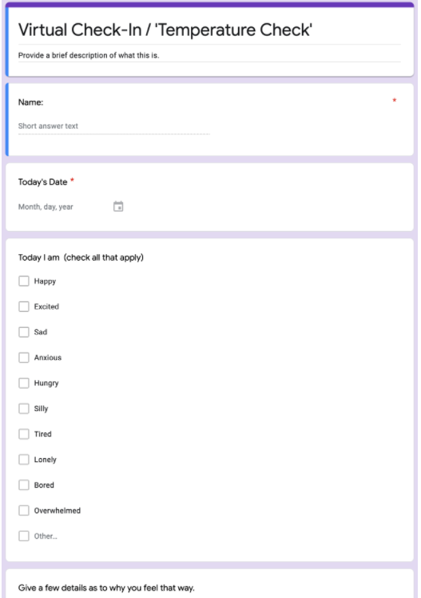
Check-in Routine

Slide 21
Communicating Emotions

Slide 22
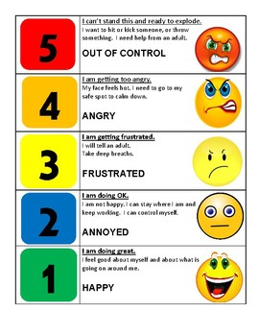
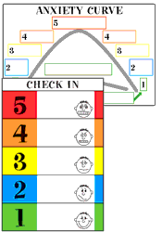
The 5-Point Scale

Slide 23
Who Has?
Ways to build positive relationships.

Slide 24
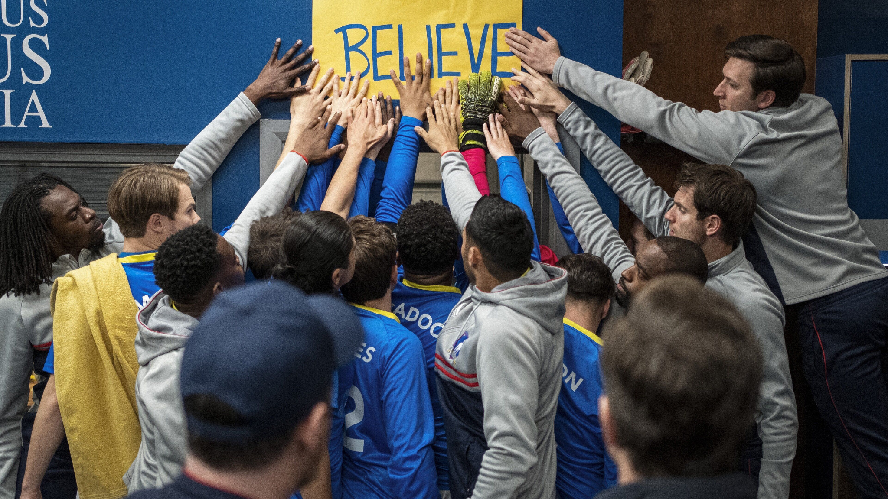
Ted on: Positive Environments

Slide 25
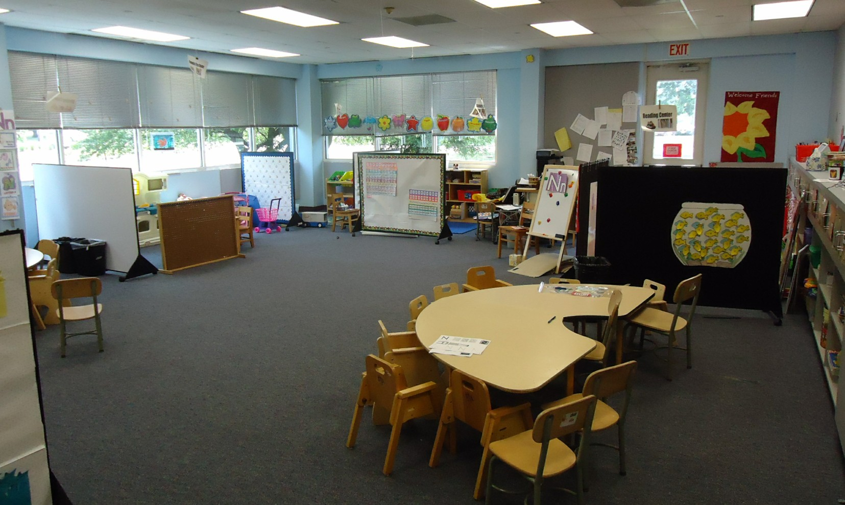
Physical Environment
Provide a sense of safety, calm, and security
reduce triggers
create welcoming
space

Slide 26
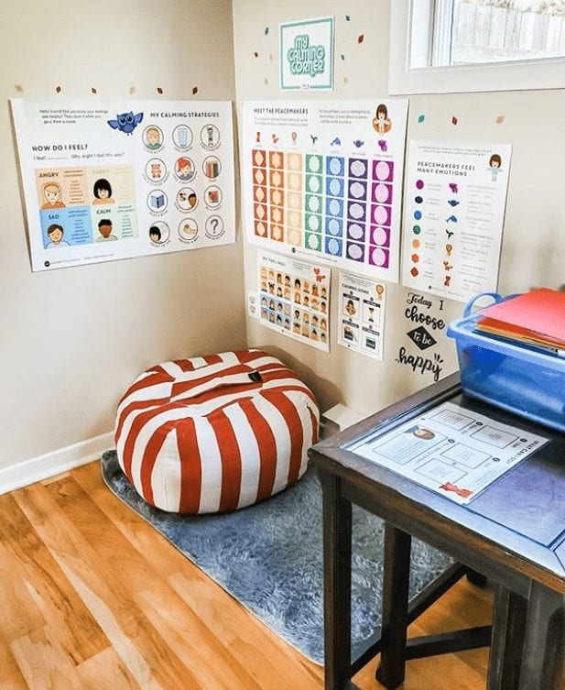
Creating Calm Spaces

Slide 27
Considerations
Improve Lighting | Use small lamps, fluorescent light covers, dimmer switch
Reduce Noise | Tennis balls on chairs
Improve Visuals | Post positive messages, reduce clutter, consider furniture arrangement and traffic patterns , use agendas
Bring in Nature | Have plants, use a water feature, have pictures of landscapes and nature
Establish Calming Areas | Quiet space, chair, sensory materials
Adapted from Trauma Informed Design in the Classroom: Frey, Fisher, Smith October 2020 Educational Leadership

Slide 28
Coping Skill Spotlight:
“Imagine Your Favorite Place”
Imagine your most favorite, calming place.
It could be a beach, a garden, or in nature, even on stage.
Take a few minutes and think about
what it would be like to be there.
What is around you?
What’s under your feet?
What do you smell?
What do you hear?
How warm or cool is it?
Really think deeply about all of those senses, and imagine you are there for a few minutes.

Slide 29
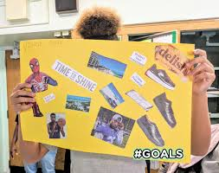
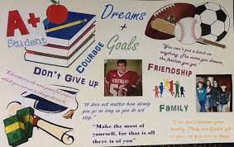
Visualization and Goal Setting
When we practice visualization, we can see the end goal and envision the steps to get there.
Vision Boards can act as a tool to facilitate that process
You can create visual representations of goals through a collage of pictures and words.
This can serve as a reminder of what you want to achieve and help motivate you to make the vision a reality.
Can be done individually or as a group.

Slide 30
I’m Determined Good Day Plan

Slide 31
Active Supervision
A key element of active supervision is the ability to build relationships. What ideas can you share about how you or someone in your school/division monitored students and made connections?
Moving
Scanning
Interacting

Slide 32
Routines to Create Emotionally Safe Environments
Welcoming Inclusion Activity or Routine
Engaging Strategies (self and others)
Optimistic Closure Routine
Building Rapport Questions
https://schoolguide.casel.org/uploads/sites/2/2018/12/SEL-3-Signature-Practices-Playbook-10.21.19.pdf

Slide 33
Grounding with “5,4,3,2,1”
5 things you can see
4 things you can touch
3 things you can hear
2 things you can smell
1 thing you can taste

Slide 34
Self-Management Activities
Time Management:
Checklists,Logs, ABC prioritizing
Stress Management:
Mindfulness, exercise, yoga, movement breaks, deep breathing
Brain Breaks Example: Would you rather?
https://www.youtube.com/watch?v=FOgcrNrtfpo
Motivation Management
Goal setting and reflection
Service to others

Slide 35
Classroom Expectations: Consistency Matters
Our physical and emotional well-being impacts our ability to think and learn effectively
Increases predictability
Students can focus on being engaged
Aligned with Schoolwide expectations

Slide 36
School-wide Matrix
Teaching Matrix | All Settings | Hallways | Playgrounds | Cafeteria | Library/ Computer Lab | Assembly | Bus
Respect Ourselves | Be on task. Give your best effort. Be prepared. | Walk. | Have a plan. | Eat all your food. Select healthy foods. | Study, read, compute. | Sit in one spot. | Watch for your stop.
Respect Others | Be kind. Hands/feet to self. Help/share with others. | Use normal voice volume. Walk to right. | Play safe. Include others. Share equipment. | Practice good table manners | Whisper. Return books. | Listen/watch. Use appropriate applause. | Use a quiet voice. Stay in your seat.
Respect Property | Recycle. Clean up after self. | Pick up litter. Maintain physical space. | Use equipment properly. Put litter in garbage can. | Replace trays & utensils. Clean up eating area. | Push in chairs. Treat books carefully. | Pick up. Treat chairs appropriately. | Wipe your feet. Sit appropriately.
Expectations

Slide 37
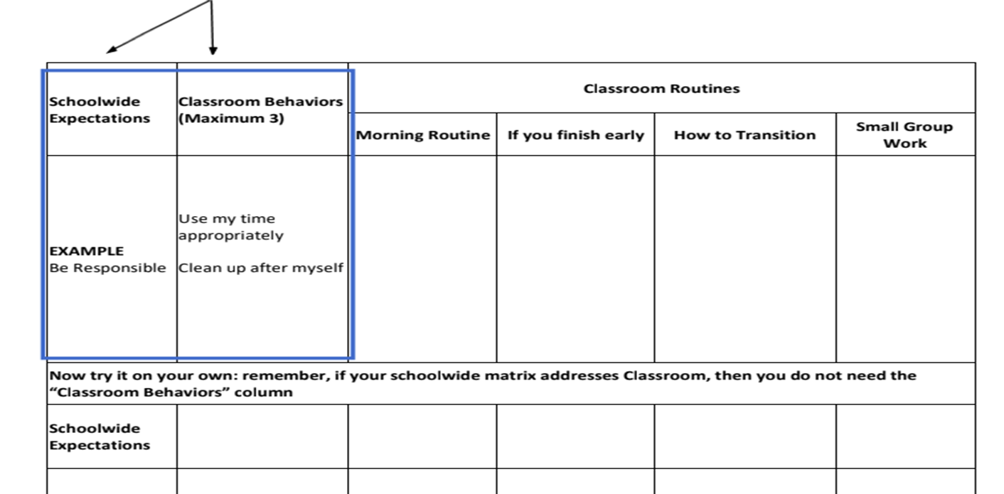
Classroom Expectations:

Slide 38
Classroom Matrix: Routines
 |  | CLASSROOM PROCEDURES
 |  | SMALL GROUP INSTRUCTION | HOW TO ASK FOR HELP | WHEN I FEEL UPSET/ FRUSTRATED
 | Respect | LISTEN TO PEERS WHEN THEY SPEAK USE KIND WORDS | RAISE HAND OR USE PRIVATE SIGNAL TO GAIN TEACHERS ATTENTION | COMMUNICATE WITH TEACHER/ADULT USE KIND WORDS
 | Responsible | KEEP UP WITH YOUR MATERIALS | WAIT FOR TEACHER ACKNOWLEDGEMENT | IDENTIFY EMOTION
 | Safe | WALK WHEN MOVING AROUND THE CLASSROOM | USE QUIET VOICE | USE COPING STRATEGY
EXPECTATIONS

Slide 39
Establishing a Sense of Safety
Focus on positive relationships
Set up a trauma-sensitive physical environment
Define, teach, & acknowledge appropriate behavior
Class expectations and norms
Practice active supervision
Establish routines and procedures
Consider structures to support SEL (Class meeting structure)

Slide 40
Who Has?
Ways to build positive environments.

Slide 41
Ted on: Engaging Students

Slide 42
Routines and Procedures
Classroom Procedures are steps for accomplishing classroom tasks; they
explain the accepted process for carrying out a specific activity such as:
Walking in the hallway
Using lockers
Sharpening pencils
Routines are procedures that are used on a consistent basis, such as:
When students arrive to class
During in-class transitions
At dismissal

Slide 43
Explicit Teaching in Every Routine
I do- informing, explaining, modeling, and providing examples
We do- working together to complete the steps of a particular task
You do- students practice what was taught by themselves

Slide 44
Behavior Can Be Taught
Direct Instruction
Modeling
Practice
Feedback/Acknowledgement
Error Correction
Re-teaching

Slide 45
Behavior Change
Behavior change can be quick, or it can be incremental and take time.
Expected behavior can be maintained by reinforcement.
For change to occur, you must address/ acknowledge setting events, skill deficits and functions of behavior.

Slide 46
Replacement Behaviors
A replacement behavior is an alternative behavior that allows a student to meet the same need or achieve a similar outcome as the undesired behavior they are currently using.

Slide 47
Important Consideration for Replacement Behaviors
Remember that students,
like adults, are not wired to
be one-time learners.
Teaching replacement behaviors allows you to encourage behavioral learning so that students’ needs are fulfilled, but it is done in a way that is more pro-social.

Slide 48
Teach Specific Skills
Social Emotional skills
Self Awareness
Self Management
Social Awareness
Relationship skills
Decision making skills
Replacement behaviors
Cueing and prompting
workbook

Slide 49
Caution: There IS a Good Time
When to teach:
NOT when the child is engaging in the inappropriate behavior, especially if stressed or escalated
Where to teach
in a safe environment;
then practice generalization
How to teach
using the Teaching Model– with praise and role modeling – and practice!

Slide 50
Prompting & Cueing
A hint meant to encourage a person to perform a desired behavior.
Paired with a desired behavior (i.e. social skill, coping skill, replacement behavior)
Subtle
Verbal, visual, gesture etc.

Slide 51
Opportunities to Respond
Students are
able to:
Teachers are able to:
Remain attentive and on task
Retrieve, rehearse and practice information, concepts, skills and strategies being taught
Refrain from inappropriate behaviors
Provide corrective feedback immediately
Adjust the lesson
Offer behavior specific praise

Slide 52
Teacher Talk Time
How much time are you talking?
______% of students surveyed in Virginia cohorts reported that their teachers talk most of the time.
When in fact….
Teacher talk should be no more than ____ to ____ % of instructional time.
76
40
50

Slide 53
Opportunities to Respond - When and How to Use
Oral responses
Choral
Partner or team
Individual
Written responses
Response system
Graphic organizer
Action responses
Act out/Gestures
Hand signals
Manipulatives

Slide 54
More OTR Ideas
socrative.com
polleverywhere.com
Kahoot.com
Plickers.com
Set of few choices (e.g., noun, pronoun, verb, adverb, letters, numbers, story elements)
Guided Notes – teacher prepared handouts leading students through a presentation or lecture with visual cues or prepared blank spaces to fill in key facts or concepts
Numbered Heads Together
Students in quads, assigned a number
Teacher poses question
Group discusses/agrees on answer
Random/specific numbered students get called on to report

Slide 55
Who Has?
Ways to engage/support students.

Slide 56
Ted on: Feedback that Moves Students Forward

Slide 57
Formative Assessment
Formative assessment is a process used by students and teachers during instruction to elicit and use evidence to improve understanding of intended learning outcomes and support students to become more self-directed learners.

Slide 58
Five Strategies of
Formative Assessment
Clarify, share, and understand learning intentions and success criteria
Find out what students have learned
Provide feedback that moves learning forward
Activate students as instructional resources for one another
Activate students as owners of their own learning

Slide 59
Focus on: Activate students as owners of their own learning
Self-regulated Learning
Share learning goals
Promote the belief that learning is incremental
Decrease comparisons with others
Provide feedback that moves them forward
Transfer control of the learning from teacher to student

Slide 60
How to support students to become owners of their learning
Individual Tracking
Individual Understanding
Graphs
Stars on rubrics (video)
Project checklists
Red/Green Disks or Cups
What did we learn today?
Learning logs
“Personal best” selections

Slide 61
Fist to Five
Pose a topic and allow students to share their feelings by holding up a number.
0: very uneasy and need more support
5: Comfortable, excited and ready to go
Work with students to create the description of what each number means
Examples:
How happy are you to come back to school after the weekend?
How are you feeling about that activity? That concept? The upcoming test?

Slide 62
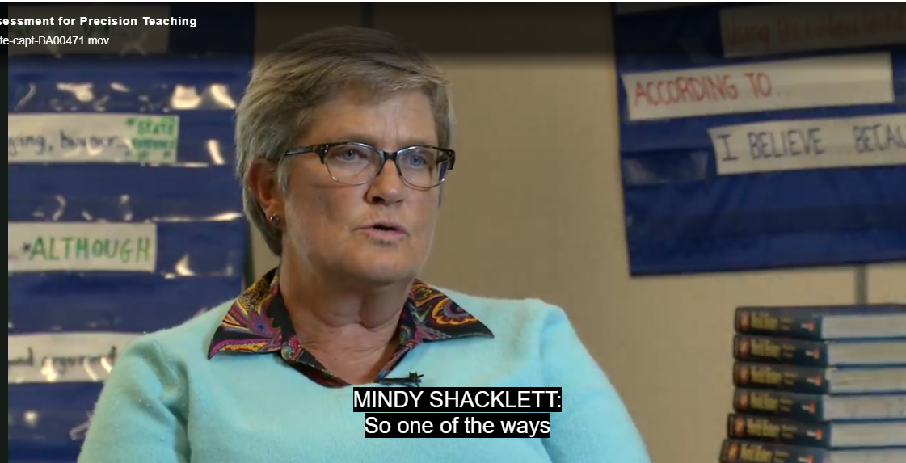
Student self monitoring

Slide 63
Strategies for Scaffolding
Partnering
Chunking
Sequencing/Progress in Complexity
Demonstrations and completed models
Provide hints and prompts
Provide aids such as cue cards and checklists

Slide 64
Supporting Self Reflection
Ending an activity, class, meeting, or day with a quick reflection and share.
Have each person share an:
Appreciation: Something they appreciated
Acknowledgement/Apology: Something they might need to acknowledge
Ah ha: something that they realized or learned.

Slide 65
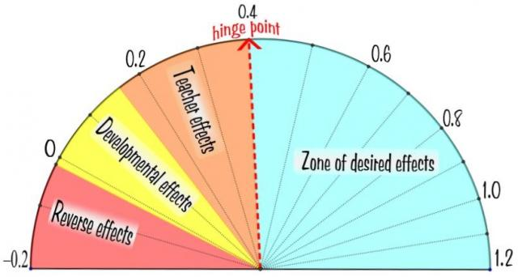
Effective Feedback
Direct Instruction
Feedback
Teacher
Clarity

Slide 66
Start here - Positive : Corrective

Slide 67
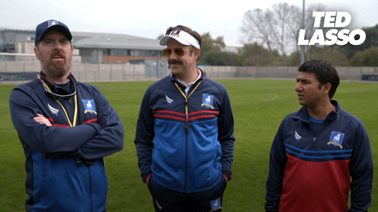
Correcting Errors Effectively
Correct Answer/Behavior
Next time.../Forward
End on Correct Response

Slide 68
Know the story
What else is really going on here?
What does this child need?
How can I change my perspective?
What keeps me only looking at the behavior?
What is this behavior communicating right now?
What in the environment could be triggering this behavior?

Slide 69
Response to Behavior
Our initial response determines what happens next.
Challenge
Reprimand
Argue
Escalate Emotion
Bigger Problem
Listen
Paraphrase
Validate
Show empathy
Calm
Support
BEHAVIOR
OUR RESPONSE
The first moment determines the next hour.
(Adapted from Bob Garrity, Garrity Mediation and Consulting)

Slide 70
As we experience a stress response we have a decrease in...
Problem solving
Communication skills
Emotional regulation
Ability to retrieve previously learned information
Decision making

Slide 71
As we experience a stress response we have an increase in….
Emotional instability
Panic
Sorrow
Anxiety
Irritability
Anger
Frustration
Shame
Impulsivity with regards to language or actions
Lack of self-control
Aggression
Word surge

Slide 72
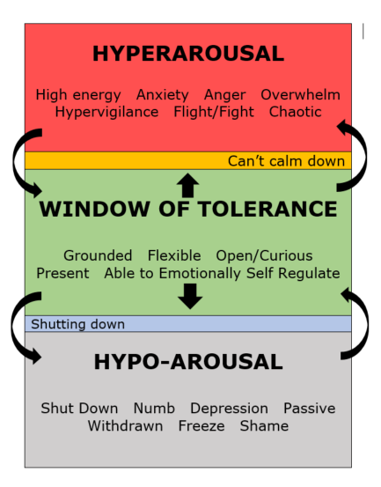
Window
of
Tolerance

Slide 73
Reacting Versus Responding
REACTING
RESPONDING
Based on feelings in the moment
Impulsive
Short-sighted
Poor communication
Problem-based
Based on feelings and reason
Deliberate
Goal driven
Connected communication
Solution-based

Slide 74
Examples
REACTING
RESPONDING
Distrust - Power - Punishment
“Hey!!”
“What are you supposed to be doing?”
“Get busy”
“What did you say?!!”
“You’re going to the office”
Referral/Suspension”
Trust - Support Understanding
“How can I help you”
“What do you need?”
Listen
“It sounds like you are having a hard time.”
Provide Support
(Adapted from Bob Garrity, Garrity Mediation and Consulting)

Slide 75
Reacting Behaviors
Agitated behavior from staff such as shouting
Cornering the student
Engaging in power struggles – ex. “In my classroom, you will….”
Moving into the student’s space
Touching or grabbing the student
Making sudden or very quick responses
Making statements that may discredit the student – ex – “this isn’t elementary school”
Becoming defensive, arguing
Communicating anger and frustration through body language

Slide 76
Reacting Behaviors
Agitated behavior from staff such as shouting
Cornering the student
Engaging in power struggles – ex. “In my classroom, you will….”
Moving into the student’s space
Touching or grabbing the student
Making sudden or very quick responses
Making statements that may discredit the student – ex – “this isn’t elementary school”
Becoming defensive, arguing
Communicating anger and frustration through body language
AVOID

Slide 77
Responding Behaviors
The most powerful response for staff is NO IMMEDIATE RESPONSE, PAUSE
Model calm
Treat student with dignity and respect
Consider how you are communicating through body language
Use private communication
Don’t communicate any anxiety, be matter-of-fact

Slide 78
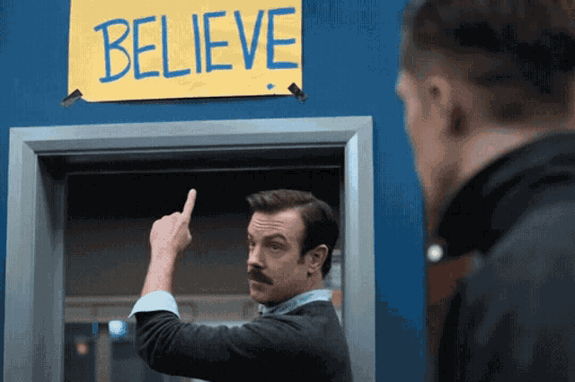
Strategies to Try
Precorrection
Limit setting
Offering Choice
Redirection / Prompting
Validation
Active Listening
Systematically Modifying Context
Differential Reinforcement
Reduce situation demands
Teacher proximity
Provide independent, passive, or movement activities
Goal: Interrupt/Intervene
(Separate student from trigger)

Slide 79
Using Precorrection to Address Behavior
Tardiness to class
Difficulty with schedule changes
Talkative during independent practice
Sleeping in class
Missing materials
Chaotic class changes
Frustration with writing tasks

Slide 80
Remember
Punishing students doesn’t teach them the right way to act.
Dwelling on an incorrect answer does not lead us to the correct answer. FEED UP FEED FORWARD

Slide 81
Connection before Correction
Talk privately with the student
Use encouraging words
Show empathy/
understanding

Slide 82
Who Has?
Ways to provide feedback to move students foward

Slide 83
Ted on: Taking on the Challenge of 2022

Slide 84
Situation: 2022
In the moment,
Don’t try to fix it.
Don’t give a life lesson or lecture.
Try using Validating Statements:
What can I help you with?
What do you need to feel safer?
I hear you, that sounds hard.
How did that make you feel?
It sounds like you are really struggling.

Slide 85
Not JUST for the Students
Count
Grounding your Senses (54321)
Deep Breathing (Box method)
Visualization
Fidget/Crafting
Listen to music
Exercise/Walk/Move
Drink more WATER

Slide 86
It’s all about…

Slide 87
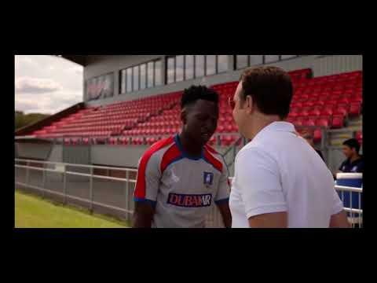
Be a Goldfish. Onward. Forward.

Slide 88
Strategy Show Off!
Share the strategies you are committing to try!

Slide 89
EXIT TICKET

Slide 90
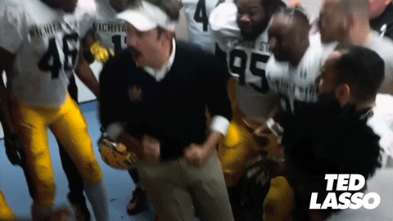
Amazing!
Here’s to you and meeting the challenges with many successes during the second half of the 21-22 school year!

