Slide 1
Welcome to Strand #1!
Data-Informed Decision Making

Slide 2
Contributors to this Professional Learning
Notes:
The work you are doing is connected to work happening all over the country (and the world). The professional learning opportunities you will be experiencing have been implemented, revised, and refined by partners from diverse schools and agencies. We look forward to learning more from you as we share this journey.

Slide 3
Materials
http://vtss-ric.org

Slide 4
What will we know?
Effective and efficient data informed decision-making systems start with strong meeting foundations and the development of an integrated data dashboard
Data informed decision-making systems support adults in the effective and efficient implementation of equitable instructional practices for teaching academic, behavior and mental wellness skills.

Slide 5
What will we do?
Develop team meeting foundations for effective decision making (DCA #4 and A-TFI 1.2b,1.6b)
Complete a data audit (DCA #14 and A-TFI 1.12a)
Develop action items for an implementation plan to provide division leadership team(s) and building level teams with access to an integrated data dashboard (DCA #14 and A-TFI 1.12a) that includes fidelity AND student outcome data
Select or revise a clear process for data informed decision making with a focus on teaching and learning (DCA #15, 19 and A-TFI 1.13)
Notes:
What will we do?

Slide 6
VTSS Implementation Matrix

Slide 7
Implementation Logic in Practice

Slide 8
Progress Monitoring

Slide 9
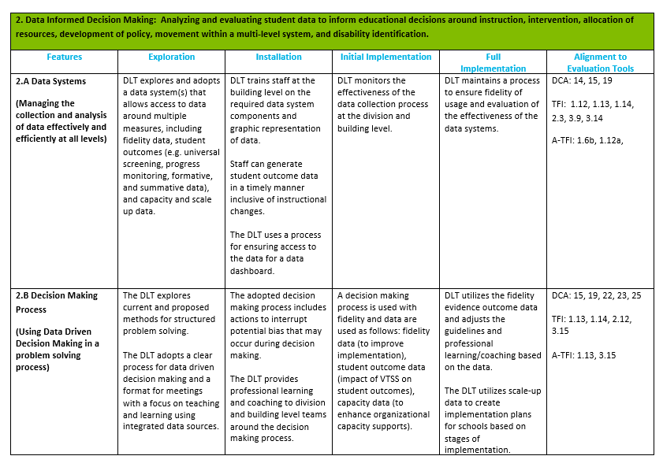
Implementation Matrix

Slide 10
Team meeting foundations
Effective and Efficient Team Meetings

Slide 11
Did you know?
90,000 public schools in the U.S.
Each school has at least one team to address challenges and build solutions.
Each team meets at least monthly.
On average there are 5 members on a team.
810,000 hours of meetings
4,050,000 hours of personal time annually?

Slide 12
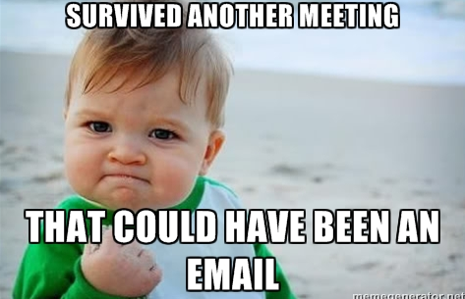
They go on….and on…and on…

Slide 13
What do we need?
A structure for meetings that lays a foundation for efficiency and effectiveness!
Notes:
Team meeting foundations/norms and the formal problem solving process.

Slide 14
And…
A formal process that the team can use to build and implement solutions!

Slide 15
Components of Effective Team Meeting Structures
Predictability
Participation
Accountability
Communication

Slide 16
Four Features of Effective Meetings: First!
Defined roles, responsibilities, and norms
Start and end on time (get agreement to extend)
Use an agenda and stick to it
Data are reviewed within every meeting
Next meeting is planned
Predictability
Participation
Accountability
Communication

Slide 17
Four Features of Effective Meetings: Second!
80% of team members are present and actively engaged
Decision makers are present at each meeting
Predictability
Participation
Accountability
Communication

Slide 18
Four Features of Effective Meetings: Third!
Facilitator, minute taker and data analyst come prepared and complete responsibilities in the meeting
Process is used to monitor progress of implemented solutions
Document all decisions
Efforts are achieving desired outcomes for students
Predictability
Participation
Accountability
Communication

Slide 19
Four Features of Effective Meetings: Fourth!
All regular team members get access to meeting minutes within 24 hours of the meeting.
Team members keep team meeting norms and agreements
Predictability
Participation
Accountability
Communication

Slide 20
Team Meeting Video
Please see your state VTSS coach for access to this video.

Slide 21
Let’s Plan: Meeting Structures
1. Preferred Outcome for Meeting Structures
2. Current Situation
3. Forces Preventing Us From Moving Towards Our Preferred Future
4. Forces Driving Us Toward the Preferred Future

Slide 22
What role will you play?
Review the roles and responsibilities of data-informed decision making teams.
What role will you play?
Who is your back up?
What support might you need to fulfill your role and from whom?
Leverage your strengths!

Slide 23
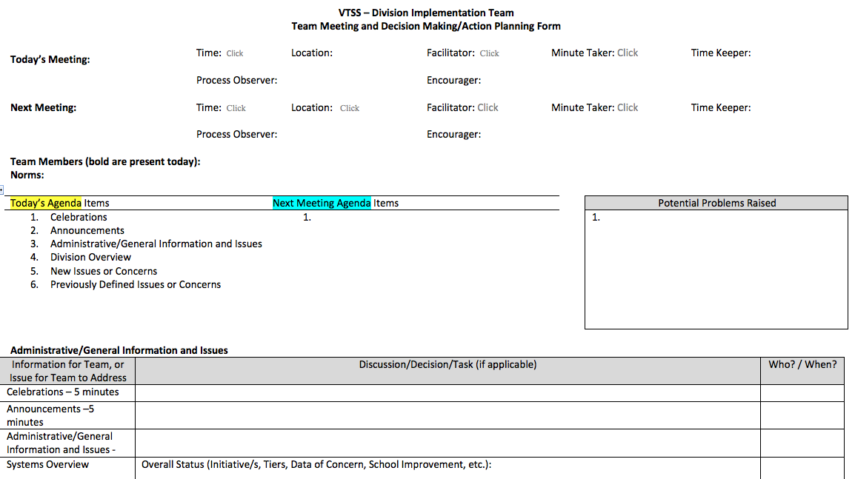
Accountable
Process to Monitor Progress
Agenda Format
Document meeting demographics (date, time, who is present, agenda items, next meeting date/time/location/roles)
General Information/Planning Items
Decision Making Items

Slide 24
Communicate
Transparent communication
Develop Norms
Include documentation or standing agenda items for who will communicate decisions, to whom and by when?
Develop norms and stick to them!

Slide 25
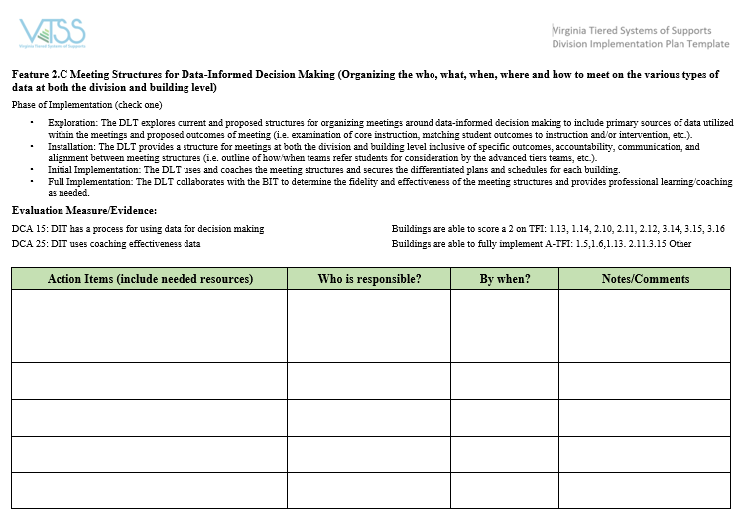
Let’s Put It All Together

Slide 26
DATA DASHBOARDS
EFFECTIVE AND EFFICIENT MEETINGS

Slide 27
Most Fun Ever!
Please see your state VTSS systems coach for access to this video.
Notes:
Data video

Slide 28
Data at EVERY Meeting!
Go Data! Go Data!
Plan for it!
Clean data – no dirty data
Include disaggregation by areas to watch – disability status, low SES, race, disproportionality, ethnicity, etc.
Multiple data points –triangulate
Have a back up plan
Get data to school teams!

Slide 29
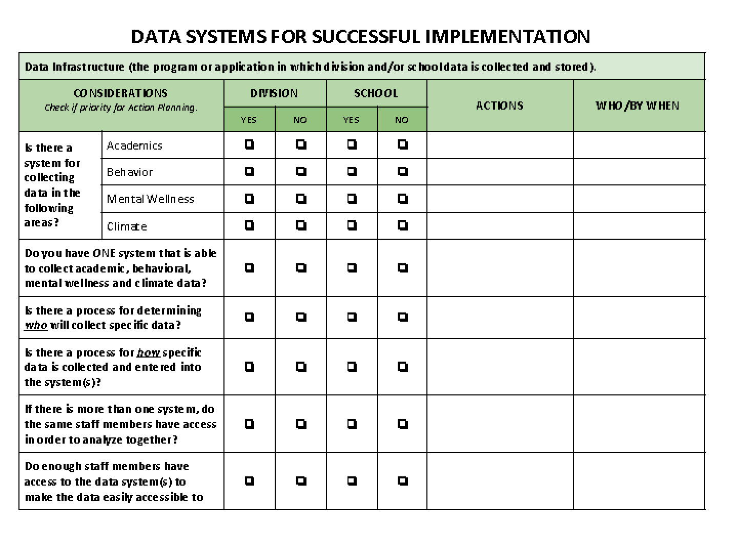
Data Audit Tool

Slide 30
Portsmouth
Please see your state VTSS systems coach for access to this video.

Slide 31
Accomack
Please see your state VTSS systems coach for access to this video.

Slide 32
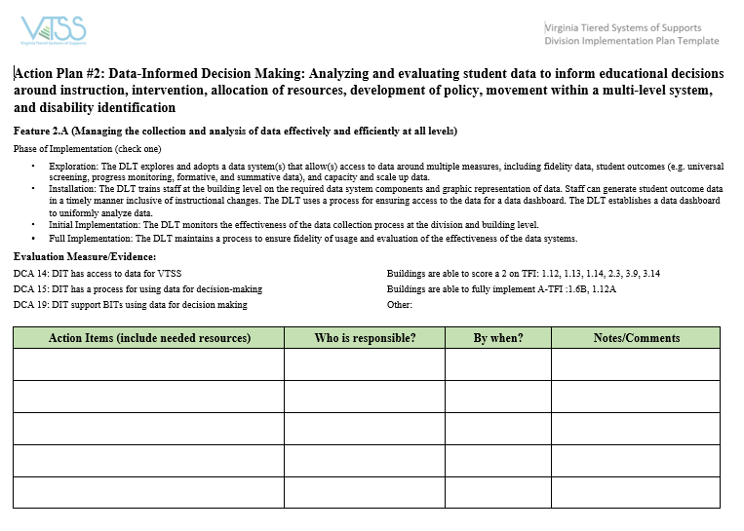
Let’s Put It All Together-Data Collection

Slide 33
Data-INFORMED decision making process
Effective and Efficient Meetings

Slide 34
DATA ANALYSTS
AN IMPORTANT ROLE FOR EFFECTIVE PROBLEM SOLVING

Slide 35
Chesapeake has data analysts
Please see your state VTSS systems coach for access to this video.

Slide 36
Let’s Practice

Slide 37
Case Study: Data/Evidence of Need:

Slide 38
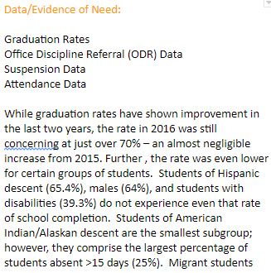
Case Study: Division’s Data
Notes:
Example of Case Study Division Data

Slide 39
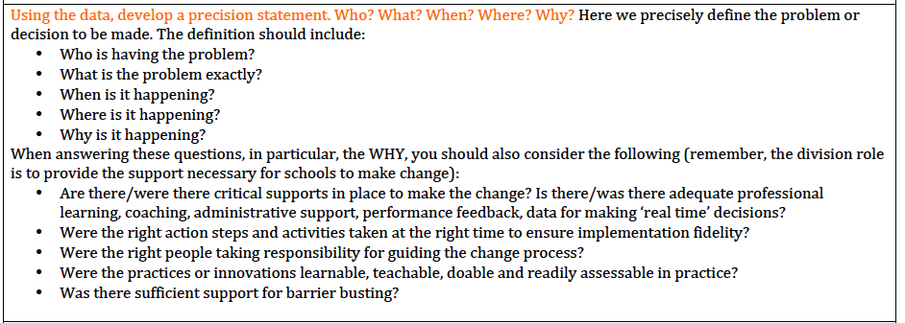
Case Study: Precision Statement

Slide 40
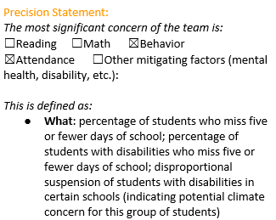
Case Study: Division’s Precision Statement

Slide 41
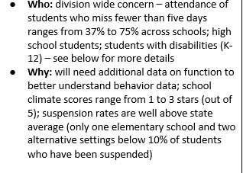
Case Study: Precisely Who and Why?

Slide 42
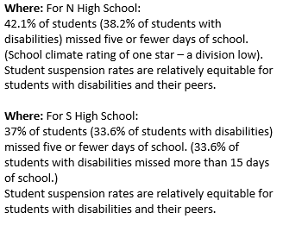
Case Study: Precisely Where?

Slide 43
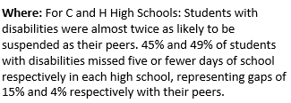
Case Study: Get Precise!

Slide 44
Case Study: Goals

Slide 45
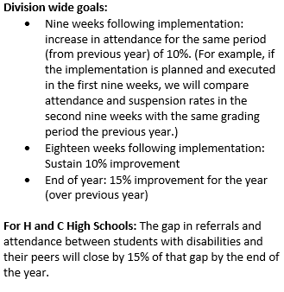
Case Study: Division’s Measurable Goals

Slide 46
Case Study Practices

Slide 47
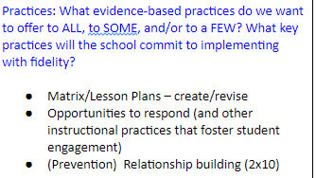
Case Study: Division’s Practices

Slide 48
Case Study: Practices Action Steps
Implementation Action Step
Who? By When?

Slide 49
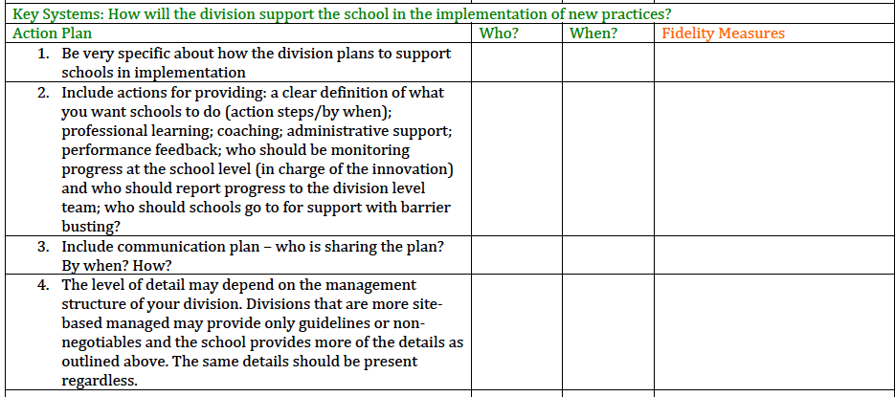
Case Study Systems

Slide 50
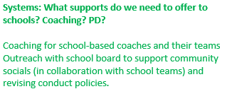
Case Study: Division’s Systems Support

Slide 51
Case Study: Systems Support
Implementation Action Steps
Who? By When?

Slide 52
Case Study Progress Monitoring
Data/Progress Monitoring: Did we do what we said we would do? With fidelity? Outcomes? Are we making progress?
Did it work?

Slide 53
Case Study: Division’s Progress Monitoring

Slide 54
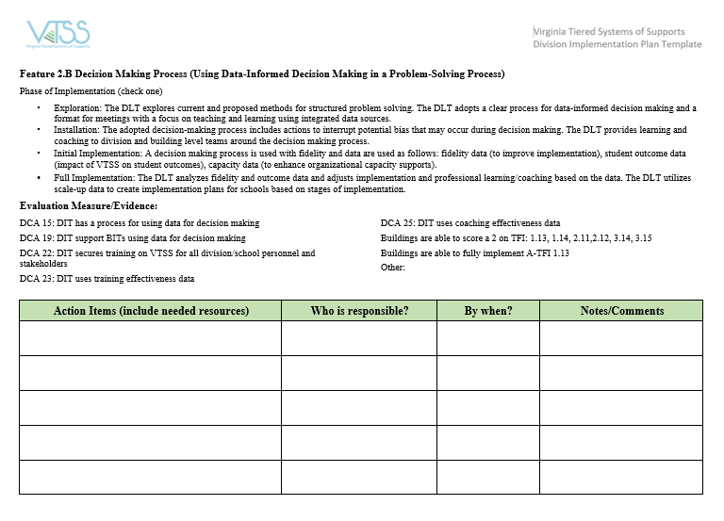
Let’s Put It All Together-DIDM

Slide 55
HOMEWORK
During the next session (Session B on December 3rd OR 5th), we will:
Apply the established DIDM process to your area of concern for practice and reflection.
Your division will be your case study.
Bring data on an area of concern for your division. The data should have charts, graphs or other easy to read reports for the team to make decisions.

Slide 56
Questions???

Slide 57
See You Soon!
Please remember to fill out the evaluations.

