Slide 1
Welcome to Strand #1!
Data-Informed Decision Making…or is it?

Slide 2
Contributors to this Professional Learning
Notes:
The work you are doing is connected to work happening all over the country (and the world). The professional learning opportunities you will be experiencing have been implemented, revised, and refined by partners from diverse schools and agencies. We look forward to learning more from you as we share this journey.

Slide 3
What will we know?
Effective and efficient data informed decision-making systems start with strong meeting foundations and the development of an integrated data dashboard.
Data informed decision-making systems support adults in the effective and efficient implementation of instructional practices for teaching academic, behavior and mental wellness skills

Slide 4
What will we do?
Review progress on your implementation plan to provide division leadership team(s) and building level teams with access to an integrated data dashboard (DCA #14 and A-TFI 1.12a) that includes fidelity AND student outcome data
Practice a clear process for data informed decision making with a focus on teaching and learning (DCA #15, 19 and A-TFI 1.13)
Analyze a “new” practice through the lens of the VTSS Evidence Based Practice Selection Tool (DCA #5)

Slide 5
VTSS Implementation Logic

Slide 6
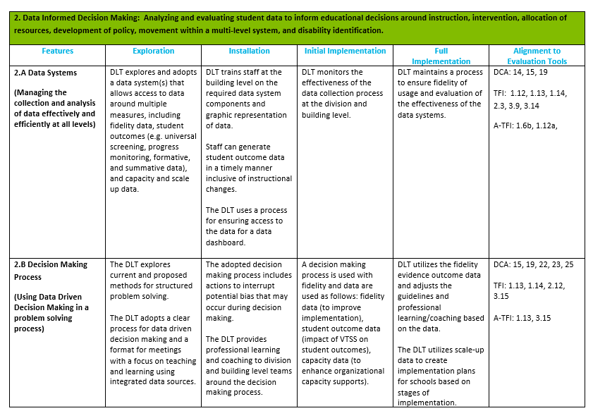
Implementation Matrix

Slide 7
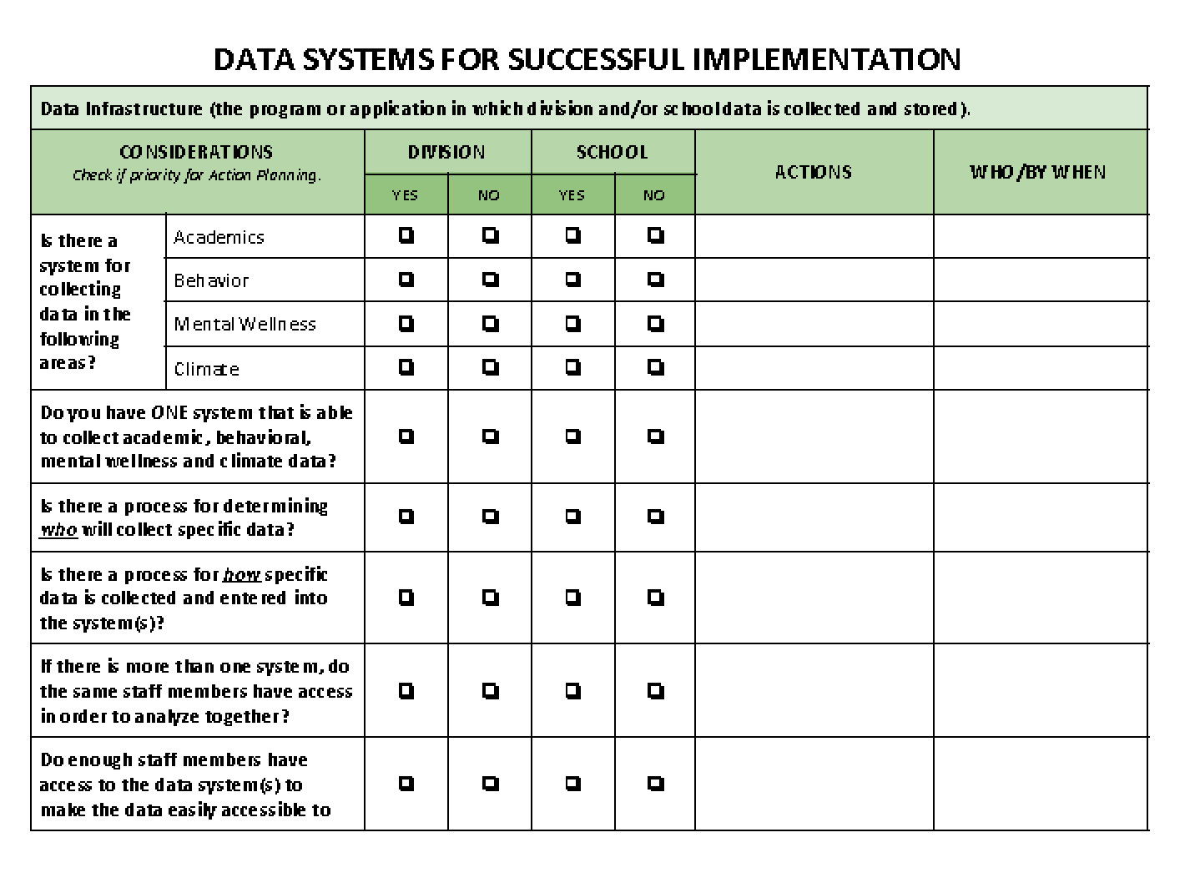
Data Audit Tool

Slide 8
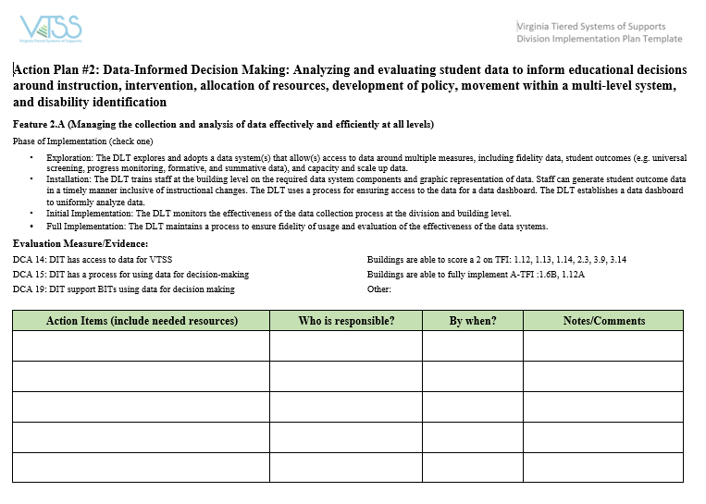
Implementation Plan

Slide 9
Flipgrid Video Directions
See your state VTSS Systems Coach for access to the video that explains the Flipgrid activity.

Slide 10
Learning Informed Decision Making
Notes:
How many of you were able to attend with one of your schools, the school based version of data driven decision making in October or the learning of TFI evaluation subscales? If not…we are offering another in February in Williamsburg. But in that learning opportunity, we talked about how data has been weaponized against us. It is used to describe the ways that divisions, schools, teachers and students are broken and need fixing. We talked about how it is up to us to change that paradigm. It is up to us to change that narrative. We are NOT broken…we are constantly learning and growing. We ARE however, the product of old systems or ways of work that are designed to get the results we are getting. So let’s revolutionize that system!! Let’s change that narrative!

Slide 11
A Culture of Inquiry
When we implement data-informed decision-making well, it can become a tool for professional learning.
In the right conditions, data analysis and problem-solving should stimulate curiosity, questions, dialogue, investigation, innovation, LEARNING, and CHANGE (among adults).
Notes:
Data is an integral part of the work we do. We have to innovate, to change the discourse from data as focal point, to data as tool… to curiosity…inquiry. When we talked to your schools –we asked what are you curious about? What intrigues you about the learning that your students are doing? What investigating can we do to discover how your students are learning and what are the patterns of errors? What do we need to learn to do to make change in how students are learning?

Slide 12
Solving problems requires change.
“Conceptual change happens when people make their current beliefs explicit, subject them to scrutiny from themselves and others, consider how new information either fits or challenges their existing beliefs, and then make permanent changes to what they know and do.”
Katz, S. & Dack, L.A. (2013) Intentional Interruptions: Breaking Down Learning Barriers to Transform Practice (p. 7)

Slide 13
How does the team make this shift?
Problem solving team already…
And can function like learning communities if they also…
Use evidence to clearly define problems
Collaborate to study impact and effectiveness of instruction
Hypothesize why things happen as they do
Brainstorm possible solutions & define success
Monitor solutions
Align their problem-solving to school-wide goals for student (and teacher!) learning
Have the autonomy to pose questions and prioritize the learning challenges that matter most to them
Collaborate with stakeholders to brainstorm solutions and define points of fidelity and flexibility
Reflect on permanent changes to practice

Slide 14
Leader Learning Teams
See your state VTSS Systems Coach for access to the Leader Learning Teams video.

Slide 15
What will we know?
We start with data – as a tool for stimulating our curiosity!
Effective and efficient decision-making systems start with strong meeting foundations and the development of an integrated data dashboard.
The process can only be strong and effective if it is well-informed.

Slide 16
Making Decisions:
Study data at the division and school-wide level as needed
Define problems very specifically because they focus on the system (what coordinated work by adults will enhance the success of all students?)
Leverage evidence-based practices AS SOLUTIONS to problems – assess - reflect
Quick Review:
Core instruction touches every student in the building. Intervention helps to mitigate learning errors.
Notes:
In an integrated tiered system, the implementation teams use data to analyze the effectiveness of instruction and interventions in both behavior AND academics.

Slide 17
Implementation Plan

Slide 18
learning THE INFORMED decision-making process
Let’s learn by doing…let’s get messy!

Slide 19
What will we know?
Data informed decision-making systems support adults in the effective and efficient implementation of instructional practices for teaching academic, behavior, and mental wellness skills.
WHAT DO WE WANT TO KNOW ABOUT SCHOOLS, TEACHERS, STUDENTS, COMMUNITY?

Slide 20
We all have a process!
See your state VTSS Systems Coach for access to the “Plan – Act – Assess – Reflect” video.

Slide 21
The VTSS Process

Slide 22
What sparks inquiry?
What are we curious about? As leaders, how do we create the conditions for schools to inquire, reflect, and change practice?

Slide 23
A Problem of Practice
Considerations
Cautions
Change that will make learning more effective for students
Change that aligns with goals you are uncovering in school improvement
Change for which you have some resources on which to build – likelihood of success
Focus on the issues that you can support from your offices
Avoid the problems that have plagued you for years – we will get there soon enough!
Avoid focusing on issues of mandates and compliance – for this first time! This should inspire learning and change.
Notes:
We plan to have a poster session on progress with this problem. So pick a problem that we can have made some progress with.

Slide 24
Let’s start our learning conversation.
I wonder…What questions do we have? Let’s do some predicting.
Notes:
Refer to “Data Driven Dialogue Predictions” (National School Reform Faculty) in workbook. Allow time for individual reflection before group discussion.
Prediction protocol…remember quiet think time first…then group chat.
Protocols and their role in change management and professional learning…structured conversations that are intentional interruptions as mentioned in the videos
modeling how you can use with school based teams…tools
“We do not learn from experience…we learn from reflecting on experience.”
― John Dewey

Slide 25
Data
Notes:
Pull out the data you brought…

Slide 26
Observations
If you were able to bring your data…
Observation protocol – Notice the last bullet! What challenged your preconceived notions?
Use that information to inform what goes in the Who? What? When? Where? portion of your precision statement!

Slide 27
Observations
If data exists but you don’t have it here and you need to get it, how? What do you need?
OR
No data…what to do?
Notes:
Observation protocol…

Slide 28
Inferences
What have I come to understand about the data? What opportunities for learning and change are present in the data?

Slide 29
Developing a precision statement.
Let’s investigate what is happening. Let’s have authentic dialogue about the learning in our division.

Slide 30
Precision Statement
Use the dialogue you just had to add to your precision statement!
Notes:
CHANGE SLIDE LAYOUT…

Slide 31
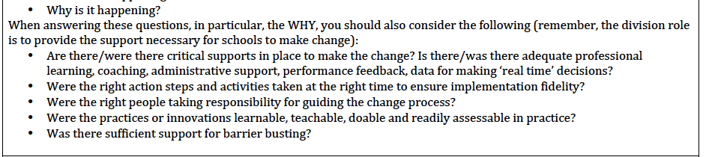
Precision Statement
Working Smarter and with greater Efficiency…
Remember! What concerns have revealed themselves in school improvement work/continuous improvement work?
Notes:
When we are asking “why” at the leadership conversation level…we are asking “why” in the system? How have we supported the conditions for change? Or not?

Slide 32
Precision statement
Notes:
KRIS WILL PLAY AROUND WITH THIS!!!! ☺
This seems like a lot of work for just this part…too often we jump from data to solution finding…we need to collaboratively inquire about this problem to find the “real problem…just the right inch…urgent learning need… followed by going deep with meaningful solutions.
Write statement…

Slide 33
Critical Friends
Focus on student learning
Pick a Division Presenter
Make their practice public
Engage in reflective dialogue and collaborative work
Inquire into, analyze and reflect upon learning
Follow the guided instructions provided by the facilitator for presenters and participants
Notes:
CFG will take about 70 minutes
Tuning for Equity

Slide 34
Squad Goals
Notes:
Student outcome focused goals ONLY.

Slide 35
Swing to Solutions
Create the conditions for supporting changes in implementation
Implementers MUST change practices!
Robust systems need to support implementers!
Learning Leaders
focus on the systems
Notes:
Graphic here that demonstrates dual solutions with leaders as the bridge or link to creating and sustaining

Slide 36
We know how to find solutions!
We’ve been problem solving for ages!
Intentional Interruption
by Stephen Katz and Lisa Ann Dack

Slide 37
Practices
THINK: Innovation!
What are the appropriate responses that address the needs implied in the data?

Slide 38
Develop solutions For Practices
Notes:
Needs to be changed for the target audience.

Slide 39
Division Initiative Map

Slide 40
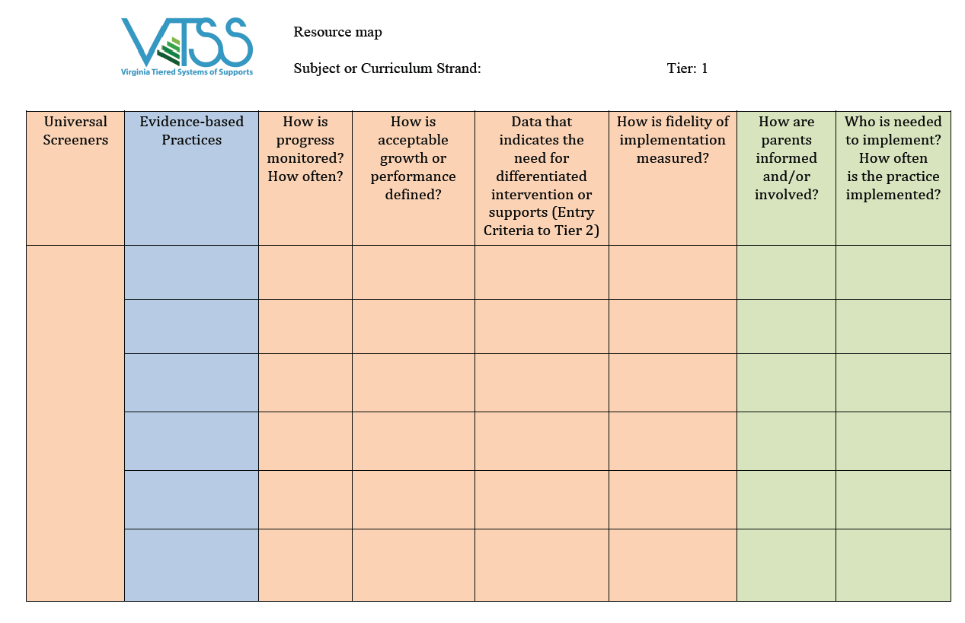
Decide your evidence-based practices!
Based on what you put here…or if you don’t have a practice that meets the need, find a new one!
What is your continuum of supports? What practices meet your goal?

Slide 41
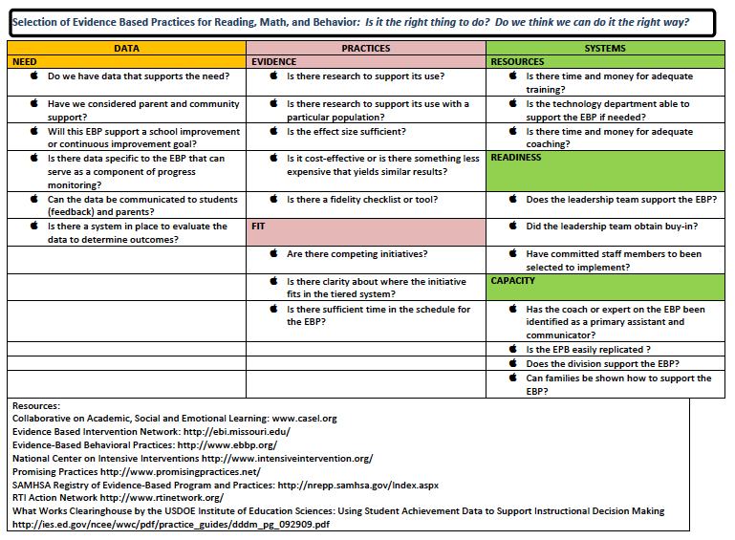
There are ways to find new practices!

Slide 42
Revisiting Practices
THINK: Innovation!
What are the appropriate responses that address the needs implied in the data?
Notes:
Identify practices

Slide 43
Looping in the Schools
How can we loop schools into the goal setting and solution finding?
ASK! Engage in collaborative inquiry with your school leadership teams (like we are doing here today)!
Notes:
How is the school’s data part of (or not) division trends?
Did we develop a good goal?
Have we developed solutions that will seem to work?
Any issues we failed to consider when we chose these solution steps?
DCA # 11…District uses a process for addressing internal barriers
Do you think these solution steps will meet our goal?

Slide 44
When student learning is our compass…
“Right” actions are identified.
Actions improve learning.
Midstream adjustments are possible.
Notes:
Remember…Katz told us…we don’t have to get it right the first time out of the gate. We have to commit to trying, to assessing, to reflecting and adjusting.

Slide 45
Remember
Selecting something that is likely to work is a good first step, but once something is implemented, the most important function of leadership is ensuring that desired outcomes are reached and sustained OVER TIME.

Slide 46
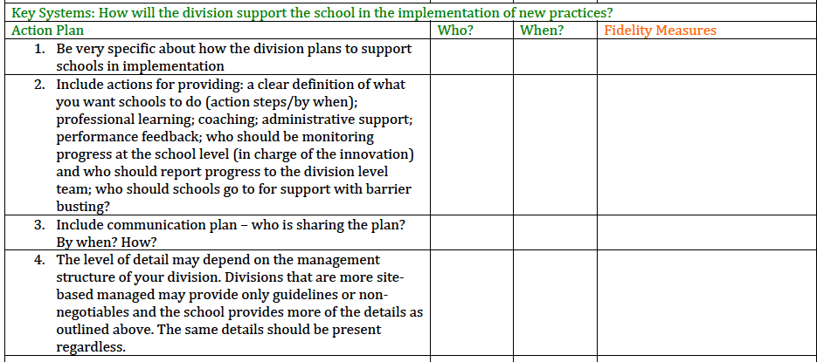
Systems
Notes:
In the systems write down school buy-in steps above. Here you are doing DCA # #18 so might document that in your implementation plan for your DCA.
Insert those leader actions that will create the conditions (remember) for the practices
Give example…planning coaching but realize that you don’t have coaching plan structure. Link to implementation plan which is how to develop coaching plans.

Slide 47
Progress Monitoring
Don’t just assess…REFLECT!

Slide 48
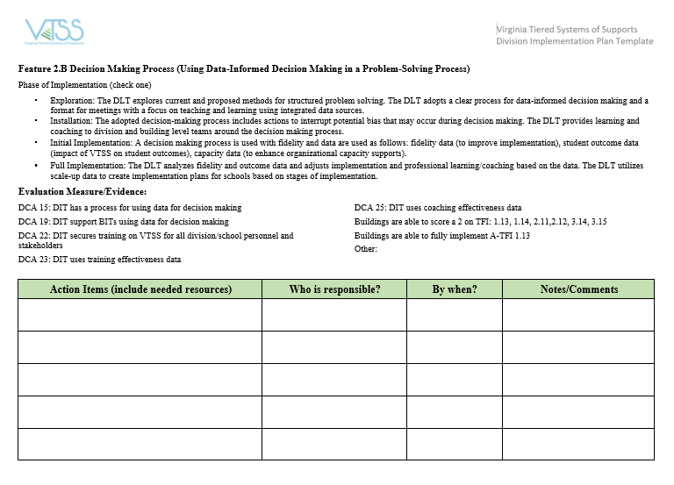
Let’s Plan

Slide 49
Homework
To Session C of this strand (Strand #1 Data-Informed Decision Making) please bring:
1. Progress monitoring data (to-date) on the plan.
2. A short “share out” of your plan and success!
Voice Thread
Flipgrid
Poster
Be Creative!
Apply a problem of practice to the established process for practice and reflection.
More details for sharing to come…just get started!

Slide 50
Closing Activity
Think about your biggest take-away from today’s discussion.
Get a piece of paper, and using only pictures or symbols (no words) record your take-away on your paper. NO TALKING!!!
Now pass your drawing to the left 4 times (so it ends up 4 people away from you). Each participant now must share out what they think your take-away is based upon your drawing.

Slide 51
THANK YOU!!!

