Slide 1
Welcome to Strand #1!
Data-Informed Decision Making

Slide 2
Materials
http://vtss-ric.org

Slide 3
What will we know?
Effective and efficient data informed decision-making systems start with strong meeting foundations and the development of an integrated data dashboard
Data informed decision-making systems support adults in the effective and efficient implementation of equitable instructional practices for teaching academic, behavior and mental wellness skills.

Slide 4
What will we do?
1. Develop team meeting foundations for effective decision making (Implementation Matrix 2.C).
2. Complete a data audit and data inventory (Implementation Matrix 2.A).
3. Develop action items for an implementation plan to provide division leadership team(s) and building level teams with access to an integrated data dashboard (Implementation Matrix 2.A and DCA #14 and 19) that includes fidelity AND student outcome data.
4. Select or revise a clear process for data-informed decision making with a focus on teaching and learning (Implementation Matrix 2.B, DCA #15).

Slide 5
VTSS Implementation Matrix

Slide 6
Implementation Logic in Practice

Slide 7
Progress Monitoring

Slide 8
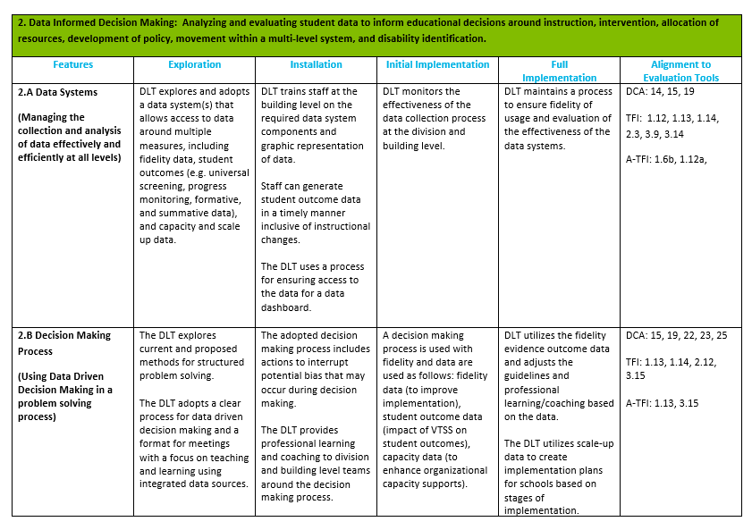
Implementation Matrix 2.A., 2.B.

Slide 9
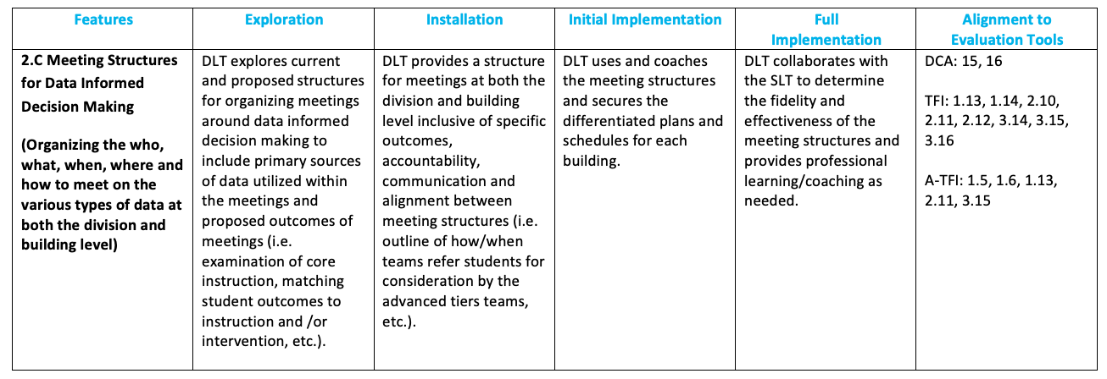
Implementation Matrix 2.C, 5.A

Slide 10
TEAM MEETING STRUCTURES

Slide 11
Components of Effective Team Meeting Structures
Components
2.C Installation Phase
DLT provides a structure for meetings at both the division and building level inclusive of specific outcomes, accountability, communication and alignment between meeting structures...
Predictability
Participation
Accountability
Communication

Slide 12
Quick Task
You are getting ready to see 4 slides as a follow-up to the 4 components of effective team meeting structures for the division.
Take notes on each slide about where you see your team currently. After the 4 slides, you will be put in a breakout room with your team to discuss.

Slide 13
Four Features of Effective Meetings
Defined roles, responsibilities, and norms
Start and end on time (get agreement to extend)
Use an agenda and stick to it
Data are reviewed within every meeting
Next meeting is planned
Predictability
Participation
Accountability
Communication

Slide 14
Four Features of Effective Meetings
80% of team members are present and actively engaged
Executive decision makers are present at each meeting
Predictability
Participation
Accountability
Communication

Slide 15
Four Features of Effective Meetings
Facilitator, minute taker and data analyst come prepared and complete responsibilities in the meeting
Process is used to monitor progress of implemented solutions
Document all decisions
Efforts are achieving desired outcomes for students
Predictability
Participation
Accountability
Communication

Slide 16
Four Features of Effective Meetings
All regular team members get access to meeting minutes within 24 hours of the meeting.
Team members keep team meeting norms and agreements
Decisions reflect to whom the information needs to be communicated
Predictability
Participation
Accountability
Communication

Slide 17
Team Meeting Video
Please see your state VTSS coach for access to this video.

Slide 18
DATA ANALYSTS
AN IMPORTANT ROLE FOR EFFECTIVE PROBLEM SOLVING

Slide 19
Additional
Data Analyst Examples
Division A: This division has subgroups that report the data to the division leadership team, i.e. literacy.
Division B: The data is organized by the accountability and testing staff.
Division C: A sophisticated data systems exists. The data analyst is the “driver” in the meeting.
The role of the data analyst(s) can vary depending on the platform, size of division, etc..
HOWEVER: Be sure that you are always coming back to monitor the goals you set in your data informed decision making process and that someone is responsible for having it available.

Slide 20
Let’s Plan: Meeting Structures
1. Preferred Outcome for Meeting Structures
(What do you want your meetings to look like, sound like…)
2. Current Situation
3. Forces Preventing Us From Moving Towards Our Preferred Future
4. Forces Driving Us Toward the Preferred Future

Slide 21
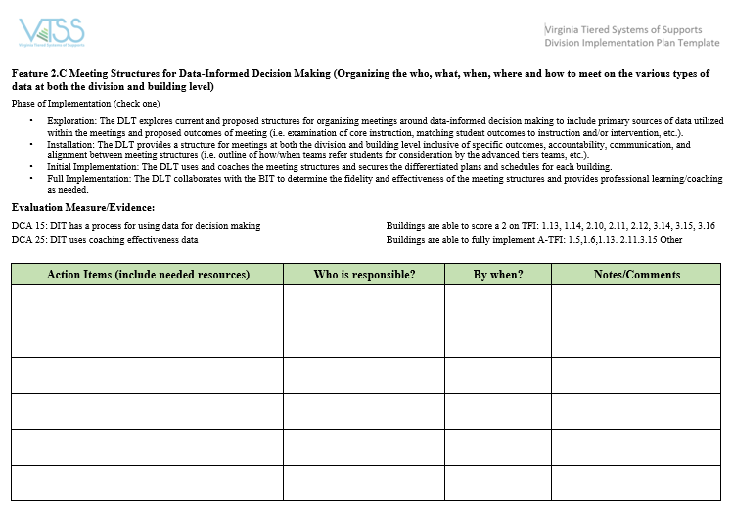
Let’s Put It All Together

Slide 22
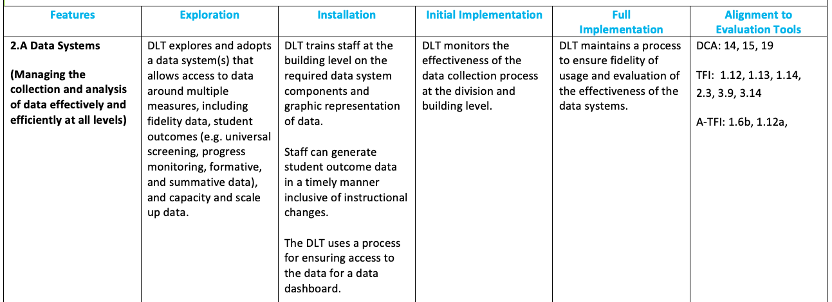
DATA SYSTEMS AND DASHBOARDS

Slide 23
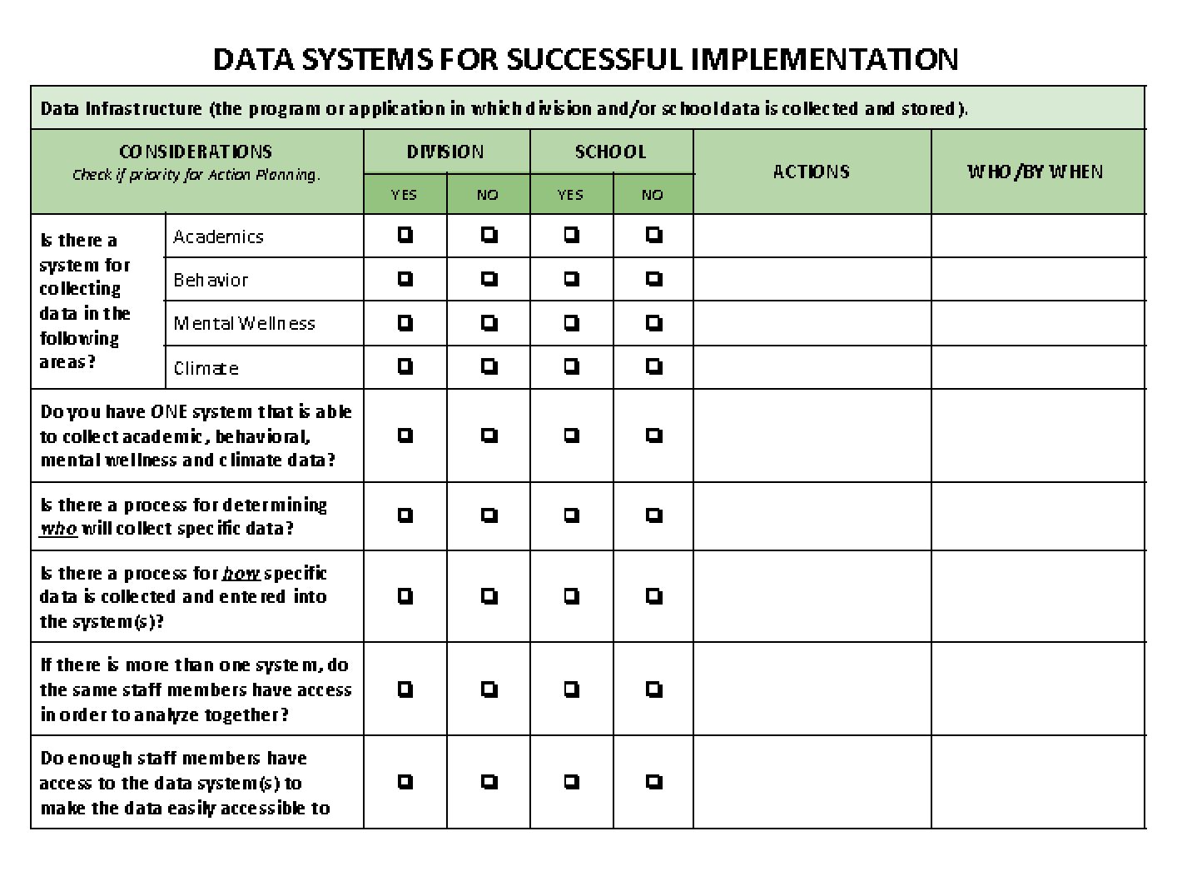
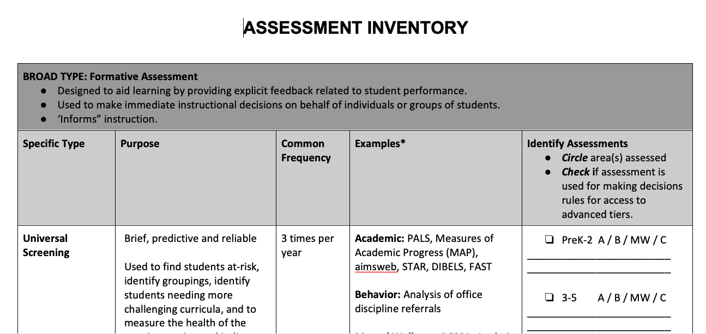
Data Audit and Inventory Tools

Slide 24
Developing a Division Data Dashboard
Step 1 – what data do you collect at the school level?
Step 2 – do you have a platform and a system for getting the data entered?
Step 3 – what are the critical indicators you would look for at the division and how will you report them?
Step 4 – determine how to disaggregate the data – does the system allow for this?
Step 5 – determine the process for gathering and presenting the data; who is positioned to do this?

Slide 25
Step 1
Data you collect in schools and/or are available in your current system. This comes from the Assessment Inventory.
Start with where you are currently, and what you are collecting now in our current reality: attendance?
ODR? reading level?

Slide 26
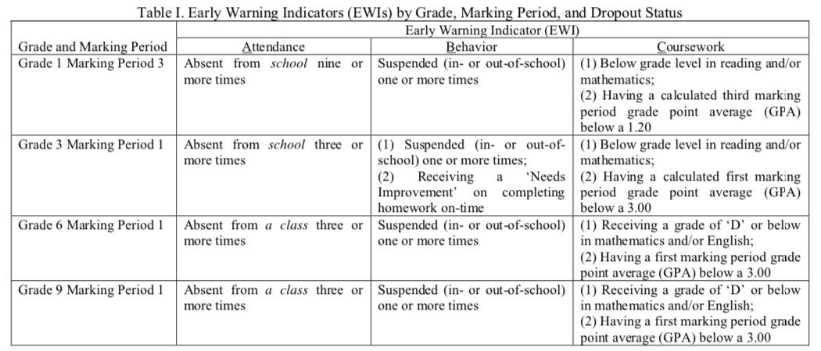
Step 1 Continued
Thanks Captain Obvious… 2 key ideas:
Refer to Materials: Montgomery Risk Factors
What are new risk factors from our current reality?

Slide 27
Step 2
What is your platform? If you are just now deciding, that’s OK! You may have some different sources and need the data analyst to put them together. This information comes from the data audit (“Data Systems for Successful Implementation”).
We can ALWAYS use the Excel sheet.
(Hint: When we document our Data Informed Decision Making, we need to make sure that we have the data points to measure our goals on this dashboard along with other division goals.)

Slide 28
Step 3
You have considered all of the various types of data the schools collect and have a platform onto which to put the data. Now:
1. What will you put on the division dashboard?
2. How will you format the data? (i.e., percent above or below, number of students, etc.)
3. How will you organize schools (i.e. elementary, middle, high or you only have 3 schools so they are all on a separate sheet)

Slide 29
Step 4
Starts with the balcony view
Determine if you are able to disaggregate the data
Example: 80% of students pass the Math SOL. Who is in the 20%?
(Hint: some help on this is coming up soon!)

Slide 30
Step 5
Decision Time!
Who will be responsible for putting the data sets into the platform?
What are the guidelines for the schools as to when the data should be available?
Revisit the data analyst role; what is their responsibility?
Who will help with the technology?

Slide 31
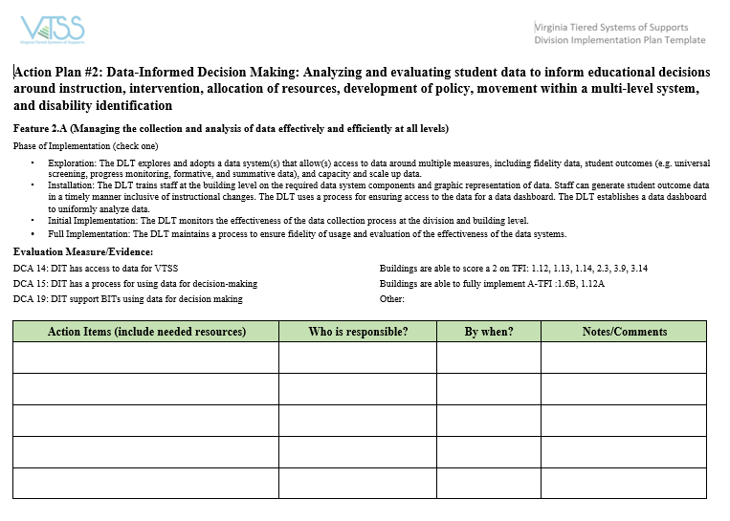
Let’s Put It All Together

Slide 32
DATA INFORMED DECISION MAKING PROCESS

Slide 33
Let’s Practice

Slide 34
Case Study

Slide 35
Data/Evidence of Need
Here, we answer the following question: Is there a problem? What is the data that indicates that there is a problem that needs to be addressed?
If possible, put links to the data sources (e.g., charts, graphs, reports) that will be used in problem solving and decision making in this section of the DIDM tool.

Slide 36
Disproportionality
Show the formula and walk through how to calculate disproportionality.

Slide 37
Case Study: Data/Evidence of Need
Review the data provided for the case study.
Is there a problem? What is the data that indicates that there is a problem that needs to be addressed?

Slide 38
Precision Statement
Using the data, precisely define the problem by identifying who, what, when, where, and why.
What is the problem? Who is having the problem? When is the problem occurring? Where is the problem occurring? Why is the problem occurring?

Slide 39
Precision Statement
Remember, the division’s role is to provide the support necessary for schools to make changes. When answering the these questions, particularly the why, consider the following...

Slide 40
Precision Statement
Are there/were there critical supports in place to make the needed change?
Is there/was there adequate professional learning, coaching, administrative support, performance feedback, and data to make “real time” decisions?
Were the right action steps take at the right time to ensure fidelity of implementation?

Slide 41
Precision Statement
4. Were the right people taking responsibility for guiding the change process?
5. Were the practices and innovations learnable, teachable, doable, and assessable in practice?
6. Was there sufficient support for barrier busting?

Slide 42
Case Study: Goals
Goals

Slide 43
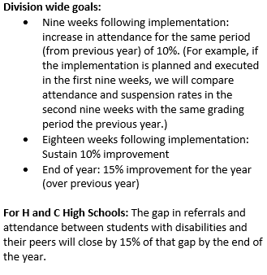
Case Study: Division’s Measurable Goals

Slide 44
Case Study Practices
Practices

Slide 45
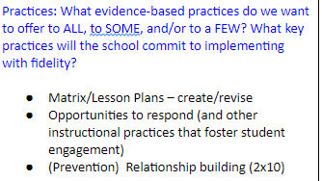
Case Study: Division’s Practices

Slide 46
Case Study: Practices Action Steps
Implementation Action Step
Who? By When?

Slide 47
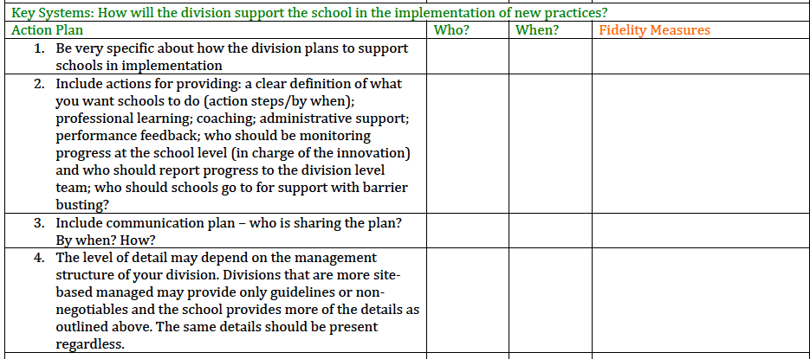
Case Study Systems

Slide 48
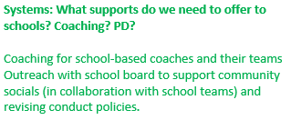
Case Study: Division’s Systems Support

Slide 49
Case Study: Division’s Systems Support
Implementation Action Steps
Who? By When?

Slide 50
Case Study Progress Monitoring
Progress Monitoring
Data/Progress Monitoring: Did we do what we said we would do? With fidelity? Outcomes? Are we making progress?
Did it work?

Slide 51
Case Study: Division’s Progress Monitoring

Slide 52
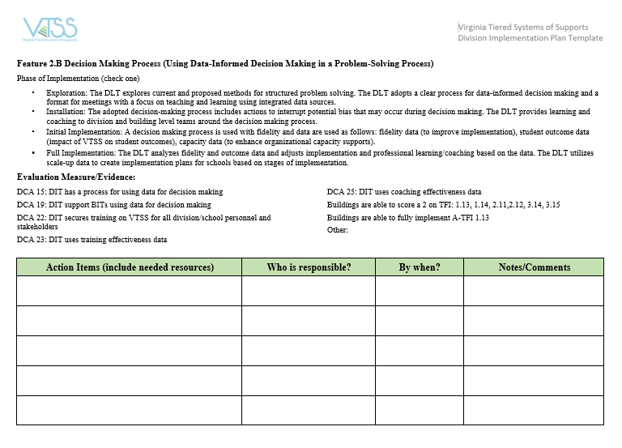
Let’s Put It All Together

Slide 53
HOMEWORK
During the next session (Session B on December 3rd OR 5th), we will:
Apply the established DIDM process to your area of concern for practice and reflection.
Your division will be your case study.
Bring data on an area of concern for your division. The data should have charts, graphs or other easy to read reports for the team to make decisions.

Slide 54
QUESTIONS???

Slide 55
See You Soon!
Please remember to fill out the evaluations.

