Slide 1
Strand 1: DIDM
March 11, 2021
Our Data Journey:
A Stop Along the Way

Slide 2
It’s Been A Journey!!
Put in the chat a professional positive that happened in 2020 that will move us forward in our journey.

Slide 3
Where the Road Has Taken Us
Exploration and Installation Activities: vision, value added, initiative mapping, systems change, evidence-based practice selection tool.
New Team Training for Schools - PBIS: starting with building a system around behavior, parallel structure of understanding implementation science and building a system
implementation matrix and DCA

Slide 4
Our Recent Path
Strand 1 for Divisions: Data-Informed Decision Making: data dashboards, problem solving process, teaming structures

Slide 5
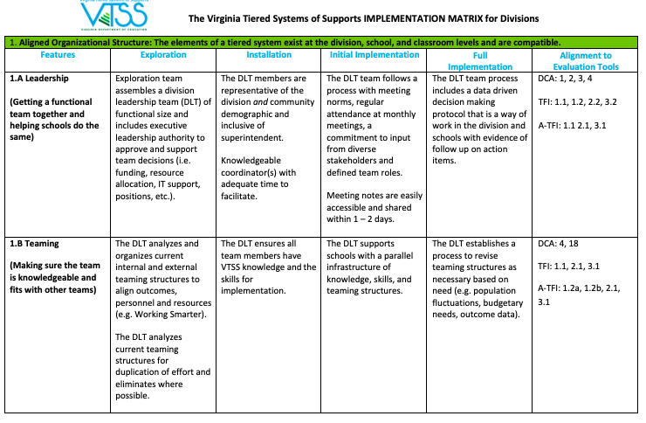
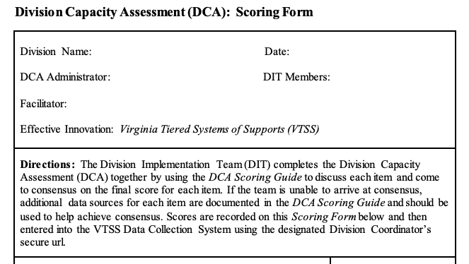
Every Trip Needs a Roadmap
VTSS Implementation Roadmap: How do we do it?
District Capacity Assessment: Do we have the capacity to sustain it?

Slide 6
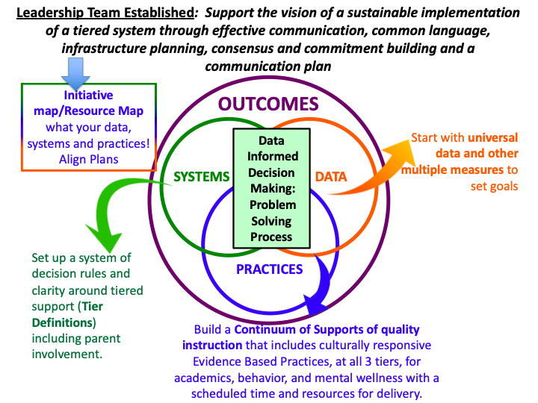
Taking Two Steps Back

Slide 7
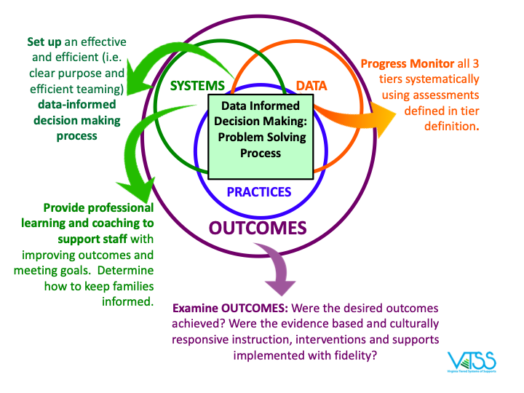
Two More Steps

Slide 8
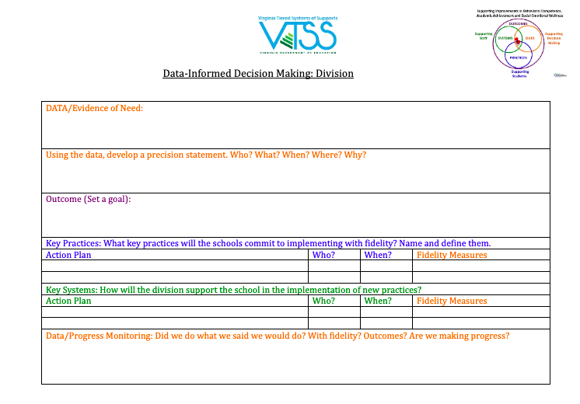
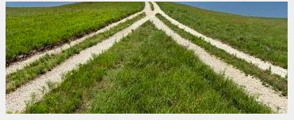
DIDM Form

Slide 9
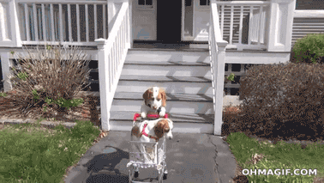
Delivering the Goods
Notes:
20 seconds
We’ve picked up a lot of stuff as we’ve traveled together. So now we should have some things documented and in place, or have them on our action items with a set completion date.

Slide 10
Deliverables
Division Initiative Map: includes the implementation pieces
Data Dashboard: data selected from assessment inventory, integrated
DIDM Process: in place today! how we think about problem solving
EBP Selection Tool: how to determine what to invest in, whether it is a fit; also a way to examine if your current practices remain a fit
Meeting Structures: how to build on what we have in preparation for Strand 2 - moving from solely behavior teams to alignment of teams which includes agendas and plans

Slide 11
Learning Intentions
Today’s Journey
Self- assess progress with action items within the implementation plan to provide division leadership team(s) and building level teams with access to an integrated data dashboard (DCA #14 and 19; IM 2.A) that includes fidelity AND student outcome data (IM 6.A and 6.B).
Practice a clear process for data-informed decision making with a focus on teaching and learning (DCA #15; IM 2.B) using their own data.
Present a “problem of practice” to the group, soliciting help from “critical friends” to strengthen the work of the division.

Slide 12
Division Spotlight 1

Slide 13
help us on the journey to greatness!
Critical Friends

Slide 14
Groups of Friends

Slide 15
Critical Friends
BreakOut Room
2 minutes for each presentation
3 minutes for participants to ask each presenter
-Clarifying Questions
- Offer Warm Feedback
- Suggestions and ideas

Slide 16
Critical Friends Protocol
Presenter (2 min.): Read the Precision Statement for your identified Problem of Practice (PoP) this year, and the EBPs and systems put in place to address the PoP.
Audience: Ask clarifying questions about what you heard.
Presenter: Provide Clarification
Audience: Provide warm feedback about what you liked. Provide cool feedback about concerns/questions in the form of “I wonder…” statements.
Presenter: Reflect on the feedback and respond.
Audience: Provide suggestions/considerations for next steps.
Notes:
Take a picture of this slide.

Slide 17
Division Spotlight 2

Slide 18
Reflect and Plan Our Route
Breakout room reflection and planning time:
What new strategies did we learn from our critical friends that will help us with our problem of practice?
What is our plan to develop and self-assess progress with the action items we identified for our Implementation plan?
What are the next steps to ensure that the division and school teams have access to an integrated dashboard?
How and when will we use the EBP selection tool to determine appropriate fit for our context?

Slide 19
Last Lesson on This Stop
Use the deliverables at the division leadership team meetings to:
plan for implementation and improvement
monitor what we have in place

Slide 20
Team Planning Breakout
11:40 a.m. - 12:30 p.m.
Breakout room reflection and planning time:
What new strategies did we learn from our critical friends that will help us with our problem of practice?
What is our plan to develop and self-assess progress with the action items we identified for our Implementation plan?
What are the next steps to ensure that the division and school teams have access to an integrated dashboard?
How and when will we use the EBP selection tool to determine appropriate fit for our context?

