Slide 1
Welcome Back to Strand #1!
Data-Informed Decision Making…or is it?
Notes:
Remind attendees they got the nuts and bolts during Session A with the case study.

Slide 2
Appreciation is given to the following for their contributions to this Professional Learning:
SAMHSA- Substance Abuse and Mental Health Services
OSEP- Center on Positive Behavioral Interventions and Supports
NIRN- National Implementation Research Network
WSIPC

Slide 3
What will we know?
Effective and efficient data informed decision-making systems start with strong meeting foundations and the development of an integrated data dashboard.
Data informed decision-making systems support adults in the effective and efficient implementation of instructional practices for teaching academic, behavior and mental wellness skills
Notes:
Same as last time; Explain its connection/application with the division’s work.
Dec. 4th – Kris
Dec. 6th - Sherol

Slide 4
What will we know?
Data-informed decision making systems support adults in the effective and efficient implementation of instructional practices for teaching academic, behavior and mental wellness skills.
WHAT DO WE WANT TO KNOW ABOUT SCHOOLS, TEACHERS, STUDENTS, FAMILIES, AND COMMUNITY?
Notes:
What systems have you put in place to monitor/ensure that your schools are effectively and efficiently implementing the instructional practices for teaching academics, behavior, and mental wellness skills?

Slide 5
What will we do?
Review progress on your implementation plan to provide division leadership team(s) and building level teams with access to an integrated data dashboard (DCA #14 and A-TFI 1.12a) that includes fidelity AND student outcome data.
Practice a clear process for data informed decision making with a focus on teaching and learning (DCA #15, 19 and A-TFI 1.13).
Analyze a “new” practice through the lens of the VTSS Evidence Based Practice Selection Tool (DCA #5).

Slide 6
VTSS Implementation Logic
Notes:
Have them teach and reteach – if time…have them give an example.

Slide 7
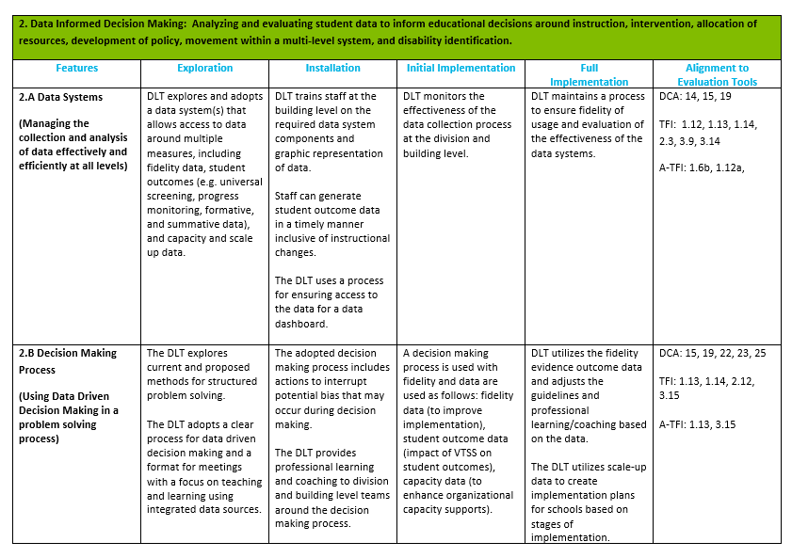
Implementation Matrix

Slide 8
Let’s review Day 1
Use your annotate tool to STAMP the right answer/s that fill
in the blanks.
In our last session we discussed how to build a data system and how data impacts our work.
We said that:
Effective and efficient data informed decision-making systems start with strong _____________________
(team members, meeting foundations, teacher input)
and the development of __________________.
(a professional development program around Data, an integrated dashboard)
Notes:
Annotate which answer fills in the blank
First blank: meeting foundations
Second blank: an integrated dashboard

Slide 9
Let’s review Day 1
Use your annotate tool to STAMP the right answer/s that fill
in the blanks.
Data informed decision-making systems support adults in the effective and efficient implementation of instructional practices for teaching _______,______,_______
(academic, football team skills, behavior, teacher attitude, mental wellness. Pick all that apply)
In the right conditions, data analysis and problem-solving should stimulate ___________________________________________.
(curiosity, questions, dialogue, investigation, innovation, learning, change
or all of the above)
Notes:
First 3 blanks: academic, behavior, mental wellness
Second blank: all of the above

Slide 10
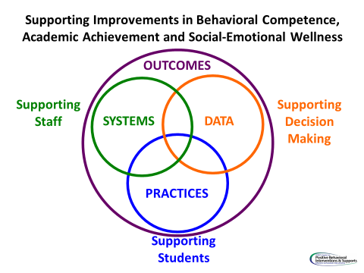
The Implementation
Logic is our guide
______________
In the chat box please type the word that will fill in the blank above.

Slide 11
What are the components of an effective team meeting structure?
Use your annotate tool: Use the Check stamp for “yes” and star stamp for “no”
Predictability
Implementation Drivers
Participation
Accountability
Random
Communication
Notes:
Annotate with a check for yes and a star for no
Yes- Predictability, Participation, Accountability, Communication
No- Implementation Drivers, Random

Slide 12
Remember your roadmap. Implementation Matrix 2A, 2B
The Implementation Matrix is your roadmap. The tools to develop and manage the data are the DATA AUDIT and the DATA INVENTORY
Notes:
Reminder that the Matrix is your roadmap. The tools to develop and manage your data system are the data audit and data inventory.

Slide 13
5 steps to developing an integrated Data Dashboard
Step 1 – what data do you collect at the school level?
Step 2 – do you have a platform and a system for getting the data entered?
Step 3 – what are the critical indicators you would look for at the division and how will you report them?
Step 4 – determine how to disaggregate the data – does the system allow for this?
Step 5 – determine the process for gathering and presenting the data; who is positioned to do this?
Where are you in this process?
POLL
Notes:
Poll here
As a final part of the review we have talked about the importance of the integrated data dashboard.

Slide 14
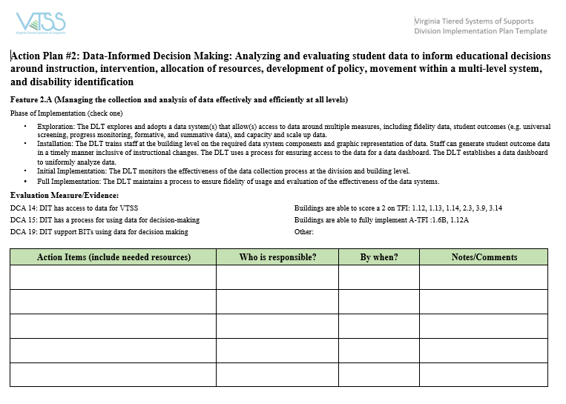
Implementation Plan

Slide 15
Breakout for Action Planning (15 minutes)
Identify specific action steps in response to each of the five steps in the development of a data dashboard.
Which data points will you consider right now in order to make decisions about your current problem of practice?
If you are currently using a data dashboard for decision making, has everyone been trained on how to use the data dashboard, disaggregate data, etc.? If not, identify the specific action steps to getting this done.
Notes:
Take a picture of this slide.
Identify a facilitator and a timekeeper.

Slide 16
Learning Informed Decision Making
Notes:
How many of you were able to attend with one of your schools, the school based version of data driven decision making in November? But in that learning opportunity, we talked about how data has been weaponized against us. It is used to describe the ways that divisions, schools, teachers and students are broken and need fixing. We talked about how it is up to us to change that paradigm. It is up to us to change that narrative. We are NOT broken…we are constantly learning and growing. We ARE however, the product of old systems or ways of work that are designed to get the results we are getting. So let’s revolutionize that system!! Let’s change that narrative!
Why would we call it LEARNING informed? Why is this distinction important? It’s because we want learn about better instruction, learn about our kids (inequit

Slide 17
Solving problems requires change.
“Conceptual change happens when people make their current beliefs explicit, subject them to scrutiny from themselves and others, consider how new information either fits or challenges their existing beliefs, and then make permanent changes to what they know and do.”
Katz, S. & Dack, L.A. (2013) Intentional Interruptions: Breaking Down Learning Barriers to Transform Practice (p. 7)
Notes:
This requires us to change how we think. We use Katz because we use data to inform, rather than “I wonder if…” rather than “I know this class…”. We want to know more and not use data to confirm our bias or exceptionality. Stay curious! Sometimes we use the data to confirm our own biases instead of staying curious.
Stress the importance of creating a safe space for this type of problem solving to occur and give a few minutes for them to talk amongst themselves about what this looks like/feels like.
Refer back to the cascading model – this culture should be reflected throughout the organization.

Slide 18
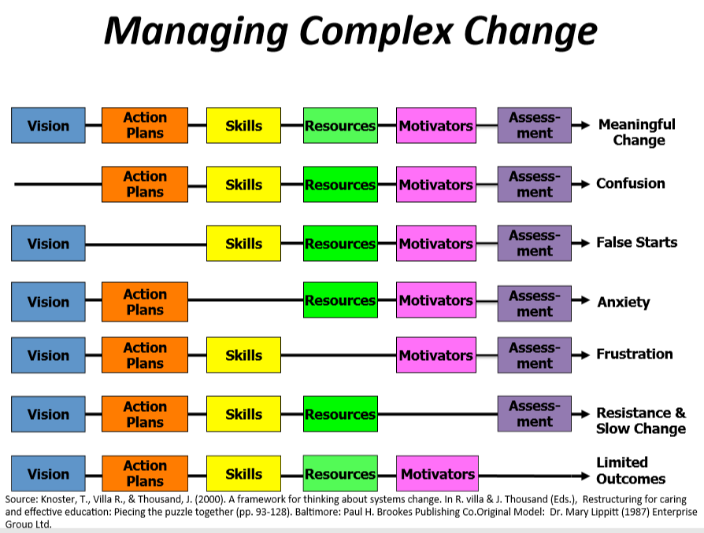
Notes:
There are six essential components in managing complex change. We cannot manage change effectively if any one component is missing.

Slide 19
A Culture of Inquiry
When we implement data-informed decision-making well, it can become a tool for professional learning.
In the right conditions, data analysis and problem-solving should stimulate curiosity, questions, dialogue, investigation, innovation, LEARNING, and CHANGE (among adults).
Notes:
Data is an integral part of the work we do. We have to innovate, to change the discourse from data as focal point, to data as tool… to curiosity…inquiry. When we talked to your schools –we asked what are you curious about? What intrigues you about the learning that your students are doing? What investigating can we do to discover how your students are learning and what are the patterns of errors? What do we need to learn to do to make change in how students are learning?
We need to shift from a Culture of GOTCHA to a culture of INQUIRY. We need to shift – not thinking about VDOE and outcomes.
This is a TOOL for learning and getting better at our charge.

Slide 20
How does the team make this shift?
Problem solving team already…
And can function like learning communities if they also…
Use evidence to clearly define problems
Collaborate to study impact and effectiveness of instruction
Hypothesize why things happen as they do
Brainstorm possible solutions & define success
Monitor solutions
Align their problem-solving to school-wide goals for student (and teacher!) learning
Have the autonomy to pose questions and prioritize the learning challenges that matter most to them
Collaborate with stakeholders to brainstorm solutions and define points of fidelity and flexibility
Reflect on permanent changes to practice
Notes:
Why does this matter? Challenge what currently doing.
Why does this matter? How can I get even better? Did it work? How do we scale up If so?
The right side is the technical side and next side is about setting goals and making connections/ adaptive change.
Question: How many of you have identified goals for teacher learning within your division? Are these goals as explicit as your goals for student learning?

Slide 21
Leader Learning Teams
Leader Learning Teams
Notes:
The video (https://vimeo.com/118496067) describes what we mean by leader learning teams and why this is so critical. What do we mean when we use the term Leader Learning teams?
“Learning Conversations”: the extent to which the work within schools feeds the conversations that we have around the table….

Slide 22
Making Decisions:
Study data at the division and school-wide level as needed
Define problems very specifically because they focus on the system (what coordinated work by adults will enhance the success of all students?)
Leverage evidence-based practices AS SOLUTIONS to problems – assess - reflect
Core instruction touches every student in the building. Intervention helps to mitigate learning errors.
In an integrated tiered system, the implementation teams use data to analyze the effectiveness of instruction and interventions in both behavior AND academics.
Notes:
This is a quick review: study, define and leverage solutions.

Slide 23
How well does your team function with decision making?
Notes:
Use the “annotate” feature in Zoom to select what represents your team’s current functioning.

Slide 24
LEARNING THE INFORMED DECISION-MAKING PROCESS
Let’s learn by doing…let’s get messy!
Notes:
BREAK
Dec. 4th – Sharon

Slide 25
We all have a process!
Plan-Act-Assess-Reflect
Notes:
https://thelearningexchange.ca/videos/plan-act-assess-reflect/
“Investment in Learning”: Is “Plan – Act – Assess - Reflect” a part of your current culture or are you stuck at the “Plan – Act – Act – Act…?
How important is making time to Assess and Reflect to achieving our identified outcomes? How might it impact teaching and learning?
This is one decision making process. What process does your division currently use for decision making? We started walking you through the VTSS DIDM process in October. Today, we will focus on developing SMART goals, identifying appropriate EBPs and the systems that support staff in implementing those EBPs with fidelity.

Slide 26
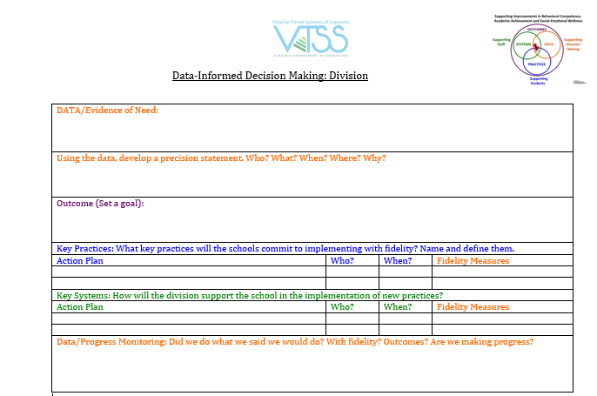
The VTSS Process
Notes:
We started learning and using VTSS’s decision-making about this document this last time…..

Slide 27
WHAT SPARKS INQUIRY?
What are we curious about? How do we as leaders, create the conditions for schools to inquire, reflect, and change practice?
Notes:
Here we introduce that divisions will present their problem of practice at the next Strand I event. Let’s decide what this problem is so you’ll be prepared.
Dec. 4th – Sharon
Dec. 6th - Sharon

Slide 28
A problem of practice.
Considerations
Cautions
Change that will make learning more effective for students
Change that aligns with goals you are uncovering in school improvement
Change for which you have some resources on which to build – likelihood of success
Focus on the issues that you can support from your offices
Avoid the problems that have plagued you for years – we will get there soon enough!
Avoid focusing on issues of mandates and compliance – for this first time! This should inspire learning and change.

Slide 29
Swing to Solutions
Create the conditions for supporting changes in implementation
Implementers MUST change practices!
Robust systems need to support implementers!
Learning Leaders
focus on the systems
Notes:
Graphic here that demonstrates dual solutions with leaders as the bridge or link to creating and sustaining
Only now are we ready to swing to solutions.

Slide 30
We know how to find solutions!
We’ve been problem solving for ages!
Intentional Interruption
by Stephen Katz and Lisa Ann Dack

Slide 31
What are our goals?
Outcome (Set a Goal): How do you want your division’s data picture to change? What do you want to see?
Specific
Measureable
Achievable
Relevant
Time-bound

Slide 32
Practices
THINK: Innovation!
What are the appropriate responses that address the needs implied in the data?
Notes:
Before implementing any new practices, refer to your division initiative map (and schools’ resource maps). Are you currently implementing a practice that works? Do you already have practices that work, but might need to be tweaked for fidelity, scaling up to another area or grade level, etc. Remember that the practice(s) you select should be teachable, learnable, doable, and readily assessed in practice.

Slide 33
Develop solutions For Practices
Notes:
This is an example of

Slide 34
Academic Solutions
How can we assure that all students have the background knowledge?
Pre-teach
Teach/Instructional Delivery
Cue
Practice with task specific feedback
Reinforce
Error Correction
How can we define explicit lesson design and delivery?
How can we prompt the 5C’s (Critical Thinking,
Creativity, Communication, Collaboration & Citizenship)?
How can we build in multiple opportunities for performance feedback? Using growth mindset as a frame!
How can we build in massed AND spaced practice in brain friendly intervals?
How do we reteach and make sure students end with the correct response?
Notes:
Reference ECS
When we are looking at academics, it’s the same thing; the same process. Ex. Teaching a concept in math is the exact same as teaching behavior
Dec. 4th – Kris
Dec. 6th - Kris

Slide 35
Behavior Solutions
Prevent
Teach
Prompt
Reinforce
Extinguish or Withhold Reward
Correction
How can we avoid the problem context?
How can we define, monitor, and teach what we
want?
How can we set up opportunities for the desired behavior?
How can we build in systematic reward for the desired behavior?
How can we prevent the problem behavior from being rewarded?
What are effective and consistent consequences for problem behavior?
Notes:
The solutions and practices need to be focused. Don’t just address the behavior, want to address all of the components above.
Sherol’s example of Win/Win… how do we fill in those gaps to make sure
I.e. if behavior issue – what to prevent, teach, etc. Not just a celebration system but make sure have taught the behavior, prompted and reinforced.
Dec. 4th – Kris
Dec. 6th - Kris

Slide 36
Division Initiative Map
Notes:
Once we know what we need, before search for anything new, check your initiative map

Slide 37
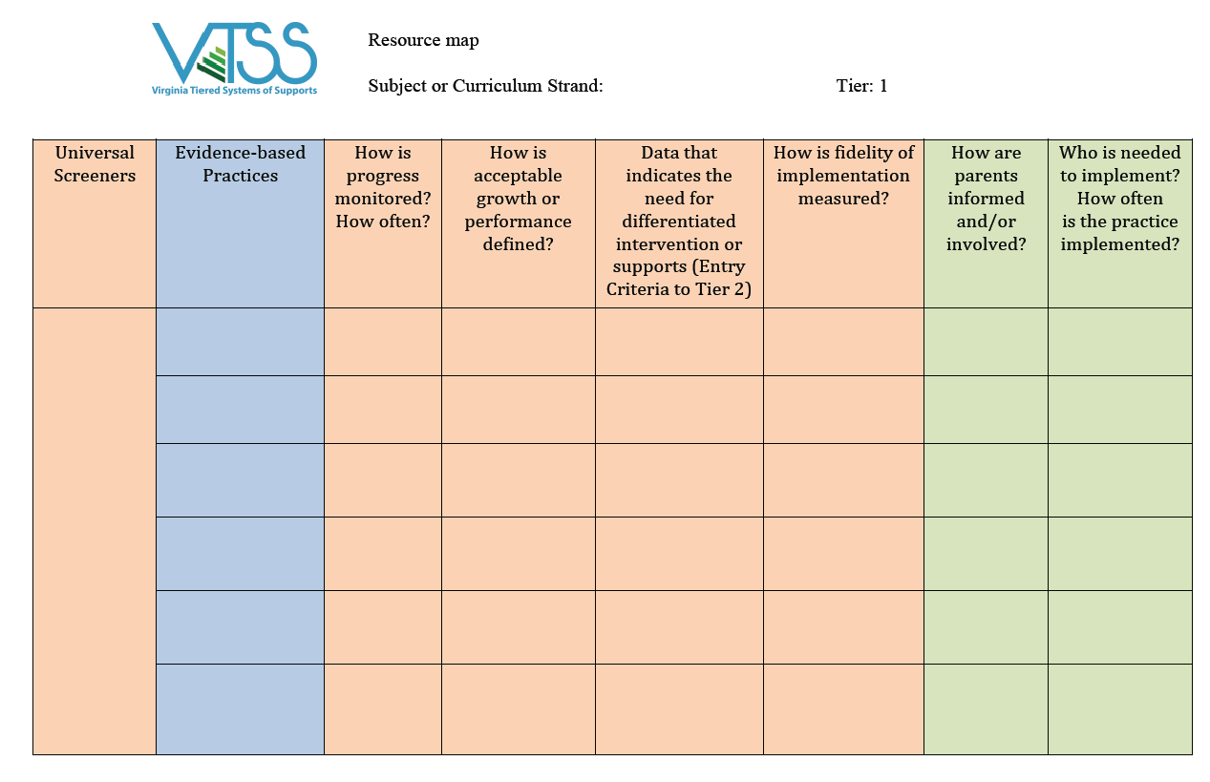
Decide your evidence based practices!
Based on what you put here…or if you don’t have a practice that meets the need, find a new one!
What is your continuum of supports? What practices meet your goal?
Notes:
Start with your division initiative map. Do you have what you already need within your division? Before you start going out to find something else!
…. or resource map at the school level.

Slide 38
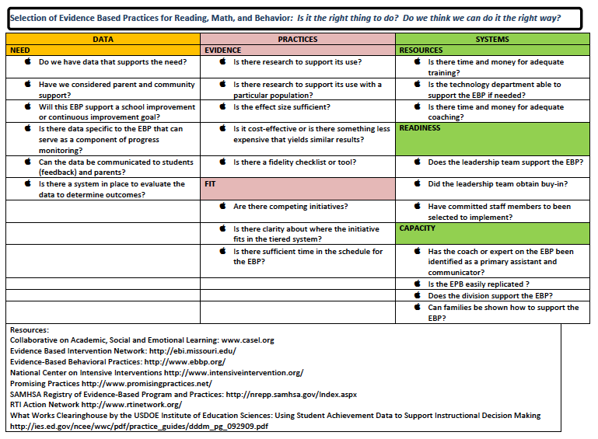
There are ways to find new practices!
Notes:
How many of you currently have a standard tool that is consistently used throughout the division, including at the school level, for selecting evidence-based practices? VTSS provides the Selection of Evidence-Based Practices Selection Tool for divisions and schools to use.

Slide 39
Let’s practice! (Breakout)
Place a by the
questions you can answer.
Place a by the
questions you need to investigate but know where to find the answer.
Place a by the questions you are uncertain how to approach.
Notes:
Pause to review the selection tool. Spend time really looking at this tool.
Consider a practice that you are considering adopting for implementation OR one that you’ve recently adopted. Answer the questions on the EBP Selection Tool.
Practice that they recently adopted…or one of the practices recently adopted thru VTSS initial implementation (PBIS examples).

Slide 40
Looping in the Schools
How can we loop schools into the goal setting and solution finding?
ASK! Engage in collaborative inquiry with your school leadership teams (like we are doing here today)!
How is the school’s data part of (or not) division trends?
Did we develop a good goal?
Have we developed solutions that will seem to work?
Are there any issues we failed to consider when we chose these solution steps?
(DCA # 11…District uses a process for addressing internal barriers.)
Do you think these solution steps will meet our goal?
Notes:
Looping schools into the decision-making process helps to identify internal barriers to implementation of any division-wide efforts. Using a formal decision-making process as we are explaining here is another way of identifying internal barriers and taking steps towards addressing them.
As the division team how will you loop the schools back in? Don’t go in and say ‘here’s what we’re doing’ this was a model for what you'll do with the schools. Here’s what we decided as a division but what are you curious about as a school?
Do we have any barriers? Address what could get in your way. What gets in the way, becomes the way?
So, this is when the DLT/DC goes to work with the schools.

Slide 41
When student learning is our compass.
“Right” actions identified.
Actions improve learning.
Midstream adjustments are possible.
Notes:
Remember…Katz told us…we don’t have to get it right the first time out of the gate. We have to commit to trying, to assessing, to reflecting and adjusting.
Refocus – the outcome should always be driven by what we want the kids to do, we’ll eventually always get their if we keep this focus. OK to make midstream adjustments.
Ex. Goals were what teachers were going to do instead of what student outcomes should be.

Slide 42
Remember
Selecting something that is likely to work is a good first step, but once something is implemented, the most important function of leadership is ensuring that desired outcomes are reached and sustained OVER TIME.
Notes:
This is long term; takes a while.
Dec. 4th – Kris
Dec. 6th - Kris

Slide 43
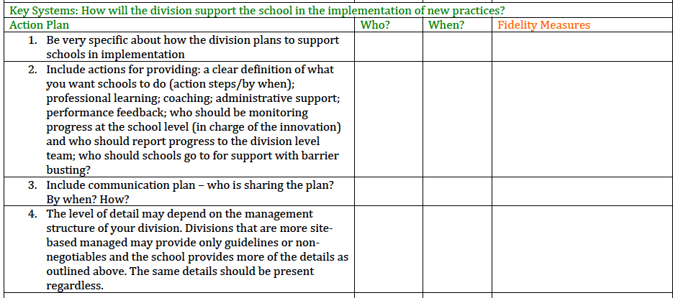
Systems
Notes:
In the systems write down school buy-in steps above...what is needed. Here you are doing DCA # #18 so might document that in your implementation plan for your DCA. Insert those leader actions that will create the conditions (remember) for the practices
Give example…planning coaching but realize that you don’t have coaching plan structure. Link to implementation plan which is how to develop coaching plans.
For this to work – what does the school need?

Slide 44
Progress Monitoring
Don’t just assess…REFLECT!
Notes:
Spend some time here
Give examples

Slide 45
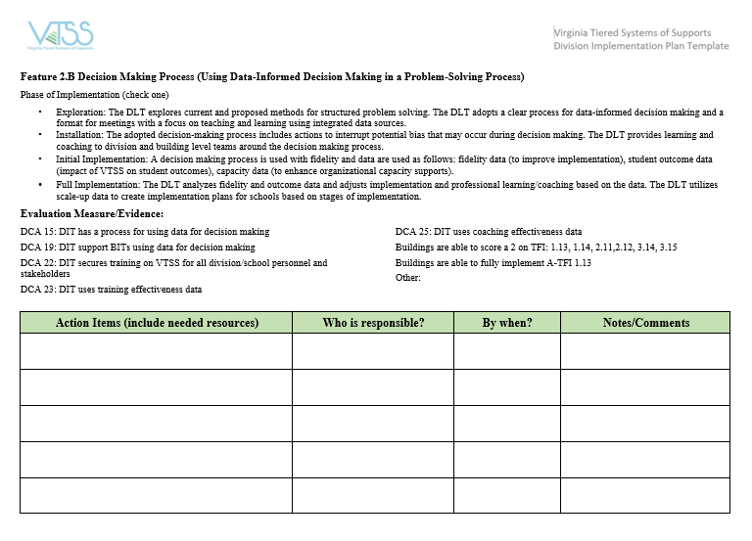
Let’s Plan

Slide 46
Homework
To Session C in March please bring:
1. Progress monitoring data (to-date) on the plan.
2. A short “share out” of what you accomplished this year in developing your data dashboard and applying the DIDM process to your problem of practice.
Glows
Grows
BE CREATIVE!
Apply a problem of practice to the established process for practice and reflection.
More details for sharing to come…just get started!
Notes:
Now with all that planning, when you come back for Session C, it’s all about you. We/ the presenters won’t be talking. Divisions are presenting, videos, costumes, skits, we love creative ideas! It’s OK to just report on the part of the plan you did. It’s OK if you couldn’t get all the work done in the schools but tell us your next steps. Share what accomplished.

Slide 47
Final Breakout Instructions
Using your problem of practice,
Set an outcome goal to work towards for the 2020-2021 school year.
Use the EBP Selection Tool to identify evidence-based practices that the division will support schools in using to address the problem.
Identify the systems that the division will put in place to support staff in implementing the EBPs.
Be specific about the PL and coaching needs of school staff in order to implement with fidelity.
How will you progress monitor?
***How will each of these be communicated to school teams?

Slide 48
Closing Activity
Think about your biggest take-away from today’s discussion.
Get a piece of paper, and using only pictures or symbols (no words) record your take-away on your paper. NO TALKING!!!
Now pass your drawing to the left 4 times (so it ends up 4 people away from you). Each participant now must share out what they think your take-away is, based on your drawing.

Slide 49
Please remember to fill out the evaluations.

