Slide 1
Integrating and Aligning Academic Data, Practices and Systems
Strand 2: October 2019

Slide 2
Your Strand 2 Team
Mike Crusco, RIC
Chris Frawley, TTAC @ VCU
Sandy Hart, RIC
Wanda Vaughan, RIC

Slide 3
Our WHY

Slide 4
Today’s Learning Intentions: I
Review the responsibilities of the Division Leadership Team necessary to support the alignment of supports within a VTSS structure. (Matrix 1.B, 1.C)
Understand and begin the process of developing a division assessment inventory. (Matrix 5.A).
Develop an aligned template for a data dashboard. (Matrix 5.A)
Review the purposes of universal screening within a VTSS framework and investigate key components of a good screener. (Matrix 5.B)

Slide 5
Today’s Learning Intentions: II
Understand the elements of the screening process to include communication with families; begin development/enhancement of screening process. (Matrix 5.C)
Identify uses of screening data at the division and school level and identify challenges to discussing and utilizing screening data. (Matrix 5.C)
Introduce the Academic Tiered Fidelity Inventory for use with schools.

Slide 6
Implementation Logic
The Implementation Logic depicts the VTSS way of work. A school or division outlines a set of outcomes necessary for the success for ALL students. Data is utilized to support decision making and progress monitoring. Practices are selected to support student learning. Systems are put in place to support the adults in the implementation of evidence based practices and data collection and analysis. Together, the interplay of data, systems and practices supports improvements in behavioral competence, academic achievement and social emotional wellness.
OUTCOMES
Supporting
Staff
Supporting
Decision
Making
SYSTEMS
DATA
PRACTICES
Supporting
Students
Notes:
Activity: Chart paper and record responses to the questions below:
Where do you support the division with the systems? Where do you support the system with data and decision making? How do you support the system with practices?
Share out with group.

Slide 7
The Work You Are Already Doing
Student Outcomes
Expectations
Monitor Student Academic Progress
Align Planning,
Delivery and Assessment
Professional Development
VTSS
Framework
Systemic Approach
Data Informed
Evidence-based practices
Monitoring
Support students and staff
Continuous Improvement
Collect and analyze data
Plan and implement
Monitor and reflect

Slide 8
VTSS Implementation Logic
Data informs:
Collect and analyze data
Monitor student academic progress
OUTCOMES
Supporting
Staff
Supporting
Decision
Making
SYSTEMS
DATA
Professional Learning:
DIDM
Alignment
Planning
Delivery
Evidence-based practices
Plan
Implement with fidelity
Monitor with fidelity
PRACTICES
Supporting
Students
Notes:
8

Slide 9
Alignment of Teams
Examine your current teaming and planning.

Slide 10
TEAMING AND PLANNING
Aligned Organizational Structure

Slide 11
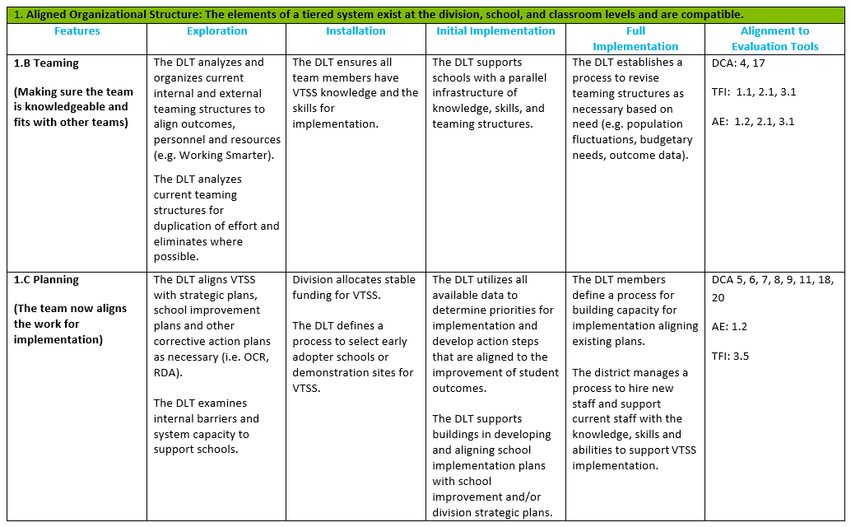
Implementation Matrix 1.B and 1.C

Slide 12
Ensure Teaming and Planning
Ensure all team members have knowledge of VTSS and skills for implementation.
Team process includes a data driven decision making protocol to guide allocation of resources.
Facilitates and monitors an integrated professional learning plan.
Align VTSS with strategic plans, school improvement plans, and other corrective action plans as necessary and prioritize.
Define a process for building capacity for implementation at the school level.
Ensure fit of curriculum, instruction, and environment.

Slide 13
Planning Tools
Working Smarter, Not Harder
Initiative Mapping
Resource mapping within the schools

Slide 14
Academic Tiered Fidelity Inventory (A-TFI)
The academic tiered fidelity inventory also references the importance of teams. Each team in the school includes staff with expertise to support the function of the team and represents the diversity of the building. Additionally, each school team has defined goals that support improvement, defined communication loops among all teams and regularly scheduled meetings.

Slide 15
With your team, answer..
What plans (e.g., school improvement, Corrective Action Plans) do we have in our division that can support this work? Are they aligned?
What division team members might we need to include for academic alignment?
What other tools or activities do we need to complete or revisit as a division team?

Slide 16
VTSS Action Planner
1.B Teaming
1.C Planning

Slide 17
Aligning Assessments
Examine your current teaming and planning.
Identify your assessments to create an assessment inventory, create an assessment plan, and review your data audit.

Slide 18
Integrating Academics & Behavior
HOW WE DECIDE WHAT INSTRUCTION OR SUPPORTS TO GIVE STUDENTS (Tiers)
Data-informed Decision Making Process
Continuum of Instruction & Intervention (Tiers)
HOW STUDENTS RESPOND TO OUR INSTRUCTION AND RELATED SUPPORTS (Data)
Notes:
Intent: This is the big picture of the integrated process. What does integrated problem solving look like?
Trainer Talking Points:
This is really about how we make decisions in an integrated model.
Deciding what instruction students need is having a process where we use data to inform what instruction and supports students need and have access to and in implementing that continuum of instruction and interventions examining how they respond and what needs to change or stay the same and then again...back and forth.
Tying all of these components together are our practices and procedures for using various types and sources of data in an effort to make decisions about what students should get, why, and for how long.

Slide 19
ASSESSMENT INVENTORY AND PLANNING FOR STUDENT GROWTH
Monitoring Student Progress

Slide 20
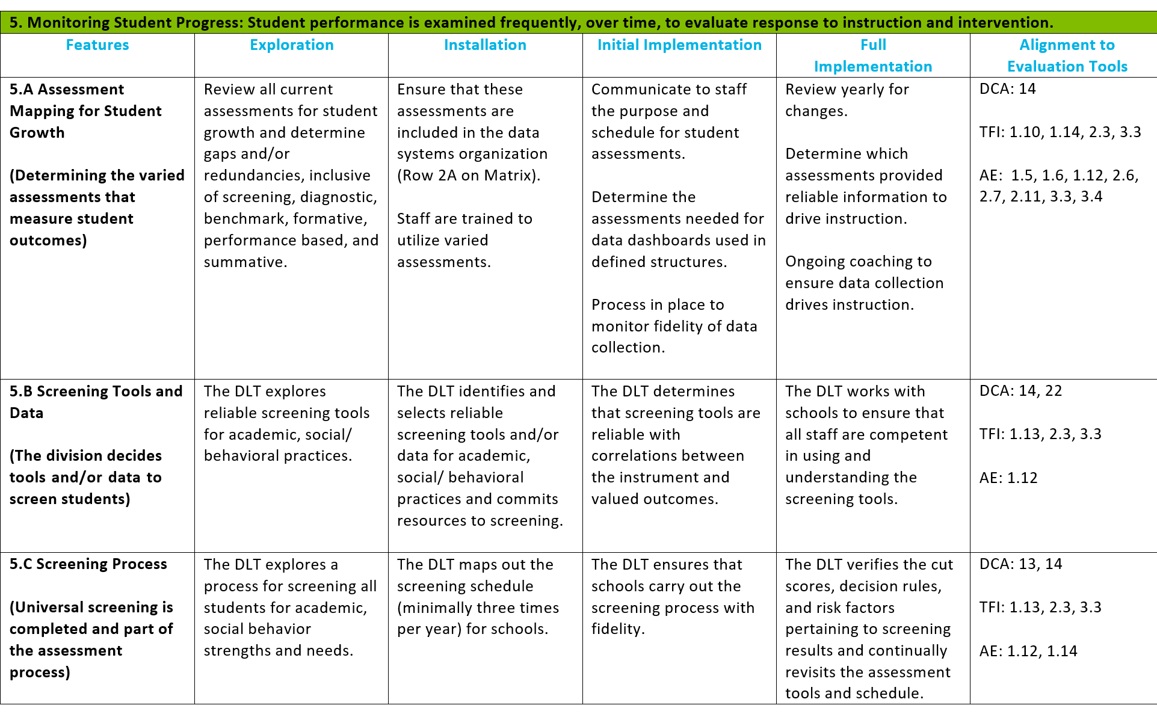
Implementation Matrix 5.A

Slide 21
Deliberate and Purposeful Assessment
Provide timely, actionable feedback
Embedded in instruction
Aligned to standards and learning goals
Elicit student demonstration of complex knowledge
Accurately measure student achievement
Equitable – accessible and fair
Transparent – to students and parents
Multiple measures used
Source: VDOE Supporting Instruction and Deeper Learning through Balanced Assessment Institute, June 2019

Slide 22
Types of Assessment
Diagnostic assessment
Assessment before learning
Formative assessment
Assessment for learning
Summative assessment
Assessment of learning
Source: VDOE Supporting Instruction and Deeper Learning through Balanced Assessment Institute, June 2019
Notes:
Diagnostic: Assessment that determines student areas of strength and academic need prior to instruction: Assessment before learning
Formative: A process or assessment designed to intentionally collect information about the nature or degree of student learning during instruction, providing feedback to teachers and students and allowing for teachers and students to make instructional decisions (adjustments and modifications): Assessment “for” learning
Summative: Used to evaluate student learning, skill acquisition, and academic achievement at the conclusion of a unit, project, course, semester, program, or school year. Typically, summative assessments are comprehensive and representative of a set of knowledge and skills, and associated with high-stakes decisions (e.g., a grade in a course, promotion to another level, verification of a course credit): Assessment “of” learning

Slide 23
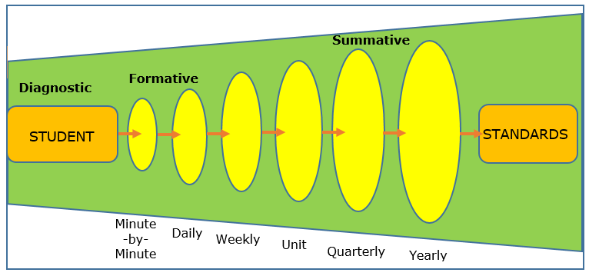
Assessment Grain Size
Adapted from California Department of Education
Source: VDOE Supporting Instruction and Deeper Learning through Balanced Assessment Institute, June 2019

Slide 24
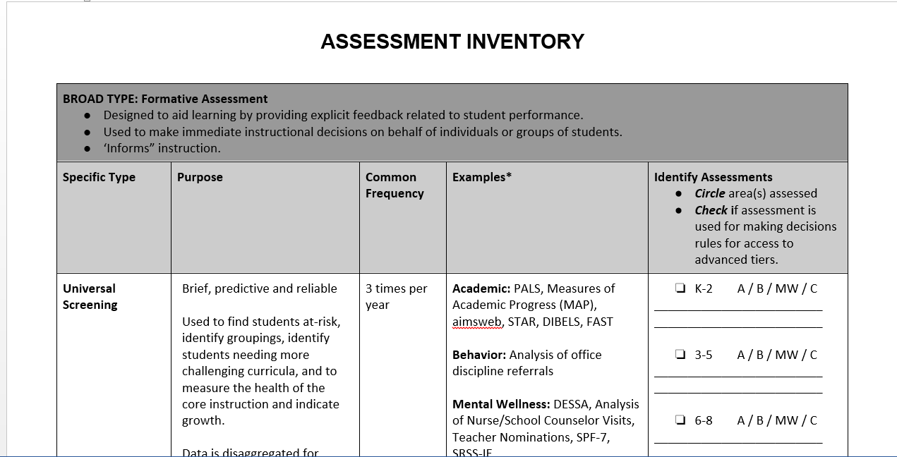
Example: Assessment Inventory

Slide 25
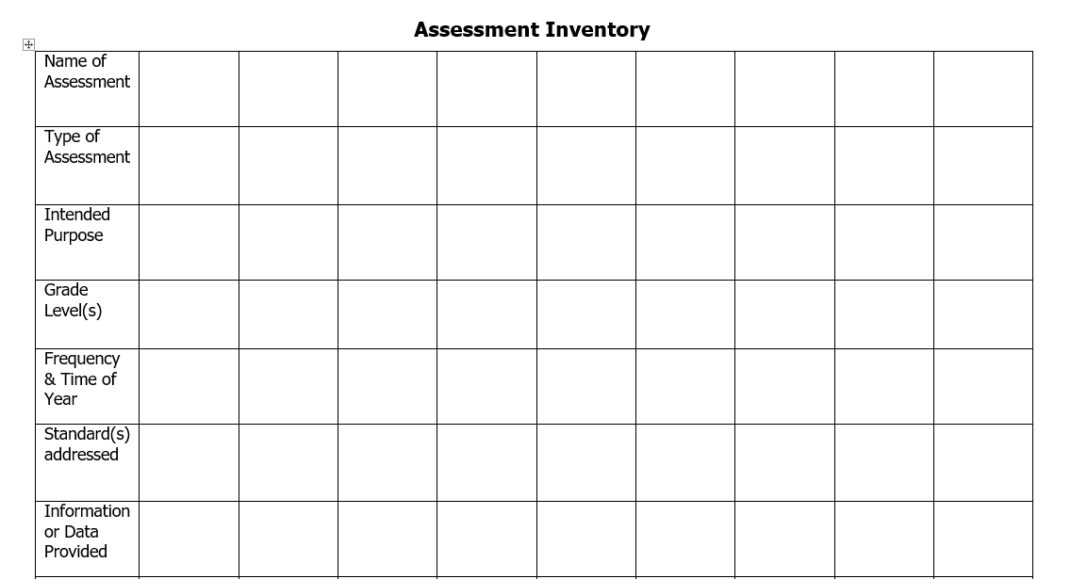
Assessment Inventory
(another example)
Source: VDOE Supporting Instruction and Deeper Learning through Balanced Assessment Institute, June 2019

Slide 26
Why are we doing an assessment inventory?
It helps everyone understand all of the assessments.
Our decision rules will come from your data; what data do you have?
Data are needed for evaluation of your outcomes.

Slide 27
Assessment Inventory
Captures information about the assessments administered to students in the division.
The assessment inventory tool is intended to guide divisions in looking across assessments to inform their recommendations and decisions regarding the creation of a balanced assessment system.
Source: VDOE Supporting Instruction and Deeper Learning through Balanced Assessment Institute, June 2019
Notes:
Research on balanced assessment:
School staff must be willing to:
Evaluate assessments in terms of the value they bring to student learning and instructional practice
Question whether an assessment actually improves instruction
Observe how assessments influence the way teachers converse with one another about teaching and learning

Slide 28
In addition,
an assessment inventory...
Provides the opportunity to ask questions:
How much time do we spend giving assessments?
Are there assessments that provide the same information?
Are we including performance based assessments?
What assessments might we remove from the list?

Slide 29
Assessment Inventory Scenarios
With your team, read the scenario assigned to you.
Discuss the question at the end of the scenario.
Be prepared to share with the group.

Slide 30
Team Activity

Slide 31
Academic Tiered Fidelity Inventory (A-TFI): 1.6a and 1.6b

Slide 32
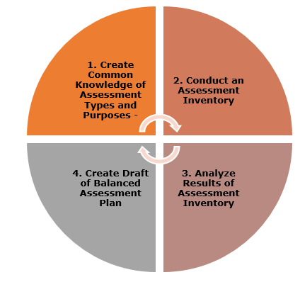
Developing a
Balanced Assessment Plan
Source: VDOE Supporting Instruction and Deeper Learning through Balanced Assessment Institute, June 2019

Slide 33
REVISIT THE DIVISION AUDIT
Monitoring Student Progress

Slide 34
Implementation Matrix

Slide 35
Revisit the division data audit

Slide 36
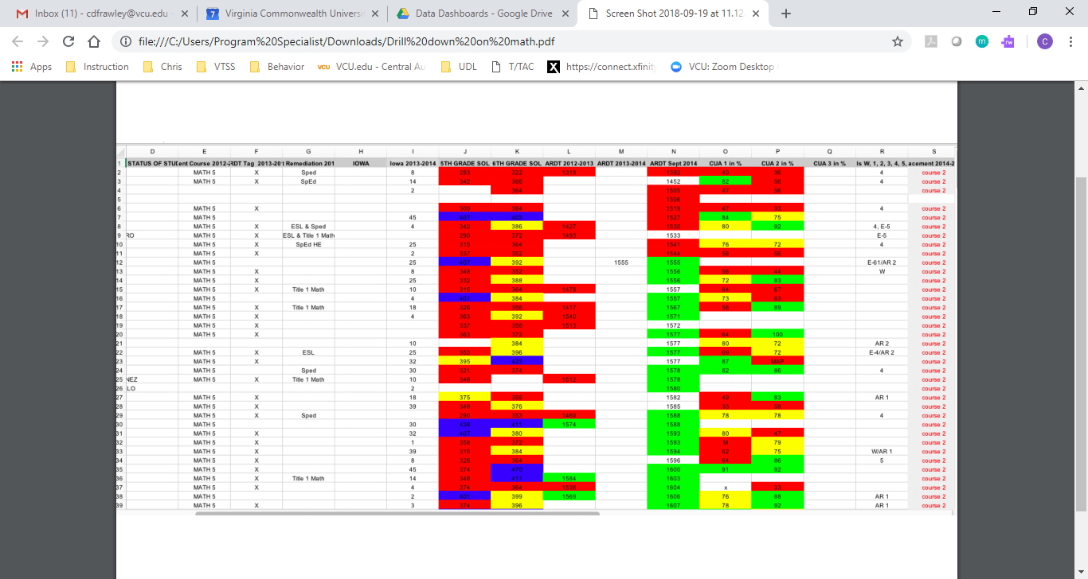
What do you include on your data dashboard?

Slide 37
Academic Tiered Fidelity Inventory (A-TFI): 1.12a

Slide 38
VTSS Action Planner: 5.A
5.A
Assessment Mapping for Student Growth

Slide 39
With your team, answer…
What are your next steps with completing an assessment inventory or revisiting an existing assessment inventory?
Can you financially support the assessments you are using currently?
How are you using data from assessments? How do you know?
How is your division creating a balanced assessment plan and how will it help you with this work?

Slide 40
Academic Alignment
Examine your current teaming and planning.
Identify your assessments to create an assessment map and review your data audit.
Review the purposes of universal screening within a VTSS framework and investigate the components of a good screener.

Slide 41
SCREENING TOOLS AND DATA
Monitoring Student Progress

Slide 42
Implementation Matrix: Component 5
Notes:
On your own, read across the rows for screening tools and screening process. Think about where your division team is now. Think about what steps are missing to move you to the next stage. Discuss as a team. These will inform your action plans.

Slide 43
Where are you?
Using what we have and exploring other screening tools
Using screening tools for some content areas and grade levels
Collecting screening data but not systematically using it for division and school goal setting and planning
Analyzing academic and behavior data in separate meetings
Notes:
We know all of our divisions have academic structures in place and all are different. Tell us more about you. Let’s look at screening tools first. Read all descriptions and decide as a team which number best describes your division right now. Have one member of each team hold up a number card.
Our plan for this afternoon is to go over quickly each stage of implementation of screening but then offer each team to select a “next steps” project to begin on today.
Activity here: Have two sheets of chart paper hung near each division. Label one “Screening tools we are using” Label the other, “We are still looking for…”. At some point later in the presentation, participants can network to discuss with one another.

Slide 44
Why Screen?
Don’t we have enough assessment data?
Discuss as a team
How would you answer?
What questions are answered by screening data?
How will the division team use screening information to support schools and students?
Notes:
In talking about any assessment, we need to acknowledge the concern about over testing. First, we need to be clear about the purpose and importance of screening tools. Secondly, we should be open to the idea of abandoning some assessments to avoid redundancy.

Slide 45
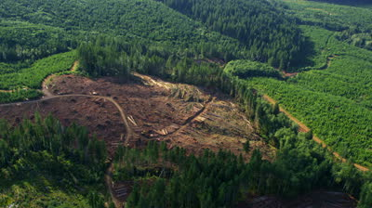
Why look at ALL?
Notes:
As a division team, you will be taking a broad view of the state of the division.

Slide 46
Why universal screening?
Division
School
Is the core instruction sufficient and is it improving?
For which groups (gaps, schools, grade levels) is it working/not working?
What is the efficacy of the tiered interventions?
Is the core instruction sufficient and is it improving?
For which groups (gaps, grade levels, classrooms) is it working/not working?
What is the efficacy of the tiered interventions?
What is the individual growth of our students?

Slide 47
Know the indicators of a good screener
1. Is brief
2. Is predictive
3. Is reliable
4. Provides an awareness of false positives
5. Provides normative data
6. Can be disaggregated

Slide 48
Examples and non-examples
Screening Tools
Not Screening Tools
DIBELS
Oral Reading Fluency
Easy CBM
STAR
MAP
AIMSweb
DESSA
SABRES
Quick Phonics Screener
QRI-IV
DRA2
Running Records
Report Cards
Meeting SOL standards
Core curriculum weekly tests on skills that are learned
Notes:
The tools on the left are useful , often for diagnosis or to answer the question, “We taught it, did they learn it?”, but do not fit the criteria of a good screener.

Slide 49
Let’s talk about high school
The term universal screening doesn’t apply here.
There are a lot of data available.
Have the pertinent data been assembled in an accessible format?
Once a group of students who may be at risk have been identified, more information may be needed.
What do we know about students who are new to school?

Slide 50
Websites for screening tools
National Center on Intensive Intervention
Comprehensive, Integrated Three-tiered Model of Prevention
Notes:
Explain the process of exploring the tools chart for the NCII. Refer to the handout.
Activity: Take some time to review screening tools, depending on what you need.
-A universal screener for K-6
-A screener for math
-Tools for secondary levels
-Tools to screening for mental, emotional wellness.

Slide 51
Aligning Screeners
Examine your current teaming and planning.
Identify your assessments to create an assessment inventory and review your data audit.
Review the purposes of universal screening within a VTSS framework and investigate the components of a good screener.
Develop a screening process OR enhance an existing screening process.

Slide 52
Who and When?
When? Fall, winter, spring
Who? School-wide assessment team (SWAT)? Teachers?
“If a school is adopting…periods of time for assessing number of ODRs, we recommend aligning the screening periods with existing academic benchmarking periods.”
Integrated Multi-Tiered Systems of Support
McIntosh & Goodman (2016) p. 47

Slide 53
Support the staff
Professional learning
Why screen?
How to screen?
How to interpret screening data?

Slide 54
Support the families
Another test!
What will be done with the results?
How will this help my child?
How and how often will I hear more?

Slide 55
Are screeners listed on your Balanced Assessment Plan?
When will you?
When will you?
Plan training on conducting screening assessments
Communicate screening schedule
Summarize data and disseminate results
Conduct fidelity checks of assessment administration
Prepare for winter screenings
Communicate, analyze, monitor
Prepare for spring screenings
Review/revise assessment plan for next year

Slide 56
Using screening data at the division level
Where we are
Where we want to be
5%
15%
15%
At least 80%
25%
60%
Notes:
We’re going to move now from the tools and process of screening to the conversations about screening data, starting with the division level conversation.
In the broadest sense, this is our first question….Based on our definition of proficiency, how many students are proficient? Are we where we want to be?

Slide 57
Are we improving outcomes for students?
18%
11%
25%
12%
15%
11%
64%
70%
74%
Improving outcomes for all groups of students?
Notes:
If progress is good, maintain supports.
Do you, as a division team, have a sense of this progress? What about for gap groups? Is one of your gap groups of particular concern?

Slide 58
Is there a need across the division?
Notes:
Analyze by schools, grade levels, content. How will this information impact our decision making? Where should resources be concentrated?

Slide 59
Does behavior data show an improving climate?
Notes:
The climate for learning affects all students and adults.

Slide 60
Early Warning Systems
Risk Category
Data Source
Attendance
Behavior
Course Performance
Essential Skills (e.g., reading, math)
Current Attendance
Current ODRs
Spring Grades
Last year’s Outcome data
Current CBM
Notes:
For secondary schools, an Early Warning System is often used.

Slide 61
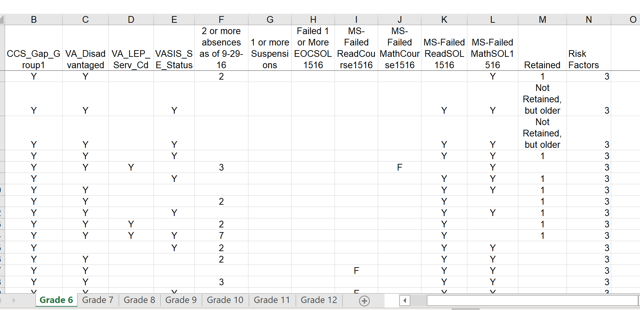
Looking at Risk Factors
Notes:
Charlottesville City screens for risk factors

Slide 62
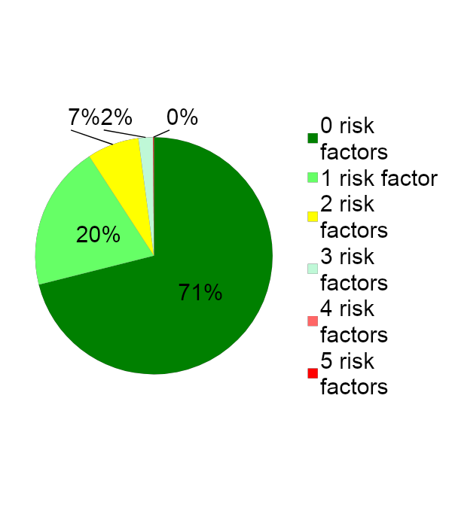
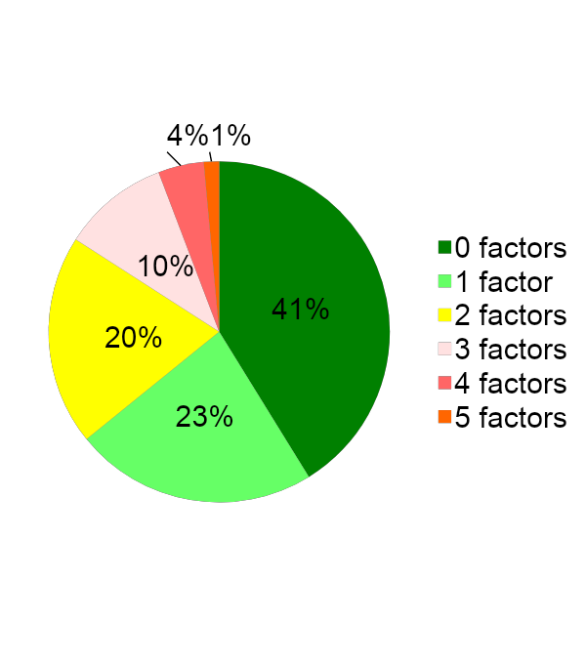
Where are the students with the greatest needs?
School A
School B
Notes:
Division teams can compare schools by risk factors. We can look at these graphs over time. Are interventions working to impact risk?

Slide 63
Virginia’s Early Warning System
Virginia’s Early Warning System for High Schools:
(http://www.doe.virginia.gov/support/school_improvement/early_warning_system/index.shtml)

Slide 64
Questions to consider for data analysis (overall results)
Prerequisite: What is the expected proficiency level for students in academics and behavior?
Questions:
What percentage of schools are meeting proficiency levels at elementary, middle, high?
What percentage of (critical) grade levels are meeting proficiency?
What are the division trends over time?
But don’t stop there…
Notes:
This may take several meetings

Slide 65
Disproportionality begins in Tier I
Questions to consider:
For each gap group, what is the percentage of schools at each level meeting proficiency?
For each gap group, what is the percentage of (critical) grade levels
meeting proficiency?
For each gap group, what are the division trends over time?

Slide 66
Division team agenda:
Screening results

Slide 67
Questions to consider for data analysis (root causes)
More about this in December….
Curriculum
Quality core instruction
Instructional practices
Climate for learning
Culturally responsive supports
Notes:
Look at December items.

Slide 68
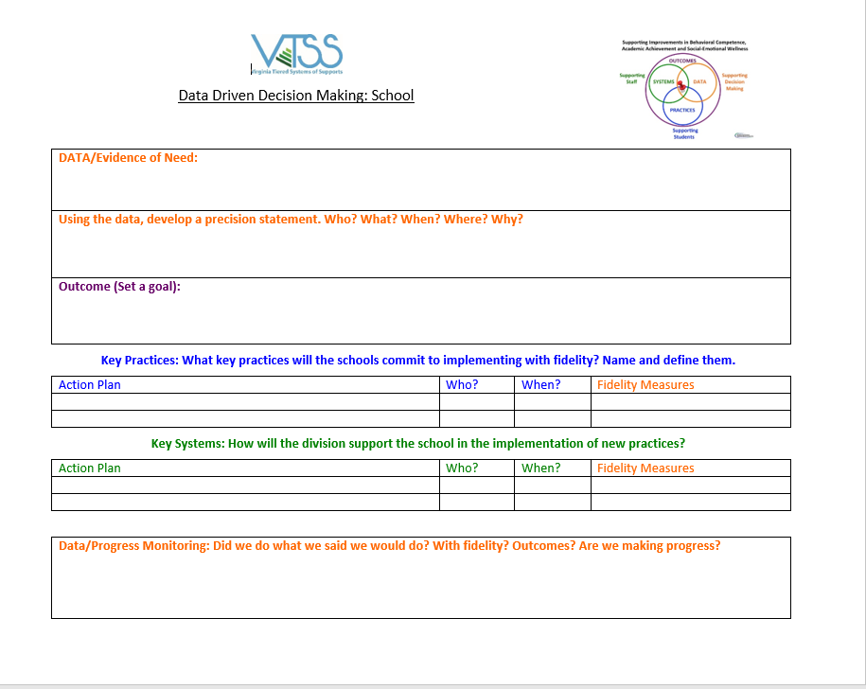
Are you ready to write a precision statement?
Notes:
Even before you have analyzed root cause, you can define the problem and set a goal.
Share handout of Gloucester data

Slide 69
How does the division team support schools?
What professional learning will be needed?
How will the school process differ from the division process?
How will the division team provide support-who and when?
How will the division team monitor fidelity of the process?

Slide 70
Decision Rules
80% Decision Rule: If 80% of students by gap group (e.g., race, special program, grade level) are meeting benchmarks, celebrate the success of your Core Program and look for ways to improve. If less than 80% are meeting benchmark, evaluate the Core Program and look for ways to improve.
Notes:
Move under #63. This works for divisions and schools

Slide 71
Decision Rules and/or Cut Scores
Decision Rule
Cut Score
20% Decision Rule: The lowest 20% of students at each grade level based on school-wide academic screening measures and/or with chronic behavior needs will receive strategic group intervention(s).
Students achieving at the 25th percentile or lower on screening instruments will be evaluated for Tier II support using additional data.
Notes:
This is an equity practice

Slide 72
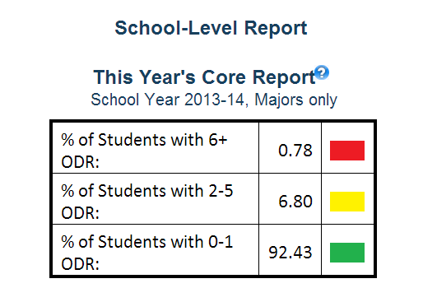
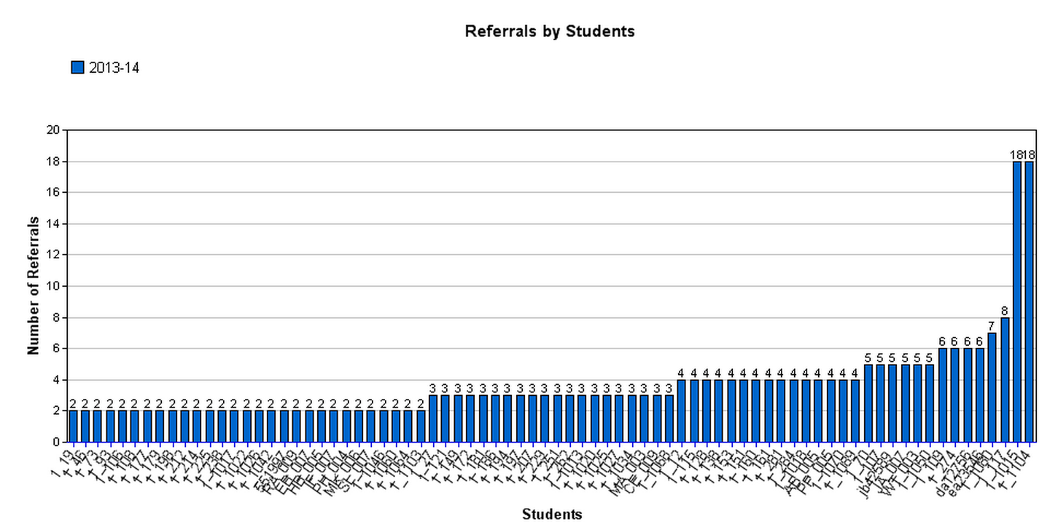
For behavior…most schools start here
Do they have an effective core for behavior?

Slide 73
Prepare for the meeting-Elementary

Slide 74
Prepare for the meeting-Secondary

Slide 75
Prepare school teams for questions and concerns
I get the idea of Fall and Spring screening, but why can’t we just skip Winter?
Why are we using Curriculum Based Measurements (e.g., 1 minute reading passages)? Aren’t they just fluency checks?
Our team wants to substitute our own benchmark tests for the screener. Okay?
Why use this screener? These items are not part of our curriculum.
What else?

Slide 76
Action Planning for Exploration/Installation
Identify the priority needs for screening tools
Use the search tool to review screeners
Plan for selection and implementation of screeners including
Resources
Schedule
Professional learning and buy in
Communication within the division and with stakeholders
Develop a presentation to introduce/review screening procedures for staff

Slide 77
Action Planning for Implementation
Review current screening structure for any gaps
Develop a DLT agenda to review screening data, including who will prepare the data. Include the questions the team will address.
Prepare professional learning for schools in the effective review and use of screening data.

Slide 78
Academic Tiered Fidelity Inventory (A-TFI): 1.12b and 1.13

Slide 79
VTSS Action Planner: 5.B and 5.C
5.B Screening Tools & Data
5.C Screening Process
Notes:
Add a slide for networking process.

Slide 80
Screening
Examine your current teaming and planning.
Identify your assessments and create an assessment map OR review your data audit.
Review the purposes of universal screening within a VTSS framework and investigate the components of a good screener.
Develop a screening process OR enhance an existing screening process.
Determine uses of screening data and identify potential challenges to discussing and utilizing screening data.

Slide 81
Resources
Horner, R. (n.d.) School-wide positive behavior support: Linking social and academic gains. Presentation to Washington Association of School Administrators.
McIntosh, K. & Goodman, S. (2016). Integrated multi-tiered systems of support. New York: The Gilford Press.
Oregon Response to Instruction and Intervention. (2019). Team and Data-based Decision Making.
Retrieved from Training & Data-Based Decision Making
(http://www.oregonrti.org/teamingdecisionmaking)

