Slide 1
Integrating and Aligning Academic Data, Practices and Systems
Strand 2: March 2020

Slide 2
Your Strand 2 Team
Mike Crusco, RIC
Chris Frawley, TTAC@VCU
Sandy Hart, RIC
Wanda Vaughan, RIC

Slide 3
Community Norms
Be Responsible | Take care of your needs. Share your questions with the group.
Be Respectful | Turn volume/sound off on cell phones. Listen to others attentively. Follow up and complete assigned tasks.
Be Engaged | Ask what you need to know to understand and to contribute. Share your expertise, information and ideas.

Slide 4
Retrieval Practice Grid Strand 2: Sessions A and B
Explain the two components that define quality instruction. | List three reasons for using universal screeners. Give two examples each of elementary and secondary academic screeners. | Explain the two types of Tier 1 data meeting structures. How are they used in your division?
How can a division use universal screening data for analysis? | What assessment data could be included in a data dashboard? | Explain the importance of equitable classroom practices. What data are you collecting to indicate they are/are not present in classrooms?
Explain the importance of the division initiative map and how your division has used it. | Name one thing your division has implemented/completed as a result of your attendance in the first two sessions of Strand 2. | Describe how a division or school would use the Selection of Evidence-based Practices Tool.
How does the cascading model of support apply to data meeting structures? | How is your division using the assessment inventory and balanced assessment plan? | Describe how you have shared your work in Strand 2 with other division and school personnel.

Slide 5
For session materials and presentations
For assistance (Password: vtss):
https://vtss-ric.org/implementers/divisions/from-start-2-sust/strand-2/

Slide 6
Today’s Learning Intentions
Understand the elements of progress monitoring at Tier 1 and ensure a plan for utilizing these data exists. (Matrix 5D)
Examine how the division team guides schools to define access to Tier 2 supports. (Matrix 1E)
Develop a plan to monitor fidelity of implementation of evidence-based practices. (Matrix 3D, 6B)
Develop a plan for implementing Tier 1 data meeting structures at the school and division level and determine how to measure the fidelity and effectiveness of the meeting structures. (Matrix 2C)
Identify connections to the Academic Tiered Fidelity Inventory.

Slide 7
Monitoring Student Progress
PROGRESS MONITORING AT TIER 1

Slide 8
Academic Alignment
Understand the elements of progress monitoring at Tier 1 and ensure a plan for utilizing these data exists. (Matrix 5.D)

Slide 9
Implementation Matrix 5.D

Slide 10
Progress Monitoring
Which tier(s) should progress monitoring be used?
Tier 1
Tier 2
Tier 3
Tiers 2&3 only
All tiers
Notes:
Answer: E

Slide 11
Progress Monitoring
OUTCOMES
Progress monitor all 3 tiers systematically.
SYSTEMS
DATA
PRACTICES

Slide 12
Progress Monitoring
Table talk: How would you define progress monitoring?

Slide 13
Definition
“…is used to assess student progress or performance in those areas in which they were identified by universal screening as being at-risk for failure (e.g., reading, mathematics, social behavior). It is the method by which teachers or other school personnel determine if students are benefitting appropriately from the typical (e.g., grade level, locally determined, etc.) instructional program, identify students who are not making adequate progress, and help guide the construction of effective intervention programs for students who are not profiting from typical instruction” (paragraph 2). RTI Action Network
Notes:
Student academic performance is assessed using brief measures. It takes place frequently: weekly, biweekly or monthly. Progress monitoring informs instruction in general and special education classrooms and monitors student progress at a three tiers.

Slide 14
Progress Monitoring
Which statement is NOT a benefit of progress monitoring?
Lack of documentation of student progress
Students learn more quickly
Communication improves
Teachers have higher student expectations
Notes:
Answer: A

Slide 15
Benefits of Progress Monitoring
Students learn more quickly
Teachers make more informed instructional decisions
Documentation of student progress
Communication improves
Teachers have higher student expectations
Decrease in special education referrals
Source: RTI Action Network
Notes:
Students learn more quickly because they are receiving more appropriate instruction.
Teachers make more informed instructional decisions
Documentation of student progress is available for accountability purposes
Communication improves between families and educators about student progress
Teachers have higher student expectations for their students
Decrease in special education referrals

Slide 16
Progress Monitoring:
Tier 1
Examine the division’s use and analysis of universal screening.

Slide 17
Assessment Inventory: Universal Screeners
Notes:
In October, we discussed the assessment map and assessment plan. As a division team, the assessment map can assist you with identifying the various assessments, including universal screeners, that you division administers throughout the year. For example, screening measures can be literacy (e.g., word identification, letter naming, cloze), EWS indicators, office discipline referrals, attendance.
Remember, universal screening helps to answer these questions…
Is the core instruction sufficient (is it working) and is it improving (i.e., health of the curriculum)?
For whom is it working/not working?
What is the efficacy of the tiered interventions?
Who can we reliably say is at risk for not meeting state standards?
What is the individual growth of our students?

Slide 18
Progress Monitoring:
Tier 1
Examine the division’s use and analysis of universal screening.
Evaluate the use of formative assessment.

Slide 19
Assessment Inventory:
Progress Monitoring of Core Instruction
Notes:
A practice in which “teachers routinely collect evidence about student learning in real time so that they can rapidly adjust the instruction to better meet students’ needs.” Source: Wiliam, D. (2018). Creating the Schools Our Children Need. p. 183
Five Features of Effective Formative Assessment
Ensuring that students know what they are meant to be learning.
Finding out what students have learned
Providing feedback that improves student learning
Having students help each other learn
Developing students’ ability to monitor and assess their own learning

Slide 20
Progress Monitoring Measures: Tier 1
How are mastery measures used? What is an example?
How are curriculum-based measurements used?
What is an example?

Slide 21
Progress Monitoring Measures: Tier 1
Mastery Measures
Curriculum-based Measurement (CBM)
The skills are broken into sequenced sub-skills.
One by one, each skill is assessed in a unit of study.
Assessment is based on a pre-planned instructional sequence.
Students demonstrate mastery by meeting a pre-planned specified criterion.
Teachers introduce a new skill after students achieve mastery on previous skill.
Skills can be taught in a logical order.
Growth is tracked over the year.
Each probe includes sample items from all skills taught during the year.
Student success is based on individual goals.
Each probe tests prior material.
Probes, administration and scoring are standardized.
Sources: RTI Action Network, The Iris Center
Notes:
When progress monitoring at Tier 1, there are typically two measures used: mastery measures and curriculum-based measurement. Both measures assess skills aligned with the curriculum, skills are assessed frequently, and the assessment results assist in instructional planning.
For high school: Can use a read aloud task, a reading maze task, a mathematics probe (e.g., computation, estimation, algebra) and written expression. Source: https://rti4success.org/sites/default/files/HSTII_Progress_Monitoring_Webinar_5-12-10.pdf

Slide 22
Curriculum-based Measurement
Using CBM:
Teachers’ students achieve higher grades when using it to guide instruction
Teachers plan more effective instruction
Students are more aware of their performance
Students feel more responsible for their learning
It can predict success on high stakes tests
Source: The Iris Center

Slide 23
Tier 1 Academic Progress Monitoring:
Two weeks of Partner Reading
ORF increase from 92 to 135
Notes:
Partnering has come up throughout this module on Ensuring Student Success, as a method for increasing Opportunities to Respond, as a tool for Formative Assessment, and now as a tool for scaffolding.
Let’s look at this study from a group at the University of Minnesota to expand on a couple of points about this Effective Practice.
There is a high Hattie’s Effect size for Partner Reading. Effect size applies to ALL students. Partner Reading does not only benefit weaker students; the stronger member of the partnership also benefits from this practice.
In this study in selected third grade classrooms, the Oral Reading Fluency score in the first column shows there are more than half the students are not meeting the fall benchmark.
Then, partner reading was implemented for all students and all students made growth.

Slide 24
Progress Monitoring: Student 1
Source: National Center on Response to Intervention
Notes:
An example of a student monitoring his/her progress.

Slide 25
Progress Monitoring: Student 2
Source: National Center on Response to Intervention
Notes:
An example of a student monitoring his/her progress.

Slide 26
Resource Mapping
Notes:
In a cohesive system, ideally the progress monitoring data should be linked to other types of data and data collection in the school. For example if the school does universal screening(benchmarking) it is very nice if those same measures can be used for progress monitoring.

Slide 27
Progress Monitoring: Tier 1
Assess all students at least three times a year to monitor student progress (e.g., universal screening, benchmark assessments, office discipline referrals).
Use data to determine effectiveness of core instruction (e.g., academic, social-emotional); create a more responsive learning environment for all students.
Use formative assessment throughout the year.
Analyze data to determine who is not making adequate progress based on grade level expectations.
Source: Pennsylvania Training and Technical Assistance Network
Notes:
Process

Slide 28
Aligned Organizational Structure
ALIGNED DEFINITIONS OF MULTI-TIERED SUPPORTS

Slide 29
Academic Alignment
Understand the elements of progress monitoring at Tier 1 and ensure a plan for utilizing these data exists. (Matrix 5D)
Examine how the division team guides schools to define access to Tier 2 supports. (Matrix 1E)

Slide 30
Implementation Matrix 1.E

Slide 31
Leadership Team Established: Support the vision of a sustainable implementation of a tiered system through effective communication, common language, infrastructure planning, consensus and commitment building and a communication plan
Resource map what you have for data, systems, and practices!
Start with universal data and other multiple measures to set goals.
OUTCOMES
SYSTEMS
DATA
Set up a system of decision rules and clarity around tiered support (tier definitions).
PRACTICES
Build a continuum of supports that includes culturally responsive evidence based practices, at all 3 tiers, for academics and behavior with a scheduled time and resources for delivery.
Notes:
‹#›
All of the fidelity documents used in VTSS start with the most important piece of implementation, and that is the establishment of an effective leadership team with membership that represents the division. As you can see, this team has some very clear roles and responsibilities.
(fly) One of the first activities is to examine the existing data, practices, and systems that have led to the “current reality.”
(fly) We then move to looking at our universal measures and other data, and it may be necessary to take a step backwards and do an assessment map to determine what can be eliminated or possibly added.
(fly) All these activities allow us to then clearly define our tiers so that there is clarity around what we mean by tiers of support.
(fly) Now, within those tiers, we have the evidence based practices that will assist us in accomplishing goals for students, and this continuum of supports, or the “tools in our toolbox” will help us make the proper instructional matches in all areas.

Slide 32
Risk Factors
Risk Category
Data Source
Attendance
Behavior
Course Performance
Essential Skills (e.g., reading, math)
Current Attendance
Current ODRs
Spring Grades
Last year’s Outcome data
Current CBM
Notes:
Possible risk factors for secondary students.

Slide 33
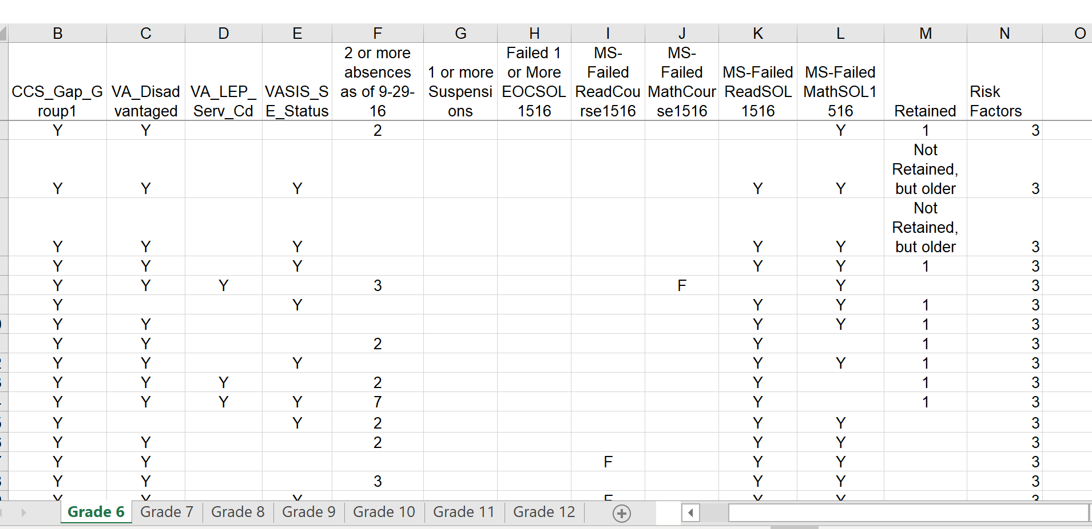
Looking at Risk Factors

Slide 34
Resource Mapping

Slide 35
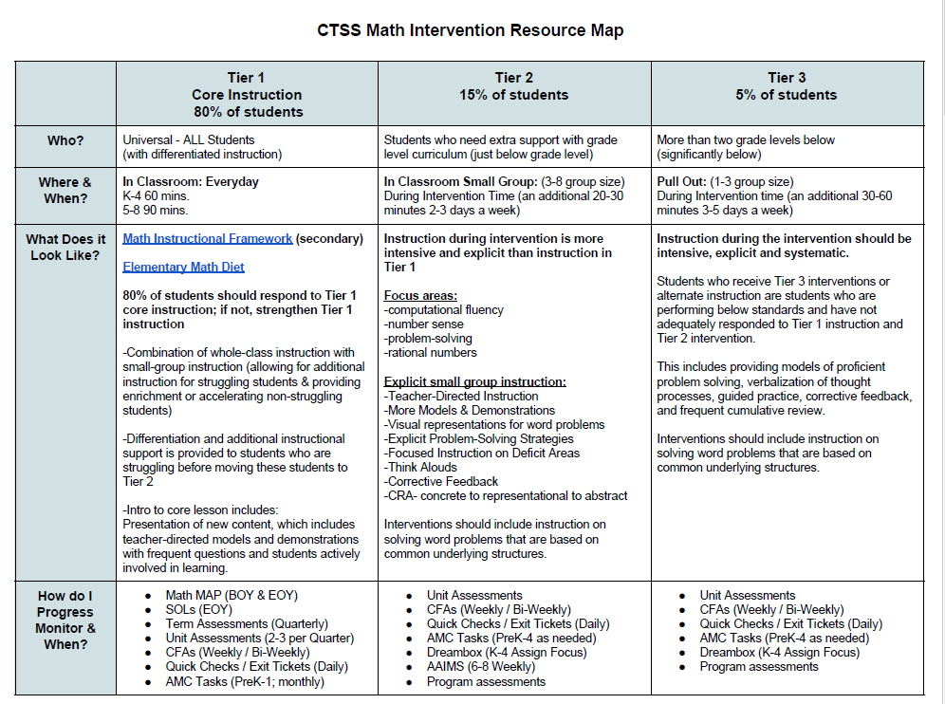
Resource Map Example

Slide 36
Resource Map Math Example:
Identifying need for Tier 2 Supports
Notes:
Ask: When considering other data sources, how might you use these data for developing Tier definitions (e.g., attendance, academic performance in specific performance).
Consider large numbers of students that end up qualifying for Tier 2 supports. Is this a Tier 1 issue?

Slide 37
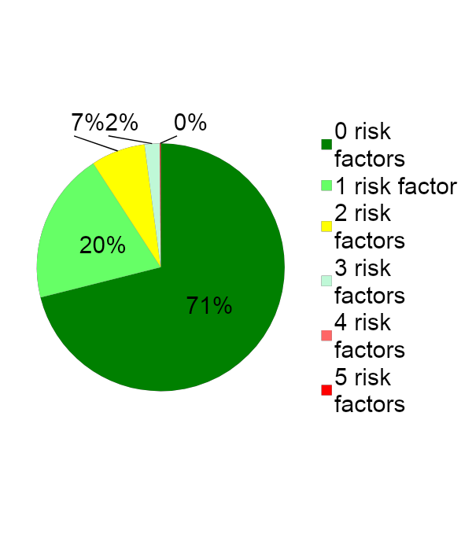
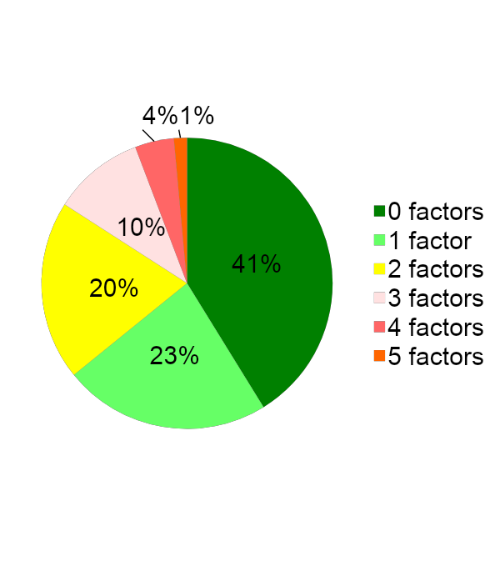
Where are the students with the greatest needs?
School A
School B
Notes:
Make sure we talk about resources and magnitude of the risk factors when considering supports for students (and staff).

Slide 38
Division Decision Making

Slide 39
Academic Tiered Fidelity Inventory (A-TFI)
Notes:
Process

Slide 40
A-TFI continued
Notes:
Process

Slide 41
Team Time
Select between 1-3 schools in your division to discuss.
Look at the A-TFI items 1.5, 1.6a, 1.9
Decide how your schools would score on the A-TFI items and why.
How does this information inform the division team re: PD, coaching, resources?

Slide 42
Action Plan 1.E

Slide 43
Action Plan 5.D

Slide 44
Action Planning 1.E & 5.D
What data are you using to progress monitor at Tier 1?
How do you provide professional learning and coaching on using assessment data to inform instruction?
How do you know your Tier 1 progress monitoring data are reliable and consistent with outcomes?
Describe your plan for revisiting the monitoring tools, data and schedule.
How will the division team communicate the Tier 1 definition(s) and how will it allocate resources?
How will the division team define entry criteria for Tier 2? What data will be used for analysis?

Slide 45
Evidence-based Practices
FIDELITY OF PRACTICES

Slide 46
Academic Alignment
Understand the elements of progress monitoring at Tier 1 and ensure a plan for utilizing these data exists. (Matrix 5D)
Examine how the division team guides schools to define access to Tier 2 supports. (Matrix 1E)
Develop a plan to monitor fidelity of implementation of evidence-based practices. (Matrix 3D, 6B)

Slide 47
Implementation Matrix 3.D
Notes:
As we finish up our sessions for the year, you may want to hold on to the matrix that you have used to indicate your level of implementation. Ay you could use this, as well as your action plans , to look forward to your meetings for the following few months to set some topics for action and/or discussion

Slide 48
Implementation Matrix 6.B

Slide 49
Quality Instruction defined….now what?
Communicated…..
Professional learning conducted….
Coaching and supporting of teachers…
But…is it happening in the classroom? How many? How do you know and how do you address it?

Slide 50
Monitoring Fidelity
What tools exist in your division to monitor fidelity in your schools?
Notes:
Provide examples for the participants to consider prior to recording their answer.
Jot down some fidelity monitoring tools that you are aware of. Share with a partner, discuss as a table

Slide 51
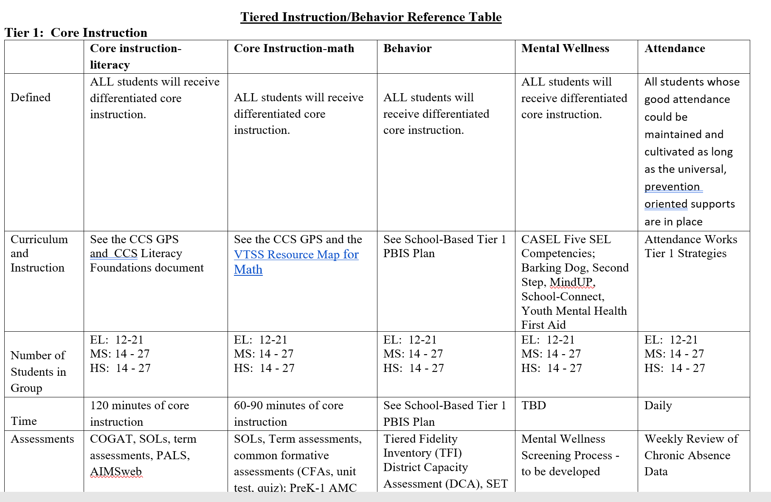
Tier Definition: Including Times and Group Size
Notes:
Check your own documents. Are groups meeting for the correct number of times and length? Are group sizes staying within guidelines?

Slide 52
What about meetings?
Notes:
How are meetings being monitored. Is it possible to monitor in person, or is it done through reviewing of documents?
Is attendance regular? Are teams following up?

Slide 53
Data Informed Decision Making
Notes:
Is a problem solving process being followed? Not every problem needs to be addressed by using this tool completely, but are all teams familiar with the steps and questions to ask in approaching a problem

Slide 54
Fidelity
Evidence Based
Practices (3.D)
Implementation (6.B)
Practices used and observable
Components of the instructional tool (balanced literacy)
Evidence based programs taught as designed
Alignment!
Schedule/Group size
TFI and A-TFI data
Resources available and in use
Assessments
Attendance
Students
Teachers
Notes:
We're talking about two general categories of fidelity….fidelity of use of EBPs, in other words, are we seeing the practices being used in classrooms. And secondly, fidelity to the implementation of the practices. For example, if we call for 90 minutes of math instruction per day in a 6th grade classroom, is that what is happening?
Also remember, some packaged programs have their own fidelity tools, which can be useful. They will describe components of the program and how it should be taught. The idea is to be able to answer the question, “Are we doing it the way we said we were going to do it?”
Don’t forget the fidelity of assessments. As PALS assessments are given over multiple years, it’s easy to imagine that the fidelity to the directions might get lost. What to do about that?

Slide 55
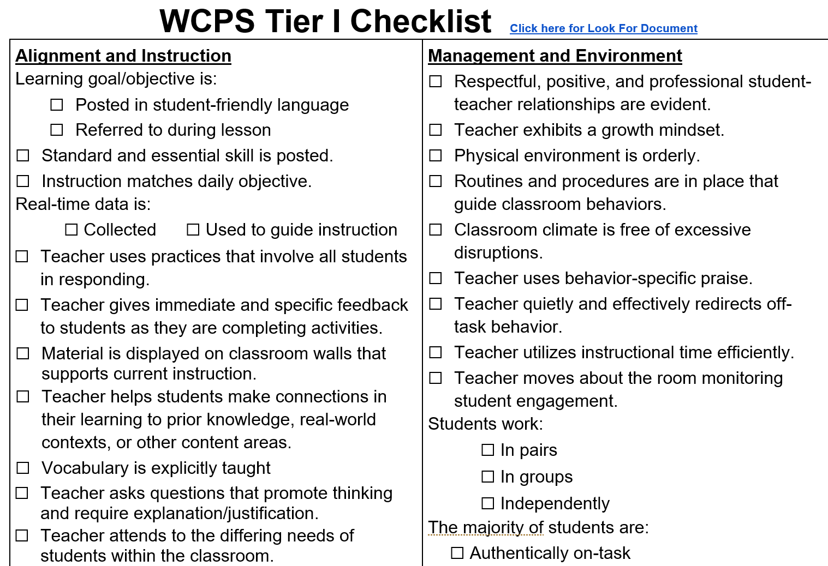
Effective practices….are they observable?
Notes:
We talked about Warren Count’s development of their Tier 1 checklist. This is their finished product and it’s in your resources folder
Share how school divisions and administrators are using checklists in their schools (e.g., Danville, Warren, Sandy’s administrator example).

Slide 56
Revisiting Warren County
Notes:
Video of Lisa Rudacille Cue up Lisa’s slide to 2.42

Slide 57
Example: Walkthrough Observation Data
Notes:
As walkthoughs are completed, the data is immediately entered on google sheets for analysis. They are also share with the teacher.
Can we add a circle around 7-9 from the left? Those bars refer to the following items on the checklist:
Real time data is collected
Real time data is used to guide instruction
Teacher uses practices that involve all students in responding
It’s important not to be overwhelmed by looking at so many practices at once.

Slide 58
Narrow the focus to one practice
Notes:
It often wise to narrow the focus to from 1-3 practices. Considering the data from the last slide, a division might decide to focus on Formative Assessment or Opportunities to Respond. They might take steps to
Review expectations (perhaps using modules from ECS). Encourage peer observations using a short tool. Allow teachers to reflect and support one another.
This one-practice observation tool is an example from the Effective Classroom Systems PD.
Share the process Warren county uses to focus on three instructional practices during a school year.

Slide 59
Looking at the A-TFI
Notes:
Process

Slide 60
A-TFI: Evidence based practices
Notes:
Process

Slide 61
A-TFI: Implementation of Tier 1
Notes:
Process

Slide 62
Team Time
Select between 1-3 schools in your division to discuss.
Look at the A-TFI items 1.4a, 1.8, 1.14
Decide how your schools would score on the A-TFI items and why.
Does this information inform the division team re: PD, coaching, resources?
Look at other A-TFI items or schools.
What would a fidelity plan look like?

Slide 63
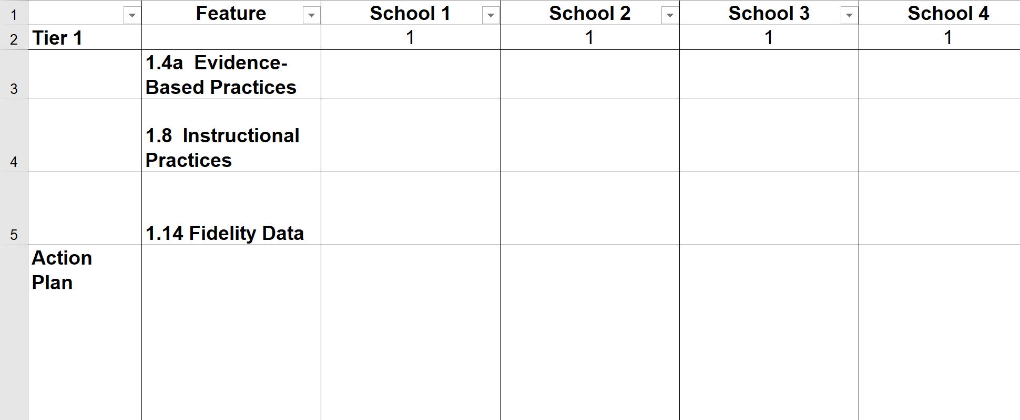
Create a Plan
Notes:
One way to monitor the ATFI from the division level is to create a spreadsheet for each feature. Schools can enter action plans in their column.
Danville example

Slide 64
Action Planning 3.D & 6.B
What tools have been selected by the division team to assess fidelity of evidence based practices?
If needed, which tools does the division need to create?
How will the purpose and use of the tools be communicated to division and school leaders and teachers?
When and how will fidelity data be monitored?
How will fidelity data be used? (e.g., plan professional learning, reallocate resources among schools, what else)?

Slide 65
Action Plan 3.D

Slide 66
Action Plan 6.B

Slide 67
Data-Informed Decision Making
MEETING STRUCTURES FOR DATA INFORMED DECISION MAKING

Slide 68
Academic Alignment
Understand the elements of progress monitoring at Tier 1 and ensure a plan for utilizing these data exists. (Matrix 5D)
Examine how the division team guides schools to define access to Tier 2 supports. (Matrix 1E)
Develop a plan to monitor fidelity of implementation of evidence-based practices. (Matrix 3D, 6B)
Examine the division plan for supporting the implementation of Tier 1 data meeting structures at the school and division level to improve student outcomes. (Matrix 2C)

Slide 69
Implementation Matrix 2.C

Slide 70
Types of Data Driven Discussions
1. Universal Screening
2. Grade Level/Content Area Performance (Tier 1)
3. Individual Student Data and Intervention Efficacy (Tier 2/Tier 3)
4. Individual Student Problem Solving and Intervention Planning (Tier 2/Tier 3)

Slide 71
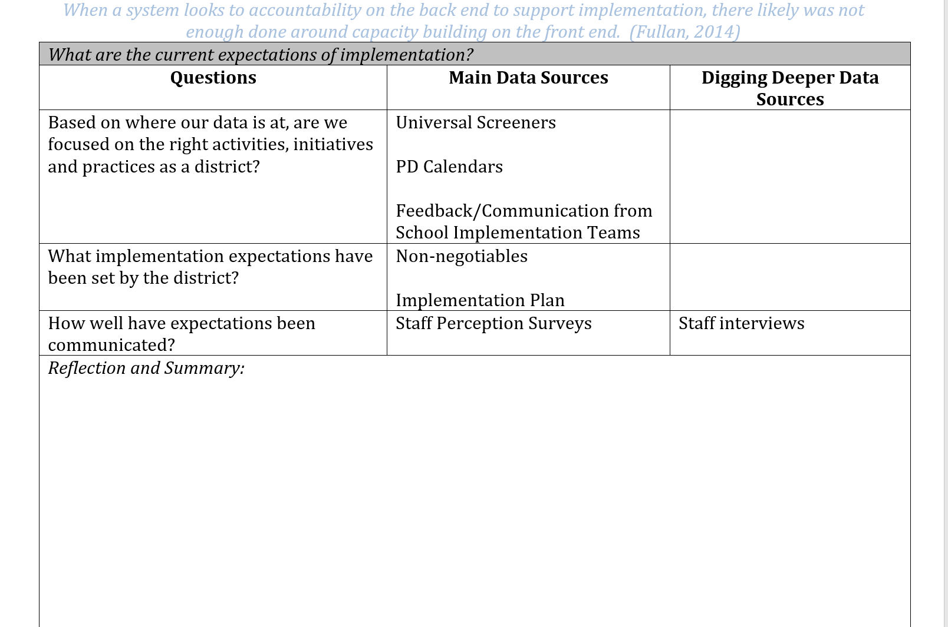
Division Reflection:
Focus and Communication
Notes:
We introduced these documents in the December session.

Slide 72
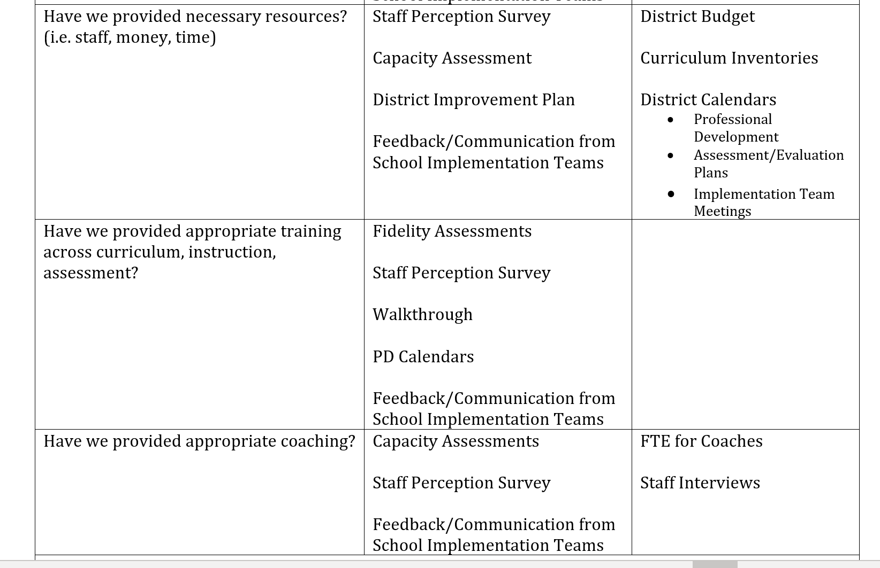
Division Reflection:
Capacity

Slide 73
What are the root causes for concerns? (Secondary example)

Slide 74
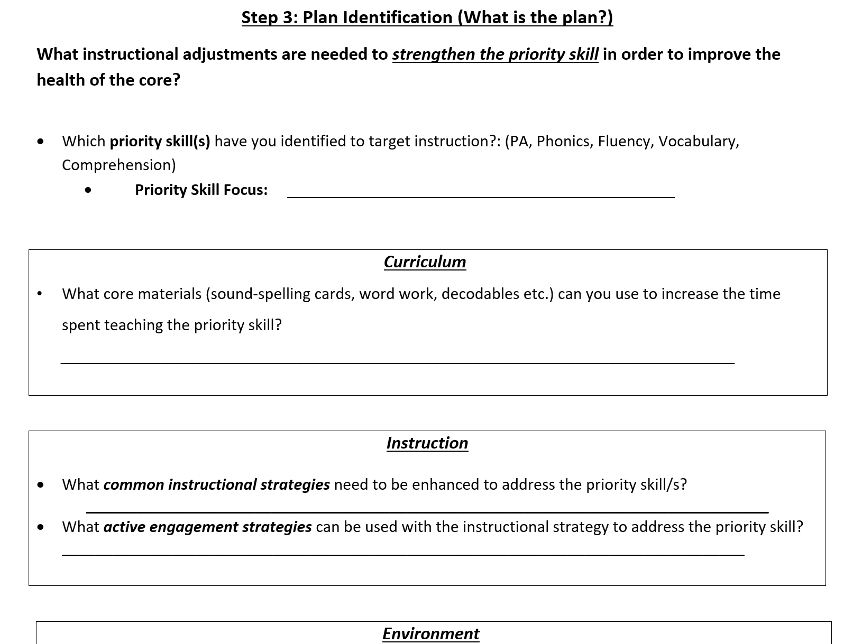
What instructional adjustments need to be made? (Elementary example)

Slide 75
Data Informed Decision Making

Slide 76
Questions for Data Analysis
What is the specific problem to be addressed by the team?
Analyze the problem using data to determine why the issue is occurring. Use strategies tied to your content knowledge, variables you can control, and instructionally relevant areas. Questions to consider, “Why is/are the desired goal(s) not occurring? What are the barriers to the student(s) doing/knowing what is expected?” Design or select instruction to address the specific problem.
Develop and implement a plan driven by the results of the team’s problem analysis by establishing a performance goal and developing an intervention plan to achieve the goal. Include information about how the student’s progress will be monitored and/or how the teacher(s) will be supported. Ask, “What are we going to do?”

Slide 77
Implementation Matrix 2.C

Slide 78
A Cascading Model of Support
USDOE, OSEP PBIS TA Center
Who is supported?
VDOE
Regional Team
Division Team
Building Leadership Team
Building Staff
Source: Michigan’s Integrated Behavior and Learning Support Initiative
Students and Families
Improved student outcomes
Notes:
This visual illustrates the support (e.g., professional development, coaching) provided at all levels of the cascade.

Slide 79
A-TFI Connections
Notes:
Process

Slide 80
Team Time
Select between 1-3 schools in your division to discuss.
Look at the A-TFI items 1.6b and 1.15a
Decide how your schools would score on the A-TFI items and why.
Does this information inform the division team re: PD, coaching, resources?
Look at other A-TFI items or schools.

Slide 81
Action Plan 2.C

Slide 82
With your team, discuss these questions.
What current meeting structure(s) do you have in place for data informed decision making at the division and building levels? What data are utilized within these meetings?
If you do not have a meeting structure in place or data identified, what are your next steps?
How do you/will you support the use of the meeting structures for your schools?
How will the division assess the fidelity of the schools’ data meeting structures?

Slide 83
We need your feedback!
Visit your email to complete the session evaluation.

Slide 84
Summary Activity
Notes:
Networking questions

Slide 85
References
Dexter, D. & Hughes, C. (n.d.). Progress monitoring within a response-to-intervention model. Retrieved from http://www.rtinetwork.org/learn/research/progress-monitoring-within-a-rti-model
Fallon, N. (2018). SWOT analysis: What it is and when to use it. Retrieved from https://www.businessnewsdaily.com/4245-swot-analysis.html
National Center on Response to Intervention. (2012). RTI implementer series: Module 2: Progress monitoring, Training manual. Retrieved from http://rti4success.org

Slide 86
References
Pearson. (2014). Part 1: Monitoring progress. Progress monitoring and learning progressions - What is the difference?. Retrieved from https://www.pearsoned.com/part-1-monitoring-progress-progress-monitoring-learning-progressions-difference/
Pennsylvania Training and Technical Assistance Network. (n.d.). Response to intervention. Retrieved from https://www.pattan.net/multi-tiered-system-of-support/multi-tiered-system-of-supports-academic/response-to-intervention-rti
The Iris Center Peabody College Vanderbilt University. (n.d.). Classroom assessment (Part 1): An introduction to monitoring academic achievement in the classroom. Retrieved from https://iris.peabody.vanderbilt.edu/module/gpm/#content

