Slide 1
Integrating and Aligning Academic Data, Practices and Systems
Strand 2: December 2019

Slide 2
Previous learning intentions
Review the responsibilities of the Division Leadership Team necessary to support the alignment of supports within a VTSS structure. (Matrix 1.B, 1.C)
Understand the process of developing a division assessment map and begin a division assessment map. (Matrix 5.A)
Evaluate existing data dashboards and design components that integrate additional data. (Matrix 5.A)
Review the purposes of universal screening within a VTSS framework and investigate the components of a good screener. (Matrix 5.B)
Understand the elements of the screening process to include communication with families; begin development/enhancement of screening process. (Matrix 5.C)
Identify uses of screening data at the division and school level and identify challenges to discussing and utilizing screening data. (Matrix 5.C)

Slide 3
Block Party
Review the previous learning intentions.
Think about a discussion or an action(s) that your team conducted after the October session.
Select the colored card that matches one of the learning intentions. Write your team’s action(s) on the card.

Slide 4
Revisiting your need to know questions.

Slide 5
Today’s Learning Intentions
Develop a written description of quality Tier 1 academic instruction and create a system for communicating instructional expectations to stakeholders. (Matrix 3A)
Examine existing evidence-based Tier 1 practices to create an inventory of division priorities related to academic instruction. (Matrix 3C)
Develop a plan for implementing Tier 1 data meeting structures at the school and division level and determine how to measure the fidelity and effectiveness of the meeting structures. (Matrix 2C)

Slide 6
Supporting Improvements in Behavioral Competence, Academic Achievement and Social-Emotional Wellness
OUTCOMES
Supporting
Staff
Supporting
Decision
Making
SYSTEMS
DATA
PRACTICES
Supporting
Students

Slide 7
Academic Alignment
Develop a written description of quality Tier 1 academic instruction and create a system for communicating instructional expectations to stakeholders. (Matrix 3A)

Slide 8
Evidence Based Practices
Quality Core Instruction

Slide 9
Evidence-Based Practices:
3.A Quality Core Instruction

Slide 10
Quality instruction…
How is it defined?
What is taught?
How it is taught?
Aligned to the standards.
Standards unpacked?
Pacing guides?
High impact practices in the classroom?
Providing experiences in the 5Cs?
Critical thinking
Creative thinking
Communication
Collaboration
Citizenship

Slide 11
Quality Instruction:
What is the foundation for our division?

Slide 12
Secondary IES Resources
Source: https://ies.ed.gov/

Slide 13
Activity: Let’s Talk Instruction
Review the descriptions of effective teaching strategies in the folder. Silently decide on the ones that you consider the most important for your division.
Write your top 7 ideas on Post-it notes.
Put your sticky notes on the chart paper
Silently move notes to group ideas.
Discuss and realign on chart paper in rows or columns.
Discuss as a team: Are these valued practices evident in your documents? Is there a common understanding of their importance?

Slide 14
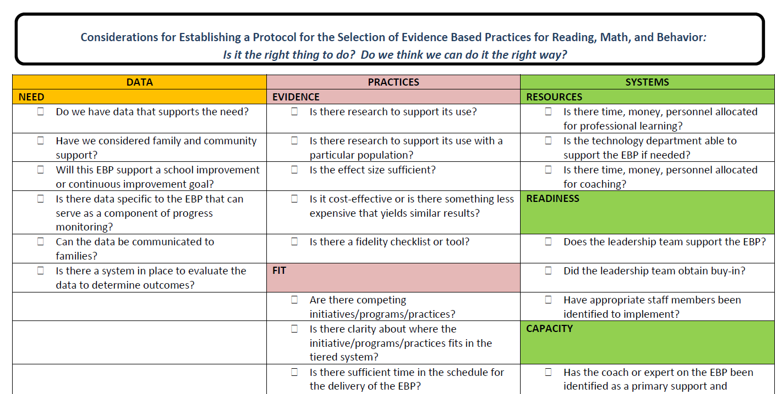
Selection of
Evidence-based Practices

Slide 15
Team Exercise
Select an adopted practice/program or one being considered for adoption.
Read aloud questions from the selection of evidence-based practices tool. Discuss responses as a team. If data are not known, could it be obtained?
How could this process be helpful to your team and division?

Slide 16
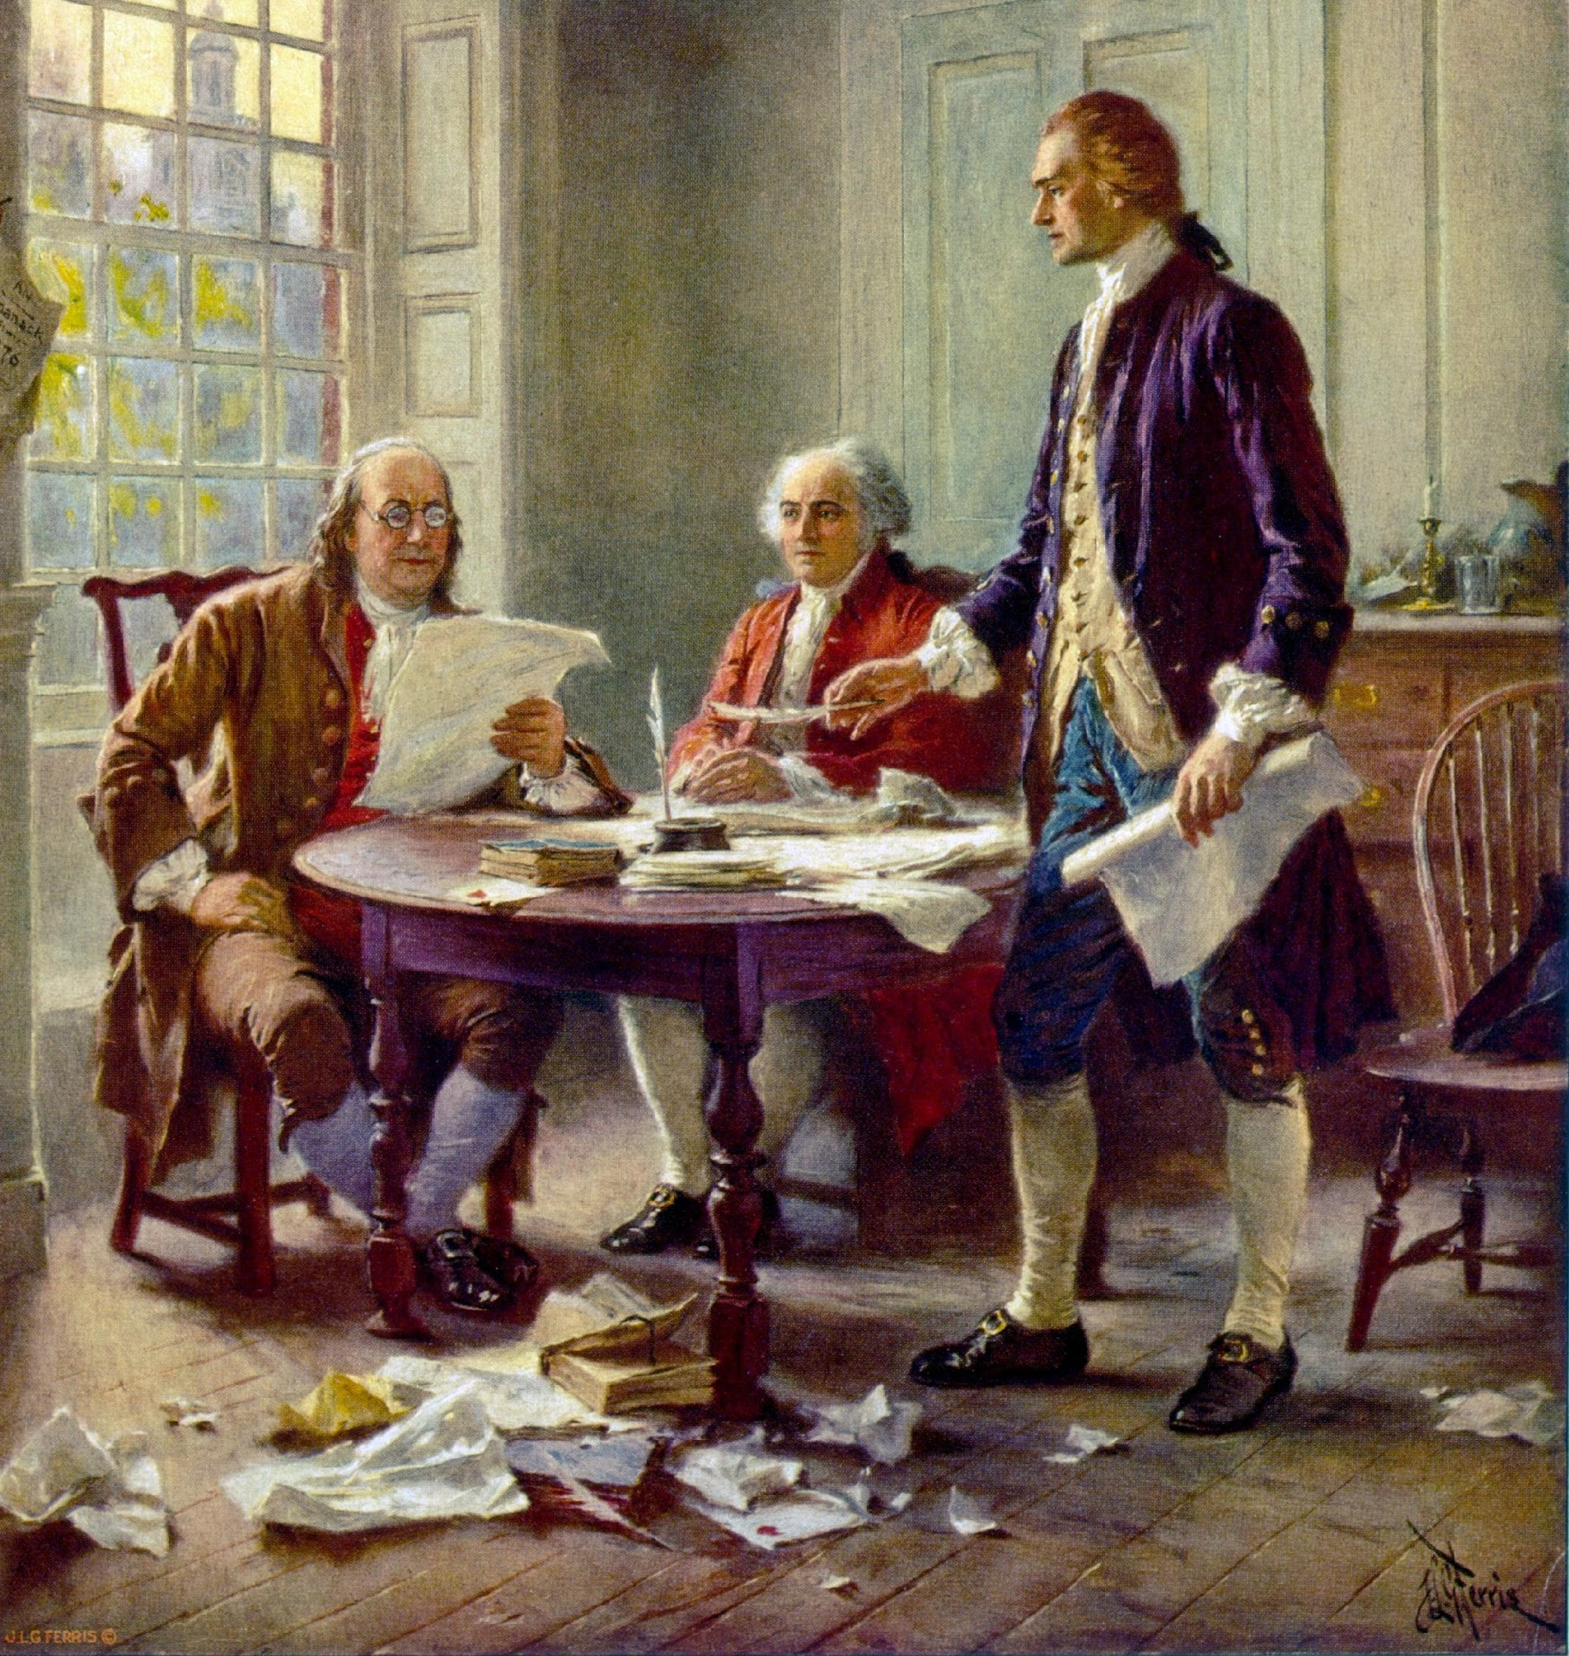
Document, Document, Document!

Slide 17
Team review of sample documents
Independently or as a jigsaw: Read the documents in the Sample Expectations for Tier 1 Instruction folder.
As a team, discuss any thoughts/next steps related to:
Content
Format
Other
What ideas were generated for writing or revising a document for your division?
:

Slide 18
Partnership Buy-In
Internal
External
Instructional leaders
Building Administrators
Teachers
Paraprofessionals
Others
Families
Community
Others

Slide 19
Develop a Shared Understanding
Learning walks
Instructional rounds
Tandem walkthroughs
Video reviews
Other ways…

Slide 20
The Warren County Journey to Defining a Vision of Quality Instruction
Notes:
Video of Lisa Rudacille

Slide 21
Action Plan

Slide 22
Action Planning
Which instructional practices will you identify/have you identified for your division?
Do you have a document that describes your instructional practices? How are they documented and reviewed? Is the language clear?
What is your plan for communicating with key stakeholders?
Do you have a plan for aligning professional development (e.g., professional learning sessions, coaching) and monitoring implementation? What are your next steps?

Slide 23
Evidence Based Practices
Continuum of Supports that is Culturally Responsive

Slide 24
Academic Alignment
Develop a written description of quality Tier 1 academic instruction and create a system for communicating instructional expectations to stakeholders. (Matrix 3A)
Examine existing evidence-based Tier 1 practices to create an inventory of division priorities related to academic instruction. (Matrix 3C)

Slide 25
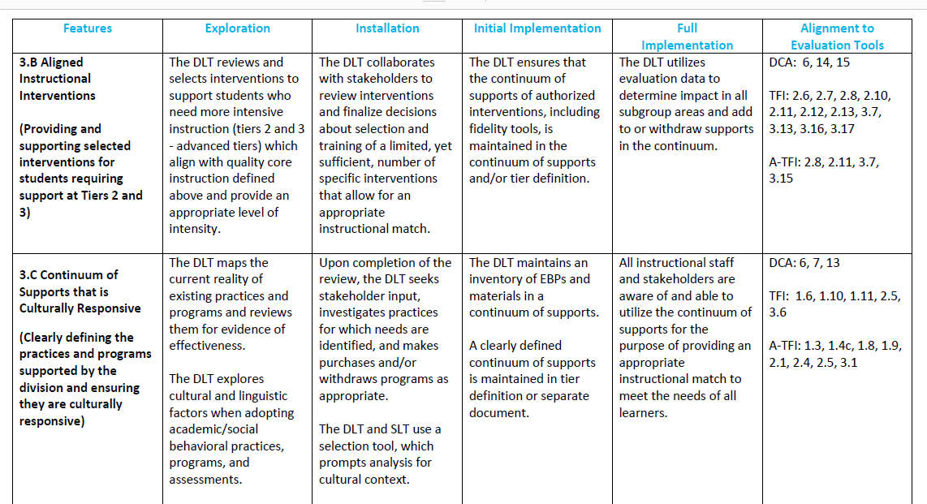
Evidence-Based Practices: 3.C Continuum of Supports that is Culturally Responsive

Slide 26
Why Initiative Mapping (IM)
IM helps to determine what we are doing.
IM helps us determine the data and other systems needed for high fidelity implementation of our current practices.
IM helps us determine if we have practices to address gaps between our expected outcomes and actual outcomes.
IM helps us determine if we need to make changes in what we are practicing.

Slide 27
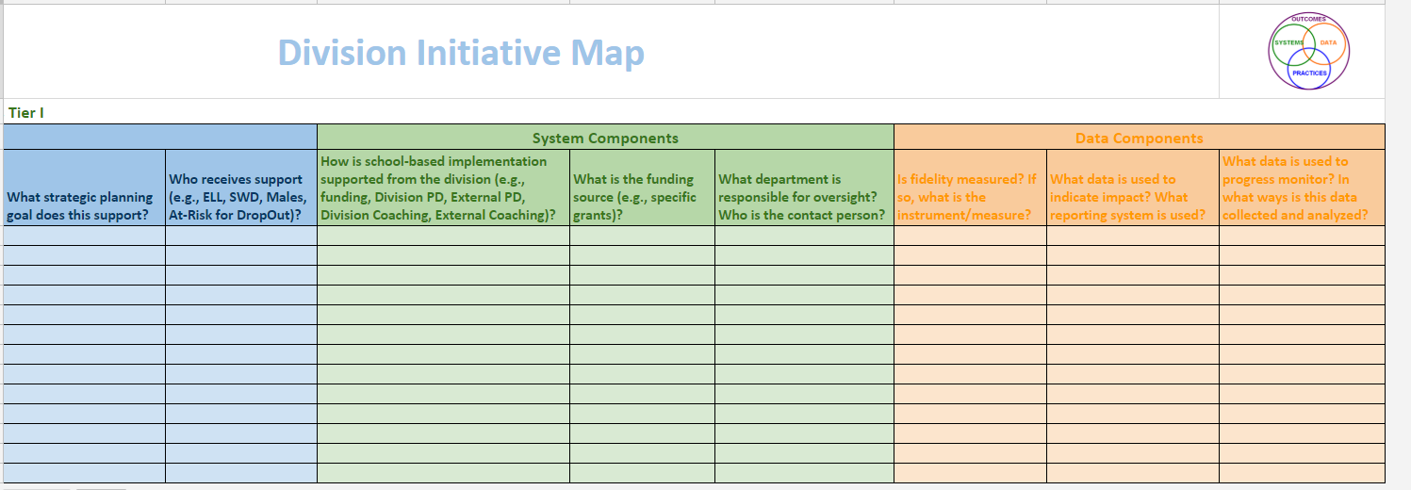
Initiative Map

Slide 28
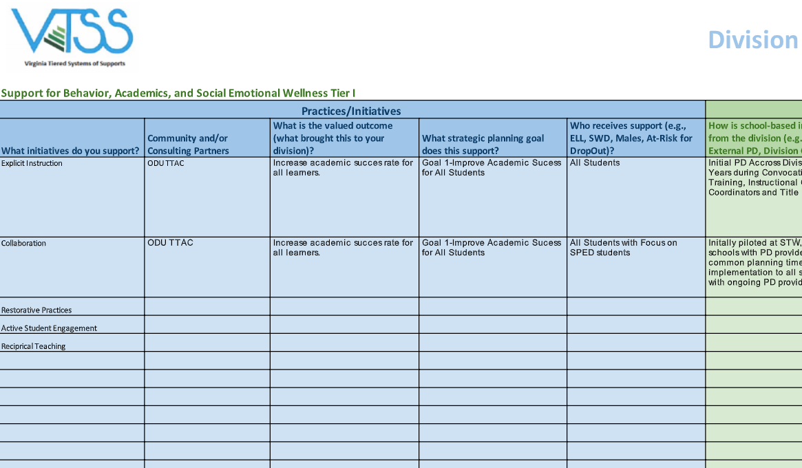
Initiative Map
(Academic Example)

Slide 29
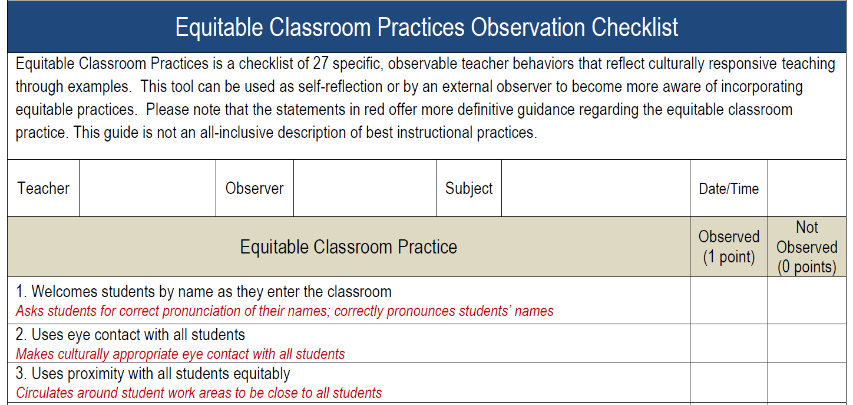
Equitable Classroom Practices

Slide 30
Equitable Classroom Practices:
Discussion Questions
Where are these practices reflected in your instructional guidance, walkthrough documents, etc.?
What data do you have to support their implementation?
How has your division provided professional learning related to these practices?

Slide 31
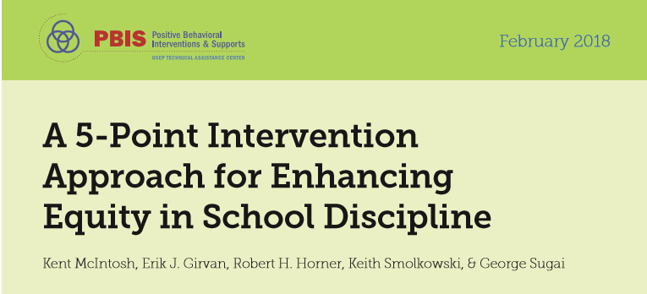
Cultural Responsiveness Resources

Slide 32
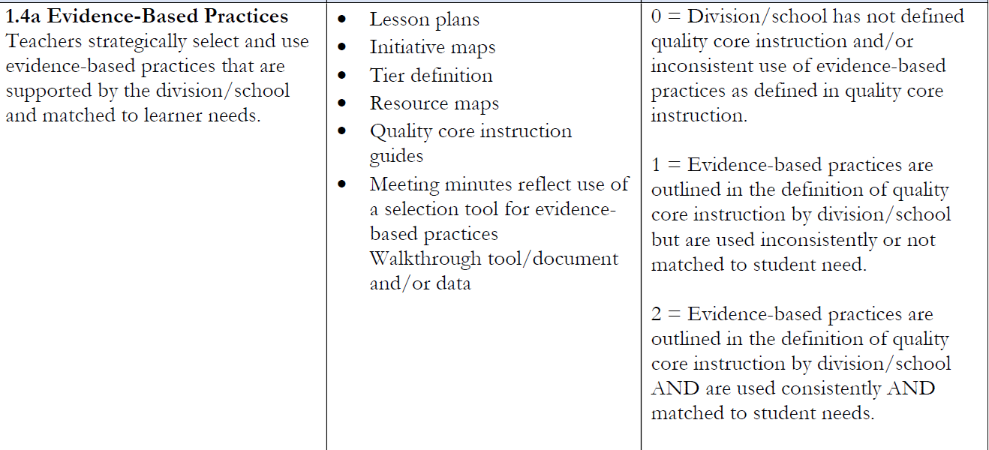
A-TFI connection

Slide 33
Action Plan

Slide 34
Action Planning
On your action planner for this section, add next steps for initiative mapping. Areas to consider:
Is your initiative map complete or do you need to develop a plan to complete it?
What is your plan to review/update your map?
How are you communicating your initiatives to your various stakeholder groups?
How do you use your map to assist you in making decisions around instruction?

Slide 35
Action Planning
Add any additional next steps around 3c. Some areas to consider are:
What are your next steps around evaluating or selecting evidenced based practices? Do you have a process for selection?
What are your next steps related to having a continuum of supports that is culturally responsive?

Slide 36
Evidence Based Practices
Meeting Structures for Data Informed Decision Making (Tier 1)

Slide 37
Academic Alignment
Develop a written description of quality Tier 1 academic instruction and create a system for communicating instructional expectations to stakeholders. (Matrix 3A)
Examine existing evidence-based Tier 1 practices to create an inventory of division priorities related to academic instruction. (Matrix 3C)
Develop a plan for implementing Tier 1 data meeting structures at the school and division level and determine how to measure the fidelity and effectiveness of the meeting structures. (Matrix 2C)

Slide 38
Where are you with data meeting structures?
Each table has a list of questions related to data meeting structures.
As a division, select one of the questions to discuss. If time permits, select a second question for discussion.

Slide 39
Data Informed Decision Making:
2.C Meeting Structures for Data Informed Decision Making

Slide 40
Data Informed Decision Making
Analyzing and evaluating student data to inform educational decisions around instruction, intervention, allocation of resources, development of policy, movement within a multi-level system, and disability identification.

Slide 41
Improving Decision Making
Problem
Solution
Problem
Problem Solving
Solution
Action Planning

Slide 42
Implementation Matrix 2.C

Slide 43
Types of Data Driven Discussions
1. Universal Screening
2. Grade Level/Content Area Performance (Tier 1)
3. Individual Student Data and Intervention Efficacy (Tier 2/Tier 3)
4. Individual Student Problem Solving and Intervention Planning (Tier 2/Tier 3)

Slide 44
Types of Data Driven Discussions
#1
Universal Screening

Slide 45
How are you discussing universal screening data?
Is the core instruction sufficient (is it working) and is it improving (i.e., health of the curriculum)?
For whom is it working/not working?
What are the root causes?
What are our next steps (e.g., instructional adjustments, reviewing lesson plans)?

Slide 46
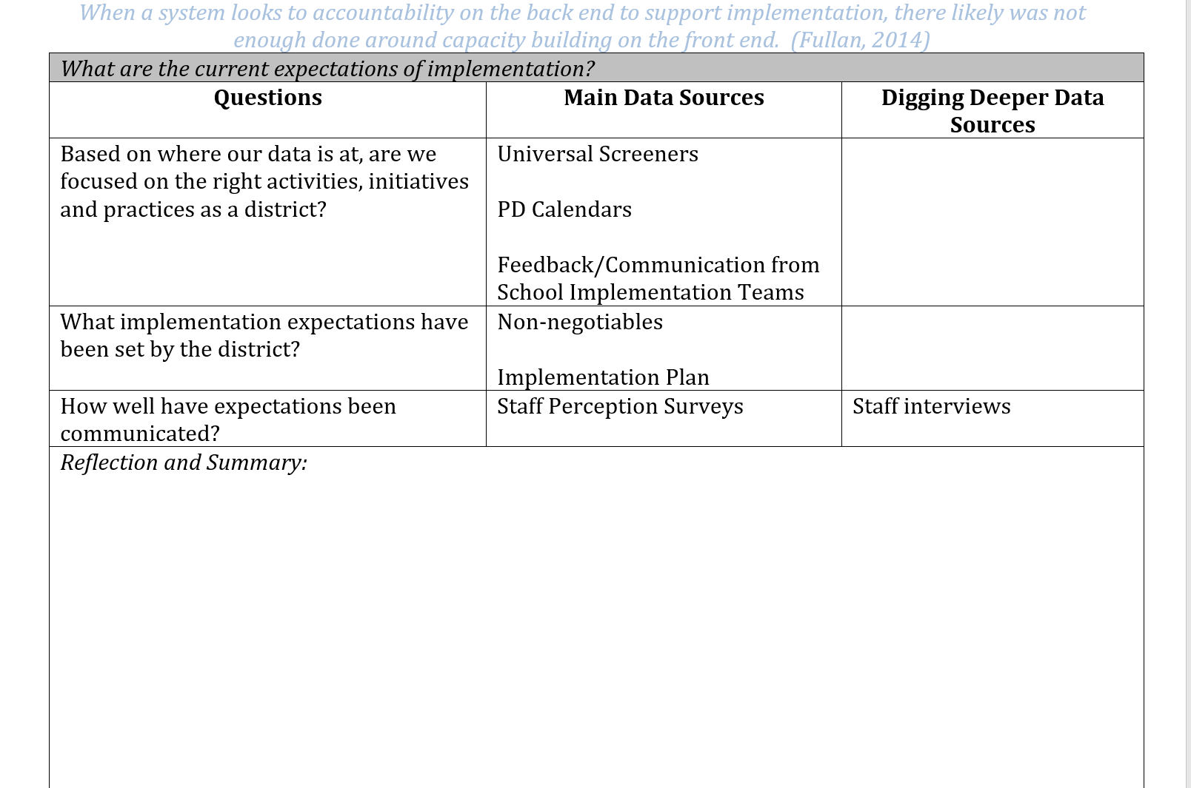
Division Reflection:
Focus and Communication

Slide 47
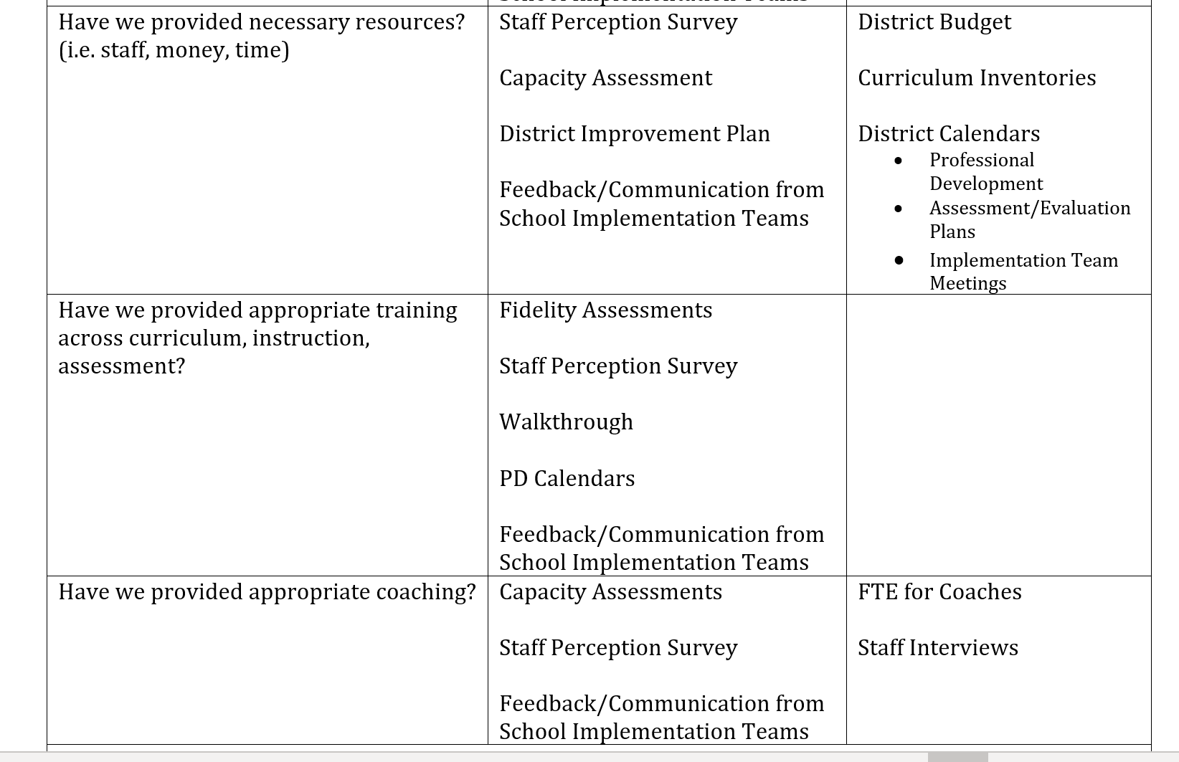
Division Reflection:
Capacity
Notes:
Oregon school-based meeting document example

Slide 48
Types of Data Driven Discussions
#2
Grade Level/Content Area Performance

Slide 49
Grade Level/Content Level Performance Discussions
Tier 1
We taught it!
Did they get it?
For academics, these are the Virginia standards. For behavior, this is the schoolwide matrix.
Often, this meeting is referred to as a PLC or whatever name the school or division calls it (it needs a name).

Slide 50
What are the root causes for concerns? (Elementary)

Slide 51
What are the root causes for concerns? (Secondary)

Slide 52
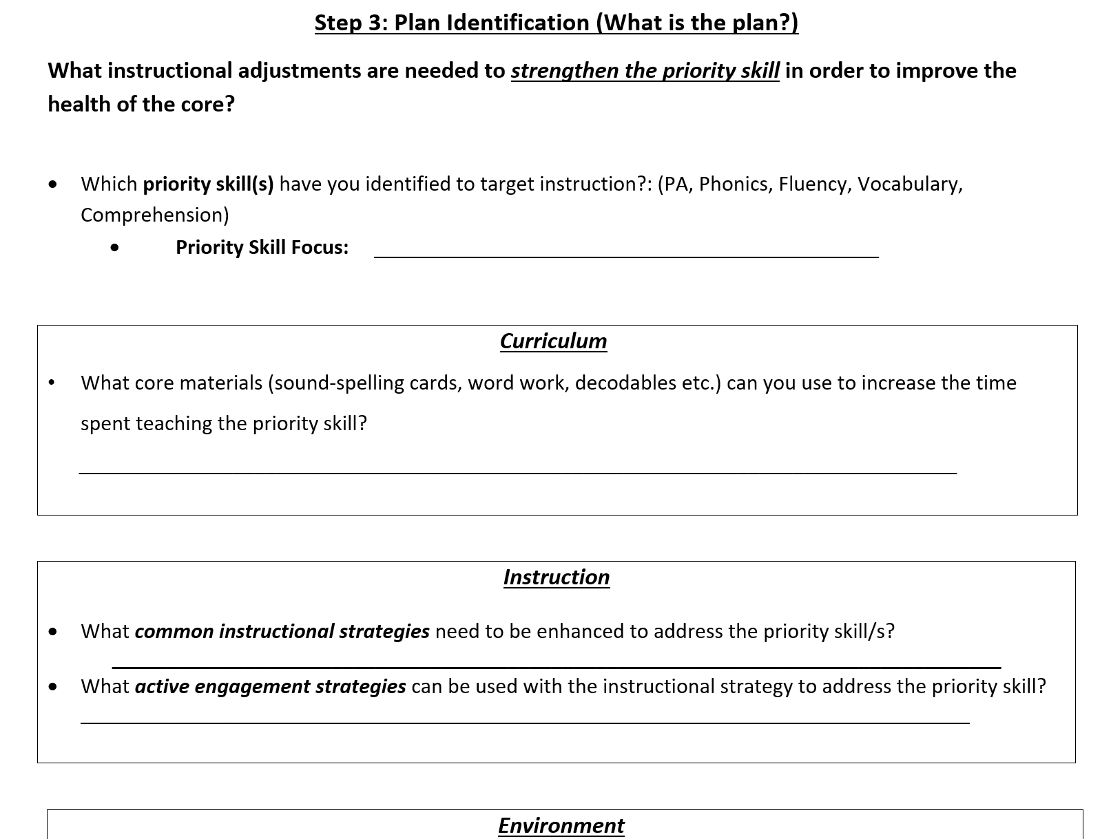
Instructional Adjustments (Elementary)

Slide 53
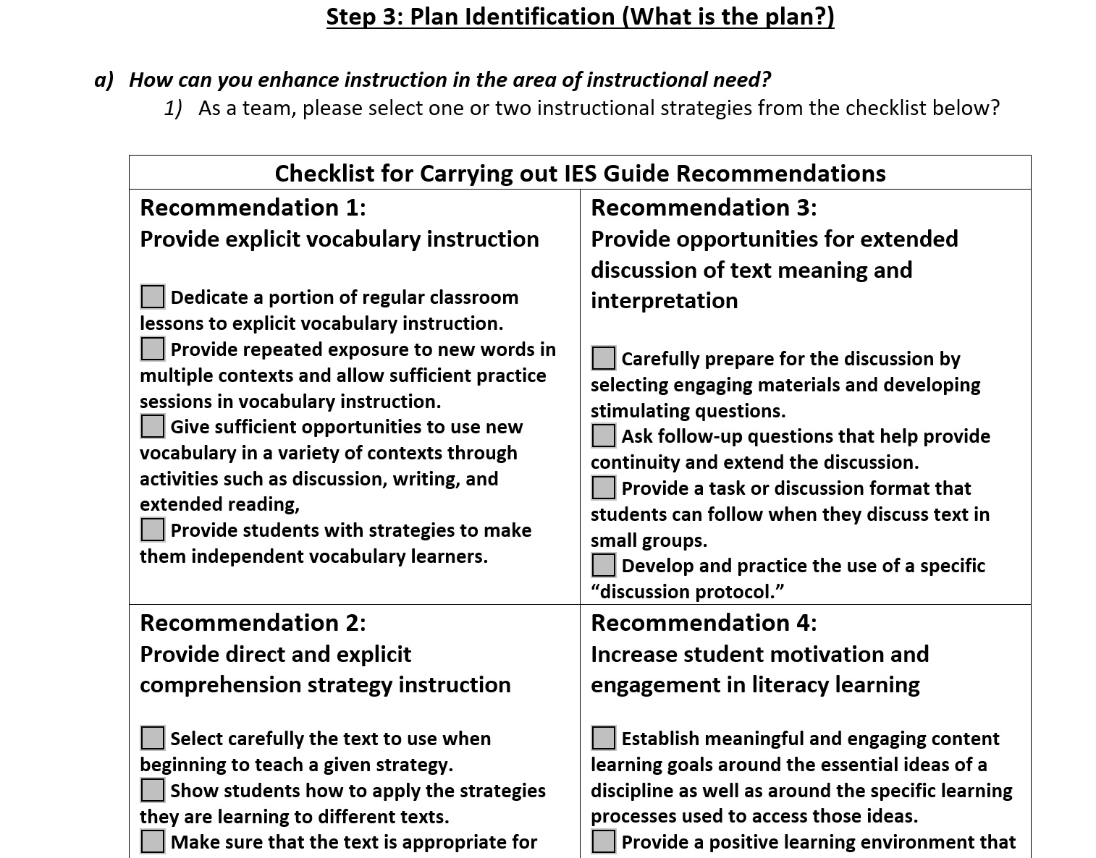
Instructional Adjustments (Secondary)

Slide 54
Questions for Data Analysis
What is the specific problem to be addressed by the team?
Analyze the problem using data to determine why the issue is occurring. Use strategies tied to your content knowledge, variables you can control, and instructionally relevant areas. Questions to consider, “Why is/are the desired goal(s) not occurring? What are the barriers to the student(s) doing/knowing what is expected?” Design or select instruction to address the specific problem.
Develop and implement a plan driven by the results of the team’s problem analysis by establishing a performance goal and developing an intervention plan to achieve the goal. Include information about how the student’s progress will be monitored and/or how the teacher(s) will be supported. Ask, “What are we going to do?”

Slide 55
How do we reflect on grade level or content level data?
Handout: Data Reflection Sheet
Big Idea: It doesn’t have to look like this, but it has a measure of accountability and the system is the same each time.
What is helpful about this example is that the data MUST be there. It starts with the data.

Slide 56
Implementation Matrix 2.C

Slide 57
A Cascading Model of Support
USDOE, OSEP PBIS TA Center
Who is supported?
VDOE
Regional Team
Division Team
Building Leadership Team
Building Staff
Source: Michigan’s Integrated Behavior and Learning Support Initiative
Students and Families
Improved student outcomes

Slide 58
A-TFI connection

Slide 59
Action Plan

Slide 60
With your team, discuss these questions.
What current meeting structure(s) do you have in place for data informed decision making at the division and building levels? What data are utilized within these meetings?
If you do not have a meeting structure in place or data identified, what are your next steps?
How do you/will you support the use of the meeting structures for your schools?

Slide 61
Summary of the Day
Develop a written description of quality Tier 1 academic instruction and create a system for communicating instructional expectations to stakeholders. (Matrix 3A)
Examine existing evidence-based Tier 1 practices to create an inventory of division priorities related to academic instruction. (Matrix 3C)
Develop a plan for implementing Tier 1 data meeting structures at the school and division level and determine how to measure the fidelity and effectiveness of the meeting structures. (Matrix 2C)

