Slide 1
Strand 2:
Integrating and Aligning Academic Data, Practices and Systems
October 2021

Slide 2
Today’s Learning Intentions
Review the responsibilities of the Division Leadership Team to align all supports within a VTSS structure. (Matrix 1B, 1C)
Understand the process of developing an assessment inventory. (Matrix 5A)
Understand the use of a Universal Screening process within a tiered system, including purpose, selection, and importance for evaluating overall academic health; the use of an Early Warning System will also be explored (Matrix 5B & 5C)
Begin the development of a process to create a written description of the expectations for quality Tier 1 academic instruction and a system for communicating the expectations to stakeholders. (Matrix 3A, 1.G, 1.H)

Slide 3
VTSS Implementation Components
Aligned Organizational Structure
Data-informed Decision Making
Evidence-based Practices
Family, School, Community Partnerships
Monitoring Student Progress
Evaluation of Process

Slide 4
Supporting Improvements in Behavioral Competence, Academic Achievement and Social-Emotional Wellness
OUTCOMES
Supporting
Staff
Supporting
Decision
Making
SYSTEMS
DATA
PRACTICES
Supporting
Students

Slide 5
Integrating Academics, Behavior, and Mental Wellness
HOW WE DECIDE WHAT INSTRUCTION OR SUPPORTS TO GIVE STUDENTS (Tiers)
Continuum of Instruction & Intervention (Tiers)
Data-based Problem Solving Process
HOW STUDENTS RESPOND TO OUR INSTRUCTION AND RELATED SUPPORTS (Data)

Slide 6
Academic Alignment
Review the responsibilities of the Division Leadership Team to align all supports within a VTSS structure. (Matrix 1B, 1C)

Slide 7
Aligned Organizational Structure: Teaming and Planning
Aligned Organizational Structure
TEAMING AND PLANNING

Slide 8
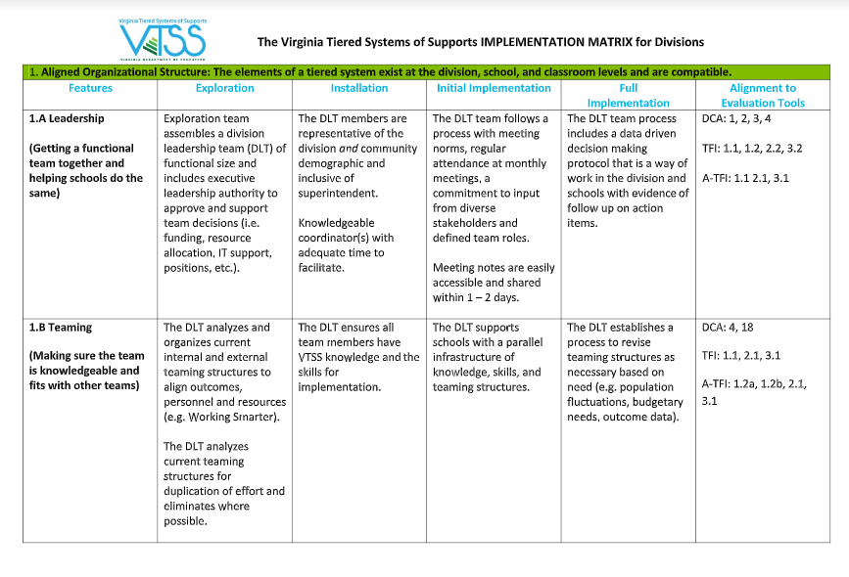
Aligned Organizational Structure: Features 1.B and 1.C

Slide 9
Teaming (1.B)
DLT supports schools with a parallel infrastructure of knowledge, skills, and team structures.

Slide 10
Planning (1.C)
DLT aligns VTSS with strategic plans, school improvement plans, and other Corrective Action Plans (as necessary).
DLT examines internal barriers and systems capacity to support schools.

Slide 11
A quick reflection...
Our Division Leadership Team (DLT) has academic representation.
We have aligned our strategic plan, school improvement plan, and/or other corrective action plans with VTSS.
Our DLT needs to examine our internal barriers and systems capacity to support our schools with integrating academics, behavior and mental wellness.

Slide 12
Monitoring Student Progress: ASSESSMENT INVENTORY AND PLANNING FOR STUDENT GROWTH
Monitoring Student Progress
ASSESSMENT INVENTORY AND PLANNING FOR STUDENT GROWTH

Slide 13
Academic Alignment
Review the responsibilities of the Division Leadership Team to align all supports within a VTSS structure. (Matrix 1B, 1C)
Understand the process of developing an assessment inventory. (Matrix 5A)

Slide 14
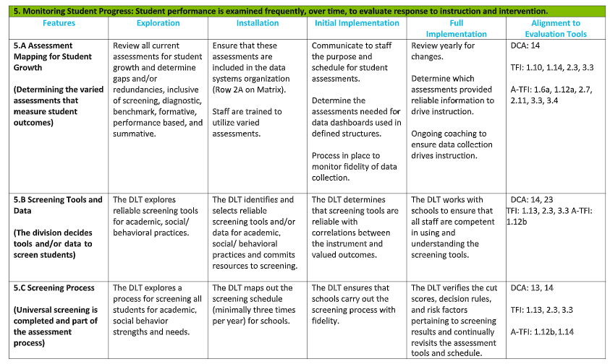
Monitoring Student Progress:
Feature 5.A

Slide 15
Assessments to include in a Comprehensive Assessment Plan
Universal Screening Assessments
Diagnostic Assessments
Progress Monitoring Assessments
These assessments are brief, uncomplicated and should not be redundant with any other assessments.

Slide 16
Assessing your Assessments
Is it appropriate for the intended purpose?
What does the assessment tell us?
Are we using each assessment appropriately?
Is the assessment reliable and valid?
Is each assessment efficient?
What kind of manpower is need to administer the assessment?
How will you manage and access the assessment data?

Slide 17
Reasons to complete an assessment inventory
It helps everyone understand all of the assessments.
Decision rules will come from your data; what data do you have?
Data are needed to evaluate your outcomes.
Photo by Julia M. Cameron from Pexels

Slide 18
An assessment inventory
Provides the opportunity to ask questions:
How much time do we spend giving assessments?
Are there assessments that provide the same information?
Are we including performance based assessments?
What assessments might we remove from the list?

Slide 19
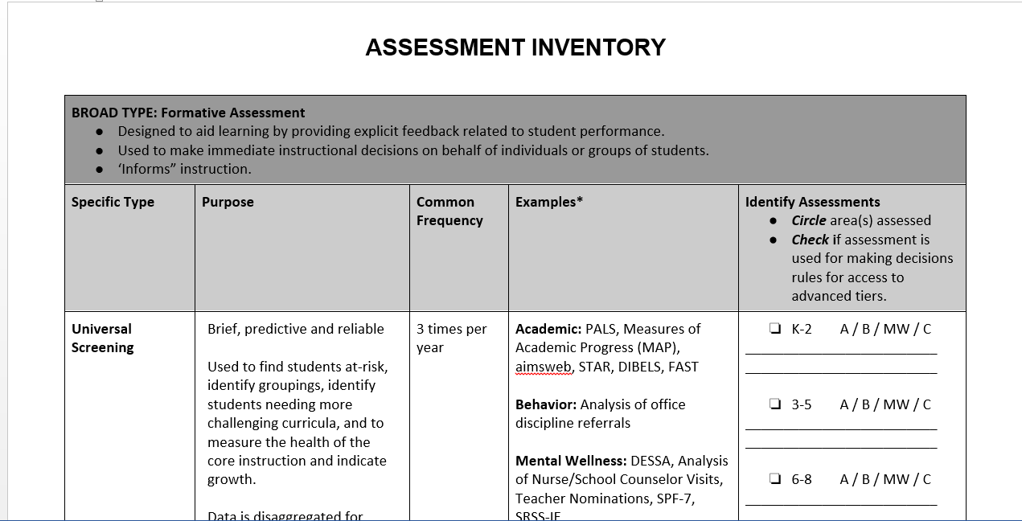
Assessment Inventory

Slide 20
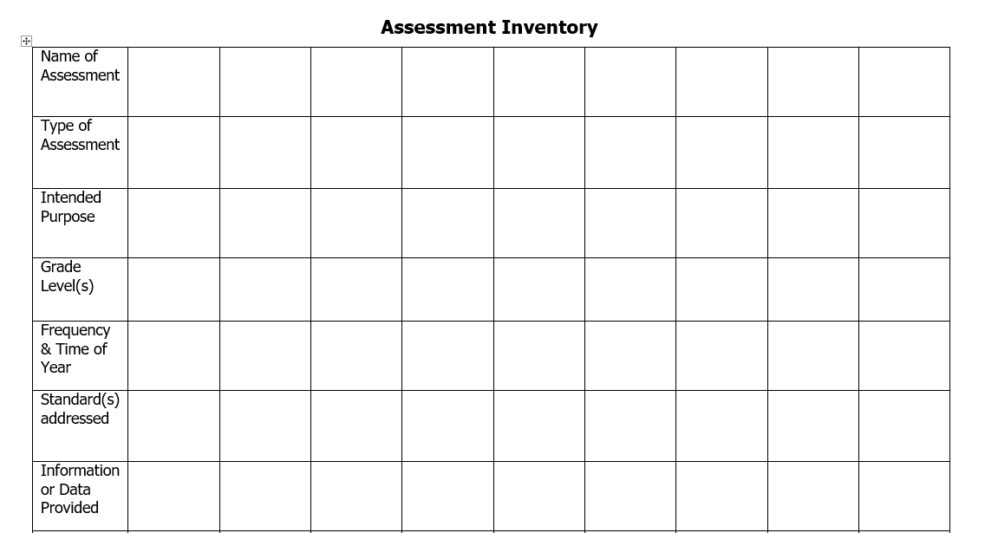
Assessment Inventory
(another example)
Source: VDOE Supporting Instruction and Deeper Learning through Balanced Assessment Institute, June 2019

Slide 21
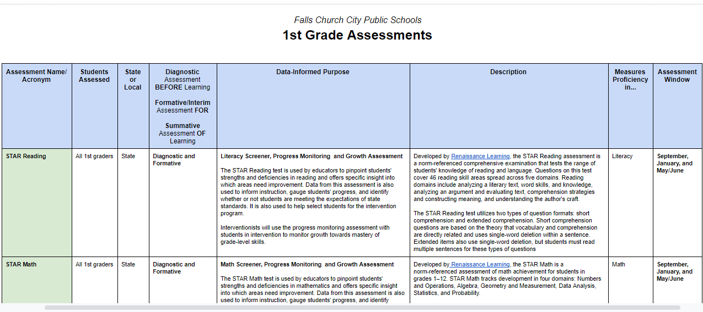
Example:
Falls Church City Public Schools

Slide 22
Data-informed Decision Making: Addition of Academic Data to the Division DIDM Process
Data-informed Decision Making
Addition of Academic Data to the Division DIDM Process

Slide 23
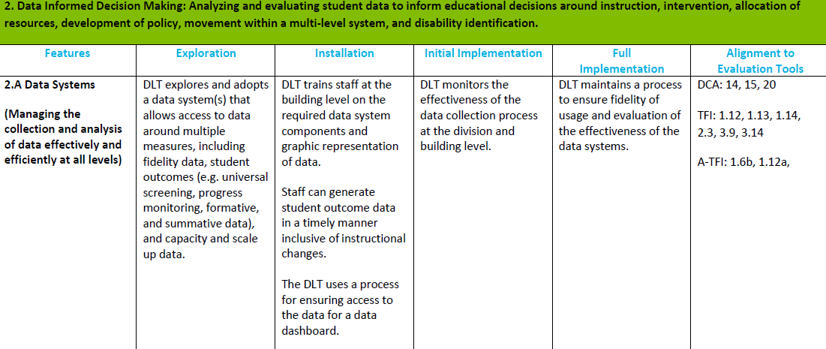
Data-informed Decision Making:
Feature 2.A

Slide 24
Revisit the division data audit

Slide 25
Academic Alignment
Review the responsibilities of the Division Leadership Team to align all supports within a VTSS structure. (Matrix 1B, 1C)
Understand the process of developing an assessment inventory. (Matrix 5A)
Understand the use of a Universal Screening process within a tiered system, including purpose, selection, and importance for evaluating overall academic health; the use of an Early Warning System will also be explored (Matrix 5B & 5C)

Slide 26
Monitoring Student Progress: Screening Tools and Data
Monitoring Student Progress
SCREENING TOOLS AND DATA

Slide 27
Monitoring Student Progress:
Feature 5.B

Slide 28
Why universal screening?
What is the health of the core instructional program?
For which groups is instruction working, not working?
Is the tiered system having an impact?
What is the individual growth of students?

Slide 29
Know the indicators of a good screener
1. Is brief (and doable under current conditions)
2. Is predictive
3. Is reliable
4. Provides an awareness of false positives
5. Provides normative data
6. Can be disaggregated

Slide 30
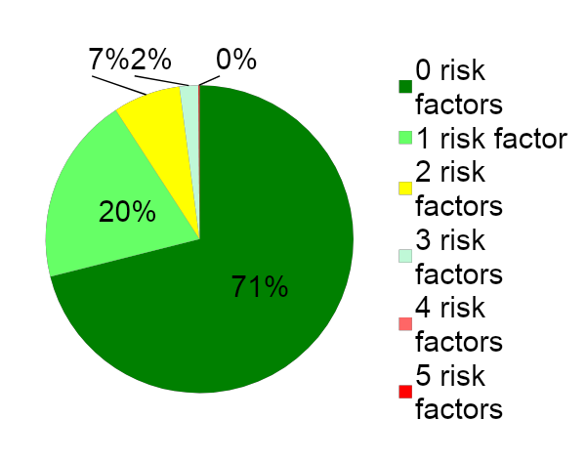
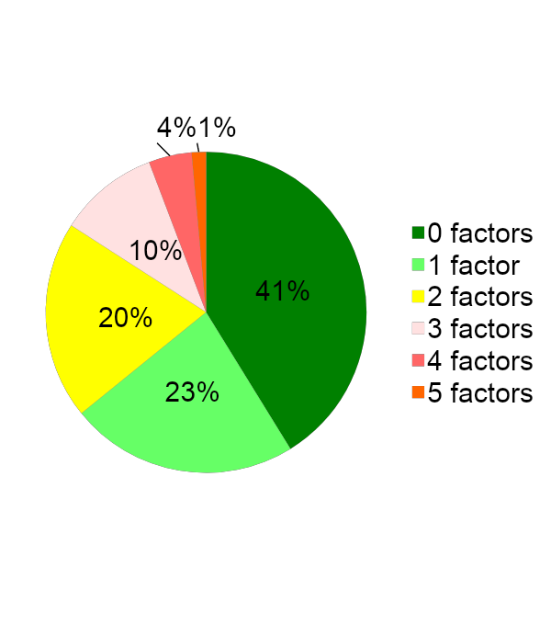
Considerations when Selecting Screening Tools
Can the data be compared across schools?
Is there a way to display data graphically?

Slide 31
Fall data sources
VDOE Fall Growth Assessments (grades 3-8)
PALS (grades PreK-3)
VKRP
Commercial screening tools (e.g., DIBELS, FastBridge, I-Ready)
Early Warning Systems (for some)
Classroom data (e.g., running records, benchmark assessments)

Slide 32
Websites for screening tools
Academic Screening Tools Chart
https://www.ci3t.org/systematic-screening-considerations-and-commitment-to-continued-inquiry
Screening

Slide 33
Screening in the upper grades
Who’s at risk of not graduating?
Use an early warning system
Learn more about that group of students
Track the risks to those students regularly (data dashboard) and provide supports, interventions

Slide 34
Chicago Public Schools Freshmen on Track
“Two surprisingly simple factors: (1) a student’s completion of five full-year course credits; and (2) that student’s not failing more than one semester of a core course, such as Math or English… Those two factors, combined, became known as the Freshman On-Track (FOT) metric. Freshmen who were on-track by this measurement were 3.5 times more likely to graduate than students who were off-track.”
Graduation Rates:
1998 =52.4%
2007 =60%
2018 =78.2%
2019 = 82%

Slide 35
Early Warning Systems
Risk Category
Data Source
Attendance
Behavior
Course Performance
Essential Skills (e.g., reading, math)
Current Attendance
Current ODRs
Grades
Outcome data
Current skill assessments

Slide 36
Screening Scenarios
K-2 Reading: PALS, Math: Fastbridge
3-8 VDOE fall assessments
9-12 Early Warning System
K-2 PALS, Acadience for reading and math
3-8 VDOE fall assessments plus STAR reading and math
9-12 EWS plus STAR for some students in reading and/or math
K-2 MAP for reading and math, PALS
3-8 I-Ready, VDOE fall assessments
9-12 Star for some students reading and math, Early Warning System

Slide 37
Monitoring Student Progress: Screening Process
Monitoring Student Progress
SCREENING PROCESS

Slide 38
Monitoring Student Progress:
Feature 5.C

Slide 39
Using screening data at the division level
Where we are
Where we want to be
5%
15%
15%
At least 80%
25%
60%

Slide 40
Current reality: Are some triangles upside down?
Below Benchmark 60%-80%
At Benchmark 20%-40%

Slide 41
Is there a need across the division or with certain schools?

Slide 42
Where are the students with the greatest needs?
School A
School B

Slide 43
Questions to consider for data analysis
Which schools will face the biggest challenges in achieving end of year benchmarks?
Which grade levels, subject areas?
Which groups of students?

Slide 44
How does the division team support schools with screening?
What professional learning will be needed?
How will the school process for data review differ from the division process?
How will the division team provide support-who and when?
How will the division team monitor fidelity of the process?
Assessment integrity
Use of decision rules, cut scores

Slide 45
Decision Rules and/or Cut Scores
Decision Rule
Cut Score
20% Decision Rule: The lowest 20% of students at each grade level based on school-wide academic screening measures and/or with chronic behavior needs will receive strategic group intervention(s).
Students achieving at the 25th percentile or lower on screening instruments will be evaluated for Tier II support using additional data.
Reminder: Screening scores are never the only data point used to determine risk.

Slide 46
Today’s Learning Intentions
Review the responsibilities of the Division Leadership Team to align all supports within a VTSS structure. (Matrix 1B, 1C)
Understand the process of developing an assessment inventory. (Matrix 5A)
Understand the use of a Universal Screening process within a tiered system, including purpose, selection, and importance for evaluating overall academic health; the use of an Early Warning System will also be explored (Matrix 5B & 5C)
Begin the development of a process to create a written description of the expectations for quality Tier 1 academic instruction and a system for communicating the expectations to stakeholders. (Matrix 3A, 1.G, 1.H)

Slide 47
VTSS Implementation Components
Aligned Organizational Structure
Data-informed Decision Making
Evidence-based Practices
Family, School, Community Partnerships
Monitoring Student Progress
Evaluation of Process

Slide 48
Evidence-based Practices: QUALITY CORE INSTRUCTION
Evidence-based Practices
QUALITY CORE INSTRUCTION

Slide 49
Evidence-based Practices:
Feature 3.A
The DLT reviews current expectations for quality instruction in order to meet the curricula standards.

Slide 50
Focus: Tier 1 instruction
Below Benchmark 60%-80%
At Benchmark 20%-40%

Slide 51
Supporting Improvements in Behavioral Competence, Academic Achievement and Social-Emotional Wellness
OUTCOMES
Supporting
Staff
Supporting
Decision
Making
SYSTEMS
DATA
PRACTICES
Supporting
Students

Slide 52
DATA
Identify data sources
Universal screening data
Other data sources
Analyze the data
Ask questions
Set a goal/goals
Based on the data, where do we want to go and by when? (i.e., SMART goal)

Slide 53
PRACTICES
What are we doing to accelerate learning?
Look at your Division Initiative Map:
Are initiatives being implemented as planned?
Are additional initiatives needed to support the identified goal?
Implement evidence-based practices
Use VDOE resources
Math
English
SEL
Use High Leverage Practices

Slide 54
SYSTEMS
Provide professional learning opportunities
Provide coaching
Monitor instruction

Slide 55
Evidence-based Practices:
December 2021

Slide 56
References
Oregon Response to Instruction and Intervention. (2019). Team and Data-based Decision Making. Retrieved from http://www.oregonrti.org/teamingdecisionmaking
Sommers, B. (2020, April 13). Upstream. Learning Omnivores. https://learningomnivores.com/what-were-reading/upstream/
Virginia Department of Education (VDOE). (2019, June). Supporting instruction and deeper learning through balanced assessment. Presentation at VDOE institute, Charlottesville, Virginia.

Slide 57
References
Virginia Department of Education. (2020). Recover, redesign, restart. http://www.doe.virginia.gov/support/health_medical/covid-19/recover-redesign-restart-2020.pdf
Virginia Department of Education. (2020). Virginia learns everywhere: A report and recommendations from Virginia’s educators on the continuity for learning (C4L) task force. http://www.doe.virginia.gov/instruction/c4l/virginia-learns-anywhere.pdf. enow
Chenoweth, K. Districts that Succeed, Harvard Education Press, 2021

